Slide 1



Hazard Communication 2012 – The Revised Standard and What Changes You Can Expect in the Workplace
August 13, 2012
1:00-2:30 PM

Slide 2
Hazard Communication and the Globally Harmonized System (GHS) Overview
Why OSHA adopted the GHS
Overview of the changes to the HazCom Standard
Overview of Compliance Assistance Resources
Directorate of Enforcement Programs Products

Slide 3
Why did OSHA align the HCS with GHS?
A common, coherent approach to classifying and communicating chemical hazards.
Harmonized definitions of hazards
Specific criteria for labels
Harmonized format for safety data sheets

Slide 4
Benefits of Adopting the GHS
Increase the quality and consistency of information provided to the workers, employers and chemical users.
Reduce confusion/Increase comprehension of hazards.
Improve downstream risk management.
Facilitate training.
Help address literacy problems.
Other benefits include facilitation of international trade in chemicals.

Slide 5
Development of Final Rule
An ANPR to modify to the existing HCS to align it with the GHS was published in 2006.
NPRM Published in the Federal Register on September 30, 2009 (74 FR 50280-50549).
Public hearings in 2010.
The final rule was published in the Federal Register on March 26, 2012 and became effective on May 25, 2012.

Slide 6
Notable changes
Using a “specification” approach rather than a “performance-oriented” approach
“Hazard classification” rather than “hazard determination”
Labels are more defined and will now require:
Product identifier
Pictogram
Signal word
Hazard statement(s)
Precautionary statement(s)
Name, address, and telephone number

Slide 7
Notable changes, cont.
“Safety data sheet” (rather than “material safety data sheet”) uses a 16-section format.
Guidance in the GHS (such as decision logics in criteria) has been removed to streamline provisions.
May be provided as a separate document to assist compliance later.

Slide 8
Modified Hazard Communication Standard

Slide 9
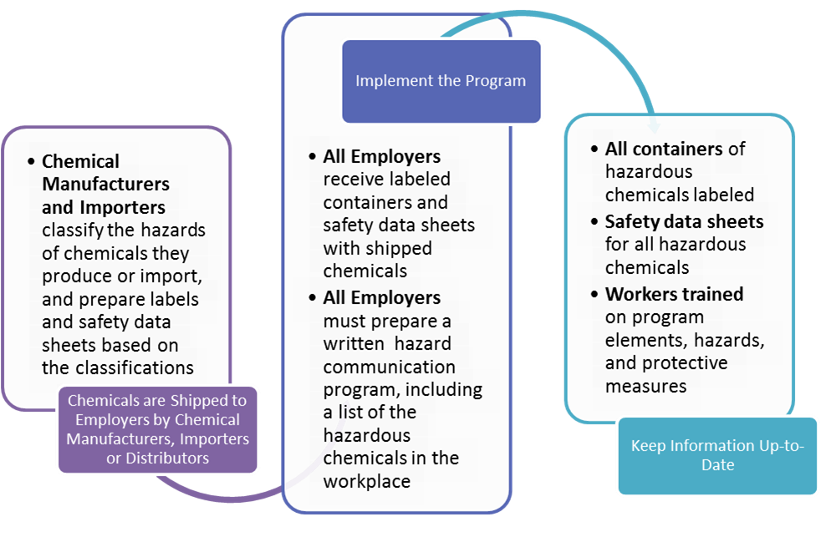
How Hazard Communication Works

Slide 10
Organization of the Final Rule
Purpose
Scope and Application
Definitions
Hazard Classification
Written Hazard Communication Program
Labels and Other Forms of Warning
Safety Data Sheets
Employee Information and Training
Trade Secrets
Effective Dates
Appendices A–F

Slide 11
Appendices
Appendix A, Health Hazard Criteria (Mandatory) (NEW)
Appendix B, Physical Hazard Criteria (Mandatory) (NEW)
Appendix C, Allocation of Label Elements (Mandatory) (NEW)
Appendix D, Safety Data Sheets (Mandatory) (NEW)
Appendix E, Definition of “Trade Secret” (Mandatory)
Appendix F, Guidance for Hazard Classifications re: Carcinogenicity (Non-Mandatory) (NEW)

Slide 12
a) Purpose
HazCom 1994
HazCom 2012
All hazards to be evaluated.
Comprehensive hazard communication program to transmit information.
Preempt state laws.
All hazards to be classified.
Other provisions the same, except OSHA added that the rule is consistent with Revision 3 of the GHS.
Slight clarifying modification was made to the language regarding preemption.

Slide 13
b) Scope and Application
HazCom 1994
HazCom 2012
All chemicals known to be present are covered.
Practical accommodations for special situations.
Addresses interface with other Federal laws.
Minimal changes except to conform terminology, and remove reference to current Appendix E which has been deleted from the standard and a clarification on Federalism.

Slide 14
c) Definitions
HazCom 1994
HazCom 2012
Includes specific definitions for terms used in the standard, as well as all physical hazards.
Physical hazard definitions removed from paragraph (c), and placed in a new Appendix B on physical hazard classification criteria.
Following terms are also deleted: flashpoint (methods included in Appendix B), hazard warning, material safety data sheets.
Some definitions are revised to be GHS-consistent.
New definitions added for classification.

Slide 15
d) Hazard Classification
HazCom 1994
HazCom 2012
Performance-oriented
Definitions in paragraph (c), Appendices A and B
Appendix B—parameters for evaluating data
“Floor” of chemicals considered hazardous
“One study” rule
Standardized mixture cut-off rules
Specific and detailed
Concept of “classification” vs. determination in current rule
Each hazard class has detailed criteria to apply to data on the chemical
No floor; based on weight of evidence
Mixture rules are specific to each hazard class

Slide 16
Hazard Classification
Each physical or health hazard is a “hazard class” (e.g., Carcinogenicity is a hazard class).
A “hazard class” may be sub-divided in the criteria into several “hazard categories” based on the degree of severity of the hazard.
Placing a chemical into a “hazard class” , and where necessary, a “hazard category”, is the concept of classification—determining not only the hazard, but also the severity of the effect.

Slide 17
Hazard Classification, cont.
Manufacturers are still responsible for determining the hazards of the chemicals they produce or import.
Classification (similar to hazard determination) is based on the full range of available information. The procedures for determining if the manufacturer has properly performed the hazard classification are provided in Appendix A (health) and Appendix B (physical).

Slide 18
Health Hazards
Hazard Class | Hazard Category
Acute Toxicity | 1 | 2 | 3 | 4
Skin Corrosion/ Irritation | 1A | 1B | 1C | 2
Serious Eye Damage/ Eye Irritation | 1 | 2A | 2B
Respiratory or Skin Sensitization | 1
Germ Cell Mutagenicity | 1A | 1B | 2
Carcinogenicity | 1A | 1B | 2
Reproductive Toxicity | 1A | 1B | 2 | Lactation
STOT – Single Exposure | 1 | 2 | 3
STOT – Repeated Exposure | 1 | 2
Aspiration | 1
Simple Asphyxiants | Single Category

Slide 19
HazCom 1994: Mixtures
For mixtures, the approach for health hazards is to base it on a percentage cut-off of 0.1% for carcinogens, and 1% for all other effects.

Slide 20
HazCom 2012: Mixtures
The GHS has a tiered approach to mixtures, with each health hazard class having a specific approach.
Step 1: Use available test data on the mixture as a whole to classify the mixture based on the substance criteria.
Step 2: Use bridging principles to extrapolate from other data (e.g., dilution principle).
Step 3: Estimate hazards based on known information regarding the ingredients of the mixture (cut-offs may be applied).
Except for chronic health hazards.
Chemical manufacturers and importers may rely on the information provided in ingredient SDSs unless they have a reason to know that it is inaccurate.

Slide 21
Physical Hazards
Hazard Class | Hazard Category
Explosives | Unstable Explosives | Div 1.1 | Div 1.2 | Div 1.3 | Div 1.4 | Div 1.5 | Div 1.6
Flammable Gases | 1 | 2
Flammable Aerosols | 1 | 2
Oxidizing Gases | 1
Gases under Pressure Compressed Gases Liquefied Gases Refrigerated Liquefied Gases Dissolved Gases | 1
Flammable Liquids | 1 | 2 | 3 | 4
Flammable Solids | 1 | 2
Self-Reactive Chemicals | Type A | Type B | Type C | Type D | Type E | Type F | Type G
Pyrophoric Liquids | 1
Pyrophoric Solid | 1
Pyrophoric Gases | Single category
Self-heating Chemicals | 1 | 2
Chemicals, which in contact with water, emit flammable gases | 1 | 2 | 3
Oxidizing Liquids | 1 | 2 | 3
Oxidizing Solids | 1 | 2 | 3
Organic Peroxides | Type A | Type B | Type C | Type D | Type E | Type F | Type G
Corrosive to Metals | 1
Combustible Dusts | Single category

Slide 22
Hazards not Otherwise Classified
This definition was added to ensure that hazards currently covered by HCS continue to be covered.
Information will be required on the safety data sheets in Section 2.
Hazard information on the label, is not mandatory, but can be provided under supplementary information.
Such hazards must also be addressed in worker training.

Slide 23
Simple Asphyxiant and Pyrophoric Gas
“Simple asphyxiant” means a substance or mixture that displaces oxygen in the ambient atmosphere, and can thus cause oxygen deprivation in those who are exposed, leading to unconsciousness and death.
Label: Warning. May displace oxygen and cause rapid suffocation.
“Pyrophoric gas” means a chemical in a gaseous state that will ignite spontaneously in air at a temperature of 130 degrees F (54.4 degrees C) or below.
Label: Danger. Catches fire spontaneously if exposed to air.

Slide 24
Combustible Dust
Combustible dust is covered separately from HNOC, but is not specifically defined.
Guidance for defining combustible dust is to be taken from existing documents, including the directive for the National Emphasis Program; the NFPA standards also provide useful information.
Combustible dust must be addressed on labels where appropriate:
Warning. May form combustible dust concentrations in air.
Paragraph (f)(4) may apply to materials shipped in solid form, that create combustible dust when processed.

Slide 25
e) Written Hazard Communication Program
HazCom 1994
HazCom 2012
Employers must have a written program describing how the rule will be implemented, including a list of hazardous chemicals, methods for informing employees about non-routine tasks.
No changes.
Employers will have to make sure the program is current when the new provisions are implemented (e.g., list of hazardous chemicals may have to be updated).

Slide 26
f) Labels and Other Forms of Warning
HazCom 1994
HazCom 2012
Shipped containers to be labeled with identity, appropriate hazard warnings, and responsible party.
Performance-oriented, specifics left to discretion of chemical manufacturer or importer.
Shipped containers to be labeled with product identifier; signal word; hazard statement(s); pictograms; precautionary statements; and responsible party.
Specifies information by hazard class and category.

Slide 27
Approach to Labels
The final rule—like the GHS—is a specification approach to labels. In Appendix C, OSHA has indicated by hazard class and hazard category the label elements that must be on the label.
Appendix C is basically a cookbook approach to labeling—once classification of the hazards is completed, Appendix C is to be consulted to determine how to convey the required information.

Slide 28
Label Requirements – Shipped Containers
Product identifier
Signal word
Hazard statement(s)
Pictogram(s)
Precautionary statement(s)
Name, address, and phone number of the responsible party

Slide 29
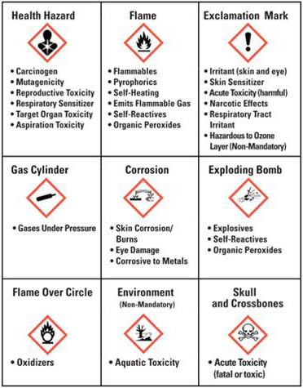
HCS Pictograms and Hazards

Slide 30


Red vs. Black Borders
OSHA is requiring red borders regardless of the shipment’s destination.
The red borders increase comprehensibility.
Blank red diamonds are not permitted on a label.

Slide 31
Updating Labels
OSHA proposed to require labels to be updated within three months of getting new and significant information about the hazards.
The final rule requires containers shipped six months after the information is available to be labeled accordingly.

Slide 32
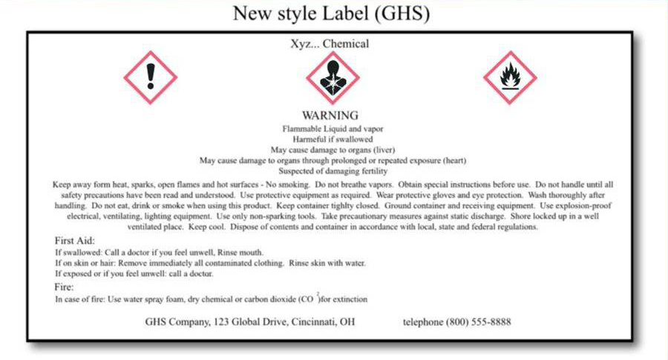
Label Example

Slide 33
Workplace Labeling
OSHA is maintaining the approach used in the current HCS that allows employers to use workplace-specific labeling systems as long as they provide the required information.
However, such workplace label systems may need to be updated to make sure the information is consistent with the new classifications.
NFPA/HMIS Systems
(ratings systems v. classification)

Slide 34
g) Safety Data Sheets
HazCom 1994
HazCom 2012
Specifies what information is required, but chemical manufacturer or importer can use whatever format or order of information they want.
Mandates 16-section SDS headings, order of information, and what information is to be provided under the headings.
Will not enforce sections 12-15 that require information outside OSHA’s jurisdiction.

Slide 35
16-Section Safety Data Sheet
Identification of the substance or mixture and of the supplier
Hazards identification
Composition/information on ingredients Substance/Mixture
First aid measures
Firefighting measures
Accidental release measures
Handling and storage
Exposure controls/personal protection
Physical and chemical properties
Stability and reactivity
Toxicological
Ecological information (non mandatory)
Disposal considerations (non mandatory)
Transport information (non mandatory)
Regulatory information (non mandatory)
Other information including information on preparation and revision of the SDS

Slide 36
Appendix D
Specifies the minimum information to be included in each of the 16 sections.
Two revisions in this information are in the final rule:
ACGIH TLVs continue to be required on the SDS.
Information regarding carcinogenicity classifications by IARC and NTP also continue to be required.

Slide 37
h) Employee Information and Training
HazCom 1994
HazCom 2012
Requires employee information and training before a worker is exposed to the hazardous chemicals in the workplace, and whenever the hazard changes.
Clarifies that the labels on shipped containers and workplace labels must be explained, as well as SDS format.
Workers will have to be trained on the new label and SDS formats before all the provisions of the rule are effective.

Slide 38
Training
Employers shall train employees regarding the new label elements and safety data sheets format by December 1, 2013.

Slide 39
Training, cont.
Label elements
Train employees on the type of information that the employee would expect to see on the new labels.
How they might use that information.
Product identifier, Signal word, Hazard statement(s), Pictogram(s), Precautionary statement(s), and Name, address and phone number of the responsible party.
General understanding how the elements interact.
For example, explain there are two signal words: Danger means a more severe hazard within a hazard class. Warning is for the less severe hazard
Safety Data Sheet Format
Train the employees on the standardized 16 section format and the type of information they would find in the various sections.

Slide 40
i) Trade Secrets
HazCom 1994
HazCom 2012
Allows specific chemical identity to be protected when it is a legitimate trade secrete.
Specifies conditions for protection, and for release when there is a safety and health need for the information.
Process remains the same.
Percentage of a substance in a mixture is also considered to be a type of trade secret subject to the provisions in the rule.

Slide 41
j) Effective Dates – HazCom 2012
Effective Completion Date | Requirement(s) | Who
December 1, 2013 | Train employees on the new label elements and SDS format. | Employers
June 1, 2015* December 1, 2015 | Comply with all modified provisions of this final rule, except: Distributors may ship products labeled by manufacturers under the old system until December 1, 2015. | Chemical manufacturers, importers, distributors and employers
June 1, 2016 | Update alternative workplace labeling and hazard communication program as necessary, and provide additional employee training for newly identified physical or health hazards. | Employers
Transition Period | Comply with either 29 CFR 1910.1200 (this final standard), or the current standard, or both | All chemical manufacturers, importers, distributors and employers
*This date coincides with the European Union implementation date for classification of mixtures.

Slide 42
Other Affected Standards

Slide 43
Approach to Other Standards
Many other OSHA standards contain criteria related to defining hazards, as well as other provisions that rely on those criteria.
OSHA undertook a comprehensive review of its rules to identify what needed to be changed.
OSHA has proposed modifications to all of those standards that it determined needed to be consistent with the GHS.

Slide 44
Health Standards
The substance-specific standards generally pre-date the HCS, and do not have a comprehensive approach to hazard communication.
The final rule references HazCom 2012 in each of these standards to ensure they have all the protections of the rule.
In addition, OSHA updated the provisions regarding what is to be communicated to workers to ensure the health effects are consistent with the GHS criteria.
Regulated area signs will need to be updated to reflect the new language.
Employers have until June 1, 2016 to update the signs.

Slide 45
Substance-Specific Health Standards
Standard | Substance | Original signs | Final Changes
1910.1001 1915.1001 | Asbestos Regulated areas Where the use of respirators and protected clothing is required | DANGER ASBESTOS CANCER AND LUNG DISEASE HAZARD AUTHORIZED PERSONNEL ONLY RESPIRATORS AND PROTECTIVE CLOTHING ARE REQUIRED IN THIS AREA | DANGER ASBESTOS MAY CAUSE CANCER CAUSES DAMAGE TO LUNGS AUTHORIZED PERSONNEL ONLY WEAR RESPIRATORY PROTECTION AND PROTECTIVE CLOTHING IN THIS AREA

Slide 46
Health Standards
Asbestos (1910.1001; 1926.1101; 1915.1001)
13 Carcinogens (1910.1003)
Vinyl Chloride (1910.1017)
Inorganic Arsenic (1910.1018)
Lead (1910.1025; 1926.62)
Chromium (VI) (1910.1026; 1926.1126; 1915.1026)
Cadmium (1910.1027; 1926.1127)
Benzene (1910.1028)
Coke Oven Emissions (1910.1029)
Cotton Dust (1910.1043)
1,2-dibromo-3-chloropropane (1910.1044)
Acrylonitrile (1910.1045)
Ethylene Oxide (1910.1047)
Formaldehyde (1910.1048)
Methylenedianiline (1910.1050; 1926.60)
1,3-Butadiene (1910.1051)
Methylene Chloride (1910.1052)
Occupational exposure to hazardous chemicals in laboratories (1910.1450)

Slide 47
Safety Standards
OSHA updated a number of safety standards to be consistent with the criteria in the HazCom 2012.
The manner in which this was done depended on the provisions of the standard being considered, and approaches varied.
In some cases, it was decided that changes could not be made at this time given the source of the standard or other constraints.
OSHA sought to minimize the impact on the scope or substantive provisions of the standards that were updated.

Slide 48
Safety Standards PSM 1910.119(a)(1)(ii)
HazCom 1994
HazCom 2012
A process which involves a flammable liquid or gas (as defined in 1910.1200(c) of this part) on site in one location, in a quantity of 10,000 pounds (4535.9 kg) or more except for:
A process which involves a Category 1 flammable gas (as defined in 1910.1200 (c)) or a flammable liquid with a flashpoint below 100 °F (37.8 °C) on site in one location, in a quantity of 10,000 pounds (4535.9 kg) or more except for:

Slide 49
Safety Standards
Flammable Liquids (1910.106; 1926.52)
Spray finishing using flammable and combustible materials (1910.107)
Process safety management of highly hazardous chemicals (1910.119; 1926.64)
Hazardous waste operations and emergency response (1910.120; 1926.65)
Dipping and coating operations: Coverage and definitions (1910.123)
General requirements for dipping and coating operations (1910.124)
Additional requirements for dipping and coating operations that use flammable liquids or liquids with flashpoints greater than 199.4 °F (93 °C) (1910.125)
Welding, Cutting, and Brazing (1910.252)

Slide 50
The Workplace
For Employers
Initial employee training on the label elements
Minimal training on new SDS format
Continue to maintain the updated SDSs
Review current hazard communication program and update as necessary
For Manufacturers
Initial start-up costs associated with reclassification, producing new labels, safety data sheets, training

Slide 51
Guidance & Outreach

Slide 52
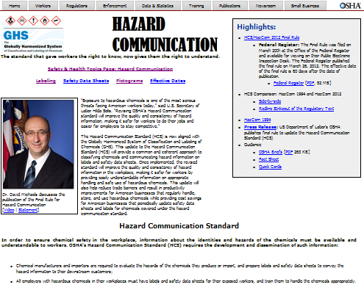
Updated HazCom Webpage

Slide 53
Guidance & Outreach
Highlights
HCS/HazCom Final Rule
Federal Register: The Final Rule was filed on March 20th at the Office of the Federal Register and available for viewing on their Public Electronic Inspection Desk. The Federal Register published the final rule on March 26, 2012. The effective date of the final rule is 60 days after the date of publication.
HCS Comparison: HazCom 1994 and Hazcom 2012
Side-by-side
Redline Strikeout of the Regulatory Text
HazCom 1994

Slide 54
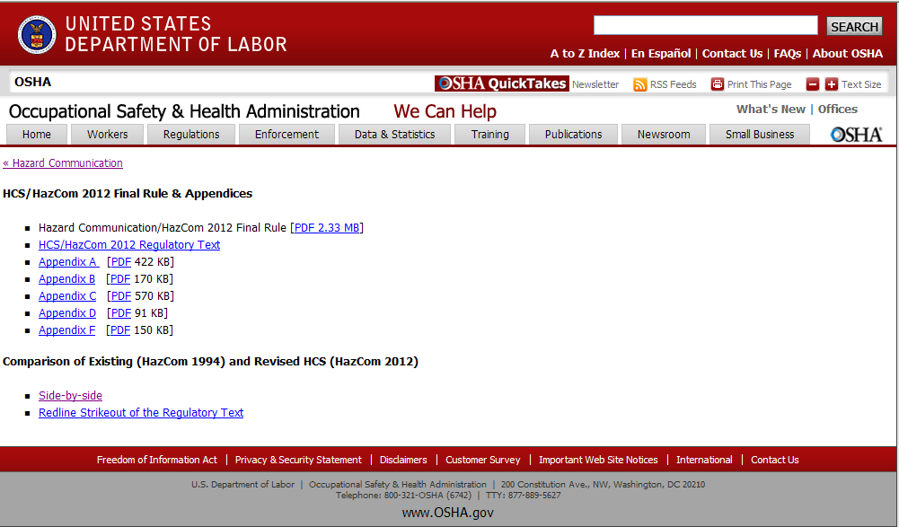
Guidance & Outreach

Slide 55
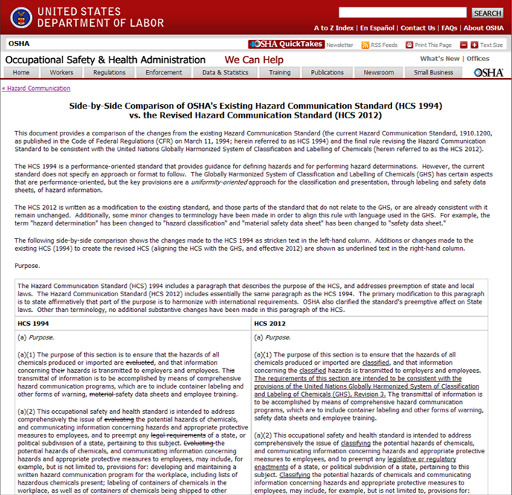
Guidance & Outreach

Slide 56
Guidance & Outreach
Press Release: US Department of Labor's OSHA publishes final rule to update the Hazard Communication Standard (HCS)
Guidance
OSHA Briefs
Fact Sheet
Quick Cards

Slide 57
Guidance & Outreach
OSHA is developing an array of guidance materials
Initial Materials
Quick cards, OSHA briefs, booklets, small entity compliance guides
Technical Materials
Model training materials; Safety Data Preparation guidance; Hazard Classification Guidance
Web Applications
SDS Electronic Form; Label Elements Application; Acute Toxicity Calculator

Slide 58
Updated Webpages
HazCom 2012 Webpage
http://www.osha.gov/dsg/hazcom/index.html
Safety & Health Topics Webpage
http://www.osha.gov/dsg/hazcom/index2.html

Slide 59

UN GHS Links & Information
United Nations Economic Commission for Europe GHS Sub-committee
http://www.unece.org/trans/danger/publi/ghs/ghs_welcome_e.html

Slide 60
Directorate of Enforcement Programs: Products
Letters of Interpretation
Provide guidance on specific sections of the standard.
Where appropriate, will be incorporated into the directive.
Hazard Communication Directive
Provides guidance on how OSHA enforces the Hazard Communication Standard.

Slide 61
Hazard Communication Directive
Provides an outline to compliance officers of what to review and how to cite violations of either HazCom 1994 or HazCom 2012.
Covers sections of the standard and provides clarification on how the individual subparts should be reviewed and enforced.

