Slide 1
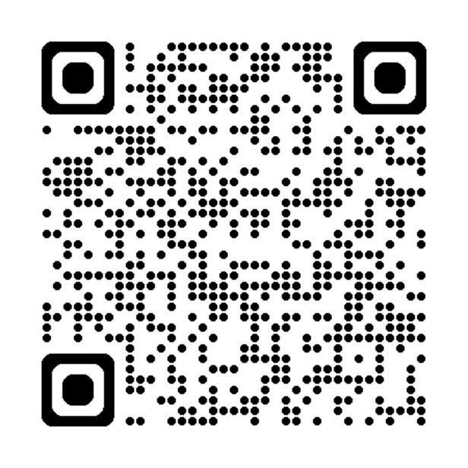
Mirror Check Initiative
Preventing Backovers

Slide 2
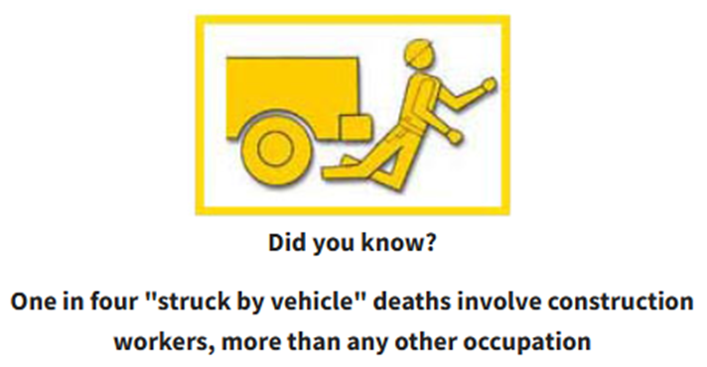
The Main Point
Raise awareness for back overs in the construction industry.

Slide 3

Risks
Limited Visibility
Lack of Planning
Inadequate Warning Systems
Worker Proximity
Distractions
Fatigue
Stress
Poor Communication
Untrained Personnel
Inconsistent Safety Measures
Pressing Deadlines

Slide 4
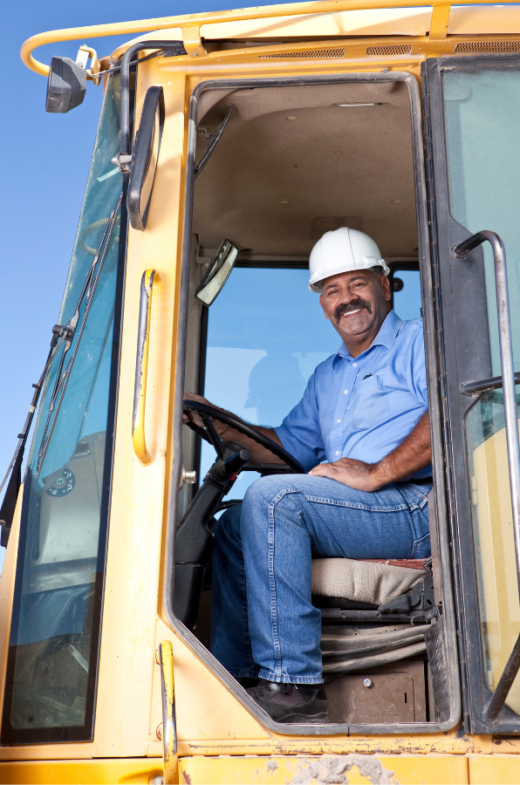
Solutions
Implementing effective solutions is key to minimizing backover accident risks.
Hazards are inevitable in construction, but accidents and injuries can be prevented with proper precautions.
Proactive measures and well-defined plans of action are crucial.
Taking these steps significantly reduces the likelihood of backover incidents.
Prioritizing safety protects workers on-site and promotes a safer work environment.

Slide 5

Alarms
Alarms on heavy machinery alert workers to potential hazards, reducing the risk of backover accidents and injuries.
Audible and visual alarms improve awareness of nearby workers, especially in blind spots, preventing collisions.
Alarms encourage cautious operation around workers and obstacles, fostering a culture of safety and vigilance on job sites.
NOTE: OSHA requires alarms on heavy machinery to alert workers of potential hazards and prevent accidents.

Slide 6
Mirror Adjustment
Good visibility is no accident!
Proper mirror adjustment is essential for safety.
Ensure all mirrors are positioned to eliminate and minimize blind spots.
Adjust mirrors before starting the vehicle.
Regularly check and re-adjust mirrors as needed during driving.
Clear visibility reduces accidents and enhances driver awareness.
Reminder: Mirrors are intended for detection
and not for gathering detailed information.

Slide 7


Mirror Adjustment
Five Good Reasons to Turn Out Your Mirrors
No need to constantly look over your shoulder (but it’s still helpful occasionally)
A quick glance at the mirror is enough to check the blind zone—turning your head at highway speeds means traveling 3 lengths of a dump truck
Glancing at the mirror keeps your forward view in sight, incorporating blind zones into your visual scan
Blind zones can be easily included in your overall visual scanning process
At night, no more glare from headlights in your mirrors, improving visibility

Slide 8
Mirror Adjustment
Inside Mirror:
Adjust the inside mirror to fully view the rear window from the driver's seat. You should be able to see through the mirror by moving only your eyes, not your head.
Drivers who are 6 feet tall or taller may benefit from flipping the mirror upside down, if possible. This raises the bottom edge by 1 to 2 inches, helping reduce a significant blind spot in the front for taller drivers. (Suggestion: opportunity for conversation)

Slide 9
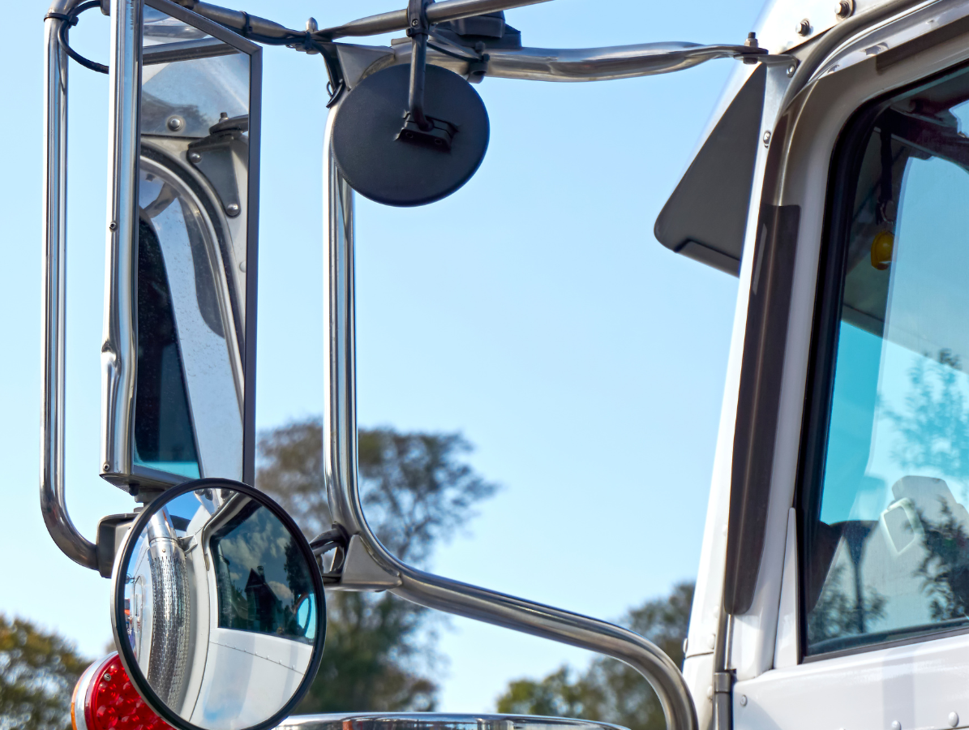
Mirror Adjustment
Side Mirror:
To adjust the driver's side-view mirror, place your head against the left side window and set the mirror so you can just barely see the side of the machinery/equipment on the right edge of the mirror.
To adjust the passenger's side-view mirror, position your head just above the center console and set the mirror so you can barely see the side of the vehicle on the left edge. If the vehicle lacks remote mirror-adjustment controls, you may need assistance for proper adjustment.

Slide 10
Mirror Adjustment
New Adjustments:
With these settings, you'll have nearly continuous visibility around your vehicle, making it easier to spot nearby roadway users. For instance, when a vehicle passes on your left, you'll see it first in the rearview mirror, then in the left side mirror, and finally with your side vision.
Before driving with the updated mirror settings, test them while your vehicle is parked. For instance, parallel park along a street and observe how passing vehicles appear in your mirrors and peripheral vision. This will help you adjust to the new settings before driving in traffic.

Slide 11

Mirror Adjustment
Remember:
Even with properly adjusted mirrors, blind spots may still exist. To reduce risk, always make a final check to the sides before making any lateral moves.

Slide 12

Spotters
Spotters are effective for protecting employees on foot behind vehicles with obstructed views, but they can also be at risk of injury or death
Ensure spotters and drivers establish clear hand signals before backing up to avoid miscommunication
Instruct spotters to maintain constant visual contact with the driver while the vehicle is backing to ensure safety

Slide 13
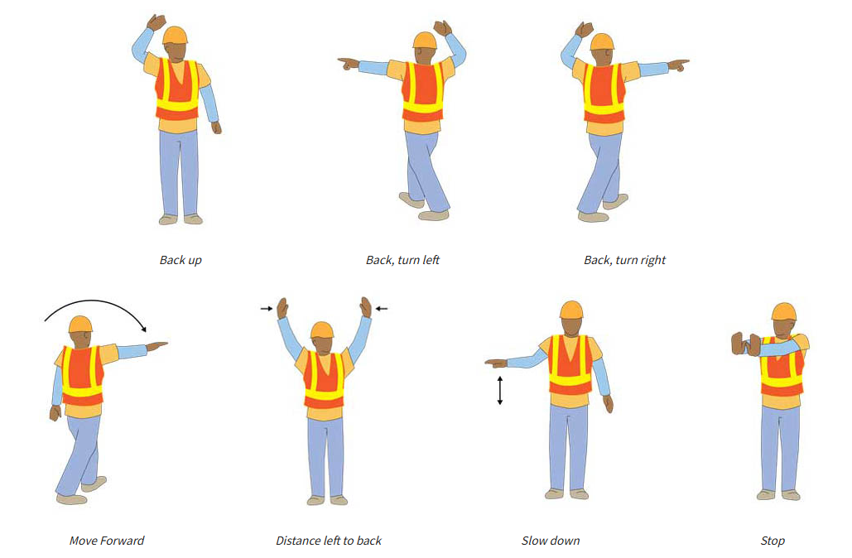
Suggested Spotting Signals
Notes:
Spotters are a proven method of protecting employees on foot behind vehicles with an obstructed view, but spotters themselves can be at risk for injury or even death. Employers can implement the following actions to help keep spotters safe:
Ensure that spotters and drivers agree on hand signals before backing up.
Instruct spotters to always maintain visual contact with the driver while the vehicle is backing.
Instruct drivers to stop backing immediately if they lose sight of the spotter.
Not give spotters additional duties while they are acting as spotters.
Instruct spotters not to use personal mobile phones, personal headphones, or other items which could pose a distraction during spotting activities.
Provide spotters with high-visibility clothing, especially during night operations.

Slide 14

Spotters
Prohibit spotters from using personal mobile phones, headphones, or other distractions during spotting tasks
Instruct drivers to stop backing up immediately if they lose sight of the spotter to prevent accidents
Do not assign additional duties to spotters while they are focused on spotting to ensure full attention
Provide spotters with high-visibility clothing, particularly during night operations, to enhance safety

Slide 15
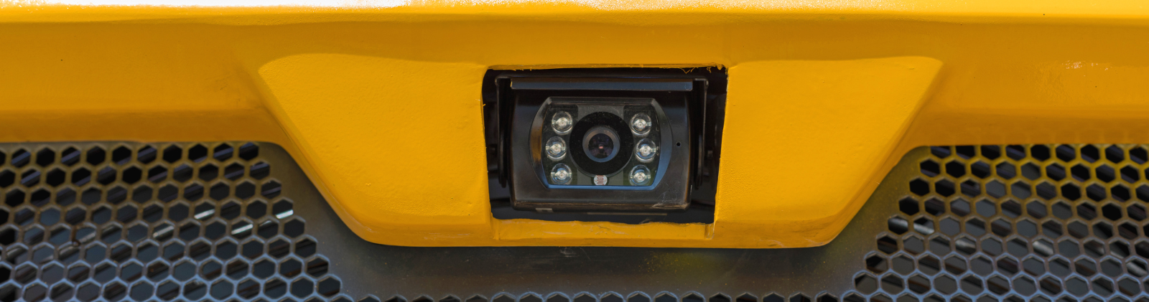
Cameras
Rear-view cameras enhance safety by improving visibility for drivers. Vehicles can have them pre-installed or added later, with screens mounted without blocking the driver's view. In harsh environments, rugged cameras may be needed. Large vehicles, like dump trucks, may require multiple cameras to eliminate blind spots and prevent accidents.

Slide 16

Proximity Detection Systems
Radar and ultrasonic technologies enhance backing safety. Radar systems transmit signals that bounce off objects and alert the driver. They must be positioned to avoid interference from harmless objects. Ultrasonic systems emit high-frequency waves to measure distance and alert the driver. Both can be mounted on most vehicles and may be optional from some manufacturers.
Did You Know?: Personal motor vehicles manufactured after 2015 come equipped with proximity detection systems

Slide 17
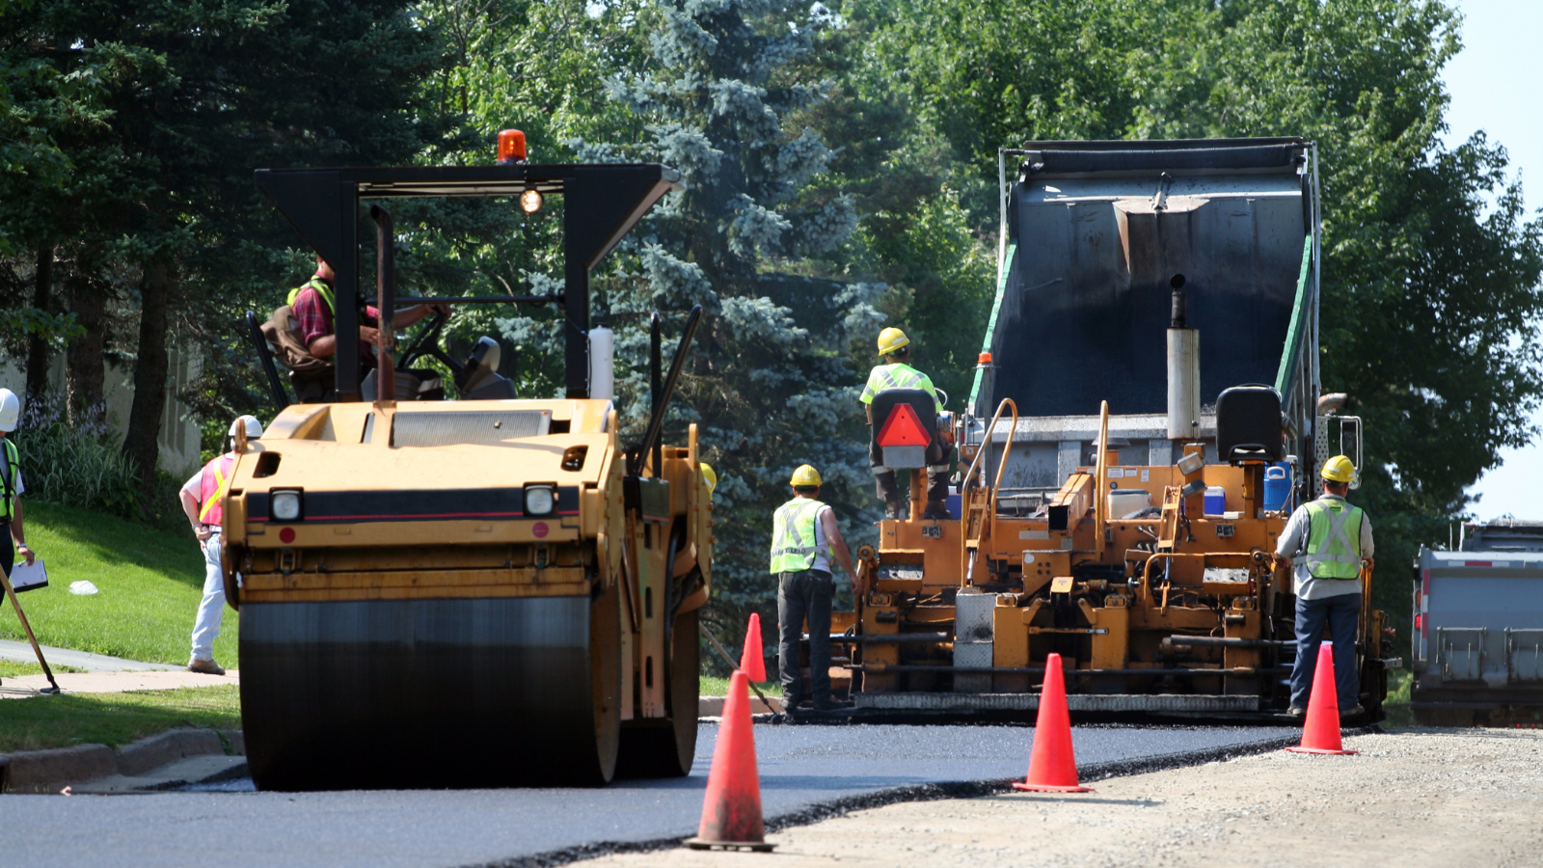
Tag-based Systems
An electromagnetic proximity detection system uses field generators and tags.
One setup places the generators on the vehicle and the tags on workers, while the other reverses the configuration, with tags on the vehicle and generators worn by workers.
These systems can be programmed to warn workers, stop the vehicle, or both when workers enter the danger zone.

Slide 18
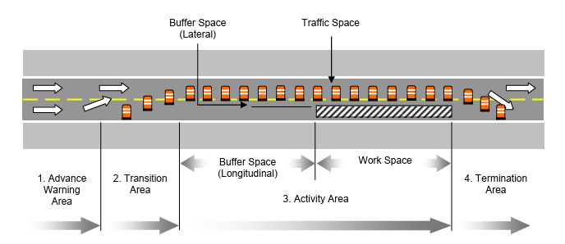
Internal Traffic Control Plans
A Traffic Control Plan helps address struck-by hazards by coordinating the movement of equipment, workers, and vehicles at a worksite. It minimizes or eliminates conflicts between vehicles and personnel, reducing or preventing the need for vehicles to back up.

Slide 19
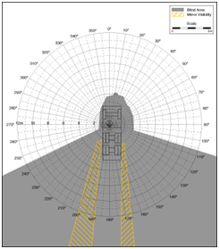
Blind Spots & Blind-Area Diagrams
A blind-area diagram shows areas around a vehicle that are not visible from the operator’s position, using light sources for the eyes and shadows for blind spots caused by obstructions.
Diagrams are created for three height levels:
Ground level
900 mm (2.95 feet)
1500 mm (4.92 feet)
Used in training, they highlight hazards, identify obstructions, and guide equipment selection for improved safety and visibility.
Construction Equipment Visibility

Slide 20
Helpful Tips
Being struck is the biggest danger around vehicles and equipment.
Workers should:
Always remain alert
Check surroundings often, listen for warnings and backup alarms
Keep a safe distance from moving vehicles
Stay behind protective barriers where possible
Look out for each other, warn coworkers
Follow internal traffic control plans
Always wear proper class of safety vest in the work zone

Slide 21
Helpful Tips
Treat equipment and vehicles with caution.
Around equipment, vehicles:
Communicate with operators by radio signals and/or eye contact
Don't approach until you communicate with operator, and they acknowledge you
Stay clear of vehicles, know traffic control plan
Use spotters when you must work with your back to equipment or traffic

Slide 22

Knowledge Check - Questions
Who is responsible for providing reflective vest at work?
Who is responsible for ensuring employees are using their PPE?
What action will help you hear better before backing up?
The type of plan which coordinates traffic flow at your facility?

Slide 23
Knowledge Check - Answers
Who is responsible for providing reflective vest at work? Employer
Who is responsible for ensuring employees are using their PPE? Employer
What action will help you hear better before backing up? Rolling down your window
The type of plan which coordinates traffic flow at your facility? Internal traffic control

Slide 24
Resources
National Safety Council (NSC)
U.S. Department of Transportation (DOT) – Federal Highway Administration
National Institute for Occupational Safety & Health (NIOSH)
The Center for Construction Research and Training (CPWR)
American Road & Transportation Builders Association (ARTBA)
Bureau of Labor Statistics (BLS)
American Industrial Hygiene Association (AIHA)
Occupational Safety & Health Administration (OSHA)

Slide 25
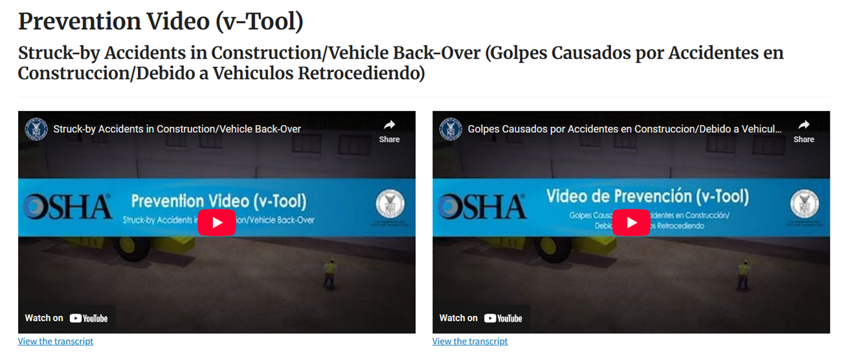
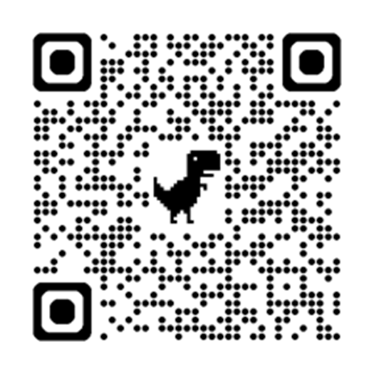
Resources

Slide 26

THANK YOU

