Slide 1

MAST CLIMBING Scaffolds
Office of Engineering Services
Directorate of Construction

Slide 2

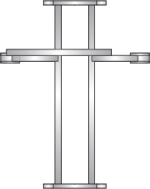

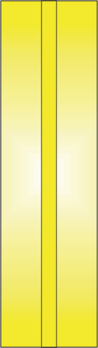
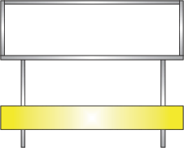
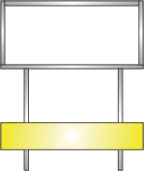



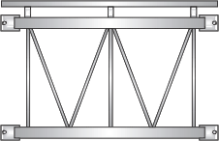
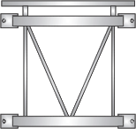
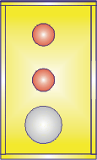



Twin Mast Platform
Wing
Center Span
Wing

Slide 3




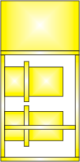
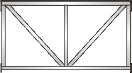
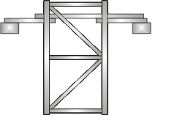

Multiple Mast Platforms
Multiple Center Spans
Deck surfaces which can operate independently

Slide 4
Special Configurations
Asymmetric Configurations

Slide 5
Special Configurations
Twin Decks Platforms

Slide 6
Special Configurations
Multi Deck Platforms

Slide 7


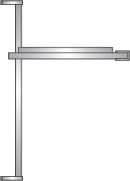

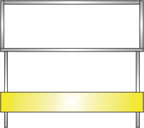
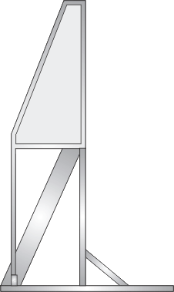
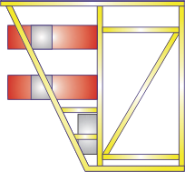
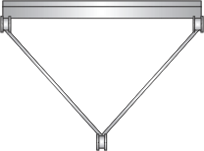

Special Configurations
Inclined Masts
(Both positive and negative inclines)

Slide 8
COMMON HAZARDS

Slide 9
Common Hazards
Overloading
No load table at site
Lack of control switches for loads
Materials falling from platform
Notes:
Overloading the platform and the unavailability of the load table at the site.
Lack of control switch when heavy materials are lifted exceeding rated loads.
Dropping of tools and material from the platform when the platform moves up due to lack of barriers.

Slide 10
Common Hazards
Fall protection
Too far from face of the building
No Interior guardrails
Lack of guardrails
No personal fall arrest systems
Notes:
Lack of proper fall protection when the platform is too far away from the face of the building.
Excessive gaps between the platform and the edge of the building.
Lack of guardrails.

Slide 11
Common Hazards
Improper connections
Proximity to live electrical lines
Use of corroded and damaged platform structural member
Notes:
Lack of proper connections between the structural members of the platform.
Placing the platform too close to live electrical lines.
Use of corrosive and damaged platform structural members

Slide 12
Common Hazards
Deviating from original design
Descending out of control
Lack of top mast section to limit upward movement
Notes:
Configuring the platform in a manner that deviates from the original design.
Platform descending out of control to the ground.
Lack of a top mast to prevent further upward movement of the platform.

Slide 13
Common Hazards
Anchorage for lateral loads
Lack of lateral anchorage
Dismantling
Stabilizing the mast
Removing anchorage
Notes:
Lack of lateral anchorage at regular intervals to provide stability.
Anchoring the mast at locations not capable of supporting the lateral loads.
During dismantling, removing the last tie without providing additional stability to the mast.

Slide 14
Common Hazards
Lack of safety training
No competent and/or qualified persons on the job
Notes:
Safety training; having competent and qualified persons on the job.

Slide 15
Mechanical Issues

Slide 16
Mechanical
Duplicative drive units per mast
Over speed safety gear
Rack and Pinions
Notes:
Duplicate drive units per mast, or drive unit/s and independent over speed safety gear on each mast (to protect against single mechanical component failure).
Over speed safety gear (if fitted) that engages if the work platform over speeds in the down direction. The braking effect of the safety gear should progressively increase as the work platform descends until the descent is halted.
Rack and Pinions - racks should be made from gear quality ductile alloy steel. Pinions should be made from forged steel.
Note: A useful list of mechanical and electrical controls published by the International Powered Access Federation (Health & Safety Guidance for Mast Climbing Work Platforms):

Slide 17
Mechanical
Safety margins for gear teeth
Top of mast drive pinions
Deceleration drive gear buffers
Notes:
Safety margins that compensate for wear of gear teeth on the rack, particularly if there is only one rack per mast.
Drive pinions located relative to the mast guide rollers such that the work platform cannot be driven off the top of the masts
Buffers with sufficient energy absorbing capacity to protect the drive gear and the work platform structure from damage due to deceleration when stopped by the buffers alone from the tripping speed of the safety gear, if fitted, or maximum controlled descent speed. This should apply with any combination of rated load on the work platform.
Note: A useful list of mechanical and electrical controls published by the International Powered Access Federation (Health & Safety Guidance for Mast Climbing Work Platforms):

Slide 18
Mechanical
Rollers
To ensure correct pinion to rack meshing
To prevent snagging
Notes:
Rollers on the back of the rack at the pinion to rack meshing points (or other mesh control provisions) to ensure correct pinion to rack meshing under all foreseeable service conditions (allowing for work platform to mast roller clearances and rack deflection, etc.)
Rollers or slides on ends of work platform (especially with single mast arrangements), if necessary to prevent snagging.
Note: A useful list of mechanical and electrical controls published by the International Powered Access Federation (Health & Safety Guidance for Mast Climbing Work Platforms):

Slide 19
Mechanical
Platform emergency lowering during power failure
Securing fencing
Notes:
Emergency lowering means that are safe and convenient to operate from the work platform in the event of power failure
Secure fencing of all trapping hazards, or other effective safeguards, so far as this is reasonably practicable.
Note: A useful list of mechanical and electrical controls published by the International Powered Access Federation (Health & Safety Guidance for Mast Climbing Work Platforms):

Slide 20
Mechanical
Weather protection for safety critical components
Davit hoist or handling devices for erection and dismantling
Notes:
Weather protection for emergency brakes and other safety critical mechanical components.
Davit/s or other means of handling the mast sections during erection/dismantling. Fixing points for hooks to prevent them snagging while not in use.
Note: A useful list of mechanical and electrical controls published by the International Powered Access Federation (Health & Safety Guidance for Mast Climbing Work Platforms):

Slide 21
Electrical Issues
Notes:
Note: A useful list of mechanical and electrical controls published by the International Powered Access Federation (Health & Safety Guidance for Mast Climbing Work Platforms):

Slide 22
Electrical
2 bottom limit switches in series
Automatic arrangements of over speed safety gear
Drive unit failure
Tripped condition
Notes:
2 bottom limit switches in series. The final limit switch not automatically resetting.
Automatic arrangements to prevent elevation in the event that one drive unit has failed unless over speed safety gear is fitted
Automatic arrangements to ensure that when the over speed safety gear is in the tripped condition, the work platform drive unit/s cannot be operated by means of the normal controls.
Note: A useful list of mechanical and electrical controls published by the International Powered Access Federation (Health & Safety Guidance for Mast Climbing Work Platforms):

Slide 23
Electrical
Electrical
Leveling within design tolerance
Hold-to-run controls
Emergency stop switch
Notes:
Leveling of the work platform within the design tolerance, by automatic means, for multi masted MCWPs.
Hold-to-run controls on the work platform for the elevating and descending motions.
Emergency stop switch at the control position which acts via circuitry, independent of that used by the normal service controls.
Note: A useful list of mechanical and electrical controls published by the International Powered Access Federation (Health & Safety Guidance for Mast Climbing Work Platforms):

Slide 24
Electrical
Electrical
Supply cable snagging
Vertical movement alarm
Weather protection
Notes:
Supply cable handling arrangements that will avoid cable snagging, so far as is reasonably practicable.
Vertical movement alarm for the work platform with provision for muting while there is no risk of the work platform injuring anybody on the ground or balconies etc.
Weather protection for all safety critical electrical components
Note: A useful list of mechanical and electrical controls published by the International Powered Access Federation (Health & Safety Guidance for Mast Climbing Work Platforms):

Slide 25

Thank you !

