Slide 1
Planning for Emergencies in
Your Workplace

Slide 2
Contents
Emergencies in the Workplace
Emergency Action Plans
Take Preparedness Home
[Customize for how you want to use this presentation with your employees ]

Slide 3
Why prepare?
Emergencies can happen at any time
The best time to prepare = before it happens
Emergency preparedness:
  Reduces the amount of damage or losses
  Reduces unexpected costs due to emergencies
  Lessens the severity or amount of injuries
  Helps return to full capacity and operations faster

Slide 4
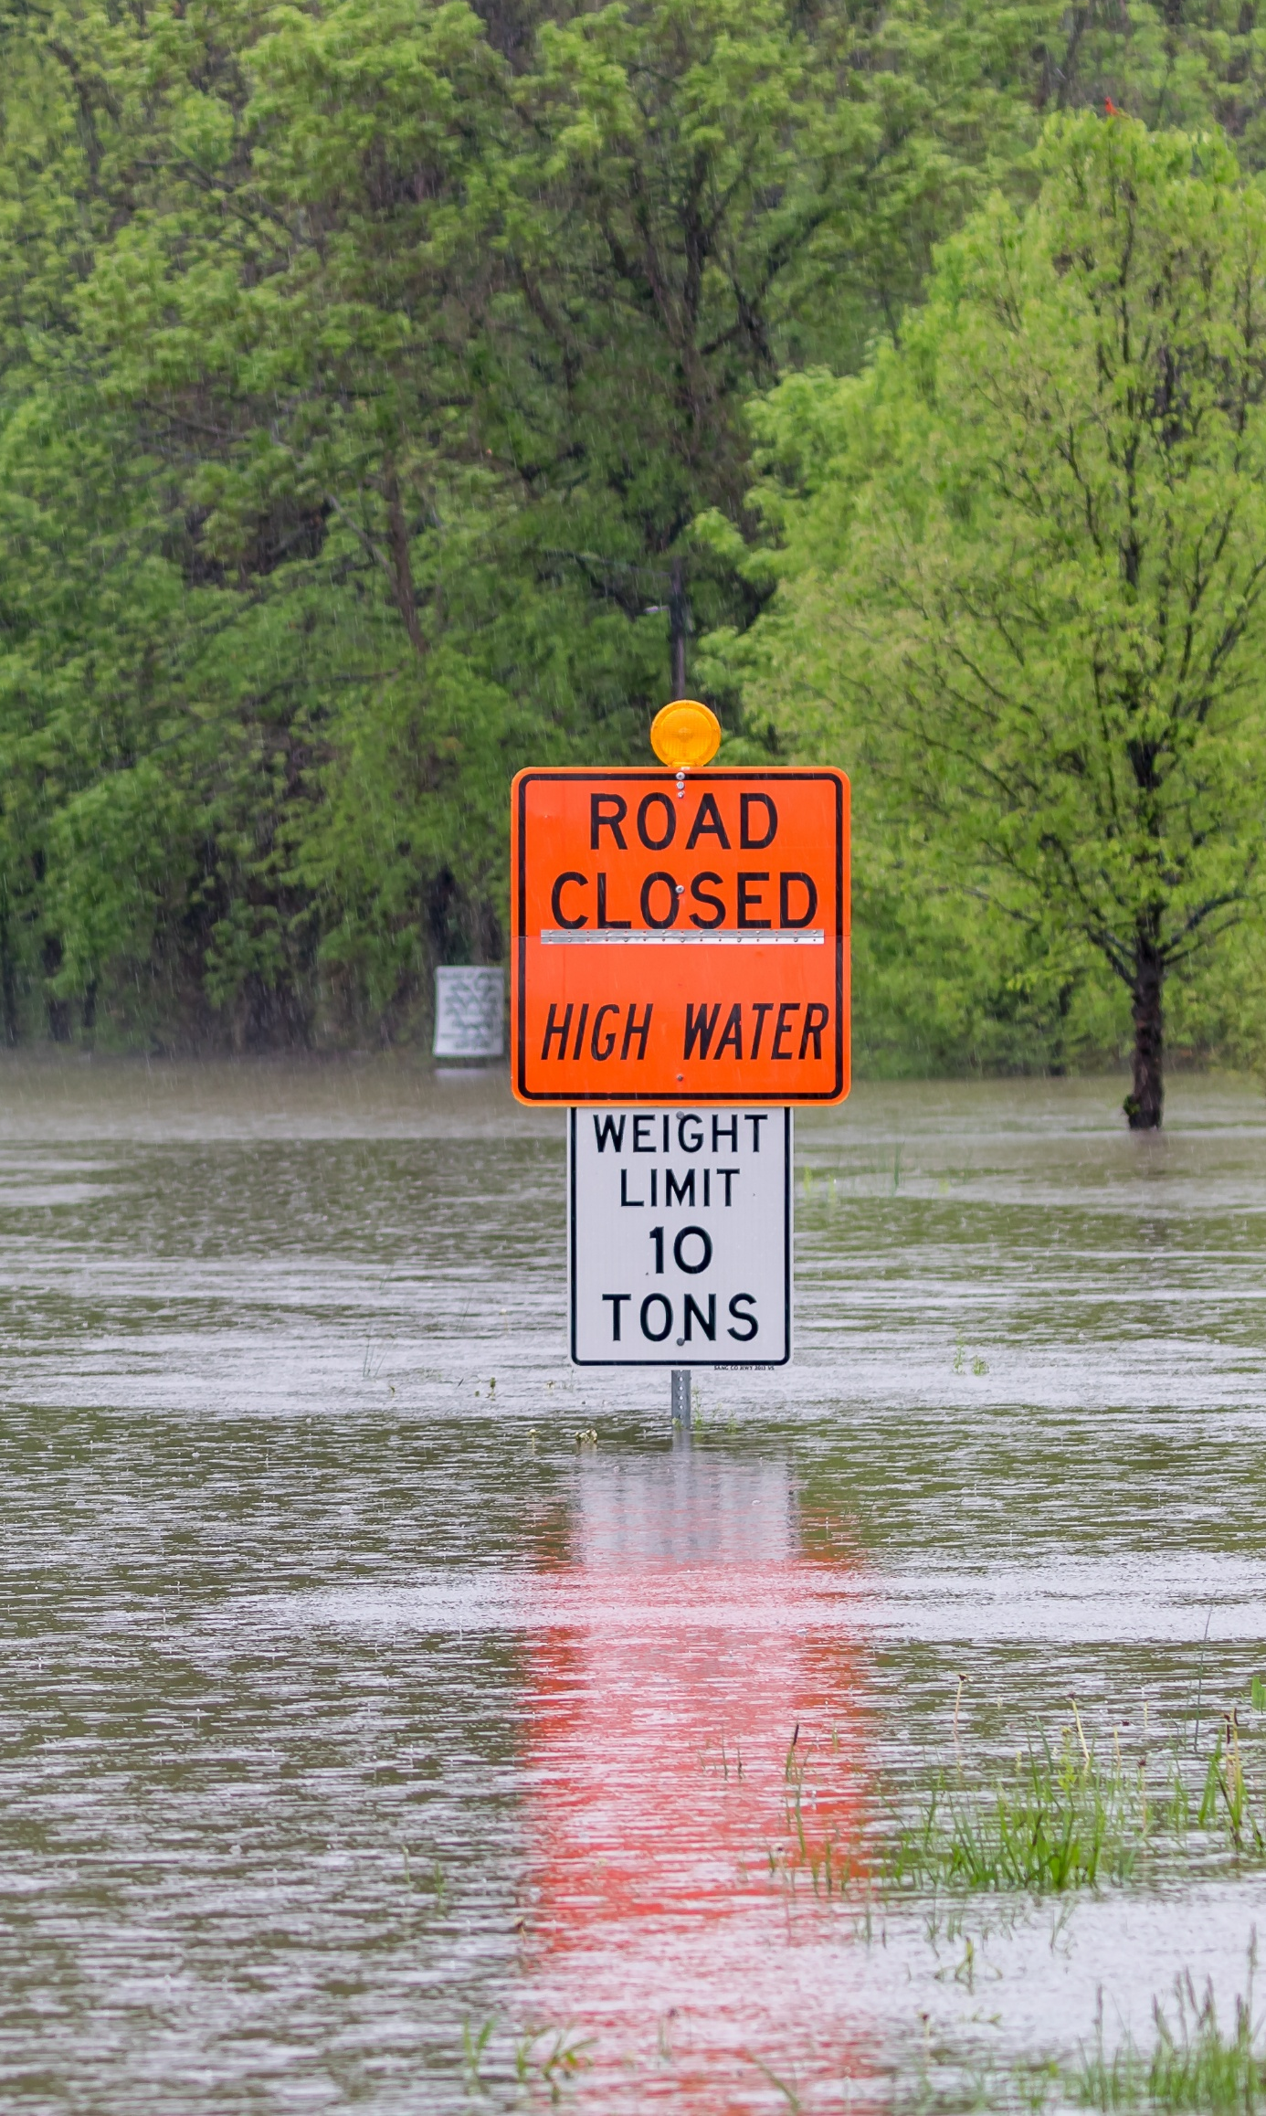
What is a workplace emergency?
An unforeseen situation that:
  Threatens workers, customers, or the public,
  Disrupts or shuts down operations, or
  Causes physical or environmental damage.

Slide 5




Types of Emergencies
Your industry, location, and other factors can mean some emergencies are more likely than others.
However, a workplace should plan for all possible emergencies.
Natural Disasters
Outages
Chemical
Social/Civil
Notes:
Find resources for different industries and types of emergencies: https://www.osha.gov/emergency-preparedness
Natural Disasters: floods, hurricanes, tornadoes, fires, earthquakes, snow or ice storms, etc.
Outages: electricity, water, or other essential requirements
Chemical: toxic gas releases, chemical spills, radiological accidents, etc.
Social/Civil: public health emergencies/pandemics, civil disturbances, terrorism or war, workplace violence, etc.

Slide 6

Steps to Emergency Preparedness
  Be informed
    Sign up for alerts and warnings
    Follow the news
  Make a plan
    Have an emergency action plan (EAP)
    Build a kit (ready.gov/kit)
  Prepare and act
    Update policies and procedures
    Assign responsibilities
    Prepare supplies
    Conduct drills and practice your plan
Notes:
Be Informed:
Sign up for local emergency and weather alerts
Identify and follow a trusted source of local and national news
Identify if an emergency radio or alert system should be installed at your facility
Make a Plan:
Make or review your workplace emergency action plan (EAP)
Have a policy for how and when to put the EAP into action
Build a disaster preparedness kit
Prepare and Act:
Update policies and procedures as needed
Ensure staff are trained and supplies are available
Assign emergency responsibilities
Conduct drills and practice your plan at regular intervals

Slide 7





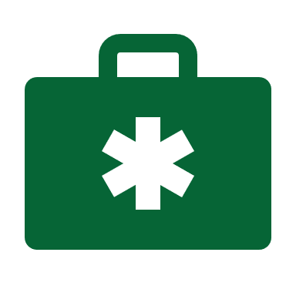


What is in an Emergency Action Plan?
How to report emergencies
Evacuation procedures and routes
Training policies or requirements
Communications procedures
Reduced capacity or critical operations plans
First-aid, AED, and other materials locations
Staff contacts and emergency responsibilities
Local emergency services information
Notes:
Learn more about Emergency Action Plans: https://www.osha.gov/emergency-preparedness/getting-started
Best practices for your EAP:
Include various perspectives from your workplace to create and review an EAP.
Create an EAP for each location if are multiple worksites.
Communicate with local agencies, departments, and services.
Conduct regular EAP reviews for changes or updates.
Include the EAP in onboarding and regular training.

Slide 8
Emergency Action Plan: Reporting & Communicating
How to report emergencies
Communications procedures
Procedures to report an emergency
Alert methods (visual/audio)
Who communicates emergency information and how
Where to find worker personal information
What does emergency reporting and communications look like at your workplace?

Slide 9
Emergency Action Plan: Evacuations & Operations
Evacuation procedures and routes
Reduced capacity or critical operations plans
Evacuation conditions
Responsibilities during an evacuation
Exit diagrams
Assembly areas
Establish a buddy system for individuals who may need assistance
Actions to take in various emergencies
Who and how to shut down critical equipment/operations
What is your approach to emergency evacuations and operations?
Notes:
Establish a buddy system for those individuals or colleagues who may need assistance during an evacuation and know how to use an evacuation chair.

Slide 10
Emergency Action Plan: Training & Supplies
Training policies or requirements
First-aid, AED, and other materials locations
How and when to conduct emergency training
How and when to conduct drills
Discuss special hazards
  Flammable materials
  Toxic chemicals
  Water-reactive substances
  Radioactive sources
Locations of critical safety and emergency supplies
What does this look like at your workplace?

Slide 11
Emergency Action Plan: Staff & Services Contacts
Staff contacts and emergency responsibilities
Local emergency services information
Key emergency contacts and information
Responsibilities in different situations
Authority for critical decision making
Information on local emergency responders and agencies
Who are your key staff and local emergency services?
Notes:
Local emergency services: know not only to how to how to contact in an emergency, but also the key contact for coordinating with this agency.

Slide 12
Emergency Response: Should I stay or should I go?
Different emergencies require different responses
EAPs should include when a workplace evacuation is necessary, or if the workplace should shelter-in-place
Learn more about evacuation and shelter-in-place procedures
How do you know what response plan to follow?
Notes:
Evacuation: https://www.osha.gov/emergency-preparedness/getting-started#v-nav-evacuation
Shelter in Place: https://www.osha.gov/etools/evacuation-plans-procedures/eap/shelter-in-place

Slide 13
Take Preparedness Home

Slide 14

Be Prepared at Home
Being prepared can save lives and minimize damage
Think about:
  Creating a family emergency plan
  Including dependents and pets in plans
  Maintaining emergency supplies
  Knowing how to shut off utilities
  Securing important documents
  Practicing emergency drills
Notes:
Find kids and family resources at ready.gov/kids

Slide 15
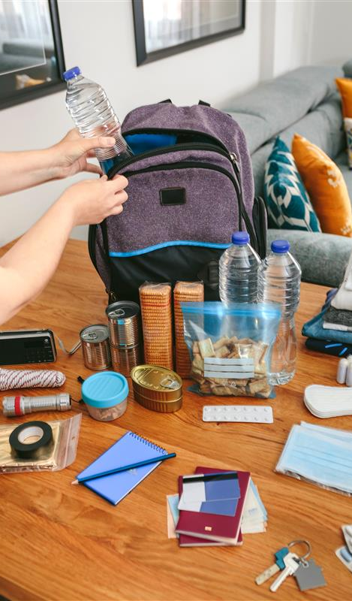
Home Emergency Preparedness Kits
Build an emergency kit to last you at least 3 days
Find basic emergency kit supplies at ready.gov/kit
Consider unique needs for your family, including supplies for pets or seniors
Do you have an emergency kit?
Notes:
Find more information on emergency kits and supplies unique to the needs of your family at https://www.ready.gov/kit.
Basic kit supplies to include:
Water (bottles or jugs) and food (non-perishable, like cans and dry goods)
Medicine (include OTC medicines and important prescriptions)
Battery-powered NOAA weather radio
Flashlights, cell phone chargers, power bricks, and batteries for devices that need them
Whistle
Dust masks
Tools, can openers, and fire starters
Important documents and identification
Pet food and supplies for three days

Slide 16
Preparing at Work and Home
Work
Prepare and plan for 24 hours of an emergency situation
Likely not alone
Following workplace plan
Home
Prepare and plan for 3 days of an emergency situation
Rely on yourself and family
You create the plan
Need supplies for everyone
Both
Everyone knows the plan
Practice and drills
Personalized to the location and people
Notes:
At work, prepare and plan for 24 hours of an emergency situation. At home, prepare and plan for 3 days of an emergency situation.

Slide 17
[Customize the rest of this presentation to…
Take the Response Ready Workplace Challenge
Complete the Develop an Emergency Action Plan worksheet
Train staff on a specific emergency response procedures
Share important information or contacts about emergency response in your workplace
…and more!]
Notes:
The Response Ready Workplace Challenge (https://www.osha.gov/safeandsound/activities#accordion-84740-collapse3) is one of the Safe and Sound Core Element Challenges (see all: https://www.osha.gov/safeandsound/activities).
The Develop an Emergency Action Plan worksheet: (ttps://www.osha.gov/sites/default/files/3_HPC_Develop_An_Emergency_Action_Plan.pdf) is part Safety and Health Programs Step-by-Step Guide (https://www.osha.gov/safety-management/step-by-step-guide/).

Slide 18
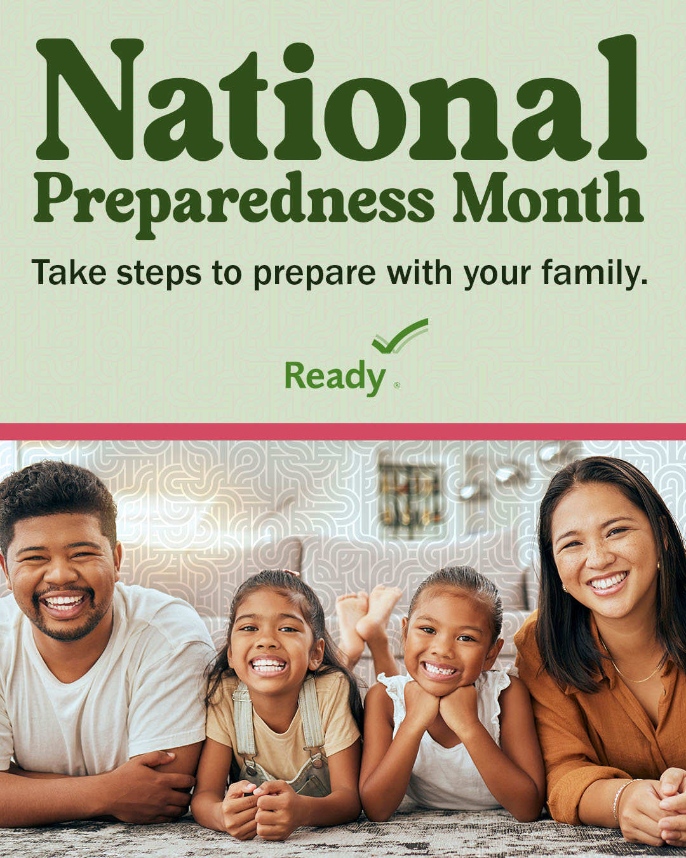
National Preparedness Month
September 2025
Preparing for emergencies and disasters can keep you, your family, and your community safe
Find National Preparedness Month resources
Notes:
Find toolkits, resources, and information on National Preparedness Month at https://www.ready.gov/September

Slide 19
Helpful Resources and Tools
OSHA
  Emergency Preparedness Home Page https://www.osha.gov/emergency-preparedness
  General Business Preparedness for Business, Construction, and Maritime Industries https://www.osha.gov/emergency-preparedness/getting-started
  Evacuation Plans and Procedures eTool: Develop and Implement an EAP https://www.osha.gov/etools/evacuation-plans-procedures/eap/develop-implement
Ready.gov
  Ready Business https://www.ready.gov/business
  Family and Kid-friendly Emergency Resources ready.gov/kids
  National Preparedness Month: ready.gov/september
  Build an emergency kit: ready.gov/kit

