Slide 1
The Six Steps of a Job Hazard Analysis
A Workplace Training to Identify and Control Hazards
Customize this presentation and add your logo here!

Slide 2

What is a job hazard analysis?
A job hazard analysis, or JHA, is an exercise in identifying what can go wrong
It focuses on:
Identifying hazards before they occur
Relationships between the worker, task, tools, and environment
Eliminating or reducing risks
Emerging hazards
Notes:
A job hazard analysis (JHA) is a technique that focuses on job tasks to identify hazards before they occur.
It focuses on the relationship between the worker, the task, the tools, and the work environment.
Ideally, after you identify uncontrolled hazards, you will take steps to eliminate or reduce them.
A JHA also identifies hazards that might emerge when a new process or piece of equipment is introduced in the future.

Slide 3

Why is a job hazard analysis important?
A JHA makes a workplace safer by:
Looking at your operations and job procedures for hazards
Using workers’ knowledge and expertise
Implementing controls and continual improvement
Notes:
Finding and fixing hazards in the workplace is an ongoing process that helps better identify and control sources of potential injuries or illnesses.
Not only does it uncover hazards already in your workplace, but also hazards that could come up in the future.
Improves communication between employees and management about potential safety issues.

Slide 4

What kind of jobs have hazards?
All workplaces have job hazards.
Some examples in our workplace are:
{List a typical machinery hazard in your workplace}
{List a typical chemical hazard in your workplace}
{List any noise or vibration hazards in your workplace}
{List a common ergonomic hazard in your workplace}
Etc.
Notes:
Agricultural worker handling a chemical substance
Office workers using non-ergonomic computer equipment
Job hazards can cause injury, illness, and even fatality
All workplaces have job hazards.
Some examples are:
Construction worker working at heights
Mining worker operating around explosives
Warehouse worker lifting heavy objects

Slide 5
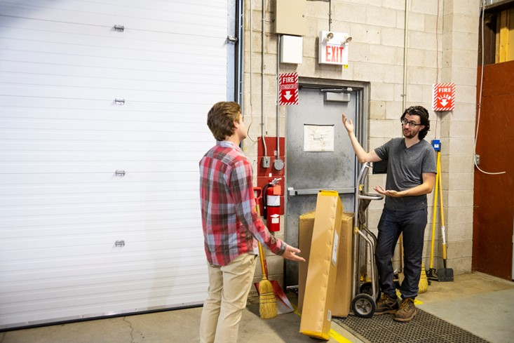
Goals of a job hazard analysis
The goal of a JHA is to discover:
How
An incident happens
The hazard(s) can be controlled
What
Are the potential consequences and worst-case scenarios?
Are the contributing factors?
Notes:
Also: how likely is it that an incident will occur?

Slide 6
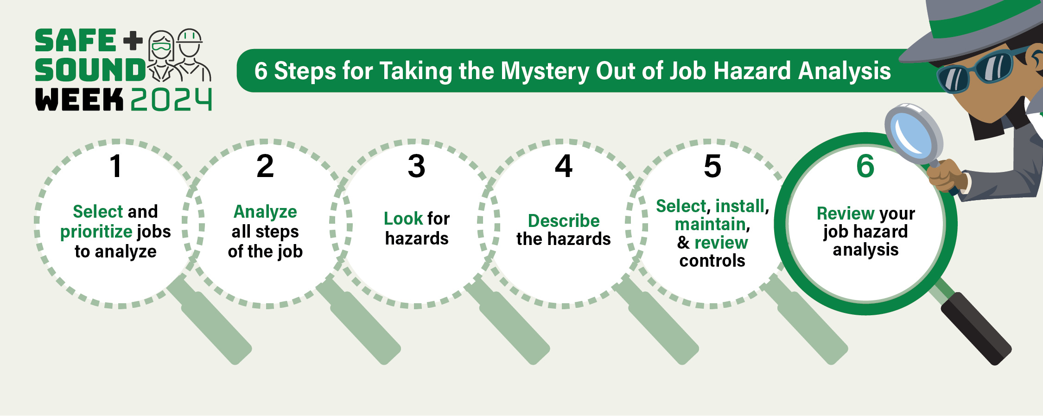
Six steps of a job hazard analysis
Notes:
Select and prioritize jobs to analyze
Analyze all steps of the job
Look for hazards
Describe the hazards
Select, install, maintain, and review controls
Review your job hazard analysis

Slide 7

Step 1: Select and prioritize jobs to analyze
Start with the jobs…
Where close calls have happened
With past injuries
Where potential injury could be severe
Where procedures are outdated
With new or updated processes
Assigned to newer or less-experienced staff
Notes:
Start with the jobs where the potential injury could be severe or the jobs that frequently result in injuries when performed.
Engage with your workers and review injury and illness records to help make this determination.
Workers are the experts at the jobs they perform.
A JHA should include jobs that rely on machinery that requires continuous maintenance or upgrades.

Slide 8

Step 2: Analyze all steps of the job
Detail all aspects of the job performed
Break it into a series of smaller steps
Take photos or video to record the process
Consult with workers to ensure the list of steps is accurate and comprehensive
Notes:
Detail all aspects of the job performed in the JHA.
This means each step of the process is as accurately described as possible.
This is critical so that new workers can consult the JHA and best prepare for the job.
Safety managers can make videos and take photos to help record this process.

Slide 9
Step 3: Look for hazards
What could go wrong? Review all previous injury or illness records.
Hazards can be broken down into these categories:
Machine-related
Example: burns or crushed fingers
Physical
Example: Heights that pose a fall risk
Biological
Example: Exposure to a virus
Chemical
Example: Working with toxic substances
Ergonomic
Example: Repetitive motions that cause muscle stress

Slide 10

Step 4: Describe the hazards
Determine the potential who, what, when, where, why and how of each hazard.
Who does the hazard affect?
What causes the hazard?
When is the hazard likely to impact the worker?
Where does the operation occur?
Why does the accident occur?
What are other contributing factors?
Notes:
Now that you have identified the job hazard, put on your detective hat to determine the potential who, what, when, where, why, and how the hazard caused the injury or illness.

Slide 11
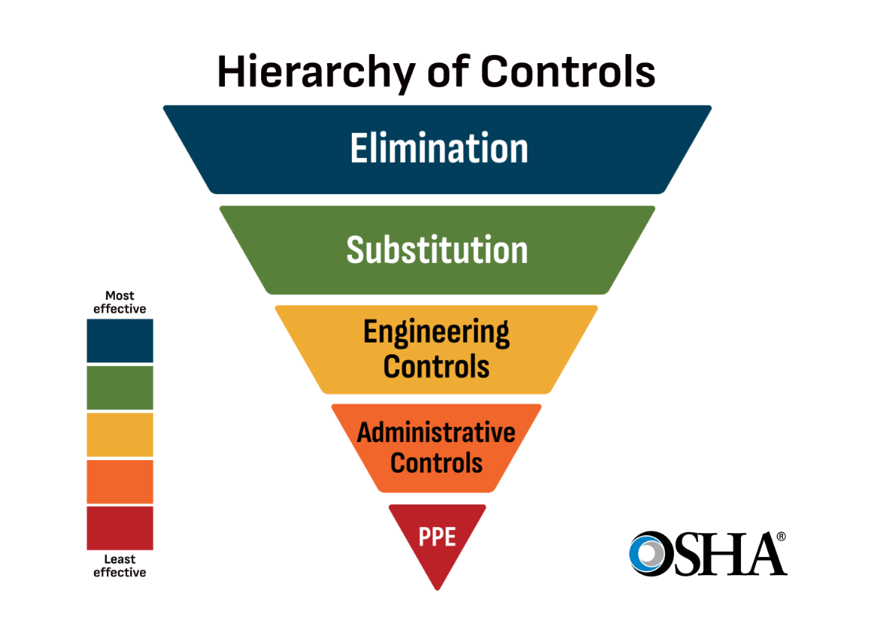
Step 5: Select, install, maintain, and review controls
Hierarchy of controls - a method of identifying and ranking safeguards to protect workers from hazards.
Helps choose the most effective controls.
Notes:
The hierarchy of controls is a method of identifying and ranking safeguards to protect workers from hazards.
They are arranged from the most to least effective and include elimination, substitution, engineering controls, administrative controls and personal protective equipment.
In this step, safety managers can detail the implementation of a hazard control or a combination of hazard controls that will most effectively prevent the hazard from causing an injury.

Slide 12
Step 5: Select, install, maintain, and review controls (cont.)
Steps of the Hierarchy of Controls
Elimination: The hazard no longer exists
Substitution: Change out a material or process
Engineering Controls: Prevent hazards from getting to workers
Administrative Controls: Change the way work is performed
Personal Protective Equipment (PPE): Use clothing or devices for protection
Most Effective
Least Effective
Notes:
The hierarchy of controls is a method of identifying and ranking safeguards to protect workers from hazards.
They are arranged from the most to least effective and include elimination, substitution, engineering controls, administrative controls and personal protective equipment.
In this step, safety managers can detail the implementation of a hazard control or a combination of hazard controls that will most effectively prevent the hazard from causing an injury.

Slide 13

Step 6: Review your job hazard analysis
Follow up to implement controls and commit to continual improvement
Share the JHA with your workers
Routinely update the JHA as workers, processes, machinery, or equipment change
Check that controls are still effective
Notes:
Congratulations! You developed a JHA.
The last part is to review the JHA and to continually update it as aspects of the job change or evolve over time.
For example, this could be upgrading machinery or equipment or specifying if an injury or illness occurs.

Slide 14
Customize the rest of this presentation to…
Explain why your business is going to complete a job hazard analysis.
Why it’s an important part of your safety and health program, what you want to achieve, who will be included, etc.
Start a group discussion on identifying hazards in your workplace.​​
Deliver a training on a specific JHA topic​​.

Slide 15


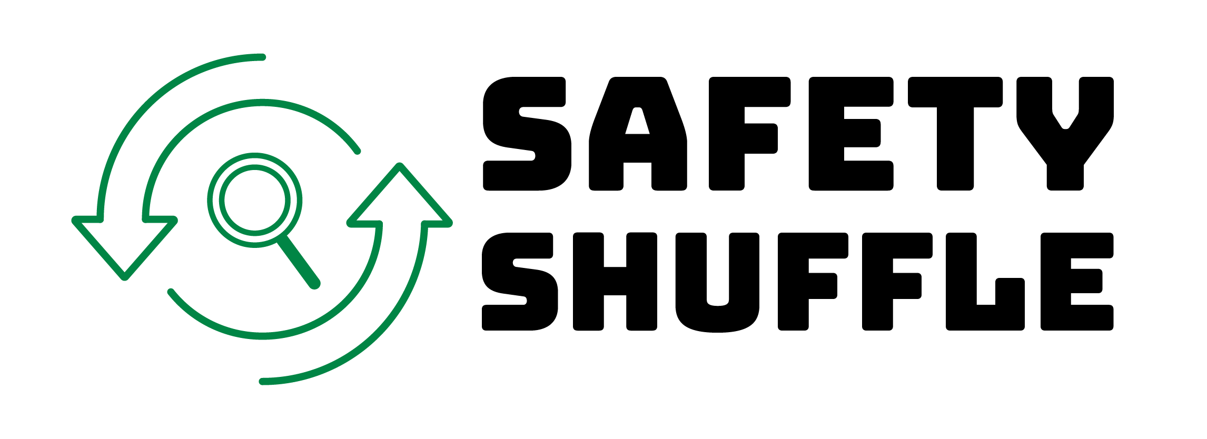
Additional resources
Safety and Health Programs Step-by-Step Guide: osha.gov/safety-management/step-by-step-guide
Safe + Sound Challenge Activities: osha.gov/safeandsound/activities
Hazard Identification Training Tool: osha.gov/hazfinder
On-Site Consultation Program: osha.gov/consultation
Hierarchy of Controls (CDC): cdc.gov/niosh/hierarchy-of-controls/about/

