Slide 1
OSHA Trenching and Excavation

Slide 2
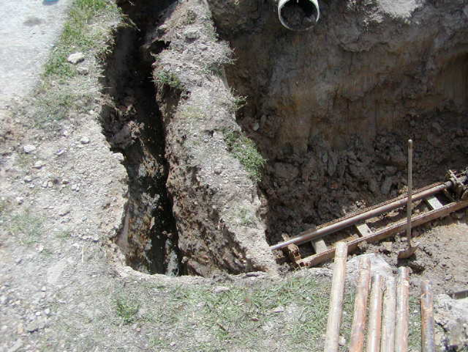
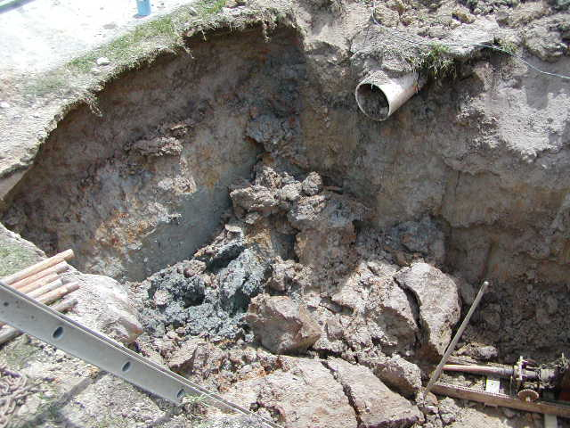
Why a Trenching and Excavation Safety Initiative?
Nation-wide Trench and Excavation Cave-in related Fatality Data*:
2022 – 39
2023 – 15
2024 – 15
2025 – 21
* OSHA Information System

Slide 3

Cave-ins are Preventable
SLOPE or bench trench walls at an angle inclined away from the excavation.
SHORE trench walls by installing aluminum hydraulic or other types of supports to prevent soil movement.
SHIELD trench walls with trench boxes or other types of supports to prevent soil cave-ins.

Slide 4
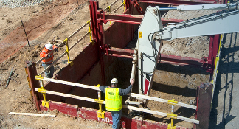
OSHA Cave-in Prevention Requirements
Trenches under 5 feet deep must be examined by a competent person to determine if a protective system is required.
Trenches 5 feet deep or greater require a protective system.
Trenches 20 feet deep or greater require a protective system designed by a registered professional engineer.

Slide 5
Address all Trench and Excavation Hazards
Ensure there is a safe way to enter and exit the trench
Keep materials away from the edge of the trench
Look for water accumulation and/or atmospheric hazards
Train workers to recognize trenching and stop work when conditions become unsafe
Competent person inspections to identify and abate all hazards

Slide 6
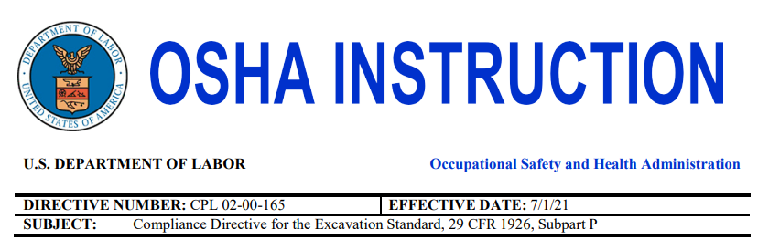
Compliance Directive for the Excavation Standard
Issued July 1, 2021
Intended to serve as a standard-specific reference for OSHA Compliance Safety and Health Officers (CSHOs) regarding the application of Subpart P of 29 CFR Part 1926, providing supplemental compliance inspection guidance and citation policies.

Slide 7
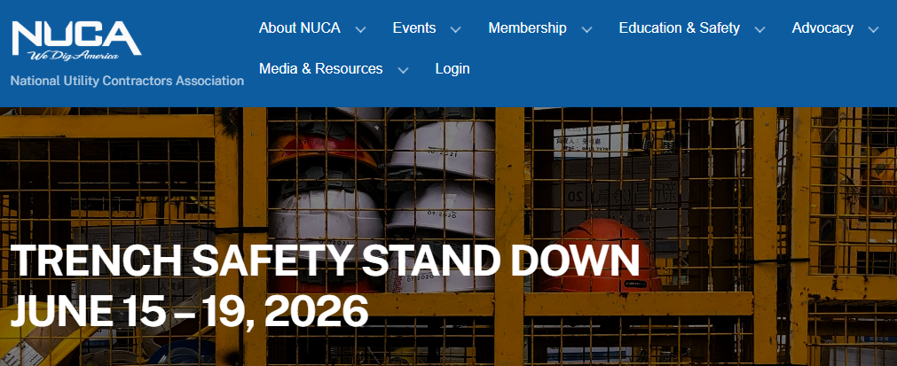
Participate in National Utility Contractors Association's Trench Safety Stand Down
The goal of the event is to reach those working in and around trenches and excavations and provide information about current excavation requirements and safety procedures.
Trench Safety Stand Down week presents the opportunity for employers to talk directly to employees about the importance of safety at the job site.
https://nuca.com/events/tssd

Slide 8
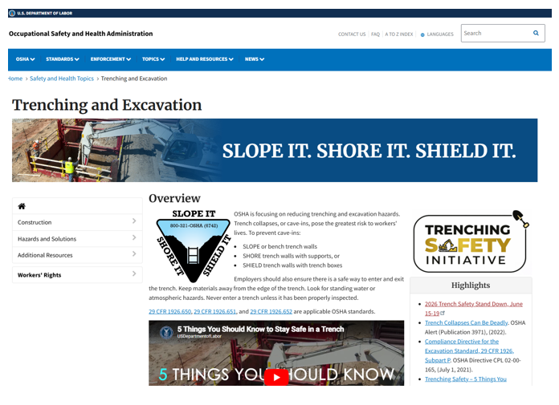
OSHA Trench Safety Resources

