Slide 1
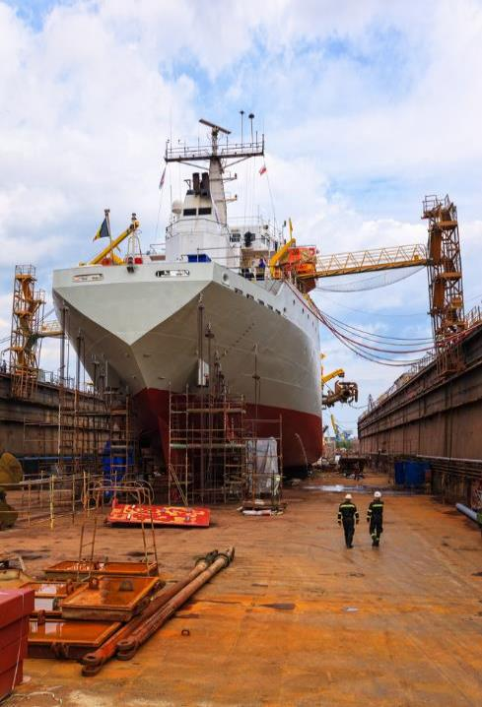

Most Frequently Cited Serious Violations
Maritime Industry FY2025
OSHA Federal Standards
October 1, 2024 – September 30, 2025

Slide 2
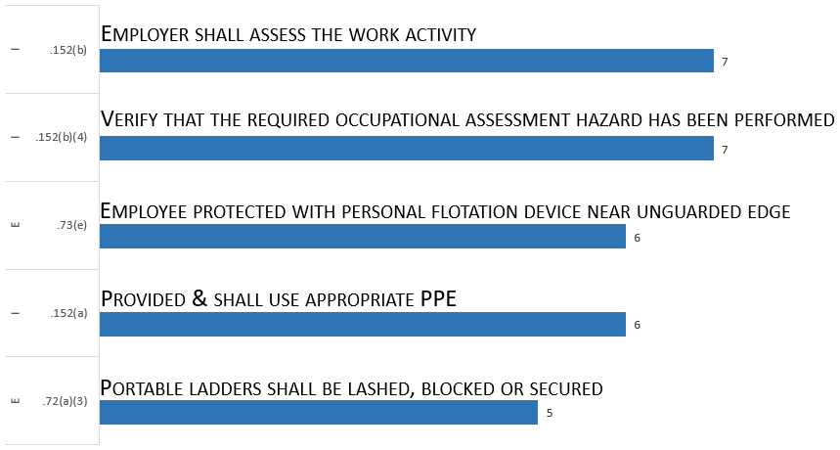
Most Frequently Cited Serious Violations in Shipyard Employment FY 2025
29 CFR 1915

Slide 3
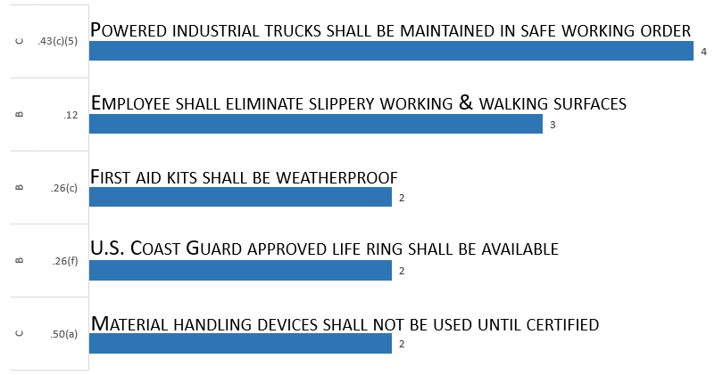
Most Frequently Cited Serious Violations in Marine Terminals FY 2025
29 CFR 1917

Slide 4
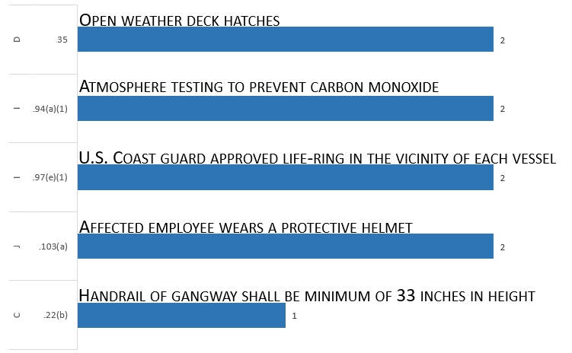
Most Frequently Cited Serious Violations in Longshoring FY 2025
29 CFR 1918

