Slide 1


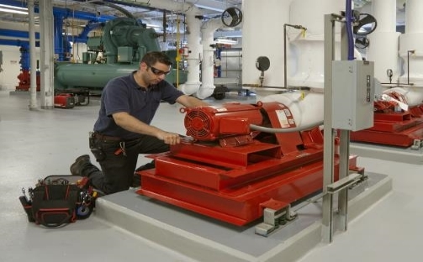
Most Frequently Cited Serious Violations
General Industry FY2024
OSHA Federal Standards
October 1, 2023 – September 30, 2024

Slide 2
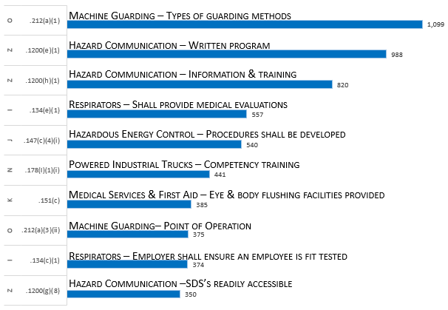
Most Frequently Cited Serious Violations in General Industry FY 2024
29 CFR 1910.
1910 Overall MFC

Slide 3
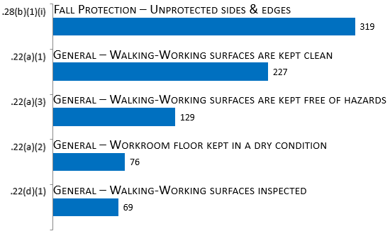
Walking-Working Surfaces
[1910.21 – .30]
29 CFR 1910.
Subpart D

Slide 4
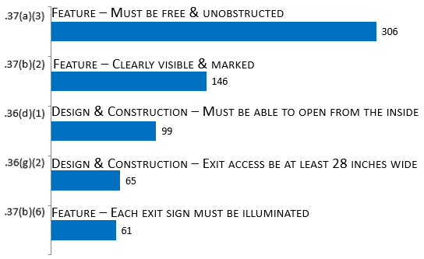
Exit Routes & Emergency Planning
[1910.33 – .39]
29 CFR 1910.
Subpart E

Slide 5
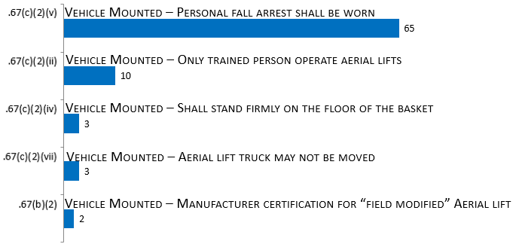
Powered Platforms, Manlifts, & Vehicle-Mounted Work Platforms [1910.66 – .68]
29 CFR 1910.
Subpart F

Slide 6
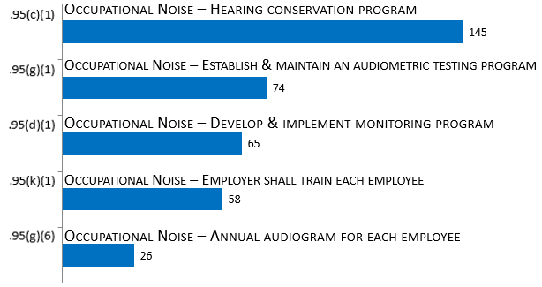
Occupational Health & Environmental Control
[1910.94 – .98]
29 CFR 1910.
Subpart G

Slide 7
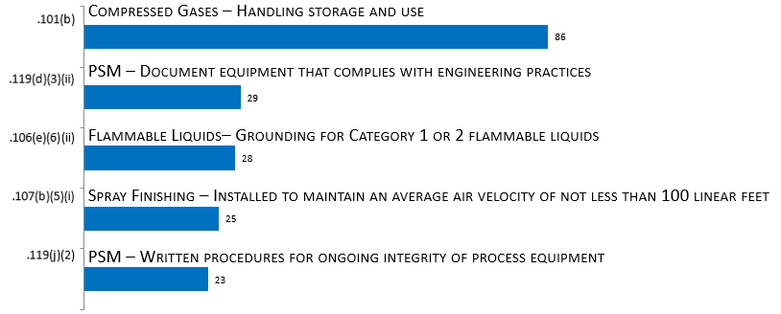
Hazardous Materials
[1910.101 – .126]
29 CFR 1910.
Subpart H

Slide 8
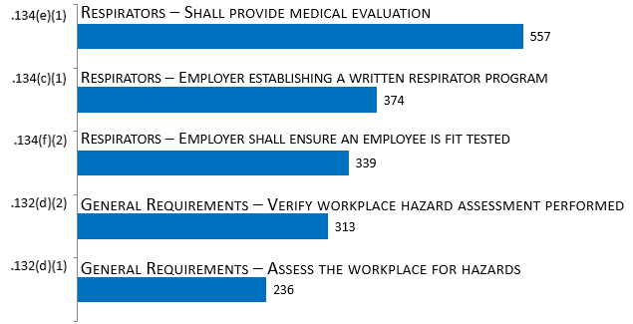
Personal Protective Equipment [1910.132 – .138]
29 CFR 1910.
Subpart I

Slide 9
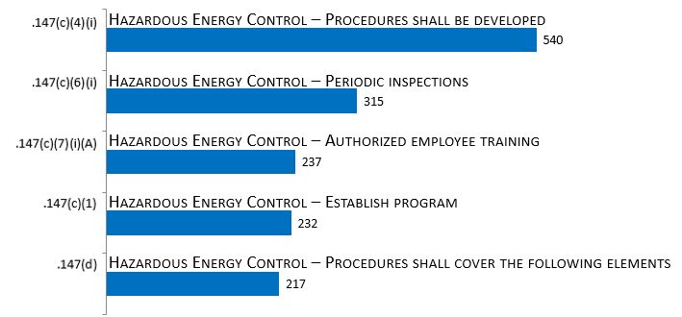
General Environment Controls
[1910.141 – .147]
29 CFR 1910.
Subpart J

Slide 10
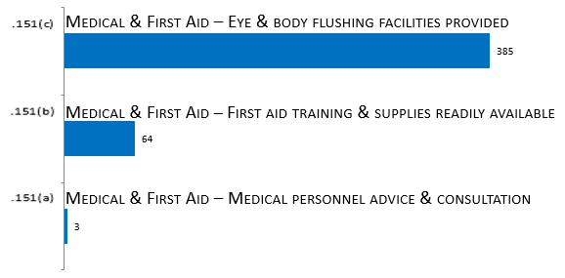
Medical & First Aid
[1910.151 –.152]
29 CFR 1910.
Subpart K

Slide 11
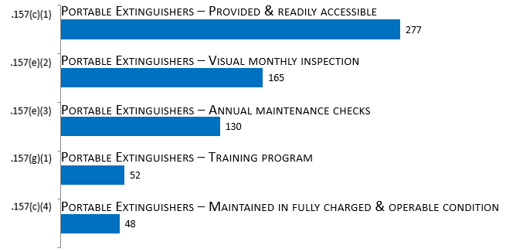
Fire Protection
[1910.155 – .165]
29 CFR 1910.
Subpart L

Slide 12
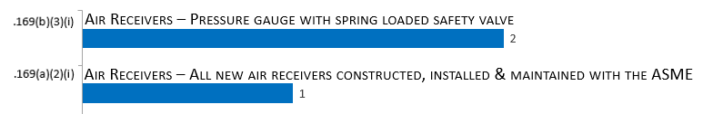
Compressed Gas & Compressed Air Equipment [1910.166 – .169]
29 CFR 1910.
Subpart M

Slide 13
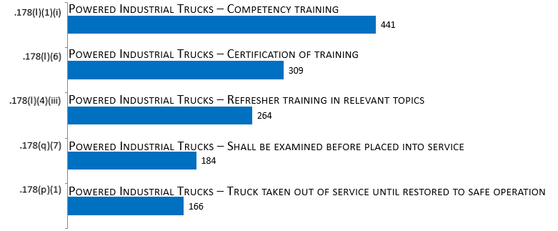
Materials Handling & Storage [1910.176 – .184]
29 CFR 1910.
Subpart N

Slide 14
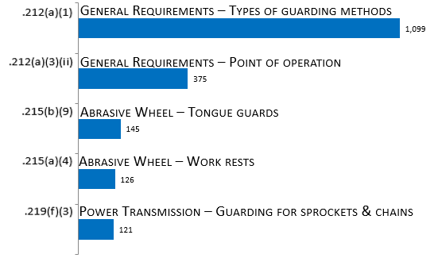
Machinery & Machine Guarding [1910.211 – .219]
29 CFR 1910.
Subpart O

Slide 15
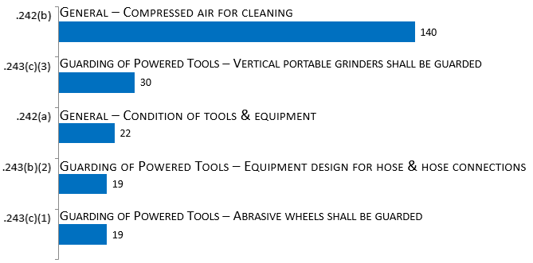
Hand & Portable Powered Tools & Other Hand-Held Equipment
[1910.241 – .244]
29 CFR 1910.
Subpart P

Slide 16
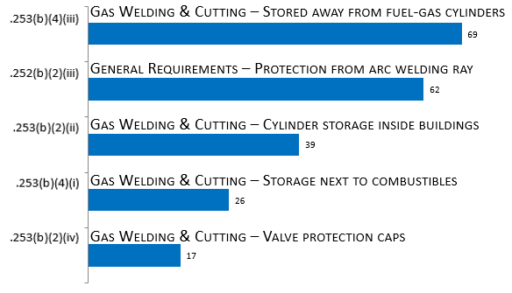
Welding, Cutting, & Brazing
[1910.251 – .255]
29 CFR 1910.
Subpart Q

Slide 17
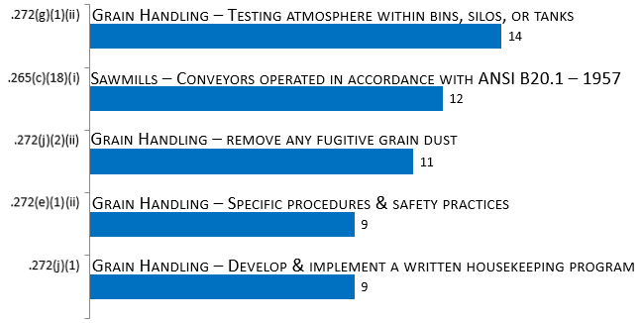
Special Industries
[1910.261 – .272]
29 CFR 1910.
Subpart R

Slide 18
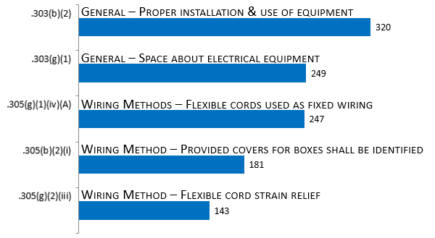
Electrical
[1910.301 – .399]
29 CFR 1910.
Subpart S

Slide 19
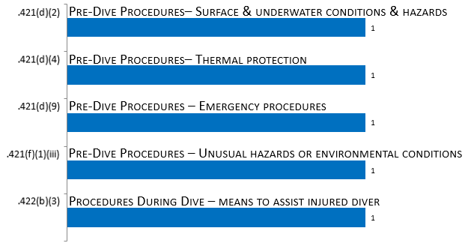
Commercial Diving Operations
[1910.401 – .440]
29 CFR 1910.
Subpart T

Slide 20
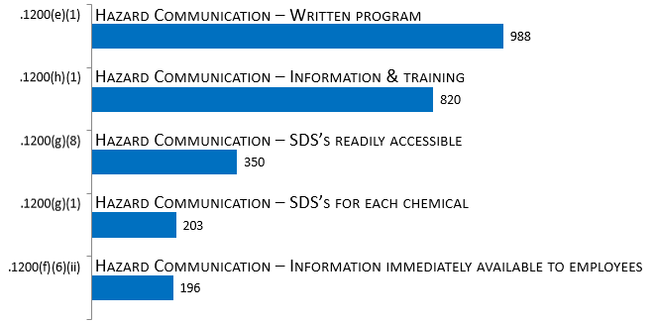
Toxic & Hazardous Substance
[1910.1000 – .1450]
29 CFR 1910.
Subpart Z

