Slide 1
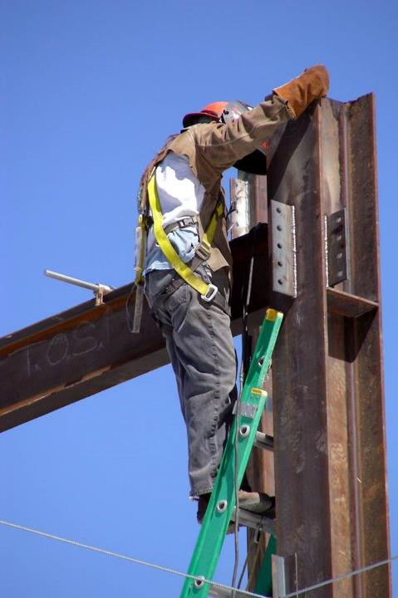

Most Frequently Cited Serious Violations
Construction Industry FY2025
OSHA Federal Standards
October 1, 2024 – September 30, 2025

Slide 2
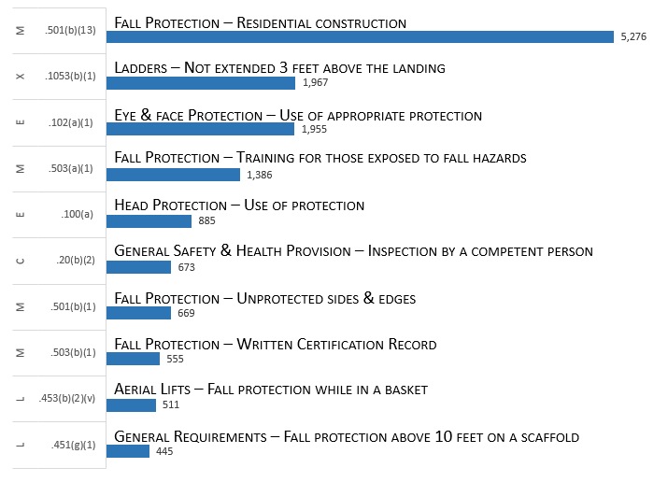
Most Frequently Cited Serious Violations in Construction FY 2025
29 CFR 1926.
1926 Overall MFC

Slide 3
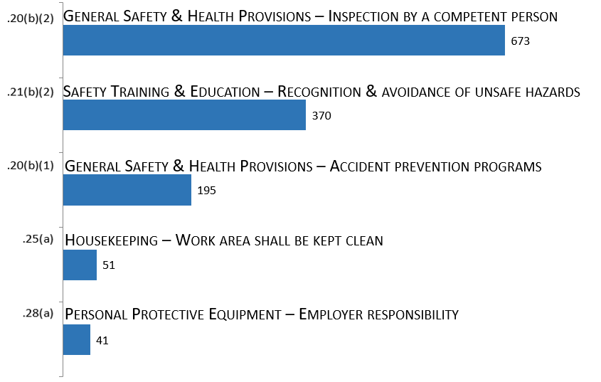
General Safety & Health Provisions [1926.20 – .35]
29 CFR 1926.
Subpart C

Slide 4
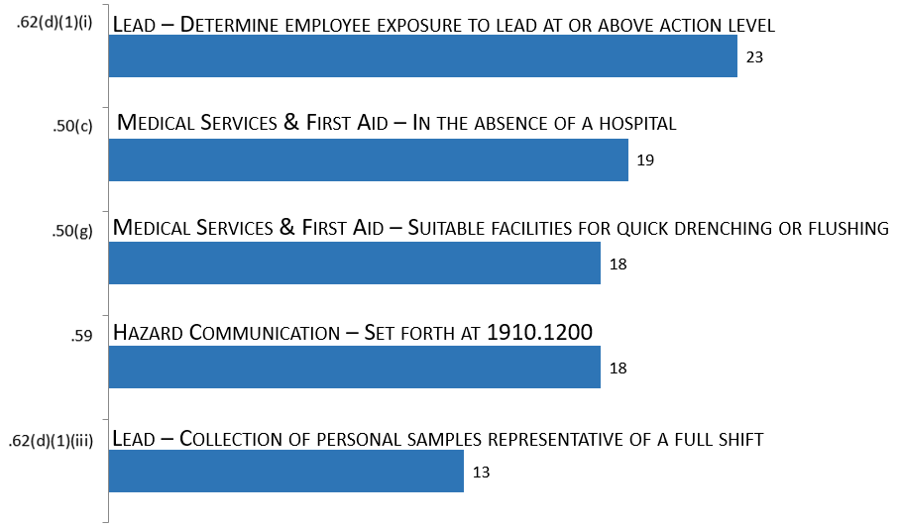
Occupational Health & Environmental Controls [1926.50 – .66]
29 CFR 1926.
Subpart D

Slide 5
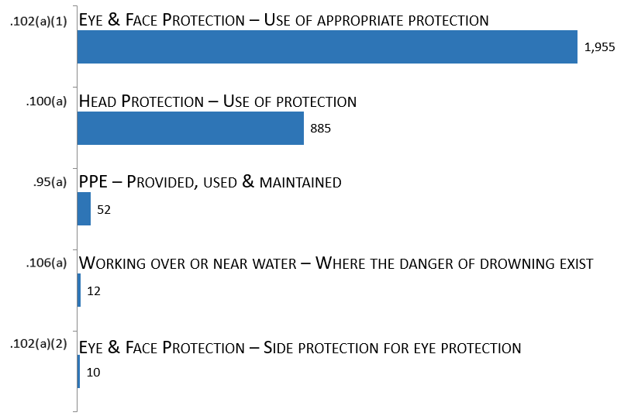
Personal Protective & Life Saving Equipment [1926.95 – .107]
29 CFR 1926.
Subpart E

Slide 6
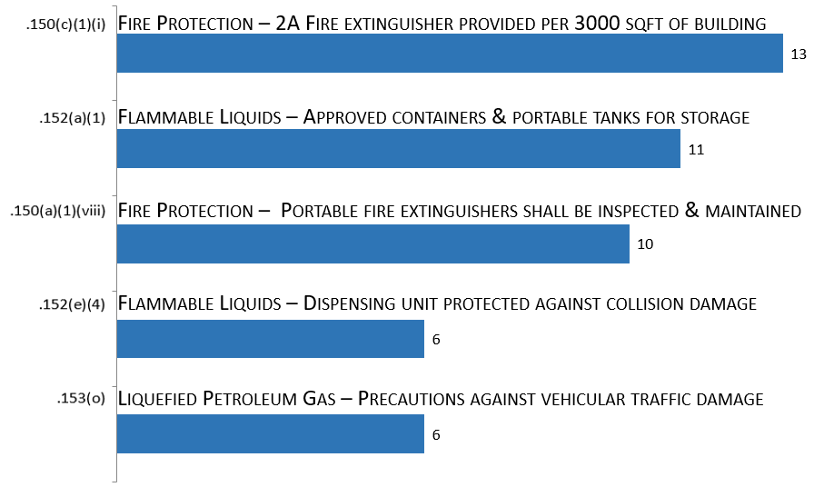
Fire Protection & Prevention [1926.150 – .159]
29 CFR 1926.
Subpart F

Slide 7
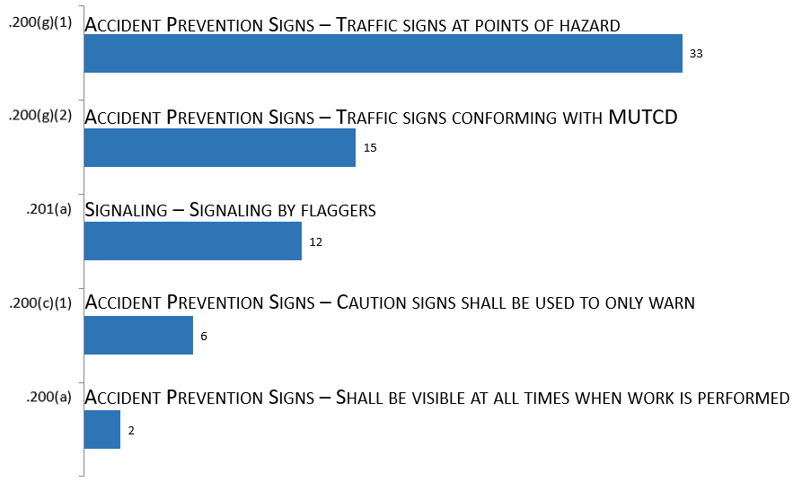
Signs, Signals & Barricades [1926.200 – .203]
29 CFR 1926.
Subpart G

Slide 8
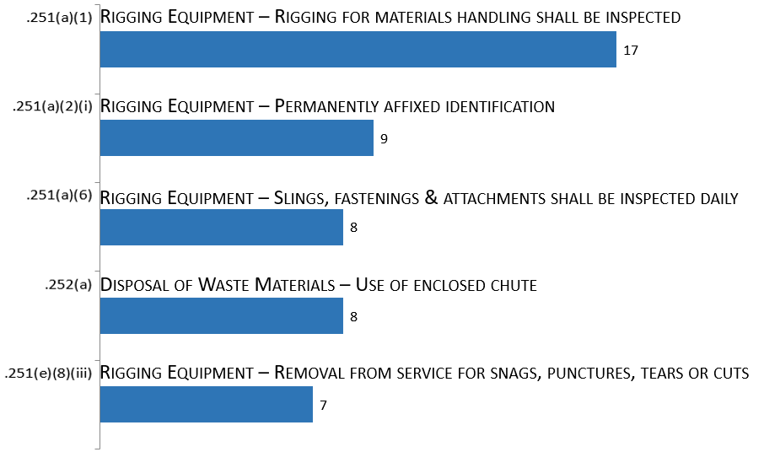
Materials Handling, Storage, Use & Disposal [1926.250 – .252]
29 CFR 1926.
Subpart H

Slide 9
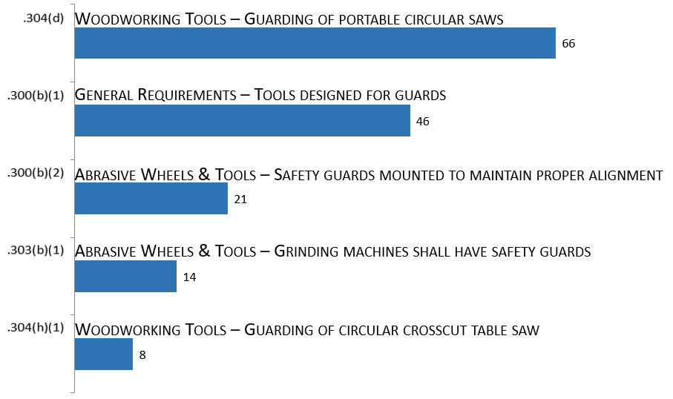
Tools - Hand & Power [1926.300 – .307]
29 CFR 1926.
Subpart I

Slide 10
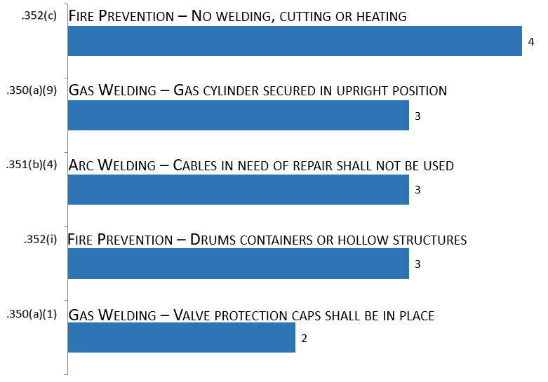
Welding & Cutting [1926.350 -.354]
29 CFR 1926.
Subpart J

Slide 11
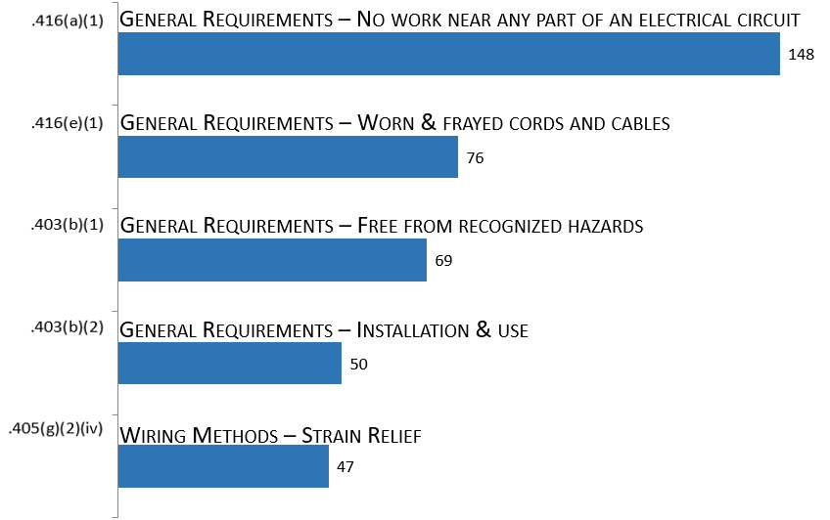
Electrical [1926.400 – .449]
29 CFR 1926.
Subpart K

Slide 12
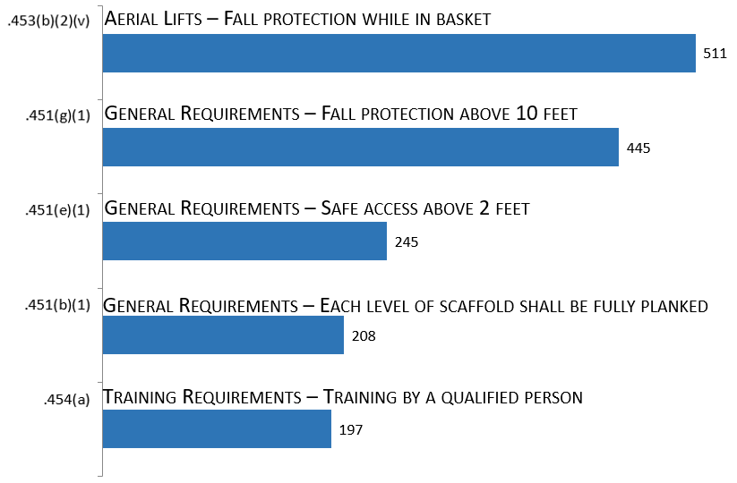
Scaffolds [1926.450 – .454]
29 CFR 1926.
Subpart L

Slide 13
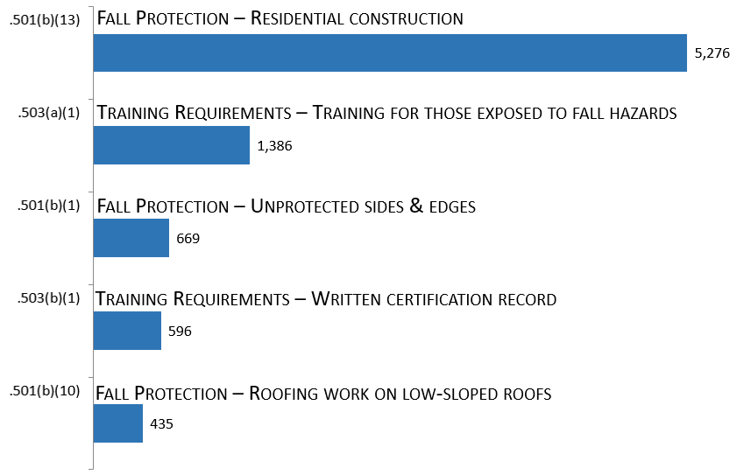
Fall Protection [1926.500 – .503]
29 CFR 1926.
Subpart M

Slide 14
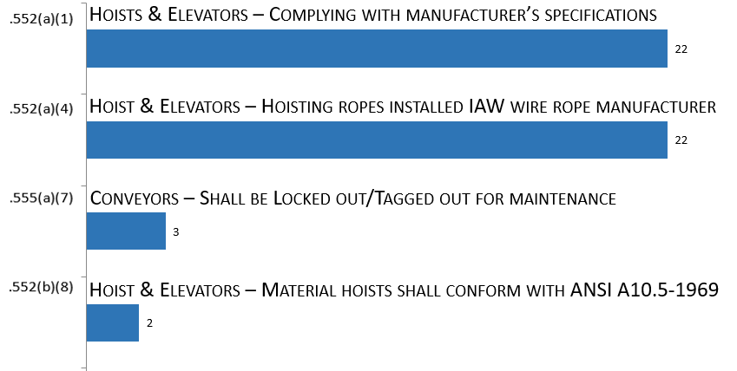
Helicopters, Hoists, Elevators, & Conveyors [1926.550 – .556]
29 CFR 1926.
Subpart N

Slide 15
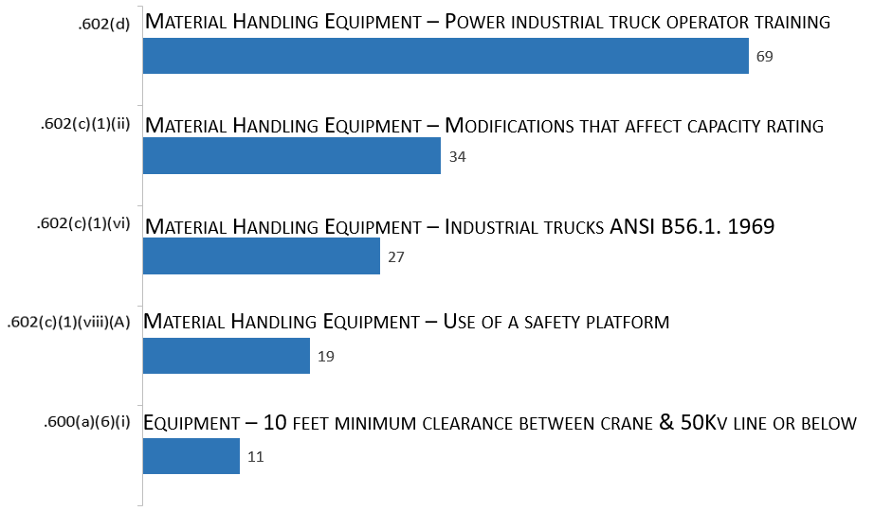
Motor Vehicles, Mechanized Equipment, & Marine Operations [1926.600 – .606]
29 CFR 1926.
Subpart O

Slide 16
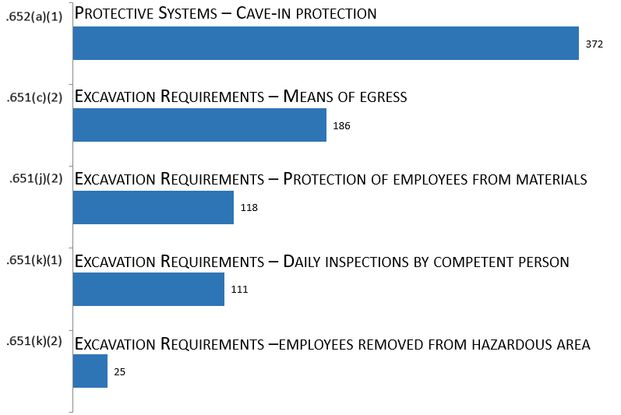
Excavations [1926.650 – .652]
29 CFR 1926.
Subpart P

Slide 17
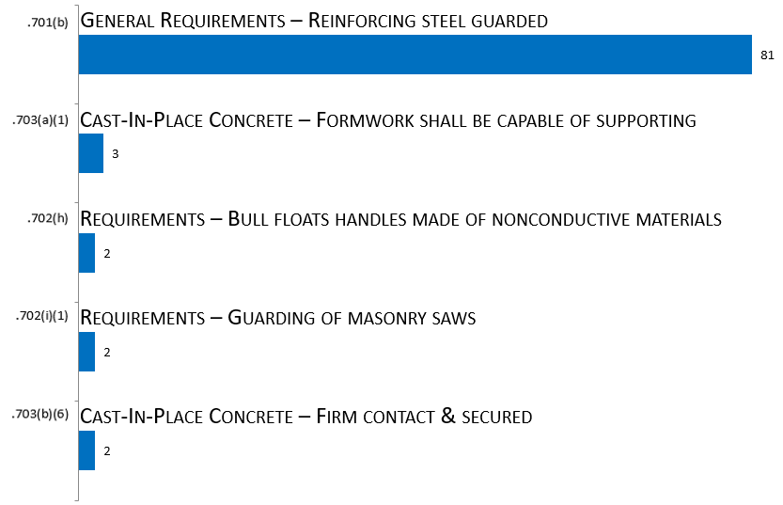
Concrete & Masonry Construction [1926.700 – .706]
29 CFR 1926.
Subpart Q

Slide 18
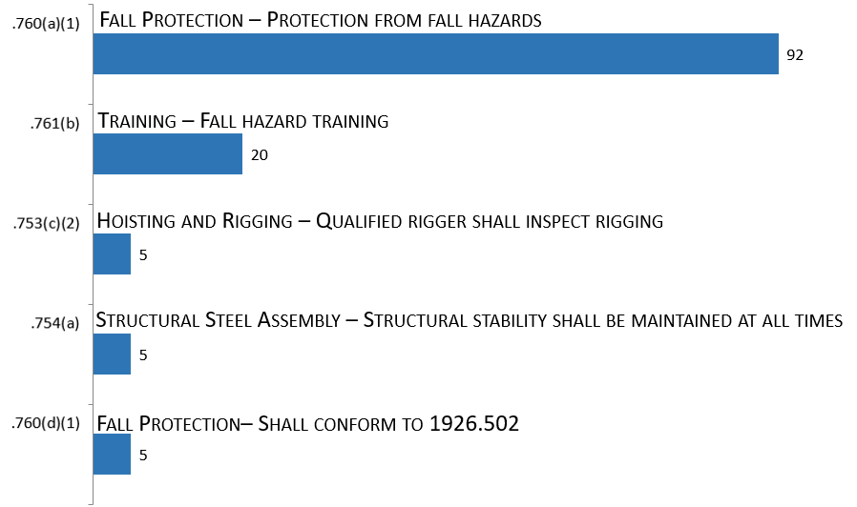
Steel Erection [1926.750 – .761]
29 CFR 1926.
Subpart R

Slide 19
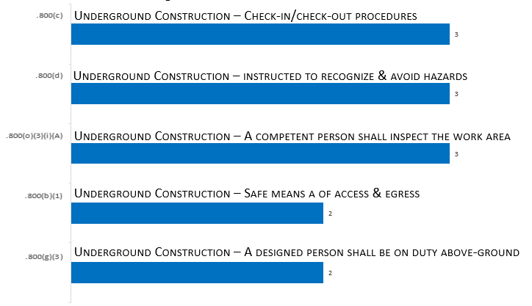
Underground Construction, Caissons, Cofferdams, & Compressed Air [1926.800 – .804]
29 CFR 1926.
Subpart S

Slide 20
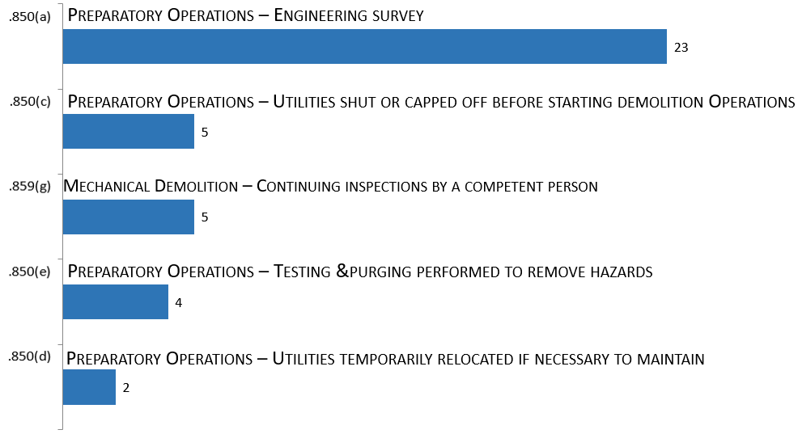
Demolition [1926.850 – .860]
29 CFR 1926.
Subpart T

Slide 21
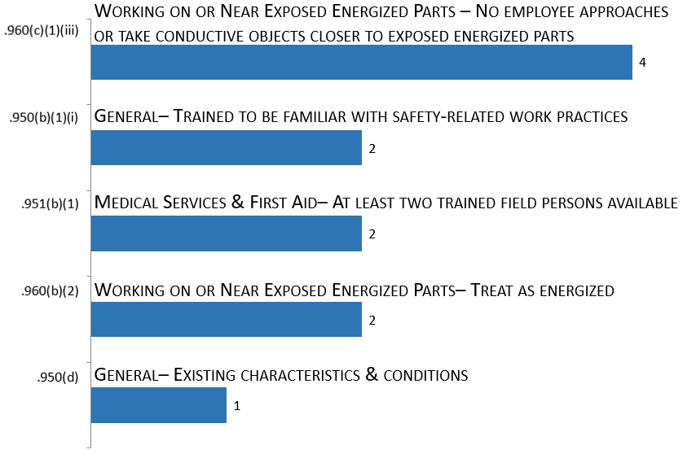
Electrical Power Transmission & Distribution [1926.950 – .968]
29 CFR 1926.
Subpart V

Slide 22
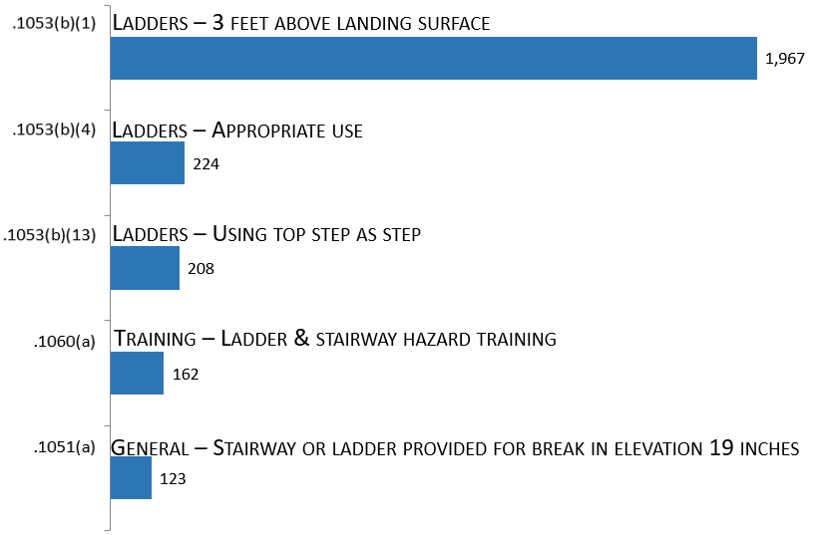
Stairways & Ladders [1926.1050 – .1060]
29 CFR 1926.
Subpart X

Slide 23
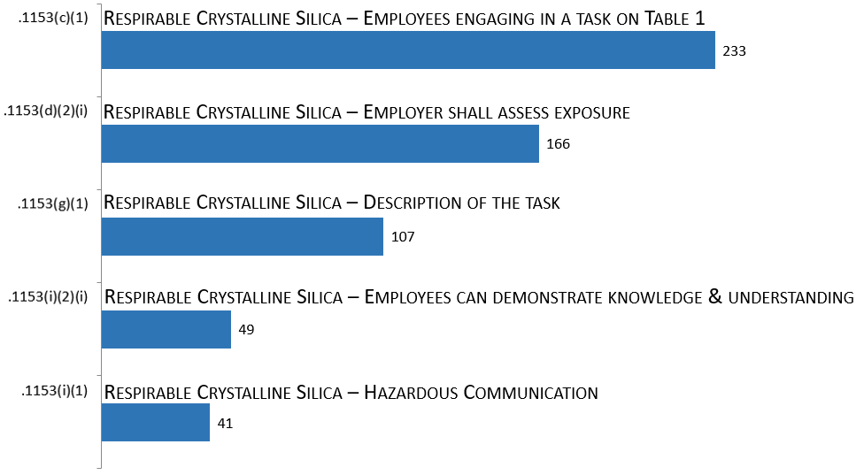
Toxic & Hazardous Substances [1926.1100 – .1152]
29 CFR 1926.
Subpart Z

Slide 24
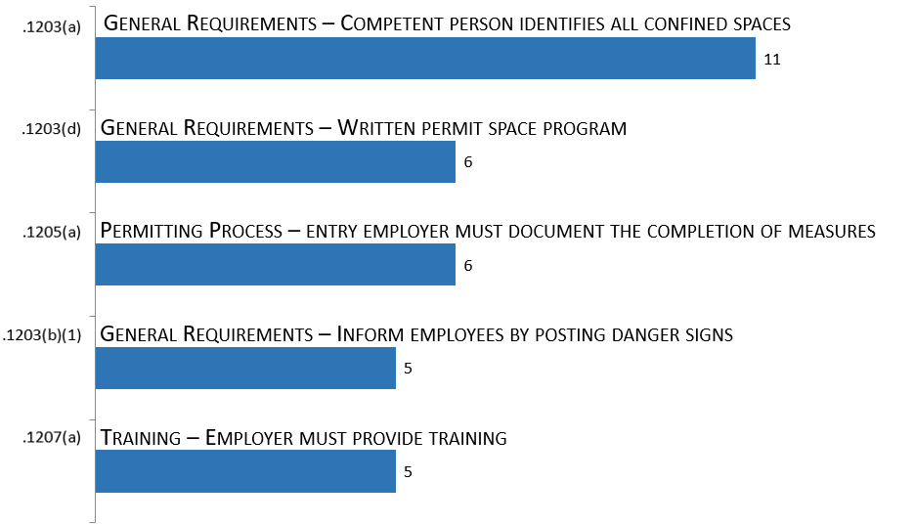
Confined Space in Construction [1926.1200 – .1212]
29 CFR 1926.
Subpart AA

Slide 25
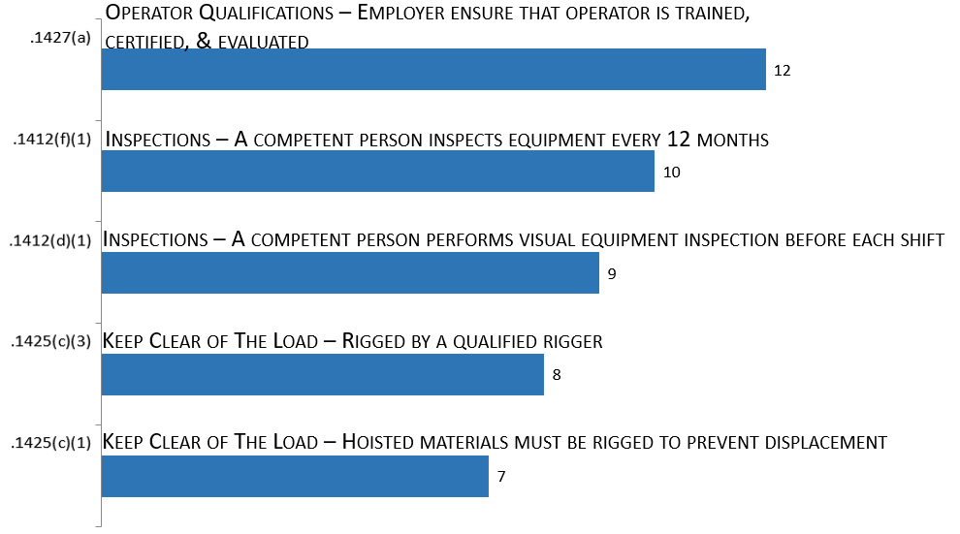
Cranes and Derricks in Construction [1926.1400 – .1442]
29 CFR 1926.
Subpart CC

