Slide 1

The OSHA Alliance Program

Slide 2
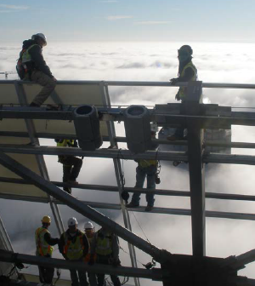
OSHA is committed to a balanced approach to meet its worker safety and health mission
Standards
Enforcement
Compliance Assistance and Training

Slide 3





OSHA works with stakeholder groups through its Cooperative Programs
Alliance Program
OSHA Strategic Partnership Program
Voluntary Protection Programs (VPP)
OSHA Challenge
On-Site Consultation Program & Safety and Health Achievement Recognition Program (SHARP)

Slide 4

Alliances foster collaborative relationships
Between:
OSHA National, Regional, or Area Offices, and
Employer and employee groups (trade or professional associations, unions, consulates, community and faith-based groups, and government agencies)
To:
Build trust
Encourage information sharing
Promote education

Slide 5
Alliances are formalized through an agreement
Initial agreements: two years
Renewals: up to five years
Follow standard template with the following overall goals:
Raising awareness: outreach and communication
Training and education
Participants do not receive enforcement exemptions

Slide 6
Alliance participants agree to several “fundamental requirements”
Committing time and resources to accomplish Alliance goals
Disseminating information to stakeholders on OSHA’s initiatives and resources
Engaging with and encouraging member participation in OSHA outreach campaigns
Bringing together employer, worker, and agency perspective in Alliance activities

Slide 7
Successful Alliances may be promoted to Ambassador
Eligibility after successful completion of an initial agreement and one renewal
Continued collaboration with OSHA through established relationship
“Evergreen” with no expiration date
Fewer reporting requirements

Slide 8
Active Alliances

Slide 9
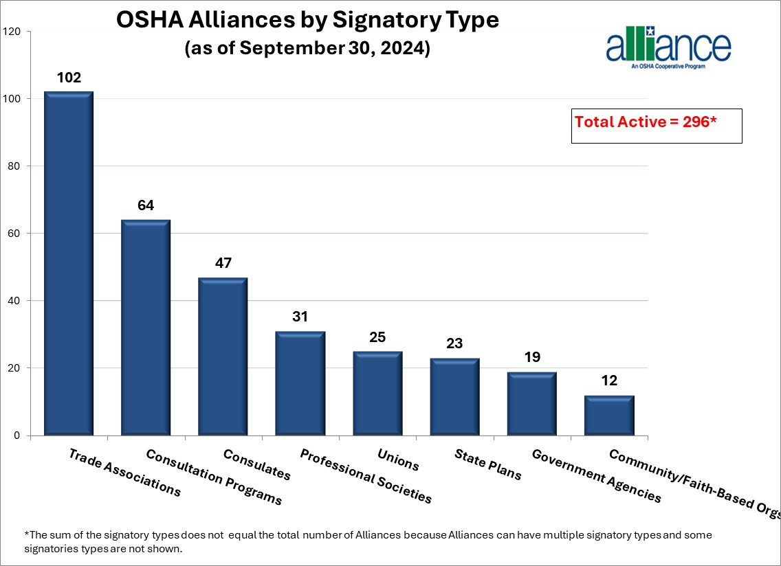
A variety of organizations sign Alliances with OSHA

Slide 10
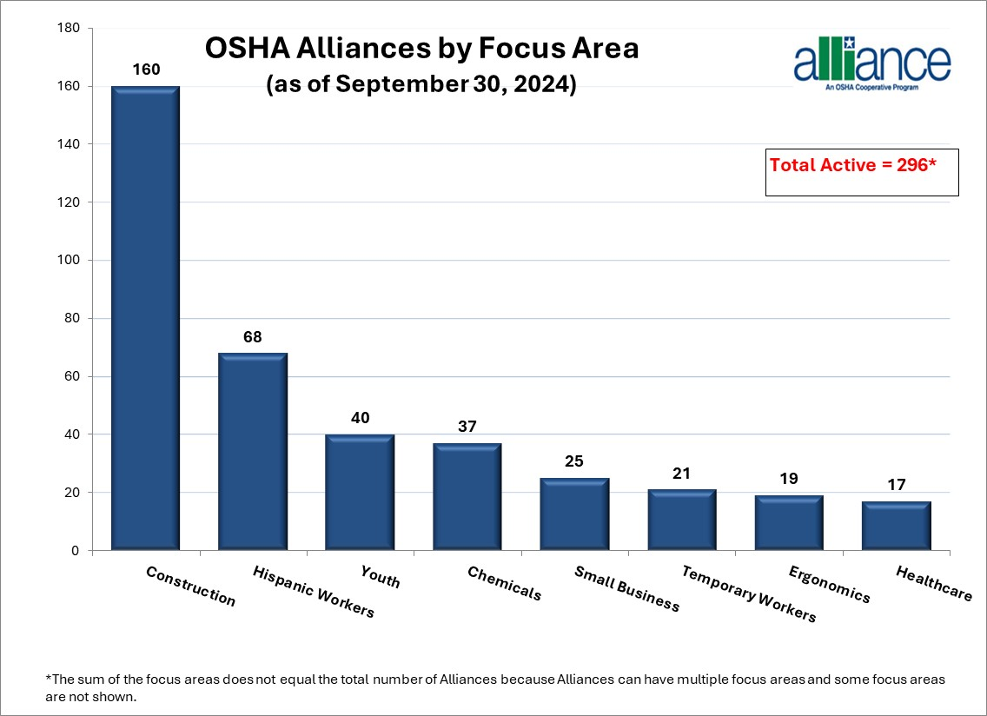
Alliances cover a range of safety and health topics

Slide 11
In FY 2024, National Alliances helped OSHA reach stakeholders nationwide
Conducted >400 dissemination activities, reaching 600,000
Provided billboard space to support OSHA’s outreach initiatives
Conducted >50 events or training activities reaching nearly 20,000
Provided 10 technical training sessions for 150 representatives from federal OSHA, state OSHA agencies, and On-Site Consultation Programs.

Slide 12
In FY 2024, Regional and Area Office Alliances helped train employers and employees
Examples:
The Wichita, KS Area Office provided trenching and excavation safety training to small construction businesses through the Missouri Common Ground Alliance.
The Boston, MA and Providence, RI Area Offices conducted workplace safety trainings for seafood processing workers through their alliance with the New Bedford (CT) Worker Center.
Regional and Area Offices conducted >1,400 outreach and training activities, reaching nearly 500,000, and likely impacting many more

Slide 13

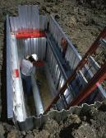


Alliances promote member engagement in OSHA’s national initiatives
Safe + Sound
Heat Illness Prevention
Fall Prevention
Trenching and Excavation
Temporary Workers

Slide 14
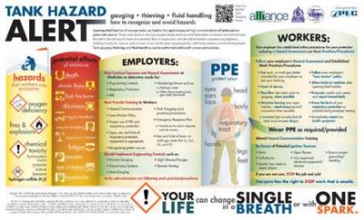
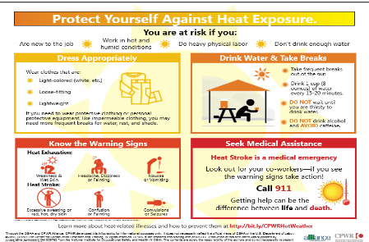
Alliances develop innovative and industry-specific resources
Hazard alert developed through the OSHA/National STEPS Network/NIOSH Alliance
Infographic developed through the OSHA/CPWR Alliance

Slide 15
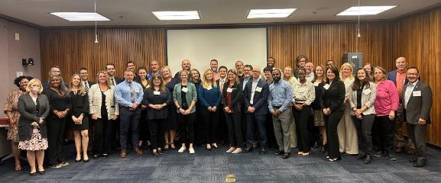
Alliances network with one another and cross-collaborate
Alliance Program Forum: National Alliances hear OSHA updates and network
Alliance Program Construction Roundtable: National construction-related Alliances collaborate

Slide 16
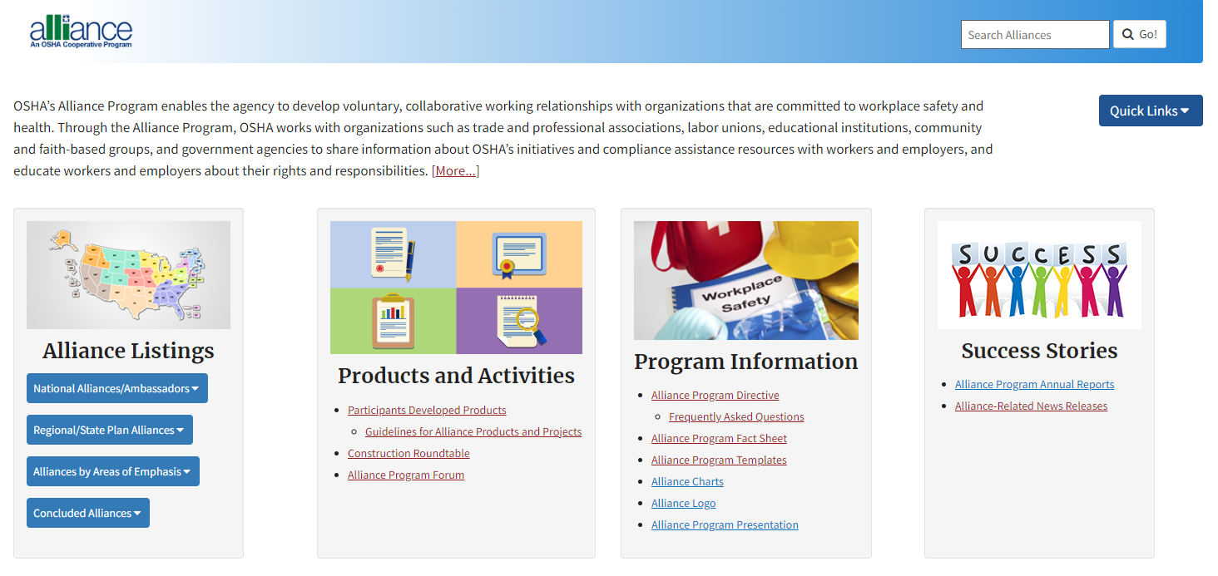
Find out more at osha.gov/alliances

Slide 17
Contact Us
National Alliances
Contact OSHA’s Office of Outreach Services and Alliances at (202) 693-2340.
Regional and Area Office Alliances
Contact your local OSHA Regional or Area Office. See osha.gov/contactus/bystate

Slide 18

osha.gov
800-321-OSHA (6742)

