Slide 1
FALL PREVENTION/
FALL PROTECTION
SUSAN HARWOOD GRANT
#SH0512SHP
2019-2020
Notes:
Greenville Technical College has been awarded the Susan Harwood Grant in support of OSHA training standards. This Fall Prevention/ Fall Protection training is intended to be used as a training aid and for general information only; the creator assumes no responsibility for any loss or damage resulting from its use. OSHA has also issued a general disclaimer.
OSHA GENERAL DISCLAIMER
This material is not a substitute for any provision of the Occupational Safety and Health Administration (OSHA) or any standards issued by OSHA. If at any time it is discovered that the materials presented vary from Federal or State OSHA regulations, American National Standards Institute (ANSI), state laws or local ordinances, it is understood that those regulations, laws and ordinances will take precedence over the materials presented herein. In some cases, the information given may imply a higher level of protection than required in some Federal or State OSHA regulations. The mention of any products or materials by brand name in no way constitutes endorsement. Any products or materials not mentioned within this manual that may be considered acceptable as protective devices, equipment, or practices is not intentional and should not rule out their acceptability as employee or environmental protection.

Slide 2
Why Are You Here?
Welcome and Introductions
  Please share
    Your name, the company you work for, and what you do
Module Overview
  Course agenda
  Course Manual
  You will learn…
  This course
Notes:
Let’s Get Started!
Why Are You Here?
Falls are the leading cause of death in construction. One of every three construction fatalities are as a result of falls.
Falls are among the most common causes of serious work related injuries and deaths and employers must set up the workplace to prevent employees from falling off overhead platforms, elevated work stations or into holes in the floor and walls.
OSHA requires that fall protection be provided at elevations of four feet in general industry workplaces (29 CFR 1910 Subpart D Walking-Working Surfaces), five feet in shipyards (29 CFR 1915 Subpart E Scaffolds, Ladders and Other Working Surfaces), six feet in the construction industry (29 CFR 1926 Subpart M Fall Protection) and eight feet in longshoring operations (29 CFR 1918 Subpart A General Provisions and Subpart H Handling Cargo).
This course will enhance communication of fall hazards for trainers, aid in the prevention of accidents, and to aid trainers in successfully deliver training material.
Once you have successfully completed a fall protection/fall prevention Train-the-Trainer course delivered by a competent trainer, you will be a competent person capable of providing training to others. This certification will allow you to provide 4 hour training to employees of various industries including construction and general industry.

Slide 3
Course Agenda
Registration, Introduction and Pre-Test
Module 1: Introduction to Fall Protection
Module 2: Fall Arrest System
Skills Assessments #1, #2, #3, #4
Break
Module 3: Fall Prevention Systems
Module 4: Ladder Safety Devices
Skills Assessments #5
Case Study Group Discussion
Lunch
Test
Module 5: Introduction to Adult Learning
Module 6: Teaching Requirements
Break
Group Teach Back
Wrap-up
Notes:
This agenda is included in the student notebook.

Slide 4
Course Manual Overview
Six Modules
Case Study Group Discussion (in Appendix A)
Group Teach Back
Additional Appendices
  Appendix B - Fall Protection for Scaffolds and Related Equipment
  Appendix C - OSHA Standards Related to Fall Protection
  Appendix D - Examples: Fall Anchors by Type
  Appendix E - Glossary
Notes:
Modules - In addition to this introduction, there are six modules in this course
Module 1 Introduction to Fall Protection
Module 2 Fall Arrest System
Module 3 Fall Prevention Systems
Module 4 Other Fall Hazards: Ladders
Activities and Exercises - The course includes activities and exercises to help you identify methods for reducing the amount of fall on construction site and general industry and contain tools and tip on how to successfully teach this course to others. Many of the exercises and activities take place in small groups, so you will have an opportunity to share your experience and ideas with others in the class.
Test - Participants must pass the test administered at the end of the course in order to earn completion. Failure to pass the test means you must retake the course.
Train-the-Trainer Only:
Module 5 Introduction to Adult Learning
Module 6 Teaching Requirements
Group Teach Back

Slide 5
You Will Learn...
Why is fall protection important?
What can be done to reduce falls?
What is fall prevention/fall protection?
How to use restraint systems
How to use ladder safety devices
How to use the elements of adult learning theory
How to deliver training effectively
Notes:
Module 1: Identifies the problems associated with working at elevated heights, outlines the OSHA regulations associated with fall protection, and who is responsible for providing this training it employees. This modules also discusses the protection afforded to whistleblowers.
Module 2: Describes the different components of a personal fall arrest system and explains how to determine which system is best to use on the job.
Module 3: Identifies the different fall restraint systems available and explains how to set up these systems on the job.
Module 4: Emphasizes the importance of paying attention to the use of ladders on the job site and explains how to use them safely.
TRAIN THE TRAINER MODULES ONLY:
Module 5: Teaches participants how to teach a block of instruction to others using adult learning techniques.
Module 6: Identifies the requirements for successfully completing a training in accordance OSHA Grant and Greenville Technical College guidelines.

Slide 6
This Course
Explains the OSHA requirements for Fall Protection/Fall Prevention
Awards .4 Continuing Education Units (CEUs) for successful completion when taught Trainers who have completed the Greenville Technical College Train-he-Trainer course
Demonstrates YOUR commitment to safety
But,
Is not a substitute for any provision of the Occupational Safety and Health Administration (OSHA) or any standards issued by OSHA
Notes:
Explain the course outcomes listed on the slide.
Review the answers to the PRE-TEST included in the student manual:
1. T
2. T
3. F
4. T
5. T
6. F
7. F
8. All of the above (answer d)
9.T

Slide 7
MODULE 1: INTRODUCTION TO FALL PROTECTION
Overview
Why is fall protection important?
How do you report fatalities and catastrophes?
What are the employer responsibilities, workers’ rights, and whistleblower protections?
What is a qualified person and a competent person?
Notes:
Upon completion of this module the student will be able to explain:
Why fall protection is important and what can be done to reduce falls.
How to report the deaths and dismemberment that happens on a job site.
Who is responsible to make sure employees are protected, employees right to be protected and who protected if they decide to report their employers for unsafe conditions.
What it take to be a qualified and competent person on a job site.

Slide 8
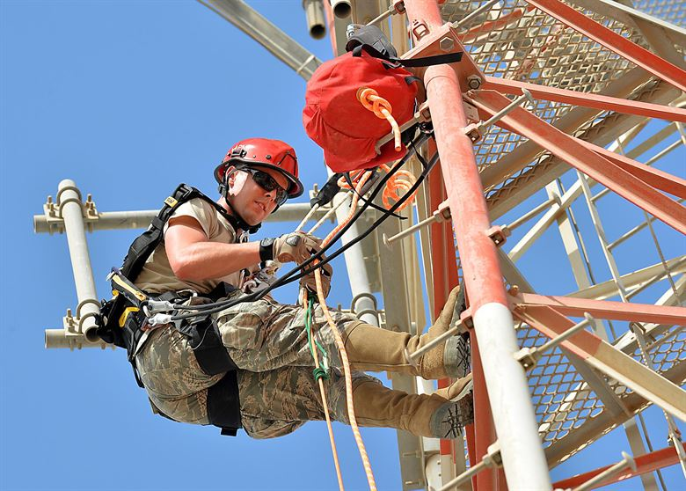
Why is fall protection important?
Falls are the leading cause of death in construction.
Falls are among the most common causes of serious work-related injuries and deaths.
Notes:
According to the US Center for Disease Prevention
Falls are the number one cause of construction worker fatalities.
The Construction FACE database of the National Institute on Occupational Safety and Health shows that between 1982 and 2015, 20 percent of all construction fatalities occur in the worker’s first two months on the job.
The Construction FACE Database (CFD) is a database in Excel created by CPWR - The Center for Construction Research and Training to facilitate the use of information provided by the NIOSH Fatality Assessment and Control Evaluation (FACE) Reports for users who want to analyze FACE reports using a statistical package.
What can be done to reduce falls?
OSHA requires that fall protection be provided at elevations of four feet in general industry workplaces, five feet in shipyards, six feet in the construction industry and eight feet in longshoring operations.
OSHA requires that fall protection be provided when working over dangerous equipment and machinery, regardless of the fall distance.

Slide 9
What can be done to reduce falls?
Provide working conditions that are free of known dangers.
Keep floors in work areas in a clean and, so far as possible, a dry condition.
Select and provide required personal protective equipment at no cost to workers.
Train workers about job hazards in a language that they can understand.
Notes:
Explain the ways to reduce falls listed on the slide. Then discuss the following employer responsibilities.
To prevent employees from being injured from falls, employers must:
Guard every floor hole into which a worker can accidentally walk (using a railing and toe-board or a floor hole cover).
Provide a guard rail and toe-board around every elevated open sided platform, floor or runway.
Regardless of height, if a worker can fall into or onto dangerous machines or equipment (such as a vat of acid or a conveyor belt) employers must provide guardrails and toe-boards to prevent workers from falling and getting injured.
Other means of fall protection that may be required on certain jobs include safety harness and line, safety nets, stair railings and handrails.

Slide 10
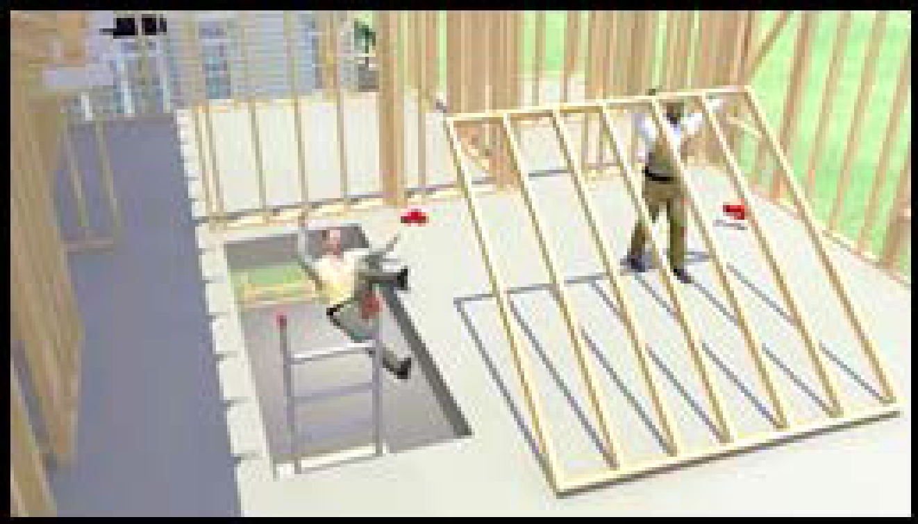
FATAL FACT #1
A full-time carpenter was working on the second floor of a wood framed (new construction) residential house.
Falls more than 20 feet through an unguarded stairway opening to the concrete basement floor.
He was killed in the fall from fatal head and internal injuries.
Notes:
In the U.S., more than 800 construction workers die every year while on the job. Falls are the number one cause of fatalities in construction. Falls cause one of every three construction worker deaths. These falls happen in a split second while workers are on roofs, scaffolds, ladders, bridges, and other work surfaces. But these deaths can be prevented. The video you are about to see shows how quickly falls at construction sites can lead to workers' deaths. The video will also show what employers must do so that the work can be done more safely. Employers have a responsibility to provide a safe workplace and required protective equipment. You'll see that using the right type of fall protection saves lives. Please be advised. The scenes you are about to see deal with deaths at construction sites and might be disturbing for some people. All scenes are based on true stories.
Skilled and Experienced Workers
Often skilled and experienced workers fall victim to unexpected and unavoidable circumstances on a job sites.
OSHA 1926.501 Subpart M outlines the construction industry standards required for all worksites where falls from elevated platforms are possible. In this example, employees were working on the second floor near an open stairwell. There was no guardrail or floor cover, and the workers were not wearing personal fall protection. After framing one section of a wall, the workers raised it and moved forward to put it into place. While moving forward, one of the workers stepped towards the unguarded stairwell to hold the side of the wall section.
He fell down the unguarded stairwell opening. He fell 20 feet and landed on the concrete basement floor. He died from fatal head and internal injuries. Let's look at the events leading up to this tragic incident and see how it could have been prevented.
Originally, the workers were nailing in the boards to frame a section of the new wall, and the stairwell was not protected by a guardrail. Now, the stairwell is protected by a guardrail as required by OSHA. As before, the workers are moving forward to install the completed wall section. This time, as the worker steps toward the stairwell, the guardrail stops him; he continues forward to place the framed section in place. Another way to protect workers is by putting a proper cover over the stairwell opening. The cover must be secure. With the proper cover, the worker steps onto the cover and continues to put the section in place.
Link to Spanish video: https://youtu.be/MybFvRDb0Tc

Slide 11
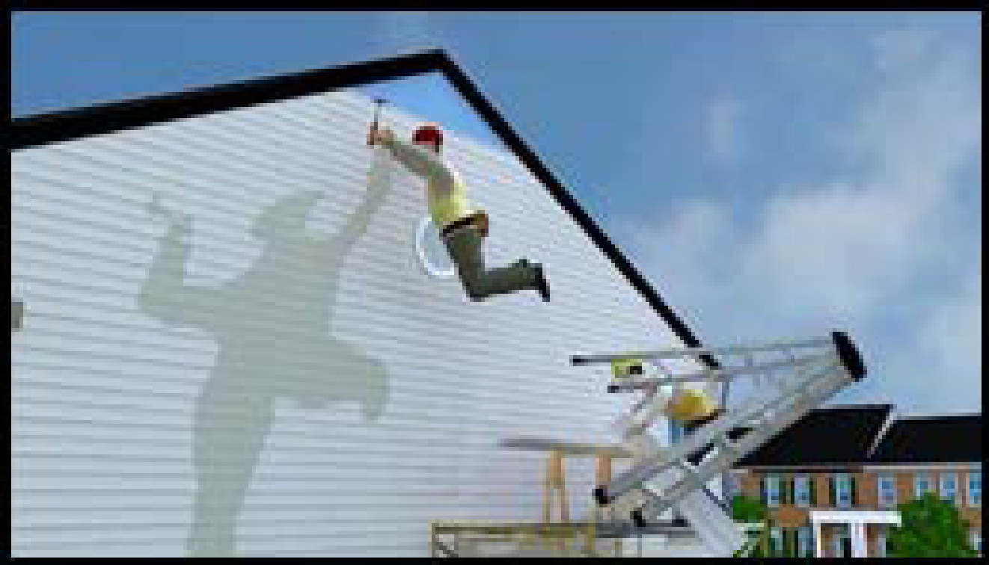
FATAL FACT #2
A worker was installing vinyl siding on a two-story townhome.
He placed a ladder on top of a scaffold.
Standing on the top step of the ladder, overreached and the ladder overturned.
He fell 20 feet to the driveway below.
He died later that day from injuries caused by the fall.
Notes:
Improper use of Equipment Causes Death
Often times the falls from an elevation over 6 ft in construction and 4 ft, in general industry isn’t caused my holes or unprotected leading edges. Many employees improperly use equipment that results in their own death. OSHA 29 CFR 1926.451 Subpart L address the rules for ladders used on or with scaffolds.
A worker was installing vinyl siding on a two-story townhome. He was standing on a ladder that was placed on top of a scaffold. A co-worker was on the scaffold cutting pieces of siding. The scaffold had no guardrails. The workers were not wearing any fall protection. While standing on the top step of the ladder, the worker putting up siding overreached to one side and the ladder overturned. He fell nearly 20 feet and landed on the driveway below. He died later that day from injuries caused by the fall.
Let's look at the events leading up to this tragic incident, and see how it could have been prevented. Originally, the worker installing siding was standing on a ladder that was placed on top of a scaffold. This is a very serious and dangerous OSHA violation. Also, there was no fall protection for these workers. OSHA requires employers to provide workers with fall protection when they are working on scaffolds more than 10 feet above a lower level.
Let's look again at the worker installing siding. But now, the worker is standing on a fully-decked pump-jack scaffold. It has guardrails at the top, middle, and ends. So, instead of being at risk from falling while installing siding, this worker is now protected from fall hazards.
This example shows the importance of following OSHA's fall protection standards. These types of construction deaths are preventable. The fall protection measures shown here save workers' lives. Use fall protection on the job: it could be the difference between life life and death.
Link to Spanish video: https://youtu.be/Nd9RWLvcpUE

Slide 12
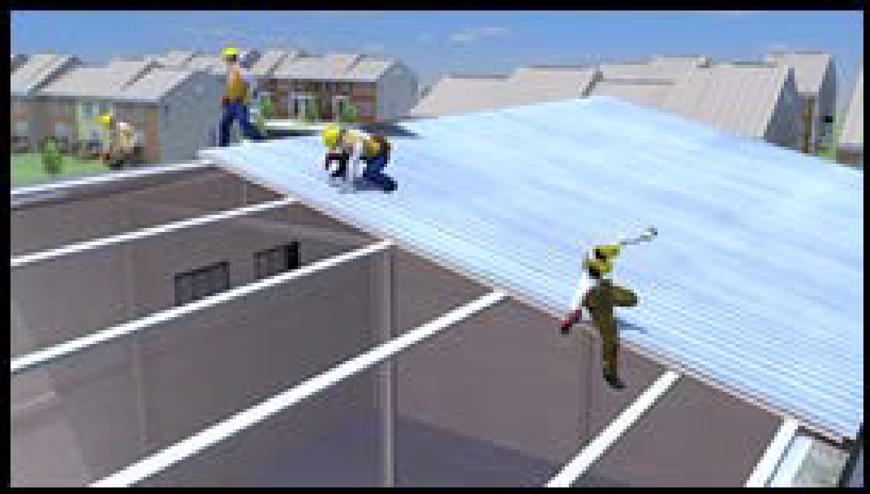
FATAL FACT #3
Four workers were installing sheet metal steel decking on a pre-engineering building.
One worker lost his footing and fell through an opening.
He died the next day from injuries caused by the fall.
Notes:
Warning Lines, Control Access, Safety Monitoring Systems Oh My!
Four workers were insulating the roof and applying the top layer of sheet metal roof decking on a tall, pre-engineered building. The roof was fairly flat, there was no controlled decking zone, and the workers were not wearing any personal fall protection. The workers were using drills to screw the metal sheets into the purlins.
As one of the workers walked down the roof, he lost his footing. He fell through the space between the purlins, and landed on the floor below. He died the next day from his injuries.
Let's look at the events that led up to this tragic incident, and see how it could have been prevented. Originally, the workers had no fall protection, which OSHA requires the employer to provide when working at heights of 15 feet and above.
Let's look again at the workers installing the metal roofing sheets and see what happens when these workers use fall protection. They are now using a temporary horizontal lifeline. This involves a horizontal cable attached to two or more anchor points on the roof. In this system, the workers connect their harnesses to a horizontal lifeline that is secured to the roof structure instead of individual anchor points.
Again, as the worker loses his footing and falls between the purlins, his lifeline stops him from falling to the floor below. While he is hanging from his fall arrest system, a co-worker brings over a lift and rescues the worker.
Link to Spanish video: https://youtu.be/m88kSUNx-RQ

Slide 13
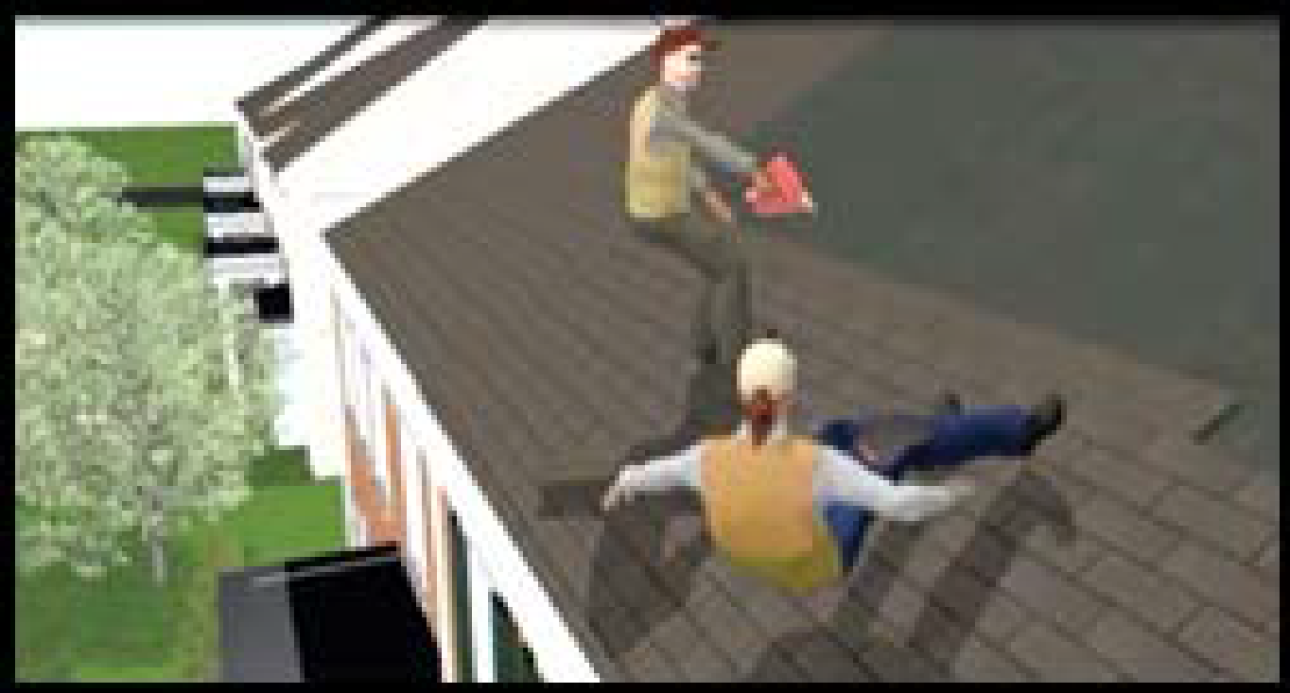
FATAL FACT #4
Two workers were re-roofing a two-story home with a pitched roof.
One of the workers reached to pick up another shingle, lost her balance and fell more than 20 feet to the driveway below.
She died instantly from her injuries.
Notes:
Its about working together.
Two workers were reroofing a two-story home with a pitched roof. They were not wearing any personal fall protection. The workers used nail guns to install shingles over an old layer of shingles.
One of the workers was close to the edge of the roof. As she reached to pick up another shingle, she lost her balance. She slipped off the edge of the roof. She fell more than 20 feet and landed on the driveway below. She died instantly from her injuries.
Let's look at the events leading up to this tragic incident, and see how it could have been prevented. Originally, the workers had no fall protection, which OSHA requires when working in residential construction at heights of 6 feet and above.
Let's look again at the workers installing shingles. Now, they are both wearing personal fall arrest systems. Each system has a full-body harness, a rope-grab lifeline, and connectors. Snaphooks connect each worker's rope-grab lifeline to secure roof anchors, which are located higher up on the roof. D-rings connect the workers' safety harnesses to their rope-grab lifelines.
As before, the worker reaches over to pick up a shingle, loses her balance, slips, and falls. But now, because she is wearing a fall arrest system, she only slips 2 feet and doesn't fall off the roof.
Link to Spanish video: https://youtu.be/50ftrd9rjfI

Slide 14

What happens when someone gets hurt?
Employee Rights
Employer Responsibility
Notes:
EMPLOYEES:
You have the right to notify your employer or OSHA about workplace hazards.
You have the right to keep your name confidential.
You have the right to request an OSHA inspection.
You have the right to participate in that inspection.
You have the right to file a complaint.
You have a right to see OSHA citations issued to your employer.
Your employer must correct workplace hazards.
You have the right to copies of your medical records.
EMPLOYERS:
You must furnish your employees a place of employment free from recognized hazards.
You must comply with the occupational safety and health standards issued under the OSH Act.
Reporting Fatality
Injury and Illness Information to the Government requires that employers report all work related fatalities within eight (8) hours and all work-related inpatient hospitalizations, all amputations and all losses of an eye within 24 hours.

Slide 15
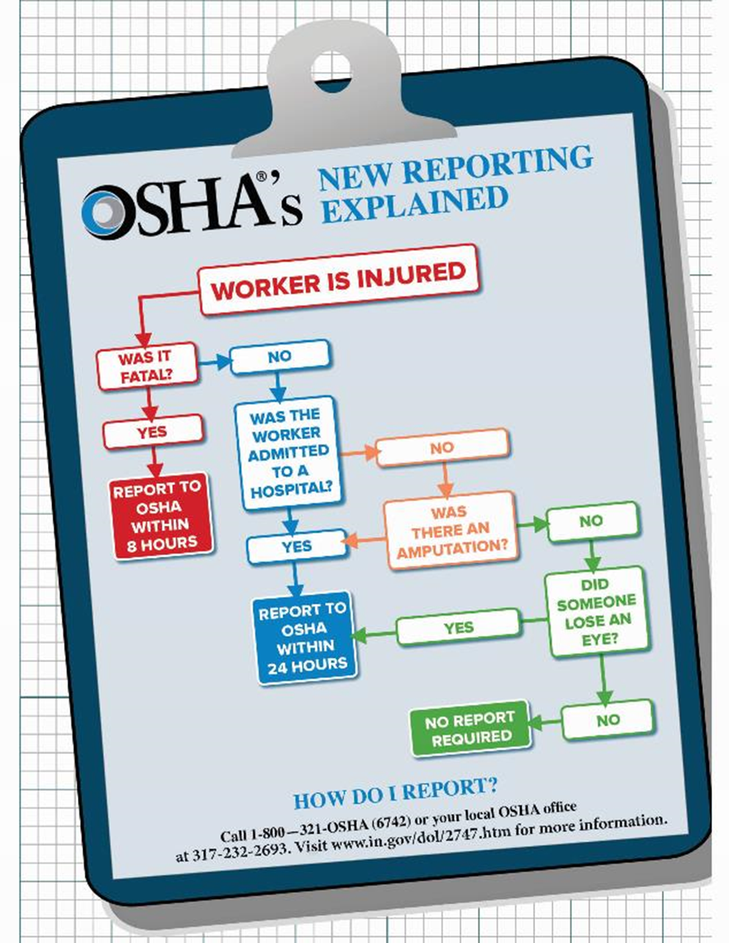
Refusing work is protected if…
You have asked the employer to eliminate the danger, and the employer failed to do so; and
You refused to work in “good faith;” and
A reasonable person would agree that there is a real danger of death or serious injury (illness); and
There isn’t enough time, due to the urgency of the hazard, to get it corrected through regular enforcement channels, such as requesting an OSHA inspection.
Notes:
Your right to refuse to do a task is protected if all of the following conditions are met:
“Good Faith.” This means that you must genuinely believe that an imminent danger exists. Your refusal cannot be a disguised attempt to harass your employer or disrupt business.
When all of these conditions are met, you take the following steps:
Ask your employer to correct the hazard;
Ask your employer for other work;
Tell your employer that you won’t perform the work unless and until the hazard is corrected; and
Remain at the worksite until ordered to leave by your employer. (Clarify that the worker should not remain in the hazardous area.)

Slide 16
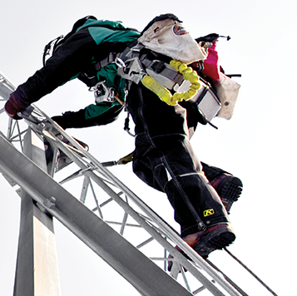
What are Employers’ Responsibilities to provide fall protection?
Assess the workplace
Industry requirements -
  4 feet: General Industry
  5 feet: Shipyards
  6 feet: Construction Industry
  8 feet: Longshoring
Notes:
Responsibilities
Employers must assess the work conditional in order to provide the proper fall protection.
There are different action levels that require fall protection in different industries:
Industry Fall Protection Action Level
General Industry: 4 feet
Shipyards: 5 feet
Construction Industry: 6 feet
Longshoring: 8 feet
Fall protection requirements can apply at heights of less than 6 feet when working near dangerous equipment.
For example, working over machinery with open drive belts, pulleys or gears or open vats of degreasing agents or acid.

Slide 17

Your rights as a Whistleblower
You may file a complaint.
You have the right to report unsafe working conditions.
You have the right to file a complaint with out fear of retaliation.
Note: There is a time limit.
Notes:
Your Rights as a Whistleblower
You may file a complaint with OSHA.
If your employer retaliates against you by taking unfavorable personnel action document your experience and issue it within your report.
Whistleblower Laws Enforced by OSHA
Each law requires that complaints be filed within a certain number of days after the alleged retaliation.
You may file complaints by telephone or in writing under the:
Occupational Safety and Health Act (30 days)
Surface Transportation Assistance Act (180 days)
Asbestos Hazard Emergency Response Act (90 days)
International Safe Container Act (60 days)
Federal Rail Safety Act (180 days)
National Transit Systems Security Act (180 days)
Under the following laws, complaints must be filed in writing:
Clean Air Act (30 days)
Comprehensive Environmental Response, Compensation and Liability Act (30 days)
Energy Reorganization Act (180 days)
Federal Water Pollution Control Act (30 days)
Pipeline Safety Improvement Act (180 days)
Safe Drinking Water Act (30 days)
Sarbanes-Oxley Act (90 days)
Solid Waste Disposal Act (30 days)
Toxic Substances Control Act (30 days)
Wendell H. Ford Aviation Investment and Reform Act for the 21st Century (90 days)

Slide 18
Qualified Person
Recognized degree or professional certificate
Extensive knowledge, training, and experience in the fall protection and rescue field
Capable of designing, analyzing, evaluating and specifying fall protection and rescue systems
Responsibility for design of anchorage points for personal fall arrest systems (PFAS)
Notes:
Qualified person means a person who, by possession of a recognized degree, certificate, or professional standing, or who by extensive knowledge, training and experience, can successfully demonstrate the ability to solve/resolve problems relating to the subject matter, the work, or the project.
Anchorage Points
a registered professional engineer with experience in designing fall protection systems, or another qualified person with appropriate education and experience should design an anchor point to be installed.
A qualified person should be used to evaluate the suitable of these "make shift" anchorages with a focus on proper strength.

Slide 19
Competent Person
Individual chosen by the employer …
Responsible for immediate supervision, application, and observing of the employer’s managed fall protection program
Can identify, evaluate and address existing and potential fall hazards (through training and knowledge)
Has the employer’s authority to take prompt corrective action regarding such hazards
Notes:
Competent person
means one who can identify existing and predictable hazards in the surroundings or working conditions which are unsanitary, hazardous, or dangerous to employees, and who has authorization to take prompt corrective measures to eliminate them.
Within OSHA’s fall protection standards, a “Competent Person” is required to perform frequent and regular inspections of the job-site materials and equipment.
A competent person must also train each employee on how to recognize fall hazards and the procedures to be followed in order to minimize these hazards.
Training Requirements
The nature of fall hazards in the work area.
The correct procedures for erecting, maintaining, disassembling, and inspecting the fall protection systems to be used.
The role of employees in fall protection plans.
OSHA fall protection standards.
The use and operation of guardrail systems, personal fall arrest systems, safety net systems, warning line systems, safety monitoring systems, controlled access zones, and other protection to be used.
The role of each employee in the safety monitoring system when this system is used.
The correct procedures for the handling and storage of equipment and materials and the erection of overhead protection.

Slide 20
Occupational Safety and Health Act of 1970
OSHA MISSION
Safe and healthy working conditions
Enforceable standards
State programs
Research
Information, education and training
Notes:
The OSHA ACT of 1970 states its mission as the following:
“To assure safe and healthful working conditions for working men and women; by authorizing enforcement of the standards developed under the Act; by assisting and encouraging the States in their efforts to assure safe and healthful working conditions; by providing for research, information, education, and training in the field of occupational safety and health...”
Safe and healthy working conditions
The employer must determine if the walking/working surfaces on which its employees are to work have the strength and structural integrity to support employees safely.
Employees shall be allowed to work on those surfaces only when the surfaces have the requisite strength and structural integrity.
Enforceable standards
CFR 29 1926.501 Subpart M lays out the requirements and criteria for fall protection in construction workplaces. For example, it applies when workers are working at heights of 6 feet or more above a lower level. It also covers protection from falling objects, falls from tripping over or falling through holes, and protection when walking and working around dangerous equipment without regard to height.
The standard identifies certain areas and activities where fall protection or falling object protection may be needed.
For example, it might require fall protection for a worker who is: on a ramp, runway, or another walkway; at the edge of an excavation; in a hoist area; on a steep roof; on, at, above, or near wall openings; on a walking or working surface with holes (including skylights) or unprotected sides or edges; above dangerous equipment; above a lower level where leading edges are under construction; on the face of formwork and reinforcing steel; or otherwise on a walking or working surface 6 feet or more above a lower level.
The standard may also require fall protection where a worker is: constructing a leading edge; performing overhand bricklaying and related work; or engaged in roofing work on low-slope roofs, precast concrete.

Slide 21

Code of Federal Regulations (CFR)
Download the most recent copy of fall protection regulations from osha.gov
(or ecfr.gov.)
General Duty Clause
29 CFR 1926 Subpart M
29 CFR 1910 Subpart D
Notes:
General Duty Clause:
An employer failed to keep the workplace free of a hazard to which employees of that employer were exposed.
The hazard was recognized. (Refer to examples in student book.)
The hazard was causing or was likely to cause death or serious physical harm.
There was a feasible and useful method to correct the hazard.
29 CFR 1926 Subpart M Fall Protection for Construction Industry:
Applies when working at heights of 6 feet or more above a lower level
Also covers protection from falling objects, falls from tripping over or falling through holes, and protection when walking and working around dangerous equipment without regard to height
Does not apply to workers inspecting, investigating, or assessing workplace conditions prior to the actual start of work or after all construction work has been completed
29 CFR 1910 Subpart D Walking-Working Surfaces for General Industry
Effective date January 17, 2017
Similar to construction industry rules
Contains specific requirements for fall protection systems
Requires worker training
Some phased requirements
Refer to detailed explanation of requirements in student text

Slide 22
MODULE 1 NOW YOU KNOW…
Falls are the leading cause of death in construction.
OSHA requires that fall protection be provided at elevations of
  4 feet general industry, 5 feet shipyards, 6 feet construction and 8 feet longshoring operations.
Report fatality within (8) hours and all work-related inpatient hospitalizations, amputations and losses of an eye within 24 hours.
Qualified person has a recognized degree, or by extensive knowledge, training and experience can successfully demonstrate the ability to solve/resolve problems.
Competent person can identify existing and predictable hazards and has authorization to take prompt corrective measures to eliminate them.
Notes:
Refer to Key Take-aways listed at end of chapter and emphasize points on slide

Slide 23
MODULE 2: FALL ARREST SYSTEM
Overview
Difference between Fall Prevention and Fall Protection
What makes up a Personal Fall Arrest System (PFAS)
How far can you fall while using a PFAS
How to rescue a falling worker
Inspection and maintenance of PFAS
Notes:
Upon completion of this module the student will be able to explain:
Explain Fall Prevention and Fall Protection
Identify the components of a Personal Fall Arrest System
Calculate the total fall protection clearance distance
Describe fallen worker rescue
Describe the inspection and maintenance process for the Personal Fall Arrest Systems

Slide 24
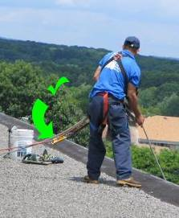
What is Fall Prevention/ Fall Protection?
Fall prevention is preventing workers from falling by using engineering controls (e.g., guardrails and hole covers) or restraint systems.
Fall arrest or protection is preventing injury during and after a fall by using Personal Fall Arrest Systems (PFAS) or safety nets and having an effective rescue plan in place.
Notes:
There are several ways employers can protect workers from falls, including using conventional means such as guardrail systems, safety net systems and personal fall protection systems, the adoption of safe work practices, and the provision of appropriate training. The use of warning lines, designated areas, control zones and similar systems are permitted by OSHA in some situations and can provide protection by limiting the number of workers exposed.
Whether conducting a hazard assessment or developing a comprehensive fall protection plan, thinking about fall hazards before the work begins will help the employer to manage fall hazards and focus attention on prevention efforts. If personal fall protection systems are used, attention should be given to identifying attachment points and to ensuring that employees know how to properly use and inspect the equipment.

Slide 25
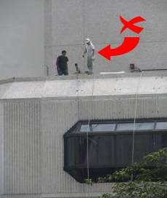
Conventional and Alternative Fall Protection Systems
Conventional and Alternative fall protection systems may be separated into two categories:
Active Fall Protection Systems
Passive Fall Protection Systems
Notes:
Introduce the two categories of fall protection systems.

Slide 26
Fall Protection Systems
ACTIVE
PASSIVE
Personal Fall Arrest Systems (PFAS)
Positioning Device Systems
Restraint System
Warning Line Systems
Controlled Access Zones
Controlled Decking Zone
Safety Monitoring Systems
Safety Net Systems
Protection from Falling Objects
Guardrails*
Hole Covers*
* Eliminates Fall Hazards
Notes:
Ask the class to explain why these examples are “active” or “passive.”

Slide 27
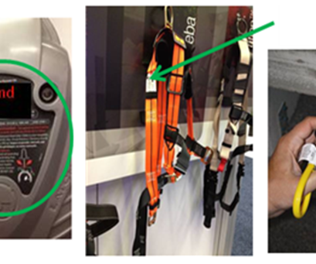
Personal Fall Protection Equipment for Personal Fall Arrest Systems (PFAS)
A PFAS is a system with components that work together to protect workers when they fall from elevated heights.
PFAS components include an anchorage, connectors, and a full-body harness, and may include a shock-absorbing lanyard, a retractable lifeline, and/or a deceleration device.
Notes:
Personal Fall Protection Equipment for Personal Fall Arrest Systems
Be sure to point out the PFAS acronym!
A PFAS is a system with components that work together to protect workers when they fall from elevated heights. PFAS components include an anchorage, connectors, and a full-body harness, and may include a shock-absorbing lanyard, a retractable lifeline, and/or a deceleration device (see 29 CFR 1926.500(b)).
PFAS components will be marked by the manufacturer with pertinent information specific to the equipment, such as warnings, serial/model number, capacity, and the materials used to make the component. Information (e.g., proper use, maintenance, inspection) about fall protection components is typically provided in equipment manuals.
Although some components may look the same, they may not be interchangeable if they are from different manufacturers or from different equipment series made by the same manufacturer.

Slide 28
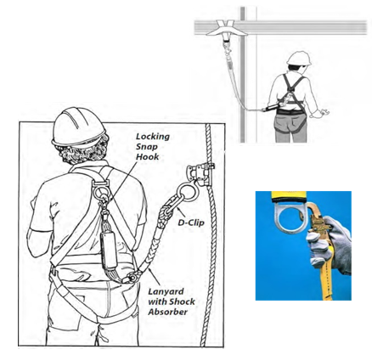
Personal Fall Arrest System
Harnesses
The dorsal D-ring
Fit is adjusted so that all straps are snug
No dangling leg straps or arm straps
Notes:
Harnesses include shoulder straps and leg straps, a sub-pelvic assembly, adjustable buckles or fasteners, and one or more D-rings to connect to a lanyard.
The dorsal D-ring (between the worker's shoulder blades) is used with a fall arrest system.
D-rings in other positions are sometimes included for use with ladder safety devices.
Some harnesses come with D-rings on the front, sides, and lower back.

Slide 29
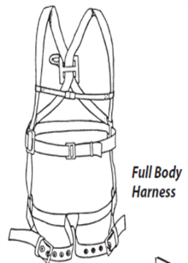
Full Body Harness
A full body harness is required for fall arrest.
Safety harnesses distribute fall-arrest impact through the thighs and buttocks.
Safety belts (waist belts) are no longer permitted for use as personal fall arrest equipment.
  In a fall arrest, they can cause serious damage to internal organs such as the spleen and pancreas.
Notes:
Discuss the features of a full body harness and explain why safety belts are no longer allowed.

Slide 30
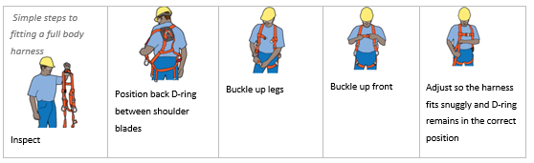
Simple Steps to Fitting a Full Body Harness
Notes:
Use the illustrations or demonstrate how to properly fit a full body harness system.

Slide 31
Inspection and Maintenance of Personal Fall Arrest Systems
To maintain their service life and high performance, all belts and harnesses shall be inspected frequently.
Visual inspection before each use is required as is a routine inspection by a competent person.
We will discuss specific conditions where the equipment should be removed from service and replaced.
Notes:
Introduce the concept of inspection and maintenance of PFAS.
Point out that the visual inspection before use is required, and routine inspections by a competent person are required.
Introduce the discussion of specific conditions where equipment must be removed from service and replaced.

Slide 32
Harness Inspection
Begin at one end, hold the body side of the belt toward you, grasping the belt with your hands six to eight inches apart.
Bend the belt in an inverted "U."
Watch for frayed edges, broken fibers, pulled stitches, cuts or chemical damage. Check D-rings and D-ring metal wear pads for distortion, cracks, breaks, and rough or sharp edges.
The D-ring bar should be at a 90 degree angle with the long axis of the belt and should pivot freely.
Notes:
Describe the steps for harness inspection.

Slide 33
Lifeline Anchors
Anchorage points should be able to support 5000 pounds.
*Remember: fall-arrest loads can be as high as 2000 pounds, depending on body weight and fall distance.
Suitable anchorages include:
  Designed systems for repair or maintenance work.
  Concrete or structural steel columns and beams.
Notes:
Emphasize the requirements for lifeline anchors.

Slide 34
Attaching Anchors
Anchors for PFAS be able to hold at least 5,000 pounds.
Always follow the anchor manufacturer’s instructions or consult a qualified person.
Never anchor a fall arrest system to stink pipes, scupper drain covers, handrails, roof hatches, fixed ladders or stairs, vent pipes, formwork, shoring jacks, old masonry, or light structural parapets.
Notes:
Point out the safety factor for anchor attachments and refer to the illustrations in the student text.

Slide 35
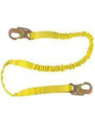
Lanyards
Lanyards connect the harness directly to an anchorage.
Lanyards should be either rope or synthetic web straps.
Lanyards should have spliced eyes with thimbles and be fitted with locking snap hooks or D-clips.
Lanyards with shock absorbers are strongly recommended.
  Never shorten a lanyard by tying knots in it.
Notes:
Describe acceptable lanyards.

Slide 36
Lanyard Inspection
When inspecting lanyards, begin at one end and work to the opposite end.
Slowly rotate the lanyard so that the entire circumference is checked.
Spliced ends require attention.
Notes:
Hardware
Snaps: Inspect closely for hook and eye distortion, cracks, corrosion, or pitted surfaces. The keeper or latch should seat into the nose without binding and should not be distorted or obstructed. The keeper spring should exert sufficient force to firmly close the keeper. Keeper locks must provide the keeper from opening when the keeper closes.
Thimbles: The thimble (protective plastic sleeve) must be firmly seated in the eye of the splice, and the splice should have no loose or cut strands. The edges of the thimble should be free of sharp edges, distortion, or cracks.
Steel Lanyards: While rotating a steel lanyard, watch for cuts, frayed areas, or unusual wear patterns on the wire. The use of steel lanyards for fall protection without a shock-absorbing device is not recommended. Do not use steel lanyards in the presence of electrical hazards.
Web Lanyard: While bending webbing over a piece of pipe, observe each side of the webbed lanyard. This will reveal any cuts or breaks. Due to the limited elasticity of the web lanyard, fall protection without the use of a shock absorber is not recommended.
Rope Lanyard: Rotation of the rope lanyard while inspecting from end to end will bring to light any fuzzy, worn, broken or cut fibers. Weakened areas from extreme loads will appear as a noticeable change in original diameter. The rope diameter should be uniform throughout, following a short break-in period. When a rope lanyard is used for fall protection, a shock-absorbing system should be included.

Slide 37
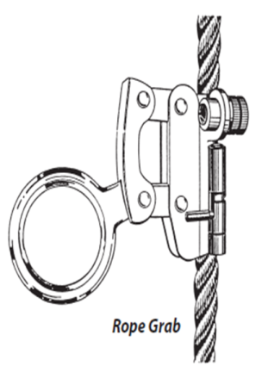
Rope Grabs
Mechanical rope grabs are used to attach lanyards to vertical lifelines.
Most rope grabs employ a device that locks on the lifeline when the lanyard is sharply tugged or pulled.
Rope grabs must be installed in the right direction.
Notes:
Describe rope grabs.

Slide 38
Visual Indication of Damage to Webbing and Rope Lanyards
Heat
Chemical
Ultraviolet Rays
Molten Metal or Flame
Paint and Solvents
Notes:
Heat-In excessive heat, nylon becomes brittle and has a shriveled brownish appearance. Fibers will break when flexed and should not be used above 180 degrees Fahrenheit.
Chemical - Change in color usually appears as a brownish smear or smudge. Transverse cracks appear when belt is bent over tight. This causes a loss of elasticity in the belt.
Ultraviolet Rays - Do not store webbing and rope lanyards in direct sunlight, because ultraviolet rays can reduce the strength of some material.
Molten Metal or Flame - Webbing and rope strands may be fused together by molten metal or flame. Watch for hard, shiny spots or a hard and brittle feel. Webbing will not support combustion, nylon will.
Paint and Solvents - Paint will penetrate and dry, restricting movements of fibers. Drying agents and solvents in some paints will appear as chemical damage.

Slide 39
Shock Absorbers
Shock absorbers are strongly recommended for use in fall- arrest systems.
Shock absorbers can reduce fall-arrest loads by as much as 50%
Some shock absorbers are built into the lanyard.
The tear-away type also gives clear indication that fall arrest has occurred and that the system should be replaced.
Any fall arrest component involved in a fall arrest should be taken out of service to prevent reuse.
Notes:
Describe shock absorbers and explain how they are used.

Slide 40
Shock-absorbing Packs Inspection
The outer portion of the shock-absorbing pack should be examined for burn holes and tears.
Stitching on areas where the pack is sewn to the D-ring, belt or lanyard should be examined for loose strands, rips and deterioration.
Notes:
Explain the process for inspecting shock-absorbing packs.

Slide 41
Cleaning of Equipment
Basic care for fall protection safety equipment
Nylon and polyester
Drying
Notes:
Basic care for fall protection safety equipment will prolong and endure the life of the equipment and contribute toward the performance of its vital safety function.
Proper storage and maintenance after use is as important as cleaning the equipment of dirt, corrosives or contaminants.
The storage area should be clean, dry and free of exposure to fumes or corrosive elements.
Nylon and Polyester - Wipe off all surface dirt with a sponge dampened in plain water.
Squeeze the sponge dry. Dip the sponge in a mild solution of water and commercial soap or detergent.
Work up a thick lather with a vigorous back and forth motion. Then wipe the belt dry with a clean cloth. Hang freely to dry but away from excessive heat.
Drying - Harness, belts and other equipment should be dried thoroughly without exposure to heat, steam or long periods of sunlight

Slide 42
Lifelines
Vertical Lifelines
Horizontal Lifelines
Capable of sustaining a 5000 pound load and used by one worker
Free of defects and protected from abrasion
Anchored and long enough to reach safe landing level
Knotted at bottom to prevent grab from sliding off the end
Can increase the area in which a worker is protected
Use automatic pass through to allow worker to keeps both hands free
Notes:
Vertical lifelines must be:
capable of sustaining a 5000 pound load
used by only one worker at a time
free of cuts, abrasions, and other defects protected from chafing and abrasion
long enough to reach the ground (or a safe landing level above ground)
knotted at the bottom to prevent the grab from sliding off the end anchored to a fixed support capable of sustaining a 5000 load
Horizontal lifelines:
can increase area where worker is protected
use automatic pass through to allow workers to keep hands free

Slide 43
Using Fall Arrest Systems Safely
Ensure that personal fall arrest systems will, when stopping a fall:
Limit maximum arresting force to 1,800 pounds.
Be rigged such that an employee can neither free fall more than 6 feet nor contact any lower level.
Bring an employee to a complete stop and limit maximum deceleration distance to 3½ feet.
Notes:
Describe points on the slide for using fall arrest systems safely.

Slide 44
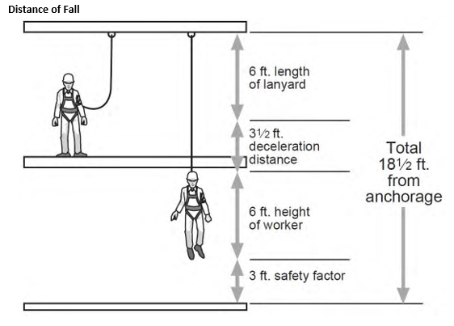
Measurements for Assessing Fall Hazards and Controls
A few basic measurements and equations can aid in evaluating:
  The necessary total fall clearance distance for PFASs
  Swing fall hazards for PFASs
Notes:
Explain the diagram.

Slide 45
Total Fall Distance for PFAS
The total fall clearance distance is the minimum vertical distance between the worker and the lower level.
The total fall clearance distance is calculated before a decision is made to use a PFAS.
Please note *If the available distance is not greater than the total fall clearance distance, it is inappropriate to use the PFAS and a fall restraint system might be used instead.
Notes:
Introduce the calculations needed to determine fall clearance distance.

Slide 46
Total Fall Clearance Distance Calculations
Simple to perform based on several factors, including:
  Lanyard length;
  The height at which the lanyard is anchored relative to where the other end attaches to the worker's harness;
  The distance the worker will travel as the deceleration device absorbs the energy from the fall (i.e., slows it down);
  The worker's height;
  D-ring shift; and
  A safety factor.
Notes:
Describe each factor.

Slide 47
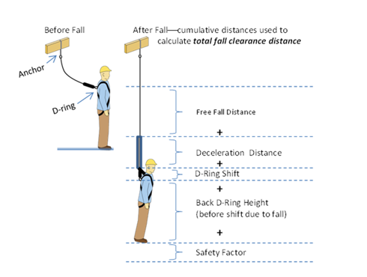
Calculating Total Fall Clearance
Free fall distance must be 6 feet or less and prevent the worker from contacting a lower level.
Deceleration distance must be no greater than 3.5 feet.
D-ring shift is often assumed to be one foot.
Back D-ring height is often standardized as five feet for six-foot-tall workers.
Safety factor is typically 2 feet.
Notes:
Use the illustration to make sure the students understand the calculation.

Slide 48
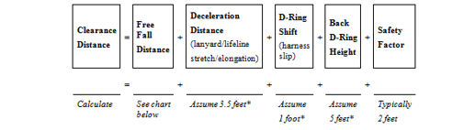
Total Fall Distance Equation
A fall arrest system will not protect a falling worker if the calculated clearance distance is greater than the actual distance available below the elevated work area.
Notes:
The equation shows how to add the various values in order to calculate total fall clearance distance.

Slide 49
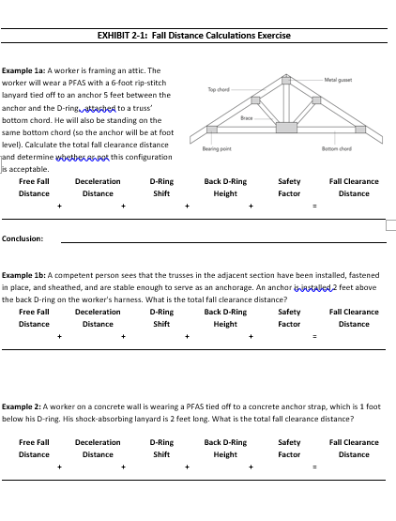
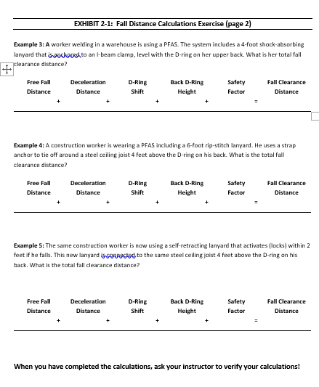
Exhibit 2-1: Fall Distance
Calculations Exercise (pp. 2-12, 2-13)
Calculating free fall distance based on D-ring location:
D-ring ABOVE Anchor
Free fall distance = Lanyard length + Distance from D-ring to anchor
D-ring BELOW anchor
Free fall distance = Lanyard length - Distance from D-ring
to anchor
D-ring LEVEL with anchor
Free fall distance = Lanyard length
Workers using a shock-absorbing lanyard (e.g., ripstitch lanyard)
Self-retracting lanyards typically activate, and thus limit free fall distance, within 2 feet
Notes:
Slide is shown during Module 2a exercise. Make sure each student fills in the correct answers in their Student Manual.
Example 1a: Free fall distance = 6-foot lanyard + 5 feet between the anchor and D-ring = 11 feet
Answer 1a: The free fall distance (11 feet) is greater than the 6-foot maximum.
(The free fall distance can be reduced by moving the anchor above the D-ring. For example, if a section of truss has been stabilized and sheathed, the anchorage point might be moved above the worker’s head.
Example 1b: Free fall distance = 6-foot lanyard – 2 feet between the anchor and D-ring = 4 feet, Deceleration distance = 3.5 feet, D-ring shift = 1 foot, Back D-ring height = 5 feet, Safety factor = 2 feet. Answer 1b: total necessary fall clearance distance = 4 + 3.5 + 1 + 5 + 2 = 15.5 feet.
Example 2: Free fall distance = 2-foot lanyard + 1 foot between the anchor and D-ring = 3 feet, Deceleration distance = 3.5 feet, D-ring shift = 1 foot, Back D-ring height = 5 feet, Safety factor = 2 feet. Answer 2: total fall clearance distance = 3 + 3.5 + 1 + 5 + 2 = 14.5 feet. In this case the free fall distance is 3 feet (less than OSHA's 6-foot maximum); however, the total fall distance is 14.5 feet. There needs to be at least 14.5 feet of clear space below the worker. Where guardrails cannot be used, fall restraint is a better option than fall arrest for a work area with limited clearance below.
Example 3:Free fall distance = 4-foot lanyard, Deceleration distance = 3.5 feet, D-ring shift = 1 foot, Back D-ring height = 5 feet, Safety factor = 2 feet. Answer 3: total fall clearance distance = 4 + 3.5 + 1 + 5 + 2 = 15.5 feet.
Example 4: Free fall distance = 6-foot lanyard – 4 feet between the D-ring and the anchor = 2 feet, Deceleration distance = 3.5 feet, D-ring shift = 1 foot, Back D-ring height = 5 feet, Safety factor = 2 feet. Answer 4: total fall clearance distance = 2 + 3.5 + 1 + 5 + 2 = 13.5 feet.
Example 5: Free fall distance = 2 feet (This self-retracting lanyard automatically limits free fall distance to 2 feet as stated in the Example 5 problem statement (see 29 CFR 1926.502(d)(12)). Deceleration distance = 3.5 feet, D-ring shift = 1 foot, Back D-ring height = 5 feet, Safety factor = 2 feet. Answer 5: total fall clearance distance = 2 + 3.5 + 1 + 5 + 2 = 13.5 feet. This value can then be compared to the vertical clearance actually available at the work location.

Slide 50
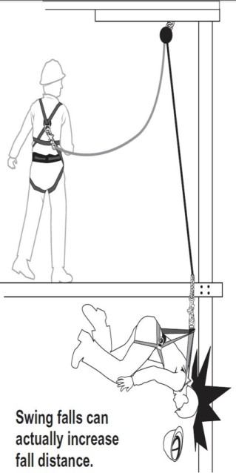
How To Evaluate The Swing Fall Hazard
The swing fall hazard is created by the pendulum effect.
A worker who falls while connected to an anchor (unless it is directly overhead) will swing back and forth like a pendulum.
Workers can be seriously injured if they strike objects during a swing fall.
Notes:
The swing fall hazard is created by the pendulum effect, which can swing a fallen worker into a nearby surface, such as a wall or protruding beam.
In addition to calculating the total fall clearance distance before beginning work on an elevated level, it is important to evaluate the swing fall hazard at the edges where a worker might fall.
A worker who falls while connected to an anchor (unless it is directly overhead) will swing back and forth like a pendulum.
Workers can be seriously injured if they strike objects during a swing fall.
NOTE: Installing the anchorage point directly above the work area (i.e., connected to an overhead attachment point with sufficient strength) will help prevent injury.

Slide 51
Fallen Worker Rescue
Aided Rescue
Self-Rescue
Worker who is suspended from a lifeline and cannot perform a self-rescue
Will need help from trained rescuers using appropriate equipment
Off-site emergency response personnel may rescue suspended workers
*Note: Most 911 responders are not trained in how to do so
Worker can take steps to minimize suspension trauma
Self-rescue methods allow fallen worker to temporarily relieve pressure on the legs
Worker may be able to lower himself or herself to the lower level
Notes:
Rig fall arrest systems to allow movement of the worker only as far as the edge of the walking/working surface, when used at hoist areas. An effective fallen worker rescue plan addresses the procedures, equipment, and personnel needed to ensure that a rescue proceeds quickly and efficiently when a fall occurs.
Even when a PFAS works properly, the fallen worker is still in danger. The worker's body weight places pressure on the harness straps, which can compress the veins, and cause blood to pool, in the lower extremities and reduce blood return to the worker's heart.
This condition is called suspension trauma, also known as harness hang syndrome. In medical terms, this results in orthostatic intolerance. If the pressure is not reduced promptly, the worker can lose consciousness within minutes. To delay post suspension trauma, activate the rescue plan immediately.
Self-rescue and aided rescue are two techniques for rescuing a suspended worker. Rescuing the worker promptly (i.e., aided rescue) or ensuring the worker can self-rescue is imperative to preventing injury or a fatality.

Slide 52
How To Self-Rescue
The first thing you should do is relieve the harness pressure.
The foot wrap will relieve the pressure and allow you to climb up or down for short distances.
Notes:
Introduce the initial step for self-rescue.

Slide 53
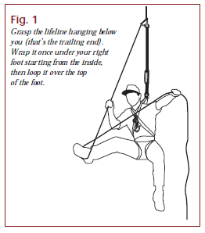
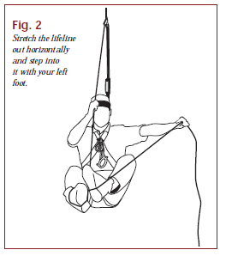
How To Do A Foot Wrap: Figure 1 & Figure 2
Step 1 - Grasp the lifeline hanging below you (that’s the trailing end). Wrap it once under your right foot starting from the inside, then loop it over the top of the foot.
Step 2 - Stretch the lifeline out horizontally and step into it with your left foot.
Notes:
Explain how to do a Foot Wrap.

Slide 54
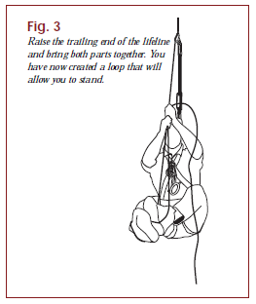
How To Do A Foot Wrap: Figure 3
Step 3 - Raise the trailing end of the lifeline and bring both parts together. You have now created a loop that will allow you to stand.
Notes:
Explain how to do a Foot Wrap (continued).

Slide 55
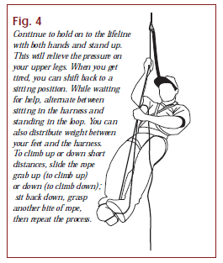
How To Do A Foot Wrap: Figure 4
Step 4 - Continue to hold on to the lifeline with both hands and stand up.
This will relieve the pressure on your upper legs. When you get tired, you can shift back to a sitting position.
While waiting for help, alternate between sitting in the harness and standing in the loop. You can also distribute weight between your feet and the harness.
To climb up or down short distances, slide the rope grab up (to climb up) or down (to climb down); sit back down, grasp another bite of rope, then repeat the process.
Notes:
Explain how to do a Foot Wrap (continued).

Slide 56
Hands-on Exercises
Practice the following skills
  Skill Set #1 Inspection of complete PFAS System
  Skill Set #2 Don full body harness
  Skill Set #3 Identifying the proper steps in determining how and when to use a personal fall protection system
  Skill Set #4 Perform a foot wrap for self-rescue
Work in Groups of 2 to 6
Notes:
Instructors must complete a skill check-off for each skill set.

Slide 57
MODULE 2 NOW YOU KNOW...
Difference between Fall Protection and Fall Prevention
Order of fall protection: engineering controls, a fall restraint system, followed by a fall arrest system
“Personal fall arrest system” (PFAS): body harness, an anchorage, and connectors (may include a lanyard, deceleration device, lifeline, or suitable combination)
Safety belts (waist belts) no longer permitted for use as personal fall arrest equipment
Notes:
Preventing workers from falling by using engineering controls (e.g., guardrails and hole covers) or restraint systems is known as fall prevention . Preventing injury during and after a fall by using Personal Fall Arrest Systems (PFAS) or safety nets and having an effective rescue plan in place is known as Fall arrest/protection
The preferred order of fall protection is; engineering controls, a fall restraint system, followed by a fall arrest system
“Personal fall arrest system” (PFAS) means a system used to arrest an employee in a fall from a working level. It consists of a body harness, an anchorage, and connectors and may include a lanyard, deceleration device, lifeline, or suitable combinations of these
Safety belts (waist belts) are no longer permitted for use as personal fall arrest equipment

Slide 58
MODULE 2 NOW YOU KNOW (continued)...
Anchorage points should be able to support 5000 pounds
Always follow the anchor manufacturer’s instructions, consult a qualified person when installing and using anchors
Never shorten lanyard by tying knots; lanyard must not be looopedover object and tied back to itself
Total fall clearance free fall distance cannot exceed 6 feet
Self-retracting lanyards limit free fall distance (up to 2 feet)
Visually inspect equipment before each use and have routine inspection by a competent person
Notes:
Review Key Points on slide:
Anchorage points should be able to support 5000 pounds.
Always follow the anchor manufacturer’s instructions or consult a qualified person when installing anchors to ensure they are strong. enough to hold the sudden weight of a falling worker.
Never shorten lanyard by tying knots or looping over object and tying back to itself.
Total fall clearance free fall distance cannot exceed 6 ft.
Self-retracting lanyards limit free fall distance, within 2 feet.
Visual inspection before each use is required as is a routine inspection by a competent person.
Additional reminders:
Never anchor a fall arrest system to stink pipes, scupper drain covers, handrails, roof hatches, fixed ladders or stairs, vent pipes, formwork, shoring jacks, old masonry, or light structural parapets.
Install a continuous pass through horizontal lifeline. It allows workers to move through multiple spans with 100% tie-off at all times.
When using a self-retracting lifeline be sure to check the manufacturer guidelines.
Make sure the lines do not run over an unpadded, sharp edge.
Be sure to evaluate the potential for a swing fall.
When inspecting snap hooks, the keeper or latch should be double locking to prevent rollout.

Slide 59

FALL PROTECTION/ FALL PREVENTION

Slide 60
MODULE 3: FALL PREVENTION SYSTEM
Overview
How do you build a guardrail system?
What is a safety net system?
What different types of fall prevention can be used?
What are the different parts of a fall restraint system?
What are positioning device systems?
Notes:
Upon completion of this module you will be able to:
Explain the requirements for building guardrail system
Describe the safety net system
Describe the different types of fall prevention
Define the different parts of a fall restraint system
Describe positioning device systems

Slide 61
Guardrail Systems
A guardrail system can be used as a barrier installed to prevent workers from falling off a work surface edge to a lower level
Guardrails can also be used to keep workers from falling into holes or openings in decking or floors
Guardrails are typically constructed using:
  Upright supports attached to the working surface;
  A horizontal top rail connected to the supports;
  One or more midrails running parallel to the toprail; and
  Toeboards when necessary to protect workers below from falling objects.
Notes:
Introduce basic requirements of guardrail systems.

Slide 62
Guardrail Systems (continued)
Effective guardrail systems will have at a minimum:
  A surface that is smooth and free from burrs to prevent punctures and lacerations and to prevent snagging of clothing.
  Toprails and midrails that are at least 1/4 inch in diameter.
  Strength to withstand at least 200 pounds applied within 2 inches of the top edge in any outward or downward direction.
Effective guardrail systems will not have:
  Guardrails that deflect to lower than 39 inches above the working surface when 200 pounds of pressure are applied in a downward direction.
  Toprails and midrails that overhang terminal posts to constitute a projection hazard.
Notes:
Effective guardrail systems will have at a minimum:
A surface that is smooth and free from burrs to prevent punctures and lacerations and to prevent snagging of clothing (see 29 CFR 1926.502(b)(6)).
Toprails and midrails that are at least 1/4 inch in diameter (see 29 CFR 1926.502(b)(9)).
Strength to withstand at least 200 pounds applied within 2 inches of the top edge in any outward or downward direction (see 29 CFR 1926.502(b)(3)).
Effective guardrail systems will not have
Guardrails that deflect to lower than 39 inches above the working surface when 200 pounds of pressure are applied in a downward direction.
Toprails and midrails that overhang terminal posts to constitute a projection hazard.

Slide 63
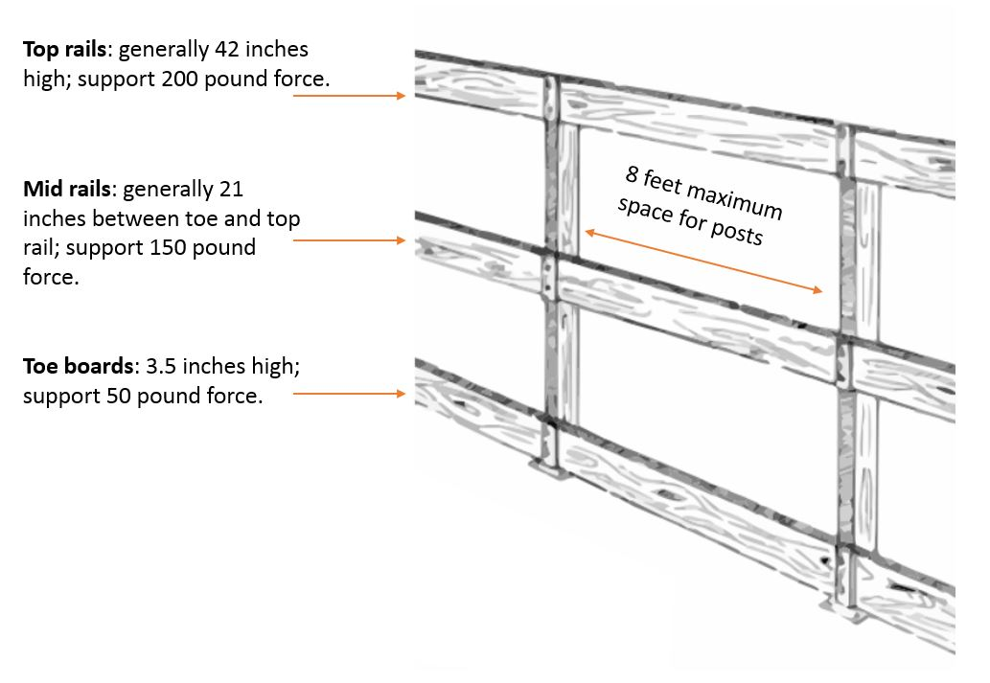
Guardrail Requirements
*
Notes:
More guardrail requirements:
A toprail between 39 and 45 inches from the working level, raised as necessary to account for workers using stilts or otherwise working in an elevated location above the work surface (see 29 CFR 1926.502(b)(1)).
Midrails (or equivalent structural members) that withstand at least 150 pounds of force in the downward or outward direction (see 29 CFR 1926.502(b)(5)).
A midrail, mesh, screen, or equivalent intermediate structural members installed between the guardrail system top edge and the walking/working surface when there is no wall or parapet wall at least 21 inches high (see 29 CFR 1926.502(b)(2)).
Intermediate members (such as balusters), when used between posts, that are not more than 19 inches apart (see 29 CFR 1926.502(b)(2)(iii)).
Flags made of high visibility material every 6 feet if wire rope is used for top rails
Basic guardrail components come in a variety of materials and configuration options. It is common for employers to use material available or produced at the worksite. Upright supports may be made from wood, formed metal, pipe, or composites. Wire rope is sometimes used for the top rails and midrails.
These are guidelines as a starting point for designing guardrail systems. However, the guidelines do not provide all the information necessary to build a complete system. The components of a guardrail system must still be designed and assembled in such a way that the completed system meets all applicable requirements.
Workers installing or removing guardrails must be protected using other forms of fall protection whenever the guardrail systems are not attached securely to a stable structure
NOTE: *8 feet maximum space for posts is based on non-mandatory standards

Slide 64
Temporary Guardrails
Premade or job-made guardrails can be installed for temporary use.
Temporary guardrails can be used while constructing a wall, completing floor decking, or replacing a roof.
These guardrails are often constructed from reusable materials or premade guardrail system components.
Notes:
Temporary Guardrails
Premade or job-made guardrails can be used as temporary guardrails while more permanent structures are being installed or when the work is transient or in a space not intended as a permanent work area. For example, temporary guardrails can be used while constructing a wall, completing floor decking, or replacing a roof (see Figure 4). These guardrails are often constructed from reusable materials or premade guardrail system components as shown in Figure 4 (see 29 CFR 1926.502(b)).
Premade guardrails are particularly susceptible to damage if not handled properly when disassembled and stored. Specific handling instructions are typically included in the manufacturer’s recommended procedures for disassembling and storing the guardrail components. If railing components are bent, broken, or missing, the guardrail may not be effective. Damage is more likely to occur if the components are dropped when disassembled, transported in vehicles, or stored in areas not protected from conditions that could cause corrosion or distortion.

Slide 65
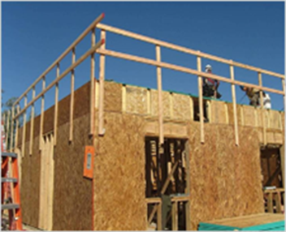
Temporary Guardrails (continued)
Premade guardrails are particularly susceptible to damage.
If railing components are bent, broken, or missing, the guardrail may not be effective.
Damage is more likely to occur if the components are dropped when disassembled, transported in vehicles, or stored in areas not protected from conditions that could cause corrosion or distortion.
Notes:
Temporary Guardrails
Premade guardrails are particularly susceptible to damage if not handled properly when disassembled and stored.
Specific handling instructions are typically included in the manufacturer’s recommended procedures for disassembling and storing the guardrail components.
If railing components are bent, broken, or missing, the guardrail may not be effective.
Damage is more likely to occur if the components are dropped when disassembled, transported in vehicles, or stored in areas not protected from conditions that could cause corrosion or distortion.

Slide 66
Special Guardrails
Guardrails for:
  Scaffolds
  Aerial Lifts
  Scissor Lifts
Stairrails
Handrails
Notes:
Briefly mention these special types of guardrails. They are not included in the student text.
Guardrails for Scaffolds, Aerial Lifts, and Scissor Lifts
Guardrails, possibly in combination with additional types of fall protection systems (e.g., PFAS or restraint system), may be used to address these hazards (see 29 CFR 1926.451(g)(1); 29 CFR 1926.453(b)(2)(v); 29 CFR 1926.954(b)(3)(iii)(A)).
Stairrails
A stairrail system is a vertical barrier that runs along the unprotected side edge of a stairway to prevent workers from falling to lower levels (see Figures 5 and 6). The top surface of the stairrail system may be used as the handrail (see 29 CFR 1926.1050(b); 29 CFR 1926.1052(c)(7)).
Handrails
Effective handrails provide an adequate handhold for workers to grasp to prevent them from falling (see Figure 6 and 29 CFR 1926.1052(c)(1), (c)(9)).
Effective handrails are 30 to 37 inches high and meet the guardrail strength requirements (i.e., able to withstand 200 pounds of weight applied within two inches of the top edge in any downward or outward direction at any point along the top edge) (see 29 CFR 1926.1052(c)(5), (c)(6)).

Slide 67
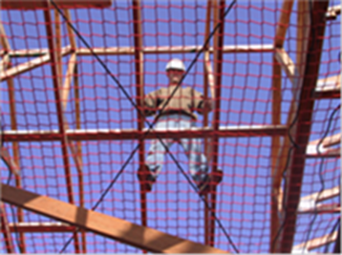
Safety Net Systems
Safety net systems are an option when workers are working at elevated heights with hazardous vertical drops.
Safety net systems are commonly used during work on bridges and large structures.
Notes:
"Safety net systems." Safety net systems and their use shall comply with the following provisions:
Safety nets shall be installed as close as practicable under the walking/working surface on which employees are working, but in no case more than 30 feet (9.1 m) below such level. When nets are used on bridges, the potential fall area from the walking/working surface to the net shall be unobstructed.
Safety nets shall be installed with sufficient clearance under them to prevent contact with the surface or structures below when subjected to an impact force.
Defective nets shall not be used. Safety nets shall be inspected at least once a week for wear, damage, and other deterioration. Defective components shall be removed from service. Safety nets shall also be inspected after any occurrence which could affect the integrity of the safety net system.
Materials, scrap pieces, equipment, and tools which have fallen into the safety net shall be removed as soon as possible from the net and at least before the next work shift.
The maximum size of each safety net mesh opening shall not exceed 36 square inches (230 cm) nor be longer than 6 inches (15 cm) on any side, and the opening, measured center-to-center of mesh ropes or webbing, shall not be longer than 6 inches (15 cm).
Each safety net (or section of it) shall have a border rope for webbing with a minimum breaking strength of 5,000 pounds (22.2 kN).

Slide 68
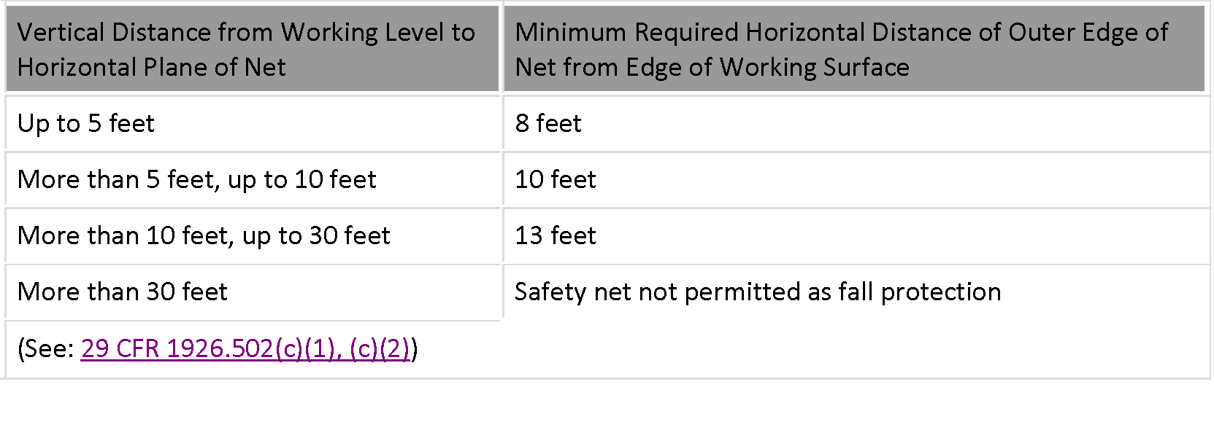
Safety Net System Dimensions
Notes:
Discuss dimension requirements for safety nets.

Slide 69
Effective Hole Covers
Large enough to provide appropriate overlap to prevent workers from falling through
Strong enough to support at least twice the anticipated weight imposed by the heaviest load
Left in place over the hole until access is needed
Inspected periodically to identify deterioration
Secured and do not create trip hazards
Clearly marked as hole covers
Notes:
Effective Hole Covers
Covers are strong protective surfaces used on walking/working surfaces or roadways to prevent workers from falling through a hole. Covers for permanent holes are typically built for a specific purpose (e.g., permanent access points, manhole covers, and trap doors) and are only effective when they are properly designed and secured in place. Covers for temporary holes are often constructed on work sites with reusable materials, most commonly using plywood and steel plates. Other options for covers include grates designed to support weight, custom boxes to cover a hole with an elevated lip or partially installed equipment, and temporary trapdoors.
Effective hole covers are:
Large enough to provide appropriate overlap to prevent workers from falling through.
Strong enough to support at least twice the anticipated weight imposed by the heaviest load (see 29 CFR 1926.502(i)(1), (i)(2)).
Left in place over the hole until access is needed.
Inspected periodically to identify deterioration.
Secured (see 29 CFR 1926.502(i)(3)) and do not create trip hazards.
Clearly marked as hole covers (see 29 CFR 1926.502(i)(4)).
The following materials lack the strength necessary to prevent a worker from falling through a hole (see 29 CFR 1926.502(i)(1), (i)(2)):
Cardboard;
Tarps;
Materials not intended to bear the anticipated load (e.g., plastic or glass);
Loose materials that could separate (e.g., unsecured two-by-four planks);
Damaged materials (e.g., deteriorating wood, a bent metal plate);
Drywall or particle board; and
Chicken wire or other fencing material.

Slide 70

Hole Covers
Heavy plywood is a common choice for covering temporary holes in floors and roofs, but plywood strength and durability can vary.
All covers shall be color coded or they shall be marked with the word “Hole” or “Cover.”
Notes:
Discuss the use of plywood hole covers and marking requirements for hole covers.

Slide 71
Hole Covers
Cover or guard floor holes as soon as they are created during new construction.
For existing structures, survey the site and continually audit, covering openings or holes immediately.
Construct all floor hole covers to effectively support 2x maximum weight.
Secure all floor hole covers to prevent accidental displacement by the wind, equipment, or employees.
Color code or mark all hole covers.
Page 42
Notes:
Hole covers:
Cover or guard floor holes as soon as they are created during new construction.
For existing structures, survey the site before working and continually audit as work continues. Guard or cover any openings or holes immediately.
Construct all floor hole covers so they will effectively support two times the weight of employees, equipment, and materials that may be imposed on the cover at any one time.
Secure all floor hole covers to prevent accidental displacement by the wind, equipment, or employees.
All covers shall be color coded or they shall be marked with the word “Hole” or “Cover”.

Slide 72
Plywood Strength vs. Durability
Plywood Strength
Plywood Durability
Susceptible to damage over time from exposure to water, traffic, and heavy loads
Reduced-strength indicated by cracks, chips, warped appearance, worn surface, de-lamination, water stains
Binding agents degrade in moist environment (more rapidly for interior-grade than exterior-grade)
Weight of hauling equipment and load concentrated into smaller area
Common routes experience additional wear and tear to flooring
Add protective layer as preventive measure
Notes:
Plywood Strength Rating Systems
Several factors determine and measure plywood strength. In the United States, two groups provide the most commonly used plywood rating systems: APA–The Engineered Wood Association (formerly the American Plywood Association and Douglas Fir Plywood Association) and the Timber Engineering Company (TECO). CSHOs should refer to these organizations for detailed information.
The hole size and the expected load weight are considered when determining if the plywood is effective for use as a hole cover (see 29 CFR 1926.501(b)(4); 29 CFR 1926.502(i)(1), (i)(2)).
Plywood Strength and Durability
Plywood is susceptible to damage over time from exposure to water, traffic, and heavy loads that may reduce its strength. Some indicators of reduced-strength plywood may include cracks, chips, a warped appearance, a worn surface, de-lamination, and water stains. Expected damage after exposure to water depends on whether the plywood is exterior-grade or interior-grade. The binding agents (i.e., adhesive) used to adhere interior-grade plywood layers degrade more rapidly in a moist environment than do the binders used in exterior-grade plywood. For specific cases, SLTC, in conjunction with the U.S. Forest Service Products Laboratory, can evaluate plywood strength degradation.
When workers are using hauling equipment, the weight of the equipment and its load is concentrated into the smaller area that contacts the ground (e.g., the load in a wheelbarrow will concentrate where the wheel hits the ground – an area of just a few inches in size). Commonly used routes for hauling these loads will experience additional wear and tear to the flooring. Adding a protective layer to the floor along these routes is one way to prevent damage to the flooring from concentrated loads. Typical protective layers may include liquid latex compounds, penetrating oils, sheet plastics, and interlocking membranes.

Slide 73
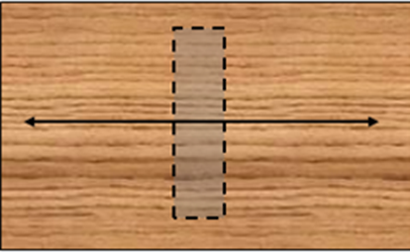
Plywood Cover Size and Orientation
The plywood piece is larger than the hole size so that it is possible to cover the hole with the shortest panel side overlaying the longest unsupported hole dimension.
The panel overlaps the supporting surfaces around the hole far enough for needed support.
The panel is positioned with the strength axis (grain direction) running along the shortest unsupported hole dimension.
Notes:
The plywood cover’s size and orientation can affect the cover’s overall effectiveness. Plywood covers rest on the hole edges that are supported through the joists. The following are indications that a plywood cover’s size and orientation will generally keep workers from falling through a hole:
•The plywood piece is larger than the hole size so that it is possible to cover the hole with the shortest panel side overlaying the longest unsupported hole dimension.
•The panel overlaps the supporting surfaces around the hole far enough for needed support.
•The panel is positioned with the strength axis (grain direction) running along the shortest unsupported hole dimension

Slide 74
Protection From Falling Objects
Protection from falling objects require Toeboards that:
  Withstand force of at least 50 pounds.
  Are a minimum of 3 1/2 inches in vertical height.
  Are solid or have openings not over 1 inch in greatest dimension.
Guardrail systems openings must be small enough to prevent passage of potential falling objects.
Materials and equipment must NOT be stored within 6 feet of a roof edge unless guardrails are erected at the edge.
Canopies must be strong enough to prevent collapse and to prevent penetration by any objects which may fall onto the canopy.
Notes:
Protection from falling objects require -Toeboards, erected along the edge of the overhead walking/working surface for a distance enough to protect employees below and capable of withstanding, without failure, a force of at least 50 pounds applied in any downward or outward direction at any point along the toeboard.
Toeboards are minimum of 3 1/2 inches in vertical height from their top edge to the level of the walking/working surface. No more than 1/4 inch clearance above the walking/working surface. They must be solid or have openings not over 1 inch in greatest dimension.
Where tools, equipment, or materials are piled higher than the top edge of a toeboard, paneling or screening shall be erected from the walking/working surface or toeboard to the top of a guardrail system's top rail or midrail, for a distance sufficient to protect employees below.
Guardrail systems openings must be small enough to prevent passage of potential falling objects.
During the performance of overhand bricklaying and related work: No materials or equipment except masonry and mortar shall be stored within 4 feet of the working edge. Excess mortar, broken or scattered masonry units, and all other materials and debris must be kept clear from the work area by removal at regular intervals.
During the performance of roofing work: Materials and equipment must be stored within 6 feet of a roof edge unless guardrails are erected at the edge. Materials which are piled, grouped, or stacked near a roof edge shall be stable and self-supporting.
Canopies must be strong enough to prevent collapse and to prevent penetration by any objects which may fall onto the canopy.

Slide 75
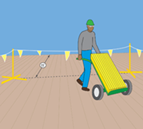
Warning Or Marking Systems
Warning Line Systems
  A warning line system is a barrier erected on a flat or low- sloped roof to warn workers that they are approaching an unprotected roof side or edge.
Notes:
A warning line system is a barrier erected on a flat or low- sloped roof to warn workers that they are approaching an unprotected roof side or edge (see 29 CFR 1926.500(b); 29 CFR 1926.501(b)(10); Figure 11). A warning line system includes a line (rope, wire, or chain) and supporting stanchions (see 29 CFR 1926.502(f)(2)).
Warning lines are not engineered to physically prevent or arrest falls and may not be used in all situations. On flat or low-sloped roofs, warning lines are used in conjunction with conventional fall protection or a safety monitoring system (see 29 CFR 1926.501(b)(10)).
Workers are not allowed in the area between the warning line and the unprotected edge, except during roofing work (see 29 CFR 1926.502(f)(3)). Any employee performing roofing work between the warning line and the roof edge must be protected using another form of fall protection

Slide 76
Controlled Access Zoning
Controlled Access Zones (CAZs)
A controlled access zone is a clearly marked, designated work area where certain work may take place without conventional fall protection systems.
Controlled access zones are used to keep out workers other than those authorized to enter a work area.
In overhand bricklaying and related work, CAZs can be used provided that workers are not reaching more than 10 inches below the walking or working level they are on.
Notes:
Controlled Access Zones (CAZs)
A controlled access zone is a clearly marked, designated work area where certain work (e.g., overhand bricklaying) may take place without conventional fall protection systems (see 29 CFR 1926.500(b)). Controlled access zones are used to keep out workers other than those authorized to enter a work area (see 29 CFR 1926.502(g)).
Situations where CAZs are used:
Overhand bricklaying and related work (see 29 CFR 1926.501(b)(9));
Leading edge work (see 29 CFR 1926.501(b)(2); 29 CFR 1926.502(k)(7));
Residential construction (see 29 CFR 1926.501(b)(13); 29 CFR 1926.502(k)(7)); and
Precast concrete erection (see 29 CFR 1926.501(b)(12); 29 CFR 1926.502(k)(7)).
In overhand bricklaying and related work, CAZs can be used provided that workers are not reaching more than 10 inches below the walking or working level they are on (see 29 CFR 1926.501(b)(9)).
CAZs may be used for leading edge work, precast concrete work, and residential construction work only as part of a fall protection plan when conventional fall protection is infeasible or creates a greater hazard (see 29 CFR 1926.501(b)(2)(i), (b)(12), (b)(13); 29 CFR 1926.502(k)).

Slide 77
Control Lines Used in a CAZ
The CAZ must be erected 6 feet or less and not more than 25 feet from the unprotected or leading edge.
When erecting precast concrete members, the control line can be up to 60 feet or half the length of the concrete.
The control line shall be connected on each side to a guardrail system or wall.
Each line shall be flagged or otherwise clearly marked at not more than 6-foot intervals with high-visibility material.
Notes:
Control lines shall consist of ropes, wires, tapes, or equivalent materials, and supporting stanchions as follows: Each line shall be flagged or otherwise clearly marked at not more than 6-foot (1.8 m) intervals with high-visibility material. Each line shall be rigged and supported in such a way that its lowest point (including sag) is not less than 39 inches (1 m) from the walking/working surface and its highest point is not more than 45 inches (1.3 m) [50 inches (1.3 m) when overhand bricklaying operations are being performed] from the walking/working surface. Each line shall have a minimum breaking strength of 200 pounds (.88 kN). 29 CFR 1926.502(g)(3).

Slide 78
Controlled Decking Zones (CDZ)
A controlled decking zone is a clearly marked work area used during steel erection.
Initially installing decking at the leading edge of the work area 15 feet and up to 30 feet above a lower level.
The boundaries of a CDZ must be designated and clearly marked at 90 feet wide and 90 feet deep from any leading edge.
Notes:
Discuss controlled decking zones.

Slide 79
Safety Monitoring Systems
A safety monitoring system uses a competent person as a safety monitor who can recognize and warn workers of fall hazards
Safety monitor must ensure they can:
  Recognize fall hazards;
  Warn the employee when it appears that the employee is unaware of a fall hazard or is acting in an unsafe manner;
  The safety monitor shall be on the same walking/working surface and within visual sighting distance of the employee being monitored;
  The safety monitor shall be close enough to communicate orally with the employee; and
  The safety monitor shall not have other responsibilities which could take the monitor's attention from the monitoring function.
Notes:
Safety Monitoring Systems
A safety monitoring system uses a competent person as a safety monitor who can recognize and warn workers of fall hazards (see 29 CFR 1926.500(b); 29 CFR 1926.502(h)(1)). Safety monitoring systems are typically used as part of fall protection plans during precast concrete erection work, leading edge work, and residential construction work when conventional fall protection is infeasible or would create a greater hazard and alternative measures (such as scaffolds, ladders, or vehicle mounted work platforms) are not used (see 29 CFR 1926.501(b)(2), (b)(12), (b)(13); 29 CFR 1926.502(k)(6), (k)(8)). Also, when conducting roofing work on a flat or low sloped roof that is 50 feet or less in width, a safety monitoring system may be used as a stand-alone fall protection technique (see 29 CFR 1926.501(b)(10)).
Only workers engaged in low-sloped roofing work and workers performing the specific job tasks covered by a fall protection plan are allowed in an area where workers are being protected by a safety monitoring system (see 29 CFR 1926.502(h)(3)). The worker designated as the safety monitor may not perform other job tasks that could take attention away from the monitoring function (see 29 CFR 1926.502(h)(1)(v)).

Slide 80
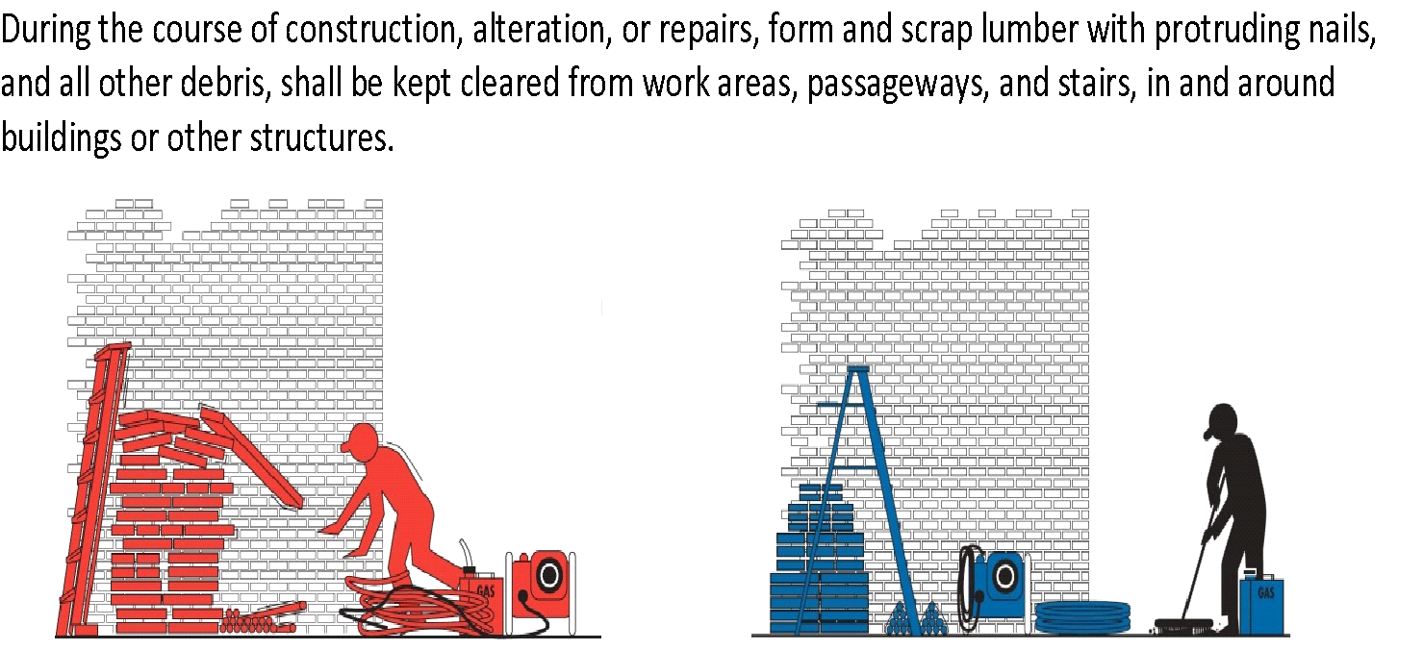
Housekeeping
Wrong
Right
Notes:
Discuss the importance of good housekeeping.

Slide 81
Fall Protection Plans
The fall protection plan is:
Used when conventional fall protection equipment is infeasible
Prepared by a qualified person
Developed specifically for the site
May be used for leading-edge work, precast concrete work, or residential construction work
Must be maintained
Notes:
A fall protection plan is created when its infeasible or conventional fall protection equipment creates a greater hazard to use. Any changes to the fall protection plan shall be approved by a qualified person.
• A copy of the fall protection plan with all approved changes shall be maintained at the job site.
• The implementation of the fall protection plan shall be under the supervision of a competent person.
• The fall protection plan shall document the reasons why the use of conventional fall protection systems (guardrail systems, personal fall arrest systems, or safety nets systems) are infeasible or why their use would create a greater hazard.

Slide 82
Fall Restraint Systems
Fall restraint systems prevent the user from falling any distance.
OSHA has no specific standards for restraint systems, however, at a minimum:
  fall restraint systems should have the capacity to withstand at least 3,000 pounds of force or twice the maximum expected force that is needed to restrain the worker from exposure to the fall hazard.
This system holds the worker in place while keeping his/her hands-free to work
Notes:
Fall Restraint Systems and Positioning Devices
Fall restraint systems prevent the user from falling any distance. To determine the force needed to restrain a worker, consideration is given to the force that would be generated by the worker walking, leaning, or sliding down the working surface. OSHA has no specific standards for restraint systems, however, at a minimum, fall restraint systems should have the capacity to withstand at least 3,000 pounds of force or twice the maximum expected force that is needed to restrain the worker from exposure to the fall hazard.

Slide 83
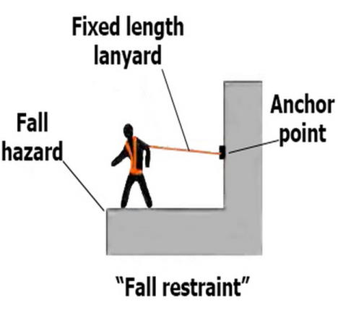
Fall Restraint Systems
A fall restraint system is comprised of a body belt or body harness, an anchorage, connectors, and other necessary equipment.
Other components typically include a lanyard and may also include a lifeline and other devices.
Notes:
When a restraint system is used for fall protection from an aerial lift or a boom-type elevating work platform, the employer must ensure that the lanyard and anchor are arranged so that the employee is not potentially exposed to falling any distance.
While fall restraint systems are not mentioned in OSHA’s fall protection rules, OSHA will accept a properly utilized fall restraint system in lieu of a personal fall arrest system when the restraint system is rigged so that the worker cannot get to the fall hazard.
In effect, (if properly used) the system tethers a worker in a manner that will not allow a fall of any distance. A fall restraint system is comprised of a body belt or body harness, an anchorage, connectors, and other necessary equipment.
Other components typically include a lanyard, and may also include a lifeline and other devices.

Slide 84
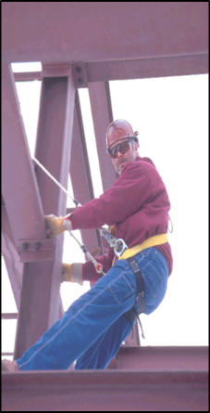
Positioning Device Systems
Holds the worker in place while keeping hands free
Activated when the worker leans back
May only be used on an elevated vertical surface (such as wall or pole)
Not specifically designed for fall arrest purposes
Body belt may be used with "positioning device”
Permit fall of up to 2 feet
May not be used for bucket trucks, scissor lifts and boom-type elevating work platforms
Notes:
In §1926.500 of the construction standards for fall protection, a "positioning device system" is defined as a body belt or body harness system rigged to allow an employee to be supported on an elevated vertical surface, such as a wall (or a pole), and work with both hands free while leaning. Therefore, in construction work, a positioning device may be used only to protect a worker on a vertical work surface. These devices may permit a fall of up to 2 feet (0.6 m). They may be used in concrete form work, installation of reinforcing steel, and certain telecommunications work. Since construction workers in bucket trucks, scissor lifts and boom-type elevating work platforms are on a horizontal surface, a positioning device may not be used for those workers.

Slide 85
MODULE 3 NOW YOU KNOW…
A toprail of the guardrail is 42 in high and must withstand a force of at least 200 pounds.
Toeboards shall be capable of withstanding a force of at least 50 pounds.
A hole is anything bigger than 2 inches and color coded or marked with the word “Hole” or “Cover.”
The warning line shall be erected around all sides of the roof work area at 6 feet.
Flagged are placed at 6-foot intervals with high-visibility material.
A restraint system prevents a worker from being exposed to any fall.
Positioning device system are rigged to permit a fall of up to 2 feet.
Notes:
A toprail of the guardrail is 42 in high.
Guardrail system must be capable of withstanding a force of at least 200 pounds.
Toeboards shall be capable of withstanding, without failure, a force of at least 50 pounds.
A hole is anything bigger than 2 inches.
All covers shall be color coded or they shall be marked with the word “Hole” or “Cover.”
The warning line shall be erected around all sides of the roof work area at 6 feet.
Flagged are placed at 6-foot intervals with high- visibility material.
A restraint system prevents a worker from being exposed to any fall.
A positioning device system is body harness system rigged to allow an employee to be supported on an elevated vertical surface only.
Positioning device system are rigged to permit a fall of up to 2 feet.

Slide 86
MODULE 4: OTHER FALL HAZARDS: LADDERS
Overview
Why is ladder safety important?
What safety devices are used on ladder systems?
What are the general requirements for ladder safety?
What are the rules for use of different types of ladders?
What inspection and maintenance requirements apply to ladders?
Notes:
Upon completion of this module you will be able to:
Explain why ladder safety in construction is important ‘
Describe safety devices used on ladder systems
Describe the general requirements for ladder safety
Explain the rules for use of different types of ladders
Describe ladder inspection and maintenance requirements

Slide 87
Other Fall Hazards - Ladders
The ladder system
How does the system work?
Cable and fixed rail systems
The "climb assist" system
Notes:
Other Fall Hazards - Ladders
Other fall hazards like Ladders or ladder systems contribute to falls and deaths on the job. The system includes a body harness, carabiner, carrier rail, and safety sleeve. Ladder safety devices are available as a cable (i.e., vertical lifeline) or fixed rail system.
How does the system work?
The worker wears a body harness attached to the system by a carabiner. The system uses a cable/safety sleeve, shuttle, or cable grab specifically designed to attach the climber to the vertical line or rail. The cable grab or shuttle freely travels up or down the lifeline/rail as the worker ascends or descends the ladder, allowing the worker to maintain full contact with the ladder. If the worker falls, a locking cam or friction brake in the cable grab or shuttle locks onto the cable or rail and arrests the fall.
Typically, cable and fixed rail systems are permanently attached to the ladder or supporting structure. The cable (flexible carrier) or rail (rigid carrier) is attached by mountings at the top and bottom of the fixed ladder, with intermediate mountings or cable guides for added strength. Existing ladders may be retrofitted with commercially available ladder climbing systems.
A ladder climbing system should not be confused with a "climb assist" system, which consists of motorized equipment that ascends the ladder and partially bears the worker’s weight. Some, but not all, climb assist systems incorporate fall protection features.

Slide 88
Stairs and Ladders
General Requirements
When there is a break in elevation of 19 inches
When there is only one point of access between levels
When there are more than two points of access between levels
Note: The standard does not apply to ladders specifically manufactured for scaffold access and egress but does apply to job-made and manufactured portable ladders intended for general purpose use.
Notes:
General Requirements
When there is a break in elevation of 19 inches, no ramp, runway, embankment or personnel hoist is available, employers must provide a stairway or ladder at all worker points of access.
When there is only one point of access between levels, employers must keep it clear of obstacles to permit free passage by workers. If free passage becomes restricted, employers must provide a second point of access and ensure that workers use it.
When there are more than two points of access between levels, employers must ensure that at least one point of access remains clear. In addition, employers must install all stairway and ladder fall protection systems required by these rules and ensure that their worksite meets all requirements of the stairway and ladder rules before employees use stairways or ladders. See 29 CFR 1926.1050-1060 for the details of the standard.
Note: The standard does not apply to ladders specifically manufactured for scaffold access and egress, but does apply to job-made and manufactured portable ladders intended for general purpose use. Rules for ladders used on or with scaffolds are addressed in 29 CFR 1926.451 Subpart L.

Slide 89
Rules for Ladders
Important rules for ladders:
Maintain ladders free of oil, grease and other slipping hazards.
Do not load ladders beyond their maximum intended load nor beyond their manufacturer’s rated capacity.
Use ladders only for their designed purpose.
Keep areas clear around the top and bottom of ladders.
Do not move, shift or extend ladders while in use.
Notes:
Here are some additional points addressed in the student textbook:
Use ladders only on stable and level surfaces unless secured to prevent accidental movement.
Do not use ladders on slippery surfaces unless secured or provided with slip-resistant feet to prevent accidental movement.
Do not use slipresistant feet as a substitute for exercising care when placing, lashing or holding a ladder upon slippery surfaces.
Secure ladders placed in areas such as passageways, doorways or driveways, or where they can be displaced by workplace activities or traffic to prevent accidental movement. Or use a barricade to keep traffic or activity away from the ladder.
Keep areas clear around the top and bottom of ladders.
Do not move, shift or extend ladders while in use.
Use ladders equipped with nonconductive side rails if the worker or the ladder could contact exposed energized electrical equipment.
Face the ladder when moving up or down.
Use at least one hand to grasp the ladder when climbing.
Do not carry objects or loads that could cause loss of balance and falling.

Slide 90
Rules for Ladders (includes Jobsite Ladders)
Double-cleated ladders or 2+ ladders are required if only one access point to work area.
Ladder rungs, cleats and steps must be parallel, level, and uniformly spaced 10-14 inches apart (step stools 8-12 inches; base section of extension trestle ladders 8-18 inches).
Ladders must not be tied or fastened together.
Ladder components must be surfaced.
Wood ladders must NOT be coated with opaque covering.
Notes:
General Requirements
Double-cleated ladders or two or more ladders must be provided when ladders are the only way to enter or exit a work area where 25 or more employees work or when a ladder serves simultaneous two-way traffic.
Ladder rungs, cleats and steps must be parallel, level and uniformly spaced when the ladder is in position for use.
Rungs, cleats and steps of portable and fixed ladders (except as provided below) must not be spaced less than 10 inches (25 cm) apart, nor more than 14 inches (36 cm) apart, along the ladder’s side rails.
Rungs, cleats and steps of step stools must not be less than 8 inches (20 cm) apart, nor more than 12 inches (31 cm) apart, between center lines of the rungs, cleats and steps.
Rungs, cleats and steps at the base section of extension trestle ladders must not be less than 8 inches (20 cm) nor more than 18 inches (46 cm) apart, between center lines of the rungs, cleats and steps. The rung spacing on the extension section must not be less than 6 inches (15 cm) nor more than 12 inches (31 cm).
Ladders must not be tied or fastened together to create longer sections unless they are specifically designed for such use.
When splicing side rails, the resulting side rail must be equivalent in strength to a one-piece side rail made of the same material.
Two or more separate ladders used to reach an elevated work area must be offset with a platform
or landing between the ladders, except when portable ladders are used to gain access to fixed ladders.
Ladder components must be surfaced to prevent snagging of clothing and injury from punctures or lacerations.
Wood ladders must not be coated with any opaque covering except for identification or warning labels, which may be placed only on one face of a side rail.

Slide 91
Specific Types of Ladders
Do not use single-rail ladders.
Use non-self-supporting ladders at an angle where the horizontal distance from the top support to the foot of the ladder is approximately one-quarter of the working length of the ladder.
Use wooden ladders built at the jobsite with spliced side rails at an angle where the horizontal distance is one-eighth of the working length of the ladder.
The top of a non-self-supporting ladder must be placed with two rails supported equally unless it is equipped with a single support attachment.
Notes:
Explain items on slide.

Slide 92
Stepladders
Do not use the top or top step of a stepladder as a step.
Do not use cross bracing on the rear section of stepladders for climbing unless the ladders are designed and provided with steps for climbing on both front and rear sections.
Metal spreader or locking devices must be provided on stepladders to hold the front and back sections in an open position when ladders are being used.
Notes:
Discuss the safe use of stepladders.

Slide 93
Portable Ladders
The minimum clear distance between side rails for all portable ladders must be 11.5 inches.
The rungs and steps of portable metal ladders must be corrugated, knurled, dimpled, coated with skid-resistant material or treated to minimize slipping.
A ladder extension must not deflect under a load that would cause the ladder to slip off its supports.
Notes:
When portable ladders are used for access to an upper landing surface, the side rails must extend at least 3 feet above the upper landing surface
Non-self-supporting and self-supporting portable ladders must support at least four times the maximum intended load; extra heavy-duty type 1A metal or plastic ladders must sustain 3.3 times the maximum intended load.
To determine whether a self-supporting ladder can sustain a certain load, apply the load to the ladder in a downward vertical direction with the ladder placed at a horizontal angle of 75.5 degrees.

Slide 94
Fixed Ladders
If the total length of the climb on a fixed ladder equals or exceeds 24 feet, the ladder must be equipped with ladder safety devices.
Fixed ladders must be able to support at least two loads of 250 pounds (114 kg) each, concentrated between any two consecutive attachments.
Notes:
Fixed ladders must be provided with cages, wells, ladder safety devices or self-retracting lifelines where the length of climb is less than 24 feet (7.3 m) but the top of the ladder is at a distance greater than 24 feet (7.3 m) above lower levels. Fixed ladders must be able to support at least two loads of 250 pounds (114 kg) each, concentrated between any two consecutive attachments. Additional points:
Landing platforms must be provided at maximum intervals of 50 feet (15.2 m).
Each step or rung of a fixed ladder must be able to support a load of at least 250 pounds
Minimum clear distance between the sides of individual rung/step ladders and between the side rails of other fixed ladders must be 16 inches (41 cm).
Rungs of individual rung/step ladders must be shaped to prevent slipping off the end of the rungs.
Rungs and steps of fixed metal ladders manufactured after March 15, 1991, must be corrugated, knurled, dimpled, coated with skid-resistant material or treated to minimize slipping.
Minimum perpendicular clearance between fixed ladder rungs, cleats, and steps and any obstruction behind the ladder must be 7 inches (18 cm), except that the clearance for an elevator pit ladder must be 4.5 inches (11 cm).
Minimum perpendicular clearance between the centerline of fixed ladder rungs, cleats and steps, and any obstruction on the climbing side of the ladder must be 30 inches (76 cm). If obstructions are unavoidable, clearance may be reduced to 24 inches (61 cm), provided a deflection device is installed to guide workers around the obstruction.
Step-across distance between the center of the steps or rungs of fixed ladders and the nearest edge of a landing area must be no less than 7 inches (18 cm) and no more than 12 inches (30 cm). A landing platform must be provided if the step-across distance exceeds 12 inches (30 cm).
Fixed ladders without cages or wells must have at least a 15-inch (38 cm) clearance width to the nearest permanent object on each side of the centerline of the ladder.
Side rails of through or side-step fixed ladders must extend 42 inches (1.1 m) above the top level or landing platform served by the ladder.
Fixed ladders must be used at a pitch no greater than 90 degrees from the horizontal, measured from the back side of the ladder.

Slide 95
Defective Ladders
Ladders needing repairs are subject to the following rules:
Portable ladders with structural defects must be marked or tagged.
Fixed ladders with structural defects must be withdrawn from service.
  Fixed ladders are considered withdrawn from use when tagged with "Do Not Use" or similar language, or marked as defective.
Ladder repairs must restore the ladder to a condition meeting its original design criteria before the ladder is returned to use.
Notes:
Ladders needing repairs are subject to the following rules:
Portable ladders with structural defects—such as broken or missing rungs, cleats or steps, broken or split rails, corroded components or other faulty or defective components—must immediately be marked defective or tagged with "Do Not Use" or similar language and withdrawn from service until repaired.
Fixed ladders with structural defects—such as broken or missing rungs, cleats or steps, broken or split rails or corroded components— must be withdrawn from service until repaired.
Defective fixed ladders are considered withdrawn from use when they are immediately tagged with "Do Not Use" or similar language, or marked in a manner that identifies them as defective, or blocked—such as with a plywood attachment that spans several rungs.
Ladder repairs must restore the ladder to a condition meeting its original design criteria before the ladder is returned to use.

Slide 96
Wooden Ladders
Never paint wooden ladders. Paint hides signs of deterioration and may accelerate rotting by trapping moisture in the wood.
Coat wooden ladders with a clear, non-toxic wood preservative or varnish.
Inspect wooden ladders frequently for splits, shakes, and cracks in the side rails and rungs, warping or loosening of rungs, loosing of metal hardware, and deformation of metal parts.
Notes:
Discuss key points for use of wooden ladders.

Slide 97
Aluminum Ladders
Treat aluminum ladders with care. They are more susceptible to damage than wooden ladders.
Because they conduct electricity well, never use aluminum ladders where electrical contact is possible.
Check side rails and rungs regularly for dents, bends, and loose rungs.
If repair by a qualified person is not possible, the ladder must be destroyed.
Notes:
Discuss key points for use of aluminum ladders.

Slide 98
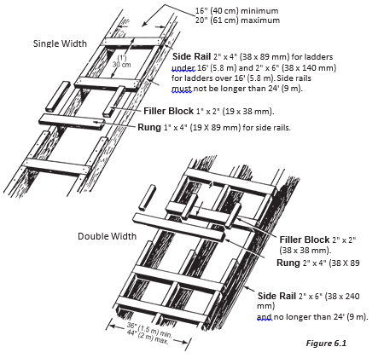
Job-Built Ladders
Wood used for job-built ladders should be straight-grained and free of loose knots, sharp edges, splinters, and shakes.
The ladder should not be longer than 24 feet in working length.
Job-built ladders should be inspected every day and, if defective, repaired immediately or taken out of service and destroyed.
Notes:
Discuss key points for use of job-built ladders.

Slide 99
Ladder Use #1
Check ladder for defects before use.
Clear scrap and material away from the base and top of ladder.
Secure the top and base against movement.
Set the ladder on a firm, level surface. On soft, uncompacted or rough soil, use a mud sill.
Notes:
The next three slides emphasize key points for ladder use.

Slide 100
Ladder Use #2
Make sure that rails on ladders extend at least 3 feet above the landing. This allows for secure grip while stepping on or off.
A ladder used as a regular means of access must:
  Extend 3 feet above the landing or floor.
  Have a clear toe space of at least 10 inches behind every rung.
  Have sufficient clearance from obstructions on the climbing side.
  Be located so that an adequate landing area is clear of obstructions at the top and bottom.
  Be secured at the top and bottom to prevent movement.
Notes:
Key points for ladder use (slide 2).

Slide 101
Ladder Use #3
Set straight or extension ladders one foot out for every 4 feet up, depending on length of ladder.
Before setting up ladders, always check for overhead power lines.
Do not position ladders against flexible or moveable surfaces.
Notes:
Key points for ladder use (slide 3).
ADDITIONAL POINTS IN STUDENT TEXT:
Always face the ladder when climbing up or down and while working from it.
Maintain 3- point contact when climbing up or down. That means two hands and one foot or two feet and one hand on the ladder at all time.
Keep your center of gravity between the side rails. Your belt buckle should never be outside the side rails.
When climbing up or down, do not carry tools or materials in your hands. Use a hoist rope instead.
Keep boots clean of mud, grease, or any slippery materials which could cause loss of footing.
Never erect ladders on boxes, carts, tables, or other unstable surfaces.
Never use ladders horizontally as scaffolds planks, runaways, or for any other purpose for which they have not been designed.
Stand no higher than the third or fourth rung from the top. Maintain knee contact for balance.
Do not splice short ladders together to make a long ladder. The side rails will not be strong enough for the extra loads.
Do not use ladders for bracing. They are not designed for this type of loading.
Do not set up ladders in doorways, passageways, driveways, or any other location where they can be struck or knocked over.
Never rest a ladder on its rungs. Ladders must rest on their side rails.
To erect long, awkward or heavy ladders, get help to avoid injury from overexertion.

Slide 102
Ladder Inspection and Maintenance
Ladders shall be inspected by a competent person for visible defects on a periodic basis and after any occurrence that could affect their safe use.
Ladders should only be repaired by qualified persons.
Defective ladders must be taken out of service and both locked and tagged for repair or scrapped.
Inspect ladders for structural rigidity.
Inspect non-skid feet for wear, imbedded material, and proper pivot action on swivel feet.
Notes:
Discuss requirements for ladder inspection and maintenance (Slide 1 of 2).

Slide 103
Ladder Inspection and Maintenance (continued)
Replace frayed or worn ropes on extension ladders with types and sizes equal to manufacturer’s original rope.
Check aluminum ladders for dents and bends in side rails, steps, and rungs.
Do not use metal pipe to replace rungs.
Check wooden ladders for cracks, slits, and rot.
Check all ladders for grease, oil, caulking, imbedded stone and metal, or other materials the at could make them unsafe.
Notes:
Discuss requirements for ladder inspection and maintenance (Slide 2 of 2).

Slide 104
Ladder Safety Checklist
To prevent falls from ladders, make sure you have the following controls in place:
Use only ladders that are in good condition and designed to handle the climbing job that needs to be done.
Train employees on proper ladder use.
Make proper ladder use a performance requirement for the job.
Require employees to complete a ladder inspection before each use.
Notes:
This is a brief “big-picture” ladder safety checklist.

Slide 105
Criteria for Ladder Purchase and Care
Check OSHA standards for the type of ladder you are using.
Use only Underwriter’s Laboratory approved ladders (will have the UL seal).
Protect wood ladders with a clear sealer, such as varnish, shellac, linseed oil or wood preservative because paint can hide defects.
Notes:
Discuss items on slide related to ladder purchase and care.

Slide 106
Hands-on Skills
Skill Assessment #5 - Using the proper steps to set up and use a ladder.
  Students must properly set up and demonstrate proper ladder climbing techniques
  Climb both up and down.
  Use 3 points of contact.
  Demonstrate the 4-foot rule.
Notes:
Document the successful completion of the skill assessment using the forms provided.

Slide 107
MODULE 4 NOW YOU KNOW…
Fixed ladders includes a body harness, carabiner, carrier rail, and safety sleeve.
Stairways and ladders are major sources of injuries and fatalities.
Employers must provide a stairway or ladder at all worker points of access, 19in or more.
Use ladders only for their designed purpose.
Do not move, shift or extend ladders while in use.
Ladders should only be repaired by qualified persons.
Maintain 3- point contact when climbing up or down.
Use only Underwriter’s Laboratory approved ladders (will have the UL seal).
Notes:
● Ladder safety devices or systems are used to climb fixed ladders includes a body harness, carabiner, carrier rail, and safety sleeve.
● Stairways and ladders are major sources of injuries and fatalities among construction workers.
● When there is a break in elevation of 19 inches or more and no ramp, runway, embankment or personnel hoist is available, employers. must provide a stairway or ladder at all worker points of access.
● Use ladders only for their designed purpose.
● Keep areas clear around the top and bottom of ladders. Do not move, shift or extend ladders while in use.
● Ladders should only be repaired by qualified persons.
● Maintain 3- point contact when climbing up or down.
● Use only Underwriter’s Laboratory approved ladders (will have the UL seal).

Slide 108
APPENDIX A: CASE STUDY #1
When removing old shingles at the peak of a pitched roof of a residential building, a roofing helper struck with his body the newly stacked bundle of shingles located next to him.
The victim chased the shingles to stop them from falling off the roof, lost his balance, and fell 16.5 feet.
Notes:
(Excerpt¹ from FACE website (Case 9816) with partial modifications in the scenario)
On July 18, 1998, a 25-year-old male roofer helper (the victim) died after falling 16.5 feet from a roof to a concrete basement way while trying to stop a bundle of shingles from sliding off a roof edge.
The company owner had decided to replace the shingles on the roof of his residence and his adjacent garage. He and his eldest son, the company co-owner, had instructed his youngest son, 25 years of age, to ask two of his friends to help him remove the old fiberglass shingles from both structures. A 25-year-old (the victim) and a 16- year-old agreed to help with the job.
On the first day of the job, all five workers carried bundles of new shingles to the peak of the residence’s 5.5:12 (5.5 inches of rise for every 12 inches of width) pitched roof. The shingles were stacked 3 or 4 bundles high along the roof’s peak. The 25- and 16-year-old workers then took shovels up the ladder to the residence’s roof while the father and two sons climbed a ladder to the garage roof to determine what materials would be needed to complete the garage roof.
As the two men began removing the shingles the victim contacted a stack of shingles with part of his body, or the shovel, and a bundle began to slide down the back side of the roof. The victim began to chase the bundle in an attempt to retrieve it. None of the other workers saw the victim fall off the roof, but he apparently lost his balance and fell 16.5 feet from the roof to a concrete driveway below, striking his head on the concrete.
…The co-owner stated that approximately 0.5 hours before the incident, he knocked a whole stack of shingles off the back side of the roof, damaging the eaves. He stated that at that time he instructed the workers to let the shingles go if the materials began to slide down the roof.

Slide 109
Case Study #1 Discussion
Questions
  What unsafe action(s) caused the incident?
  What action(s) can be taken to avoid the incident?
Notes:
Assumptions
Activity: Removing old shingles (fiberglass shingles) and installing new shingles (3-tab asphalt composite roofing shingles (1’*3’*4”))
Location: Peak of the pitched roof of a residence. (Slope: 24 degree above horizontal)
Work expectation: Doing a good, safe job in a reasonable time
Scenario: When removing old shingles, the worker struck with his body the newly stacked bundle of shingles next to him at the peak of the roof. He then chased the bundle to stop the shingles from falling, lost his balance, and fell 16.5 feet.
Questions
Ask what unsafe action(s) caused the incident. Items to discuss:
Safety issues of the work on open-sided roof edges
Ask what action(s) can be taken to avoid the incident. (Which is the correct, or safe, way of performing the task? The answer is C.)
Items to discuss:
Slide-guard – Can only be used up to 25 feet when several site requirements are met (1926.500 Appendix E).
Guardrails – Each employee on a steep roof with unprotected sides and edges 6 feet (1.8 m) or more above lower levels shall be protected from falling by guardrail systems with toeboards, safety net systems, or Personal Fall Arrest Systems (PFAS) (1926.501(b)(11)). Practically, guardrails are not intended for steep, pitched roofs.
Not all the roof edges in Option B are protected.
Harness and life line – Should be able to withstand 5,000 pounds of force.
Make sure the harness fits and is not defective when using Personal Fall Arrest Systems (PFAS).
Always stay connected/tie off.
Ensure that all anchor points are safe.

Slide 110
APPENDIX A: CASE STUDY #2
Laborer Killed in Fall Through Roof
A 40-year-old laborer/helper died when he fell through an opening in a warehouse roof.
He fell approximately 27 feet to the floor below.
Notes:
The employer in this incident was a roofing contractor that had been in operation for 22 years and employed 12 workers. The employer had a written safety policy and safety program. General written safety rules were reviewed with all employees upon hire. Training was accomplished on the job. Tailgate safety meetings were conducted by the job foreman when necessary. Safety meetings were held prior to the start of each job to discuss the safety hazards associated with that job. The victim had worked for the employer for 12 years and had 15 years prior experience. This was the first fatality experienced by the employer.
The employer had been contracted to replace the fiberglass insulation and corrugated metal roof panels on an 80-foot-wide by 140-foot-long church roof with a 1:12 pitch. A five-man crew (general superintendent, foreman, roofer, and 2 sheet metal mechanics) was sent to the site to complete the task. The men were to remove 36-inch wide sections of metal roof panels and insulation at a time and replace them with new panels and insulation. This required removing three, 3-foot-wide by 6-foot-long panels and replacing them with the new 20-inch-wide by 16- foot-long panels.
To remove the panels, the roofer would hold the end of the old panels up and pull them back as the sheet metal mechanics removed the screws that attached the panels to the roof joists. Because the men were installing panels smaller in width than those being replaced, open space with exposed insulation existed around the work area.
At 3:00 p.m. on the second day at the site, work had progressed to a point where the men had completed work on an area measuring approximately 25 feet by 115 feet. As the victim finished removing the screws holding the next piece of old panel, he stood up and stepped backward into an opening approximately 3 feet by 6 feet that was covered only with fiberglass insulation, and fell 30 feet to the hardwood floor inside the church, striking his head.

Slide 111
Case Study #2 Discussion
Questions
  What unsafe action(s) caused the incident?
  What action(s) can be taken to avoid the incident?
Notes:
Assumptions
Activity: Removing screws of the old metal roof panels. (panel type: corrugated metal panel; Old panel size: 3 feet by 6 feet; New panel size: 20 inches by 16 feet)
Location: Roof deck of a church (Roof size: 80 feet by 140 feet, with a 1:12 pitch (angle=4.76 degrees))
Work expectation: Doing a good safe job in a reasonable amount of time
Scenario: After removing the screws that attached the old metal roof panels to the roof joists, a sheet metal mechanic stood up, stepped backward and fell 30 feet through a roof opening covered only with fiberglass insulation. The worker struck his head on the floor and died
Questions
Ask what unsafe action(s) caused the incident. Items to be discussed:
Safety issues when removing old metal roof panels and installing new ones
Safety issues for roof openings
Ask what action(s) can be taken to avoid the incident. (Which is the correct, or safe, way of performing the task? The answer is C)
Items to be discussed:
Guardrails and its suitability - notice that slide guard is not an acceptable means of fall protection here!
Plywood that is (1) thick enough and (2) marked with the word “HOLE” for securely covering up roof holes and openings (The plywood should have a safety factor of 2 based on OSHA standards).
Don’t sit or walk on skylights or other openings.
Harness and lifeline - should be able to withstand 5,000 pounds of force.
Make sure the harness fits and is not defective when using Personal Fall Arrest Systems (PFAS).
Always stay connected/tied off.
Ensure that all anchor points are safe.

Slide 112
FALL PROTECTION/FALL PREVENTION

Slide 113
MODULE 5: INTRODUCTION TO ADULT LEARNING
Overview
Conditions needed for successful learning
Adult learning theory
Considerations for working with adult learners
Activity-based learning activities
Giving objective feedback
Notes:
Upon completion of this module you will be able to explain:
Describe the conditions for successful learning
Describe two key elements of adult learning theory
Discuss the seven considerations when working with adult learners
Give examples of at least five activity-based learning activities
Explain how to give objective feedback

Slide 114
Robert Gagne’s Conditions Of Learning
Gagne identifies five major categories of learning:
Verbal information
Intellectual skills
Cognitive strategies
Motor skills
Attitudes
Notes:
In order to present the successful training programs, particularly to diverse audiences with different training needs, trainers need to be able to adapt course material.
This training introduces participants to the elements of instructional design, Gagne’s conditions of learning, and elements of adult learning theory. .
Personal requirements include good communication and reflection skills, flexibility; and, they should show respect and acceptance towards people with and without special language needs.

Slide 115
Conditions for Successful Learning
Gaining attention (reception)
Informing learners of objectives (direction or expectancy)
Recall (retrieval)
Presenting new material (content)
Providing learning guidance (semantic encoding)
Eliciting performance (responding)
Providing feedback (reinforcement)
Assessing performance (retrieval/evaluation)
Retention and transfer (closure/generalization)
Notes:
Gagne states that different internal and cognitive conditions are necessary for learning. For example, if cognitive strategies are to be learned, there must be a chance to practice developing new solutions to problems; to learn new attitudes, the learner must be exposed to a credible role model or persuasive arguments.
The following examples for the nine conditions of learning can be changed to focus on examples relative to the training being developed or delivered
1. Gain attention – show variety of Personal Fall Arrest System (PFAS).
2. Identify objective – pose question: “What is a full body harness?
3. Recall prior learning – review definitions of PFAS.
4. Presenting new material – give definition of safety nets.
5. Guide learning–show actual example or photo of safety nets.
6. Elicit performance – ask participants to create a Level B ensemble for a given task.
7. Provide feedback – check examples as correct/incorrect.
8. Assess performance– provide scores and remediation.
9. Enhance retention/transfer – show pictures of PPE and ask participants to identify where and how it should be used.

Slide 116
Key Elements of Adult Learning Theory
Key Element One:
Adults learn best by doing.
Participants should be engaged in learning and encouraged to be self-directed.
Take advantage of participants’ experience and previous experiences.
Learning activities have more direct relevance if they relate directly to learners’ circumstances.
Key Element Two:
Take individual learning styles for each new element of learning and provide the information in at least two different ways and three different times.
Use varying approaches and circumstances.
Notes:
Review key elements of adult learning theory:
Please encourage participants to engage their students by conducting reviews of the information that was just covered.
Additional Tips Related to Adult Learning
Establish a climate conducive to learning.
This varies based on what type of training will be given, the expected audience, the training venue, and many other items.
Design training to be approximately 35% presentation and 65% application and feedback.

Slide 117
Considerations for Adult Learners
Realistic goals and objectives
Control over the what, who, how, why, when, and where of learning
Direct, concrete experiences to apply the learning in real work
Support from peers to reduce the fear of judgment during learning
Feedback
Small group activities
Prior knowledge and experience
Notes:
Discuss considerations on slide.
Adults need to participate in small group activities during the learning to move them beyond understanding to:
o Application
o Analysis
o Synthesis
o Evaluation
Small group activities provide an opportunity to share, reflect, and generalize their learning experiences.
Adult learners come to learning with a wide range of previous:
o Experiences
o Knowledge
o Self Direction
o Interests
o Competencies
This diversity must be accommodated in the professional development planning.

Slide 118
Activity-Based Learning (AbL)
Process that involves participants in:
DOING, THINKING AND APPLYING
Includes range of activities such as:
  interactive lecture
  hands-on
  class discussion
  small group exercises
Notes:
Activity-based learning is a process that involves participants in doing things, thinking about what they are doing and applying what they have learned to new situations. The process includes a range of activities such as interactive lecture, hands-on, class discussion, small group exercises, videotapes, case studies, role plays, reflective exercises, panel of experts, brainstorming, guest speakers, and demonstration.

Slide 119
The Interactive Lecture
Hands-on
Class Discussion
Small Group Discussions
Videotapes
Case Studies
Role-playing
Reflective Exercises
Panels of Experts
Brainstorming
Guest Speakers
Notes:
The use of interactive lecture allows the opportunities for the instructor to present factual material in a direct, logical manner while relating the participants’ background and experience to course topics, stimulating critical and creative thinking and providing examples and stories.
Hands-on
The use of hands-on allows opportunities for the participant to show the instructor how well he/she can perform a particular task or procedure.
Class Discussion
The use of class discussion after a learning activity allows opportunities for the participant to gather ideas, analyze issues and /or generate solutions or recommendations.
Small Group Discussions
Small group exercises usually consist of participants from different backgrounds and experiences working toward a common goal. For example, a small group may analyze a job site accident, determine what caused it and establish guidelines to prevent it from happening.
Videotapes
The use of videotapes is an entertaining way of teaching content and keeping the participants’ attention while stimulating discussion.
Case Studies
The use of case studies allows opportunities for the participants to develop analytical skills, explore complex issues and apply new knowledge and skills.
Role-playing
The use of role-playing allows opportunities for the participants to assume the role of others and thus appreciate another point of view, explore complex issues and rehearse skills before applying them in real situations.
Reflective Exercises
The use of reflective exercises allows opportunities for the participants to think for themselves without being influenced by others and then share their individual thoughts with others.
Panels of Experts
The use of experts allows opportunities for the participants to become aware of different opinions and then generate solutions or recommendations based on further reflection and discussion.
Brainstorming
The use of brainstorming allows opportunities for the participants to think creatively, participate fully, draw on their background and trigger other ideas.
Guest Speakers
The use of guest speakers allows opportunities for the participants to personalize the topics and break down stereotypes.

Slide 120
Demonstration
Giving objective behavioral feedback
Feedback on behavior rather the person
Feedback on observations rather than inferences
Description rather than judgment
Feedback on behavior to specific situations
Feedback on the sharing of ideas and information

Slide 121
MODULE 5: NOW YOU KNOW...
Robert Gagne’s conditions of learning theories
Five major categories of learning
Nine conditions that directly relate to successful learning
Adults learn best by doing
Establish climate conducive to learning
Adult learners need direct, concrete experiences to apply the learning in real work
Activity-based learning techniques
Importance of hands-on skill assessments
Important aspects of giving feedback
Notes:
•Robert Gagne’s Conditions of Learning stipulates there are several different types or levels of learning with each requiring different types of instruction
•The five major categories of learning are: Verbal information, Intellectual skills, Cognitive strategies, Motor skills, and Attitudes
•There are nine conditions that directly relate to successful learning: Gaining attention, Informing learners of objectives, Recall, Presenting new material, Providing learning guidance, Eliciting performance, Providing feedback, Assessing performance, Retention and transfer
•Adults learn best by doing
•Establish a climate conducive to learning
•Adult learners need direct, concrete experiences to apply the learning in real work
•Activity-based learning is a process that involves participants in doing things, thinking about what they are doing and applying what they have learned to new situations.
•The use of hands-on allows opportunities for the participant to show the instructor how well he/she can perform a task or procedure
•One of the most important aspects of giving feedback is keeping it objective and behavioral.

Slide 122
MODULE 6: TRAINING REQUIREMENTS
Overview
Greenville Technical College training standards and expectations
Required paperwork for course credit

Slide 123
Course Material
Instructors are required to return the following course paperwork
  Instructor Verification Sheet
  Class Roster
  Student Training Attendance Confirmation
  Training Course Evaluation
  Examination Answer Sheets
  Hands-On Skills Assessments
Notes:
Explain the Greenville Technical College course documentation requirements.

Slide 124
MODULE 6: NOW YOU KNOW…
Course Folder Contents
  Instructor Verification Sheet
  Class Roster
  Student Training Attendance Confirmation
  Training Course Evaluation (if scanned, someone other than instructor should open envelope)
  Examination Answer Sheets
  Hands-On Skills Assessments
Mail to: Grant Program Manager Nikeema Swaby
Mail Stop 1121, PO Box 5616
Greenville, SC, 29606
Scan to: nikeema.swaby@gvltec.edu
Greenville Technical College Continuing Education Unit (CEU) Course Certificates will be mailed two weeks after receiving all course documents.
Notes:
Ensure all students know the timeframe for certificate mailing. Review the course folder contents again to make sure everyone understands their responsibilities.

