Slide 1
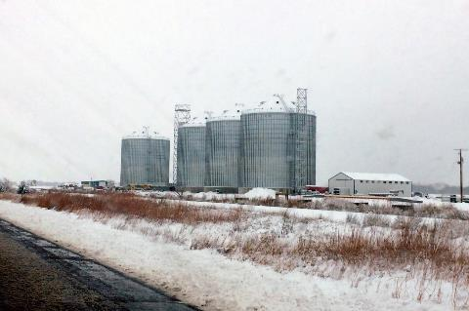
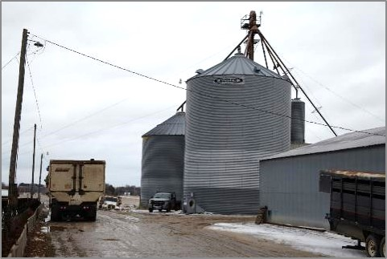
Winter & Cold Weather Hazards

Slide 2
Disclaimers
This material was produced under grant number SH-37173-SH1 from the Occupational Safety and Health Administration, U. S. Department of Labor.
It does not necessarily reflect the views or policies of the U. S. Department of Labor, nor does mention of trade names, commercial products, or organizations imply endorsement by the U. S. Government.
Notes:
Explain – GHSC received funding from OSHA. In order to comply with the grant we do need them to sign in and need to collect the following information:
Supervisor or worker. This information is for statistical purposes to show the types of population receiving training.
Employer. This is to establish an employer/employee relationship as covered under OSHA. Volunteer rescue workers who may be attending should list their employer; not the volunteer rescue squad. Farmers should list the registered business name of their farm. Farm employees should provide the business name listed on their paycheck.
OSHA does NOT contact the employer.
GHSC may contact the attendee or employer for follow-up evaluation in compliance with grant requirements.

Slide 3
Machinery, Equipment, Vehicle Use

Slide 4
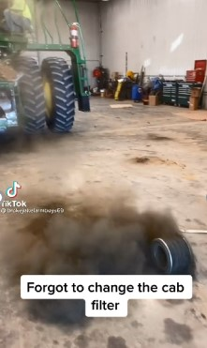
Preventive Maintenance
Planned maintenance better than unplanned maintenance.
Prevents cold weather breakdowns
Maintenance Schedules
Daily checks
Different in cold?
Notes:
Animated slide – Play TICTOK video first – forgot PM. Then Click once for each bullet point.
Planned maintenance will keep vehicles & equipment ready for winter weather.
A cold weather breakdown can be make the maintenance or repair more difficult and more stressful.
Follow the manufacturer's maintenance schedule – this also usually protects your warranty. Make note if there are differences for cold weather.
Do basic equipment checks before each use – tires, wipers, lights, gas, oil, etc.
Clean the equipment after use and after any spills to keep corrosives off, and enhance safety in entering/exiting.

Slide 5
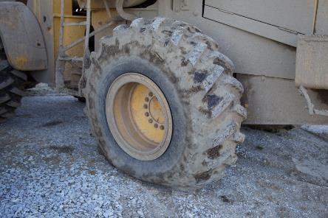
PM Checklist
Typical Checks
Tires
Fuels
Lubricants
Filters
Seals
Worn Parts
Guards!
Notes:
Agricultural & other equipment generally has guards and other safety features. Make sure they are in place, in good repair, and functional.
DO NOT remove guards except for maintenance and make sure they are put back on.

Slide 6
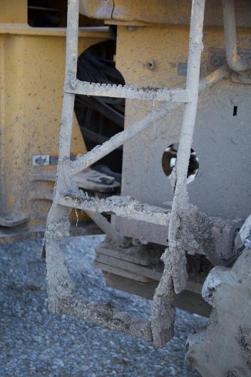
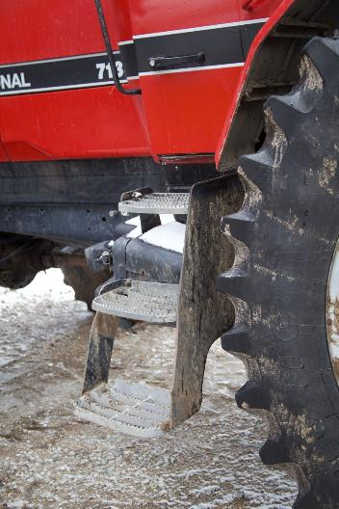
Purchasing Decisions
Notes:
When making purchasing decisions – consider safety features.
For example, the right photo shows a better type of step for equipment ingress and egress. The tread is deeper and there is a safely handle.

Slide 7
Other considerations
Add insulation or covers over outdoor components
Prevent condensation
Inspect for uninvited guests
Batteries – Follow jump starting safety procedures
Warm up machinery before use
Test run regularly
Keep equipment clean
Avoid using open flames to thaw parts
Notes:
Develop a way to thaw parts when frozen that does not use open flames. Use insulation/covers to help protect equipment.
As mentioned previously, hydraulic fluid gels when cold. Warming machinery up before use, helps it convert back to the liquid state and flow as intended.
Machinery should be started /test run regularly to keep batteries from dying, gears lubricated, etc.
Don't run machinery in closed spaces. Have proper ventilation and/or do it outside if weather permits.

Slide 8
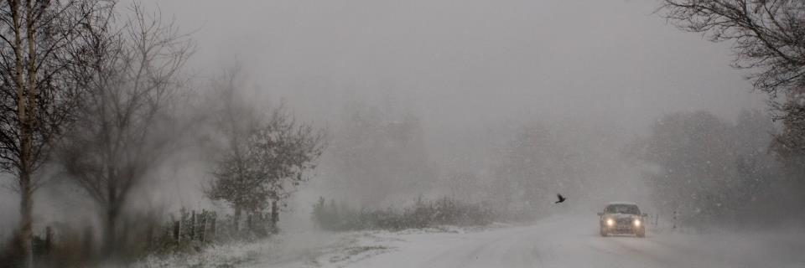
Winter Driving
Train workers before use of company vehicles.
Inspect vehicle –
Brakes, cooling, electrical, exhaust, tires, lights, wipers, defroster
Emergency kit
Know what to do if stranded
Full tank of gas
Practice driving
Do NOT steer into skid with ABS system
Do NOT use cruise control
Allow extra time & distance
Notes:
In 2019 - 440 fatal crashes, and an estimated 33,000 injury crashes that occurred in wintry conditions. NHTSA
Employers – train workers before using company vehicles in winter driving conditions. Know company policy & insurance.
SEE APPENDIX #3 FOR VEHICLE CHECKLIST & INFORMATION.
Practice cold weather driving! During daylight, rehearse maneuvers slowly on the ice or snow in an empty lot
Know type of brakes & what to do: stomp on antilock brakes, pump non-antilock brakes. ABS do NOT steer into skid.
SLOW DOWN & INCREASE DISTANCE between cars. Stopping distances are longer on water, ice and snow.
Don’t idle for a long time with the windows up or in an enclosed space
STAY SAFE. Avoid fatigue. Get plenty of rest before driving. Take breaks at least every 3 hours and/or switch drivers. Watch for pedestrians, stalled/parked vehicles. No alcohol or drug use. Hands-free cell phone use. No eating.
Keep emergency kit in vehicle : Cellphone or two-way radio, windshield ice scraper, snow brush, flashlight & extra batteries, shovel, tow chain, traction aids (bag of sand, cat litter), emergency flares, jumper cables, snacks, water, road maps, blankets, change of clothes
If you are stranded in a vehicle, stay in the vehicle. Call for emergency assistance. Notify supervisor of situation. Only leave vehicle if help is visible within 100 yards. You may become disoriented and get lost in blowing and drifting snow! Display a trouble sign by raising the hood. Turn on the vehicle’s engine for about 10 minutes each hour and run the heat to keep warm. Turn on the vehicle’s dome light when the vehicle is running as an additional signal.
Beware of carbon monoxide poisoning. Keep exhaust pipe clear of snow & open a downwind window slightly for ventilation.
Watch for signs of frostbite & hypothermia. Do minor exercises to maintain good blood circulation. Clap hands & move arms and legs occasionally. Try not to stay in one position for too long. Stay awake – makes you less vulnerable to cold-related health problems. Use blankets, newspapers, maps, and even the removable car mats for added insulation. Avoid overexertion since cold weather puts an added strain on the heart. Shoveling snow or pushing a vehicle can bring on a heart attack or make other medical conditions worse.
https://www.nhtsa.gov/winter-driving-tips ; https://www.osha.gov/sites/default/files/publications/SafeDriving.pdf ; https://www.osha.gov/winter-weather/hazards ; https://ohsonline.com/articles/2017/12/05/winter-driving-safety.aspx?m=1#:~:text=During%20daylight%2C%20rehearse%20maneuver%20slowly,water%2Dcovered%20ice%20and%20ice.

Slide 9
Cold Stress
4 Types of Cold Stress

Slide 10
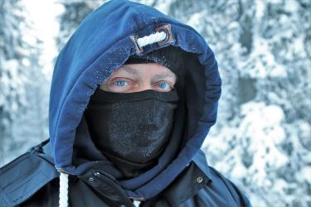
Cold Stress – 4 Factors
A drop in skin temperature resulting in a decrease in internal body temperatures.
Four Contributing Factors
Cold temperatures
High or cold wind
Dampness
Cold water
When the body cannot warm itself cold related illness and injury may occur.
Notes:
Cold air, water, and snow draw heat from the body. Body works harder to maintain its core temperature
Cold stress is defined as a drop in skin temperature due to persistent cold temperatures that results in a decrease in internal body temperatures.
Cold stress occurs by driving down the skin temperature, and eventually the internal body temperature. When the body is unable to warm itself, serious cold-related illnesses and injuries may occur, and permanent tissue damage and death may result.
Four factors contribute to cold stress: cold temperatures, high or cold wind, dampness and cold water. A cold environment forces the body to work harder to maintain its core temperature.
Cold air, water, and snow all draw heat from the body. Body works harder to maintain its core temperature.
Hhile it is obvious that below freezing conditions combined with inadequate clothing could bring about cold stress, it is important to understand that it can also be brought about by temperatures in the 50's coupled with rain and/or wind.
Among the most common types of cold stress are trench foot (exposure of foot to prolonged cold/wet conditions), frostbite (damage from the freezing of skin and tissue), and hypothermia (body temperature drops below 95 degrees Fahrenheit).
Picture Pixabay – Pasja1000 Image by <a href="https://pixabay.com/users/pasja1000-6355831/?utm_source=link-attribution&amp;utm_medium=referral&amp;utm_campaign=image&amp;utm_content=3951279">pasja1000</a> from <a href="https://pixabay.com/?utm_source=link-attribution&amp;utm_medium=referral&amp;utm_campaign=image&amp;utm_content=3951279">Pixabay</a>

Slide 11
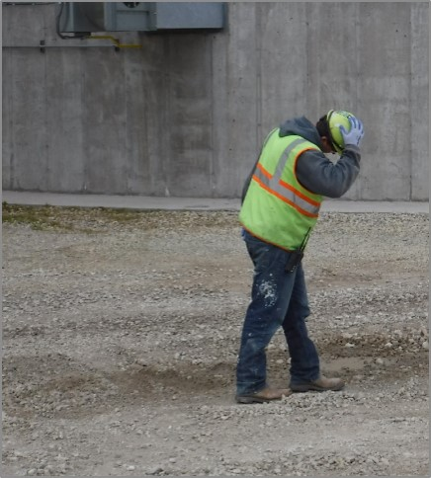
Cold Stress Varies by Region
Cold Stress & its effects vary according to region. Persons unaccustomed to winter weather can experience cold stress when temperatures are in the 50's coupled with rain and/or wind.
Notes:
it is important to understand that it can also be brought about by temperatures in the 50's coupled with rain and/or wind.
"What constitutes cold stress and its effects can vary across different areas of the country. In regions relatively unaccustomed to winter weather, near freezing temperatures are considered factors for cold stress. Whenever temperatures drop decidedly below normal and as wind speed increases, heat can more rapidly leave your body. These weather-related.

Slide 12
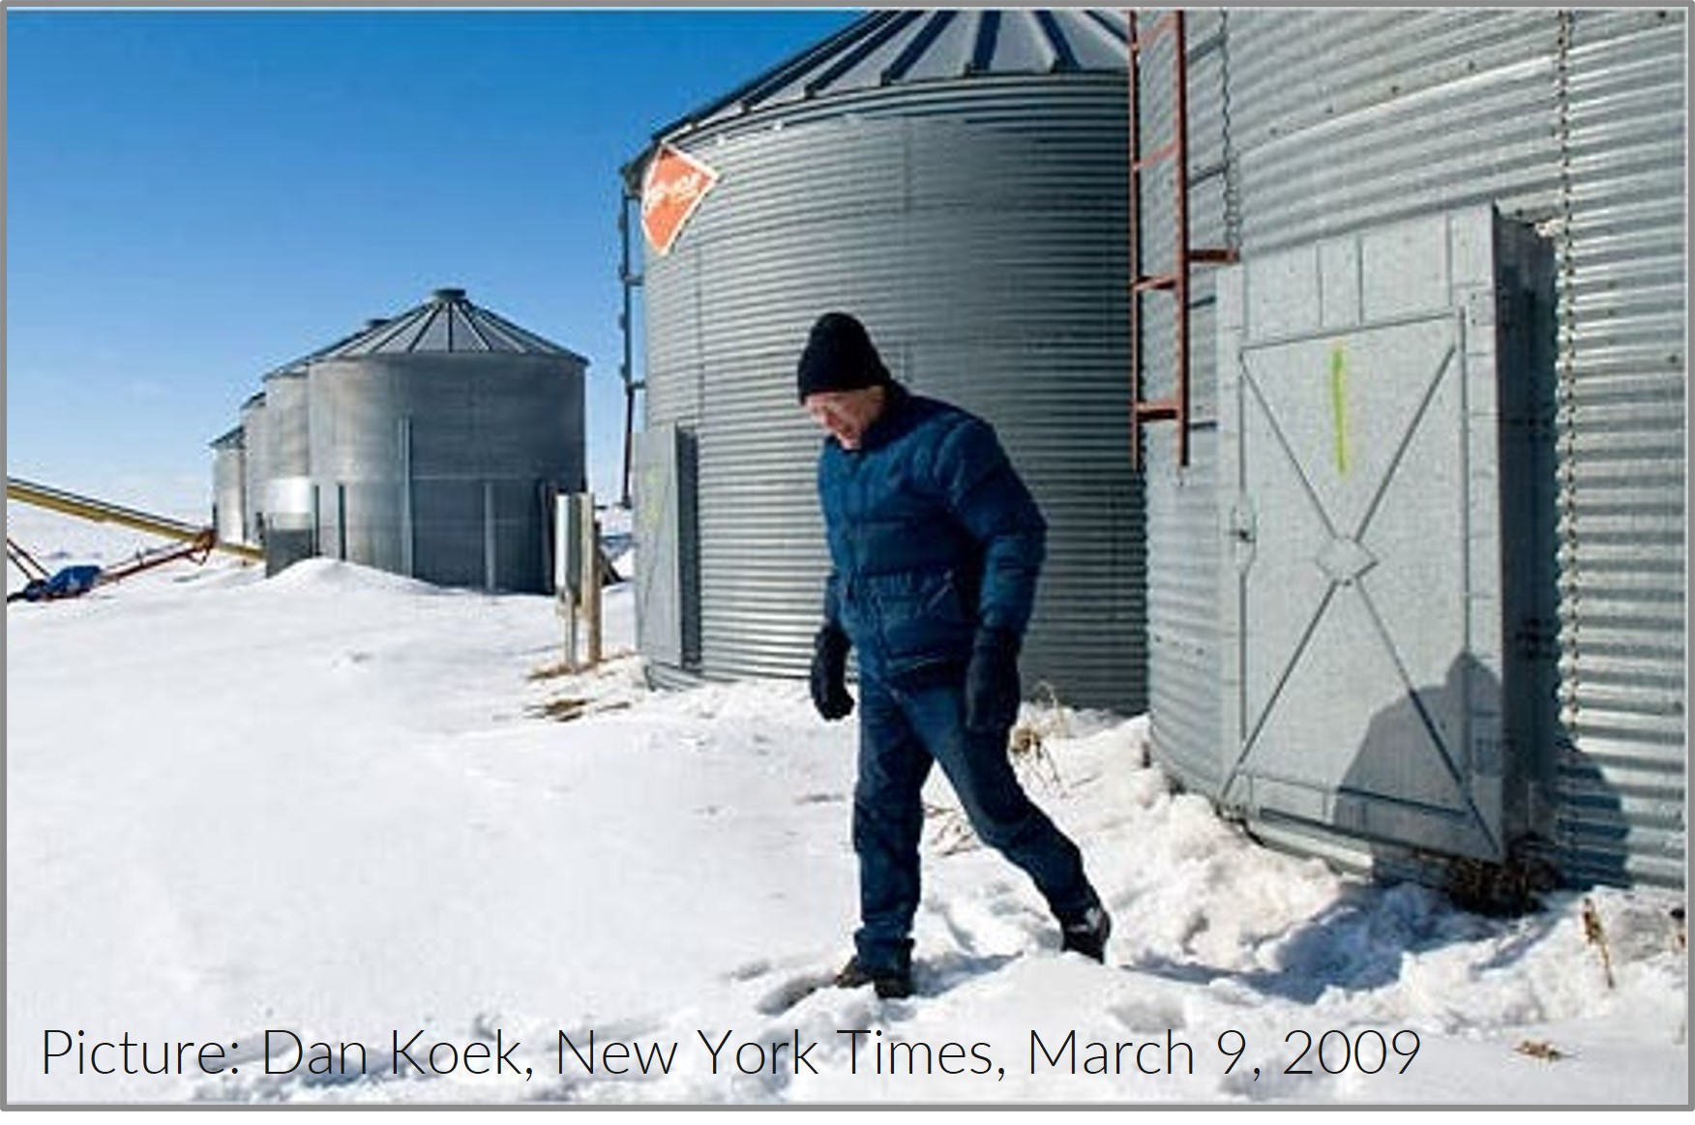
4 Types of Cold Stress
Hypothermia
Frost Bite
Trench Foot
Chilblaines
Picture: Dan Koek, New York Times, March 9, 2009
Use a buddy system. Helps in early detection of cold stress symptoms.
Notes:
4 types of cold stress.
Hypothermia is the most severe, followed by frost bite, trench foot, chilbaines.
Use of a buddy system, can help in early detection of cold stress symptoms as well as provide reinforcement to take breaks, get warm, etc. when working in unfavorable weather conditions.

Slide 13
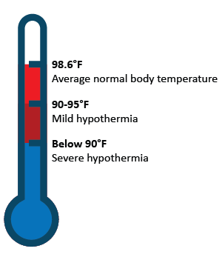
Hypothermia
Hypothermia - abnormally low body temperature. Drops to 95º F or less.
Body uses up stored energy & cannot produce heat.
Prolonged exposure to cold temperatures.
Temps above 40º & chill from water/wind.
Notes:
When exposed to cold temperatures, your body begins to lose heat faster than it can be produced. Prolonged exposure to cold will eventually use up your body’s stored energy. The result is hypothermia, or abnormally low body temperature. A body temperature that is too low affects the brain, making the victim unable to think clearly or move well. This makes hypothermia particularly dangerous because a person may not know it is happening and will not be able to do anything about it. https://www.cdc.gov/niosh/topics/coldstress/coldrelatedillnesses.html
Hypothermia occurs when the normal body temperature (98.6°F) drops to less than 95°F. Hypothermia is most likely at very cold temperatures, but it can occur even at cool temperatures (above 40°F) if a person becomes chilled from rain, sweat, or immersion in cold water.
Hypothermia can occur when you are exposed to cold air, water, wind, or rain. Your body temperature can drop to a low level at temperatures of 50°F (10°C) or higher in wet and windy weather, or if you are in 60°F (16°C) to 70°F (21°C) water. If you have mild hypothermia, home treatment may be enough to bring your body temperature back up to normal.
Most at risk are those with prolonged exposure to cold – working outdoors, homeless, outdoor recreation
Other risk factors:
Elderly or very young – unable to regulate body temperature
People who drink alcohol or use illicit drugs.
Certain medical conditions can affect the body’s ability to maintain an adequate temperature or to feel cold. These conditions include:
hypothyroidism, which occurs when your thyroid gland produces too little hormone
arthritis
dehydration
diabetes
Parkinson’s disease, which is a nervous system disorder that affects movement
https://www.cdc.gov/disasters/winter/staysafe/hypothermia.html#:~:text=What%20is%20hypothermia%3F,leads%20to%20lower%20body%20temperature.

Slide 14
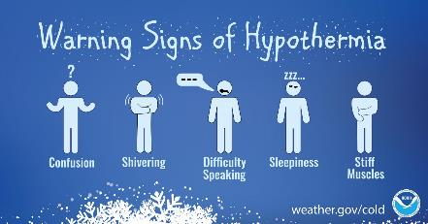
Hypothermia Symptoms
Hypothermia affects the brain. Victim is unable to think clearly or move well.
Late Symptoms
Danger
Person may not recognize it & not be able to do anything about it.
No Shivering
Blue Skin
Dilated Pupils
Slowed Pulse & Breathing
Unconciousness
Notes:
https://www.cdc.gov/niosh/topics/coldstress/coldrelatedillnesses.html
https://www.weather.gov/wrn/infographics_winter
Symptoms of hypothermia can vary depending on how long you have been exposed to the cold temperatures.
Early Symptoms
Shivering
Fatigue – Exhaustion or feeling very tired - Drowsiness
Loss of coordination – Fumbling Hands
Confusion and disorientation - /Slurred Speech, Memory Loss
Late Symptoms
No shivering
Blue skin
Dilated pupils
Slowed pulse and breathing
Loss of consciousness
First Aid - Take the following steps to treat a worker with hypothermia:
Alert the supervisor and request medical assistance.
Move the victim into a warm room or shelter.
Remove their wet clothing.
Warm the center of their body first-chest, neck, head, and groin-using an electric blanket, if available; or use skin-to-skin contact under loose, dry layers of blankets, clothing, towels, or sheets.
Warm beverages may help increase the body temperature, but do not give alcoholic beverages. Do not try to give beverages to an unconscious person.
After their body temperature has increased, keep the victim dry and wrapped in a warm blanket, including the head and neck.
If victim has no pulse, begin cardiopulmonary resuscitation (CPR).

Slide 15

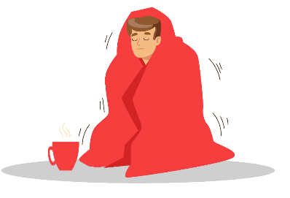



Hypothermia First Aid
If you notice signs of hypothermia
1
Request immediate medical assistance.
A warm beverage can help increase body temperature. Do NOT give alcohol.
2
Move victim to warm room or shelter.
3
Remove wet clothing.
Warm center of body first – chest, neck, head, and groin.
Warm the person up under dry layers of clothing & blankets. Keep them dry & warm.
If victim has no pulse, begin CPR!
4
Notes:
Take the following steps to treat a worker with hypothermia:
Alert the supervisor and request medical assistance.
Move the victim into a warm room or shelter.
Remove their wet clothing.
Warm the center of their body first-chest, neck, head, and groin-using an electric blanket, if available; or use skin-to-skin contact under loose, dry layers of blankets, clothing, towels, or sheets.
Warm beverages may help increase the body temperature, but do not give alcoholic beverages. Do not try to give beverages to an unconscious person.
After their body temperature has increased, keep the victim dry and wrapped in a warm blanket, including the head and neck.
If victim has no pulse, begin cardiopulmonary resuscitation (CPR).

Slide 16

Frostbite
Injury to the body, caused by freezing. Usually tissue damage that affects nose, ears, cheeks, chin, fingers or toes. Can be severe and cause permanent damage.
Symptoms
Reduced blood flow to hands & feet
Numbness
Aching
Tingling or stinging
Bluish or pale, waxy skin
First Aid
Get into warm room as soon as possible.
Do not walk on frostbitten feet or toes, unless necessary.
Immerse affected area in warm (not hot) water or warm area using body heat.
Do not use a heating pad, fireplace, or radiator for warming.
Do not massage the frostbitten area; doing so may cause more damage.
Notes:
https://www.cdc.gov/niosh/topics/coldstress/coldrelatedillnesses.html
https://www.mayoclinic.org/diseases-conditions/frostbite/symptoms-causes/syc-20372656
https://my.clevelandclinic.org/health/diseases/15439-frostbite
https://www.nhs.uk/conditions/frostbite/
https://wikem.org/wiki/Frostbite
https://www.medicalnewstoday.com/articles/166187
https://www.emedicinehealth.com/frostbite/article_em.htm
Pictures: https://wikem.org/wiki/Frostbite

Slide 17
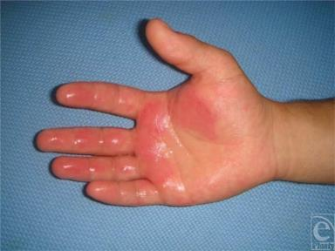
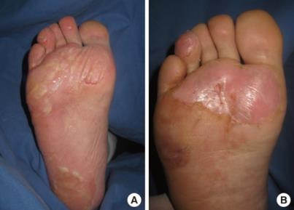
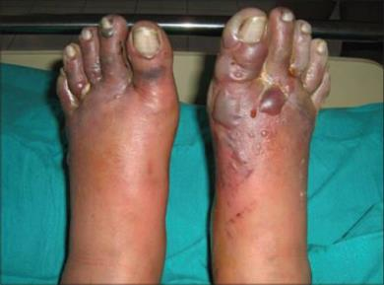
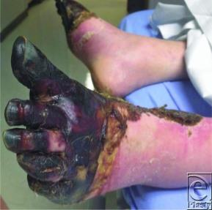
4 Stages of Frostbite
1
2
3
4
Notes:
2 categories of frostbite
Superficial - Experience burning, numbness, tingling, itching, or cold sensations in the affected areas. The regions appear white and frozen, but if pressed on, they retain some resistance.
Deep frostbite - An initial decrease in sensation that is eventually completely lost. Swelling and blood-filled blisters are noted over white or yellowish skin that looks waxy and turns a purplish blue as it rewards. The area is hard, has no resistance when pressed on, and may even appear blackened and dead. Experience significant pain as the areas are rewarmed and blood flow reestablished. A dull continuous ache transforms into a throbbing sensation in 2 to 3 days. This may last weeks to months until final tissue separation is complete.
Four (2) Stages of Frostbite
First-degree (Frostnip)- Partial-skin freezing. This only affects the surface of the skin. Early symptoms are pain and itching. Irritates the skin and pain such as stinging and burning, followed by throbbing. The skin then develops white or yellow patches and may become numb. Due to its surface-level impact, frostnip does not usually cause permanent damage. However, an area of skin with first-degree frostbite may lose sensitivity to heat and cold for a short period.
Second-degree - Full-thickness skin freezing. Blisters but has no major damage. This may cause the skin to freeze and harden but does not affect the deep tissues. After 2 days, purple blisters may develop in areas that froze. These blisters may turn black and become hard, taking 3–4 weeks to heal. A person with second-degree frostbite who has nerve damage might experience numbness, pain, or total loss of sensation in the area. The decreased sense of heat and cold may be permanent. Mild to moderate pain with rewarming. Good prognosis.
Third-degree - Tissue loss involving entire thickness (all layers) of the skin and causes permanent tissue damage. In people with the most severe presentations of frostbite, the damage penetrates deeper, causing deep tissue injury. Extremity feels like a "block of wood" followed by burning, throbbing, shooting pains. Hemorrhagic blisters form and are associated with skin necrosis and blue-gray discoloration. Severe pain with rewarming. Usually a poor prognosis.
Fourth-degree - frostbite occurs when bone and tendon freeze. Muscles, subcutaneous tissues, blood vessels, nerves, bones, and tendons freeze. There is little edema. The skin feels smooth and waxy. Deep, aching joint pain. Skin is mottled with nonblanching cyanosis and formation of deep, dry, black eschar (dead tissue that falls off). Some people may lose the use of an extremity, for example, a foot or a hand. For some people, this is permanent. No pain with rewarming because area is dead. May develop gangrene. Extremely poor prognosis.

Slide 18
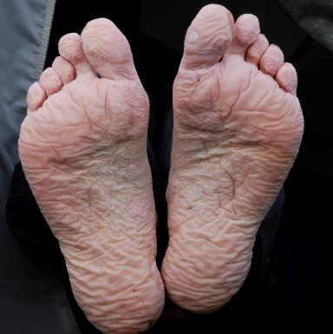
Trench Foot/Immersion
Non-freezing injury of the feet caused by prolonged exposure to wet & cold conditions.
Symptoms
Reddening skin, tingling, pain, swelling, leg cramps, numbness, and blisters.
Notes:
Can be very painful, but is preventable & treatable.
CDC list of symptoms –
Tingling and/or itching sensation, pain, swelling, cold and blotchy skin, numbness, and a prickly or heavy feeling in the foot. T
he foot may be red, dry, and painful after it becomes warm.
Blisters may form, followed by skin and tissue dying and falling off.
In severe cases, untreated trench foot can involve the toes, heel, or entire foot.
Prevention - When possible, air-dry and elevate your feet, and exchange wet shoes and socks for dry ones to help prevent the development of trench foot.

Slide 19
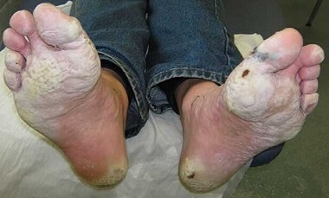
Trench Foot/Immersion First Aid
Remove wet shoes/boots & wet socks
Dry the feet & avoid working on them
Keep affected feet elevated & avoid walking
Get medical attention
Notes:
CDC – Treatment
Treatment for trench foot is similar to the treatment for frostbite. Take the following steps:
Thoroughly clean and dry your feet.
Put on clean, dry socks daily.
Treat the affected part by applying warm packs or soaking in warm water (102° to 110° F) for approximately 5 minutes.
When sleeping or resting, do not wear socks.
Obtain medical assistance as soon as possible.
If you have a foot wound, your foot may be more prone to infection. Check your feet at least once a day for infections or worsening of symptoms.

Slide 20
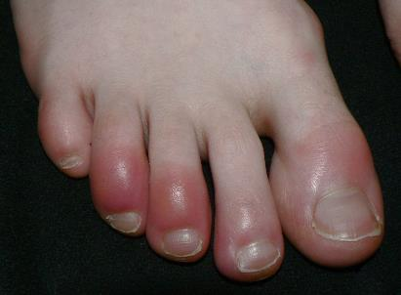
Chilblains
Painful inflammation of small blood vessels caused by repeated exposure to above freezing cold air. Usually affects toes, fingers, cheeks, ears. Returns with additional exposure.
Wikimedia-Wintertenen
Notes:
Usually affects fingers, toes, cheeks, ears. Returns with additional exposure.
Chilblains are caused by the repeated exposure of skin to temperatures just above freezing to as high as 60 degrees F. The cold exposure causes damage (painful inflammation) to the capillary beds (groups of small blood vessels) in the skin. This damage is permanent and the redness and itching will return with additional exposure. Also known as pernio.
Symptoms of chilblains include:
Small, itchy red patches on the skin – often feet or hands
Possible blistering or skin ulcers in sever cases
Inflammation (swelling of the skin)
Burning sensation on your skin
Changes in skin color from red to dark blue accompanied by pain.
First Aid - Workers suffering from chilblains should:
Avoid scratching
Slowly warm the skin
Use corticosteroid creams to relieve itching and swelling
Keep blisters and ulcers clean and covered
https://www.cdc.gov/niosh/topics/coldstress/coldrelatedillnesses.html
https://www.mayoclinic.org/diseases-conditions/chilblains/symptoms-causes/syc-20351097#:~:text=Chilblains%20(CHILL%2Dblayns)%20are,on%20your%20hands%20and%20feet.
https://www.healthdirect.gov.au/chilblains
https://www.nhs.uk/conditions/chilblains/

Slide 21
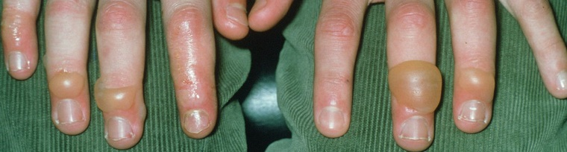
Chilblains Symptoms & First Aid
Symptoms
First Aid
Itchy red patches
Swelling, blistering
Burning sensation
Skin color changes
Red to dark blue
Avoid scratching
Slowly warm skin
Corticosteroid creams
Keep blisters/ulcers clean & covered
Healthdirect.gov.au
Notes:
Usually affects fingers, toes, cheeks, ears. Returns with additional exposure.
Chilblains are caused by the repeated exposure of skin to temperatures just above freezing to as high as 60 degrees F. The cold exposure causes damage (painful inflammation) to the capillary beds (groups of small blood vessels) in the skin. This damage is permanent and the redness and itching will return with additional exposure. Also known as pernio.
Symptoms of chilblains include:
Small, itchy red patches on the skin – often feet or hands
Possible blistering or skin ulcers in sever cases
Inflammation (swelling of the skin)
Burning sensation on your skin
Changes in skin color from red to dark blue accompanied by pain.
First Aid - Workers suffering from chilblains should:
Avoid scratching
Slowly warm the skin
Use corticosteroid creams to relieve itching and swelling – these can be prescription or oer the counter
Keep blisters and ulcers clean and covered
https://www.cdc.gov/niosh/topics/coldstress/coldrelatedillnesses.html
https://www.mayoclinic.org/diseases-conditions/chilblains/symptoms-causes/syc-20351097#:~:text=Chilblains%20(CHILL%2Dblayns)%20are,on%20your%20hands%20and%20feet.
https://www.healthdirect.gov.au/chilblains
https://www.nhs.uk/conditions/chilblains/

Slide 22

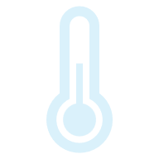
Wind Chill
Body's rate of heat loss from combined effect of low air temperature & wind speed.
Single value accounts for air temperature & wind speed
Example: Air temp 40°F, wind speed 35 mph = wind chill temperature of 28°F
Actual effect of environmental cold on exposed skin
Both air temperature & wind speed affect how cold a person feels.
Notes:
Outdoor workers exposed to cold and windy conditions are at risk of cold stress. Both air temperature and wind speed affect how cold they feel.
Wind Chill is the term used to describe the rate of heat loss from the human body, resulting from the combined effect of low air temperature and wind speed.
The Wind Chill temperature is a single value that takes both air temperature and wind speed into account.
For example, when the air temperature is 40°F, and the wind speed is 35 mph, the wind chill temperature is 28°F; this measurement is the actual effect of the environmental cold on the exposed skin.
National Weather Service (NWS) Wind Chill Calculator: With this tool, one may input the air temperature and wind speed, and it will calculate the wind chill temperature.
The American Conference of Governmental Industrial Hygienists (ACGIH) developed the following Work/Warm-up Schedule for a 4-hour shift takes both air temperature and wind speed into account, to provide recommendations on scheduling work

Slide 23
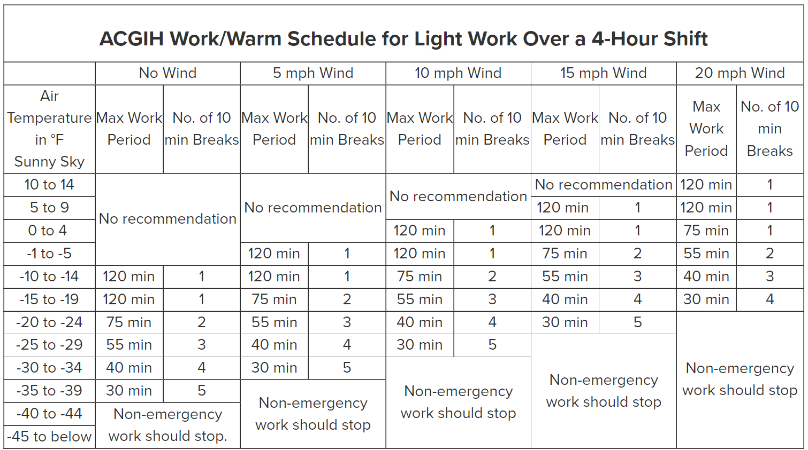
Work/Warm Schedule – light work
Non-emergency work should stop.
Non-emergency work should stop.
Non-emergency work should stop.
Non-emergency work should stop.
Non-emergency work should stop.
Light work -mostly standing; little to no movement.
Notes:
The American Conference of Governmental Industrial Hygienists (ACGIH) developed the following Work/Warm-up Schedules for a 4-hour shift takes both air temperature and wind speed into account, to provide recommendations on scheduling work breaks and ceasing non-emergency work.
The American Conference of Governmental Industrial Hygienists (ACGIH) developed the following Work/Warm-up Schedules for a 4-hour shift takes both air temperature and wind speed into account, to provide recommendations on scheduling work breaks and ceasing non-emergency work. The first schedule is for light work (mostly standing, little to no movement) and the second is for moderate to heavy work.
As wind speed increases – the max work period decreases and frequency of warm-up breaks increases.

Slide 24
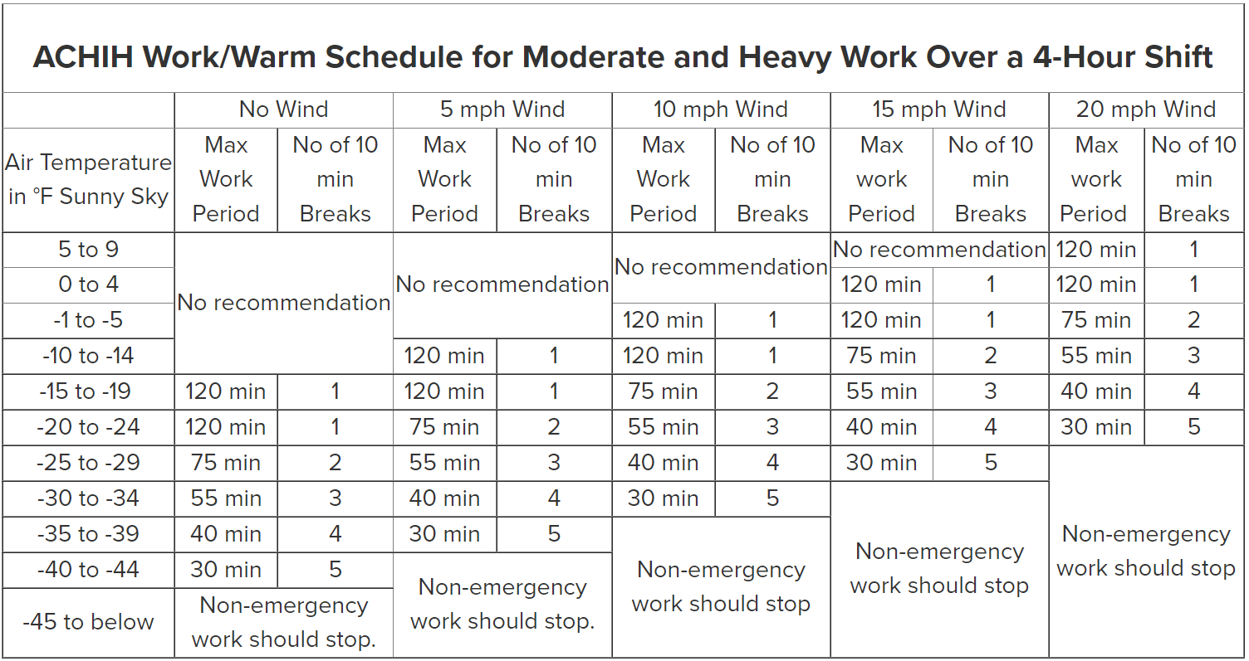
Work/Warm Schedule – Heavy/Moderate Work
Non-emergency work should stop.
Non-emergency work should stop.
Non-emergency work should stop.
Non-emergency work should stop.
Non-emergency work should stop.
10 minute warm-up periods and extended break (e.g. lunch) at end of 4 hour work period in a warm location.
Notes:
The American Conference of Governmental Industrial Hygienists (ACGIH) developed the following Work/Warm-up Schedules for a 4-hour shift takes both air temperature and wind speed into account, to provide recommendations on scheduling work breaks and ceasing non-emergency work.
The American Conference of Governmental Industrial Hygienists (ACGIH) developed the following Work/Warm-up Schedules for a 4-hour shift takes both air temperature and wind speed into account, to provide recommendations on scheduling work breaks and ceasing non-emergency work. The first schedule is for light work (mostly standing, little to no movement) and the second is for moderate to heavy work.
As wind speed increases – the max work period decreases and frequency of warm-up breaks increases.

Slide 25
Summary and Best Practices

Slide 26
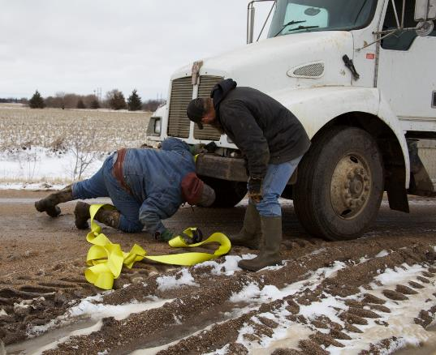
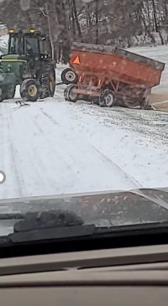
Plan and Be Prepared
Notes:
Tic Tok video – tractor & grain cart slide off road and grain spills.
Picture of break dow in snow/mud/cold trying to hook up tow ropes.

Slide 27
SUMMARY
Planning is key to prevention.
Check weather forecast
Outdoor work during warmer part of the day (usually afternoon).
Appropriate clothing
Keep hydrated; Limit alcohol/tobacco use
Take breaks from cold
Know signs of cold stress
Buddy system
Notes:
Preventing Cold Stress
Planning for work in cold weather is the most important defense in preventing cold stress. Wearing appropriate clothing and being aware of how your body is reacting to the cold are important to preventing cold stress. Avoiding alcohol, certain medications and smoking can also help to minimize the risk.
Protective Clothing
Wearing the right clothing is the most important way to avoid cold stress. The type of fabric also makes a difference. Cotton loses its insulation value when it becomes wet. Wool, on the other hand, retains its insulative qualities even when wet.
Work Practices
Drinking: Drink plenty of liquids, avoiding caffeine and alcohol. It is easy to become dehydrated in cold weather.
Work Schedule: If possible, heavy work should be scheduled during the warmer parts of the day. Take breaks out of the cold. Two examples of work schedules are at the bottom of the page.
Buddy System: Try to work in pairs to keep an eye on each other and watch for signs of cold stress. Victims of hypothermia may not recognize symptoms.

Slide 28

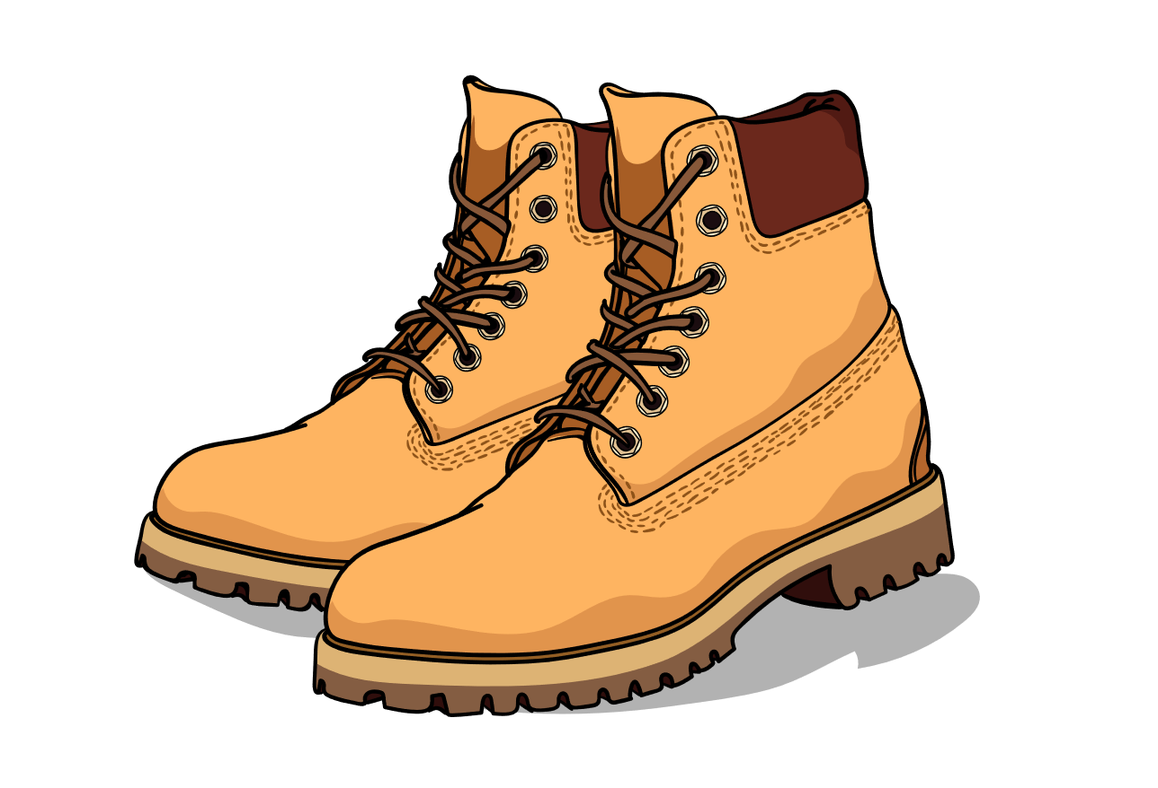
Knowledge Present
24% of trips & falls are caused by incorrect footwear!
Notes:
Research shows that 24% of slips and falls are caused by incorrect footwear. This is one of the leading causes of STF's.
Make sure your employees are wearing proper footwear with slip-resistant soles and good traction all year round. Insulated boots are recommended in winter. Rubber boots with a good tread pattern are also useful during any wet conditions.
https://www.alertmedia.com/blog/slips-trips-falls/
Doc Martin boot - <a href="https://lovepik.com/images/png-clothing.html">Clothing Png vectors by Lovepik.com</a>

Slide 29
Questions?

Slide 30
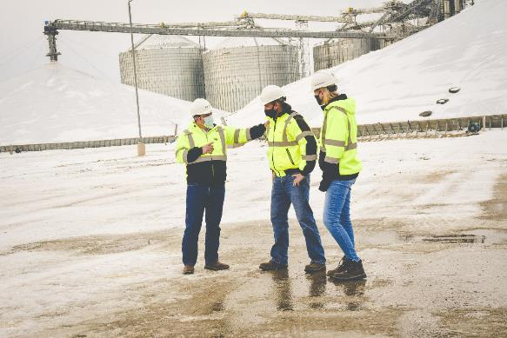
Ending Slide
Protect our most valuable resource
Our Workers!
Courtesy of CVA Coop
For more information visit grainsafety.org

Slide 31
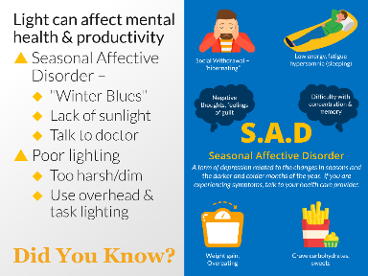
Appendix 1
SAD – Seasonal Affective Disorder
Notes:
Seasonal Affective Disorder (SAD) aka “The Winter Blues”— CHARACTERISTICS Most notes are taken directly/verbatim from - https://www.nimh.nih.gov/health/publications/seasonal-affective-disorder
Begins and ends about the same time every year. In most cases, SAD symptoms start in the late fall or early winter and go away during the spring and summer. People may start to feel “down” when the days get shorter in the fall and winter and begin to feel better in the spring, with longer daylight hours.
More serious mood & behavior changes may indicate the need for medical intervention.
For winter-pattern SAD, additional specific symptoms may include: Oversleeping (hypersomnia); ; Overeating, particularly with a craving for carbohydrates; Weight gain; Social withdrawal (feeling like “hibernating”).
Who develops SAD? It is commonly thought SAD is more prevalent in women, but some studies suggest it affects males & females equally. It is more common in those living farther north with shorter daylight hours and more common amoung younger adults.
More common in people with major depressive disorder or bipolar disorder, especially bipolar II disorder.
Additionally, people with SAD tend to have other mental disorders, such as attention-deficit/hyperactivity disorder, an eating disorder, an anxiety disorder, or panic disorder
Sometimes runs in families. More common in people who have relatives with other mental illnesses, such as major depression or schizophrenia.
What causes SAD? It is thought the decrease in sunlight during fall & winter may disrupt your body's internal (biological) clock – circadian rhythm. https://www.mayoclinic.org/diseases-conditions/seasonal-affective-disorder/symptoms-causes/syc-20364651
People with SAD may have reduced activity of the brain chemical (neurotransmitter) serotonin, which helps regulate mood – "happy" hormone. Research suggests sunlight controls the levels of molecules that help maintain normal serotonin levels, but in people with SAD, this regulation does not function properly, resulting in decreased serotonin levels in the winter.
Findings suggest people with SAD produce too much melatonin—a hormone that is central for maintaining the normal sleep-wake cycle. Overproduction of melatonin can increase sleepiness, lethargy, lack of energy.
Both serotonin and melatonin help maintain the body’s daily rhythm that is tied to the seasonal night-day cycle. In people with SAD, the changes in serotonin and melatonin levels disrupt the normal daily rhythms. As a result, they can no longer adjust to the seasonal changes in day length, leading to sleep, mood, and behavior changes.
Vitamin D deficits may exacerbate these problems. Vitamin D is believed to promote serotonin activity. Vitamin D is obtained through food and produced by the body when exposed to sunlight on the skin. With less daylight in winter, people with SAD may have lower vitamin D levels, which may further hinder serotonin activity.
Treatment of SAD - four main categories that may be used alone or in combination:
Light therapy - Person sits in front of a very bright light box (10,000 lux) every day for about 30 to 45 minutes, usually first thing in the morning, from fall to spring. The light boxes, which are about 20 times brighter than ordinary indoor light, filter out the potentially damaging UV light, making this a safe treatment for most..
Psychotherapy
Antidepressant medications
Vitamin D

Slide 32
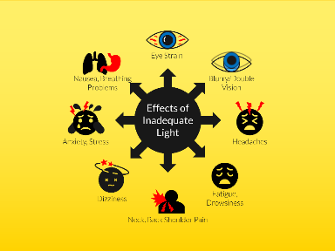
Appendix 2
Lighting
Notes:
Work area lighting – Use a mixture of overhead & task lighting. Increase ways for natural light to enter the work areas. Replace some florescent lighting with "Daylight" bulbs that mimic natural lighting and/or install florescent covers.
To achieve a balance between natural and artificial light and to avoid shadows and glare, place lights parallel to the window and the workspace.
Use task lights closer to desks rather than relying on overhead lighting all day to help reduce your office energy consumption up to 67 percent. For desktop or laptop work, well-distributed diffuse light is best.
Warm white LED or incandescent lights provide the best lighting for eyestrain headache sufferers. Unlike fluorescent bulbs, they emit a warm glow with nominal blue light. Excess amounts of blue light have been shown by research to trigger migraine attacks. Incandescent light bulbs are not as energy efficient.
Note law changes regarding incandescent lights. There are bans in some states. More restrictions go into effect in 2025 under the 2007 Energy Independence and Security Act through the US Dept. of Energy.
Florescent lighting is a popular choice because of its relatively inexpensive cost and they last a long time. Problems associated with them include very harsh on the eyes and containing Mercury- a toxin.
Florescent lights, even CFL's, "flicker". Most people don't register the inconsistencies, but it can quickly become a problem. If bulbs aren’t replaced or taken care of properly, they are more susceptible to flickering, which can cause uncomfortable side effects for employees. Some people are sensitive to flickering and it can cause them to experience the problems listed above more frequently and severely.
Any type of florescent light has color shift over time. Florescent lights may not supply the broad spectrum of light and they emit more blue light than CFLS. which can trigger migraine attacks.
Warm up periods – florescent lights generally have to warm up to their full brightness when turned on.
Recycling Costs/Environmental Concerns – Florescent lights & CFL's contain mercury. Mercury is toxic especially to young children and unborn babies. May be considered hazardous waste even if they contain just a little mercury. The US EPA recommends fluorescent lamps be segregated from general waste for recycling or safe disposal. Some jurisdictions require recycling of them.
BROKEN FLORESCENT LIGHT. Although a CFL contains a small amount of mercury, take extra care when a florescent light breaks. The mercury escapes as both a gas that can be inhaled and as very fine powder.
Immediately open windows and ventilate the space and step outside for a couple minutes.
Get all the people and pets out of the room for 15 minutes and let the room air out.
Shut off central heating or HVAC systems to keep the gases and powder from being spread.
DO NOT TOUCH THE MERCURY. Scoop up larger pieces of the bulb from hard surfaces with stiff paper or cardboard. Use gloves to pick up pieces off carpet to avoid contact. Use sticky tape or duct tape to pick up smaller fragments. For hard surfaces, wipe down the area with a damp paper towel or a wet wipe. Do NOT use vacuums or brooms as they can spread mercury to other parts of the area.
Place all materials in a glass jar with a metal lid if available, otherwise they should be placed in a sealable plastic bag. Plastic bags do NOT contain the mercury fumes so take it outside immediately.

Slide 33
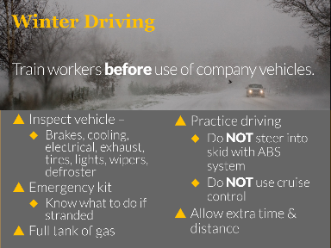
Appendix 3
Winter Driving – Vehicle Checklist
Notes:
Check the vehicle to ensure proper working order.
Brakes: Brakes should provide even and balanced braking. Also check that brake fluid is at the proper level.
Cooling System: Ensure proper mixture of 50/50 antifreeze & water in cooling system at the proper level.
Electrical System: Check the ignition system. Make sure battery is fully charged &the connections are clean. Check the alternator belt is in good condition with proper tension. When the temperature drops, so does battery power. In cold weather, gasoline and diesel engines take more battery power to start, and electric and hybrid-electric vehicles’ driving range can be reduced..
Engine & Exhaust System: Inspect all engine systems. Check exhaust for leaks and all clamps & hangers are snug.
Tires: Check for proper tire inflation & tread depth (at least 2/32 of an inch). Tire inflation pressure drops as outside temps drop. Ensure each tire is filled to vehicle manufacturer’s recommended inflation pressure, (in owner’s manual and on a label located on the driver's side door frame). Do not inflate tires to pressure listed on the tire itself. That number is the maximum pressure the tire can hold, not the recommended pressure for the vehicle. Check tires when they are cold, meaning they have not been driven on for at least three hours. Check each tire’s age. Some vehicle manufacturers recommend replacing tires every six years regardless of use. Check tires & sidewalls for damage & uneven wear - cuts, punctures, bulges, scrapes, cracks, or bumps. CHECK the spare tire.
Oil: Check oil is at proper level.
Visibility Systems: Inspect all exterior lights, defrosters (windshield & rear window), and wipers. Install winter windshield wipers.
Rev 12/01/2022

