Slide 1
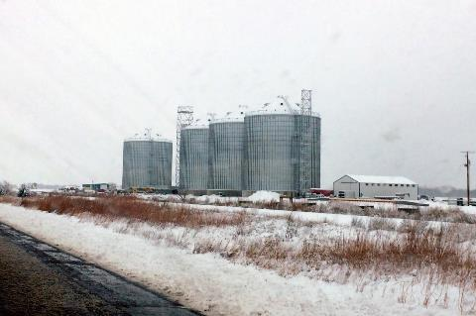
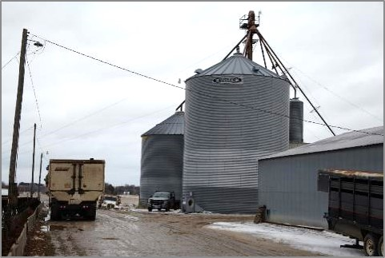
Winter & Cold Weather Hazards

Slide 2
Presenter Name
Picture Placeholder
Title and company
Email
Phone

Slide 3
Disclaimers
This material was produced under grant number SH-37173-SH1 from the Occupational Safety and Health Administration, U. S. Department of Labor.
It does not necessarily reflect the views or policies of the U. S. Department of Labor, nor does mention of trade names, commercial products, or organizations imply endorsement by the U. S. Government.
Notes:
Explain – GHSC received funding from OSHA. In order to comply with the grant we do need them to sign in and need to collect the following information:
Supervisor or worker. This information is for statistical purposes to show the types of population receiving training.
Employer. This is to establish an employer/employee relationship as covered under OSHA. Volunteer rescue workers who may be attending should list their employer; not the volunteer rescue squad. Farmers should list the registered business name of their farm. Farm employees should provide the business name listed on their paycheck.
OSHA does NOT contact the employer.
GHSC may contact the attendee or employer for follow-up evaluation in compliance with grant requirements.

Slide 4
Employee Rights
Employees are entitled to:
Safe & healthy working conditions
Fair compensation for all hours worked
Report unsafe conditions without retaliation
  Call, write or email the OSHA area office within 30 days to report employer retaliation
Employers are responsible for providing a safe workplace.
www.osha.gov & www.whistleblowers.gov
Notes:
Explain - All DOL grants require that employees are informed of their rights.
Employees are entitled to a safe and healthy working environment
To fair receive compensation for their work.
To report unsafe conditions to the OSHA hotline without punishment, discrimination.or other retaliation by the employer.
Report occurrences of employer retaliation by calling, writing, or emailing the OSHA Area office within 30 days of the retaliation.
Explain - Employers have a legal responsibility to provide a safe workplace. They must ensure the regulations which govern their business are instituted and followed when there is one or more employees.
Discuss - It is the employers’ responsibility to know the rules and laws – federal and state.
It is employers’ responsibility to ensure employees, know, understand and follow regulations and company policies.
Stress - If employers are unsure of the regulations they should consult with the appropriate agency. Every state has an on-site consultation program jointly funded by OSHA and the state which provides assistance in learning and complying to the regulations.
The OSHA website provides contact information for each state’s on-site consultation program.
Illinois Department of Labor has the on-site consultation program in Illinois.
Stress - Employers should also know and understand the state’s laws as they may be more restrictive than OSHA. Some states are governed by an OSHA State plan rather than federal OSHA.
Contact the state department of labor for questions.
Visit the OSHA website for information about state plans.
Remind employees – it is the employee’s responsibility to follow the safety practices, policies, and procedures of their employers.
NOTE: It is ESPECIALLY imperative for youth/young workers to access information and know their rights, what to expect, and how to get help if needed.
More information about employee rights can be found on the OSHA website: www.osha.gov or the Department of Labor’s main website www.dol.gov .
Information about whistleblower protection can be found at www.whistleblowers.gov

Slide 5
Learning Objectives
At the end of this session, participants will be able to:
Identify different types of winter/cold weather work hazards.
Explain prevention strategies associated with winter/cold weather work hazards.
Understand how to prevent cold stress.
Notes:
Learning objectives are the main points you (the participant) should take away at the end of the course.
At the end of this session, you will be able to:
Identify hazards to avoid when entering a grain bin.
Describe grain conditions and its relationship to bin entry.
Explain appropriate procedures to follow before entering a grain bin.
Define the role and responsibilities of the observer.
Discuss difficulties encountered in practicing safe grain bin entry procedures.

Slide 6
Topics Covered
Overview – Cold Weather in the US
Preparations for Cold Weather
Proper Dress
Preventive Maintenance
Machinery and Equipment Systems
Summary & Best Practices
Notes:
Introduce the module topics/outline.
Explain the main sections may have subtopics which will be introduced at the beginning of each section.
Subtopics include areas such as coverage of the confined space standard, employer responsibilities, a permit required confined space program requirements, permit requirements, reclassification of a confined space, and alternate procedures.
Stress – this training is intended to be interactive. You’ll be asking for examples of different hazards from the participants and supplementing points in training with real life examples.
State - Part of the goal of this training is to share information and ideas about best practices, look at the realistic ways tasks are performed, discuss barriers to employing safe practices and solutions to those barriers.
Emphasize - We will be discussing what types of incentives are needed in terms of changing perceptions & attitudes and the cost of safety practices.

Slide 7
Overview-
Cold Weather in the US
Types of Hazards & Weather Terms

Slide 8
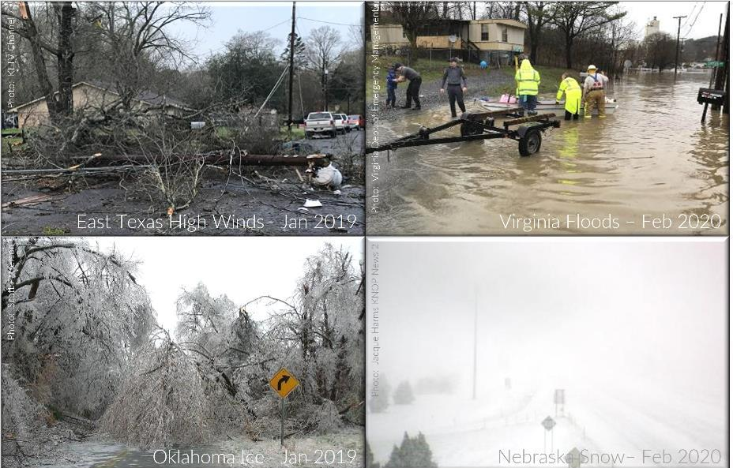
Winter in the US
Notes:
Winter hazards differ across the United States depending on the climate and types of weather experienced.
Understanding what is typical in your region helps to identify and plan for hazards.
It also helps to identify when atypical weather is expected allowing for preparation and decision making on how, where, how much, etc. and whether a worker should be exposed to unusual weather events.
Example: Southern States typically do not get much snow accumulation or ice. They may not understand how slippery a metal ladder can be; they may be unfamiliar with driving in ice/snow (especially if they are young drivers), etc.
When workers are unfamiliar with a hazard, it can lead to more injuries.
Be prepared to make changes to schedules, tasks, etc. based on the exposure to the hazard risks.
Delayed starts, early dismissals, reduced staffing, postponing outside work, half-time schedules, volunteer staffing, etc. are just some of the options available to managers.
When extreme, unusual and/or unfamiliar weather hazards are predicted only critical operations should be done to minimize exposure to hazards and experienced personnel should be leading these.
Per DOT - Over 70 percent of the nation's roads are located in snowy regions, which receive more than five inches (or 13 cm) average snowfall annually.
Nearly 70 percent of the U.S. population lives in these snowy regions
Picture East Texas: https://www.kltv.com/2019/03/14/storms-knock-out-power-thousands-e-texas/ (This was taken from a video). There is also a gallery of pictures available at https://www.kltv.com/community/user-content/
Picture Oklahoma – Jim Patterson pinterest
– https://okcfox.com/news/local/over-300000-power-outages-12-injuries-from-oklahoma-ice-storm
Picture Virginia – http://floodlist.com/america/usa/usa-winter-storm-floods-south-east-february-2020
Picture Nebraska - https://www.knopnews2.com/content/news/I80-I76-closing-in-western-Nebraska-568940881.html

Slide 9
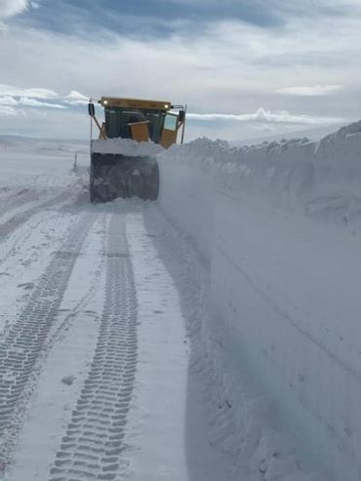
Winter/Cold Weather Hazards
Slips, trips, falls & strains
Winds/tornados
Snow, ice, sleet, rain
Floods
Downed power lines & trees
Snow removal
Winter driving
Cold stress
Equipment start-up
Bulky clothes/PPE
Photo: News Channel Nebraska Central, February 17, 2020, WYDOT District 1; I- 80 near Elk Mountain mile marker 253
Notes:
Photo: https://www.newschannelnebraska.com/story/41710215/wyoming-aiming-to-open-interstate-80-between-11-am-and-1-pm
Winter hazards are not just the weather conditions, but how those conditions affect how we work, & PPE use.
List of some of the hazards associated with winter weather across the United States.
NSC – IN 2021 known 209 deaths due to winter weather the leading cause of weather related deaths; and second in weather related injuries. Heat was 2nd weather-related deaths (301 ; floods were third -150 deaths;
Tornados are leading cause of weather-related injuries 881 injuries; winter second; high winds/ thunderstorms were 3rd with 155 injuries
Center for Disease Control (CDC), winter weather kills more than twice as many Americans as summer heat.
Snow shoveling is responsible for causing illness & death during the winter. A Nationwide Children's Hospital reports about 100 people die each year after snow shoveling triggered a heart attack. https://www.abc10.com/article/weather/accuweather/how-dangerous-is-winter-weather/507-e0a5f7d8-35f9-43c9-97d0-dcbe9f1f5f23
U.S. Bureau of Labor Statistics –in 2017, over 20,000 workplace injuries were linked to ice, sleet, or snow requiring employees to take at least one day off work.
In 2020, ice, sleet, or snow was responsible for 41.5% of weather-related workplace fatalities.
Winter conditions are incredibly dangerous for your employees. A winter slip averages $47,681 per workers’ compensation claim, as well as increased insurance premiums. Cause a major hit to productivity.
Research shows 24% of slips & falls are caused by incorrect footwear. Ensure employees weariproper footwear with slip-resistant soles and good traction all year round. Insulated boots are recommended in winter. Rubber boots with a good tread pattern are also useful during any wet conditions.
https://www.alertmedia.com/blog/slips-trips-falls/
According to SFM claims data, 25 percent of ice- and snow-related falls occur in parking lots . 20% of these result in lost time from work. https://www.sfmic.com/safety/avoid-winter-slips-and-falls/#:~:text=According%20to%20OSHA%2C%20slips%20and,only%20to%20motor%20vehicle%20accidents)
American Journal of Emergency Medicine recently published results of a 17-year study that documents the most common injuries associated with shoveling snow. ~11,000 people are hospitalized per year, and 195,000 across the whole span, due to accidents stemming from snow shoveling. Most of these injuries fell into the following categories: back injuries, head injuries, bone fractures, and heart attacks/strokes.
The most common reasons for sustaining a snow shoveling injury included: slip and fall accidents, overexertion, and being struck by a shovel.

Slide 10
Preparing for
Cold Weather
Preparation, Time Management, Training, Preventive Maintenance

Slide 11
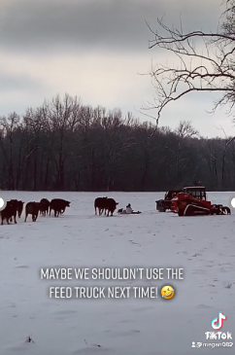
Preparations
BE PREPARED!
Just do it!
Plan
Communicate
Ask/Answer Questions
Don't forget safe grain handling procedures!
Notes:
Animated slide – Play TICTOK video first – not a good plan. Then Click once for each bullet point.
Working in cold weather is not a JUST DO IT situation.
All businesses should have a cold weather plan that is communicated clearly to all employees.
Management should encourage employees to ask questions and be prepared to answer them.
Preparations and accommodations for cold weather do NOT take the place of following safe grain handling procedures.

Slide 12
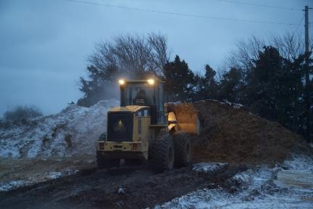
Time Management
"I'll get gas in the morning:)"
Plan daily tasks based on anticipated weather.
  Outside tasks in the afternoon when possible.
  Other times may require additional resources.
Notes:
Daily tasks should be based on anticipated weather.
For example, if a blizzard is expected overnight "I'll get gas in the morning" is not taking the weather into consideration.
Understand additional resources, including personnel, may be needed if tasks are performed during colder parts of the day, and/or when extreme weather is present.

Slide 13
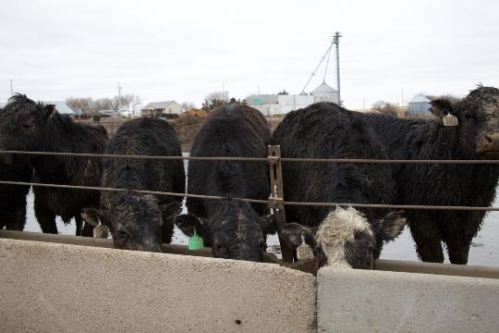
Training – Part of Preparation
Be Prepared
  Prevent
  Recognize
  Treat/Repair
How to Monitor
  Weather
  Systems
  Workers
Notes:
Employers and employees need to be trained to recognize, prevent, report, and treat/repair cold weather hazards.
Training needs to include how to monitor weather, systems/process in the work environment, and workers.
Include what are specific procedures for different weather events and hazards such as when to put out signs saying "falling snow" or something similar.

Slide 14
Winter Weather Terms
Winter Weather Advisory
Issued for accumulations of snow, freezing rain, freezing drizzle and sleet which will cause significant inconveniences and, if caution is not exercised, could lead to life threatening situations.
Wind Chill Advisory
Issued when wind chill temperatures are expected to be a significant inconvenience to life with prolonged exposure, and, if caution is not exercised, could lead to hazardous exposure.
Wind Chill Warning
Issued when wind chill temperatures are expected to be hazardous to life within several minutes of exposure.
Winter Storm Warning
Issued when hazardous winter weather in the form of heavy snow, blizzard conditions, heavy freezing rain or heavy sleet is imminent or occurring. Usually issued 12 to 24 hours before the event is expected to begin.
Winter Storm Watch
Alerts the public to the possibility of a blizzard, heavy snow, heavy freezing rain or heavy sleet. Winter Storm watches are usually issued 12 to 48 hours before the beginning of a winter storm.
Blizzard Warning
Issued for sustained or gusty winds of 35 mph or more, and falling or blowing snow creating visibilities at or below 1/4 mile; these conditions should persist for at least three hours.
(From: National Oceanic and Atmospheric Administration (NOAA))
Notes:
Be familiar with weather terms and/or hang a chart in public spaces.
Listening to weather reports can help with planning. When advisories are issued, operations should be dprepare to switch to the plans specific for the weather event.
Watches & Warnings provide time to take care of critical needs and shift operations as needed for the weather event.
ALL affected employees should know and understand what the procedures are for the different types of weather events.
Although not on this list, Severe thunderstorms, hail, and tornadoes are also events that should have plans in place.

Slide 15
Proper Dress & PPE

Slide 16
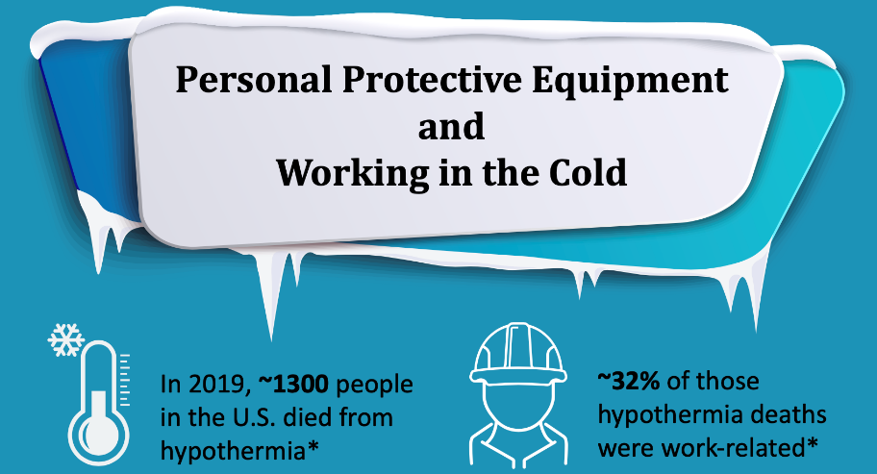
Cold Weather Wear
Notes:
These are from NIOSH

Slide 17
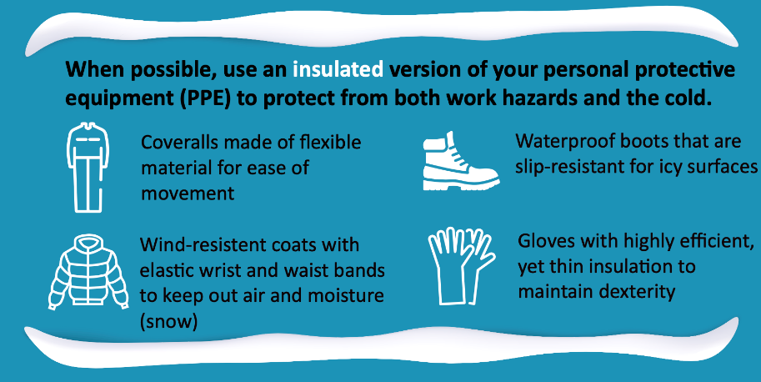
Proper Dress
Notes:
From NIOSH

Slide 18
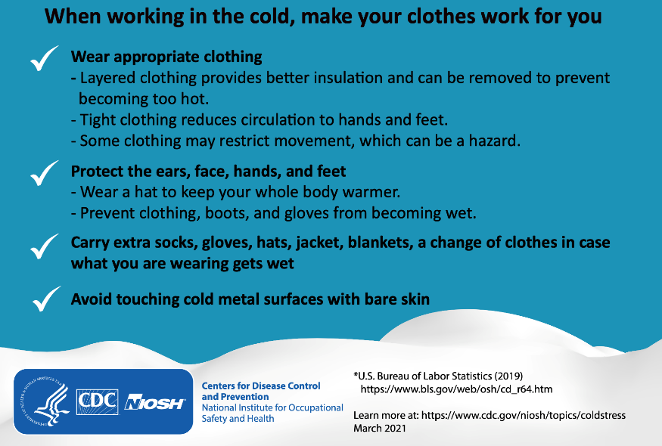
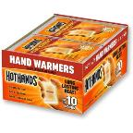
Cold Weather Dress Tips
Notes:
NIOSH
Don't forget to layer.
Also wear a hat.
Use handwarmers, etc.
Have extra clothes.
DO NOT TOUCH COLD METAL SURFACES WITH BARE SKIN!

Slide 19
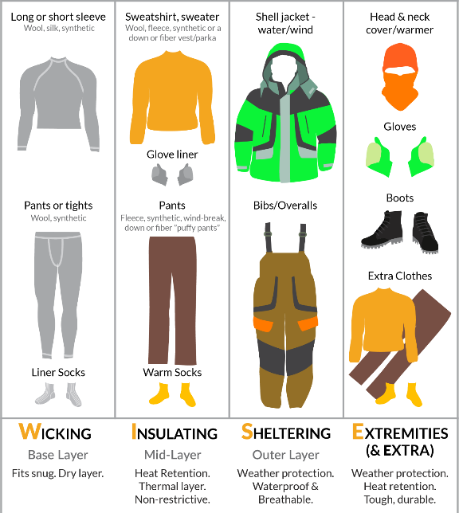
Cold Weather Layering
W.I.S.E. (ly)
Add & subtract layers as needed.
NO cotton. It absorbs moisture & draws heat away from the body.
AVOID denim as a mid-layer. A cotton material that loses insulating capability when wet & takes a long time to dry.
Notes:
A hat should always be worn in cold weather as a majority of body heat can escape through an uncovered heat.
When hard hats are required, don't attempt to wear them over another hat as the bulkiness of the hat will interfere with the hard hat's ability to protect. Use a hardhat liner that works with your hardhat. There are several different styles and options. Some go over the hard hat, some are designed to attach to the hard hat, and some go underneath.
Gloves – it is important to wear gloves to protect the fingers from frostbite. Most work gloves are not designed to protect against cold, but rather specific hazards such as punctures/cuts, chemicals, electricity, etc. A glove liner increases insulation while minimizing bulkiness. Glove liners are designed to layer – as with clothes in cold weather. There are many types of glove liners and materials depending on needs.
Some glove liners provide moisture wicking. Especially good for long work hours to avoid a "sticky feeling", they are breathable and ventilated.
Glove liners allow for greater sensitivity & dexterity of hands to grip, grab, and handle small objects. Work gloves tend to be thick and bulky which can make it more difficult for workers to have the sensation need to perform fine motor tasks.
Some glove liners provide extra protection against hand injuries due to cuts, punctures, impact.
Glove liners can add an extra layer of protection against wetness.
Clothing – Dress like an onion. 3 layers of clothing is better than 1 heavy layer. Consider a moisture wicking garmet worn close to the skin. The mid-layer should not bee too tight and provide insulation . The out layer protects against the weather – should be waterproof, help cut down wind, etc. This layer needs to be breathable, rugged and durable.
Footwear – Use rubber over boots to protect against water. Ice cleats can be used to help prevent slip, trips, falls.

Slide 20
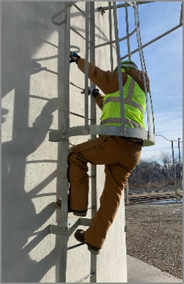
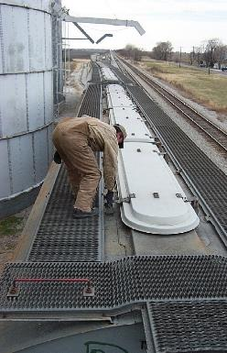
Bulky, Warm Clothing
Ill-fitting clothes
Pant legs that drag
Restrictive clothing
  Does not allow for free movement
Can
Increase STF & entanglement hazards
Affect fit & function of PPE
Notes:
Workers & managers need to be aware the bulky, warm clothing necessary to protect against cold weather can not only make some tasks a bit harder, but also can contribute to an increase in hazards particularly slip, trips, (stumbles), and falls as well as entanglement hazards in machines.
Bulkiness can affect how a person is able to move – such as climbing a ladder.
The bulkiness of the clothing can also affect how PPE fits and functions. It is important to adjust PPE (such as body harnesses) to accommodate for the extra clothing and ensure it still fits and functions properly.

Slide 21
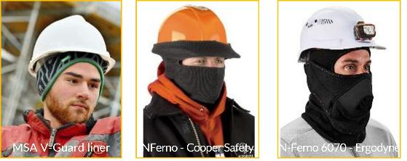
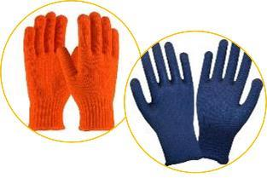
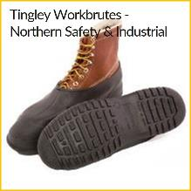
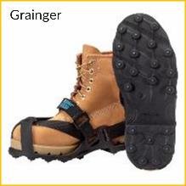
Cold Weather PPE
Hard hat liners
Provide insulation
Reduce STF risk
Rubber overshoes
Ice Cleats
Notes:
A hat should always be worn in cold weather as a majority of body heat can escape through an uncovered heat.
When hard hats are required, don't attempt to wear them over another hat as the bulkiness of the hat will interfere with the hard hat's ability to protect. Use a hardhat liner that works with your hardhat. There are several different styles and options. Some go over the hard hat, some are designed to attach to the hard hat, and some go underneath.
Gloves – it is important to wear gloves to protect the fingers from frostbite. Most work gloves are not designed to protect against cold, but rather specific hazards such as punctures/cuts, chemicals, electricity, etc. A glove liner increases insulation while minimizing bulkiness. Glove liners are designed to layer – as with clothes in cold weather. There are many types of glove liners and materials depending on needs.
Some glove liners provide moisture wicking. Especially good for long work hours to avoid a "sticky feeling", they are breathable and ventilated.
Glove liners allow for greater sensitivity & dexterity of hands to grip, grab, and handle small objects. Work gloves tend to be thick and bulky which can make it more difficult for workers to have the sensation need to perform fine motor tasks.
Some glove liners provide extra protection against hand injuries due to cuts, punctures, impact.
Glove liners can add an extra layer of protection against wetness.
Clothing – 3 layers of clothing is better than 1 heavy layer. Consider a moisture wicking garmet worn close to the skin. Clothing should not bee too tight and provide insulation much like wool.
Footwear – Use rubber over boots to protect against water. Ice cleats can be used to help prevent slip, trips, falls.
Sunburn/windburn – Yes, even during winter you can get sunburned. Snow reflects up to 80 percent of the sun’s UV light, so the rays hit you twice, further increasing your risk of skin cancer and premature aging. Additionally, UVA rays can penetrate through clouds, fog and even glass especially on bright sunny days when the snow is reflecting the sun. Likewise those UV rays cause sun glare which can burn the surface of the eye. This creates a temporary, but extremely painful, condition called photokeratitis - more commonly known as snow blindness. Vision loss from snow blindness is temporary and usually resolves in 24 to 48 hours.
Symptoms of snow blindness include: Burning eyes, Light sensitivity, Eye pain, Red eyes, Blurry vision, A gritty sensation in the eye, Watery eyes, Headaches, Swollen eyes, Swollen eyelids, Halo glare around lights
Wear sunglasses that block 100 percent of the sun's UV rays when you are outdoors during the day. For extended periods of time outdoors, invest in wrap-style frame sunglasses that protect your eyes from indirect as well as direct sunlight or use side shields.
Apply a broad-spectrum sunscreen with an SPF of 15 or higher daily to all exposed skin, and make sure to cover often-missed spots like the tops of your ears, around the eyes and near the hairline. Consider choosing a moisturizing sunscreen with ingredients like lanolin or glycerin to combat dry winter skin. Use a lip balm to protect lips from sun exposure and chapped, cracking, dryness. Wear a brimmed hat to keep sun off neck and face.

Slide 22
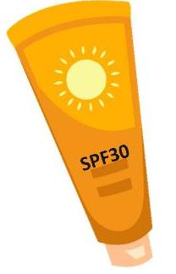


Sun & Wind Protection
UVA rays penetrate clouds, fog, glass and cause sun glare.
Snow blindness
Sunburn
Windburn
Increased risk of skin cancer & premature aging
Snow reflects up to 80% of sun's UV light, so the rays hit you twice.
Notes:
Sunburn/windburn – Yes, even during winter you can get sunburned. Snow reflects up to 80 percent of the sun’s UV light, so the rays hit you twice, further increasing your risk of skin cancer and premature aging. Additionally, UVA rays can penetrate through clouds, fog and even glass especially on bright sunny days when the snow is reflecting the sun. Likewise those UV rays cause sun glare which can burn the surface of the eye. This creates a temporary, but extremely painful, condition called photokeratitis - more commonly known as snow blindness. Vision loss from snow blindness is temporary and usually resolves in 24 to 48 hours.
Symptoms of snow blindness include: Burning eyes, Light sensitivity, Eye pain, Red eyes, Blurry vision, A gritty sensation in the eye, Watery eyes, Headaches, Swollen eyes, Swollen eyelids, Halo glare around lights
Wear sunglasses that block 100 percent of the sun's UV rays when you are outdoors during the day. For extended periods of time outdoors, invest in wrap-style frame sunglasses that protect your eyes from indirect as well as direct sunlight or use side shields.
Apply a broad-spectrum sunscreen with an SPF of 15 or higher daily to all exposed skin, and make sure to cover often-missed spots like the tops of your ears, around the eyes and near the hairline. Consider choosing a moisturizing sunscreen with ingredients like lanolin or glycerin to combat dry winter skin. Use a lip balm to protect lips from sun exposure and chapped, cracking, dryness. Wear a brimmed hat to keep sun off neck and face.

Slide 23


Snowman Science Challenge!
What percent of body heat do we lose through our head not wearing a hat?
10%
30%
50%
65% +
Notes:
The truth is, you won’t squander anywhere close to 50% of your body heat through an uncapped noggin. Will you lose some heat? Absolutely…but a 2008 study shows that it’s more in the 10% range for adults.
That figure makes sense, as it roughly matches the head’s percentage of your body’s total surface area. Or to put it another way, you’re losing heat in direct proportion to the amount of exposed skin.
Where did this "myth" about heat pouring out of your head originate? Most point to an old U.S. Army Field Manual that estimated soldiers could lose 40% to 45% of their body heat through an unprotected head.
If your mom used to tell you this – she's not entirely wrong. You do lose some body heat. More importantly, Frostbite symptoms can start to develop quickly on any exposed skin — especially ears and noses — when temperatures dip into the single digits Fahrenheit.
AND to validate the old tale a bit more - Children tend to lose a higher percentage of body heat through their heads because compared to adults, their heads are bigger in comparison to their bodies.
https://health.clevelandclinic.org/body-heat-loss/

Slide 24
Physical Hazards
Lighting, STF, Falling Snow

Slide 25
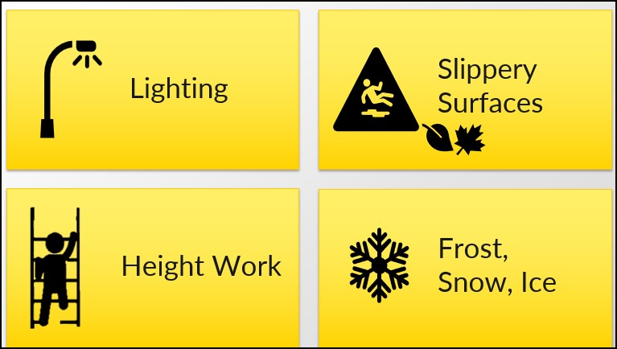
Winter Slip, Trip, Fall Hazards
Notes:
Animated Slide – Click on each yellow box to reveal text underneath.
Lighting - Poor lighting is a major contributing factor to slips, trips, and falls. It becomes a more serious issue in winter months when workers often arrive and leave when there is little or no sunshine making it hard to see obstacles, ice & other hazards. Doorways, walkways, work areas, stairways, parking lots, etc. should be well lit to prevent injuries.
Slippery Surfaces – In some areas of the US, fall events such as leaves falling off trees and grass turning brown is a slower process resulting in continuous organic debris blowing across walkways and work surfaces and accumulating in decomposing piles. Winter brings rain, floods, and mud rather than snow & ice.
Regularly clear walking/working surfaces of leaves and debris.
Provide mats to wipe off mud and/or dry footwear.
Clean up any mud, puddles, etc. which may accumulate on walking/working surfaces.
Frost, Snow, Ice causes a lose of grip with the surface. Maintain safe walking and working surfaces by immediately and repeatedly clearing away snow and ice. Prevent ice formation and/or melt snow, ice, frost by spreading de-icer such as rock salt. Sand adds traction to slippery surfaces but does not facilitate melting.
Height work during winter months must be undertaken with extreme caution. It is beneficial for companies to have written policies concerning height work during different types of weather. Height work should be avoided during inclement weather including windy weather, rain, snow, sleet, ice, etc. If work must be done, employers should ensure workers are properly equipped & trained to work in the conditions and perform the job tasks.
Working at heights over 4 feet or over equipment such as conveyors, kettles, mixers, etc. requires appropriate fall protection such as guard rails, personal fall protection systems, etc. at all times. Inclement weather may necessitate additional fall protection measures be taken.
Ladders are to be inspected before each use including ensuring it is free from mud, ice, debris, etc.
If ladders cannot be adequately cleared and maintained to ensure a firm foot hold and hand hold, they should not be used during weather events.
Portable ladders (extension, step ladders, etc.) must be set up on a firm and level surface and should be blocked to prevent slippage. When weather elements interfere with the ability to ensure a firm and stable surface, they should not be used.
NEVER use a conductive ladder when lightening or the possibility of lightening is present.
Do NOT use a conductive ladder near power lines.
Remember – wind is generally stronger as elevation increases. This should be taken into account when determining whether it is safe to use a ladder during a breezy or windy day.
Power lines – Inclement weather raises the risk of working near power lines. Decreased visibility of power lines during overcast, rainy, snowy, etc. days; potential movement and or sag; increased risk of damage to power lines due to ice/snow, are some of the factors to consider when determining if it is safe to perform work activities near power lines.

Slide 26
Winter Slip, Trip, Fall Hazards
LIGHTING
Arrive /leave work in dark
Install bright lighting
  Outdoor work paths, work areas, parking lots, etc.
SLIPPERY SURFACES
Remove wet/decaying leaves
Avoid wet grass, mud, puddles
Clean up mud, water, debris, etc.
HEIGHT WORK
Fall protection
  Guard rails, PPE
Ladders clear snow/ice
  Set on firm surface
  Do not use on windy days
Caution near power lines
FROST, SNOW, ICE
Lack of grit
Remove snow & ice
Spread de-icer
  Rock salt stops ice forming & melts existing snow/ice
  Sand adds grit to a surface
Notes:
Lighting - Poor lighting is a major contributing factor to slips, trips, and falls. It becomes a more serious issue in winter months when workers often arrive and leave when there is little or no sunshine making it hard to see obstacles, ice & other hazards. Doorways, walkways, work areas, stairways, parking lots, etc. should be well lit to prevent injuries.
Slippery Surfaces – In some areas of the US, fall events such as leaves falling off trees and grass turning brown is a slower process resulting in continuous organic debris blowing across walkways and work surfaces and accumulating in decomposing piles. Winter brings rain, floods, and mud rather than snow & ice.
Regularly clear walking/working surfaces of leaves and debris.
Provide mats to wipe off mud and/or dry footwear.
Clean up any mud, puddles, etc. which may accumulate on walking/working surfaces.
Frost, Snow, Ice causes a lose of grip with the surface. Maintain safe walking and working surfaces by immediately and repeatedly clearing away snow and ice. Prevent ice formation and/or melt snow, ice, frost by spreading de-icer such as rock salt. Sand adds traction to slippery surfaces but does not facilitate melting.
Height work during winter months must be undertaken with extreme caution. It is beneficial for companies to have written policies concerning height work during different types of weather. Height work should be avoided during inclement weather including windy weather, rain, snow, sleet, ice, etc. If work must be done, employers should ensure workers are properly equipped & trained to work in the conditions and perform the job tasks.
Working at heights over 4 feet or over equipment such as conveyors, kettles, mixers, etc. requires appropriate fall protection such as guard rails, personal fall protection systems, etc. at all times. Inclement weather may necessitate additional fall protection measures be taken.
Ladders are to be inspected before each use including ensuring it is free from mud, ice, debris, etc.
If ladders cannot be adequately cleared and maintained to ensure a firm foot hold and hand hold, they should not be used during weather events.
Portable ladders (extension, step ladders, etc.) must be set up on a firm and level surface and should be blocked to prevent slippage. When weather elements interfere with the ability to ensure a firm and stable surface, they should not be used.
NEVER use a conductive ladder when lightening or the possibility of lightening is present.
Do NOT use a conductive ladder near power lines.
Remember – wind is generally stronger as elevation increases. This should be taken into account when determining whether it is safe to use a ladder during a breezy or windy day.
Power lines – Inclement weather raises the risk of working near power lines. Decreased visibility of power lines during overcast, rainy, snowy, etc. days; potential movement and or sag; increased risk of damage to power lines due to ice/snow, are some of the factors to consider when determining if it is safe to perform work activities near power lines.

Slide 27
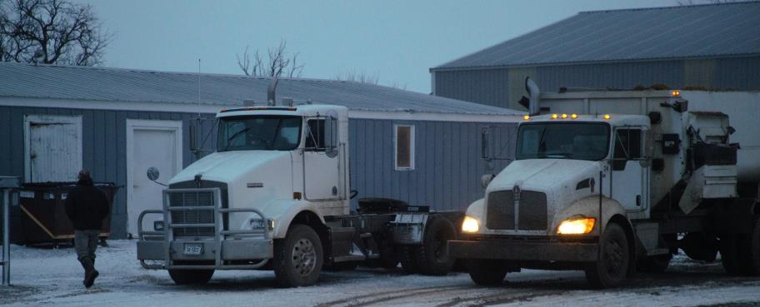
Winter Light
Shortened daylight hours. Workers arrive & leave in dark conditions. Less sunlight filters indoors.
Ensure adequate lighting to reduce hazards
Outdoor paths, parking lots, stairs, work areas
Indoor halls, stairs, work areas – overhead & task
Grain dust areas – NFPA dust explosion approved
Notes:
Lighting - Poor lighting is a major contributing factor to slips, trips, and falls. It becomes a more serious issue in winter months when workers often arrive and leave when there is little or no sunshine making it hard to see obstacles, ice & other hazards.
Doorways, walkways, work areas, stairways, parking lots, etc. should be well lit to prevent injuries. This is an area often overlooked, especially outdoor lighting.
Investing in lighting can help reduce rates of injury.
Concentrate on the travel paths employees use, parking lots, and outside work areas. While a slightly shaded place may be ideal in summer to provide relief from sun and heat – that same spot may be a hazard in winter when not enough light is available to do tasks.
Indoors - the travel paths and stairs are common culprits for small and large STF related injuries. Install lighting and back up lights in these areas. For work areas, it is good to use a mix of both overhead and task lighting. Also, study any areas and times where glare make completing tasks indoors challenging and address these.
Clearly mark exits and keep them clear.
Make sure lighting does not cast shadows on transition areas, like stairs, doorways, etc.
When installing lighting is not an option, consider alternatives that can provide workers the light needed to see and perform their tasks safely such as headlamps, flash lights, etc.
Make sure any light sources in areas where grain dust can accumulate, meets the NFPA standards.
CS CASH Photo - https://www.flickr.com/photos/cscash/

Slide 28

Did You Know?
Light can affect mental health & productivity
Seasonal Affective Disorder –
  "Winter Blues"
  Lack of sunlight
  Talk to doctor
Poor lighting
  Too harsh/dim
  Use overhead & task lighting
Notes:
Light – or rather lack of adequate lighting can affect mental health and productivity.
Seasonal Affective Disorder (SAD) aka “The Winter Blues”— is a type of depression. characterized by its recurrent seasonal pattern, with symptoms lasting about 4 to 5 months per year.
Most notes are taken directly/verbatim from - https://www.nimh.nih.gov/health/publications/seasonal-affective-disorder
In some cases, mood changes are more serious and can affect how a person feels, thinks, and handles daily activities. If you notice significant changes in your's or another person's mood and behavior whenever the seasons, it may be SAD. Contact your doctor or mental health care provider. & encourage others to do so.
Symptoms for winter-pattern SAD, may include: Oversleeping (hypersomnia); Overeating, particularly with a craving for carbohydrates; Weight gain; Social withdrawal (feeling like “hibernating”).
"Winter pattern' SAD, is contributed to the absence of the full-spectrum of light a person normally receives from sunlight. During the dreary, gray skies of the winter months, a lot of the light spectrum is blocked and our bodies respond in a negative way. Without the full-spectrum of light we get from daylight, certain bodily functions are not instigated or supported, causing us to feel down in the dumps.
Who it Affects. People in any region, age, or gender can develop SAD. Occurs more often in women than men. More common in those living farther north, where there are shorter daylight hours in winter. More common amount younger adults & persons with other mental health disorders, major depression of Bipolar disorders.
More information is included in an Appendix Page – including suggested causes and treatment. Flourescent lighting can mimic the conditions associated with Seasonal Affective Disorder. Many people report similar symptoms when they’re subjected to working under fluorescent lights and don’t get outside in the sunlight during the day.
Poor indoor lighting – Productivity
Physical symptoms are listed on the next slide.
When people experience physical discomfort due to inadequate light or harsh lighting, they have a hard time concentrating and being productive.
Some people are sensitive to the flickering of fluorescent lights.

Slide 29

Effects of Inadequate Light
Notes:
The type of light employees experience can directly affect physical health, mood/mental health, and productivity.
Too little/dim - can strain the eyes and cause headaches, lowering productivity and resulting in employee fatigue. Dim lights also result in drowsiness or lack of focus.
Too harsh of lighting which is more common causes eye strain and triggers migraine headaches.
Muscle strain occurs when trying to adjust for lighting issues, glare, etc. This usually affects the neck, shoulder, and back area – which can then exacerbate headaches, nausea, sleeplessness, etc.
Inadequate lighting where tools are being used – such as the maintenance shop area – can increase the risk of an injury incident.
Transitioning from indoor work to outdoor areas or vise versa can be hazardous as glare and shadows can temporarily leave a worker with impaired vision. This is not thought about much but can contribute to STF's and other incidents..
Work area lighting – Use a mixture of overhead and task lighting. When possible, increase ways for natural light to enter the work areas.
Consider replacing some of the florescent lighting with "Daylight" blubs which mimic natural lighting and/or install florescent covers. MORE INFORMATION ON LIGHTING IS AVAILABLE IN APPENDIX 2.
Ways to avoid eye strain:
Use eye drops to avoid eye dryness.
Employees can try blue light glasses.
Stay hydrated. Drink plenty of water. This helps keeps the eye tissue hydrated.
Sometimes an anti-glare computer screen is beneficial, but do your research.
Incorporate the 20-20-20 Rule. The American Academy of Ophthalmology recommends using it when your weary eyes need a break; after 20 minutes of screen exposure, focus on an object 20 feet away from your desk. Do it for 20 seconds.
This ‘rule of thumb’ applies to all digital devices, and those fluorescent bulbs hanging over your head are no exception.
Encourage employees to do this by setting the cell phone to vibrate every 20 minutes until if becomes a habit.
https://www.ncbi.nlm.nih.gov/pmc/articles/PMC3222423/
https://www.ccohs.ca/oshanswers/ergonomics/office/eye_discomfort.htm l -
https://www.ccohs.ca/oshanswers/ergonomics/lighting_checklist.html
https://www.scientificamerican.com/article/are-compact-fluorescent-lightbulbs-dangerous/#
http://www.epa.gov/waste/hazard/wastetypes/universal/lamps/index.htm
https://www.inc.com/rebecca-deczynski/increased-healthcare-costs-employers-mercer-survey.html
https://www.office3sixty.com/Home/fluorescent-lights-how-are-they-affecting-your-employees/

Slide 30

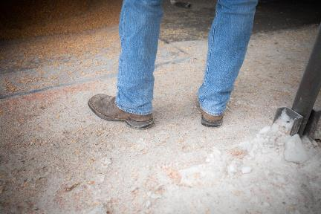
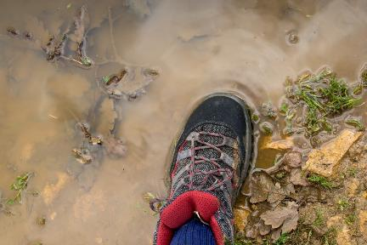
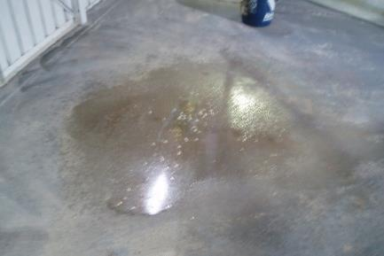
Slippery Surfaces
Remove wet/decaying leaves
Clean up spilled grain
Avoid mud, wet grass, puddles, sloped terrain
Clean up water, mud, debris, etc.
Notes:
Slippery Surfaces – In some areas of the United States, fall events such as leaves falling off trees and grass turning brown is a slower process which resulting in continuous organic debris blowing across walkways and work surfaces and accumulating in decomposing piles. Winter brings rain, floods, and mud rather than snow & ice.
Regularly clear walking/working surfaces of leaves and debris.
Establish and mark clear walking paths, including crossings across vehicle areas, that can be maintained relatively free of mud, debris, etc.
Temporary solutions include plywood, pallets, rubber tiles, etc.
Mulch, gravel, wood chips, etc. are other options. Though they aren't as easily cleaned, they help provide traction.
Be mindful of hazards created by the solutions.
For example, plywood can become slippery covered in mud and the change in elevation is a trip hazard. Mark the edges with paint or tape, and consider no-slip adhesive strips. Plywood that can withstand water can be hosed off, but be mindful of creating "more mud".
When possible, mark off places where you don't want people or vehicles to go – such as sloped terrains.
Provide mats and/or bootbrushes with a scaper to wipe off mud and/or dry footwear.
Clean up any mud, puddles, etc. which may accumulate on walking/working surfaces.
Mud is not only slippery, but ruts are easily formed presenting more trip hazards. When ruts freeze or dry they become more like a hard object/projectile sticking out of the ground creating an even larger trip hazards. If they then become snow covered, it becomes more dangerous as they can't be seen.
While it is likely not feasible to eliminate these entirely, consider ways to reduce the hazard such as some type of covering like gravel, wood chips, mulch, etc.
Keep cleaning tools such as broom, mops, etc. convenient such as dump pit areas, entry ways, etc. Keep them from becoming trip hazards by handing them on the wall, in a storage closet (either built-in or freestanding), etc.
Photo: Decaying Leaves - jon-moore-HsJlyi_CFVY-unsplash.jpg
Photo: Puddle - richard-bell-yU8xgckYKtM-unsplash.jpg

Slide 31
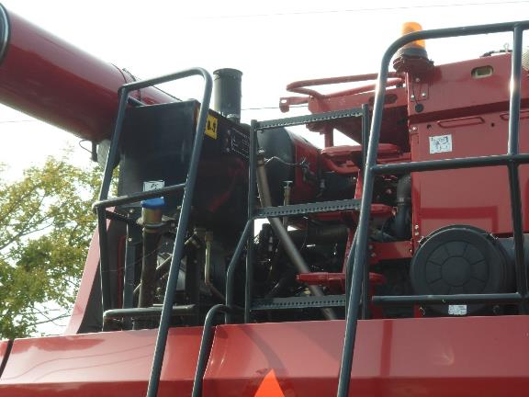
Equipment - Slippery Surfaces
Hydraulics
Maintenance
Repairs
Clean out
Notes:
Hydraulic fluid can spill onto the walking/working surface of equipment through maintenance, repairs, and clean out of the hydraulic system as well as if there are leaks.
Hydraulic fluid will make the surface slick and should be cleaned up immediately.
Hydraulic fluid that mixes with dirt can harden making clean up more difficult.
Cleaning up hydraulic spills/Leaks –
AVOID contact with the hydraulic fluid. Use proper PPE such as gloves, boots, and protective trousers, if needed.
For larger spills and leaks use something to absorb and contain the spill such as kitty litter, pin shavings, straw, absorbent granules, etc. Sweep up the material into a trash bag and dispose of properly.
Hydraulic oil is considered hazardous waste. Check with your local landfill on disposal procedures for materials used to absorb spills.
Dispose of hydraulic oil properly. Make sure it is contained in a properly labeled, sealable, leak-proof, water-proof container while waiting for disposal or recycling. Know your local management regulations.
Use concentrated Dawn or (other grease fighting) dishwashing soap to remove residue – use a soft bristle brush to scrub and rinse the area thoroughly.
Other oil clean-up products are available. Follow manufacturer's instructions and make sure they won't damage your equipment.
Winter effects on hydraulic fluid – Cold weather causes hydraulic fluid to gel, but it does not freeze. When it thickens, allow it to warm up before trying to work with it as you would under normal circumstances.
Warning: The gel can become some thick the hydraulic fluid won't flow the point of hydraulic fluid. Allow the machine to warm-up and the gel to warm up so it flows before engaging the hydraulic systems.
Exposure - https://www.poison.org/articles/hydraulic-fluids-are-potentially-dangerous-203
Skin– Generally if hydraulic fluid gets on the skin, just wasing with soap and water is all that is needed. Sometimes the hydraulic fluids can cause skin drying and irritation.
Eye – Most exposures are resolved with gentle flushing of the eye with water. Do a gentle eye rinse for 15 minutes with water at a comfortable temperature, letting the water run over the eye and blinking occasionally under the stream of water. You don't have to hold the eye open. Vision may be temporarily blurry as oily substances can leave a film on the eye. If blurriness persists or the eye remains irritate, seek medical attention.
Ingestion – Swallowing hydraulic fluid is potentially dangerous. It can get into the airway more easily than water-based substance. If someone coughs hard or vomits after swallowing the hydraulic fluid they are in danger of aspiration. If the substance is swallowed and goes to the stomach, diarrhea is usually the only adverse effect.
If someone has been exposed to hydraulic fluid log on to the webPOISONCONTROL® online tool for guidance or call Poison Control at 1-800-222-1222. Assistance is available 24 hours a day.

Slide 32
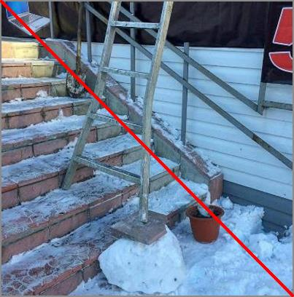
Height Work
Fall protection
  Guardrail system
  Personal fall arrest
Ladders clear snow/ice
  Set on firm surface
  Snow, mud, ice needs to be cleared away
  Do not use on windy days
Caution near power lines
Notes:
Height work during winter months must be undertaken with extreme caution. It is beneficial for companies to have written policies concerning height work during different types of weather.
Height work should be avoided during inclement weather including windy weather, rain, snow, sleet, ice, etc. If work must be done, employers should ensure workers are properly equipped & trained to work in the conditions and perform the job tasks.
Working at heights over 4 feet or over equipment such as conveyors, kettles, mixers, etc. requires appropriate fall protection such as guard rails, personal fall protection systems, etc. at all times. Inclement weather may necessitate additional fall protection measures be taken.
Ladders are to be inspected before each use including ensuring it is free from mud, ice, debris, etc.
If ladders cannot be adequately cleared and maintained to ensure a firm foot hold and hand hold, they should not be used during weather events.
Portable ladders (extension, step ladders, etc.) must be set up on a firm and level surface and should be blocked to prevent slippage. When weather elements interfere with the ability to ensure a firm and stable surface, they should not be used.
NEVER use a conductive ladder when lightening or the possibility of lightening is present.
Do NOT use a conductive ladder near power lines.
WARNING – wind is generally stronger as elevation increases. This should be taken into account when determining whether it is safe to use a ladder during a breezy or windy day.
Power lines – Inclement weather raises the risk of working near power lines. Decreased visibility of power lines during overcast, rainy, snowy, etc. days; potential movement and or sag; increased risk of damage to power lines due to ice/snow, are some of the factors to consider when determining if it is safe to perform work activities near power lines.
Picture: https://www.pinterest.com/ladderm8rix/ Posted by G Robinson Safety Ltd on Take Ladder Safety Seriously – UK Ladder-winter-G Robinson Safety Ltd saved to Take Ladder Safety Seriouslydownload.jpg

Slide 33
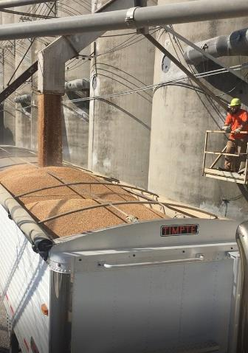
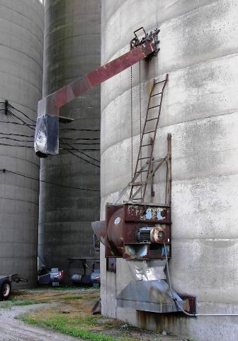
Fall Hazards
Good platform-standard handrail system
Ladder set up to unplug spout or work on unloading gate or chain
Notes:
Elevated working/walking surfaces, such as platforms, should have a proper guardrail system – with top & mid-rail, and toeboards and a swing gate or other closure. If a guard rail system is not in place, personal fall protection is required.
The picture on the right is unacceptable. The ladder is not set up properly, there is no working surface, no guardrails and there are obstructions to even safely climbing the ladder.
REMEMBER – if a ladder is used on an elevated surface – the guardrails must be of sufficient height to protect the worker while on the ladder or other fall protection must be used. Since guard rails are generally not extended to the that protective height – ladders should not be used on elevated work platforms. https://www.youtube.com/watch?v=KWxVlcuK1_w&t=18s

Slide 34
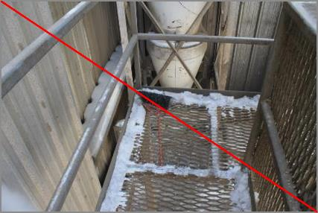
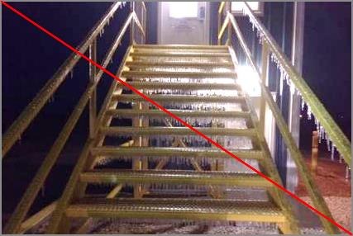
Metal Has Less Traction
Metal has a low force of friction/traction. Surfaces become smooth & slippery with wear and can be very slick when wet, muddy, icy, greasy, etc.
Notes:
Grain facilities & farms have a lot of metal walking & working surfaces – pit grates, ramps, ladders, stairs, work platforms, & walkways.
Metal has a lower force of friction/traction and can be more slippery than many other materials. Metal surfaces can become smooth and slippery with wear, and are extremely slick when wet, muddy, or greasy.
Slips are when there is too little friction or traction between feet (footware) & walking/working surface, resulting in loss of balance. (i.e, foot slides from intended surface step loss of balance).
Metal will freeze and form ice faster than pavement.
34

Slide 35
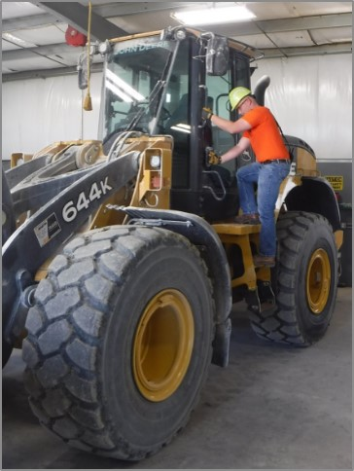
3 Point Contact
Maintain 3 points of contact when entering & exiting trucks, equipment.
Face equipment at all times
Firmly grasp handholds
Feet in center of step
Release handhold only when footing is secure
Keep 2 hands & 1 foot OR 2 feet & 1 hand in contact with equipment.
Notes:
Just as with ladders, when dismounting and mounting equipment, the workers need to ensure 3 points of contact are maintained.
Face the vehicle/equipment and firmly grasp handholds.
Place feet firmly and fully in center of steps. A good rule of thumb is the heel of the work boot should touch the edge of the step.
Release the handhold only when securely settled in the seat or footing is secure.
Check the conditions of the ground prior to dismounting to be aware of any hazardous conditions/obstacles,
If steps have snow accumulation sweep the foot across the step to dislodge the snow prior to placing foot on it.
35

Slide 36
3 Point Contact Videos
https://www.youtube.com/watch?v=RhXSXSx3dk0
Colorado DOT – 3 points contact & other safety (very thorough) https://www.youtube.com/watch?v=oVKL476GADg
Driving school video https://www.youtube.com/watch?v=fGUMZxs5nYE
This is okay - https://www.youtube.com/watch?v=XRoMSsTho4E
Notes:
36

Slide 37
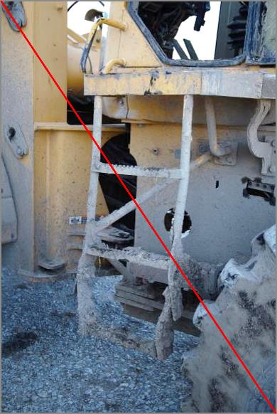
Tips for Bad Weather Entry/Exit
Keep the step area clean
  Clear off mud, ice, snow, debris before entering & exiting
Look at ground area before entry/exit
  Debris, rocks, etc.
  Snow, mud, ice, etc.
Clean off work boots
Notes:
In this picture, notice the mud caked on the steps.
Step areas should be kept clean of debris, mud, ice, snow, etc.
Check the conditions of the ground prior to dismounting to be aware of any hazardous conditions/obstacles.
If steps have snow accumulation sweep the foot across the step to dislodge the snow prior to placing foot on it.
If an obstacle is known to be in the landing zone, navigate carefully. Once feet are firmly on the ground and the handhold can be released remove the obstacle if possible so it is not present when re-entering the vehicle/equipment

Slide 38
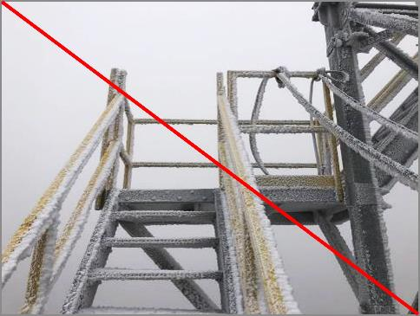
No Heights When There’s Ice
Rain, snow, ice, mud, etc. make walking/working surfaces hazardous.
Walk on driest, firmest path
Clear off, de-ice before use
Avoid climbing, elevated surfaces
Notes:
When there is inclement weather, height work should be avoided.
Always walk on the designated walkways or find the driest, clearest path.
When every possible, remove snow and de-ice before using a walkway.
Understand areas that are at higher elevation and/or are shaded, and/or on the north facing side, may have ice when other areas do not.

Slide 39
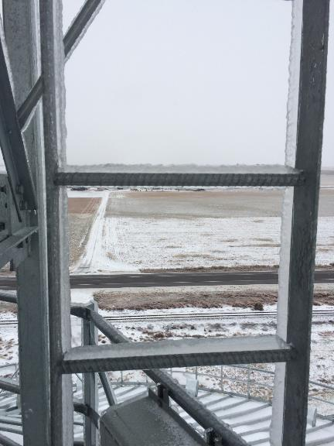
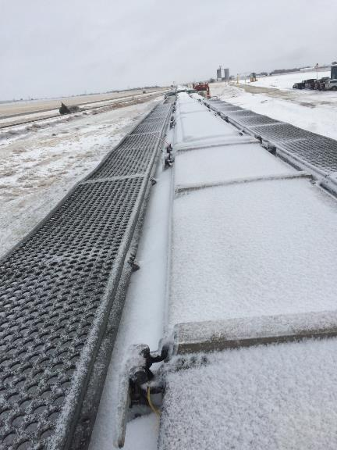
Clear Walking/Working Surfaces
Notes:
Left – bin ladder
Right – railcar
Railcars – the openings can become frozen and when they are broken lose can cause workers to stumble and lose their balance. Always use fall protection when working on top of railcars.
Rolling stock is not covered by OSHA but the workers are!

Slide 40
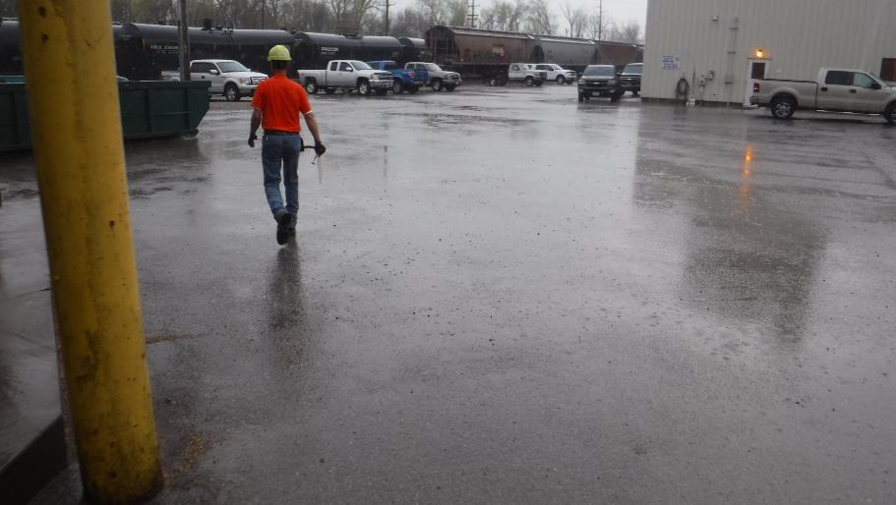
Black Ice
Notes:
Black ice is particularly dangerous for pedestrians and vehicles as it may just look like the pavement is wet. It is hard to see as it is often transparent blending into the ground and surroundings.
Black ice forms when rain or sleet falls onto the frozen ground. Low temperatures cause the moisture to freeze into a thin layer of ice on road surfaces.
Black ice often forms at night or in the early morning hours when temperatures are at their lowest.
More shaded areas and less traveled bridges, roads and overpasses, are also common places for black ice to form.
When low temperatures and moisture (rain, sleet, etc.) is predicted, spreading ice melt before the freeze occurs or shortly after on walkways and parking lots can help reduce falls.

Slide 41
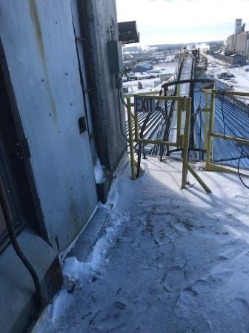
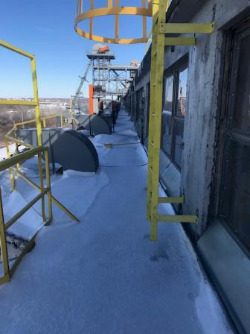
Entry & Exit Points
Obstructions & overhangs can create uneven freezing, thawing, & snow coverage.
Notes:
Notice the frozen footprints on the left.
Grain elevators may have several entry and exit points in the form of doors, ladders, platform, etc.
These areas may experience uneven coverage of snow/ice, freezing, and thawing as they may be shaded with overhangs, obstructions, etc.
Entry points at elevations may have drifts or ice buildup from dripping overhangs which can block or impede opening the doors, etc.
While other areas of the structure may be clear and passable, caution should be taken in areas which receive less direct sunlight.

Slide 42
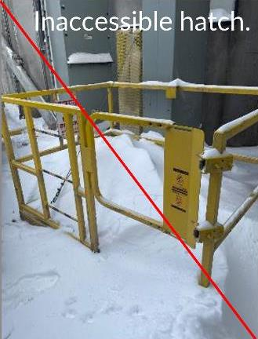
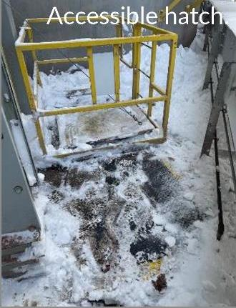
Blocked Entry/Exit
Blocked entry/exit points are a hazard. Keep clear of snow, ice, debris, etc.
Notes:
Examples of Entry & Exit points.
Left is blocked & inaccessible.
Right has been somewhat cleared.
Important to clear hatches completely leading to tunnels, etc. so snow and ice does not fall into the hatch while worker is descending a ladder or when they open the hatch.

Slide 43
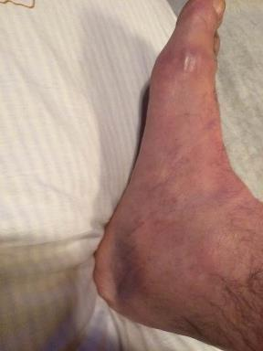
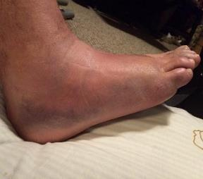
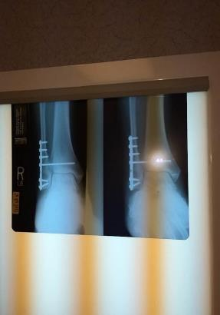
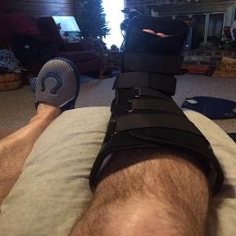
We all need reminders
We ALL Need Reminders!
Injury from fall on ice. Safety Director walked around bin. One side had melted ice, the other side was still icy. Had failed to use PPE (ice cleats). Not a proud moment.
Notes:
Result was broken ankle, surgery and pins as well as being off work for several weeks and physical therapy.
As an example, the Safety Director insisted on being issued a written warning for failing to use provided PPE.

Slide 44
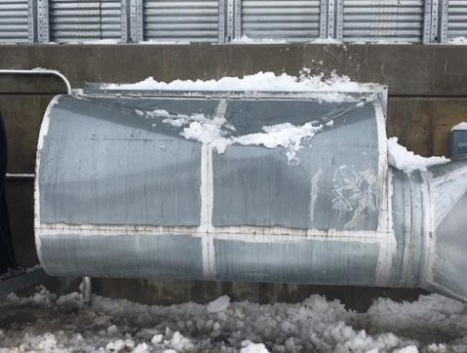
Falling Snow & Ice
Witnesses said they heard a very loud bang but had no idea what had happened. Snow fell from a bin roof and damaged a fan transition.
Snow fell 90 ft onto this aeration fan transition
Notes:
John Lee incident
This large industrial unit was severely damaged. What would have happened had the snow fallen on a person?
Remember – laws of gravity. The higher the point something falls from the more speed and force it will pick up as it falls. Snow falling from 90 feet of height will have a stronger force of impact than snow falling from 4 feet of height.

Slide 45
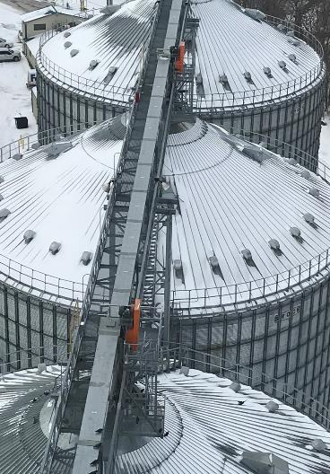
Weight of Snow on Bin Roof
Snow weight varies – depth & moisture content
105’ diameter grain bin
  140 roof sections
  4 roof sections/bin sheet
Ave. 20 lbs per cubic foot
1000 lbs of snow on each roof panel!
Notes:
105’ diameter grain bin has 140 roof sections and 4 roof sections for every bin sheet.
Snow varies in weight depending on depth & moisture content.
Using snow weighing 20 pounds per cubic foot, there could be as much as 1000 lbs on each roof panel.
What could that much falling snow do to a worker?
Prohibit workers from working under ice and snow.

Slide 46
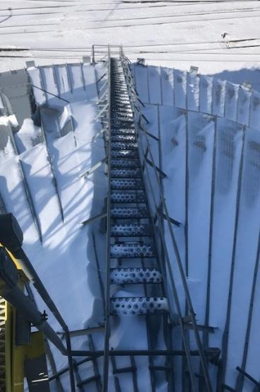
Falling Snow Hazards
Be aware & avoid areas where falling snow/ice can occur.
Bin roofs & anywhere at height
Sun warms roof sheet & creates falling snow
  Can occur below freezing temperatures
North side usually last snow to fall
Notes:
Employees should avoid areas when snow is on bin roofs or anywhere at height.
Even on a below freezing day, the sun can warm up a roof sheet and create a snow fall situation.
Remember the north side is usually last snow to fall.
It’s very important that all employees are aware of areas where snowfall can occur.
Avoid these locations to prevent injury.

Slide 47
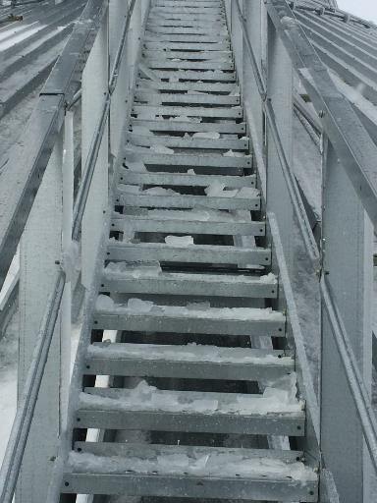
Prevention Strategies
Identify hazard area & restrict access . Don’t use as walkways, work areas.
When clearing ice & snow overhead, ensure no one can enter the danger zone.
Start at bottom. Work up.
Require hard hats.
Falling ice chunks can cause serious injury
Notes:
Conduct a thorough assessment of potential hazard areas for falling ice and snow – preferably before cold/winter weather hits.
As possible, mark/barricade danger zones, and/or designate them as restricted areas to keep people away from them. Inform all your employees of these restrictions.
Have a plan for how you will clean off bin stairs, ladders, work platforms, etc. and keep the area clear underneath these areas of others when clearing away snow and ice.
Require hard hats when falling snow/ice is a potential hazard.
Work from the safest starting point. If the top of a staircase/ladder can be safely accessed by an inside entry, work down pushing the accumulated ice/snow to the lower level step. Clean off snow and spread deicer or sand to provide traction

Slide 48
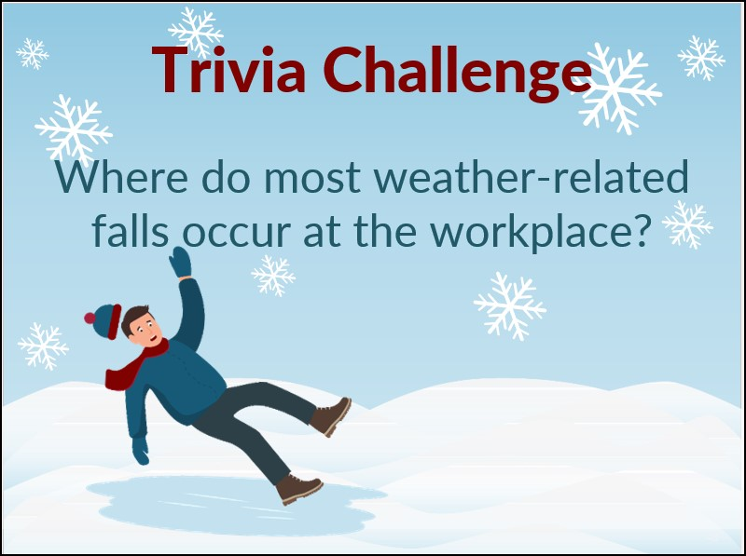
TRIVIA CHALLENGE
Notes:
According to SFM claims data, 25 percent of ice- and snow-related falls occur in parking lots - that is the largest.
20 percent of slips and falls that occur in parking lots result in lost time from work https://www.sfmic.com/safety/avoid-winter-slips-and-falls/#:~:text=According%20to%20OSHA%2C%20slips%20and,only%20to%20motor%20vehicle%20accidents)

Slide 49
Winter Tip – Unclench, relax
Cold weather causes our muscles to lose heat. Our muscles tighten & we clench our teeth to help us stay warm, but it makes us work harder.
Relax your jaw, & the muscles of your face, neck & shoulders.

Slide 50
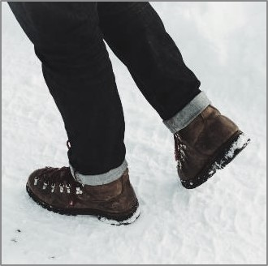
Winter Walking
Take short steps
Walk at a slower pace
  React quickly to changes in traction
Heel-to-toe gait pattern
  Don’t shuffle or glide on ice
Contract core musculature
  Protects spine
Notes:
Slips, trips and falls are a leading cause of injury throughout the year, but especially during winter months when snow and ice are present.
To prevent slips and falls, people must adjust their gait pattern to keep weight on one leg orthe other through a type of waddling walk – like a penguin.
Keeping one’s core contracted helps provide balance and readiness to react to slips and protects the spine.
FALL LIKE A PRO!
Tuck your chin in
Turn as your falling, focusing on landing on the side of your body
Keep limbs bent focusing on protecting your head (straight limbs can snap or break under impact)
Loosen up as you fall
Advanced Fallers Only: Do a barrel roll… In other words, roll with the fall. However, we don’t advise this as you could roll into another accident.
Picture: Pixabay

Slide 51

Winter Tip -Walk Like a Penguin
  Videos about walking on ice
  https://www.youtube.com/watch?app=desktop&v=K6T2DJ_n9pM
  https://www.youtube.com/watch?v=LHaWGibGwyk
  https://www.youtube.com/watch?v=BlMo3C4dAPw
Notes:
Here are some videos about walking on ice:
https://www.youtube.com/watch?app=desktop&v=K6T2DJ_n9pM
https://www.youtube.com/watch?v=LHaWGibGwyk
https://www.youtube.com/watch?v=BlMo3C4dAPw

Slide 52

Correct Way to Fall
Tuck your chin into chest.
Bend your knees.
Cross your arms or swing the away from the ground.
Turn body. Try to land on your side.
Loosen up as you fall.
Avoid falling backwards. Protect your head. Don't use your arms to catch your fall.
Notes:
Here's another video – https://www.nbcnews.com/better/health/if-you-have-fall-ice-here-s-how-not-hurt-ncna712051
Avoid falling backward.
Tuck your chin to your chest. This helps protect your head and prevents it from hitting the ground.
If you are going to fall Bend your knees. It reduces the distance of the fall.
Cross your arms over your chest or swing them away from the ground and your body. This protects them from being crushed by the weight of the fall, and/or being snapped.
Turn as you are falling & try to land on your side. There is less chance of serious injury.
Loosen up as you fall. Reduces the chance of breaking a bone.
Do a barrel roll – i.e. roll with the fall. You could, however, roll into another accident, so use with caution.
https://www.premierphysicaltherapy.com/blog/what-to-do-if-youve-slipped-on-ice

Slide 53

Falling on Ice the Right Way
https://www.youtube.com/watch?v=yAMbnG0lsT8&t=4s
Notes:
Here's another video – https://www.nbcnews.com/better/health/if-you-have-fall-ice-here-s-how-not-hurt-ncna712051
Avoid falling backward.
Tuck your chin to your chest. This helps protect your head and prevents it from hitting the ground.
If you are going to fall Bend your knees. It reduces the distance of the fall.
Cross your arms over your chest or swing them away from the ground and your body. This protects them from being crushed by the weight of the fall, and/or being snapped.
Turn as you are falling & try to land on your side. There is less chance of serious injury.
Loosen up as you fall. Reduces the chance of breaking a bone.
Do a barrel roll – i.e. roll with the fall. You could, however, roll into another accident, so use with caution.
https://www.premierphysicaltherapy.com/blog/what-to-do-if-youve-slipped-on-ice
https://www.google.com/search?q=how+to+break+fall+on+ice&rlz=1C1SQJL_enUS899US900&hl=en&sxsrf=ALiCzsa3T3DbA3GLHjBCNQbPKtJM78Q7LA:1671446305365&source=lnms&sa=X&ved=2ahUKEwiq96ravoX8AhXdnWoFHUcMC9YQ_AUoAHoECAoQAg&biw=1800&bih=1052&dpr=1.8#kpvalbx=_mT6gY8ejFLKjqtsP0Z6o2Ao_34

Slide 54
Snow Removal
Shoveling, snow blower, plows
Notes:
GHSC – Winter & Cold Weather Hazards

Slide 55

Health Hazards
Shoveling snow is a strenuous, aerobic activity. Cold weather taxes the body & makes it work harder.
Health hazards include exhaustion, dehydration, back injuries, muscle strains, and heart attacks.
Notes:
Because shoveling is an aerobic activity that most people are not prepared to do, it creates numerous health risks.
About 137,000 people in the United States are treated at medical facilities every year for snow shoveling injuries.
https://www.healthline.com/health-news/snow-shoveling-injuries-heart-attacks-how-to-avoid#Preparation,-fitness,-and-footwear
Of those, about 28,000 people are treated in emergency rooms.
And about 100 of them die, - from heart attacks.
In a 2011 report, soft tissue injuries were listed as the most common snow shoveling injuries at 55 percent. Lacerations came in at 9 percent and fractures and heart episodes were at 7 percent each.
Of the soft issue injuries - injuries to the lower back accounted for 34% of the cases. The most common mechanism of injury/nature of medical emergency was acute musculoskeletal exertion (54%) followed by slips and falls (20.0%) and being struck by a snow shovel (15.0%). https://pubmed.ncbi.nlm.nih.gov/20825768/
Picture: FEMA_-_40421_-_North_Dakota_resident_shovels_snow_off_his_sidewalkAndrea Booher, Public domain-Wikimedia Commons.jpg

Slide 56

Shovel Safe
Notes:
Shovel often & Take frequent breaks! When heavy snow accumulation is expected, it is advisable to shovel periodically to prevent injury. It is easier &faster to shovel 1 inch of snow four times than trying to shovel 4 inches of snow all at once.
To avoid injury when shoveling snow use proper shoveling posture – found on the hand out and remember THROW snow when light & fluffy; PUSH snow when wet, heavy, deep.
The Canadian Center for Occupational Health and Safety recommends the rate for continuous shoveling tasks is considered to be around 15 scoops per minute. The Canadians know snow!
https://www.ccohs.ca/oshanswers/ergonomics/snow_shovelling.html
Using the recommended rate for continuous shoveling, the load lifted should not exceed 10-15 pounds. Shoveling more frequently helps maintain the recommended load lifting limit.
Stay hydrated while shoveling. The cold prevents us from noticing how hard our body is working. We may not even realize we are sweating & losing fluids. Ensure we take in fluids every 15 minutes to replenish the body’s water loss.
The body works harder in cold weather because our muscles lose heat faster causing them to become fatigued more quickly and take longer to recover. We cannot do as much physical activity in the cold and tire more easily. It is important to not exhaust ourselves when working outside in the cold.
Be aware of heart attack risks. Cold weather constricts blood flow, can boost blood pressure, interrupt blood flow to part of the heart, and make blood more likely to form clots. When a blood clot forms inside a coronary artery (a vessel that nourishes the heart), it can completely block blood flow to part of the heart. When this happens the heart muscle cells begin to shut down and die – what is known as a heart attack.
Don’t shovel first thing in the morning. Most heart attacks occur first thing in the morning, when your blood is most likely to clot.
If you are over 55 and or have coronary artery disease (CAD) and/or risk factors for CAD such as diabetes, hypertension, smoking, elevated cholesterol, or being overweight, sedentary, and are MALE you should not shovel snow. MALES have a greater risk for heart attack shoveling snow. https://www.verywellhealth.com/snow-shoveling-and-heart-attacks-4131555
Signs of a heart attack are a squeezing pain in the chest, shortness of breath, pain that radiates up to the left shoulder and down the left arm, or a cold sweat. Other signs include jaw pain, lower back pain, unexplained fatigue or nausea, and anxiety. Head indoors right away if your chest starts hurting, you feel lightheaded or short of breath, your heart starts racing, or some other physical change makes you nervous. https://www.health.harvard.edu/blog/protect-your-heart-when-shoveling-snow-201101151153
(2012 published study) - 7% of cardiac emergencies in winter were directly related to snow shoveling.
(2017 published study from Canada) found one-third of the heart attacks occurred the day after a substantial snowfall. Furthermore, they found the more it snowed (the deeper the snow, or the more consecutive days it snowed) the higher the incidence of heart attacks. Found an association only with men, and not with women. https://www.verywellhealth.com/snow-shoveling-and-heart-attacks-4131555
apmhealth.com

Slide 57

Proper Shoveling Techniques
Using ergonomically correct shovel, bend low at the knees. Keep back straight and feet apart in strong stance.
Scoop and lift upward with your legs. Do not lift with your back! Keep the shovel close to your body making it easier to lift.
Turn sideways without twisting your back. Point your feet in the direction you are throwing. and toss the snow.
If the snow is deeper than one foot, use your shovel as a blade to chop it down before shoveling it up.
Notes:
It may surprise you to learn that snow shoveling is responsible for causing illness and even death during the winter. A Nationwide Children's Hospital reports about 100 people die each year after snow shoveling triggered a heart attack. https://www.abc10.com/article/weather/accuweather/how-dangerous-is-winter-weather/507-e0a5f7d8-35f9-43c9-97d0-dcbe9f1f5f23
Although other serious injuries can occur, almost all deaths are due to a heart attack.
Common injuries from shoveling include:
Broken bones – most commonly wrists, hips, or tailbone
Muscles, sprains, and ligament strains
Fractures, including spinal compression fractures
Back Injuries
Head Injuries - Concussions / Traumatic Brain Injuries
Internal bruising and bleeding risks
Heart Attacks/Strokes
the results of a 17-year study that documents the most common injuries associated with shoveling snow.
The study found that 11,000 people were hospitalized per year, and 195,000 across the whole span, due to accidents stemming from snow shoveling. Most of these injuries fell into the following categories: back injuries, head injuries, bone fractures, and heart attacks/strokes.
The CAUSE of injuries - The most common reasons for sustaining a snow shoveling injury included: slip and fall accidents, overexertion, and being struck by a shovel.
https://newsnetwork.mayoclinic.org/discussion/safety-tips-when-shoveling-snow/
https://www.nsc.org/home-safety/tools-resources/seasonal-safety/winter/snow-shoveling
American Physical therapy Assn - https://www.choosept.com/health-tips/6-tips-shovel-snow-safely
https://www.insureinfoblog.com/2016/02/snow-shoveling-101-best-shovels-best-techniques/ and Fix.com on Clearing Snow Safely and Efficiently

Slide 58


Sand vs De-icer
Sand adds traction. Does not melt ice. Apply wet to prevent blowing away. Can collect in drainage areas and clog pipes.
De-icer - rock salt or ice melt. Apply before snow or shovel first. Does not work in extreme cold. Corrodes steel & concrete.
Notes:
The purpose of sand and even deicer to an extent is to add traction to a surface to prevent slipping/sliding – whether that is a person or vehicle.
SAND – Apply wet to prevent blowing away. Can collect in drainage areas/drains, and clog pipes.
DE-ICER - Monitor the forecast and spread deicer before snow falls. Apply before snow or shovel first to make it effective.
Make sure you check the minimum temperature it will work in. If you buy de-icer that works as low as 15 degrees Farenheight, it will not be as effective in lower temperatures.
Annually, check the concrete and steel surfaces where de-icer is used to stay ahead of corrosion and creating additional hazards.
Photo road -https://www.mdt.mt.gov/visionzero/roads/images/winter-road.jpg (Dreamstime royalty free)
Photo rock salt - https://commons.wikimedia.org/wiki/File:CNX_Chem_11_04_rocksalt.jpg

Slide 59












Snowblower Hazards
Read manual
Clear obstacles
Fuel outdoors & with a cold engine
Walking speed
Discharge away from people into wind
Keep hands/feet away from moving parts
NEVER use hands to clear a jam; use a stick
No loose clothing
Never leave running machine unattended
Do not use on inclines
Notes:
Amputated fingertips is the most common injury when using a snowblower.
Read the operator’s manual and become familiar with all the controls. Know how to stop the machine quickly. Leave all of the safety features intact.
Clear any obstacles/objects before beginning that could get picked up such as doormats, branches, etc.
Be aware of the location of the power cord if using an electric snowblower. make sure it is properly grounded to protect workers from electric shock or electrocution.
Always add fuel outdoors before starting the machine when the engine is cold. NEVER re-fuel the machine while it is running or the engine is hot. The vapors are highly flammable, explosive and dangerous if inhaled. Be aware of burn risks as parts of the machine, especially the engine and muffler, become extremely hot.
DO NOT store inside building where open sparks or flames are present or next to water heaters or furnaces.
Do not run the machine in enclosed spaces as there is a risk of carbon monoxide building up.
Do not try to rush. Walk behind snowblower keeping a firm grip on handles at all times. Reduce chance of jams/clogs by working the snow slowly. Use caution when backing up or changing directions to avoid tripping.
Always be prepared to release the snow blower and/or the traction drive if you lose your footing.
Be careful of curbing, holes in the pavement and other obstacles which may be covered by snow.
Snowblowers pick up rocks & other debris. Some machines can throw snow 30 feet or more. Objects can be propelled at great speed & cause injury to a person. Ensure the discharge is pointed away from people, vehicles, and buildings and discharges into wind direction so snow/debris does not blow back onto operator.
Keep hands and feet away from all moving parts of the machine at all times.
If a jam or clog occurs, shut off the machine and wait for all moving parts to stop completely. Use a long stick or similar object. to clear wet snow or debris from the machine. Be prepared for the machine to jump once the obstruction has been cleared. NEVER place your hands inside the machine and/or near the auger.
If recommended, remove the spark plug wire from the spark plug to prevent unexpected start–up.
Whenever refueling, performing maintenance or cleaning, ensure the machine is shut off, all moving parts have stopped and use some type of lockout procedures to protect against unexpected start up.
Ensure manufacturer’s guards are intact, in place, and functioning properly.
When operating snowblower DO NOT wear loose clothing (long scarves, outerwear with strings, etc) that can get caught in moving parts. Tie up long hair, tuck loose pantlegs into boots, dress in layers & wear boots with good traction.
Wear PPE such as googles to shield eyes from flying debris and ear plugs or muffs to protect against noise. Do not wear headphones.
Never leave the snowblower unattended when running, even for a short period. Shut it down before leaving.
Avoid the use of alcohol or drugs when using a snow blower.
https://www.wnins.com/resources/personal/features/snowblowersafety.shtml#:~:text=Add%20fuel%20outdoors%2C%20as%20the,and%20muffler%2C%20become%20extremely%20hot.

Slide 60


Snowplow Safety
Know area, road surfaces & hidden obstacles before plowing.
Warning lights, back up alarms
Use a seatbelt
L K
Speed – 14 mph plowing
  40 mph transporting
Angle blade to right in transport
  Lower blade when finished
Notes:
Read the manual before operating.
Plow Transport – angle the blade toward the curb. Reduces chance of catching a curb or snowbank.
Keep plow control turned off to prevent accidental operation.
Never operate plow while transporting it to and from job site.
When transporting, position blade so it does not block plow headlights or operator's vision.
Avoid overheating. Check the temperature gauge often. If vehicle becomes overheated, stop and correct problem. If it overheates during transport, stop and adjust blade postiont to allow more airflow to radiator.
Know Surfaces & Obstacles.
Know where obstacles are before plowing that will be covered with snow – curbs, sidewalk edges, fire hydrants, water drains, - anything sitkcing out of the ground. Mark any obstructions that will be hard to see when there is snow.
When plowing dirt or gravel, lower the low shoes. This raises the blade so you don't scarpe the surface away. For asphalt or concrete, raise or remove plow shoes so you scrape as close to surface as possible.
Hydraulics – when finished plowing lower blade to ground and turn the plow control off for safety and to take stress of the hydraulic system.
Backing up – don't rely on vehicle mirrors. Turn around and look where you are going.
Use back up and warning lights. ALWAYS use a good amber flashing warning light while plowing.
https://www.bossplow.com/en/plowing-tips
https://www.emcins.com/losscontrol/insights-d/newsletters/local/2015/12-1/
https://www.wikihow.com/Plow-Snow
https://www.zequip.com/store/western-prodigy-snow-plow
Picture: shutterstock stock photo - Stock Photo ID: 2093863084 Nyker

Slide 61
Machinery, Equipment, Vehicle Use

Slide 62

Preventive Maintenance
Planned maintenance better than unplanned maintenance.
Prevents cold weather breakdowns
Maintenance Schedules
  Daily checks
  Different in cold?
Notes:
Play TICTOK video first – forgot PM. Then discuss each bullet point.
Planned maintenance will keep vehicles & equipment ready for winter weather.
A cold weather breakdown can be make the maintenance or repair more difficult and more stressful.
Follow the manufacturer's maintenance schedule – this also usually protects your warranty. Make note if there are differences for cold weather.
Do basic equipment checks before each use – tires, wipers, lights, gas, oil, etc.
Clean the equipment after use and after any spills to keep corrosives off, and enhance safety in entering/exiting.

Slide 63

PM Checklist
Typical Checks
  Tires
  Fuels
  Lubricants
  Filters
  Seals
  Worn Parts
  Guards!
Notes:
Agricultural & other equipment generally has guards and other safety features. Make sure they are in place, in good repair, and functional.
DO NOT remove guards except for maintenance and make sure they are put back on.

Slide 64


Purchasing Decisions
Notes:
When making purchasing decisions – consider safety features.
For example, the right photo shows a better type of step for equipment ingress and egress. The tread is deeper and there is a safely handle.

Slide 65
Other considerations
Add insulation or covers over outdoor components
Prevent condensation
Inspect for uninvited guests
Batteries – Follow jump starting safety procedures
Warm up machinery before use
  Test run regularly
Keep equipment clean
Avoid using open flames to thaw parts
Notes:
Develop a way to thaw parts when frozen that does not use open flames. Use insulation/covers to help protect equipment.
As mentioned previously, hydraulic fluid gels when cold. Warming machinery up before use, helps it convert back to the liquid state and flow as intended.
Machinery should be started /test run regularly to keep batteries from dying, gears lubricated, etc.
Don't run machinery in closed spaces. Have proper ventilation and/or do it outside if weather permits.

Slide 66

Winter Driving
Train workers before use of company vehicles.
Inspect vehicle –
  Brakes, cooling, electrical, exhaust, tires, lights, wipers, defroster
Emergency kit
  Know what to do if stranded
Full tank of gas
Practice driving
  Do NOT steer into skid with ABS system
  Do NOT use cruise control
Allow extra time & distance
Notes:
In 2019 - 440 fatal crashes, and an estimated 33,000 injury crashes that occurred in wintry conditions. NHTSA
Employers – train workers before using company vehicles in winter driving conditions. Know company policy & insurance.
SEE APPENDIX #3 FOR VEHICLE CHECKLIST & INFORMATION.
Practice cold weather driving! During daylight, rehearse maneuvers slowly on the ice or snow in an empty lot
Know type of brakes & what to do: stomp on antilock brakes, pump non-antilock brakes. ABS do NOT steer into skid.
SLOW DOWN & INCREASE DISTANCE between cars. Stopping distances are longer on water, ice and snow.
Don’t idle for a long time with the windows up or in an enclosed space
STAY SAFE. Avoid fatigue. Get plenty of rest before driving. Take breaks at least every 3 hours and/or switch drivers. Watch for pedestrians, stalled/parked vehicles. No alcohol or drug use. Hands-free cell phone use. No eating.
Keep emergency kit in vehicle : Cellphone or two-way radio, windshield ice scraper, snow brush, flashlight & extra batteries, shovel, tow chain, traction aids (bag of sand, cat litter), emergency flares, jumper cables, snacks, water, road maps, blankets, change of clothes
If you are stranded in a vehicle, stay in the vehicle. Call for emergency assistance. Notify supervisor of situation. Only leave vehicle if help is visible within 100 yards. You may become disoriented and get lost in blowing and drifting snow! Display a trouble sign by raising the hood. Turn on the vehicle’s engine for about 10 minutes each hour and run the heat to keep warm. Turn on the vehicle’s dome light when the vehicle is running as an additional signal.
Beware of carbon monoxide poisoning. Keep exhaust pipe clear of snow & open a downwind window slightly for ventilation.
Watch for signs of frostbite & hypothermia. Do minor exercises to maintain good blood circulation. Clap hands & move arms and legs occasionally. Try not to stay in one position for too long. Stay awake – makes you less vulnerable to cold-related health problems. Use blankets, newspapers, maps, and even the removable car mats for added insulation. Avoid overexertion since cold weather puts an added strain on the heart. Shoveling snow or pushing a vehicle can bring on a heart attack or make other medical conditions worse.
https://www.nhtsa.gov/winter-driving-tips ; https://www.osha.gov/sites/default/files/publications/SafeDriving.pdf ; https://www.osha.gov/winter-weather/hazards ; https://ohsonline.com/articles/2017/12/05/winter-driving-safety.aspx?m=1#:~:text=During%20daylight%2C%20rehearse%20maneuver%20slowly,water%2Dcovered%20ice%20and%20ice.

Slide 67
Cold Stress
4 Types of Cold Stress

Slide 68

Cold Stress – 4 Factors
A drop in skin temperature resulting in a decrease in internal body temperatures.
Four Contributing Factors
Cold temperatures
High or cold wind
Dampness
Cold water
When the body cannot warm itself cold related illness and injury may occur.
Notes:
Cold air, water, and snow draw heat from the body. Body works harder to maintain its core temperature
Cold stress is defined as a drop in skin temperature due to persistent cold temperatures that results in a decrease in internal body temperatures.
Cold stress occurs by driving down the skin temperature, and eventually the internal body temperature. When the body is unable to warm itself, serious cold-related illnesses and injuries may occur, and permanent tissue damage and death may result.
Four factors contribute to cold stress: cold temperatures, high or cold wind, dampness and cold water. A cold environment forces the body to work harder to maintain its core temperature.
Cold air, water, and snow all draw heat from the body. Body works harder to maintain its core temperature.
Hhile it is obvious that below freezing conditions combined with inadequate clothing could bring about cold stress, it is important to understand that it can also be brought about by temperatures in the 50's coupled with rain and/or wind.
Among the most common types of cold stress are trench foot (exposure of foot to prolonged cold/wet conditions), frostbite (damage from the freezing of skin and tissue), and hypothermia (body temperature drops below 95 degrees Fahrenheit).
Picture Pixabay – Pasja1000 Image by <a href="https://pixabay.com/users/pasja1000-6355831/?utm_source=link-attribution&amp;utm_medium=referral&amp;utm_campaign=image&amp;utm_content=3951279">pasja1000</a> from <a href="https://pixabay.com/?utm_source=link-attribution&amp;utm_medium=referral&amp;utm_campaign=image&amp;utm_content=3951279">Pixabay</a>

Slide 69

Cold Stress Varies by Region
Cold Stress & its effects vary according to region. Persons unaccustomed to winter weather can experience cold stress when temperatures are in the 50's coupled with rain and/or wind.
Notes:
it is important to understand that it can also be brought about by temperatures in the 50's coupled with rain and/or wind.
"What constitutes cold stress and its effects can vary across different areas of the country. In regions relatively unaccustomed to winter weather, near freezing temperatures are considered factors for cold stress. Whenever temperatures drop decidedly below normal and as wind speed increases, heat can more rapidly leave your body. These weather-related.

Slide 70

4 Types of Cold Stress
Hypothermia
Frost Bite
Trench Foot
Chilblaines
Use a buddy system. Helps in early detection of cold stress symptoms.
Notes:
4 types of cold stress.
Hypothermia is the most severe, followed by frost bite, trench foot, chilbaines.
Use of a buddy system, can help in early detection of cold stress symptoms as well as provide reinforcement to take breaks, get warm, etc. when working in unfavorable weather conditions.

Slide 71

Hypothermia
Hypothermia - abnormally low body temperature. Drops to 95º F or less.
Body uses up stored energy & cannot produce heat.
Prolonged exposure to cold temperatures.
  Temps above 40º & chill from water/wind.
Notes:
When exposed to cold temperatures, your body begins to lose heat faster than it can be produced. Prolonged exposure to cold will eventually use up your body’s stored energy. The result is hypothermia, or abnormally low body temperature. A body temperature that is too low affects the brain, making the victim unable to think clearly or move well. This makes hypothermia particularly dangerous because a person may not know it is happening and will not be able to do anything about it. https://www.cdc.gov/niosh/topics/coldstress/coldrelatedillnesses.html
Hypothermia occurs when the normal body temperature (98.6°F) drops to less than 95°F. Hypothermia is most likely at very cold temperatures, but it can occur even at cool temperatures (above 40°F) if a person becomes chilled from rain, sweat, or immersion in cold water.
Hypothermia can occur when you are exposed to cold air, water, wind, or rain. Your body temperature can drop to a low level at temperatures of 50°F (10°C) or higher in wet and windy weather, or if you are in 60°F (16°C) to 70°F (21°C) water. If you have mild hypothermia, home treatment may be enough to bring your body temperature back up to normal.
Most at risk are those with prolonged exposure to cold – working outdoors, homeless, outdoor recreation
Other risk factors:
Elderly or very young – unable to regulate body temperature
People who drink alcohol or use illicit drugs.
Certain medical conditions can affect the body’s ability to maintain an adequate temperature or to feel cold. These conditions include:
hypothyroidism, which occurs when your thyroid gland produces too little hormone
arthritis
dehydration
diabetes
Parkinson’s disease, which is a nervous system disorder that affects movement
https://www.cdc.gov/disasters/winter/staysafe/hypothermia.html#:~:text=What%20is%20hypothermia%3F,leads%20to%20lower%20body%20temperature.

Slide 72

Hypothermia Symptoms
Hypothermia affects the brain. Victim is unable to think clearly or move well.
Late Symptoms
Danger
Person may not recognize it & not be able to do anything about it.
No Shivering
Blue Skin
Dilated Pupils
Slowed Pulse & Breathing
Unconciousness
Notes:
https://www.cdc.gov/niosh/topics/coldstress/coldrelatedillnesses.html
https://www.weather.gov/wrn/infographics_winter
Symptoms of hypothermia can vary depending on how long you have been exposed to the cold temperatures.
Early Symptoms
Shivering
Fatigue – Exhaustion or feeling very tired - Drowsiness
Loss of coordination – Fumbling Hands
Confusion and disorientation - /Slurred Speech, Memory Loss
Late Symptoms
No shivering
Blue skin
Dilated pupils
Slowed pulse and breathing
Loss of consciousness
First Aid - Take the following steps to treat a worker with hypothermia:
Alert the supervisor and request medical assistance.
Move the victim into a warm room or shelter.
Remove their wet clothing.
Warm the center of their body first-chest, neck, head, and groin-using an electric blanket, if available; or use skin-to-skin contact under loose, dry layers of blankets, clothing, towels, or sheets.
Warm beverages may help increase the body temperature, but do not give alcoholic beverages. Do not try to give beverages to an unconscious person.
After their body temperature has increased, keep the victim dry and wrapped in a warm blanket, including the head and neck.
If victim has no pulse, begin cardiopulmonary resuscitation (CPR).

Slide 73


Hypothermia First Aid
If you notice signs of hypothermia
A warm beverage can help increase body temperature. Do NOT give alcohol.
Warm center of body first – chest, neck, head, and groin.
Warm the person up under dry layers of clothing & blankets. Keep them dry & warm.
If victim has no pulse, begin CPR!
4
Notes:
Take the following steps to treat a worker with hypothermia:
Alert the supervisor and request medical assistance.
Move the victim into a warm room or shelter.
Remove their wet clothing.
Warm the center of their body first-chest, neck, head, and groin-using an electric blanket, if available; or use skin-to-skin contact under loose, dry layers of blankets, clothing, towels, or sheets.
Warm beverages may help increase the body temperature, but do not give alcoholic beverages. Do not try to give beverages to an unconscious person.
After their body temperature has increased, keep the victim dry and wrapped in a warm blanket, including the head and neck.
If victim has no pulse, begin cardiopulmonary resuscitation (CPR).

Slide 74

Frostbite
Injury to the body, caused by freezing. Usually tissue damage that affects nose, ears, cheeks, chin, fingers or toes. Can be severe and cause permanent damage.
Symptoms
Reduced blood flow to hands & feet
Numbness
Aching
Tingling or stinging
Bluish or pale, waxy skin
First Aid
Get into warm room as soon as possible.
Do not walk on frostbitten feet or toes, unless necessary.
Immerse affected area in warm (not hot) water or warm area using body heat.
Do not use a heating pad, fireplace, or radiator for warming.
Do not massage the frostbitten area; doing so may cause more damage.
Notes:
https://www.cdc.gov/niosh/topics/coldstress/coldrelatedillnesses.html
https://www.mayoclinic.org/diseases-conditions/frostbite/symptoms-causes/syc-20372656
https://my.clevelandclinic.org/health/diseases/15439-frostbite
https://www.nhs.uk/conditions/frostbite/
https://wikem.org/wiki/Frostbite
https://www.medicalnewstoday.com/articles/166187
https://www.emedicinehealth.com/frostbite/article_em.htm
Pictures: https://wikem.org/wiki/Frostbite

Slide 75




4 Stages of Frostbite
1
2
3
Notes:
2 categories of frostbite
Superficial - Experience burning, numbness, tingling, itching, or cold sensations in the affected areas. The regions appear white and frozen, but if pressed on, they retain some resistance.
Deep frostbite - An initial decrease in sensation that is eventually completely lost. Swelling and blood-filled blisters are noted over white or yellowish skin that looks waxy and turns a purplish blue as it rewards. The area is hard, has no resistance when pressed on, and may even appear blackened and dead. Experience significant pain as the areas are rewarmed and blood flow reestablished. A dull continuous ache transforms into a throbbing sensation in 2 to 3 days. This may last weeks to months until final tissue separation is complete.
Four (2) Stages of Frostbite
First-degree (Frostnip)- Partial-skin freezing. This only affects the surface of the skin. Early symptoms are pain and itching. Irritates the skin and pain such as stinging and burning, followed by throbbing. The skin then develops white or yellow patches and may become numb. Due to its surface-level impact, frostnip does not usually cause permanent damage. However, an area of skin with first-degree frostbite may lose sensitivity to heat and cold for a short period.
Second-degree - Full-thickness skin freezing. Blisters but has no major damage. This may cause the skin to freeze and harden but does not affect the deep tissues. After 2 days, purple blisters may develop in areas that froze. These blisters may turn black and become hard, taking 3–4 weeks to heal. A person with second-degree frostbite who has nerve damage might experience numbness, pain, or total loss of sensation in the area. The decreased sense of heat and cold may be permanent. Mild to moderate pain with rewarming. Good prognosis.
Third-degree - Tissue loss involving entire thickness (all layers) of the skin and causes permanent tissue damage. In people with the most severe presentations of frostbite, the damage penetrates deeper, causing deep tissue injury. Extremity feels like a "block of wood" followed by burning, throbbing, shooting pains. Hemorrhagic blisters form and are associated with skin necrosis and blue-gray discoloration. Severe pain with rewarming. Usually a poor prognosis.
Fourth-degree - frostbite occurs when bone and tendon freeze. Muscles, subcutaneous tissues, blood vessels, nerves, bones, and tendons freeze. There is little edema. The skin feels smooth and waxy. Deep, aching joint pain. Skin is mottled with nonblanching cyanosis and formation of deep, dry, black eschar (dead tissue that falls off). Some people may lose the use of an extremity, for example, a foot or a hand. For some people, this is permanent. No pain with rewarming because area is dead. May develop gangrene. Extremely poor prognosis.

Slide 76

Trench Foot/Immersion
Non-freezing injury of the feet caused by prolonged exposure to wet & cold conditions.
Symptoms
Reddening skin, tingling, pain, swelling, leg cramps, numbness, and blisters.
Notes:
Can be very painful, but is preventable & treatable.
CDC list of symptoms –
Tingling and/or itching sensation, pain, swelling, cold and blotchy skin, numbness, and a prickly or heavy feeling in the foot. T
he foot may be red, dry, and painful after it becomes warm.
Blisters may form, followed by skin and tissue dying and falling off.
In severe cases, untreated trench foot can involve the toes, heel, or entire foot.
Prevention - When possible, air-dry and elevate your feet, and exchange wet shoes and socks for dry ones to help prevent the development of trench foot.

Slide 77

Trench Foot/Immersion First Aid
Remove wet shoes/boots & wet socks
Dry the feet & avoid working on them
Keep affected feet elevated & avoid walking
Get medical attention
Notes:
CDC – Treatment
Treatment for trench foot is similar to the treatment for frostbite. Take the following steps:
Thoroughly clean and dry your feet.
Put on clean, dry socks daily.
Treat the affected part by applying warm packs or soaking in warm water (102° to 110° F) for approximately 5 minutes.
When sleeping or resting, do not wear socks.
Obtain medical assistance as soon as possible.
If you have a foot wound, your foot may be more prone to infection. Check your feet at least once a day for infections or worsening of symptoms.

Slide 78

Chilblains
Painful inflammation of small blood vessels caused by repeated exposure to above freezing cold air. Usually affects toes, fingers, cheeks, ears. Returns with additional exposure.
Notes:
Usually affects fingers, toes, cheeks, ears. Returns with additional exposure.
Chilblains are caused by the repeated exposure of skin to temperatures just above freezing to as high as 60 degrees F. The cold exposure causes damage (painful inflammation) to the capillary beds (groups of small blood vessels) in the skin. This damage is permanent and the redness and itching will return with additional exposure. Also known as pernio.
Symptoms of chilblains include:
Small, itchy red patches on the skin – often feet or hands
Possible blistering or skin ulcers in sever cases
Inflammation (swelling of the skin)
Burning sensation on your skin
Changes in skin color from red to dark blue accompanied by pain.
First Aid - Workers suffering from chilblains should:
Avoid scratching
Slowly warm the skin
Use corticosteroid creams to relieve itching and swelling
Keep blisters and ulcers clean and covered
https://www.cdc.gov/niosh/topics/coldstress/coldrelatedillnesses.html
https://www.mayoclinic.org/diseases-conditions/chilblains/symptoms-causes/syc-20351097#:~:text=Chilblains%20(CHILL%2Dblayns)%20are,on%20your%20hands%20and%20feet.
https://www.healthdirect.gov.au/chilblains
https://www.nhs.uk/conditions/chilblains/

Slide 79

Chilblains Symptoms & First Aid
Symptoms
First Aid
Itchy red patches
Swelling, blistering
Burning sensation
Skin color changes
  Red to dark blue
Avoid scratching
Slowly warm skin
Corticosteroid creams
Keep blisters/ulcers clean & covered
Healthdirect.gov.au
Notes:
Usually affects fingers, toes, cheeks, ears. Returns with additional exposure.
Chilblains are caused by the repeated exposure of skin to temperatures just above freezing to as high as 60 degrees F. The cold exposure causes damage (painful inflammation) to the capillary beds (groups of small blood vessels) in the skin. This damage is permanent and the redness and itching will return with additional exposure. Also known as pernio.
Symptoms of chilblains include:
Small, itchy red patches on the skin – often feet or hands
Possible blistering or skin ulcers in sever cases
Inflammation (swelling of the skin)
Burning sensation on your skin
Changes in skin color from red to dark blue accompanied by pain.
First Aid - Workers suffering from chilblains should:
Avoid scratching
Slowly warm the skin
Use corticosteroid creams to relieve itching and swelling – these can be prescription or oer the counter
Keep blisters and ulcers clean and covered
https://www.cdc.gov/niosh/topics/coldstress/coldrelatedillnesses.html
https://www.mayoclinic.org/diseases-conditions/chilblains/symptoms-causes/syc-20351097#:~:text=Chilblains%20(CHILL%2Dblayns)%20are,on%20your%20hands%20and%20feet.
https://www.healthdirect.gov.au/chilblains
https://www.nhs.uk/conditions/chilblains/

Slide 80


Wind Chill
Body's rate of heat loss from combined effect of low air temperature & wind speed.
Single value accounts for air temperature & wind speed
  Example: Air temp 40°F, wind speed 35 mph = wind chill temperature of 28°F
Actual effect of environmental cold on exposed skin
Both air temperature & wind speed affect how cold a person feels.
Notes:
Outdoor workers exposed to cold and windy conditions are at risk of cold stress. Both air temperature and wind speed affect how cold they feel.
Wind Chill is the term used to describe the rate of heat loss from the human body, resulting from the combined effect of low air temperature and wind speed.
The Wind Chill temperature is a single value that takes both air temperature and wind speed into account.
For example, when the air temperature is 40°F, and the wind speed is 35 mph, the wind chill temperature is 28°F; this measurement is the actual effect of the environmental cold on the exposed skin.
National Weather Service (NWS) Wind Chill Calculator: With this tool, one may input the air temperature and wind speed, and it will calculate the wind chill temperature.
The American Conference of Governmental Industrial Hygienists (ACGIH) developed the following Work/Warm-up Schedule for a 4-hour shift takes both air temperature and wind speed into account, to provide recommendations on scheduling work

Slide 81

Work/Warm Schedule – light work
Light work -mostly standing; little to no movement.
Notes:
The American Conference of Governmental Industrial Hygienists (ACGIH) developed the following Work/Warm-up Schedules for a 4-hour shift takes both air temperature and wind speed into account, to provide recommendations on scheduling work breaks and ceasing non-emergency work.
The American Conference of Governmental Industrial Hygienists (ACGIH) developed the following Work/Warm-up Schedules for a 4-hour shift takes both air temperature and wind speed into account, to provide recommendations on scheduling work breaks and ceasing non-emergency work. The first schedule is for light work (mostly standing, little to no movement) and the second is for moderate to heavy work.
As wind speed increases – the max work period decreases and frequency of warm-up breaks increases.

Slide 82

Work/Warm Schedule – Heavy/Moderate Work
10 minute warm-up periods and extended break (e.g. lunch) at end of 4 hour work period in a warm location.
Notes:
The American Conference of Governmental Industrial Hygienists (ACGIH) developed the following Work/Warm-up Schedules for a 4-hour shift takes both air temperature and wind speed into account, to provide recommendations on scheduling work breaks and ceasing non-emergency work.
The American Conference of Governmental Industrial Hygienists (ACGIH) developed the following Work/Warm-up Schedules for a 4-hour shift takes both air temperature and wind speed into account, to provide recommendations on scheduling work breaks and ceasing non-emergency work. The first schedule is for light work (mostly standing, little to no movement) and the second is for moderate to heavy work.
As wind speed increases – the max work period decreases and frequency of warm-up breaks increases.

Slide 83
Summary and
Best Practices

Slide 84


Plan and Be Prepared
Notes:
Tic Tok video – tractor & grain cart slide off road and grain spills.
Picture of break dow in snow/mud/cold trying to hook up tow ropes.

Slide 85
SUMMARY
Planning is key to prevention.
Check weather forecast
Outdoor work during warmer part of the day (usually afternoon).
Appropriate clothing
Keep hydrated; Limit alcohol/tobacco use
Take breaks from cold
Know signs of cold stress
Buddy system
Notes:
Preventing Cold Stress
Planning for work in cold weather is the most important defense in preventing cold stress. Wearing appropriate clothing and being aware of how your body is reacting to the cold are important to preventing cold stress. Avoiding alcohol, certain medications and smoking can also help to minimize the risk.
Protective Clothing
Wearing the right clothing is the most important way to avoid cold stress. The type of fabric also makes a difference. Cotton loses its insulation value when it becomes wet. Wool, on the other hand, retains its insulative qualities even when wet.
Work Practices
Drinking: Drink plenty of liquids, avoiding caffeine and alcohol. It is easy to become dehydrated in cold weather.
Work Schedule: If possible, heavy work should be scheduled during the warmer parts of the day. Take breaks out of the cold. Two examples of work schedules are at the bottom of the page.
Buddy System: Try to work in pairs to keep an eye on each other and watch for signs of cold stress. Victims of hypothermia may not recognize symptoms.

Slide 86


Trivia
24% of trips & falls are caused by incorrect footwear!
Notes:
Research shows that 24% of slips and falls are caused by incorrect footwear. This is one of the leading causes of STF's.
Make sure your employees are wearing proper footwear with slip-resistant soles and good traction all year round. Insulated boots are recommended in winter. Rubber boots with a good tread pattern are also useful during any wet conditions.

Slide 87
QUestions?

Slide 88

Protect our most valuable resource -
Our Workers!
Courtesy of CVA Coop

Slide 89

Appendix 1
SAD – Seasonal Affective Disorder
Notes:
Seasonal Affective Disorder (SAD) aka “The Winter Blues”— CHARACTERISTICS Most notes are taken directly/verbatim from - https://www.nimh.nih.gov/health/publications/seasonal-affective-disorder
Begins and ends about the same time every year. In most cases, SAD symptoms start in the late fall or early winter and go away during the spring and summer. People may start to feel “down” when the days get shorter in the fall and winter and begin to feel better in the spring, with longer daylight hours.
More serious mood & behavior changes may indicate the need for medical intervention.
For winter-pattern SAD, additional specific symptoms may include: Oversleeping (hypersomnia); ; Overeating, particularly with a craving for carbohydrates; Weight gain; Social withdrawal (feeling like “hibernating”).
Who develops SAD? It is commonly thought SAD is more prevalent in women, but some studies suggest it affects males & females equally. It is more common in those living farther north with shorter daylight hours and more common amoung younger adults.
More common in people with major depressive disorder or bipolar disorder, especially bipolar II disorder.
Additionally, people with SAD tend to have other mental disorders, such as attention-deficit/hyperactivity disorder, an eating disorder, an anxiety disorder, or panic disorder
Sometimes runs in families. More common in people who have relatives with other mental illnesses, such as major depression or schizophrenia.
What causes SAD? It is thought the decrease in sunlight during fall & winter may disrupt your body's internal (biological) clock – circadian rhythm. https://www.mayoclinic.org/diseases-conditions/seasonal-affective-disorder/symptoms-causes/syc-20364651
People with SAD may have reduced activity of the brain chemical (neurotransmitter) serotonin, which helps regulate mood – "happy" hormone. Research suggests sunlight controls the levels of molecules that help maintain normal serotonin levels, but in people with SAD, this regulation does not function properly, resulting in decreased serotonin levels in the winter.
Findings suggest people with SAD produce too much melatonin—a hormone that is central for maintaining the normal sleep-wake cycle. Overproduction of melatonin can increase sleepiness, lethargy, lack of energy.
Both serotonin and melatonin help maintain the body’s daily rhythm that is tied to the seasonal night-day cycle. In people with SAD, the changes in serotonin and melatonin levels disrupt the normal daily rhythms. As a result, they can no longer adjust to the seasonal changes in day length, leading to sleep, mood, and behavior changes.
Vitamin D deficits may exacerbate these problems. Vitamin D is believed to promote serotonin activity. Vitamin D is obtained through food and produced by the body when exposed to sunlight on the skin. With less daylight in winter, people with SAD may have lower vitamin D levels, which may further hinder serotonin activity.
Treatment of SAD - four main categories that may be used alone or in combination:
Light therapy - Person sits in front of a very bright light box (10,000 lux) every day for about 30 to 45 minutes, usually first thing in the morning, from fall to spring. The light boxes, which are about 20 times brighter than ordinary indoor light, filter out the potentially damaging UV light, making this a safe treatment for most..
Psychotherapy
Antidepressant medications
Vitamin D

Slide 90

Appendix 2
Lighting
Notes:
Work area lighting – Use a mixture of overhead & task lighting. Increase ways for natural light to enter the work areas. Replace some florescent lighting with "Daylight" bulbs that mimic natural lighting and/or install florescent covers.
To achieve a balance between natural and artificial light and to avoid shadows and glare, place lights parallel to the window and the workspace.
Use task lights closer to desks rather than relying on overhead lighting all day to help reduce your office energy consumption up to 67 percent. For desktop or laptop work, well-distributed diffuse light is best.
Warm white LED or incandescent lights provide the best lighting for eyestrain headache sufferers. Unlike fluorescent bulbs, they emit a warm glow with nominal blue light. Excess amounts of blue light have been shown by research to trigger migraine attacks. Incandescent light bulbs are not as energy efficient.
Note law changes regarding incandescent lights. There are bans in some states. More restrictions go into effect in 2025 under the 2007 Energy Independence and Security Act through the US Dept. of Energy.
Florescent lighting is a popular choice because of its relatively inexpensive cost and they last a long time. Problems associated with them include very harsh on the eyes and containing Mercury- a toxin.
Florescent lights, even CFL's, "flicker". Most people don't register the inconsistencies, but it can quickly become a problem. If bulbs aren’t replaced or taken care of properly, they are more susceptible to flickering, which can cause uncomfortable side effects for employees. Some people are sensitive to flickering and it can cause them to experience the problems listed above more frequently and severely.
Any type of florescent light has color shift over time. Florescent lights may not supply the broad spectrum of light and they emit more blue light than CFLS. which can trigger migraine attacks.
Warm up periods – florescent lights generally have to warm up to their full brightness when turned on.
Recycling Costs/Environmental Concerns – Florescent lights & CFL's contain mercury. Mercury is toxic especially to young children and unborn babies. May be considered hazardous waste even if they contain just a little mercury. The US EPA recommends fluorescent lamps be segregated from general waste for recycling or safe disposal. Some jurisdictions require recycling of them.
BROKEN FLORESCENT LIGHT. Although a CFL contains a small amount of mercury, take extra care when a florescent light breaks. The mercury escapes as both a gas that can be inhaled and as very fine powder.
Immediately open windows and ventilate the space and step outside for a couple minutes.
Get all the people and pets out of the room for 15 minutes and let the room air out.
Shut off central heating or HVAC systems to keep the gases and powder from being spread.
DO NOT TOUCH THE MERCURY. Scoop up larger pieces of the bulb from hard surfaces with stiff paper or cardboard. Use gloves to pick up pieces off carpet to avoid contact. Use sticky tape or duct tape to pick up smaller fragments. For hard surfaces, wipe down the area with a damp paper towel or a wet wipe. Do NOT use vacuums or brooms as they can spread mercury to other parts of the area.
Place all materials in a glass jar with a metal lid if available, otherwise they should be placed in a sealable plastic bag. Plastic bags do NOT contain the mercury fumes so take it outside immediately.

Slide 91

Appendix 3
Winter Driving – Vehicle Checklist
Notes:
Check the vehicle to ensure proper working order.
Brakes: Brakes should provide even and balanced braking. Also check that brake fluid is at the proper level.
Cooling System: Ensure proper mixture of 50/50 antifreeze & water in cooling system at the proper level.
Electrical System: Check the ignition system. Make sure battery is fully charged &the connections are clean. Check the alternator belt is in good condition with proper tension. When the temperature drops, so does battery power. In cold weather, gasoline and diesel engines take more battery power to start, and electric and hybrid-electric vehicles’ driving range can be reduced..
Engine & Exhaust System: Inspect all engine systems. Check exhaust for leaks and all clamps & hangers are snug.
Tires: Check for proper tire inflation & tread depth (at least 2/32 of an inch). Tire inflation pressure drops as outside temps drop. Ensure each tire is filled to vehicle manufacturer’s recommended inflation pressure, (in owner’s manual and on a label located on the driver's side door frame). Do not inflate tires to pressure listed on the tire itself. That number is the maximum pressure the tire can hold, not the recommended pressure for the vehicle. Check tires when they are cold, meaning they have not been driven on for at least three hours. Check each tire’s age. Some vehicle manufacturers recommend replacing tires every six years regardless of use. Check tires & sidewalls for damage & uneven wear - cuts, punctures, bulges, scrapes, cracks, or bumps. CHECK the spare tire.
Oil: Check oil is at proper level.
Visibility Systems: Inspect all exterior lights, defrosters (windshield & rear window), and wipers. Install winter windshield wipers.
Rev 12/01/2022

