Slide 1
Responding to Workplace Violence in Healthcare
Options for when de-escalation doesn’t work
Notes:
Welcome everyone.
Thank them for attending this important course and for their dedication to safety in the workplace.
Provide any necessary general instructions including location of emergency exits, restroom locations, and expected breaks.
Introduce the program.
You will hear things and see things in the class that you would not normally see in a classroom setting, but are things seen and heard in the patient care settings.
This course is NOT a substitute for any organizationally adopted de-escalation program (e.g., NVCI, NAPPI).

Slide 2
Responding to Workplace Violence in Healthcare
Authorship and Disclaimer
Authorship
  This course was developed by Summa Health in Akron, Ohio, and is a collaboration between Summa Health’s departments of nursing, emergency preparedness and protective services. For more information, contact Protective Services/Police Department at Summa Health.
Disclaimer
  This material was produced under grant number SH-05150-SH9 from the Occupational Safety and Health Administration, U.S. Department of Labor. It does not necessarily reflect the views or policies of the U.S. Department of Labor, nor does mention of trade names, commercial products, or organizations imply endorsement by the U.S. Government.
Notes:
Purpose: Background and disclaimer – review as needed.

Slide 3

Responding to Workplace Violence in Healthcare Introduction and Warnings
Introduction
  Instructors
  How we got here
Warnings
  Violent sounds and images in simulations
  Not a substitute for N.V.C.I.
  (Non-Violent Crisis Intervention training)
  No guarantee of survival or safety when concepts are applied in real life
Notes:
Purpose: Background and warnings
Talk Points:
Optional (insert the organizations journey to get to this class):
How we got to this point in training we offer:
Discuss your facility’s previous workplace violence training and need (examples of situations) and how you came to offer this course.
Discuss NVCI and ALiCE if applicable.
A.B.L.E. fills in the gaps of workplace violence that these two programs (NVCI and ALiCE) leave to be filled and covers what staff may deal with more frequently, sometimes daily in the health system.
This course fills in the gaps of workplace violence that these two programs leave to be filled and covers what our staff deals with more frequently, sometimes daily in the health system.
You will hear things and see things in the class that you would not normally see in a classroom setting, but are things seen and heard in the patient care settings.
This course is NOT a substitute for any organizationally adopted de-escalation program (e.g., NVCI, NAPPI).

Slide 4
Responding to Workplace Violence in Healthcare Initial Simulation
Initial Simulation
Notes:
Prior to beginning the simulation, be sure to have confirmed that all students have completed the Trauma Screening and Pre-test, and that no student has opted out of the course.
Remind students they are free to leave the simulation or ask to observe from the side at any time, including right now. Provide accommodations as needed and in accordance with the Instructor Modules.
Move students to the simulation area.
Provide all pre-briefing instructions per the Instructor Modules. Use the checklists provided to ensure complete instructions.
Conduct the initial simulation and move back to the classroom area.
*Always conduct the simulations and training only as provided in the Instructor Modules and accompanying videos.

Slide 5
Responding to Workplace Violence in Healthcare Objectives
Objectives
To increase confidence in your reactions to violence by building a response framework
To move away from a victim mindset . . .
. . . and toward a Survivor mindset
Notes:
Purpose: Set objectives to accomplish during training
Talk Points:
Only two objectives.
First Objective is building a framework of response to provide a structured way of processing the response and steps needed to take in a crisis. For the situation of a violent incident, we want to help build a framework of response that your minds can revert to when critical thinking shuts down. Like the structures and frameworks built for national or unified responses to a crisis, this concept focuses on a framework for individual response to the crisis.
Second Objective is to move our mindset away from a ‘victim mindset’ and toward a ‘survival mindset’.
To better explain this (next slide)

Slide 6
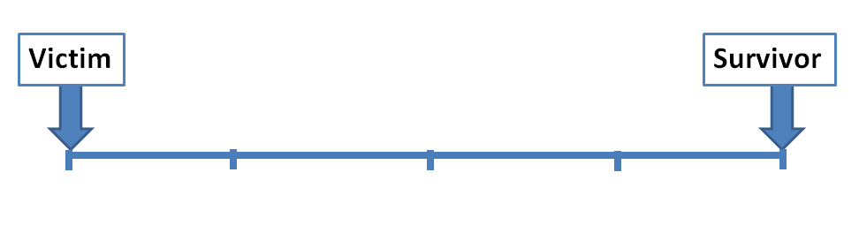
Responding to Workplace Violence in Healthcare Mindset Sliding Scale
Notes:
Purpose: Describe the meanings behind a Victim mindset and a Survival mindset through use of a scale visual.
Talk Points:
What does it mean to have a victim mindset? Possibly ask how many participants would consider themselves to have a victim mindset.
This is possibly the person who never thinks anything bad will happen to them.
This person may walk outside looking up at the sky or down at the phone without assessing the situation around them, seeing the person in the car watching them, the person hiding in the bush, the car flying through the lot, the slightly ajar door or broken light bulb, the tree branch dangling ready to fall, or has their back to large crowds or events, etc.
This person would be the person that didn’t prepare or even think about preparing for any type of attack or physically aggressive situation.
What does it mean to have a survival mindset? Ask how many participants consider themselves to have a survival mindset
On it’s extreme, this is the person who looks over their shoulder everywhere they go, looks for escape routes in every room, building, or venue they go into, watches everyone with suspicion with no regard for offending or being politically incorrect, possibly has a bunker in their back yard, has firearms for personal and home defense, has razor-wire around their property, stays off the grid to avoid identity theft or pattern tracing.
Most people will fall somewhere in between on this scale. Our objective is to move you, wherever you're at, closer toward survivor.

Slide 7

Responding to Workplace Violence in Healthcare Definition
What is Workplace Violence?
  Occupational Safety and Health Administration (OSHA) defines workplace violence as:
    Any act or threat of physical violence, both verbal and nonverbal, harassment, intimidation, or other threatening disruptive behavior that occurs at the work site.
Notes:
Purpose: Define “Workplace Violence”
Talk Points:
Read slide.
Discuss this definition and how many things we deal with in healthcare settings that fit this definition

Slide 8
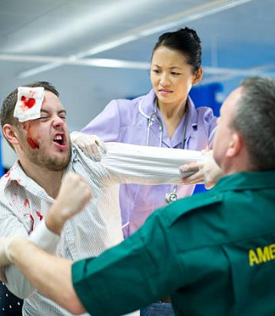
Responding to Workplace Violence in Healthcare Incident Examples
In the healthcare environment, these acts and threats include incidents such as:
                Combative patients
                Violent terminations
                Domestic disputes
                Homicidal or suicidal acts
                Patient or family dissatisfaction, wrongful death
                Chemically induced behavior (Narcan, intoxication)
Notes:
Purpose: continued- Defining Workplace Violence.
Talk Points:
Traditionally, we in healthcare reserve the term workplace violence for the following – read slide.
Really, our definition needs to convert to ALL of the forms of violence toward Healthcare workers, such as:
Biting
Kicking
Punching
Pushing
Pinching
Shoving
Scratching
Spitting at you
Name calling
Intimidating
Threatening
Yelling
Harassing (Sexual and Verbal)
Striking
Beating
Choking
Stabbing
Killing

Slide 9

Responding to Workplace Violence in Healthcare Statistics
    Statistics….
      According to the Online Journal of Issues in Nursing (OJIN), nurses are ranked number one of employees in all industries experiencing workplace violence.
    The Centers for Disease Control and Prevention (CDC) states that nursing is the highest safety risk occupation.
Notes:
Purpose: Bring realization that nursing/healthcare workers work in the most violent environment.
Talk Points:
Review OJIN statement
Review CDC statement

Slide 10

Responding to Workplace Violence in Healthcare More Statistics
    More Statistics . . .
    According to OSHA, there are approximately 25,000 workplace violence assaults per year, 70-74% of which are against healthcare workers.
    Due to under-reporting of assaults, these statistic is said to be low.
      How many of you have been kicked, bitten, hit, had pudding thrown at you, grabbed, etc.?
Notes:
Purpose: Bring realization that nursing/healthcare workers work in the most violent environment.
Talk Points:
Review OSHA statement and statistic from 2014. The numbers have only increased.
Assaults suspected of being low due to under reporting – OSHA.
What would this ‘percentage of assaults against healthcare workers’ be if we reported all of the forms of violence?
Other industries report these things that healthcare workers have developed decades of tolerances too.

Slide 11
Responding to Workplace Violence in Healthcare Simulation Video: Lobby
Will it happen here?
Click and Select Video #01 SIMULATION Hospital Lobby Active Shooter
Notes:
Purpose: Further bring realization that violent events can and will happen “here”
* High resolution videos are available on the linked page if your presentation capabilities permit.
01 SIMULATION Hospital Lobby Active Shooter
Watch video in class:
Click link to enter webpage.
Select low- or high-resolution video file: 01 SIMULATION Hospital Lobby Active Shooter
Click to play video.
Talk Points:
Possibly share a similar experience/incident in own hospital.

Slide 12
Responding to Workplace Violence in Healthcare Question
  What would you do?
        With your patients?
        Visitors?
        Children?
Notes:
Purpose: Get the class thinking of options and engaged in discussion
Talk Points:
What would you do?
(Minimal instructor talking, let the class talk and provide options. It will be tempting to relay knowledge and start teaching at this point, but stay the course, don’t jump ahead, transition into the next slide after some quick engagement)

Slide 13
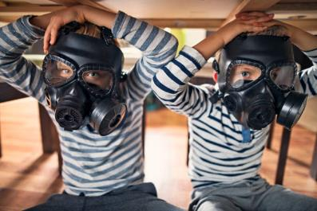

Responding to Workplace Violence in Healthcare Drills Historically
Past “crisis” training typically included:
  Tornado Drills
  Fire Drills
  Nuclear Air Raid Drills
Notes:
Purpose: Describe the proven tendency of “people” to revert to other crisis training taken in life when an incident occurs.
Talk Points:
What have you been trained to do in the past?
Many people haven’t had crisis or disaster training since their K-12 experience, where we did tornado drills and fire drills.
If you were in school in the 70’s and 80’s, you were likely trained in Nuclear air raid drills as well.
In fire drills, we learned to line up and follow the person in front of you, typically led by a teacher.
In tornado drills, we huddled to interior walls and faced away from the windows, hid under desks, went to corridors and lined against the walls, or huddled in corners.
So what do we do in a crisis? We revert to what we’re trained to do.
In Columbine High School during the shooting, surveillance videos of kids doing just that.
Hiding under desks and tables in the library and cafeteria.
Running around following the person in front of them.
In the library, there was a serpentine-like line of kids running between the tables without a direction or goal.
All proven to not be good options as a response to two kids with guns.
A photo was available, but now taken down to protect student privacy, of some students sitting on the floor, by the front of the classroom while a lone gunman shot and killed 32 people on the campus of Virginia Tech in 2007. The students stayed in their classroom, huddling, while the gunman shot and killed many.
Facts: 32 people were killed and 17 others wounded. Two semi-automatic pistols. Cho, the shooter, walked onto the second floor and into a classroom (206), shot the professor and fired several rounds into the students, then walked to the next classroom (211) and repeated. Cho went back to 206 a second time and shot more. Other classrooms, heard shooting. One classroom (207) the students held the door. Cho went on to the next classroom (204) where professor tried to hold the door shut while students climbed out and dropped from the 2nd story window. He went to another classroom (204) and starting shooting students. Cho went returned to the same classroom he started (206) and walked up and down the aisles shooting again. Then back to 211 where he shot more students, here is where he took his own life.
Referring to the picture (room 207 or 205)..
Is this a good option?
What are we doing here? (waiting for help, waiting for an “all clear”)
(Prepare the students for The Huddle in-class activity as provided in the Instructor Modules.)

Slide 14


Responding to Workplace Violence in Healthcare The Huddle Activity
Click speaker to begin timer
Notes:
(The Huddle activity as provided in the Instructor Modules.)
(If you are not going to include The Huddle activity in your class, you may go to the next slide and view an example of The Huddle. If you are including the activity, you will this slide for your timer.)
Inform students of a short activity where they will huddle together while a simulated gunman (an actor) will come into the room.
Allow students to step to the side or view from a comfortable space if they request accommodations.
See Instructor Modules for instructions on how to run this activity.
Have students move and huddle together. Dim the lights.
*Always conduct the simulations and training only as provided in the Instructor Modules and accompanying videos.

Slide 15
Responding to Workplace Violence in Healthcare The Huddle Example Video
The Huddle
Click and Select Video #02 Huddle Observation Instruction Part 1
Notes:
Purpose: This video is included here due to Covid pandemic restrictions. If your facility requires at least six (6) feet distancing, The Huddle activity can be viewed here and discussed as a class. If your facility does not have restrictions in place, complete the activity using the previous slide and skip this slide.
* High resolution videos are available on the linked page if your presentation capabilities permit.
View video #02 Huddle Observation Instruction Part 1
Watch video in class:
Click link to enter webpage.
Select low- or high-resolution video file: 02 Huddle Observation Instruction Part 1
Click to play video.
Talk Points:
Discuss the video and how you may have felt in the same situation.

Slide 16



Responding to Workplace Violence in Healthcare Response Statistics
The average police response times to an active aggressor incident is 5 - 20 minutes in the United States
The average duration of incident with an active Shooter is 3 - 4 minutes
Notes:
Purpose: To show that the class is on there own for the first minutes of an incident.
Talk Points:
Review the first statement and second statement.
Who is really the FIRST responder?
You are.
You must have other options than what we experienced.

Slide 17
Responding to Workplace Violence in Healthcare Ask Yourself
What options did we choose?
What happened to our critical thinking?
Notes:
Purpose: Reflect on what happens physiologically to our bodies.
Talk Points:
In a crisis, our heart rates go up.
When our heart rates go up, our critical thinking shuts down.
When our critical thinking shuts down, we freeze or revert to whatever training we have had.

Slide 18
Responding to Workplace Violence in Healthcare A.B.L.E.
A
Accept that it’s really happening, you cannot react until you accept the circumstance.
B
L
E
Barricade yourself and others in,
so that the aggressor stays out.
Leave the area. Get as far away as possible.
Engage the aggressor, if you must, fight back.
Notes:
Briefly discuss acronyms your organization uses (e.g., R.A.C.E. and P.A.S.S for fire safety)
Add “A.B.L.E.” to this list to help us remember how to respond during a workplace violence situation.

Slide 19
Responding to Workplace Violence in Healthcare Crisis Starts
BOOM
What do we do?
  When a balloon pops . . .
  When someone slams a book on the desk . . .
  When someone nearly hits you when changing lanes . . .
  When a patient or visitor yells at or threatens you . . .
Notes:
Purpose:
Talk Points:
Sometimes this is referred to as “fight or flight”. It’s a bit more complex when we were conditioned to do something different than flight.
This may look more like “fight or flight or duck under tables or run aimlessly or yell or attack or other things”
From this point on in the class, we’re going to indicate any violent crisis as the “Boom”. This could be a bomb, a violent encounter like yelling or slamming, a gun shot.
Let’s talk about what happens to our body when a balloon pops, a book slams on a desk, a near car accident, a person gets up in your face yelling.
Stress
According to the Cleveland Clinic, elevated heart rates are a natural response to stress. Excessive stress in your life can invoke the fight-or-flight reaction, which is the body's natural alarm system. When you face real or perceived threats to health or safety, the brain's hypothalamus region is stimulated, which produces nerve and hormonal signals that act on the adrenal glands. During stressful situations, the adrenal glands, which sit on top of the kidneys, release significant amounts of hormones, especially adrenaline and cortisol. These two hormones work in concert to ready the body for action. Adrenaline boosts your heart rate, along with blood pressure and energy supplies, while cortisol mobilizes stored sugars, increases the brain's use of glucose and down-regulates nonessential bodily functions, among other activities. Chronic activation of the body's stress-response system increases the risk of health problems, including heart disease, digestive problems and depression.

Slide 20
Responding to Workplace Violence in Healthcare Initial Choices
BOOM
Accept It
Don’t Accept
Notes:
Purpose: To begin describing the importance of Accepting what is happening.
Talk Points:
When a BOOM happens, your brain either accepts what is happening right away… or it doesn’t accept that what is happening is real or we’ve been trained to react a different way to circumstances close to the one in front of our face. How well prepared is YOUR brain?

Slide 21
Responding to Workplace Violence in Healthcare Why we freeze
Don’t Accept
= What does this mean?
Why do people freeze?
No framework for the event
No similar life experience or training
Physical capabilities or limitations
Emotional capabilities or limitations
Notes:
Purpose: Describe the framework concept of who our brain would manage the situation.
Talk Points:
Framework: previous training or work experience. Military, safety trainings, self-defense classes, or previous Law Enforcement experience. This could provide you more options to critical think yourself through a BOOM (incident).
Physical limitations
Platform example: person had fallen off a train platform, some people may freeze if they are unable to jump down from an 8’ high platform. – physical limitation
Emotional limitations
Eye-pop example: In a previous class someone had stated they would “take their fingers and pop out their attacker's eyes. Some may not be able to take themselves there emotionally if they don’t prepare themselves to do this. – emotional limitation
This section doesn’t provide the full story to be able to replicate.

Slide 22
Responding to Workplace Violence in Healthcare Intuition
    Gift of Intuition
    Gut feeling
            Mother’s intuition
            Hair stands up on the back of your neck
            Déjà vu
Notes:
Purpose: Introduction to the Gut Feeling
Talk Points:
How many people have experienced a gut feeling they couldn’t explain, déjà vu, hair standing up on the back of your neck, or just a feeling?
How many people have listened to this feeling? Normally we do not listen to this feeling, we ignore it. Sometimes we are even intrigued by danger.
Talk to the class about their own experiences so they can relate to it. Most tend to relate to leaving something on and leaving the house.
What is happening: your subconscious is trying to communicate with your conscious. We tend to be reactive to things throughout the day but listening to your gut feeling/intuition is something we can control, and we must listen to it. Sometimes we may not be able to explain it, but it could very well prevent you from becoming victimized.
Examples;
Home invasion - we put our window shade up and watch the neighbor's home and police cars
Elevator – a person ignored their gut feeling, got on (or stayed on) the elevator, and was assaulted
Include any appropriate such experiences you are comfortable sharing.
_____________________________
Instructors only – the following books are excellent sources of information to support this section and provide examples to share:
The Gift of Fear by Gavin deBecker is a must read for relatable stories to share.
As are the following:
Gut Feeling by Gerd Gigerenzer.
Blink Malcolm Gladwell.
This is the source of the “elevator” story.
Reconditioning ourselves to not worry about being offense. Safety FIRST. Don’t worry about how it might look or make the person feel.
Lengthy discussion on reconditioning ourselves to not ignore our instincts because we don’t want to be rude, hurt feelings, etc.
Humans are the only species that ignores their gut feeling.

Slide 23
Responding to Workplace Violence in Healthcare Gut Feelings
Always trust your gut . . .
It knows what your head
hasn’t yet figured out.
Notes:
Read slide.

Slide 24
Responding to Workplace Violence in Healthcare Trust your gut
Human vs. Animal
High stakes predictions - we make them every day
Animals:
      Always listen to “intuition” and . . .
        - run from danger
        - fight back when threatened or cornered
        - enact a self-defense mechanism
Humans:
      Are the only species that ignore their intuition warning them of “DANGER”
Notes:
Purpose:
Talk Points:
Ask the class who they think listens to their intuition/gut feeling better, humans or animals.
Animals do, they run from danger, humans tend to be intrigued by danger and want to see what is happening.
There is a lot of unknowns when your curiosity gets the best of you.
Some people dismiss their intuition.
Examples; rattlesnakes warn if you are too close by rattling their tail and if you ignore it that warning they are liable to strike you.
Deer, squirrels, birds, bears, in the back yard – they tend to flee if you try to go toward them, they are not staying around to figure out if there is danger.
As humans we do not generally listen to our gut feelings.

Slide 25
Responding to Workplace Violence in Healthcare Accept It
BOOM
Accept It
Don’t Accept
Freeze
(NOT AN OPTION)
Notes:
Purpose:
Talk Points:
From this point on in your life, we are taking away your permissions to freeze.
We must accept that what is happening is real as soon as possible.
This is the first step before we can allow ourselves to apply options to respond.

Slide 26
Responding to Workplace Violence in Healthcare Options
Our options: A.B.L.E.
    A
    B
    L
    E
Notes:
Purpose: First option is a must, Accept
Talk Points:
Accept what is happening as real as soon as possible.

Slide 27
Responding to Workplace Violence in Healthcare A - Accept
A = Accept what is happening
- quickly -
B
L
E
Notes:
Purpose: Carry over from previous
Talk Points:
Read slide.

Slide 28
Responding to Workplace Violence in Healthcare It’s real
Accept It
It’s happening
It’s real
This may take seconds or minutes.
Some events gradually build,
        . . . while some events have “no-warning”
You won’t be able to REACT until you Accept the situation.
Notes:
Purpose: Describe that not all BOOMs are instant.
Talk Points:
Review slide and provide examples such as threats over a timeframe, escalating behaviors over a timeframe, maybe even days or weeks in some cases.
For events that may build up, we all have a “safety” switch that needs to be turned on when attempts to resolve or other alternatives are not an option any further.
That safety switch is different in each person, some have different thresholds and experiences.
Trust your gut. Your gut will know when it’s time to switch from ‘de-escalate’ or tolerate to ‘take measures to be safe’.
Reinforce that you can only react if you accept the situation.

Slide 29
Responding to Workplace Violence in Healthcare React
Accept It
BOOM
Don’t Accept
React
(help yourself, help others)
(NOT AN OPTION)
Notes:
Purpose: Building framework
Talk Points:
Again, reinforce. You can’t react until you accept.

Slide 30

Responding to Workplace Violence in Healthcare It’s your right!
Take control of your choices to be safe.
Take control of your choices to survive.
You have a responsibility to your
  family, friends, patients,
  and co-workers to survive!
You have the right to survive!
Notes:
Purpose: Mindset needed when accepting that a violent event is imminent.
Talk Points:
Take control.
Review statements in slides.
Everyone has someone that counts on them to be in their life, we have a duty to them to take action.
Remember - One person does not have the right to take your choices away.
Flip the switch to survivor mindset!

Slide 31

Responding to Workplace Violence in Healthcare Activate Emergency Response
Activate a call for help by:
  Dialing
    Your in-house emergency number
    (Remember to dial for an outside line if needed)
  Vocera or other personal communication device
    (If available)
  Using the Code Violet button on your phone
    (If available)
  9-1-1 or local emergency number
    Place dialing instructions at each phone
Notes:
Customize this slide as needed to reflect your facility’s information and procedure.
Purpose: Review the notification options and methods for the class to start a response for security, police, help.
Talk Points:
Discuss how to call for help from your workplace (or wherever you are located).
The timer - remember the timer from the earlier exercise? A response doesn’t start until a notification is made.
Calling may not be an option at first, but as soon as an opportunity occurs, this must occur to decrease the time of response for help.
If using your cell phone to call 911, local police or other emergency services, they may they ask for your address.
Not all emergency services have automatic number identification or automatic location identification (ANI/ALI).
As well, your call may go into a service area that does not service where you are (due to cell tower location).
Your call may be transferred to another call center where you will most likely be asked to repeat the information.
Calling 911 from within the hospital may result in response delays.
(Detail your facility procedures)

Slide 32

Responding to Workplace Violence in Healthcare Save the number
Program our emergency number into your cellular
This number should appear
first in your contacts.
Notes:
CUSTOMIZE THIS SLIDE TO INCLUDE YOUR FACILITY’S INFORMATION.
Purpose: Describe cellular 9-1-1 calls and provide an additional option if one exists.
Talk Points:
For campuses covered by physical responders (police or security), it is a good idea to have the direct number programmed into your phone.
Starting with an “AA” will put it to the top of contacts.
The chances of calling from a landline is low in many situations, such as parking lots, hallways, closets, etc.
The 9-1-1 call may get routed several times to get to the appropriate responders.
Most 9-1-1 centers do not have high-level GPS technology.
Outside responders will likely not know where “6 West”, “H-Lot”, “Facilities Engineering”, “Basement Pharmacy”, etc. are located.
May save many “ticks” on the timer by dialing directly to onsite personnel if available in your facility.
If the site doesn’t have onsite responders staffed, 9-1-1 is your option.
Be prepared to provide specific directions. Plan it out, because in a crisis, you will not be able to critically think.
Plan should include “I’m at 111 Big Blvd, on the 2nd floor, in the cafeteria, in the west building, that is quickest accessed through the south entrance of that building”.
[Next slide is the “flash” slide]

Slide 33
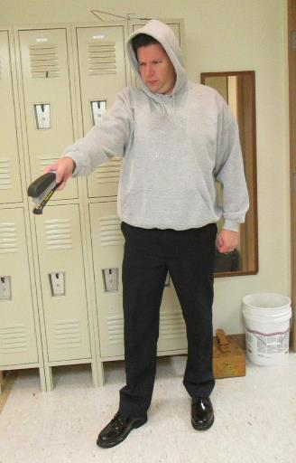
Responding to Workplace Violence in Healthcare Be attentive
Describe this…
Notes:
Purpose: Show how a description is tough to attain in a flash.
Talk Points:
Show flash of the picture.
Ask the class to describe what they saw.
Then review the picture for accuracy.

Slide 34
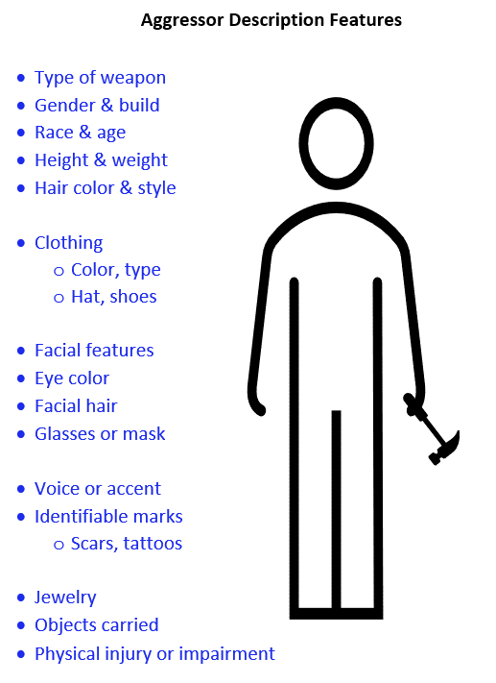
Responding to Workplace Violence in Healthcare What to notice
What to report:
  Number of aggressors
  Aggressor's description
  Type of weapon(s)
  Last known location
  Direction of travel
Notes:
Purpose: What information to report for critical decision making by responders and those occupants of the zone.
Talk Points:
Practice scanning someone from the top down, you will be impressed with what you remember with a quick glance.
Top down.
We don’t want to focus on the details, unless you are in a safe place and can see from a safe distance. You will likely remember a lot from the top down glance.
Getting a description is 2nd to getting to safety. When you call and make notification, here are items important to describe.
Read slide.
Describe weapons.. Not just knives and guns. Large or small knife. Long or short gun. IV poles, bed rails, trays, letter openers, pipes, etc., are ALL weapons and require a different level of response from emergency responders.
Having a weapon also will determine what options of response we have the BOOM occurs and we Accept it.
Reflect on items within healthcare that can be used as a weapon, IV pole, etc.
Difference in law enforcement response based on weapon or not, level of aggression.
Information provided to law enforcement dictates their response, i.e., they have a gun.

Slide 35
Responding to Workplace Violence in Healthcare Simulation Video: Patient Room
Let’s watch this scenario…….
  Would you do anything differently?
Click and Select Video #09 SIMULATION Patient Room Active Shooter
Notes:
Purpose: Introduce the idea of an active shooter at work.
* High resolution videos are available on the linked page if your presentation capabilities permit.
View video #09 SIMULATION Patient Room Active Shooter
Watch video in class:
Click link to enter webpage.
Select low- or high-resolution video file: 09 SIMULATION Patient Room Active Shooter
Click to play video.
Talk Points:
Ask and discuss how students may have reacted differently in the same situation.

Slide 36
Responding to Workplace Violence in Healthcare React by barricading
Accept It
BOOM
Barricade
Don’t Accept
React
(help yourself, help others)
(NOT AN OPTION)
Notes:
Purpose: Adding Barricade to the framework
Talk Points:
What can we do? What can we do besides huddle in the corner or under a desk?
Barricade.

Slide 37
Responding to Workplace Violence in Healthcare B - Barricade
A
B = Barricade - create a barrier
between you and the aggressor
L
E
Notes:
Purpose: Define barricade for the purpose of this option to a violent act.
Talk Points:
In the same ballpark as “hide” from “Run, hide, fight”, the focus of barricading is most effective in most situations.
Barricade between you and whatever bad situation is happening.
Typical response to a home invasion: HIDE. Why to we do this? We don’t give ourselves other options.
How to barricade a nursing unit….fire doors. Homework: Can you barricade your unit?
If you can’t barricade your unit, if not, where could you barricade yourself on the unit.
Critical thinking is impaired unless you prepare in advance of the scenario and what you would do or where you would go to barricade. How can I effectively barricade?

Slide 38
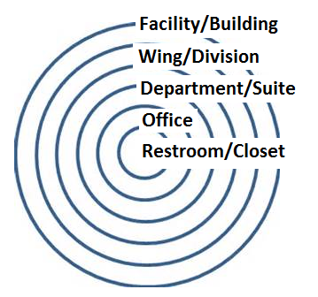
Responding to Workplace Violence in Healthcare Barricade options - levels
Where can you barricade yourself?
Facility
Wing/Division
Department/Suite
Office
Restroom/Closet
Notes:
Purpose: Describe the options of most appropriate or natural barriers.
Talk Points:
If something bad is happening outside, the first option should be to keep it outside. Some buildings are already locked down or have the ability to lock them down quickly.
If something bad happens inside, can we lock down a wing?
If something bad happens inside the wing, can we lock down the unit?
- Remember that there are fire doors between each unit or wing. Can they be locked? Homework.
If something bad happens inside the unit, where can we lock down?
Places already locked down include med rooms, staff lounges, offices.
Preparation includes the awareness that not all occupants will know what to do. Whether it’s due to one nurse assigned to four different patients or just untrained people, those that are trained and prepared will need to grab others as much as possible.
In the video, could they have barricaded in the bathroom?
Homework: how would you barricade yourself and others away from bad things? At work? At home? At church? At an airport? Example of former student being present at Ft. Lauderdale airport shooting, several gates away from the shooting. She took as many people as she could into a conference room and barricaded. She Accepted and reacted, taking people with her.
You may be the only one trained and find yourself giving orders to others.

Slide 39
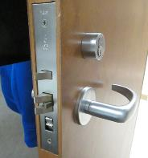


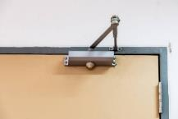
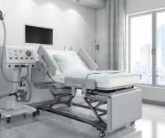
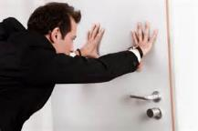
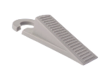
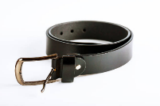
Responding to Workplace Violence in Healthcare Barricade options - items
How does your door operate?
What could you use?
Notes:
Purpose: Barricading a door
Talk Points:
In the video, they could have blocked the door with the bed. What could you use in this classroom to keep someone bad out.
…allow class to think through options…
Describe doors.
If you see hinges, it opens towards you. Barricading by place objects in front is effective.
If you don’t see hinges, the door opens away. Holding it shut may be an option. What could you use?
Describe how a ‘closer’ works (hardware on the top of some doors). This could be kept from opening and keep the door shut.
If the door is able to be locked, locked.
Describe a wedge under the door or door stopper. Substitutes include running shoe fronts, wallet, foot. If preparing for a wedge as an option, test it ahead of time to ensure it works.
Again, homework.
Glass doors on nursing units. Can the IV pole be placing in the track to prevent it from sliding open?
Use examples in the room from where you are teaching.
Use real stories!
How survivors think about what you would do if something bad happens. Think through the scenario in all situations as you go through your day to day activities. Thinking about “what if” prepares you to “accept” and react quickly because you have thought through the scenario in advance.

Slide 40

Responding to Workplace Violence in Healthcare Barricade options - examples
Beds/Desks
What is available?
Beds
Nightstands
Belt
IV Tubing
Restraint Belts
Notes:
Purpose: think and prepare how to barricade workspaces.
Talk Points:
Discuss the many items in their work area that could be used to help barricade.

Slide 41

Responding to Workplace Violence in Healthcare Lockdown Policy
Hospital Lockdown Policy:
  The objective of lockdown is to control entry into the hospital while maintaining safety and service.
  Partial lockdown: Protective Services will limit access into selected areas of the hospital by controlling entry points.
  Full facility lockdown: Protective Services will limit access into all entry points.
Notes:
CUSTOMIZE THIS SLIDE TO MEET YOUR FACILITY’S PROCEDURES.
Purpose: To describe how Lockdown Policy/Procedures fit into Barricade.
Talk Points:
For instances where a BOOM is imminent, but there is time to prepare.
* Insert the facility’s or organization lockdown procedures and capabilities here.
Tailgating is a major concern in an effective lockdown or an established restricted area. Only a culture of safety amongst employees and organization can combat this concern. Remember that in many cases, the bad actor is an employee or former employee, or someone appearing (dressing) like they belong there. Requiring everyone to swipe in or badge in is key to an optimum secure setting.

Slide 42
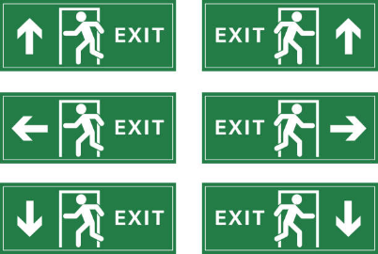
Responding to Workplace Violence in Healthcare Know your exits
Know your EXITS and
how to avoid the dangerous areas
Notes:
Purpose: Introduce the option of Leaving.
Talk Points:
If something happens in a building adjacent to yours or on a different floor, what might be another option besides barricading in place?
Discuss options at each location. LEAVE (favorite option). Get out. Train yourself to get out.
[**Instructors – refer to your state’s regulations on whether “leaving” is deemed illegal due to your facility, employees, or clients.**]

Slide 43
Responding to Workplace Violence in Healthcare React by leaving
Accept It
BOOM
Barricade
Leave
Don’t Accept
React
(help yourself, help others)
(NOT AN OPTION)
Notes:
Purpose: Build Leave into framework.
Talk Points:
[Instructors – refer to your state’s regulations on whether “leaving” is deemed illegal due to your facility, employees, or clients.]
Review slide.

Slide 44
Responding to Workplace Violence in Healthcare L - Leave
A
B
L = Leave - put as much distance as
possible between you and
the aggressor
E
Notes:
Purpose: Define Leave as an option to response of a violent act.
Talk Points:
Similar to “Run” in “Run, Hide, Fight”, the focus here is to put as much distance as you can between you and the aggressor.
Might sound logical or as though it’s an easy choice, however, if you don’t prepare, you won’t be able to apply this option.
For example: can you get up and run out in a meeting or appointment? You have to give yourself permission during your preparation.
I.e. “When something bad happens, I’m taking my patient and going this way”

Slide 45
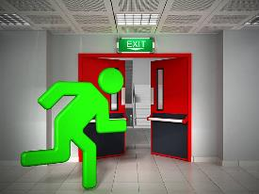
Responding to Workplace Violence in Healthcare Help patients leave
Ambulatory Patients
  Leave is an option (RUN)
  Leave through a predetermined evacuation route
  Leave belongings behind
  Know where your exits lead
  Have a meet up location
Notes:
Purpose: Highlight elements to execute an effective Leave option.
Talk Points:
Know your exits and know where exits lead.
Pausing on know your exits: During the Columbine shooting, not one person ran out of the emergency fire exit. Why? There were kids hiding under the tables just feet from the exit. But no one ran out. This is because they did not have permission to use this exit, there were signs reading “do not exit”, “alarm will sound”.
In a crisis, unless using this exit is part of the preparedness, our critical thinking is inhibited and doesn’t allow us to consider this an option. Our plan must include that you will do things that you do not normally have permission to do.
Leave belongings behind.
Reflect on home application; LEAVE is safest. Grab the PEOPLE (kids) and get out by whatever pathway is open. Leave is the safest option.
Application of real-life stories of how people do silly things before they LEAVE. (e.g., turn off stove, shut down computer, finish filling the washing machine, etc.)
Critical thinking shuts down.

Slide 46
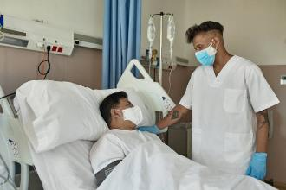
Responding to Workplace Violence in Healthcare Barricade with patients
Non-Ambulatory Patients
Removing the patient may not be an option
Barricade or “defend” in place
    Turn off lights
    Silence cell phones
    Block windows
    Position behind cover
    Treat injured if trained
    Await directions
Notes:
Purpose: What if Leave is not an option.
Talk Points:
Explain why each bullet point is relevant.
Explain conceal vs. cover.
Conceal is to hide but does not stop bullets. Cover shelters you from bullets.
Perpetrator typically try the door, if locked, they move on.
Details of what provides “cover” and what open provides concealment.

Slide 47

Responding to Workplace Violence in Healthcare When you do leave
Upon exiting the building:
Do not expect police to initially help you
    Officers are trained to neutralize the threat
    Rescue operations will arrive next
Do not have anything in your hands
Officers may point their gun at you
Raise your open hands so officers can
see your empty hands
Treat the injured if you are trained
Notes:
Purpose: Describe what to expect when leaving.
Talk Points:
Don’t expect officers to help you if the threat is still active. If you remember the timer, the officers’ job is to stop the aggressor to prevent further injuries.
Help others get out that may be hurt.
Having nothing in your hands is important. The only thing that can hurt an officer is your hands. If they see your hands are empty, you are not a threat.
Remember that the officers’ heart rate is escalated too. Having things in your hands puts them in a bad spot if they are expecting to encounter someone with a weapon or gun. Put your cell phone in your pocket, waistband, bra, etc. unless using it up to your ear.

Slide 48
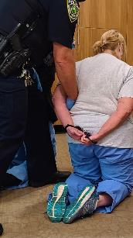
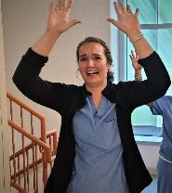
Responding to Workplace Violence in Healthcare What to expect
Expect that you:
  May have weapons pointed at you
  May be searched
  May be handcuffed
  May be told to lay on the ground
Notes:
Purpose: Expect… continued
Talk Points:
In some severe incidents, or incidents where the aggressor is unknown, don’t be offended or non-compliant if officers must clear you. Bad people wear scrubs and business clothes too. You may be searched, handcuffed, or otherwise detained as part of officers securing the area.
Provide real life stories and examples of incidents if available.

Slide 49
Responding to Workplace Violence in Healthcare Break time
Break (10 minutes)
Next up:
        Simulations…
Notes:
Purpose:
Talk Points:
Provide students a break. Let them know that the simulations will begin when they return.

Slide 50

Responding to Workplace Violence in Healthcare Simulation rules begin
Simulation Rules
Do not touch the actors
Do not throw anything
The Safe-Zone:
        Outside of the room, and
        any other designated area
Notes:
Purpose: Rules
Talk Points:
Read slide. Clarify any student questions.
Point out where the “safe zone” is in your area for viewing the simulation but not participating.
*Always conduct the simulations and training only as provided in the Instructor Modules and accompanying videos.

Slide 51
Responding to Workplace Violence in Healthcare Begin simulations
Begin Simulations
Notes:
Move students to simulation space.
Provide all instructions (again) to better ensure everyone remembers from earlier.
Use the checklist provided in the Instructor Modules to remember each point.
*Always conduct the simulations and training only as provided in the Instructor Modules and accompanying videos.

Slide 52
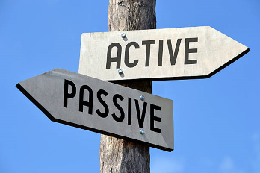
Responding to Workplace Violence in Healthcare Simulation review
Simulation Review
Notes:
Talk Points:
Review simulations and actions with class prior to beginning Engage as described in the Instructor Modules.

Slide 53
Responding to Workplace Violence in Healthcare The last resort
Finally, as a last resort,
      and sometimes the only option . . .
Notes:
Purpose: Build last option of to complete the framework of response
Talk Points:
When the option of Barricade or Leaving are not there, you cannot freeze or do nothing. You must engage the aggressor.

Slide 54
Responding to Workplace Violence in Healthcare React by engaging
Accept It
BOOM
Barricade
Leave
Don’t Accept
React
(help yourself, help others)
(Not an option)
Engage
Notes:
Purpose: Introduce Engage.
Talk Points:
Review entire slide and note that from “React” you can make any of the three (3) choices. Your choice will depend on the situation at hand and your actions may change and the situation changes.

Slide 55
Responding to Workplace Violence in Healthcare E - Engage
A
B
L
E = Engage - physically confront
aggressor as a last resort
Notes:
Purpose:
Talk Points:
We save ENGAGE for last so you all don’t beat us up in the simulations. ☺
This is when we have no other options available, we must confront the aggressor.

Slide 56
Responding to Workplace Violence in Healthcare You are strong
Engage
Tools to engage
You are strong, but you may not know it yet
You have an inner voice that is STRONG and directive
You have permission to “not be nice” to survive
You must believe that you are strong and will survive
Notes:
Purpose: Mindset to engage
Talk Points:
You must believe in yourself. You are your own “first responder” for the first couple minutes before help arrives/ or the whole duration until you can get yourself to safety.
Use your voice as a weapon. Most random one on one assaults are driven by an aggressor looking for an easily victimized target. A strong voice can turn an aggressor away, as the impression is you are not easily victimized.
Show example of a strong and directive inner voice, (someone walking behind them closely, turn and asking if you can help them).
Remind them of when they yelled “gun, gun, gun” in the simulations too.
You have the right and duty to survive for yourself and loved ones. [Make them feel empowered here.]
You are all in.

Slide 57

Responding to Workplace Violence in Healthcare Be powerful
Tools to Engage (Continued)
  Feel your balance
  Learn to be a tactical breather
  Always stand in a balanced fighting stance
  Power comes from the hips
  Practice falling and getting up
  Invest in your fitness
Notes:
Purpose:
Talk Points:
Feel your balance: don’t stand with feet shoulder width apart, take a bladed stance.
Demonstrate this for them, show the different in your balance and strength standing both ways. If you have a partner allow them to give you a push to show what each looks like. In your bladed stance you will see you are more balanced and powerful in this position.
The bladed stance allows you to move around easier as well. Demonstrate this for them.
Tactical breather: you’ve all experienced a scare before, whether a loud noise, a scary movie, a BOOM. Breathing calms you down to be able to think clearly and strategically. There are many articles easy to find online that explain how the brains neurons are released to counteract emotional excitement. Breathing in through your nose with deep breaths and out of your mouth is effective.
While practicing falling and getting up might seem silly, many people will ‘give up’ if they fall down in a crisis. Some curl up in a ball and cover their head. Practicing rolling over and jumping back up could save you from getting hurt.
Also practicing rolling on your back and getting ready to kick an offender is an effective move as well. Demonstrate what this looks like with a training partner. You can kick to groin or legs to keep an aggressor off you, and even spin around as the aggressor moves.
Invest in your fitness. If your escape route is down 6 flights of stairs, make sure you can do it. if you need to climb over a 3-foot wall to escape, make sure you can do it. if you need to run down a 50-yard corridor to an exit, make sure you can do it. You may need to strike someone 10 times to fight them off, practice strings of striking a mattress or pillow.

Slide 58
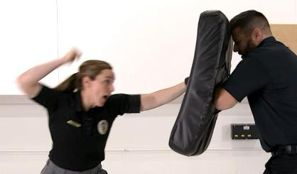
Responding to Workplace Violence in Healthcare Engage: Hammer Fist
Strikes
  Hammer fist
  Kick with balance
  Always strike the midline of the body
  The goal is to always get away
Notes:
Talk Points:
Again, this training goes back to picking up where de-escalation leaves off.
You may have to strike someone to fight them off. Don’t use your knuckles to punch someone if possible, use the meaty part of your fist like a hammer. Demonstrate by explaining pounding on a door. Use your hips to generate power while delivering a strike. The action looks like throwing a ball really hard.
If you must kick, use your hips to generate power. Knees to the groin or legs are effective.
Aim for the midline of the body for kicks and strikes.
Your goal isn’t to win a fight, but to create an opportunity to get away.
See video for additional instructor information.
*Always conduct the simulations and training only as provided in the Instructor Modules and accompanying videos.

Slide 59
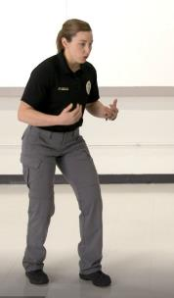

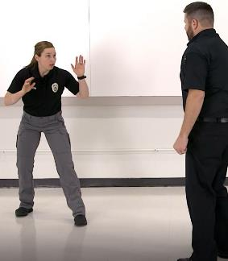
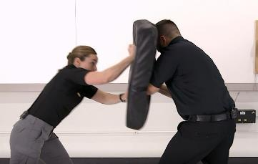
Responding to Workplace Violence in Healthcare How to use the Hammer Fist
Notes:
Instructors – decide which technique will be instructed live vs. using the video provided. Also decide which techniques will be practiced by students in accordance with the Instructor Modules and videos provided.
Always make accommodations for and be aware of maintaining a safe environment for students and instructors.
Talk points: (these will vary depending on your instructional method. This slide is use for teaching purposes in either case so you will see it duplicated after the video).
We are going to provide demonstrations of each technique.
Demonstrate for and teach students about how to use the technique.
Instructors can teach it live, or use the video provided on an upcoming slide.
Provide a pad and allow students to practice.
Allow students to practice with a partner or instructor if you choose to do so.
Watch the student’s technique and provide any correction needed to assist them in completing their most optimal technique. Focus on the mechanics of the technique and guide students accordingly. Provide positive and constructive feedback to students.
This slide:
A series of photos showing different stages of the Hammer Fist strike. The instructor keeps a solid, balanced stance, steps forward to strike a pad held by another instructor, and then moves back several steps with hands up in a defensive posture.

Slide 60
Responding to Workplace Violence in Healthcare Hammer Fist Video
Hammer Fist Strike
Instructional Video
Click and Select Video #20 Tools to Engage Strikes Hammer Fist
Notes:
Watch video to teach the technique if not teaching it live.
* High resolution videos are available on the linked page if your presentation capabilities permit.
View video #20 Tools to Engage Strikes Hammer Fist
Watch video in class:
Click link to enter webpage.
Select low- or high-resolution video file: 20 Tools to Engage Strikes Hammer Fist
Click to play video.

Slide 61
Responding to Workplace Violence in Healthcare How to use the Hammer Fist.
Notes:
Instructors – decide which technique will be instructed live vs. using the video provided. Also decide which techniques will be practiced by students in accordance with the Instructor Modules and videos provided.
Always make accommodations for and be aware of maintaining a safe environment for students and instructors.
Talk points: (these will vary depending on your instructional method. This slide is use for teaching purposes in either case so you will see it duplicated after the video).
We are going to provide demonstrations of each technique.
Demonstrate for and teach students about how to use the technique.
Instructors can teach it live, or use the video provided on an upcoming slide.
Provide a pad and allow students to practice.
Allow students to practice with a partner or instructor if you choose to do so.
Watch the student’s technique and provide any correction needed to assist them in completing their most optimal technique. Focus on the mechanics of the technique and guide students accordingly. Provide positive and constructive feedback to students.
This slide:
A series of photos showing different stages of the Hammer Fist strike. The instructor keeps a solid, balanced stance, steps forward to strike a pad held by another instructor, and then moves back several steps with hands up in a defensive posture.

Slide 62
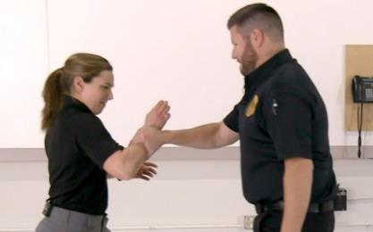
Responding to Workplace Violence in Healthcare Engage: Snake & Vine
Wrist Grab
  Snake and the vine
  Never pull someone toward you
Notes:
Purpose: Getting out of a wrist grab.
Instructors – decide which technique will be instructed live vs. using the video provided. Also decide which techniques will be practiced by students in accordance with the Instructor Modules and videos provided.
Always make accommodations for and be aware of maintaining a safe environment for students and instructors.
Talk points:
We are going to provide demonstrations of each technique.
Demonstrate for and teach students about how to use the technique.
Instructors can teach it live, or use the video provided on an upcoming slide.
See video for additional instructor information.
*Always conduct the simulations and training only as provided in the Instructor Modules and accompanying videos.

Slide 63
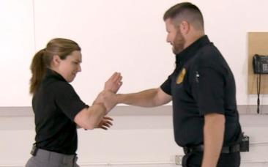
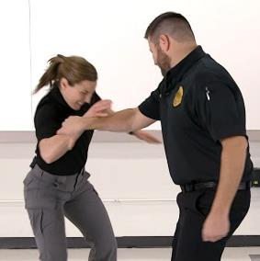
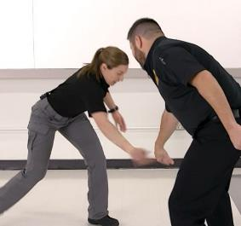
Responding to Workplace Violence in Healthcare How to use the Snake & Vine
Notes:
Instructors – decide which technique will be instructed live vs. using the video provided. Also decide which techniques will be practiced by students in accordance with the Instructor Modules and videos provided.
Always make accommodations for and be aware of maintaining a safe environment for students and instructors.
Talk points: (these will vary depending on your instructional method. This slide is use for teaching purposes in either case so you will see it duplicated after the video).
We are going to provide demonstrations of each technique.
Demonstrate for and teach students about how to use the technique.
Instructors can teach it live, or use the video provided on an upcoming slide.
Allow students to practice with a partner or instructor if you choose to do so.
Watch the student’s technique and provide any correction needed to assist them in completing their most optimal technique. Focus on the mechanics of the technique and guide students accordingly. Provide positive and constructive feedback to students.
This slide:
A series of photos showing different stages of defending against a wrist grab. The instructor has been grabbed on the wrist by another instructor who acts as the aggressor. Using a release technique where you circle your hand and wrist around the attacker’s forearm and forcefully push down to release their grip on your wrist.

Slide 64
Responding to Workplace Violence in Healthcare Snake & Vine Video
Wrist Grab Defense
Instructional Video
Click and Select Video #21 Tools to Engage Wrist Grab Snake and the Vine
Notes:
Watch video to teach the technique if not teaching it live.
* High resolution videos are available on the linked page if your presentation capabilities permit.
View video #21 Tools to Engage Wrist Grab Snake and the Vine
Watch video in class:
Click link to enter webpage.
Select low- or high-resolution video file: 21 Tools to Engage Wrist Grab Snake and the Vine
Click to play video.

Slide 65
Responding to Workplace Violence in Healthcare How to use the Snake & Vine review
Notes:
Instructors – decide which technique will be instructed live vs. using the video provided. Also decide which techniques will be practiced by students in accordance with the Instructor Modules and videos provided.
Always make accommodations for and be aware of maintaining a safe environment for students and instructors.
Talk points: (these will vary depending on your instructional method. This slide is use for teaching purposes in either case so you will see it duplicated after the video).
We are going to provide demonstrations of each technique.
Demonstrate for and teach students about how to use the technique.
Instructors can teach it live, or use the video provided on an upcoming slide.
Allow students to practice with a partner or instructor if you choose to do so.
Watch the student’s technique and provide any correction needed to assist them in completing their most optimal technique. Focus on the mechanics of the technique and guide students accordingly. Provide positive and constructive feedback to students.
This slide:
A series of photos showing different stages of defending against a wrist grab. The instructor has been grabbed on the wrist by another instructor who acts as the aggressor. Using a release technique where you circle your hand and wrist around the attacker’s forearm and forcefully push down to release their grip on your wrist.

Slide 66
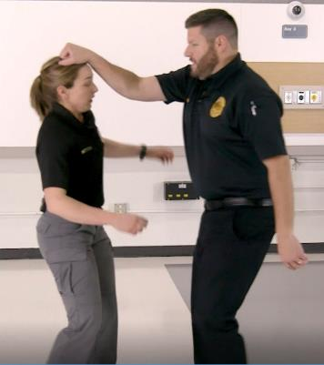
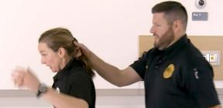
Responding to Workplace Violence in Healthcare Engage: Be a Ballerina
Hair Pull / Grab
  Be a Ballerina
  It’s all about the angles
Notes:
Purpose: getting out of a hair pull/grab.
Talk Points:
Grabbing hair from the front, top, or back is common.
This technique also works from the front.
Instructors – decide which technique will be instructed live vs. using the video provided. Also decide which techniques will be practiced by students in accordance with the Instructor Modules and videos provided.
Always make accommodations for and be aware of maintaining a safe environment for students and instructors.
See video for additional instructor information.
*Always conduct the simulations and training only as provided in the Instructor Modules and accompanying videos.

Slide 67
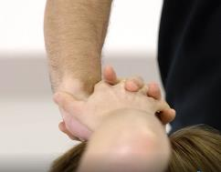

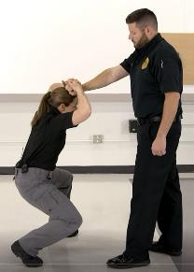
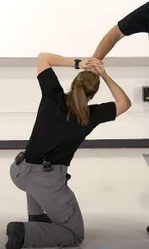
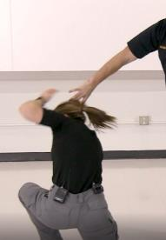
Responding to Workplace Violence in Healthcare How to Be a Ballerina
Notes:
Instructors – decide which technique will be instructed live vs. using the video provided. Also decide which techniques will be practiced by students in accordance with the Instructor Modules and videos provided.
Always make accommodations for and be aware of maintaining a safe environment for students and instructors.
Talk points: (these will vary depending on your instructional method. This slide is use for teaching purposes in either case so you will see it duplicated after the video).
We are going to provide demonstrations of each technique.
Demonstrate for and teach students about how to use the technique.
Instructors can teach it live, or use the video provided on an upcoming slide.
Allow students to practice with a partner or instructor if you choose to do so.
Watch the student’s technique and provide any correction needed to assist them in completing their most optimal technique. Focus on the mechanics of the technique and guide students accordingly. Provide positive and constructive feedback to students.
This slide:
A series of photos showing different stages of defending against a hair pull/grab. The instructor’s hair has been grabbed (top of head) by another instructor who acts as the aggressor. The victim places their hands firmly on top of the aggressor’s hands on their head. Pressing or pulling down forcefully, to ensure a solid hold, the victim dips down, bends slightly forward, and starts to twist or turn to one side. This action puts significant force on the attacker’s wrist which can be very painful. The attacker releases their grip in response to the pain.

Slide 68
Responding to Workplace Violence in Healthcare Be a Ballerina Video
Hair Pull/Grab Defense
Instructional Video
Click and Select Video #22 Tools to Engage Hair Pull Be a Ballerina
Notes:
Watch video to teach the technique if not teaching it live.
* High resolution videos are available on the linked page if your presentation capabilities permit.
View video #22 Tools to Engage Hair Pull Be a Ballerina
Watch video in class:
Click link to enter webpage.
Select low- or high-resolution video file: 22 Tools to Engage Hair Pull Be a Ballerina
Click to play video.

Slide 69
Responding to Workplace Violence in Healthcare How to Be a Ballerina review
Notes:
Instructors – decide which technique will be instructed live vs. using the video provided. Also decide which techniques will be practiced by students in accordance with the Instructor Modules and videos provided.
Always make accommodations for and be aware of maintaining a safe environment for students and instructors.
Talk points: (these will vary depending on your instructional method. This slide is use for teaching purposes in either case so you will see it duplicated after the video).
We are going to provide demonstrations of each technique.
Demonstrate for and teach students about how to use the technique.
Instructors can teach it live, or use the video provided on an upcoming slide.
Allow students to practice with a partner or instructor if you choose to do so.
Watch the student’s technique and provide any correction needed to assist them in completing their most optimal technique. Focus on the mechanics of the technique and guide students accordingly. Provide positive and constructive feedback to students.
This slide:
A series of photos showing different stages of defending against a hair pull/grab. The instructor’s hair has been grabbed (top of head) by another instructor who acts as the aggressor. The victim places their hands firmly on top of the aggressor’s hands on their head. Pressing or pulling down forcefully, to ensure a solid hold, the victim dips down, bends slightly forward, and starts to twist or turn to one side. This action puts significant force on the attacker’s wrist which can be very painful. The attacker releases their grip in response to the pain.

Slide 70
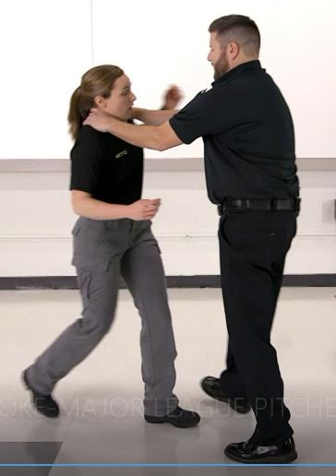
Responding to Workplace Violence in Healthcare Engage: Major League Pitcher
Front Choke Hold
  Major League pitcher
  Power from the hips
Notes:
Purpose: getting out of a front choke hold
Talk Points:
Most assaults on women, especially domestic, involve choking.
See video for additional instructor information.
Also, not captured in the video is being choked on a wall. Same concept of swinging (or swimming) your arm over top and turning will break the grip.
Instructors – decide which technique will be instructed live vs. using the video provided. Also decide which techniques will be practiced by students in accordance with the Instructor Modules and videos provided.
Always make accommodations for and be aware of maintaining a safe environment for students and instructors.
*Always conduct the simulations and training only as provided in the Instructor Modules and accompanying videos.

Slide 71
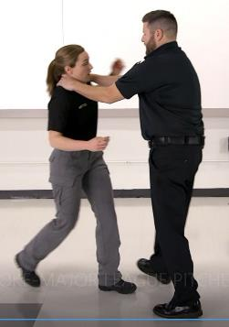
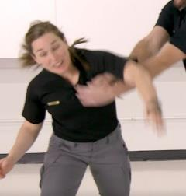
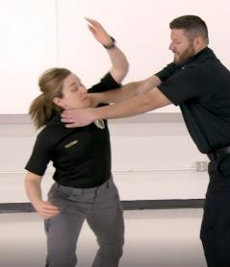
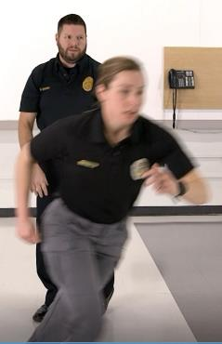
Responding to Workplace Violence in Healthcare How to be a ML Pitcher
Notes:
Instructors – decide which technique will be instructed live vs. using the video provided. Also decide which techniques will be practiced by students in accordance with the Instructor Modules and videos provided.
Always make accommodations for and be aware of maintaining a safe environment for students and instructors.
Talk points: (these will vary depending on your instructional method. This slide is use for teaching purposes in either case so you will see it duplicated after the video).
We are going to provide demonstrations of each technique.
Demonstrate for and teach students about how to use the technique.
Instructors can teach it live, or use the video provided on an upcoming slide.
Allow students to practice with a partner or instructor if you choose to do so.
Watch the student’s technique and provide any correction needed to assist them in completing their most optimal technique. Focus on the mechanics of the technique and guide students accordingly. Provide positive and constructive feedback to students.
This slide:
A series of photos showing different stages of defending against an attacker who grabs their neck from the front in a choke hold. The instructor, using a technique that is similar to pitching a baseball, raises their arm up, turns to the opposite direction, and then forcefully brings their outstretched arm down which completing the turn. This breaks the attacker’s grip allowing the victim to get away.

Slide 72
Responding to Workplace Violence in Healthcare Major League Pitcher Video
Front Choke Defense
Instructional Video
Click and Select Video #23 Tools to Engage Front Choke Major League Pitcher
Notes:
Watch video to teach the technique if not teaching it live.
* High resolution videos are available on the linked page if your presentation capabilities permit.
View video #23 Tools to Engage Front Choke Major League Pitcher
Watch video in class:
Click link to enter webpage.
Select low- or high-resolution video file: 23 Tools to Engage Front Choke Major League Pitcher
Click to play video.

Slide 73
Responding to Workplace Violence in Healthcare How to be a ML Pitcher review
Notes:
Instructors – decide which technique will be instructed live vs. using the video provided. Also decide which techniques will be practiced by students in accordance with the Instructor Modules and videos provided.
Always make accommodations for and be aware of maintaining a safe environment for students and instructors.
Talk points: (these will vary depending on your instructional method. This slide is use for teaching purposes in either case so you will see it duplicated after the video).
We are going to provide demonstrations of each technique.
Demonstrate for and teach students about how to use the technique.
Instructors can teach it live, or use the video provided on an upcoming slide.
Allow students to practice with a partner or instructor if you choose to do so.
Watch the student’s technique and provide any correction needed to assist them in completing their most optimal technique. Focus on the mechanics of the technique and guide students accordingly. Provide positive and constructive feedback to students.
This slide:
A series of photos showing different stages of defending against an attacker who grabs their neck from the front in a choke hold. The instructor, using a technique that is similar to pitching a baseball, raises their arm up, turns to the opposite direction, and then forcefully brings their outstretched arm down which completing the turn. This breaks the attacker’s grip allowing the victim to get away.

Slide 74
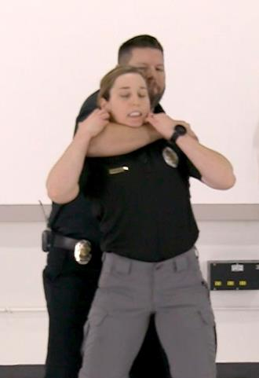
Responding to Workplace Violence in Healthcare Engage: Squash the Bug
Grab from Behind
  Squash the bug
  Groin strikes
Notes:
Purpose: Getting out of a choke hold from behind.
Talk Points:
.. Watch video..
Re-emphasize the airway. Most critical part. You can black out in seconds because of the blood flow to the brain and airway blockage.
See video for additional instructor information.
Instructors – decide which technique will be instructed live vs. using the video provided. Also decide which techniques will be practiced by students in accordance with the Instructor Modules and videos provided.
Always make accommodations for and be aware of maintaining a safe environment for students and instructors.
*Always conduct the simulations and training only as provided in the Instructor Modules and accompanying videos.

Slide 75

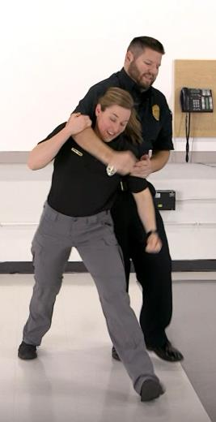
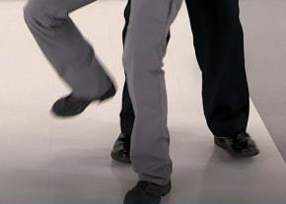
Responding to Workplace Violence in Healthcare How to Squash the Bug
Notes:
Instructors – decide which technique will be instructed live vs. using the video provided. Also decide which techniques will be practiced by students in accordance with the Instructor Modules and videos provided.
Always make accommodations for and be aware of maintaining a safe environment for students and instructors.
Talk points: (these will vary depending on your instructional method. This slide is use for teaching purposes in either case so you will see it duplicated after the video).
We are going to provide demonstrations of each technique.
Demonstrate for and teach students about how to use the technique.
Instructors can teach it live, or use the video provided on an upcoming slide.
Allow students to practice with a partner or instructor if you choose to do so.
Watch the student’s technique and provide any correction needed to assist them in completing their most optimal technique. Focus on the mechanics of the technique and guide students accordingly. Provide positive and constructive feedback to students.
This slide:
A series of photos showing different stages of defending against an attacker who grabs a victim around the neck from behind. The instructor who is grabbed protects their airway by pulling down on the attacker’s forearm and pressing their own chin towards their chest to help provide air access. The instructor then uses their heel to stomp forcefully down the shin and on top of the foot of the attacker. This is followed by the instructor using a Hammer Fist strike to the groin of the attacker.

Slide 76
Responding to Workplace Violence in Healthcare Squash the Bug Video
Grab from Behind Defense
Instructional Video
Click and Select Video #24 Tools to Engage Rear Choke Squash the Bug
Notes:
Watch video to teach the technique if not teaching it live.
* High resolution videos are available on the linked page if your presentation capabilities permit.
View video #24 Tools to Engage Rear Choke Squash the Bug
Watch video in class:
Click link to enter webpage.
Select low- or high-resolution video file: 24 Tools to Engage Rear Choke Squash the Bug
Click to play video.

Slide 77
Responding to Workplace Violence in Healthcare How to Squash the Bug review
Notes:
Instructors – decide which technique will be instructed live vs. using the video provided. Also decide which techniques will be practiced by students in accordance with the Instructor Modules and videos provided.
Always make accommodations for and be aware of maintaining a safe environment for students and instructors.
Talk points: (these will vary depending on your instructional method. This slide is use for teaching purposes in either case so you will see it duplicated after the video).
We are going to provide demonstrations of each technique.
Demonstrate for and teach students about how to use the technique.
Instructors can teach it live, or use the video provided on an upcoming slide.
Allow students to practice with a partner or instructor if you choose to do so.
Watch the student’s technique and provide any correction needed to assist them in completing their most optimal technique. Focus on the mechanics of the technique and guide students accordingly. Provide positive and constructive feedback to students.
This slide:
A series of photos showing different stages of defending against an attacker who grabs a victim around the neck from behind. The instructor who is grabbed protects their airway by pulling down on the attacker’s forearm and pressing their own chin towards their chest to help provide air access. The instructor then uses their heel to stomp forcefully down the shin and on top of the foot of the attacker. This is followed by the instructor using a Hammer Fist strike to the groin of the attacker.

Slide 78
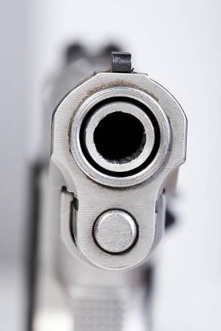
Responding to Workplace Violence in Healthcare Hit rates
Just how good are the shooters?
Let’s see . . .
    What is a trained
    officer’s hit rate?
Notes:
Purpose: Understand shot accuracy.
Talk Points:
Trained officers, spending many hours per year on the shooting range and other active shooting training are about 20-30% accuracy in a real shooting event.
Untrained aggressors are 1-5% accurate.
Moving targets are harder than stationary. Remember the timer exercise. The hit rate will be high when hiding under desks or huddled in the corner. The hit rate will be low if running or moving around.
Let’s talk about another way to interrupt the aim of an aggressor with a firearm…
Now watch the video.

Slide 79
Responding to Workplace Violence in Healthcare How to distract a shooter
Distraction . . . What Causes a Reaction?
Click and Select Video #26 Distraction What Causes a Reaction
Notes:
Purpose: To demonstrate how a distraction can take a shooter’s aim off target.
This slide may be skipped for instructors who have the laser equipment and demonstrate live in class.
* High resolution videos are available on the linked page if your presentation capabilities permit.
View video #26 Distraction What Causes a Reaction
Watch video in class:
Click link to enter webpage.
Select low- or high-resolution video file: 26 Distraction What Causes a Reaction
Click to play video.

Slide 80
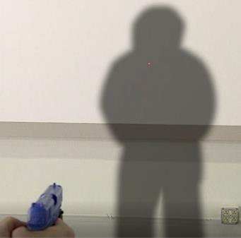
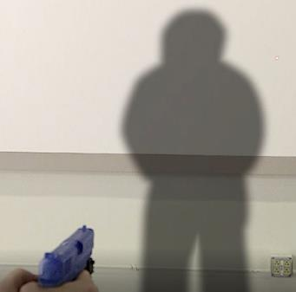
Responding to Workplace Violence in Healthcare Distraction and aim
Just how good are the shooters?
Notes:
Purpose: Understand shot accuracy.
Talk Points:
Review how accuracy is greatly affected with just a small movement that will take the aim off target.
Photo shows a fake gun (for demonstration purposes) pointing at a silhouette of a person and a laser dot at the place where the bullet would strike if shot. An arrow is used to help note where the laser dot is located on the chest of the silhouette.

Slide 81
Responding to Workplace Violence in Healthcare What can you throw?
What Could You Use As A Distraction?
Soda Cans
Food Trays
Laptop
IV Pole
Phone
Charts
Lunch Bags
Stapler
Book Bags
Keyboard
Notes:
Purpose: Describe things to use as a distraction.
Talk Points:
You must prepare to throw your items that you wouldn’t normally throw. Give yourself permission. Say “When a man with a gun walks in, I’m going to throw … “
Think of things at hand like stapler, coffee cup, bottle, stack of papers, binder, etc.
A chair would take a second or two, but if that’s what you got, you do what is necessary.

Slide 82

Responding to Workplace Violence in Healthcare Authority granted
Authority
Authority must be given to employees
Employees must give themselves authority
Notes:
Purpose: Give yourself permission to use company equipment.
Talk Points:
When critical thinking shuts down, you will not throw things that you would normally get in trouble for like laptop or equipment, UNLESS you give yourself permission and prepare to use it if it’s a matter of being safe, or worse, life or death.

Slide 83
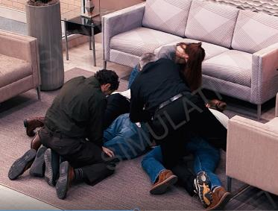
Responding to Workplace Violence in Healthcare Engage: The Swarm
Very simple and effective tactic: The Swarm
The goal is to control 3 points:
  Arms
  Legs
  Head
Notes:
Purpose: Introduce the swarm technique.
Talk Points:
Now, once you throw a distraction, you must follow up with an option. What are your options?
Leave… or Engage.
Again, you are all in. The swarm technique is an effective method when other options aren’t applicable.
This is what it might look like in a lobby setting.
Now watch video demonstration of the swarm.
*Always conduct the simulations and training only as provided in the Instructor Modules and accompanying videos.

Slide 84
Responding to Workplace Violence in Healthcare The Swarm Video Demo
The Swarm Demonstration
Click and Select Video #25 SIMULATION Swarm Maneuver Demo
Notes:
View video demonstrating the Swarm Technique used in a lobby setting.
View video #25 SIMULATION Swarm Maneuver Demo
Watch video in class:
Click link to enter webpage.
Select low- or high-resolution video file: 25 SIMULATION Swarm Maneuver Demo
Click to play video.
* High resolution videos are available on the linked page if your presentation capabilities permit.

Slide 85
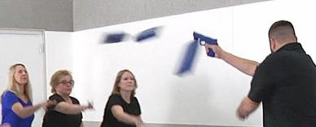
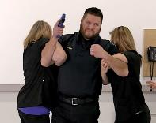
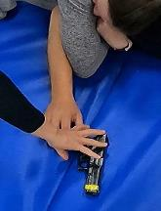
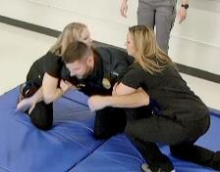
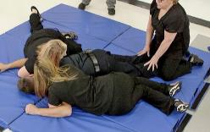
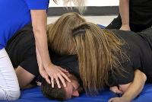
Responding to Workplace Violence in Healthcare How to Swarm
Notes:
Instructors – decide which technique will be instructed live vs. using the video provided. Also decide which techniques will be practiced by students in accordance with the Instructor Modules and videos provided.
Always make accommodations for and be aware of maintaining a safe environment for students and instructors.
Talk points: (these will vary depending on your instructional method. This slide is use for teaching purposes in either case so you will see it duplicated after the video).
We are going to provide demonstrations of each technique.
Demonstrate for and teach students about how to use the technique.
Instructors can teach it live, or use the video provided on an upcoming slide.
Allow students to practice with a partner or instructor if you choose to do so.
Watch the student’s technique and provide any correction needed to assist them in completing their most optimal technique. Focus on the mechanics of the technique and guide students accordingly. Provide positive and constructive feedback to students.
*Always conduct the simulations and training only as provided in the Instructor Modules and accompanying videos.
This slide:
A series of photos showing different stages of defending against an instructor pointing a fake gun at a small group of people. The small group of people throw foam pads (for demonstration purposes so as to not injure the instructor) to cause the gunman to move the gun’s aim as they protect their face and head from the objects being thrown. The same group then swarms the gunman, two of them wrap their arms firmly around the attacker’s arm above the elbow, and then drop their weight to pull the attacker to the ground (which is covered by a padded mat). One person sits on the gunman’s lower legs. One person holds the gunman’s head down to the mat. One person reaches for the gun and removes it from the reach of the gunman.

Slide 86
Responding to Workplace Violence in Healthcare The Swarm Video
The Swarm
Instructional Video
Click and Select Video #27 Tools to Engage Weapon Swarm Maneuver
Notes:
Watch video to teach the technique if not teaching it live.
* High resolution videos are available on the linked page if your presentation capabilities permit.
View video #27 Tools to Engage Weapon Swarm Maneuver
Watch video in class:
Click link to enter webpage.
Select low- or high-resolution video file: 27 Tools to Engage Weapon Swarm Maneuver
Click to play video.

Slide 87
Responding to Workplace Violence in Healthcare How to Swarm review
Notes:
Instructors – decide which technique will be instructed live vs. using the video provided. Also decide which techniques will be practiced by students in accordance with the Instructor Modules and videos provided.
Always make accommodations for and be aware of maintaining a safe environment for students and instructors.
Talk points: (these will vary depending on your instructional method. This slide is use for teaching purposes in either case so you will see it duplicated after the video).
We are going to provide demonstrations of each technique.
Demonstrate for and teach students about how to use the technique.
Instructors can teach it live, or use the video provided on an upcoming slide.
Allow students to practice with a partner or instructor if you choose to do so.
Watch the student’s technique and provide any correction needed to assist them in completing their most optimal technique. Focus on the mechanics of the technique and guide students accordingly. Provide positive and constructive feedback to students.
*Always conduct the simulations and training only as provided in the Instructor Modules and accompanying videos.
This slide:
A series of photos showing different stages of defending against an instructor pointing a fake gun at a small group of people. The small group of people throw foam pads (for demonstration purposes so as to not injure the instructor) to cause the gunman to move the gun’s aim as they protect their face and head from the objects being thrown. The same group then swarms the gunman, two of them wrap their arms firmly around the attacker’s arm above the elbow, and then drop their weight to pull the attacker to the ground (which is covered by a padded mat). One person sits on the gunman’s lower legs. One person holds the gunman’s head down to the mat. One person reaches for the gun and removes it from the reach of the gunman.

Slide 88

Responding to Workplace Violence in Healthcare Hostage Situations
Hostage:
If you are taken hostage:
  Be patient
  Be alert and follow instructions
  Do not speak unless spoken to
  Avoid arguments or appearing hostile
  Conserve your energy
  Be observant
Notes:
Purpose: What to do if taken hostage.
Talk Points:
Review points on slide.
Know that you will have an opportunity to get out of this situation.
If you encounter officers and they holler “drop, drop, drop” or “down, down, down”, fall straight down by buckling your legs.
Some responders are trained to yell this so that you leave the target (aggressor) up half wide open.
[Instructors – consider discussing this situation and law enforcement responses with your local emergency responders.]

Slide 89
Responding to Workplace Violence in Healthcare A.B.L.E. Recap
Accept It
BOOM
Barricade
Leave
Don’t Accept
React
(help yourself
& help others)
(Not an option)
Engage
Notes:
Purpose: Review the framework of response.
Talk Points:
To recap and review.
When a BOOM happens you what? - (Accept)
Freezing is no longer an option!
Once you accept the reality, you can react. What are your options? (Barricade, Leave, Engage)
These are your only options. They may not be in a particular order of applicability.
You may have someone burst into your area, Leaving or Engaging are your options
You may be Leaving and must duck into a closet and Barricade.
Provide additional examples and ask students what they might do if X happened, or then Y happened. Use several examples to help students work through how their reactions would vary depending on the situation presented and that the situation will change.

Slide 90
Responding to Workplace Violence in Healthcare Review Objectives
Review of Objectives
To increase confidence in your reactions to a crisis by building a framework of options
  Accept that its happening and take action.
  Options for fire drills and tornados do not fit options for violent people
  Barricade . . . Leave . . . Engage
To move away from a Victim Mindset . . .
. . . and toward a Survival Mindset
  React to your intuition - that gut feeling
  You have a right and duty to survive
Notes:
Purpose: Review the objectives laid out at the beginning of class.
Talk Points:
Did we build a framework of response?
Did we move away from a victim mindset (easily victimized) toward a survivor mindset?

Slide 91
Responding to Workplace Violence in Healthcare Confirming Statement
  When confronted with violence,
  I will NOT FREEZE.
  I will take action, and
  I will survive.
Notes:
Purpose: Last statement of commitment to responses
Talk Points:
Have the class all practice their inner voices in unison, loud enough that people in the floor above can hear and read the statement together as a group.
Repeat if not loud enough.

Slide 92

Responding to Workplace Violence in Healthcare Questions and Feedback
Questions and Feedback
Notes:
Purpose: Dismissal
Talk Points:
Those questions can stick around. Thank you for your engagement in the class.
Remind students to complete the post test and evaluation.

