Slide 1

Excavation and Trenching Hazards in Construction
A Language and Literacy Appropriate Safety Training
This material was produced under a grant (SH-05149-SH9) from the Occupational Safety and Health Administration, U.S. Department of Labor. It does not necessarily reflect the views or policies of the U.S. Department of Labor, nor does mention of trade names, commercial products, or organizations imply endorsement by the U.S. Government.
Notes:
Note for Trainer:
Since workers are the target audience, this presentation emphasizes hazard identification, avoidance, and control – not standards. No attempt has been made to treat the topic exhaustively. It is essential that trainers tailor their presentations to the needs and understanding of their audience.

Slide 2
Disclaimer
No legal advice is offered or implied, and no attorney-client relationship is intended or established. If legal advice or other expert assistance is required, the services of a competent professional should be sought.
It is the responsibility of the employer and its employees to comply with all pertinent OSHA rules and regulations in the jurisdiction in which they work.
Notes:
Note for Trainer:
This page is copied from the fy10_sh-20999-10-electrical-safety PowerPoint
2

Slide 3
Objectives
Understand basic terms and knowledge
Recognize competent persons and employer responsibilities to protect workers
Raise awareness about the hazards of working in trenches
Identify major types of excavation hazards at construction workplaces
Learn how to prevent excavation accidents at construction sites
Notes:
Note for Trainer:
Training objectives are listed here.
3

Slide 4
Step-by-Step Training Agenda
Sign Up
Basic Terms
Pre-Test
Case Study
Training Modules
Excavation Hazards
Case Study
Excavation Hazards Prevention
Post-Test
Feedback Survey
Notes:
Note for Trainer:
This page shows the step-by-step training agenda.
4

Slide 5
Sign-In
It is time to fill out the sign-in sheet
Notes:
Note for Trainer:
It is time to fill out the sign-in sheet.
5

Slide 6
Pre-Test
Please Begin Pre-Test (15 Minutes)
Notes:
Note for Trainer:
Please begin Pre-Test (15 Minutes).
6

Slide 7
Section I: Training Modules
Section I: Basic Terms and Case Study
Worker Rights under OSH Act
Basic Terms Associated with Excavation
Excavation and Trenching Hazards Statistics
A Case Study Discussion
Notes:
Note for Trainer:
The first section of the training will be about basic concepts and one case study.
7

Slide 8
Section II: Training Modules
Section II: Excavation Hazards in Construction
Cave-In (Trench Collapse)
Water Accumulation
Oxygen Deficiency and Toxic Fumes
Ingress or Egress
Exposure to Falling Loads
Mobile Equipment
Electrocution or Explosion
Notes:
Note for Trainer:
The second section will be about excavation hazards in Construction.
8

Slide 9
Section III: Training Modules
Section III: Excavation Hazards Prevention
Cave-In Protection Measures
Look for Standing Water in Trenches
Test for Atmospheric Hazards
Ensure a Safe Way of Entering and Exit
Don’t Work under Suspended or Raised Loads
Keep Materials Away from Trench Edges
Never Dig Trench Unless Being Properly Inspected
Notes:
Note for Trainer:
The third section of the training will be about excavation hazards prevention.
9

Slide 10
Training Modules Agenda for Section I
Section I: Basic Terms and Case Study
Worker Rights under OSHA Act
Basic Terms Associated with Excavation
Excavation and Trenching Hazards Statistics
A Case Study Discussion
Section II: Excavation Hazards in Construction
Section III: Excavation Hazards Prevention
Notes:
Note for Trainer:
The first section of the training will be about basic concepts and one case study.
10

Slide 11
Worker Rights Under the OSH Act
Workers have rights to
Working condition without a risk of serious harm
Review employer’s records of work-related injuries and illnesses
Get a copy of their medical records
Receive information and training about hazards and prevention methods, and the OSHA standards
Notes:
Note for Trainer:
According to (https://www.osha.gov/OshDoc/data_Hurricane_Facts/trench_excavation_fs.pdf), workers have the right to: Working conditions that do not pose a risk of serious harm. Receive information and training (in a language and vocabulary the worker understands) about workplace hazards, methods to prevent them, and the OSHA standards that apply to their workplace. Review records of work-related injuries and illnesses. File a complaint asking OSHA to inspect their workplace if they believe there is a serious hazard or that their employer is not following OSHA’s rules. OSHA will keep all identities confidential. Exercise their rights under the law without retaliation, including reporting an injury or raising health and safety concerns with their employer or OSHA. If a worker has been retaliated against for using their rights, they must file a complaint with OSHA as soon as possible, but no later than 30 days.

Slide 12
More Worker Rights Under the OSH Act
Workers have rights to
File a complaint asking OSHA to inspect workplace
OSHA will keep all identities confidential
Exercise rights under the law without retaliation
If a worker is retaliated against for using their rights, the worker must file a complaint with OSHA as soon as possible (no later than 30 days)
Notes:
Note for Trainer:
According to (https://www.osha.gov/OshDoc/data_Hurricane_Facts/trench_excavation_fs.pdf), workers have the right to: Working conditions that do not pose a risk of serious harm. Receive information and training (in a language and vocabulary the worker understands) about workplace hazards, methods to prevent them, and the OSHA standards that apply to their workplace. Review records of work-related injuries and illnesses. File a complaint asking OSHA to inspect their workplace if they believe there is a serious hazard or that their employer is not following OSHA’s rules. OSHA will keep all identities confidential. Exercise their rights under the law without retaliation, including reporting an injury or raising health and safety concerns with their employer or OSHA. If a worker has been retaliated against for using their rights, they must file a complaint with OSHA as soon as possible, but no later than 30 days.

Slide 13
Worker Rights: OSHA Standard
OSHA safety training and education standard for construction industry, in Title 29, Code of Federal Regulations (29 CFR 1926), mandates that “The employer shall instruct each employee in the recognition and avoidance of unsafe conditions and the regulations applicable to his work environment to control or eliminate any hazards or other exposure to illness or injury”.
Notes:
Note for Trainer:
Refer to https://www.osha.gov/laws-regs/regulations/standardnumber/1926/1926.21

Slide 14
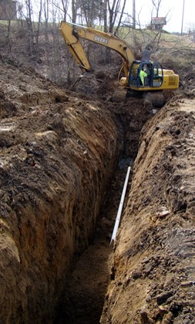
Basic Terms (Part 1)
Excavation: a man-made cut, cavity, trench, or depression formed by earth removal
Trench: an underground narrow excavation
Width ≤ 15 feet
Depth > Width
Trench Depth
Trench Width
OSHA Regulation: 1926.650
All excavations are inherently unstable and hazardous
Notes:
Note for Trainer:
Difference between an excavation and a trench (refer to https://www.osha.gov/Publications/osha2226.pdf):
OSHA defines an excavation as any man-made cut, cavity, trench, or depression in the Earth’s surface formed by earth removal.
A trench is defined as a narrow excavation (in relation to its length) made below the surface of the ground. In general, the depth
of a trench is greater than its width, but the width of a trench (measured at the bottom) is not greater than 15 feet (4.6 m).
Photo is copied from (https://www.osha.gov/doc/quickaction.html)

Slide 15
Basic Terms (Part 2)
Soil Stability: When stress (e.g., water or force) is applied to soil, soil will decompose due to the loss of its compressive strength and stiffness
Four Types of Soils: Based on soil stability
Type C
Type B
Type A
Stable Rock
Low
Stability
High
Stability
Notes:
Note for Trainer:
Soils can be classified as Type A, Type B, or Type C. Type A soil is the most stable soil in which to excavate. Type C is the least stable soil.
It's important to remember that a trench can be cut through more than one type of soil.
Refer to https://www.osha.gov/dts/vtools/construction/soil_testing_fnl_eng_web_transcript.html

Slide 16
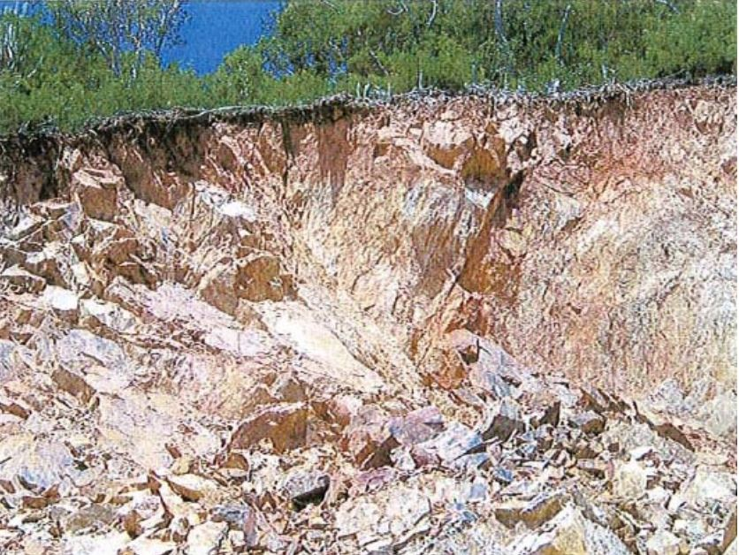
Basic Terms (Part 3)
Stable Rock: natural solid mineral matter that can be excavated with vertical sides and remain intact while exposed
Is this stable rock?
It is hard to determine stable rock unless know
Whether cracks exist and
Whether cracks run into/ away from excavation
Notes:
Note for Trainer:
According to OSHA Regulation 1926.650(b), "Stable rock" means natural solid mineral material that can be excavated with vertical sides and will remain intact while exposed. Unstable rock is considered to be stable when the rock material on the side or sides of the excavation is secured against caving-in or movement by rock bolts or by another protective system that has been designed by a registered professional engineer.
Refer to (https://www.osha.gov/dts/osta/otm/otm_v/otm_v_2.html), stable rock is usually identified by a rock name such as granite or sandstone. Determining whether a deposit is of this type may be difficult unless it is known whether cracks exist and whether or not the cracks run into or away from the excavation.
Photo is copied from (https://www.osha.gov/doc/engineering/2007_r_02.html)

Slide 17
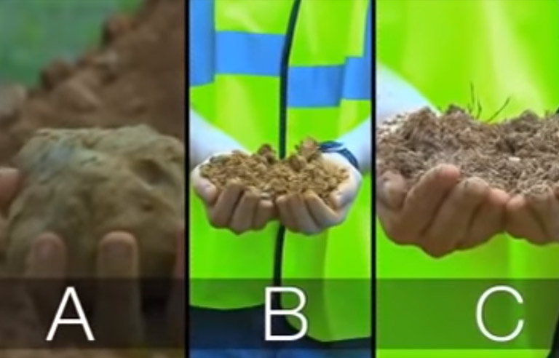
Basic Terms (Part 4)
 | Type A Soils | Type B Soils | Type C Soils
Features | cohesive; high strength | often cracked; medium strength | No stick together; low strength
Weight | ≥1.5 tons/ square foot | 0.5~1 tons/ square foot | ≤0.5 tons/ square foot
A video is embedded here for soil classification, found at
(https://www.youtube.com/watch?v=nks5rdeFF5Q)
OSHA Regulation: 1926 Subpart P App A
Notes:
Note for Trainer:
Table information is found at https://www.osha.gov/dts/vtools/construction/soil_testing_fnl_eng_web_transcript.html
Photo is copied from OSHA video (https://www.osha.gov/dts/vtools/construction/soil_testing_fnl_eng_web.html)

Slide 18
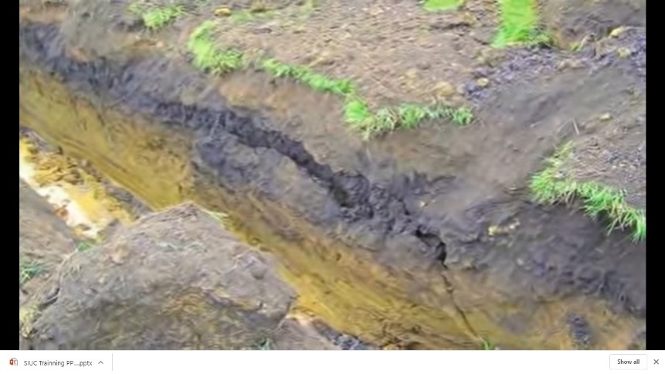
Basic Terms (Part 5)
 | Type A Soils | Type B Soils | Type C Soils
Example | Clay Silty Clay Sandy Clay | Angular Gravel Previously Distributed Soils Dry Unstable Rock | Granular Soils Submerged Rock Soil From which Water is Freely Seeping
No Soil is Type A if it
Is fissured
Is subject to vibration
Has been previously disturbed
Has seeping water
OSHA Regulation: 1926 Subpart P App A
Notes:
Note for Trainer:
Photo is copied from (https://www.osha.gov/dts/vtools/construction/soil_testing_fnl_eng_web.html) at 6 minutes 11 seconds

Slide 19
Basic Terms (Part 6)
Thumb Penetration Test: a method of quickly and visually estimate the type of soil
Press the end of a thumb into a fresh clump of soil
Type A Soils
Type B Soils
Type C Soils
Thumb makes an indentation in soil with great effort
Thumb sinks into soil up to the end of thumbnail
Thumb sinks all the way into soil
Notes:
Note for Trainer:
A thumb penetration test is used to quickly estimate the compressive strength of a cohesive soil sample. To perform the thumb penetration test, simply press the end of your thumb into a fresh clump of soil. If the soil sample is Type A, your thumb will only make an indentation in the soil with great effort, as you can see demonstrated here. If the soil sample is Type B, your thumb will sink into the soil up to the end of your thumbnail, just like this. If the soil sample is Type C, your thumb will sink all the way into the soil clump, as you can see here. Your results for this test will probably be somewhere in between these results.
Refer to https://www.osha.gov/dts/vtools/construction/soil_testing_fnl_eng_web_transcript.html

Slide 20
Basic Terms (Part 7)
A Competent Person
Be capable of identifying existing and predictable excavation hazards
Be authorized to take prompt corrective measures to eliminate the hazards
OSHA Regulation: 1926.650
Notes:
Note for Trainer:
"Competent person" means one who is capable of identifying existing and predictable hazards in the surroundings, or working conditions which are unsanitary, hazardous, or dangerous to employees, and who has authorization to take prompt corrective measures to eliminate them. (Refer to https://www.osha.gov/laws-regs/regulations/standardnumber/1926/1926.650)

Slide 21
Basic Terms (Part 8)
Under the OSHA excavation standards, tasks performed by a Competent Person include:
Classifying soil
Inspecting protective systems
Designing structural ramps
Monitoring water removal equipment
Conducting site inspections
OSHA Publication: 2226
Notes:
Note for Trainer:
Under the Excavation standards, tasks performed by the competent person include: Classifying soil; Inspecting protective systems; Designing structural ramps; Monitoring water removal equipment; and Conducting site inspections.
(Refer to https://www.osha.gov/Publications/osha2226.pdf)

Slide 22
Basic Terms (Part 9)
A Competent Person inspects excavations, the adjacent areas and protective systems
Daily
Prior to the start of work
As needed throughout shift
After every rainstorm
After other hazard increasing occurrence
OSHA Regulation: 1926.651
Notes:
Note for Trainer:
Daily inspections of excavations, the adjacent areas, and protective systems shall be made by a competent person for evidence of a situation that could result in possible cave-ins, indications of failure of protective systems, hazardous atmospheres, or other hazardous conditions. An inspection shall be conducted by the competent person prior to the start of work and as needed throughout the shift. Inspections shall also be made after every rainstorm or other hazard increasing occurrence. These inspections are only required when employee exposure can be reasonably anticipated.
Refer to https://www.osha.gov/laws-regs/regulations/standardnumber/1926/1926.651

Slide 23
Basic Terms (Part 10)
Employer Responsibilities
Under the Occupational Safety and Health Act of 1970, employers are responsible for providing safe and healthful workplaces for their employees.
OSHA’s role is to ensure the safety and health of workers by setting and enforcing standards, and providing training, education, and assistance.
OSHA: Trenching and Excavation Safety Factsheet
Notes:
Note for Trainer:
Under the Occupational Safety and Health Act of 1970, employers are responsible for providing safe and healthful workplaces for their employees. OSHA standards require that employers provide workplaces free of recognized hazards. The employer must comply with the trenching and excavation requirements of 29 CFR 1926.651 and 1926.652 or comparable OSHA-approved state plan requirements.
OSHA’s role is to help ensure these conditions for America’s working men and women by setting and enforcing standards, and providing training, education and assistance. (Refer to https://www.osha.gov/OshDoc/data_Hurricane_Facts/trench_excavation_fs.pdf)

Slide 24

Excavation Hazard Statistics
According to the U.S. Department of Labor
97 excavation fatalities from 2013-2017 in construction industry (36 death in 2016)
Excavation fatality rate is 112% higher than the rate for general construction
Most death are
men in age of 25-34
due to asphyxiation or internal injuries
companies of less than 50 workers
occurred in May, August, November in the South and Midwest
Notes:
Note for Trainer:
https://blogs.cdc.gov/niosh-science-blog/2019/06/06/trenching/
36 death in 2016 is found at (https://www.nesglobal.net/trenching-excavation-fatalities-reach-alarming-number/)
112% is found at (https://www.osha.gov/SLTC/etools/construction/trenching/mainpage.html)
https://www.cdc.gov/niosh/topics/trenching/default.html
Photo is copied from (https://www.osha.gov/SLTC/etools/construction/trenching/mainpage.html)

Slide 25
Excavation Hazard Status
In recent years, trenching and excavation fatalities reach an alarming number
Current status and trend
Skilled construction labor is in short supply
Some young construction workers are lack of experience, especially in trenching and excavation
A video is embedded here for trenching and excavation safety, found at
(https://www.youtube.com/watch?v=6dTu34WqCC0)
Notes:
Note for Trainer:
https://blogs.cdc.gov/niosh-science-blog/2019/06/06/trenching/
https://www.constructionequipment.com/trench-excavation-deaths-hit-all-time-high
Photo is copied from (https://www.osha.gov/Publications/OSHA3886.pdf)

Slide 26
OSHA Educational Efforts
From 2018, OSHA started National Emphasis Program (NEP) on trenching and excavation to increase education and enforcement efforts
Require each area office and region develop and implement outreach program
Increases compliance assistant for trenching
Issue trenching safety QuickCard, updated posters and web pages
Notes:
Note for Trainer:
https://blogs.cdc.gov/niosh-science-blog/2019/06/06/trenching/
https://www.cpwr.com/sites/default/files/publications/SS2019-Trenching-Fatalities-Causes-and-Reduction.pdf

Slide 27
Excavation Hazard Symbols
These symbols tell you if the situation in the picture is safe or not safe during this training.
Safe
Not safe
√
×
Notes:
Note for Trainer:
This program will help you first getting familiar with basic concepts of excavation and trench, and then being able to recognize common excavation and trench hazards in construction and finally learning your ways to decrease those hazards at your job site. Throughout this whole program, you will be shown some examples of safe and unsafe practice and conditions. The green “Yes” checkmark will be used to denote safe conditions, while the red “No” circle symbol is used to denote unsafe conditions.

Slide 28
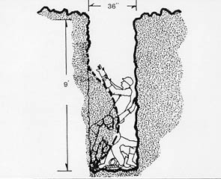
A Case Study Discussion
Excavation is very hazardous (injury or death)
×
A video is embedded here for trench cave-in case study, found at
(https://www.youtube.com/watch?v=mjBBmzlKjKg)
Notes:
Note for Trainer:
One of the most dangerous types of construction work is trenching, which kills 40 construction workers every year. Workers can suffer death or serious injury within minutes of being caught in a trench cave-in.
Photo is copied from (https://www.osha.gov/sites/default/files/2018-12/fy15_sh-27662-sh5_Excavation_Safety.pptx)

Slide 29
A Case Study Discussion (Part 1)
Q1: Who is responsible for providing necessary excavation safety training for employees?
OSHA? Employers? Employees? Competent Person?
Answer: Employers
Employers must provide safety training in a language and vocabulary that workers can understand. Employers make sure employees have and use safe tools and equipment
Notes:
Note for Trainer:
https://www.osha.gov/as/opa/worker/employer-responsibility.html

Slide 30
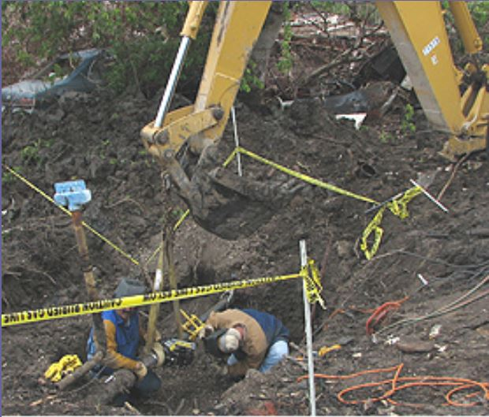
Q2: During excavation, should workers keep tools and materials close to trench edge for easy access?
A Case Study Discussion (Part 2)
Answer: No
Equipment and materials can easily fall or roll into a trench and hurt workers inside in the trench
×
Notes:
Note for Trainer:
Keep excavated soil (spoils) and other materials at least 2 feet (0.6 meters) from trench edges. (Refer to OSHA Trenching and Excavation Safety Factsheet https://www.osha.gov/OshDoc/data_Hurricane_Facts/trench_excavation_fs.pdf)
Photo is copied from (https://www.osha.gov/SLTC/etools/hurricane/trenches.html)

Slide 31
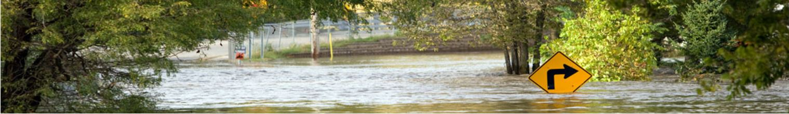
Q3: Is wet weather a potential reason for cave-ins?
A Case Study Discussion (Part 3)
Answer: Yes
Water seeps into the ground and makes it unstable. Small cracks in the ground cause trench collapse
A video is embedded here for trench cave-in accident partly due to wet weather, found at
(https://www.wnep.com/embeds/video/523-8f5e2fd4-bc82-45e5-9d85-ca6c8ace15ab/iframe)
Notes:
Note for Trainer:
Photo is copied from (https://www.osha.gov/dts/weather/flood/)
31

Slide 32
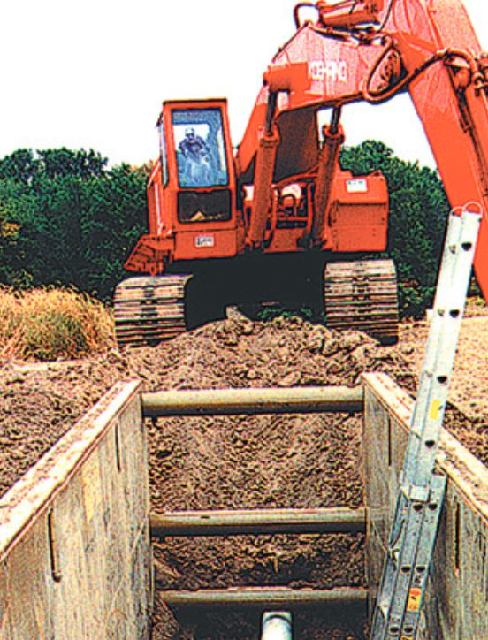
Q4: Can vibrations from nearby construction equipment (e.g., excavator) cause trench collapse?
A Case Study Discussion (Part 4)
Answer: Yes
Machinery near excavation causes excessive vibration of the ground and forces soil to shift
×
A video is embedded here for a trench cave-in, found at
(https://www.youtube.com/watch?v=0wmcD3aM8X4)
Notes:
Note for Trainer:
Photo is copied from (https://www.osha.gov/Publications/trench/3215_trench_poster_eng.pdf)

Slide 33
A Case Study Discussion (Part 5)
Q5: When working in a trench, you notice a condition indicating a possible cave-in. What should you do first?
Answer: Exit the trench immediately
Trench collapse may quickly bury workers with a large amount of soil, and cause serious injury
Notes:
Note for Trainer:
Cave-ins pose the greatest risk and are more likely than some other excavation-related incidents to result in worker fatalities. One cubic yard of soil can weigh as much as a car.
(Refer to OSHA Trenching and Excavation Safety Publication https://www.osha.gov/Publications/osha2226.pdf)

Slide 34
A Case Study Discussion (Part 6)
Q6: If a pack of cigarettes falls from your pocket into an unprotected trench, is it safe to jump into this trench to pick up it?
Answer: No.
Never enter unprotected trench. Trench collapse is sudden without warning, so never assume that a worker would have time to exit of the trench when cave-in happens.
Notes:
Note for Trainer:
Never enter unprotected trench. Trench collapse is sudden without warning, so never assume that a worker would have time to exit of the trench when cave-in happens.

Slide 35
A Case Study Discussion (Part 7)
Q7: If you observe a trench collapse, do you immediately enter the trench to rescue buried coworkers?
Answer: No. Since a second collapse may occur, untrained rescuers could be trapped and become victims
Notes:
Note for Trainer:
https://www.pecsafety.com/safetymeetings/2012-02-Excavating-and-Trenching-Quiz.pdf
https://www.digdifferent.com/online_exclusives/2018/05/think-it-cant-happen-to-you-how-to-respond-to-a-trench-collapse

Slide 36
A Case Study Discussion (Part 8)
Date | Place | What happen? | Injury
July 2019 | Alabama | Trench sidewall collapsed, burying workers under 2 feet of soil. | Died due to asphyxiation
July 2019 | Virginia | In an unsecured trench, sidewall collapsed, trapping two workers | Buried and killed by asphyxiation
April 2019 | Utah | A worker entered excavation with hand tools, the spoils pile collapsed and trapped him in the trench. | Asphyxiation due to the weight of soil and died
Notes:
Note for Trainer:
https://www.osha.gov/fatalities
https://www.osha.gov/pls/imis/establishment.inspection_detail?id=1395796.015
https://www.osha.gov/pls/imis/establishment.inspection_detail?id=1417434.015
https://www.osha.gov/pls/imis/establishment.inspection_detail?id=1395796.015

Slide 37
A Case Study Discussion (Part 9)
Date | Place | What happen? | Injury
April 2019 | Georgia | A worker was standing on the street at the edge of an excavation and guiding his coworker to operate a backhoe. The street surface collapsed, he dropped into excavation. The opposite side of excavation then collapsed. | Buried under soil (died)
May 2017 | New York | A worker was directing a crane operator while standing inside an excavation. The ground gave away and collapsed. | Fell in hole and engulfed (died)
Notes:
Note for Trainer:
The last accident is quite similar to the case study that we discuss.
https://www.osha.gov/pls/imis/establishment.inspection_detail?id=1396424.015
https://www.osha.gov/pls/imis/establishment.inspection_detail?id=1235208.015

Slide 38
Other Reported Accidents
Source: https://www.osha.gov/pls/imis/accidentsearch.search
Event Description
Employee is killed when trench wall collapses
Employee’s ankle is crushed in trench collapses
Employee in trench cave-in has ankle broken
Employee is buried in trench cave-in and legs are fractured
Employee is caught in trench cave-in and hip is dislocated
Employee is caught in trench collapse and incurs multiple fractured ribs
Notes:
Note for Trainer:
https://www.osha.gov/oshstats/commonstats.html
https://www.osha.gov/pls/imis/AccidentSearch.search?acc_keyword=%22Cave-In%22&keyword_list=on

Slide 39
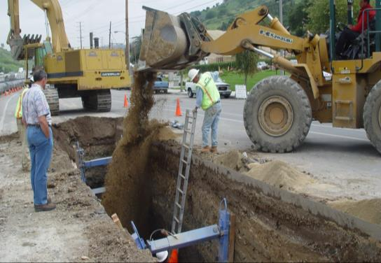
Excavation Hazards
×
Notes:
Note for trainer:
Ask the class how many of these exist in this photo?
Have the students brainstorm on what environmental hazards might be.
Ask the students which they feel is the greatest hazard?
Photo is copied from (https://www.osha.gov/sites/default/files/2018-12/fy15_sh-27662-sh5_Excavation_Safety.pptx).

Slide 40
Training Modules Agenda for Section II
Section I: Basic Terms and Case Study
Section II: Excavation Hazards in Construction
Cave-In (Trench Collapse)
Water Accumulation
Oxygen Deficiency or Toxic Fumes
Ingress or Egress
Falls or Exposure to Falling Loads
Mobile Equipment
Electrocution or Explosion
Section III: Excavation Hazards Prevention
Notes:
Note for Trainer:
The second section will be about excavation hazards in Construction.

Slide 41
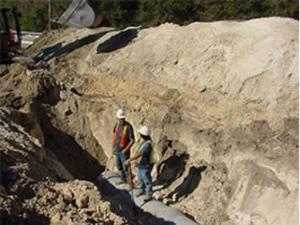
Hazard 1: Cave-In (Part 1)
It is natural for a trench to try to fill itself.
2-3 cubic feet of soil makes person out of breathing and causes permanent brain damage
Hazardous for employees to work in an unprotected excavation with debris piled atop the excavation
×
OSHA Regulation: 1926.650(b)
Notes:
Note for Trainer:
According to OSHA Regulation 1029.650(b), "Cave-in" means the separation of a mass of soil or rock material from the side of an excavation, or the loss of soil from under a trench shield or support system, and its sudden movement into the excavation, either by falling or sliding, in sufficient quantity so that it could entrap, bury, or other wise injure and immobilize a person.
Cave-ins pose the greatest risk and are much more likely than other excavation related accidents to result in worker fatalities.
Only 2-3 cut feet of soil can put enough pressure on your body and keep you out of breathing. Only 4-6 minutes without oxygen, can cause permeant brain damage, 10 minutes will be too late.
OSHA standards require that all trenches and excavations 5 feet or deeper be protected against sidewalls collapsing. This photo illustrates hazards such as employees working in an unprotected excavation, without a ladder and with debris piled atop the excavation. These workers could have been crushed and buried in seconds beneath tons of soil and debris, without any escape options.
Photo is captured from OSHA News Release (https://www.osha.gov/news/newsreleases/region1/02102014)

Slide 42
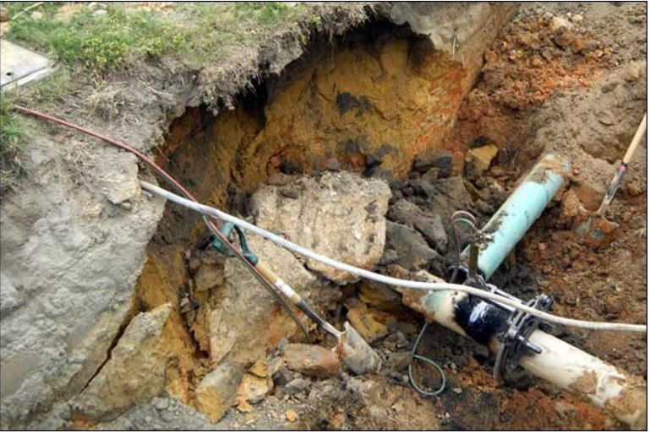
Hazard 1: Cave-In (Part 2)
×
Notes:
Note for Trainer:
On April 20, 2011, OSHA Compliance Officer Eliseo Hernandez and Assistant Area Director Joseph Roesler were on their way to an inspection near Auburn, Alabama, on Wednesday. Along the way they noticed an open excavation where employees were not protected from cave-ins. Immediately, they stopped and opened an inspection. The excavation was approximately 5 and 1/2 feet deep where two employees were working under an excavator bucket connecting a water line. Just after Hernandez removed the employees from the hazard, the wall of the excavation fissured and collapsed. No one was hurt, and the emphasis program on excavation and trenching demonstrated its value.
Photo is copied from (https://www.osha.gov/doc/trench-collapse.html)

Slide 43
Hazard 1: Cave-In (Part 3)
Q8: Why cave-in hazards are so dangerous?
A cubic yard of soil weights up to 3000 pounds
Falling off a trench 6 feet overhead
Falling time = 0.6 seconds
Hitting speed = 13.3 miles per hour
Broken bones, internal bleeding, punctured organs, no blood circulation, asphyxiation
Notes:
Note for Trainer:
Falling time calculator is from (https://keisan.casio.com/exec/system/1224852055)
Soil: Weighs about 2,200 pounds per cubic yard, depending on the moisture content. Sand, Gravel, Stone: Can tip the scales at upwards of 3,000 pounds per cubic yard.
Source: https://todayshomeowner.com/buying-materials-by-the-cubic-yard-faq/#:~:text=Soil%3A%20Weighs%20about%202%2C200%20pounds,3%2C000%20pounds%20per%20cubic%20yard.

Slide 44
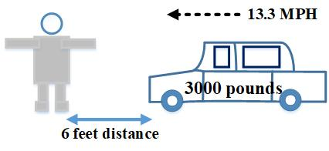
Hazard 1: Cave-In (Part 4)
While working in a trench, imagine that a car of 3000 pounds may strike you at 13 MPH anytime when cave-in happens.
A video is embedded here for a car crash accident, found at
(https://www.youtube.com/watch?v=YMnvC0oae10)
Notes:
Note for Trainer:
This page shows an imagnation of how dangerous a cave-in hazard could be.

Slide 45
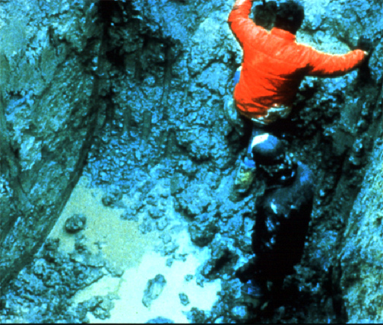
Hazard 2: Water Accumulation (Part 1)
When water is present, the ground is saturated, so it is extremely hazardous to enter
workers are difficult to get out of excavation
×
water undermine the sides of excavation
×
Notes:
Note for Trainer:
Water in an excavation can undermine the sides of the excavation and make it more difficult for workers to get out of the excavation.
(Refer to OSHA Publication Trenching and Excavation Safety 2226-10R, https://www.osha.gov/Publications/osha2226.pdf)
Photo is copied from (https://www.osha.gov/sites/default/files/2018-12/fy15_sh-27662-sh5_Excavation_Safety.pptx)

Slide 46
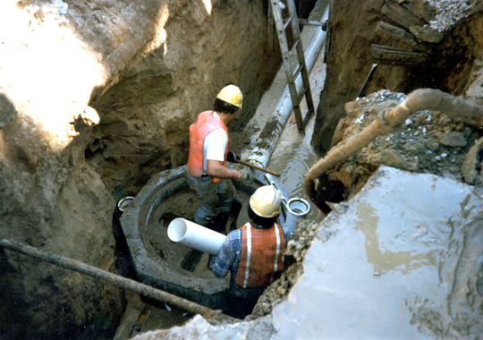
Hazard 2: Water Accumulation (Part 2)
Standing Water Increases the Risk of Cave-in
×
Notes:
Note for Trainer:
Water in an excavation can undermine the sides of the excavation and make it more difficult for workers to get out of the excavation.
(Refer to OSHA Publication Trenching and Excavation Safety 2226-10R, https://www.osha.gov/Publications/osha2226.pdf)
Photo is copied from (https://www.osha.gov/sites/default/files/2018-12/fy15_sh-27662-sh5_Excavation_Safety.pptx)

Slide 47
Hazard 2: Water Accumulation (Part 3)
A video is embedded here for a trench collapse accident, found
at
(https://denver.cbslocal.com/2019/10/04/backhoe-excavating-company-fine-trench-collapse-two-workers-killed-windsor-firestone-construction-accident-christopher-ramirez-jorge-valadez/)
In this video, fatal trench collapse occured when
Water was accumulating in the trench
Workers in the trench without protective systems
Notes:
Note for Trainer:
https://www.9news.com/article/news/local/citations-fines-after-fatal-trench-collapse-in-windsor/73-57fd32e4-50af-434b-b3fd-855d16e63c2f
https://denver.cbslocal.com/2019/10/04/backhoe-excavating-company-fine-trench-collapse-two-workers-killed-windsor-firestone-construction-accident-christopher-ramirez-jorge-valadez/

Slide 48
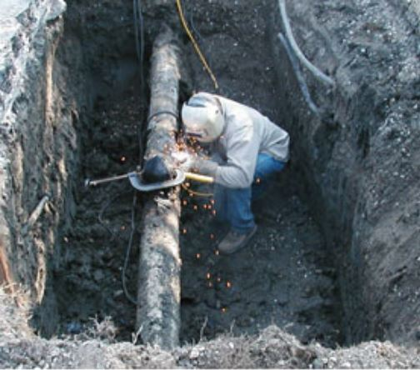
Hazard 3: Oxygen Deficiency or Toxic Fumes (Part 1)
Test for atmospheric hazards if trench depth >4 feet
Especially when
Gasoline engine-driven equipment is running
Welding in trenches containing flammable, combustible substances
×
OSHA Publication: 2226
Notes:
Note for Trainer:
According to OSHA Regulation 1926.650(b), "Hazardous atmosphere" means an atmosphere which by reason of being explosive, flammable, poisonous, corrosive, oxidizing, irritating, oxygen deficient, toxic, or otherwise harmful, may cause death, illness, or injury.
According to (https://www.osha.gov/dts/osta/otm/otm_v/otm_v_2.html), Employees shall not be permitted to work in hazardous and/or toxic atmospheres. Such atmospheres include those with: Less than 19.5% or more than 23.5% oxygen; A combustible gas concentration greater than 20% of the lower flammable limit; and Concentrations of hazardous substances that exceed those specified in the Threshold Limit Values for Airborne Contaminants established by the ACGIH (American Conference of Governmental Industrial Hygienists).
https://www.osha.gov/SLTC/etools/construction/trenching/mainpage.html
Photo is copied from (https://www.osha.gov/SLTC/etools/hurricane/trenches.html)

Slide 49
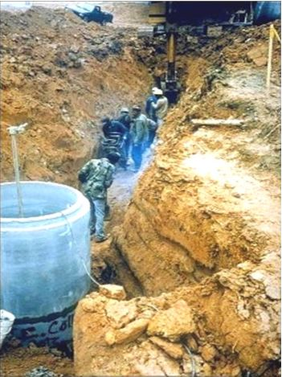
Hazard 3: Oxygen Deficiency or Toxic Fumes (Part 2)
Testing and Control
Hazardous fumes
Toxic gases (e.g., sulfide)
Flammable gases or vapors
Oxygen deficiency (<19.5% oxygen)
×
A video is embedded here for oxygen deficiency, found at
(https://www.youtube.com/watch?v=Z8226Umtgx4)
Notes:
Note for Trainer:
https://www.osha.gov/SLTC/etools/construction/trenching/mainpage.html
Atmospheric testing is required before workers enter an excavation greater than 4 feet (1.22 meters) in depth where an oxygen deficiency or a hazardous atmosphere is present or could reasonably be expected, such as in excavations in landfill areas or excavations in areas where hazardous substances are stored nearby.
Photo is copied from (https://osha.oregon.gov/edu/Documents/workshop-materials/1-320i.pdf)

Slide 50
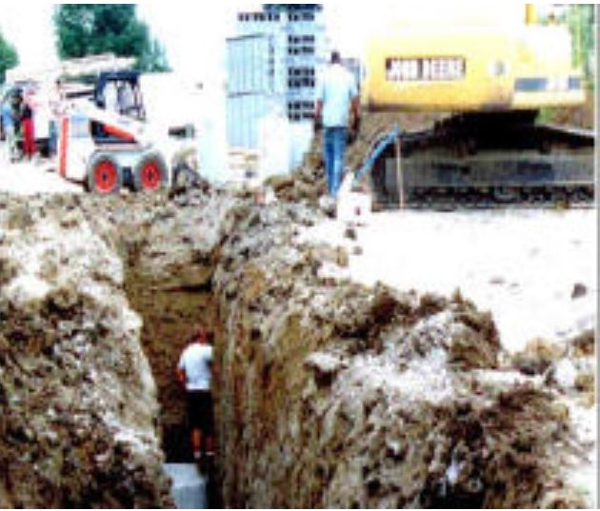
Hazard 4: Ingress or Egress (Part 1)
Q9: Does this site have an ingress or egress for this worker to safely get in or get out of this trench?
Answer: No
Ingress = Entry
Egress = Exit
×
Notes:
Note for Trainer:
According to (https://www.osha.gov/dts/osta/otm/otm_v/otm_v_2.html), Ingress and Egress mean "entry" and "exit," respectively. In trenching and excavation operations, they refer to the provision of safe means for employees to enter or exit an excavation or trench.
Photo is copied from (https://www.osha.gov/SLTC/trenchingexcavation/newsletter.html)

Slide 51
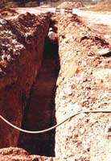
Hazard 4: Ingress or Egress (Part 2)
a worker is in a trench without any protective system
×
×
no means of egress
Notes:
Note for Trainer:
Photo is copied from (https://www.osha.gov/SLTC/etools/construction/trenching/mainpage.html)

Slide 52
Hazard 5: Falls or Exposure to Falling Loads (Part 1)
Workers may unintendedly lose balance and fall
×
Notes:
Note for Trainer:
In addition to cave-ins and related hazards, workers involved in excavation work are exposed to hazards involving falls and falling loads. As a result, fall protection is required around excavations and trenches.
According to OSHA Regulation 1926.501(b)(7), each employee at the edge of an excavation 6 feet (1.8m) or more in depth shall be protected from falling by guardrail systems, fences, or barricades when the excavations are not readily seen because of plant growth or other visual barrier. Each employee at the edge of a well, pit, shaft, and similar excavation 6 feet (1.8m) or more in depth shall be protected from falling by guardrail systems, fences, barricades, or covers.
Photo is copied from (https://www.osha.gov/SLTC/trenchingexcavation/newsletter.html)

Slide 53
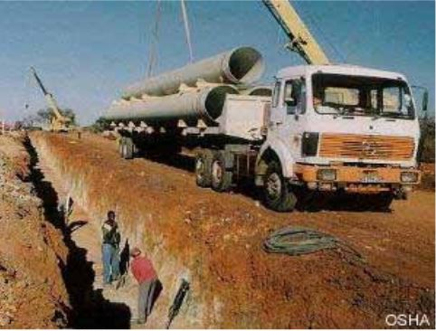
Hazard 5: Falls or Exposure to Falling Loads (Part 2)
It is hazardous for employees under loads handled by lifting or digging equipment
×
Notes:
Note for Trainer:
According to OSHA Regulation 1926.651(e), no employee shall be permitted underneath loads handled by lifting or digging equipment. Employees shall be required to stand away from any vehicle being loaded or unloaded to avoid being struck by any spillage or falling materials. Operators may remain in the cabs of vehicles being loaded or unloaded when the vehicles are equipped, in accordance with §1926.601(b)(6), to provide adequate protection for the operator during loading and unloading operations.
Photo is copied from (https://osha.oregon.gov/edu/Documents/workshop-materials/1-320i.pdf)

Slide 54
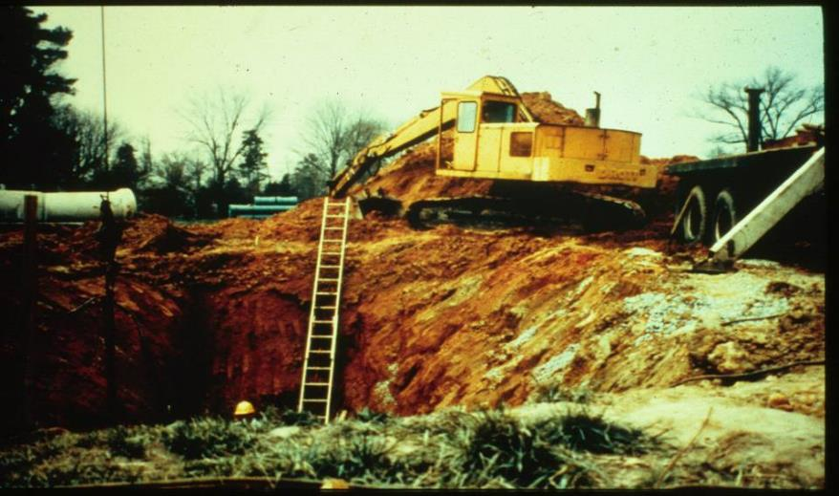

Hazard 6: Mobile Equipment (Part 1)
It is hazardous when the operator of mobile equipment does not have a clear direct view of excavation edge
Notes:
Note for Trainer:
When mobile equipment is operated adjacent to an excavation; the operator must have a clear and direct view of the edge of the excavation, or… A warning system shall be utilized such as barricades, hand or mechanical signals, or stop logs. If possible, the grade should be away from the excavation.
According to OSHA Technical Manual (https://www.osha.gov/dts/osta/otm/otm_v/otm_v_2.html), Procedures to protect employees from being injured or killed by vehicle traffic include: requiring a designated, trained flag person along with signs, signals, and barricades when necessary.
Photo is copied from (https://www.osha.gov/sites/default/files/2020-04/Excavating%20%26amp%3B%20Trenching%20Awareness%20For%20The%20Construction%20Industry.pptx)

Slide 55
Hazard 6: Mobile Equipment (Part 2)
It is hazardous when heavy equipment is not kept away from excavation edges
×
Notes:
Note for Trainer:
Keep heavy equipment away from excavation edges.
According to OSHA Regulation 1926.651, employees shall be protected from excavated or other materials or equipment that could pose a hazard by falling or rolling into excavations. Protection shall be provided by placing and keeping such materials or equipment at least 2 feet (.61 m) from the edge of excavations, or by the use of retaining devices that are sufficient to prevent materials or equipment from falling or rolling into excavations, or by a combination of both if necessary.
According to OSHA Regulation 1926.651(I), walkways shall be provided where employees or equipment are required or permitted to cross over excavations. Guardrails which comply with §1926.502(b) shall be provided where walkways are 6 feet (1.8 m) or more above lower levels.
Photo is copied from (https://www.osha.gov/Publications/trench/3215_trench_poster_eng.pdf)

Slide 56
Hazard 7: Electrocution or Explosion (Part 1)
It is hazardous when workers dig around underground utilities
Confirm the exact underground locations of
Sewer line
Telephone line
Fuel line
Electric line
Water line
×
A video is embedded here for trenching and excavation hazards, found at
(https://www.youtube.com/watch?v=29lCiaj3OIk)
Notes:
Note for Trainer:
Electrocution or explosions can occur when workers contact underground utilities. Underground Installations include, but are not limited to, utilities (sewer, telephone, fuel, electric, water, and other product lines), tunnels, shafts, vaults, foundations, and other underground fixtures or equipment that may be encountered during excavation or trenching work.
https://www.osha.gov/SLTC/etools/construction/trenching/mainpage.html
https://precast.org/2012/11/prevent-excavation-cave-in-fatalities/
Photo is copied from (Photo is copied from (https://www.osha.gov/doc/trench-collapse.html))

Slide 57
Hazard 7: Electrocution or Explosion (Part 2)
Q10: should you contact utility companies before underground digging?
Answer: Yes
Contact local officials or utility companies before digging
Notes:
Note for Trainer:
According to OSHA Regulation 1926.651(b)(1), the estimated location of utility installations, such as sewer, telephone, fuel, electric, water lines, or any other underground installations that reasonably may be expected to be encountered during excavation work, shall be determined prior to opening an excavation.
Consultations with local officials and utility companies. This information will help employers determine the amount, kind, and cost of safety equipment they will need to perform the work safely.
https://www.osha.gov/SLTC/etools/construction/trenching/mainpage.html

Slide 58
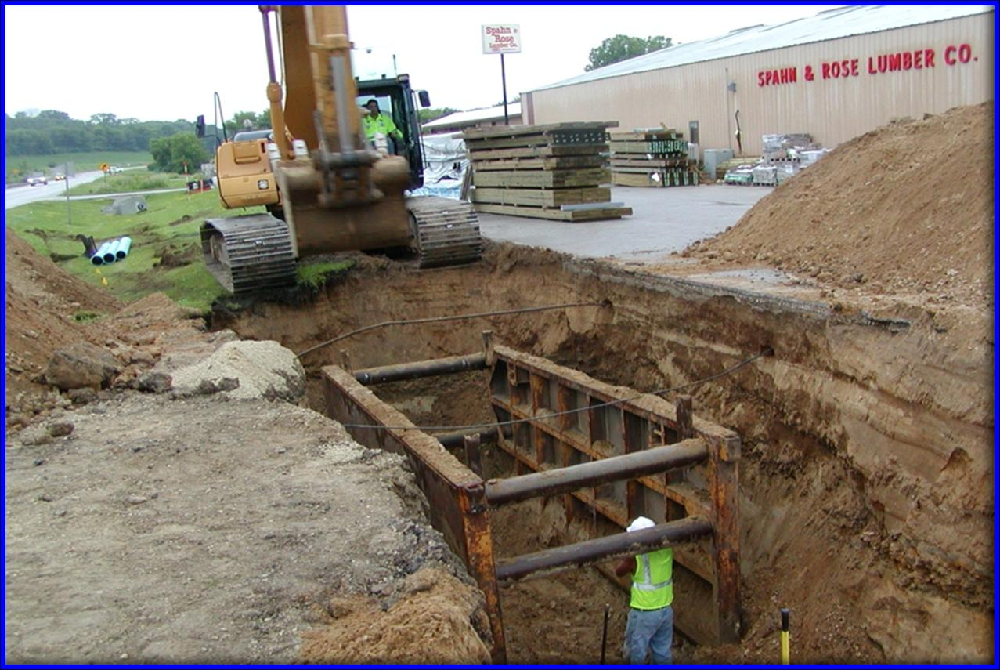
Quiz 1
What excavation hazards can you find below?
trench box should be above the top of trench to prevent spoils from falling back into excavation
×
×
excavator too close to trench edge
Notes:
Note for Trainer:
Photo is copied from (https://www.osha.gov/dte/outreach/construction/focus_four/electrocution/electr_hazrec.ppt)

Slide 59
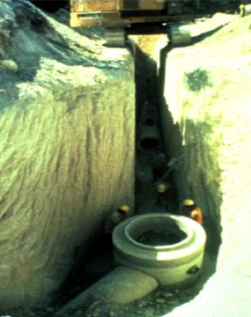
Quiz 2
What excavation hazards can you find below?
×
×
debris falling into trench
fumes from equipment
×
cave-in hazards
vibrations from equipment
×
exposure to falling loads
Notes:
Note for Trainer:
Photo is copied from (https://www.osha.gov/sites/default/files/2018-12/fy07_sh-16582-07_excav_trenching.ppt)

Slide 60
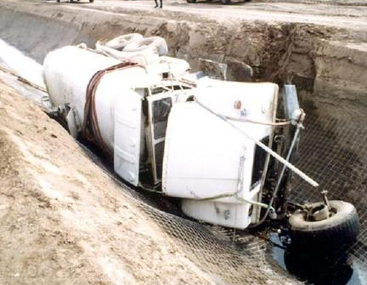
Quiz 3
How to prevent cars from falling into excavation?
install barricades
×
×
×
keep spoil at least 2 feet away from the excavation
require a designated trained flagperson
Notes:
Note for Trainer:
Photo is copied from (https://www.osha.gov/sites/default/files/2018-12/fy15_sh-27662-sh5_Excavation_Safety.pptx)

Slide 61
Training Modules Agenda for Section III
Section I: Basic Terms and Case Study
Section II: Excavation Hazards in Construction
Section III: Excavation Hazards Prevention
Cave-in Protection Measures
Look for Standing Water in Trenches
Test for Atmospheric Hazards
Ensure a Safe Way of Entering and Exit
Don’t Work under Suspended or Raised Loads
Keep Materials Away from Trench Edges
Never Dig Trench Unless Being Properly Inspected
Notes:
Note for Trainer:
The third section of the training will be about excavation hazards prevention.

Slide 62
Cave-In Protection Measures (Part 1)
OSHA excavation standards requires a protective system in place
when an excavation is 5 feet deep or greater unless the excavation is made entirely in stable rock
If less than 5 feet deep, a competent person may determine that a protective system is required.
OSHA Publication: 2226
Notes:
Note for Trainer:
According to OSHA Trenching and Excavation Safety Publication 2226-10R 2015 (https://www.osha.gov/Publications/osha2226.pdf), the Excavation standards do not require a protective system when an excavation is made entirely in stable rock or when an excavation is less than 5 feet (1.52 meters) deep and a competent person has examined the ground and found no indication of a potential cave-in.
According to OSHA Trenching and Excavation Safety Factsheet (https://www.osha.gov/OshDoc/data_Hurricane_Facts/trench_excavation_fs.pdf), trenches 5 feet (1.5 meters) deep or greater require a protective system unless the excavation is made entirely in stable rock. If less than 5 feet deep, a competent person may determine that a protective system is not required.
https://www.osha.gov/Publications/trench/trench_safety_tips_card.pdf
https://www.osha.gov/Publications/osha2226.pdf

Slide 63
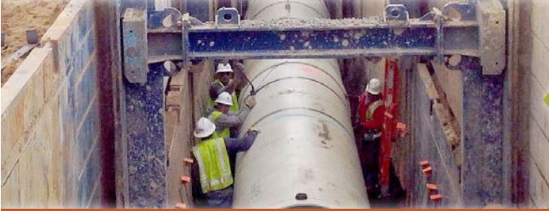
Cave-In Protection Measures (Part 2)
Do not enter unprotected trenches
When excavations are ≥ 5 feet deep, protective systems are required unless the excavation is made entirely in stable rock
√
OSHA: Trenching and Excavation Safety Factsheet
Notes:
Note for Trainer:
According to OSHA Trenching and Excavation Safety Factsheet (https://www.osha.gov/OshDoc/data_Hurricane_Facts/trench_excavation_fs.pdf), do not enter an unprotected trench! Trenches 5 feet (1.5 meters) deep or greater require a protective system unless the excavation is made entirely in stable rock.
Photo is copied from (https://www.osha.gov/Publications/OSHA3974.pdf)

Slide 64
Cave-In Protection Measures (Part 3)
When excavations are ≥ 20 feet deep
Protective systems are required to be designed by a registered professional engineer
Protective systems are based on tabulated data prepared and/or approved by a registered professional engineer
OSHA: Trenching and Excavation Safety Factsheet
Notes:
Note for Trainer:
According to OSHA Regulation 1926.650(b), "Registered Professional Engineer" means a person who is registered as a professional engineer in the state where the work is to be performed. However, a professional engineer, registered in any state is deemed to be a "registered professional engineer" within the meaning of this standard when approving designs for "manufactured protective systems" or "tabulated data" to be used in interstate commerce.
According to OSHA Trenching and Excavation Safety Factsheet (https://www.osha.gov/OshDoc/data_Hurricane_Facts/trench_excavation_fs.pdf), trenches 20 feet (6.1 meters) deep or greater require that the protective system be designed by a registered professional engineer or be based on tabulated data prepared and/or approved by a registered professional engineer in accordance with 1926.652(b) and (c).
According to OSHA Regulation 1926.650(b), "Tabulated data" means tables and charts approved by a registered professional engineer and used to design and construct a protective system.
Refer to 29 CFR 1926 Subpart P for the requirements.

Slide 65
Cave-In Protection Measures (Part 4)
Factors involved in protective system design
Soil analysis and characteristics
Depth of cut
Water content of soil
Changes caused by weather and climate
Surcharge loads (i.e., excessive vertical load or weight caused by spoil, vehicle, or equipment)
Other operations in the trench vicinity
OSHA: Trenching and Excavation Safety Factsheet
Notes:
Note for Trainer:
According to (https://www.osha.gov/OshDoc/data_Hurricane_Facts/trench_excavation_fs.pdf), designing a protective system can be complex because you must consider many factors: soil classification, depth of cut, water content of soil, changes caused by weather or climate, surcharge loads (e.g., spoil, other materials to be used in the trench) and other operations in the vicinity.
Surcharge is defined from (https://www.osha.gov/dts/osta/otm/otm_v/otm_v_2.html). Surcharge means an excessive vertical load or weight caused by spoil, overburden, vehicles, equipment, or activities that may affect trench stability.

Slide 66
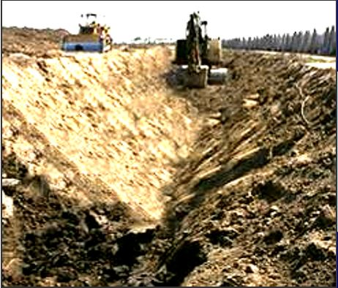
Slope Trench Walls (Part 1)
Sloping means cutting back the trench wall at an angle inclined away from the excavation
√
OSHA Regulation:
1926.650
Notes:
Note for Trainer:
https://www.osha.gov/Publications/trench/trench_safety_tips_card.pdf
Reference 1926.650
Sloping (sloping system) -- protects employees from cave-ins by excavating to form sides of an excavation that are inclined away from the excavation to prevent cave-ins. The angle of incline varies with differences in such factors as the soil type, environmental conditions of exposure, and application of surcharge loads.
Photo is copied from (https://www.osha.gov/sites/default/files/2018-12/excavation_safety_part2.ppt)

Slide 67
Slope Trench Walls (Part 2)
Soil Type | Maximum Depth | Height/Depth | Slope Angle
Stable Rock | 20 feet | Vertical | ≤ 90 degree
Type A | 20 feet | 0.75 to 1 | ≤ 53 degree
Type B | 20 feet | 1 to 1 | ≤ 45 degree
Type C | 20 feet | 1.5 to 1 | ≤ 34 degree
Maximum depth (20 feet)
Slope angle
Trench
OSHA Regulation: 1926 Subpart P App B
Notes:
Note for Trainer:
This page shows the trench slope height/depth and angle for each type of soil.

Slide 68
Slope Trench Walls
Q11: If a type of soil is unknown, what type of soil should we assume in designing a protective systems for excavation and trench safety?
Answer: Type C soil. Type C soil is the most unstable and is prone to cave-in. It is proper to conservatively estimate.
Notes:
Note for Trainer:
Refer to https://www.pecsafety.com/safetymeetings/2012-02-Excavating-and-Trenching-Quiz.pdf

Slide 69
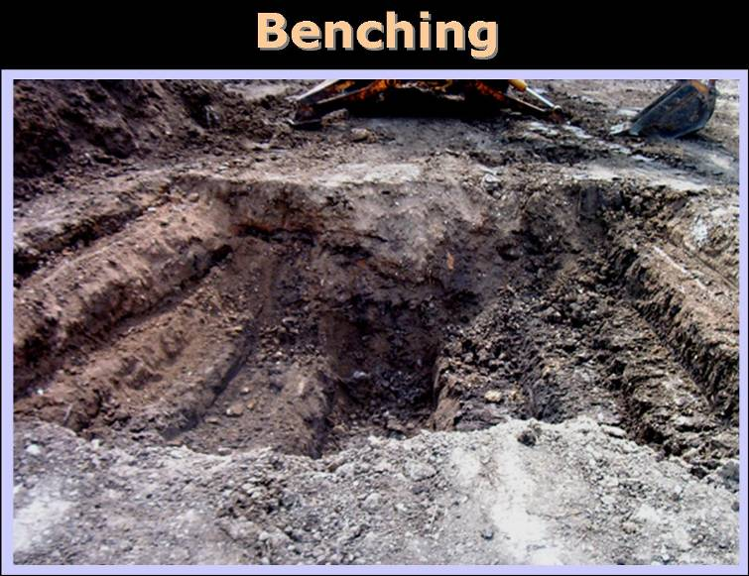
Bench Trench Walls
Benching makes the side of an excavation to form one or series of horizontal levels or steps
√
OSHA Regulation:
1926.650
Note Benching is not allowed in Type C soil
Notes:
Note for Trainer:
https://www.osha.gov/Publications/trench/trench_safety_tips_card.pdf
Reference 1926.650
Sloping (sloping system) -- protects employees from cave-ins by excavating to form sides of an excavation that are inclined away from the excavation to prevent cave-ins. The angle of incline varies with differences in such factors as the soil type, environmental conditions of exposure, and application of surcharge loads.
According to OSHA Trenching and Excavation Safety Publication 2226-10R 2015 (https://www.osha.gov/Publications/osha2226.pdf), Institute and enforce work rules prohibiting workers from working on faces of sloped or benched excavations at levels above other workers unless the workers at the lower levels are adequately protected from the hazards of falling, rolling, or sliding material or equipment.
Photo is copied from (https://www.osha.gov/sites/default/files/2018-12/excavation_safety_part2.ppt)

Slide 70
Shore Trench Walls with Supports (Part 1)
Shoring means a structure such as a metal hydraulic, mechanical or timber shoring system that supports the sides of an excavation to prevent cave-ins
OSHA Regulation: 1926.650
Notes:
Note for Trainer:
According to OSHA Regulation 1926.650, "Shoring (Shoring system)" means a structure such as a metal hydraulic, mechanical or timber shoring system that supports the sides of an excavation and which is designed to prevent cave-ins.

Slide 71
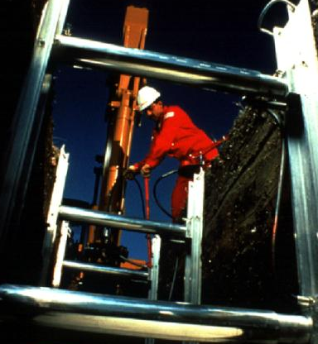
Shore Trench Walls with Supports (Part 2)
Hydraulic Trench Support
Use hydraulic jacks the operator can easily drop the system into the hole
Once in place, hydraulic pressure is increased to keep the forms in place
Trench pins are installed in case of hydraulic failure
√
OSHA Regulation: 1926 Subpart P App D
Notes:
Note for Trainer:
Photo is copied from (https://www.osha.gov/sites/default/files/2018-12/fy15_sh-27662-sh5_Excavation_Safety.pptx)

Slide 72
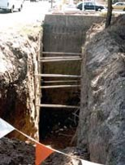
Shore Trench Walls with Supports (Part 3)
Make inadequate shoring does little other than provide a false sense of security!
×
Notes:
Note for Trainer:
Photo is copied from (https://www.osha.gov/SLTC/etools/construction/trenching/mainpage.html)

Slide 73
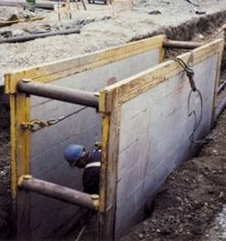
Shield with Trench Boxes (Part 1)
Using prefabricated, protective structures (e.g., trench boxes) supports to prevent soil cave-ins
The top edge of a shielding must extend a minimum of 18 inches above the vertical part of the wall
√
Notes:
Note for Trainer:
Refer to (https://www.osha.gov/laws-regs/standardinterpretations/2000-08-10-0)
Specifically, the trench shield extends 18 inches (0.45 m) above the vertical part of the walls, but is below the top of the trench. Therefore, where the top of the shield is below grade, it must extend a minimum of 18 inches above the vertical part of the wall.
Photo is copied from (https://www.osha.gov/sites/default/files/2018-12/excavation_safety_part_2.ppt)

Slide 74
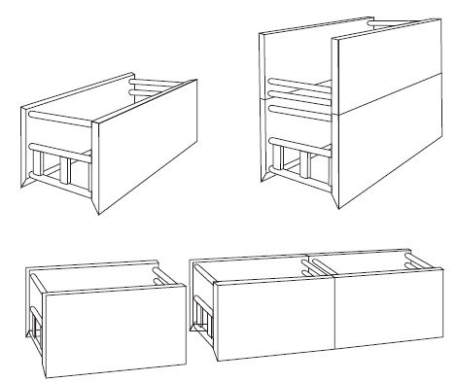
Shield with Trench Boxes (Part 2)
Shield System
Notes:
Note for Trainer:
SHIELD (SHIELD SYSTEM) means a structure that is able to withstand the forces imposed on it by a cave-in and thereby protect employees within the structure. Shields can be permanent structures or can be designed to be portable and moved along as work progresses.
Trench shields and boxes, if installed correctly, are designed to protect workers from the forces of a cave-in
In order for the shield to do its job, the worker must stay within the protection of the shield even when entering and exiting
Use a trench box or shield designed or approved by a registered professional engineer or based on tabulated data prepared or approved by a registered professional engineer. Timber, aluminum, or other suitable materials may also be used.
Photo is copied from (https://www.osha.org/Publications/osha2226.pdf)

Slide 75
Quiz 4
Q12: Name Three Common Types of Protective Systems in Excavation Job
Answer:
Sloping
Shoring
Shielding
Notes:
Note for Trainer:
Review the three common types of protective systems in excavation Job.

Slide 76
Cave-In Protection Measures (Part 5)
Shoring, shielding and sloping are acceptable to OSHA
It is up to the competent person to determine which method is the most effective for the job
Keep excavations open the minimum amount of time needed to complete operations
Notes:
Note for Trainer:
Refer to https://www.osha.gov/SLTC/trenchingexcavation/newsletter.html

Slide 77
Cave-In Protection Measures (Part 6)
Equipment for protective systems must not have damager or defects that impair function
If equipment is damaged, competent person must examine to see if suitable for continued use
If not suitable, remove it from service until a professional engineer approves it for use
Notes:
Note for Trainer:
Reference 1926.652 (d)
Materials and equipment used for protective systems shall be free from damage or defects that might impair their proper function.
Manufactured materials and equipment used for protective systems shall be used and maintained in a manner that is consistent with the recommendations of the manufacturer, and in a manner that will prevent employee exposure to hazards.
When material or equipment that is used for protective systems is damaged, a competent person shall examine the material or equipment and evaluate its suitability for continued use. If the competent person cannot assure the material or equipment is able to support the intended loads or is otherwise suitable for safe use, then such material or equipment shall be removed from service, and shall be evaluated and approved by a registered professional engineer before being returned to service.

Slide 78
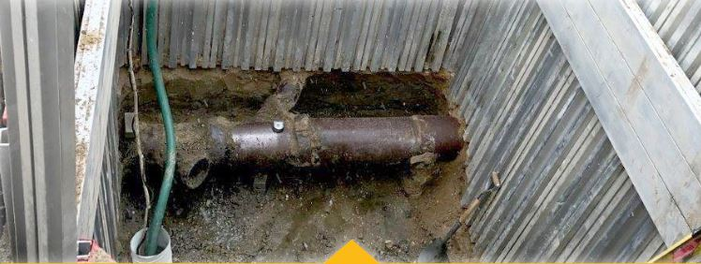
Look for Standing Water in Trenches (Part 1)
Do not enter excavations where water is accumulating or has accumulated unless adequate precautions are taken
×
Water in trench is hazardous
Notes:
Note for Trainer:
The OSHA standards prohibit employers from allowing workers to enter an excavation where water has accumulated or is accumulating unless adequate precautions are taken to protect workers.
Photo is copied from (https://www.osha.gov/Publications/OSHA3974.pdf)

Slide 79
Look for Standing Water in Trenches (Part 2)
Methods for controlling standing water in trenches
Use of special support or shield systems
Water removal equipment
Use of safety harness and lifeline
Surface water diverted away from the trench
Employees removed from the trench during rains
Trenches inspected by a competent person after each rain and before employees re-enter the trench
OSHA: Technical Manual
Notes:
Note for Trainer:
According to OSHA Technical Manual (https://www.osha.gov/dts/osta/otm/otm_v/otm_v_2.html), Methods for controlling standing water and water accumulation must be provided and should consist of the following if employees are permitted to work in the excavation: Use of special support or shield systems approved by a registered professional engineer. Water removal equipment, i.e. well pointing, used and monitored by a competent person. Safety harnesses and lifelines used in conformance with 29 CFR 1926.104. Surface water diverted away from the trench. Employees removed from the trench during rainstorms. Trenches carefully inspected by a competent person after each rain and before employees are permitted to re-enter the trench.

Slide 80
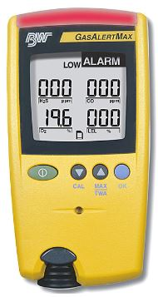
Test for Atmospheric Hazards (Part 1)
Test for atmospheric hazards for > 4 feet deep trenches
low oxygen
hazardous fumes
toxic gases
high combustible gas
Test should be conducted before employees enter the trench
Test should be done regularly to ensure that the trench remains safe
Notes:
Note for Trainer:
Refer to https://www.osha.gov/dts/osta/otm/otm_v/otm_v_2.html
When testing for atmospheric contaminants, the following should be considered: Testing should be conducted before employees enter the trench and should be done regularly to ensure that the trench remains safe. The frequency of testing should be increased if equipment is operating in the trench. Testing frequency should also be increased if welding, cutting, or burning is done in the trench.
Photo is copied from (https://osha.oregon.gov/edu/Documents/workshop-materials/1-320i.pdf)

Slide 81

Test for Atmospheric Hazards (Part 2)
Ensure acceptable atmospheric conditions through
Atmospheric testing
Removal of the substance
Proper ventilation
Respiratory protection
Employees required to wear respiratory protection must be trained
Notes:
Note for Trainer:
According to (https://www.osha.gov/dts/osta/otm/otm_v/otm_v_2.html), Employees required to wear respiratory protection must be trained, fit-tested, and enrolled in a respiratory protection program. Some trenches qualify as confined spaces. When this occurs, compliance with the Confined Space Standard is also required.
According to OSHA Trenching and Excavation Safety Publication 2226-10R 2015 (https://www.osha.gov/Publications/osha2226.pdf), If hazardous atmospheric conditions exist or may reasonably be expected to develop in an excavation, the employer must ensure the ready availability of emergency rescue equipment, such as breathing apparatus, a safety harness and line, or a basket stretcher. This equipment must be attended when in use.
Refer to https://osha.oregon.gov/edu/Documents/workshop-materials/1-320i.pdf
Photo is copied from (https://www.osha.gov/SLTC/etools/respiratory/)

Slide 82
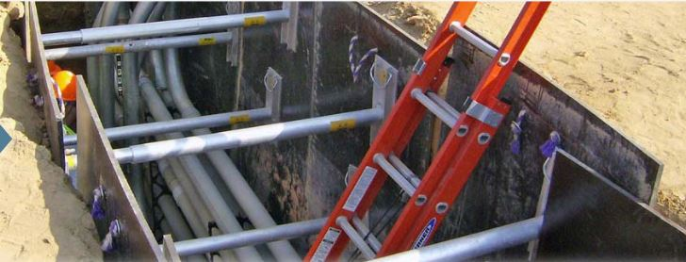
Ensure a Safe Way of Entering and Exiting (Part 1)
Safe means to enter/exit trenches >= 4 feet deep
Stairway, ladder, ramp, or other safe means
Ensure workers do not need to travel more than 25 feet to the closest means of egress
√
OSHA Regulation: 1926.651(c)(2)
Notes:
Note for Trainer:
According to OSHA Regulation 1926.651(c)(2), A stairway, ladder, ramp or other safe means of egress shall be located in trench excavations that are 4 feet (1.22 m) or more in depth so as to require no more than 25 feet (7.62 m) of lateral travel for employees.
Photo is copied from (https://www.osha.gov/Publications/OSHA3974.pdf)

Slide 83
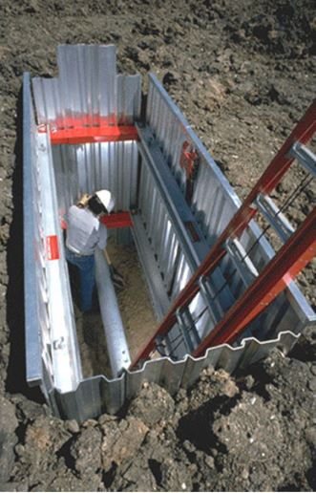
Ensure a Safe Way of Entering and Exiting (Part 2)
Ladders must be secured and extend at least 3 feet above the landing
Metal ladders should be used with caution, especially when electric utilities are present
√
Notes:
Note for Trainer:
According to (https://www.osha.gov/dts/osta/otm/otm_v/otm_v_2.html), Ladders must be secured and extend a minimum of 36 in (0.9 m) above the landing. Metal ladders should be used with caution, particularly when electric utilities are present.
Photo is copied from (https://osha.oregon.gov/edu/Documents/workshop-materials/1-320i.pdf)

Slide 84
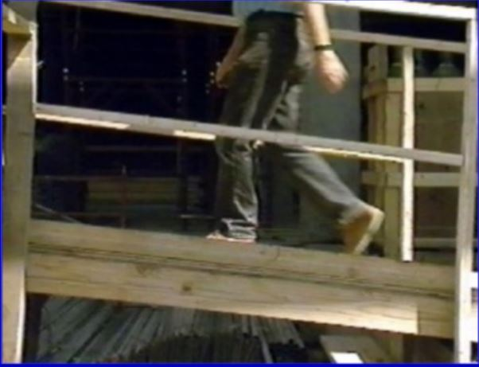
Ensure a Safe Way of Entering and Exiting (Part 3)
Structural Ramps
A ramp built of steel or wood designed by a competent person
Used solely as a means of ingress or egress from excavations
√
OSHA Regulation: 1926.650(b), 1926.651(b)
Notes:
Note for Trainer:
According to OSHA Regulation 1926.650(b), "Ramp" means an inclined walking or working surface that is used to gain access to one point from another, and is constructed from earth or from structural materials such as steel or wood.
According to OSHA Regulation 1926.651(b), Structural ramps that are used solely by employees as a means of access or egress from excavations shall be designed by a competent person. Structural ramps used for access or egress of equipment shall be designed by a competent person qualified in structural design, and shall be constructed in accordance with the design.
Photo is copied from (https://www.osha.gov/sites/default/files/2018-12/fy15_sh-27662-sh5_Excavation_Safety.pptx)

Slide 85
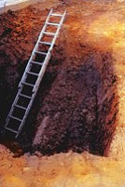
Ensure a Safe Way of Entering and Exiting (Part 4)
Egress must be uniform in thickness and joined in a manner to prevent tripping or displacement
×
no safe access or egress
OSHA Publication: 2226
Notes:
Note for Trainer:
According to OSHA Trenching and Excavation Safety Publication 2226-10R 2015 (https://www.osha.gov/Publications/osha2226.pdf), structural members used for ramps or runways must be uniform in thickness and joined in a manner to prevent tripping or displacement.
Photo is copied from (https://www.osha.gov/SLTC/etools/construction/trenching/mainpage.html)

Slide 86
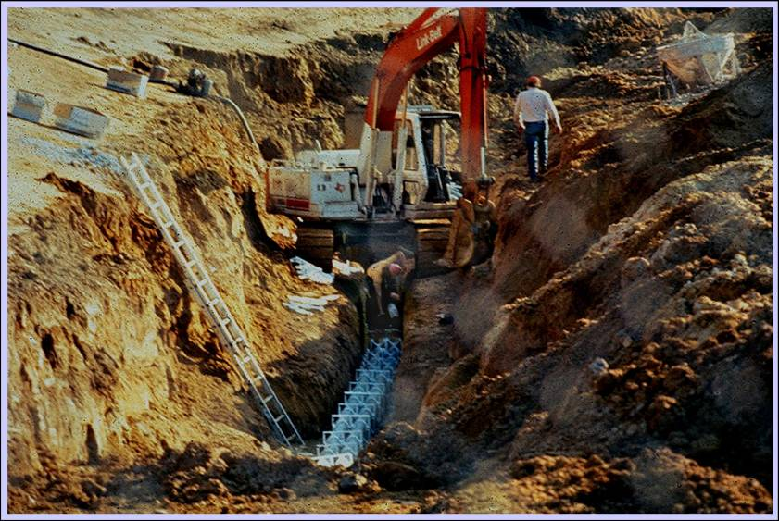
Ensure a Safe Way of Entering and Exiting (Part 5)
ladder is too short
unprotected excavation
×
×
Notes:
Note for Trainer:
Reference 1926.651(c) and 1926.1053 (ladder)
Photo is copied from (http://www.osha.gov/sites/default/files/2018-12/excavation_safety_part_1.ppt)

Slide 87
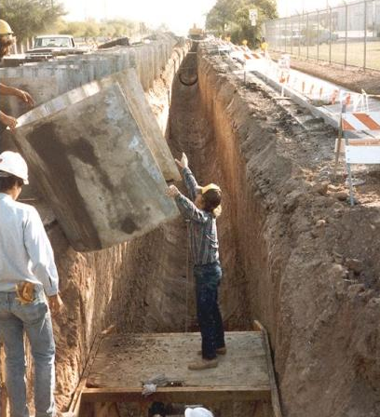
Don’t Work under Suspended or Raised Loads
Workers are not permitted to work under raised loads. Workers should stand away from equipment being loaded or unloaded.
raised loads may fall and injury workers in trenches
×
OSHA: Technical Manual
Notes:
Note for Trainer:
According to OSHA Technical Manual (https://www.osha.gov/dts/osta/otm/otm_v/otm_v_2.html), Employees are not permitted to work under raised loads. Employees are required to stand away from equipment that is being loaded or unloaded. Equipment operators or truck drivers may stay in their equipment during loading and unloading if the equipment is properly equipped with a cab shield or adequate canopy.
According to OSHA Regulation 1926.651, no employee shall be permitted underneath loads handled by lifting or digging equipment. Employees shall be required to stand away from any vehicle being loaded or unloaded to avoid being struck by any spillage or falling materials.
Photo is copied from (https://www.osha.gov/sites/default/files/2018-12/fy15_sh-27662-sh5_Excavation_Safety.pptx)

Slide 88
Keep Materials Away from Trenches (Part 1)
Keep excavated soil (spoils) and other materials at least 2 feet from trench edges
OSHA Regulation:
1926.651(j)(2)
measures from the nearest part of spoil to excavation edge
2 feet
spoils
Trench
Pressure from spoils
Notes:
Note for Trainer:
You must be protected from excavated or other materials or equipment that could pose a hazard by falling or rolling into excavations.
According to OSHA Regulation 1926.651(j)(2), Protection shall be provided by placing and keeping such materials or equipment at least 2 feet (.61 m) from the edge of excavations, or by the use of retaining devices that are sufficient to prevent materials or equipment from falling or rolling into excavations, or by a combination of both if necessary. Possibly could be further back due to “surcharge load”

Slide 89
Keep Materials Away from Trenches (Part 2)
spoils should be at least 2 feet away from trench edge
×
Notes:
Note for Trainer:
Photo is copied from (https://www.osha.gov/SLTC/etools/construction/trenching/mainpage.html)

Slide 90
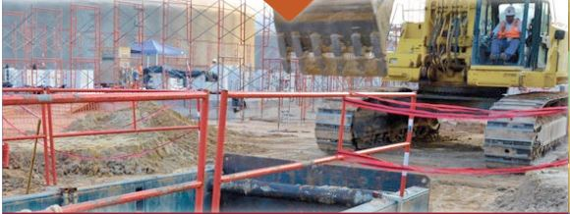
Keep Materials Away from Trenches (Part 3)
Identify sources that affect trench stability and use warning systems (e.g., barricades, stop logs)
excavator may affect trench stability
√
use barricades to surround trench
OSHA Regulation: 1926.501(b)(7)
Notes:
Note for Trainer:
According to OSHA regulations 1926.501(b)(7), each employee at the edge of an excavation 6 feet (1.8 m) or more in depth shall be protected from falling by guardrail systems, fences, or barricades when the excavations are not readily seen because of plant growth or other visual barrier; Each employee at the edge of a well, pit, shaft, and similar excavation 6 feet (1.8 m) or more in depth shall be protected from falling by guardrail systems, fences, barricades, or covers.
According to OSHA Technical Manual (https://www.osha.gov/dts/osta/otm/otm_v/otm_v_2.html), the following steps should be taken to prevent vehicles from accidentally falling into the trench: Barricades must be installed where necessary.
Hand or mechanical signals must be used as required. Stop logs must be installed if there is a danger of vehicles falling into the trench. Soil should be graded away from the excavation; this will assist in vehicle control and channeling of run-off water.
According to OSHA regulations 1926.501(b)(7), Each employee at the edge of a well, pit, shaft, and similar excavation 6 feet (1.8 m) or more in depth shall be protected from falling by guardrail systems, fences, barricades, or covers.
Picture is from (https://www.osha.gov/Publications/OSHA3974.pdf)

Slide 91
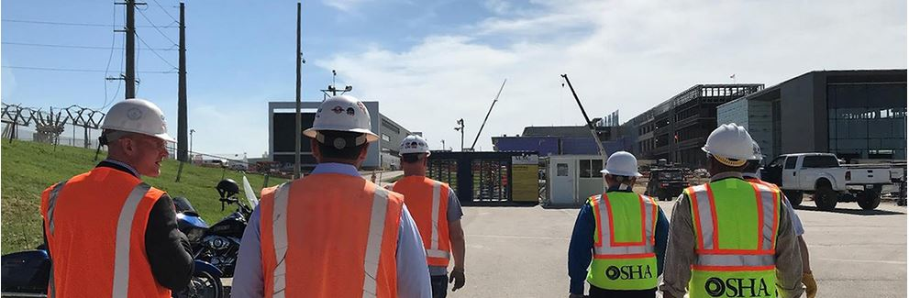
Keep Materials Away from Trenches (Part 4)
Personnel wear high visibility or other suitable clothing when walking around trenches
√
OSHA: Trenching and Excavation Safety Factsheet
Notes:
Note for Trainer:
According to According to (https://www.osha.gov/OshDoc/data_Hurricane_Facts/trench_excavation_fs.pdf), Ensure that personnel wear high visibility or other suitable clothing when exposed to vehicular traffic.
According to OSHA Technical Manual (https://www.osha.gov/dts/osta/otm/otm_v/otm_v_2.html), Procedures to protect employees from being injured or killed by vehicle traffic include: Providing employees with and requiring them to wear warning vests or other suitable garments marked with or made of reflectorized or high-visibility materials.
Picture is copied from (https://www.osha.gov/enforcement)

Slide 92
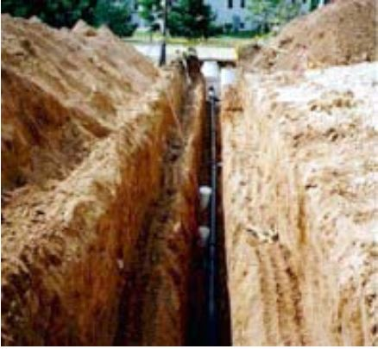
Quiz 5
Q13: what excavation hazards do you find?
×
spoils are too close to trench edge, so spoils could easily roll back on top of workers
Notes:
Note for Trainer:
Photo is copied from (https://www.osha.gov/SLTC/etools/construction/trenching/mainpage.html)

Slide 93
Never Dig Trench Unless Being Properly Inspected (Part 1)
Before beginning excavation
Determine the proper locations of utility installations
One common practice is to call 811 – the “call before you dig” number
Contact and notify utility companies or owners to inform them of the proposed work within established or customary local response times
OSHA Publication: 2226
Notes:
Note for Trainer:
According to OSHA Trenching and Excavation Safety Publication 2226-10R 2015 (https://www.osha.gov/Publications/osha2226.pdf), Before starting work, the Excavation standards require employers to do the following: Determine the approximate location(s) of utility installations — including sewer, telephone, fuel, electric, and water lines. One common industry practice is to call 811, the “Call Before You Dig” number, to establish the location of any underground utility installations in the work area. Contact and notify the utility companies or owners involved to inform them of the proposed work within established or customary local response times.

Slide 94
Never Dig Trench Unless Being Properly Inspected (Part 2)
If utility companies cannot establish exact location of utility installations, workers may proceed with caution to use detection equipment or other acceptable means to locate
While the excavation is open, underground installations are protected, supported or removed as necessary to safeguard workers
OSHA Publication: 2226
Notes:
Note for Trainer:
According to OSHA Trenching and Excavation Safety Publication 2226-10R 2015 (https://www.osha.gov/Publications/osha2226.pdf), Ask the utility companies or owners to establish the location of underground installations prior to the start of excavation work. If they cannot respond within 24 hours (unless the period required by state or local law is longer) or cannot establish the exact location of the utility installations, employers may proceed with caution, which includes using detection equipment or other acceptable means to locate utility installations. Determine the exact location of underground installations by safe and acceptable means when excavation operations approach the approximate location of the installations. Ensure that while the excavation is open, underground installations are protected, supported or removed as necessary to safeguard workers.

Slide 95
A Kentucky Trench Accident
A video is embedded here for construction laborer crushed in trench collapse, found at
(https://www.wave3.com/story/29298688/trench-rescue-underway-on-dixie-highway/)
Discussion: what factors contributes to this accident? What measures do you suggest to avoid this accident?
Notes:
Note for Trainer:
http://elcosh.org/document/4226/d001510/kentucky-face-case-report%3A-19-year-old-construction-laborer-crushed-in-trench-collapse-while-laying-sewage-pipe.html
https://www.wave3.com/story/29298688/trench-rescue-underway-on-dixie-highway/
When discussing the possible factors and suggested suggestions, please refer to http://www.mc.uky.edu/kiprc/face/reports/pdf/15KY031.pdf

Slide 96

Training Modules Summary (Part 1)
The greatest risk in an excavation is cave-ins
Protected through sloping, shielding, shoring
Other excavation hazards include
Water accumulation
Oxygen deficiency or toxic fumes
Ingress or egress
Falls or exposure to falling loads
Mobile equipment
Electrocution or explosion
Notes:
Note for Trainer:
Ensure that workers are not allowed under loads being handled by excavators or hoists.
Avoid the operation of equipment near the top edge of an excavation because this increases the chance of slope failure.
The storage of materials near the top edge of an excavation, vibration and the presence of water also increase the chance of slope failure.
Photo is copied from (https://www.osha.gov/Publications/trench/trench_safety_tips_card.pdf)

Slide 97
Training Modules Summary (Part 2)
For a Competent Person
Ensures safety measures in place
Design and install protective systems
Test for soil type
Test for low oxygen, hazardous fumes and toxic gases
Inspect all trenches at the start of each shift
Inspect all trenches after a rainstorm
Ensure availability of emergency rescue equipment
Remove workers from hazardous area
Notes:
Note for Trainer:
The designated competent person should have and be able to demonstrate the following:
Training, experience, and knowledge of:
soil analysis;
use of protective systems; and
requirements of 29 CFR Part 1926 Subpart P
Ability to detect:
conditions that could result in cave-ins;
failures in protective systems;
hazardous atmospheres; and
other hazards including those associated with confined spaces.
Authority to take prompt corrective measures to eliminate existing and predictable hazards and to stop work when required.
(Refer to https://www.osha.gov/dts/osta/otm/otm_v/otm_v_2.html)

Slide 98
Training Modules Summary (Part 3)
For a Construction Worker
Don’t enter unprotected trenches even for a short task
Recognize potential hazards before entering trenches
Know location of a safe way to enter and exit trenches
Keep loads and piles at least 2 feet from trench edges
Exit the trench and call the competent person if you see any problem of protective systems
A video is embedded here for excavations in construction/trenching, found at
(https://www.youtube.com/watch?v=cFYkeT0Yk6k&ab_channel=USDepartmentofLabor)
Notes:
Note for Trainer:
It's important for employers to follow OSHA's excavation standards to ensure that workers are provided with a safe workplace. The trench cave-in prevention measures save workers' lives. Use these protections on the job: it could be the difference between life and death.

Slide 99
Any Questions?
Notes:
Note for Trainer:
Ask the audience if there is any questions.

Slide 100
Post-Test
Please Begin Post-Test (15 Minutes)
Notes:
Note for Trainer:
Please begin Post-Test (15 Minutes)
100

Slide 101
Feedback Survey
Please fill in the feedback survey
Notes:
Note for Trainer:
Hand out the feedback survey.
101

Slide 102
Post-Test Solution
Interactive Post-Test Q/A Session
Notes:
Note for Trainer:
Go over the post-test questions for your audience and ask if there is any question.
102

Slide 103
The End Thank you!
Notes:
Note for Trainer:
Collect the survey responses from your audience before the end of the training.

