Slide 1
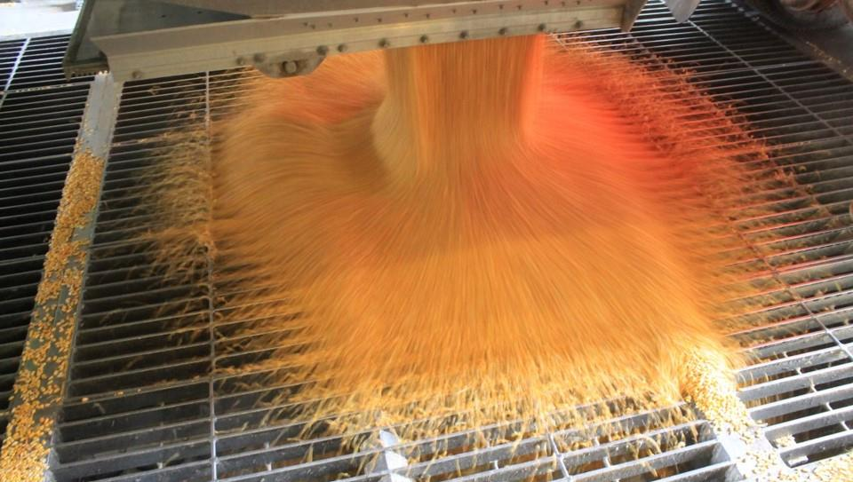
Dump Pit Safety
Loading & Unloading Hazards

Slide 2
Introduction
This Dump Pit Safety module is part of a curriculum series addressing hazards found in grain handling facilities including grain bins and their surrounding area. Its purpose is to assist participants to identify and abate hazards in the workplace.
The content was developed in collaboration with the Grain and Feed Association of Illinois.
Notes:
Other modules
Overview of Grain Handling and Storage Safety (introductory module)
Agricultural Confined Space Hazards
Cold Weather Hazards
Entanglement Hazards and Guarding
Fall Hazards & Prevention
Heat Stress
How Grain Quality Affects Safety
Introduction to Lifeline Protection Systems (mini module)
Lock out/Tag out (mini module)
Near Misses & Near Miss Reporting
Reducing Grain Bin Entry Risks

Slide 3
Disclaimers
This material was produced under grant number SH-37173-SH1 from the Occupational Safety and Health Administration, U. S. Department of Labor. It does not necessarily reflect the views or policies of the U. S. Department of Labor, nor does mention of trade names, commercial products, or organizations imply endorsement by the U. S. Government.
Notes:
Explain – GHSC received funding from OSHA. In order to comply with the grant we do need them to sign in and need to collect the following information:
Supervisor or worker. This information is for statistical purposes to show the types of population receiving training.
Employer. This is to establish an employer/employee relationship as covered under OSHA. Volunteer rescue workers who may be attending should list their employer; not the volunteer rescue squad. Farmers should list the registered business name of their farm. Farm employees should provide the business name listed on their paycheck.
OSHA does NOT contact the employer.
GHSC may contact the attendee or employer for follow-up evaluation in compliance with grant requirements.

Slide 4
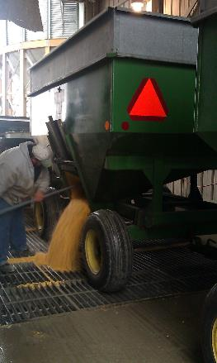
Unloading hazards
Straight Trucks, Tandem/Cargo Doors, Wagons

Slide 5
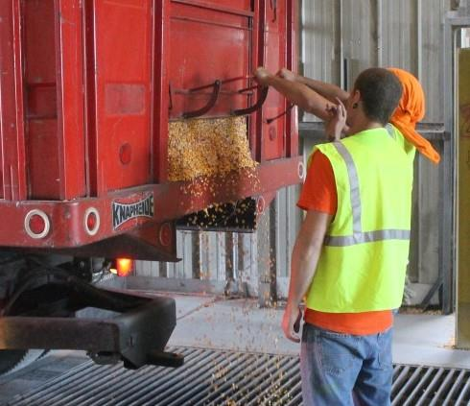
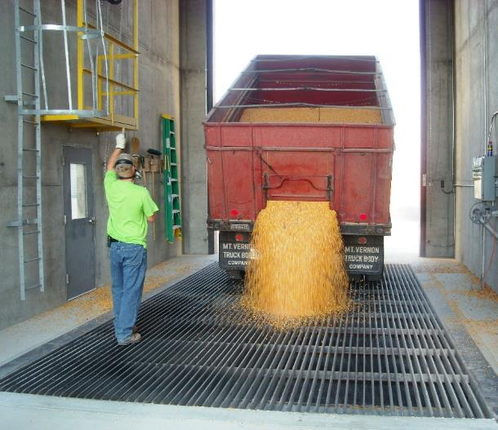
Straight Trucks – Prepare to Empty
Open the gate.
Move to driver’s side. Signal driver to raise bed. Use consistent hand signals.

Slide 6
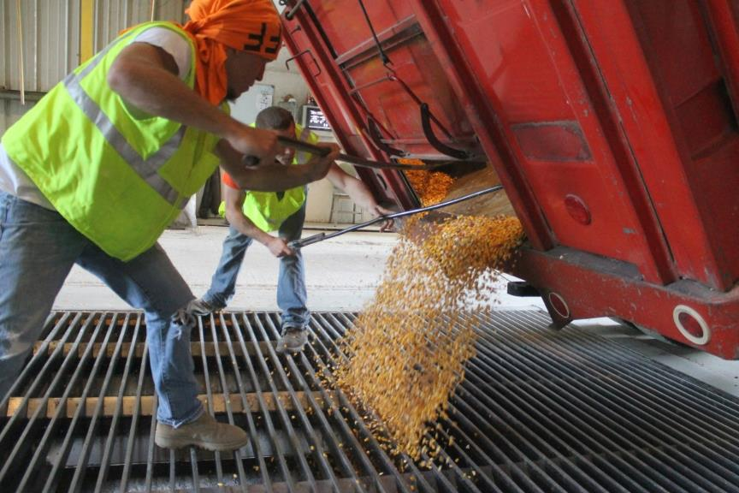

Straight Trucks - Unloading
Rake out the corners of the truck bed. Then instruct driver to lower truck bed.

Slide 7
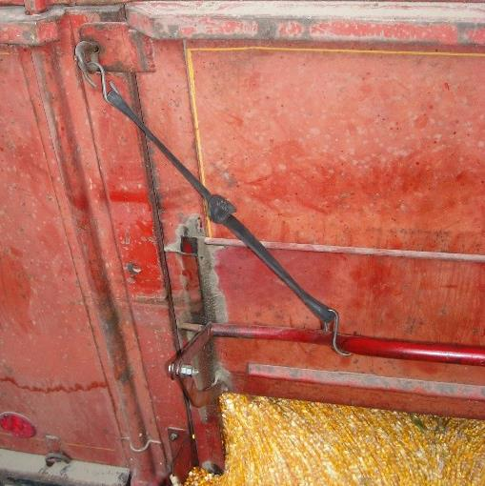
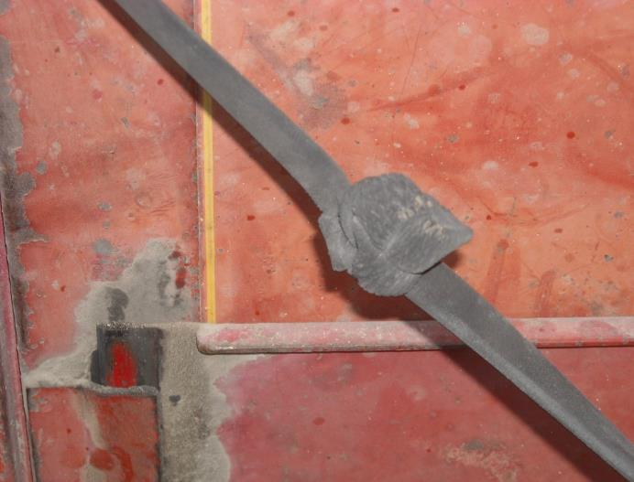
Straight Trucks – Tarp Straps
Always hook the gate. Keeps it from sliding down unexpectedly.
Use caution with the tarp straps. Some get brittle/dry rotted and can break.
Notes:
Many of the straight trucks (as they are generally older) use tarp straps to keep the gate open.
They are usually "with the vehicle" and may not be in good repair which means they can snap. Workers need to stay back and out of reach of the strap in case it breaks during unloading.

Slide 8
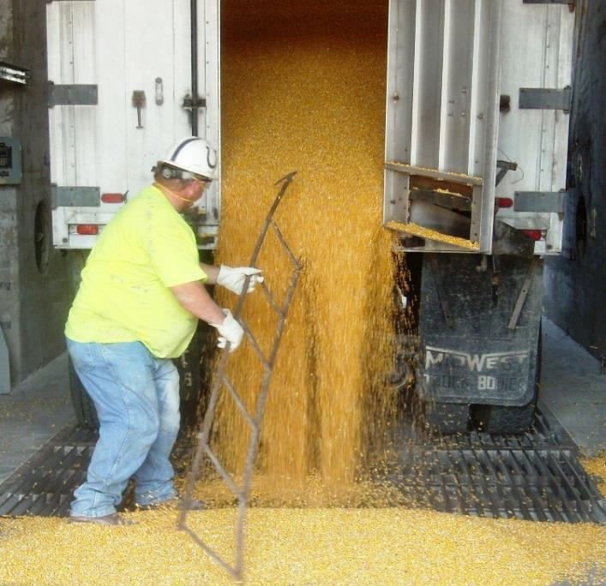
Non-Grain Objects in Dump Load
100 lb tractor weights
Cold Beer
Loaded Rifle
Railroad Tie
Log chains
Water heaters
Chain saws
Ladders
Broken shingles
Dead and live animals
Cell phones
1600 lbs of sod
Stay Clear as truck bed is hoisted.
Notes:
A big problem and safety hazard for dump pit workers is objects coming out of the truck with the grain. These are items that have been seen coming out of a grain truck with the grain.
Sometimes producers "forget" to check the truck and ensure it is empty before loading it with grain.
Once the gate is open, the worker needs to be clear of the area while the bed is hoisted and gravity takes over.
Picture – Worker narrowly misses gettinghit with ladder coming out of the truck.

Slide 9
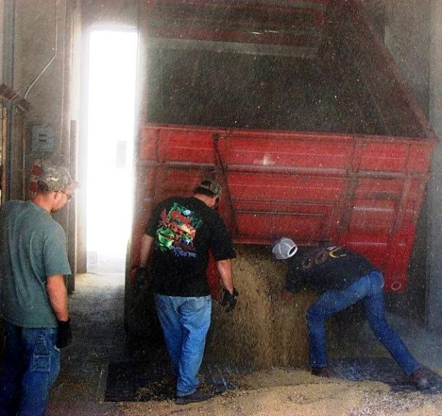
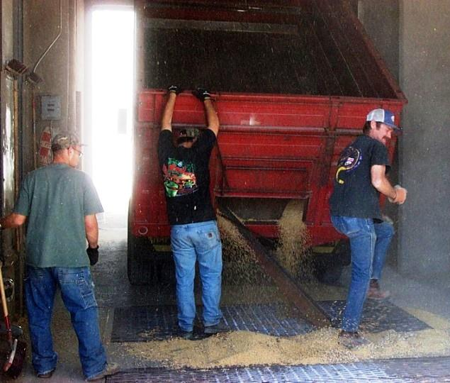
Foreign Object Hazard
Large piece of angle iron wedged into truck bed.
Iron came out striking worker's knee. No serious injury sustained.
Notes:
More objects in the grain truck.
Worker escaped serious injury but did get hit with the object.

Slide 10
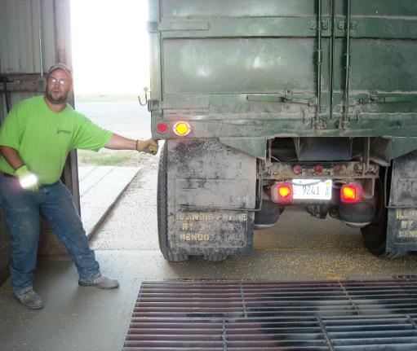
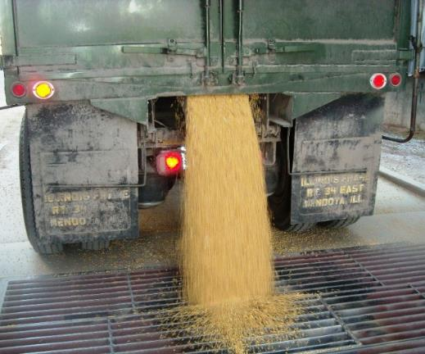
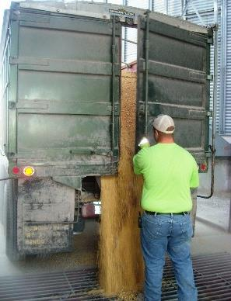
Opening Tandems/Cargo Doors
Open small gate to take pressure off door
Then open cargo door
Notes:
It's important to take the pressure off the main cargo door as once it is opened, the grain flows out quickly.
Without relieving the pressure, the worker can be hit with several tons of grain when opening the cargo door.

Slide 11
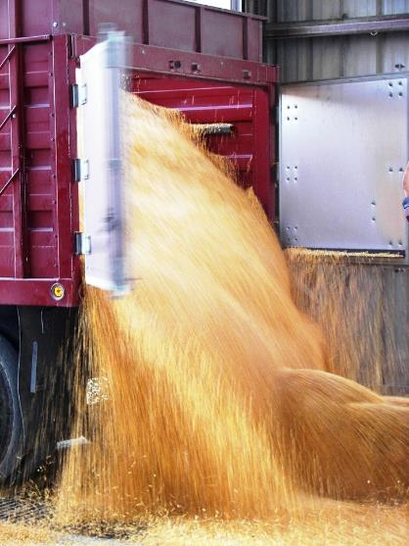
Emptying Tandems/Cargo Doors
Tremendous pressure can be pushing on the door, especially if the bed is raised.
Can cause cargo door to open violently.
Notes:
This is what the worker can experience with a tandem/cargo door opening if there is no way to relieve some of the pressure.

Slide 12
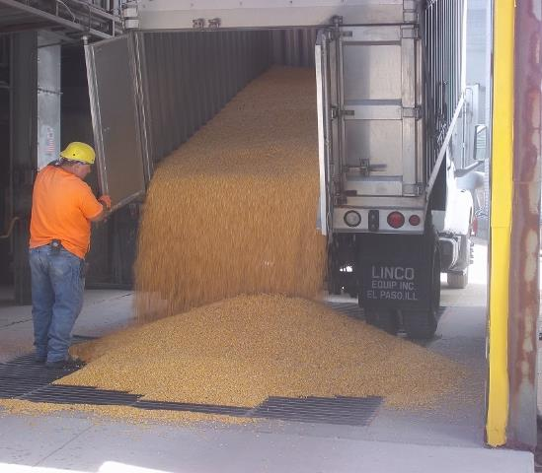
Right Side Cargo Door
Some companies do not open the right cargo door.
When the bed is hoisted up all the way it can damage the door.
Notes:
Arrow points to interference which can damage door if truck bed is fully hoisted.

Slide 13
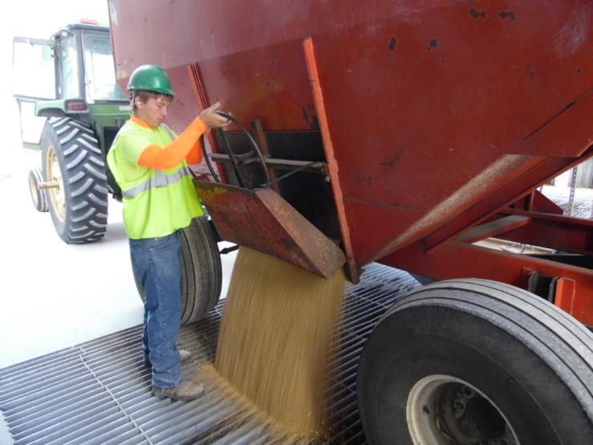
Wagons
Stand to the side to turn the wheel
Step away from wagon as the grain unloads
Wear gloves
Notes:
Don't stand in front of the wheel in case there is a malfunction and the grain rushes out. The force can knock the worker down.

Slide 14
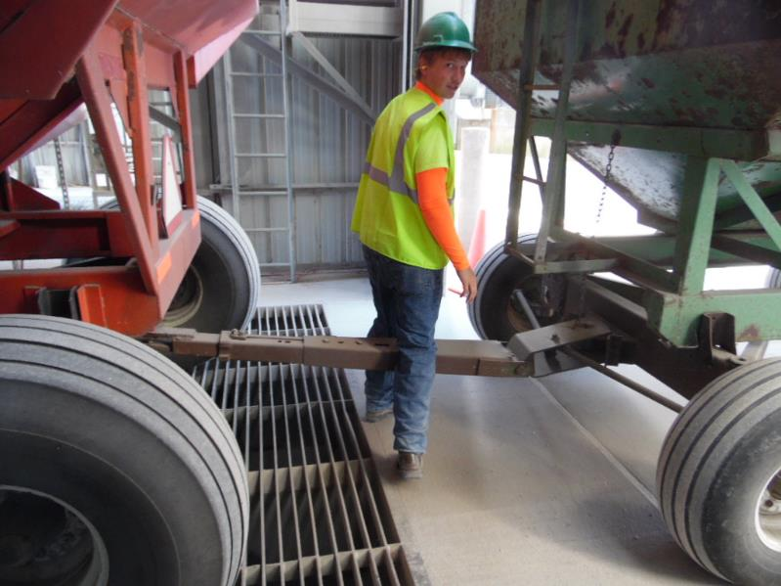
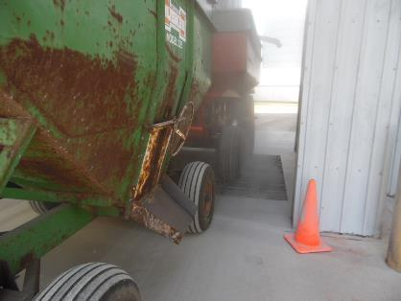
Struck-By Hazard
Do NOT cross between wagons.
Notes:
NEVER step across a hitch and NEVER cross between wagons. If the vehicles move, the worker can fall, be struck, or be crushed between them.

Slide 15
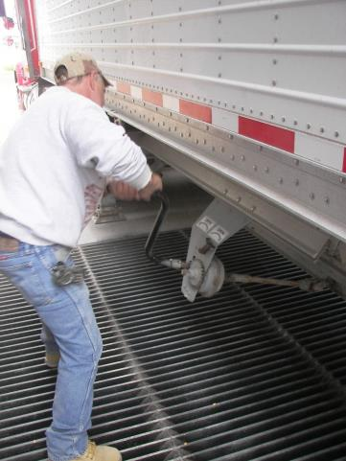
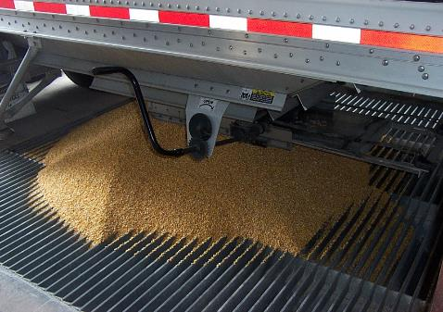
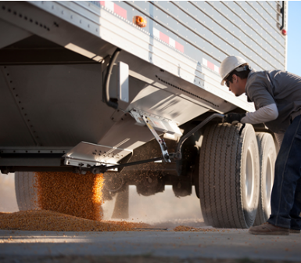
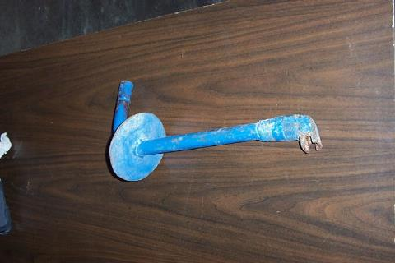
Hooper Bottom Trailers
Modified crank to prevent dropping into the pit
Notes:
These types of trucks empty at the bottom.
This can be an awkward position and put strain on the back.
Sometimes the crank can fall off into the pit or when down not clear the pit area well

Slide 16
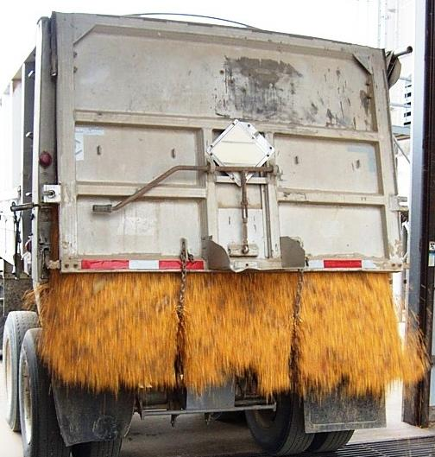
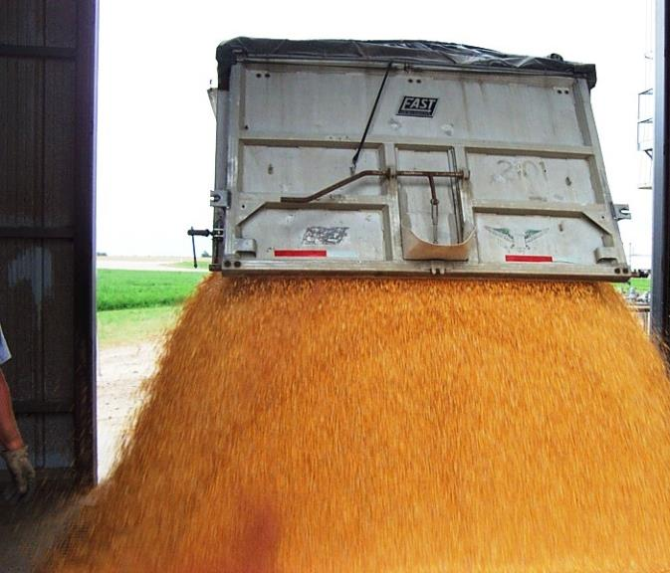
End Dump Semi-Trailer
Stand to side. Signal driver to release the gate.
Release both latches.

Slide 17
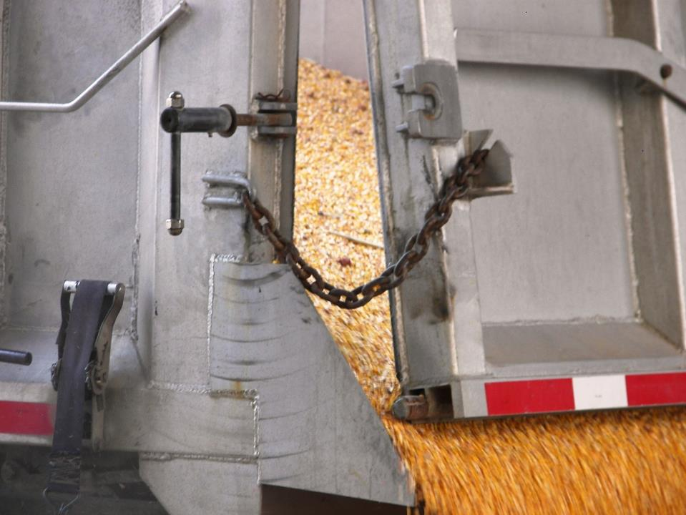
Semi-Trailer Gate
Safety Chains
Stand to side before signaling driver to release gate.
Notes:
The worker needs to move to the side BEFORE the driver releases the gate or can be knocked down by the unloading grain.

Slide 18
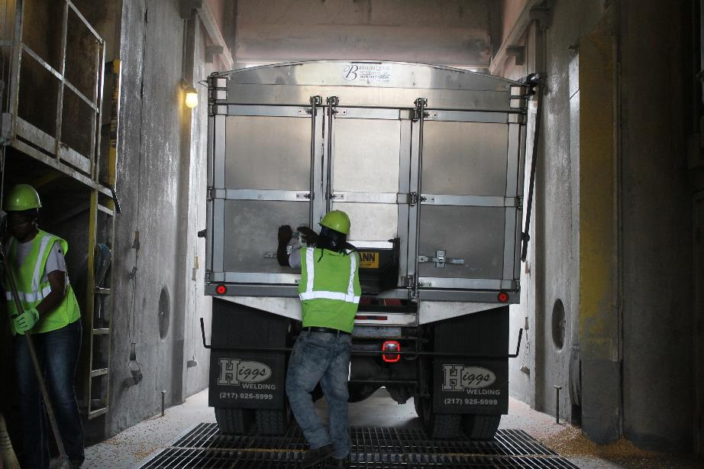
Secure Trucks
Ensure ALL Trucks/Wagons are secured BEFORE leaving dump pit.
Notes:
An unsecured opening can injure a worker or anyone who might be in the line of fire if the "door" swings open.

Slide 19
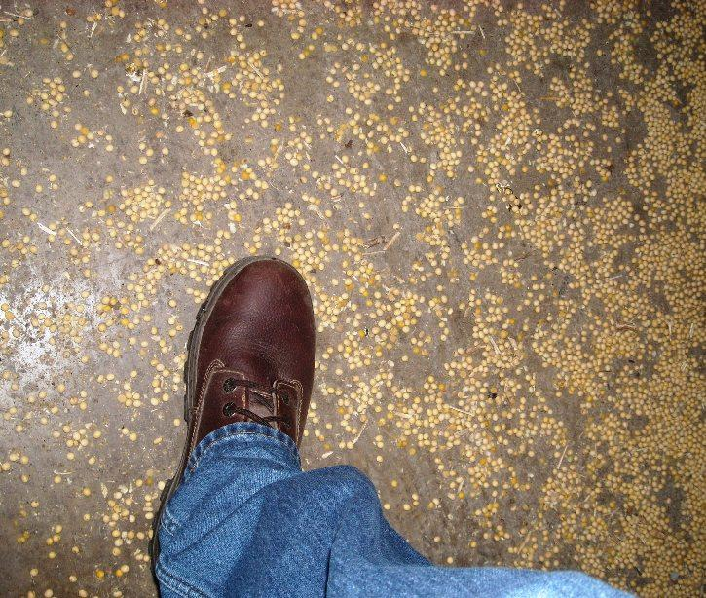
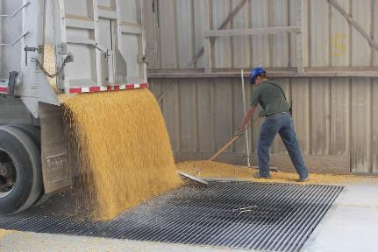
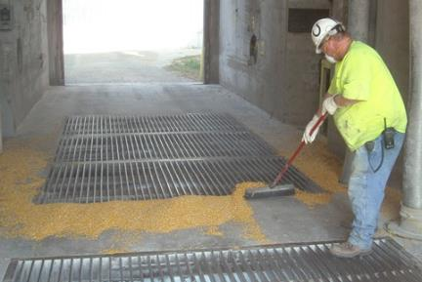
Housekeeping
Walking on soybeans is like walking on marbles
Dangerous to employees & customers
Notes:
As mentioned previously, cleaning up the area after unloading a truck is a BEST PRACTICE as grain can be "slippery" when walked on.
Best to clean up after each truck to keep walking-working surfaces free of debris.

Slide 20
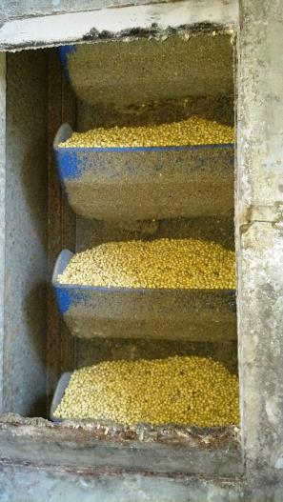
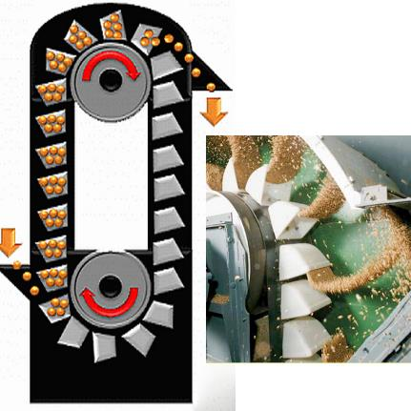
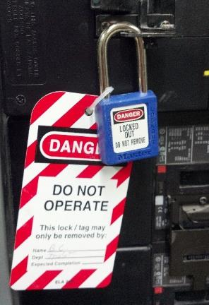
Choked Bucket Leg
Choked leg - buildup of grain in the leg resulting in the stoppage of grain flow & bucket movement.
Notes:
Defnition of a choked leg.
ALWAYS LOTO before working on the grain leg to unplug it.

Slide 21
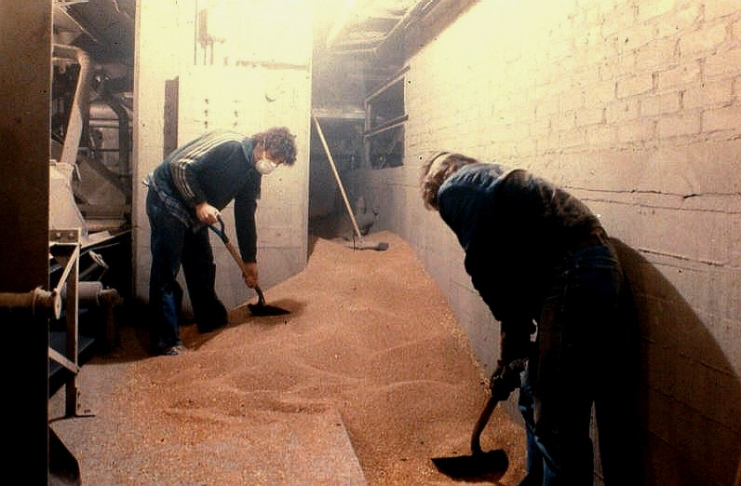
Choked Grain Leg
Notes:
View of a grain leg that is choked and spilled grain inside the leg. The grain cannot flow smoothly through the buckets and conveyor system and could cause belts to overheat.

Slide 22
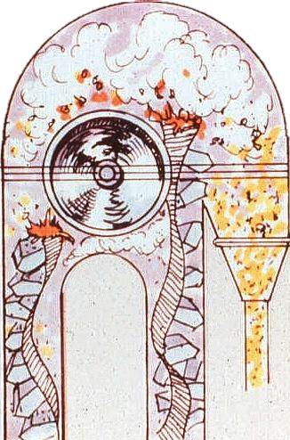
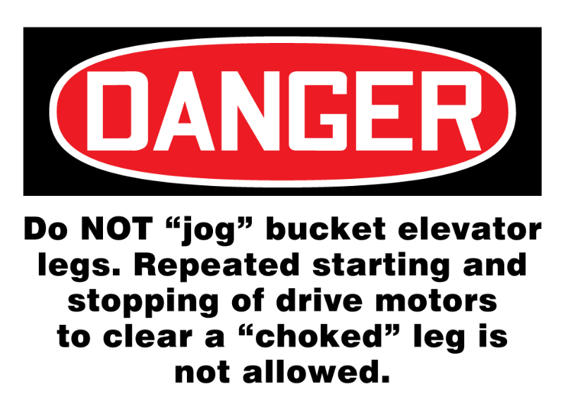
Do NOT "Jog" Bucket Elevator Legs
Notes:
"Jogging" a grain leg by relatedly starting and stopping can cause a build up a heat and ignite a fire.

Slide 23
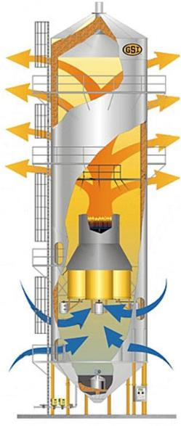
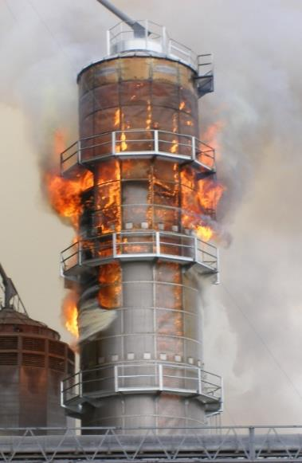
Grain Dryers
Know where gas & electrical shutoff are located
Follow dryer manufacturers’ recommendation for cleaning
Notes:
If there is a dryer fire, shut off the electric and/or gas.
Prevent fires by regularly cleaning the dryer.

Slide 24
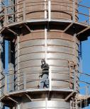
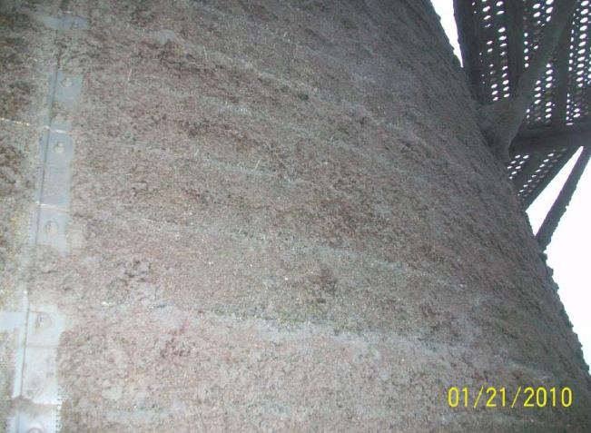
Outside of Grain Dryer
Notes:
Notice the fall protection railings.

Slide 25
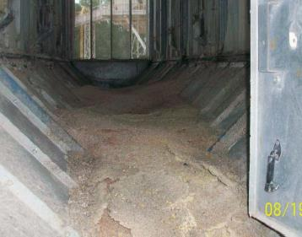
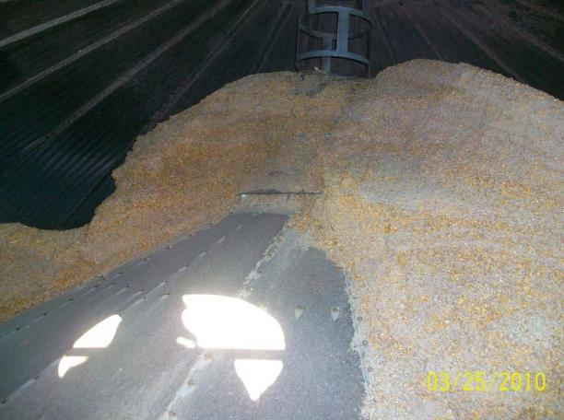

Inside of Grain Dryer
Notes:
The inside of a dryer.
A type of resin like substance can build up and catch fire.

Slide 26
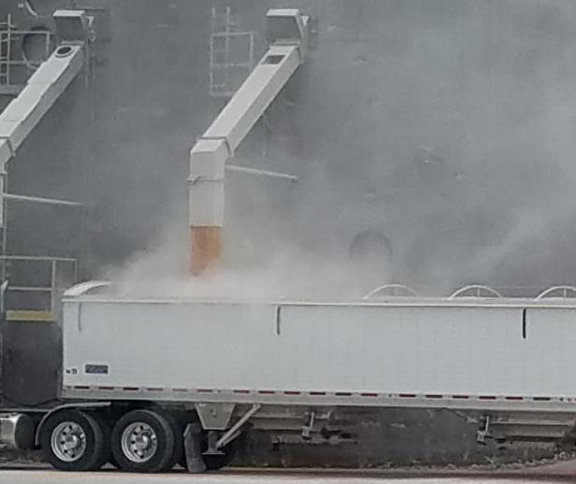
loading hazards

Slide 27
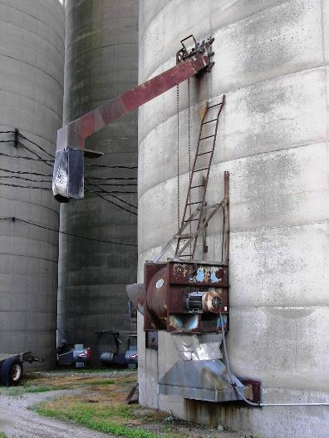
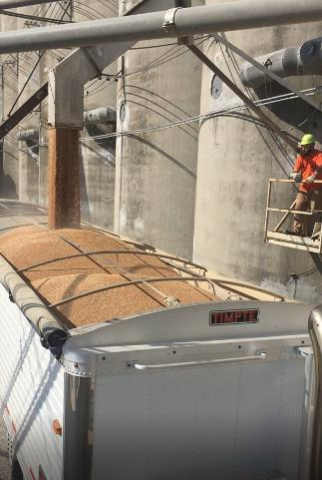
Fall Hazards
Good platform - standard handrail system
Ladder set up to unplug spout or work on unloading gate or chain
Notes:
Protect against fall hazards at grain loading locations with a guardrail system around the platform.
RIGHT – This is completely unsafe and improper use of ladder.

Slide 28
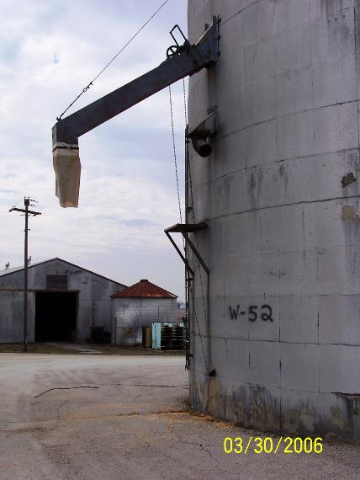
Injury Incident
Employee crawled up truck ladder onto spout to unplug it. Fell 15’ onto asphalt.
Injuries
One month in hospital
Broken left wrist required surgery
Right elbow (pins)
Impact right side of head; Left side hematoma
Cut near eye; lost all vision in right eye
Bone injuries healed completely with therapy
Area employee fell from
Notes:
Injury Incident

Slide 29
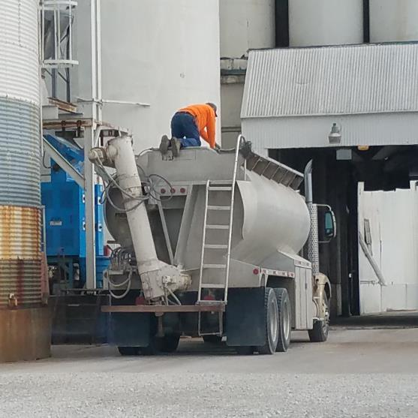
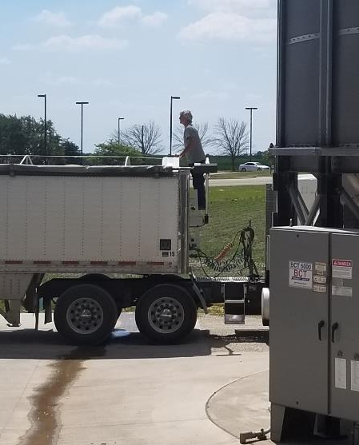
Rolling Stock
Rolling Stock is not covered by OSHA regulation but employees are!!!!!

Slide 30
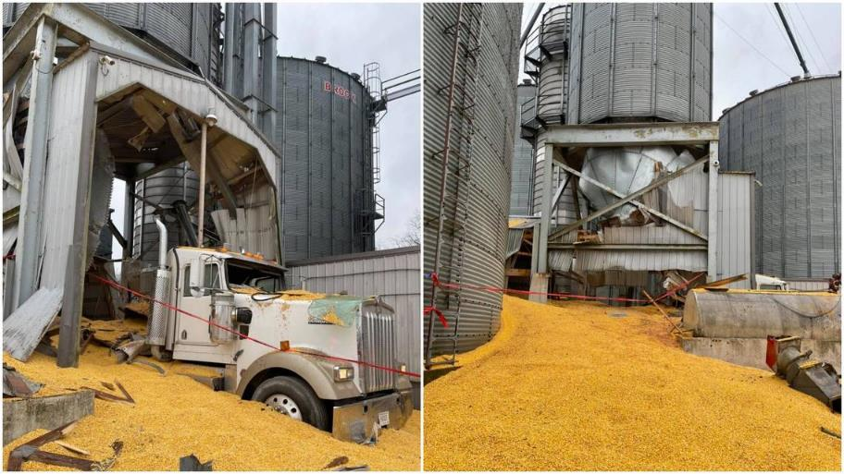
Inspect Grain Storage Structures
In December 2020 an 8,000 bushel hopper bottom overhead loadout bin collapsed burying a truck driver. Roughly 448,000 pounds of grain was spilled. Hopper bins are basically hanging the grain above the ground. Tremendous force is placed upon all grain bins and they must be in good condition.

Slide 31
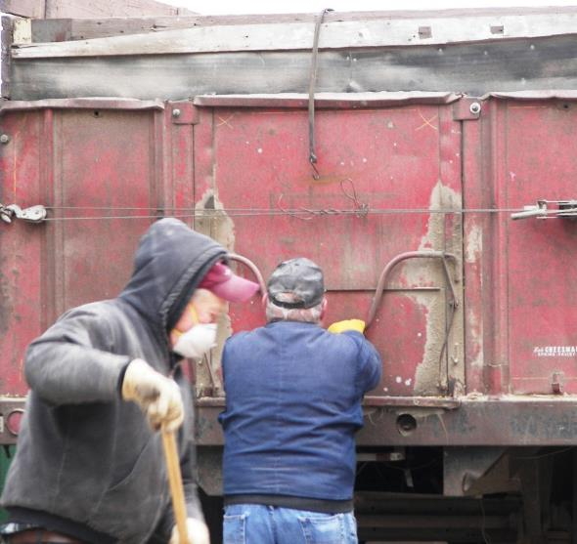
Summary- Dump Pit Safety
Loading & Unloading grain vehicles presents hazards to employees
Minimize hazards
Use best practice procedures
“Train” drivers and employees
#1 procedure is be alert
Notes:
Stay Alert when loading/unloading grain to known and potential hazards.
Train employees and drivers about hazards and the procedures for unloading grain to minimize risks.

Slide 32
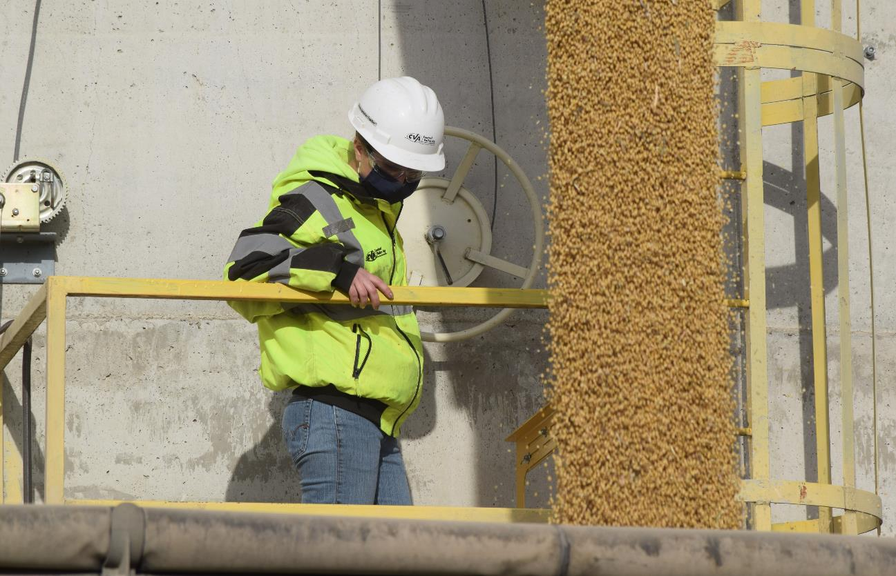

End slide
Protect our most valuable resource
Our Workers!
More information visit
grainsafety.org
Picture courtesy of CVA Coop

