Slide 1
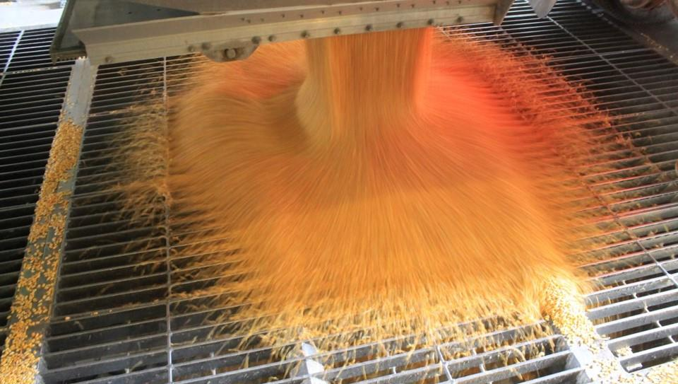
Dump Pit Safety
Loading & Unloading Hazards

Slide 2
Introduction
This Dump Pit Safety module is part of a curriculum series addressing hazards found in grain handling facilities including grain bins and their surrounding area. Its purpose is to assist participants to identify and abate hazards in the workplace.
The content was developed in collaboration with the Grain and Feed Association of Illinois.
Notes:
Other modules
Overview of Grain Handling and Storage Safety (introductory module)
Agricultural Confined Space Hazards
Cold Weather Hazards
Entanglement Hazards and Guarding
Fall Hazards & Prevention
Heat Stress
How Grain Quality Affects Safety
Introduction to Lifeline Protection Systems (mini module)
Lock out/Tag out (mini module)
Near Misses & Near Miss Reporting
Reducing Grain Bin Entry Risks

Slide 3
Disclaimers
This material was produced under grant number SH-37173-SH1 from the Occupational Safety and Health Administration, U. S. Department of Labor. It does not necessarily reflect the views or policies of the U. S. Department of Labor, nor does mention of trade names, commercial products, or organizations imply endorsement by the U. S. Government.
Notes:
Explain – GHSC received funding from OSHA. In order to comply with the grant we do need them to sign in and need to collect the following information:
Supervisor or worker. This information is for statistical purposes to show the types of population receiving training.
Employer. This is to establish an employer/employee relationship as covered under OSHA. Volunteer rescue workers who may be attending should list their employer; not the volunteer rescue squad. Farmers should list the registered business name of their farm. Farm employees should provide the business name listed on their paycheck.
OSHA does NOT contact the employer.
GHSC may contact the attendee or employer for follow-up evaluation in compliance with grant requirements.

Slide 4
Rights & Responsibilities
Employees are entitled to:
Safe & healthy working conditions
Fair compensation for all hours worked
Report unsafe conditions without retaliation
Call, write or email the OSHA area office within 30 days to report employer retaliation
Employers are responsible for providing a safe workplace free from known hazards.
www.osha.gov & www.whistleblowers.gov
Notes:
Explain - All DOL grants require that employees are informed of their rights.
Employees are entitled to a safe and healthy working environment
To fair receive compensation for their work.
To report unsafe conditions to the OSHA hotline without punishment, discrimination.or other retaliation by the employer.
Report occurrences of employer retaliation by calling, writing, or emailing the OSHA Area office within 30 days of the retaliation.
Explain - Employers have a legal responsibility to provide a safe workplace. They must ensure the regulations which govern their business are instituted and followed when there is one or more employees.
Discuss - It is the employers’ responsibility to know the rules and laws – federal and state.
It is employers’ responsibility to ensure employees, know, understand and follow regulations and company policies.
Stress - If employers are unsure of the regulations they should consult with the appropriate agency. Every state has an on-site consultation program jointly funded by OSHA and the state which provides assistance in learning and complying to the regulations.
The OSHA website provides contact information for each state’s on-site consultation program.
Illinois Department of Labor has the on-site consultation program in Illinois.
Stress - Employers should also know and understand the state’s laws as they may be more restrictive than OSHA. Some states are governed by an OSHA State plan rather than federal OSHA.
Contact the state department of labor for questions.
Visit the OSHA website for information about state plans.
Remind employees – it is the employee’s responsibility to follow the safety practices, policies, and procedures of their employers.
NOTE: It is ESPECIALLY imperative for youth/young workers to access information and know their rights, what to expect, and how to get help if needed.
More information about employee rights can be found on the OSHA website: www.osha.gov or the Department of Labor’s main website www.dol.gov .
Information about whistleblower protection can be found at www.whistleblowers.gov

Slide 5
Learning Objectives
At the end of this module participants will be able to:
Identify hazards associated with grain trucks when loading/unloading grain.
Identify specific practices to increase safety in dump pit areas.
Notes:
Introduce the learning objectives. These are the knowledge the participant should acquire as well as tasks or skills they should learn to perform.
Explain – the module was designed to seek interaction from the participants. Questions will be asked throughout to generate discussion.
Encourage – the sharing of ideas, information, experiences so everyone can learn.

Slide 6
Topics Covered
Emergency Action Plans
Contributing Factors to Safety
Personal Protective Equipment
Dump Pit Safety
Unloading Hazards
Loading Hazards
Summary & Best Practices
Notes:
Introduce the module topics/outline.
Explain the main sections may have subtopics which will be introduced at the beginning of each section.
Subtopics include areas such as coverage of the confined space standard, employer responsibilities, a permit required confined space program requirements, permit requirements, reclassification of a confined space, and alternate procedures.
Stress – this training is intended to be interactive. You’ll be asking for examples of different hazards from the participants and supplementing points in training with real life examples.
State - Part of the goal of this training is to share information and ideas about best practices, look at the realistic ways tasks are performed, discuss barriers to employing safe practices and solutions to those barriers.
Emphasize - We will be discussing what types of incentives are needed in terms of changing perceptions & attitudes and the cost of safety practices.

Slide 7

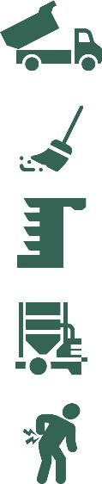
10 Ways to Make Your Facility Safe During Harvest
Emergency Action Plans
Avoid Fatigue Related Injuries
Infectious Disease / COVID-19 Protocols
Personnel Protective Equipment
Customer Relations
Dump Pit Safety
Housekeeping
Unplugging a Grain Leg
Grain Dryer Operation Safety
Back Safety
Notes:
Ten (10) Focus areas during the busy harvest season to increase safety.
Emergency Action Plans are not just for grain engulfment but should cover all types of emergencies including weather, fire, chemical spills, vehicle accidents, etc. Harvest is a busy time. Having the plans in place and ensuring employees know what they are can decrease delays in responding effectively to emergency events.
Fatigue is an often unrecognized hazard. During harvest producers and commercial elevators are working long hours. Fatigue can lead to accidents and injuries which may not otherwise occur. Employers and employees should be aware of signs of fatigue and know its affects on decision making and ability to perform job tasks.
Covid-19 protocols or rather any infectious disease protocols should be followed to prevent illness outbreaks among workers. When workers are already fatigued, they are more susceptible to picking up illnesses, adding to increased injury/accident risk. At a time when additional, temporary help is required to handle the volume, high levels of absenteeism due to illness is difficult to accommodate. The best way to avoid this is to use recognized prevention protocols and encourage sick workers to stay home to prevent the spread of illness.
Personal Protective Equipment is a "last defense" but the proper use of PPE can reduce injuries as well as protect workers against health hazards such as respiratory infections. Grain dust contains fungi and bacteria which can lead to chronic respiratory illness. Loading and unloading grain exposes workers to large amounts of dust. Proper PPE can reduce exposure.
Customer Relations – Good relations with customers can significantly impact the safety of workers. Many elevators are located in small, rural, communities. Often the same people are hauling the grain into the local elevators. When there are strong, positive relationships the drivers and elevator personnel there tends to be greater vigilance and adherence to safety measures.
Dump Pit Safety – The dump pits are extremely busy during harvest. Having established procedures and safety practices in place is important to reducing accidents and injuries.
Housekeeping & Preventative maintenance – keeping dump pits, roadways, walkways, and other high traffic areas clean of spilled products, and other hazards such as oil spills, etc. decreases exposure to slip/tri and fall hazards.Keeping dust levels down int bucket elevators, etc. when there is such hhigh volume of grain being moved, decreases the risk of hot spots, belt rubs, etc. which can lead to fires and explosions.
Unplugging Grin Legs – Again, the volume of grain being moved during harvest increases risk. Keeping grain legs in good operating condition, unplugging grain legs when it occurs, and being vigilant in observing any problems prevents the risk of fire/explosion, and other hazards.
Grain Dryer Operation Safety – Grain Dryers have several hazards associated with their use including high temperatures, confined spaces, and fire potential. During this high volume period, it is critical to follow safety procedures. Harvest is a time when many grain dryer fires occur.
Back Safety – This is a time of intense physical work – bending, lifting, stretching, twisting, climbing, pulling, walking, etc. Workers need to pay attention to how they are completing tasks and take care to reduce strains and sprains of the back and other muscles. Strains and sprains are usually the biggest injury category in elevators.

Slide 8
Emergency action plans

Slide 9
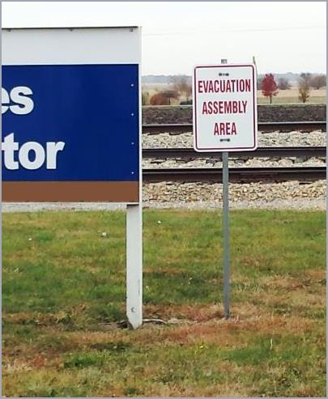
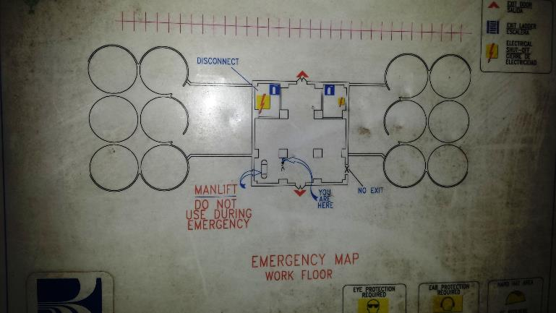
Evacuation & Meeting Place
EAP covers evacuation of personnel & visitors
Notes:
All workers should know the evacuation plans and assembly points for different types of emergencies especially those related to weather and fires.
Evacuation routes and assembly areas should be clearly marked both for employees and visitors.

Slide 10
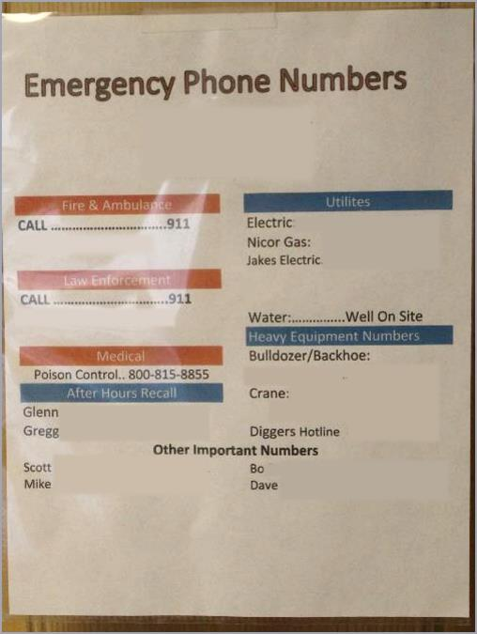
Emergency Phone Numbers
Post where easily seen
Fire/Rescue/Medical
Law Enforcement
Utilities
Who to call in emergency/after hours
Other
Notes:
Emergency phone numbers should be posted in several locations throughout the facility as well as in vehicles and equipment.
All workers should know where these are located and who to call.
Notice on this emergency number list are contacts for heavy equipment – bulldozer/backhoe, crane, etc. which may be needed.

Slide 11
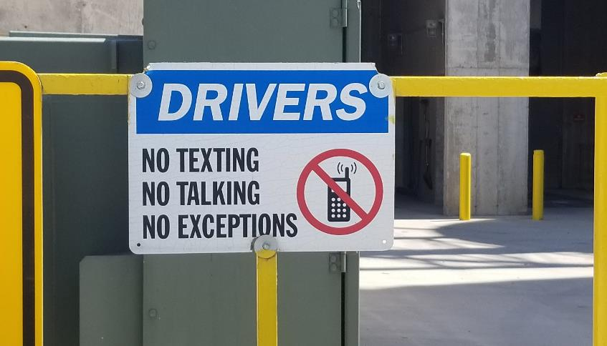
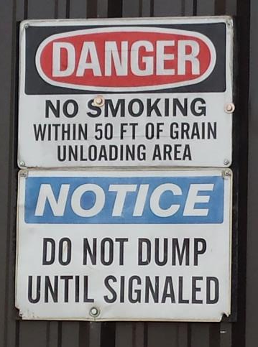
Signage for Hazards
Notes:
Facilities should have signage warning of hazards.
This is important for both employees as well as the customers.
Signage should be posted at intervals if possible – especially along the route to the dump pit area where trucks may wait in lines.
Notice the "drivers" sign prohibiting cell phone use. When approaching the dump pit area, drivers should not be distracted in order to hear, see, and follow the instructions of the elevator personnel, and be aware of the surroundings. There is a great deal of movement with vehicles, equipment, and people in this area.
NO SMOKING – grain dust is explosive. There is a great volume of dust that rises when trucks are being emptied.
Drivers should never dump their grain until signaled to do so. Many dump pit areas are tight spaces. Workers need to be clear of the truck, and hazards before unloading occurs.

Slide 12
Contributing factors
Factors Contributing to Dump Pit Hazards

Slide 13

Fatigue Contributes to Unsafe Behaviors
Lack of sleep has same effects as alcohol
Weariness
Sleepiness
Irritability
Reduced alertness
Impaired decision making
Lack of motivation, concentration & memory
RoadSafetyCommission@RoadSafetyWA
Notes:
Fatigue does not receive enough recognition as a safety hazard.
During harvest, both the customer (producer/truck drivers) and the elevator employees are working long hours. Many facilities operate 24 hours during this time or stay open until late for drivers to come in from the fields or have trains coming in and out at all hours.
Fatigue no only affects "mood" but decision making, reaction time, concentration, and memory. When dealing with traffic, product, rail cars, etc. this can have devastating consequences.
While it is not always possible to reduce overall work hours during this time, employers should take steps to develop schedules to reduce fatigue among employees such as staggered schedules, breaks, quiet times, etc. Employers/supervisors should be aware of signs of fatigue among workers such as behavioral changes and adjust work tasks, etc.
Staying hydrated and eating healthy can help reduce some of the effects of fatigue. During this busy time, employers might consider setting up portable water stations near the work area and encourage workers to stay hydrated with water rather than caffeine.
While the lines may be long, employers should ensure workers take breaks and meal breaks and encourage workers to rest during any 'downtime'. Providing a quiet area for retreat – apart from the employee "break room", is a good alternative. This should be designated a "quiet zone' – no music, tvs, etc. with dimmer lighting. The point is to reduce stimuli in order to provide a respite.

Slide 14

COVID-19
All employees are essential
Know your company’s policy regarding masks and follow them
Be aware of your health level every day
Be honest. Report any symptoms immediately to your supervisor
If you have been exposed to someone who has tested positive, quarantine for the recommended length of time.
Notes:
All employees are essential – this should be communicated in the facilities policies and actions.
All facilities should have a covid/infectious disease policy which is known to the employees.
Employees should be aware of their health and report any symptoms to the supervisor.
Employers should ensure there are handwashing/sanitation stations throughout the facility, be regularly cleaning/disinfecting high touch/public areas, and, if possible, have a 'no contact" emergency plan that can be used in case of significant community positivity for an infectious disease including flu, RSV, etc.
Employees who may have been exposed should follow protocols such as masks, distancing, etc.

Slide 15
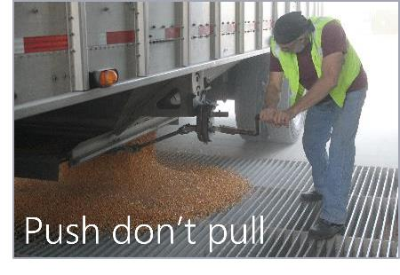
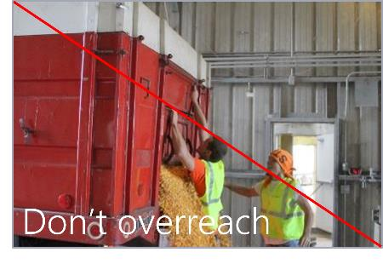
Prevent Back Injuries
Slow down
Stretch first
Rest your back
Push don’t pull
Avoid twisting at the waist
Don’t overreach
Get help lifting awkward or heavy objects
Lift correctly with your legs
Notes:
Prevent back injuries by following recommended safety practices.
During this time of high physical activity, employees should be encouraged to stretch before beginning work. Some facilities start shifts with stretching exercises. Although workers may scoff at the idea, it can help decrease the risk of strains and sprains.
Many facilities are reporting new hires do not have prior experience with physical labor and lack stamina. It these instances, employers are developing a work schedule to "acclimatize" workers to the physical demands of the job – much like acclimatizing workers to heat.

Slide 16
Personal protective equipment

Slide 17
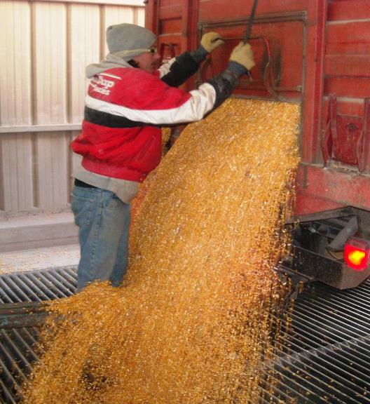
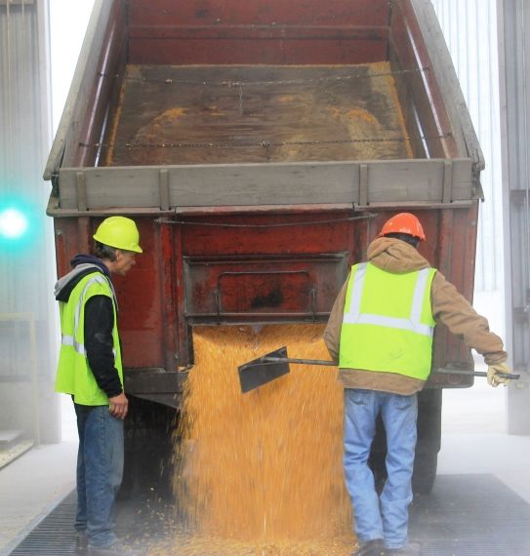
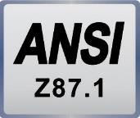
Personal Protective Equipment in Dump Pits
The more visible you make yourself the safer you will be.
Common PPE
Gloves
Hard hats
Dust mask
High Vis Clothing
Safety glasses or goggles
Steel toed boots
Notes:
PPE should meet the ANSI z87.1 standard to provide the appropriate level of protection.
LEFT – swim googles are not approved eye protection.
These are older pictures and there is increasing recognition that hard hats and dust masks should be worn at all times although it is not necessarily required by OSHA standards.
Safety glasses or googles should be worn to protect the eyes from grain dust.
High vis clothing – or at least a vest- is becoming very common in grain facilities although not necessarily required. With the amount of traffic, days with low visibility, and reduced visibility if there is a lot of dust, this helps workers be more visible to drivers and each other.

Slide 18
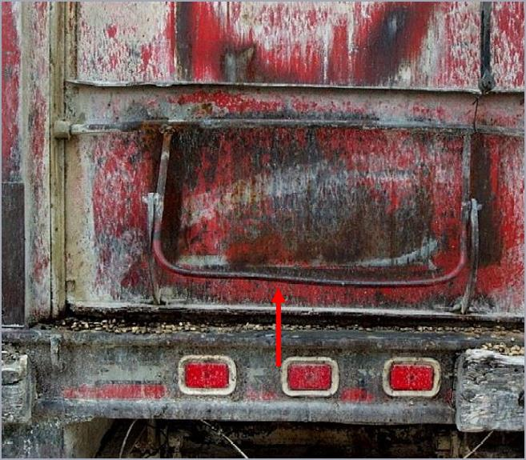
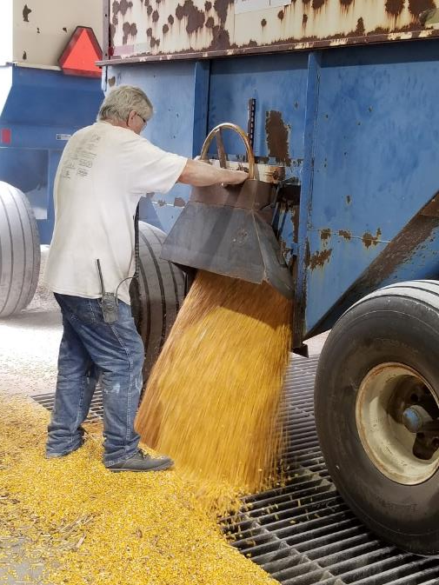
Gloves - Important To Wear
Dump gate could have burrs or rough spots.
Turning wheel can cause scraped knuckles.
Notes:
There is a bigger push to recognize the importance of wearing gloves while working in the grain facility. Facilities should set their own policies about when gloves are required.
When working in dump pits workers should be wearing gloves to protect their hands from scrapes, cuts, etc.
Dump pit workers are dealing with many types of trucks in various conditions. Some are old and could have burrs, rough spots, etc. and/or latches, wheels, etc. which do not turn easily.
Gloves also help protect against tetanus from rusty metals and helps protect scratches, etc. from becoming infected from grain contaminants.
It is important the gloves have good grip for handling the locks & latches on trucks.

Slide 19
Dump pit Hazards

Slide 20
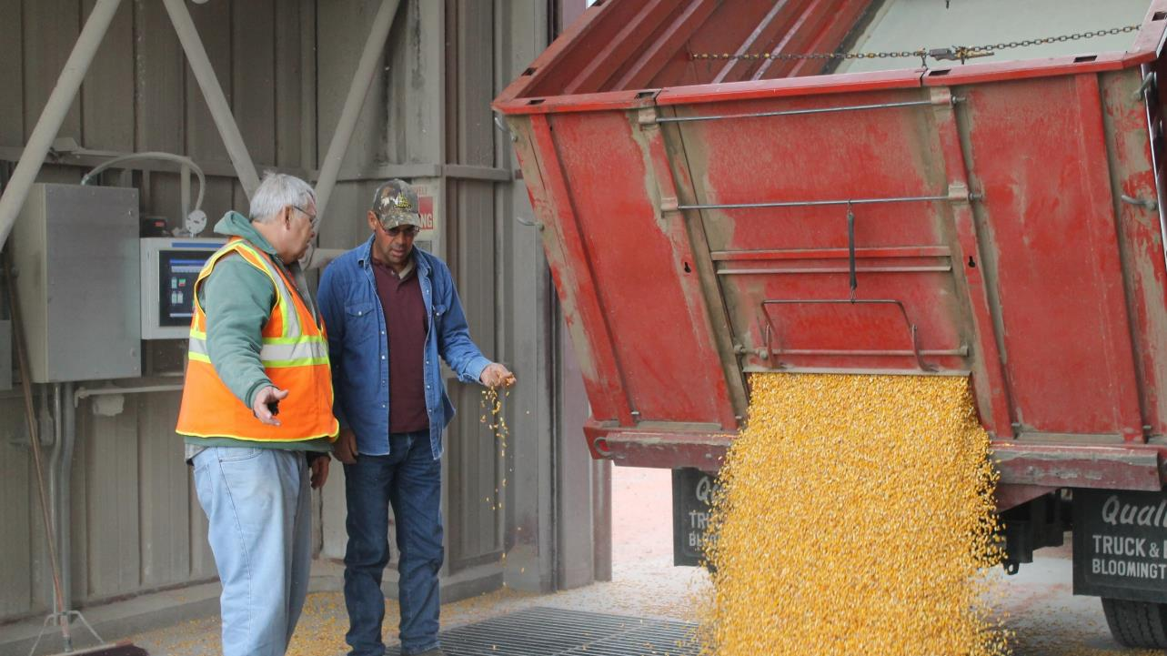
Good Customer Relations
A good relationship with the drivers does affect safety.
They “look out” for you.
Will be more likely to listen to your directions.
Notes:
Customer relations directly impacts safety.
They are more likely to be vigilant, look out for you, follow directions, and often be a bit more patient.
While "patience" may not sound like a "safety measure" at first, consider the implications of an impatient driver. They may not be as aware of the surroundings (a lot of traffic and people movement), may not wait until the dump or all clear signal is given, etc.
Struck-by and crush injuries with vehicles occur when the driver does not see the worker – impatience lends to not being vigilant and noticing the surroundings.
Often the driver is to remain in the vehicle while the load is being dumped. In this photo, the driver can be seen talking with the elevator personnel. Drivers should only exit the vehicle with permission.

Slide 21
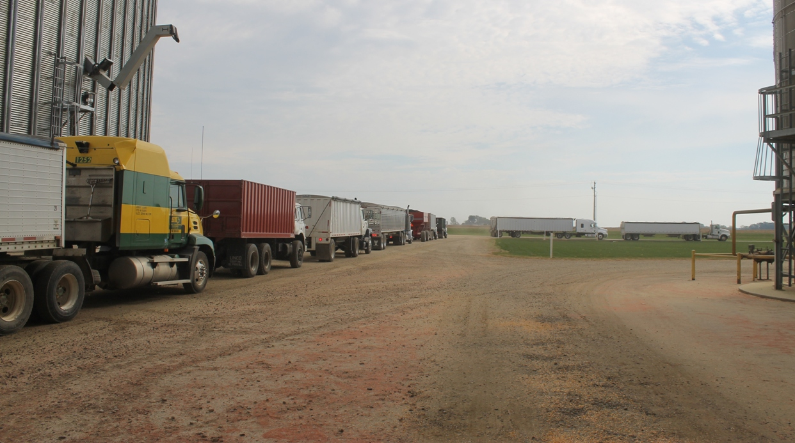
High Volume Times/Dump Pit Hazards
Traffic levels increase
Inexperienced vehicle drivers
Trucks/wagons in bad repair
Inexperienced temporary workers
Long hours/fatigue
Notes:
It is critical to understand safety during harvest is impacted by a variety of factors both within and outside of the facility.
The facility's job is to recognize these factors, implement policies and work procedures to alleviate as many of the hazards as possible, and train employees including the temporary employees.
Inexperienced drivers and vehicles in bad repair pose a hazard to elevator workers. While the facility cannot "correct" these situations, they can plan for them.
Have clearly marked traffic patterns, signage, and/or other traffic control measures to direct traffic flow.
Designate pedestrian walkways for both workers and guests.
Keep roadways in as good of condition as possible. Although often the facility has dirt roads, have plans to deal with muddy roads, deep ruts, ice, etc. to ensure the safety of drivers and workers.
Recognize again, most facilities are in rural areas and often may be right off a main road/highway. Ensure traffic lines do not block entry and exits to roads, etc.
BE AWARE of carbon monoxide fumes from idling trucks.

Slide 22
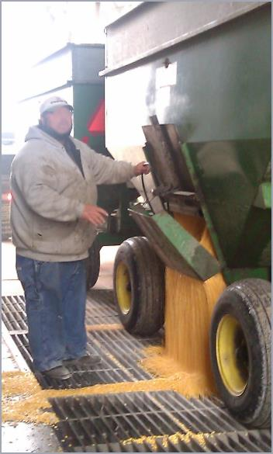
3 Tenets of Dump Pit Safety
Never walk in front of vehicles even if you think they are out of gear
Always make sure the driver sees you before you operate gates or doors
Always make sure the driver sees you before exiting the dump pit
Notes:
The 3 main rules for dump pit safety.
In this picture notice there are tandem grain carts. After emptying the first cart, the driver will have to move forward to empty the second. Good communication is key so the driver does not move until given the instruction to do so. It's important to remember that after closing the hatch, the worker often sweeps the grate area. This may occur after the truck leaves the pit area or in this case would occur before pulling in the second cart and again after the truck leaves the area.

Slide 23
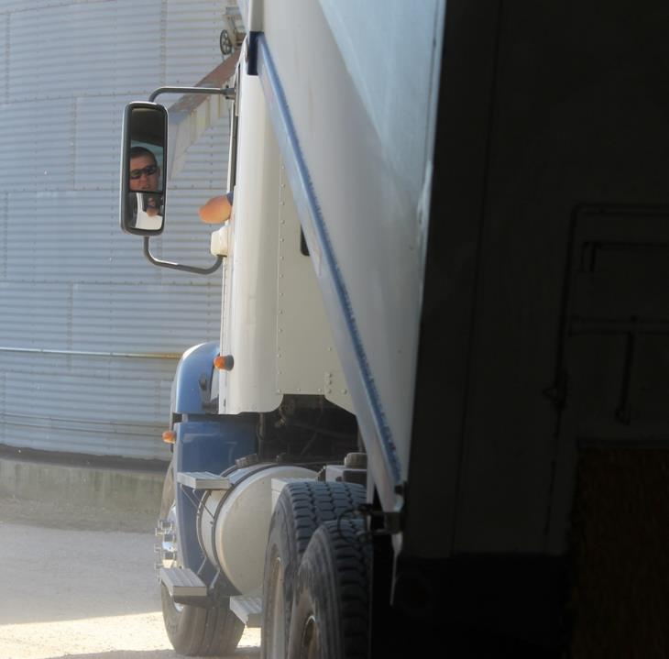
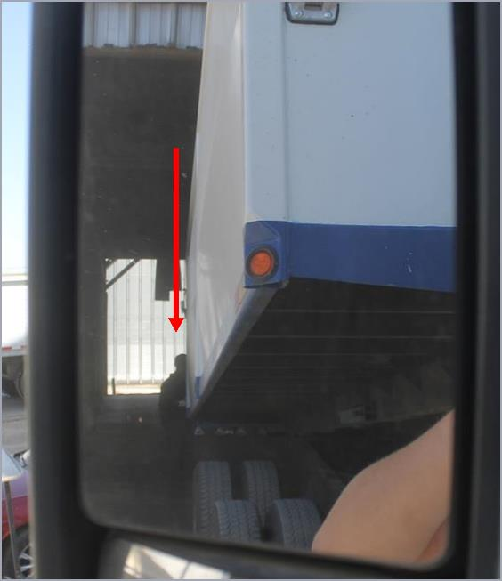
Driver's view of workers
This is what drivers see
If you can’t see the driver's mirrors, they can’t see you
Notes:
This is a great picture of what the driver sees and why it is important for the worker to make sure they are visible.

Slide 24
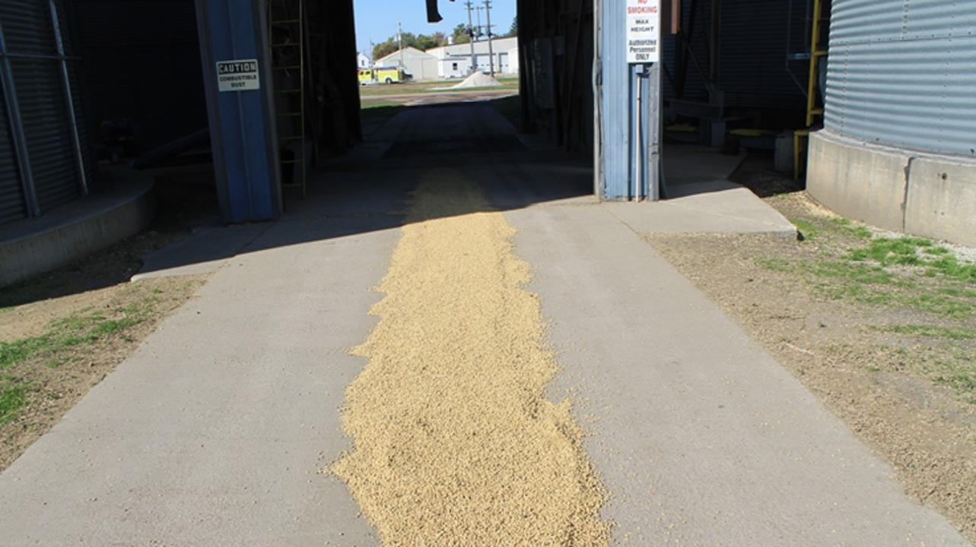
Dump Pit
Notes:
This picture shows hazards that are often overlooked. We purposefully did not retouch this photo to show exactly what the driver and worker must deal with.
First, the trail of spilled grain. Having a long pavement is a plus to be easier to clean up, but also can make it a bit more slippery.
Second, notice how dark the pit area is. The driver is going to go from bright sunlight to a dim environment to bright sunlight– which means the eyes need time to adjust and can temporarily impair the driver's vision.
The worker in the pit is working in dim light.
The pit area is small!

Slide 25
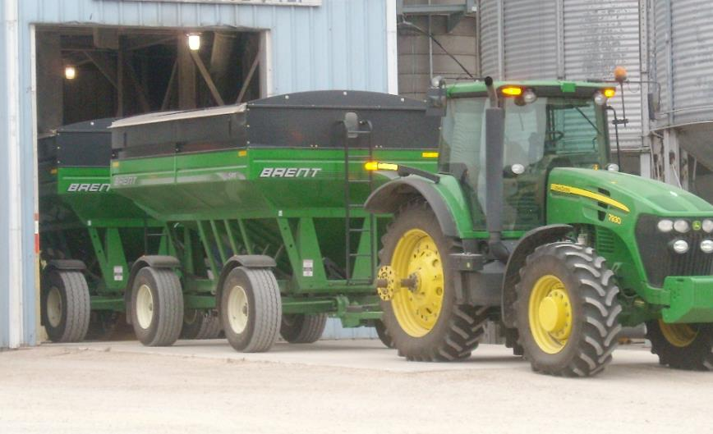
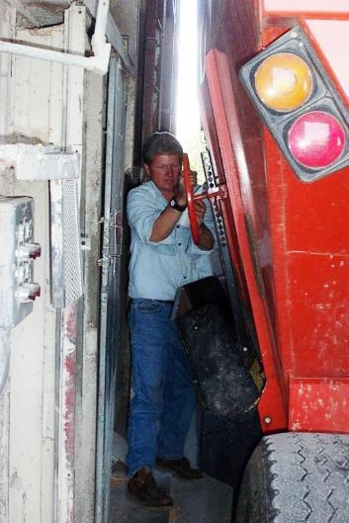
Dump Pit Size vs Equipment Size
Notes:
This shows a perspective of how small many pit areas are.
LEFT – the truck exiting the pit area. Notice again the tandem carts.
RIGHT – Notice how little room there is between the truck and the wall. The worker is in an awkward position to operate the hatch controls and has little room to work.

Slide 26
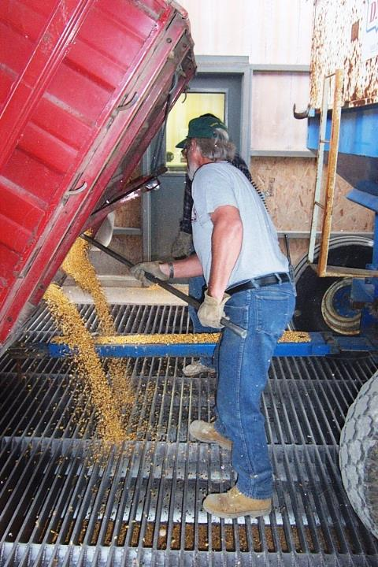
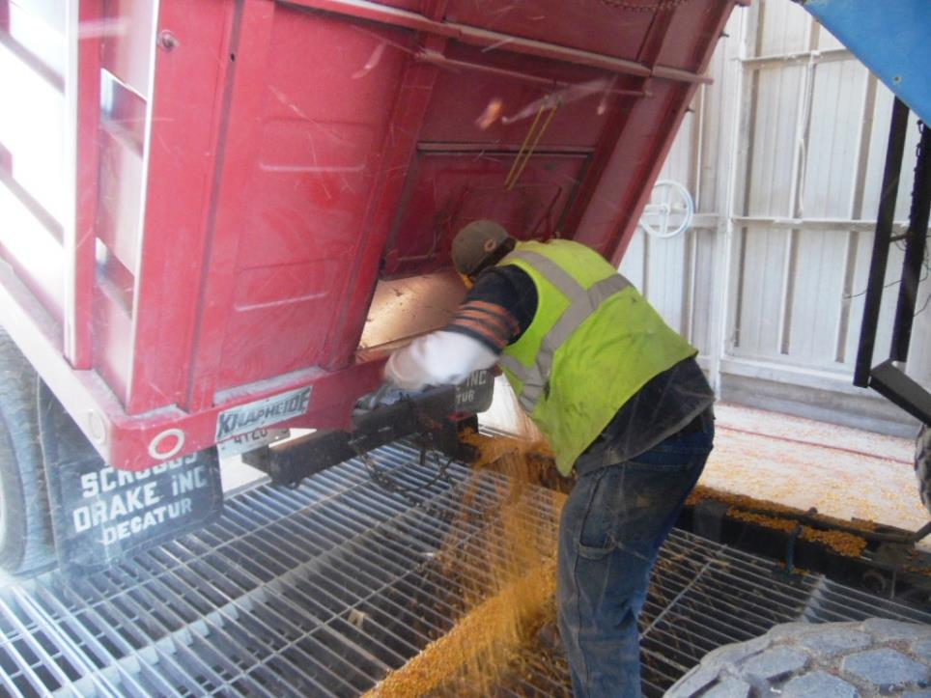
Truck & Gravity Wagon
Always make sure the driver sees you before exiting the dump pit.
Notes:
The worker needs to be clear of the travel path of the truck BEFORE the driver exits the dump pit.
There are 2 pictures here.
LEFT – worker is raking out the grain. Notice he is in between two vehicles (red on left and blue on right. The worker needs to be clear of the area for the red vehicle to lift its bed.
RIGHT – again, worker is opening the unloading gate and is between 2 vehicles. You can see how when the red vehicle is tilted there is little room between the two vehicles.

Slide 27
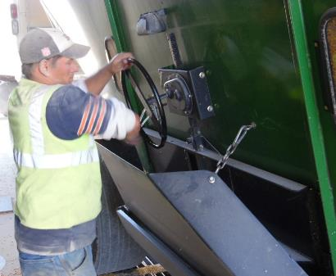
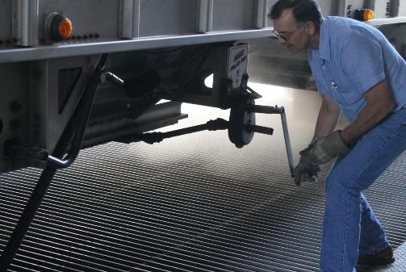
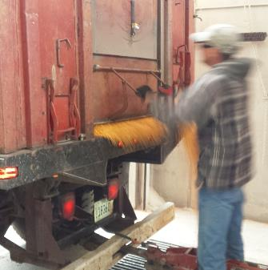
Opening Mechanisms
Many different vehicles.
All types of opening mechanisms
Notes:
Trucks have many types of opning mechanisms.
LEFT – Wheel crank on back.
CENTER – crank – opens bottom.
RIGHT – lift gate on back.
Many facilities are adopting a model that the driver must operate the opening mechanism. It does protect the worker as the driver cannot accidently move the truck. It also prevents the worker getting hurt trying to open a mechanism that may not be in good repair. The con is having to ensure the driver is safe while outside the vehicle.

Slide 28
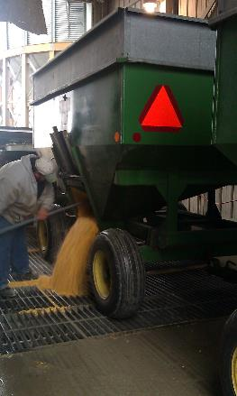
Unloading hazards
Straight Trucks, Tandem/Cargo Doors, Wagons

Slide 29
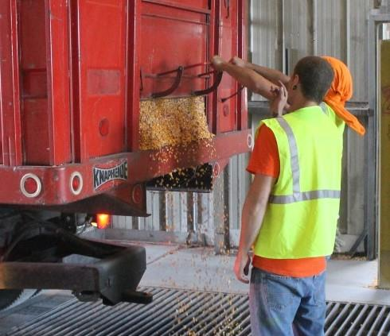
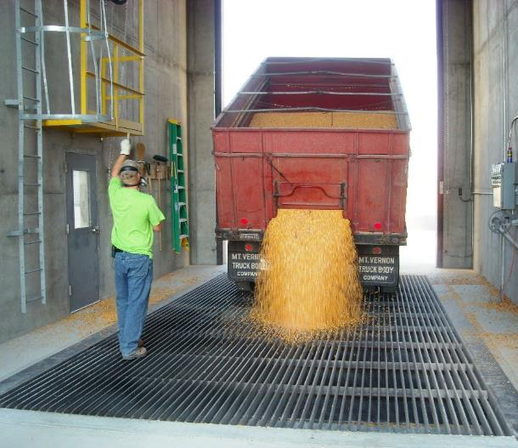
Straight Trucks – Prepare to Empty
Open the gate.
Move to driver’s side. Signal driver to raise bed. Use consistent hand signals.

Slide 30
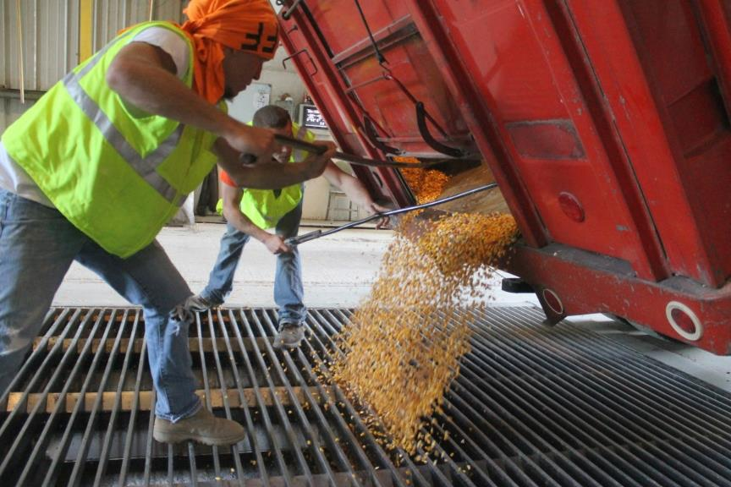
Straight Trucks - Unloading
Rake out the corners of the truck bed. Then instruct driver to lower truck bed.

Slide 31
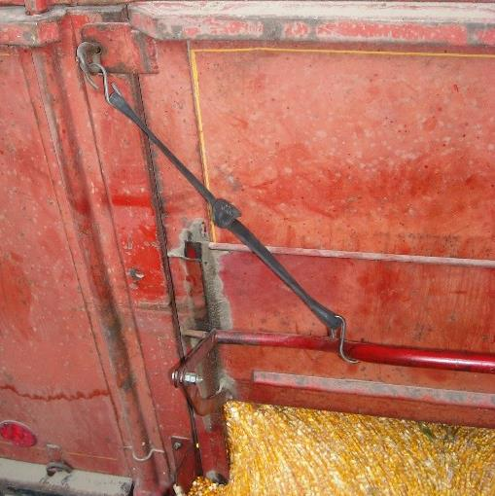
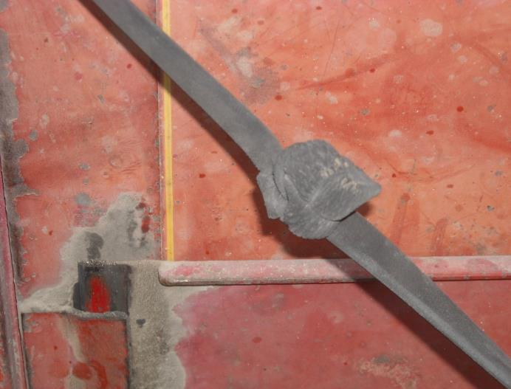
Straight Trucks – Tarp Straps
Always hook the gate. Keeps it from sliding down unexpectedly.
Use caution with the tarp straps. Some get brittle/dry rotted and can break.
Notes:
Many of the straight trucks (as they are generally older) use tarp straps to keep the gate open.
They are usually "with the vehicle" and may not be in good repair which means they can snap. Workers need to stay back and out of reach of the strap in case it breaks during unloading.

Slide 32
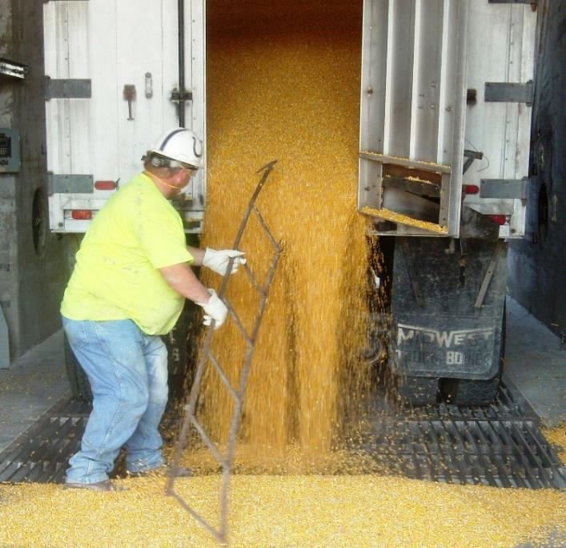
Non-Grain Objects in Dump Load
100 lb tractor weights
Cold Beer
Loaded Rifle
Railroad Tie
Log chains
Water heaters
Chain saws
Ladders
Broken shingles
Dead and live animals
Cell phones
1600 lbs of sod
Stay Clear as truck bed is hoisted.
Notes:
A big problem and safety hazard for dump pit workers is objects coming out of the truck with the grain. These are items that have been seen coming out of a grain truck with the grain.
Sometimes producers "forget" to check the truck and ensure it is empty before loading it with grain.
Once the gate is open, the worker needs to be clear of the area while the bed is hoisted and gravity takes over.
Picture – Worker narrowly misses gettinghit with ladder coming out of the truck.

Slide 33
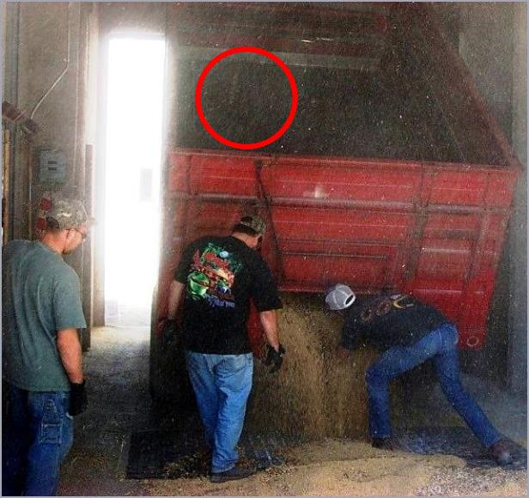
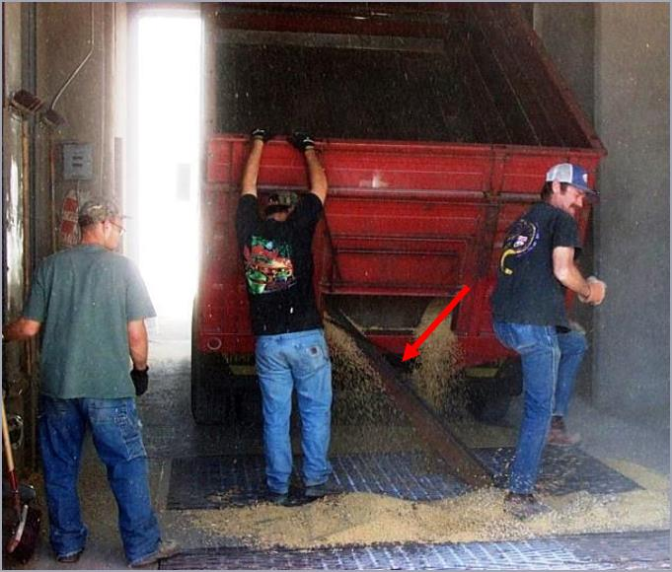
Foreign Object Hazard
Large piece of angle iron wedged into truck bed.
Iron came out striking worker's knee. No serious injury sustained.
Notes:
More objects in the grain truck.
Worker escaped serious injury but did get hit with the object.

Slide 34
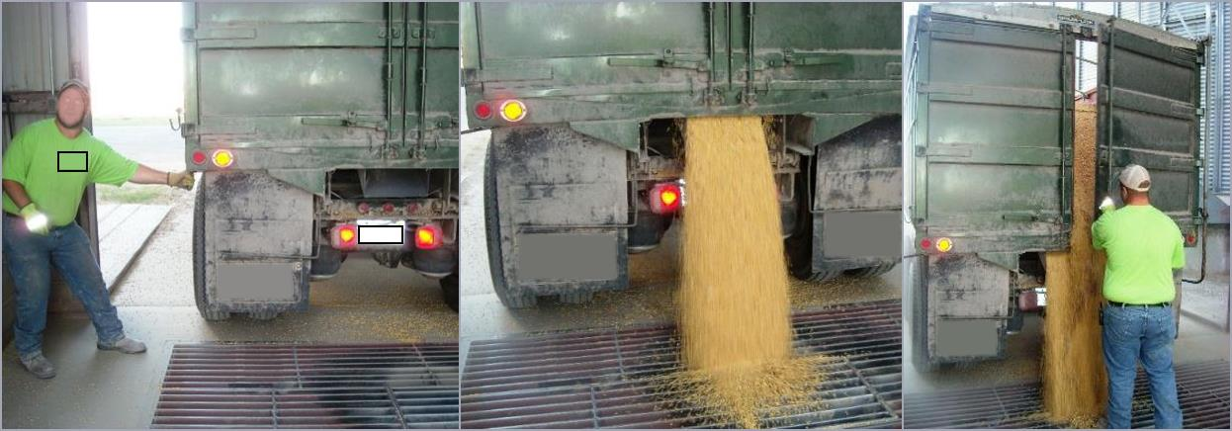
Opening Tandems/Cargo Doors
Open small gate to take pressure off door
Then open cargo door
Notes:
It's important to take the pressure off the main cargo door as once it is opened, the grain flows out quickly.
Without relieving the pressure, the worker can be hit with several tons of grain when opening the cargo door.

Slide 35
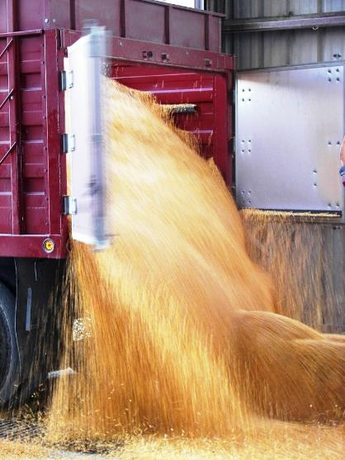
Emptying Tandems/Cargo Doors
Tremendous pressure can be pushing on the door, especially if the bed is raised.
Can cause cargo door to open violently.
Notes:
This is what the worker can experience with a tandem/cargo door opening if there is no way to relieve some of the pressure.

Slide 36
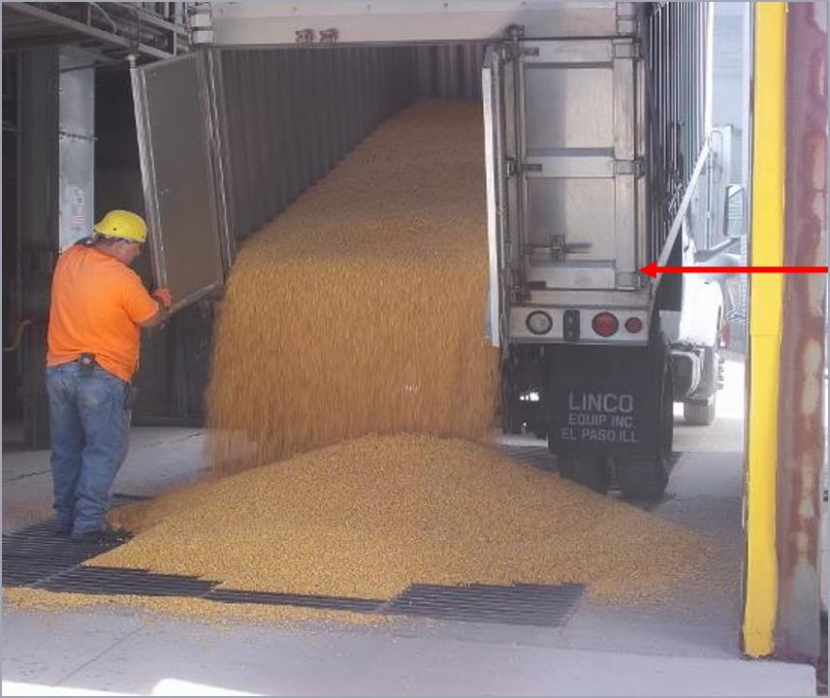
Right Side Cargo Door
Some companies do not open the right cargo door.
When the bed is hoisted up all the way it can damage the door.
Notes:
Arrow points to interference which can damage door if truck bed is fully hoisted.

Slide 37
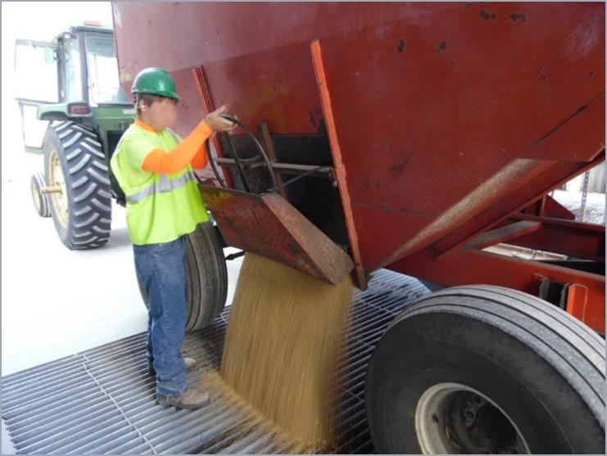
Wagons
Stand to the side to turn the wheel
Step away from the wagon as the grain unloads
Wear gloves
Notes:
Don't stand in front of the wheel in case there is a malfunction and the grain rushes out. The force can knock the worker down.

Slide 38
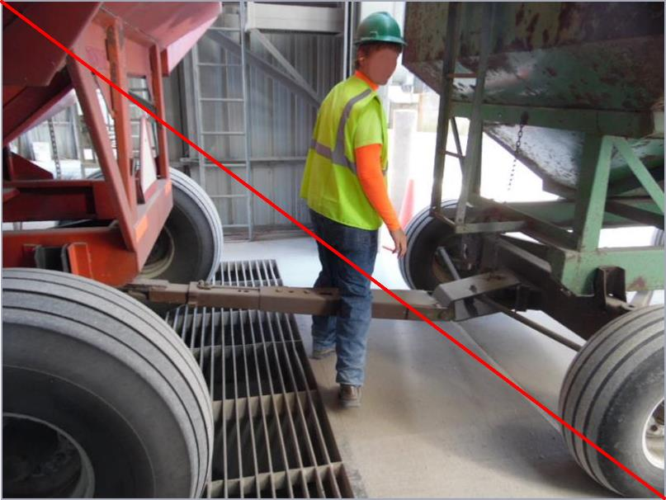
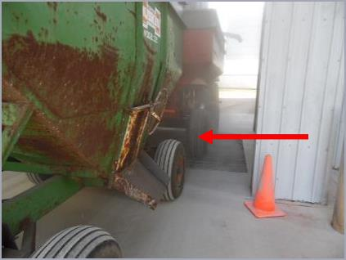
Struck-By Hazard
Do NOT cross between wagons.
Notes:
NEVER step across a hitch and NEVER cross between wagons. If the vehicles move, the worker can fall, be struck, or be crushed between them.

Slide 39
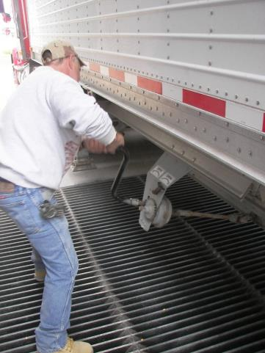
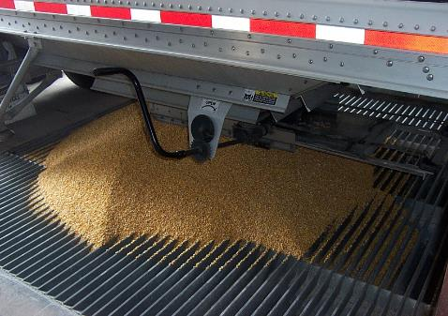
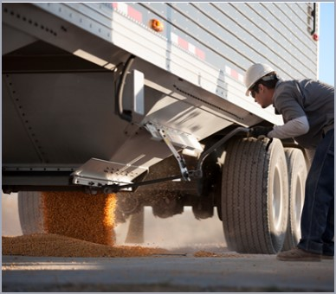
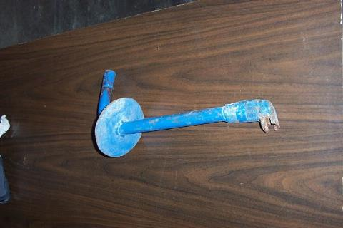
Hooper Bottom Trailers
Modified crank to prevent dropping into the pit
Notes:
These types of trucks empty at the bottom.
This can be an awkward position and put strain on the back.
Sometimes the crank can fall off into the pit or when down not clear the pit area well

Slide 40
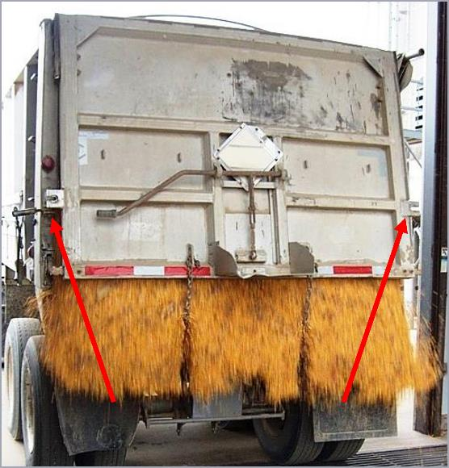
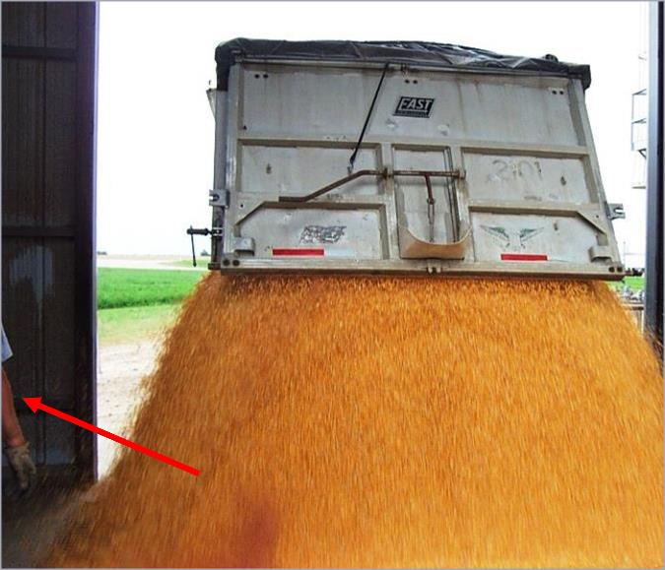
End Dump Semi-Trailer
Stand to side. Signal driver to release the gate.
Release both latches.

Slide 41
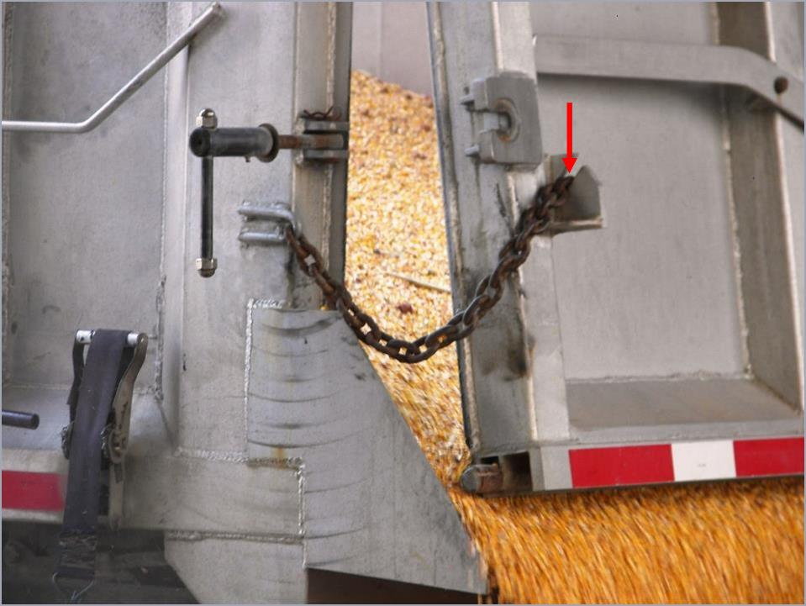
Semi-Trailer Gate
Safety Chains
Stand to side before signaling driver to release gate.
Notes:
The worker needs to move to the side BEFORE the driver releases the gate or can be knocked down by the unloading grain.

Slide 42
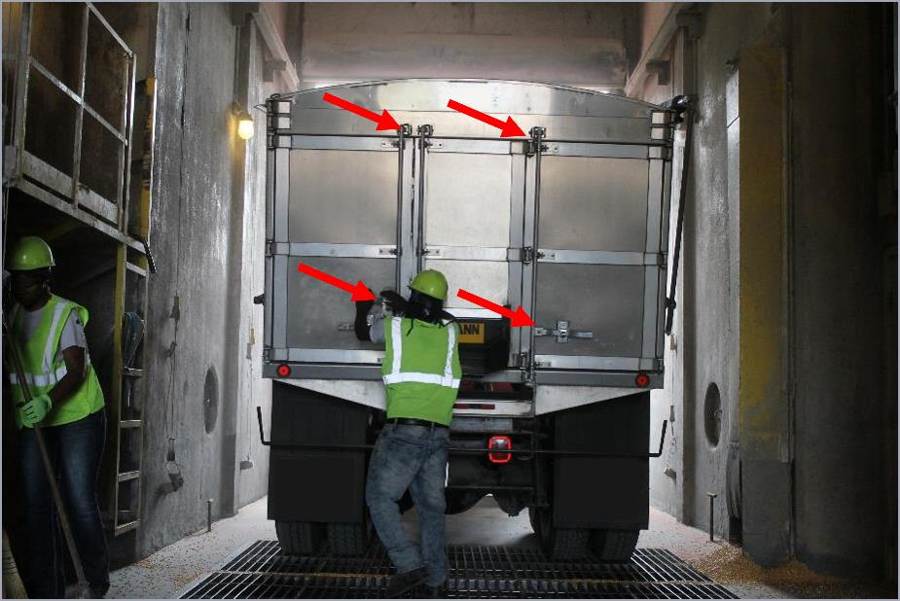
Secure Trucks
Ensure ALL Trucks/Wagons are secured BEFORE leaving dump pit.
Notes:
An unsecured opening can injure a worker or anyone who might be in the line of fire if the "door" swings open.

Slide 43



Housekeeping
Walking on soybeans is like walking on marbles
Dangerous to employees & customers
Notes:
As mentioned previously, cleaning up the area after unloading a truck is a BEST PRACTICE as grain can be "slippery" when walked on.
Best to clean up after each truck to keep walking-working surfaces free of debris.

Slide 44



Choked Bucket Leg
Choked leg - buildup of grain in the leg resulting in the stoppage of grain flow & bucket movement.
Notes:
Defnition of a choked leg.
ALWAYS LOTO before working on the grain leg to unplug it.

Slide 45

Choked Grain Leg
Notes:
View of a grain leg that is choked and spilled grain inside the leg. The grain cannot flow smoothly through the buckets and conveyor system and could cause belts to overheat.

Slide 46



Do NOT "Jog" Bucket Elevator Legs
Notes:
"Jogging" a grain leg by relatedly starting and stopping can cause a build up a heat and ignite a fire.

Slide 47


Grain Dryers
Know where gas & electrical shutoff are located
Follow dryer manufacturers’ recommendation for cleaning
Notes:
If there is a dryer fire, shut off the electric and/or gas.
Prevent fires by regularly cleaning the dryer.

Slide 48


Outside of Grain Dryer
Notes:
Notice the fall protection railings.

Slide 49


Inside of Grain Dryer
Notes:
The inside of a dryer.
A type of resin like substance can build up and catch fire.

Slide 50

loading hazards

Slide 51


Fall Hazards
Good platform - standard handrail system
Ladder set up to unplug spout or work on unloading gate or chain
Notes:
Protect against fall hazards at grain loading locations with a guardrail system around the platform.
RIGHT – This is completely unsafe and improper use of ladder.

Slide 52

Injury Incident
Employee crawled up truck ladder onto spout to unplug it. Fell 15’ onto asphalt.
Injuries
One month in hospital
Broken left wrist required surgery
Right elbow (pins)
Impact right side of head; Left side hematoma
Cut near eye; lost all vision in right eye
Bone injuries healed completely with therapy
Notes:
Injury Incident

Slide 53


Rolling Stock
Rolling Stock is not covered by OSHA regulation but employees are!!!!!

Slide 54

Inspect Grain Storage Structures
In December 2020, an 8,000-bushel hopper bottom overhead loadout bin collapsed, burying a truck driver. Roughly 448,000 pounds of grain was spilled. Hopper bins basically hang grain above the ground. Tremendous force is placed upon all grain bins, and they must be in good condition.

Slide 55

Summary- Dump Pit Safety
Loading & Unloading grain vehicles presents hazards to employees
Minimize hazards
Use best practice procedures
“Train” drivers and employees
#1 procedure is be alert
Notes:
Stay Alert when loading/unloading grain to known and potential hazards.
Train employees and drivers about hazards and the procedures for unloading grain to minimize risks.

Slide 56

End slide
Protect our most valuable resource
Our Workers!
Picture courtesy of CVA Coop

