Slide 1
Electrical Safety for
Wind Tower Construction and Maintenance
Developers:
Gavin Burdge, M.S., CSP, CIH
Mikhail Golovkov, M.S.
Miaozong Wu, Ph.D., CSP, ARM
University of Central Missouri
Warrensburg, MO
The training material was developed under the Susan Harwood Grant SH-05153-SH9 from the Occupational Safety and Health Administration (OSHA), U.S. Department of Labor.
Notes:
Welcome to our training course.
Address safety issues: exits, what to do in case of fire etc.
The primary objective of this training course is to increase the awareness and skills for recognizing electrical hazards related to wind tower construction and maintenance.
The course training materials were developed by three members with a team effort: Introduce developers & instructors and the employer.

Slide 2
Acknowledgement
This material was produced under grant number SH-05153-SH9 form the Occupational Safety and Health Administration, U.S. Department of Labor. It does not necessarily reflect the views or policies of the U.S. Department of Labor, nor does mention of trade names, commercial products, or organizations imply endorsement by the U.S. Government.
Training materials developed with grant funds are available at https://www.osha.gov/dte/library/ and https://www.ucmo.edu/osha-grant
Notes:
Training materials for this course were developed with financial support from OSHA Susan Harwood Grant under the grant number SH-05153-SH9.
Importantly, the contents discussed in this course does not necessarily reflect the views or policies of the OSHA, or imply endorsement by the U.S. Government.
Training materials developed with grant funds are available at OSHA website (https://www.osha.gov/dte/library/) and University Of Central Missouri website (https://www.ucmo.edu/osha-grant)

Slide 3
Worker Rights and Responsibilities
The OSH Act gives workers the right to safe and healthful workplace. Here are links with detailed information: https://www.osha.gov/Publications/osha3021.pdf
For example, workers have the right:
to know about laws and your rights
to receive training
to information
to participate in activities to ensure their protection from job hazards
Notes:
The OSHA grant requires us to inform you about worker rights and responsibilities under the OSH Act.
The OSH Act gives workers the right to safe and healthful workplace. This link is an OSHA publication 3021 published in 2017 about Workers’ Rights.
For example,
Workers have the right to know about laws and your rights under the Occupational Safety and Health Act.
Workers have a right to receive training about hazards and controls. Training is very important to prevent workplace incidents and injuries.
Workers have the right to access to information related to workplace safety and health information, such as chemical hazard information, exposure monitoring data, and OSHA Form 301 which records workplace injuries, and any OSHA citations. Employers are required to display the poster of workplace safety and health information. Employers must display the poster in a conspicuous place where workers can see it.
Workers have a right to understand workplace hazards and participate in activities to control hazards and protect from injuries. Such activities as accident investigation, complaint filing to OSHA and OSHA inspection.

Slide 4
Worker Rights and Responsibilities (Cont'd)
Workers have the responsibility:
to comply with all OSHA standards
to comply with employer's safety and health rules
to report any hazards to your supervisor
to report any job-related illness or injury to your supervisor
Source: https://www.osha.gov/Publications/Mach_SafeGuard/rights.html
Notes:
Workers also have the responsibility:
to comply with all the OSHA standards
to comply with the employer's safety and health rules
to report any hazards to your supervisor
to report any job-related illness or injury to your supervisor
Here is a link from OSHA about Worker Rights and Responsibilities. https://www.osha.gov/Publications/Mach_SafeGuard/rights.html

Slide 5
Discrimination Rights
OSHA prohibits employers from discharging or in any manner discriminating against employees:
for reporting work-related injuries and illnesses
for requesting information on injuries and illnesses
for anonymously requesting an OSHA inspection of workplace hazards
Notes:
OSHA prohibits employers from discharging or in any manner discriminating against employees
for reporting work-related injuries and illnesses
for requesting information on injuries and illnesses
for anonymously requesting an OSHA inspection of workplace hazards

Slide 6
What are we leaning - Outline
Three parts course:
Module 1. Electric hazards in wind industry: electric shock and electric arc.
Module 2. Protection against electric hazards: protective materials and PPE properties.
Module 3. Safe energized electrical work standardization: normative regulations and other consensus standards
Notes:
This training course is to increase the awareness and skills for recognizing electrical hazards related to wind tower construction and maintenance.
This training course is structured in three modules. All modules can be taught together as a 4-hours session. Modules can be also taught independently that allow flexibility in course time management.
Module 1 for identifying properties, specifics of electric hazards and how they can hurt workers;
Module 2, technical means and ways of protection from electrical hazards; and
Module 3, what is required in mandatory government regulations, and consensus safety standards.
One note before we start. The targeted industry for this training course is wind tower and its associated equipment construction and maintenance. However, electrical hazards are common in many other industries, such as electrical utility industry, manufacturing, and construction industry. This training and educational material is also applicable in these industries and can benefit those workers.

Slide 7
Module 3
Safe energized electrical work standardization
Notes:
In this section we will discuss safe energized electrical work standardization.

Slide 8
Outline
Hierarchy of controls and application
Electrical safety standards
OSHA Regulations (overview)
Working on or near exposed energized parts
Protection from flames and electric arcs
OSHA electrical PPE regulations
Consensus standards
Conclusions
Notes:
Standardization is essential part of electrical safety and a place where previous experiences are generalized into regulations and requirements.
These are topics that are discussed in this module.
Hierarchy of controls and application
Electrical safety standards
OSHA Regulations (overview)
Working on or near exposed energized parts
Protection from flames and electric arcs
OSHA electrical PPE regulations
Consensus standards

Slide 9
Learning Objectives
Identify electrical safety regulations and consensus standards, including OSHA, NFPA, ASTM, and IEEE.
Apply safe energized electrical work practices and PPE standards to prevent electric shock and electric arc exposure.
Notes:
The Learning Objectives of this module include:
Identify electrical safety regulations and consensus standards, including OSHA, NFPA, ASTM, and IEEE.
Apply safe energized electrical work practice and PPE standards to prevent electric shock and electric arc exposure.

Slide 10
Pre-training Quiz
Which organization provides legal regulations governing wind turbine construction and maintenance?
a) U.S. Department of Energy (DOE)
b) National Fire Protection Association (NFPA)
c) American Society for Testing and Materials (ASTM)
d) Occupational Safety and Health Administration (OSHA)
Which is correct about “29 CFR 1910”?
a) Title 29 is for CDC / NIOSH
b) Title 29 is for DOE
c) Part 1910 is for general industry
d) Part 1910 is for construction industry
Notes:
Before moving onto the core of this module, we would like to have a quiz which will help us understand where you are. The quiz includes 4 questions. Please circle just one choice as your best answer to each question.
We will return to this quiz at the end of our session.

Slide 11
Pre-training Quiz (Cont'd)
Which of the following regulation(s) apply to wind turbine construction, operation and maintenance (select the best answer)?
a) 1910.137 - Electrical Protective Equipment.
b) 1910.269 - Electric Power Generation, Transmission, and Distribution.
c) 1926.97 - Electrical protective equipment.
d) 1926 Subpart V - Electric Power Transmission and Distribution
e) All the above

Slide 12
Pre-training Quiz, Cont'd
Which of the following electrically safe work practices is correct?
a) Only qualified employees may work on or with exposed energized lines or parts of equipment.
b) The minimum approach distance is dependent on voltage, so AC or DC doesn’t matter.
c) Increasing distance away from the arc will increase incident heat energy exposure.
d) When performing for wind turbine maintenance, protective grounding is not necessary if the lines and equipment have been deenergized.

Slide 13
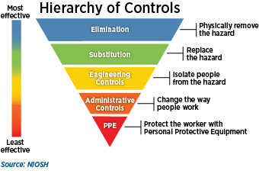
1. Hierarchy of controls and application
Notes:
Safety science prioritizes measures reducing risk of electrical hazards (electric shock and electrical arc exposure) from the most effective to the least effective in the following order: elimination, substitution, engineering controls, administrative controls, and PPE.

Slide 14
Application
Most Effective | Elimination | Eliminate the potential exposure to energized parts by remote work using “smart” controls | Can be designed into the system; May not always be feasible.
 | Replace the hazard e.g. substitution | Use systems which are not energized, or lower the voltage. | May not feasible of practical for wind turbine work.
 | Engineering Controls | Grounding, design of equipment to work outside the hazard zones. | Dependent on understanding of systems and their design.
Least Effective | PPE | Requires worker compliance; Adequate PPE must be determined prior to potential exposures. | Requires worker training, PPE fitting, selection of proper PPE, maintenance and cleaning, wearing PPE when necessary.
Notes:
This table shows examples of the different electrical controls following the control hierarchy. The most effective method for reducing electrical hazards is to eliminate the hazard. In electrical generation work, elimination may not always be feasible, but it can still be achieved by designing remote work procedures into the system.
"Grounding" is and example of an engineering control and is intentionally creating a low-resistance path which helps protect workers providing path for the current to pass through to the ground.
Engineering controls are dependent on understanding electrical systems.
The least effective method of control is PPE because it relies on proper equipment fit and selection, comfort, maintenance, storage, cleaning and inspection.

Slide 15
2. Electrical safety standards
Legal standards - OSHA regulations:
Must be complied, but not necessarily the highest level of standard in protection.
Employers are encouraged to provide more protection to their workers than the minimum standard required in OSHA regulations.
Consensus Standards:
NFPA (National Fire Protection Association)
ASTM International (American Society for Testing and Materials)
IEEE (Institute for Electrical and Electronics Engineers)
Notes:
There are two types electrical safety standards, including
Legal standards: OSHA is a government agency under the Department of Labor which develops and publishes legal requirements for workplace safety, including electrical safety which reduce the chances for workplace injuries and illnesses. OSHA electrical safety regulations must be complied, are the minimum requirements, but not necessarily are the highest level of standard in protection. Employers are encouraged to provide more protection to their workers than the minimum using OSHA regulations.
National Consensus Standard represent best practices: there are several national/international organizations who develop various consensus standards related to electrical safety, including the ASTM International (American Society for Testing and Materials), IEEE (Institute for Electrical and Electronics Engineers), and NFPA (National Fire Protection Association).
Appendix G of 1910.269 contains a list of the consensus references which can provide information for understanding and complying with the requirements contained in § 1910.269. The national consensus standards referenced in this appendix contain detailed “how to” specifications for complying with the more performance-based requirements of § 1910.269.

Slide 16
Electrical Safety Standards Overview
Regulations
Consensus standards
OSHA
ASTM
NFPA
IEEE
Workplace safety
Materials and PPE specs
Workplace safety NFPA 70E
NESC®
Equipment design
IEEE 1814
PPE requirement
PPE test methods
Equipment maint. NFPA 70B
Shock PPE test methods
IEEE 1584 arc calculation
Arc PPE test methods
NEC
NFPA 70
Notes:
This diagram is an overview of Electrical Safety Standards.
OSHA regulations outline employer obligations including workplace electrical safety and PPE requirements. Violators of OSHA regulations are subject to fines or prosecution.
Three organizations have developed and published consensus standards related to electrical safety, including ASTM, NFPA and IEEE (Institute of Electrical and Electronics Engineers).

Slide 17
3. OSHA Regulations (overview)
Compliance with OSHA electrical safety standards are required by law.
Title 29 – Department of Labor
one of fifty titles comprising the United States Code of Federal Regulations (CFR)
containing the principal set of rules and regulations issued by federal agencies regarding labor
available in digital and printed form, and can be referenced online using the Electronic Code of Federal Regulations (e-CFR).
Notes:
Now we will discuss OSHA electrical safety regulations that apply to wind turbine construction and maintenance industry.
We focus on provisions for energized electrical work.
Compliance with OSHA electrical safety standards found in the federal government’s Department of Labor regulations are required by law.
Title 29 is the federal designation for all of the Department of Labor rules and regulations.
CFRs contain the principal set of rules and regulations issued by federal agencies regarding labor including labor management standards, the Occupational Safety and Health Administration, and other labor related rules.
These regulations are available in digital and printed form, and can be referenced online.

Slide 18
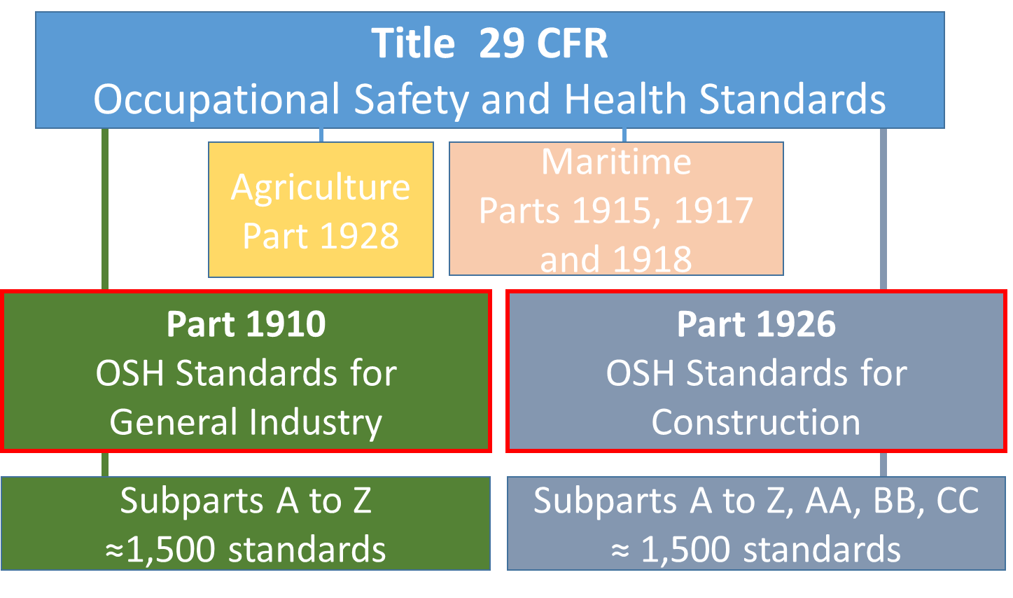
OSHA Labor Regulations (overview)
Notes:
Title 29 Code of Federal Regulations are the Department of Labor Regulations and Legal Rules published through specific procedures determined by the Occupational Safety and Health Act.
OSHA electrical safety standards are found in both Part 1910 and Part 1926.
Part 1910 covers the safety and health requirements for general industry. OSHA uses the term "general industry" to refer to all industries not included in agriculture, construction or maritime. General industries are regulated by OSHA's general industry standards, directives, and standard interpretations.
Part1926 covers OSHA safety and health requirements for construction industries. OSHA defines "Construction work" which means work for construction, alteration, and/or repair, including painting and decorating (1910.12(b). "Construction work" involving energy production by wind includes the erection of new electric transmission and distribution lines and equipment, and the alteration, conversion, and improvement of the existing transmission and distribution lines and equipment [1910.12(d)].
Both parts, 1910 and 1926, comprise numerous Subparts in alphabetical order and specific standards. Each parts contain about 1,500 total individual requirements.

Slide 19
OSHA Applicability for Wind Energy Industry
Two parts are applicable in regards of live work safety depending on project stages:
Construction (erection) of new wind turbine towers:
Regulated by Part 1926
Operation and maintenance on commissioned towers:
Regulated by Part 1910
Notes:
Now we will discuss OSHA electrical safety regulations that apply to wind turbine construction, operation and maintenance. We focus on provisions for energized work.
Depending on project stages, two parts are applicable in regards of live work safety with wind industries:
Construction (erection) of new wind turbine towers or electric power transmission or distribution lines associated with wind energy is regulated by Part 1926.
Operation and maintenance work on existing wind towers is regulated by Part 1910.

Slide 20
OSHA Regulations on Electrical Safety
29 CFR 1910 General Industry
1910 Subpart I - Personal Protective Equipment
1910.137 - Electrical Protective Equipment.
1910 Subpart R - Special Industries
1910.269 - Electric Power Generation, Transmission, and Distribution. (focusing on operation and maintenance)
1910 Subpart S – Electrical
29 CFR 1926 Construction
1926 Subpart E - Personal Protective and Life Saving Equipment
1926.97 - Electrical protective equipment.
1926 Subpart V - Electric Power Transmission and Distribution (focusing on construction)
1926 Subpart K – Electrical
Notes:
OSHA electrical safety standards for energized work can be found in both Parts: 1910 - Occupational Safety and Health Standards for General Industry and 1926 - Occupational Safety and Health Regulations for Construction.
This slide outlines the electrical safety standards in both 1910 and 1926. Both standards have similar subpart structure of electrical safety regulations, including:
1) Electrical Protective Equipment is regulated by 1910.137 and 1926.97.
2) Electric Power Generation, Transmission, and Distribution. 1910.269 applies to the operation and maintenance of electric power generation, control, transformation, transmission, and distribution lines and equipment. 1926 Subpart V covers the construction of electric power transmission and distribution lines associated with wind turbines.
3) Other Electrical standards (1910 Subpart S and 1926 Subpart K): these standards are for electric utilization systems, including all electric equipment and installations used to provide electric power and light for employee workplaces.

Slide 21
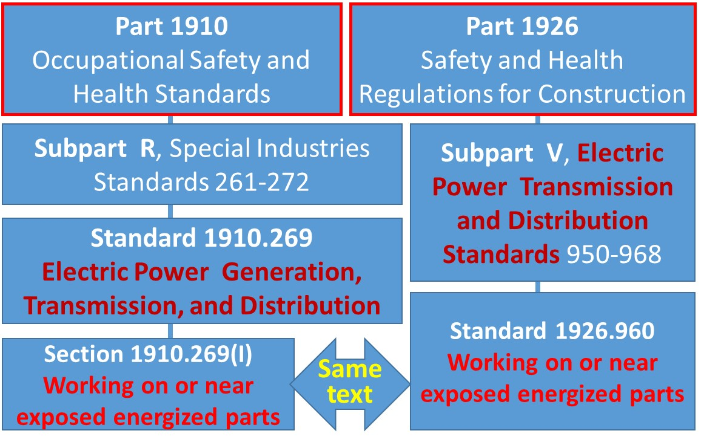
4. Working on or near exposed energized parts
Notes:
Energized work is regulated by different parts, subparts and standards for wind tower construction, operation and maintenance. However, the same text (rules) is used when it comes to specific type of activity such as working on or near exposed energized parts.
Further in this course, we will reference the general industry standard 1910.269(I) for “working on or near exposed energized parts” which applies to work on exposed live parts, or near enough to them to expose the employee to any hazard live parts may present. However, the reference to construction standard is 1926.960 for working on or near exposed energized parts, found in 1926 Subpart V for electric power transmission and distribution.

Slide 22
Working on or near exposed energized parts
OSHA does not allow working on exposed energized parts unless:
  De-energizing introduces additional or increased hazards, or
  De-energized work is not feasible due to equipment design or operational limitations.
  Any exceptions will apply to your work?
  Note: Since the same text on live working safety is included in maintenance and construction parts (1910.269(I) and 1926.960), only 1910.269(I) is referenced.
Notes:
In the module 1, we discussed the structure of wind turbine, and in or near wind turbines there are several places that energized electrical components are exposed, which present shock or electric arc exposure risk to workers.
What are OSHA regulations about working on exposed energized electrical components?
First and foremost, OSHA does not allow working on exposed energized parts unless:
De-energizing introduces additional or increased hazards, or
De-energized work is not feasible due to equipment design or operational limitations.
Examples of such conditions include: troubleshooting and testing for voltage, and certain switching procedures. These exceptions need to be identified and incorporated into work procedures when necessary with recognition of the increased risk for shock or electric arc.
Discussion: During wind turbine construction or maintenance work, are there any situation can fit with one of these two exceptions?

Slide 23
Working on or near exposed energized parts (Cont'd)
OSHA requires (1910.269(l)):
Qualified employees are required
OSHA definition: “by possession of a recognized degree, certificate, or professional standing, or who by extensive knowledge, training and experience, has successfully demonstrated his ability to solve or resolve problems relating to the subject matter, the work, or the project”
At least two employees shall be present while performing certain types of work such as installation, removal, or repair of deenergized lines if an employee is exposed to contact with other parts energized at more than 600 volts.
Notes:
OSHA requirements for Electric Power Generation, Transmission, and Distribution. 1910.269, paragraph (l) sets requirements for all work with or on energized circuits or electric parts
Only qualified employees may work on or with exposed energized lines or parts of equipment. Qualified person is the one “by possession of a recognized degree, certificate, or professional standing, or who by extensive knowledge, training and experience, has successfully demonstrated his ability to solve or resolve problems relating to the subject matter, the work, or the project”.
OSHA sets a requirements that at least two employees shall be present while any employees perform certain types of work such as installation, removal, or repair of deenergized lines if an employee is exposed to contact with other parts energized at more than 600 volts.
Discussion: How often have you worked alone at the field?

Slide 24
Working on or near exposed energized parts, Cont'd
Several critical safety practices:
Minimum approach distances: follow the Table R-3 (AC systems) or Table R-8 (DC systems)
Insulation of energized parts
Safe working position
Conductive articles
Wearing electric shock and electric arc protection PPE
Making connections and disconnections safely etc.
Notes:
When working on or near exposed energized parts, there are several critical safety practices required by OSHA. We will discuss them in the following slides.

Slide 25
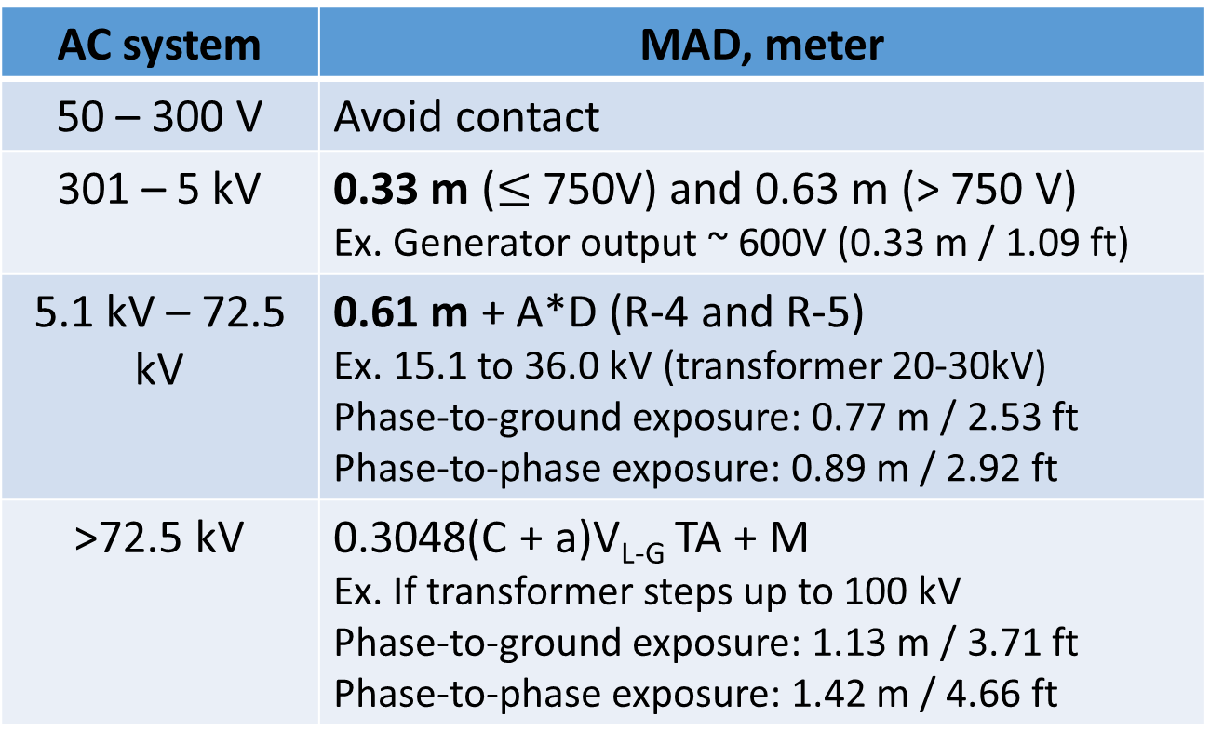
Minimum approach distances (MAD)
Related to phase-to-phase system voltages:
AC system | MAD, meter
50 – 300 V | Avoid contact
301 – 5 kV | 0.33 m ($≤$ 750V) and 0.63 m (> 750 V) Ex. Generator output ~ 600V (0.33 m / 1.09 ft)
5.1 kV – 72.5 kV | 0.61 m + A*D (R-4 and R-5) Ex. 15.1 to 36.0 kV (transformer 20-30kV) Phase-to-ground exposure: 0.77 m / 2.53 ft Phase-to-phase exposure: 0.89 m / 2.92 ft
>72.5 kV | 0.3048(C + a)V_{L-G} TA + M Ex. If transformer steps up to 100 kV Phase-to-ground exposure: 1.13 m / 3.71 ft Phase-to-phase exposure: 1.42 m / 4.66 ft
Notes:
For example, the minimum approach distance determination is covered under 1910.269(l)(3).
The generator in a wind turbine produces alternating current (AC) electricity. Here is the OSHA table R-3 AC Live-Line Work Minimum Approach Distance.
For phase-to-phase system voltages of 301 V to 5 kV: the minimum approach distance is fixed at 0.33 meters. In other words, workers must not get closer with any body part, or take any conductive object closer than 1 foot 2 inches to the energized part; For example, if wind turbines generate an AC power of 600V output, employees should maintain a MAD of 0.33 m or 1.09 ft (about 1 foot one inch).
However, when a transformer steps up the generator terminal voltage to a voltage over 750 V, values must be obtained Table R5 and Table R4 from 1910.269 paragraph l and also found in Appendix B. For 750 Volt energized conductor, the MAD should be 0.63 m or 2.07 ft (2 feet 1 inch).
If transformed steps up to a medium voltage ex. 20-30 kV, the MAD should increase accordingly. If the wind farm is large and the distance to the electrical grid is long, a transformer may be used to further step up to a higher voltage above 100 kV at transmission level.
For voltages over 72.5 kilovolts (72,500 Volts), an engineering analysis is required.

Slide 26
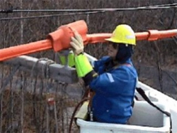
Type of insulation
Exposed energized parts can be insulated by a dielectric/insulating substance to offer a high resistance between conducting surfaces and workers, or
Employees use rubber insulating gloves and sleeves (PPEs) and insulating equipment.
Ensure employees not to reach into the minimum approach distance when putting on and removing these insulating PPEs.
Prevention of slip, trip and fall.
Source: www.osha.gov
Notes:
Another critical safety practice is insulation. This picture shows both types of insulation (insulation of energized line and use of rubber insulating gloves and sleeves). We discussed this in module 2.
Type of insulation is covered under 1910.269(l)(4), and includes:
1) Exposed energized parts can be insulated by a dielectric substance or air space to permanently offer a high resistance between conducting surfaces and workers, or
2) Employees can use rubber insulating gloves and sleeves (PPEs) and insulating equipment as insulation from energized parts.
Importantly, when putting on and removing PPE, ensure employees cannot reach into the minimum approach distance, so they can’t accidently contact the exposed energized parts.
Also employees should have stable working position and prevent slip, trip and fall that may bring the employee's body into contact with exposed, uninsulated parts.
This picture shows both types of insulation (insulation of energized line and use of rubber insulating gloves and sleeves).

Slide 27
Grounding: connection / disconnection
Grounding for the protection of employees (1910.269(n)):
After deenergized lines and equipment for wind turbine maintenance, proper protective grounding shall be installed.
To allow fault current to flow to ground
Protective grounding equipment: an ampacity $≥$ No. 2 AWG copper
 | Connect grounds | Remove grounds
Ground-end connection | Attach first
Deenergized line/equipment |  | Remove first
Notes:
Grounding is another example of connection / disconnection.
Grounding of generation, transmission, and distribution lines and equipment after deenergized is important for protecting employees.
Grounding allows fault current to flow to ground.
Protective grounding equipment / device needs to have an ampacity ≥ No. 2 AWG copper.
Connecting grounds: Attach the ground-end connection first, and then the other end to the deenergized lines or equipment.
Removing grounds: remove the grounding device from the line or equipment first, and then the ground-end connection.

Slide 28
Other safe practices
Remove conductive articles, such as keychains or watch chains, rings, or wrist watches or bands, to reduce the risks of contact with the energized parts.
Tools or gloves shouldn’t be used above the rated voltage.
Non-current-carrying metal parts of equipment or devices, such as transformer cases and circuit-breaker housings, shall be treated as energized.
Notes:
There are other critical safe practices:
When an employee performs work within reaching distance of exposed energized parts of equipment, the employer shall ensure that the employee removes or renders nonconductive all exposed conductive articles, such as keychains or watch chains, rings, or wrist watches or bands.
Tools or gloves shouldn’t be used above the rated voltage. 1910.269(l)(9).
Non-current-carrying metal parts of equipment or devices, such as transformer cases and circuit-breaker housings, shall be treated as energized. 1910.269(l)(11).

Slide 29
5. Protection from flames and electric arcs
Employer shall identify and assess hazards from flames or from electric arcs. Sources electric arcs and flames may include:
Energized circuit parts not guarded or insulated
Switching devices that produce electric arcs in normal operation
Sliding parts that could fault during operation (ex. rack-mounted circuit breakers)
Energized electric equipment that could fail (ex. damaged insulation, overloaded, arcing)
Lightning and overheating (friction, bearings and brakes, etc.)
Notes:
In addition to protection from electric shock, employer shall identify and assess hazards from flames or from electric arcs and the probability of an electric arc. OSHA will consider an employee exposed to electric-arc hazards if there is a reasonable likelihood that an electric arc will occur in the wind turbine work area, in other words, if the probability of such an event is higher than it is for the normal operation of enclosed equipment.
Sources electric arcs and flames may include:
Energized circuit parts not guarded or insulated, or whether conductive objects can come too close to, or fall onto the energized parts.
Switching devices that produce electric arcs in normal operation.
Sliding parts could fault during normal operation, servicing or maintenance involving high risk (ex. rack-mounted circuit breakers).
Energized electric equipment that could fail (ex. damaged insulation, overloaded) or evidence of impending failure such as arcing or overheating.
Lightning strike, equipment failure or malfunction and overheating (friction, bearings and brakes, etc.) are main causes of wind turbine fires.

Slide 30
Protection from flames and electric arcs
Employer shall estimate the incident heat energy (IHE) to protect burn injuries. The method is in 29 CFR 1910.269 Appendix E, for example
NFPA 70E Annex D, "Sample Calculation of Flash Protection Boundary"
"Predicting Incident Energy to Better Manage the Electric Arc Hazard on 600 V Power Distribution Systems" by Doughty, Neal, and Floyd
IEEE Std 1584 “Guide for Performing Arc-Flash Hazard Calculations”
ARCPRO software developed by Kinetics
IHE is approximately inversely proportional to the square of the distance between the employee and the arc.
Notes:
Here are the standards about how to estimate the incident heat energy to protect one from burn injuries. The methods are referenced in 29 CFR 1910.269 Appendix E, available at https://www.osha.gov/laws-regs/regulations/standardnumber/1910/1910.269AppE for example:
NFPA 70E Annex D, "Sample Calculation of Flash Protection Boundary“.
"Predicting Incident Energy to Better Manage the Electric Arc Hazard on 600 V Power Distribution Systems" by Doughty, Neal, and Floyd.
IEEE Std 1584 “Guide for Performing Arc-Flash Hazard Calculations”.
ARCPRO software developed by Kinectrics.
Incident Heat Energy is approximately inversely proportional to the square of the distance between the employee and the arc. Therefore, increasing distance will drop heat energy substantially.
These OSHA requirements are covered under 1910.269(l)(8); and more information is also available at: Appendix E to Subpart V of Part 1926 - Protection From Flames and Electric Arcs.

Slide 31
Protection from flames and electric arcs (Cont'd)
PPE assessment and other protective equipment needs should consider:
Flame-resistant (FR) clothing should not melt, or ignite and continue to burn when exposed to flames and electric arcs
Clothing made from acetate, nylon, polyester, rayon and polypropylene, either alone or in blends should be prohibited.
Arc rating (AR) for protective clothing and equipment: should exceed 2.0 cal/cm²
Notes:
For an assessment for exposure to flames: the hazard and risk analysis should identify employees potentially exposed to hazards from flames. Factors to consider for this assessment include: The proximity of employees to open flames, and for flammable material in the work area, and whether there is a reasonable likelihood that an electric arc or an open flame can ignite the material.
Use of PPE and other protective equipment should consider:
Flame-resistant (FR): FR clothing will not melt, or ignite and continue to burn when exposed to flames and electric arcs. Therefore, clothing made from acetate, nylon, polyester, rayon and polypropylene, either alone or in blends is prohibited.
The level of arc flash protection is provided in calories per square centimeter. Arc rating (AR) for protective clothing and equipment should exceed 2.0 cal/cm2
All AR clothing is flame resistant, but not all FR rated clothing has been Arc Rated. Guidance for protection from flames and electric arc is found in Appendix E to Subpart V. Note that PPE does not prevent an incident and using arc rated clothing at its arc rating provides only a 50 percent probability from a second degree burn. Properly selected PPE may minimize the severity of an injury.

Slide 32
Protection from flames and electric arcs, Cont'd
1910.269(l)(8)(v)
The employer shall ensure that each employee exposed to hazards from electric arcs wears protective clothing and other protective equipment with an arc rating greater than or equal to the heat energy estimated under paragraph (l)(8)(ii) of this section whenever that estimate exceeds 2.0 cal/cm2.
This protective equipment shall cover the employee's entire body, except as follows:
Notes:
1910.269(l)(8)(v) requires that each employee exposed to hazards from electric arcs wears protective clothing and other protective equipment with an arc rating greater than or equal to the heat energy estimated under paragraph (l)(8)(ii) of this section whenever that estimate exceeds 2.0 cal/cm2.
This requirements is one of the key provisions for safe energized work. As we know arc can start for a number of reasons. Although PPE is considered as the last line of defense by safety professionals, there is nothing else but your electric arc PPE is between your body and arc.
Entire body is a key word in this rule.

Slide 33
Protection from flames and electric arcs, Exceptions
  Exceptions include:
  Arc-rated protection is not necessary for the employee's hands when the employee is wearing rubber insulating gloves with protectors, or if the estimated incident energy is no more than 14 cal/cm², heavy-duty leather work gloves with a weight of at least 407 gm/m² (12 oz/yd²),
  Arc-rated protection is not necessary for the employee's feet when the employee is wearing heavy-duty work shoes or boots. (NO steel toe shoes)
Notes:
Rubber gloves with leather protectors provide arc protection for the hands. According to utility industry experts there are no known cases of severe hand burns in an arc when rubber gloves and leather protectors are worn. Arc rating of rubber glove in combination with leather protectors is required for an incident energy above 40 cal/cm².
There is no arc test standard for boots or shoes. However arc exposure of heavy work leather shoes at 12 inch distance showed no sock ignition and no significant discoloration.

Slide 34
Exceptions (Cont'd)
  Exceptions include:
  Arc-rated protection is not necessary for the employee's head when the employee is wearing head protection meeting § 1910.135 if the estimated incident energy is less than 9 cal/cm² for exposures involving single-phase arcs in open air or 5 cal/cm² for other exposures,
  The protection for the employee's head may consist of head protection and a faceshield with a minimum arc rating of 8 cal/cm² if the estimated incident-energy exposure is less than 13 cal/cm² for exposures involving single-phase arcs in open air or 9 cal/cm² for other exposures.
Notes:
This slide shows requirements of 1910.269, paragraph (l)(8) for head and face protection from flames and electric arcs.
Arc-rated protection is not necessary for the employee's head when the employee is wearing head protection meeting § 1910.135 if the estimated incident energy is less than 9 cal/cm² for exposures involving single-phase arcs in open air or 5 cal/cm² for other exposures. Head protection meeting 1910.135 is a hardhat. Hardhat has no arc rating but it is always used with arc rated face protection.
Typical face protection against electric arc is arc rated face shield used with or without balaclava, arc rated hood, and balaclava google system. In 1910.269(l)(8) OSHA specifies minimum requirements regarding energy limits, above which arc rated protection is required. Some consensus standards are stricter on the issue.

Slide 35
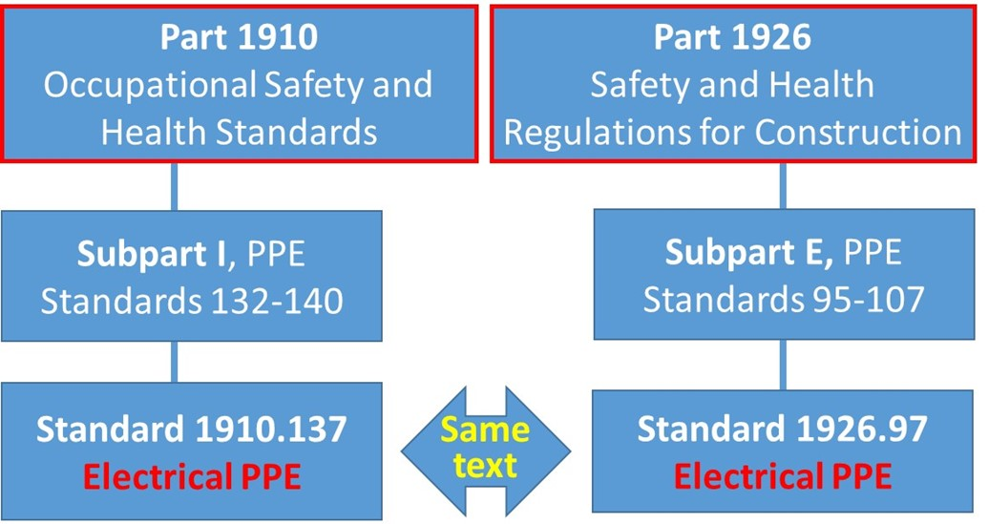
6. OSHA electrical PPE regulations
Notes:
Now moving on to PPE requirements.
Personal protective equipment for wind tower workers shall meet the requirements of 1910 Subpart I “Personal Protective Equipment” and 1910.269(g) as well. Similar to safe energized work regulations, OSHA uses the same text for PPE for both maintenance of equipment found in 1910.269 and construction industry requirements found in 1926 Subpart V. Major requirements under Subpart I are: PPE is provided and used that is necessary to protect employees from hazards; select PPE according to the hazard assessment required by OSHA in 1910.132(d), and provide PPE training. Main headings for PPE are head, eye and face protection, respiratory protection, foot and hand protection.
Electrical protective equipment is covered in 1910.137 which include design requirements for specific types of protective equipment. Rubber insulating blankets, rubber insulating matting, rubber insulating covers, rubber insulating line hose, rubber insulating gloves, and rubber insulating sleeves. “Keep in mind that all electrical protective rubber insulating electrical protective products are electrically tested by the manufacturer prior to the first shipment.” And “remember, do not place rubber insulating products into service unless they have been tested electrically within the previous 12 months”

Slide 36
Payment obligations
Employer has PPE payment obligations, including:
flame-resistant and arc-rated clothing
electrical protective equipment
fall protection
Notes:
Employer has PPE payment obligations, including, but not limited to, flame-resistant and arc-rated clothing, electrical protective equipment, and fall protection.

Slide 37
Electrical protective equipment
Covered under 1910.137 (subpart I) and 1926.97 (subpart E)
Design requirements for specific types of electrical protective equipment:
Rubber insulating blankets
Rubber insulating matting
Rubber insulating covers
Rubber insulating line hose
Rubber insulating gloves
Rubber insulating sleeves
Notes:
OSHA “Electrical Protective Equipment” requirements are covered under 1910.137 (Subpart I) and 1926.97 (Subpart E). Both standards are same.
The standard includes design requirements for specific types of electrical protective equipment. Design requirements for rubber insulated protective equipment is tested by the manufacturer to ensure its effectives which shall be capable of withstanding the proof-test voltage (ac or dc as specified) continuously for 1 minute for matting and 3 minutes for other protective equipment. Design requirements for specific types of electrical protective equipment: Rubber insulating blankets, Rubber insulating matting, Rubber insulating covers, Rubber insulating line hose, Rubber insulating gloves, Rubber insulating sleeves. Each of these have an ASTM reference standard.
Rubber insulating equipment design meet national consensus standards which set performance requirements American Society for Testing and Materials (ASTM) D120-09, Standard Specification for Rubber Insulating Gloves; ASTM D178-01 (2010), Standard Specification for Rubber Insulating Matting; ASTM D1048-12, Standard Specification for Rubber Insulating Blankets; ASTM D1049-98 (2010), Standard Specification for Rubber Insulating Covers; ASTM D1050-05 (2011), Standard Specification for Rubber Insulating Line Hose; ASTM D1051-08, Standard Specification for Rubber Insulating Sleeves. Many companies in the U.S. have testing laboratories to conduct evaluation and testing of their products. Note that NFPA does not test or certify the effectiveness of electrical protective PPE.
We discussed rubber insulating PPE and equipment in module 2.

Slide 38
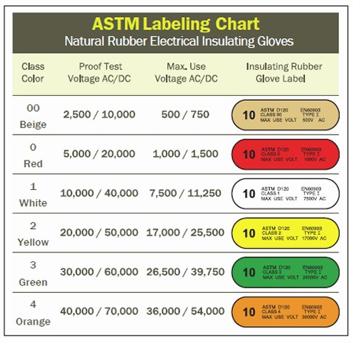
Rubber insulating equipment
Blankets, gloves, and sleeves shall be produced by a seamless process.
Class/type and mark on equipment:
Class 00
Class 0
Class 1
Class 2
Class 3
Class 4
Type I (Nonozone-resistant equipment)
Type II (Ozone-resistant equipment)
Notes:
Rubber insulated electrical protective gloves are rated for the voltage for which the gloves will be exposed. Leather protectors protect the rubber gloves from puncture or damaging the gloves. Rubber insulated gloves have six ASTM defined voltage classes from Class 00 for the lowest voltage to Class 4 with the highest maximum use voltages. Type I and Type II indicate ozone resistance.
This table shows different classes of rubber insulating equipment.

Slide 39
Electrical protective equipment
Electrical requirements will be assessed by breakdown voltage test, and the equipment:
Shall be capable of withstanding the proof-test voltage (ac or dc as specified) continuously for 1 minute for matting and 3 minutes for others.
Gloves: subject to additional voltage test after the 16-hour water soak
Notes:
Breakdown voltage test should be used to test electrical Protective Equipment.
The equipment shall be capable of withstanding the proof-test voltage (ac or dc as specified) continuously for 1 minute for matting and 3 minutes for others.
Gloves: subject to additional voltage test after the 16-hour water soak.

Slide 40
Electrical protective equipment (Cont'd)
Workmanship and finish:
Equipment shall be inspected and free of physical irregularities (ex. indentations, protuberances, or imbedded foreign material) that can adversely affect their insulating properties.
Several ASTM testing standards can be used: D120-09, D178-01, D1048-12, D1049-98, D1050-05, D1051-08, F1236-96 and F819-10.
Notes:
Here is the workmanship and finish requirement. Basically, equipment shall be free of physical irregularities (ex. indentations, protuberances, or imbedded foreign material) that can adversely affect their insulating properties. Insulating equipment shall be inspected for damage before each day's use and immediately following any incident that can reasonably be suspected of causing damage. Before each use, gloves and sleeves must be inspected for holes; rips or tears; ozone damage, cuts or ultraviolet damage; and signs of deterioration.
Several ASTM testing standards can be used. For example ASTM D120, Standard Specification for Rubber Insulated Gloves; D1048 - Standard Specification for Rubber Insulated Blankets; D1050- Standard Specification for Rubber Insulated Line Hose; D1051 - Standard Specification for Rubber Insulating Sleeves; F819 – Standard Terminology Related to Electrical Protective Equipment.

Slide 41
Electrical protective equipment, Cont'd
In-service care and use of electrical protective equipment:
Shall be maintained in a safe, reliable condition.
Shall be inspected for damage before each day's use and immediately following any incident that can reasonably be suspected of causing damage.
Shall be given an air test, along with the inspection.
Shall be cleaned as needed to remove foreign substances.
Notes:
Another important regulation is in-service care and use of electrical protective equipment. Rubber insulated gloves with leather protectors must be worn whenever there is a danger of electric shock from contact with exposed energized conductors or circuit parts. Leather protectors protect the insulated gloves from cuts, abrasions and puncture.
Electrical protective equipment shall be maintained in a safe, reliable condition.
Insulating equipment shall be inspected for damage before each day's use and immediately following any incident that can reasonably be suspected of causing damage.
Insulating gloves shall be given an air test, along with the inspection. The air testing method is described in ASTM F496-14a Standard Specification for In-Service Care of Insulating Gloves and Sleeves. The glove is filled with air, either manually or with a powered inflator, and then checked for leakage. Instructions for performing air test and inspection are found at: http://www.elcosh.org/document/1667/d000574/Insulating+Gloves.html?show_text=1
Insulating equipment shall be cleaned according to the manufacturer’s recommendations.
OSHA also requires electrical safety equipment to be subjected to periodic electrical tests [1910.137(c)(2)(viii)] to ensure the gloves continue to perform as rated. Protective equipment used for the primary insulation of employees from energized circuit parts shall be capable of passing a current test when subjected to the highest nominal voltage on the insulated equipment to be used. Rubber insulating gloves must be electrically tested before first issue and every six months thereafter. New insulating equipment is not permitted to be placed into service unless it has been electrically tested within the previous 12 months.

Slide 42
Electrical protective equipment, (Cont'd)
In-service care and use of electrical protective equipment:
Storage shall protect from light, temperature extremes, excessive humidity, ozone, and other damaging substances and conditions.
Repaired insulating equipment shall be retested before it may be used by employees.
Defect examples: hole, tear, puncture, cut, ozone cutting (interlacing cracks), embedded foreign object, swelling, softening, hardening, or becoming sticky or inelastic, etc.
Notes:
In-service care and use of electrical protective equipment also include:
Storage: Electrical protective equipment shall be maintained in a safe, reliable condition. Gloves need to be stored properly when not in use. Insulating equipment shall be stored in such a location and in such a manner as to protect it from physical damage other damaging substances and conditions.
Repaired Insulating equipment shall be retested before it may be used by employees.
Defect examples include the following and should be removed for use: hole, tear, puncture, cut, ozone damage, cutting (interlacing cracks), embedded foreign object, swelling, softening, hardening, or becoming sticky or inelastic, etc.

Slide 43
In addition to energized work and PPE provisions, the same text is also used for several other topics
Many paragraphs are same or similar with 1910.269. For example,
Training
Information transfer
Existing characteristics and conditions
Fall protection
Deenergizing lines and equipment for employee protection
Grounding for the protection of employees
Notes:
Just for information.
Many paragraphs in 1926 Subpart V are same or similar with 1910.269. For example,
Training
Information transfer
Existing characteristics and conditions
PPE - Fall protection
Deenergizing lines and equipment for employee protection (1926.961)
Grounding for the protection of employees (1926.962)

Slide 44
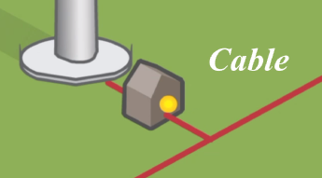
Electrical Incident Example
In May 2009, a wind turbine employee was working in the bottom power cabinet of a wind turbine. He was checking the electrical connections and came into contact with a bus bar when an electric arc occurred. After arriving at a local hospital he was later transferred by med-vac to burn center hospital in Oklahoma City where the person died. (https://www.osha.gov/dep/greenjobs/windenergy.html)
Notes:
Here is an example electrical wind turbine accident published by OSHA.
Discussion:
What may have caused this incident? Multiple reasons: not following deenergizing procedures, no electrical safety program, LO/TO, grounding; not using insulated tools, not wearing electric shock and electric arc PPE.
What type of arc occurred here? Likely ejected arc if incident involved medium voltage (13.8 kV or 35 kV) bus
What actions were needed to prevent this incident? Training on safe work practices, training on electric hazards. Job briefing and task hazard and risk analysis
What information is missing from this report and what information is needed from this fatality to conduct a thorough investigation? Missing the equipment voltage and current capacity, location of the arc protection boundary, the results of a job briefing, whether an electrical safety program existed, how the worker came into contact with energized conductors, written determination of why this work must be done energized, the results, if any of an energized work permit and what shock and electric arc PPE was being used and/or necessary for this work task. Type of PPE worn and necessary for completion of the job tasks. What was the duration of exposure to electricity?
What emergency actions were needed during this incident? Activate the emergency response plan.

Slide 45
7. Consensus standards
Several organizations have developed and published consensus standards related to electrical safety, and some standards have been referenced by OSHA.
NFPA (National Fire Protection Association NFPA): NFPA 70 National Electrical Code (NEC), 70B, 70E.
ASTM (American Society for Testing and Materials): test methods for electric shock and arc protective materials and PPEs.
IEEE (Institute of Electrical and Electronics Engineers): National Electrical Safety Code (NESC)®, IEEE 1814 and 1584.
Notes:
Several organizations have developed and published consensus standards related to electrical safety, and some standards have been adopted by OSHA and become enforceable.
NFPA has three important electrical safety standards: 1) the most commonly used standard for workplace electrical safety in the industrial sector is NFPA 70E. 2) NFPA 70B is the standard for electrical equipment maintenance. 3) The National Electrical Code for safe electrical construction is NFPA 70.
ASTM standards cover: 1) specifications for materials and PPE against electric shock and electric arc hazards; 2) destructive and nondestructive test methods for protective equipment.
IEEE has developed several important standards on electrical safety for utilities:
1) National Electrical Safety Code (NESC)®;
2) IEEE 1814 is “Recommended Practice for Electrical System Design Techniques to Improve Electrical Safety” which provides a "tool kit" of techniques to enable the system designer to specify equipment features, apply protective schemes, and make informed system installation design choices.
3) IEEE 1584 is the Guide for Performing Arc-Flash Hazard Calculations which enable qualified person(s) to analyze power systems for the purpose of calculating the incident energy to which employees could be exposed during operations and maintenance work.

Slide 46
NFPA
Electrical Safety
  Free from unacceptable risks of injury from exposure to energized conductors or circuit parts
Safe Installation
  NFPA 70® National Electrical Code®
  NFPA 70B Recommended Practice for Electrical Equipment Maintenance
Preventive Maintenance
Protection of workers from electrical hazards
NFPA 70E ® Electrical Safety in the Workplace
Notes:
There are different NFPA electrical safety standards.
NFPA 70® is National Electrical Code® for safe installation of electrical wiring and equipment. Despite its authoritative positioning and national title, NEC standards are not federal law. But NEC standards are either adopted by local governments or local governments create and enforce their own electric code.
NFPA 70B “Recommended Practice for Electrical Equipment Maintenance” specifies the details for preventive maintenance program for the prevention of equipment failure and worker injuries.
NFPA 70E addresses the protection of a worker when exposed to electrical hazards, and provides the employer with the direction required to create an electrical safety program.

Slide 47
NFPA 70E: Standard for Electrical Safety in the Workplace
Key Definitions and Concepts:
Electrical Hazard: “A dangerous condition such that contact or equipment failure can result in electric shock, arc flash burn, thermal burn or arc blast”.
Electrically Safe Work Condition: “A state in which an electrical conductor has been 1) disconnected from energized parts; 2) locked/tagged in accordance with standards/policy; 3) tested to ensure the absence of voltage; 4) and grounded if determined necessary”.
Notes:
Some key definitions and concepts from NFPA 70E:
Electrical Hazard: “A dangerous condition such that contact or equipment failure can result in electric shock, arc flash burn, thermal burn or arc blast”.
Electrically Safe Work Condition: “A state in which an electrical conductor has been 1) disconnected from energized parts; 2) locked/tagged in accordance with standards/policy; 3) tested to ensure the absence of voltage; 4) and grounded if determined necessary”.

Slide 48
Electrically Safe Work Condition
Deenergized:
Describes an operating condition of electrical equipment, but NOT a safe condition.
Different safe work boundary locations:
Arc flash protection boundary
Shock protection boundary, which can be divided into two distances:
Limited approach boundary for unqualified workers: a shock hazard exists, and PPE required.
Restricted approach boundary for qualified workers only: must be protected from unanticipated contact with energized conductors
Notes:
Deenergized describes an operating condition of electrical equipment free from any electrical connection to a source of potential difference and from electrical charge. Deenergized does not describe a safe condition and should not be confused with an electrically safe work condition where a conductor or circuit part has been disconnected from the energy source or energized parts, locked out according to written procedures and established standards, tested to ensure the absence of voltage and grounded if necessary.
Two different electric arc boundaries exist including:
Arc flash protection is the boundary within which persons may be exposed to a second degree burn from an arc flash. The second degree burn threshold is used because of the probability that the worker will not suffer a permanent injury.
Shock Protection Boundaries: Shock protection boundaries are the limited approach boundary and restricted approach boundary.
The Limited Approach Boundary defines the approach distance for unqualified workers beyond which special precautions are necessary. All unqualified workers working within this boundary must be supervised by a qualified worker. An unqualified person wearing appropriate PPE can enter the boundary, but only if escorted at all times by a qualified person, and then only if informed of arc flash hazards. All unqualified workers working within this boundary must be supervised by a qualified worker.
Restricted approach boundary is for entry by Qualified Persons only. In the restricted approach boundary, qualified persons must be protected from unanticipated contact with energized conductors or circuit parts. The qualified person is insulated or guarded from the energized electrical components or the energized conductors or circuit parts are insulated from the qualified person and from any other conductive object at a different potential.

Slide 49
Safe work boundary locations
Shock and arc flash protection boundaries:
Shock protection boundary:
Limited Approach Boundary
Restricted Approach Boundary
Arc Flash Boundary
Exposed Energized Parts
Notes:
This diagram shows the location of different boundaries.
The location of each these shock protection boundaries is dependent on the maximum voltage the worker may be exposed.
The limited approach boundary is the closest an unqualified person can enter without being escorted by a qualified person.
The restricted approach boundary is the closest distance a qualified worker can come to energized conductor or circuit part without following additional safety precautions.

Slide 50
IEEE’s National Electrical Safety Code (NESC)-general rules
Qualifications of employees:
Employees whose duties require working on or in the vicinity of energized equipment or lines shall perform only those tasks for which they are trained, equipped, authorized, and so directed.
Inexperienced employees shall:
  (a) work under the direction of an experienced and qualified person at the site
  (b) perform only directed tasks.
Notes:
Finally, we want to briefly discuss IEEE’s National Electrical Safety Code, because it is U.S. consensus standard for utility workers for the safe installation, operation, and maintenance of electric power and communication utility systems including power substations, power and communication overhead lines, and power and communication underground lines.
Qualified employees whose duties require working on or in the vicinity of energized equipment or lines shall perform only those tasks for which they are trained, equipped, authorized, and so directed.
Inexperienced unqualified employees will work under the direction of the qualified person and perform only directed tasks.

Slide 51
IEEE’s National Electrical Safety Code (NESC) )-protective equipment
Tools and protective equipment
Employees shall use the personal protective equipment, the protective devices, and the special tools provided for their work.
Before starting work, these devices and tools shall be carefully inspected to make sure that they are in good condition.
Notes:
Tools and protective equipment
Employees shall use the personal protective equipment, the protective devices, and the special tools provided for their work.
Before starting work, these devices and tools shall be carefully inspected to make sure that they are in good condition.

Slide 52
IEEE’s National Electrical Safety Code (NESC) – Arc Rated Clothing
Assessment shall be performed to determine potential exposure to an electric arc for employees who work on or near energized parts or equipment – NESC Rule 410A3.
Based on the assessment, wear arc rated clothing suitable for the assigned task and the work environment.
Clothing must not ignite and continue to burn when exposed to an electrical arc,
Has an arc rating or ATPV rating at least equal to the level of energy calculated by an arc hazard analysis for the specific job assignment.
When working in the vicinity of energized lines or equipment, employees should avoid wearing exposed metal articles.
Notes:
Electrical safety of an electric utility system's transmission and distribution facilities, substations and generation fall under the National Electrical Safety Code®, Article 410.A.3.
Assessment shall be performed to determine potential exposure to an electric arc for employees who work on or near energized parts or equipment – NESC Rule 410A3.
Based on the assessment, wear arc rated clothing suitable for the assigned task and the work environment.
Clothing must not ignite and continue to burn when exposed to an electrical arc. No clothing with blends of acetate, nylon, polyester, or polypropylene
Protective clothing must have arc rating or Arc Thermal Protective Value ATPV rating at least equal to the level of energy calculated by an arc hazard analysis for the specific job assignment.
When working in the vicinity of energized lines or equipment, employees should avoid wearing exposed metal articles.

Slide 53
8. Conclusions
OSHA sets the legal safety and health regulations for protecting workers in wind turbine construction (1926) and operation and maintenance on existing wind towers (1910).
There are many consensus standards related to electrical safety, which provide the best safety practices and guidelines for safe electric works.
Properly applying the hierarchy of controls including engineering, administrative and PPE, can reduce the risks of being adversely exposed to electric shock and arc flash, and prevent work-related injuries.
Notes:
OSHA sets the legal safety and health regulations for protecting workers in wind turbine construction (1926) and operation and maintenance on existing wind towers (1910).
There are many consensus standards related to electrical safety, which provide the best safety practices and guidelines for safe electric works.
Properly applying the hierarchy of controls including engineering, administrative and PPE, can reduce the risks of being adversely exposed to electric shock and arc flash, and prevent work-related injuries.

Slide 54
Post-training Quiz
Which organization provides legal regulations governing wind turbine construction and maintenance?
a) U.S. Department of Energy (DOE)
b) National Fire Protection Association (NFPA)
c) American Society for Testing and Materials (ASTM)
d) Occupational Safety and Health Administration (OSHA)
Which is correct about “29 CFR 1910”?
a) Title 29 is for CDC / NIOSH
b) Title 29 is for DOE
c) Part 1910 is for general industry
d) Part 1910 is for construction industry
Notes:
Answers: question 1 – d; question 2 – c.

Slide 55
Post-training Quiz (Cont'd)
Which of the following regulation(s) apply to wind turbine construction, operation and maintenance (select the best answer)?
a) 1910.137 - Electrical Protective Equipment.
b) 1910.269 - Electric Power Generation, Transmission, and Distribution.
c) 1926.97 - Electrical protective equipment.
d) 1926 Subpart V - Electric Power Transmission and Distribution
e) All the above
Notes:
Answer: question 3 – e

Slide 56
Post-training Quiz, Cont'd
Which of the following electrically safe work practices is correct?
a) Only qualified employees may work on or with exposed energized lines or parts of equipment.
b) The minimum approach distance is dependent on voltage, so AC or DC doesn’t matter.
c) Increasing distance away from the arc will increase incident heat energy exposure.
d) When performing for wind turbine maintenance, protective grounding is not necessary if the lines and equipment have been deenergized.
Notes:
Answer: question 4 – a
Note that a qualified person is defined as “one who has skills and knowledge related to the construction and operation of the electrical equipment and installations and has received safety training to recognize and avoid the hazards involved.”

Slide 57
Questions?

