Slide 1
Electrical Safety for Wind Tower Construction and Maintenance
Developers:
Mikhail Golovkov, M.S.
Gavin Burdge, M.S., CSP, CIH
Miaozong Wu, Ph.D., CSP, ARM
University of Central Missouri
Warrensburg, MO
The training material was developed under the Susan Harwood Grant SH-05153-SH9 from the Occupational Safety and Health Administration (OSHA), U.S. Department of Labor.
Notes:
Welcome to our training course.
Address safety issues: exits, what to do in case of fire etc.
The primary objective of this training course is to increase the awareness and skills for recognizing electrical hazards related to wind tower construction and maintenance.
The course training materials were developed by three members with a team effort: Introduce developers & instructors and the employer.

Slide 2
Acknowledgement
This material was produced under grant number SH-05153-SH9 form the Occupational Safety and Health Administration, U.S. Department of Labor.
It does not necessarily reflect the views or policies of the U.S. Department of Labor, nor does mention of trade names, commercial products, or organizations imply endorsement by the U.S. Government.
Training materials developed with grant funds are available at https://www.osha.gov/dte/library/ and https://www.ucmo.edu/osha-grant
Notes:
Training materials for this course were developed with financial support from OSHA Susan Harwood Grant under the grant number SH-05153-SH9.
Importantly, the contents discussed in this course does not necessarily reflect the views or policies of the OSHA, or imply endorsement by the U.S. Government.
Training materials developed with grant funds are available at OSHA website (https://www.osha.gov/dte/library/) and University Of Central Missouri website (https://www.ucmo.edu/osha-grant)

Slide 3
Worker Rights for Safe Workplace
The OSH Act gives workers the right to safe and healthful workplace. Here are links with detailed information: https://www.osha.gov/Publications/osha3021.pdf
For example, workers have the right:
to know about laws and your rights
to access workplace safety and health information
to participate in activities to ensure their protection from job hazards
to receive training on hazards in the workplace
Notes:
The OSHA grant requires us to inform you about worker rights and responsibilities under the OSH Act.
The OSH Act gives workers the right to safe and healthful workplace. This link is an OSHA publication 3021 published in 2017 about Workers’ Rights.
For example,
Workers have the right to know about laws and your rights under the Occupational Safety and Health Act.
Workers have the right to access to information related to workplace safety and health information, such as chemical hazard information, exposure monitoring data, and OSHA Form 301 which records workplace injuries, and any OSHA citations. Employers are required to display the poster of workplace safety and health information. Employers must display the poster in a conspicuous place where workers can see it. Poster link: https://www.osha.gov/Publications/poster.html
Workers have a right to understand workplace hazards and participate in activities to control hazards and protect from injuries. Such activities as accident investigation, complaint filing to OSHA and OSHA inspection.
Workers have a right to receive training about hazards and controls. Training is very important to prevent workplace incidents and injuries.

Slide 4
Worker Responsibilities
Workers have the responsibility:
to comply with all OSHA standards
to comply with employer's safety and health rules
to report any hazards to your supervisor
to report any job-related illness or injury to your supervisor
Source: www.osha.gov/workers
Notes:
Workers also have the responsibility:
to comply with all the OSHA standards
to comply with the employer's safety and health rules
to report any hazards to your supervisor
to report any job-related illness or injury to your supervisor
Here is a link from OSHA about Worker Rights and Responsibilities.
Link from OSHA about Worker Rights and Responsibilities: https://www.osha.gov/workers/

Slide 5
Discrimination Rights
OSHA prohibits employers from discharging or in any manner discriminating against employees:
for reporting work-related injuries and illnesses
for requesting information on injuries and illnesses
for anonymously requesting an OSHA inspection of workplace hazards
Notes:
OSHA prohibits employers from discharging or in any manner discriminating against employees
for reporting work-related injuries and illnesses
for requesting information on injuries and illnesses
for anonymously requesting an OSHA inspection of workplace hazards

Slide 6
What are we leaning - Outline
Three modules in this training course:
Module 1. Electric hazards in wind industry: electric shock and electric arc.
Module 2. Protection against electric hazards: protective materials and PPE properties.
Module 3. Safe energized electrical work standardization: normative regulations and other consensus standards
Notes:
This training course is to increase the awareness and skills for recognizing electrical hazards related to wind tower construction and maintenance.
This training course is structured in three modules. All modules can be taught together as a 4-hours session. Modules can be also taught independently that allow flexibility in course time management.
Module 1 for identifying properties, specifics of electric hazards and how they can hurt workers;
Module 2, technical means and ways of protection from electrical hazards; and
Module 3, what is required in mandatory government regulations, and consensus safety standards.
One note before we start. The targeted industry for this training course is wind tower and its associated equipment construction and maintenance. However, electrical hazards are common in many other industries, such as electrical utility industry, manufacturing, and construction industry. This training and educational material is also applicable in these industries and can benefit those workers.

Slide 7
Module 2
Protection against electric hazards
Notes:
So now we want to discuss “Protection against electric hazards”.

Slide 8
Outline
Electric shock protection:
rubber voltage gloves, rubber sleeves, line hoses, rubber blankets, hot sticks, etc.
PPE daily inspections and checkups, periodic testing
Electric arc protection:
Fire Retardant (FR) and Arc Rates (AR) materials
AR PPE and arc testing
Myths and realities in arc protection
Limitations of arc rating
Notes:
These are topics that we will discuss in this module.
The focus is how to protect wind turbine workers from electric hazard and understand basic principles of protection.

Slide 9
Learning Objectives
Learn principals of protection against electrical hazards through:
Barrier
Safe Distancing
Deenergizing
Learn and understand the differences between electric shock and electric arc PPEs
Learn and understand how to avoid electric arc exposure
Notes:
The Learning Objectives of this module include:
Learn principals of protection against electrical hazards through 1) Barrier, 2) Safe Distancing, and 3) Deenergizing.
Learn and understand the differences between electric shock and electric arc PPE.
Learn and understand how to avoid electric arc exposure.

Slide 10
Pre-training Quiz
1. Does arc rated clothing also protect against electric shock?
a) yes b) no
2. Do rubber gloves with leather protector protect against electric arc hazards?
a) yes b) no
3. Shock protection PPE must pass:
a) factory high voltage proof test
b) in-service periodical high voltage proof test
c) none of the above d) all the above
4. Arc protective PPE must pass:
a) factory arc proof test
b) in-service periodical arc proof test
c) none of the above d) all the above
5. Can electric arc generate “pressure wave”?
a) yes b) no
Notes:
Before moving onto the core of this module, we would like to have a quiz which will help us understand where you are. The quiz includes 5 questions. Please circle just one choice as your best answer to each question.
We will return to this quiz at the end of our session.

Slide 11
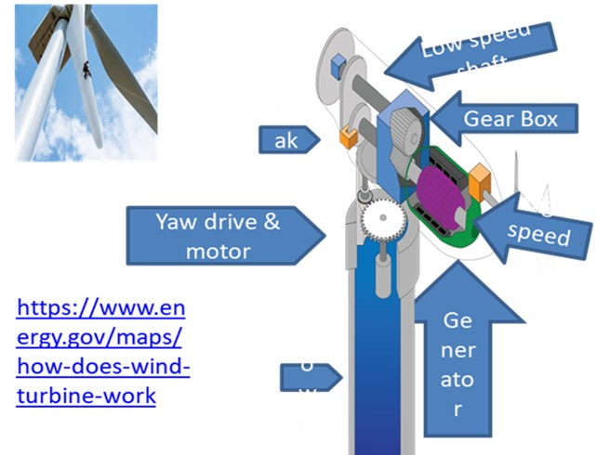
1. Summary of hazards (Module 1)
Electrical hazards
Tower fire
Falls
Rotating parts
Sound/noise
Mechanical tower destruction
Confined and enclosed spaces
Notes:
In the Module 1, we have discussed the hazards related to wind turbine construction and maintenance.
Wind mechanical energy is converted to electrical energy with its associated hazards capable of causing injury, death or disability.
In addition to electrical hazards, workers in wind turbine construction and maintenance are exposed to other hazards, such as fire, falls, noise, confined space, etc. The accidents and injuries from these hazards can be directly or indirectly related to electrical hazards. For example, falls can be triggered by electric shock.

Slide 12
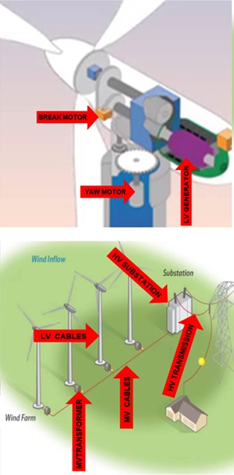
Electrical hazards
Electric shock: it’s a current that kills
direct and indirect contact or flashover from energized part
touch and step potential
Electric arc: it’s a thermal energy that ignites clothing and burns skin
Temperature of ionized gas is a minimum of 5,000 ᴼC
Unprotected skin can be exposed to extreme temperatures
Non-FR clothing can be ignited resulting in non-survivable skin burn
Notes:
Electric hazards are associated with equipment with rated voltage above 50 Volts including motors, generator, low voltage cables terminations and cables, step up transformers, high voltage cables terminations and cables, high voltage substation equipment, and overheard transition lines.
These electric hazards include electric shock and electric arc.

Slide 13
Types of Electric Arc
Depending on arc electrode configuration, system voltage and design of electrical installation:
Open air arc (in line electrodes)
Arc in a box (box arc)
Moving (running or traveling) arc
Ejected arc
Tracking arc
Notes:
Not all electric arcs in electrical equipment in wind energy, or in any other industrial and utility transmission and distribution network, are the same.
Differences in arc configuration and arc behavior determine the way thermal energy distribution occurs, which in turn effects PPE protection properties.
In technical magazines and publications, electric arc classification is extended for five different types. Standardization is lagging to include this knowledge.
The arc type in the classification is based on several differentiating factors: arc electrode geometrical configuration; nominal voltage of electrical installation; shape of arc; arc inside enclosure or in the open air; and predominant radiant or convective heat dissipation; stationary or moving arc; and contact with energized parts or voltage flashover.

Slide 14
2. Protection from electrical hazards
Protection from electrical hazards can be achieved in three ways:
Barrier between the hazard and human body
Safe distance from the hazard
Deenergize
Notes:
This and the next slides will provide an overview of electrical protection.
Protection from electrical hazards can be achieved in different ways, including barrier, safe distance, and deenergize. We will discuss in more detail.

Slide 15
PPE and live line tools
PPE and tools can be different forms or shapes and made from different materials
In electric industry:
shock PPE are widely made of rubber
arc protective PPE are widely made of Fire Retardant (FR) materials
Notes:
PPE and tools can be different forms or shapes and made from different materials. For example, in electric industry, electric shock PPE and arc protective PPE are made of different materials.

Slide 16
3. Electric shock protection
Barrier: PPEs
Safe distance from the hazard
Deenergize
Barrier
Safe Distance
Deenergize
PPE:
Rubber gloves
Rubber sleeves
Rubber blankets
Line hoses
Rubber footwear
Live line tools:
Hot sticks
Insulated platforms
Insulated boom bucket trucks
Insulated ladders
Workplace:
Voltage detectors
Temporary grounds
Lockout/Tagout
Notes:
Now we will discuss electric shock protection, which can be achieved by three different ways: barrier, safe distance, deenergized.

Slide 17
3.1 Barrier - PPE
Many electric shock PPEs are made from rubber.
Why rubber?
Rubber includes elastomers and elastomeric compounds, regardless of origin.
Because of their electrical resistance, soft rubber goods are used as insulation and protective material for electric shock PPEs.
Notes:
Many electric shock PPEs are made from rubber. Why rubber?
Many electric shock PPEs are made from rubber. Why rubber?
Rubber includes elastomers and elastomeric compounds, regardless of origin.
Because of their electrical resistance, soft rubber goods are used as insulation and protective material for electric shock PPE.

Slide 18
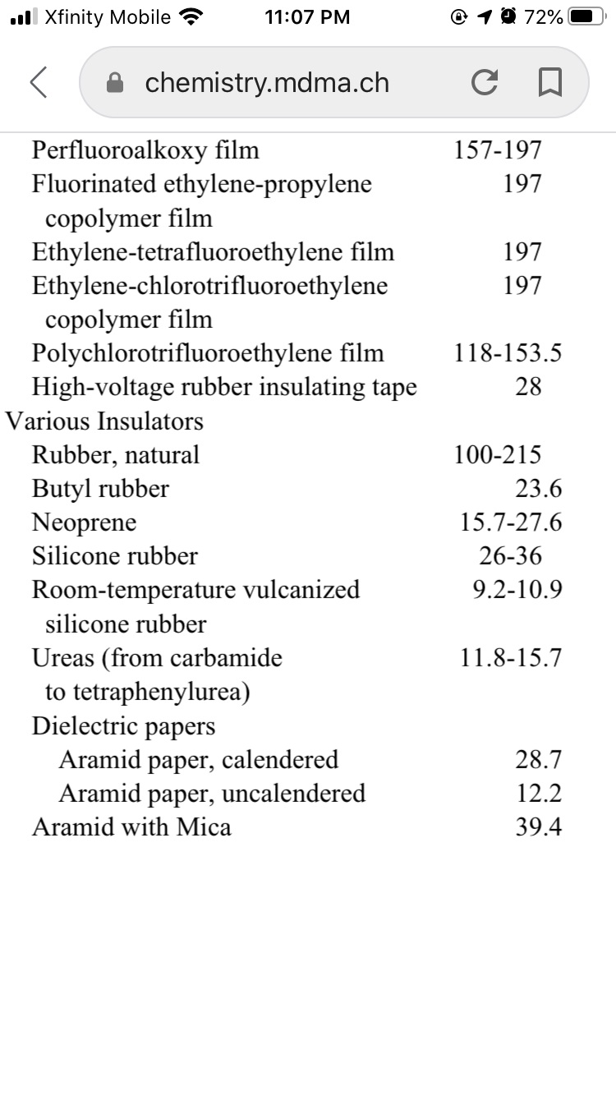
Rubber
Dielectric properties of rubbers (kV/mm):
(chemistry.mdma.ch)
Notes:
Rubber is flexible and has good dielectric properties that make rubber essential for protection against electric shock. This table shows the dielectric strength of various rubber. The number indicates the maximum electric voltage that the material can withstand without undergoing electrical breakdown and becoming electrically conductive.
Reference:
https://chemistry.mdma.ch/hiveboard/rhodium/pdf/chemical-data/diel_strength.pdf

Slide 19
ASTM standards
Many ASTM standards have been developed:
rubber insulating gloves (ASTM D120)
rubber insulating sleeves ASTM D1051
rubber insulating blankets (ASTM D1048)
rubber insulating matting (ASTM D178)
rubber insulating sheeting (ASTM F2320)
rubber insulating covers (ASTM D1049)
rubber insulating line hose (ASTM D1050)
dielectric footwear (ASTM F1117)
electrically insulating aprons (ASTM F2677)
Notes:
Many rubber-made PPE articles and other electrical protective equipment are covered with ASTM standard specifications.

Slide 20
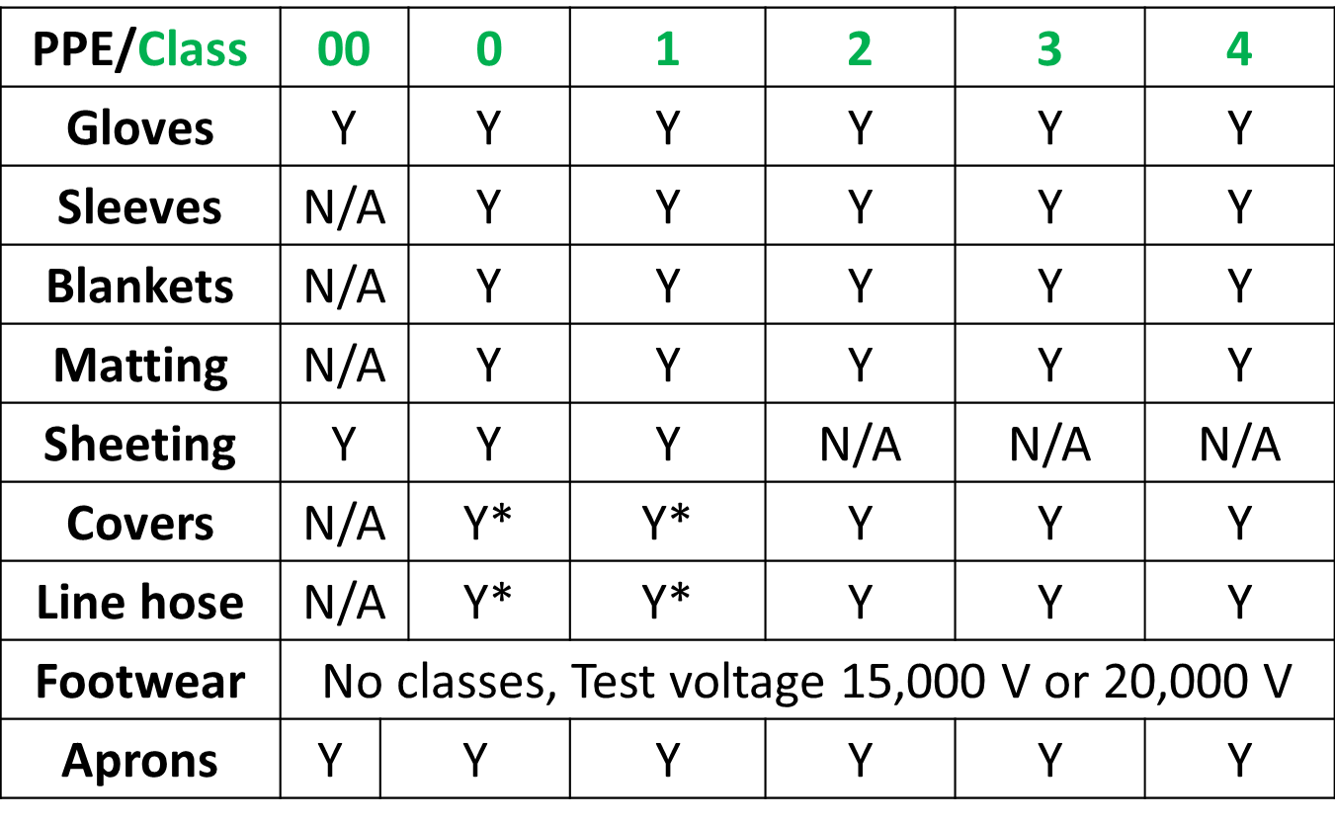
Classification of rubber made PPE
* this class in the specification standard but rarely manufactured
Notes:
This table shows there are different classes of PPE, and electrical protective equipment from 00 to 4. For example, covers are designated in specification standard by 5 classes: 0 to 4. But they are manufactured primarily in classes 2, 3, and 4.

Slide 21
Rubber insulating gloves
First rubber gloves was invented by by William Halsted in 1894 to be used during medical surgeries.
It is hard to trace back when rubber gloves started in electrical industry for protection from electricity.
ASTM D120 rubber glove specification going back to 1979 edition
Preceding standard was ANSI J6.6 rubber insulating gloves edition 1967
Notes:
Rubber glove were invented by surgeons in late 19th century. They have been used in electrical safety world for a long time. Standardization on electrical rubber gloves can be traced back to mid last century or earlier. Today rubber insulating gloves are the most common PPE for electrical workers.

Slide 22
Rubber PPE classification
Class of Glove | AC Proof-Test Voltage, rms, V | Maximum AC Use Voltage ac rms, V | DC Proof-Test Voltage, avg, V | Maximum DC Use Voltage avg, V | Label color
00 | 2,500 | 500 | 10,000 | 750 | Beige
0 | 5,000 | 1,000 | 20,000 | 1,500 | Red
1 | 10,000 | 7,500 | 40,000 | 11,250 | White
2 | 20,000 | 17,000 | 50,000 | 25,500 | Yellow
3 | 30,000 | 26,500 | 60,000 | 39,750 | Green
4 | 40,000 | 36,000 | 70,000 | 54,000 | Orange
Notes:
There are six glove classes with Maximum AC Use Voltage from 500 V to 36,000 V covering the entire range of low and medium voltage equipment. The table shows more detailed information on rubber gloves.
Voltage protective properties dependent on glove thickness. So, it’s thickness that determines the class of rubber glove.
One important note though. Classes are color coded by the color of the LABEL but not by the color of glove itself.

Slide 23
PPE inspection
Video: Glove pinhole demo
https://www.youtube.com/watch?v=8d6gCSxRg6U&feature=youtu.be
OR
https://ucmo.hosted.panopto.com/Panopto/Pages/Viewer.aspx?id=6353ecb5-bc83-486a-ae78-ac2401477a2b
Why gloves need to be often checked?
The distance between task done well and electric shock or electrocution is one invisible pinhole.
Notes:
This video justifies why rubber gloves must be checked often. What you see in this video is a high voltage source inside this blue box. The arrows show high voltage electrode, grounded wire, and electric arc. Electric arc happens when ground is bought closely to the high voltage.
Then you see the glove in action. When put upon the high voltage electrode, rubber glove creates a barrier between high voltage and ground. Ground is touching the glove but no arc occurs because of that barrier.
Then comes a little punch hole into the glove. After that, the glove is no longer the barrier between the high-voltage and the ground and you can see arc again.
However, when you use a good glove with appropriate class, you can touch the high voltage electrode with no harm.

Slide 24
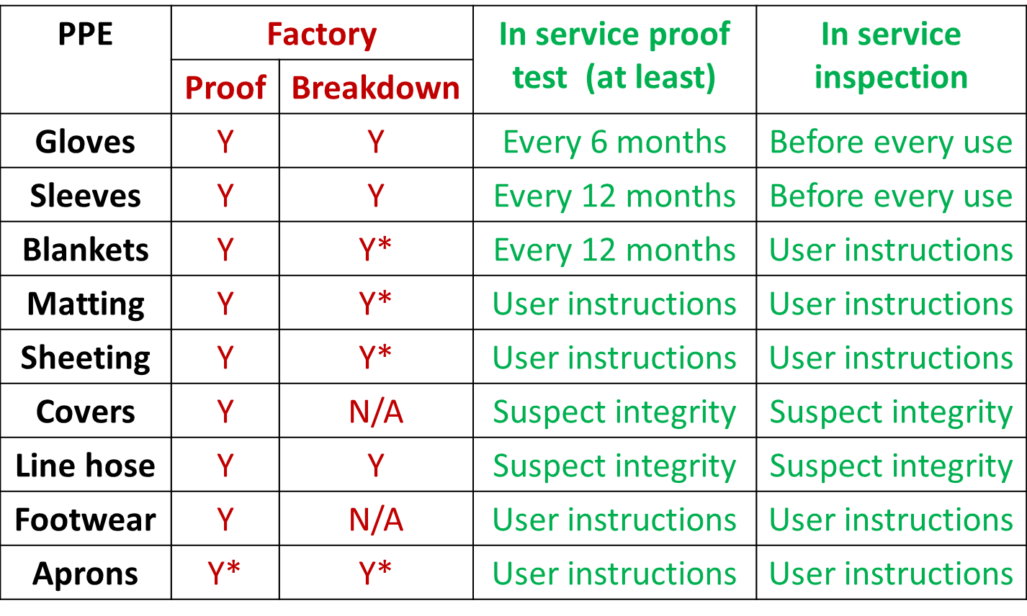
PPE inspection and testing
* test for materials PPE are made off
Notes:
IIn addition to frequent inspection, rubber gloves must be proof tested every six months. All other rubber PPE and electric protective equipment must be inspected in service and proof tested as well but with different time intervals, or when damage suspected, or per the instruction of the manufacturer and end user.
Additional testing is needed randomly for selected materials testing them at higher voltage. Name of this testing in different standards could be different but this test is always done at higher voltage.

Slide 25
Daily glove inspection
Daily inspection shall be done by wearer
Inspection includes:
Visual inspection inside and outside surface for cuts, punctures, abrasion, scratches, age cracks, breakdown, and other defects
Air test by rolling the cuff tightly toward the palm; Air test may be enhanced by listening for escaping air.
Inspect leather protector for holes or other damage
Notes:
Here is how to conduct the daily inspection on glove:
Daily inspection shall be done by wearer, and inspection includes:
Visual inspection inside and outside surface for cuts, punctures, abrasion, scratches, age cracks, breakdown, and other defects
Air test by rolling the cuff tightly toward the palm, and blow air into the glove; Air test is enhanced by listening for escaping air indicating leakage.
Inspect leather protector for holes or other damage.

Slide 26
Resources for daily glove inspection
Resources:
ASTM F1236 “Standard Guide for Visual Inspection of Electrical Protective Rubber Products”
ASTM F496 “Standard for In-Service Care of Insulating Gloves and Sleeves”
Numerous video clips of the inspection process available on the Internet
https://www.youtube.com/watch?v=-MF4xfUT2iw
https://www.youtube.com/watch?v=Fn9f_VXFznY
https://www.youtube.com/watch?v=KnTcemo3aaw
Notes:
There are galore of resources for daily inspection in standards and in video clips available on the Internet. Few links are on the screen.
https://www.youtube.com/watch?v=-MF4xfUT2iw
https://www.youtube.com/watch?v=Fn9f_VXFznY
https://www.youtube.com/watch?v=KnTcemo3aaw

Slide 27
3.2 Safe distance - Low voltage live line tools
At low voltage (<1000 V AC or <1500 V DC):
ASTM F1505 “Standard Specification for Insulated and Insulating Hand Tools”
Insulated: metal tool covered with insulating material
Insulating:-made predominantly of insulating material
Examples of hand tools: screwdrivers, wrenches, pliers, nippers, strippers, cable cutting tools, cable scissors, knives, and tweezers.
Insulated and insulating hand tools can be used to provide safe distance.
Notes:
At low voltage (<1000 V AC or <1500 V DC), ASTM F1505 “Standard Specification for Insulated and Insulating Hand Tools”
Insulated: metal tool covered with insulating material
Insulating:-made predominantly of insulating material
Examples of hand tools: screwdrivers, wrenches, pliers, nippers, strippers, cable cutting tools, cable scissors, knives, and tweezers.
Insulated and insulating hand tools can be used to provide safe distance.

Slide 28
Safe distance – Medium and high voltage live line tools
At medium and high voltage (>1000 V AC or >1500 V DC):
Insulated tools and equipment can be used to provide safe distance.
ASTM and ANSI standards applied:
insulating clampsticks (ASTM F1825)
telescoping tools (ASTM F1826)
insulating work platforms (ASTM F1564)
insulating areal devices (ANSI A92.2)
Notes:
At high voltage (>1000 V AC or >1500 V DC), there are several standards:
ASTM F1825 “Standard Specification for Clampstick Type Live Line Tools”
ASTM F1826 “Standard Specification for Live Line and Measuring Telescoping Tools”
ASTM F1564 “Standard Specification for Structure-Mounted Insulating Work Platforms for Electrical Workers”
ANSI A92.2 “Vehicle-Mounted Elevating and Rotating Aerial Devices”

Slide 29
Insulating distance
Video: Distance bucket truck 500 kV
https://www.youtube.com/watch?v=wETMWaM-GHE&feature=youtu.be
OR
https://ucmo.hosted.panopto.com/Panopto/Pages/Viewer.aspx?id=81d90e3e-1ff2-43d7-a53b-ac2401476557
Notes:
Safe distance can be provided between worker at the ground potential and energized conductor. Such type of distancing is provided when using clampstick or telescoping tool.
Safe distance can be also provided between worker and ground allow touching and working on energized conductor without PPE like rubber gloves, rubber sleeves etc. Such distancing can be provided by insulating platforms or bucket trucks with insulating boom. There is still a need in equalizing potentials of energized conductor and worker/bucket to avoid unpleasant but otherwise harmless sparking. Metal wand connected to a bucket is used. This video is an example of insulated bucket truck for bare hands’ work based on required safe work practices and procedures This video is recorded using special camera capable to catch moment of connecting to hot wire and equalizing voltage potentials. Safe distancing from ground is provided by insulating boom (top arrow) with available rated voltage up to 750 kV. Second arrow pointed to a metal and grounded boom. Special on-the- job training is required for this type of work.

Slide 30
What to watch for when using distancing
Video: Arc at HV sub man in bucket
https://www.youtube.com/watch?v=W761w4j4DeM&feature=youtu.be
OR
https://ucmo.hosted.panopto.com/Panopto/Pages/Viewer.aspx?id=04f7a162-bbd2-4fb3-b6bb-ac24014747d2
Be aware of your surroundings when using distance tools. Typical mistake is bypassing insulating means. While using equalizing wand, bucket is lowed to dangerous ground proximity bypassing insulating boom. The result is flashover and electric arc.
Notes:
Typical mistake when using distance tools is bypassing insulating means. While using equalizing wand, bucket is lowered to dangerous ground proximity bypassing insulating boom. The result is flashover and electric arc. Hopefully the wand worked as a fuse melting quickly and preventing more damage.

Slide 31
3.3 Deenergized work
It is the safest way of working to avoid electric shock and electric arc.
Steps to follow:
Isolate, deenergize (OSHA 1910.269, NFPA 70E)
Lock out, tag out (OSHA 1910.269, NFPA 70E)
Check voltage
High voltage detectors (ASTM F1796)
High voltage proximity alarm for overhead line (ASTM F3283)
Grounding and equipotential:
Temporary ground (ASTM F855)
Equipotential bond mat (ASTM F2715)
Notes:
This slide reflects the sequence of steps to be followed: isolate, deenergize, LOTO, check voltage absence, and install ground.

Slide 32
4. Electric arc protection
Barrier: PPEs
Safe distance from the hazard
Deenergize
Barrier
Distance
Deenergize
Arc rated PPE:
Clothing
Face protection
Hand protection Arc blankets
Live line tools:
Remote racking Meter pullers
Arc rated switchgear
Workplace:
Voltage detectors
Temporary grounds
Lockout/Tagout
Arc protection = shock protection +more
Notes:
Now we will discuss electric arc protection. As you can see on this slide, the general block diagram is very similar to one for electric shock protection. Generally, ways of arc protection are the same as for shock protection: creating a barrier between the hazard and a body, providing extra distance between the hazard and a body, and most importantly deenergize.
Opposite to electric shock protection, science and practice of arc protection is much younger and with accreted (accumulation of ) inconsistences and myths. Understanding these myths is an essential part of learning and applying electric arc protection.
Since arc protection is needed during work on energized conductors, shock protection is first and foremost. Arc protection is always an addition to shock protection. Sometimes shock protection can be arc protection as well. For example, rubber gloves with leather protectors are also an arc protection.

Slide 33
Myth: arc rated clothing protect from electric shock
Myth (quote from white paper):
At the right cal rating (as dictated by your Arc Flash hazard assessment), Company name’s PPE will insulate you, stopping the electrical energy created by the incident using your body as a conductor and causing serious internal burns.
Notes:
Here is the first Myth. A quote from a white paper: At the right cal rating (as dictated by your arc flash hazard assessment), the PPE will insulate you, stopping the electrical energy created by the incident from using your body as a conductor and preventing the flow of serious current causing internal burns.
This assumption is incorrect! What is described in this white paper is the case of electric shock, and the prevention of current flowing though muscles and internal organs. Arc PPE DOES NOT protect against electric shock, See it on next video.

Slide 34
Do arc PPE protect from electric shock?
Video: FR jacket no shock protection
https://www.youtube.com/watch?v=TiK7T2SVttc&feature=youtu.be
OR
https://ucmo.hosted.panopto.com/Panopto/Pages/Viewer.aspx?id=e98b8b2c-1f17-414f-aa20-ac2401471d85
Myth: Arc Flash PPE protects you from internal burns caused by the energy in an arc flash incident.
Reality: Video illustrates that AR clothing has no dielectric insulating properties whatsoever. AR clothing can insulate from thermal energy and prevent skin burn but not from high voltage, electric shock, or your body conducting current and causing serious internal burns.
Notes:
Myth: Arc Flash PPE protects you from internal burns caused by the energy in an arc flash incident.
Reality: Video illustrates that AR clothing has no dielectric insulating properties whatsoever. AR clothing can insulate from thermal energy and prevent skin burn but not from high voltage, electric shock, or your body conducting current and causing serious internal burns.

Slide 35
Rubber gloves with leather protectors can protect against electric arc
Video: Rubber glove in arc
https://www.youtube.com/watch?v=4Gt_8lPUtmo&feature=youtu.be
OR
https://ucmo.hosted.panopto.com/Panopto/Pages/Viewer.aspx?id=fe3be75e-8336-4244-8553-ac240146e306
Rubber gloves with leather protectors is a proven protection against heat energy dissipated from electric arc.
Notes:
However, the opposite is true: electric shock PPE can also protect against thermal energy of an electric arc. This video is an example of rubber glove protecting not only against electric shock but also from thermal effect of electric arc. Rubber glove with leather protectors is a proven protection against heat energy dissipated from electric arc.

Slide 36
Shock PPE/equipment in electric arc
Several other shock protective PPEs/equipment can protect against electric arc.
Tools that provide distance form arc (clampsticks and telescoping tools)
Rubber sleeves and aprons to some extend
Notes:
Several other shock protective PPE/equipment can protect against electric arc as well. Ex.
Tools that provide distance form arc (clampsticks and telescoping tools)
Rubber sleeves and aprons to some extent

Slide 37
Myths: electric arc is unpredictable
Myth:
Arc is unpredictable, and all arcs are “burn equal”.
Current standardization in North America does not recognize:
type of arc
effect of arc type on protective properties for materials
significance of arc type for the outcome of arc rating testing
Reality: direction of thermal energy dissipation is predictable based on arc type.
Notes:
There is no recognition of five different types of arc yet in current standardization. However, as it was shown in Module 1 of this training course, there are substantial differences among arc types and exposures.
Understanding and predicting type of arc is a crucial step in safe work environment as far as arc concerns. We will learn later how type of arc can affect protective properties.

Slide 38
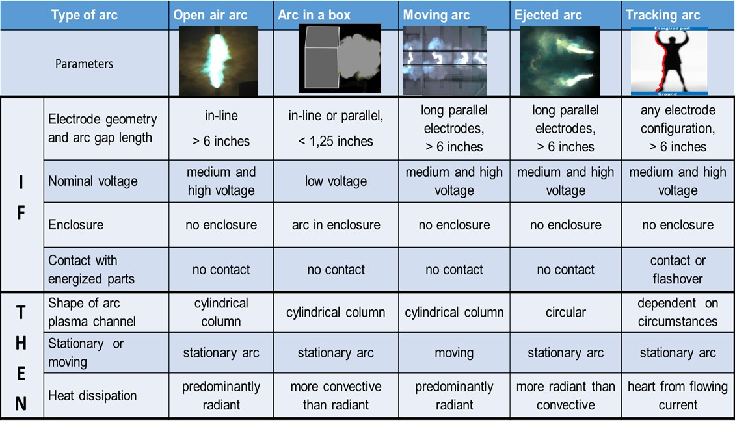
Electric arc types and predictability
(Golovkov et al., Professional Safety magazine , June – September, 2017)
Notes:
The uniqueness of this training course includes delivering knowledge that is not widely known but effective for arc protection.
For example, this summary table is a resource for planning any energized work. This is the first step for hazard assessment that should be used along with or even before other steps required by OSHA regulations or NFPA 70E standard.
As an example: If you are planning work in low voltage power or control panel with door open, and you must use rubber gloves to prevent direct contact with energized conductor, and in case of electric arc occurring inside panel, then the arc plasma channel with temperature 5,000 $℃$ will stay inside panel, but dangerously hot air will still exit through open door. So the best mitigation technique is you should avoid positioning yourself to the open door and stay to the side as much as possible. Using PPE is also a must and required by safety rules.
Reference:
Electric Arc. Protecting Against Thermal Effect, Part 1: Types of Electric Arc By Mikhail Golovkov, Holger Schau and Gavin Burdge, Professional Safety Journal, July 2017

Slide 39
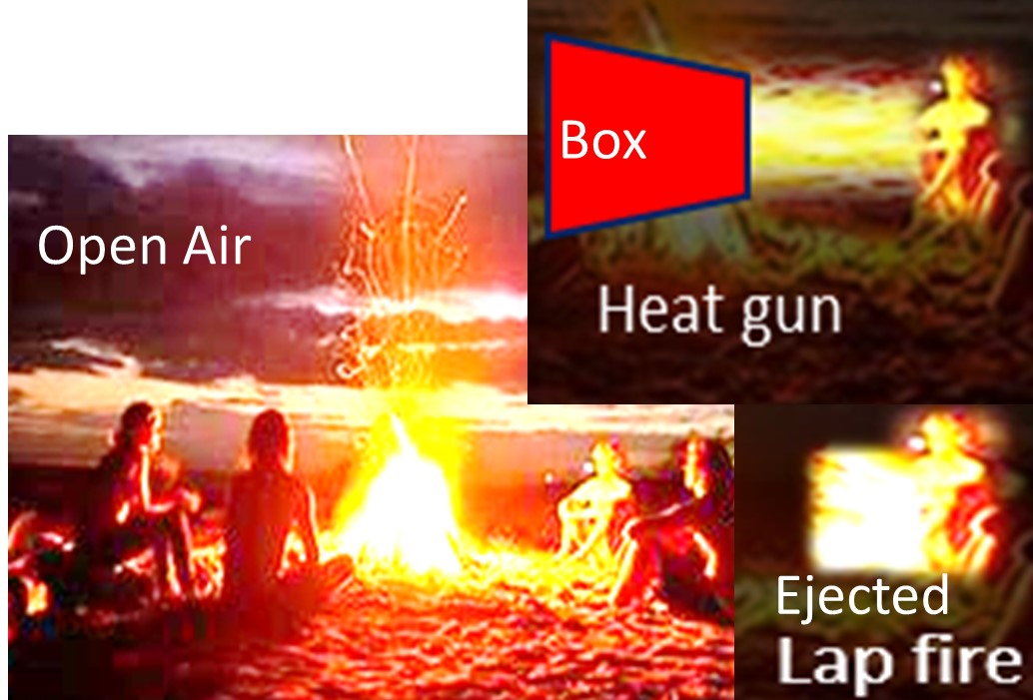
Campfire analogy
Notes:
In open air arc, thermal energy will be dissipated into all direction equally and predominantly as radiated heat (bright light). It can be compared with the camp fire when everybody around equally receiving the same heat feeling “cozy and warm”.
However, heat dissipation in box arc has different pattern. Imagine fire is put in a box with one side open and a strong fan is turned on blowing all heat in one direction towards one “guest of honor”. He/she will be at great risk of arc exposure. Everybody else around is in dark and cold.
Ejected arc is delivering the entire fire directly into the laps of that one “guest of honor”. Severe burns may occur.
Evidently in all three scenarios, the amount of heat energy is different, increasing from open air arc, to arc in a box, to ejected arc.
Critical in electric arc protection is to avoid becoming the “guest of honor”.

Slide 40
Myths: “arc blast” is “dynamite like” explosion
Video: Blast myth
https://www.youtube.com/watch?v=qT0_ZnYhYQg&feature=youtu.be
OR
https://ucmo.hosted.panopto.com/Panopto/Pages/Viewer.aspx?id=875592eb-7215-4b62-b75d-ac2401467cdb
Myth: arc blast is “dynamite like” explosion.
Training
Electric arc educational videos
Manufacturer marketing videos
Sales presentations
Notes:
Next myth is “arc blast” or “pressure wave”. You can often hear this myth on all these occasions: training, electric arc education videos, manufactures marketing videos, and sales presentations. However, electric arc can be called “explosion” only casually or emotionally.

Slide 41
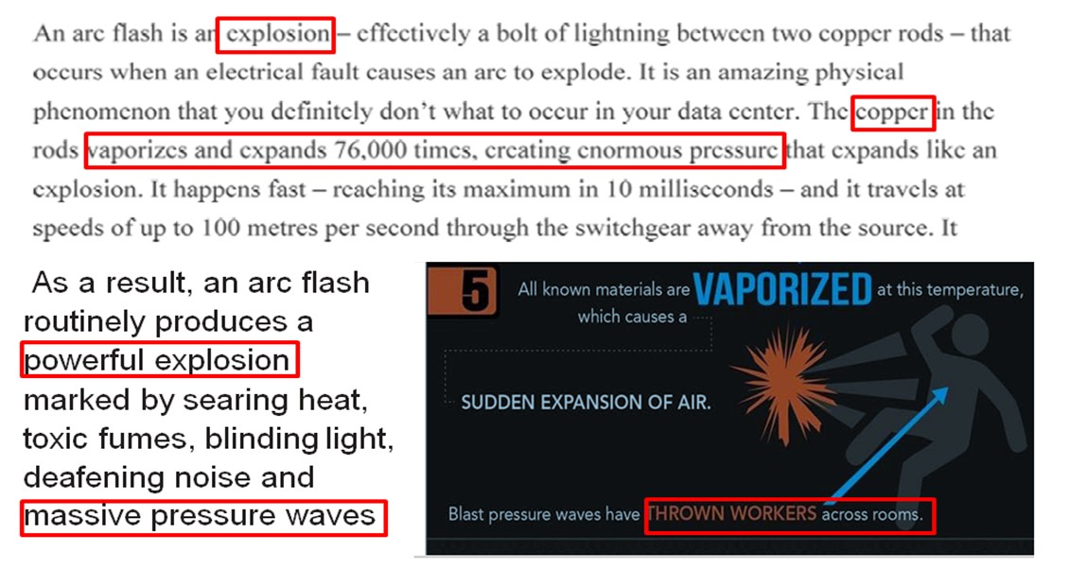
White papers, magazines, articles
Electric arc is still dangerous for personnel mainly due to its thermal effect dissipating large amount of heat energy. Arc rated PPE are required.
Notes:
“Explosion”, “massive pressure waves”, “throwing workers across rooms”, “evaporating and expanding 76,000 times” all these description of electric arc are false when arc is burning in open air or in enclosure with open door.

Slide 42
Reality in the lab: mannequin still in place during and after ejected and box arc
Video: No blast ejected arc
https://www.youtube.com/watch?v=J4YrmyOP4og&feature=youtu.be
OR
https://ucmo.hosted.panopto.com/Panopto/Pages/Viewer.aspx?id=fa59c3ba-de9d-473b-8aa2-ac2401465ea0
Video: No blast Ejected arc 3 phase
https://www.youtube.com/watch?v=Ej_fc0Toc7c&feature=youtu.be
OR
https://ucmo.hosted.panopto.com/Panopto/Pages/Viewer.aspx?id=791a1fad-4e7f-485c-ba8b-ac2401463ef0
Video: No blast box arc
https://www.youtube.com/watch?v=z-qBkKaBLK0&feature=youtu.be
OR
https://ucmo.hosted.panopto.com/Panopto/Pages/Viewer.aspx?id=0b019b84-ebdd-401c-ac8e-ac24014615cf
Notes:
No mannequins “flying across the rooms” in lab testing.

Slide 43
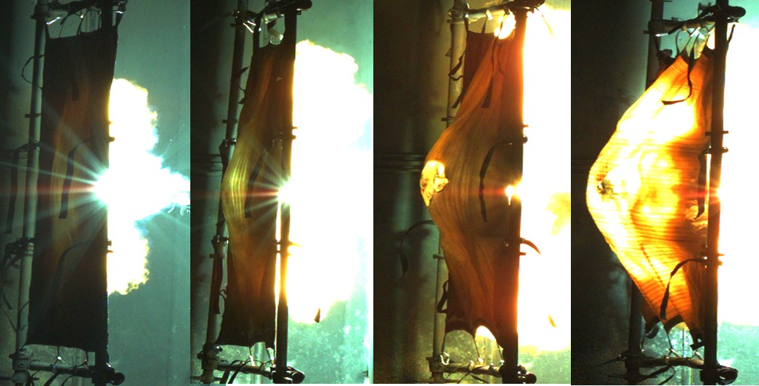
Reality in the lab: electromagnetic forces not a “blast”
5 kA 10 kA 20 kA 33 kA
Notes:
These photos illustrate electromagnetic forces generated when ejected arc channel is trapped in the bulge of arc blanket during the test. Ejected arc configuration in open air is used in arc blanket testing. Each blanket is a heavy seven layers of Kevlar® and Nomex® fabrics. There are four freeze-frames from four high speed test videos in this collage. Each test was done with different fault current. At 5 kA electromagnetic force is low and test blanket is flat. Bulging increases with higher current. It is electromagnetic force causing bulging but not “blast” or “pressure wave”.

Slide 44
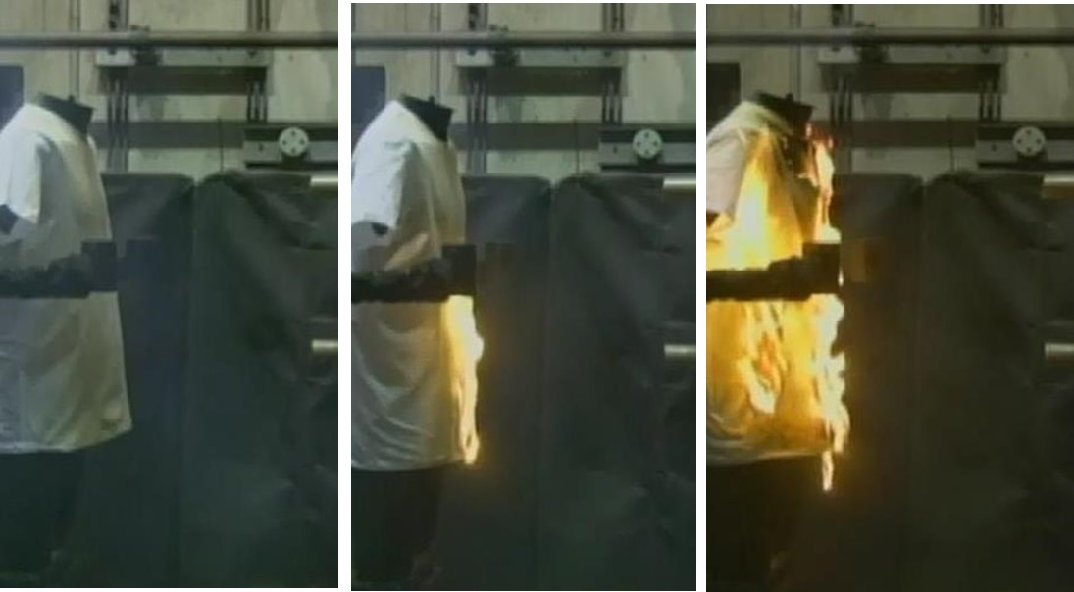
Electromagnetic behavior of an arc
4 kA 8 kA 16 kA
Notes:
Although there is no “blast”, thermal hazard in ejected arc is proportional to arc current. A higher arc current generates a higher electromagnetic force that ejects arc channel from electrode gap sooner and to a greater distance. Ignition of non-FR T-shirt is current-dependent for the same geometry. Testing was done at the same arc duration. There are no calculations that take into account this effect.

Slide 45
Reality in the field: no flying human bodies in arc event in open air or open box
Video: No blast arc in MV switchgear
https://www.youtube.com/watch?v=Qp3SCM2Uqwk&feature=youtu.be
OR
https://ucmo.hosted.panopto.com/Panopto/Pages/Viewer.aspx?id=2b5c0d39-8b65-47b4-9e00-ac2401460013
Video: No blast LV arc
https://www.youtube.com/watch?v=_A6nG5tbQwk&feature=youtu.be
OR
https://ucmo.hosted.panopto.com/Panopto/Pages/Viewer.aspx?id=e1058454-6715-4b2c-8a5a-ac240145d27b
Video: No blast cable arcing next to the house
https://www.youtube.com/watch?v=WrLjnFsAe1U&feature=youtu.be
OR
https://ucmo.hosted.panopto.com/Panopto/Pages/Viewer.aspx?id=682b99e3-1f1e-4a99-ad7d-ac240145b133
Notes:
No “flying bodies” or broken glass or door in theses video ether. Both men are moving on their own power.

Slide 46
Reality in the field: no flying human bodies in arc event in open box
Video: Arc in a box two men
https://www.youtube.com/watch?v=CIlFCLwYqZc&feature=youtu.be
OR
https://ucmo.hosted.panopto.com/Panopto/Pages/Viewer.aspx?id=3d042508-823d-486a-b341-ac24014586a7
Notes:
Remember this video of arc in a box from Module 1. The door is open, so there is no pressure wave that is capable of throwing two electricians back from electric panel. However, there is a force that helps them escape a dangerous place. This force is human body self-preservation, adrenaline rush supplying oxygen inrush to muscles and adding strength to involuntary muscles movement. They wouldn’t beat Usain Bolt but estimated from video 12-14 mph speed is accomplishment for ordinary man in gear.

Slide 47
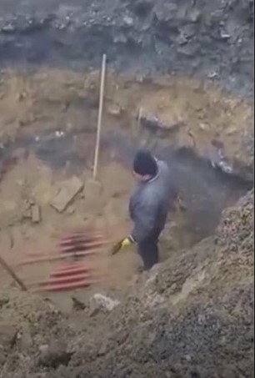
Spiking the cable: what blast?
Video: Spiking the cable what blast
https://www.youtube.com/watch?v=TXW3OWZgIfg&feature=youtu.be
OR
https://ucmo.hosted.panopto.com/Panopto/Pages/Viewer.aspx?id=30f1fbf3-37e8-4ce7-97c6-ac240145686c
What blast?
Notes:
There are things to learn except "never do it again". First of all, there is no “pressure wave” and “flying body” no matter how violent electric arc seems.
However, there are right things, there are lucky things and there are things that could be done better. Let's look at technical details of this video. The right thing is that worker used spike with long clean and (appears to be) wooden/plastic (not metal) handle. This handle is a game changer because: a) It isolates this worker from energized conductor eliminating electric shock or electrocution; b) It provides extra distance between the body and electric arc and consequently mitigates exposure to thermal energy.

Slide 48
Types of explosions
Natural - arise from volcanic activity
Astronomical - star explodes in the universe
Nuclear - nuclear fission or combination of fission and fusion
Chemical detonation - rapid and violent oxidation reaction that produces large amounts of hot gas
Electrical - high current electrical fault
Mechanical and vapor - bursting of a sealed container under internal pressure
https://en.wikipedia.org/wiki/Explosion
Notes:
Wikipedia defines several types of explosions including “electrical” as high current electric fault.

Slide 49
Reality: electrical explosion?
Electric arc may be probably called an “explosion” but only casually or emotionally
Electric arc is electrical phenomena, it is the continuous electrical discharge or continuous flowing of fault current
Rate of energy dissipation in electric arc is much slower (generally in hundreds of milliseconds) than that in chemical detonation (single digit milliseconds for explosives),
No detonation and supersonic or subsonic distractive pressure wave during electric arc discharge in open air or in enclosure with door opened
Notes:
Arc is electric discharge of certain duration.
Rate of energy dissipation is much slower than that in chemical detonation, which means no significant or destructive pressure wave.
Video examples from the lab and from the field demonstrate no destruction or harm to the bodies.

Slide 50
Reality: no explosion capable lifting 200 pounds man
There is no explosion that can lift 200 pounds man and throw him wide and far.
However, human bodies are being moved in arc events. In opposite, mannequins in numerous arc videos are standing “like rocks”.
The difference between human and mannequin is that mannequin does not have survival mechanism as humans do.
It is unexpected scare, survival self-defense or adrenalin rush that move electrician out of harm’s way during the stressful moments.
Notes:
In these videos there is no evidence of flying human bodies or mannequins.
There is no explosion that can lift 200 pounds man and throw him wide and far.
However, human bodies are moving in real life arc events. In opposite, mannequins in numerous arc videos are standing “like rocks”.
The difference between human and mannequin is that mannequin does not have survival mechanism as humans do.
It is unexpected scare, survival self-defense or adrenalin rush that move electrician out of harm’s way during the stressful moments.

Slide 51
Reality: adrenaline rush and body moving
Some medical information on adrenaline rush:
Adrenaline is a stress hormone secreted from the adrenal glands on the kidneys.
Adrenaline helps your body react more quickly. It makes the heartbeat faster, increases blood flow to the brain and muscles.
The body goes into fight-or-flight responses. Adrenaline acts on muscles, allowing them to contract more than they can when the body is in a calm or neutral state.
Notes:
Here is some medical information on adrenaline rush.
What causes adrenaline rush?
The inner glands produce adrenaline. Adrenaline helps your body react more quickly. It makes the heartbeat faster, increases blood flow to the brain and muscles, and stimulates the body to make sugar to use for fuel. When adrenaline is released suddenly, it's often referred to as an adrenaline rush.
Adrenaline is a stress hormone secreted from the adrenal glands on the kidneys.
Adrenaline helps your body react more quickly. It makes the heart beat faster, increases blood flow to the brain and muscles.
The body goes into fight-or-flight responses. Adrenaline acts on muscles, allowing them to contract more than they can when the body is in a calm or neutral state.
--- More information:
What happens when you have an adrenaline rush?
Adrenaline is a stress hormone secreted from the adrenal glands on the kidneys. The body goes into fight-or-flight responses in threatening environments when under stress which produces adrenaline. Learn how adrenaline rushes happen and how it impacts the body both positively and negatively
Is it good to have an adrenaline rush?
When your adrenal glands dump the stress hormones cortisol and adrenaline into the bloodstream to create an “adrenaline rush,” your body is activating a heightened state of physical and mental alertness. As long as it's not long-lasting, that burst of human jet fuel can be a good thing.
How does adrenaline affect the body?
When adrenaline is released, it signals the brain to redirect energy and blood from the internal organs to the muscles to prepare to fight or flee. Adrenaline causes an increased heart rate, high blood pressure and rapid, shallow respiration. The body temperature will increase and cause sweating.
Does adrenaline make you stronger?
But adrenaline's effect on muscles accounts for amazing strength. Adrenaline acts on muscles, allowing them to contract more than they can when the body is in a calm or neutral state. ... This means that more oxygen is carried to your muscles by the extra blood, which allows your muscles to function at elevated levels.

Slide 52
Reality: Impact with obstacle on workers way can cause serious injury.
The fact that electrician is blinded by blight light, shocked by high temperature, scared and disoriented by unexpected danger, just adds to real picture of strong and fast reflexive body movement.
Impact with any obstacle on workers way can cause serious bodily injury.
Electric arc is dangerous for personnel mainly due to its thermal effect dissipating large amount of heat energy. Arc rated PPE are required.
Notes:
The fact that electrician is blinded by blight light, shocked by high temperature, scared and disoriented by unexpected danger, just adds to real picture of strong and fast reflexive body movement.
Impact with any obstacle in workers way can cause serious bodily injury.
Electric arc is dangerous for personnel mainly due to its thermal effect dissipating large amount of heat energy. Arc rated PPE are required.

Slide 53
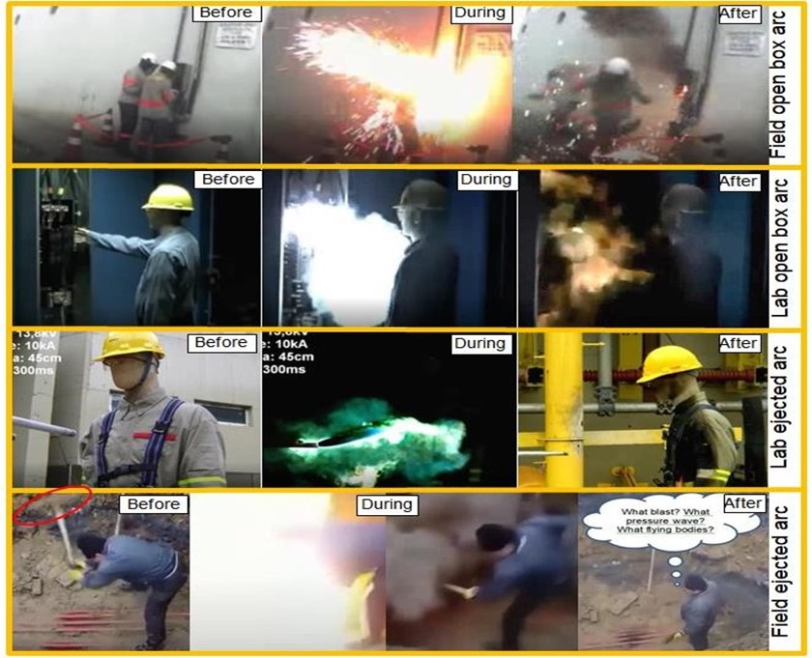
Reality: no blast, pressure wave in open air
Notes:
There are three still frames from each of four videos at the attached collage: two labs and two field cases. Note that in both box cases, either door is open or front cover is removed. Each frame is showing positions of humans or mannequins just before, during, and after arc exposure. Obviously, there is damage to either human or mannequin and they retained their original positions except field box arc case (top row). In that case electricians are running away under their own power.
These and many other visual materials (video and photos) do evidence that in electric arc incident there is no such thing as “arc pressure wave”, or “arc blast”, or “arc explosion”. There is a loud sound that accompanies electric arc in the same way as any other electric discharge (for example lightning).

Slide 54
What should avoid when working on box with open door (not being “guest of honor”)
Standing up front the opening
Looking into possible path of energy release
Video: Arc in a box no harm to worker
https://www.youtube.com/watch?v=peymghAqAcc&feature=youtu.be
OR
https://ucmo.hosted.panopto.com/Panopto/Pages/Viewer.aspx?id=9b03f77f-4cd7-4e2c-823c-ac24014543b7
Video: Arc in a box MV no harm to worker
https://www.youtube.com/watch?v=g6qjEDjgGcM&feature=youtu.be
OR
https://ucmo.hosted.panopto.com/Panopto/Pages/Viewer.aspx?id=0fa78f32-5b99-4438-9bec-ac2401453928
Video: Aux transformer cubicle arc in Russia
https://www.youtube.com/watch?v=-TfoqAozOnY&feature=youtu.be
OR
https://ucmo.hosted.panopto.com/Panopto/Pages/Viewer.aspx?id=755d964f-b4f1-4be9-b4c0-ac2401451e52
Notes:
Example of working in front of open door. In the first two videos, electricians survived with no harm as both of them were not in a path of energy release. In the third video two of the three escaped, but the third one was injured and still in front of cubicle.
However, it is a very different phenomenon of arc burning in enclosure.

Slide 55
Reality: mechanical explosion when arc in enclosure
Electric arc in enclosure:
Pure mechanical explosion will occur when arc is in enclosure
High pressure is generated only if arc is burning inside enclosed volume (box, panel, cubicle) with closed doors.
Ideal gas equation PV/T=constant: A rapid temperature increased in confined space/compartment will result in pressure spike as long as the volume remains unchanged (door kept closed).
Notes:
In a closed compartment, the situation may be totally different. Rapid temperature rise of confined air will cause a rapid increase of pressure inside compartment. Due to increased pressure, there may or may not rupture of the lock or walls of the compartment depending on their mechanical strength. Pressure can be released though ruptured wall or reduced naturally after arc interruption followed by air cooling.

Slide 56
Mechanical explosion
Video: Arc in closed cubicle with swinging door
https://www.youtube.com/watch?v=x7tvU4tZJp4&feature=youtu.be
OR
https://ucmo.hosted.panopto.com/Panopto/Pages/Viewer.aspx?id=9729b396-a709-48f9-802b-ac2401451eea
A worker may experience a push or slap if he is on the way of swinging/flying door or loose wall panel.
Numbers like 2000 lb/in² in one video, thousands pounds per foot in another video, or 100 kPa (14.5 lb/in²) are more anecdotal than real
Notion that “Copper expanding 67,000 or 76,000 times” is not relevant for electric arc
Notes:
Example of swinging door. Luckily, operators were not in its way.

Slide 57
Awareness of box arc striking at any moment
Video: MV substation arc in normal condition
https://www.youtube.com/watch?v=15hj4-047EQ&feature=youtu.be
OR
https://ucmo.hosted.panopto.com/Panopto/Pages/Viewer.aspx?id=67f98a4d-50b7-426b-9045-ac2401451e19
As recorded in many videos, arc incident is likely to happen when some work is being done on equipment.
Just be aware that arc may happen at any moment making door swinging violently.
Notes:
This is an example of a box arc in “normal” condition when no switching or other work is being done on equipment.

Slide 58
Myth: arc rating on your garment label is constant and universal measure of protective properties in any electric arc
ASTM F1959 Definition: “arc rating - value attributed to materials that describes their performance to exposure to an electrical arc discharge”.
Arc rating is perceived to be an absolute constant for the material regardless arc parameters.
The definition pretends to be universal to any and all electric arc discharges regardless type of arc.
But does one value fits them all?
Notes:
ASTM F1959 arc test method for FR textiles specify requirements for test equipment and outlines test procedure and test protocol resulting in arc rating. There is no reference to any type of arc in the definition. The false perception is that arc performance or numerical value of the arc rating is always the same.

Slide 59
PPE selection requirements
Method 1 (incident energy method NFPA 70E)
Estimate arc thermal hazard calculating Incident Energy (IE) of potential arc exposure (cal/cm²)
Select arc PPE with arc rating equal or higher than estimated thermal hazard
Method 2 (task table method NFPA 70E)
Select PPE based on preformed task, system voltage, and projected fault current
PPE arc rating is determined from task table
Method 3 (table method IEEE NESC)
Select PPE based on tables depending on voltage, current and arc duration
Notes:
The first method for incident energy calculation is more theoretical and involves for each point in electric network:
extensive data collection for all equipment: generators, transformers, motors, cable and overhead lines, relays, fuses, breakers, switchgear, panels etc.
calculations: fault current, fault clearing time, incident energy.
All calculated parameters are specific and different for each and every piece of equipment in electric network.
The second method is based more on the past experience of safe work:
Method 1 is predominant. However, it is less reliable because of variability of arc PPE protective properties and specifically variability of arc rating from point to point of electrical network.
For example, PPE with arc rating of 8 cal/cm² will perform at 10 cal/cm² at one point of network but can only at 6 cal/cm²at another.
Next few slides will explain why PPE may underperform their labeled rating.

Slide 60
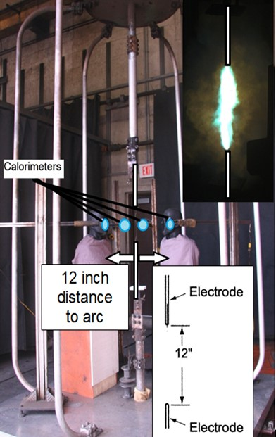
Reality: arc rating is limited to a single set of test conditions
Arc Rating is determined according to ASTM F1959 standard test method
Test performed using open air arc with in-line vertical electrodes
Test parameters:
8 kA arc current
12 inch distance between test specimen and arc electrodes
12 inch distance between tips of vertical electrodes
Notes:
Arc rating is limited to a single set of test conditions. For example, the parameters in this test included:
8 kA arc current;
12 inch distance between test specimen and arc electrodes; and
12 inch distance between tips of vertical electrodes.

Slide 61
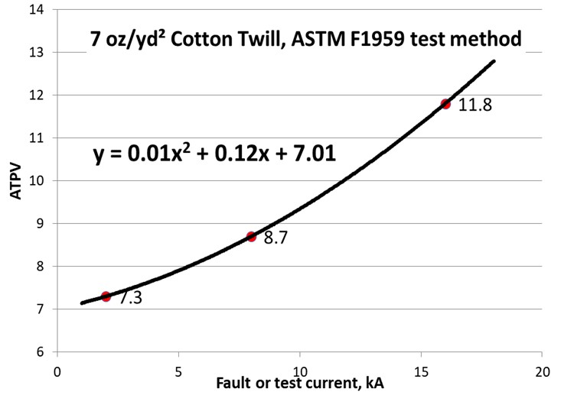
Actual arc rating is variable with test/fault arc current
Arc Rating dependency on fault current is known in ASTM since 2004
New research data is in correlation with the 2004 data
Notes:
Arc rating is not constant and depends on arc current.

Slide 62
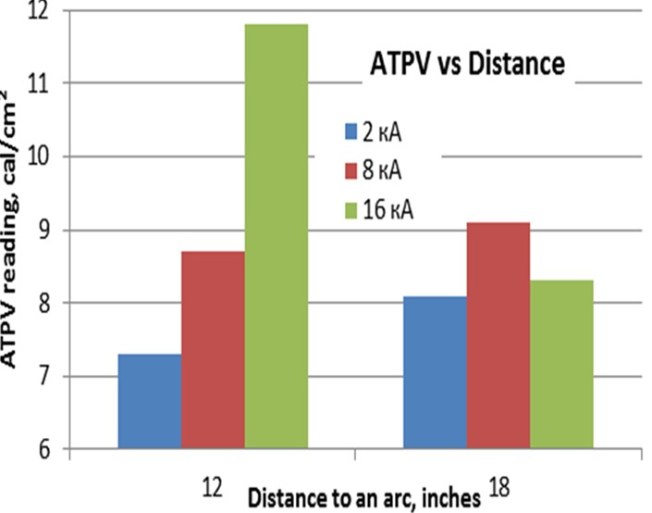
Actual Arc Rating is variable with fault current and distance to arc
Arc rating and thermal properties are dependent on a distance to arc
Difference in arc rating increases with test current level above 8 kA
Notes:
Arc rating is also dependent on the distance to arc.

Slide 63
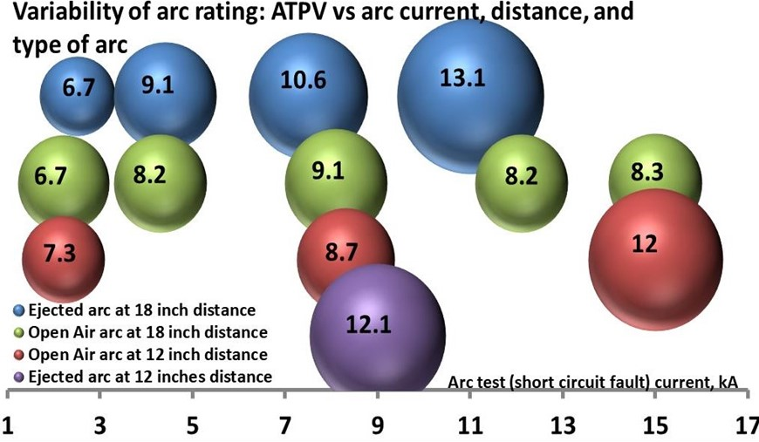
Actual arc rating is variable with fault current and distance to arc and type of arc
All testing was done with the same fabric from the same single roll.
Higher numbers to the right of the chart do not mean better protection.
Notes:
One more dimension of arc rating variability is the type of arc.
One more dimension of arc rating variability is the type of arc.
All testing was done with the same fabric from the same single roll.
Range of Arc Thermal Protective Values (ATPVs) is from 6.7 to 13.1 or nearly 100% difference.
Higher numbers to the right of the chart do not mean better protection.

Slide 64
Reality: arc rating is unknown in real field situation
Protective properties are not the same and depend on a number of factors.
PPE selection based on IE method does not account these factors.
PPE will be underperformed because of arc rating variability
Notes:
Protective properties are not the same and depend on a number of factors.
PPE selection based on Incident Energy (IE) method does not account for these factors.
PPE will be underperformed because of arc rating variability.

Slide 65
Reality: higher arc rating - less protection time for single layer garments
A higher ATPV actually provides misleading information because skin burn occurs in shorter time.
For example:
Single layer 7 oz cotton fabric has demonstrated ATPV of 7.3 cal/cm² at 2 kA arc current and 12 cal/cm² at 15 kA arc current.
However, PT is 4.5 times shorter (less protective) at the higher current and arc rating
Notes:
Relation between arc rating value and protective time is in inverse protection.
All data show that arc rating as determined according to ASTM standards is not the best and most reliable measurement of PPE arc protective properties

Slide 66
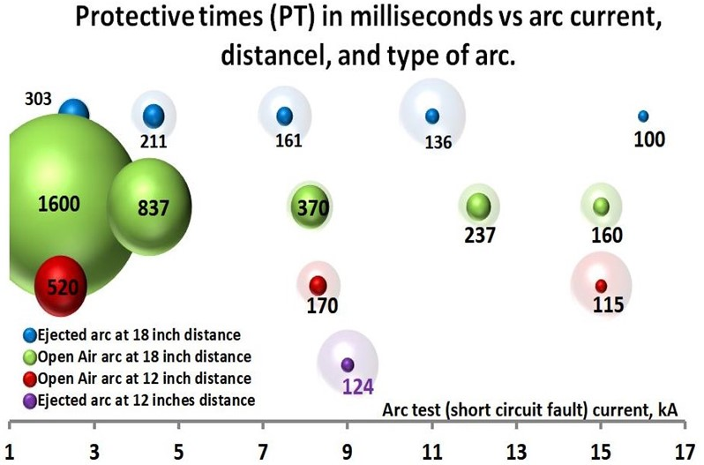
Better and real measurement of arc protective properties
Protective time (PT) is the time from arc start until enough heat energy is transferred to cause second-degree skin burn.
Notes:
Protective time (PT) is the time from arc start until enough heat energy is transferred to cause second-degree skin burn.
PT is the direct measure of how long a fabric material will provide protection.

Slide 67
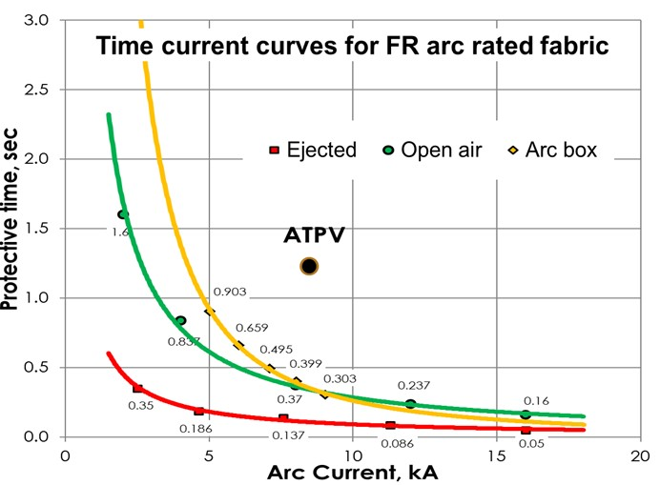
Protective TCC (PTCC)
An arc rated material will protect from second degree skin burn at any combination of arc current and clearing time from the area below PTCC.
This area represents safe PPE work condition or safe zone.
Notes:
Protective properties are better described by area under curve than a single dot on x-y plane.

Slide 68
Other myths
There are few other myths in protection against electric arc. Among them are:
“Thousands fatalities“ from electric arc or statistical exaggeration of fatal and nonfatal arc trauma
Short sleeves shirts and T-shirts are in compliance with OSHA
Mesh vents in garments are in compliance with OSHA
Notes:
There are few other myths that are listed on this slide and that are not in the scope of this training materials due to lack of time. For example, “thousands of fatalities“ from electric arc occur annually; and statistical exaggeration of fatal and nonfatal arc trauma. Also short sleeves shirts and T-shirts are in compliance with OSHA and mesh vents in garments are in compliance with OSHA PPE requirements (they are not).

Slide 69
Other good work practices
Step aside when you see parallel electrodes are pointing at you because you are in a direct path of potential ejected arc. Such situations are:
end of overhead line or transition of overhead line into cable line
end of buswork at MV and HV substation
medium voltage cubicle with breaker racked out and exposed contacts of buswork
When working on overhead lines, chose you position on the side or below wires and never between wires.
Notes:
Step aside when you see parallel electrodes are pointing at you because you are in a direct path of potential ejected arc. Such situations are:
end of overhead line or transition of overhead line into cable line.
end of buswork at MV and HV substation.
medium voltage cubicle with racked out and exposed contacts of buswork.
When working on overhead lines, choose you position on the side, or below wires and never between wires.

Slide 70
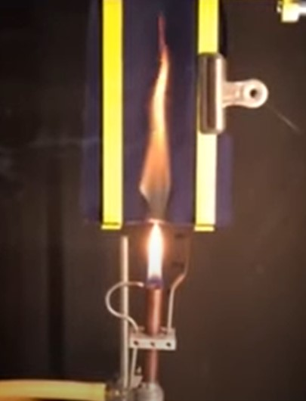
Back to arc protective PPE
Generally arc protective PPE are made from Fire Retardant (FR) materials
To be RF textile material mast pass vertical flame test ( ASTM D6413)
By Benchmark FR
Notes:
Now, after we learn how to protect ourselves from electric arc using knowledge of arc types and behavior, we will look at what additional help we can get.
These are most commonly used PPE. Arc protective materials are made from Fire Retardant (FR) materials. FR textiles must pass a vertical flame test (found in ASTM D6413)

Slide 71
Arc protective PPE
Meltable and ignitable materials are prohibited:
Meltable fabrics:
Acetate,
Nylon and spandex,
Polyester and polypropylene, even in blend
Ignitable fabrics:
Untreated Cotton
When these fibers melt, they can adhere to the skin, thereby transferring heat rapidly, exacerbating burns, and complicating treatment.
Notes:
Not all materials are allowed for arc rated PPE manufacturing.
Meltable and ignitable materials are prohibited.

Slide 72
Electric arc protection - barrier
Arc protective workwear (ASTM F1506) – single and multilayer shirts, pants, coveralls, jackets, bibs, undergarments, etc.
Face protection (ASTM F2178) – faceshields with and without balaclavas, single and multilayer hoods, balaclava – goggle systems
Arc protective rainwear (ASTM 1891) – jackets, pants, overcoats
Hand protection (ASTM F2675) – arc rated work gloves
Arc blanket (ASTM 2676)
Notes:
ASTM standards exist for each type of electric arc protection barrier. For example, arc protective rainwear: jackets, pants and overcoats are covered in ASTM 1891.

Slide 73
Electric arc protection – distance
Remote raking devises
Remote switching
Arc shield attached on live line tools or on racking rods (ASTM F2522 test method)
Meter pulling devices (ASTM test method in development)
Notes:
How to use safe distance to protect from electric arc.
Remote raking devises
Remote switching
Arc shield attached on live line tools or on racking rods (ASTM F2522 test method)
Meter pulling devices (ASTM test method in development)

Slide 74
Other electric arc tested PPE
Arc tested fall protection (ASTM F887)
Harnesses
Fall arresting lanyards
Positioning devises
Notes:
This slide shows arc tested fall protection requirements described in ASTM F887, Standard Specifications for Personal Climbing Equipment.

Slide 75
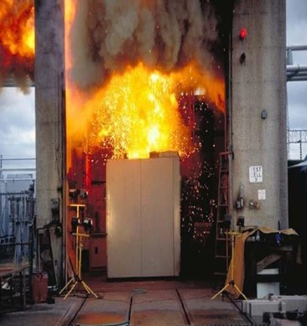
Safety by design
Channeling arc products away from possible worker location in front of cubicle (photo right)
Light sensitive instantaneous trip protection
IEEE standard in development- IEEE P1814 “Recommended Practice for Electrical System Design Techniques to Improve Electrical Safety”
Notes:
Safety by design falls into “engineering controls” of the safe work hierarchy of controls. For example, light sensitive instantaneous trip protection and other examples currently being developed in IEEE Standard P1814.

Slide 76
Arc testing is destructive testing
Video: Arc test
https://www.youtube.com/watch?v=m_0yN0jz2F0&feature=youtu.be
OR
https://ucmo.hosted.panopto.com/Panopto/Pages/Viewer.aspx?id=4d62204a-f3c6-4d7d-9774-ac2401451e89
A destructive testing
No arc testing is used in production or for finished goods
Only type and certification testing
Most arc PPEs, including workwear, face protection, hand protection, fall protection:
Tested only with open air arc
Standard test parameters: 8 kA test current, 12-inch distance to arcing electrodes
Notes:
Arc testing is a destructive testing method. Tested specimens are not reusable. Arc testing is used as a development, certification, or incident replication tool.
No production arc testing
Most arc protective PPE, including workwear, face protection, hand protection, and fall protection are:
Tested only with open air arc; and
Tested using standard test parameters: 8 kA test current, and 12-inch distance to arcing electrodes.

Slide 77

Arc testing
Arc blanket:
Tested using ejected arc
Standard test parameters are 5 kA, 10 kA, 15 kA, 25 kA, and 40 kA.
Blankets:
Tested at three current levels depending on rating
Notes:
Ejected arc is also used for arc blanket testing
Arc blanket is tested using ejected arc with standard test parameters: 5 kA, 10 kA, 15 kA, 25 kA, and 40 kA.
Arc suppression blankets are tested at three current levels depending on blanket’s rating.

Slide 78
Conclusions: principals of protection
Electric shock and electric arc PPEs and live line tools provide protection in three different ways:
Creating a barrier between the hazard and worker’s body
Providing extra distance between the hazard and worker’s body
Creating safe work condition deenergizing , locking power source, and grounding
Notes:
These are takeaways from Module 2 of the training course.
Electric shock and electric arc PPE and live line tools provide protection in three different ways:
Creating a barrier between the hazard and worker’s body;
Providing extra distance between the hazard and worker’s body; and
Creating safe work condition deenergizing , locking power source, and grounding

Slide 79
Conclusions: electric shock PPE
Integrity and good condition of shock and arc PPE is a key for survival when working energized line and equipment.
Shock protection PPE must be inspected before each use (gloves and sleeves) or often.
Shock protection PPE must pass factory and in-service periodical HV proof tests (non-destructive).
Notes:
Integrity and good condition of shock and arc PPE is a key for survival when working energized line and equipment. Shock protection gloves and sleeves must be inspected before each use by wearer. Shock protection PPE must pass factory and in-service periodical HV proof tests (non-destructive).

Slide 80
Conclusions: electric arc PPE
Knowledge of electric arc types and understanding basic physics of arc behavior are critical, and help to:
Foresee direction of energy release and select proper position to avoid in its path.
Be vigilant but not be scared (by unsubstantiated myths and rumors).
Understand rules but not following them blindly.
Arc rated PPEs are not arc tested at factory or in-service, because arc test is a destructive test.
Following manufacturer’s care instruction is a key to maintain arc protective properties and not lose FR properties.
Notes:
Knowledge of electric arc types and understanding basic physics of arc behavior are critical, and help to:
Foresee direction of energy release and select proper position to avoid in its path.
Be vigilant but not be scared (by unsubstantiated myths and rumors).
Understand rules but not following them blindly.
Arc rated PPEs are not arc tested at factory or in-service, because arc test is a destructive test. Following manufacturer’s care instruction is a key to maintain arc protective properties and not lose FR properties.
In Modules 1 and 2 we learned electrical hazards, their properties, behaviors, and how to protect yourself from electric hazards. Knowledge of electric arc types is crucial for survival should electric arc happened. PPE and their use have also been discussed. In Module 3 we will discuss regulations and standards on how to maintain safe work conditions.

Slide 81
Post-training Quiz
1. Does arc rated clothing also protect against electric shock?
a) yes b) no
2. Do rubber gloves with leather protector protect against electric arc hazards?
a) yes b) no
3. Shock protection PPE must pass:
a) factory high voltage proof test
b) in-service periodical high voltage proof test
c) none of the above d) all the above
4. Arc protective PPE must pass:
a) factory arc proof test
b) in-service periodical arc proof test
c) none of the above d) all the above
5. Can electric arc generate “pressure wave”?
a) yes b) no
Notes:
Now we would like to take another quiz. Please circle just one choice as your best answer to each question.
Answers and questions:
1: Does arc rated clothing also protect against electric shock? No: b)
2: Do rubber gloves with leather protector protect against electric arc hazards? Yes: a)
3: Shock protection PPE must pass factory arc proof test, and in-service periodic arc proof test: All of the above: d)
4: Arc protective PPE must pass: None of the above because arc protective test is destructive: c)
5: Can electric arc always generate “pressure wave”? No: b

Slide 82
Questions?
Notes:
Any questions?

