Slide 1
Recognizing and Controlling Hazards From Exposed Environments
Module # 7

Slide 2
Disclaimer
This material was produced under grant number SH-05144-SH9 from the Occupational Safety and Health Administration, U.S. Department of Labor. It does not necessarily reflect the views or policies of the U.S. Department of Labor, nor does mention of trade names, commercial products, or organizations imply endorsement by the U.S. Government.

Slide 3
Learning Objectives
Recognizing and controlling hazards from exposed environments, in wind tower construction, maintenance and demolition:
Explain the factors that affect thermal balance.
Recognize the signs of heat stress.
Recognize the signs of cold stress.
Recognize other potential hazards in exposed environments.
Identify best practices while working externally.
Identify obstacles to safe practices at a worksite.

Slide 4
Thermal Balance
Definition:
Thermal balance is the state of equilibrium in which the sum heat flowing in and out of a system equals zero.
This implies an equal rate of gain and loss of heat by the system.
Involves mathematical determination and comparison of heat flow within a system.
Thermal balance is achieved when body heat from metabolism dissipates and is in thermal equilibrium with the surroundings.
Notes:
The human body is a system that:
Generates heat through metabolism, using food as the fuel.
Dissipates excess heat into the environment to maintain optimum temperature.
Loses more heat than required in cold environments.
The body does not exert enough heat, in hot environment.
Extreme scenarios of cold and hot are not undesirable.

Slide 5
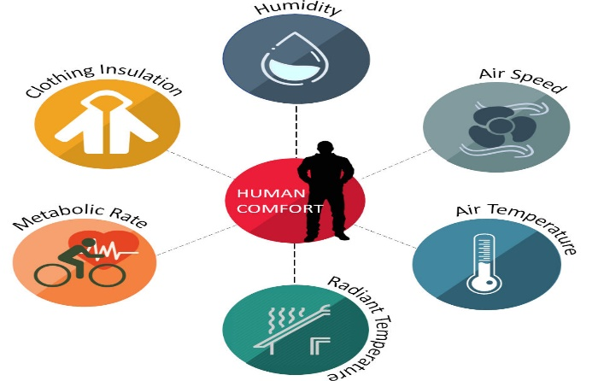
Factors that Affect Thermal Balance
Personal factors:
Metabolic rate
Clothing insulation
Environmental factors:
Air temperature
Air speed
Mean radiant temperature
Relative humidity
Notes:
Image source:
Praveen Kumar via https://www.simulationhub.com/blog/role-of-cfd-in-evaluating-occupant-thermal-comfort
Image source:https://www.hse.gov.uk/temperature/thermal/factors.htm

Slide 6
Metabolic Rate
According to the American Society of Heating, Refrigerating and Air-Conditioning Engineers (ASHRAE) 55-2010 standard, metabolic rate is the level of transformation of chemical energy into heat and mechanical work by metabolic activities within an organism.
Usually expressed in terms of unit area of the total body surface.
Differs from person to person.
Is influenced by the physical, eating and drinking habits of a person.
Notes:
Another factor that affect thermal balance is the body shape of the individual. This is because the rate of dissipation of heat depends on the surface area of the body.
Ask: Which body shape dissipate heat easily, a tall or short person?
Answer: A tall and skinny person has a larger surface-to-volume ratio than a short and rounded-shaped person, and can, therefore, dissipate heat more easily and tolerate higher temperatures than the latter.

Slide 7
Clothing Insulation
Definition:
Is the thermal insulation provided by the clothing worn by a person
The amount of clothing layers worn has a significant impact on thermal balance.
Multiple layers can prevent heat loss, and either keeps a person warm or causes overheating and heat stress.
Inadequate amount of clothing layers can result in cold stress.
Air speed and relative humidity may reduce insulation.
Notes:
Other physical characteristics of a person such as age, weight, fitness level and sex can influence the thermal balance of an individual.

Slide 8
Air Temperature, Air Speed, Mean Radiant Temperature
Air temperature: Is the temperature of the air surrounding an individual.
Air speed: The speed of air moving around a person at a specific time and location, irrespective of direction.
It can help cool a person in a warm environment, through heat loss by convection.
Mean radiant temperature: The amount of radiant heat transferred from the surface of a warm object.
Depends on ability of material to absorb or emit heat.
Has more influence on heat gain or loss compared with air temperature.

Slide 9
Relative Humidity
Definition:
The ratio of the actual amount of water vapor in the air to the maximum amount of water vapor that the air can hold at a specific air temperature and pressure.
Sweating helps the body loose heat through evaporation from the skin.
In high relative humidity, there is reduced heat loss through sweating due to maximum water vapor in air.
Humidity within vapor-impermeable PPE will be higher than that of the environment.

Slide 10
Recognize the Signs of Heat Stress
Wind energy workers:
Perform work tasks in exposed environment.
Are sometimes exposed to extreme heat
Work in hot and humid environments
Are potentially at risk of heat stress.
Heat stress is a hazard which can result in injuries and occupational illnesses.
Notes:
Prevention of heat stress is important in workers. They should be trained on the concept, effects and preventive measures.

Slide 11
Effects of Heat Stress
Headache
Heat exhaustion
Heat stroke
Heat cramps
Heat rashes
Sunburns
Fatigue
Notes:
The following groups of workers have greater risk of heat stress than others:
Workers who are 65 years or older
Workers who are overweight,
Persons with heart diseases
Those who have high blood pressure
People who are on medication that may be affected by extreme heat.

Slide 12
Signs of Heat Exhaustion (1)
Fatigue
Cold, pale, and clammy skin
Headache
Fainting
Irritability
Notes:
Ask: What should you do if you observe these signs and symptoms?
Answer:
Move to a cool place
Loosen your clothes
Put on cool or wet clothes
Seek medical help immediately if:
There is vomiting
Symptoms get worse,
Symptoms persists beyond an hour.
Source:
https://www.osha.gov/SLTC/heatstress/heatrelated_illness_firstaid.html

Slide 13
Signs of Heat Exhaustion (2)
Thirst
Nausea or vomiting
Dizziness or lightheadedness
Heavy sweating
Elevated body temperature or fast heart rate
Notes:
Ask: What should you do if you observe these signs and symptoms?
Answer:
Move to a cool place
Loosen your clothes
Put on cool or wet clothes
Seek medical help immediately if:
There is vomiting
Symptoms get worse,
Symptoms persists beyond an hour.
Source:
https://www.osha.gov/SLTC/heatstress/heatrelated_illness_firstaid.html

Slide 14
Signs of Heat Stroke (1)
Confusion
Headache
Dizziness
Slurred speech
Unconsciousness
Notes:
In case of a medical emergency:
Call 911 immediately
Move the person to a cooler place
Use wet cloths or a cool bath to lower the body temperature
Source:
https://www.osha.gov/SLTC/heatstress/heatrelated_illness_firstaid.html

Slide 15
Signs of Heat Stroke (2)
Seizures
Heavy sweating, hot, red, damp or dry skin.
High body temperature (103ºF or higher)
Rapid heart rate
Notes:
In case of a medical emergency:
Call 911 immediately
Move the person to a cooler place
Use wet cloths or a cool bath to lower the body temperature
Source:
https://www.osha.gov/SLTC/heatstress/heatrelated_illness_firstaid.html

Slide 16
Signs of Heat Cramps & Heat Rash
Heat cramps
Muscle spasms or pain
Usually in legs, arms, or trunk
Heat rash
Clusters of red bumps on skin
Often on neck, upper chest, and skin folds
Notes:
Ask: What is the first aid for these heat related illnesses?
Answer: For heat cramps:
Stop physical activity
Move to a cool place.
Drink water or sport drink
Wait for the cramps to subside
Get medical help immediately if:
Cramps last more than 1 hour
Individual is on a low sodium diet
Individual has a heart disease.
For heat rash:
Stay in a cool and dry place
Keep the rash dry
Apply medicated powder to soothe rash.

Slide 17
Signs of Heat Syncope & Rhabdomyolysis
Heat syncope
Fainting
Dizziness
Rhabdomyolysis (muscle breakdown)
Muscle pain
Dark or reduced urine
Fatigue

Slide 18
First Aid for Heat-related Illnesses
Move the affected person to a ventilated area.
Reduce body temperature with a cold water or an ice bath.
Remove protective clothing
Place wet towels on the head, neck etc.
Ensure uninterrupted circulation of air.
Provide adequate care and attention
Call 911 immediately if symptoms of heat stroke are observed.
Notes:
Some workers are at a higher risk of heat-related illness than others. They include:
Workers who are 65 years old and above
Workers without prior experience in warm working environments.

Slide 19
Cold Stress
With increased wind speed and low temperatures, there is usually rapid heat loss.
Extreme cold environment can cause health emergencies in outdoor workers.
Cold stress occurs when there is a reduction in body temperature below normal
This situation can result in critical health issues including tissue damage and death.

Slide 20
Contributory Factors
Long exposure to extreme cold
Inappropriate dressing for the weather
Wetness
Exhaustion
Poor physical condition
Health conditions such as hypertension, hypothyroidism, and diabetes.
11
Notes:
https://www.osha.gov/SLTC/emergencypreparedness/guides/cold.html

Slide 21
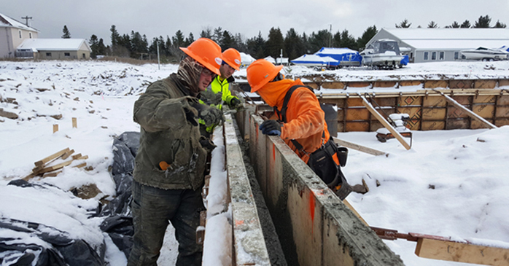
Illnesses From Cold Stress
Common illnesses from cold stress include:
Hypothermia
Frostbite
Trench Foot
Chilblains
Source: LHSFNA

Slide 22
Recognize the Signs of Cold Stress: Hypothermia
Hypothermia, which is an abnormally low body temperature, affects the brain and thought process of an individual.
Early Symptoms:
Shivering
Fatigue
Loss of coordination
Confusion and disorientation
Late Symptoms:
Blue skin
Dilated pupils
Slowed pulse and breathing
Loss of consciousness
Notes:
https://www.cdc.gov/niosh/topics/coldstress/coldrelatedillnesses.html

Slide 23
Treatment of Hypothermia
First aid:
Inform the supervisor immediately
Relocate affected individual to warm environment.
Take off wet clothes.
Give sweetened warm beverages to help increase body temperature.
Keep dry and cover with warm blanket.
Seek medical help.
If victim has no pulse:
Call 911 for emergency medical assistance,
Perform rescue breathing for 3 minutes
Administer cardiopulmonary resuscitation (CPR)

Slide 24
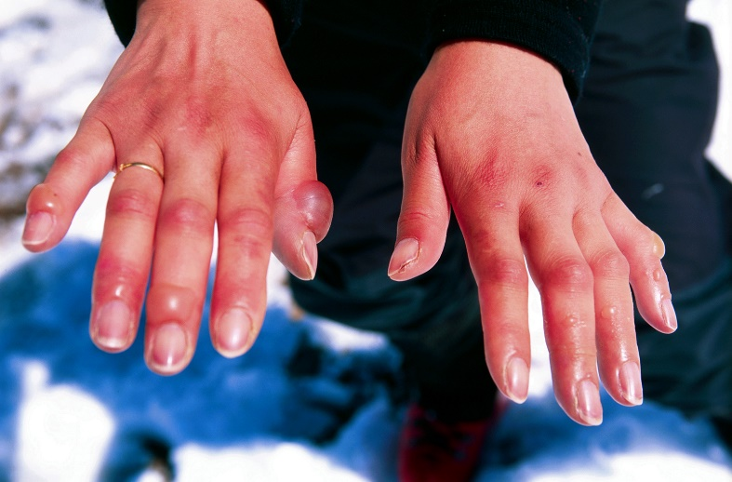
Recognize the Signs of Cold Stress: Frostbite
Frostbite involves:
freezing of certain parts of the body especially fingers and toes
Reduced blood flow to hands and feet
Symptoms:
Numbness of affected parts.
Tingling or stinging
Aching
Bluish or pail, waxy skin
Reddened skin.
Body parts feel firm.
Blisters may occur in affected parts.
Source: Britanica

Slide 25
Treatment of Frostbite
First aid for frostbite:
Get into a warm room.
Avoid walking on frostbitten feet or toes.
Immerse the affected area in warm water
Warm the affected area with heat from the body
Do not rub or massage the frostbitten area
Do not use a heating devices to warm body parts.

Slide 26
Recognize the Signs of Cold Stress: Trench Foot
Symptoms:
Reddening of skin
Numbness
Leg cramps
Swelling
Tingling pain
Blisters or ulcers
Bleeding under skin
Gangrene (Foot may turn dark purple, blue, or gray)
Notes:
https://www.cdc.gov/niosh/topics/coldstress/coldrelatedillnesses.html
https://www.osha.gov/SLTC/emergencypreparedness/guides/cold.html

Slide 27
Treatment of Trench Foot
First aid for trench foot:
Call 911 immediately in an emergency
Remove shoes/boots and wet socks.
Dry feet.
Avoid walking on feet as this may cause tissue damage.

Slide 28
Recognize the Signs of Cold Stress: Chilblains
Symptoms:
Redness
Itching
Possible blistering
Inflammation
Possible ulceration in severe cases

Slide 29
Treatment of Chilblains
First aid for chilblains:
Avoid scratching
Slowly warm the skin
Use corticosteroid creams to relieve itching and swelling
Keep blisters and ulcers clean and covered

Slide 30
Other Hazards
Sun exposure hazards:
UV radiation can cause skin cancer
Sunburns
Hazardous noise leading to hearing loss
Contact with poisonous plants hazards
Exposure to venomous spider and snake bites
Risk of stinging insects or scorpions
Exposure to mosquito-borne diseases
Risk of tick-borne diseases
Risk of Lyme disease
Lightning.

Slide 31
Best Practices in Exposed Environments (1)
Schedule work on cooler days to avoid heat stress.
Establish a buddy system and train them to watch out for first symptoms of heat stress.
Encourage workers to drink water at least every 20 minutes.
Workers should take regular breaks to cool off in airconditioned site office.
Reduce energy requirements of the job.

Slide 32
Best Practices in Exposed Environments (2)
Assign an adequate amount of workers to each task.
Develop a program to acclimatize workers to heat and increase their physical fitness.
Train supervisors and workers on heat and cold stresses and other outdoor work hazards.
Apply sunscreen products with an SPF of at least 15.
Utilize UV-protective sunglasses for protection against UVA and UVB light.

Slide 33
Best Practices in Exposed Environments (3)
Train workers to recognize symptoms of cold stress.
Create buddy system among workers
Encourage them to monitor their physical condition and coworkers.
Ensure workers dress properly for the cold.
Stay dry in the cold. Moisture or dampness can increase the rate of heat loss from the body.

Slide 34
Best Practices in Exposed Environments (4)
Keep extra clothing handy.
Drink warm sweetened beverages to keep warm
Use proper engineering controls, safe work practices, and personal protective equipment (PPE)
Encourage workers to take short breaks when in discomfort.
Assign tasks according to outdoor work experience of workers.

Slide 35
Best Practices in Exposed Environments (5)
CDC recommends to shorten work tasks and increase rest periods when:
Temperature, humidity, and sunshine increase.
There is limited air flow in work area.
Protective clothing or equipment is worn.
Heavy-duty tasks are performed

Slide 36
Best Practices in Exposed Environments (6)
Supervisors should be trained on:
Weather acclimatization program.
Response procedure for signs of heat or cold-related illness.
Monitoring and using weather reports.
Response during extreme weather events.
Worker hydration and intermittent breaks.

Slide 37

Major Hazards
Heat stress:
Heat exhaustion
Heat stroke
Cold stress:
Hypothermia
Frostbite
Trench Foot
Source: ASSP
Notes:
Ask: What are the major hazards you may be exposed to in outdoor environments?
Recognize hazards learned in this module. Take necessary precaution to be safe on the job.

Slide 38
Control Measures
Perform work on cooler days to avoid heat stress.
Train supervisors and workers on heat, cold stresses and other outdoor work hazards.
Encourage workers to take short breaks in heat or cold discomfort
Stay hydrated

Slide 39

Review & Questions
Name three important things you learned in this section.

