Slide 1
Wind Energy:
The OSHA Requirements
Module # 6

Slide 2
Disclaimer
This material was produced under grant number SH-05144-SH9 from the Occupational Safety and Health Administration, U.S. Department of Labor. It does not necessarily reflect the views or policies of the U.S. Department of Labor, nor does mention of trade names, commercial products, or organizations imply endorsement by the U.S. Government.

Slide 3
Learning Objective
Identify hazards associated with wind energy industry
Learn how workers are exposed to such hazards and to protect them from it.
Enumerate Recommendation for safe working on wind farms and related OSHA standards to be followed
Notes:
Wind Energy is a growing industry, the hazards are not unique. OSHA has many standards that cover them.
Wind Energy workers are exposed to hazards that can result in fatalities and serious injuries. Many incidents involving falls, severe burns from electrical shocks and arc flashes, and crushing injuries have been reported to OSHA.
This module provides information about some of the hazards that workers in the wind energy industry may face.

Slide 4
Scope and Application
Wind Energy industry is growing
OSHA standards cover most hazards
Workers are exposed to hazards that can result in fatalities and serious injuries.
Hazards reported to OSHA include falls, severe burns, electrical shock and arc flashes.
Notes:
Wind Energy is a growing industry, the hazards are not unique. OSHA has many standards that cover them.
Wind Energy workers are exposed to hazards that can result in fatalities and serious injuries. Many incidents involving falls, severe burns from electrical shocks and arc flashes, and crushing injuries have been reported to OSHA.
This module provides information about some of the hazards that workers in the wind energy industry may face.

Slide 5
Crane, Derrick and Hoist Safety (1)
Cranes, derricks, and hoists are used to move heavy equipment during wind turbine installation and maintenance.
Fatalities and serious injuries can occur if cranes are not used or inspected properly.
Fatalities may occur when crane boom or load strikes a powerline
Other hazards include struck-by or caught-between swing radius of crane
Failure to assemble or disassemble the crane properly may be hazardous

Slide 6
Crane, Derrick and Hoist Safety (2)
Relevant OSHA standards addressing safety issues include:
The General Industry standard
  29 CFR 1910.179: Overhead and gantry cranes
  29 CFR 1910.180: Crawler locomotive and truck cranes
The Construction Industry standard
  29 CFR 1926.1417

Slide 7

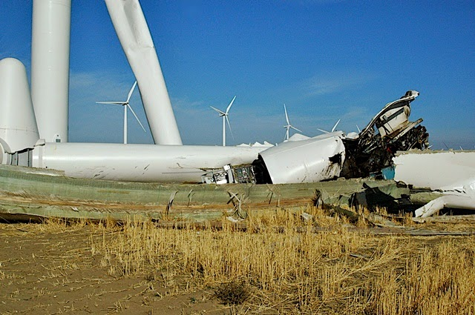

Crane, Derrick and Hoist Safety (3)
  Crane to close to powerline
  Wind speed must be considered during turbine installation
Case study: https://www.smart-energy.com/renewable-energy/fifth-ge-wind-turbine-collapse-in-2019-leaves-worker-injured/

Slide 8
Recommendations for working with crane, derrick, and hoist (1)
Cranes should be operated by qualified and trained personnel.
A designated competent person must inspect crane and controls before use.
Crane should be placed on stable and level surface.
Avoid unlocking or removing pins without secure sections during (dis)assembly

Slide 9
Recommendations for working with crane, derrick, and hoist (2)
Extend outriggers and accessible areas in swing radius of crane.
Watch out for overhead electric powerlines
Maintain at least 10-foot safe working clearance from powerlines.
Inspect rigging prior to use
Do not wrap hoist lines around load.
Do not move loads over workers.

Slide 10
Recommendations for working with crane, derrick, and hoist (3)
Utilize correct load chart for configuration, setup, load weight and lift path of crane.
Do not exceed load chart capacity while making lifts.
Raise load a few inches. Hold, verify capacity/balance, test brake system before delivering load.
Follow signals and manufacturer instructions while operating crane.

Slide 11
Other Factors to Consider (1)
Wind Turbines are installed in windy areas
Consider effect of wind speeds during lifting activities
Employer should determine maximum safe wind speed for lifting operations
Load charts do not generally consider take wind speeds
Post maximum allowable wind speed and derating information conspicuously in cab or on load chart
See 29 CFR 1926.1417(c) OSHA standard
Notes:
See 29 CFR 1926.1417(c) [PDF].
The maximum allowable wind speed and derating information need to be posted conspicuously in the cab or on the load chart
https://www.osha.gov/dep/greenjobs/windenergy_crane.html

Slide 12
Other Factors to Consider (2)
Extreme weather such as rain, snow or fog conditions can adversely impact crane and lifting operations.
Consider crane hydraulics and possible derating of crane at temperatures below 10º F
Adjust equipment and/or operations to address effect of wind, ice, and snow on equipment stability and rated capacity.
See 29 CFR 1926.1417(n) of the OSHA standard
Danger! A crane boom can become a lightning rod during thunderstorms

Slide 13
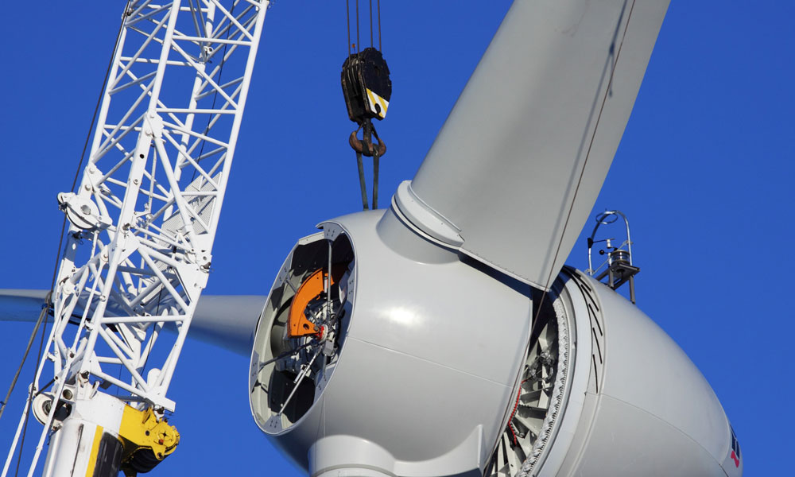

Other Factors to Consider (3)
  Crane too close to turbine
  Extreme weather like rain and fog impact crane operations

Slide 14
Electrical Hazards
Workers in wind farms are exposed to arc flashes and electric shock hazards
Tools and equipment used can contact powerlines
Workers must stay at least 10 feet away from powerlines.
  OSHA 29 CFR 1926, subpart cc
    1926.1408: power line safety (up to 350kV)
Wind farm employers are covered by Electric power generation, transmission, and distribution standards.
Employers are required to implement safe work practices and worker training requirements
OSHA's Electric Power Generation, Transmission and Distribution standard, 29 CFR 1910.269 is applicable.

Slide 15
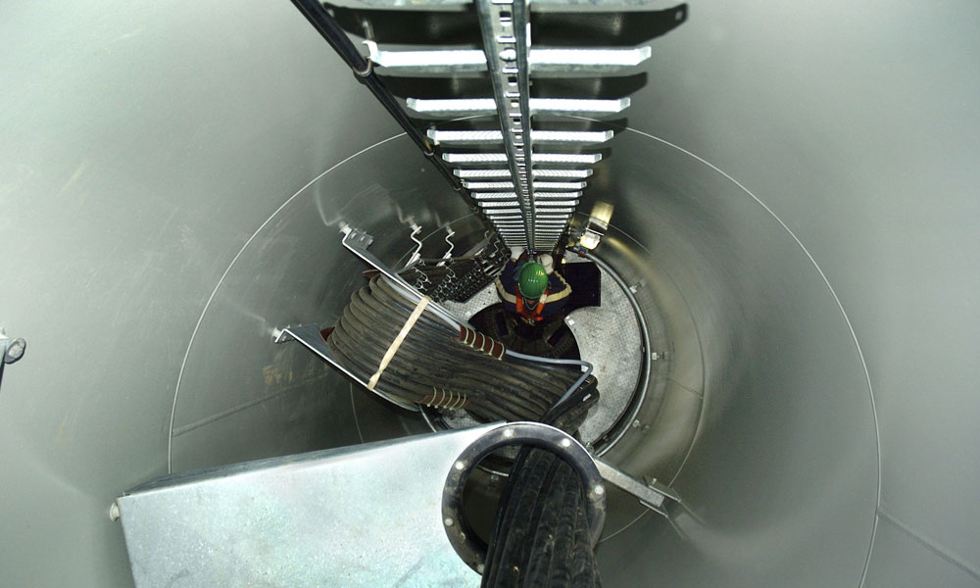
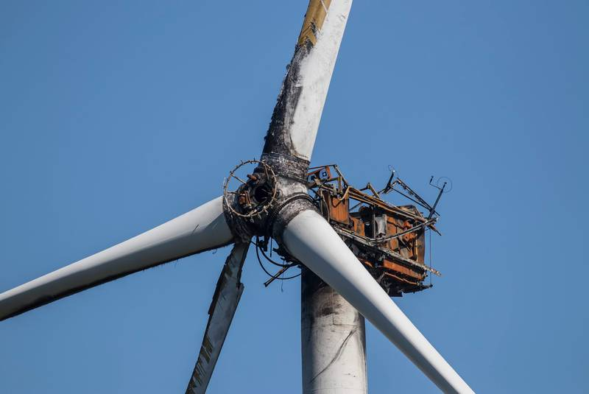
Electrical Hazards (2)
  Electrical components in confined space
  Electrical hazard on wind farms

Slide 16
Fall Hazards (1)
Workers who erect and maintain wind turbines are exposed to fall hazards.
Some wind turbines are over 100 feet tall
Exposure to high winds pose threat to workers at high elevations
Fall protection requirements by OSHA differ for construction / installation and maintenance

Slide 17
Fall Hazards (2)
Construction workers exposed to fall distances of over 6 feet must be protected from falls
Construction industry standard 29 CFR 1926.500 for Fall Protection by OSHA must be followed
Maintenance workers exposed to fall distances of over 4 feet must be protected from falls
OSHA General industry standard 29 CFR 1910.28 for Fall Protection by OSHA must be followed
Maintenance workers that utilize fixed ladders exceeding 20 feet in length must follow 29 CFR 1910.23
Standards require duty to have protection from fall and falling objects

Slide 18
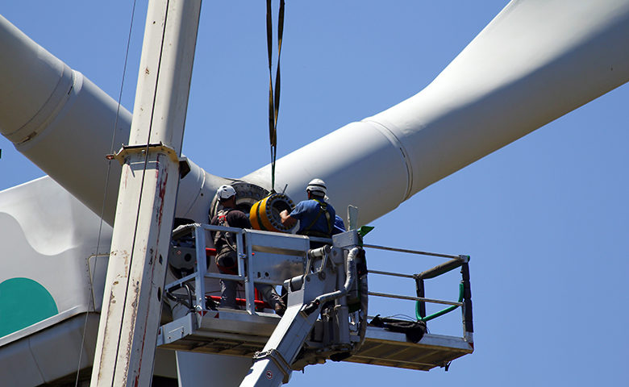
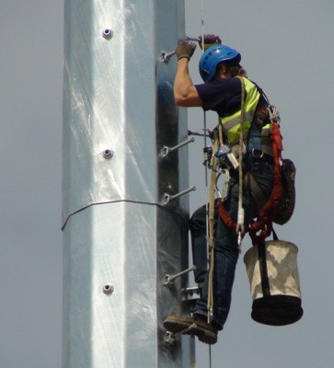
Fall Hazards (3)
  Exposure to fall hazards
  Fall protection standards provided by OSHA must be followed

Slide 19
Fire Hazards (1)
Electrical parts of wind turbines create fire hazards
Construction and insulation materials in Nacelle are combustible.
Workers should be trained about fire hazards and emergency responses:
General principles of fire extinguisher use
Hazards involved with incipient stage of fire fighting
Toxic gases and oxygen deficiency
Notes:
OSHA’s Fire Safety page should be consulted for additional information on fire hazards.
Fire Safety Advisor is available as an additional resource in mitigating fire hazards associated with Wind Turbines.

Slide 20
Fire Hazards (2)
Create plan that outlines role of key personnel during fire event
Provide evacuation plan for workers on wind turbines.
Install fire detection and emergency alarm systems in nacelle for early warning and escape
Maintain systems in operable condition. See OSHA standards 1910.160(c) and 1910.165(d).
Notes:
Workers should know what to do and how to escape in a fire emergency.
Wind turbines should be provided with quick escape descent devices for workers to escape in the event of a fire or other emergency.
OSHA’s Fire Safety page should be consulted for additional information on fire hazards.
Fire Safety Advisor is available as an additional resource in mitigating fire hazards associated with Wind Turbines.

Slide 21
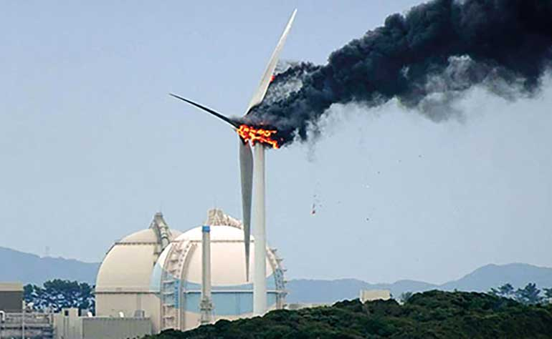
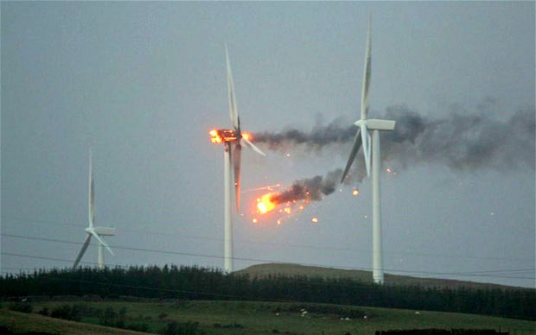
Fire Hazards (3)
Electrical parts of wind turbines can be source of fire hazard
Materials in Nacelle are combustible

Slide 22
Lockout/Tagout (1)
Lockout/Tagout (LOTO) refers to specific practices and procedures to safeguard employees
Performed during servicing or maintenance
Workers are protected from:
  Unexpected energization machinery
  Release of hazardous energy.
Only authorized employees may lockout or tagout machines or equipment.
    See OSHA 29 CFR 1910, Subpart R 1910.269(d), Hazardous energy control (lockout/tagout) procedures
Notes:
https://www.osha.gov/dep/greenjobs/windenergy_loto.html

Slide 23
Lockout/Tagout (2)
Authorized employees should lock/tag out isolating devices in safe or off position
Safely discharge stored or residual
Verify equipment is isolated from energy source prior to operation.
Maintain lock and tag on the machine until work is completed.
See OSHA 29 CFR 1910, Subpart J 1910.147, The control of hazardous energy (lockout/tagout)

Slide 24
Lockout/Tagout (3)
Lockout/Tagout must be done solely to isolate energy from equipment.
Must identify name of worker applying device.
Same authorized employee is responsible for both placement and removal of lock/tag
Follow procedure outlined in Lockout/Tagout standard by OSHA.

Slide 25
Machine Guarding (1)
Wind turbine production involves numerous parts including gears and blades
Production usually involves machines of various configurations
Workers may be exposed to hazards of moving parts of machines if adequately protected
Unguarded moving parts of turbine may cause severe workplace injuries
Injuries include crushed fingers or hands, amputations, burns, or blindness.

Slide 26
Machine Guarding (2)
Employers must protect workers from machine hazards
Rotating parts of machines must be properly guarded prior to use
Employers must comply with OSHA standard 1926 Subpart I – Tools: Hand and Power.

Slide 27
Respiratory Protection (1)
Construction and maintenance of turbine blades involve buffing and resurfacing operations
May expose workers to harmful gases, vapors and dusts.
Workers must be protected from inhalation hazards with appropriate respirators and ventilation
Effective respiratory protection depends on the following:
  using correct type of respirator
  Knowledge of operation by workers
  Storage in good working condition based on manufacturer's recommendations

Slide 28
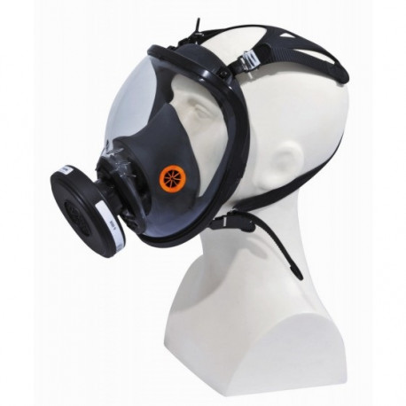
Respiratory Protection (2)
  An effective respirator program must cover the following factors:
    Written worksite specific procedures
    Air quality standard
    Medical evaluation
    Training
    Fit testing
    See OSHA 29 CFR 1910, Subpart I – Personal Protective Equipment
    1910.134, respiratory protection

Slide 29
Respiratory Protection (2) continued
  An effective respirator program must cover the following factors:
    Selection of appropriate respirator approved by the National Institute for Occupational Safety and Health (NIOSH)
    Inspection, cleaning, maintenance, and storage
    Work area surveillance
    Program evaluation
    See Also OSHA 29 CFR 1926, Subpart E – Personal Protective and life saving Equipment
    1926.103, respiratory protection

Slide 30
Respiratory Protection (3)
  Training must include an explanation of the following:
    Why respirator use is necessary
    Nature of respiratory hazard
    Consequences of incorrect fitting and inadequate maintenance
    Reasons for selection of respirator type
    Capabilities and limitations of selected respirator

Slide 31
Respiratory Protection (3) continued
    Operation and inspection of respirator
    Respirator maintenance and storage requirements
    Effective respirator use in emergency situations
    Fixing malfunctioning respirator
    Recognition of medical signs and symptoms against effective use of respirator

Slide 32

Review & Questions
Name three important things you learned in this section.

