Slide 1
Recognizing and Controlling Hazards From Working at Height
Module # 3

Slide 2
Disclaimer
This material was produced under grant number SH-05144-SH9 from the Occupational Safety and Health Administration, U.S. Department of Labor. It does not necessarily reflect the views or policies of the U.S. Department of Labor, nor does mention of trade names, commercial products, or organizations imply endorsement by the U.S. Government.

Slide 3
Learning Objectives
To recognize and control hazards from working at heights in wind tower construction, maintenance and demolition:
Analyze wind energy worksites for fall-related hazards.
Identify best practices and important controls for preventing falls.
Practice the proper use of fall protection gear.
Recognize and use OSHA standards related to falls and fall protection.

Slide 4
Working at Heights on Wind Energy Work Sites
Working at heights is a major hazard on wind energy work sites.
The work cycle, including the erection of the tower, the placement of the rotor, commissioning and maintenance involve working at heights.
Many injuries and fatalities on these sites arise from falls from height.
Notes:
Working height refers to work circumstances above or below the ground, in which a worker could fall and sustain injuries if no precautions are taken.
It involves the use of ladders, ropes, mobile elevating work platform, etc. to gain access to work at a height.
The worker stands or sits on a platform or hangs in a suspension on ropes with harnesses and lanyards to perform the work.
Fall injury is a major hazard in this process. According to the Bureau of Labor Statistics (BLS), fatal work-related falls to a lower level increased 26 percent from 2011 (553 fatal falls) to 2016 (697 fatal falls), and a total of 3,723 fatal falls over the 6-year period.
Working at heights usually requires access to perform the task. Falls can result from:
Breaking of ropes
Slipping
Loss of balance
Damage of lanyards
Breakage of blade
Collapse of rotor or tower
Failure of fall arrest system
The following can be done to reduce the risk:
Train workers on safe ways to work at height
Inspect tower and rotor assembly, using a drone to ensure stability of the structure before work is carried out
Work should not be done during high winds
Inspect fall ropes and fall arrest system before every use
Avoid overloading ropes
According to regulations, workers on wind turbines/farms, who are exposed to fall distances of at least 6 feet, must be protected from falls using:
Guardrail Systems
Safety net Systems
Personal fall arrest systems
Working at heights is a usual phenomena throughout the lifecycle of a wind energy project.
It is particularly more frequent during the operation and maintenance phases.
The aim of managing work at height is to prevent injury from falls. This usually requires appropriate planning and scheduling of the works.

Slide 5
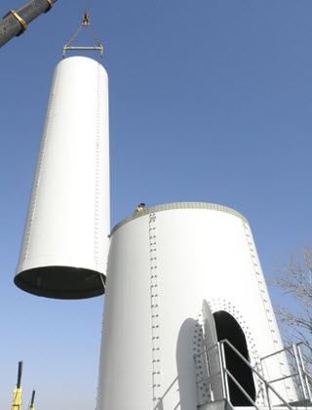
Example #1
Worker in first tower section ready to receive second section
Picture source: Northstar Wind
OSHA Fall Protection Options
Guardrail Systems
Safety net Systems
Personal fall arrest systems
Notes:
The worker in the tower section is at risk of being struck by the swinging section. Likewise, there exists a fall hazard.
OSHA has different fall protection requirements for construction (installation of towers) and general industry (maintenance).
Construction workers on wind turbines when exposed to fall distances of 6 feet or more must be protected from falls by using one of the following methods:
Guardrail Systems
Safety net Systems
Personal fall arrest systems
Maintenance work involving wind turbines is generally considered to fall under OSHA’s general industry standards. Such workers when exposed to fall hazards of 4 feet or more must be protected by a standard railing. If such a railing is not possible then the workers must be protected from falls using personal protective equipment such as a personal fall arrest system or a safety net.
Ask the participants to identify the hazards in this picture.

Slide 6
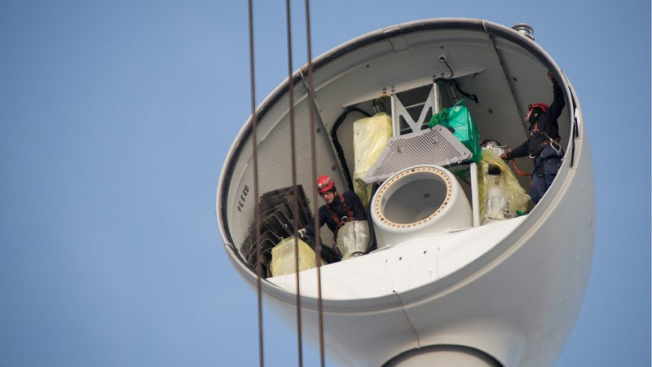
Example #2
Working at height during nacelle assembly
Workers within nacelle ready to receive other components.
OSHA crane standards: https://www.osha.gov/dep/greenjobs/windenergy_crane.html
Notes:
Ask: Identify the hazards on this slide. (Potential hazard: Fall from height, rigging, struck by)
Cranes are to be operated only by qualified and trained personnel.
A designated competent person must inspect the crane and all crane controls before use.
Be sure the crane is on a firm/stable surface and level.
During assembly/disassembly do not unlock or remove pins unless sections are blocked and secure (stable).
Fully extend outriggers and barricade accessible areas inside the crane’s swing radius.
Watch for overhead electric power lines and maintain at least a 10-foot safe working clearance from the lines.
Inspect all rigging prior to use; do not wrap hoist lines around the load.
Be sure to use the correct load chart for the crane’s current configuration and setup, the load weight and lift path.
Do not exceed the load chart capacity while making lifts.
Raise load a few inches, hold, verify capacity/balance, and test brake system before delivering load.
Do not move loads over workers.
Be sure to follow signals and manufacturer instructions while operating cranes.

Slide 7
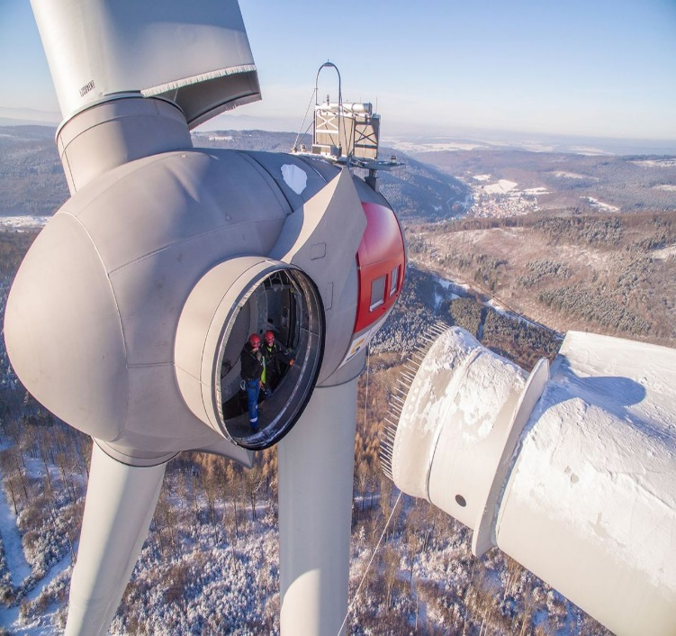
Example #3
Blade Installation
Workers inside hub to receive and attach blade
7
Notes:
This picture represents potential hazards for construction workers, such as struck by and fall from the height. OSHA identified standards for fall protection requirements and crane standard operations should be followed to minimize the risk of occupational accidents.

Slide 8
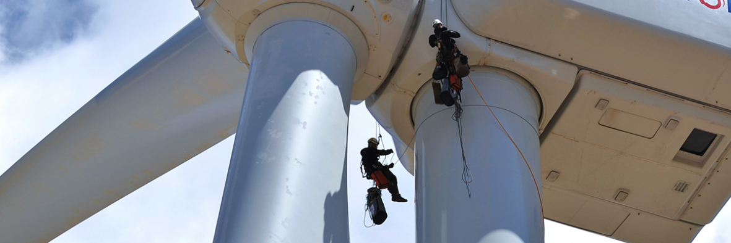
Example #4
Maintenance workers using rope access on turbine.
Notes:
Maintenance work involving wind turbines is generally considered to fall under OSHA’s general industry standards. Such workers when exposed to fall hazards of 4 feet or more must be protected by a standard railing. If such a railing is not possible then the workers must be protected from falls using personal protective equipment such as a personal fall arrest system or a safety net.

Slide 9
Fall Case Studies
Worker falls from wind turbine, critically injured http://ramar.worldnow.com/story/40333481/worker-falls-from-wind-turbine-critically-injured
Man hurt after falling from wind turbine in Pratt still hospitalized
https://www.kwch.com/content/news/One-person-injured-after-falling-from-wind-generator-near-Pratt-385371451.html
Worker Survives 126-Foot Fall From Wind Turbine in Kansas
https://ktla.com/news/nationworld/worker-survives-126-foot-fall-from-wind-turbine-in-kansas/
Video: Rescue Operation of Wind Turbine Worker Falling
https://www.youtube.com/watch?v=ayTtNre2-rY

Slide 10
Working at Heights on Wind Energy Work Sites
Access to heights is achieved by:
A ladder inside the tower
Mobile lifting equipment
Ropes with harness and lanyards
Use of personnel lifts

Slide 11
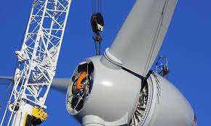
Existing Hazards
Fall from heights may result from:
Slipping
Tripping
Overreaching
Over balancing
Collapse of tower
Fatigue
Strong Winds
Notes:
Construction workers should be trained to be able to identify potential factors, listed in this slide, that contribute to fall hazards.

Slide 12
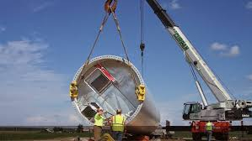
Existing Hazards (2)
Fall from heights may result from:
Collapse of mobile work platform
Collapse of crane
Failure of fall arrest system
Struck by swinging load
Struck by falling or flying object
Notes:
Construction workers should be trained to be able to identify potential factors, listed in this slide, that contribute to fall hazards.

Slide 13
Best Practices for Working at Heights
Best Practices for Working at Heights
Avoid work at height if possible. Execute as much assembly as can be achieved on ground before lifting in place.
Plan and organize all works at height.
Most tasks especially preventive maintenance should be scheduled during the summer.
Allow only competent workers to work at height.
Notes:
An OSHA "competent person" is defined as "one who is capable of identifying existing and predictable hazards in the surroundings or working conditions which are unsanitary, hazardous, or dangerous to employees, and who has authorization to take prompt corrective measures to eliminate them.

Slide 14
OSHA Standards (1)
OSHA Standards (1)
OSHA requires employers to:
Provide working conditions free of known dangers.
Keep work areas clean and organized.
Provide required personal protective equipment at no cost to workers. This includes safety harness and line, safety nets, stair railings and handrails.
Train workers about job hazards in a language they understand.
Notes:
OSHA
Construction Industry (29 CFR 1926)
1926.451, General requirements (Scaffolding) [related topic page]
1926.452, Additional requirements applicable to specific types of scaffolds
1926.454, Training requirements (Scaffolding)
1926.501, Duty to have fall protection
1926.502, Fall protection systems criteria and practices
1926.503, Training requirements (Fall protection)
1926.760, Steel erection (Fall protection)
1926.800, Underground construction
1926.1051, General requirements (Stairways and ladders)
1926.1052, Stairways
1926.1053, Ladders
1926.1060, Training requirements (Stairways and ladders)
1926.1423, Cranes and derricks in construction (Fall protection)
Most Frequently Cited Standards
1926.501(b)(13)
1926.501(b)(1)
1926.501(a)(1)
1926.501(b)(10)
1926.501(b)(11)
1926.501(b)(4)(i)

Slide 15
OSHA Standards (2)
OSHA Wind Energy Falls Standards require employers to provide fall protection at the following workplaces:
Four feet elevation for general industry
Six feet elevation for the construction industry.
Working over dangerous equipment and machinery, irrespective of the fall distance.
Notes:
OSHA Wind Energy: Falls - https://www.osha.gov/dep/greenjobs/windenergy_falls.html
ANSI+ASSP+Z359.7: https://webstore.ansi.org/preview-pages/ASSE/preview_ANSI+ASSP+Z359.7-2019.pdf

Slide 16
Important Controls for Preventing Falls (1)
Important Controls for Preventing Falls (1)
The following control measures should be put in place for the installation phase:
Place guardrails around the work area where the worker is exposed to fall hazards.
Deploy safety nets around the fall hazard area to intercept a fall incident.
Provide well fitted, full body personal fall arrest systems for every worker.
Use harnesses and PFAS designed for industrial climbing.
Use a double-legged personal 12-foot free fall energy-absorbing lanyard, as per ANSI Z359.13, for all work atop the tower.
Notes:
According to OSHA’s construction safety standards, workers on a construction site who are exposed to falls at 6 feet or more, are required to be provided fall protection in one of three ways:
1. Place guardrails around the hazard area.
2. Deploy safety nets.
3. Provide fall arrest systems.
https://www..com/news-events/wind-turbine-worker-safety-common-hazards-and-how-to-avoid-them/
Tradesmeninternational
ANSI Z359.13: https://www.assp.org/standards/standards-topics/fall-protection-and-fall-restraint-z359

Slide 17
Important Controls for Preventing Falls (2)
Use a twin-tail lanyard of a minimum of 6-foot free fall specification for other works.
Use anchorage capable of supporting at least 5,000 pounds for all PFAS.
Ensure that workers hands, gloves and shoes are free of slippery substances.
Train workers for proper use of PFAS.
Stay away from base of tower when work is ongoing.

Slide 18
Adverse Conditions
Adverse Conditions
The following adverse conditions should be considered in the work planning:
High wind events with increased safety risk, while workers are on top or around the turbine.
Risk of snow occurring during work activities.
Inadequate visibility due to fog.
Cold weather with increased risk of cold stress, frostbite and hypothermia.

Slide 19
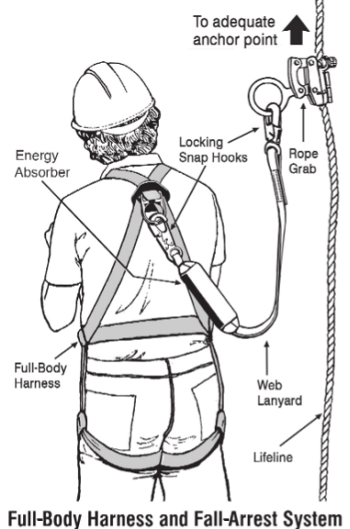
Proper Use of Fall Protection Gear

Slide 20
Rope Access / Positioning Technique
Rope access/positioning technique should be used under the following conditions:
Have at least two separately anchored ropes. One for means of access, egress and support, and the other for safety line.
The user should wear a full-body harness and be connected to both working and safety lines.
Working line should be equipped with safe means of ascent and descent. It should have a self-locking system to prevent the user from falling, in case the user loses balance or control.
The safety line should be equipped with a mobile fall protection system, connected to the user of the system.

Slide 21
Slip & Trip
The following steps should be taken to prevent slip and trip falls:
Keep worksite clean and free from clutter.
Wear non-slip shoes
Keep hands and feet free from slippery substances
Avoid working outside the turbine when ice is formed on it.

Slide 22
Summary of Control Measures
There should be a dedicated safety coordinator assigned to every wind tower project site.
Plan and carry out work during minimal wind speed.
Provide and ensure proper usage of approved personal fall arrest system (PFAS), by all workers exposed to fall hazards.
Stay away from mobile cranes.
Do not stand under or near the base of the tower while work is ongoing.
Only trained and competent personnel should work at heights.
OSHA Online Whistleblower Complaint https://www.osha.gov/whistleblower/WBComplaint.html

Slide 23

Review & Questions
Name three important things you learned in this section.

