Slide 1
Job Hazard Analysis
Module # 2

Slide 2
Disclaimer
This material was produced under grant number SH-05144-SH9 from the Occupational Safety and Health Administration, U.S. Department of Labor. It does not necessarily reflect the views or policies of the U.S. Department of Labor, nor does mention of trade names, commercial products, or organizations imply endorsement by the U.S. Government.

Slide 3
Learning Objectives
Hazard analysis of critical processes in wind tower construction, maintenance and demolition include:
Working at heights
Wind turbine and tower assembly
Working around electricity
Working in exposed environments
Wind turbine component offloading
Rotor assembly and Nacelle placement
Mechanical completion and commissioning
Notes:
There are so many steps involved in a wind turbine project. They include:
Construction of access roads
Turbine foundation,
Turbine construction
Electrical collection
Operation and Maintenance of building
Commercial operation
This module will focus on the critical processes related to the construction, maintenance and demolition stages. These stages have critical processes that pose some occupational health hazards in their execution.
Occupational health involves the preconception, recognition, appraisal and management of risk that stems from the workplace which could affect the health of workers.
A wind turbine project has the following work trades:
Crane Operator: Loading and offloading components, moving components around the site, lifting of components into place for assembly and installation, de-assembling and demolition.
Truck drivers: Transporting components by road from the demolition site to the place of installation.
Fitters: Assembling and de-assembling cranes, fitting together, assembling and installation of turbine components.
Electrician: Performing electrical works, installation of underground cables, connecting to substation, installation of switchgear and transformer, and performing test runs for commissioning.
Electrical technician: Performing maintenance and repair works.
Mechanical technician: Performing maintenance and repair works.
Maintenance crew: Cleaning turbine blades and other works.
These trade occupations face dangerous working conditions when performing their tasks. It is therefore important for workers in the wind power industry to be aware of the general hazards associated with these processes.
Fall injury is a major hazard in these processes, due to the exposure from working at height.
According to the Bureau of Labor Statistics (BLS), fatal work-related falls to a lower level increased 26 percent from 2011 (553 fatal falls) to 2016 (697 fatal falls) and a total of 3,723 fatal falls over the 6-year period.
Workers are also exposed to struck by and electrical hazards by working around electricity.

Slide 4
What is a Hazard?
Any agent with the potential to:
Cause harm to humans
Damage to property
Damage environment
Exposure to it creates risk
Can be natural or man made
Notes:
Hazards in their nature, can be in two forms:
Natural
Man made (human induced).
Hazards are different from risk:
A hazard is any agent with the potential to cause harm or damage to humans, property, or the environment.
On the hand, risk is the probability that an exposure to a hazard or hazardous situation would result in a negative consequence. Risks occur only when there is an exposure to a hazard. A situation known as an incident arises, when there is an interaction with the hazard, during the exposure.

Slide 5
What are the Types of Hazard? (1)
Hazards types include:
Fall
Fire
Electrical
Mechanical
Physical

Slide 6
What are the Types of Hazard? (2)
Hazards types include:
Struck-by
Health
Safety
Confined space

Slide 7
What is Job Hazard Analysis?
What is Job Hazard Analysis?
The process of identifying the dangers associated with specific job tasks before they occur.
To eliminate or reduce the risk of injuries and fatalities to workers
To investigate accidents.
To train workers on job safety.
Notes:
Job Hazard analysis is a critical process used for identifying and reducing hazards associated with job tasks
It is also known as job safety analysis (JSA)
Why is a JHA important? - Once hazards are known, they can be controlled, eliminated or reduced.
This process can be used to train workers on job safety, thereby raising their awareness and recognition of the hazards. It can also be used to investigate accidents on a job.
The information obtained from the process serves as a database of probable accident scenarios associated with such job tasks.

Slide 8
Process for Conducting Job Hazard Analysis
Discuss with the workers about what is to be done.
Involve workers in the entire process
Identify the necessary steps involved in the execution of each job task.
Identify and include the OSHA standards and requirements that apply to the jobs.
Notes:
It is important to involve the workers in the process because they are familiar with the work process. They may provide suggestions about the best ways to execute the work safely.

Slide 9
Job Hazard Analysis Form
Job Task Procedure | Potential Hazards | Control Measures
…….. …….. …….. …….. | …….. …….. …….. …….. | …….. …….. …….. ……..
11
Notes:
Basic Job Hazard Analysis Form

Slide 10
Working at Height Hazard Analysis (1)
Existing Hazards: | Control Measures:
Fall from height | Perform work during friendly weather. Use harness and fall arrest system properly.
Collapse of the tower | Ensure that all sections and components are bolted and welded correctly.
Collapse of mobile work platform | Periodically inspect and maintain all equipment. Inspect PPE and all work platforms before every use.
Collapse of crane | Ensure that crane is properly installed. Avoid overloading crane.
Failure of fall arrest system | Inspect the personal arrest system before and after every use.
Struck by swinging load | Stay away from swinging crane load. Do not carry out work in a windy atmosphere.

Slide 11
Working at Height Hazard Analysis (2)
Existing Hazards: | Control Measures: Measures:
Struck by falling or flying object | Ensure that no one stands under the tower where others are working on top. Do not work on, nor go near the tower during strong winds. Perform work in little to no wind speed. Carry all tools in a handy man’s bag. Be aware of the surroundings.
Hit by collapse crane | Ensure that the crane: Pad is well constructed Properly erected Not overloaded
Electrical fire | Provide a fire extinguisher in nacelle. Train workers to use extinguisher for small fires. Fire insulation should be considered in nacelle design. Ensure that rotating components are well lubricated to prevent fire due to friction. Provide parachutes for quick decent to escape from fire.

Slide 12
Working at Height Hazard Analysis (3)
Existing Hazards: | Control Measures:
Heat stress | Gradually acclimatize worker to heat. Perform work in coolest part of the day or on cooler days to avoid heat stress.
Cold stress | Ensure that workers dress properly for the cold. Train workers to recognize the symptoms of cold stress. Create buddy system among workers and encourage them to monitor their physical condition and that of their coworkers.

Slide 13
Hazard Analysis of Mechanical Assembly of Large Components (1)
Existing Hazards: | Control Measures:
Fall from height | Use harnesses and fall prevention equipment properly. Minimize amount of slack in fall arrest system. Avoid overreaching.
Struck by: Falling object Swinging crane load | Be aware of your surroundings. Keep away from swinging crane load.
Collapse of tower structure | Ensure to bolt and weld tower sections and components properly. No one should be near the tower during strong winds.
Collapse of crane | Ensure proper installation of crane. Avoid overloading of crane.
Confined space | Place “Confined Space” warning label on tower, nacelle, hub and blades.
Notes:
Safety Co-ordination onsite:
There should be a competent safety coordinator appointed to coordinate and oversee safety actions. He should update and disseminate safety information.

Slide 14
Hazard Analysis of Mechanical Assembly of Large Components (2)
Existing Hazards: | Control Measures:
Trapped between | Avoid getting into narrow spaces between components.
Grinding of fingers by gear components | Watch your fingers and prevent them from being caught between moving parts.
Electrocution | Only properly trained technicians should work on electrical components. De-energize electrical equipment and components of turbine before working on it.
Caught on spinning shaft. | Disengage rotor to prevent blades from spinning while work is being done. Place a lock on the controls to prevent them from being turned back on while work done. Keep loose ends of your cloths attached to your body, to prevent them from being caught on moving parts.

Slide 15
Hazard Analysis of Working around Electricity (1)
Existing Hazards: | Control Measures:
Fall from height | Use harnesses and fall prevention equipment properly. Minimize amount of slack in fall arrest system. Avoid overreaching. Keep your feet and hands free from slippery substances.
Electrocution Electrical shocks | Only properly trained technicians should work on electrical components. De-energize electrical equipment and components of turbine. Avoid working in damp conditions. Use custom logout-tagout system on parts being worked on. Disengage rotor to prevent blades from spinning. Place a lock on the controls to prevent them from being turned back on while working on electrical components. Overhead cables should be de-energized before working close.
Notes:
There are electrical hazards in most parts of the turbine, including the confined interior of the nacelle and tower section.
The interior of the tower section houses the ladder and the electrical power cables which transport the generated electrical energy from the nacelle to the substation or grid. Therefore, there is exposure to electrical hazards.
The nacelle, which sits on top of the tower, houses the generator, gearbox, drive train and all the mechanical and electrical components that converts the wind energy into electrical energy. Likewise, there is likelihood of electrical hazards.
The fitter, electrician, electrical/mechanical technician and maintenance crew are the workers with the greatest exposure in these areas.
Inform participants to always inspect and test switchgear boxes and metal surfaces supporting electrical/electronic control gadgets, before touching or working on them.

Slide 16
Hazard Analysis of Working around Electricity (2)
Existing Hazards: | Control Measures:
Explosion Arc flash Arc blast Electrical fire Burns Lightning | Prevent overheating in the nacelle. Prevent friction in rotor at blade pivoting points. Lubricate all moving joints. Prevent leakage of hydraulic oil. Prevent short circuiting of electrical components. The parking brakes should not be configured to apply on the blades during high winds to avoid high heat and explosion. A slip clutch should be used to ensure that any loss of yaw control will not generate excessive heat. Use fire retardant materials in the design and construction. A fire detection mechanism should be installed in the nacelle. Provide parachutes for quick decent in case of fire.

Slide 17
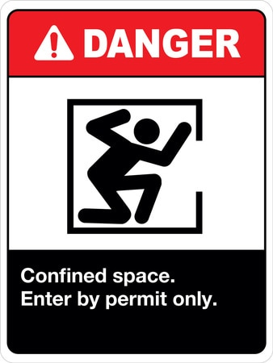
Hazard Analysis of Working in Exposed Environments
Existing Hazards:
Falls and fatigue
Confined space
Heat stress
Cold stress
Respiratory problems from harmful gases, dust and vapor.
Explosion
Fire
Electrical hazards
Notes:
Fires and explosions are significant sources of dangers in confined areas. This is particularly critical because workers may find it difficult to escape from such spaces in the event of these hazards.
The smoke can build up quickly, and the space may become unstable due to the explosion. Fire in a confined space can be set off by a spark or the ignition of flammable material.
Warning signs should be posted in the nacelle, hub and tower entrance.

Slide 18
Control Measures for Hazards in Exposed Environments (1)
Heat stress:
Perform work on cooler days to avoid heat stress.
Nacelle should be ventilated and air-conditioned
Conduct air sampling in nacelle before working in it.
Establish buddy system among workers. Train them to watch for first symptoms of heat stress.
Notes:
Symptoms of heat stress and exhaustion:
Increased irritability
Loss of concentration
Inability to perform physical or mental tasks
Nausea
Heavy sweating
Headache
Cold, pale, moist skin
Muscle cramps
Dizziness
Fatigue.
Heat stroke is considered a medical emergency. Call 911 in the event of the following symptoms:
Nausea
Hot, dry skin
loss of consciousness
confusion
strange behavior
high body temperature
Headache
https://www.ccohs.ca/products/posters/longdesc/work_heat.html

Slide 19
Control Measures for Hazards in Exposed Environments (2)
Heat stress:
Encourage workers to drink water at least every 20 minutes.
Gradually acclimatize workers to heat.
Workers should take regular breaks to cool off in airconditioned site office.
Notes:
Symptoms of heat stress and exhaustion:
Increased irritability
Loss of concentration
Inability to perform physical or mental tasks
Nausea
Heavy sweating
Headache
Cold, pale, moist skin
Muscle cramps
Dizziness
Fatigue.
Heat stroke is considered a medical emergency. Call 911 in the event of the following symptoms:
Nausea
Hot, dry skin
loss of consciousness
confusion
strange behavior
high body temperature
Headache
https://www.ccohs.ca/products/posters/longdesc/work_heat.html

Slide 20
Control Measures for Hazards in Exposed Environments (3)
Cold stress:
Train workers to recognize the symptoms of cold stress.
Encourage workers to monitor their physical condition and that of their coworkers.
Ensure that workers are adequately dressed for the weather.
Stay dry. Moisture or dampness increases the rate of heat loss from the body.
Notes:
This information is from OSHA

Slide 21
Control Measures for Hazards in Exposed Environments (4)
Cold stress:
Keep extra clothing handy when there is a need to change outfits
Drink warm fluids
Use proper engineering controls, safe work practices, and personal protective equipment (PPE)
Notes:
This information is from OSHA

Slide 22
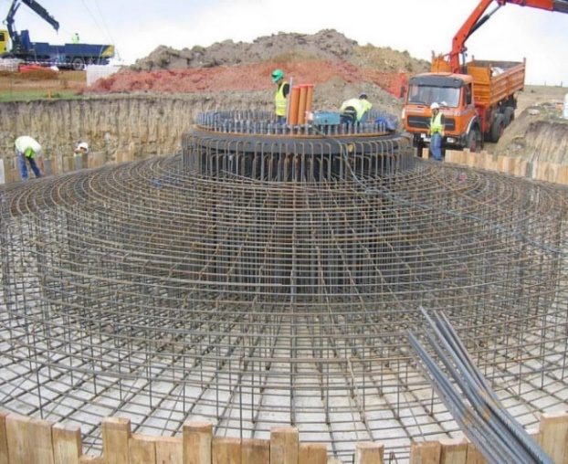
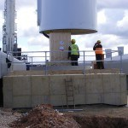
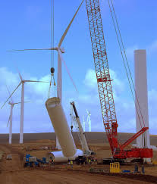
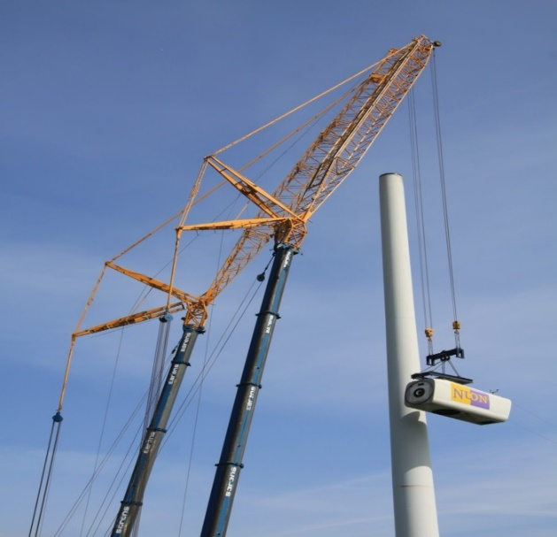
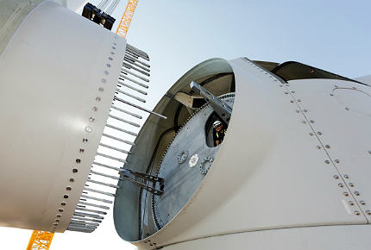
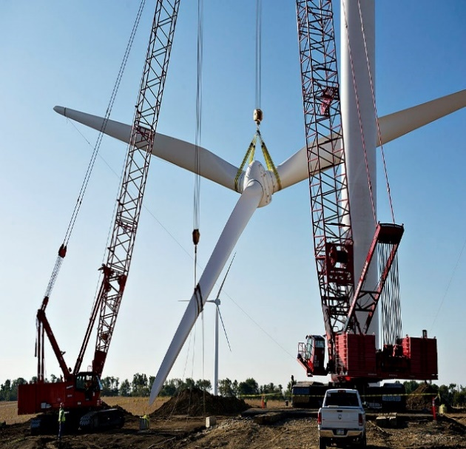
Hazard Analysis of Wind Turbine Assembly and Erection
Notes:
Wind turbine assembly and erection involves several processes.. The pictures show some of the stages from foundation construction to rotor placement.
Ask participants to:
Identify what task or stage of wind turbine assembly is captured in each picture.
Identify the existing and potential hazards associated with these stages.
Answers:
i)Top left picture shows wind turbine foundation construction.
ii) Top middle picture shows installation of first tower section.
iii) Top right shows installation of second tower section.
iv) Bottom left picture shows placement of nacelle.
V) Bottom middle shows rotor assembly.
Vi) Bottom right shows rotor installation.

Slide 23
Hazard Analysis of Wind Turbine Assembly and Erection (1)
Existing Hazards: | Control Measures: Measures:
Falls due to: Slipping Tripping Overreaching Over balancing Collapse of tower Collapse of crane Object hit Fatigue | Consider weather conditions in planning the work, with emphasis on: Wind speed: All works can be executed in little or no wind conditions All internal works can be done in moderate wind speed No work should be done in strong winds on turbines. Lightning: No work when there is a lightning forecast. Ensure proper use of lanyards and PFAS, together with the following: Keep your hands and feet free from slippery substances and work area from cluster Avoid overreaching and over balancing. Ensure proper erection of tower. Avoid working on the tower during strong winds. Ensure that crane is properly installed. Be aware of your surroundings. Take regular breaks to avoid fatigue.
Notes:
According to OSHA, the characteristics of a confined space includes the following:
The worker can get into the space to perform the required work.
The space should not be used for permanent human occupation.
Entry and exit from confined spaces is restricted.

Slide 24
Hazard Analysis of Wind Turbine Assembly and Erection (2)
Existing Hazards: | Control Measures:
Crane or heavy equipment. | Don’t stand in front of a moving vehicle or crane. Park vehicles and mobile equipment on levelled surfaces.
Struck by: Swinging crane load Falling objects | Be aware of the surroundings. Stay away from loaded crane or machinery. Avoid loitering at the base of tower. Avoid working on tower during strong winds.
Confined space resulting in low oxygen, Asphyxiation. | Consider adequate ventilation during design and construction. Provide portable oxygen tanks for workers.

Slide 25
Hazard Analysis of Wind Turbine Assembly and Erection (3)
Hazard Analysis of Wind Turbine Assembly and Erection (3)
Existing Hazards: | Control Measures:
Fire due to: Accumulated hazardous gases in confined space. Explosion Lightning Overheating | Prevent overheating in the nacelle. Prevent friction in rotor at blade pivoting points. Lubricate all moving joints. Prevent leakage of hydraulic oil. Prevent short circuiting of electrical components. Use fire retardant materials in the design and construction of turbine components A fire detection mechanism should be installed in the nacelle.
Physical exertion and fatigue | Avoid physically lifting large components. Take regular breaks.

Slide 26
Hazard Analysis of Wind Turbine Assembly and Erection (4)
Existing Hazards: | Control Measures:
Confined spaces resulting in: Lack of oxygen leading to Asphyxiation Accumulation of hazardous gases Hot toxic fumes Hot and humid conditions, etc. | Consider ventilation in the design and construction. Provide portable oxygen tanks for workers. Take regular breaks. Perform air sampling in confined spaces. Post warning signs at the entrance of confined spaces
Caught on moving parts | Beware of moving parts of turbine. Disengage rotor to prevent blades from spinning. Place a lock on controls to prevent accidental operations Keep loose ends of cloths attached to the body.
Drowning | Provide life vest for workers during offshore operations Experience in swimming must be a requirement on offshore turbines.
Notes:
Provide portable gas monitoring devices for workers. Perform air sampling in confined spaces before beginning operations.
A good grounding system should be done to protect the turbine from lightning strikes that can cause fire.

Slide 27
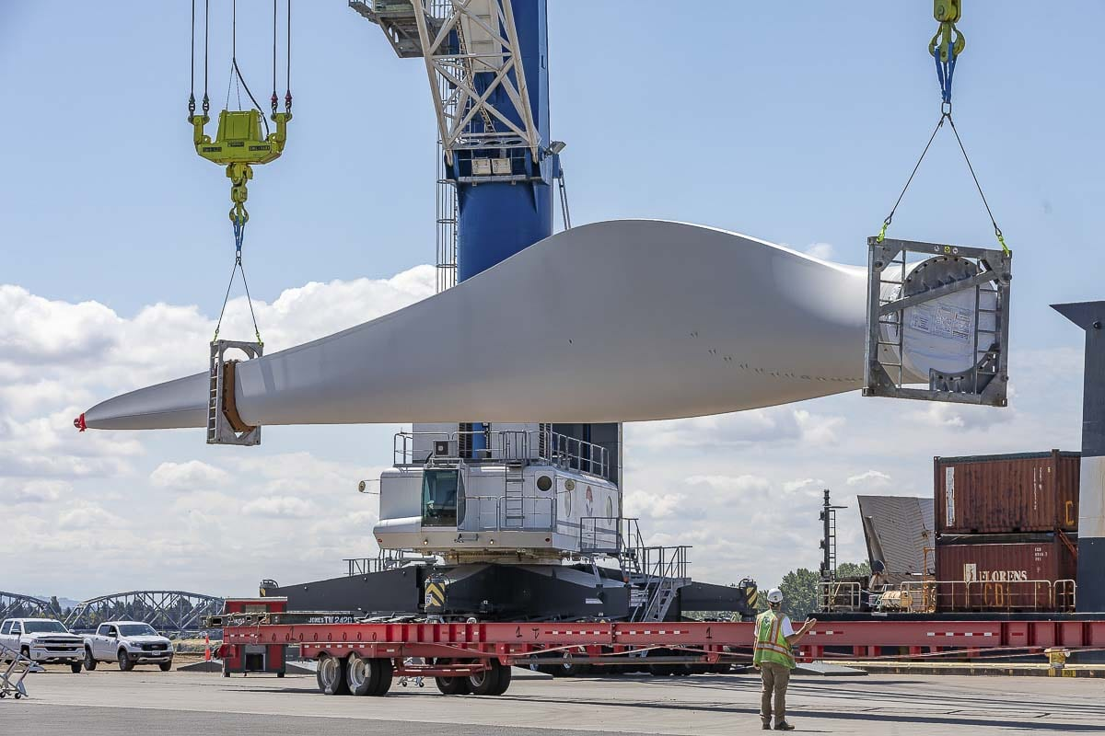
Hazard Analysis during Offloading (1)
Photo by Mike Schultz
Notes:
A161-foot wind turbine blade being unloaded onto a flatbed truck

Slide 28
Hazard Analysis during Offloading (2)
Existing Hazards: | Control Measures:
Crane collapse | Cranes should be carefully installed, not overloaded and maintained regularly.
Struck-by hazards | Be aware of the surroundings. Stay away from loaded cranes. Avoid loitering at the base of tower while work is ongoing. Avoid working in or around tower during strong winds.
Run-over hazards | Do not stand in front of a moving vehicle or mobile crane. Park all vehicles and mobile equipment on levelled surfaces.
Fall, tripping and slipping hazards | Keep your hands and feet free from slippery substances. Keep work area and walkways free from cluster.

Slide 29
Hazard Analysis of Tower Assembly (1)
Existing Hazards: | Control Measures:
Fall, slipping and tripping hazards | Perform work in appropriate weather. Use harness and fall arrest system properly. Keep your hands and feet free from slippery substances. Keep work area and walkways free from cluster. Avoid overreaching and over balancing. Avoid working on the tower during strong winds. Ensure that crane is correctly installed. Be aware of your surroundings. Take regular breaks to avoid fatigue.
Tower collapse | Bolt and weld tower sections and components correctly. Avoid loitering around tower during strong winds.

Slide 30
Hazard Analysis of Tower Assembly (2)
Existing Hazards: | Control Measures:
Struck-by hazards | Be aware of your surroundings. Stay away from mobile crane Do not stand under or near the base of the tower. Avoid working on the tower during strong winds.
Crane collapse | Crane should be properly installed and regularly maintained.
Run-over hazards | Do not stand in front of a moving vehicle or mobile crane. Ensure vehicles and mobile equipment are parked on a levelled area.

Slide 31
Hazard Analysis of Nacelle Placement (1)
Existing Hazards: | Control Measures:
Fall, slipping and tripping hazards | Work in an appropriate weather, with little to no wind speed. Workers must be trained in use of any scaffold, mobile equipment and/or lift and follow the manufacturer’s instructions. Use harness and fall arrest system. Keep hands and feet free from slippery substances and work area from cluster. Avoid overreaching and overbalancing. Ensure that the tower is correctly erected Ensure that crane is correctly installed. Be aware of your surroundings. Take regular breaks to avoid fatigue.
Tower collapse | Bolt and weld tower sections correctly. Avoid working during strong winds.
Notes:
Ensure that tools are packed away safely and that roofing sheets, cones, signage and other loose materials are safely secured. (A 18 miles per hour wind classified on the beaufort scale as a ‘fresh breeze’), can pick up a piece of scrap material and carry it as far out as the height from which it came)

Slide 32
Hazard Analysis of Nacelle Placement (2)
Existing Hazards: | Control Measures:
Struck-by hazards | Be aware of your surroundings. Stay away from mobile cranes. Avoid loitering at the base of tower Avoid working on tower during strong winds.
Crane collapse | Crane should be properly installed and maintained
Run-over hazards | Don’t stand in front of a moving vehicle or crane. Park vehicles and mobile equipment on a levelled surface
Trapped-between | Avoid narrow spaces between components.

Slide 33
Hazard Analysis of Nacelle Placement (3)
Existing Hazards: | Control Measures:
Caught on spinning shaft Contact with moving parts | Recognize and beware of moving parts of the turbine. Disengage rotor to prevent blades from spinning Place a lock on the controls to prevent accidental operations. Keep loose ends of cloths attached to the body.
Electrical shocks Electrocution | Only trained technicians should work. Always de-energize electrical equipment and components of turbine. Avoid working in damp conditions. Use custom logout-tagout system on parts being worked on. Disengage rotor to prevent blades from spinning Place a lock on the controls to prevent accidental operations. Recognize electrical components and proceed with caution.

Slide 34
Hazard Analysis of Nacelle Placement (4)
Existing Hazards: | Control Measures:
Confined space | Consider ventilation in the design and construction Nacelle design should be air-conditioned. Provide portable oxygen tanks for long works. Take regular breaks. Perform air sampling in confined spaces Post warning signs at the entrance of confined spaces.
Collapse of work platform | Periodically inspect and maintain all equipment. Inspect PPE and all work platforms before every use. Ensure that crane is installed correctly. Avoid overloading crane.

Slide 35
Hazard Analysis of Nacelle Placement (5)
Existing Hazards: | Control Measures:
Fire Explosion Arc flash/blast | Prevent overheating in the nacelle. Prevent friction in rotor at blade pivoting points Lubricate all moving joints Prevent leakage of hydraulic oil. Prevent short circuiting Use fire retardant materials in design and construction of turbine components A fire detection mechanism must be installed in the nacelle.
Heat stress | Perform work on cooler days. Nacelle design should be well-ventilated and air-conditioned. Conduct air sampling in nacelle before commencing operations. Establish a buddy system among workers. Pracrtice fluid intake at least every 20 minutes. Gradually acclimatize workers to heat. Take regular breaks to cool off in airconditioned site office.

Slide 36
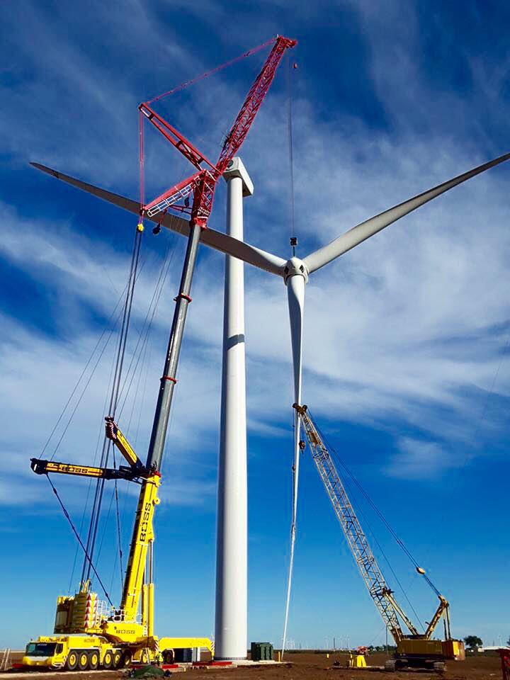
Hazard Analysis of Rotor Assembly & Placement (1)
Photo source: Boss Crane (https://www.bosscrane.com/industries-served/wind-energy-services/)
Notes:
The picture shows a fully assembled rotor lifted during installation.
Let participants identify the activity shown in the picture and the possible hazards
Photo source: Boss Crane (https://www.bosscrane.com/industries-served/wind-energy-services/)

Slide 37
Hazard Analysis of Rotor Assembly & Placement (2)
Existing Hazards: | Control Measures:
Fall, slip & trip hazards | Be aware of the surroundings. Perform work in an appropriate weather, with little to no wind speed. Use harness and fall arrest system properly. Keep your hands and feet free from slippery substances and working area from cluster Avoid overreaching and over balancing Avoid working on the tower during strong winds. Ensure that crane is correctly installed. Take regular breaks to avoid fatigue. If possible, assembly components on ground before lifting in place
Struck-by hazards | Be aware of the surroundings. Stay away from mobile cranes Do not stand under or near the base of the tower Avoid working on or approaching the tower during strong winds.

Slide 38
Hazard Analysis of Rotor Assembly & Placement (3)
Existing Hazards: | Control Measures:
Run-over hazards | Do not stand in front of a moving vehicle or mobile crane. Park vehicles and mobile equipment on levelled surfaces
Crane collapse | Crane pads should be well constructed. Crane should be correctly installed and regularly maintained
Tower collapse | Tower foundation should be well constructed. Bolt and weld tower sections and components properly. No one should be near the tower during strong winds.
Rotor collapse | Ensure: Hub is always assembled correctly. Blades are correctly attached and bolted Work is done in little to no wind speed.

Slide 39
Hazard Analysis of Rotor Assembly & Placement (4)
Existing Hazards: | Control Measures:
Collapse of work platform | Periodically inspect and maintain all equipment. Inspect PPE and all work platforms before every use.
Trapped between | Avoid getting into narrow spaces between components.
Confined space in hub | Ventilation should be considered in the design and construction of the hub. Provide workers with portable oxygen tanks for extended periods in the tower, nacelle and hub. Take regular breaks outside confined spaces. Perform air sampling in confined spaces, before commencing operations.

Slide 40
Hazard Analysis of Mechanical Completion & Commissioning (1)
Existing Hazards: | Control Measures:
Fall from height | Perform work in an appropriate weather, with little to no wind speed. Use harness and fall arrest systems properly. Keep your hands and feet free from slippery substances. Keep work area and walkways free from cluster. Avoid overreaching. Avoid over balancing. Ensure that the tower is correctly erected. Avoid operations during strong winds. Be aware of your surroundings. Take regular breaks to avoid fatigue.
Tower collapse | Tower foundation should be well constructed. Bolt and weld tower sections and components correctly. No one should loiter around tower during strong winds.

Slide 41
Hazard Analysis of Mechanical Completion & Commissioning (2)
Existing Hazards: | Control Measures:
Electrical shocks Electrocution | Only trained technicians should work De-energize electrical equipment of turbine before working Avoid working in damp conditions. Use custom logout-tagout system on active parts Disengage rotor to prevent blades from spinning Place a lock on the controls Recognize electrical components throughout the turbine. Inspect and test switchgear boxes and metal surfaces

Slide 42
Hazard Analysis of Mechanical Completion & Commissioning (3)
Existing Hazards: | Control Measures:
Fire/Explosion | Prevent overheating in the nacelle. Prevent friction in rotor at blade pivoting points Lubricate moving joints Prevent leakage of hydraulic oil Prevent short circuiting of electrical components. Use fire retardant materials in the design and construction phases A fire detection mechanism should be installed in the nacelle.

Slide 43
Hazard Analysis of Mechanical Completion & Commissioning (4)
Existing Hazards: | Control Measures:
Contact with moving parts Caught on spinning shaft | Beware of all moving parts of the turbine. Disengage rotor to prevent blades from spinning Place a lock on the controls to prevent accidental operations. Keep loose ends of cloths attached to the body
Confined space | Ventilation should be considered in the design Provide workers with portable oxygen Take regular breaks Perform air sampling

Slide 44
Major Hazards
Fall from height
Struck-by:
Falling object
Swinging load
Flying object
Electrical shocks
Electrocution
Fire
Notes:
Ask: What are the major hazards you recognize in your workplace?
Discuss.

Slide 45
Control Measures (1)
There should be a dedicated safety coordinator assigned to every wind tower project site.
Plan and carry out work in little to no wind speed.
Provide and ensure proper usage of approved personal fall arrest systems (PFAS) by all workers exposed to fall hazards.
Stay away from mobile cranes.
Do not stand under or near the base of the tower while work is ongoing

Slide 46
Control Measures (2)
Only trained technicians should work on electrical components.
De-energize electrical equipment and components of turbine before commencing operations.
Prevent overheating in the nacelle.
Prevent friction in rotor at blade pivoting points to avoid fire or explosion due to overheating.

Slide 47

Review & Questions
Name three important things you learned in this section.

