Slide 1
Electrical Safety for
Wind Tower Construction and Maintenance
Developers:
Mikhail Golovkov, M.S.
Gavin Burdge, M.S., CSP, CIH
Miaozong Wu, Ph.D., CSP, ARM
University of Central Missouri
Warrensburg, MO
The training material was developed under the Susan Harwood Grant SH05153SH9 from the Occupational Safety and Health Administration (OSHA), U.S. Department of Labor.
Notes:
Welcome to our training course.
Address safety issues: exits, what to do in case of fire etc.
The primary objective of this training course is to increase the awareness and skills for recognizing electrical hazards related to wind tower construction and maintenance.
The course training materials were developed by three members with a team effort: Introduce developers & instructors and the employer.

Slide 2
Acknowledgement
This material was produced under grant number SH05153SH9 form the Occupational Safety and Health Administration, U.S. Department of Labor. It does not necessarily reflect the views or policies of the U.S. Department of Labor, nor does mention of trade names, commercial products, or organizations imply endorsement by the U.S. Government.
Training materials developed with grant funds are available at https://www.osha.gov/dte/library/ and https://www.ucmo.edu
Notes:
Training materials for this course were developed with financial support from OSHA Susan Harwood Grant under the grant number SH-05153-SH9.
Importantly, the contents discussed in this course does not necessarily reflect the views or policies of the OSHA, or imply endorsement by the U.S. Government.
Training materials developed with grant funds are available at OSHA website (https://www.osha.gov/dte/library/) and University Of Central Missouri website (https://www.ucmo.edu/osha-grant)

Slide 3
Worker Rights and Responsibilities
The OSH Act gives workers the right to safe and healthful workplace. Here are links with detailed information: https://www.osha.gov/Publications/osha3021.pdf
For example, workers have the right:
to know about laws and your rights
to receive training
to information
to participate in activities to ensure their protection from job hazards
Notes:
The OSHA grant requires us to inform you about worker rights and responsibilities under the OSH Act.
The OSH Act gives workers the right to safe and healthful workplace. This link is an OSHA publication 3021 published in 2017 about Workers’ Rights.
For example,
Workers have the right to know about laws and your rights under the Occupational Safety and Health Act.
Workers have a right to receive training about hazards and controls. Training is very important to prevent workplace incidents and injuries.
Workers have the right to access to information related to workplace safety and health information, such as chemical hazard information, exposure monitoring data, and OSHA Form 301 which records workplace injuries, and any OSHA citations. Employers are required to display the poster of workplace safety and health information. Employers must display the poster in a conspicuous place where workers can see it.
Workers have a right to understand workplace hazards and participate in activities to control hazards and protect from injuries. Such activities as accident investigation, complaint filing to OSHA and OSHA inspection.

Slide 4
Worker Rights and Responsibilities (Cont'd)
Workers have the responsibility:
to comply with all OSHA standards
to comply with employer's safety and health rules
to report any hazards to your supervisor
to report any job-related illness or injury to your supervisor
Source: https://www.osha.gov/Publications/Mach_SafeGuard/rights.html
Notes:
Workers also have the responsibility:
to comply with all the OSHA standards
to comply with the employer's safety and health rules
to report any hazards to your supervisor
to report any job-related illness or injury to your supervisor
Here is a link from OSHA about Worker Rights and Responsibilities. https://www.osha.gov/Publications/Mach_SafeGuard/rights.html

Slide 5
Discrimination Rights
OSHA prohibits employers from discharging or in any manner discriminating against employees:
for reporting work-related injuries and illnesses
for requesting information on injuries and illnesses
for anonymously requesting an OSHA inspection of workplace hazards
Notes:
OSHA prohibits employers from discharging or in any manner discriminating against employees
for reporting work-related injuries and illnesses
for requesting information on injuries and illnesses
for anonymously requesting an OSHA inspection of workplace hazards

Slide 6
What are we leaning - Outline
Three parts course:
Module 1. Electric hazards in wind industry: electric shock and electric arc.
Module 2. Protection against electric hazards: protective materials and PPE properties.
Module 3. Safe work standardization: normative regulations and other consensus standards
Notes:
This training course is to increase the awareness and skills for recognizing electrical hazards related to wind tower construction and maintenance.
This training course is structured in three modules. All modules can be taught together as a 4-hours session. Modules can be also taught independently that allow flexibility in course time management.
Module 1 for identifying properties, specifics of electric hazards and how they can hurt workers;
Module 2, technical means and ways of protection from electrical hazards; and
Module 3, what is required in mandatory government regulations, and consensus safety standards.
One note before we start. The targeted industry for this training course is wind tower and its associated equipment construction and maintenance. However, electrical hazards are common in many other industries, such as electrical utility industry, manufacturing, and construction industry. This training and educational material is also applicable in these industries and can benefit those workers.

Slide 7
Module 1
Electric Hazards in Wind Industry
Notes:
With that, lets start with “electrical hazards”.

Slide 8
Outline
Wind energy today and in perspective
Wind turbine common design
Sources of electric hazards
Electric shock hazard: direct and indirect contact, touch and step potential
Human body reaction on electric current and voltage
Electric arc hazards: thermal, blinding light, loud sound, clothing ignition, uncontrollable body movement
Electric Arc Properties and Behavior
Types of Arc
Notes:
These are topics that we will discuss in this module.

Slide 9
Learning Objectives
Understand the difference between electric shock, electrocution and electric arc thermal injuries
Identify hazardous currents and their effects on the human body during electric shock
Learn what is an electric arc (arc flash)
Learn how Identify and distinguish different types of electric arcs
Notes:
The learning objectives for this module will include:
Understand the difference between electric shock, electrocution and electric arc thermal injuries.
Identify hazardous currents and their effects on the human body during electric shock.
Learn what an electric arc (also commonly called arc flash) is.
Learn how to identify and distinguish between different types of electric arcs.
Specific electrical work may consist of a diversity of tasks and work locations during a work day. This work also involves diversity of rated voltages with different design and construction of electrical equipment. However, behind these diversities technical commonalities exist for their electric hazards and their similar properties and behavior.
Emphasis in this module is on physical and technical properties of electrical hazards that electrical workers face daily. Emphasis is on knowledge of the danger or hazard, what to possibly expect from these hazards and when to expect it. This knowledge is leading into setting up safe work conditions and safe work practices.
As we said earlier, in this course we are looking to achieve objectives not thorough teaching of theory but rather by showing video examples that explain physical properties.

Slide 10
Pre-training Quiz
1. Which is the primary contributing factor for occupational fatality when exposed to electricity?
a) voltage b) current
2. What is the threshold level of current that can cause heart fibrillation?
a) 1 mA b) 10 mA c) 20 mA d) 100 mA
3. How many types electric arc can be classified into?
a) all arcs are the same b) 2 types
c) 3 types d) 4 types e) 5 types
4. What is the most common hazardous effect of electric arc for a human body?
a) sound wave b) thermal energy c) bright light d) electric shock
Notes:
Before moving onto the core of this module, we would like to have a quiz which will help us understand where you are. The quiz includes 4 questions. Please circle just one choice as your best answer to each question.

Slide 11
1. Wind energy industry today
One of the fastest growing industries (BLS)
Generation and unit size
Wind mechanical energy conversion into electrical energy
General hazards
Notes:
Before we discuss electric hazards, we will provide an overview of current state and growth potential of the wind industry.

Slide 12
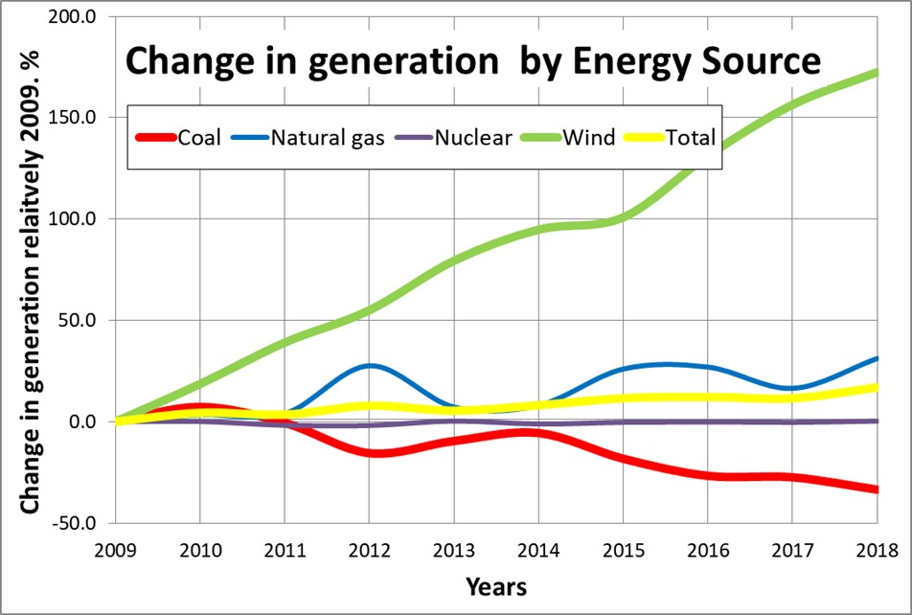
Wind energy is growing
https://www.eia.gov/electricity/monthly/#tabs_unit-3
Notes:
Energy generation from wind is growing faster than from any of the other major sources of energy, including coal, natural gas, and nuclear. Solar energy is growing faster but it is not yet reach threshold of being a major energy source.
Over last 9 years wind energy generation has increased about 170% or 2.7 times. While nuclear generation is holding steady, natural gas is slightly growing, and coal energy generation is on a down slope.
Only major sources of energy production are shown.

Slide 13
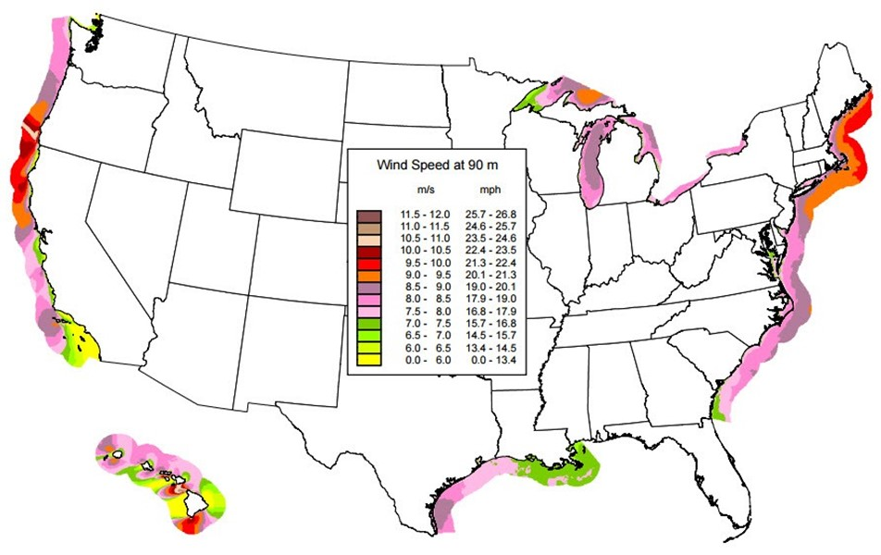
U.S. Offshore Wind Resource
https://windexchange.energy.gov/maps-data/320
Notes:
Although today in US most of the wind generation is land-based, offshore wind resources are of a great value in land areas along the coast where land based generation is not feasible because of low average inland wind speeds. UK and China are leaders in offshore wind generation when it comes to the size and capacity of single wind farm.
The map shows the off-the-coast predicted mean annual wind speeds at 90-m height.
Areas with annual average wind speeds of 7 meters per second (m/s) and greater at 90-m height are generally considered to have a wind resource suitable for offshore development.

Slide 14
Wind Tower Construction and Electricity Generation
Wind turbine components:
Blades and Rotor
Low speed shaft (30-60 rpm)
Gearbox
High speed shaft (1000-1800 rpm)
Generator
Anemometer
Controller (8-16 to 55 mph)
Pitch System
Break
Yaw drive, motor
Tower
Nacelle
Video: how does a wind turbine work?
https://www.energy.gov/maps/how-does-wind-turbine-work
OR
https://www.youtube.com/watch?v=J3vr-94nZQY&feature=youtu.be
OR
https://ucmo.hosted.panopto.com/Panopto/Pages/Viewer.aspx?id=8f2218cf-11fc-42bd-a53e-ac24013af2e4
Notes:
This video clip will explain how wind energy is converted into electric energy (or how electric energy is generated from wind). It will also describe general constructions and equipment that is required to be placed in the tower to generate electricity.
This information might be not new for you but we will need it for identifying locations and sources of electric hazards.
The main components of a wind turbine include propeller-like blades, rotor, Main shaft (including low-speed shaft, gear box and high-speed shaft), generator, anemometer for wind speed and wind vane for wind direction measurement, controller, pitch system and brake, yaw drive and motor, and supporting tower. The nacelle sits atop the tower and contains the gear box, low- and high-speed shafts, generator, controller, and brake. Some nacelles are large enough for a helicopter to land on.
The energy in the wind turns propeller-like blades around a rotor. Blades and hub together form the rotor. The rotor is connected to a main shaft, which spins a generator to create electricity. This electricity can present electric arc, and electrocution hazards which must be understood and protected against during wind turbine construction and maintenance work. Therefore, wind kinetic energy → mechanical energy (shaft rotation) → electrical energy.

Slide 15
Electricity from Wind Turbines
Video: Wind farm electricity flow
https://www.youtube.com/watch?v=hSqA8wOCK3Q&feature=youtu.be
OR
https://ucmo.hosted.panopto.com/Panopto/Pages/Viewer.aspx?id=6993f69d-7d56-4e63-96a7-ac24013adf00
Notes:
Previous clip demonstrated how electricity is generated from the wind. Blades and rotor, low speed shaft, gearbox, high speed shaft, and generator.
This video clip explains transmission and distribution of generated electrical energy.
Electricity is generated at low voltage below 1 kilovolt, usually 500-700 volts. This voltage level is too low for power collection and transmission because of higher loses.
For that reason there is a step up transformer at the bottom of each tower. Low voltage cables connect generator at the top of the tower with step up transformer at the bottom. Network of step up transformers connected with underground cables is used to collect generated energy to wind farm substation. A collection network is usually operated at 35 kilovolts.
At the substation, collected energy is metered and converted into overhead transmission system through another step up transformer.
Reference:
https://www.researchgate.net/figure/General-description-of-a-wind-turbine-system-The-appropriate-voltage-level-is-related-to_fig2_221911675

Slide 16
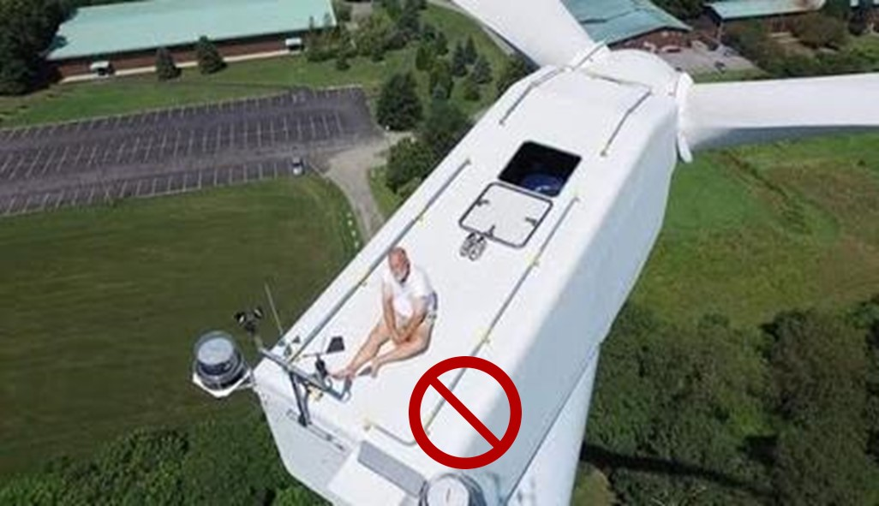
Wind turbine is a complicated piece of equipment, but a dangerous place for sun bathing. What can be possibly go wrong with wind turbine?
Notes:
Wind turbine tower is an elegant masterpiece of technology, but it is a dangerous place for sun bathing. Wind turbines are a complicated piece of heavy rotating machinery and can be deadly when things are out of control.
Multiple hazards of various nature are associated with this equipment.
Complicating factor is that wind energy facilities are often located in remote areas far from hospitals and rescue services. This geography makes hazard recognition and control even more important to have plans in place for the prevention of serious incident causing personal injuries and to understand how to protect against the hazards of electrical hazards.

Slide 17
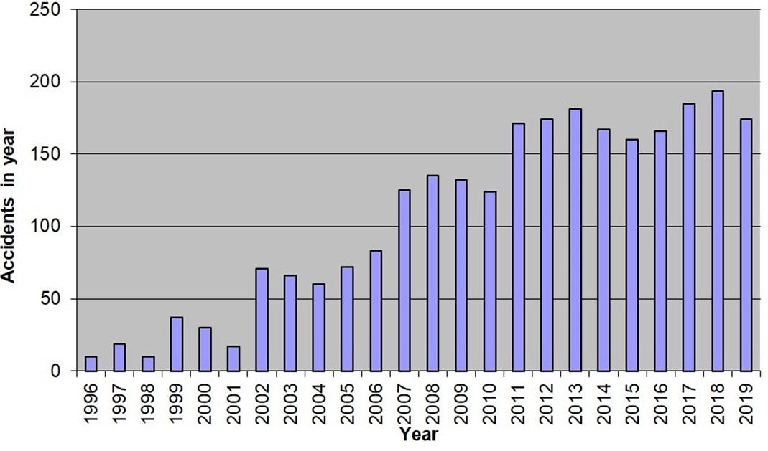
Wind Turbine Accident data (worldwide)
Compliments of Caithness Windfarm Information Forum www.caithnesswindfarms.co.uk
Notes:
Statistical data on what can go wrong. This figure shows increased wind turbine accidents worldwide. These data were collected from media reports, so the actual number of accidents is expected to be higher as many accidents go unreported.
As of January 2019, the U.S. Wind Turbine Database (USWTDB) contains more than 58,000 turbines.
Reference:
http://www.caithnesswindfarms.co.uk/accidents.pdf
http://www.caithnesswindfarms.co.uk/fullaccidents.pdf

Slide 18
Many things can go wrong and multiple hazards are present
Wind turbine accident statistics (collected by CWIF):
Total number of reported accidents: 2663 up to Mar 2020 (~1/3 accidents occurred in the U.S.)
Fatal accidents: 151 with 200 fatalities
Accidents with worker injuries: 178 with 208 wind turbine workers injured
Fire incidents: 392
Transport: 230
Environmental damage (ex. bird deaths): 278
Others: 554
(caithnesswindfarms.co.uk)
Notes:
Data from the U.K. Caithness Wind Farm Information Forum provides the most comprehensive injury data currently available anywhere in the world.
Up to march of 2020 there were 2663 accidents reported by media. Interestingly, about 1/3 of these accidents occurred in the U.S.
200 known fatalities have occurred.
During the 178 accidents, 208 wind industry or construction/maintenance workers were injured.
A total of 392 fire incidents were reported. Fire can arise from a number of sources. The biggest problem with turbine fires is that, because of the turbine height, the fire fighters can do little but watch it burn itself out.
Reference:
http://caithnesswindfarms.co.uk/AccidentStatistics.htm

Slide 19
2. Wind Tower Hazards
Electrical hazards: electric shock, electrocution, and electric arc burns
Mechanical tower destruction: falling debris
Tower fire: falling burning debris
Falls: turbine towers average almost 290 feet tall
Rotating parts: low-speed shaft (30-60 rpm); high-speed shaft (1,000-1,800 rpm)
Sound / noise
Confined and enclosed spaces: OSHA 1910.269(e)
Notes:
This slide identifies general hazards associated with wind tower construction and maintenance.
Electrical hazards will be discussed in detail later.
Few quick comments.
Mechanical destruction can happen when brakes fail and rotors exceed design speed. Rotor over speeding results in mechanical destruction of blades or entire tower.
Ignition of oil that is used in large quantities can add to a destruction. Example of these two hazards are included in the next few slides.
Fall from nacelle is practically nonsurvivable event considering height.
There are two noise sources from wind turbine: blade movement and turbine machinery. At the bottom of the tower noise with estimated level of 100 DB (same as lawnmower) is predominantly from blade movement. Machinery noise is attenuated there by the distance of the tower height. In the nacelle noise is a combination of both. Over-exposure to their otherwise harmless low noise has some undesirable possible outcomes such as dizziness, headaches, and sleep disturbance.
Applicability of OSHA rules for confined space in wind industry will be discussed in Module 3 along with other regulations and standardization.

Slide 20
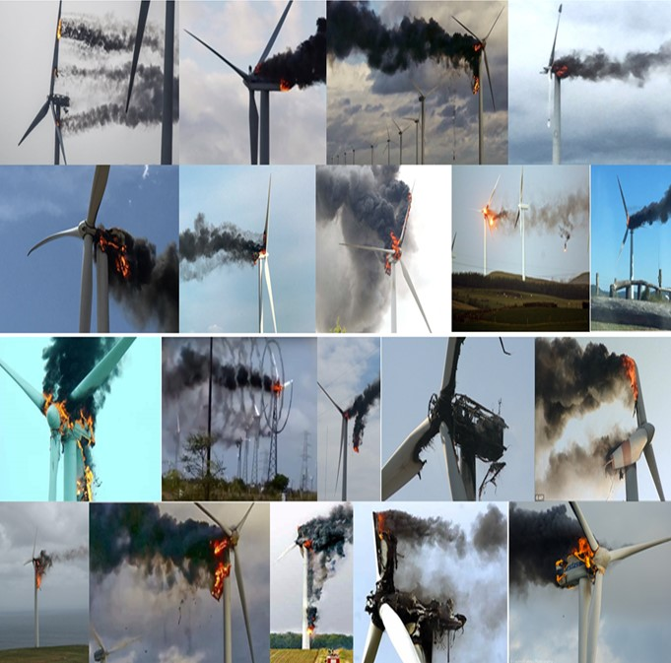
Fire and burning debris
Video: Wind turbine fire
https://www.youtube.com/watch?v=BBkHciKOPd0&feature=youtu.be
OR
https://ucmo.hosted.panopto.com/Panopto/Pages/Viewer.aspx?id=d3100c76-4d93-4983-8826-ac24013ac790
Notes:
For example, this slide shows Wind turbine catches on fire and creates a swirling vortex.
It is hard to extinguish especially high up in the air.
These pictures show different fire accidents.

Slide 21
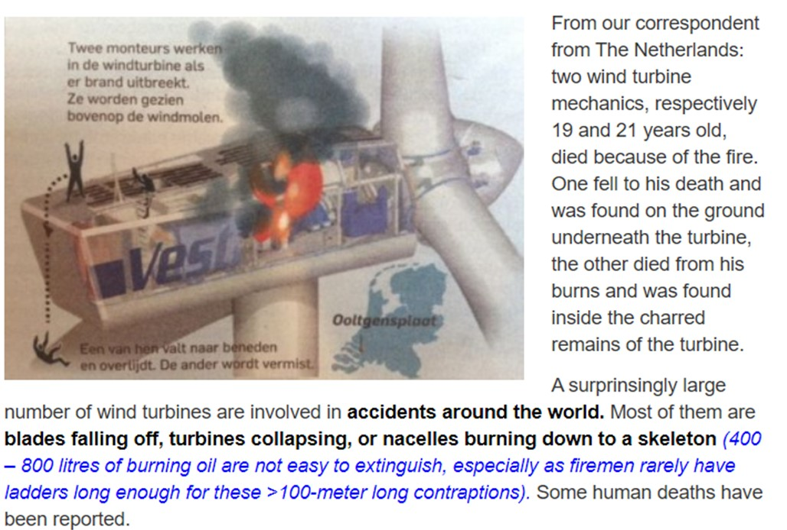
Fire and fatalities
http://www.epaw.org/multimedia.php?lang=en&article=a19
21
Notes:
Example of two young lives perished in turbine fire is described in this slide. 19 and 21 years old workers died because of the fire. One fell and one died from burns in a confined space of nacelle.
Mechanical and fire accident impose hazard to personnel.

Slide 22
Mitigation of general hazard
Wind turbine is mechanically and electrically complicated equipment:
Awareness of constantly present hazards is a key for personal safety
Awareness of surroundings (ex. inside nacelle)
Stay away from “line of fire”
Not to take safety lightly
Notes:
Awareness of situation in general and during high wind can prevent injuries.
Awareness of surroundings, such as working inside nacelle may require to follow rules for confined space.
Working in an electrically safe work condition such as deenergized lines and equipment is always safest and preferred way for electrical equipment, and we will discuss these important topic in other modules.

Slide 23
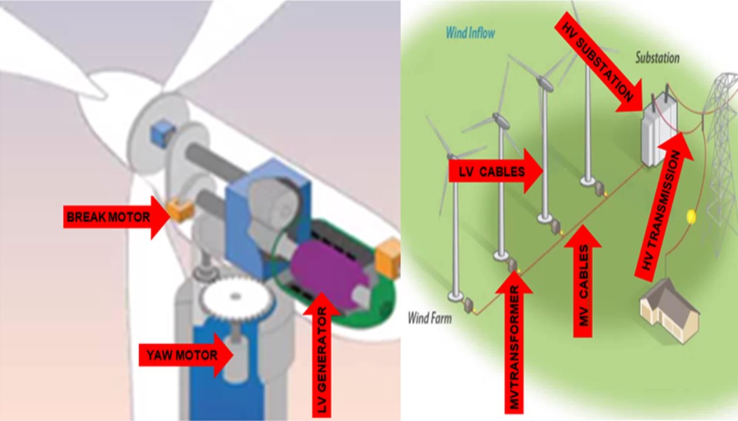
3. Electrical hazards
Notes:
Now we want to discuss electrical hazards.
As we discussed above, wind mechanical energy is converted to electrical energy with its associated hazards capable of causing injury, disability or death.
Electric hazards are associated with equipment with rated voltage above 50 Volts.
Electric hazards exist in many places of wind turbines and during electricity transmission and distribution, including motors, generator, low voltage cables terminations and cables, step up transformers, high voltage cables terminations and cables, high voltage substation equipment, and overheard transition lines.
These electric hazards are electric shock and electric arc, and electric faults or overloads which could cause electrical fires.

Slide 24
Voltages in Wind Turbine
Generator terminal voltage:
Usually a voltage below 1 kV
At collection level:
Around 20-35 kV
Transmission level
Can be over 100 kV
Notes:
As a reminder, typical voltages in wind industry are below 1000 volts at generator, around 20,000-25,000 volts for collection network, and can reach over 100 kilovolts for transmission level.

Slide 25
Electric shock and electrocution
Video: Electric shock
https://www.youtube.com/watch?v=XyKMMDDb9z4&feature=youtu.be
OR
https://ucmo.hosted.panopto.com/Panopto/Pages/Viewer.aspx?id=962a57a1-d166-469f-8dfb-ac24013ab148
This video shows an example of possible worker electrocution.
Worker is climbing overhead line pole and touching energized wire.
Electric shock can result in human fatality commonly described as electrocution. Electrocution is a heart failure due to a fibrillation that can be combined with severe injury to internal tissues or organs.
Notes:
Electric shock can result in human fatality commonly described as electrocution. Electrocution is a heart failure due to a fibrillation that can be combined with severe injury to internal tissues or organs. This video shows an example of electrocution.

Slide 26
Electric arc and equipment damage
Video: Ejected arc HV breaker failure
https://www.youtube.com/watch?v=tgN3XqVPFw4&feature=youtu.be
OR
https://ucmo.hosted.panopto.com/Panopto/Pages/Viewer.aspx?id=9c283d7f-daf5-4827-89c4-ac24013aff0e
Video example of electric arc at the high voltage substation is shown in this slide.
An electric arc is the second electrical hazard.
An electric arc accident can also happen in low and medium voltage installation.
Notes:
The second electrical hazard is an electric arc. Electric arc at a high voltage substation is shown in this video. However, electric arc accident can happen in low and medium voltage installation. Generally medium voltage is considered from 600-1000 volts, which is about the voltage at wind turbine generator.
OSHA has reported several example incidents involving electrical hazard injuries at wind energy locations (OSHA, 2019). For example, here are two scenarios:
Working in the bottom power cabinet of a wind turbine checking the electrical connections and came into contact with a bus bar with a fatal electric arc.
A site foreman was replacing a 480-volt circuit breaker serving a wind turbine. While turning a rotary switch, the worker did not test the circuit to ensure that it was de-energized. The circuit breaker remained energized by back feed from a transformer, caused a fault, and the resultant electric arc caused burns to the worker's face and arms and ignited his shirt.

Slide 27
4. Electrical Shock Hazards
NFPA 70E:
“A source of possible injury or damage to health associated with current through the body caused by contact or approach to energized electrical conductors or circuit parts”.
Voltage: IEC 60038
Extra-low voltage: below 50 volts – the risk is low.
Low voltage: 50-1,000 volts AC or 120-1,500 V DC.
“OSHA considers any voltage of all voltages of 50 volts or above to be hazardous.”
High voltage: >1,000 V AC or >1,500 V DC; (>600 volts in 1910.303)
Notes:
Informational note in NFPA 70E-2018 Article 105 explains shock hazard: A source of possible injury or damage to health associated with current through the body caused by contact or approach to energized electrical conductors or circuit parts.
According to International Standard IEC 60038, voltage can be ranked from extra-low to high. When voltage is below 50 V, the risk is low; OSHA considers all voltages of 50 volts or above to be hazardous.
Reference:
https://www.osha.gov/laws-regs/standardinterpretations/2015-09-04

Slide 28
Human body reaction to electric shock
Video: Volts or Amps Kill You?
https://www.youtube.com/embed/9iKD7vuq-rY
Video clip in this slide explains how electric current effects human body.
An injury and damage to health resulting from electric shock is dependent on the magnitude of the electrical current, the power source frequency (e.g., 60 Hz) and the path and time duration of current through the body. The physiological reaction ranges from perception, muscular contractions, inability to let go, ventricular fibrillation, tissue burns and death.
Notes:
This video clip will explain how electric current effects human body.
So the injury and damage to health resulting from electric shock is dependent on the magnitude of the electrical current, the power source frequency (e.g., 60 Hz) and the path and time duration of current through the body. The physiological reaction ranges from perception, muscular contractions, inability to let go, ventricular fibrillation, tissue burns and death.

Slide 29
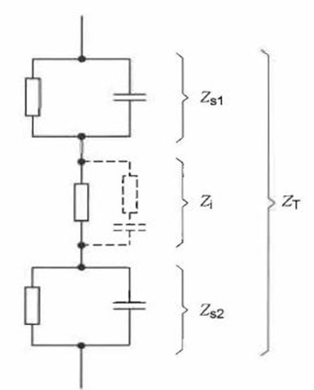
Simplified model of human impedance
IEC 60479 -1
Zs1 and Zs2 - Skin impedances
Zi - Internal impedance
ZT - Total human body impedance
(Jiang, 2018)
Notes:
This slide and the next slide shows that internal impedance (resistance to current flow) is a complicated combination of resistances of various tissues into component parts.
Voltage potential is in one end of this schematic diagram and the ground potential is at the other end.
Since it is the current that kills, human body resistance is a crucial factor in reducing the current and increasing chance of survival.
There are two impedances of the skin, Zs1 and Zs2, in series with internal impedance (Zi) on the diagram. One at the voltage, and another at the ground potential.
Dry skin has a high resistance and limits current flowing through the body. As it was explained in the clip, wet skin is losing its resistance reducing overall impedance by 100 times. Increased current is resulting in higher likelihood of electric shock.
Internal impedance is complicated combination of resistances of various tissues.
Reference:
Hai Jiang, Ph.D., P.E. Evaluation of Heart Current Factor Using Computational Human Body Phantom. 3rd International Symposium Electricity and Safety in the 21st Century, Dresden, Germany, November 5-6, 2018

Slide 30
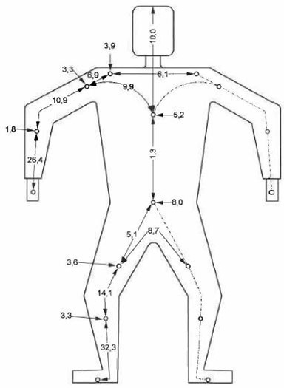
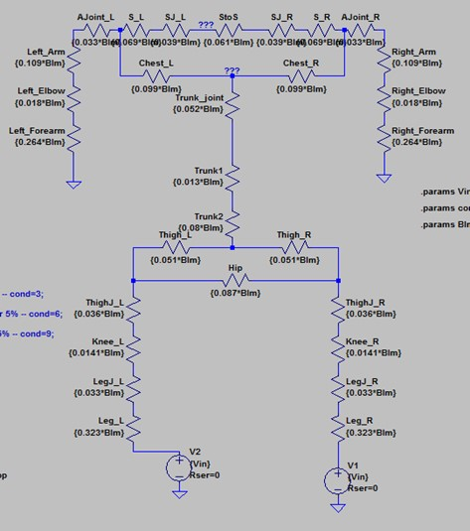
Internal Body Impedance Model
(Jiang, 2018)
Notes:
That is how internal impedance can be represented by researches. Why these complications are needed and what is the value of using such models? You may know that the severity of electric shock depends on what parts of the body are touching voltage and ground potential. Touch points not only determine path of the current. Touch points also determine impedance of the current path and magnitude of the current flowing through the body.

Slide 31
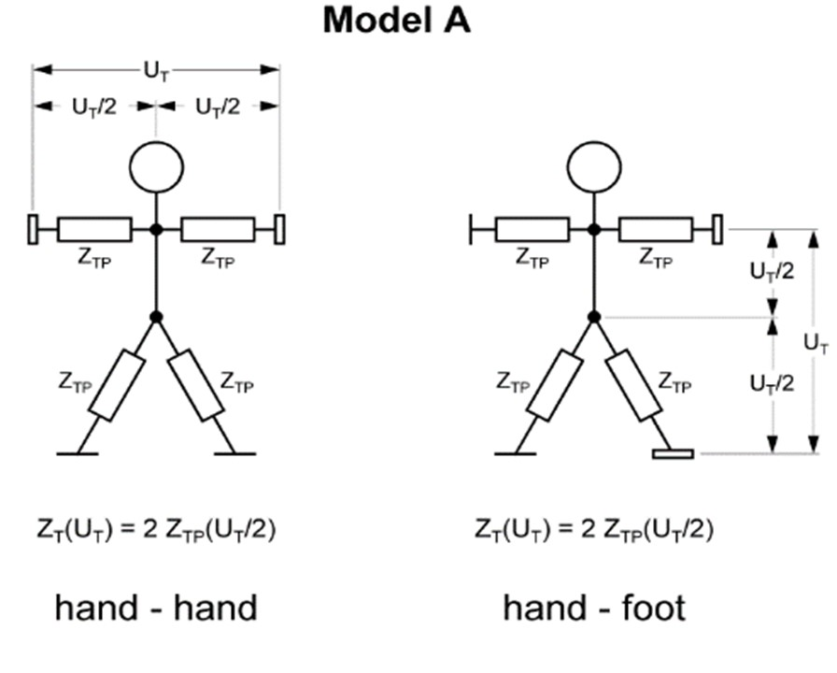
Touch models “hand-hand” and “hand-foot”
(Hirtler, 2018)
Notes:
This diagram and the next couple slides using different touch potential models illustrate that injury to internal organs from current flow is dependent upon the path of current through the body.
Touch potential is the voltage differences between any two points on a person’s body causing current flow.
This slide represents the flow of electric current through the body represented by hand-to-hand and hand-to-foot.
Reference:
Dipl.-Ing. Reinhart Hirtler. Protection against Electric Shock 3rd International Symposium Electricity and Safety in the 21st Century, Dresden, Germany, November 5-6, 2018

Slide 32
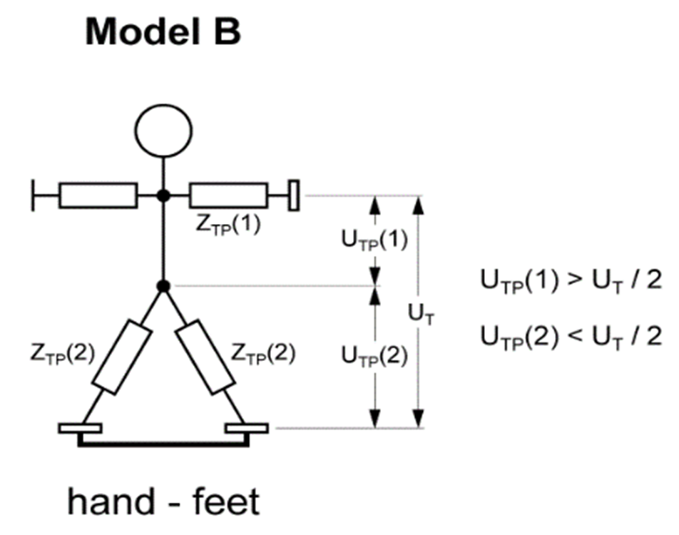
Touch model “hand-both feet”
(Hirtler, 2018)
Notes:
Different from hand-foot touch points, the current is higher for hand-both feet touch model because of parallel feet impedances.

Slide 33
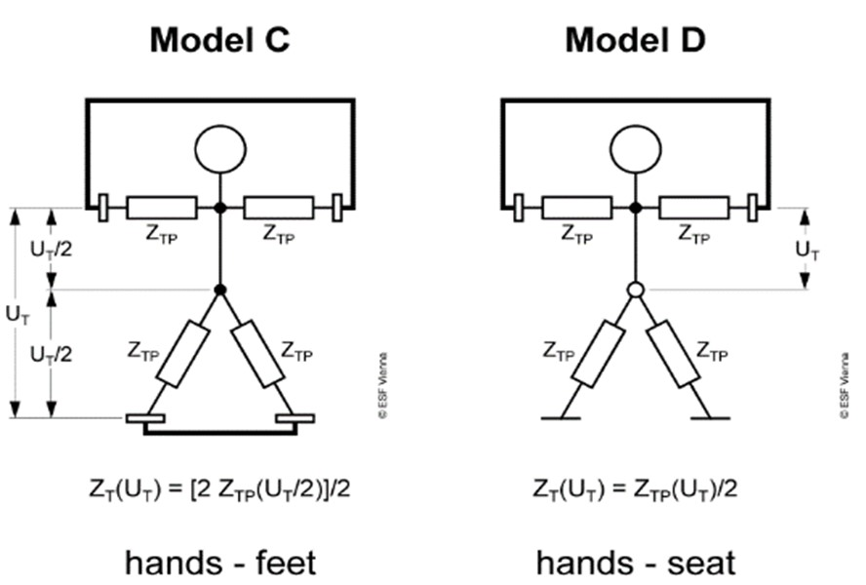
Touch models “both hands-both feet” and “both hands-seat”
(Hirtler, 2018)
Notes:
Additional modeling of current flow through the human body, Model C and Model D shows even less impedance (resistance) for current flow from hands-to-feet (Model C where current flows from the hands to the seat and then current flows from the seat to the feet) and hand-to-seat (Model D) touch models.

Slide 34
Human impedance vs touch model
 | Voltage | Body Current | Body impedance
Pathways | V | mA | Ohm
Left Hand to Both Feet | 110 | 81.7 | 1346.39
Left Hand to Left Feet | 110 | 60.0 | 1833.33
Left Hand to Right Feet | 110 | 61.3 | 1794.45
Both Hand to Both Feet | 110 | 57.4 | 1916.38
Left hand to Right Hand | 110 | 67.3 | 1634.47
Back to Left hand | 110 | 132.0 | 833.33
Back to Right hand | 110 | 131.0 | 839.69
Chest to Right Hand | 110 | 132.0 | 833.33
Chest to Left Hand | 110 | 129.3 | 850.73
Left Foot to Right Foot | 110 | 64.0 | 1718.75
(Jiang, 2018)
Notes:
Summary table includes result of calculation for the above touch models. The highest current is associated with the shortest path as highlighted.
Reference:
Hai Jiang, Ph.D., P.E. Evaluation of Heart Current Factor Using Computational Human Body Phantom. 3rd International Symposium Electricity and Safety in the 21st Century, Dresden, Germany, November 5-6, 2018

Slide 35
Situations causing electric shock
Low voltage electric shock:
Direct contact to energized part
Direct contact to a part that become energized because of insulation failure (touch potential)
Foot to foot (step) potential from energized wire touching the ground
Medium and high voltage electric shock:
Indirect contact (ex. touching wire with metal ladder, touching machinery that is in contact with energized wire)
Flashover on direct approach to a medium or high voltage energized part
Notes:
Electric shock can be divided into low and medium/high voltage electric shock.
There are several different situations that can lead to electric shock. Low, medium or high voltage electric shocks from energized conductors can result from direct or indirect contact. Indirect contact is when someone is touching equipment, such as a ladder or aerial work platform that has become energized by contact with energized overhead line.
Electric current will start flowing through workers body when direct contact is established with low voltage energized conductor or circuit part and the ground at the same time. Electric current will also start flowing when a person is touching a piece of equipment with failed or damaged insulation. Such equipment could be a metal enclosure or conductive handle of low voltage machinery, electric appliance, or electric powered tool.
When an energized conductor falls on a conductive object, such as wet wood or directly to the ground, the object and immediate area of the ground become energized, creating a zone of voltage difference or potential in relation to the ground called step potential. As resistance of the soil is never zero, a voltage drop or difference in voltage potential in relation to current flow through the soil is called step potential.
Step potential of a few hundred volts is created mostly by fallen energized overhead line wire. For variety of reasons, this fault may not be cleared by line protection allowing current to flow from a wire into the ground in all directions from contact point.

Slide 36
Electric shock – indirect contact of flashover
Video: Indirect contact shock through machinery
https://www.youtube.com/watch?v=Bhv8VM0xQXE&feature=youtu.be
OR
https://ucmo.hosted.panopto.com/Panopto/Pages/Viewer.aspx?id=8a2663d9-c42e-4422-a539-ac24013aa668
Video: Indirect contact shock through flashover
https://www.youtube.com/watch?v=n42VNpZHHsg&feature=youtu.be
OR
https://ucmo.hosted.panopto.com/Panopto/Pages/Viewer.aspx?id=bd56a298-0961-4308-b16a-ac24013a9f48
Notes:
These two videos demonstrate two different ways of getting an electric shock: indirect contact with energized machinery such as a dump truck or aerial platform contacting power line, and indirect contact from electric arc or electric flashover.
The first video shows indirect contact through touching equipment that has come into contact with energized overhead line. Even for indirect contact there is arcing and sparking between truck and overhead line.
In the second video flashover is between an arm and a wire. Flashover or electric arc is an electrical breakdown of insulation of air between two conductors. Human contact to medium and high voltage energized equipment can result in a flashover (i.e., a high-voltage electric short circuit made through the air between conductors), and the current flows from energized conductor to human body. As we know, current easily flows through the human body because it has relatively low impedance of about 100 kiloohms. Therefore, the human body acts as extension of ground potential. The current flow results in the same flashover as the outcome when weather grounded conductor or human body approaches and inadvertently contacts an energized circuit part.
More about protection against electric shock is coming in Module 2.

Slide 37
5. Electric Arc
Electric arc - electric discharge in a gaseous media consisting of plasma channel between electrodes of different potential.
Length and shape of a plasma channel is dependent on system voltage and electromagnetic forces.
Need at least two electrodes
Electric discharge: a discharge channel between electrodes filled with plasma with very high conductivity
Plasma – is the fourth (gas, liquid and solid) state of the matter. All ionized conductive medium. No molecules, only ions and electrons.
Notes:
We are now moving to the second electrical hazard, electric arc. Flashover is the manifestation of an electric arc. As it was stated earlier, in contrary to electric shock, electric arc is less understood.
It is important to emphasize that electric arc is an electric discharge phenomena. Not chemical, not mechanical but purely electrical.
Secondly, electric arc is a continuous discharge between two conductive objects and the arc has a certain duration determined by clearing time of fuses or relay protection of the circuit breakers. The electric arc, also called arc flash is not an instantaneous detonation or explosion but is a longer process in time. Arc duration in electrical equipment can reach from few milliseconds to few seconds.
Thirdly, electric arc consists of highly conductive, high temperature plasma channel between two (single phase or phase to phase arc) or between three or four conductors (three phase arc). Plasma is an ionized gas consisting of free electrons and positive ions, the fourth state of matter. Completely ionized air provides high conductivity from the plasma of the channel.

Slide 38
Electric Arc
High temperature
Temperature of ionized gas is a minimum of 5000 ᴼC around the borderline between plasma and overheated air.
Temperature in arc jets (immediate arc electrode area) can reach 50,000 ᴼC.
Therefore, electric arc is associated with thermal hazard and burns.
5) Strong electromagnetic forces affecting directionality of thermal energy dissipation.
Notes:
To maintain all ionized medium, the temperature of the ionized gas must be above 5,000 degrees centigrade. An electric arc consists of a plasma cloud of hot gases, molten conductors and plasma dust, as well as a defined plasma jet. Within the arc jets the temperature is even higher.
So, thermal hazards are the most prominent danger form of electric arc.
Electromagnetic forces between currents in electrical conductors and arc plasma channel greatly affect arc behavior. In normal operation, when load currents are in the range of hundreds of amperes and probability for an arc flash event is low, electromagnetic forces are insignificant in magnitude. However, during a fault and an electric arc event fault current is increasing into kilo amperes range. Electromagnetic forces not only become highly destructive for equipment but also interact with the plasma channel to move or change its shape and length.
There are numerous and different definition in standards. There is a term “arc flash”. Although it is widely used in the industry, it does not accurately reflect what electric arc is. In fact, it is defined as “dangerous condition caused by electric arc”. So knowledge of electric arc is still a must for understanding protection.

Slide 39
Injuries Associated with Arc
Thermal skin burn:
  Unprotected skin can be exposed to extreme temperatures
  Non-FR clothing can ignite resulting in non-survivable skin burn area of the body
Contact with hot materials from heating or ignition
Molten metal
Notes:
Unlike electric shock, when current is flowing through the body causing internal tissue burns, electric arc is associated with external skin burns from thermal energy of electric arc. The severity of burn trauma depends on area of a skin burn and degree (depth) of skin burn.

Slide 40
Injuries Associated with Arc (Cont'd)
Eye injuries: ultraviolet (UV) and infrared (IR) light emitted from an electric arc
Hearing damages: arc discharge is accompanied with loud sound
Lung damage: breathing in hot air can cause significant damage
Involuntary movement: human body survival reflex and adrenaline rush can cause physical injuries to a body, and even fall from loss of balance
Notes:
Other hazards and possible injuries are eye injuries from ultraviolet (UV) and infrared (IR) light emitted from an electric arc; hearing damage because arc discharge is accompanied with loud sound; lung damage from breathing in hot air; and involuntary movement. Some injuries may be reversible and curable while the others are not.

Slide 41
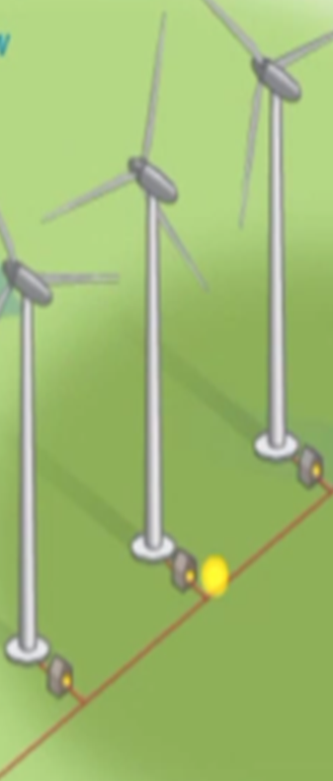
Example of Electric Arc Injuries
In October 2010, a wind farm technician suffered third-degree burns to his neck, chest and arms and second degree burns to his face after energy from an arc flash struck him while working.
OSHA determined that the technician’s employer failed to ensure workers attached personal lockout/ tagout devices on tower turbine switch gear at ground level. Other employees were working on the towers 350 feet off the ground. A transformer unexpectedly activated, injuring the technician.
Notes:
Skin burn injuries from electric arc are real. Here is one example:
In October 2010, a wind farm technician suffered third-degree burns to his neck, chest and arms and second degree burns to his face after energy from an arc flash struck him while working. OSHA determined that the technician’s employer failed to ensure workers attached personal lockout/ tagout devices on tower turbine switch gear at ground level. Other employees were working on the towers 350 feet off the ground. A transformer unexpectedly activated, injuring the technician.
However, there are some inconsistences and incompleteness in reporting of arc incidents. Therefore, arc statistics are often sketchy and incomplete in fatal and non-fatal injury reports.

Slide 42
Sources of Electric Arcs
Energized circuit parts: unguarded and uninsulated / exposed
Switching devices that produce electric arcs in normal operation
Sliding parts that could fault during operation (for example, rack-mounted circuit breakers)
Energized electric equipment that could fail (for example, electric equipment with damaged insulation or with evidence of arcing or overheating).
Notes:
Sources of electric arc: energized circuit parts not guarded or insulated, switching devices that produce electric arcs in normal operation, sliding parts that could fault during operation (for example, rack-mounted circuit breakers), and energized electric equipment that could fail (for example, electric equipment with damaged insulation or with evidence of arcing or overheating).
More information:
Energized circuit parts not guarded or insulated:
whether conductive objects can come too close to or fall onto the energized parts.
Exposed, energized circuit parts:
whether the employee is closer to the part than the minimum approach distance established by the employer (as permitted by § 1910.269(l)(3)(iii)).
Operation of electric equipment with sliding parts:
That could fault during operation is part of the normal operation of the equipment or occurs during servicing or maintenance, and
Sliding parts that could fault during operation (for example, rack-mounted circuit breakers).
Energized electric equipment:
With evidence of impending failure, such as evidence of arcing or overheating; or
Could fail (for example, electric equipment with damaged insulation or with evidence of arcing or overheating).
Appendix E to § 1910.269-Protection From Flames and Electric Arcs
Probability that an electric arc will occur. Identify employees exposed to electric) arc hazards. The Occupational Safety and Health Administration will consider an employee exposed to electric) arc hazards if there is a reasonable likelihood that an electric arc will occur in the employee's work area, in other words, if the probability of such an event is higher than it is for the normal operation of enclosed equipment.
Factors to consider include:
For energized circuit parts not guarded or insulated, whether conductive objects can come too close to or fall onto the energized parts, For exposed, energized circuit parts, whether the employee is closer to the part than the minimum approach distance established by the employer (as permitted by § 1910.269(l)(3)(iii)). Whether the operation of electric equipment with sliding parts that could fault during operation is part of the normal operation of the equipment or occurs during servicing or maintenance, and for energized electric equipment, whether there is evidence of impending failure, such as evidence of arcing or overheating.

Slide 43
Reasons for Electric Arcs
Mechanical failure when equipment is operated to close or open: circuit breakers, disconnect and load switches
Low and medium voltage circuit breakers are racking in or out
Grounded conductive equipment coming to close proximity to unguarded, uninsulated, and exposed parts
Energized electric equipment with damaged insulation or with evidence of arcing or overheating
Accidental operation or malfunction of breakers to energize grounded equipment
Human errors and dropping tool on energized equipment
Notes:
Most likely electric arc is started because of human error and equipment mechanical breakage of insulation as a result of normal operating. Here list some reasons. Mechanical failure of equipment; Low and medium voltage circuit breakers are racking in or out; Grounded conductive equipment coming to close to unguarded, uninsulated, and exposed parts; Energized electric equipment with damaged insulation or with evidence of arcing or overheating; Accidental operation or malfunction of breakers to energize grounded equipment; Human errors and dropping tool on energized equipment.

Slide 44
Types of Electric Arc
Depending on arc electrode configuration, system voltage and design of electrical installation:
Open air arc (in line electrodes)
Arc in a box (box arc)
Moving (running or traveling) arc
Ejected arc
Tracking arc
Notes:
Not all electric arcs in electrical equipment in wind energy or any other industrial and utility transmission and distribution networks are the same. Differences in arc configuration and behavior determine the way thermal energy distribution occurs which in turn affects PPE protection properties.
In technical magazines and publications, electric arc classification includes five different types. Current standardization is lagging to include this knowledge.
The arc type in the classification is based on several differentiating factors: arc electrode geometrical configuration; nominal voltage of electrical installation; shape of arc; arc occurs inside enclosure or in the open air, predominant radiant or convective heat dissipation; stationary or moving arc; and contact with energized parts or voltage flashover.

Slide 45
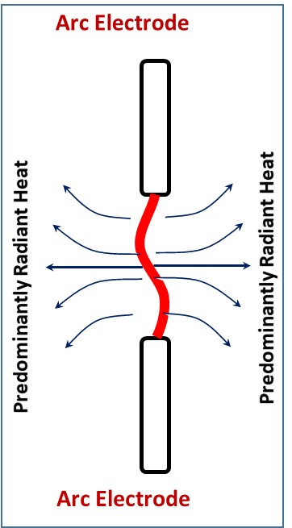
1) Open Air Arc
Two electrodes are in line
High and medium voltage vertical “butted” electrodes in open air
Arc vertical position plasma jets oppose and rotate.
High radiant heat energy component
Bright light
Stable and stationary arc
Arc duration is equal to fault duration
Thermal energy is dissipated equally in all radial directions
Skin burn and non-FR clothing ignition occurs through radiant heat transmission (light)
Notes:
Open air electric arc is the medium and high voltage arc burning in open air with no enclosure around it as shown on this slide. Open air arc is stable and will last until protective device clears the fault. The shape of the plasma channel can be described as a cylinder. The heat energy is dissipated equally in all directions predominantly through radiated light.
Potentially an open air arc can be started as a result of:
a) bushing flashover at high and medium voltage transformer (power and instrument) or breaker.
b) flashover of a support and suspension insulators of power lines.
c) flashover at substation buswork.

Slide 46
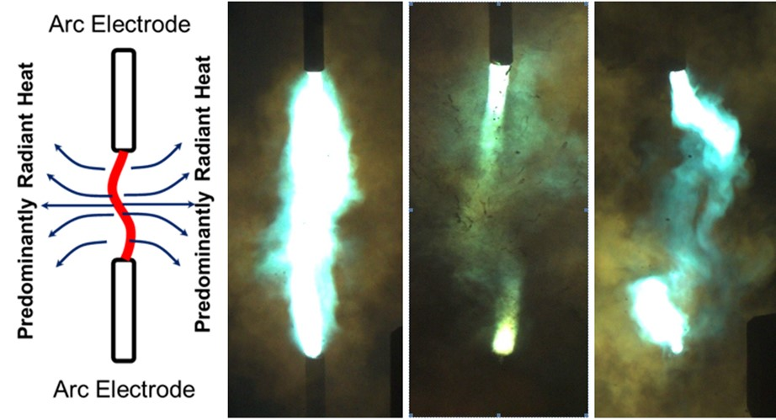
High and Medium Voltage Open Air Arc
Golovkov et al., 2017
Notes:
The in-line electrode geometry of the open air arc does not generate electromagnetic interaction between current flowing in electrodes and current in the electric arc plasma channel that would force the plasma channel out of and away from the arc gap. Which means outside of the path of the arc, worker injuries probably will not occur.
Electromagnetic forces only cause spinning of arc jets in electrode area as seen at this photo.

Slide 47
Example of Open Air Arc in the Lab
Video: Open air arc
https://www.youtube.com/watch?v=r5mikbrGhtg&feature=youtu.be
OR
https://ucmo.hosted.panopto.com/Panopto/Pages/Viewer.aspx?id=d902ecd6-1ffb-4d37-a36d-ac24013a8f05
Example video of open air arc recorded in the lab is shown at this slide.
Although arc jets are spinning and deviating from strictly vertical, arc plasma channel is still in electrode gap and connecting arc jets. The temperature of arc jets is higher than in the middle of arc channel, therefore, arc jets are brighter in the video.
Notes:
Example of open air arc video recorded in the lab is shown at this slide. Although arc jets are spinning and deviating from strictly vertical, arc plasma channel is still in electrode gap and connecting arc jets. The temperature of arc jets is higher than in the middle of arc channel, therefore, arc jets are brighter in the video.

Slide 48
Open Air Arc in the Field
Video: Open air arc overhead line
https://www.youtube.com/watch?v=6sxGj_WAZu8&feature=youtu.be
OR
https://ucmo.hosted.panopto.com/Panopto/Pages/Viewer.aspx?id=05fbcf62-31f7-4d57-a7ef-ac24013a813c
Video: Open air arc and two men
https://www.youtube.com/watch?v=31-xHIldNaY&feature=youtu.be
OR
https://ucmo.hosted.panopto.com/Panopto/Pages/Viewer.aspx?id=31ef67e5-ad15-46f2-8f00-ac24013a77e8
Notes:
These two video clips are real life examples of open air arc. Important for protection is that arc is stable, it is staying in the gap, and thermal energy is dissipated equally in all radial directions.

Slide 49
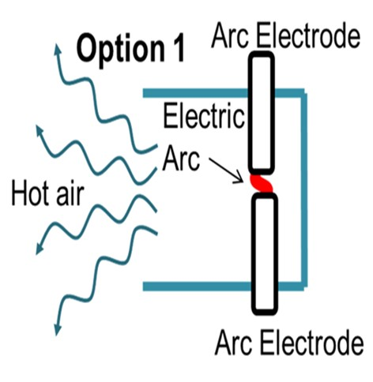
2) Box Arc
Low voltage can sustain only short arcs
Only hot air is out of the box. No “plasma ball”.
In a closed box electric arc generates high temperature resulted in high pressure build up and rupture of an enclosure
Notes:
Arc in a box is the low voltage electric arc in enclosure. Thermal energy is dissipated though only one side open for the performed task or because of lock or hinge failure. Arc electrodes could be in-line or parallel with a short gap.
Typically the nominal voltage of electrical installations is between 400 volts and 1000 volts. The low voltage arc can exist only in short gaps of 2 inches or less. Sustainable electric arc in 120 volts equipment is unlikely, and in 240 volts equipment the low voltage arc can or cannot be sustained, depending on design. Generally the design spacing (arc gap in a potential electric arc event) between phases is too large for the voltage of 120 volts or 240 volts to support a stable and lasting arc.
Arc in a box could be more dangerous than an open air arc. With an arc in a box, all of the energy is concentrated in a focused path usually straight out the door where workers are standing.
Typical of nearly all arc events in industrial electrical equipment (MCC’s, panelboards, switchgear, meter sockets, etc.).

Slide 50
Box Arc Examples in the Lab
Video: box arc in the lab
https://www.youtube.com/watch?v=hTXvK0RfA8U&feature=youtu.be
OR
https://ucmo.hosted.panopto.com/Panopto/Pages/Viewer.aspx?id=12d36796-79fe-4e63-9b99-ac24013a6d52
Video: box arc with mannequin
https://www.youtube.com/watch?v=9QjF9NFQbCk&feature=youtu.be
OR
https://ucmo.hosted.panopto.com/Panopto/Pages/Viewer.aspx?id=1dd7d0f5-8ad7-46aa-bcfb-ac24013a5bba
Notes:
Arc plasma channel is not visible outside the box because of a very short arc length. The plasma channel is all inside the enclosure and only the exhaust of very hot air through one open side can be seen. Hot air is mistaken by many for arc or plasma cloud. In reality the arc is always inside the box.

Slide 51
Box Arc in the Field
Video: Arc in a box two men
https://www.youtube.com/watch?v=NL08y0Ojj7I&feature=youtu.be
OR
https://ucmo.hosted.panopto.com/Panopto/Pages/Viewer.aspx?id=398125b2-bb19-4215-9b33-ac24013a423f
Video example of box arc in the field is shown in this slide.
Video of two electricians who are working in low voltage panel. Wearing protection, Wearing protection, left electricians unharmed in this case.
Notes:
Example of box arc is shown in the next video of two electricians who are working in low voltage panel. Wearing protection, left electricians unharmed in this case.

Slide 52
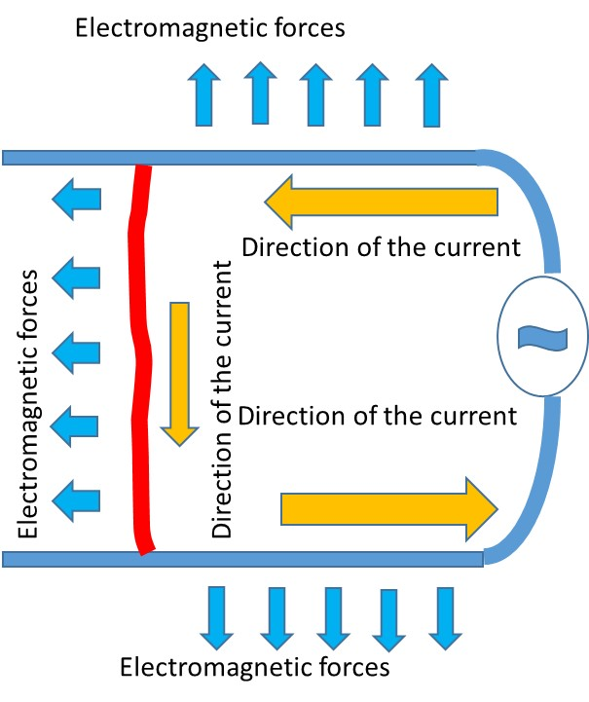
3) Moving Arc
Arc travels along conductors
Can deliver heat energy to a worker form a distance
Especially Dangerous when staying between conductors
Limited exposure when staying on the side.
Notes:
Moving arc is the medium or high voltage arc in open air propagating between the two long parallel conductors. Arc current flowing through the ionized plasma channel interacts electromagnetically with fault currents flowing in conductors. As the result, the plasma channel is forced to move along the conductors in the direction away from the power source such as generation station or feeding substation.

Slide 53
Moving Arc Example in the Lab
Video: Moving arc in the lab
https://www.youtube.com/watch?v=neHYuTcRZfw&feature=youtu.be
OR
https://ucmo.hosted.panopto.com/Panopto/Pages/Viewer.aspx?id=22a9b085-7478-45c5-aa2b-ac24013a15b2
Notes:
This video shows a moving arc plasma channel which is generally contained within the arc gap between parallel conductors where the arc is not stationary. Heat energy dissipation is equal in all directions and radiated light is similar to the open air arc except that the source of radiated light is moving.

Slide 54
Moving Arc in the Field
Video: Moving arc in the field
https://www.youtube.com/watch?v=So0Fu12ToVU&feature=youtu.be
OR
https://ucmo.hosted.panopto.com/Panopto/Pages/Viewer.aspx?id=29ddd75f-aae6-45eb-a79e-ac24013a1433
Notes:
This video is a real-life example of moving arc between two conductors in the field.

Slide 55
Moving Arc in the Field and Linemen
Video: Moving arc in the field with two men
https://www.youtube.com/watch?v=p3UNTpSUOPI&feature=youtu.be
OR
https://ucmo.hosted.panopto.com/Panopto/Pages/Viewer.aspx?id=a8f5a66b-2c8a-4e4a-b54c-ac240139f247
Notes:
This video shows two linemen exposed to a moving arc. Velocity of the moving arc is dependent on fault current magnitude and can reach more than 100 miles per hour. Such high velocity is reducing the time of potential arc exposure for a worker if he/she is on the side of the line.
The measured incident energy in experiments on the side of the line and at the distance of 12 inches was below 2 cal/cm². Low heat exposure from the moving arc at the side of the line does not require specific testing.
Intentionally or not, workers have chosen safest positions for the task: one is staying at the side of the line and another is under and at the power source side relatively work site. Both positions are out of arc reach. Clothing and other PPE are not even slightly scorched.
Jumping ahead into Module 2 “arc protection”. These videos are examples of how hazard assessments and work planning must consider arc type because that knowledge helps avoid arc exposure altogether. For example, a worker is not stuck in a bucket helpless in the path of an electric arc if a bucket is properly positioned. There would have been different outcome had worker positioned between phases. Direct contact with arc plasma channel (a minimum of 5,000C°) would have been unavoidable.

Slide 56
Moving Arc Example: Position Between Conductors
Video: Moving arc between wires
https://www.youtube.com/watch?v=nPlY-cqKAWI&feature=youtu.be
OR
https://ucmo.hosted.panopto.com/Panopto/Pages/Viewer.aspx?id=4a2bcfeb-2df0-4594-b3b8-ac240139ce72
Notes:
Video example shown in this slide is of moving arc effect on fabric positioned between conductors.
There would have been different outcomes if worker was positioned between phases and direct contact with arc plasma channel (a minimum of 5,000C) would have been unavoidable.
Dangerous when staying between conductors.

Slide 57
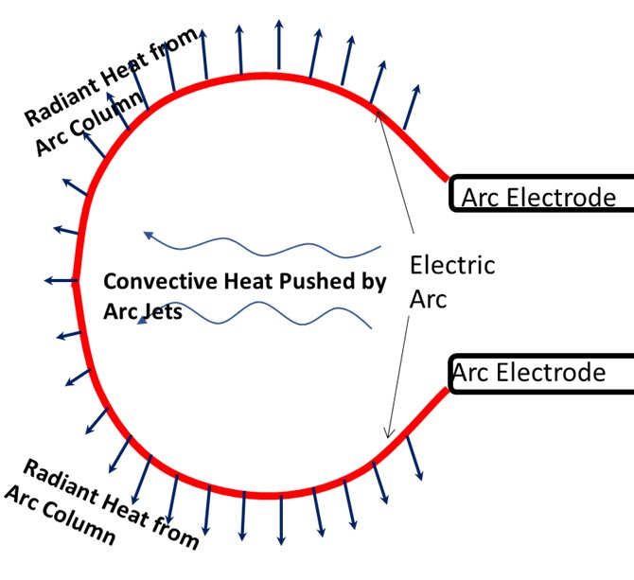
4) Ejected Arc
Moving arc reaches the end of line.
Arc elongates and extends to far away from electrodes
Delivers temperatures in excess of 5,000 degrees to worker
Notes:
Ejected arc is a medium or high voltage arc formed at the tips of parallel conductors or electrodes. The same way as for the moving arc, ejected arc current flows through the ionized plasma channel and interacts electromagnetically with fault currents flowing in conductors. As a result, the arc plasma channel is forced out of the gap between conductors; the channel is elongated and changes its shape from a column to nearly a circle.
Both the radiant energy component from the plasma channel and convective heat component strengthened by the arc jets from the electrode tips are strong.

Slide 58
Ejected Arc Example in the Lab
Video: Moving arc into ejected
https://www.youtube.com/watch?v=liGi7oKOnvk&feature=youtu.be
OR
https://ucmo.hosted.panopto.com/Panopto/Pages/Viewer.aspx?id=7df77cc9-8cd9-46c1-8778-ac240139bdd8
Notes:
This video demonstrates one example of an ejected arc forming when the moving arc reaches the end of long parallel conductors.

Slide 59
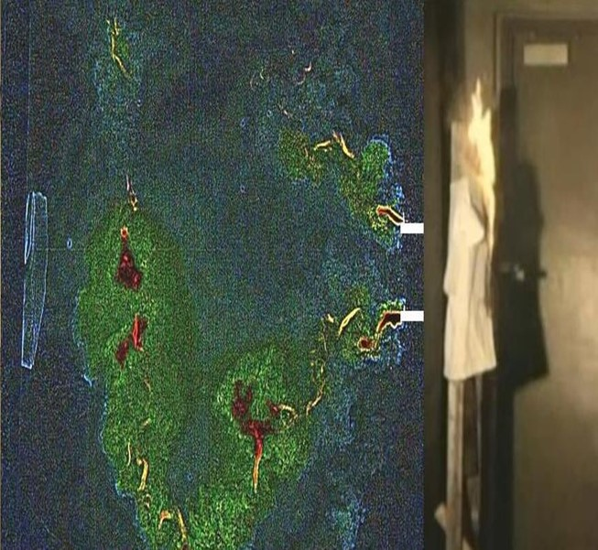
Ejected Arc Capable to Ignite non-FR From a Distance
Video: Ejected arc with mannequin
https://www.youtube.com/watch?v=Lb27IKqhKQc&feature=youtu.be
OR
https://ucmo.hosted.panopto.com/Panopto/Pages/Viewer.aspx?id=24664a05-9486-4d10-a302-ac240139a046
Ignition of non-FR T-shirt
6.5 ft away
Notes:
This video shows ignition of non-FR T-shirt 6.5 ft away. Most importantly, the ejected arc elongation and corresponding heat energy dissipation are generally very directional. Ejected arc is elongated in the direction of an imaginary continuation of parallel arc electrodes.

Slide 60
Ejected Arc in the Field
Video: Ejected arc at a high voltage substation
https://www.youtube.com/watch?v=ROEz9eW6Tjk&feature=youtu.be
OR
https://ucmo.hosted.panopto.com/Panopto/Pages/Viewer.aspx?id=611aefa9-e791-4a9b-b414-ac2401397eb4
Notes:
Notice in this video the sustained ejected arc event driven by the magnetic forces on the plasma channel. While the result can exceed the rating of arc PPE, it can also be countered by proper body positioning.

Slide 61
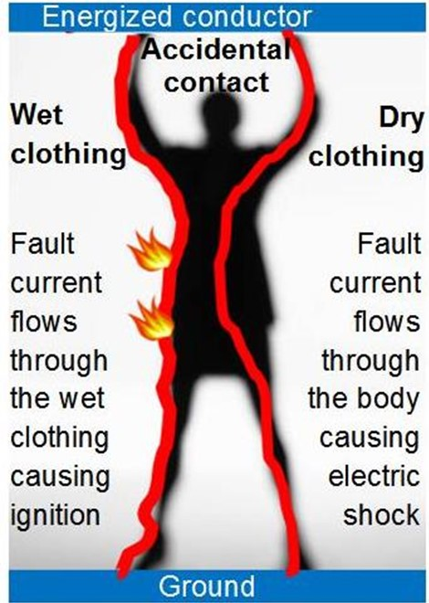
5) Tracking Arc (wet clothing or skin )
A conductor (ex. human) bridges the hot line and ground
Current passing through the wet conductive clothing
Can cause both electrocution and fire
Can cause ignition of underlayer clothing
Notes:
High voltage on the skin surface or wet clothing can result in tracking arc.
Tracking arc is very different from all others because the arc follows a path underneath the person’s clothing where the wet under-clothing closest to the skin can ignite. The tracking arc is the electric arc that can occur on a worker’s wet, sweaty skin surface under the clothing as result of a worker having a direct or indirect contact with the energized part, or as a result of a worker approaching to the energized part. The tracking arc event represents a double hazard of electrocution and non-AR clothing ignition.
Current flows along the wet skin surface or in wet clothing instead of through the body. This type of arc is especially dangerous because it can propagate underneath the arc flash PPE and ignite flammable undergarments, leading to very serious whole-body burns.

Slide 62
Tracking Arc Example in the Field
Video: Tracking arc stick on HV line
https://www.youtube.com/watch?v=TaDJQkGdYVI&feature=youtu.be
OR
https://ucmo.hosted.panopto.com/Panopto/Pages/Viewer.aspx?id=9aab45d1-74fb-4cea-8013-ac2401397fce
Notes:
This video clip explains the mechanism of tracking arc formation. Wet clothing, or in this case a tree branch containing moisture shown in this video, has limited impedance (resistance). Moisture is reducing the impedance to cause current to flow through but not low enough to cause short circuit. Current flowing through conductor (for example, wet clothing) is always heating it up causing moisture evaporation and partial localized spot drying. These high impedance dry spots now connected in series with low impedance wet skin and clothing sections result in high voltage across dry spots. Partial arc starting continues to bridge dry spots further reducing impedance and shortening wet length. Then more evaporation is evident from the video. The process will lead to flash-over.
In case of wet or sweaty flammable (non FR) clothing or under-layer, partial arc will ignite non FR undergarments. Wet skin burn is expected because of arc tracking.

Slide 63
Tracking Arc Examples: Man on the Train
Video: Tracking arc man and contact wire
https://ucmo.hosted.panopto.com/Panopto/Pages/Viewer.aspx?id=5ed2fb4b-6a15-4fbf-97ed-ac280160b0ce
OR
https://drive.google.com/file/d/1HX3HmwdbGd_9-5J2pGinqD43v2ZWH_xL/view
Video example of tracking arc on approach to energized conductors is shown in this slide.
There are two separate arc events captured in the video. The first one was likely a tracking arc along sweat skin. Wet skin diverted current from flowing through the body and saving person from electric shock. However, the second arc event did cause electric shock as the skin dried as a result of first arc event. This man collapsed afterwards.
Notes:
Most commonly tracking arc can be initiated under following conditions:
Accidental direct contact with medium voltage energized conductor or touching lifting or other construction machinery while the machinery is accidentally coming into contact with a medium voltage energized conductor, and the worker’s non-arc rated (AR) clothing or underlayer is wet from sweat or rain.
Approaching an energized conductor at a short enough distance to cause flashover. Electric arc flows onto the worker’s body where the arc will cause ignition of non-AR clothing.
Wet clothing becomes accidentally grounded causing flashover and fault current flowing through wet clothing and igniting non-AR clothing.
This video is an example of tracking arc on approach to energized conductors. There are two separate arc events captured in the video. The first one was likely a tracking arc along sweat skin. Wet skin diverted current from flowing through the body and saving person from electric shock. However, the second arc event did cause electric shock as the skin dried as a result of first arc event. This man collapsed afterwards.

Slide 64
Tracking Arc and Electrocution in the Field
Video: Tracking arc accident on 4 painters
https://ucmo.hosted.panopto.com/Panopto/Pages/Viewer.aspx?id=20767fc8-8928-4c74-b2de-ac280160b09a
OR
https://drive.google.com/file/d/1h3P-uNw9x6DlVN_wT2jl6051gbivLyJ9/view
Video example of tracking arc and electrocution in the field is shown in this slide.
This accident involved electric shock and electrocution as well as tracking arc and clothing ignition.
There were four non-electrical workers involved in the accident with several different individual outcomes.
Notes:
Next video is very gruesome as it led to fatalities. But we can learn from it. This accident involved electric shock and electrocution as well as tracking arc and clothing ignition. Original video is about 10 minutes long and this version is compilation of several important episodes.
There were four non electrical workers involved in the accident with several different individual outcomes. We will identify them by letters N, E, S, and W by their “geographical” location.
This accidental indirect contact to energized conductor occurred through moving scaffolding. Event started as electric shock for all workers. Apparently scaffolding kept energized for a long time and beyond the duration of the video.
Worker N was unable to recover from the shock and was motionless after it. Electric shock survival depends on age and individual heal condition of the victim.
Workers E and W were still in contact with energized scaffolding and a floor. They were still down but they were moving and apparently recovered from initial electric shock. Clothing must be wet to divert current from flowing through the body to mitigate lethal shock. However tracking arc was initiated igniting clothing and causing large are and apparently fatal skin burn.
Worker S was not touching energized scaffolding, did not have tracking arc and ignition of his clothing. He was the only survivor because of that. He recovered from initial electric shock, tried to run away, got another shock, recovered again and finally escaped from the scene.

Slide 65
Type of Arc - Summary
Any hazard assessment, incident investigation, or PPE selection is incomplete without first and foremost knowing type of arc
Knowledge of expected arc type help organizing and setting up safe workplace
Thermal energy dissipation is often directional depending on arc type
Direction of thermal energy dissipation is predictable
Notes:
Working de-energized is always preferable but when live working cannot be avoided completely, strict OSHA rules are legally required and must be followed. Energized work is only permitted when it can be demonstrated that energized work is necessary. OSHA has strict requirements when energized work is permitted. These regulatory requirements are addressed in Module 3.
Knowing what to expect, a complete job briefing and risk assessment along with preparedness is a key for safe work and survival when something goes wrong for energized work. We believe that knowledge of electric arc behavior, electric arc types and awareness of what type to expect for your task can be a real lifesaver.

Slide 66
Conclusions for Module 1
Electric hazards in wind construction and maintenance are electric shock and electric arc
Multiple video material demonstrated example of how electric hazards can impact human body and human body reaction
Electric current not voltage cause damage resulting from electric shock
Not all arcs are burn equal
Arc properties and types are discussed in detail using video materials.
Notes:
These are takeaways from this part of the training course.
In Module 2 we will discuss protection from electrical hazard, properties of FR materials and FR and arc rated PPE.

Slide 67
Post-training Quiz
1. Which is the primary contributing factor for occupational fatality when exposed to electricity?
a) voltage b) current
2. What is the threshold level of current that can cause heart fibrillation?
a) 1 mA b) 10 mA c) 20 mA d) 100 mA
3. How many types electric arc can be classified into?
a) all arcs are the same b) 2 types
c) 3 types d) 4 types e) 5 types
4. What is the most common hazardous effect of electric arc for a human body?
a) sound wave b) thermal energy c) bright light d) electric shock
Notes:
Now we would like to take another quiz. Please circle just one choice as your best answer to each question.
Answers: 1-b; 2-d; 3-e; 4-b.

Slide 68
Questions?

