Slide 1
Training Requirements in OSHA Standards

Slide 2
Sponsorship
Department of Labor
Occupational Health and Safety Administration (OSHA)
Susan Harwood Training Grant
This material was produced under Susan Harwood grant number SH-22315-SH11 Occupational Safety and Health Administration, U.S. Department of Labor. The contents in this presentation do not necessarily reflect the views or policies of the U.S. Department of Labor, nor does the mention of trade names, commercial products, or organizations imply endorsement by the U.S. Government.
Revisions were made to this material under grant number SH-05059-SH8 from the Occupational Safety and Health Administration, U.S. Department of Labor.
Notes:
Introduce the class with brief overview:
This project will deliver occupational health and safety training to new and established small businesses with less than 250 employees; included in this targeted population are limited English proficiency workers, non-literate/low literacy workers, young workers, temporary workers, minority and other hard-to-reach- workers, and workers in high-hazard industries.

Slide 3
Document Everything
Document Everything!

Slide 4
Section One
OSHA

Slide 5
Lesson Overview
Purpose:
To provide introductory information about OSHA
Topics:
Why is OSHA important to you?
What rights do you have under OSHA?
What responsibilities do you have under OSHA?
What do the OSHA standards say?
How are OSHA inspections conducted?
Where can you go for help?
Notes:
Overview and learning objectives

Slide 6
Why is OSHA Important to You?
OSHA was created because, until 1970, there were no national laws for safety and health hazards.
In 1970 there were an estimated 14,000 workplace fatalities
In 2017 there were 5,147 workplace fatalities
In 2017 there were 2.8 million non-fatal workplace injuries reported

Slide 7

History of OSHA
OSHA stands for the Occupational Safety and Health Administration, an agency of the U.S. Department of Labor
OSHA’s responsibility is worker safety and health protection
On December 29, 1970, President Nixon signed the OSH Act
This Act created OSHA, the agency, which formally came into being on April 28, 1971

Slide 8
OSHA’s Mission
The mission of OSHA is to ensure safe and healthful working conditions for working men and women by setting and enforcing standards and by providing training, outreach, education and assistance..
Some of the things OSHA does to carry out its mission are:
develop job safety and health standards and enforce them through worksite inspections,
maintain a reporting and recordkeeping system to keep track of job-related injuries and illnesses, and
provide training programs to increase knowledge about occupational safety and health.
Notes:
Review OSHA’s mission to preserve life and reduce accidents, injuries and fatalities

Slide 9
General Duty Clause
Section 5(a)(1) of the OSH Act states:
(a)Each employer –
shall furnish to each of his employees employment and a place of employment which are free from recognized hazards that are causing or are likely to cause death or serious physical harm to his employees;
(2)shall comply with occupational safety and health standards promulgated under this Act.
(b)Each employee shall comply with occupational safety and health standards and all rules, regulations, and orders issued pursuant to this Act which are applicable to his own actions and conduct.

Slide 10
What Rights Do Employees Have Under OSHA?
You have the right to:
A safe and healthful workplace
Know about hazardous chemicals
Information about injuries and illnesses in your workplace
Complain or request hazard correction from employer
Training
Hazard exposure and medical records
File a complaint with OSHA
Participate in an OSHA inspection
Be free from retaliation for exercising safety and health rights
Notes:
Rights under OSHA Act

Slide 11
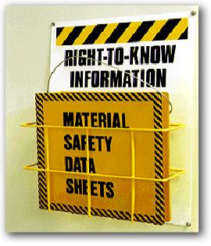
Your Right to…
Know About Hazardous Chemicals
Employers must have a written, complete hazard communication program that includes information on:
Container labeling
Safety Data Sheets (SDSs)
Worker training. The training must include the physical and health hazards of the chemicals and how workers can protect themselves; including specific procedures the employer has implemented to protect workers, such as work practices, emergency procedures, and personal protective equipment

Slide 12
Your Right to… Know About Workplace injuries and Illnesses
OSHA’s Recordkeeping rule requires most employers with more than 10 workers to keep a log of injuries and illnesses
Workers have the right to review the current log, as well as the logs stored for the past 5 years
Workers also have the right to view the annually posted summary of the injuries and illnesses (OSHA 300A)

Slide 13
Your Right to… Request Workplace Safety Corrections
Workers may bring up safety and health concerns in the workplace to their employers without fear of discharge or discrimination, as long as the complaint is made in good faith
OSHA regulations [29CFR 1977.9(c)] protect workers who complain to their employer about unsafe or unhealthful conditions in the workplace

Slide 14
Your Right to… Training
Workers have a right to get training from employers on a variety of health and safety hazards and standards that employers must follow

Slide 15
Your Right to… Medical Records
Review the Log and Summary of Occupational Injuries and Illnesses (OSHA 300) at a reasonable time and in a reasonable manner or have an authorized representative do so for you.
Employers must inform you of the existence, location and availability of your medical and exposure records when you first begin employment and at least annually thereafter. Employers also must provide these records to you or your designated representatives within 15 working days of your request.

Slide 16
Your Right to… Hazard Exposure Records
Observe any monitoring or measuring of toxic materials or chemicals, as well as harmful physical agents, such as noise, and see the resulting records. If the exposure levels are above the OSHA limit, the employer must tell you what will be done to reduce the exposure.

Slide 17
Your Right to… File a complaint with OSHA
Workers may file a complaint with OSHA if they believe a violation of a safety or health standard, or an imminent danger situation, exists in the workplace
Workers may request that their name not be revealed to the employer
If a worker files a complaint, they have the right to find out OSHA’s action on the complaint and request a review if an inspection is not made

Slide 18
Your Right to…Participate in an OSHA Inspection
Employee representative can accompany OSHA inspector
Workers can talk to the inspector privately
Workers may point out hazards, describe injuries, illnesses or near misses that resulted from those hazards and describe any concern you have about a safety or health issue
Workers can find out about inspection results, abatement measures and may object to dates set for violation to be corrected

Slide 19
Your Right to… Be Free From Retaliation
Workers have the right to be free from retaliation for exercising safety and health rights
Workers have a right to seek safety and health on the job without fear of punishment
This right is spelled out in Section 11(c) of the OSH Act
Workers have 30 days to contact OSHA if they feel they have been punished for exercising their safety and health rights

Slide 20
Employer Responsibilities Under OSHA?
Provide a workplace free from recognized hazards and comply with OSHA standards
Provide training required by OSHA standards
Keep records of injuries and illnesses
Provide medical exams when required by OSHA standards and provide workers access to their exposure and medical records
Not discriminate against workers who exercise their rights under the Act (Section 11(c))
Post OSHA citations and abatement verification notices
Provide and pay for PPE

Slide 21
Employers are Required to:
Reporting and Recording Checklist
Employers must:
Report each worker death
Report each incident that hospitalizes workers
Report amputations and eye loss
Maintain injury & illness records
Inform workers how to report an injury or illness to the employer
Make records available to workers
Allow OSHA access to records
Post annual summary of injuries & illnesses

Slide 22
What do the OSHA Standards Say?
CFR numbers for OSHA standards:
Recordkeeping - 1904
General Industry - 1910
Construction - 1926
Maritime – 1915, 1917, 1918
Agriculture - 1928
OSHA issues standards for a wide variety of workplace hazards
Where there are no specific OSHA standards, employers must comply with The General Duty Clause, Section 5(a)(1)

Slide 23
Frequently Cited Standards
OSHA homepage chose Data tab, under Date chose Data and Statistics, on Data and Statistics page look under Inspection Data and choose Frequently Cited OSHA Standards.
To search Frequently Cited data:
“Select number of employees in establishment,” select ALL or one of the options listed
“Federal or State Jurisdiction,” select Federal or, from the dropdown menu, a specific state
Enter NAICS number or leave blank for complete list
Shown are search results for: All sizes of establishments, in Federal jurisdiction, by NAICS number

Slide 24
How Are OSHA Inspections Conducted?
The OSH Act authorizes OSHA Compliance Safety and Health Officers (CSHOs) to conduct workplace inspections at reasonable times
OSHA conducts inspections without advance notice, except in cases of Imminent Danger.
Anyone who tells an employer about an OSHA inspection in advance can receive fines and a jail term

Slide 25
OSHA Inspection Priority
Priority Category of Inspection
1st Imminent Danger:
Reasonable certainty an immediate danger exists
2nd Fatality/Catastrophe:
Reported to OSHA; inspected ASAP
3rd Complaints/Referrals:
Worker or worker representative can file a complaint
about a safety or health hazard
4th Programmed Inspections:
Cover industries and employers with high injury and
illness rates, specific hazards, or other exposures

Slide 26
Citations and Penalties
Violation Type WILLFUL
A violation that the employer intentionally and knowingly commits or a violation that the employer commits with plain indifference to the law.
SERIOUS
A violation where there is substantial probability that death or serious physical harm could result and that the employer knew, or should have known, of the hazard.
OTHER-THAN-SERIOUS
A violation that has a direct relationship to safety and health, but probably would not cause death or serious physical harm.
REPEATED
A violation that is the same or similar to a previous violation.
Penalty
OSHA may propose penalties of up to $70,000 for each willful violation, with a minimum penalty of $5,000 for each willful violation.
There is a mandatory penalty for serious violations which may be up to $7,000.
OSHA may propose a penalty of up to $7,000 for each other-than-serious violation.
OSHA may propose penalties of up to $70,000 for each repeated violation.

Slide 27
Where Can you Go For Help?
Sources within the workplace/worksite
Employer or supervisor, co-workers and union representatives
Safety Data Sheet (SDS) for information on chemicals
Labels and warning signs
Employee orientation manuals or other training materials
Work tasks and procedures instruction
Sources outside the workplace/worksite
OSHA website: http://www.osha.gov and OSHA offices (you can call or write)
Compliance Assistance Specialists in the area offices
National Institute for Occupational Safety and Health (NIOSH) – OSHA’s sister agency
OSHA Training Institute Education Centers
Doctors, nurses, other health care providers
Public libraries
Other local, community-based resources

Slide 28
Summary
This section covered:
The importance of OSHA, including the history of safety and health regulation leading to the creation of OSHA and OSHA’s mission
Worker rights under OSHA
Employer responsibilities
OSHA standards
OSHA inspections
Safety and health resources, including how to file a complaint

Slide 29

OSHA Recordkeeping Requirements
OSHA Recordkeeping Requirements

Slide 30
OSHA Recordkeeping Requirements 29 CFR 1904
OSHA’s reporting and recordkeeping regulations require employers to:
Maintain records, in each establishment, of occupational injuries and illnesses as they occur, and make those records accessible to employees.
Post, from February 1 through April 30, an annual summary of occupational injuries and illnesses for each establishment.
A senior company executive must certify the accuracy of the summary.

Slide 31
OSHA Recordkeeping Requirements 29 CFR 1904
Employers must:
Record any fatality regardless of the length of time between the injury and the death
Provide, upon request, pertinent injury and illness records for inspection and copying by any representative of the Secretaries of Labor or HHS, or the state during any investigation, research, or statistical compilation
Comply with any additional recordkeeping and reporting requirements in specific OSHA standards

Slide 32
OSHA Recordkeeping Requirements 29 CFR 1904 cont.
Employers with multiple worksites must keep injury and illness records for each establishment
OSHA defines an establishment as a “single physical location where business is conducted or where services are performed”
An employer whose employees work in dispersed locations must keep records at the place where the employees report for work
In some situations, employees do not report to work at the same place each day. In that case, records must be kept at the place from which they are paid or at the base from which they operate

Slide 33
Completing the OSHA Recordkeeping Forms
A review of the recordkeeping requirements and forms:
Requirement to complete the forms and evaluate specific exceptions
The forms in OSHA’s recordkeeping package
Recording criteria for injuries and illnesses
Recording injuries/illnesses on the forms

Slide 34
Who has to complete the OSHA injury and illness recordkeeping forms?
Many, but not all, employers. Exceptions are based on:
Small employer exemption – 10 or fewer employees at all times during the year
Low-hazard industry exemption
Fatality/catastrophe reporting and injury and illness surveys
Notes:
Many but not all employers must complete the OSHA injury and illness recordkeeping forms on an ongoing basis.
Employers with 10 or fewer employees throughout the previous calendar year do not need to complete these forms. Said another way, if there are more than 10 employees at any time during that calendar year, the employer may come under the requirement. When counting employees, you must include full-time, part-time, temporary, and seasonal workers. This exemption is based on the employment of the entire company rather than the establishment. For example, if a company has two establishments, one with 5 employees and one with 7 employees, the company must fill out the forms for each establishment because the company employment is greater than 10.
In addition to the small employer exemption, there is an exemption for establishments classified in certain industries. For example, the forms do not need to be completed for restaurants, banks, and medical offices. A complete list of exempt industries can be found on the Recordkeeping page by using the Partially Exempt Industries link.
Establishments normally exempt from keeping the OSHA forms must complete the forms if they are informed in writing to do so by the Bureau of Labor Statistics or OSHA. Also, exempt establishments must report to the local OSHA office within 8 hours any fatality or incident involving three or more in-patient hospitalizations.

Slide 35
What forms must be completed?
OSHA Form 300 – Log of Work-Related Injuries and Illnesses
OSHA Form 301 – Injury and Illness Incident Report
OSHA Form 300A – Summary of Work-Related Injuries and Illnesses
Notes:
There are three forms you--the employer--must complete. OSHA forms 300 and 301 are maintained on an ongoing basis. Recordable injuries and illnesses must be entered on these forms as they occur throughout the year. The OSHA Form 300A is completed after the end of the year, summarizing the number of recordable cases that occurred. Employers may use equivalent forms in place of these forms as long as the equivalent forms contain all of the same data elements and are as easy to read as the OSHA forms.

Slide 36
What cases need to be recorded on the forms?
Injuries and illnesses
Work related
Meet certain severity criteria
Notes:
Any work-related injury or illness that meets certain severity criteria must be entered on the forms within 7 calendar days of learning about its occurrence. We’ll talk about each of these bullet items on the next few slides.

Slide 37
What is considered an injury or illness?
An abnormal condition or disorder
Not an exposure, unless it results in signs or symptoms
Notes:
OSHA defines an injury or illness as an abnormal condition or disorder. Injuries and illnesses include cases such as cuts, fractures, sprains, skin diseases, or respiratory conditions. For OSHA recordkeeping purposes, an injury or illness can also consist of only subjective symptoms such as aches or pain.
Exposures that do not result in signs or symptoms are not considered injuries or illnesses and should therefore not be recorded on the OSHA forms. For example, if an employee is exposed to chlorine and does not exhibit any signs or symptoms due to the exposure, the case would not be recorded on the Log, even if it involved prophylactic—that is, preventative--medical treatment.

Slide 38
What cases are work related?
Cases caused by events or exposures in the work environment
Cases contributed to by events or exposures in the work environment
Cases significantly aggravated by events or exposures in the work environment
(For a list of activities that are not work related, see section 1904.5(b)(2)
Notes:
Cases that are caused, contributed to, or significantly aggravated by events or exposures in the work environment are considered work related for OSHA recordkeeping purposes. Work-relatedness is presumed for injuries and illnesses occurring in the workplace or in locations where the employee is located as a condition of employment. It’s important to remember that if work makes any contribution to the injury or illness, it is considered work-related for OSHA recordkeeping purposes.
There are certain activities that occur in the work environment that OSHA does not consider work related. For example, injuries resulting directly from eating, drinking, or preparing ones own food at the workplace are not considered work related. For a complete list of these activities, refer to section 1904.5(b)(2) using the Regulatory Text link found on the Recordkeeping page.

Slide 39
What are the severity criteria for a work-related injury or illness?
Death
Loss of consciousness
Days away from work
Restricted work activity or job transfer
Medical treatment beyond first aid
Notes:
Work-related injuries and illnesses that result in death, loss of consciousness, days away from work, restricted work activity, transfer to another job, or medical treatment beyond first aid must be recorded on the OSHA forms. We’ll talk about these criteria on the next few slides.

Slide 40
Determining Which Work-Related Illnesses and Injuries to Record

Slide 41
Log of Work – Form 300

Slide 42
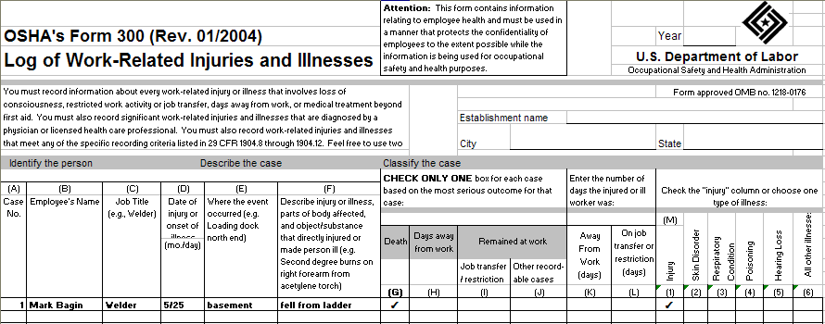
OSHA Form 300: Recording a Fatality
Notes:
For cases involving a fatality, enter a checkmark in column G on the OSHA Form 300. Note in column M whether the case involved an injury or an illness.
Also remember that you must call your local OSHA office and verbally report the fatality within 8 hours of learning of its occurrence. (For a listing of OSHA offices, see the map linked from the About OSHA page on osha.gov.)

Slide 43
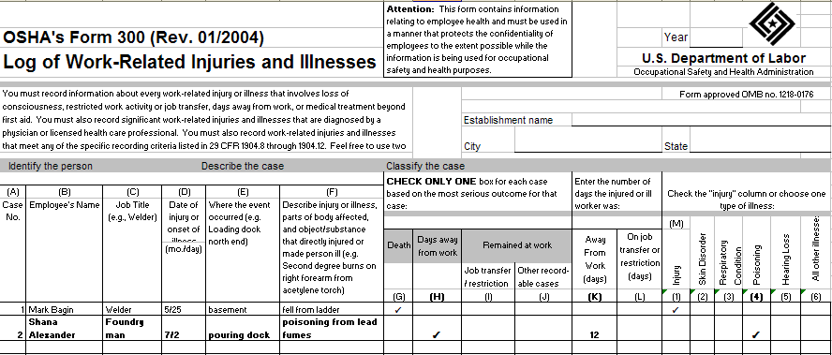
OSHA Form 300: Recording a Case with Days Away From Work
Notes:
For cases that involve one or more days away from work, you must place a checkmark in column H on the OSHA Form 300 and enter the number of calendar days the employee was away from work in column K. Then note in column M whether the case involves an injury or an illness.
When counting days, be sure to count the days the employee would not have been able to work regardless of whether he or she was scheduled to work. This would include weekends and holidays. Do not count the day of the injury. If the day count reaches 180 calendar days, you may stop counting subsequent days and enter 180 in column K.

Slide 44
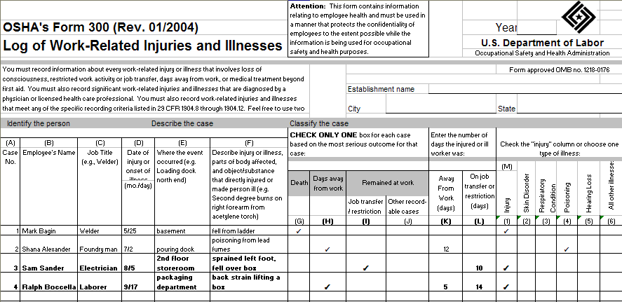
OSHA Form 300: Recording a Case with Restricted Work Activity or Job Transfer
Notes:
For cases that involve restricted work activity or job transfer, you must place a checkmark in column I on the OSHA Form 300 and enter the number of calendar days the employee was restricted in column L. You count the days in the same manner as counting days away from work. Then note in column M whether the case involves an injury or an illness.
An employee is considered restricted if he or she is unable to work a full shift or is unable to perform all of the work activities he or she would be expected to do at least once during a week.
If a case involves both days away from work AND days of restricted work activity, place a checkmark in column H, leave column I blank, and enter the correct day counts in both columns K and L. (For example, if an employee had 3 days away from work and 2 of restricted work activity, place a checkmark in column H and enter a 3 in column K and a 2 in column L.) Again, note in column M whether the case involves an injury or an illness.

Slide 45
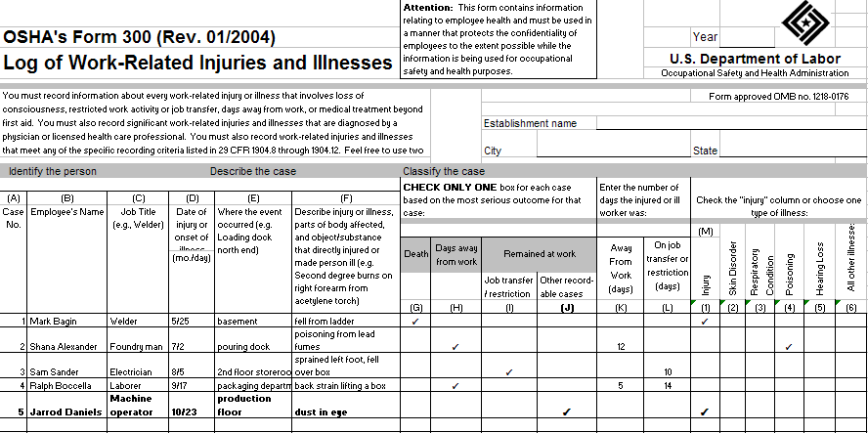
OSHA Form 300: Recording a Case with Medical Treatment beyond First Aid
Notes:
For cases that involve medical treatment beyond first aid, you must place a checkmark on the OSHA Form 300 in column J, which is for “other recordable cases.” Then note in column M whether the case involves an injury or an illness.
For OSHA recordkeeping purposes, medical treatment is any treatment for an injury or illness except diagnostic procedures, observation and counseling, and first aid. First aid consists of 14 specific treatments listed in section 1904.7(b)(5) of the regulatory text. It includes items such as non-prescription medication, wound coverings, and hot and cold treatment. You can access the complete list using the Regulatory Text link on this web page or by looking in the Overview section of the Recordkeeping Forms package (also linked from the Recordkeeping page).

Slide 46
OSHA 301, Injury and Illness Incident Report
Each employer must complete the OSHA 301 form within seven calendar days from the time the employer learns of the work-related injury or illness
This form includes more data about how the injury or illness occurred
Employees and former employees are guaranteed access to their individual OSHA 301 forms. Employee representatives will be provided access to the “information about the case” section of the OSHA 301 form in establishments where they represent employees

Slide 47
Form 301

Slide 48
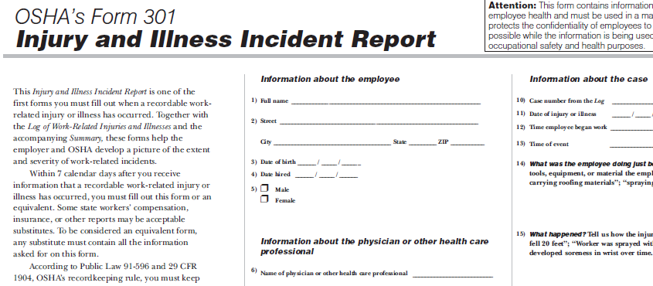
OSHA Form 301: Injury and Illness Incident Report
Notes:
You must fill out an Injury and Illness Incident Report for every recordable work-related injury or illness. Together with the Log of Work-Related Injuries and Illnesses and the accompanying Summary, these forms help the employer and OSHA develop a picture of the extent and severity of work-related incidents.
Within 7 calendar days after you receive information that a recordable work-related injury or illness has occurred, you must fill out this form or an equivalent. Some state workers' compensation, insurance, or other reports may be acceptable substitutes. To be considered an equivalent form, any substitute must contain all the information asked for on this form.

Slide 49
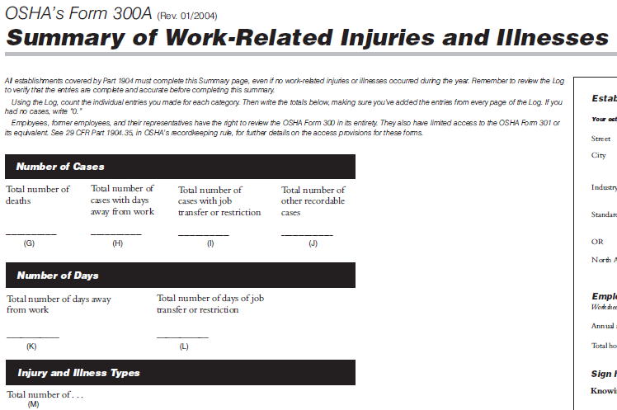
OSHA Form 300A: Summary of Work-Related Injuries and Illnesses
Notes:
All establishments covered by Part 1904 must complete the Summary of Work-Related Injuries and Illnesses, even if no injuries or illnesses occurred during the year. Remember to review the Log to verify that the entries are complete and accurate before completing this summary. Using the Form 300, count the individual entries you made for each category. Then, write the totals on the left side of the Form 300A, making sure you've added the entries from every page of the Log. If you had no cases, write in a zero.

Slide 50
Summary cont.

Slide 51
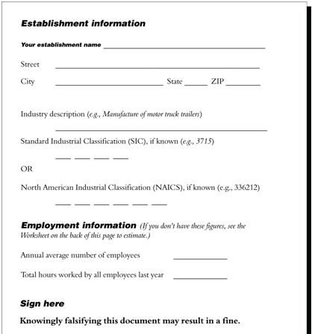
OSHA Form 300A: Information Gathering
Notes:
On the right side of the Form 300A, fill in the establishment information.
Also in this section of the form, a company official must certify that the entries on the summary are true, accurate, and complete. The certifying official must be the owner of the company, an officer of the corporation, the highest ranking company official at the establishment, or that person’s supervisor.
You must post a copy of the annual summary in each establishment in a conspicuous place or places where notices to employees are customarily posted. You must post it no later than February 1 of the year following the year covered by the records and keep the posting in place for three months until April 30.

Slide 52
Keep the Forms on File
File and update for 5 years
The recordkeeping regulation also requires establishments with 250 or more employees that are currently required to keep OSHA injury and illness records to electronically submit information from the OSHA Form 300A to OSHA annually.
Allow access to the records
Notes:
You must keep these forms on file for 5 years following the year to which they pertain. You must also update the Form 300 with any changes that may occur to the recorded cases during that period. The recordkeeping regulation also requires establishments with 250 or more employees that are currently required to keep OSHA injury and illness records to electronically submit information from the OSHA Form 300A to OSHA annually. You must make the forms available to employees, former employees, their representatives, and to OSHA officials upon request. (Note, however, that both the Log 300 and Form 301 incident reports will include information relating to employee health and thus can only be used in a manner that protects confidentiality to the extent possible while promoting occupational safety and health.) For details concerning the access provisions, refer to sections 1904.35 and 1904.40 using the Regulatory Text link on the Recordkeeping page.

Slide 53
Incident Investigation Procedure
Incident Investigation Procedure

Slide 54
Incident Investigation
Purpose
Prevent Injuries and Illness
Save Lives
Save Money
Demonstrate commitment to Health and Safety
Promote positive workplace morale
Improve management

Slide 55
Incident Investigation Worksite
Investigating a worksite incident— a fatality, injury, illness, or close call— provides employers and workers the opportunity to identify hazards in their operations and shortcomings in their safety and health programs
Most importantly, it enables employers and workers to identify and implement the corrective actions necessary to prevent future incidents
Incident investigations that focus on identifying and correcting root causes, not on finding fault or blame, also improve workplace morale and increase productivity, by demonstrating an employer’s commitment to a safe and healthful workplace

Slide 56
Incident Investigation Terms
Terms
Incident
Root Causes
Close Call
A work-related event in which an injury or ill‐health (regardless of severity) or fatality occurred, or could have occurred.
Underlying reason(s) for unsafe conditions.
Root causes generally reflect management, design, planning, organizational or operational failings
An incident that could have caused serious injury or illness but did not; also called a “near miss.”

Slide 57
Incident Investigation Approaches
Behavioral Safety Approach:
Incorrectly assumes that the majority of workplace incidents are simply the result of “human error” or “behavioral” failures
Systems Approach:
Concludes that carelessness or failure to follow a procedure alone was NOT the cause of an incident

Slide 58
Incident Investigation – Root Cause
Identifying Root Causes
The GOAL is to change the conditions under which people work by eliminating or reducing the factors that create unsafe conditions. This is typically done by implementing adequate barriers and safeguards against the factors that cause unsafe conditions or actions
Root causes often involve multiple deficiencies in the safety and health management programs. These deficiencies may exist in areas such as workplace design, cultural and organizational factors, equipment maintenance and other technical matters, operating systems and procedures, staffing, supervision, training, and others
Eliminating the immediate cause(s) is like cutting weeds, while eliminating the root cause(s) is equivalent to pulling out the roots of the weed

Slide 59
Incident Investigation - OSHA
A procedure should be in place to notify management of the incident.
OSHA must be notified of:
All work-related fatalities within 8 hours
All work-related inpatient hospitalizations, all amputations and all losses of an eye within 24 hours

Slide 60
Incident Investigation - 4 Steps
A Four-Step Systems Approach
1. Preserve & Document Scene
2. Collect Information
3. Determine Root Cause
4. Implement Corrective Actions

Slide 61
Incident Investigation – Step 1
STEP 1: Preserve & Document the Scene
Preserve the scene to prevent material evidence from being removed or altered
Investigators should document the scene by video recording, photographing or sketching
Document the injured employee’s name, injury description, whether they are temporary or permanent, date and location of the incident, and who is investigating

Slide 62
Incident Investigation – Step 2
STEP 2: Collect Information
Incident information is collected through interviews, document reviews, and other means
When interviewing injured workers and witnesses it is crucial to reduce their possible fear and anxiety, and to develop a good rapport. When conducting interviews, investigators should:
Conduct the interview in the language of the employee/interviewee; use a translator if needed.
Clearly state that the purpose of the investigation and interview is fact-finding, not fault-finding.

Slide 63
Incident Investigation – Step 2 cont.
Emphasize that the goal is to learn how to prevent future incidents by discovering the root causes of what occurred.
Establish a climate of cooperation; avoid anything that may be perceived as intimidating or in search of someone to blame
Let employee know that they can have an employee representative (e.g., labor representative), if available and/or appropriate
Ask the individuals to recount their version of what happened. Do not interrupt the interviewee
Take notes and/or record the responses; interviewee must give permission prior to being recorded

Slide 64
Incident Investigation – Step 3
STEP 3: Determine the Root Cause
The root causes are the underlying reasons why the incident occurred.
Root causes generally reflect:
Management, Design, Planning, or Operational failings
Determining the root cause is the result of persistently asking “why”
Determining the root cause is the most effective way to ensure the incident does not happen again

Slide 65
Incident Investigation - Step 3 cont.
Conclusions such as “worker was careless” or “employee did not follow safety procedures” don’t get at the root causes of the incident
To avoid incomplete and misleading conclusions in the investigative process, investigators need to continue to ask “why?” as in, “Why did the employee not follow safety procedures?”
If the answer is “the employee was in a hurry to complete the task and the safety procedures slowed down the work”, then ask, “Why was the employee in a hurry?”
The more and deeper “why?” questions asked, the more contributing factors are discovered and the closer the investigator gets to the root causes

Slide 66
Incident Investigation - Step 4
STEP 4: Implement Corrective Action
The investigation is not complete until corrective actions are implemented that address the root causes of the incident
Superficial conclusions such as "Bob should have used common sense," and weak corrective actions such as “Employees must remember to wear PPE”, are unlikely to improve safety culture or prevent future incidents
In planning corrective actions and how best to implement them, employers may find that some root causes will take time and perseverance to fix. Persisting in implementing substantive corrective actions, however, will not only reduce the risk of future incidents but also improve the company’s safety, morale and its bottom line

Slide 67
Section Two
Workplace
Safety
Program

Slide 68
Element #1
Management Commitment and Employee Involvement

Slide 69
Workplace Safety Program
What is a Workplace Safety Program?
A written plan to protect employees from work related illness and injury.
It consists of a company Environmental, Safety and Health Policy statement and the implementation of a work place safety plan and program.

Slide 70
Workplace Safety Program
Purpose- To reduce work-related injury & illness
Content- The program should include any policy, procedure, or training that protects workers from work-related injury and illness while on the job
Goals- Promote & reward safe practices at work, reducing injuries & illnesses at work and eliminating fatalities at work

Slide 71
Management/Leadership/Employee Involvement – 1 of 4
Employer and employee involvement and communication on workplace-safety and health issues is essential
Post the company’s written safety and health policy for all to see
Involve all employees in policy making on safety and health issues
Everyone must take an active part in Safety Activities

Slide 72
Management/Leadership/Employee Involvement 2 of 4
Management should promote the goal of ZERO ACCIDENTS
Safety Goals must be communicated effectively. They must be realistic and they need to reflect the Safety Culture of your organization
An effective Safety Culture requires strong commitment from the top. Safety must truly be the #1 priority. Safety must become an integral part of your business and it must become EVERYONE’s responsibility

Slide 73
Management/Leadership/Employee Involvement 3 of 4
Your plan should include statements on the value of workplace safety and why management is committed to it
A list of locations where written safety and health policies are posted for all employees to see
A schedule of when and where regular meetings are held that address employee safety and health issues
A stipulation that abiding by all safety and health rules is a condition of employment

Slide 74
Management/Leadership/Employee Involvement – slide 4
It is important to avoid conflicting management directives
Set an example by ensuring the entire message is appropriate
Management should never pressure employees to overlook safety in favor of speed
What are some messages that can give conflicting directives?
How an we be clearer in communicating directives?

Slide 75
Basic Principles of Good Safety Management
Management Commitment
Documented Safety Philosophy
Safety Goals and Objectives
Committee Organization for Safety
Line Responsibility for Safety
Supportive Safety Staff
Rules and Procedures
Audits
Safety Communications
Safety Training
Accident Investigations
Motivation

Slide 76
Basic Safety Philosophy
Every Incident can be avoided
No job is worth getting hurt for
Every job will be done safely
Incidents can be managed
Safety is everyone’s responsibility
Safety is part of best manufacturing practices
Safety standards, procedures and practices must be developed
Training- Everyone must understand AND meet the requirements
Working Safely is a Condition of Employment

Slide 77
Benefits of a Zero Incident Safety Policy
Improved Quality
Better Productivity
Team Building
Unsafe behavior stands out
Unsafe behavior is Unacceptable
Safe Work is influenced through peer pressure
Consistent planning and task execution

Slide 78
Key Safety Principles
Each employee is expected to give consideration to the prevention of injury to self and co-workers
Involvement and thinking of all people in the safety process is valued and expected
Continual Improvement is the goal
Individuals and teams must be recognized for their adherence to safe work practices

Slide 79
What a Safety Statement might look like
It is the intent of XYZ Industries to provide a safe work environment for all our workers and the wellness of our people, families and communities. We embrace healthy habits and behaviors. It is also our intent to properly manage any incidents that occur so as to minimize injury and other forms of loss. A well managed workplace safety program can benefit our company in countless ways. In order for XYZ Industries to achieve our goals, we have developed a safety program outlining our policies and procedures regarding employee health and safety. Each and every individual must become familiar with the program, follow and enforce the procedures, and become an active participant in this workplace safety program.
While management (workplace safety officer and safety committee) will be responsible for developing and organizing this program, its success will depend on the involvement of each employee. We look forward to your cooperation and participation.

Slide 80
Co-Workers Affect Each other’s Safety
Employees’ health and safety are affected not only by their own actions but by those of their co-workers
Senior management must help employees manage hazards associated with their work tasks or responsibilities. They must determine that employees are fit for work. Fitness involves: drug and alcohol issues, physical and emotional well being including fatigue and stress

Slide 81
Create Ownership of the program
Workers need to be involved in the creation and implementation of the Workplace Safety Program in order for it to succeed
For Example:
Your company is responsible for supplying appropriate safety equipment, but employees are responsible for wearing personal protective equipment at the appropriate time and place
Your company should provide training to help employees carry out their assignments, but workers are responsible for attending this training, asking questions and telling supervisors if they do not understand what is being explained

Slide 82
Allow for Continuous Improvement
In workplace safety and health, continuous improvement is about:
Seeking better ways to work
Measuring performance
Reporting against set targets
Evaluating compliance with procedures, standards and regulations
Understanding the causes of incidents and injuries
Openly acknowledging and promptly correcting deficiencies

Slide 83
Measuring Performance
Performance can be measured by:
Reduction in frequency of lost-time injury
Reduction in frequency of medical treatment (beyond first-aid care) injury
Reduction in number of sick days used
Lower workers compensation costs
Lower medical benefits payments ( doctor’s visits, prescription drugs)

Slide 84
Occupational Safety and Health Program Includes Health Program Includes
Compliance with standards
Annual safety inspections
Abatement of hazards
Procedures to report hazards without fear of reprisal
Occupational safety & health training
Accident reporting & investigations
Health surveillance programs
Performance evaluations

Slide 85
Workplace Safety Training
Employee training and education about safety rules and their responsibilities in the workplace will pay off in a safer and healthier workforce
Remember: the health and safety of employees are affected not only by their own actions but by those of co-workers
Ensure that everyone in the workplace is properly trained: managers, supervisors, and all full, part time and temporary workers
Make sure no one does any job that is unsafe

Slide 86
Workplace Safety Training cont.
Hold emergency preparedness drills for workers. Include nature of drill and expectations for employees during the drill
Pay close attention to employees learning new operations to make sure they have the proper job skills and awareness of the hazards
Supervisors and managers must be trained to recognize hazards and understand their responsibilities. Provide them with guidelines for reporting and correcting hazards

Slide 87
Workplace Safety Training (continued)
Supervisors and managers are:
Responsible for daily monitoring of workplace safety practices
Accountable for mentoring, advising and counseling staff members who are not performing up to written policies and expectations
Authorized to recommend a staff member for remedial training in a skill or on a machine or in attitude, as required

Slide 88
Supervisors Responsibilities
Set example
Know, communicate, and enforce standards
Observe employees working
Analyze & discuss safety hazards
Communicate with your employees
Follow up with your employees
Train all employees on rules & procedures
Conduct inspections
Acknowledge safety behavior
Investigate & report accidents
Correct unsafe unhealthful conditions

Slide 89
Supervisors Responsibilities (continued)
Inform all employees before their initial assignment or when a new hazardous chemical is introduced into their work area- (hazardous communication standard)
Train employees how to:
Identify and protect themselves from chemical hazards
Recognize the physical and health hazards of chemicals in their area
Obtain and use the SDS
DOCUMENT ALL TRAINING!!!!!!!!!!!!!!!!

Slide 90
8 BASIC HAZARD COMMUNICATION REQUIREMENTS
Determine hazards
Obtain SDS
Provide employees access to SDS’S
Keep SDS’S on file and accessible
Label containers
Do not remove or deface labels
Train all employees
Written Hazcom program

Slide 91
Employee Responsibilities
Comply with Occupational Safety & Health Standards
Report workplace hazards
Report to supervisor illnesses/ injuries or property damage resulting from incident – immediately!!

Slide 92
Employee Responsibilities cont.
Actively participate in the daily safety meetings
Supervisors can encourage employees to lead in regular safety meetings
Provide input in the development, review and suggestions of improvements to safe work procedures, JHA’s, SOP’s, and in incident report investigations, corrective actions and lessons learned, safety committee

Slide 93
Take an Active part in Safety Activities
Safety must be everyone’s concern. In most small companies the role of a workplace safety coordinator can be incorporated into someone’s job description. In larger groups a safety director, officer or manager is usually in charge of the workplace safety program and appoints or sets up a safety committee to assist in implementing the safety program
Committee’s can be made up of many different people with different resources and abilities

Slide 94
Take an Active part in Safety Activities cont.
Encourage employees to lead and participate in the Daily Safety Meetings
Taking personal actions and working directly with supervisors to identify, control, or eliminate potential safety hazards
Reporting of all injuries, near misses or accidents immediately
Involvement in incident/accident investigations corrective actions and sharing lessons learned

Slide 95
Misconduct
As with any other law, employers will be cited and fined. Penalties are assessed
Once you violate the law employers can be found to be negligent and liable
If you violate the law you are negligent and if someone is hurt you can be liable
If cited – this means that the law was violated and employees were placed in danger

Slide 96
Motivation and Incentive Programs
OSHA is concerned about workplace safety incentive and discipline programs that are based primarily on injury and illness numbers, they often have the effect of discouraging workers from reporting an injury or illness. OSHA strongly disapproves of programs offering workers parties and prizes for not reporting injuries, or bonuses for managers that drive down injury rates, or that discipline workers for reporting an injury
When programs discourage workers from reporting injuries or illnesses: problems stay concealed, no investigations take place, nothing is learned or corrected, workers remain exposed to harm. OSHA does support programs that reward workers for demonstrating safe work practices, reporting hazards or close calls, participating in safety and health training, or serving on a workplace safety and health committee

Slide 97
REVIEW
All injuries can be prevented
Management is responsible for preventing injuries
Working safely is a condition of employment
Training employees to work safely is essential and everyone must be involved
Prevention of personal injuries is good business

Slide 98
Element #2
Worksite Analysis

Slide 99
Safety Audits / Inspections
Analyze all workplace conditions to identify and eliminate existing or potential hazards.
An outline of the procedure for reporting hazards
Perform analysis on a regular and timely basis
Make certain all employees know and understand current hazard analysis for all jobs and processes.
Focus workplace design on all physical aspects of the work environment, including the following:
Size and arrangement of work space
Physical demands of the tasks to be performed
Design of tools and other devices people use
The fundamental goal of a workplace design is to improve people’s ability to be productive, without error or accident, for extended time periods. Proper workplace design improves both safety and productivity
We want to eliminate hazards during the design or planning stages of a project
Review incident causes, inspection results to help identify trends
Knowledge of Emergency Response Plans and procedures and participation in drills

Slide 100
Safety Audits / Inspections - Purpose
Purpose - Inspection of work areas and audits of safety programs are tools that can be used to identify problems and hazards before these conditions result in accidents or injuries. Audits also help to identify the effectiveness of safety program management and can be used as a guide to assure regulatory compliance and a safe workplace
Management Responsibilities
Design and schedule audit and inspection procedures for all work areas, processes and procedures.
Conduct routine audits and inspections
Ensure audits are conducted by employees who understand the various safety programs and policies
Supervisors Responsibilities
conduct informal daily safety inspections and ensure all unsafe conditions are corrected
conduct documented weekly inspections and ensure all unsafe conditions are corrected
Corrections
All safety deficiencies found during audits and inspections should be corrected as soon as possible. Documentation of corrections should be made on the audit or inspection sheet. And conditions that present a hazards are to be corrected or controlled immediately

Slide 101
Safety Audits / Inspections - Types
Types of Inspections
Supervisor & Management Daily Walk-through: this is an undocumented inspection that is made daily prior to startup and shift change to ensure the facility and equipment are in safe conditions for Employees. All noted unsafe areas are placed in a safe condition prior to Employees working in the area
Weekly Supervisor Inspections are conducted and recorded with a Employee. This documented inspection provides a focus to ensure current hazard controls are still effective, equipment is in safe condition and safe work practices are in use. Discrepancies are listed on the inspection sheet, recorded on work orders for correction. The inspection sheet is forwarded to the Safety Manager for review and logging to track discrepancy correction
Monthly Safety Committee Inspection. Each month members of the Safety Committee will tour the entire facility with the Safety Manager. This tour is to ensure Safety Committee Members are familiar with all areas of the operation. Record of problem areas, committee recommendations and deficiencies will be recorded and provided to management
Noise Surveys are conducted at least annually, or whenever facility modifications are made that impact the ambient or specific work area noise levels, Noise surveys are conducted by qualified persons with calibrated instruments

Slide 102
Safety Audits / Inspections – Equipment
Equipment Inspections
Are conducted to ensure specific safety equipment is in good working order and will function when needed. Examples and frequencies are:
All construction equipment - Daily prior to use – (use form and file)
Sprinkler Inspection - Monthly
Boiler Checks- Daily, Weekly , Monthly, Yearly
Emergency Lighting Test - Monthly
Fire Extinguisher Inspections - Monthly
Safety Equipment Inventories - Monthly
Emergency Lighting 90 Min. Test - Semiannually
Respirator Inspections- Before / After Use (Monthly at a minimum)
Hand tools – Daily
Scaffolding – Daily

Slide 103
Safety Audits / Inspections – Program Audits
Program Audits are conducted to check the administration of specific safety and health programs. Program Audits of the following shall be conducted annually:
Accident Prevention
Fire Prevention
Material Handling
Flammable Material Storage
Lockout-Tagout
Hazard Communication
Personal Protective Equipment
Confined Space Entry
Asbestos Controls
Boiler Safety
Bloodborne Pathogens
Contractor Safety
Electrical Safety
Tool Safety
Hot Work
Respiratory Protection

Slide 104
Safety Audits / Inspections – Cont.
It is every employees responsibility to be on the lookout for possible hazards. Report Immediately:
Slippery floors and walkways – open holes in floors
Tripping hazards, such as hose links, piping, & extension cords
Missing (or inoperative) entrance and exit signs and lighting
Poorly lighted stairs
Loose handrails or guard rails
Open, loose or broken windows
Dangerously piled supplies or equipment (HOUSEKEEPING), OILY RAGS
Unlocked doors and gates
Electrical equipment left operating, frayed cords, no LOTO, Panel doors left open, blocked access to electrical panels
Leaks of steam, water, oil other liquids, Roof leaks
Blocked aisles – Blocked fire doors
Blocked fire extinguishers, sprinkler heads, Evidence of smoking in non-smoking areas
Evidence of any equipment running hot or overheating
Safety devices not operating properly – Warning Signs Not In Place
Machine, power transmission, or drive guards missing, damaged, loose or improperly placed

Slide 105
Element #3
Hazard Prevention and Control

Slide 106
Hazard Prevention and Control
Regularly and thoroughly maintain equipment and vehicles
Ensure that employees know how to use and maintain personal protective equipment (PPE)
Train employees in proper procedures for handling specific situations
Monitoring for air quality, heat stress, noise, ergonomics and other job hazards
Emergency Action Plans and procedures - Fire, life safety and first aid issues

Slide 107
Hazard Prevention and Control continued
Employers must protect employees from hazards such as falling objects, harmful substances, and noise exposures that can cause injury
Employers must:
Use all feasible engineering and work practice controls to eliminate and reduce hazards
Use personal protective equipment (PPE) if the controls don’t eliminate the hazards
PPE is the last level of control!

Slide 108
Hazard Prevention and Control (cont.)
Engineering Controls
If . . .
The work environment can be physically changed to prevent employee exposure to the potential hazard
Then . . .
The hazard can be eliminated with an engineering control

Slide 109
Hazard Prevention and Control – If, Then
Work Practice/ Administrative Controls
If . . .
Employees can change the way they do their jobs and the exposure to the potential hazard is removed
Then . . .
The hazard can be eliminated with a work practice or administrative control
Remember… PPE is the last level of control!

Slide 110
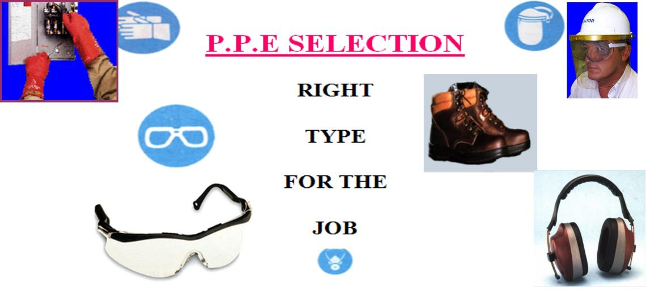
Personal Protection Equipment
Notes:
If running close on time …….scim past the PPE and go on to ORIENTATION VIDEO.

Slide 111
Hazard Prevention and Control - Standards
1926 Subpart E Personal protective and life saving equipment
1926.95 Criteria for personal protective equipment
1926.96 Occupational foot protection
1926.100 Head protection
1926.101 Hearing protection
1926.102 Eye and face protection
1926.103 Respiratory protection
1926.104 Safety belts, lifelines, and lanyards
1926.105 Safety nets
1926.106 Working over or near water

Slide 112
Hazard Prevention and Control - PPE
P.P.E. COMPLIANCE
It is the responsibility of the employee, their supervisor and the Health and Safety representative to ensure that personal protective equipment is properly selected, sized, inspected, stored and maintained

Slide 113
Hazard Prevention and Control - Compliance
PPE COMPLIANCE
Employer
Assess workplace for hazards
Provide PPE
Determine when to use
Provide PPE training for employees and instruction in proper use
Employee
Use PPE in accordance with training received and other instructions.
Inspect daily and maintain in a clean and reliable condition

Slide 114
Hazard Prevention and Control - Training
Employees required to use PPE must be trained in the following:
When PPE is necessary
How it will protect them
What its limitations are
How to properly put on, take off, adjust and wear the PPE
Proper care and maintenance of the PPE
How to identify signs of wear and what is its useful life

Slide 115
Hazard Prevention and Control - Cost
Who Pays for PPE?
On November 14, 2007, OSHA announced a new rule requiring employers to pay for almost all personal protective equipment that is required by OSHA’s general industry, construction, and maritime standards
The employer is required to pay for replacement PPE used to comply with OSHA standards unless an employee has lost or intentionally damaged PPE, then the employer is not required to pay for its replacement
When an employee provides his/her own PPE, the employer must ensure that the equipment is adequate to protect the employee from hazards at the workplace

Slide 116
Hazard Prevention and Control - Plan
Summary
Employers must have a written PPE program to:
Assess the workplace for hazards
Use engineering and work practice controls to eliminate or reduce hazards
Select appropriate PPE to protect employees from hazards that cannot be eliminated
Inform employees why the PPE is necessary, how and when it must be worn
Train employees how to use and care for their PPE, including how to recognize deterioration and failure
Require employees to wear selected PPE

Slide 117
Element #4
Safety and Health Training and Education

Slide 118
Safety and Health Training Program
Elements of a Safety and Health Training Program:
A Written Safety Program
New Employee Orientation
Job Hazard Analysis for every task performed
Trade or equipment specific safety training
OSHA 10 Hour and/or 30 hour Training Classes
First Aid /CPR/AED/Blood Borne Pathogen

Slide 119
New Employee Orientation
Needs to include:
Emergency Contacts
Emergency plan, evacuation plan, meeting places
Daily safety meetings
Harassment, Fighting, Horseplay – Zero Tolerance
Firearms, weapons, drugs or alcohol policies
Hazard Communications
Personal Protective Equipment Requirements
Required Work Clothing
Lockout/Tagout
Electrical Safety
Housekeeping
Fire Protection
Job Hazard Analysis
Quality Control Issues
Rigging
Fall Protection
Fork Lift, Scissor and Boom Lift Operation
Ladder Safety
Overhead Hazards
Heavy Equipment
Any other site specific rules – Smoking, eating, radios, Phones, visitors, no cell phones while operating equipment

Slide 120
Safety and Health Training Program - Employee
Employee Responsibilities:
Report to work "FIT FOR DUTY“
Report ALL Accidents, no matter how slight - this allows for prompt medical attention, and investigation and elimination of the cause that may place others in harm's way
Immediately correct or report any unsafe condition or hazard noted in the workplace
Employees must support the Zero Accident philosophy to assist us to provide an injury free workplace
Employees should ask questions when they do not understand. Lack of knowledge is a common cause of accidents in the workplace
Report the use of prescription medication that may have an effect on their ability to safely perform tasks or operate equipment

Slide 121
Safety and Health Training Program - Review
What have we learned so far?
Companies must establish a Safety Policy, work on developing a Safety Culture by following key safety principles, set goals and maintain a commitment for maintaining an Incident Free Environment
Implementation of the Safety Program involves all workers, especially top management
Supervisors are a key component to making it work. A supervisor can be assigned specific responsibilities and can head up a company safety committee that works on developing the safety plans and programs. The safety committee also reviews all incidents, accidents, near misses to determine contributing factors. While focusing on determining causes, it must always be remembered that the overall goal is to prevent similar accidents from happening again
Job Hazard Analysis reports, audits and inspections help us identify issues. Corrective actions can then be made prior to an incident happening. We must develop Standard Operating Procedures to give workers a plan to guide their work

Slide 122
Safety and Health Training Program – cont.
What have we learned so far?
Understanding the hierarchy of controls: Engineering – Management – Personal Protective Equipment . We have learned that when exposure to hazards cannot be engineered out of normal operations and when safe work practices and administrative controls don’t provide sufficient protection then Personal Protective Equipment (PPE) may be required to keep workers safe
Job Hazard Analysis identifies the hazards that workers are exposed to and can be used to determine how to eliminate worker exposure to hazards
We also looked at the need for New Employee Safety Orientations

Slide 123
Document Everything Review
REVIEW: What have we learned about developing a Safety Program
A written Safety Program can benefit your bottom line but the end result will depend on how well you implement your Safety Program and manage your programs.
Management must commit to safety and participate if the Safety Program is to get results.
Written Safety Policy statement.
Display the required OSHA posters.
Recordkeeping
Safety Analysis – Goal is to Eliminate Hazards - JHAs
Health & Safety Training – Supervisors are key – All employees must be trained- New Hire Orientations
Safety Inspections
Immediate Accident Reporting and Accident Investigations
Program Reviews
Document Everything !

Slide 124
Questions
Questions
?

