Slide 1
Respiratory Protection Program
Notes:
Introduce yourself
Briefly describe location of emergency exits, restrooms, smoking and eating facilities State classroom rules.
Relate any applicable experience with class and start participant introductions.

Slide 2
OSHA Susan Harwood Grant Program
This material was produced under grant number SH-22297-SH1 from OSHA. It does not necessarily reflect the views or policies of the U.S. Department of Labor, nor does mention of trade names, commercial products, or organizations imply endorsement by the U.S. Government.
Revisions were made to this material under grant number SH-05059-SH8 from the Occupational Safety and Health Administration, U.S. Department of Labor.

Slide 3
Objectives:
Review current OSHA standards for respiratory protection
Learn the requirements for the use of respiratory protection
Learn the purpose and correct use of respirators
Learn to identify different types of respirators

Slide 4
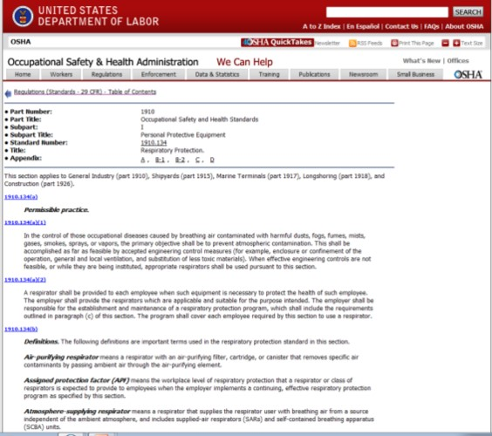
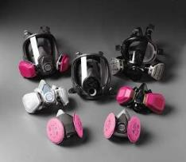
OSHA Standards: 29 CFR 1910.134
When respirators are required, a respirator program will be followed that meets the requirements of OSHA’s Respiratory Protection standard 1910.134

Slide 5
OSHA Standards: 29 CFR 1910.134 (cont.)
Standard for respiratory protection at the workplace
The employer shall be responsible for the establishment and maintenance of a respiratory protection program.
Employer provides respirators to employees
Notes:
This standard applies to General Industry, (part 1910), Shipyards (part 1915), Marine Terminals (part 1917), Longshoring (part 1918), and Construction (part 1926).
29 CFR provides guidelines and procedures for the use of respirators, also provides instructions on how to create an effective program at the work place.

Slide 6
OSHA Standards: 29 CFR 1910.134 (continued)
Primary employer safety goal is engineering and administrative controls
Annual fit test and whenever conditions change
Must be worn whenever you are working in a hazardous atmosphere
Notes:
Engineering controls:
Mechanical ventilation (fans, exhaust systems, etc)
Isolate hazard in specific building
Use of less toxic chemicals
Administrative controls
Provide respirators to employees
Training
Evaluations

Slide 7
Required Respirator Use
The employer shall provide respiratory protection for employees during: (1) Time needed to install or implement feasible engineering and work practice controls
(2) Work operations for which engineering and work practice controls are not feasible (3) Work operations where all feasible engineering and work practice controls and such controls are not sufficient to reduce exposures to or below the PEL (4) Work operations where employees are exposed above the PEL for fewer than 30 days per year, and the employer has elected not to implement engineering and work practice controls to achieve the PEL (5) Emergencies
Notes:
When airborne concentrations of chromium cannot consistently be reduced below the permissible exposure
limit, respiratory protection will be necessary.
• When this is the case, your employer will implement a respiratory protection program which establishes
procedures for the proper selection and use of respirators in the workplace.
• Part of the respiratory protection program requires employees receive a medical evaluation to ensure they are
physically able to use a respirator and undergo a series of fit testing procedures to ensure a proper fit.
• The company will provide you with a respirator that will protect you against airborne chromium exposures.
You will receive training in the proper use, storage and maintenance of the respirator.

Slide 8
Respirator Purpose
A respirator protects the user from harmful inhalation of toxic atmosphere hazards such as:
Dusts, fogs, fumes, mists, gases, smokes, sprays, fibers or vapors
The primary objective shall be to prevent contamination from toxic vapors
Notes:
Respirators can be hot, bulky, heavy and just an overall hassle. But they can also be the difference between life and death. Give your workers a straight-forward look at why they need respirators, how to properly fit and maintain them and when to use certain types. Airborne hazards Control and respirator selection Fit test and fit check Care and maintenance
A respirator is a device to protect the wearer from the inhalation of harmful atmospheres.
Before implementing a respiratory program, all efforts should first be made to engineer out the hazards either by providing ventilation or isolating source.
Respirators must be approved for the type and severity of conditions in which they are to be used

Slide 9
Respiratory Hazards
Must be evaluated by supervisor
When First Hired
If you are a New user
Working with new chemicals
If any conditions changed, stop and contact supervisor
Notes:
Respiratory hazards at the workplace should be evaluated by your supervisor or a person designated by the employer at the following times
New hire. This is when you’re provided with your respirator. Employer conducts a fit test, positive and negative test and a medical evaluation is conducted.
A new user will be provided with a respirator and same as the new hire fit test and medical evaluation will be conducted
When working with new chemicals, the supervisor should consult MSDS provided with the chemical and ensure appropriate protection is supplied to employees.
Failure to comply with established guidelines could result in death.

Slide 10
Respiratory Hazards (continued)

Slide 11
Major types of respirators
Two Types:
Air Purifying
Atmosphere supplying respirators
Both types of respirators must be approved by NIOSH and a medical evaluation required before you can be issued a respirator
Notes:
NIOSH : National institute of Occupational Safety and Health must approved all respirators.
Atmosphere supplying: Air supply is received from compressed air, oxygen tank or compressor driven air not from the atmosphere.

Slide 12
Air Purifying
Air Purifying respirators: removes contaminants by passing ambient air through the air purifying filter, cartridge or canister
Includes dust masks
Notes:
Air purifying respirators filters atmospheric air: Single Strap dust mask can be used to provide comfort during pollen season. Not intended for Lead
Dust mask must be NIOSH approved. Single strap mask are not NIOSH approved.

Slide 13
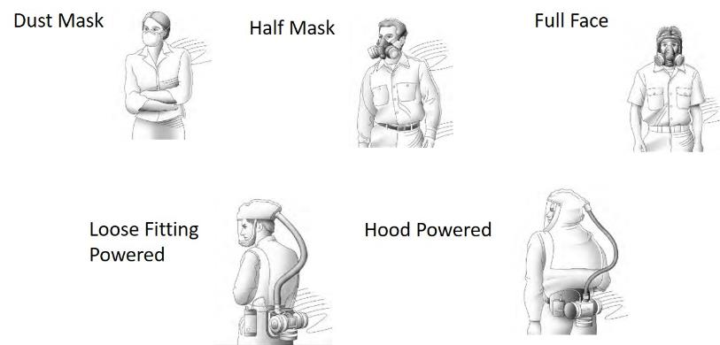
Air Purifying
Notes:
Dust mask, Half Mask and Full Face respirators need to be test fitted to the user

Slide 14
Atmosphere Supplying
Supplies the user with breathing air from other sources (compressors, compressed air) not ambient air
For IDLH environments
Notes:
Must be test fitted
Includes SCBA (Self Contained Breathing Apparatus)
IDLH – Immediate Danger to Life and Health
Poses immediate threat to life
Would cause irreversible adverse health effects
Would impair ability to escape from dangerous situation

Slide 15
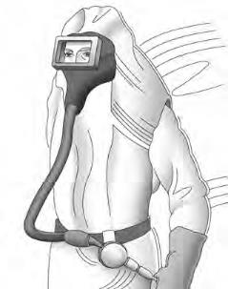
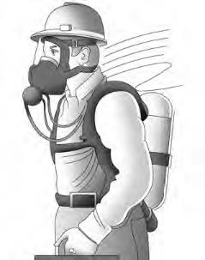
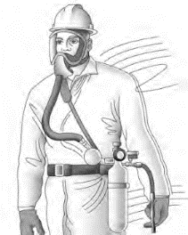
Atmosphere Supplying (continued)
Supplied Air Respirator
Abrasive Blasting
Continuous Flow
Self Contained
Breathing Apparatus
(SCBA)
Notes:
SCBA minimum service life 30 minutes

Slide 16
Selection of respirators
Selected based on respiratory hazards workers are exposed to
Only NIOSH certified respirators should be used
Selected from different models and sizes to ensure it properly fits employee
If the respiratory hazard cannot be identified, the atmosphere should be considered IDLH
Notes:
NIOSH – National Institute of safety and health
An oxygen deficient atmosphere should be considered IDLH

Slide 17
Selection of respirators (cont.)
For Immediate Danger to Life or Health, (IDLH) atmospheres:
Full face pressure demand SCBA with minimum service life of 30 minutes
Supply on demand (SAR) with self contained air supply
Notes:
An oxygen deficient atmosphere should be considered IDLH
SAR – Atmosphere supplying respirator where source of breathing is not carried by the user…

Slide 18
Selection of respirators (continued)
For Non-IDLH atmospheres:
Employer provides a respirator that is adequate for the protection of employee health
Dust Mask, Full Face piece
Notes:
In other words use a respirator that meet or exceeds required level of protection

Slide 19
Requirements: Evaluation
Must work in an environment that requires a respirator
Medical Evaluation is provided by the employer to determine the employee’s physical capability to use a respirator
A medical evaluation questionnaire is mandatory
Notes:
Employee need to be working in an environment that requires the use of a rerspirator
Using a respirator may place physiological stress on the employee and varies with type of respirator, workplace conditions and medical status of the employee.
Evaluations is conducted before any fit test takes place by a physician designated by the employer.
Students refer to the provided attachment ( OSHA respirator questionnaire)

Slide 20
Requirements: Fit Tested
Must be Fit Tested with same brand, model and size that will be used
Tested before first use
Note: Facial hair may not be permitted if employee will use a respirator that requires tight seal
Notes:
Must also pass a qualitative fit test
Additional test should be conducted if any changes are noted, employee reports changes, or if a supervisor visually notes changes in employee condition or behavior
Not only facial hair but also any other conditions like corrective glasses, dentures, or any condition that interfere with with a tight seal of the respirator.

Slide 21


Requirements: Fit Tested (continued)
Yearly training
Must fit properly
Fit tested annually
No facial hair
Must have the right cartridges
Organic vapor for liquid exposures
Organic vapor + P100 for powder exposures
Cartridges don’t last forever
Need change-out schedule
If you can smell it, you should change it
Respirators are only effective when used properly!
Notes:
In order to ensure respirators work properly, your respirator must fit properly which is verified through a yearly fit-test, and you must have no facial hair. So if we look at the graphic on the top left, we see a relative size figure showing that the size of a human hair is a lot larger than the size of the glass fiber or the asbestos fiber or the fume particles. You can imagine trying to put a respirator over that human hair, thinking of it as a piece of facial hair, and if you do that, it’s going to allow space for any of those other smaller particles to get inside the respirator. Thus, the respirator’s letting in the contaminants that you’re trying to protect yourself from. So, we’re not just concerned with “Cousin It” who’s in the bottom left corner of this slide, but we’re also concerned with the other guy who’s got maybe a couple days of stubble growth on his face. His respirator would not protect him either. Another important point is you must have the right cartridges for the exposure. It’s important to use organic vapor for liquid exposures and it’s important to use organic vapor and P100 filters for the powder exposures. Cartridges don’t last forever, you need to change them out and you need to have a change-out schedule. If you can smell it, you should change it. Now, we’ve been into these flavoring industries and we’ve walked up to people that are using respirators and asked them how the respirator’s working for them. They say, “it works great!” and when we talk to them a little bit more, we say “now that stuff you’re working with, how’s that smell?” and the guy says “oh man, it smells nasty,” so you know if the guy can smell it through his respirator he needs to change out that cartridge and the respirator’s not protecting him. Another thing that can affect cartridge is humidity. It can really decrease the cartridge life, so it’s important to take into account how humid your atmosphere is when planning your change out schedule. And finally, as with engineering controls, respirators are only effective when they’re used properly.

Slide 22
Requirements: Maintenance
Respirators should be clean and disinfected as often as necessary if used by one employee
After each use if used by more than one employee
Stored and protected from damage, dust, sunlight
Inspected before use and if found defective do not use and notify supervisor
Notes:
Employer provide cleaning and disinfecting material for respirators
Example of used by multiple employee will be training and fit testing
Inspected before use include:
Check for proper function
Check all rubber parts for deterioration
SCBA should be inspected montly

Slide 23
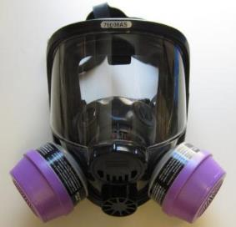
When should I use a respirator?
When exposures cannot be controlled in other ways
When employees complain of irritation regardless of exposure level
Respirators are a last choice for controlling exposures, but may be an important part of the solution to controlling hazardous atmospheres.
Notes:
When should you use a respirator? When exposures cannot be controlled in other ways, when employees complain of irritation regardless of the exposure level, anytime when using diacetyl or diacetyl substitutes, always when working with diacetyl or diacetyl substitute powders, always when exposures have not been measured, and when it is desired to keep exposures as low as possible. It is difficult to control exposures to diacetyl down to the 0.01 ppm exposure level, so it might be important to use respirators at least temporarily when implementing other controls. Although respirators should be the last choice for controlling exposures, they may be an important part of the solution in the flavoring industry to keep exposures as low as possible.

Slide 24
Summary
Employers must follow OSHA’s Respiratory Protection standard 1910.134 which includes written program, medical evaluation, fit testing, maintenance and training requirements
Two major types of respirators are: Air Purifying and Atmosphere Supplying
Fit Test: annually or if conditions change
Proper respirator and cartridge selection
Notes:
This slide lists the main points to remember when working with electricity.

Slide 25
Questions?

