Slide 1
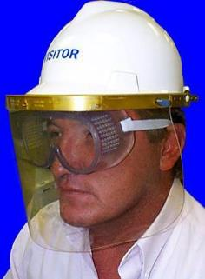
Personal Protective Equipment

Slide 2
Disclaimer
Department of Labor
Occupational Health and Safety Administration (OSHA)
Susan Harwood Training Grant
This material was produced under Susan Harwood grant number SH-20832-SH1 Occupational Safety and Health Administration, U.S. Department of Labor. The contents in this presentation do not necessarily reflect the views or policies of the U.S. Department of Labor, nor does the mention of trade names, commercial products, or organizations imply endorsement by the U.S. Government.
Revisions were made to this material under grant number SH-05059-SH8 from the Occupational Safety and Health Administration, U.S. Department of Labor.

Slide 3
Personal Protective Equipment
Employers are required to provide a hazard-free work environment
Workers must be protected against potential hazards
Personal Protective Equipment (PPE) can help protect workers when used correctly
Notes:
Employers must protect employees from hazards such as falling objects, harmful substances, and noise exposures that can cause injury. Under OSHA employers are required to provide a hazard free environment for employees. Anyone encountering hazardous conditions must be protected against the potential hazards.

Slide 4

WHAT is PPE?
Clothing and accessories
Create a barrier
Head protection
Eye and Face protective
Hearing protection
Hand protection
Foot protection
Fall protection
Notes:
The purpose of PPE clothing and equipment is to shield or isolate employees from injury

Slide 5
Personal Protective Equipment Cont.
PPE is selected based on the specific job hazards of the job
Who pays for PPE
Employers provide PPE
Notes:
The purpose of PPE clothing and equipment is to shield or isolate employees from the hazard that may be present in the work place. Employers are required to provide PPE. If employees provide their own PPE the employer is responsible to assure its adequacy, including proper maintenacne, and sanitation of such equipment.

Slide 6
Engineering Controls
PPE is always considered a last resort
Temporary type of protection
First choice will always be to eliminating hazard
Examples:
Initial design specification
Substitute less harmful material
Change process
Enclose process
Isolate process
Notes:
If the machine or work environment can be physically changed to prevent employee exposure to the potential hazard then the hazard can be eliminated with an engineering control.

Slide 7
Work Practice Controls
Employers can change the work process
Examples:
Engineering Controls
Machine Guarding
Job Rotation
House Keeping
Increase Maintenance
Notes:
If employees can be removed from exposure to the potential hzard by changing the way they do their jobs, then the hazard can be eliminated with a work practice control.

Slide 8
Job Hazards
Examples of Job Hazards are:
Noise
Chemicals
Accidental Impact
Sharp objects
Flying Particles
Dust & Mists
Bright Light
Vibration
Notes:
Typical job hazards……discuss are there any more?

Slide 9
What you should know about PPE

Slide 10
About PPE
You should know
Limitations of PPE
How to use PPE
When to use PPE
Inspect PPE before use
Replacement of PPE
Cleaning & Storage of PPE
Notes:
No single combination of PPE and clothing is capable of protecting against all hazards. Thus PPE should be used in conjunction with other pretective methods.

Slide 11
PPE Limitations
PPE acts as a barrier between you and a hazard
PPE will not protect you if it is:
not designed for the specific hazard
damaged or worn
not adjusted properly
Notes:
The use of PPE can itself create significant worker hazards, such as heat stress physical and psychological stress and imparied vision, mobility and communication. In gereal, the greater the level of PPE the greater is the associated risks. For any given situation, PPE should be selected that provide an adequate level of protection. Over portection as well as under protection can be hazardous and should be avoided.

Slide 12
Using PPE
For PPE to be effective in protecting you
Use it in the manner you have been trained
Use it only for the specific hazards for its design
Notes:
Using PPE improperly or in a manner unsutied to its design and purpose is worse than using no protection at all. W/out any protection, the worker knows they are vulnerable and might take percaustions. With some protection the employee may increase the risk by exposing himself to a hazard thinking they were safe, when in fact they were not. Each employee must be trained in the proper use of PPE and the understanding of when it is required.

Slide 13
Inspect before using
Before you use your PPE, inspect it for:
Worn or damaged parts
Leaks, cracks or deformities
Cleanliness
Correct size
Notes:
PPE should be checked daily prior to its use.

Slide 14
Replace
Replace PPE
If any PPE is damaged or worn
Get it repaired or replaced immediately
Do not work without replacement PPE
Tell your supervisor you need new PPE

Slide 15
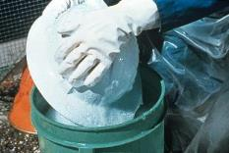
Cleaning & Storage
Clean your PPE regularly
Do not store it where it will be in contact with:
Dust & Dirt
Chemicals
Sunlight
Water

Slide 16

Written PPE Program
A written PPE Program should be establish for the job
Two basic objectives of a
PPE Program
Protect the wearer
Prevent injury
Notes:
Your PPE pgr should be in writing and be reviewed annually. Elements that should be considered in the review inlcude the number of person hurt or injured, level of exposure, adequacy of PPE selected, operational guidelines, effectiveness of training, program costs and improvements needed.

Slide 17
Comprehensive PPE Program
Hazard identification
Medical monitoring
Environmental surveillance
Selection
Use
Maintenance / Decontamination
Training

Slide 18
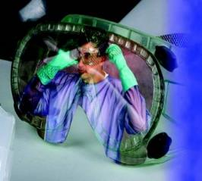
Eye and Face Protection
Notes:
Causes of eye injuries: injurious gases, vapors, and liquids. Workers handling acids or caustics and doing welding are subject to these hazards. Dust or powders fumes and mists. Flying objects or particles and glare from welding.

Slide 19

Protecting your eyes
Your eyes are very sensitive organs and may be easily injured. Eye Hazards include:
Chemical Splashes
Flying dust, chips, sparks
High Heat
Intense or UV light
Notes:
OSHA requires eye and face protection where there is a reasonable probalitity of preventable injury when such equipment is used. Employers must provide a type of protector suitable for work to be performed and employees must use the protector.

Slide 20
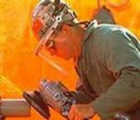
Specific hazards include…
IMPACT - Chipping, grinding machining, masonry work, woodworking, sawing, drilling, chiseling, powered fastening, riveting, and sanding.
HEAT - Furnace operations, pouring, casting, hot dipping, welding
LIGHT or RADIATION - Electric arc welding, gas welding, gas cutting
IRRITANTS / CORROSIVES - mists, dusts, sprays, splashes
Notes:
60% of workers who suffered eye injuries were not wearing eye protective equipment. When asked why they were not wearing them workers indicated that was not normally used or practiced in their type of work or it was not required.

Slide 21
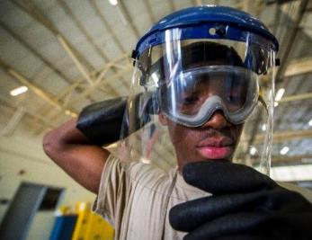
Face Protection
Use a faceshield when any of the following hazards exist:
Chemical splashes
Liquid spray
Flying chips or sparks
High Heat requires special faceshield
Notes:
Suitable eye protectors must be provided where machines or operations present the hazard of flying objects, glar, liquids, injurioous radiation or a combination of these hazards.

Slide 22
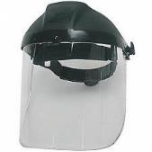
When using a faceshield…
Always us the correct type eye protection with a face shield
A faceshield is NOT designed to protect your eyes

Slide 23
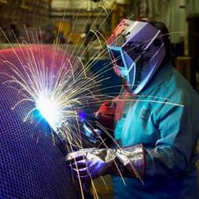
Types of Eye Protection
Safety Glasses – for flying chips & low hazards
Vented Goggles – for dust and non-hazardous mist
Non-Vented Goggles – hazardous chemicals
Dark Lenses – intense or UV light
Notes:
Protectors must provide adequate protection against the particular hazards for which they are designed. They must be reasonably confortable when worn, fit snugly without interfering with the movements or vision of the employee.

Slide 24
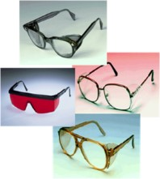
Corrective glasses and eye protection
Spectacles with protective lenses
Goggles worn over corrective spectacles
Goggles that incorporate corrective lenses
Notes:
Persons using corrective spectacles and those who are required by OSHA to wear eye protection must wear face shields , goggles or spectacles of one of the types. Spectacles with protective lenses providing optical correction, Goggles worn over corrective lens, Goggles that incorporate corrective lenses mounted behind the protective lenses.

Slide 25

Inspection/maintenance of eye protection
Keep lenses clean
Daily inspection and cleaning
Replace pitted lenses
Headbands
Storage
Notes:
It is essential that the lenses of eye protectors be kept clean. Daily lenses can cause eyestrain often an excuse for not wearing the eye protectors. Daily inspection and cleaning of the lens with soap and hot water or with a cleaning solution and tissue , is recommended. Googles and other eye protectors should be stored in their cases when not in use.

Slide 26
Head Protection
Notes:
Head injuries are caused by falling or flying objects, or by bumping the head against a fixed object.

Slide 27

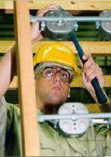
Hardhats…
Hard hats are needed to
protect against
Falling objects
Accidental impact
Use an electrically rated hard hat when there is a potential for contact with live circuits
Notes:
Hard hats require a hard outer shell and shock absorbing lining. Look at the inside of any helmet you are considering and you should see a lable showing the manufactures name the ANSI standard it meets and its class. Helmets must be always be worn as designed to be in compliance with ANSI.

Slide 28

Head Protection
Resist penetration
Absorb the shock of a blow
ANSI Standards Z89.1
Notes:
In the form of protective hats, must do two things- resist penetration and absorb the shochk of a blow. This is accomplished by making the shell of the hat of amterial hard enough to resist the blos and by utilixing a shock absorbing lining composed of headbands and crown straps to keep the shell away from the warers head. The standards use are located in ANSI =American National Safety Insititute

Slide 29
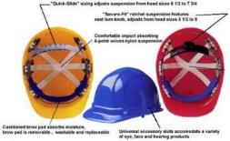
Protective Hat Types
Type 1
Type 2
Three Classes
Class G
Class E
Class C
Notes:
Type 1 Helmets intended to reduce the force of impact resulting from a blow only to the top of the head.
Type 2 Helmets intended to reduce the force of impact resulting from a blow that may be received foff center or to the top of the head
Three Classes: G= Helmets are intended to reduce the danger of contact exposure to low voltage conductors 2,200 volts. E= Helmets are intended to reduce the danger of exposure to high voltage conductors 20,000 volts. C= Helmets are not intended to provide protection against contact with electrial conductors.

Slide 30
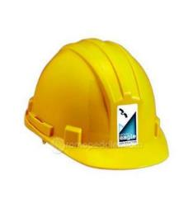
Helmet construction
Water Resistant
Slow Burning
Shell and suspension
Adjustable headbands
Notes:
Materials used in helmets should be water resistant and slow burning. Each consists essentially of a shell and suspension ventilation is provided by a space betweeen the headband and the shell. Each helmet should be accompained by instruction on the proper method of adjusting and replacing the suspension and headband.

Slide 31
Replace your hard hat if…
The suspension system shows signs of deterioration such as:
Cracking,
Tearing, or
Fraying
The suspension system no longer holds the shell from 1 inch to 1 1/4 inches away from the head.
Notes:
Headbands ae adjustable in 1/8 size increments. When the band is adjusted to the right size. It provides sufficient clearance between the shell and the headband . The removable replaceable type seatband should cover a least the forehead protion of the band.

Slide 32
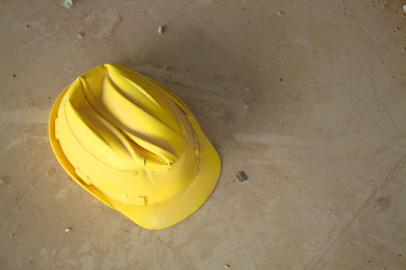
Replace your hard hat if… (continued)
The brim or shell is cracked, perforated, or deformed.
The brim or shell shows signs of exposure to heat, chemicals, ultraviolet light, or other radiation. Signs include:
Loss of surface gloss
Chalking
Flaking
Notes:
The shell should be of one piece seamless construction and designed to resist the impact of a blow from falling material. The internal cradle of the headband and sweatband forms the suspension. Any part that comes in contact with head must no be irritating to normal skin.

Slide 33
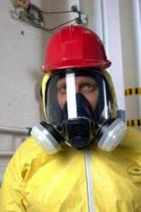
Helmet maintenance and inspection
Cleaning helmets
Inspect daily
Exposure to unusual conditions
Storage
Notes:
Consult manufacturers ref cleaning of helmets. Most warm water and a good detergent then risined in clear hot water. Inspect daily for any cracks or damage. All componets must be in good working order. Helmets should not be stored or carried on the rear window shelf of a car since suling and extreme heat may and will effect the degree of protection

Slide 34
Foot Protection

Slide 35
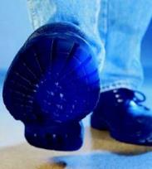
Foot Hazards
Heavy objects such as barrels or tools that might roll onto or fall onto your feet
Sharp objects such as nails or spikes that might pierce the soles or uppers of ordinary shoes
Molten metal that might splash
Hot, slippery or wet surfaces
Corrosive Chemicals
Notes:
For protection of feet and legs from falling or rolling objects, sharp objects, molten metal, hot surfaces, and wet slippery surfaces workers should use appropriate foot guards, safety shoes, or boots and leggings.

Slide 36
Hazardous conditions…
IMPACT - Carrying or handling materials such as packages, objects, parts or heavy tools which could be dropped
COMPRESSION - Work activities involving skid trucks, manual material handling carts, around bulk rolls, around heavy pipes
PUNCTURE - Sharp object hazards such as nails, wire, tacks, screws, large staples, & scrap metal
CHEMICAL - Spills, splashes, fumes, corrosives
Notes:
Footwear must meet the minimum compression and impact performance standards and testing requirements.

Slide 37

Types of foot protection
Types of foot protection
Safety shoes
Boots
Leggings
Notes:
Conductive shoes protect against the buildup of static electricity. These shoes ground the employee wearing them. Workers working in explosive and hazardous site must wear these type of shoes in order to reduce the risk. These shoes are not general purpose shoes and must be rmoved upon completion of the specific work.

Slide 38
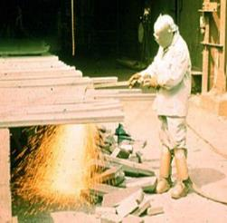
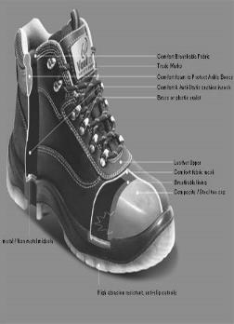
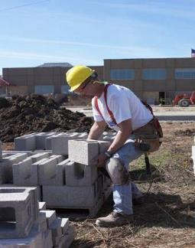
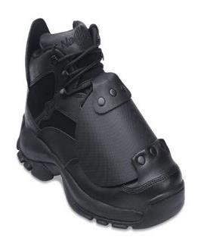
Foot protection
Notes:
Safety shoes should be sturdy and have an impact resistant toe. In some shoes, metal insoles protect against puncture wounds. Additional protection such as metatarsal guards, may be found in some types of foot wear. Safety shoes come in a variety of styles and materials, such as leather or rubber boots and oxfords.

Slide 39
Inspect footwear daily…
Look for
Cracked, torn or worn uppers
Wear, holes, tears, cracks, loss of tread on bottom
Separation between soles and uppers

Slide 40
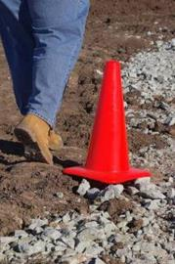
Requirements for Safety Shoes
Sturdy
Impact resistant toe
ASTM F 2413
Notes:
Safety footwear is classified according to its ability to meet minimum requirements for both compression and impact test those requirements and testing procedures may be found in ANS z41.1967 or later .

Slide 41

Hand Protection
Notes:
The nature of hazard and the operation to be performed will determine the type of glove to be worn. The variety of potential hand injuries may make selecting the appropriate pair of gloves more difficult than choosing other PPE. Take care to choose gloves designed for the specific hazard. Manufacturers can provide more information relating to your specific needs and requirements.

Slide 42
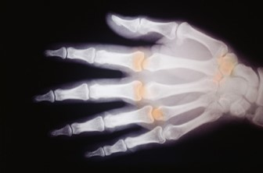
Why use hand protection?
Burns
Cuts
Electrical shock
Amputation
Absorption of chemicals
Notes:
Examples of injuries to arms and hands are burns, cuts, electrical shock, amputation and absorption of chemicals. There is a wide assortment of gloves, hand pads, sleeves, and wristlets for protection from various hazardous situations.

Slide 43
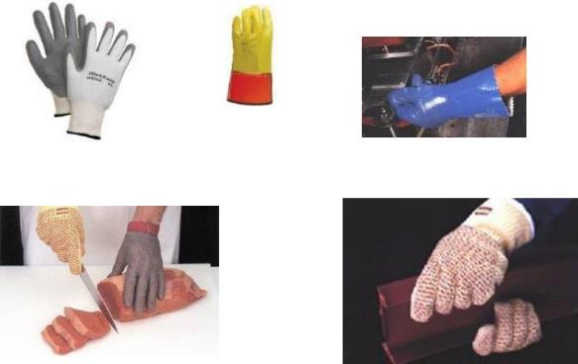
Types of hand protection
Notes:
Different types of gloves; general purpose easy to grip gloves, Line man’s glove, Nitrile type gloves liquid and chemical resistant gloves, Stainless steel mesh meating cutting gloves, Kevalr n gloves protect againts cuts, slashes and abrasion. Each used for a specific task. There are many many others. What type of gloves do they wear?

Slide 44

Glove selection
Not all gloves are created equal…. Ensure the glove you use will protect your hands from the specific hazards of the job
Chemical gloves do not last forever… understand the chemical and “break-through” characteristics of your specific glove

Slide 45

Before you use…
Do not wear gloves if they can be caught in machinery
Use the proper glove for the task
Remove rings & bracelets
Check gloves for wear and damage
Notes:
The protective glove should be selected to fit the job. Employees should become acquainted with the limitation of the gloves being used.

Slide 46
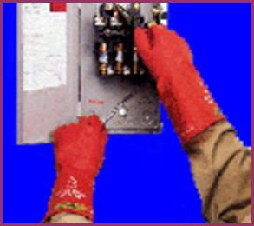
Electrical glove checks
Hole, tear, puncture, or cut
Ozone cutting or ozone checking
An embedded foreign object
Swelling, softening, hardening, or becoming sticky or inelastic
Any other defect that damages the insulating properties
AIR TEST before each use
Notes:
Electricians need special protection from shocks and burns. Rubber is considered the best material for insulating gloves and sleeves.

Slide 47

Hearing Protection

Slide 48
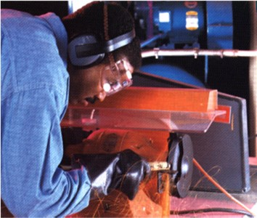
Protect your hearing…
Use hearing protection when:
in high noise areas
using power saws, & impact tools
off the job when shooting, & using power tools
Replace worn or broken hearing protectors immediately
Notes:
Exposure to high noise levels can cause hearing loss or impairment. It can create phyiscal and psychological stress. There is no cure for noise induced hearing loss, so the prevention of excessive noise exposure is the only way to avoid hearing damage.

Slide 49
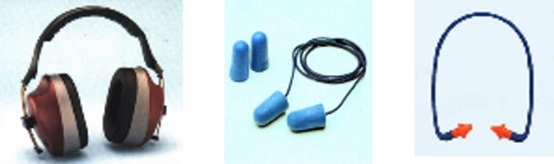
Types of Hearing Protectors
Notes:
Types of hearing protectors: Preformed or molded earplugs, Foam, Disposable earplugs, perfect seal around the ear. Preformed or molded ear plugs should be individually fitted by a professional. Foam ear plugs are self forming, Some earplugs are disposable , to be used one time and then thrown away. The non-disposable type should be cleaned after each use for proper protection. For extremely noisy situation, earmuffs and earplugs should be worn in addition to earmuffs. Ref 1926.52

Slide 50
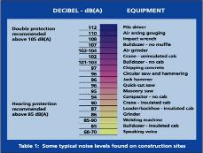
Decibel Levels

Slide 51
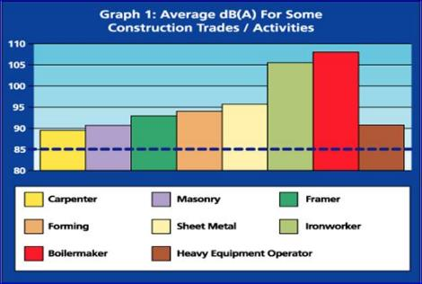
Decibel Levels Graph

Slide 52
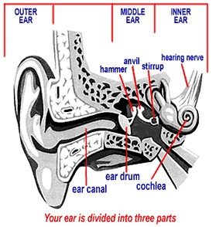
Symptoms of hearing loss
Ringing in ears
Difficulty hearing normal conversations
Noises are "fuzzy" or muffled

Slide 53


Hearing protection must
Be kept clean
Fit snugly against the head or in the ear
Have no gaps or breaks

Slide 54
Fall Protection

Slide 55
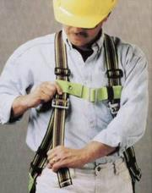
Fall Protection Equipment
Life Lines
Safety Harness
Lanyards
Self Retracting Lanyards
Notes:
Lifelines, safety harness and lanyards used for fall protection.

Slide 56
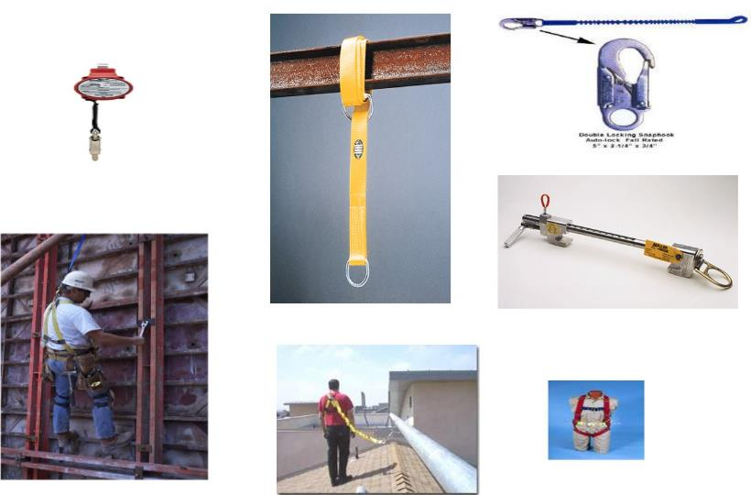
Fall equipment
Notes:
Lifelines, safety harness and lanyards must be used only for employee safeguarding. Any life line, safety harness or lanyard actually subjected to in service loading, as distingusihed from static load testing, must be immediately removed from service and not be used again for employees. Life lines shall be secured above the point of operation to an anchorage or structural member capable of supporting a minimum dead weight of 5,400lbs.

Slide 57
Specialized PPE

Slide 58

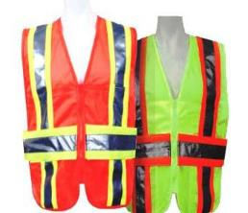
Other Hazards and Appropriate PPE
Working Around Water Requires Life Jackets
Low Light and Moving Vehicles Require Retroreflective garments
Notes:
Employees may be working near or over water. They must wear a Coast Guard approved life jacket or buoyant work vest if there is danager of falling into the water. Working in and around traffic requires workers to wear high visibility clothing. ANSI has approved criteria for high visibility worker apprel.

Slide 59
Summary

Slide 60
Protect yourself…
Use the right PPE for the Hazard
Inspect your PPE before using
Replace damaged or worn PPE
Notes:
Summary

Slide 61
Protect yourself Continued…
Store your PPE properly so it will be ready for the next use
Keep your PPE clean
Notify your supervisor if you need new PPE

Slide 62
Questions?

