Slide 1
Machine Guarding and Amputation Hazards

Slide 2
Sponsorship
This material was produced under grant number SH-22297-SH1 from OSHA. It does not necessarily reflect the views or policies of the U.S. Department of Labor, nor does mention of trade names, commercial products, or organizations imply endorsement by the U.S. Government.
Revisions were made to this material under grant number SH-05059-SH8 from the Occupational Safety and Health Administration, U.S. Department of Labor.

Slide 3
Introduction
Crushed hands and arms, severed fingers, blindness - the list of possible machinery-related injuries is as long as it is horrifying. Safeguards are essential for protecting workers from needless and preventable injuries.
A good rule to remember is: Any machine part, function, or process which may cause injury must be safeguarded.
Where the operation of a machine can injure the operator or other workers, the hazard must be controlled or eliminated.

Slide 4
Objectives
Students will:
  Identify sources of amputation hazards
  Describe available protection and safeguarding methods
  Identify hazardous machine components and motions
  Interpret OSHA’s role and standards
Notes:
The information provided in this presentation does not specifically address amputation hazards on all types of machinery in general industry, construction, maritime and agricultural operations; however, many of the described safeguarding techniques may be used to prevent other amputation injuries.

Slide 5
Causes of Machine Accidents
Reaching in to “clear” equipment
Not using Lockout/Tagout
Unauthorized persons doing maintenance or using the machines
Missing or loose machine guards

Slide 6
Machine is not safeguarded because …
Equipment came that way
I bought it used and that part was missing
Guard gets in the way
Is easier to work around it
It’s common sense: no one will put their hands in there
I don’t know…

Slide 7
Hazardous Machine Components
Point of operation
All parts of the machine which move, such as:
  flywheels, pulleys, belts, couplings, chains, cranks, gears, etc.
  feed mechanisms and auxiliary parts of the machine
In-running nip points
Notes:
flywheels, pulleys, belts, chains, couplings, spindles, cams, and gears, connecting rods and other machine components that transmit energy
Machine components
that move during machine operation such as
reciprocating, rotating, and transverse moving
parts as well as auxiliary machine parts.

Slide 8
Hazardous Machine Motions
Rotating – Circular motion
Reciprocating – Back and forth motion
Transverse – Straight continuous line
Cutting – Sawing, boring, milling
Punching – Metal Stamping
Shearing – Metal Trimming
Bending – Metal forming
Notes:
All mechanical motion is hazardous in one way or another.
“Pinch Point” Occurs when two parts move or rotate together such as gears, rollers

Slide 9
Hazardous Activities
Employees operating and caring for machinery perform activities that present amputation hazards such as:
  Set up and preparation
  Maintenance
  Machine set up
  Clearing Jams
  Lubrication and Inspection
Notes:
Employees often find themselves conducting these operations without proper training
and fail to properly implement Lock Out /Tag Out procedures resulting in injuries.

Slide 10
Amputation
Amputations are most serious and debilitating workplace injuries
They are widespread and involve a variety of activities and equipment
Amputations occur most often when workers
operate unguarded or inadequately safeguarded mechanical equipment
Notes:
Amputations are widespread and involve a variety of activities and equipment. Each year,
thousands of employees lose fingers, hands, feet, and other body parts–mostly through
compression, crushing, or by getting them caught between or struck by objects.
Most amputations involve fingertips.

Slide 11
Amputation – cont.
Injuries also happen during materials handling when using equipment such as forklifts, doors or trash compactors
When using powered and non-powered hand tools
When performing maintenance or repairs to equipment that has not been properly locked and tagged out
Notes:
Amputation often results in permanent disability
In Sept 2011 a worker cleaning a meat mixer in NJ died after falling inside the mixer

Slide 12
Controlling Amputation Hazards
Machine Safeguarding is essential for protecting employees from preventable injury
A good rule to remember is:
  Any part of a machine, function, or process that may cause injury must be safeguarded
  Safety is everyone's responsibility not just your supervisor
Notes:
Refer to slide #10, HAZARDOUS MACHINE MOTIONS and stress the importance of
properly safeguarding machines and motions to prevent injuries and the possibility of an
amputation.

Slide 13
Sources of Amputation
Mechanical power presses
Power press brakes
Powered and non-powered conveyors
Printing presses
Roll-forming and roll bending machines
Food slicers, meat grinders, meat-cutting band saws
Drill presses and shears
Lathes and milling machines
Grinders
Slitters
Notes:
Amputations occur most often when employees operate unguarded or inadequately safeguarded:

Slide 14

Protection Methods
Recognize and avoid amputation hazards through:
  Guarding
  Safe work practices
  Employee training
  Administrative controls
  Operating in a safe manner
Notes:
Machine safeguarding must be supplemented by an effective energy control (lockout/tagout) program that ensures that employees are protected from hazardous energy sources during machine servicing and maintenance work activities.
lockout/tagout is used where safeguards are rendered ineffective or do not protect employees from hazardous energy during servicing and maintenance operations.

Slide 15
Preventive Measures
Lock Out Tag Out:
The best way to prevent amputations during maintenance, repair and clearing jams while the machine is energized is a program of hazardous energy control, known as Lock Out Tag Out (LOTO)

Slide 16
Machine safeguarding
Two methods of machine safeguarding:
  Guards and Safe Guarding Devices
Guards are physical barriers that prevent access to danger area
Devices help prevent contact with points of operation and may replace or supplement guards. These devices interrupt normal operation when workers hands are inside the machine
Notes:
Guards: provide physical barriers to hazardous areas. They should be secure and strong, and employees should not be able to bypass, remove, or tamper with them. Guards should not obstruct the operator’s view or prevent employees from working.
Page 11 of your handout OSHA 3170 will show examples of safeguarding devices
Pages 13-16 will show examples of safeguarding devices.

Slide 17
Hand and Portable Power Tools
Ensure guards are in place and working when using portable circular saws with a blade of 2” or more in diameter
All portable power tools with a 2” or more diameter wheel should have a constant pressure switch
Applies to grinders, belt sanders, reciprocating saws and drills
Notes:
The upper guard shall cover the saw to the depth of the teeth, except for the minimum arc required to permit the base to be tilted for bevel cuts. The lower guard shall cover the saw to the depth of the teeth, except for the minimum arc required to allow proper retraction and contact with the work. When the tool is withdrawn from the work, the lower guard shall automatically and instantly return to covering position.

Slide 18
Requirements for Safeguards
Prevent contact - prevent worker’s body or clothing from contacting hazardous moving parts
Secure - firmly secured to machine and not easily removed
Protect from falling objects - ensure that no objects can fall into moving parts
Create no new hazards - must not have shear points, jagged edges or unfinished surfaces
Create no interference - must not prevent worker from performing the job quickly and comfortably
Allow safe lubrication - if possible, be able to lubricate the machine without removing the safeguards

Slide 19
Methods of Machine Safeguarding
Guards
  fixed
  interlocked
  adjustable
  self-adjusting
Devices
  presence sensing
  pullback
  restraint
  safety controls (tripwire cable, two-hand control, etc.)
  gates
Location/distance
Feeding and ejection methods
  Automatic and/or semi-automatic feed and ejection
  Robots
Miscellaneous aids
  awareness barriers
  protective shields
  hand-feeding tools

Slide 20
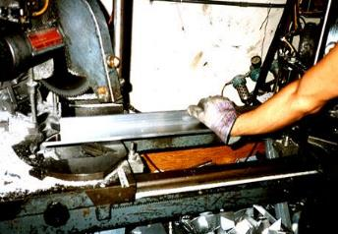
Point of Operation
That point where work is performed on the material, such as cutting, shaping, boring, or forming of stock must be guarded.
Notes:
1910.212(a)(3)(i) & (ii)

Slide 21
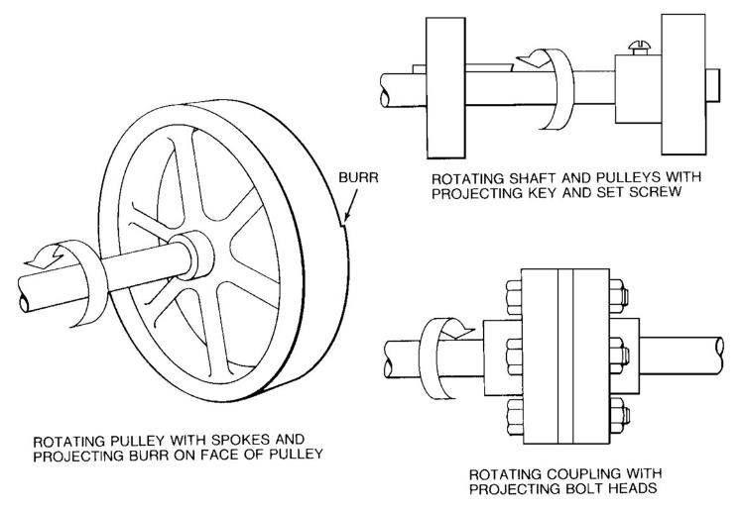
Rotating Parts

Slide 22
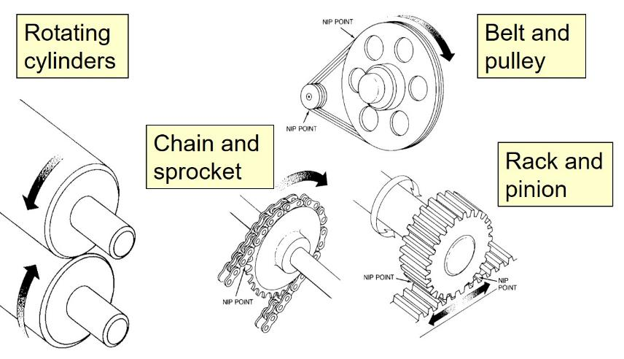
In-Running Nip Points
Notes:
In-running nip point hazards are caused by the rotating parts on machinery. There are three main types of in-running nips.
Parts can rotate in opposite directions while their axes are parallel to each other. These parts may be in contact (producing a nip point) or in close proximity to each other (where the stock fed between the rolls produces the nip points). This danger is common on machinery with intermeshing gears and rotating cylinders.
Another type of nip point is created between rotating and tangentially moving parts; for example, a chain and a sprocket, a rack and pinion, or the point of contact between a power transmission belt and its pulley.
Nip points can also occur between rotating and fixed parts which create a shearing, crushing, or abrading action; for example, spoked handwheels or flywheels, screw conveyors, or the periphery of an abrasive wheel and an incorrectly adjusted work rest.

Slide 23
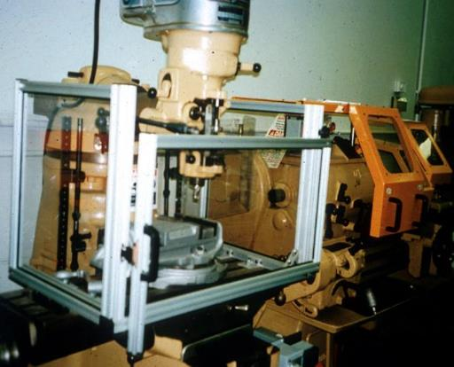
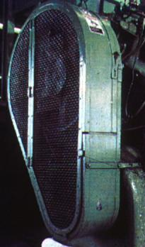
Fixed Guard
Provides a barrier - a permanent part of the machine, preferable to all other types of guards.

Slide 24
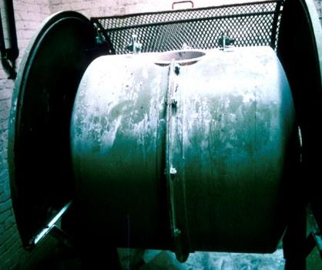
Interlocked Guard
When this type of guard is opened or removed, the tripping mechanism and/or power automatically shuts off or disengages, and the machine cannot cycle or be started until the guard is back in place.
Interlocked guard on revolving drum
Notes:
An interlocked guard may use electrical, mechanical, hydraulic, or pneumatic power or any combination of these. Interlocks should not prevent “inching” by remote control, if required. Replacing the guard should not automatically restart the machine.

Slide 25
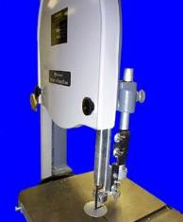
Adjustable Guard
Provides a barrier which may be adjusted to facilitate a variety of production operations.
Bandsaw blade adjustable guard

Slide 26
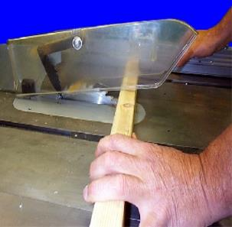
Self-Adjusting Guard
Provides a barrier which moves according to the size of the stock entering the danger area.
Circular table saw self-adjusting guard
Notes:
Self-adjusting guards avoid the potential for human error associated with adjustable guards.

Slide 27
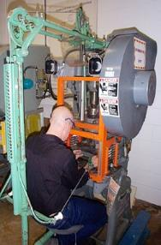
Pullback Device
Utilizes a series of cables attached to the operator’s hands, wrists, and/or arms
Primarily used on machines with stroking action
Allows access to the point of operation when the slide/ram is up
Withdraws hands when the slide/ram begins to descend

Slide 28
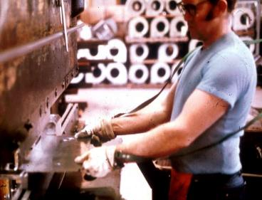
Restraint Device
Uses cables or straps attached to the operator’s hands and a fixed point
Must be adjusted to let the operator’s hands travel within a predetermined safe area
Hand-feeding tools are often necessary if the operation involves placing material into the danger area

Slide 29
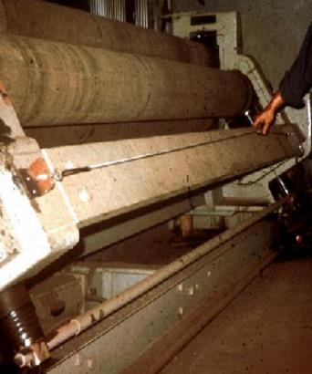
Safety Tripwire Cables
Device located around the perimeter of or near the danger area
Operator must be able to reach the cable to stop the machine
Notes:
Tripwire cables must be manually reset to restart the machine.

Slide 30
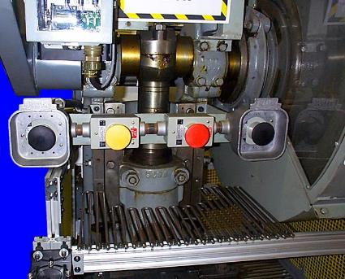
Two-Hand Control
Requires constant, concurrent pressure to activate the machine
The operator’s hands are required to be at a safe location (on control buttons) and at a safe distance from the danger area while the machine completes its closing cycle
Notes:
This kind of control requires a part-revolution clutch, brake, and brake monitor if used on a power press as shown.
A similar device, known as a two-hand trip, requires concurrent application of both of the operator’s control buttons to activate the machine cycle, after which the hands are free. This device is used with machines equipped with full-revolution clutches. The trips must be placed far enough from the point of operation to make it impossible for the operators to move their hands from the trip buttons or handles into the point of operation before the first half of the cycle is completed to prevent them from being accidentally placed in the danger area prior to the slide/ram or blade reaching the full “down” position.

Slide 31
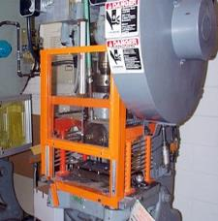
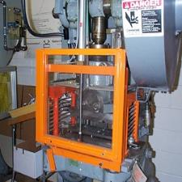
Gate
Movable barrier device which protects the operator at the point of operation before the machine cycle can be started
If the gate does not fully close, machine will not function
Gate Open
Gate Closed
Notes:
Another potential application of this type of device is where the gate is a component of a perimeter safeguarding system. Here the gate may provide protection not only to the operator but to pedestrian traffic as well.

Slide 32
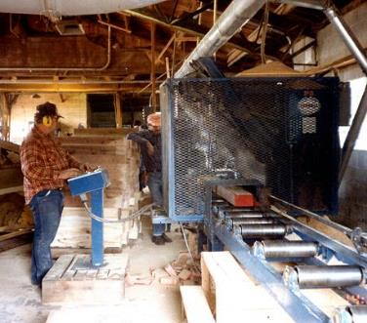
Safeguarding by Location/Distance
Locate the machine or its dangerous moving parts so that they are not accessible or do not present a hazard to a worker during normal operation
Maintain a safe distance from the danger area
Notes:
One approach to safeguarding by location is shown in this photo. Operator controls may be located at a safe distance from the machine if there is no reason for the operator to tend it.
Another approach is to locate the machine so that a plant design feature, such as a wall, protects the worker and other personnel. Enclosure walls or fences can also restrict access to machines. Another possible solution is to have dangerous parts located high enough to be out of the normal reach of any worker.

Slide 33
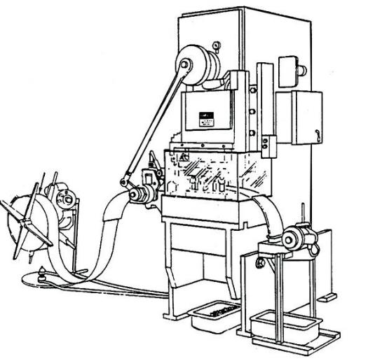
Automatic Feed
Notes:
Many feeding and ejection methods do not require operators to place their hands in the danger area. In some cases, no operator involvement is necessary after the machine is set up. In other situations, operators can manually feed the stock with the assistance of a feeding mechanism. Properly designed ejection methods do not require operator involvement after the machine starts to function.
Using feeding and ejection methods does not eliminate the need for safeguarding. Guards and other devices must be used wherever they are necessary to provide protection from hazards.
Automatic feeds reduce the operator exposure during the work process, and sometimes do not require any effort by the operator after the machine is set up and running.
The power press shown in the photo above has an automatic feeding mechanism. Notice the transparent fixed enclosure guard at the danger area.

Slide 34
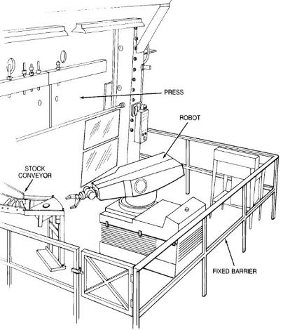
Robots
Machines that load and unload stock, assemble parts, transfer objects, or perform other tasks
Best used in high-production processes requiring repeated routines where they prevent other hazards to employees
Notes:
Robots may create hazards themselves. If they do, appropriate guards must be used. The most common technique is to use perimeter guarding with interlocked gates.
The American National Standards Institute (ANSI) safety standard for industrial robots, ANSI/RIA R15.06-1999, presents certain basic requirements for protecting the worker. However, when a robot is used in a workplace, the employer should accomplish a comprehensive operational safety and health hazard analysis and then implement an effective safeguarding system which is fully responsive to the situation. [Various effective safeguarding techniques are described in ANSI B11.19-1990 (R1997).]
Studies in Sweden and Japan indicate that many robot accidents did not occur under normal operating conditions, but rather during programming, program touch-up, maintenance, repair, testing, setup, or adjustment. During these operations, workers may temporarily be within the robot’s working envelope where unintended operation could result in injuries.

Slide 35
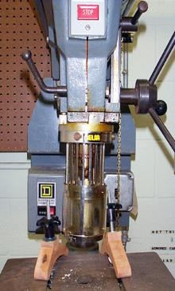
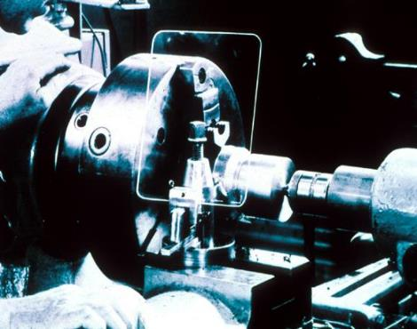
Protective Shields
These do not give complete protection from machine hazards, but do provide some protection from flying particles, splashing cutting oils, or coolants.
Notes:
Miscellaneous aids, such as these, do not give complete protection from machine hazards, but may provide the operator with an extra margin of safety.

Slide 36
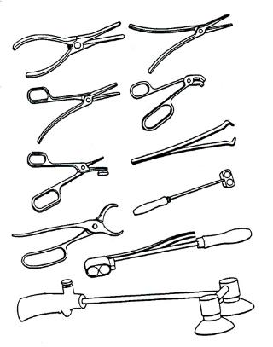
Holding Tools
Used to place and remove stock in the danger area
Not to be used instead of other machine safeguards, but as a supplement

Slide 37
Machine Guarding Examples
Some Examples of OSHA Machine Guarding Requirements . . . .

Slide 38
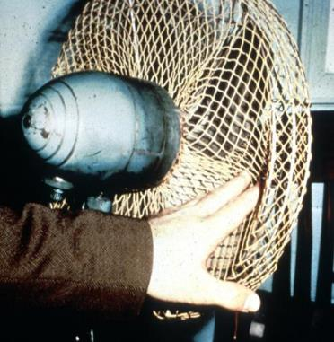
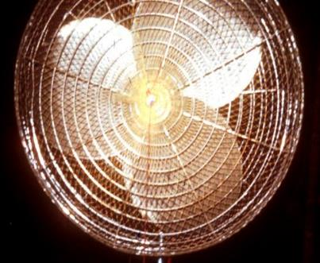
Guarding Fan Blades
When the periphery of the blades of a fan is less than 7 feet above the floor or working level, the blades must be guarded with a guard having openings no larger than 1/2 inch.

Slide 39
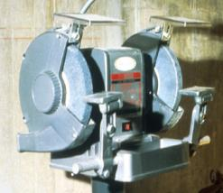
Abrasive Wheel Machinery
Work rests on offhand grinding machines must be kept adjusted closely to the wheel with a maximum opening of 1/8-inch to prevent the work from being jammed between the wheel and the rest, which may result in wheel breakage.

Slide 40
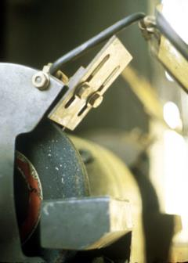
Abrasive Wheel Machinery – cont.
The distance between the wheel periphery and the adjustable tongue must never exceed 1/4-inch.

Slide 41
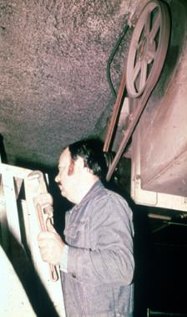
Power-Transmission Apparatus
Unguarded belt
and pulley
Power-transmission apparatus (shafting, flywheels, pulleys, belts, chain drives, etc.) less than 7 feet from the floor or working platform must be guarded.

Slide 42
Machine Safety Responsibilities
Management
  ensure all machinery is properly guarded
Supervisors
  train employees on specific guard rules in their areas
  ensure machine guards remain in place and are functional
  immediately correct machine guard deficiencies
Employees
  do not remove guards unless machine is locked and tagged
  report machine guard problems to supervisors immediately
  do not operate equipment unless guards are in place

Slide 43
Training
Operators should receive training on the following:
Hazards associated with particular machines
How the safeguards provide protection and the hazards for which they are intended
How and why to use the safeguards
How and when safeguards can be removed and by whom
What to do if a safeguard is damaged, missing, or unable to provide adequate protection

Slide 44
OSHA Standards
The following OSHA standards are a few of the regulations that protect employees from amputation hazards
  29 CFR 1910 Sub Parts O and P: Machinery and machine safeguarding
  29 CFR 1926 Subpart I covers hand tools

Slide 45
Helpful OSHA Resources
OSHA has many helpful programs, including assistance with safety and health programs, state plans, workplace consultations, voluntary protection programs, strategic partnerships, training and education

Slide 46
Summary
Safeguards are essential for protecting workers from needless and preventable machinery-related injuries
The point of operation, as well as all parts of the machine that move while the machine is working, must be safeguarded
A good rule to remember is: Any machine part, function, or process which may cause injury must be safeguarded
Proper LOTO will prevent injuries while performing maintenance on equipment
The use of guards and devices are safeguarding methods to prevent amputations
Recognize dangerous machine motions
OSHA is here to help. If in doubt refer to the standards and your supervisor

Slide 47
OSHA Contact Numbers
To report Unsafe Working Conditions, Safety and Health Violations Contact OSHA @:
1-800-321-OSHA (6742) / TTY1-877-889-5627
To File a Complaint Form:
To file an OSHA-7 report online, see how to file a complaint with OSHA (www.osha.gov)
For more information regarding your rights, see Worker Rights
Notes:
OSHA is here to assist you in preventing injuries by providing training and assistance to ALL individuals. For more in formation please contact OSHA.

Slide 48
Questions?

