Slide 1
Globally Harmonized System of Classification and Labeling of Chemicals (GHS)

Slide 2
Sponsorship
Department of Labor
Occupational Health and Safety Administration (OSHA)
Susan Harwood Training Grant
This material was produced under Susan Harwood grant number SH-22315-SH1 Occupational Safety and Health Administration, U.S. Department of Labor. The contents in this presentation do not necessarily reflect the views or policies of the U.S. Department of Labor, nor does the mention of trade names, commercial products, or organizations imply endorsement by the U.S. Government.
Revisions were made to this material under grant number SH-05059-SH8 from the Occupational Safety and Health Administration, U.S. Department of Labor.
Notes:
Introduce the class with brief overview:
This project will deliver occupational health and safety training to new and established small businesses with less than 250 employees; included in this targeted population are limited English proficiency workers, non-literate/low literacy workers, young workers, temporary workers, minority and other hard-to-reach- workers, and workers in high-hazard industries.

Slide 3
Global Harmonization System (GHS)
Notes:
Have students complete Pre-Post Assessment and collect. Make sure attendees have name on form.
This course will provide attendees essential safety skills and knowledge for emergency procedures in HAZCOM.

Slide 4
What is GHS?
  acronym for:
  Globally
  Harmonized
  System of Classification and Labeling of Chemicals
GHS

Slide 5
GHS
  GHS is a harmonized system for the classification and labeling of chemicals covering health, physical and environmental hazards.
  It provides a basis for the harmonization of regulations related to the handling of chemical materials at a global level.
  Elements of this system have been adopted by OSHA to classify and communicate hazards of chemicals based on a common set of criteria
Notes:
This system defines hazards, creates a classification process and communicates the information on labels and safety data sheets
Harmonization – implies the coordination, organization, management and synchronization of several elements. In this case of several criteria regarding handling of chemical materials.
A Harmonized System can be defined as the adjustment of differences and inconsistencies among different systems to make them uniform or mutually compatible. The GHS system is composed of several elements in such a way that the end result is an aligned system based on a common approach

Slide 6
Three Parts of GHS
  GHS establishes
    Harmonized definitions of hazards
      Physical , health, environmental
    Specific criteria for labels
      Pictograms, signal words, hazard and precautionary statements
    Harmonized format for safety data sheets
      16 sections (ANSI format)
Notes:
6
The GHS covers physical, health, and environmental hazards. The work was divided in three parts:
Classification criteria for physical hazards – developed by United Nations Subcommittee/ International Labor Organization (ILO), based on the harmonized criteria for transport goods
Classification criteria for health and environmental hazards- developed under the Organization for Economic Cooperation
Hazard communication elements – developed by ILO

Slide 7
GHS main elements
Classification criteria
  Standardized for health, physical and environmental hazards
Hazard communication elements
  Labels
    Standardized elements and format
  Safety Data Sheets
    Standardized sections and format
Notes:
7
The phrases used to indicate the degree (severity) of a hazards is called a category should be consistent across different hazard types.

Slide 8
How was GHS developed?
United Nations Organization (UN) initiative since 1992 to provide a system for the standard handling of chemicals
The system used as reference several existing system from various countries. It is now available for adoption by competent authorities around the world.
Revision 3 of the GHS was used by OSHA as the reference for the proposed Hazard Communication rule
Notes:
UN Globally Harmonized System of Classification and Labeling of Chemicals, third revision is sometimes called the “purple book”

Slide 9
Principles of Harmonization
Harmonization should not reduce the level of protection.
Requires changes in all existing systems.
The scope includes both hazard classification criteria and hazard communication tools (labels, SDS’s).
Notes:
9
Read PP page

Slide 10
Principles of Harmonization (cont.)
Target audiences include consumers, workers, transport workers and emergency responders.
Information should be presented in a comprehensive manner to all audiences
Confidential Business Information (CBI) should be protected without compromising worker safety.
Notes:
10
Read PP Page

Slide 11
Guiding Principles
All hazardous chemicals are covered including mixtures
The GHS does not include requirements for additional testing for health hazards nor establishes uniform test methods
The system takes into account existing data from testing for hazard determination.
Notes:
Information should be presented in more than one way, symbols, words, phrases, to ensure comprehension even to low literacy populations…
The comprehensibility of the components of the system should take account of existing studies and evidence gained from testing.

Slide 12
Why is the GHS needed?
The correct handling of chemicals requires that all necessary information be provided by means of labels, symbols and data sheets.
Differences in countries regulations have resulted in non standardized information for the same material leading to mishandling and /or unsafe situations
Notes:
Read PP page

Slide 13
GHS Impact
These differences impact both protection and trade.
  Protection: inconsistent information for the same chemical can lead to mishandling.
  Trade: compliance with multiple regulations regarding hazard classification and labelling is costly and time-consuming.
Notes:
The global chemical industry generates almost two trillion dollars / year and impacts millions of workers globally.

Slide 14
Application of GHS
The system is created as a “building-block” (modular) approach:
  This means that each authority / agency/ adopts the “blocks” that are applicable to existing or new regulations under their scope
Notes:
14
GHS evaluated the provisions of existing systems and agreed upon common provisions that addressed the needs of the different countries involved.
The system that harmonizes the classification and labeling of chemicals, covering physical, health, and environmental hazards.
It is not a model regulation or standard that can simply be adopted. It consists of non-mandatory recommendations and explanatory text.

Slide 15

Building Block Approach
Hazard classes
Health
Health
Physical
Physical
Acute
Toxicity
Skin
Explosives
Explosives
Category 1-4
Category 1-6
Category 1-6
The building blocks are the hazard classes and categories and each competent authority adopts the building blocks that are applicable to their specific sector.
Notes:
The system was created as a “building block/ modular” approach.

Slide 16
GHS versus OSHA’S HCS

Slide 17

Target Sectors
GHS targets these sectors:
    Workplace
    Consumers
    Transport
    Emergency Responders
Notes:
Workplace – GHS will impact the physical and health hazard criteria, the label and safety data sheet elements and format and the employee training requirements. The environmental hazards may not be covered by all workplace systems
Consumers – GHS will impact mainly the labels of products with the adoption of the GHS hazard criteria
Transport - US Department of Transportation (DOT) has adopted GHS in the labels of dangerous goods
Emergency responders - the adoption of GHS hazard criteria should improve worker safety and safety practices when handling chemical substances

Slide 18
GHS impact 1 of 2
Based on those sectors GHS impacts several US agencies:
Environmental Protection Agency (EPA)
  Pesticides Program
Consumer Product Safety Commission (CPSC)
  User end of products or materials
Department of Transportation (DOT)
  Hazardous Materials Regulations
Notes:
Read PP page

Slide 19
GHS impact
Occupational Safety and Health Administration (OSHA)
  Under HAZCOM, OSHA has more requirements affected by the GHS than any other US agency
    hazards,
    labels,
    material safety data sheets,
    training
  Main impact is on the Hazard Communication Standard which covers 945,000 hazardous chemical products and 7 million workplaces.
Notes:
OSHA is the competent authority regarding safe use of chemical in the work place the impact of GHS will reach an estimated 7 million workplaces in US .

Slide 20
HCS History
First publication on Nov.1983. Only covered manufacturing sector. Final Rule was published on Aug 1987 covering all employers except for the construction industry (temporary)
Supreme Court decision to enforce all provisions in all industrial segments was on Feb 1990.
Publication of final rule on Feb. 1994 including technical amendments and minor changes
Notes:
There has been no major revision to the rule since then, only minor changes

Slide 21
HCS Framework
Purpose - to ensure that the hazards of all chemicals produced or imported are evaluated, and that information concerning their hazards is transmitted to employers and employees.
Scope – worksites where employees could be exposed to hazardous chemicals
Notes:
Chemicals are used in every type of worksite at different levels. The amount of workers potentially exposed covers millions around the world.

Slide 22
HCS Framework (cont.)
How – transmitting information by means of a complete hazard communication program that includes:
  list of hazardous chemicals present
  container labeling and other forms of warning
  safety data sheets
  employee training
Notes:
Information must be conveyed in English (other languages are permitted), to employers and employees in different ways so that all types of workers and workplaces can be reached

Slide 23
Responsibilities under HCS
OSHA requires manufacturers and importers to evaluate the hazards related to chemicals they produce or import.
  This evaluation will be changed to a hazard classification
Employers are required to inform their employees about the hazards related to chemicals they might be exposed to and corresponding protective measures.
  Labels and safety data sheets change
  Training needs to include GHS adopted elements
Notes:
Read PP page

Slide 24
GHS – Hazard Classification
Health, Physical, Environmental

Slide 25

GHS: Environmental Hazards
Hazardous to the Aquatic Environment
  Acute – injury after short term exposure
  Chronic – injury during the organism life cycle
  Includes fish, crustaceans, and algae or other aquatic plants
The environmental hazards are not covered by OSHA. The competent authority for those would be EPA.
Notes:
Read PP page

Slide 26

GHS – Health Hazards

Slide 27

GHS Health Hazards (10)
Acute Toxicity
Skin corrosion/Irritation
Serious eye damage/eye irritation
Respiratory or skin sensitization
Germ cell mutagenicity
Carcinogenicity
Reproductive toxicity
Target organ system toxicity – Single exposure
Target organ system toxicity – repeated exposure
Aspiration hazard
Notes:
Each of these hazard classes is divided into hazard categories. Not all hazard categories were adopted for the hazard classes

Slide 28

Definitions: Health Hazards
Acute toxicity refers to those adverse effects occurring following oral or dermal administration of a single dose of a substance, or multiple doses given within 24 hours or an inhalation exposure of 4 hours.
  Substances are assigned to one of five categories based on oral, dermal, and inhalation toxicity.
  OSHA did not adopt category 5
Notes:
OSHA as the competent authority did not completely adopt the Acute Toxicity category, leaving severity category 5 out

Slide 29
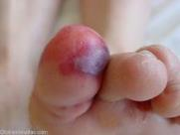
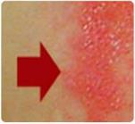
Definitions: Health Hazards (cont.)
Skin corrosion is defined as the production of irreversible damage to the skin; namely, visible necrosis through the epidermis and into the dermis, which was followed by the application of a test substance for up to 4 hours.
Corrosive reactions are typified by ulcers, bleeding, bloody scabs.
Visible damage to skin after contact with substance
Notes:
29
Basically, contact with skin for up to four hours produces irreversible damage.
OSHA is not adopting Category 3 of the skin corrosion/irritation health hazard

Slide 30

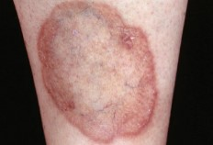
Definitions: Health Hazards -Skin
Skin irritation is defined as the production of reversible damage to the skin following the application of a test substance for up to 4 hours.
Before contact
  There are two categories for the Skin Corrosion/irritation hazard class
After contact
Notes:
30
Basically, contact with skin for up to four hours produces reversible damage.

Slide 31
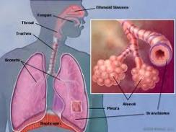
Definitions: Health Hazards - Respiratory
Skin sensitizer means a chemical that induces an allergic response following skin contact.
Respiratory sensitizer means a chemical that will lead to hypersensitivity of the airways following inhalation of the chemical.
  There are two categories for the Respiratory or Skin Sensitization hazard class
Notes:
31
Read PP page

Slide 32

Definitions: Health Hazards - Eyes
Serious eye damage is defined as the production of tissue damage in the eye, or serious physical decay of vision, following application of a test substance to the anterior surface of the eye, which is not fully reversible within 21 days of application.
Notes:
Read PP page

Slide 33
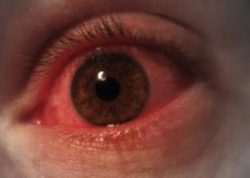
Definitions: Health Hazards – Eyes (cont.)
Eye irritation is defined as the production of changes in the eye following the application of test substance to the anterior surface of the eye which are full reversible within 21 days of application.
There are two categories for eye hazards
Notes:
Read PP page

Slide 34

Definitions: Health Hazards - Mutagenicity
Germ Cell Mutagenicity
A mutation is defined as a permanent change in the amount or structure of the genetic material in a cell.
The terms mutagenic and mutagen will be used for agents giving rise to an increased occurrence of mutations in populations of cells and/or organisms.
Two categories in this hazard class.
Notes:
Read PP page

Slide 35
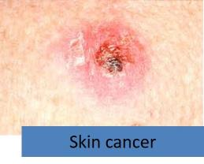
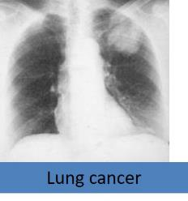
Definitions: Carcinogen
Carcinogen means a substance or a mixture of substances which induce cancer or increase its incidence.
  Substances and mixtures which have induced benign and malignant tumors in well-performed experimental studies on animals are considered also to be presumed or suspected human carcinogens.
Two categories in this hazard class
Notes:
Substances that have induced tumors of any kind will be considered carcinogens, unless there is strong evidence that the mechanism of tumor formation is not relevant for humans.

Slide 36


Definitions: Reproductive Toxicity
Reproductive toxicity means adverse effects on sexual function and fertility in adult males and females, as well as adverse effects on development of the offspring.
  Adverse effects on development of the offspring means any effect of chemicals which interferes with normal development of the conceptus either before or after birth.
Two categories in this hazard
Notes:
Read PP page

Slide 37

Definitions: STOT
Specific Target Organ Toxicity (STOT)
  Single exposure means specific, non-lethal target organ toxicity arising from a single exposure to a chemical.
  Repeated exposure requires more than one instance of exposure.
Notes:
Read PP page

Slide 38

Definitions: STOT (cont.)
STOT is caused by chemicals that are specific target organ toxicants and, as such, present a potential for adverse health effects in people who are exposed to it.
  STOT – single exposure has three hazard categories
  STOT – repeated exposure has two hazard categories.
Notes:
Read PP page

Slide 39

Definitions: Aspiration
Aspiration means the entry of a liquid or solid chemical directly through the oral or nasal cavity, or indirectly from vomiting, into the trachea and lower respiratory system.
  Includes severe acute effects such as chemical pneumonia, varying degrees of pulmonary injury or death following aspiration.
  Only one category adopted
Notes:
Category 2 of Aspiration Hazard was not adopted by OSHA.

Slide 40

GHS – Physical Hazards

Slide 41

GHS Physical Hazards (16)
Explosives
Flammable gases
Flammable aerosols
Oxidizing gases
Gases under pressure
Flammable liquids
Flammable solids
Self-reactive substances and mixtures
Pyrophoric liquids
Pyrophoric solids
Self-heating substances and mixtures
Substances which on contact with water emit flammable gases
Oxidizing liquids
Oxidizing solids
Organic peroxides
Corrosive to metals
Notes:
OSHA has the adopted GHS criteria for all physical hazards. The physical hazards criteria in Appendix B are based on the UN Recommendations for the Transport of Dangerous Goods (RTDG) already used by US DOT in the hazards material regulations . Therefore the transport labels remains the same.

Slide 42

Physical Hazards - Explosives
Explosive Substances and Mixtures
    Solid or liquid substances capable of producing gas at such a high temperature and pressure that it can cause damage to surroundings.
    Divided in 6 categories based on type of damage produced.
Notes:
These are similar to the subcategories for the transport sector.
Pyrotechnic chemicals are included even when they do not evolve gases.
A pyrotechnic chemical is a chemical designed to produce an effect by heat, light, sound, gas or smoke or a combination of these as the result of non-detonative self sustaining exothermic chemical reactions.
An explosive item is an item containing one or more explosive chemicals.
A pyrotechnic item is an item containing one or more pyrotechnic chemicals.
An unstable explosive is an explosive which is thermally unstable and/or too sensitive for normal handling, transport, or use.
An intentional explosive is a chemical or item which is manufactured with a view to produce a practical explosive or pyrotechnic effect.

Slide 43


Physical Hazards - Flammables
Flammables include
  Flammable Gases
  Flammable Aerosols
  Flammable Liquids
  Flammable Solids
Notes:
Flammables
Flammable Gases
Have a flammable range in air at 20 degrees C (68 F) and a pressure of 101.3 kilopascals (14.7 psi).
Flammable Aerosols
They are compressed, liquefied or pressurized gas that eject from the container in a foam, powder or liquid state. Classification of aerosols will depend upon concentration of flammables and heat of combustion among other test s
Flammable Liquids
Any liquid with a flash point of 93 degrees C ( 199.4 F) or less. Divided in 4 categories based on flash point and boiling point temperature
Flammable Solids
A solid, usually in a powder or granular form, that is easily combustible through friction like some metal powders. Divided in 2 categories based on burning time, burning rate and behavior when wet.

Slide 44

Physical Hazards (cont.)
Flammable gas means a gas having any flammable range with air at 20°C (68 F) and a standard pressure of 101.3 kPa (14.7 psi).
  Two categories
Notes:
Read PP page

Slide 45
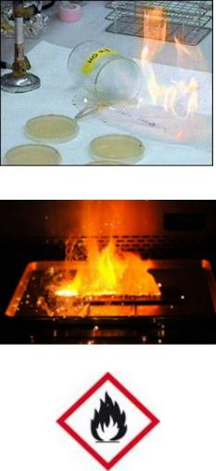
Physical Hazards...
Flammable Liquids
  Any liquid with a flash point of 93 degrees C (199.4 F) or less.
  Four categories
Flammable Solids means a solid, usually in a powder or granular form, that is easily combustible through friction
  Two categories
Notes:
Flammable Solids
A solid, usually in a powder or granular form, that is easily combustible through friction like some metal powders. Divided in 2 categories based on burning time, burning rate and behavior when wet.

Slide 46


Aerosol
Aerosol means any non-refillable receptacle containing a gas compressed, liquefied or dissolved under pressure, and fitted with a release device allowing the contents to be ejected as particles in suspension in a gas, or as a foam, paste, powder, liquid or gas.
Flammable Aerosols
  Contain Flammable components
  Two categories
Notes:
Read PP page

Slide 47

Oxidizing
Oxidizing gas means any gas which may, generally by providing oxygen, cause or contribute to the combustion of other material more than air does.
One category.
Oxidizing Liquids and Solids though not necessarily combustible on their own by yielding oxygen cause or contribute combustion of other material.
  Three categories
Notes:
Oxidizers provide oxygen thus enhancing flammability

Slide 48

Gases
Gases Under Pressure
  Gases contained in a receptacle at a pressure of 200 kPa (29 psi) or more, which are liquefied or liquefied and refrigerated
  Includes 4 groups: compressed gases, liquefied gases, dissolved gases and refrigerated liquefied gases
Notes:
Contained in a receptacle at not less 200 kPa (29 psi) @ 20 ºC (68 F). May explode from container if heated
Compressed gas is entirely gaseous at -50ºC (-58 F)
Liquefied gas is partially liquid at temperatures over 50ºC (122 F)
Refrigerated liquefied gas is partially liquid because of its low temperature
Dissolved gas is a gas dissolved in a liquid phase solvent

Slide 49

Self-Reactive Chemicals
Self-reactive chemicals are thermally unstable liquid or solid chemicals liable to undergo a strongly exothermic decomposition even without participation of oxygen or air.
Divided into 7 categories similar to those in the transport sector
Excludes oxidizers, organic peroxides and explosives.
Notes:
A self-reactive chemical is regarded as possessing explosive properties when in laboratory testing the formulation is liable to detonate, to deflagrate rapidly or to show a violent effect when heated under confinement.

Slide 50

Pyrophoric
Pyrophoric Solids/ Liquids means a solid or liquid which, even in small quantities, is liable to ignite within five minutes after coming into contact with air.
  One category for each
Notes:
The minimum temperature at which these liquids can ignite is below room temperature.

Slide 51
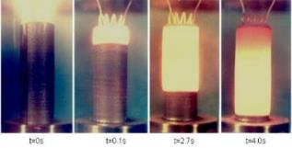

Self-Heating
Self-Heating Chemicals
  Solids or liquids, other than pyrophoric, which by reaction with air and without energy supply is liable to self heat. Two categories
  They require large amounts of material and long periods of time to ignite.
Notes:
51
These are not pyrophoric

Slide 52


Physical Hazards Contact with Water
Substances which on Contact with Water Emit Flammable Gas are solid or liquid chemicals which, by interaction with water, are liable to become spontaneously flammable or to give off flammable gases in dangerous quantities
  Three categories
Notes:
Read PP page

Slide 53
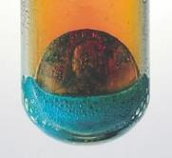


Corrosive Metals
Corrosive to Metals means a chemical which by chemical action will materially damage, or even destroy, metals.
  One category
Organic Peroxides means organic liquids or solids that can decompose explosively, burn rapidly, be sensitive to friction and react dangerously with other chemicals.
  7 categories similar to those in transport sector
Notes:
The categories are divided based upon material explosive properties. Peroxides can decompose in an explosive manner, burn rapidly, be sensitive to friction and react dangerously with other chemicals

Slide 54
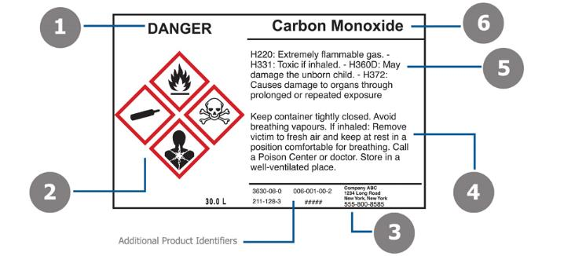
GHS – Labels - Hazard Communication Tools

Slide 55
Label Components
    Product identifier
    Supplier identifier
    Chemical identity
    Hazard pictograms*
    Signal words*
    Hazard statements*
    Precautionary information
  *Standardized Based on Appendixes
Notes:
Read PP page

Slide 56

Product Identifier
States the identity of the chemical including all the ingredients that contribute to the hazard of the mixture.
Unique means by which the chemical can be identified.
Notes:
Name or number used for a hazardous product on a label and on the SDS.
UN proper shipping name should also be used on the package when the chemical (substance or mixture) is covered by the UN RTDG.

Slide 57
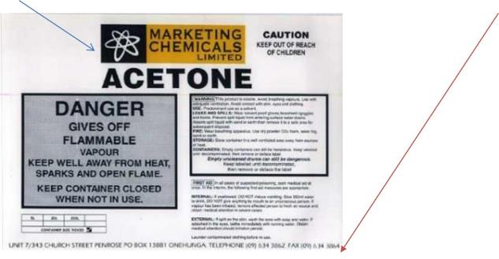
Supplier Information
Supplier Identification
Name, address and telephone number of the manufacturer or supplier of the hazardous chemical.
Notes:
57

Slide 58
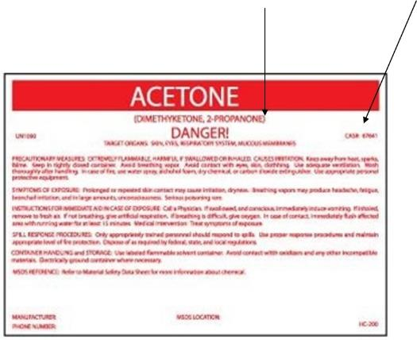
Chemical Identity
A name that will uniquely identify a chemical.
  Name as determined by IUPAC or CAS,
  or technical name as determined by ISO.
Notes:
IUPAC – International Union of Pure and Applied Chemistry
CAS – Chemical Abstract Service
ISO – International Organization for Standardization

Slide 59
Chemical Identity – cont.
For Mixtures
  Identities of all ingredients contributing to health hazards
  All ingredients that contribute to the hazard of the mixture.
Notes:
59
Identities of all ingredients contributing to
acute toxicity,
skin or eye corrosion,
germ cell mutagenicity,
carcinogenicity,
reproductive toxicity,
skin or respiratory sensitisation,

Slide 60

GHS - Pictograms

Slide 61

Pictograms
Display health, physical and environmental hazard information.
New health hazard symbol.

Slide 62

Pictogram Features
Pictograms feature a white background with a red border instead of a solid orange background.
Notes:
62

Slide 63






GHS Pictograms
Exploding bomb Explosives; Self Reactive; Organic Peroxides | Skull and Crossbones Acute toxicity (severe) | Flame Flammables; Pyrophorics; Self-Heating; Emits Flammable Gas; Self Reactive; • Organic Peroxides
Gas Cylinder Gases under pressure | Health Hazard Carcinogen; Mutagenicity; Reproductive Toxicity; Respiratory Sensitizer; Target Organ Toxicity; Aspiration Toxicity | Flame over circle Oxidizers
Corrosion Corrosives | Exclamation mark Irritant; Skin Sensitizer; Acute Toxicity (harmful); Narcotic effects; Respiratory Tract Irritant; Hazardous to Ozone Layer | Environmental Aquatic Toxicity (OSHA did not propose this pictogram)

Slide 64
Pictogram Shape & Color
For transport pictograms will not change
For other sectors pictograms will have a black symbol on a white background with a red diamond frame.
For the same hazard where a transport pictogram appears the GHS pictogram should not appear.
Notes:
For transport, pictograms will have the background and symbol colors currently used.
For other sectors, pictograms will have a black symbol on a white background with a red diamond frame. A black frame may be used for shipments within one country. OSHA will maintain the red border.
The transport pictogram has precedence over the GHS pictogram if the same hazard is present

Slide 65
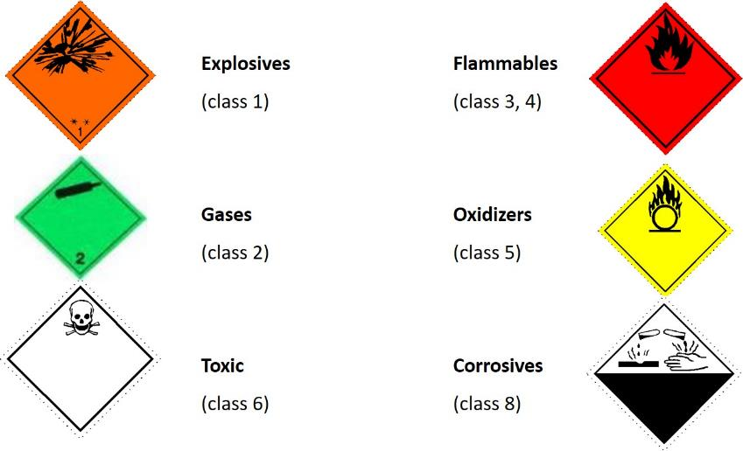
Transport Pictograms
Notes:
These classes are similar to the ones seen in the previous slide, illustrating harmonization between systems

Slide 66
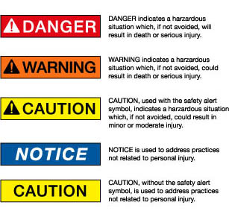
Signal Words
These words are used to alert the reader of health, physical, and environmental hazards, and the hazard’s level of severity
“Danger” and “Warning” are the only two signal words used.
Notes:
66
Words shown here are those used by the ANSI Z129.1 standard, American National Standard for hazardous Industrial Chemicals – Precautionary Labeling.
Danger – most harmful to person, because of toxicity or exposure, more severe or persistent effects
Warning - less harmful to person, lower levels of exposure or toxicity or temporary harmful effects
Lower levels of danger or exposure typically used “Caution” or “Notice” as the warning word
Studies showed people identify these words with different levels of risks or hazards, but saw little differences between the words Caution and Warning

Slide 67
Pause
Notes:
Take a moment to answer any questions of material discussed up to here. Make quick review on board

Slide 68
Hazard Statements
GHS label should include appropriate hazard and precautionary information.
A hazard statement is a phrase assigned to a hazard class that describes the nature of the hazard, and its level of severity.
  “Highly Flammable,” “Unstable Explosive,” “Toxic if Inhaled”.
There are three types: Physical, Health and Environmental
Notes:
The hazard statements have codes associated to them. OSHA has not adopted the codes but has identified statements corresponding to each hazard class. Please refer to Appendix C of the proposed rule for more information.

Slide 69
Precautionary Information
Phrases indicate measures recommended to help minimize or prevent the effects resulting from exposure, improper storage or handling of hazardous products
Precautionary statements include provisions for storage, handling, response and disposal
Appendix C contains, among other information, statements recommended for each level of hazard within each hazard class.
Notes:
Take a moment to show example of Appendix C and how to read information given here.
The GHS document includes examples of precautionary statements which can be used. The intent is to harmonize precautionary statements in the future. As with hazard, precautionary statements, have codes which will not be adopted by OSHA.

Slide 70
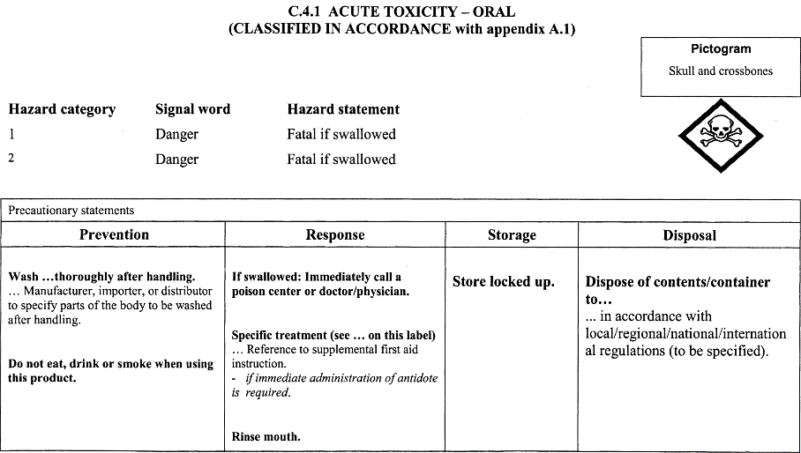
Appendix C

Slide 71
Precedence
Where a chemical is classified for a number of hazards, and the precautionary statements are similar, the most stringent shall be included on the label (this will be applicable mainly as preventive measures).
An order of precedence may be imposed by the manufacturer, importer or responsible party in situations where phrases concern “Response.”
Notes:
To reduce the variation of non-standardized information, supplementary information on the label is limited to when it provides further detail and does not contradict or cast doubt on the validity of the standardized hazard information, or when it provides precautionary information about unclassified hazards.
However OSHA recommends placing appropriate precautionary measures under the supplemental information of unclassified hazards.

Slide 72

GHS: Safety Data Sheets

Slide 73
Role of the SDS in the GHS
Primary Use of SDS: The Workplace
Employers and workers use them as an information source about hazards of a chemical substance or mixture and to obtain advice on safety precautions.
SDS information can be used by those involved in the transport of dangerous goods and emergency responders.
Notes:
It’s information enables the employer to develop an active program of worker protection measures, including training specific to the workplace.

Slide 74
When is an SDS required?
An SDS should be produced for all chemicals (substances and mixtures) which meet the harmonized criteria for physical, health or environmental hazards under the GHS and …
For all mixtures which contain substances that meet the criteria for:
  Carcinogens,
  Toxic to reproduction or
  TOST in concentrations exceeding the cut-off limits specified by the criteria for mixtures.
Notes:
TOST = Target Organ Systemic Toxicity

Slide 75
Safety Data Sheet content
1. Identification
2. Hazard (s) identification
3. Composition/ information on ingredients
4. First-aid measures
5. Fire-fighting measures
6. Accidental release measures
7. Handling and storage
8. Exposure control/ personal protection
9. Physical and chemical properties
10. Stability and reactivity
11. Toxicological information
12. Ecological information
13. Disposal considerations
14. Transport information
15. Regulatory information
16. Other information
OSHA requires sections 1-11 and 16 be mandatory
Not under OSHA jurisdiction

Slide 76
Global Harmonization System(GHS)
Exercises

Slide 77
Exercise on Pictograms
Determine the type of hazard based on the pictograms below
Notes:
Divide participants into small groups. Provide groups with reference information. Allow 10 minutes for exercise and discussion
Health – Carcinogen; Mutagenicity; Reproductive Toxicity; Respiratory Sensitizer; Target Organ Toxicity; Aspiration Toxicity
Crossbones – Acute toxicity
Exclamation - Irritant; Skin Sensitizer; Acute Toxicity (harmful); Narcotic effects; Respiratory Tract Irritant; Hazardous to Ozone Layer
Different hazards are identified with these pictograms

Slide 78
Exercise on Pictograms – cont.
Determine what pictogram would use the following chemical using the information provided
Material is extremely toxic to humans
Keep away from flames and sparks.
Corrosive to metals
Notes:
78
Skull and crossbones - toxic
Flame - flammable
Corrosion

Slide 79
Exercise on Hazards
Determine the type of precautionary statement (prevention, response, storage, disposal) of these materials given the following information
Wear cold insulating gloves
Dispose of contents in accordance with local regulations
If exposed: call poison center or doctor/ physician
Stored in a well ventilated place
Notes:
79
Wear cold insulating gloves - handling
Dispose of contents in accordance with local regulations - disposal
If exposed: call poison center or doctor/ physician – first aid measures
Stored in a well ventilated place - storage

Slide 80
Data Sheets Exercise
Using the data sheet provided, identify in which section of the data sheet you can find the following
  Health effects
  Flammability of material
  Storage precautions
  Toxicity of material
  Material identity
Notes:
Section 4 – First aid supplemented by section 2
Section 9 – Physical and chemical properties
Section 7 – Storage and handling
Section 11 - Toxicological information
Section 1 – Identification

Slide 81
Labels Exercise
With the information provided for each chemical, identify the following elements of the label. Please reference Appendix C
  Pictogram
  Signal words
  Hazard statements
  Precautionary statement
Notes:
Divide the participants into small groups and provide them with Appendix C. Indicate the name and hazard classification (heath/ physical) for the selected chemical. Instruct participants to fill out the label template.
SDS for the following Chemicals are available
Manufacturing sector – pesticides such as Aldrin, Malathion (toxic), solvents like Toluene, Xylene, (flammable)
Service sectors – solvent such as Acetone Turpentine (toxic, flammable) , Formaldehyde (toxic), PCB’s, Wax floor (irritants), cleaners such as Clorox, Lysol (corrosives),
Participants are expected to correctly identify in Appendix C the reference information for the corresponding hazard category. Allow 15 minutes for exercise and discussion.

Slide 82

HAZCOM- GHS
?
Notes:
Pass out Pre-Post Assessment, have attendees complete.
Go over answers.
Collect forms
Complete course evaluations and collect.

