Slide 1
Forklift Operator Safety Training
This material was produced under grant number SH05059-SH8 from the Occupational Safety and Health Administration, U.S. Department of Labor. It does not necessarily reflect the views or policies of the U.S. Department of Labor, nor does mention of trade names, commercial products, or organizations imply endorsement by the U.S. Government.
Notes:
INTRODUCE CLASS

Slide 2
Objectives
Explain regulatory standards
Describe powered industrial truck/forklift
Explain safety procedures
Perform pre-operational checks
Operate forklift in a simulated driving situation
Notes:
GO OVER OBJECTIVES

Slide 3
Objectives (cont.)
Explain precautions for operating a forklift
Practice good housekeeping
Explain load capacities
Demonstrate proper handling, stacking, loading and unloading
Notes:
CONTINUE GOING OVER OBJECTIVES

Slide 4

House Rules
No Cell Phones usage unless emergency!
If you hear “stop”!! You must STOP!
  No exceptions!
Respect everyone
No photography
No video
Notes:
GO OVER CLASSROOM RULES

Slide 5

Occupational Safety and Health Administration (OSHA)
On December 29, 1970, President Nixon signed the OSH Act
This Act created OSHA, the agency, which formally came into being on April 28, 1971
OSHA falls under the U.S. department of Labor
Notes:
DISCUSS BACKGROUND OF OSHA

Slide 6
OSHA’s Mission
The mission of OSHA is to assure safe and healthful working conditions for working men and women by setting and enforcing standards and by providing training, outreach, education and assistance.
OSHA does this by:
  Developing job safety and health standards and enforcing them through worksite inspections
  Providing training programs to increase knowledge about occupational safety and health
Notes:
OHSA’S MISSION - DISCUSS

Slide 7
Regulatory Standards
Occupational Safety and Health Administration (OSHA) 29 Code of Federal Regulation (CFR) 1910.178, Powered Industrial Trucks
ANSI/ITSDF B56.1-2009, Safety Standards for Low Lift and High Lift Trucks
American National Standards Institute (ANSI)
Industrial Trucks Standards Development Foundation (ITSDF)
Notes:
DISCUSS REGULATIONS

Slide 8

OSHA Makes A Difference
Prior to OSHA there were 13,800 workplace deaths per year
4,405 workers were killed on the job in 2013 (3.2 per 100,000 full-time equivalent workers)
Nearly 3.0 million serious workplace injuries and illnesses were reported by private industry employers in 2012
Notes:
DISCUSS OSHA WORKS SLIDE

Slide 9
OSHA Works
“In more than four decades, OSHA and our state partners, coupled with the efforts of employers, safety and health professionals, unions and advocates, have had a dramatic effect on workplace safety.”
Notes:
DISCUSS

Slide 10
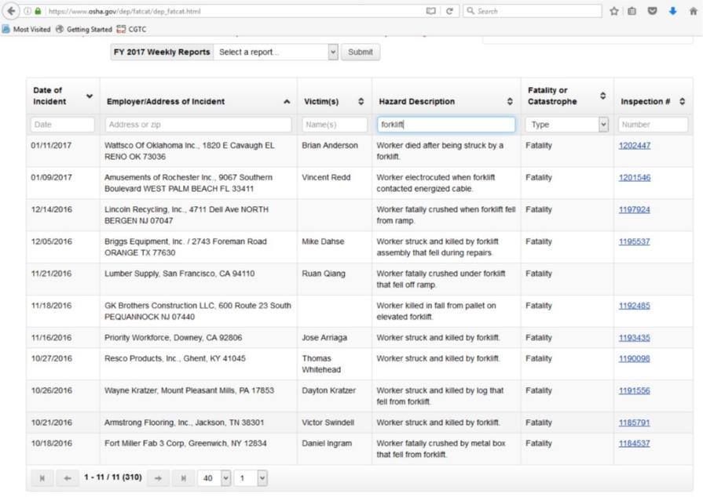
OSHA Works – Incidence Reports
Notes:
DISCUSS

Slide 11
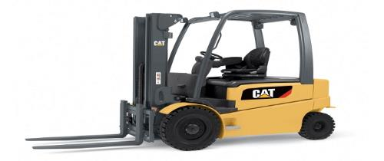
Powered Industrial Truck/Forklift
Self-propelled vehicles with 3 or 4 wheels designed to lift, transport, and position materials
Controlled by the steering of the back wheels. The front wheels are what are powered during operation
Fueled by LP (liquid propane), diesel fuel system, gasoline system, or battery
Notes:
WHAT IS A FORKLIFT?
DISCUSS SLIDE

Slide 12
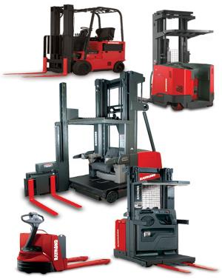
Many Different Types
Sit-down and stand-up powered industrial trucks come in a variety of models ranging from small compact three wheel indoor unit to large diesel powered outdoor yard models.
Each model varies in lifting capacity, operating environment, and size.

Slide 13
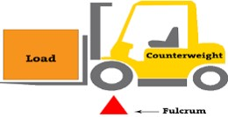
PIT/Forklift
Built on the lever principle
Front or drive wheels act as the fulcrum point
Counterweight counterbalances the weight of the load on the forks or clamps
Notes:
DISCUSS HOW A LIFT WORKS – SEE SLIDE

Slide 14
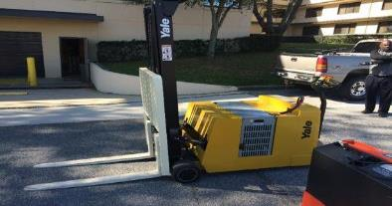
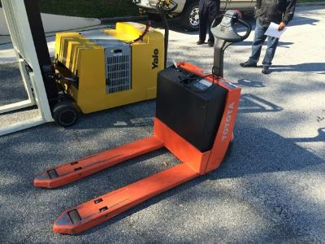
Different Types
Walk behinds are also considered “forklifts”
Notes:
CONTINUED

Slide 15
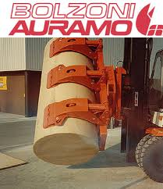
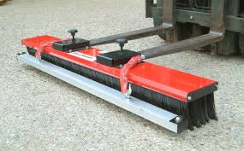
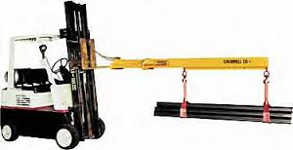
Many Different Types Material Handling
A variety of material handling implements are used such as clamps, forks, or other attachments.
Each has several things in common that must be discussed from a safety and operational standpoint.
Notes:
DISCUSS TYPES OF LIFTS

Slide 16
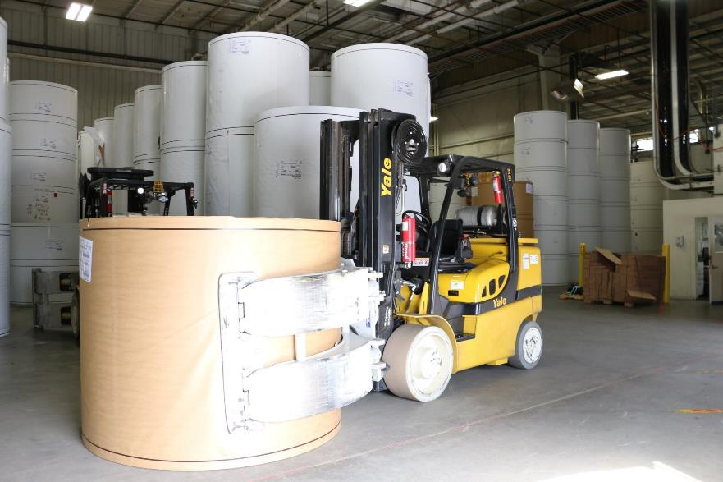
Many Different Types Lifts
Notes:
EXPLAIN TYPE OF LIFT – USED IN LOCAL PAPER FACTORY

Slide 17
Equipment Descriptions
The powered industrial truck is a vehicle that has many controls and parts.
The following items mentioned are common to most powered industrial trucks:
Notes:
GO OVER DESCRIPTIONS

Slide 18
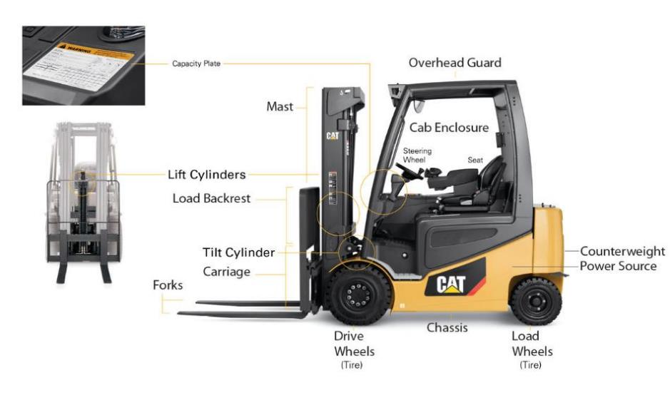
Equipment Descriptions – Points On Forklift
Notes:
DISCUSS POINTS ON FORKLIFT

Slide 19

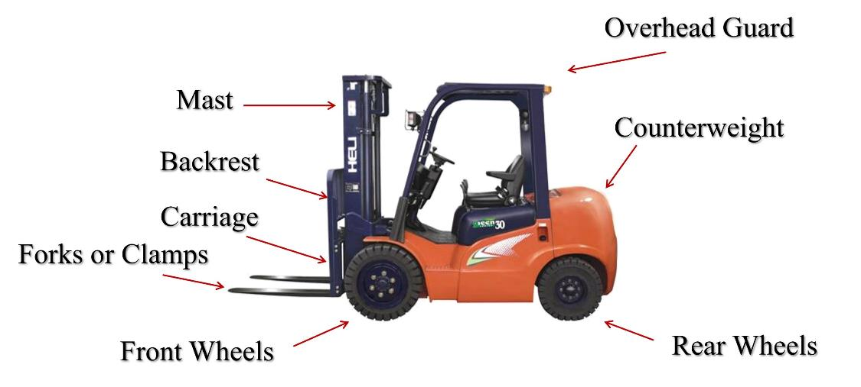
Equipment Description
Notes:
GO OVER THE POINTS OF THE FORKLIFT

Slide 20
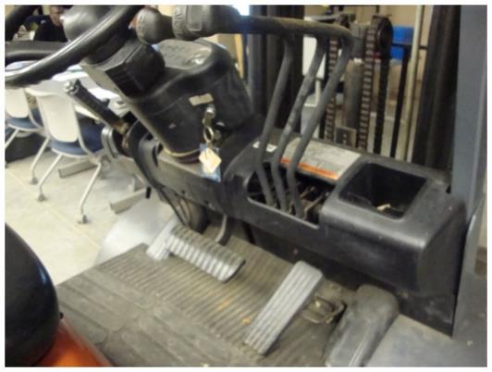
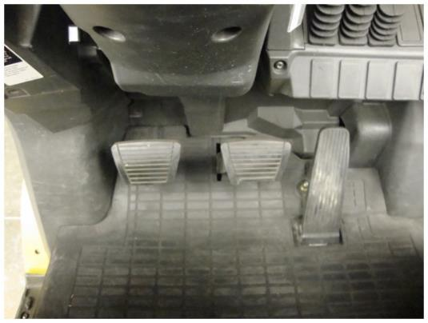
Equipment Controls
Accelerator, Foot Brake, and Clutch
Notes:
DESCRIBE PETALS

Slide 21
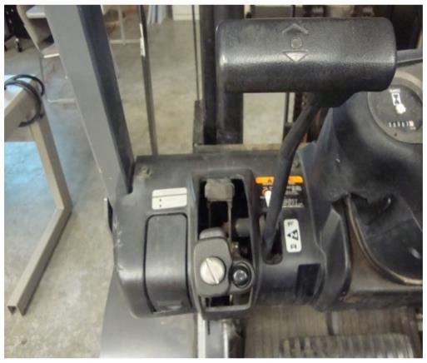
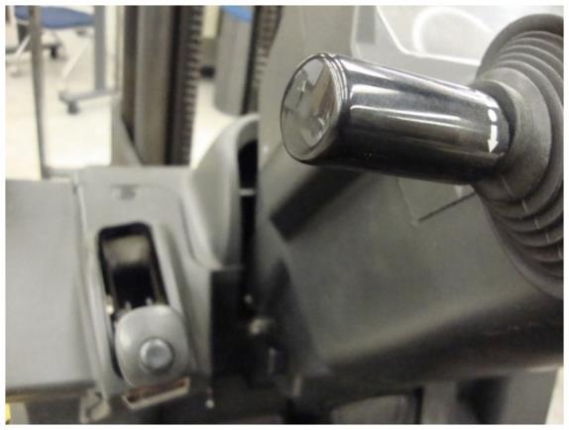
Directional Control Levers - Equipment Controls
Notes:
DISCUSS CONTROLS

Slide 22
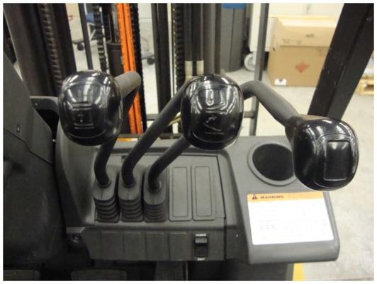
Equipment Controls - Fork, Mast and Fork/Clamps
One controls the up and down movement (forks)
The other controls the tilt or rotating movement (mast)
The other controls the side shift motion (forks/clamps)
Notes:
GO OVER CONTROLS

Slide 23
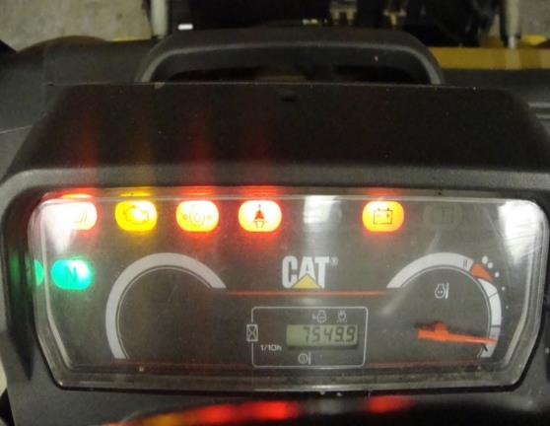
Equipment Controls - Gauges
Gauges
  Mounted on the truck instrument panel.
  They indicate the engine temperature, oil pressure, generator charging rate, condition of directional control, etc.
Notes:
DISCUSS EQUIPMENT PANEL

Slide 24
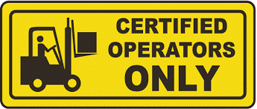
Safety
Only trained, certified and authorized drivers over the age of 18 will operate powered industrial trucks.
Know how to use all safety devices and functions.
Follow safety procedures at all times.
Notes:
DISCUSS SAFETY

Slide 25
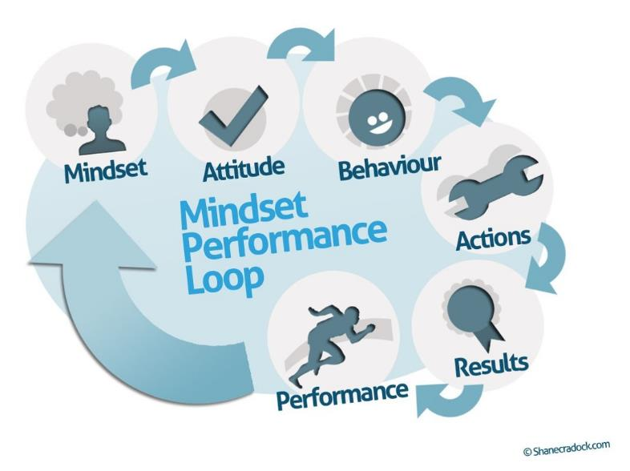
Safety Mindset
Notes:
DISCUSS

Slide 26
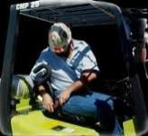
Safety – Buckle Up
Most models are operated from a sitting position.
Mount and dismount correctly.
It is important that the operator be properly seated and seat belt fastened before operating any forklift controls.
When your seat hits the seat, BUCKLE UP!
Notes:
DISCUSS

Slide 27
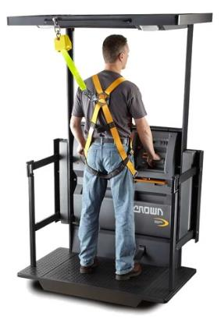
Stand-up Models
Stand-up models are operated from a standing position.
Fasten personal restraint harness before operating any forklift controls.
Notes:
DISCUSS

Slide 28
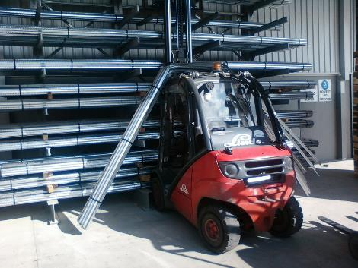
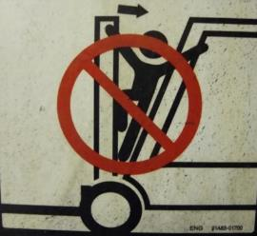
Safety - Examples
Keep arms, hands, legs, and feet in proper position.
Never place them between mast uprights or outside the running lines.
Stay within the boundaries of the overhead guard
Notes:
DISCUSS – ASK STUDENTS FOR EXAMPLES

Slide 29
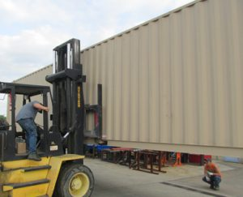
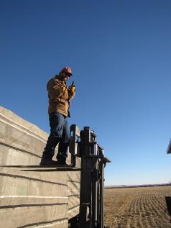
Safety Examples Cont.
Do not let anyone stand or move under raised forks
Do not carry any materials on the overhead guard
Do not hoist people using powered industrial truck forks.
Notes:
DISCUSS

Slide 30
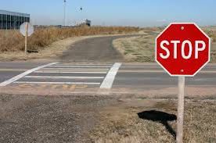
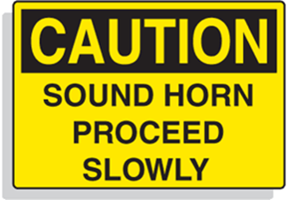
Safety - Signs
Obey all posted signs, including stop signs.
Operate the truck at a speed permitting it to stop in a safe manner.
Do not pass other trucks traveling in the same direction.
Notes:
DISCUSS

Slide 31
Safety Discussion - Cont.
A pedestrian always has the right of way over a powered industrial truck.
A hand truck always has the right of way over a powered industrial truck.
A loaded powered industrial truck has the right of way over an empty powered industrial truck.
Notes:
DISCUSS

Slide 32
Safety Discussion
Always use the aisle, if available
Never cut corners to avoid traffic
Start in low gear (if equipped)
Avoid fast starts and stops
Avoid running over obstacles
No smoking within 50 feet of the battery or LP changing station
Notes:
DISCUSS

Slide 33
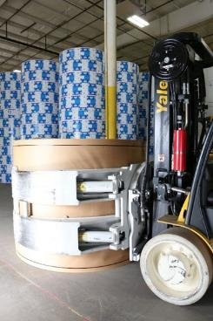
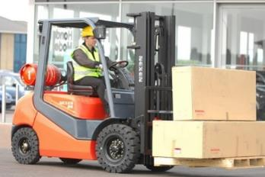
Safety Loaded
Drive with forks or clamps about 4 to 8 inches above the floor
  If loaded, tilt the load all the way back
Notes:
DISCUSS

Slide 34
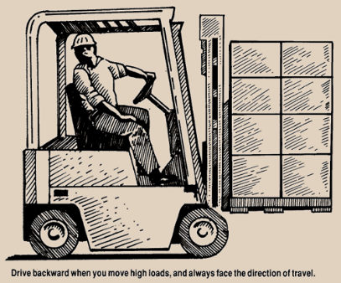
Safety – Backing Up
Drive backwards when transporting a load that obstructs your vision
When approaching employees or visitors from behind…Give a few short blasts of the horn when approximately 20 feet away.
Notes:
DISCUSS

Slide 35
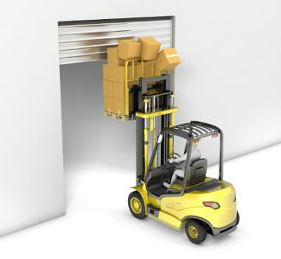
Safety - Overhead
Watch overhead clearances (sprinkler heads, conduits, product conveyor, and doors.)
Always keep in mind the size of the powered industrial truck being operated.
Notes:
DISCUSS

Slide 36
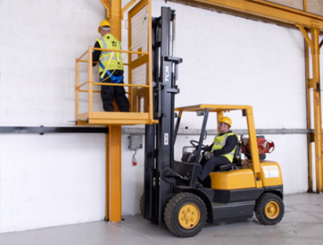
Safety – Rail Specifications
Always use an approved lifting platform
Must be securely attached to the forks and backrest
Harness must also be worn
Must be authorized by the supervisor
Specifications
42” top rail, 21” center rail, 4” toe board, door opens inward
Notes:
GO OVER POINTS

Slide 37
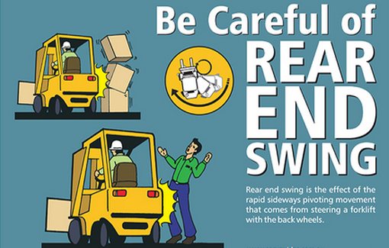
Safety – Front End and Rear End
Always allow for “rear end swing” and “front end swing”
Larger lift trucks have more “swing”
Notes:
DISCUSS

Slide 38
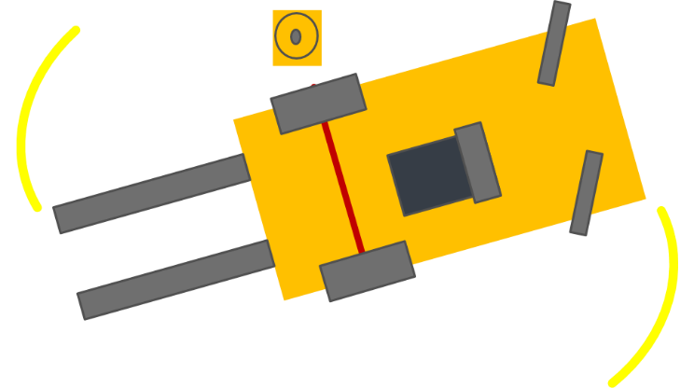
Safety – Rotation of Lift
Notes:
DISCUSS ROTATION OF LIFT

Slide 39
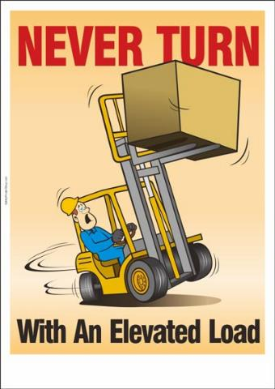
Safety - Speed
Reduce speed when turning.
Never turn on a slope or ramp.
Never turn when the load is elevated
Notes:
DISCUSS

Slide 40
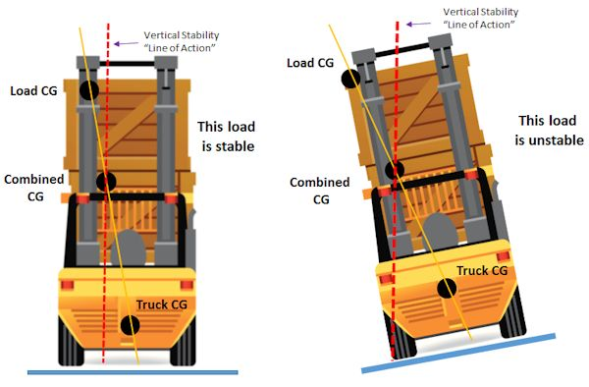
Safety – Vertical Stability
Notes:
DISCUSS

Slide 41
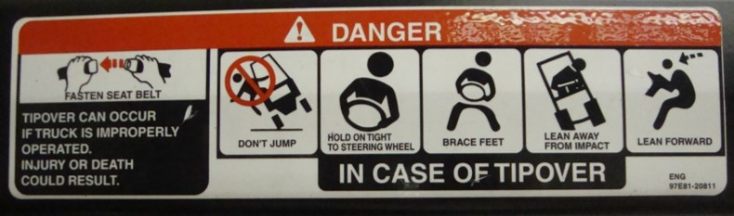
Safety – Tip Over
In the event of a tip over
    Do not jump
    Stay in the seat with the seatbelt fastened
    Grip the steering wheel tightly
    Brace your feet and allow yourself to tip over with the truck
Notes:
GO OVER SIGNAGE

Slide 42
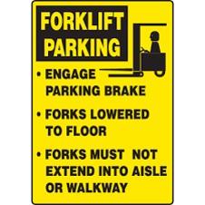
Safety - Parking
If leaving the powered industrial truck even for a moment, park in a safe place out of aisles and away from fire escapes.
    Lower the load (or forks) and set the parking brake.
    Tilt the mast forward slightly and place fork tines flat on the floor.
    Turn off the ignition.
Notes:
DISCUSS

Slide 43
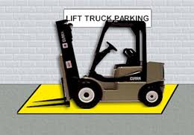
Safety – Lift Parking
Notes:
DISCUSS

Slide 44
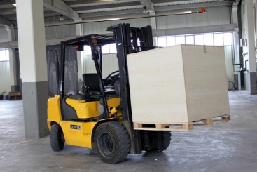
Safety Hazards
Leaving the powered industrial truck forks or any attachment high in the air while parked could cause serious injury.
Notes:
DISCUSS

Slide 45
Safety - NEVER
NEVER operate a forklift in need of repair.
NEVER drive trucks up to anyone standing in front of a bench or other fixed object.
NEVER carry other individuals.
NEVER operate a forklift for any purpose other than what it was designed for.
Notes:
DISCUSS

Slide 46
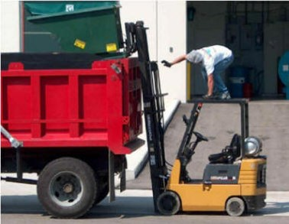
Safety – Do NOT
Notes:
DISCUSS

Slide 47
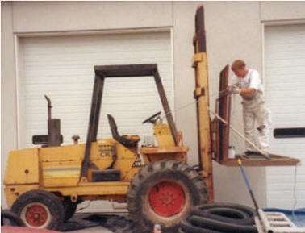
Safety Hazard
Notes:
DISCUSS

Slide 48
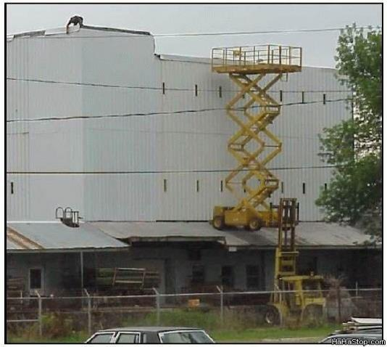
Safety - Discussion
Notes:
DISCUSS

Slide 49
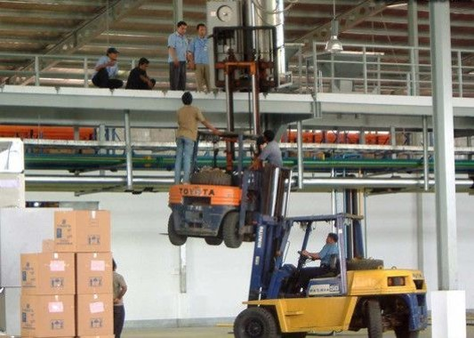
Unsafe
Notes:
DISCUSS

Slide 50
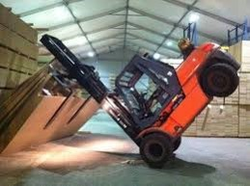
tilted
Notes:
DISCUSS

Slide 51
Safety - Statistics
85 to 100 fatalities per year.
  About 35,000 serious injuries
  About 62,000 non-serious injuries
  Injury and/or fatality occurs every three days
900,000+ forklifts
  11 percent in some kind of accident
Useful truck life is about 8 years
  90 percent in some kind of accident
Notes:
GO OVER POINTS

Slide 52
Safety - Conplacency
Main types of accidents
  Tip over’s 42%
  Crushed between forklift and a surface 25%
  Crushed between two forklifts 11%
  Struck or run over by forklift 10%
  Struck by falling material 8%
  Fall from platform on forks 4%
  COMPLACENCY is the #1 CAUSE of Forklift accidents
Notes:
DISCUSS

Slide 53
Safety - Where fatalities occur
  Manufacturing facilities 42%
  Construction 23.8%
  Wholesale trade 12.5%
  Transportation 11%
  Retail trade 9%
  Mining 1.2%
Notes:
DISCUSS

Slide 54
Pre-Operational Check
Identify Key (Motor) Off inspection criteria. KEY-OFF
Identify Key (Motor) On inspection criteria. KEY-ON
It is important to perform a pre-operational check of the powered industrial truck before operating the vehicle. (Ref: 1910.178(q)(7))
Notes:
DISCUSS

Slide 55
Pre-Operational Inspection
Any powered industrial truck not in safe operating condition is to be removed from service.
The pre-operational check/inspection shall be performed at least daily or prior to use.
The pre-operational check/inspection shall be performed after each shift.
Notes:
DISCUSS

Slide 56
Operation
Only trained operators certified and authorized by the company who are 18 years and older are allowed to operate powered industrial trucks.
You are entrusted with the proper care and operation of an expensive and valuable piece of equipment.
Notes:
DISCUSS

Slide 57
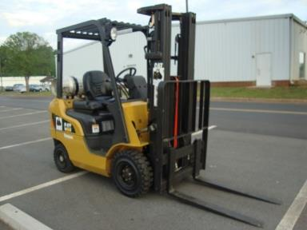
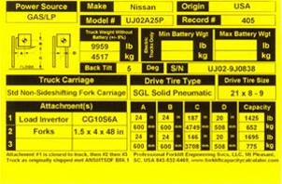
Operation - Versatility
Powered industrial trucks are quite versatile. Learning the capacity of the powered industrial truck is important.
Notes:
DISCUSS

Slide 58
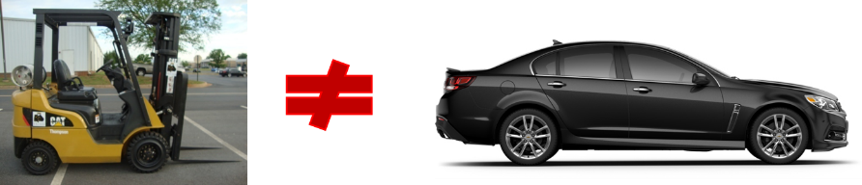
Operation - Similarities
Understand the similarities and differences between a standard size automobile and that of a powered industrial truck.
Notes:
DISCUSS

Slide 59


Operation - Automobiles and lift trucks (forklifts) have many dissimilarities.
Lift Trucks (forklifts)
Automobiles
High center of gravity
Short, narrow wheel base
Low center of gravity
Long, wide wheel base
Notes:
DISCUSS

Slide 60
PIT Operation
Powered industrial trucks are specialized machines with unique operating characteristics designed to perform specific jobs.
Function and operation are not like an automobile.
Never assume you can operate a powered industrial truck in the same manner as you would an automobile.
Never assume one forklift operates just like another.
Notes:
DISCUSS

Slide 61
Operation – Data Plate
Each powered industrial truck has a data plate.
This data plate will indicate the maximum weight the truck can handle without overloading it.
It will also indicate maximum loads, depending on the load center.
Notes:
DISCUSS

Slide 62
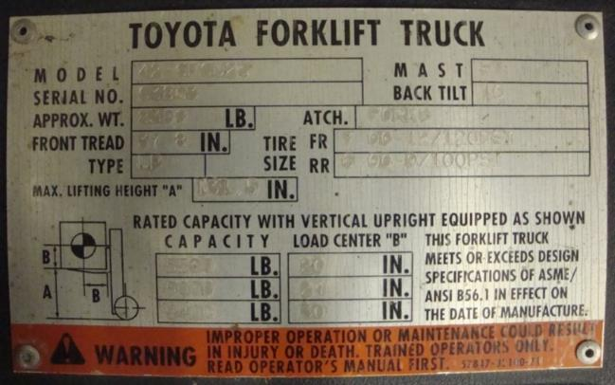

Sample Data Plates
Notes:
DISCUSS SIGNAGE

Slide 63

Operation - Warning
8380
120PSI
100PSI
131.5
B
5500
20
5000
24
4400
30
A
B
Notes:
DISCUSS

Slide 64

Operation –Stability Triangle
The powered industrial truck is a precision piece of equipment set up on a fulcrum and lever balance.
Operate the vehicle inside its stability (operating) triangle.
STABILITY TRIANGLE
Notes:
DISCUSS

Slide 65
Center of Gravity
Vehicle Center of
Gravity (Unloaded)
B
A
C
Center of Gravity
of Vehicle and
Maximum Load
(Theoretical)
Notes:
DISCUSS

Slide 66
Operation – Balanced Load
Vehicle Center of
Gravity (loaded)
B
A
C
Load Center
Notes:
This shows a balanced load

Slide 67
Operation – Unbalanced Load
Vehicle Center of
Gravity (loaded)
B
A
C
Load Center
Notes:
This shows an unbalanced load

Slide 68
Operation - Overload
The heaviest point is to the rear of the vehicle closest to the counterweight on the steer axle.
As you add weight on the forks or the front of the vehicle, the balance point or weight moves forward toward the drive axle.
Never go beyond the operating parameters of the forklift.
Overloading, traveling with the load too high, taking corners too fast and too sharp will cause the operator to go beyond these operating parameters.
Notes:
DISCUSS POINTS

Slide 69


Operation – Cover Controls
Familiarize yourself with the levers that control the forks or clamps so you know exactly what lever controls each movement.
Notes:
COVER CONTROLS

Slide 70



Operation - Mounting
Mount the truck using 3 points of contact and fasten the seat belt.
Place the transmission lever in neutral
Notes:
DISCUSS CONTROLS

Slide 71
Operation - Battery
Engage the starter by turning the ignition switch to the start position.
DO NOT engage the starter for more than 30 seconds.
DO NOT RUN THE BATTERY DOWN
Check that all instruments on the control panel are operating.
DO NOT idle the engine unnecessarily.
Raise the forks, clamps, or other attachments off the floor about 4 to 8 inches.
Notes:
DISCUSS

Slide 72
Handling and Stacking Procedures – 1 of 12
Picking Up the Load
All powered industrial trucks have a rating capacity data plate.
If in doubt about the load’s weight, check with the supervisor.
Notes:
DISCUSS

Slide 73


Handling and Stacking Procedures 2 of 12
Approach the load slowly and straight on with the forks parallel to the floor.
Make sure the forks are low enough to slide under the load.
Notes:
DISCUSS

Slide 74

Handling and Stacking Procedures – 3 of 12
Drive forward until the load touches against the backrest.
Adjust the forks sideways on the fork bar to center the load.
When forks are not centered under the load, the load may slide off the forks and become damaged.
Notes:
DISCUSS

Slide 75


Handling and Stacking Procedures 4 of 12
Lift the load slightly.
Tilt the mast back.
Allow enough backward tilt to stabilize the load
Make sure the load is square against the carriage and load backrest.
Notes:
DISCUSS

Slide 76

Handling and Stacking Procedures 5 of 12
Exercise extreme care when tilting the mast/load forward or backward.
Watch the load closely.
Slowly back away from the stack.
Lower it to traveling position.
Notes:
DISCUSS

Slide 77
Handling and Stacking Procedures 6 of 12
Driving with the load
Always use the aisle, if available.
Never cut corners to avoid traffic.
Start in low gear (if equipped).
Avoid fast starts and stops.
Avoid running over obstacles.
Notes:
DISCUSS

Slide 78

Handling and Stacking Procedures 7 of 12
Avoid railroad crossings.
Approach [uneven] roadways and railroad crossings at an angle and hold steering wheel tightly.
When driving with a load that blocks vision, drive backward.
NEVER DRIVE WITH VISION BLOCKED!
Notes:
DISCUSS

Slide 79


Handling and Stacking Procedures 8 of 12
Watch overhead obstructions closely and make sure you have clearance before proceeding.
Watch out for weak floors.
Do not drive on any floor/ground that cannot support forklift and the load.
Notes:
DISCUSS

Slide 80

Handling and Stacking Procedures 9 0f 12
Never drive onto an elevator whose listed capacity cannot support the combined weight of forklift and its load.
Notes:
DISCUSS

Slide 81
Handling and Stacking Procedures 10 of 12
Lowering and Unloading a Load
Never stop lowering action suddenly.
Do not lift or lower a load while traveling.
  Causes loss of stability
Set loads down slowly in desired position.
Never butt or ram loads.
If a load is incorrectly placed, correctly maneuver it.
Notes:
DISCUSS

Slide 82
Handling and Stacking Procedures 11 of 12
Stacking
Approach to within a foot or so of the stack or tier.
Raise the load slowly.
Tilt the mast slightly forward until it is vertical.
Squarely position load over the stack.
Back truck away slowly.
Notes:
DISCUSS

Slide 83
Handling and Stacking Procedures 12 of 12
Obey stacking instructions regarding heights.
Never allow workers or visitors to stand nearby when stacking.
Never allow anyone to stand under or walk under elevated loads.
Carefully lower the forks.
Extreme care must be taken.
The heavier the load and the higher it is raised, the truck's center of gravity (COG) reduces stability.
Notes:
COVER POINTS

Slide 84

Driving Skills
Notes:
DRIVING SKILLS

Slide 85
Driving Familiarization: Steps 1 -3
Step 1
Pre-operational check.
Step 2
Familiarize yourself with the controls and practice with the forklift while it’s stationary.
Step 3
Make sure the forks are set to the proper width to carry what you are about to lift.
Notes:
DISCUSS

Slide 86
Driving Familiarization: Steps 4 - 7
Step 4
Always yield to people or vehicles in the road during practice.
Step 5
Start the forklift using the key. Move it through basic operations.
Step 6
Practice driving the forklift in an open area.
Practice handling and stacking procedures, and loading and unloading pallet(s)
Step 7
Park the forklift when you are finished.
Notes:
DISCUSS

Slide 87
Summary
Regulatory standards
Describe powered industrial truck/forklift
Safety procedures
Pre-operational checks
Operate forklift in a simulated driving situation
Precautions for operating a forklift
Load capacities
Demonstrate proper handling, stacking, loading and unloading
Notes:
COVER SUMMARY

