Slide 1
Ergonomics-Making the Work Fit the Worker

Slide 2
OSHA Susan Harwood Grant
This material was produced under Grant Program #SH-05058-SH8 from the OSHA, U.S. Department of Labor. It Does not necessarily reflect the views or policies of the U.S. Department of Labor, nor does mentioning of trade names, commercial products, or organizations imply endorsement by the U.S. Government. Revised from grant number SH-22310-11.

Slide 3

Class Room Participation
The instructor encourages open dialog
Participants can ask questions anytime during the training presentation
Media materials will be presented to the class to discuss, assess and identify the possible hazards to excavation and trenching activities

Slide 4
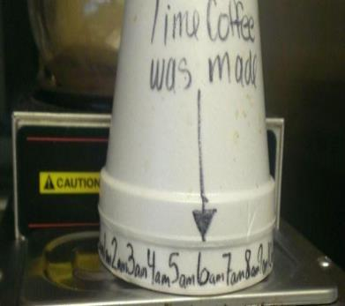
Breaks!
There will be 10-15 minutes breaks as needed throughout the training period

Slide 5

Questions and Feed Back
At the end of the presentation participants will be ask to fill out a brief questionnaire and provide feedback on the training materials

Slide 6

Objectives
Ergonomics and general duty clause
Define ergonomics
Define Musculoskeletal Disorders (MSDs)
Define and identify factors for MSD injuries.
Signs and symptoms of MSD’s
Classroom exercise
Analyze a workplace for risk factors.
Identify solutions to eliminate or reduce MSDs.

Slide 7
Ergonomics and General Duty Clause
Congress passed resolution 6 in 2001, rescinding original ergonomics rule, prohibiting OSHA from issuing a rule that is substantially the same as the 2000 standard.
Employers still have an obligation under the General Duty Clause, Section 5(a)(1) to keep the workplace free from recognized hazards.
OSHA encourages employers to implement effective programs or other measures to reduce ergonomic hazards.

Slide 8
Components of an Ergonomic Program
Management and employee commitment
Hazard communication and reporting
Job hazard analysis and control
Training
MSD medical management
Program evaluation

Slide 9

Workplace Ergonomics
Fitting the workplace to the worker to prevent injury, and increase efficiency and comfort
Image of office employee

Slide 10
Musculoskeletal Disorders (MSD’s)
Generally occur slowly over time due to repeated trauma to soft tissues (muscles, tendons, ligaments, cartilage) and nervous system.
MSD’s can happen from a one-time occurrence ie a single bad lift

Slide 11
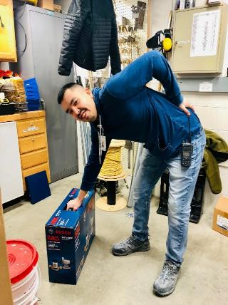
Work-Related MSD’s (WMSD’s)
Work related MSD’s are caused or aggravated by work methods and the environment
Image of maintenance employee

Slide 12
Modern Day (WMSD’s)
Carpenters elbow, tennis elbow or fisherman’s elbow-Cubital Tunnel Syndrome
Carpet layers knee, roofers knee-Patella Bursitis
IPAD/Samsung thumb-De Quevain Syndrome
Tech Neck PC-Cervical Disk Damage

Slide 13
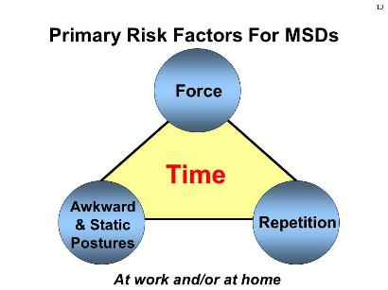
Risk Factors Causing MSD’s
  Bending
  Gripping
  Using vibrating equipment, tools or objects
  Kneeling
  Excessive force
  Poorly designed tools
  Extreme temperatures
  Static posture
  Working overhead
  Squatting/stooping
  Lifting/lowering
  Pulling/pushing
  Holding/carrying
  Repetitive movements
  Twisting
  Over-reaching
  Poor work organization

Slide 14
4 Terms Commonly Used For MSDs
    Musculoskeletal disorders (MSDs). Injuries and disorders to soft body tissues including muscles, nerves, tendons, ligaments, joints, cartilage, and spinal discs.
    Sprains and strains. A joint strain is the overstretching or tearing of muscles or tendons. Tendons are the dense fibrous cords of tissue that connect bones to muscles. ... The main difference is that with a sprain you may have bruising around the affected joint, whereas with a strain, you may have spasms in the affected muscle
    Cumulative trauma disorders (CTDs). Injuries involving strain which develop, or build up over time.
    Repetitive strain injuries (RSIs). Injuries affecting muscles, nerves and tendons by repetitive movement and overuse. The condition mostly affects the upper body.
    Repetitive motion injuries (RMIs). An injury to the body that is caused by performing the same motion over and over again thereby straining a body part.

Slide 15

Classroom Activity-Other Risk Factors
Contribute to, but do not cause WMSD’s
Temperature
Work pace and stress
Age
Hobbies
Previous injuries
Medical conditions
Smoking, noise
Fatigue
Diet
Image of two fly fishermen

Slide 16
Signs and Symptoms of MSDs
Pain-Sharp, intermittent or constant dull throbbing and radiating
Swelling-localized or defuse
Tingling or numbness-localized or radiating
Burning sensation-localized or radiating
Joint Stiffness-localized
Fingers turned white-localized
Reduced range of motion-limited
Early recognition and reporting is key to preventing workplace MSDs!
OUCH!
OUCH!

Slide 17
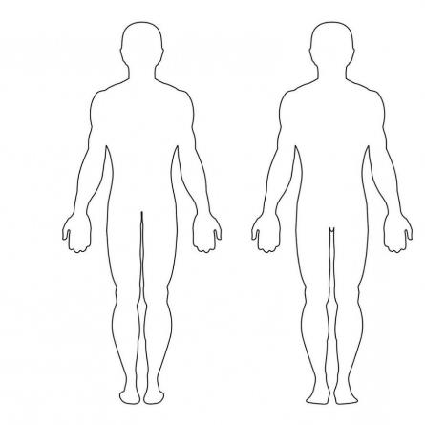
Classroom Activity 4-Body Mapping Class Exercise
Image from OSHA Susan Harwood Training PPP

Slide 18
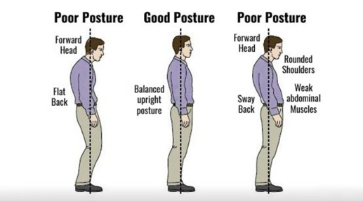
Neutral Posture Standing
Optimal position for the body to reduce the risk of WMSD’s.
Neutral posture promotes blood flow, nerve conduction, muscle strength and control.
Posture chart

Slide 19
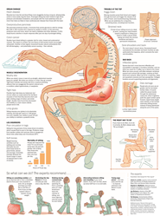
Neutral Posture Sitting

Slide 20
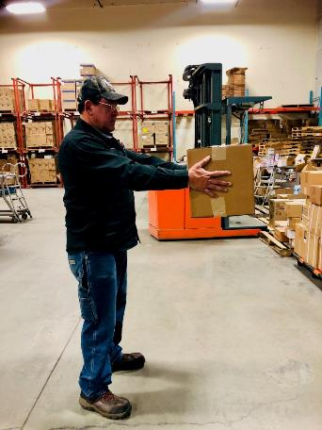
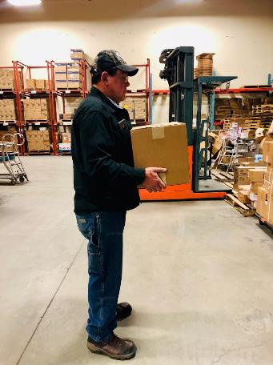


Awkward Postures While Handling Materials
Image of warehouse employee

Slide 21
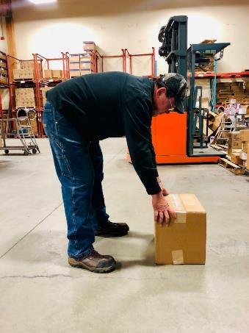
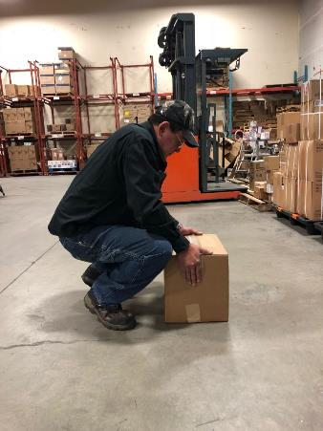
Awkward Postures While Handling Materials Continued
Image of warehouse employee

Slide 22
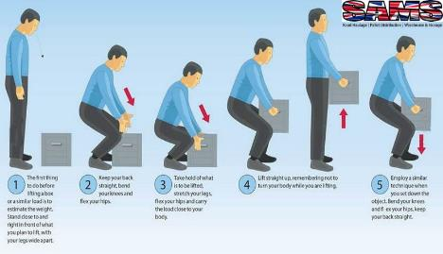
Solutions for Proper Manual Lifting
Think before lifting loads
Plan the lift
Use more than one person
Remove obstructions
Long lift consider resting on a table or bench to change grip
Keep load as close to the waist as possible
If unable to properly conduct a lift and carry use equipment

Slide 23
Classroom Activity 7 for Proper Manual Lifting

Slide 24
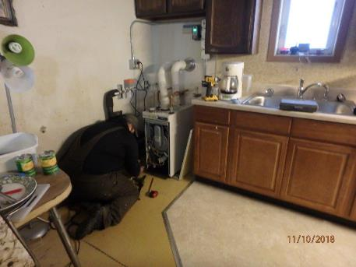
Static Posture
Holding the same position or using the same muscles for extended periods of time.
Static posture, or positions that a worker must hold for long periods of time, can restrict blood flow and damage muscles and tendons.
Images of warehouse and construction employees

Slide 25
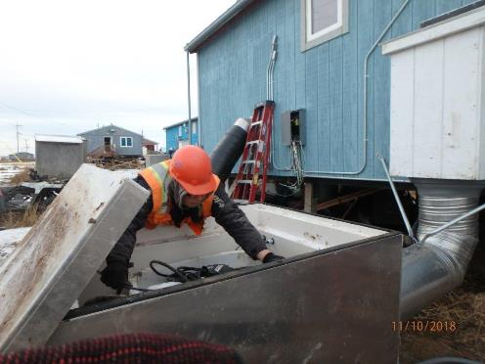
Compression
Soft tissue is pressed between the body and a sharp or hard object
Awkward hand positions on power tools
Image of construction employee

Slide 26
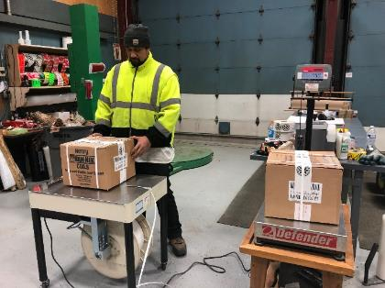
Repetition
Performing the same motion or group of motions excessively
Repetition of movements that can irritate tendons and increase pressure on nerves.
Repetition does not allow time for rest and recovery.
Image of a warehouse worker

Slide 27
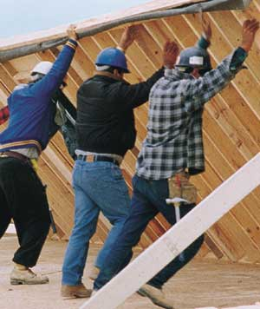
Excessive Force
Strong physical exertion.
Forceful exertions due to weight, friction, or posture can stress soft tissues.
Image of construction workers

Slide 28
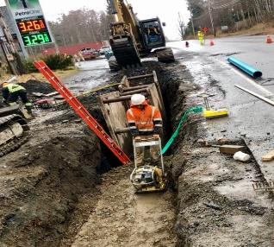
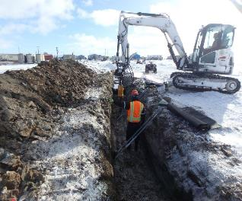
Vibration
Single point or hand and arm exposure results from hand held vibrating objects used such as power tools.
Full body vibration results primarily from vibration transmission from equipment.
Images of construction employees

Slide 29
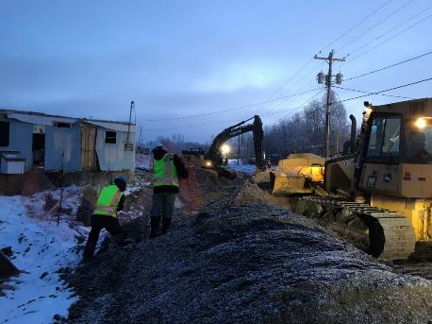
Extreme Temperatures (Cold)
Cold temperatures make the muscles less flexible, resulting in muscle strains and pulls
Low temperatures reduce sensory feedback, dexterity, blood flow, muscle strength and balance
Image of construction employees at a trench location

Slide 30
Extreme Temperatures (Hot)
Hot temperatures can lead to dehydration and muscle fatigue, especially in conjunction with high humidity
Internal body temperature rises resulting in your body’s attempt to regulate its temperature through increased blood circulation and increased perspiration
Less blood goes to the active muscles, brain and other internal organs, which reduces strength and brings on fatigue more quickly

Slide 31
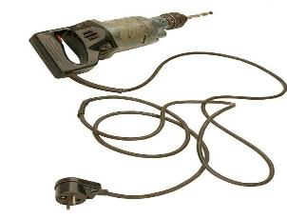
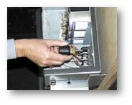
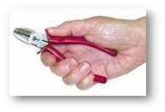
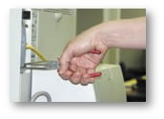
Poorly Designed Tools
Images of hand and power tools

Slide 32
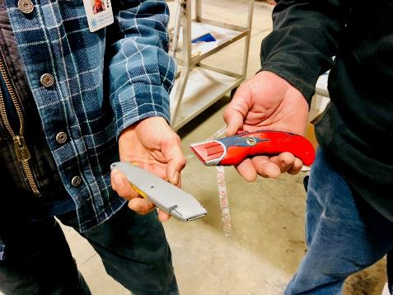
Better Hand Tools for the Job
The best tool is one that:
• Fits the job you are doing
• Fits the work space available
• Reduces the force you need to apply
• Fits your hand
• Can be used in a comfortable work position
Images of hand cutting tools

Slide 33
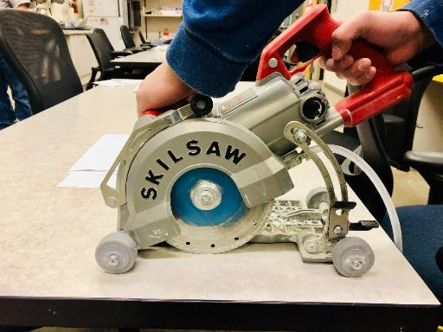
Better Power Tools For the Job
How should you select a power tool?
It should have a long trigger.
It should have low vibration and noise levels.
It should be heavy enough to do the job, but not add strain.
Use a power tool instead of a hand tool when you can.
Image of power tool

Slide 34
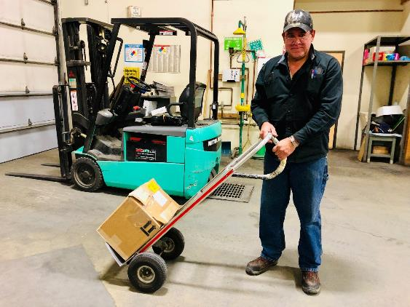
Efficient Use of Equipment
How can the work be done differently to reduce risk factors at your job?
Use platforms, lifts and forklifts
Use hoists or chain falls
Use carts and dollies
Make smaller loads
Use power tool instead of hand tools
Image of warehouse employee

Slide 35

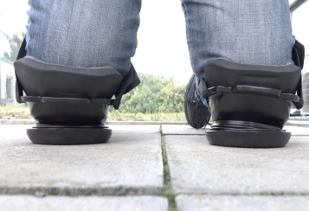
Personal Protective Equipment (PPE)
The National Institute for Occupational Safety and Health (NIOSH) recommends that employers not rely on back belts to protect workers
Examples of PPE that can help reduce MSD’s
Gloves-reduce vibration and friction
Shoulder pads
Knee pads
Appropriate clothing for weather
Images of PPE, gloves and knee pads

Slide 36
Poor Work Organization
This refers to the way jobs are structured, carried out, and supervised, for example:
Production schedule demands
Infrequent rest breaks
Not enough workers
Poor planning
Poor supervision
Lack of equipment
Lack of PPE

Slide 37
Better Planning and Organization
How can risk factors be reduced by better planning and organization?
Training
Plan the work ahead of time
Deliver materials close to where they will be used
Have proper equipment at the job site
Minimize bending, reaching or twisting – work at waist level whenever possible
Use the buddy system – get help

Slide 38
Problem Solving
What are some ways to prevent strains, sprains, and Musculoskeletal Disorders (MSDs)?
Better materials
Better equipment and tools
Improved work methods
Better work organization
Increase training
Exercises by stretching and flexing
Personal protective equipment (PPE)
Improving diet

Slide 39
Stretching and Exercises
How many of you have participated in a worksite stretch and flex program?
Pros-
Team building-interacting with each other
Open communication with workers
Easy to implement
Low cost solution
Cons-
Not taken seriously
Exercises may not be done properly
Puts pressure on workers to take responsibility for solutions
Workers may feel self-conscience

Slide 40

Challenges to Implementing Solutions
Cost too much
Slows down production
Equipment not available
Change is not easy
Management and employee participation
Preventing MSD hazards is less
expensive and more effective than
trying to control them later.

Slide 41
Workers Are the Experts
Ergonomic Programs emphasize worker participation and include five steps:
Identification of musculoskeletal disorders and workplace hazards that may cause these problems
Analysis of workplace hazards
Development of solutions to reduce or eliminate hazards,
Implementation of solutions
Evaluation of the solution's effectiveness

Slide 42

This Concludes our Training

