Slide 1
OSHA Disclaimer
This material was produced under grant number SH-31209-SH7 from the Occupational Safety and Health Administration, U.S. Department of Labor. It does not necessarily reflect the views or policies of the U.S. Department of Labor, nor does mention of trade names, commercial products, or organizations imply endorsement by the U.S. Government.
Notes:
This material was produced under grant number SH-31209-SH7 from the Occupational Safety and Health Administration, U.S. Department of Labor. It does not necessarily reflect the views or policies of the U.S. Department of Labor, nor does mention of trade names, commercial products, or organizations imply endorsement by the U.S. Government.

Slide 2
Electrical Hazards in Construction
Created by:
Construction Safety Council
Notes:
Hundreds of workers are killed or injured every year due to exposure to hazardous electrical energy. Electric shock, burns and falls are some of the hazards associated with working with electricity; electrocution is death by electric shock.
Working with and around electricity should be taken seriously as a dangerous business. This is no place to cut corners or cheat on safety. You should pay attention and know what it takes to stay safe…

Slide 3
Course Topics…
OSHA
Introduction to electrical hazards and how shocks occur
Recognition and avoidance of common electrical hazards
Overhead and underground power lines.
Ground fault protection
Extension cords and tools
Lockout/Tagout
Electrical safety-related work practices
PPE
Notes:
The goal of this course is to enhance communication of electrical hazards between employers and employees and to prevent accidents. At the conclusion, each course participant will possess the confidence to recognize and avoid unsafe conditions and behaviors as well as be able to identify regulations applicable to electrical hazards in construction. Participants will be able to:
Train competent persons.
Become more aware of electrical hazards in construction and function within a safety management system.

Slide 4
Pre-Test
Notes:
Pre-Test

Slide 5
Introduction to Electrical Hazards
Types of electrical injuries
OSHA’s Focus Four
How shocks occur
Factors affecting severity of electrical shock
Arc blast hazards
The basics of electricity
Notes:
So much in life wouldn’t be possible if it weren’t for electricity. It powers our alarm clocks, coffee pots, TV’s and power tools; in fact it’s hard to imagine life without electricity. But, it can be as dangerous as it is useful.
Electrical Injuries
There are four main types of electrical injuries:
Electrocution (death due to electrical shock);
Electrical shock;
Burns (Arc Blast); and,
Falls

Slide 6
Electrical Injuries
There are four main types of electrical injuries:
Electrocution (death due to electrical shock);
Electrical shock;
Burns (Arc Blast); and,
Falls.
Notes:
There are four main types of electrical injuries:
Electrocution (death due to electrical shock);
Electrical shock;
Burns (Arc Blast); and,
Falls

Slide 7
OSHA Focus Four
Falls
Caught-in-Between
Struck-by
Electrocution
Notes:
Construction safety is one of OSHA’s top concerns, making up more than 60% of OSHA’s inspections. Four main hazards have been identified by OSHA as responsible for the majority of injuries and fatalities.
Falls
Caught-in-Between
Struck-by
Electrocution

Slide 8
How Shocks Occur
Contact with one wire of an energized circuit and the ground.
Contact with a metallic part in contact with an energized wire while also in contact with the ground.
Contacts with both wires of an energized circuit.
Notes:
Electricity travels in closed circuits, normally through a conductor. Shock results when the body becomes part of the electrical circuit; current enters the body at one point and leaves at another.
Typically, shock occurs when:
A person contacts one wire of an energized circuit and the ground.
A person contacts a metallic part in contact with an energized wire while the person is also in contact with the ground.
A person contacts both wires of an energized circuit.

Slide 9
Effect of Current on Body
Notes:
The amount of current flowing through the body, the path the current takes through the body and the length of time that the body is in the circuit all have an effect on the severity of an injury; remove any one of these factors from the electrocution triangle, and the potential for injury is reduced.

Slide 10
Arc Flash
Dust
Dropping tools
Accidental touching
Condensation
Material failure
Corrosion
Faulty Installation
Burns (Non FR clothing can burn onto skin)
Fire (could spread rapidly through building)
Flying objects (often molten metal)
Blast pressure (upwards of 2,000 lbs. / ft²)
Sound Blast (noise can reach 140 dB – loud as a gun)
Heat (upwards of 35,000 degrees F)
Notes:
According to the National Fire Protection Association (NFPA 70E – 2018), an Arc Flash Hazard is defined as a source of possible injury or damage to health associated with the release of energy caused by an electric arc. The results are often violent and when a human is in close proximity to the arc flash, serious injury and even death can occur.

Slide 11
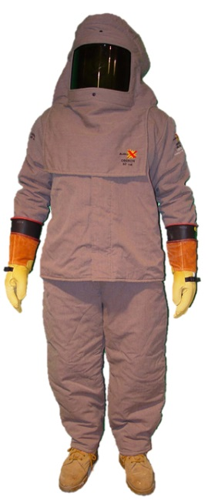
Arc Flash Suit
Complete arc-rated clothing and equipment system that covers the entire body, except for the hands and feet.
Notes:
Arc Flash Suit (NFPA 70E – 2018) is a complete arc-rated clothing and equipment system that covers the entire body, except for the hands and feet. An arc flash suit may include pants or overalls, a jacket or a coverall, and a beekeeper-type hood fitted with a face shield.

Slide 12
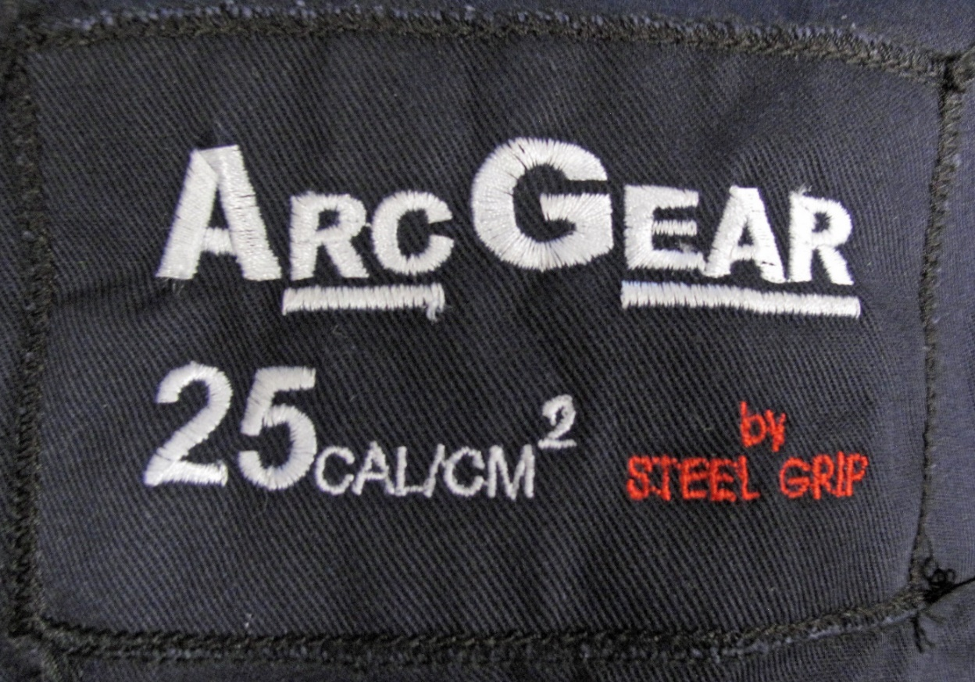
Arc Rating (cal/cm²)
Arc Thermal Performance Value (ATPV)
Energy of Breakopen Threshold (EBT)
Notes:
Arc Rating (NFPA 70E – 2018). Arc rating is the value attributed to materials that describes their performance to exposure to an electrical arc discharge. The arc rating is expressed in cal/cm² and is derived from the determined value of the arc thermal performance value (ATPV) or energy of breakopen threshold (EBT) (should a material system exhibit a breakopen response below the ATPV value). Arc rating is reported as either ATPV or EBT, whichever is the lower value.

Slide 13
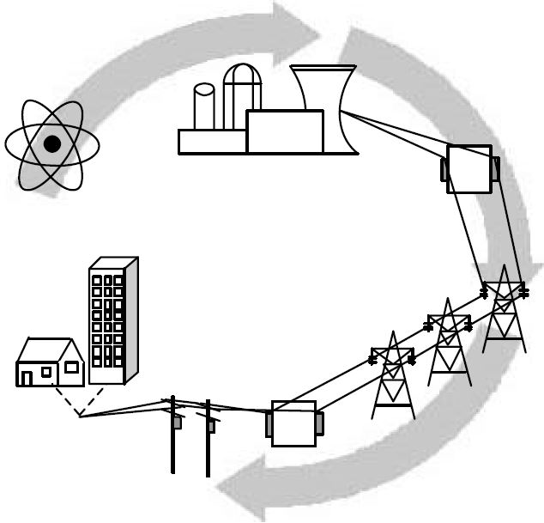
Electrical Basics
Voltage
Current
Resistance
Ground
Notes:
Where does Electricity come from?
Electricity is produced in a generating plant. When electricity leaves a power plant, its voltage is increased in order to transmit it over long distances. The high-voltage power travels along transmission lines to a substation, then distributed through more lines to service drops that step down the voltage to levels between 240 and 480 volts.

Slide 14

Voltage
Force or pressure that causes electricity to flow through a conductor and is measured in volts (V).
Notes:
Voltage is the fundamental force or pressure that causes electricity to flow through a conductor and is measured in volts (V). Voltage is synonymous with electrical pressure. The more voltage present, the more force or pressure is pushing the electricity. An overhead power line uses high voltage (thousands of volts) to carry electricity over large distances, from generating stations to our communities and then to our homes and businesses.

Slide 15
Voltage, Nominal (as defined by the NFPA 70: National Electric Code)
A nominal value assigned to a circuit or system for the purpose of conveniently designating its voltage class (e.g., 120/240 volts, 480Y/277 volts, 600 volts).
Notes:
A nominal value assigned to a circuit or system for the purpose of conveniently designating its voltage class (e.g., 120/240 volts, 480Y/277 volts, 600 volts).

Slide 16
Current Thresholds
Notes:
Voltage is the fundamental force or pressure that causes electricity to flow through a conductor and is measured in volts (V). Voltage is synonymous with electrical pressure. The more voltage present, the more force or pressure is pushing the electricity. An overhead power line uses high voltage (thousands of volts) to carry electricity over large distances, from generating stations to our communities and then to our homes and businesses.

Slide 17
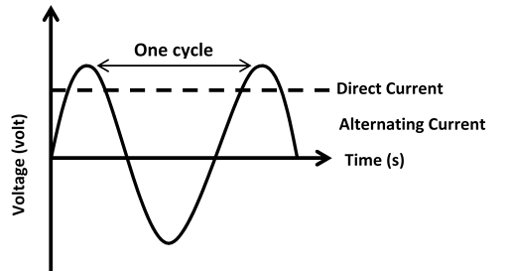
Current
Flow of electrons from a source of voltage through a conductor and is measured in amperes (Amps).
AC/DC
Notes:
Current is the flow of electrons from a source of voltage through a conductor and is measured in amperes (Amps). If the current flows back and forth (a cycle) through a conductor, it is called alternating current (AC). In each cycle the electrons flow first in one direction, then the other. In the United States, the normal rate is 60 cycles per second [or 60 Hertz (Hz)]. If current flows in one direction only (battery operated/cordless tools), it is called direct current (DC).
AC is most widely used because it is possible to step up or step down (i.e., increase or decrease) the voltage through a transformer. For example, when voltage from an overhead power line is run through a pole-mounted transformer, it can be stepped down to normal household voltage.

Slide 18
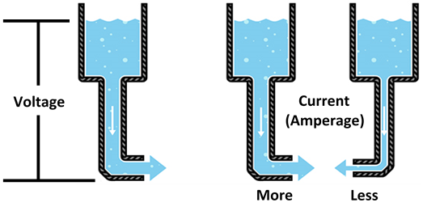
Voltage – Current Illustration
Notes:
Voltage and current can be illustrated by comparing them to water flow through a pipe. The tank of water is the pressure source or voltage. As the water flows through the pipe, the volume of water becomes the current (amperes). The smaller the diameter of the pipe will generate more water pressure (higher voltage), but the less water flow. A larger diameter pipe will result in lower pressure, but higher volume. The diameter of the pipe is compared to resistance.

Slide 19
Resistance
Factors that determine resistance:
What it is made of
Its size & length
Its temperature
Notes:
Resistance is anything that impedes (blocks) the flow of electricity through a conductor and is measured in Ohms.
Factors that determine a substance’s resistance to the flow of electricity are:
What it is made of;
Its size & length; and,
Its temperature.
Substances with very little resistance to the flow of electrical current are called conductors. Examples of good conductors are metals. Gold, silver, aluminum and copper are the best metal conductors of electricity.
Substances with such a high resistance that they can be used to prevent the flow of electrical current are called insulators. Examples of insulators are glass, porcelain, plastic, and dry wood.

Slide 20
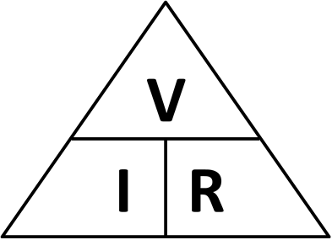
Ohm’s Law
V = I x R
R = V / I
I = V / R
Notes:
Ohm’s Law is a mathematical equation that shows the relationship between Voltage, Current and Resistance in an electrical circuit. Ohm’s Law is stated as:
V = I x R
R = V / I
I = V / R
V – is for voltage (volts), R – is for resistance (ohms), I – is for current (ampere)
Ohm’s Law states that one volt will cause a current of one ampere to flow through a conductor having the resistance of one ohm.
An easy way to remember this formula is to use the symbols and image to the right.
To determine amps (I = V/R), cover the “I” in the figure to the right.
To determine resistance (R = V/I), cover the “R”.
To determine volts (V = I x R), cover the “V”.

Slide 21
Ohm’s Law - Example
110 volt circuit
"Under dry conditions, the resistance offered by the human body may be as high as 100,000 ohms. Wet or broken skin may drop the body's resistance to 1,000 ohms," - NIOSH
Notes:
A worker is using an electric saw and perspiring. He has a hand-to-hand resistance of 1,000 ohms. The worker contacts 120 volts with one hand and touches a ground surface with the other. This completes the loop to the voltage sources. Using Ohm’s Law, calculate the flow of current.

Slide 22
Effects of Current on Body
Notes:
The amount of current flowing through the body, the path the current takes through the body and the length of time that the body is in the circuit all have an effect on the severity of an injury; remove any one of these factors from the electrocution triangle, and the potential for injury is reduced.

Slide 23
Introduction to OSHA
OSHA’s purpose and employer duty to provide a safe place of employment
Employer/employee rights & responsibilities under the OSHAct
Refusing to work because conditions are dangerous
OSHA’s multi-employer worksite citation policy
Rights as a whistleblower
OSHA policy on providing and paying for personal protective equipment
Reporting of fatalities and catastrophes
OSHA and NFPA industry consensus standards for electrical work
Qualified person
Notes:
To assure safe and healthful working conditions for working men and women; by authorizing enforcement of the standards developed under the Act; by assisting and encouraging the States in their efforts to assure safe and healthful working conditions; by providing for research, information, education, and training in the field of occupational safety and health; and for other purposes.
Be it enacted by the Senate and House of Representatives of the United States of America in Congress assembled, that this Act may be cited as the “Occupational Safety and Health Act of 1970” (OSHAct).

Slide 24
General Duty Clause
(a) Each employer
Shall furnish to each of his employees employment and a place of employment which are free from recognized hazards that are causing or are likely to cause death or serious physical harm to his employees.
Shall comply with occupational safety and health standards promulgated under this Act.
(b) Each employee shall comply with occupational safety and health standards and all rules, regulations, and orders issued pursuant to this Act which are applicable to his own actions and conduct.
Notes:
Section 5(a)(1) of the OSHAct has become known as “The General Duty Clause.” It is a catch-all phrase for citations if OSHA identifies unsafe conditions for which a regulation does not exist.
In practice, OSHA, legal precedent, and the review commission have established that if the following elements are present, then a “general duty clause” citation may be issued.
An employer failed to keep the workplace free of a hazard to which employees of that employer were exposed.
The hazard was recognized. (Examples might include: through jobsite safety personnel, employees, trade unions and other associations/organizations.)
The hazard was causing or was likely to cause death or serious physical harm.
There was a feasible and useful method to correct the hazard.

Slide 25
OSHA Standard Reference: 1910.335(a)(1)(i)
“Employees working in areas where there are potential electrical hazards shall be provided with, and shall use, electrical protective equipment that is appropriate for the specific parts of the body to be protected and for the work to be performed.”
Notes:
The above OSHA standard makes reference to “electrical protective equipment that is appropriate for the specific parts of the body.” However, OSHA falls short of specifying what exactly is “appropriate.”
In order to comply with the General Duty of this standard, the employer would need to know the magnitude of the electrical hazard and the level of protection that a specific piece of personal protection equipment will provide. Doing this without a reference to the NFPA 70E standard would be difficult. Furthermore, failing to provide the level of protection as stated in the NFPA 70E standard would be in violation of an employer’s General Duty.

Slide 26

Job Safety and Health Poster
Notes:
OSHA Job-site Poster

Slide 27
Refusing to Work because Conditions are Dangerous
Ask your employer to correct the hazard;
Ask your employer for other work;
Tell your employer that you won’t perform the work unless and until the hazard is corrected; and
Remain at the worksite until ordered to leave by your employer.
Notes:
Workers have the right to refuse to perform a task if they believe in good faith that they are exposed to an imminent danger. “Good faith” means that even if an imminent danger is not found to exist, the worker had reasonable grounds to believe that it did exist.

Slide 28
OSHA’s Multi-Employer Worksite Citation Policy
The Creating Employer
The Exposing Employer
The Correcting Employer
The Controlling Employer
Notes:
When on a construction jobsite, multiple employers and employees are exposed to a variety of hazards that may or may not have been created or under the control of any one employer. In this “multi-employer” environment, more than one employer may be citable for a hazardous condition that violates an OSHA standard.
OSHA classifies employers into one or more of four categories – the creating, exposing, correcting, and controlling employers – to determine if a citation will be issued.

Slide 29
Rights as a Whistleblower
Notes:
You may file a complaint with OSHA if your employer retaliates against you by taking unfavorable personnel action because you engaged in protected activity relating to workplace safety and health, commercial motor carrier safety, pipeline safety, air carrier safety, nuclear safety, the environment, asbestos in schools, corporate fraud, SEC rules or regulations, railroad carrier safety or security, or public transportation agency safety or security.

Slide 30
Employers must Provide and Pay for most PPE
Notes:
PPE is equipment worn to minimize exposure to a variety of hazards. Examples include items such as personal fall arrest systems, gloves, foot and eye protection, hearing protection, hard hats and respirators.

Slide 31
Reporting of Fatalities and Catastrophes
Employers must report all work related fatalities within eight (8) hours.
All work-related inpatient hospitalizations, all amputations and all losses of an eye within 24 hours.
Notes:
OSHA Standard, 29 CFR Subpart 1904.39, Reporting Fatality, Injury and Illness Information to the Government requires that employers report all work related fatalities within eight (8) hours and all work-related inpatient hospitalizations, all amputations and all losses of an eye within 24 hours. Employers must orally report the fatality/hospitalization by telephone or in-person to the OSHA Area Office or to the State Plan Office that is nearest to the site of the incident. Employers may also use the OSHA toll-free central telephone number:
1-800-321-OSHA (1-800-321-6742).

Slide 32
OSHA & NFPA Electrical Standards
29 CFR 1910 Subpart S
29 CFR 1926 Subpart K
NFPA 70E: Standard for Electrical Safety in the Workplace
Notes:
Occupational Safety and Health (OSHA) regulations for electrical work are referenced in both general industry and construction standards:
29 CFR 1910 Subpart S
29 CFR 1926 Subpart K
Originally developed at OSHA's request, NFPA 70E responds to the latest information about the effects of arc flash, arc blast, and direct current (dc) hazards, and recent developments in electrical design and Personal Protective Equipment (PPE). It provides vital information that helps employers comply with OSHA 1910 Subpart S and OSHA 1926 Subpart K.

Slide 33

Qualified Person (OSHA) – 29 CFR 1910.399
One who has received training in and has demonstrated skills and knowledge in the construction and operation of electric equipment and installations and the hazards involved.
Notes:
One who has received training in and has demonstrated skills and knowledge in the construction and operation of electric equipment and installations and the hazards involved.
Note: Whether an employee is considered to be a "qualified person" will depend upon various circumstances in the workplace. For example, it is possible and, in fact, likely for an individual to be considered "qualified" with regard to certain equipment in the workplace, but "unqualified" as to other equipment.
Note: An employee who is undergoing on-the-job training and who, in the course of such training, has demonstrated an ability to perform duties safely at his or her level of training and who is under the direct supervision of a qualified person is considered to be a qualified person for the performance of those duties.

Slide 34
OSHA Lockout/Tagout (Control of Hazardous Energy) – 29 CFR 1910.147(b)
Affected employee. An employee whose job requires him/her to operate or use a machine or equipment on which servicing or maintenance is being performed under lockout or tagout, or whose job requires him/her to work in an area in which such servicing or maintenance is being performed.
Authorized employee. A person who locks out or tags out machines or equipment in order to perform servicing or maintenance on that machine or equipment. An affected employee becomes an authorized employee when that employee's duties include performing servicing or maintenance covered under this section.
Notes:
OSHA Lockout/Tagout (Control of Hazardous Energy) – 29 CFR 1910.147(b)
Within OSHA’s Lockout/Tagout standards, the terms Authorized Employee and Affected Employee are used to describe persons of interest.

Slide 35
Qualified Person (NFPA 70E)
Such persons shall also be familiar with the proper use of the special precautionary techniques, applicable electrical policies and procedures, PPE, insulating and shielding materials, and insulated tools and test equipment.
Skills and techniques necessary to distinguish exposed energized electrical conductors and circuit parts from other parts of electrical equipment.
Skills and techniques necessary to determine the nominal voltage of exposed energized electrical conductors and circuit parts.
Approach distances specified in NFPA 70E Tables and the corresponding voltages to which the qualified person will be exposed.
Decision-making process necessary to be able to do the following:
Perform the job safety planning
Identify electrical hazards
Assess the associated risk
Select the appropriate risk control methods from the hierarchy of controls, including personal protective equipment.
Notes:
One who has demonstrated skills and knowledge related to the construction and operation of electrical equipment and installations and has received safety training to identify the hazards and reduce the associated risk.
A qualified person shall be trained and knowledgeable in the construction and operation of equipment or a specific work method and be trained to identify and avoid the electrical hazards that might be present with respect to that equipment or work method.
Such persons shall also be familiar with the proper use of the special precautionary techniques, applicable electrical policies and procedures, PPE, insulating and shielding materials, and insulated tools and test equipment.

Slide 36
Approach Boundaries (NFPA 70E – 2018)
Notes:
Approach Boundaries (NFPA 70E – 2018)
Reference: Table 130.4(D)(a) Shock Protection Approach Boundaries to Exposed Energized Electrical Conductors or Circuit Parts for Alternating-Current Systems

Slide 37
Overhead & Underground Power Lines
Identify OSHA's power line safety standards, specifically clearance distances for both known and unknown voltages.
List the options for compliance if working in close proximity to an overhead power line.
Prepare planning documentation that complies with OSHA's encroachment/electrocution prevention requirements to include procedures to be followed in the event of a power line contact.
Notes:
Power lines are lethal weapons. Although equipment operators are responsible for keeping themselves safe from overhead dangers, it’s only through employer commitment and supervision that the hazards of power lines can be properly managed.

Slide 38
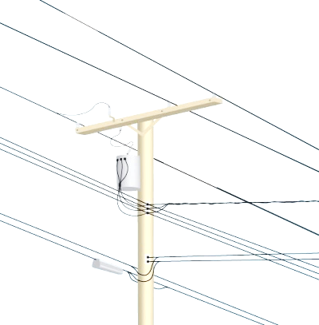
Examples of Equipment That Can Contact Power Lines:
Aluminum paint rollers
Backhoes
Concrete pumpers
Cranes
Long-handled cement finishing floats
Metal building materials
Metal ladders
Raised dump truck beds
Scaffolds
Notes:
Overhead and buried power lines at your site are especially hazardous because they carry extremely high voltage. Fatal electrocution is the main risk, but burns and falls from elevations are also hazards. Using tools and equipment that can come into contact with power lines increases these risks.

Slide 39
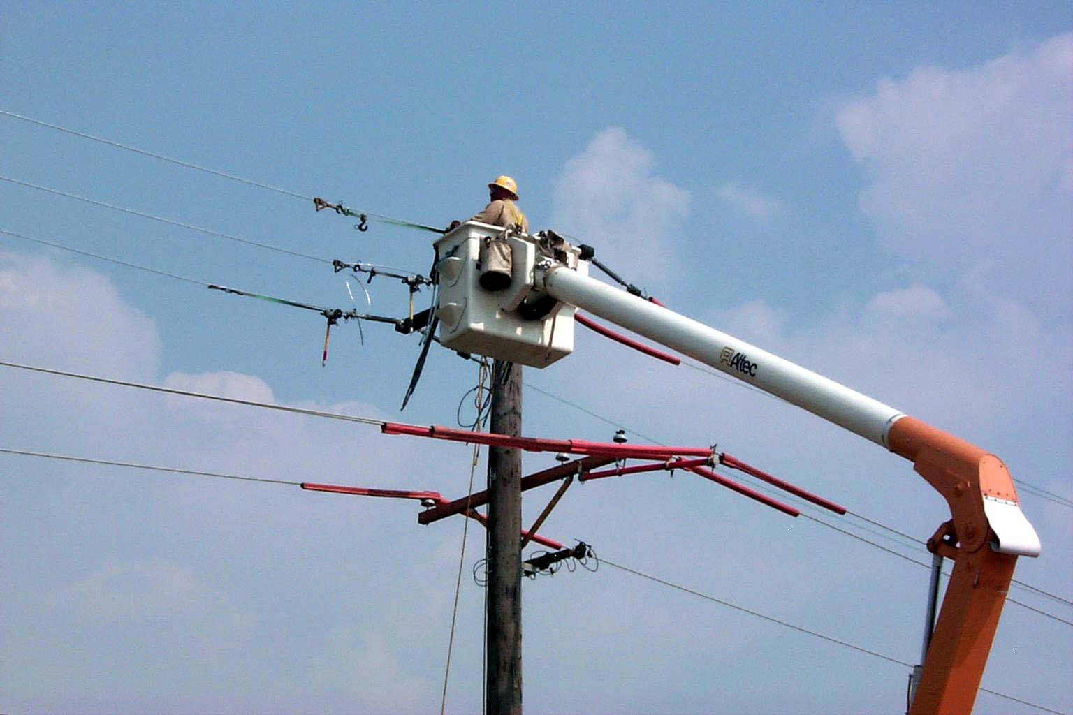
OSHA Power Line Safety Rules
STAY AWAY!
29 CFR 1926.416(a)(1). No employer shall permit an employee to work in such proximity to any part of an electric power circuit that the employee could contact the electric power circuit in the course of work, unless the employee is protected against electric shock by deenergizing the circuit and grounding it or by guarding it effectively by insulation or other means.
Notes:
The primary rule for power line safety is STAY AWAY! NFPA 70E establishes 10 feet as the minimum safe distance approach boundary for work around exposed movable conductors supported by poles (power lines). In some cases, when the voltages are high, or when working with cranes, the power line clearance distance may be further.
Also, per 29 CFR 1926.416(a)(1), no employer shall permit an employee to work in such proximity to any part of an electric power circuit that the employee could contact the electric power circuit in the course of work, unless the employee is protected against electric shock by deenergizing the circuit and grounding it or by guarding it effectively by insulation or other means.

Slide 40
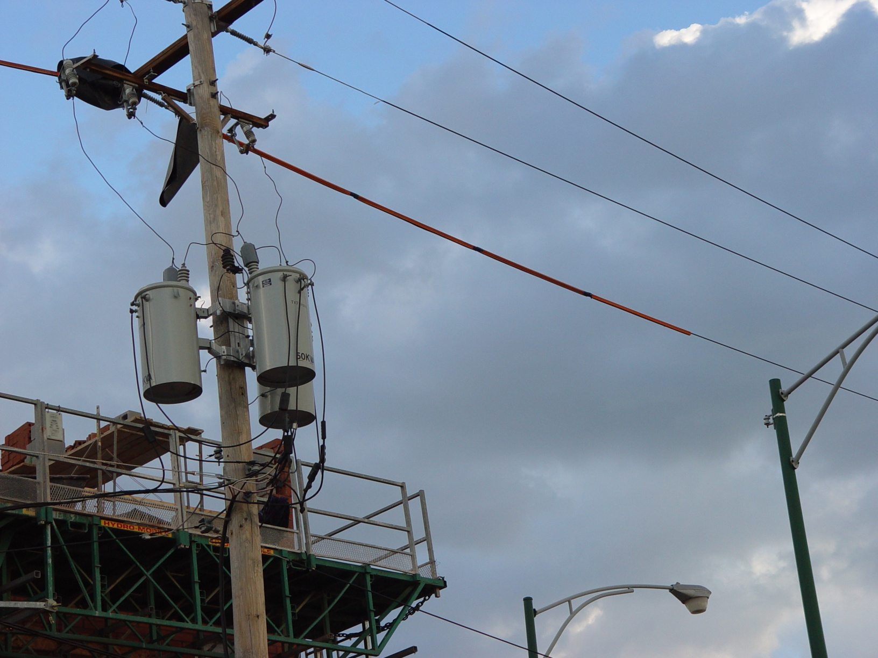
Insulated Sleeve
Notes:
Insulated power lines

Slide 41
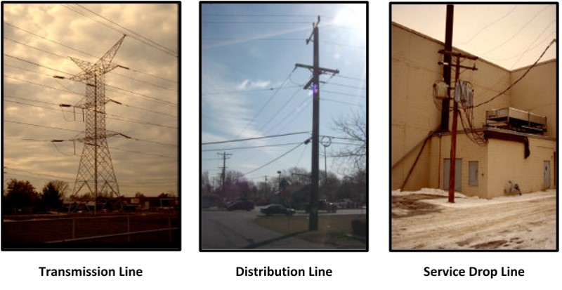
Types of Power Lines
Notes:
Electrical power is brought to us through a three part system: “high power transmission lines” running from generating stations to substations, “distribution lines”, the same lines that run through most of our neighborhoods and job sites, and “service drops” running from poles to utility customers. The majority of the power line contacts reported to OSHA involved overhead “distribution” lines. This is due to their proximity to most construction work and their frequency on the landscape.

Slide 42
Underground Power Lines – Call Before You Dig!
29 CFR 1926.651(b)(1). The estimated location of utility installations or any other underground installation that may be encountered during excavation work must be determined prior to opening an excavation.
29 CFR 1926.416(a)(2). In work areas where the exact location of underground electric powerlines is unknown, employees using jack-hammers, bars, or other hand tools which may contact a line shall be provided with insulated protective gloves.
Notes:
29 CFR 1926.651(b)(1). The estimated location of utility installations or any other underground installation that may be encountered during excavation work must be determined prior to opening an excavation.
29 CFR 1926.416(a)(2). In work areas where the exact location of underground electric powerlines is unknown, employees using jack-hammers, bars, or other hand tools which may contact a line shall be provided with insulated protective gloves.

Slide 43
General Electrical Requirements
29 CFR 1926.416(a)(3). Before work is begun the employer shall ascertain by inquiry or direct observation, or by instruments, whether any part of an energized electric power circuit, exposed or concealed, is so located that the performance of the work may bring any person, tool, or machine into physical or electrical contact with the electric power circuit. The employer shall post and maintain proper warning signs where such a circuit exists. The employer shall advise employees of the location of such lines, the hazards involved, and the protective measures to be taken.
Notes:
29 CFR 1926.416(a)(3). Before work is begun the employer shall ascertain by inquiry or direct observation, or by instruments, whether any part of an energized electric power circuit, exposed or concealed, is so located that the performance of the work may bring any person, tool, or machine into physical or electrical contact with the electric power circuit. The employer shall post and maintain proper warning signs where such a circuit exists. The employer shall advise employees of the location of such lines, the hazards involved, and the protective measures to be taken.

Slide 44
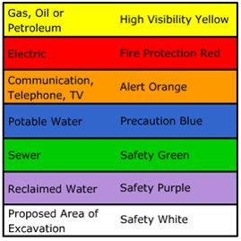
Underground Utility Marking Codes/Colors
Hand dig or use other non-intrusive means within required “Tolerance Zone” (varies by State), 18” – 24” on either side of the utility.
Watch out for utility corridors, utilities buried side-by-side and take into consideration diameter of large pipes.
Use the National 811 phone number to call for utility locates.
Notes:
Utility color codes are used to identify existing underground utilities in construction areas, to protect them from damage during excavation. Colored lines, flags, or both are used to mark the location and denote the type of underground utility.

Slide 45
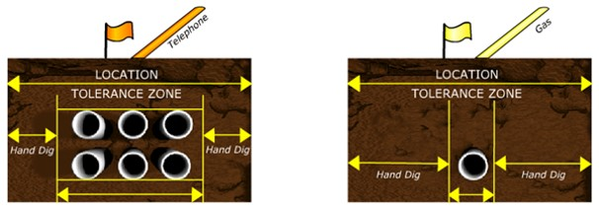
Utility Corridors
Notes:
Hand dig or use other non-intrusive means within required “Tolerance Zone” (varies by State), 18” – 24” on either side of the utility.
Watch out for utility corridors, utilities buried side-by-side and take into consideration diameter of large pipes.
Use the National 811 phone number to call for utility locates.

Slide 46
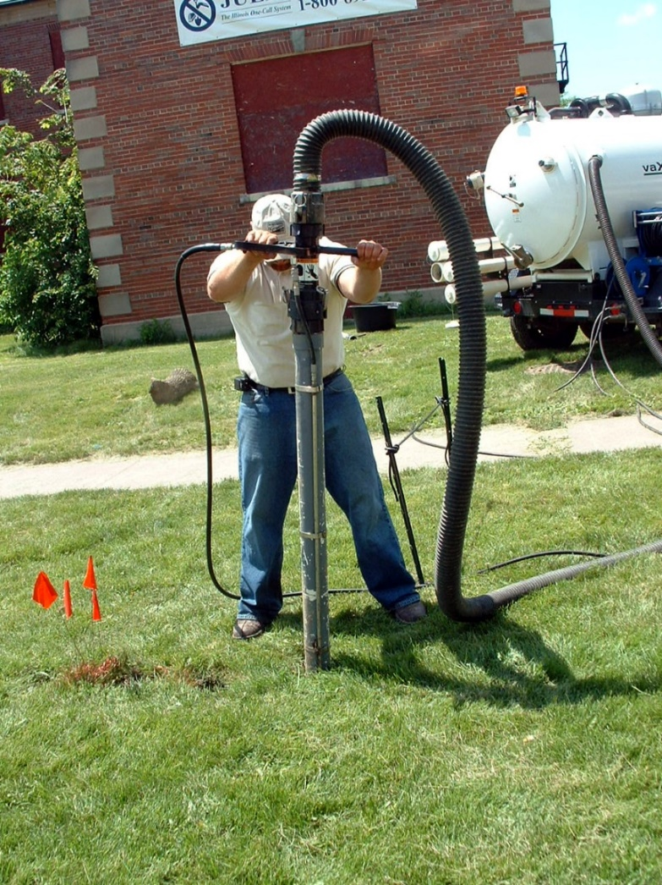
Vacuum Excavation
Notes:
Vacuum excavation example for potholing.

Slide 47
Mobile Cranes and Power Lines
Construction equipment that can hoist, lower and horizontally move a suspended load.
Notes:
Additional OSHA rules apply to power-operated equipment, when used in construction that can hoist, lower and horizontally move a suspended load.
Such equipment includes, but is not limited to:
Articulating cranes (such as knuckle-boom cranes)
Crawler cranes
Mobile truck cranes

Slide 48
Crane Work Zone (Power Line Safety)
29 CFR 1926.1408(a)(1). Identify the work zone by either:
Demarcating boundaries (such as with flags, or a device such as a range limit device or range control warning device) and prohibiting the operator from operating the equipment past those boundaries, or
Defining the work zone as the area 360 degrees around the equipment, up to the equipment's maximum working radius.
Notes:
Pursuant to 29 CFR 1926.1408(a)(1), before beginning equipment (crane) operations, the employer must identify the work zone by either:
Demarcating boundaries (for example, with flags, or a device such as a range limit device or range control warning device) and prohibiting the operator from operating the equipment past those boundaries, or
Defining the work zone as the area 360 degrees around the equipment, up to the equipment's maximum working radius.

Slide 49
Power Line Safety
20 Foot Rule…
If any part of the equipment, load line or load (including rigging and lifting accessories), if operated up to the equipment's maximum working radius in the work zone, cannot get closer than 20 feet to an overhead power line, then no further precautions may be taken.
Notes:
If any part of the equipment, load line or load (including rigging and lifting accessories), when operated up to the equipment's maximum working radius in the work zone, cannot get closer than 20 feet to an overhead power line, then no further precautions may be taken.

Slide 50
Closer than 20 feet…
29 CFR 1926.1408(a)(2). If powered operated equipment could get closer than 20 feet to a power line, the employer must meet the requirements in Option (1), Option (2), or Option (3) as follows:
Option (1)--Deenergize and ground. Confirm from the utility owner/operator that the power line has been deenergized and visibly grounded at the worksite.
Option (2)--20 foot clearance. Ensure that no part of the equipment, load line, or load (including rigging and lifting accessories), gets closer than 20 feet to the power line by implementing the procedures in “Preventing Encroachment/Electrocution”.
Option (3)--Table A clearance. Determine the line's voltage (must get line voltage from utility company) and the minimum approach distance permitted under Table A. If this option is used, then the employer must implement the procedures in “Preventing Encroachment/Electrocution”.
Notes:
29 CFR 1926.1408(a)(2). If power-operated equipment could get closer than 20 feet to a power line, then the employer must meet the requirements in Option (1), Option (2), or Option (3) as follows:
Option (1)--Deenergize and ground. Confirm from the utility owner/operator that the power line has been deenergized and visibly grounded at the worksite.
Option (2)--20 foot clearance. Ensure that no part of the equipment, load line, or load (including rigging and lifting accessories), gets closer than 20 feet to the power line by implementing the procedures in “Preventing Encroachment/Electrocution” (next page).
Option (3)--Table A clearance. Determine the line's voltage (must get line voltage from utility company) and the minimum approach distance permitted under Table A (next page). If this option is used, then the employer must implement the procedures in “Preventing Encroachment/Electrocution” (next page).

Slide 51
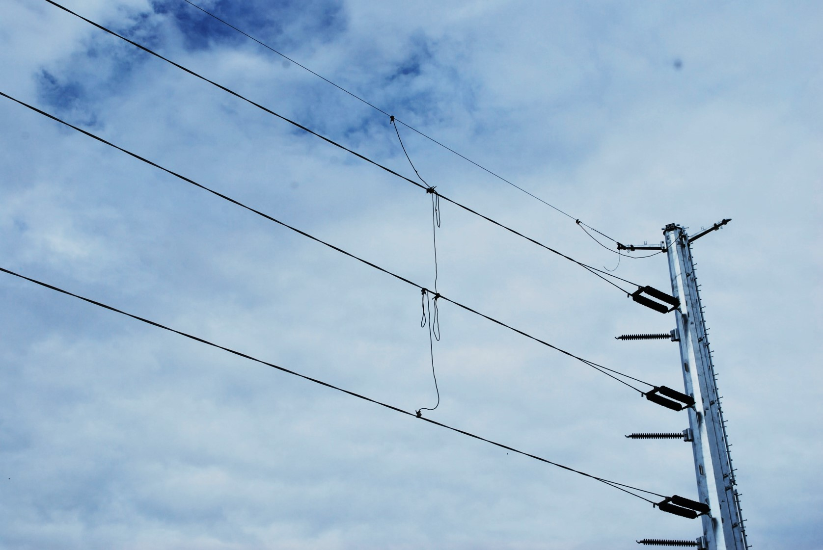
Grounded Power Line
Notes:
Deenergize and ground. Confirm from the utility owner/operator that the power line has been deenergized and visibly grounded at the worksite.

Slide 52
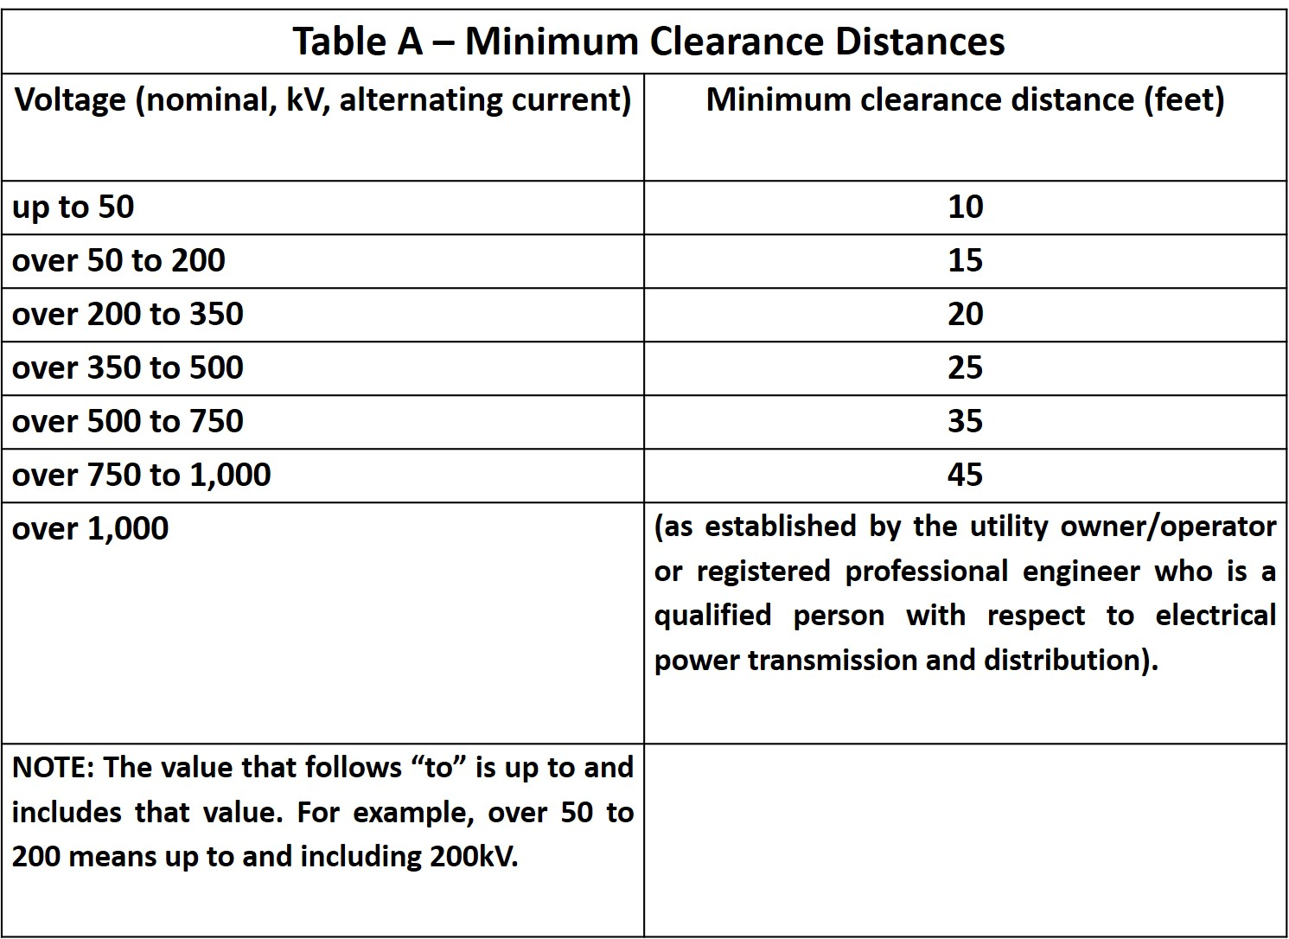
Table A
Notes:
Table A clearance. Determine the line's voltage (must get line voltage from utility company) and the minimum approach distance permitted under Table A (next page). If this option is used, then the employer must implement the procedures in “Preventing Encroachment/Electrocution”.

Slide 53
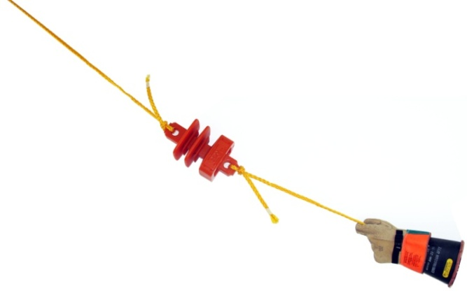
Nonconductive
Property of not becoming energized.
High dielectric properties offering a high resistance to the passage of current under the conditions of use.
Polypropylene Rope
Clean & Dry
High-voltage Rated Rubber Gloves
Notes:
Nonconductive tag line with tag line insulator.

Slide 54
Dedicated Spotter
Be equipped with a visual aid to assist in identifying the minimum clearance distance.
Be positioned to effectively gauge the clearance distance.
Able to communicate directly with the operator.
Give timely information to the operator.
Trained!
Notes:
The dedicated spotter must:
Be equipped with a visual aid to assist in identifying the minimum clearance distance.
Be positioned to effectively gauge the clearance distance.
Give timely information to the operator so that the required clearance distance can be maintained.

Slide 55
Employee Training for Power Lines
Information regarding the danger of simultaneously touching the equipment and ground.
The importance to the operator's safety of remaining inside the cab.
The safest means of evacuating from equipment that may be energized.
The danger of the potentially energized zone around the equipment (step potential).
The need for crew in the area to avoid approaching or touching the equipment and the load.
Safe clearance distance from power lines.
The limitations of an insulating link/device, proximity alarm, and range control (and similar) device, if used.
How to properly ground equipment and the limitations of grounding.
Notes:
29 CFR 1926.1408(g). Training. Power line safety training and emergency response procedures include:
Information regarding the danger of electrocution from the operator simultaneously touching the equipment and the ground.
The importance to the operator's safety of remaining inside the cab except where there is an imminent danger of fire, explosion, or other emergency that necessitates leaving the cab.
The safest means of evacuating from equipment that may be energized.
The danger of the potentially energized zone around the equipment (step potential).
The need for crew in the area to avoid approaching or touching the equipment and the load.
Safe clearance distance from power lines.

Slide 56
Warning Stickers
Two on the outside of equipment.
One inside cab.
Notes:
Power line warning stickers shall be posted on equipment.

Slide 57
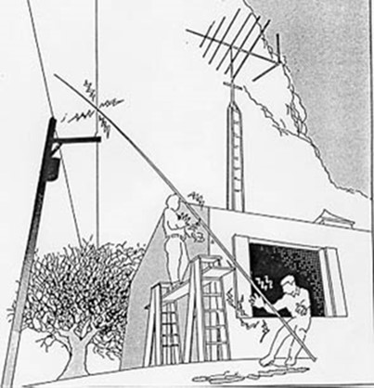
Fatal Fact – Discussion #1
Read and discuss fatal fact.
Notes:
Two employees were installing aluminum siding on a farmhouse when it became necessary to remove a 36-foot high metal pole CB antenna. One employee stood on a metal pick board between two ladders and unfastened the antenna at the top of the house. The other employee, who was standing on the ground, took the antenna to lay it down in the yard. The antenna made electrical contact with a 7200-volt power transmission tine 30 feet 10 inches from the house and 23 feet 9 inches above the ground. The employee handling the antenna received a fatal shock and the other employee a minor shock.

Slide 58
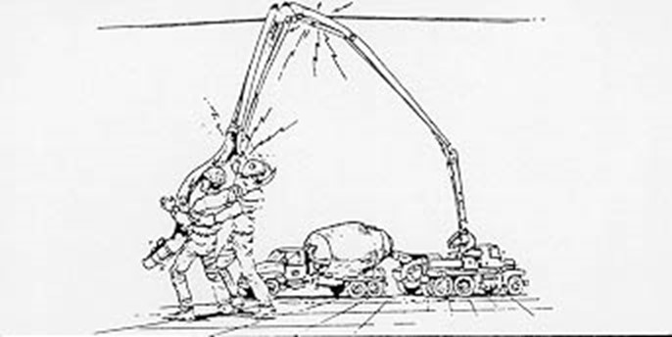
Fatal Fact – Discussion #2
Read and discuss fatal fact.
Notes:
Two employees were spreading concrete as it was being delivered by a concrete pumper truck boom. The truck was parked across the street from the work site. Overhead power lines ran perpendicular to the boom on the pumper truck.
One employee was moving the hose to pour the concrete when the boom of the pumper truck came in contact with the overhead power line carrying 7,620 volts. One employee received a fatal electric shock and fell on the other employee who was assisting him. The second employee received massive electrical shock and burns.

Slide 59
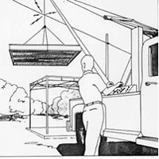
Fatal Fact – Discussion #3
Read and discuss fatal fact.
Notes:
Employees were moving a steel canopy structure using a "boom crane" truck. The boom cable made contact with a 7200-volt electrical power distribution line electrocuting the operator of the crane who was the foreman at the site.

Slide 60
Ground Fault Protection
Explain what a ground fault is and what makes it a dangerous condition
Employer’s responsibility for providing ground fault protection on job sites
Requirements for ground fault circuit interrupter use, limitations and testing
Notes:
Due to the dynamic, rugged nature of construction work, normal use of electrical equipment at a job site causes wear and tear that results in insulation breaks, short-circuits, and exposed wires. If there is no ground fault protection, then miss-use of flexible cords and power tools can cause a ground fault that sends electrical current through the worker's body, resulting in burns, explosions, fire, or death.

Slide 61
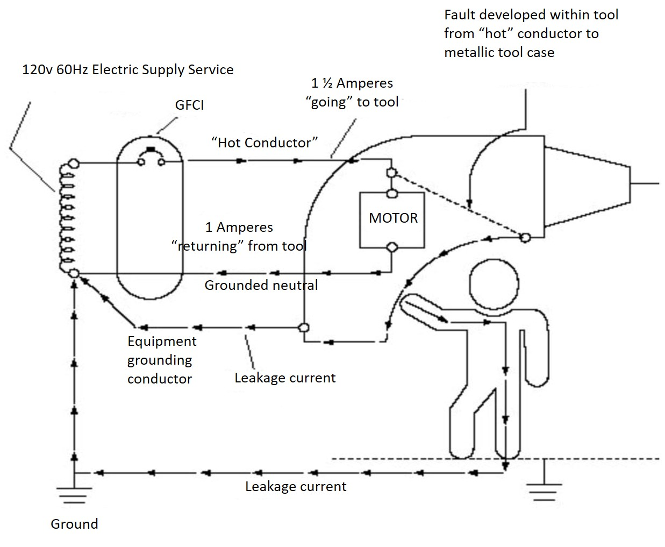
Ground Fault
Notes:
A ground fault circuit interrupter (GFCI) is a fast-acting circuit breaker that senses small imbalances in the circuit caused by current leakage to ground and, in a fraction of a second, shuts off the electricity. The GFCI continually matches the amount of current going to an electrical device against the amount of current returning from the device along the electrical path. Whenever the amount “going” differs from the amount “returning” by approximately 5 milliamps, the GFCI interrupts the electric power within as little as 1/40 of a second. (See diagram.)

Slide 62
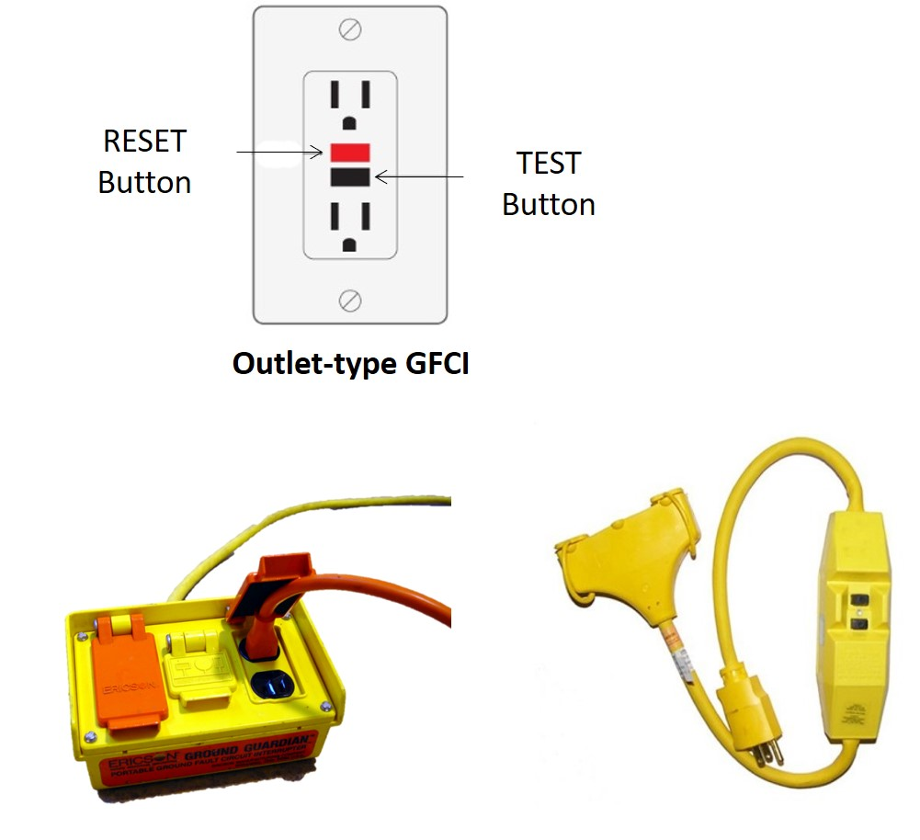
What is a GFCI?
Fast-acting circuit breaker that senses small imbalances in the circuit caused by current leakage to ground and, in a fraction of a second, shuts off the electricity.
Notes:
The GFCI, however, does not protect from line-to-line contact hazards—such as a worker holding two “hot” wires or a hot and a neutral wire in each hand. It protects against the most common form of electrical shock hazard—the ground fault, and protects against fires, overheating, and destruction of insulation on wiring.
GFCIs can be used successfully to reduce electrical hazards on construction sites. Tripping of GFCIs—interrupting current flow—is sometimes caused by wet connectors and tools. It is good practice to limit exposure of connectors and tools to excessive moisture by using water-tight or sealable connectors.
Providing more GFCIs or shorter circuits can prevent tripping caused by the cumulative leakage from several tools or by leakages from extremely long circuits.

Slide 63
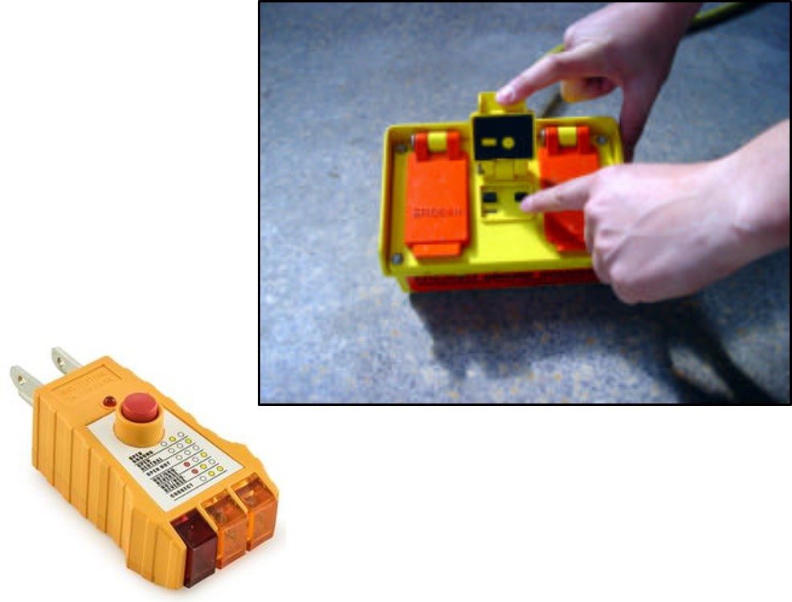
29 CFR 1926.404(b)(1). Ground fault protection
Required on all 120-volt, single-phase 15- and 20-ampere receptacle outlets on construction sites, which are not a part of the permanent wiring of the building or structure and which are in use by employees.
Notes:
29 CFR 1926.404(b)(1). Ground fault protection is required on all 120-volt, single-phase 15- and 20-ampere receptacle outlets on construction sites where the outlets are not a part of the permanent wiring of the building or structure and which are in use by construction employees. To ensure that the proper protection is in place, perform the following visual and manual tests:
Determine if the branch circuit is equipped with a GFCI device. If there is no outlet-type GFCI (the type that is installed in the outlet box) or cord-connected GFCI visible, then there may be a GFCI installed further up the circuit. Use an approved external GFCI tester at the outlet to see if there is a positive reading (indicating that the circuit is GFCI protected).
If a negative reading (a reading that indicates that the circuit is not GFCI protected) is obtained, then further investigation is required to determine whether the circuit is protected. Reliance must not be placed solely on a negative external GFCI tester reading to establish a violation of the standard. This is because there are some circumstances where a negative reading on an external tester can result even though there is a functioning GFCI protecting the circuit. Consult a qualified electrical worker.

Slide 64
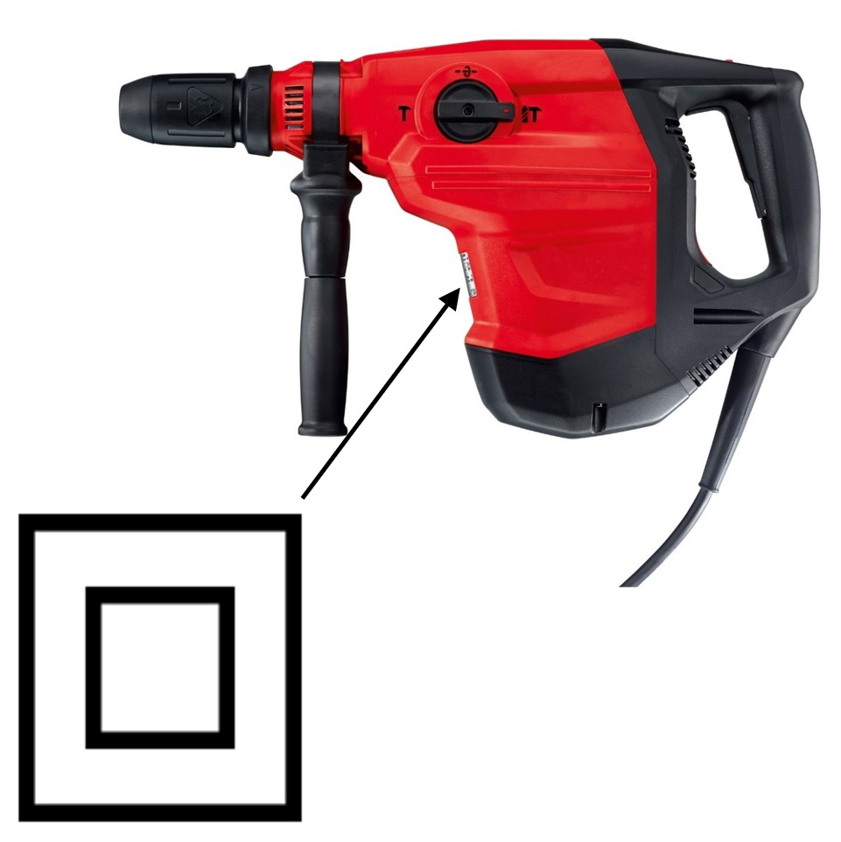
Double-Insulated Tools
Tool enclosure is completely non-conducting
No ground “Earth” wire
Identified by a double square symbol
Notes:
Hand-held tools manufactured with non-metallic cases are called double-insulated. If approved, they do not require grounding under the National Electrical Code. Although this design method reduces the risk of grounding deficiencies, a shock hazard can still exist.
Such tools are often used in areas where there is considerable moisture or wetness. Although the user is insulated from the electrical wiring components, water can still enter the tool's housing. Ordinary water is a conductor of electricity. If water contacts the energized parts inside the housing, it provides a path to the outside, bypassing the double insulation. When a person holding a hand tool under these conditions contacts another conductive surface, then an electric shock occurs.

Slide 65
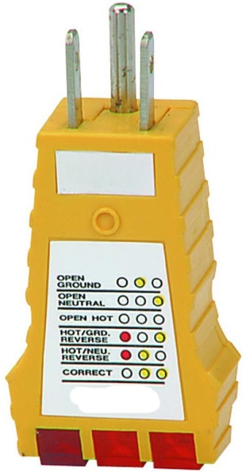
Assured Equipment Grounding Conductor Program
A continuity test to ensure that the equipment-grounding conductor is electrically continuous.
A polarity test to ensure that the equipment-grounding conductor is connected to its proper terminal.
Notes:
Assured equipment grounding conductor tests are required before first use, after any repairs, after damage is suspected to have occurred, and at 3-month intervals.

Slide 66
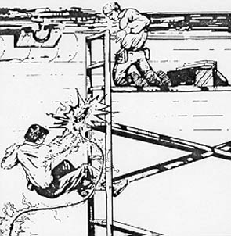
Fatal Fact – Discussion #4
Read and discuss fatal fact.
Notes:
One employee was climbing a metal ladder to hand an electric drill to the journeyman installer on a scaffold about five feet above him. When the victim reached the third rung from the bottom of the ladder he received an electric shock that killed him.

Slide 67
Extension Cords, Tools & Other Equipment
Types of extension cords, their markings, proper use and how to inspect for damage
Path to ground missing or discontinuous
Improper use of flexible and extension cords
Common misuses of equipment
Notes:
Discussion Points
Types of extension cords, their markings, proper use and how to inspect for damage
Path to ground missing or discontinuous
Improper use of flexible and extension cords
Common misuses of equipment

Slide 68
Selecting and Using the Right Extension Cord
U.S., American Wire Gauge (AWG)
#18 AWG - Lamp cords (sometimes #16).
#16 AWG - A step up from lamp cords. The most commonly used general-purpose cord gauge (used for work lights, electric trimmers, etc.) Not for high-power loads. Not recommended for construction work.
#14 AWG - Minimum size recommended for construction work.
#12 AWG - Heavy use, such as large power tools.
#10 AWG - Large loads.
Notes:
In the U.S., American Wire Gauge (AWG) indicates the size of the copper wire inside a cord. Cords in common use range from #18 AWG to #10 AWG. (Only even numbered sizes are normally used.) The higher the AWG number, the smaller the wire size.

Slide 69
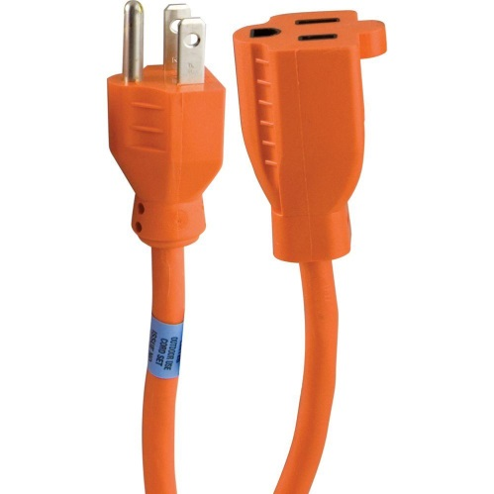
29 CFR 1926.405(a)(2)(ii)(J). Extension Cords
Cord sets used with portable tools and appliances must be of the three-wire, grounding type; and flexible cords must be designed for hard or extra-hard usage.
“S” (hard service)
“SJ” the J is for “junior”
Notes:
29 CFR 1926.405(a)(2)(ii)(J). Extension cord sets used with portable tools and appliances must be of the three-wire, grounding type; and flexible cords must be designed for hard or extra-hard usage.

Slide 70
Extension Cord Markings
T Thermoplastic insulation, instead of a rubber-type material
E Thermoplastic elastomer insulation (more rubber-like than thermoplastic)
O Oil resistant
W Moisture and sunlight resistant
Notes:
Extension cords larger than lamp cord size are marked continuously along their length with several items of information. The most important marking item is the one that tells the size of the wires inside the cord.
This marking usually appears in a form such as “14/3,” which indicates a three conductor #14 AWG cord.
The marking item that usually follows the wire gauge tells the type of cord, meaning the physical construction. The two types of construction likely to be found are “S” (hard service) and “SJ” (J is for “junior”) which is a lighter duty, less-rugged version of the type S cord.
Additional letters may follow the S or SJ. The additional letters indicate other performance characteristics.

Slide 71
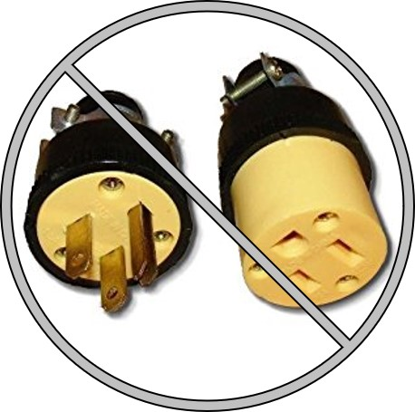
Cord Repair
Do not repair extension cords by replacing the ends. This will cause the cord to not maintain its approval for what its intended use is. For example, what was once “W” moisture and sunlight resistant cord will no longer be water tight if the plug was replaced.
Notes:
Do not repair extension cords by replacing the ends. This will cause the cord to not maintain its approval for its intended use. For example, what was once “W” (moisture and sunlight resistant) will no longer be water-tight if the plug was replaced.

Slide 72
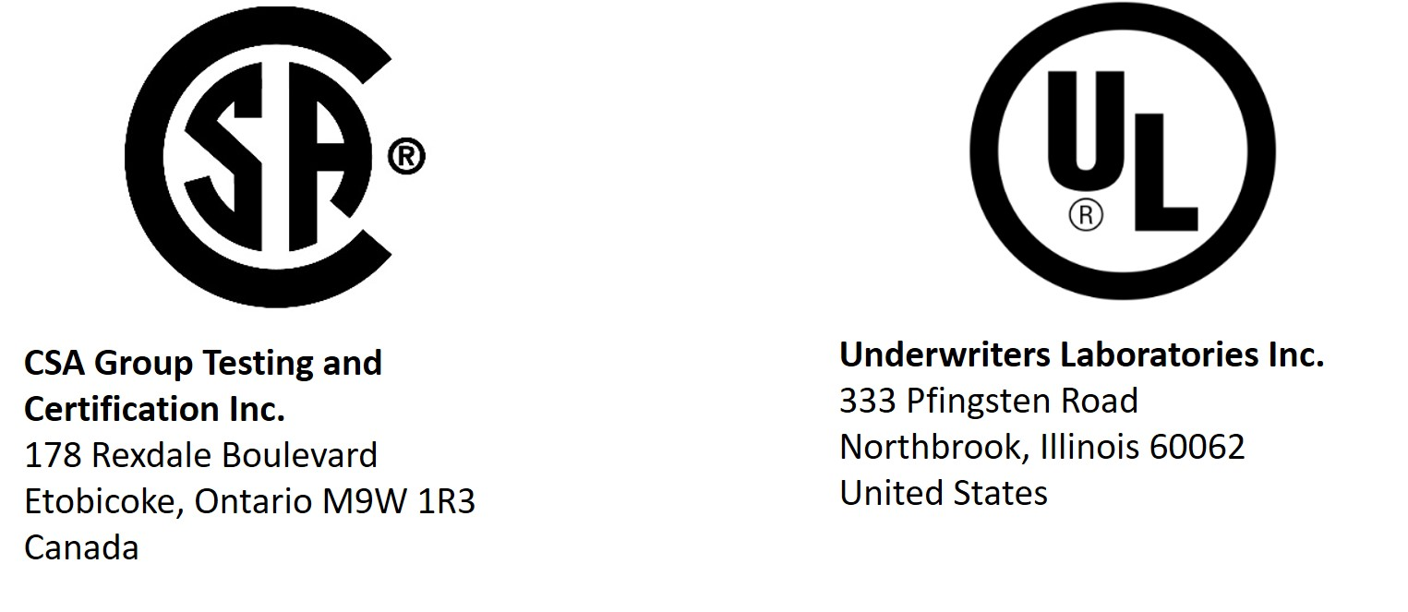
OSHA's Nationally Recognized Testing Laboratory (NRTL) Program
29 CFR 1926.403(a). Approval
All electrical conductors and equipment shall be approved.
Notes:
OSHA recognizes private sector organizations to perform certification for certain products to ensure that they meet the requirements of both the construction and general industry OSHA electrical standards. Each NRTL has a scope of test standards that it is recognized for, and each NRTL uses its own unique registered certification mark(s) to designate product conformance to the applicable product safety test standards. After certifying a product, the NRTL authorizes the manufacturer to apply a registered certification mark to the product. If the certification is done under the NRTL program, this mark signifies that the NRTL has tested and certified the product, and that the product complies with the requirements of one or more appropriate product safety test standards.

Slide 73
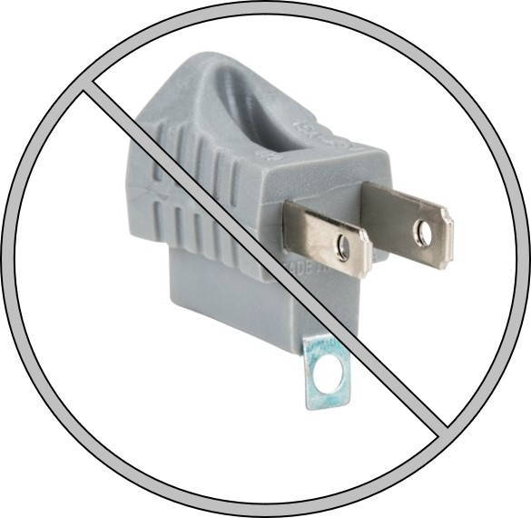
Two-prong Receptacle Adapter
Never use an adapter that will make a three-prong cord fit into a two prong receptacle.
Notes:
Never use an adapter that will make a three-prong cord fit into a two prong receptacle.

Slide 74
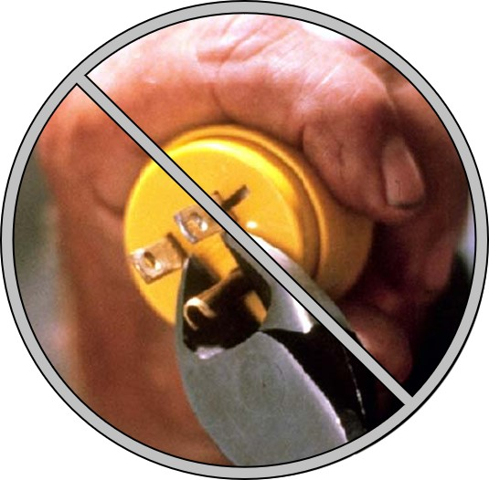
Path to Ground Missing or Discontinuous
29 CFR 1926.404(f)(6) – Grounding path.
The path to ground from circuits, equipment, and enclosures shall be permanent and continuous.
Notes:
Removing the ground pin from a plug to fit an ungrounded outlet not only makes the work area unsafe, but also makes the cord unfit for future work where there is grounding.
29 CFR 1926.404(f)(6). Grounding path. The path to ground from circuits, equipment, and enclosures shall be permanent and continuous.

Slide 75
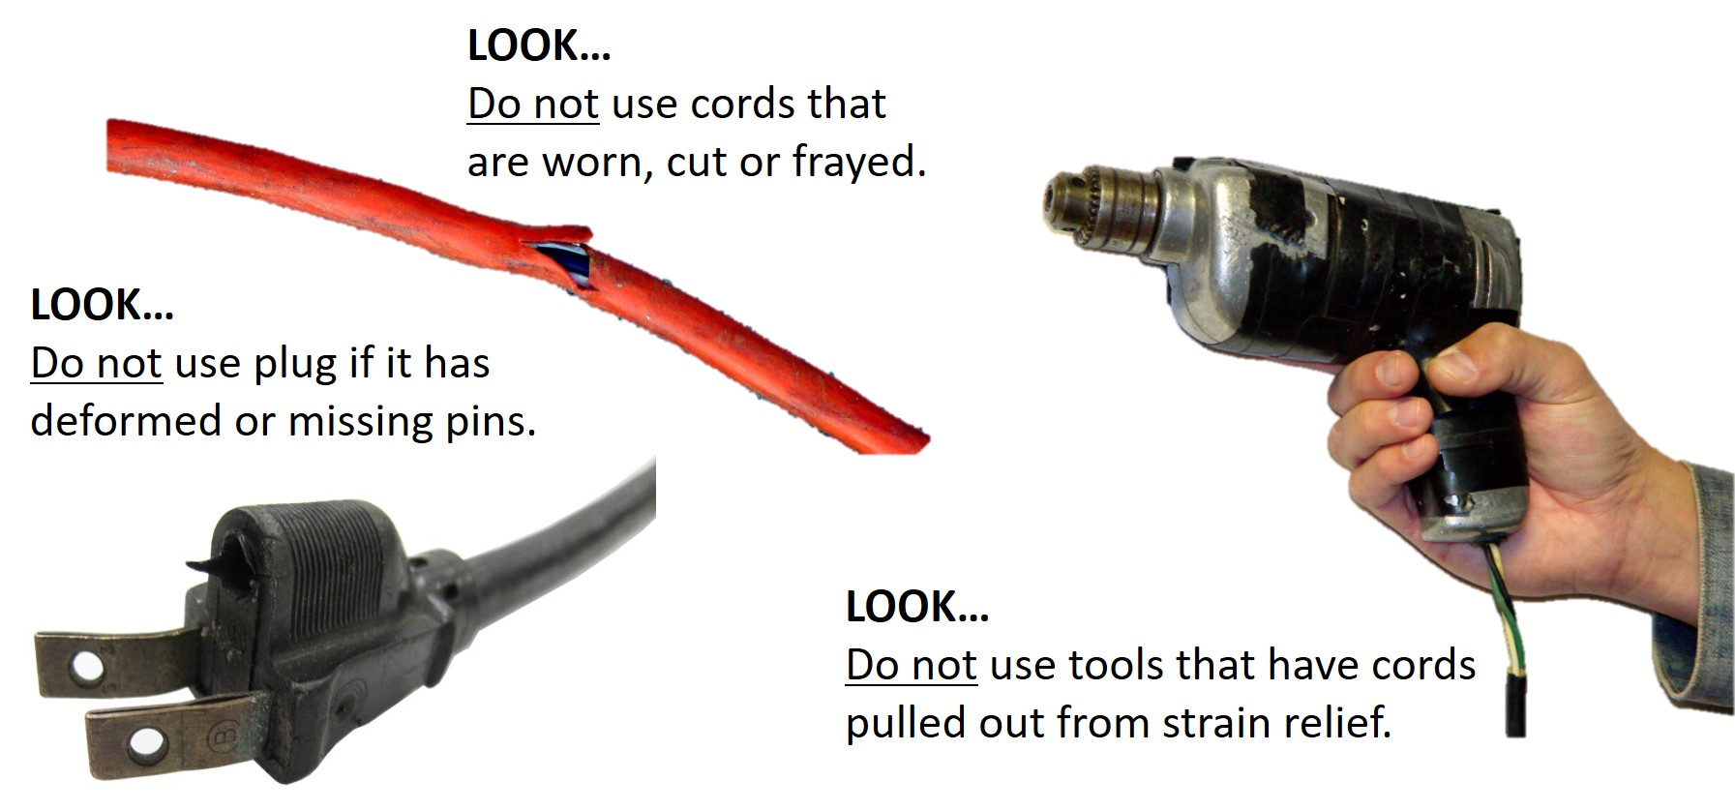
Cord and Tool Inspection
Notes:
Each cord set, attachment cap, plug and receptacle of cord sets, and any equipment connected by cord and plug, except cord sets and receptacles which are fixed and not exposed to damage, shall be visually inspected before each day's use for external defects, such as deformed or missing pins or insulation damage, and for indications of possible internal damage.
Equipment found damaged or defective shall not be used.

Slide 76
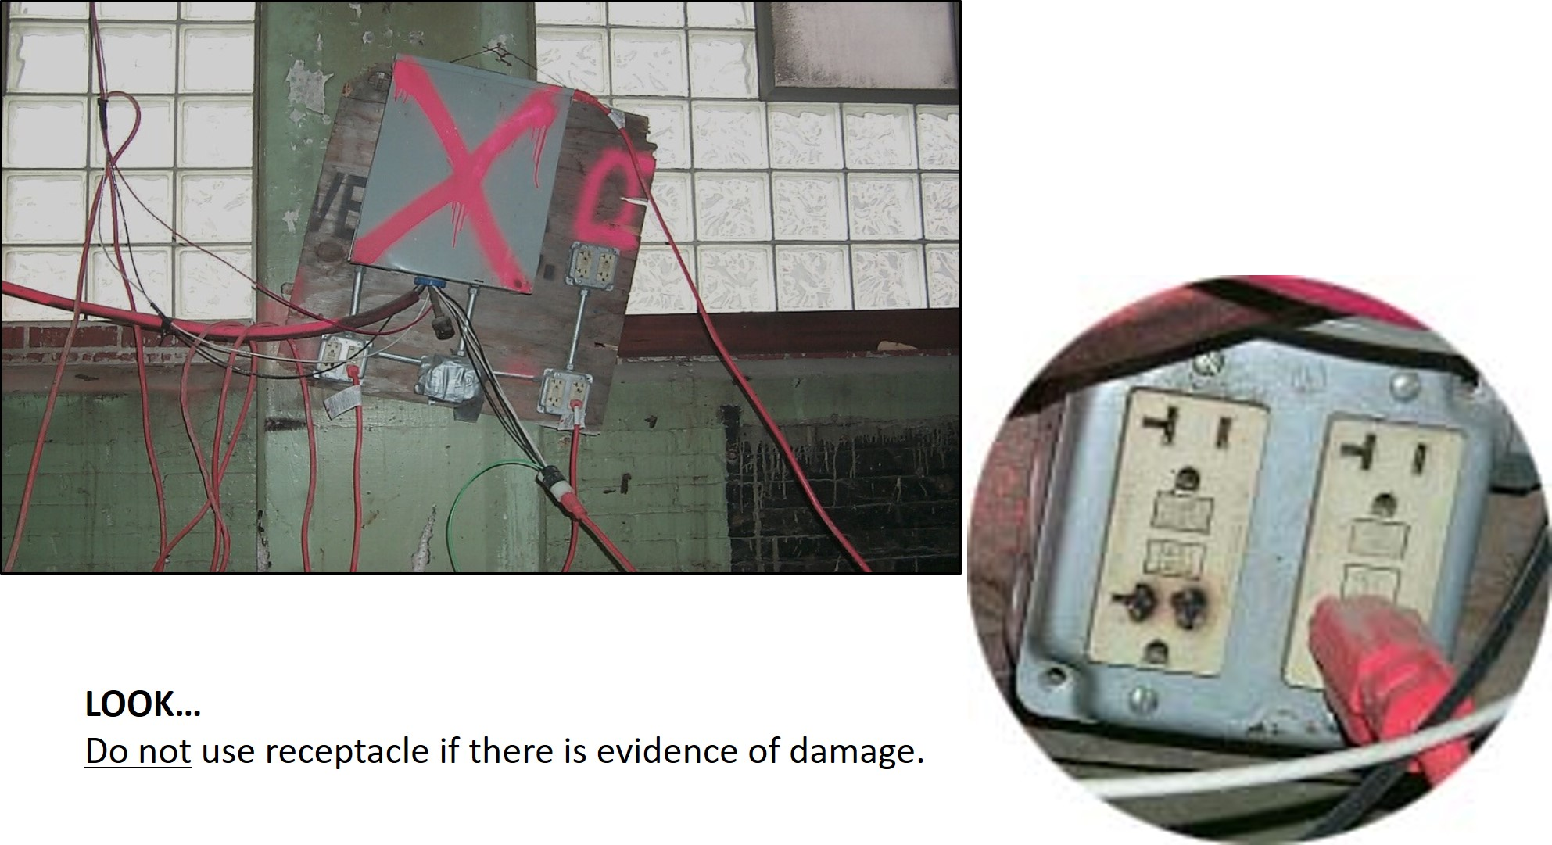
Look
Notes:
If electrical equipment is used in ways for which it is not designed, then the safety features built in by the manufacturer are unreliable. This may damage equipment and cause employee injuries.

Slide 77
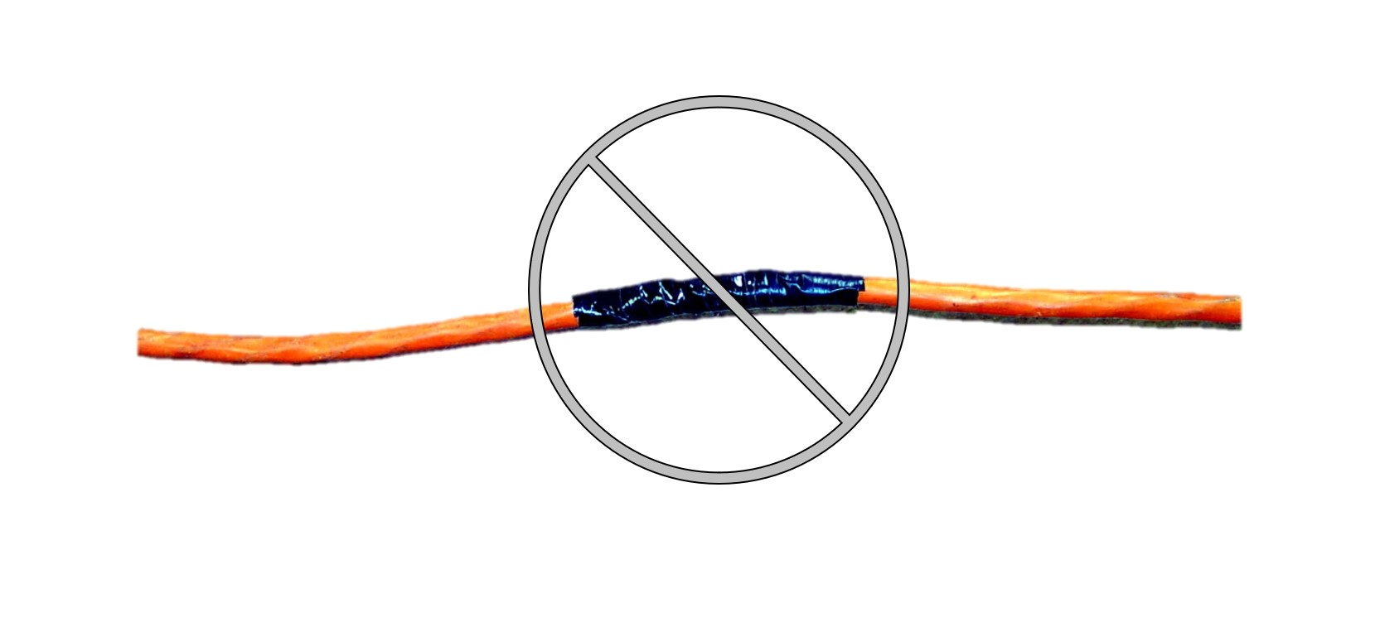
Equipment Not Used in Manner Prescribed
Do not repair electrical cords with tape! Any repairs must return the equipment to the state in which it was initially approved
Notes:
Do not repair electrical cords with tape! Any repairs must return the equipment to the state in which it was initially approved.

Slide 78
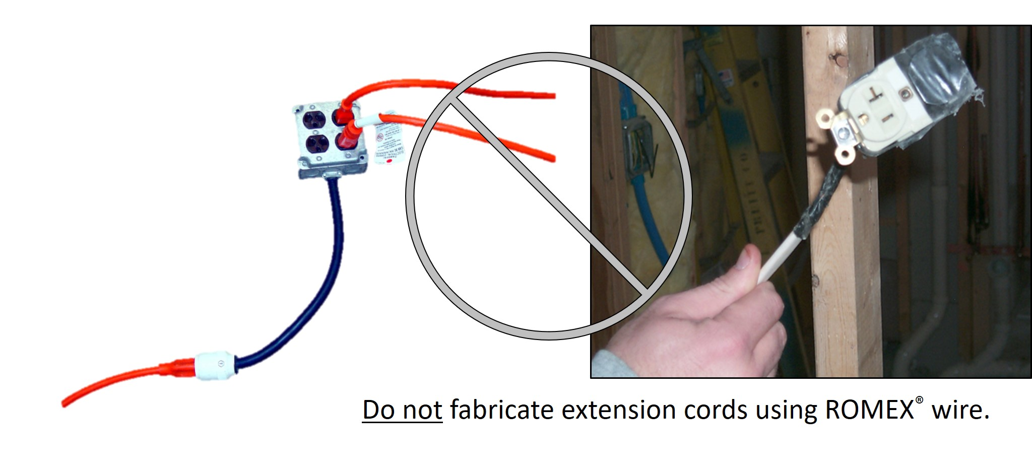
Do not use multi-receptacle boxes designed to be mounted by fitting them with a power cord and placing them on the floor.
Notes:
Do not use multi-receptacle boxes designed to be mounted by fitting them with a power cord and placing them on the floor.

Slide 79
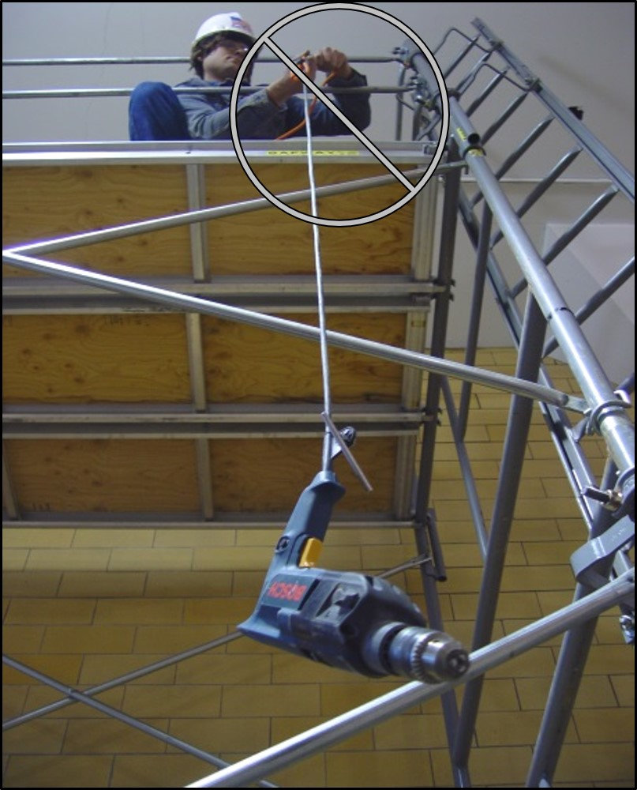
29 CFR 1926.302(a)(2)
The use of electric cords for hoisting or lowering tools shall not be permitted.
Notes:
The use of electric cords for hoisting or lowering tools shall not be permitted.

Slide 80
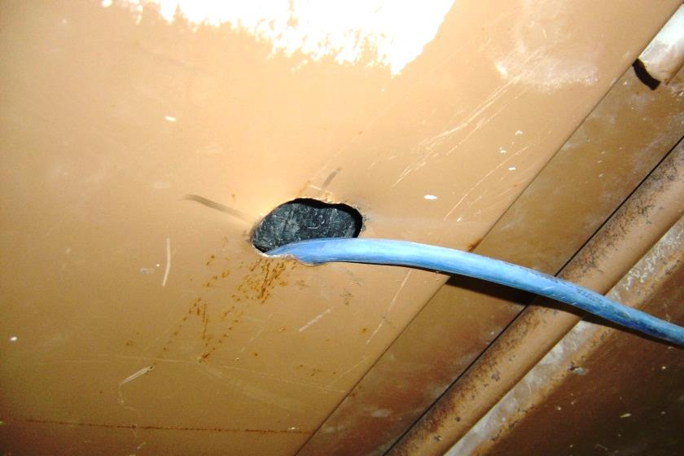
29 CFR 1926.405(a)(2)(ii)(I)
Flexible cords and cables shall be protected from damage. Sharp corners and projections shall be avoided.
Notes:
Flexible cords and cables shall be protected from damage. Sharp corners and projections shall be avoided.

Slide 81
Power Tools
29 CFR 1926.200(h). Accident Prevention Tags
Shall be used as a temporary means of warning employees of an existing hazard, such as defective tools.
Notes:
29 CFR 1926.200(h). Accident prevention tags shall be used as a temporary means of warning employees of an existing hazard, such as defective tools (picture).
As part of an ongoing accident prevention program, employers should have a system in place that allows employees to identify tools that are in disrepair. Without such a program, employees may grab a tool that is defective and try to use it.

Slide 82
Lockout/Tagout
What is hazardous energy?
What are the harmful effects of hazardous energy?
Elements of a Lockout/Tagout program (OSHA)
Electrical Safety-Related Work Practices (NFPA 70E)
Notes:
Energy sources, including electrical, mechanical, hydraulic, pneumatic, chemical, thermal, or other sources in machines and equipment can be hazardous to workers. During the servicing and maintenance of machines and equipment, the unexpected startup or release of stored energy can result in serious injury or death to workers.

Slide 83
Construction Industry Standards (OSHA)
29 CFR 1926.417(a). Controls that are to be deactivated during the course of work on energized or deenergized equipment or circuits shall be tagged.
29 CFR 1926.417(b). Equipment or circuits that are deenergized shall be rendered inoperative and shall have tags attached at all points where such equipment or circuits can be energized.
29 CFR 1926.417(c). Tags shall be placed to identify plainly the equipment or circuits being worked on.
Notes:
29 CFR 1926.417(a). Controls that are to be deactivated during the course of work on energized or deenergized equipment or circuits shall be tagged.
29 CFR 1926.417(b). Equipment or circuits that are deenergized shall be rendered inoperative and shall have tags attached at all points where such equipment or circuits can be energized.
29 CFR 1926.417(c). Tags shall be placed to identify plainly the equipment or circuits being worked on.

Slide 84
Energy Control Program (OSHA) – 29 CFR 1910.147
Lockout/Tagout program requirements:
If an energy isolating device is capable of being locked out, the employer's energy control program shall utilize lockout, unless the employer can demonstrate that the utilization of a tagout system will provide full employee protection.
If an energy isolating device is not capable of being locked out, the employer's energy control program shall utilize a tagout system.
When a tagout device is used on an energy isolating device which is capable of being locked out, the tagout device shall be attached at the same location that the lockout device would have been attached, and the employer shall demonstrate that the tagout program will provide a level of safety equivalent to that obtained by using a lockout program.
Notes:
The employer shall establish a program consisting of energy control procedures, employee training and periodic inspections to ensure that before any employee performs any servicing or maintenance on a machine or equipment where the unexpected energizing, startup or release of stored energy could occur and cause injury, the machine or equipment shall be isolated from the energy source and rendered inoperative.
Lockout/Tagout program requirements:
If an energy isolating device is capable of being locked out, the employer's energy control program shall utilize lockout, unless the employer can demonstrate that the utilization of a tagout system will provide full employee protection.
If an energy isolating device is not capable of being locked out, the employer's energy control program shall utilize a tagout system.
When a tagout device is used on an energy isolating device which is capable of being locked out, the tagout device shall be attached at the same location that the lockout device would have been attached, and the employer shall demonstrate that the tagout program will provide a level of safety equivalent to that obtained by using a lockout program.

Slide 85
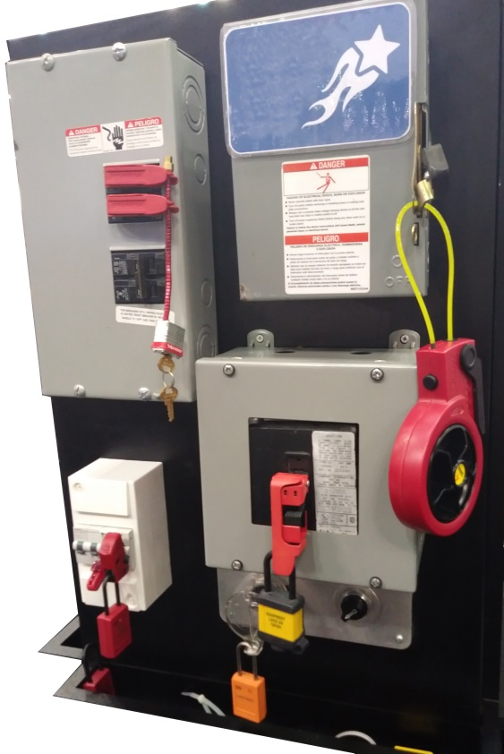
Capable of Being Locked Out
An energy isolating device is capable of being locked out if it has a hasp or other means of attachment to which, or through which, a lock can be affixed, or it has a locking mechanism built into it.
Notes:
An energy isolating device is capable of being locked out if it has a hasp or other means of attachment to which, or through which, a lock can be affixed, or it has a locking mechanism built into it. Other energy isolating devices are capable of being locked out, if lockout can be achieved without the need to dismantle, rebuild, or replace the energy isolating device or permanently alter its energy control capability.

Slide 86
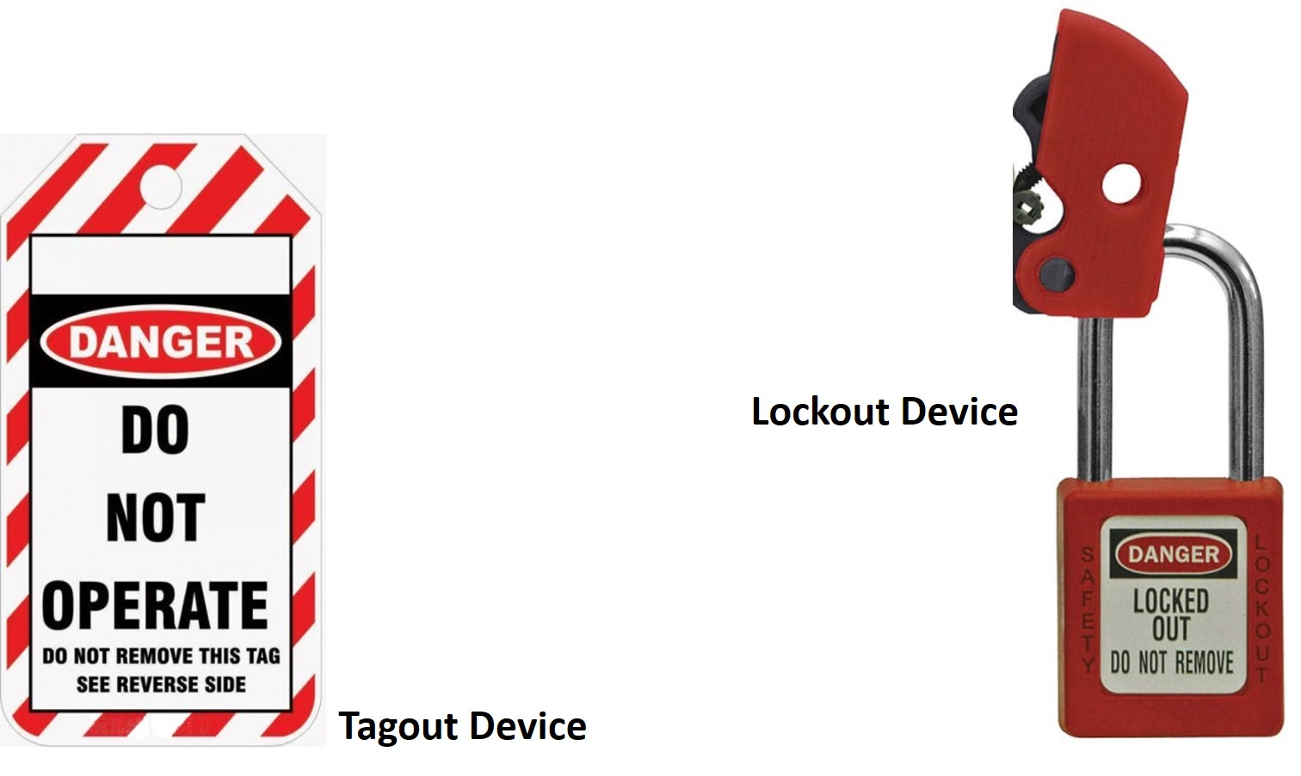
Lockout/Tagout Devices
Notes:
Lockout device. A device that utilizes a positive means such as a lock, either key or combination type, to hold an energy-isolating device in the safe position and prevent the energizing of a machine or equipment. Included are blank flanges and bolted slip blinds.
Tagout device. A prominent warning device, such as a tag and a means of attachment, which can be securely fastened to an energy-isolating device in accordance with an established procedure, to indicate that the energy-isolating device and the equipment being controlled may not be operated until the tagout device is removed.
29 CFR 1910.147(c)(5)(iii). Tagout devices shall warn against hazardous conditions if the machine or equipment is energized and shall include a legend such as the following: Do Not Start. Do Not Open. Do Not Close. Do Not Energize. Do Not Operate.

Slide 87
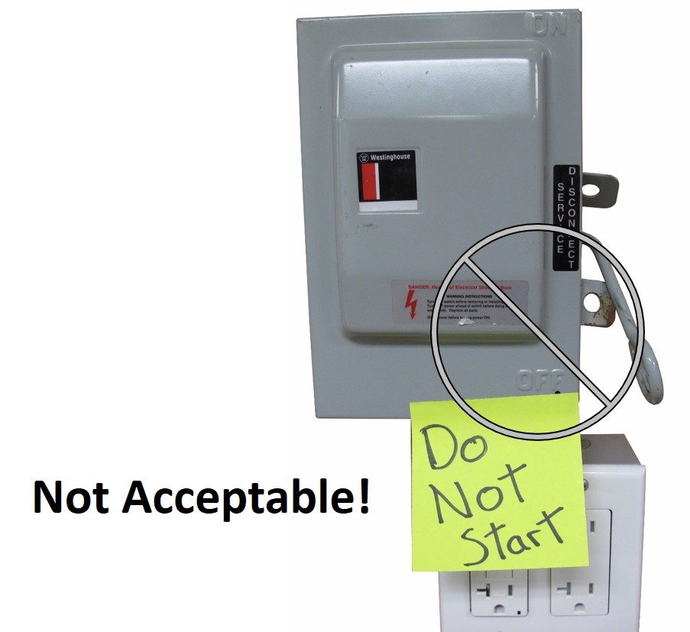
Lockout/Tagout Materials and Hardware
Durable
Standardized
Substantial
Identifiable
Notes:
Durable
Lockout and tagout devices shall be capable of withstanding the environment to which they are exposed for the maximum period of time that exposure is expected.
Tagout devices shall be constructed and printed so that exposure to weather conditions or wet and damp locations will not cause the tag to deteriorate or the message on the tag to become illegible.
Tags shall not deteriorate when used in corrosive environments such as areas where acid and alkali chemicals are handled and stored.
Standardized. Lockout and tagout devices shall be standardized within the facility in at least one of the following criteria: color; shape; or size; and additionally, in the case of tagout devices, print and format shall be standardized.
Substantial
Lockout devices. Lockout devices shall be substantial enough to prevent removal without the use of excessive force or unusual techniques, such as with the use of bolt cutters or other metal cutting tools.
Tagout devices. Tagout devices, including their means of attachment, shall be substantial enough to prevent inadvertent or accidental removal. Tagout device attachment means shall be of a non-reusable type, attachable by hand, self-locking, and non-releasable with a minimum unlocking strength of no less than 50 pounds and having the general design and basic characteristics of being at least equivalent to a one-piece, all environment-tolerant nylon cable tie.
Identifiable. Lockout devices and tagout devices shall indicate the identity of the employee applying the device(s).

Slide 88
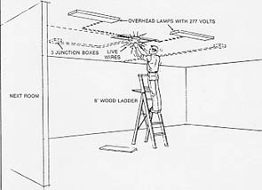
Fatal Fact – Discussion #5
Read and discuss fatal fact.
Notes:
The employee was attempting to correct an electrical problem involving two non-operational lamps. He proceeded to the area where he thought the problem was. He had not shut off the power at the circuit breaker panel nor had he tested the wires to see if they were live. He was electrocuted when he grabbed the two live wires with his left hand and then fell from the ladder.

Slide 89
Electrical Safety-Related Work Practices
Hierarchy of risk control methods
Job safety planning and job briefing
Host and contract employers’ responsibilities
Shock risk assessment
Arc flash risk assessment and equipment labeling
Emergency response training
Test instruments and equipment – ABC’s of Multimeter safety
Energized electrical work permit
Notes:
Discussion Points
Hierarchy of risk control methods
Job safety planning and job briefing
Host and contract employers’ responsibilities
Shock risk assessment
Arc flash risk assessment and equipment labeling
Emergency response training
Test instruments and equipment – ABC’s of Multimeter Safety
Energized electrical work permit

Slide 90
29 CFR 1910.333(a). "General."
Safety-related work practices shall be employed to prevent electric shock or other injuries resulting from either direct or indirect electrical contacts, when work is performed near or on equipment or circuits which are or may be energized. The specific safety-related work practices shall be consistent with the nature and extent of the associated electrical hazards.
Notes:
Electrical safety-related work practices apply to qualified persons (those who have training in avoiding the hazards of working on or near exposed energized parts) and unqualified persons (those with little or no such training) working on, near, or with electrical equipment.
29 CFR 1910.333(a). "General." Safety-related work practices shall be employed to prevent electric shock or other injuries resulting from either direct or indirect electrical contacts, when work is performed near or on equipment or circuits which are or may be energized. The specific safety-related work practices shall be consistent with the nature and extent of the associated electrical hazards.
In establishing an electrical safety-related work program, employers must consider the hierarchy of risk control methods.

Slide 91
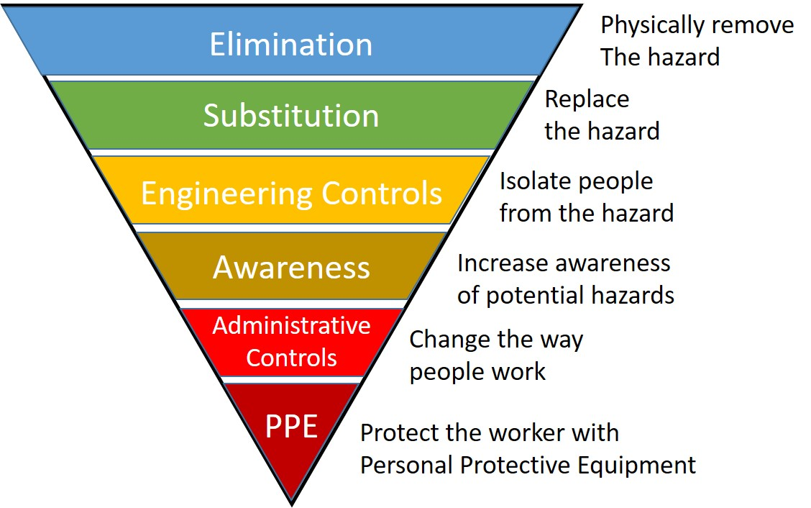
Hierarchy of Risk Control Methods
Elimination
Substitution
Engineering controls
Awareness
Administrative controls
PPE
Notes:
Safety-related work practices must include the hierarchy of risk control methods:
Elimination
Substitution
Engineering controls
Awareness
Administrative controls
Personal Protective Equipment
Note: Elimination, Substitution, and Engineering controls are the most effective methods to reduce risk, as they are usually applied at the source of possible injury or damage to health. They are also less likely to be affected by human error. Awareness, Administrative controls, and PPE are the least effective methods to reduce risk, as they are not applied at the source. They are also more likely to be affected by human error.

Slide 92
Electrical Safety Work Practices (1)
Option 1: Deenergize (Lockout/Tagout)
29 CFR 1910.333(a)(1). Live parts to which an employee may be exposed shall be deenergized before the employee works on or near them, unless the employer can demonstrate that deenergizing introduces additional or increased hazards or is infeasible due to equipment design or operational limitations.
Notes:
29 CFR 1910.333(a)(1). Live parts to which an employee may be exposed shall be de-energized before the employee works on or near them, unless the employer can demonstrate that de-energizing introduces additional or increased hazards or is infeasible due to equipment design or operational limitations. Live parts that operate at less than 50 volts to ground need not be de-energized if there will be no increased exposure to electrical burns or to explosion due to electric arcs.

Slide 93
Examples of Increased or Additional Hazards
Interruption of life support equipment
Deactivation of emergency alarm systems
Shutdown of hazardous location ventilation equipment
Removal of illumination for an area
Notes:
Note 1: Examples of increased or additional hazards include interruption of life support equipment, deactivation of emergency alarm systems, shutdown of hazardous location ventilation equipment, or removal of illumination for an area.

Slide 94

Examples of Infeasibility
Infeasibility due to equipment design or operational limitations include testing of electric circuits that can only be performed with the circuit energized and work on circuits that form an integral part of a continuous industrial process in a chemical plant that would otherwise need to be completely shut down in order to permit work on one circuit or piece of equipment.
Notes:
Note 2: Examples of work that may be performed on or near energized circuit parts because of infeasibility due to equipment design or operational limitations include testing of electric circuits that can only be performed with the circuit energized and work on circuits that form an integral part of a continuous industrial process in a chemical plant that would otherwise need to be completely shut down in order to permit work on one circuit or piece of equipment.

Slide 95
Electrical Safety Work Practices (2)
Option 2: Work On or Near Energized Parts
29 CFR 1910.333(a)(2). If the exposed live parts are not deenergized (i.e., for reasons of increased or additional hazards or infeasibility), other safety-related work practices shall be used to protect employees who may be exposed to the electrical hazards involved. Such work practices shall protect employees against contact with energized circuit parts directly with any part of their body or indirectly through some other conductive object. The work practices that are used shall be suitable for the conditions under which the work is to be performed and for the voltage level of the exposed electric conductors or circuit parts.
Notes:
29 CFR 1910.333(a)(2). If the exposed live parts are not de-energized (i.e., for reasons of increased or additional hazards or infeasibility), other safety-related work practices shall be used to protect employees who may be exposed to the electrical hazards involved. Such work practices shall protect employees against contact with energized circuit parts directly with any part of their body or indirectly through some other conductive object. The work practices that are used shall be suitable for the conditions under which the work is to be performed and for the voltage level of the exposed electric conductors or circuit parts.

Slide 96
Job Safety Planning
Be completed by a qualified person
Be documented
Include the following information:
Description of the job and the individual tasks
Identification of the electrical hazards associated with each task
A shock risk assessment for tasks involving a shock hazard
An arc flash risk assessment for tasks involving an arc flash hazard
Work procedures involved, special precautions, and energy source controls
Notes:
Before starting each job that involves exposure to electrical hazards, the employee in charge shall complete a job safety plan and conduct a job briefing with the employees involved.
The job safety plan shall:
Be completed by a qualified person
Be documented
Include the following information:
Description of the job and the individual tasks
Identification of the electrical hazards associated with each task
A shock risk assessment for tasks involving a shock hazard
An arc flash risk assessment for tasks involving an arc flash hazard
Work procedures involved, special precautions, and energy source controls

Slide 97
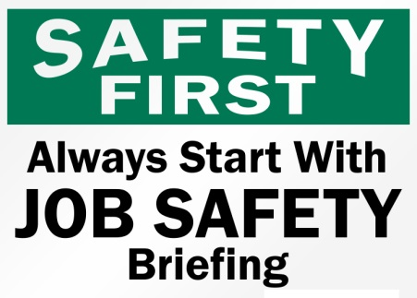
Job Briefing
The job briefing shall cover the job safety plan and the information on the energized electrical work permit, if a permit is required.
Notes:
The job briefing shall cover the job safety plan and the information on the energized electrical work permit, if a permit is required.

Slide 98
Host and Contract Employers’ Responsibilities
Host Employer
The host employer must inform contract employers of the known hazards related to the contract employer’s work. Additional information on hazards that might not be recognized by the contract employer or its employees must also be provided.
The host employer shall report observed contract employer-related violations to the contract employer.
Notes:
Host Employer
The host employer must inform contract employers of the known hazards related to the contract employer’s work. Additional information about hazards that might not be recognized by the contract employer or its employees must also be provided.
The host employer shall report observed contract employer-related violations to the contract employer.

Slide 99
Host and Contract Employers’ Responsibilities Continued
Contract Employer
The contract employer must ensure that each of his or her employees is instructed in the hazards communicated to the contract employer by the host employer. This instruction shall be in addition to the qualified person training already received.
The contract employer shall ensure that each of his or her employees follows the work practices and safety-related work rules required by the host employer.
Notes:
Contract Employer
The contract employer must ensure that each of its employees is informed about the hazards communicated to the contract employer by the host employer. This shall be in addition to the qualified person training already received.
The contract employer shall ensure that each of its employees follows the work practices and safety-related work rules required by the host employer.

Slide 100
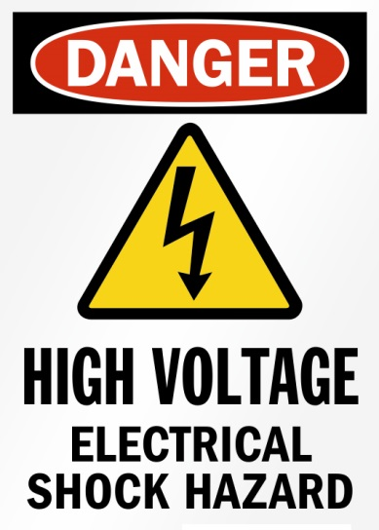
Shock Risk Assessment (NFPA 70E – 2018)
Limited Approach Boundary
Restricted Approach Boundary
Arc Flash Hazard Analysis
Notes:
A shock hazard is a source of possible injury or damage to health associated with current through the body caused by contact or approach to energized electrical conductors or circuit parts.
Only qualified persons are allowed to work on or near live electrical equipment. To establish what a safe work distance is to an exposed energized conductor, the NFPA 70E standard provides a limited and restricted approach boundary table. Working within these approach boundaries requires specialized training, tools and personal protective equipment.

Slide 101
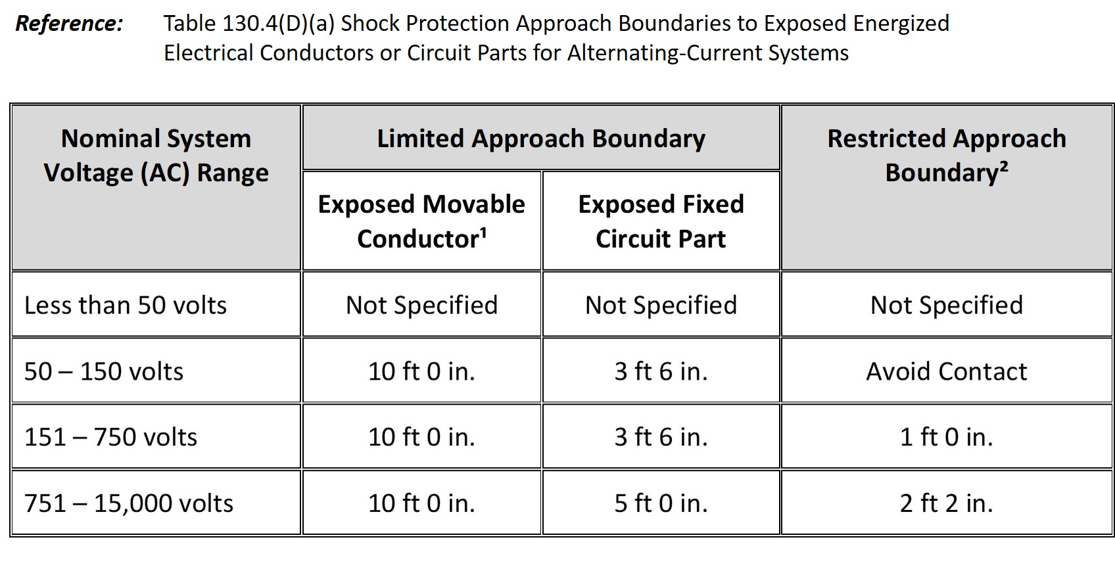
Approach Boundaries (NFPA 70E)
Notes:
Reference: Table 130.4(D)(a) Shock Protection Approach Boundaries to Exposed Energized Electrical Conductors or Circuit Parts for Alternating-Current Systems

Slide 102
Arc Flash Risk Assessment (NFPA 70E – 2018)
An arc flash hazard exists when working within a distance at which incident energy equals 1.2 cal/cm².
Three main reasons for performing an arc flash risk assessment:
To identify arc flash hazards.
To estimate the likelihood of occurrence of injury or damage to health and the potential severity of injury or damage to health.
To determine if additional protective measures are required, including the use of PPE.
Notes:
An arc flash hazard exists when working within a distance at which incident energy equals 1.2 cal/cm² (5 J/cm²).
Note: According to the Stoll skin burn injury model, the onset of a second degree burn on unprotected skin is likely to occur at an exposure of 1.2 cal/cm² (5 J/cm²) for one second.
There are three main reasons for performing an arc flash risk assessment:
To identify arc flash hazards.
To estimate the likelihood of occurrence of injury or damage to health and the potential severity of injury or damage to health.
To determine if additional protective measures are required, including the use of PPE.
For a person to cross the arc flash boundary, a person must be wearing appropriate arc-rated clothing.

Slide 103
Equipment Labeling (NFPA 70E – 2018)
Nominal system voltage
Arc flash boundary
At least one of the following:
Available incident energy and the corresponding working distance, or the arc flash PPE category in Table 130.7(C)(15)(a) or Table 130.7(C)(15)(b) for the equipment, but not both.
Minimum arc rating of clothing.
Site-specific level of PPE.
Notes:
Electrical equipment, such as switchboards, panelboards, industrial control panels, meter socket enclosures, and motor control centers, that are in other than dwelling units and that are likely to require examination, adjustment, servicing, or maintenance while energized shall be marked with a label containing the following information:
Nominal system voltage
Arc flash boundary
At least one of the following:
Available incident energy and the corresponding working distance, or the arc flash PPE category in Table 130.7(C)(15)(a) or Table 130.7(C)(15)(b) for the equipment, but not both.
Minimum arc rating of clothing.
Site-specific level of PPE.

Slide 104

Emergency Response Training (NFPA 70E – 2018)
Contact Release
First Aid, Emergency Response, and Resuscitation
Notes:
Contact Release
Employees who are exposed to shock hazards, and those who are responsible for the safe release of victims from contact with energized electrical conductors or circuit parts, shall be trained in methods of safe release.
Stand-by electrical worker wearing arc- rated clothing and holding a non-conductive pole for contact release.

Slide 105
Test Instruments and Equipment
Use
29 CFR 1910.334(c)(1). Only qualified persons may perform testing work on electric circuits or equipment.
Visual Inspection
29 CFR 1910.334(c)(2). Test instruments and equipment and all associated test leads, cables, power cords, probes, and connectors shall be visually inspected for external defects and damage before the equipment is used.
Rating of Equipment
29 CFR 1910.334(c)(3). Test instruments and equipment and their accessories shall be rated for the circuits and equipment to which they will be connected and shall be designed for the environment in which they will be used.
Notes:
Test Instruments and Equipment
Use
29 CFR 1910.334(c)(1). Only qualified persons may perform testing work on electric circuits or equipment.
Visual Inspection
29 CFR 1910.334(c)(2). Test instruments and equipment, as well as all associated test leads, cables, power cords, probes, and connectors, shall be visually inspected for external defects and damage before the equipment is used. If there is a defect or evidence of damage that might expose an employee to injury, then the defective or damaged item shall be removed from service, and no employee shall use it until repairs and tests necessary to render the equipment safe have been made.
Rating of Equipment
29 CFR 1910.334(c)(3). Test instruments and equipment (and their accessories) shall be rated for the circuits and equipment to which they will be connected and shall be designed for the environment in which they will be used.

Slide 106
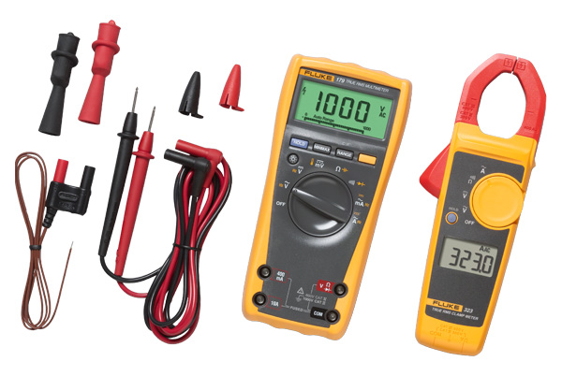
Multimeter Safety Checklist
Check for cracked or oily cases
Check for broken input jacks
Check category rating
Check that any replacement fuses and leads are approved by the manufacturer
Notes:
Multimeter Safety Checklist
Check for cracked or oily cases
Check for broken input jacks
Check category rating
Check that any replacement fuses and leads are approved by the manufacturer

Slide 107
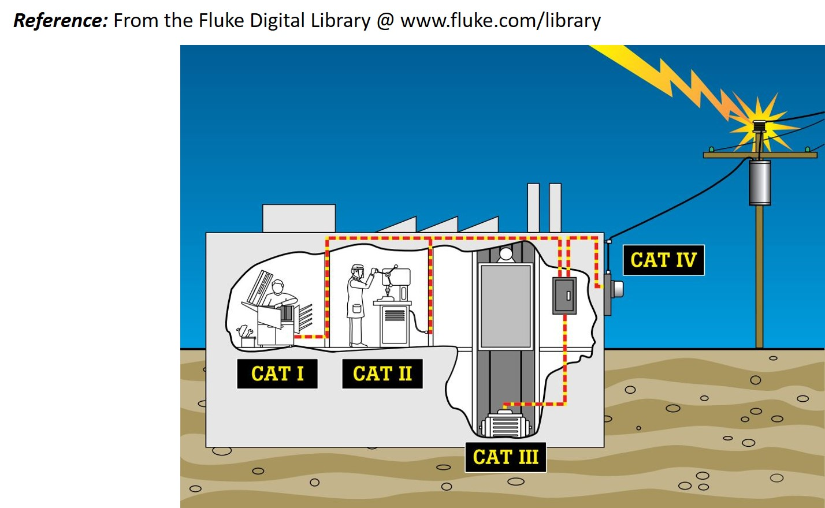
ABC of Multimeter Safety
Notes:
Reference: From the Fluke Digital Library @ www.fluke.com/library
The most important single concept to understand about multi-meter safety is the Overvoltage Installation Category. The standard defines Categories I through IV, often abbreviated as CAT I, CAT II, etc. (See Figure 1.)
A higher CAT number refers to an electrical environment with higher power available and higher energy. Thus, a multi-meter designed to a CAT III standard is resistant to higher energy than one designed to CAT II standards.
The general rule-of-thumb is that the closer you are to the power source, the higher the category number, and the greater the potential danger.

Slide 108
Energized Electrical Work Permit (NFPA 70E – 2018)
When work is performed on energized electrical equipment, an energized electrical work permit shall be required and documented under the any of following conditions:
When work is performed within the restricted approach boundary.
When the employee interacts with the equipment when conductors or circuit parts are not exposed but an increased likelihood of injury from an exposure to an arc flash hazard exists.
Notes:
When work is performed on energized electrical equipment, an energized electrical work permit shall be required and documented under any of the following conditions:
When work is performed within the restricted approach boundary.
When an employee interacts with the equipment when conductors or circuit parts are not exposed but an increased likelihood of injury from an exposure to an arc flash hazard exists.
The work permit shall include, but not be limited to, the following items:
Description of the circuit / equipment to be worked on and its location.
Description of the work to be performed.
Justification for why the work must be performed in an energized condition.
Description of the safe work practices to be employed.
Results of the shock risk assessment:
Voltage to which personnel will be exposed.
Limited approach boundary.
Restricted approach boundary.
Personal and other protective equipment required by this standard to safely perform the assigned task and to protect against the shock hazard.
Results of the arc flash risk assessment:
Available incident energy at the working distance or arc flash PPE category.
Personal and other protective equipment required to protect against the arc flash hazard.
Arc flash boundary.
Means employed to restrict the access of unqualified persons to the work area.
Evidence of completion of a job briefing, including a discussion of any job-specific hazards.
Energized work approval (authorizing or responsible management, safety officer, or owner, etc.) signature(s).

Slide 109
Personal Protective Equipment
Safeguards for personnel protection
Arc flash suit – arc rating
Arc flash PPE categories
Care and maintenance of arc-rated clothing and arc-rated arc flash suits
Voltage rated tools
Notes:
Discussion Points
Safeguards for personnel protection
Arc flash suit – arc rating
Arc flash PPE categories
Care and maintenance of arc-rated clothing and arc-rated arc flash suits
Voltage-rated tools

Slide 110
Safeguards for Personnel Protection (OSHA) – 29 CFR 1910.335
Rubber insulating protective equipment shall be maintained in a safe, reliable condition and shall be periodically inspected or tested. (See OSHA TABLE I-5-RUBBER INSULATING EQUIPMENT, TEST INTERVALS.)
If the insulating capability of protective equipment may be subject to damage during use, the insulating material shall be protected. (For example, an outer covering of leather is required for the protection of rubber insulating material.)
Notes:
Personal protective equipment (PPE) is equipment worn to minimize exposure to hazards that cause serious workplace injuries. These injuries may result from contact with electrical, mechanical, or other workplace hazards. Personal protective equipment may include items such as gloves, safety glasses and shoes, earplugs or muffs, hard hats, and arc-rated clothing.

Slide 111
Personnel Protection (OSHA) – 29 CFR 1910.335
Employees shall wear nonconductive head protection wherever there is a danger of head injury from electric shock or burns due to contact with exposed energized parts.
Employees shall wear protective equipment for the eyes or face wherever there is danger of injury to the eyes or face from electric arcs or flashes or from flying objects resulting from electrical explosion.
Notes:
Safeguards for Personnel Protection (OSHA) – 29 CFR 1910.335
Rubber insulating protective equipment shall be maintained in a safe, reliable condition and shall be periodically inspected or tested. (See next page: OSHA TABLE I-5-RUBBER INSULATING EQUIPMENT, TEST INTERVALS.)
If the insulating capability of protective equipment may be subject to damage during use, the insulating material shall be protected. (For example, an outer covering of leather is required for the protection of rubber insulating material.)
Employees shall wear nonconductive head protection wherever there is a danger of head injury from electric shock or burns due to contact with exposed energized parts.
Employees shall wear protective equipment for the eyes or face wherever there is danger of injury to the eyes or face from electric arcs or flashes or from flying objects resulting from electrical explosion.

Slide 112
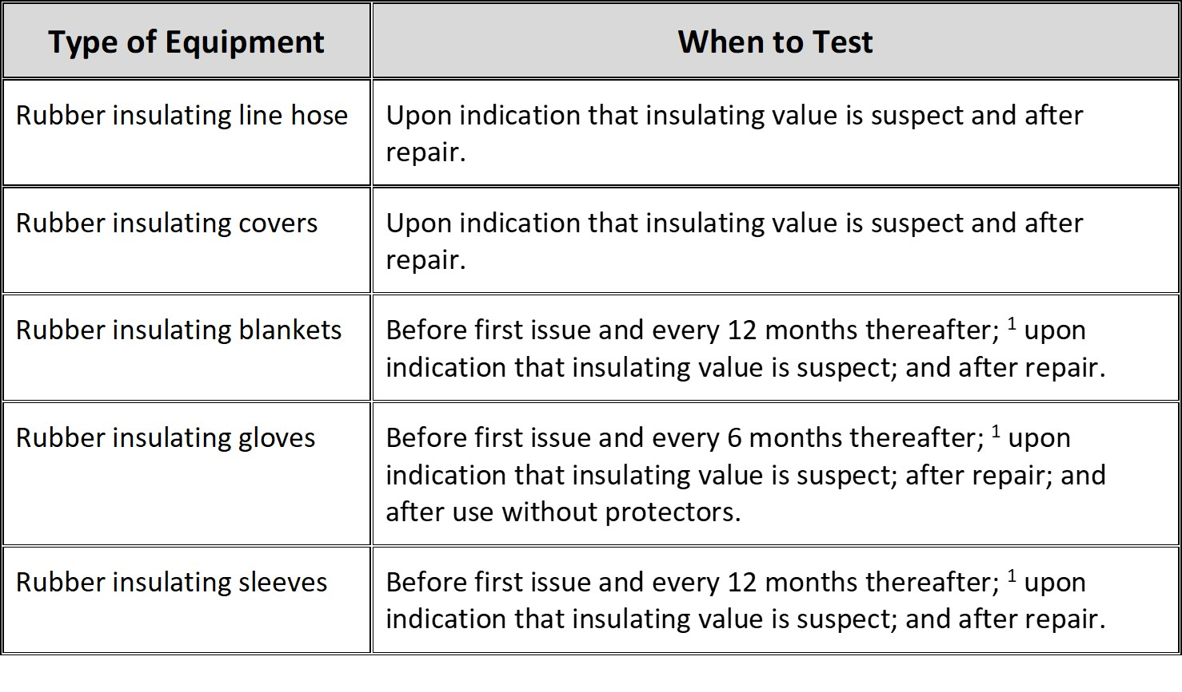
OSHA Table I-5-Rubber Insulating Equipment, Test Intervals
Notes:
OSHA Table I-5-Rubber Insulating Equipment, Test Intervals
Employers shall certify that equipment has been tested. The certification shall identify the equipment that passed the test and the date it was tested and shall be made available upon request to the Assistant Secretary for Occupational Safety and Health and to employees or their authorized representatives.

Slide 113
Arc Flash Suit – Arc Rating
Arc Flash Suit (NFPA 70E – 2018) is a complete arc-rated clothing and equipment system that covers the entire body, except for the hands and feet. An arc flash suit may include pants or overalls, a jacket or a coverall, and a beekeeper-type hood fitted with a face shield.
Notes:
Arc Flash Suit (NFPA 70E – 2018) is a complete arc-rated clothing and equipment system that covers the entire body, except for the hands and feet. An arc flash suit may include pants or overalls, a jacket or a coverall, and a beekeeper-type hood fitted with a face shield.
Arc Rating (NFPA 70E – 2018). Arc rating is the value attributed to materials that describes their performance during exposure to an electrical arc discharge. The arc rating is expressed in cal/cm² and is derived from the determined value of the arc thermal performance value (ATPV) or energy of breakopen threshold (EBT) (should a material system exhibit a breakopen response below the ATPV value). Arc rating is reported as either ATPV or EBT, whichever is the lower value.

Slide 114
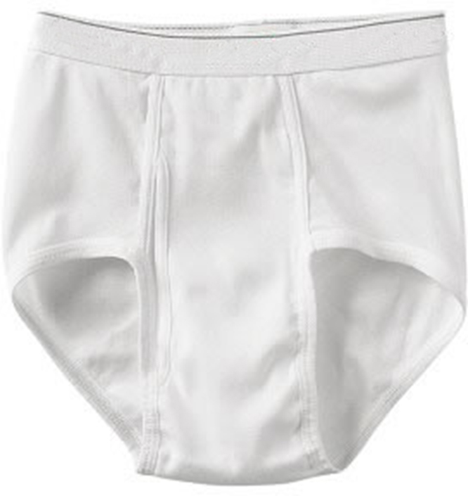
Underwear
No acetate
No Nylon
No polyester
No Polypropylene
No Spandex
Notes:
Underwear
No acetate
No Nylon
No polyester
No Polypropylene
No Spandex

Slide 115
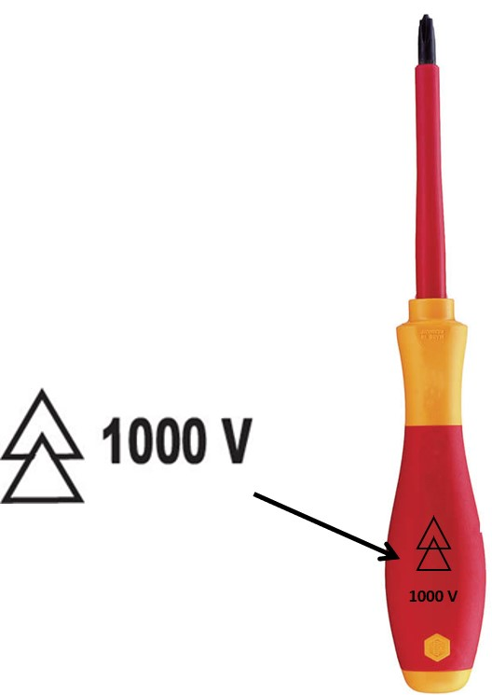
Voltage Rated Tools
Notes:
Insulated tools are hand tools used to help protect them from and reduce electrical-related incidents such as: electrocution, arc flash, and arc blasts. The use and application of insulated tools and appropriate PPE (Personal Protection Equipment) is required by OSHA. Insulated tools are rated at 1,000 volts, but subjected to 10,000 volts before distribution (mandated by the ASTM F1505 standard). Insulated tools comply with the International Electrotechnical Commission (IEC) 60900 standard and The National Fire Protection Association (NFPA) 70E standard.
Most hand tools are manufactured with a rubber coating over the handle (or handles). However, this does not mean that they are insulated tools. Therefore, they are not necessarily suitable for electrical-related work. The rubber coating on common hand tools is for comfort and grip. It is not to provide protection from electrical current.

Slide 116
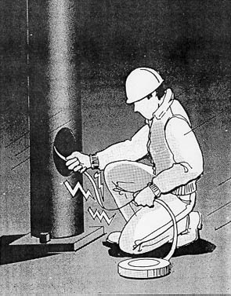
Fatal Fact – Discussion #6
Read and discuss fatal fact.
Notes:
An electrician was removing metal fish tape from a hole at the base of a metal light pole. The fish tape became energized, electrocuting him.

Slide 117
Post -Test
Thank you!
Notes:
Post-test

