Slide 1
Crystalline Silica Awareness Training Water Utility Operators and Construction Laborers

Slide 2
OSHA Susan Harwood Grant
This material was produced under Grant Program #SH-05058-SH8 from the OSHA, U.S. Department of Labor. It Does not necessarily reflect the views or policies of the U.S. Department of Labor, nor does mentioning of trade names, commercial products, or organizations imply endorsement by the U.S. Government. Revised from grant number SH-29666-SH6.

Slide 3

Class Room Participation
The instructor encourages open dialog
Participants can ask questions anytime during the training presentation
Media materials will be presented to the class to discuss, assess and identify the possible hazards to excavation and trenching activities
Notes:
We realize and appreciate that we have highly trained operators in each field of work and other competent workers in this classroom. Please feel free to add to any content, experience or lessons learned in addition to our training materials. We value your knowledge and input.

Slide 4

Breaks!
There will be 10 minutes breaks as needed throughout the training period

Slide 5

Questions and Feed Back
At the end of the presentation participants will be ask to fill out a brief questionnaire and provide feedback on the training materials

Slide 6

Training Objectives
What is silica?
Silica history
OSHA Standards on silica
Silica exposure control methods for construction
Mandatory requirements for silica exposure control
Alternative exposure control methods
Program and medical surveillance

Slide 7
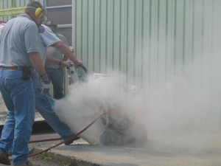
What is Silica?
Crystalline silica is a common mineral found in many naturally occurring and man-made materials used at construction sites - Examples:
Sand
Concrete
Brick
Block
Stone
Mortar
Image from remodeling magazine

Slide 8
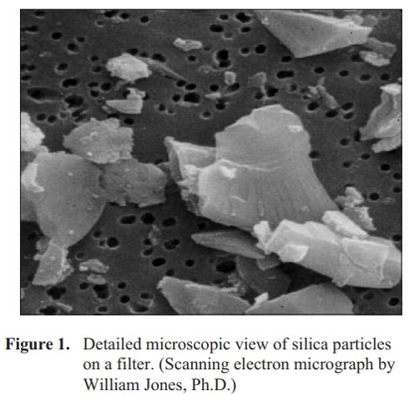
What is Respirable Crystalline Silica Continued?
Silica – very small jagged particles, like tiny shards of glass-that can be generated by high-energy operations like:
Cutting
Sawing
Grinding
Drilling
Crushing and abrasive blasting (of silica containing materials)
Image of Crystalline Silica from the NIOSH doc

Slide 9
Respirable Crystalline Silica History
Exposure to respirable crystalline silica is one of the oldest and best documented occupational health risks.
In 1700, Dr. Bernardo Ramazzini (the founder of occupational medicine) found evidence of silicosis in stone cutters.
In Early 1900’s Dr. Alice Hamilton documented silica related illnesses among granite workers.
By the 1930’s these granite workers successfully bargained for the installation of ventilation equipment in their work sheds.

Slide 10
Respirable Crystalline Silica History Continued
Despite Drs. Ramazinni and Hamilton’s work, RCS exposures and silicosis deaths continued.
Most significantly was the Hawk’s Nest Tunnel disaster in the 1930’s.
Estimated 764 out of 1,213 men who worked underground for at least two months contracted silicosis and died within five years of project completion.

Slide 11
Silica Standards
OSHA has issued a new standard (CFR 1926.1153) to curb silica related diseases in the US workers by limiting their exposure to silica
Increasing workers’ awareness of the serious health hazards of silica dust
Providing the knowledge necessary to perform work safely when there is silica exposure, and ways to limit silica exposure to levels below the Permissible Exposure Limit (PEL)

Slide 12
Regulatory Agencies
Prevention and elimination of silicosis and silica-related disease in United States are priorities of
National Institute for Occupational Safety and Health (NIOSH)
Occupational Safety and Health Administration (OSHA)
Mine Safety and Health Administration (MSHA)
American Lung Association

Slide 13
Silica Related OSHA Standards
Several OSHA standards and directives cover operations that may expose workers to silica
Air Contaminants (29 CFR 1910.1000)
Hazard Communication (29 CFR 1910.1200)
Respiratory Protection (29 CFR 1910.134)
Ventilation (29 CFR 1926.57)
Respirable Crystalline Silica (29 CFR 1926.1153)
OSHA’s Directive CPL 03-00-007 - National Emphasis Program- Crystalline
Silica hazards
Guidelines for air sampling
Guidance on calculating PELs for dust containing silica
Other compliance information (OSHA’s Directive CPL 03-00-007)

Slide 14
OSHA’s Silica Standard Definitions
Employee Exposure: Exposure to airborne silica if employees were not using a respirator.
Permissible Exposure Limit (PEL) is the maximum amount or concentration of a chemical that a worker may be exposed to under OSHA regulations.
A time-weighted average is used to calculate a workers daily exposure to a hazardous substance (such as chemicals, dusts, fumes, mists, gases, or vapors) in an 8 hour work day
Action levels are used by OSHA and NIOSH to express a health or physical hazard. They indicate the level of a harmful or toxic substance/activity which requires medical surveillance, increased industrial hygiene monitoring

Slide 15

OSHA Standard Permissible Exposure Limit and Action Level
Permissible Exposure Limit (PEL)
8-hour time-weighted average exposure limit (TWA)
50μg/m³ TWA
in the air
Construction
Action level
(AL)
25 μg/m³ TWA
in the air
Construction
If dust containing silica is visible in the air, there is a higher likelihood/chance that permissible exposure limit (PEL) is exceeded !

Slide 16
Classroom Activity-OSHA PEL

Slide 17
How Much Silica Dust is Too Much?
The safest amount of silica in the air is zero.
It only takes a very small amount of very fine respirable silica dust to create a health hazard.
Rule-of-thumb:
If dust containing silica is visible in the air, there is a higher chance of overexposure

Slide 18
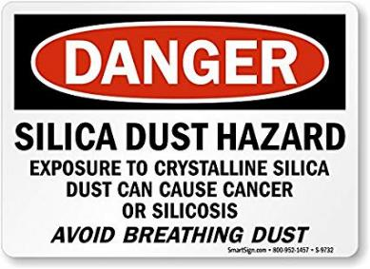
Health Risk Associated with Silica Exposure
Silicosis – irreversible, low to moderate exposure, often disabling, and sometimes fatal lung disease. One may develop TB.
Lung cancer-occurs after exposures to very high concentrations of silica
Chronic obstructive pulmonary disease (e.g., bronchitis)
Kidney and immune system diseases

Slide 19
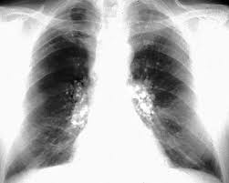
Types of Silicosis
Acute form:
Intense exposure to respirable dust of high crystalline silica content for a relatively short period (few months to less than 2 years)
Accelerated form:
Resulting from about 5-15 years of heavy exposure to respirable dusts of high crystalline silica content
Chronic form:
Most common form
Less intense exposure and usually more than 20 years
Image of Crystalline Silica in lungs

Slide 20

Silicosis an Occupational Lung Disease
Signs and Symptoms
Shortness of breath
Fever
Bluish skin at the ear lobes or lips
Disease progression
Fatigue
Extreme shortness of breath
Loss of appetite
Chest pain
Respiratory failure

Slide 21
Classroom Activity-Silica Tables

Slide 22
MATERIALS Are any of these involved?
OCCUPATIONS Are you one of these?
INDUSTRY Do you work in any of these?
Brickmason / stonemason
Blasting/drilling
Construction laborer
Crane and tower operator
Crushing and grinding machine operator
Drywall installation
Furnace, kiln, non-food oven operator
Heavy Equipment operator
Grinding, abrading, buffing, and polishing machine operator
Hand molder/shaper (not jeweler)
Heavy-equipment mechanic
Janitor or cleaner
Machinist
Metals/plastics machine operator
Molding and casting machine operator
Mining machine operator
Miscellaneous material moving equipment operator
Millwright
Operating engineer
Painter who sandblasts (High Risk)
Production supervisor
Rock driller (High Risk)
Roof bolter (High Risk)
Sandblaster (High Risk)
Steelworker
Welder/cutter
Abrasive blasting
pavement manufacturing
Blast furnaces
Cement manufacturing
Ceramics, clay, and pottery
Concrete mixing
Concrete Asphalt tunneling
Construction (mainly cement, concrete work)
Demolition
Electronics industry
Foundry industry: grinding, molding, shakeout, core room (High Risk)
Hand molding, casting, and forming
Jack hammer operations
Manufacturing abrasives, paints, soaps, and glass
Mining
Repair or replacement of linings of rotary kilns and cupola furnaces
Rolling and finishing mills
Sandblasting (High Risk)
Setting, laying, and repairing railroad track
Steelwork
Stone, brick, and concrete block cutting, blasting, chipping, grinding, and sawing
Tunneling operations
Abrasives
Coal Dust
Concrete
Filter Aids
Graphite, natural
Mica
Mineral Products
Paints
Pavement
Perlite
Plant Materials
Plastic Fillers
Polishing Compounds
Portland Cement
Sands
Silicates
Slag
Soapstone
Soil

Slide 23
Silica Exposure Control Methods for Construction
The first step for an employer is to determine if the standard applies to the worker
If the work is covered by the standard, the new standard provides flexible alternatives. Employers can either choose;
Specified exposure control methods-Use a control method laid out in Table 1 of the construction standard; or
Alternative exposure control methods-Measure workers’ exposure to silica and independently decide which dust control methods work best to limit exposures to the PEL in their workplaces

Slide 24
Silica Control Methods for Construction
Table 1
Lists 18 common tasks covering equipment found on construction sites
Describes engineering controls or control methods when working with materials containing silica
Employers who comply with Table 1 are not required to conduct exposure assessments, or comply with the PEL threshold for workers engaged in tasks creating exposures.

Slide 25
Engineering Controls
If silica is generated, OSHA requires engineering controls involving a mechanical process to eliminate exposure to silica dust
2 main methods are used to control silica dust while operating
Integrated water delivery system (IWDS)
Vacuum dust collection system (VDCS)

Slide 26

Integrated Water Delivery Controls
Water is supplied to equipment by
a pressurized container,
a constant water source e.g. a hose connected to a faucet
Using water will usually reduce levels to below the PEL in construction activities

Slide 27
Integrated Water Delivery Controls Continued
An adequate supply of water for dust suppression is needed (at the flow rates specified by the manufacturer)
The spray nozzle must be working properly to apply water at the point of dust generation
The spray nozzle should not be clogged or damaged
All hoses and connections must be intact.

Slide 28
Integrated Water Delivery System Secondary Exposures Controls
Limit secondary exposure by cleaning up any slurry generated
In cold temperatures, where there is a risk of water freezing
Electrical hazards

Slide 29
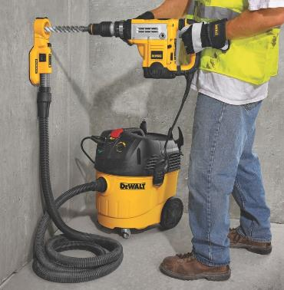
Vacuum Dust Collection Equipment
Good method for reducing silica exposures, but may not reliably keep exposure below PEL
Include dust collector (hood or shroud), vacuum, hose and filters.

Slide 30
Vacuum Dust Collection Controls
Include a dust collector (hood or shroud), vacuum, hose and filter(s)
Adequate suction to capture dust at the cutting point.
Use a HEPA filter in the vacuum exhaust, and a pre-filter or cyclonic separator to improve vacuum efficiency.
Use a hose size recommended by the manufacturer.
Use a hood or shroud that is recommended by the manufacturer
Must not introduce new hazards, such as obstructing or interfering with safety mechanisms

Slide 31
Vacuum Dust Collection Controls Continued
Keep the vacuum hose clear and free of debris, kinks and tight bends
Follow the manufacturer’s directions on how to reduce dust buildup on the filter.
Change vacuum-collection bags as needed.
Set up a regular schedule for filter cleaning and maintenance.
Avoid exposure to dust when changing vacuum bags and cleaning or replacing air filters.
Keep the grinder at the appropriate angle.

Slide 32
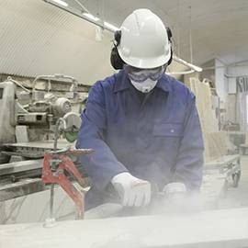
Administrative Controls
Along with the engineering controls, OSHA also requires workplace controls to eliminate exposure to silica dust
Employers are required to provide training when assigned to a position involving exposure to silica, introduces new protections or needs a refresher.

Slide 33
PPE Controls
When wet or dust collection controls are not feasible, or do not reduce silica exposures to PEL.
Employer implements a respiratory protection program that complies with OSHA’s 29 CFR 1910.134).
Employee fills out a medical questionnaire
Respiratory fit testing-assigned protection factor (APF) Table 1 as a guide
Wear the model and size of respirator that you were fit tested with
Eliminate facial hair that comes between the sealing surface of the face piece and the face or that interferes with valve function or any other condition that interferes with the seal

Slide 34
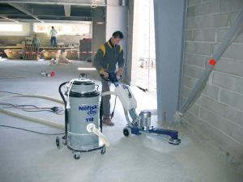
Housekeeping Safe Work Practice Controls
Standard limits the use of certain cleaning methods to prevent unnecessary exposures to employees
Do not allow dry brushing or sweeping
Do not allow the use of compressed air to clear surface areas or clothing unless an efficient ventilation system captures the dust
Wet sweeping methods can be used when HEPA filtered system is not practical
Control access to areas through the use of barriers and signage when dust is present

Slide 35
Classroom Activity-Equipment Demonstration

Slide 36
Competent Person
The employer must designate a competent person to implement the written exposure control plan
Competent person is an individual capable of
Identifying existing and foreseeable silica hazards;
Is authorized to promptly eliminate or minimize these hazards; and
Has the knowledge and ability to implement the written exposure control plan.
He/she makes frequent and regular inspections of job sites, materials, and equipment
The standard does not require specific training for a competent person.

Slide 37
Written Exposure Control Plan
Establish and implement a written exposure control plan
Designate a competent person to implement the written exposure plan
Restrict housekeeping practices that expose workers to silica, where feasible alternatives are available
Medical examination to include chest x-ray and pulmonary function testing
Training workers on the work operations that result in silica exposure and ways to limit exposure
Keep records of workers silica exposure and medical examinations

Slide 38
Alternative Silica Exposure Controls
Employers opting for not to implementing Table 1 must follow the alternative exposure control methods approach
This approach involves:
Assessing employee exposure to silica
Limiting exposure to the PEL using feasible engineering and work practice controls
Providing respiratory protection when necessary.

Slide 39

Communication of Silica Hazards
HCS requires employers to inform employees about hazardous chemicals in the workplace, such as respirable crystalline silica, through their written hazard communication programs.
Written hazard communication programs must describe how the requirements for container labels, safety data sheets (SDSs), and employee training will be met.
Employers must address at least the health hazards on cancer, lung effects, immune system effects, and kidney effects as part of the hazard communication program for respirable crystalline silica.

Slide 40
Record Keeping
Per OSHA’s Access to Employee Exposure and Medical Records regulation (29 CFR 1910.1020), employers must maintain records for
Medical records
Air monitoring data
Objective data
Exposure and medical records must be kept and made available to employees, their representatives, and OSHA

Slide 41
Employee Notification
Employers must notify each affected employee of the results of the exposure assessment within 5 working days of completing it.
“Affected” means all employees whose exposures were assessed, including employees whose exposures were represented by other employees’ exposure measurements, and those whose exposure assessments were based on objective data.
Employers must either notify each employee in writing or post the results in a location accessible to all affected employees

Slide 42
Employee Notification with Corrective Action
When an exposure assessment reveals exposures above the PEL, the written notification must also describe the corrective action the employer is taking to reduce employee exposures to or below the PEL.
Corrective actions include engineering controls. However, if engineering controls are not feasible or the employer needs more than 5 days to identify the right engineering controls, respiratory protection is the corrective action that would be described in the written notification.

Slide 43

This Concludes our Training

