Slide 1
Confined Space Entry

Slide 2
OSHA Susan Harwood Grant
This material was produced under Grant Program #SH-05058-SH8 from the OSHA, U.S. Department of Labor. It Does not necessarily reflect the views or policies of the U.S. Department of Labor, nor does mentioning of trade names, commercial products, or organizations imply endorsement by the U.S. Government. Revised from grant number SH-22297-11.

Slide 3

Classroom Participation
The instructor encourages open dialog
Participants can ask questions anytime during the training presentation
Media materials will be presented to the class to discuss, assess and identify the possible hazards to excavation and trenching activities.

Slide 4
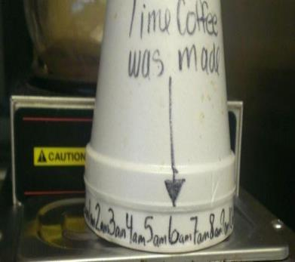
Breaks!
There will be 10-15 minutes breaks as needed throughout the training period

Slide 5

Questions and Feed Back
At the end of the training session, participants will be ask to fill out a brief questionnaire and provide feedback on the training materials

Slide 6
Objectives
OSHA and AKOSH Industry Standards
Recognize the characteristics of the confined space
Anticipate and be aware of the hazards that may be faced during entry
Classroom activities recognizing hazards and implementing controls

Slide 7
Additional Training Objectives
Recognize the adverse health effects that may be caused by the exposure to a hazard
Understand the physical signs and reactions related to exposures to such hazards
Know what personal protective equipment is needed for safe entry into and exit from the space
Non-permit CSE requirements
Permit CSE requirements
CSE alternate entry procedures
Use of atmospheric monitoring equipment
Use and maintain rescue equipment
Document training

Slide 8

Introduction to Industry Standards
29 CFR 1910.146 Permit-required confined spaces
29 CFR 1926 Subpart AA (Confined Space in Construction)
29 CFR 1926 Subpart M (Fall Prevention)
29 CFR 1926 Subpart P (Excavation and Trenching)
29 CFR 1910.132 (PPE Requirements)
NFPA 70E (Electrical Safety Standards)
AKOSH Industry Standards

Slide 9
Key Elements of a Confined Space Entry Program
Confined space and Hazard Identification
Hazard Control
Permit System
Specialized Equipment
Designations-Employees
Testing and Monitoring
Emergency Response
Training and Information
Program Review

Slide 10
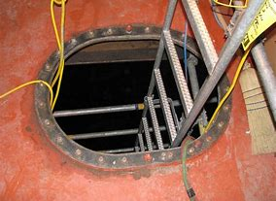
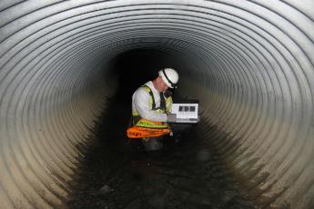
OSHA Confined Space Characteristics
A confined space also has limited or restricted means for entry or exit.
Not designed for continuous occupancy.
Confined spaces include, but are not limited to, tanks, vessels, silos, storage bins, hoppers, vaults, pits, manholes, tunnels, equipment housings, ductwork, pipelines, etc.
Little or no natural ventilation.

Slide 11
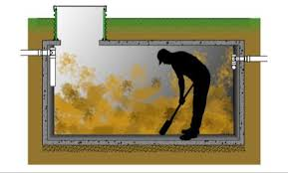
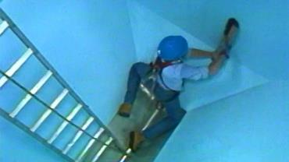
OSHA Permit Required Confined Space Characteristics
Any substance that has the ability to engulf or asphyxiate the entrant
Contains potentially hazardous atmospheres
Inwardly converging walls within the space or a floor the slopes downward, tapering to a small cross-section
Contains any other serious safety or health hazard

Slide 12
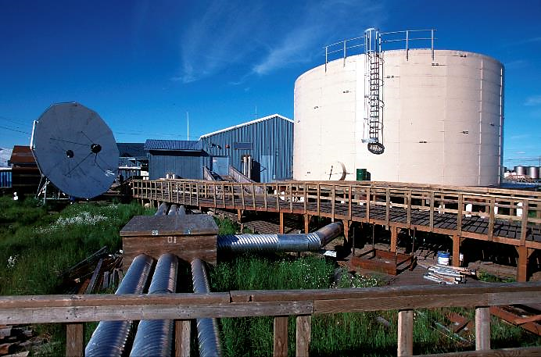

Recognized Confined Space Water Storage Tank

Slide 13
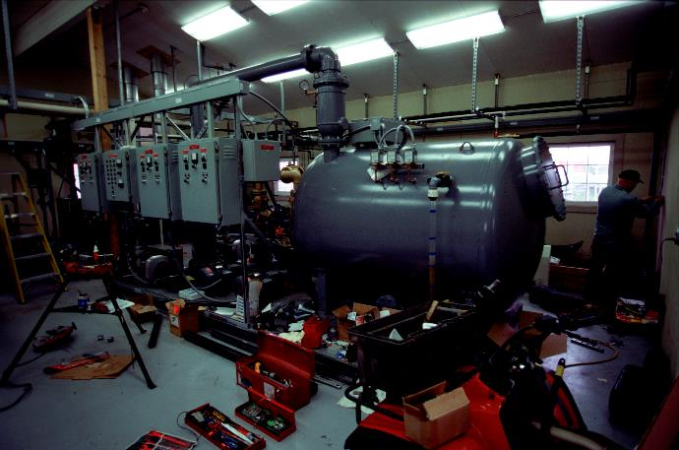

Recognized Confined Space-Selawik Water Treatment Plant

Slide 14
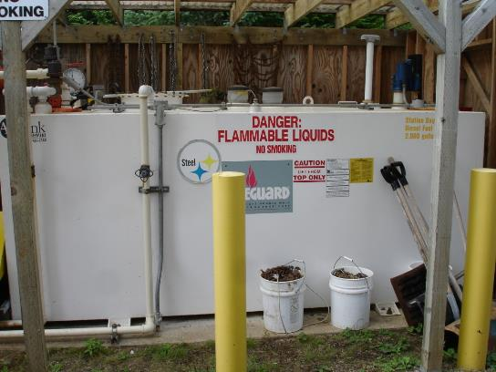
Recognize Confined Space-Fuel Storage Tanks

Slide 15
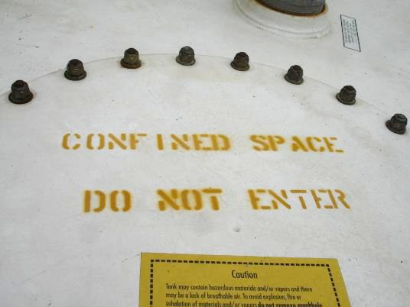
Recognize Confined Space-Labeled Do Not Enter

Slide 16
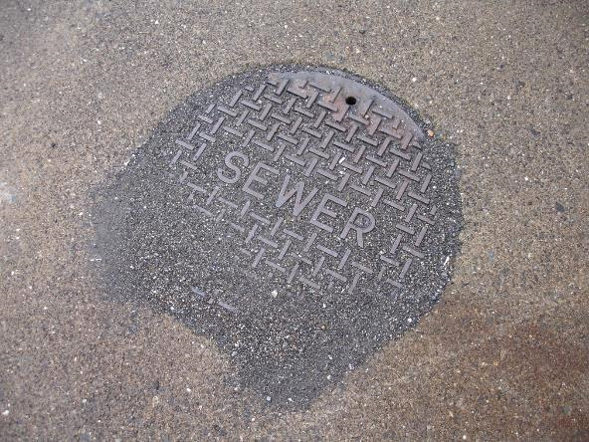
Recognizing Confined Space-Man Hole Sewer Cover

Slide 17
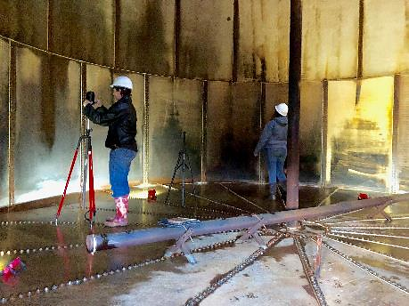
Confined Space Physical Hazards
  Engulfment-flooding,
  Entrapment-converging walls
  Collapse-trenches
  Slip/Trip/Falls-impalement
  Electrical, Mechanical
  Critters
  Ladders
  Lighting
  Temperature
  Equipment-struck against, crushing

Slide 18
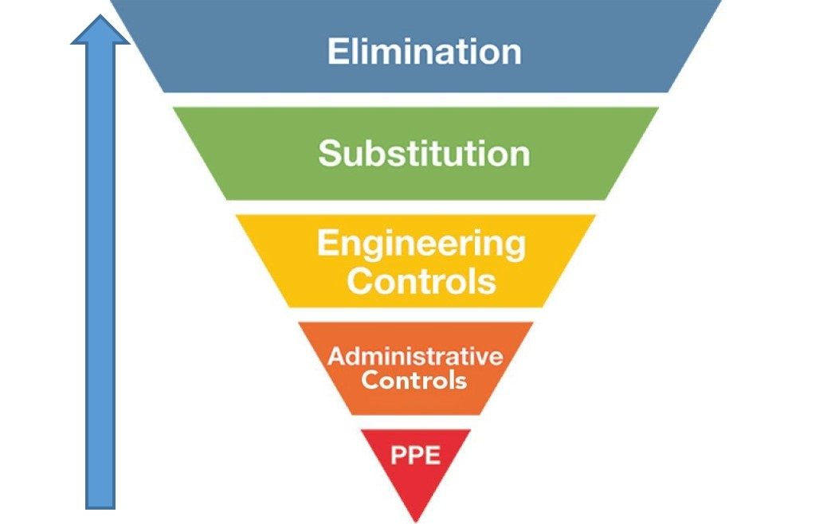
Hazard Control = Hierarchy of Controls
Most Effective
Least Effective

Slide 19
Water Storage Tank, Sewage Lift Station, and Trench
Classroom Activity

Slide 20

Group 1 Presentation
Image 1

Slide 21

Group 1 Presentation
Image 2

Slide 22
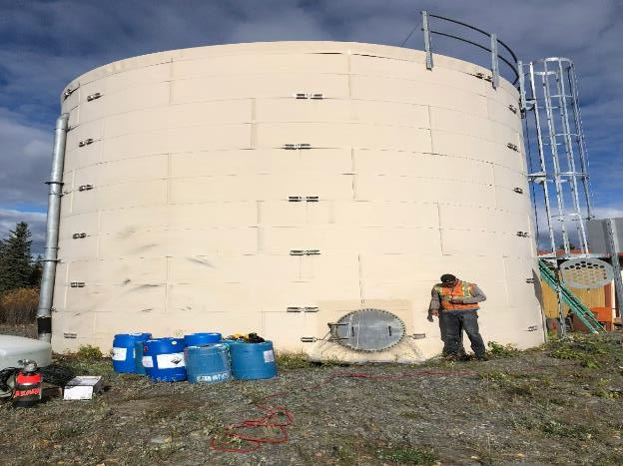
Group 1 Presentation
Image 3

Slide 23
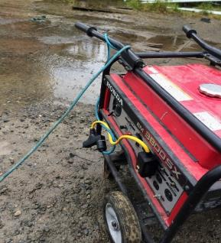
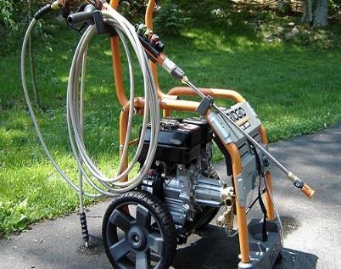
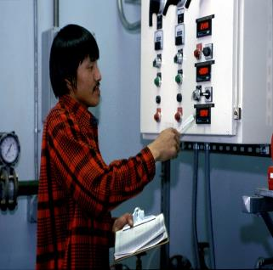
Group 1 Presentation
Images 4,5,6

Slide 24
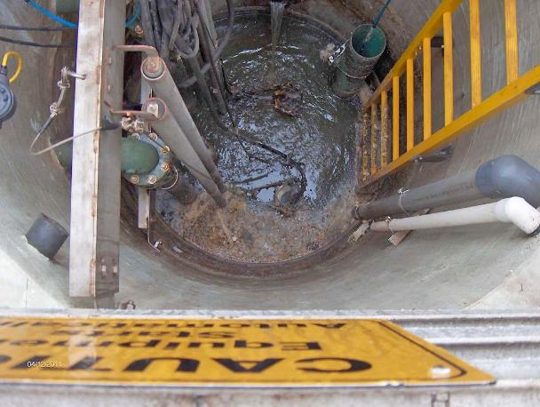
Group 2 Presentation
Image 1

Slide 25
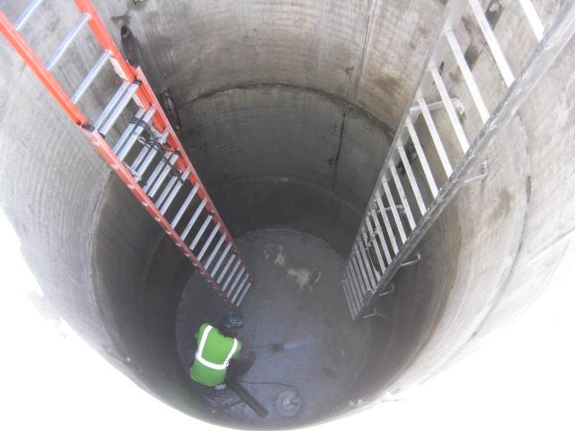
Group 2 Presentation
Image 2

Slide 26
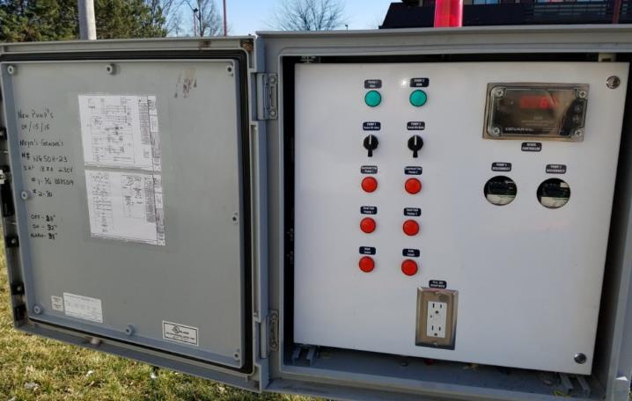
Group 2 Presentation
Image 3

Slide 27
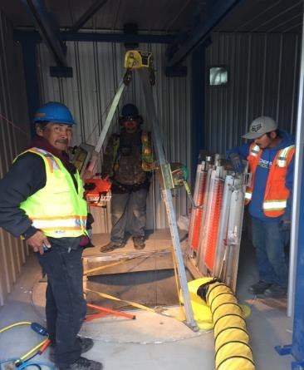
Group 2 Presentation
Image 4

Slide 28
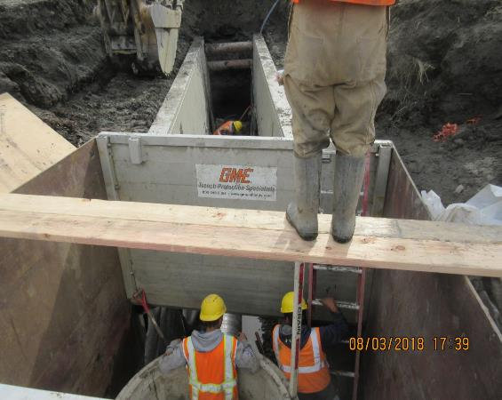
Group 3 Presentation
Image 1

Slide 29
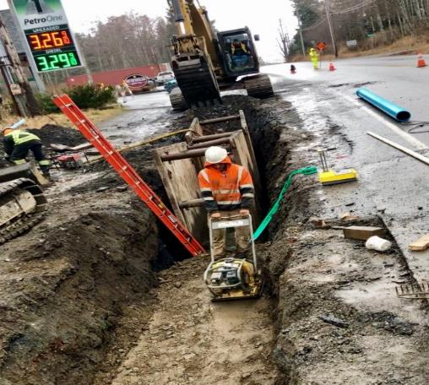
Group 3
Image 2

Slide 30

Definitions-Immediately Dangerous to Life and Health (IDLH)
  Condition that poses immediate or delayed threat to life
  Or causes irreversible adverse health effects
  Or interferes with individual’s ability to escape unaided from permit space

Slide 31
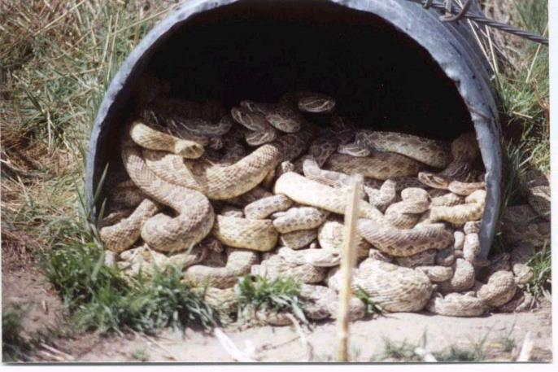
The Obvious Hazards

Slide 32
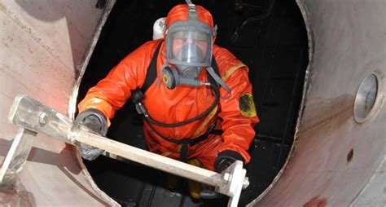
Confined Space Atmospheric Hazards
Atmospheric
  Oxygen Deficiency or Enrichment
  Explosion/Fire
  Toxic substances, Biological agents

Slide 33
Oxygen Deficiency
Greatest Potential Hazard
  Senses unreliable
  Affects judgment
  Swift, often irreversible
  Often fatal
Air contains ~20.9% O₂

Slide 34

Effects of Oxygen Deficiency
16% Impaired judgment
14% Fatigue, disorientation
10% Unconsciousness
6-8% Death
        4 Minutes: Recovery with immediate treatment
        6 Minutes: 50% fatal
        8 Minutes: 100% fatal

Slide 35
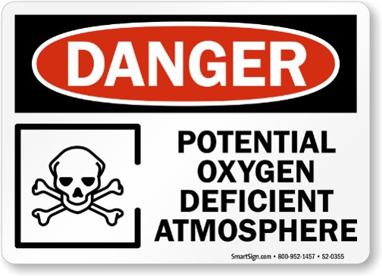
Causes of Oxygen Deficiency
Displacement by another gas or vapor
Chemical reaction
  Oxidation/Rust
  Combustion
  In appropriate use of other gases or chemicals

Slide 36
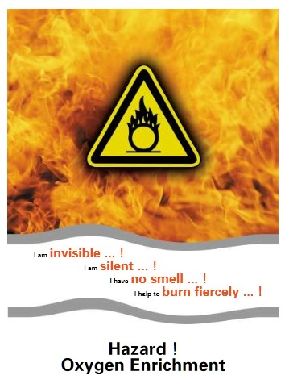
Oxygen Rich Environment
Normally safe materials can become dangerous fire hazards

Slide 37
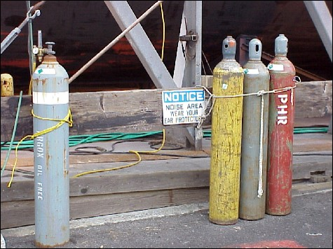
Causes of Oxygen Rich Environment
Leaks (e.g. welding cylinders)
Inappropriate use of Oxygen

Slide 38
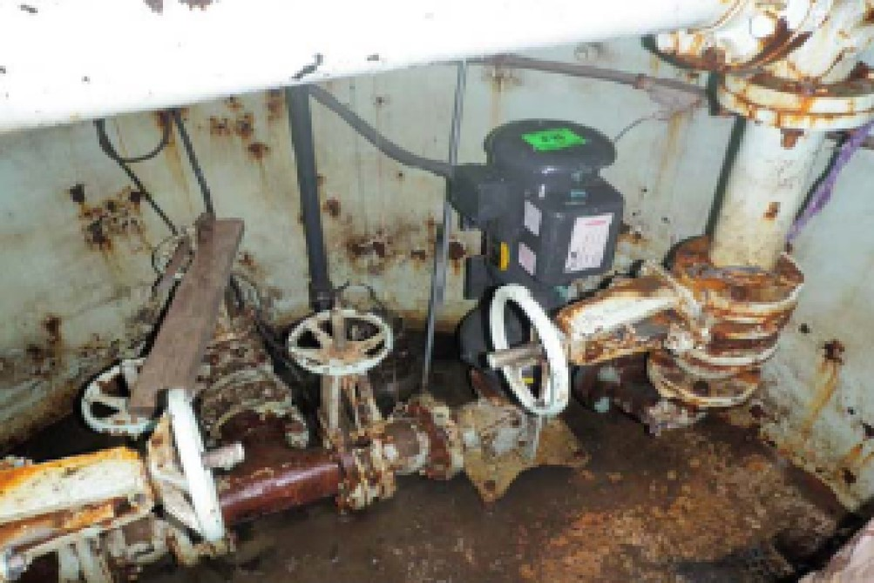
Classroom Activity Group Presentation

Slide 39

Fire and Explosion Hazards
Fire tetrahedron (O₂, fuel, heat, Chemical Reaction)
Flammable or combustible vapors burn within specific ranges
  - Flammable range is defined by:
  Upper Explosive Limit (UEL)
  Lower Explosive Limit (LEL)
Acceptable limit is 10% of the LEL

Slide 40

Explosive Limits
Benzene
1.3%
7.9%
0%
100%
LEL
UEL
LEL=Lower Explosive Limit
UEL=Upper Explosive Limit

Slide 41

Explosive Limits for Safe Entry
.13%
1.3%
7.9%
0%
100%
10% of the LEL
LEL
UEL
LEL=Lower Explosive Limit
UEL=Upper Explosive Limit

Slide 42
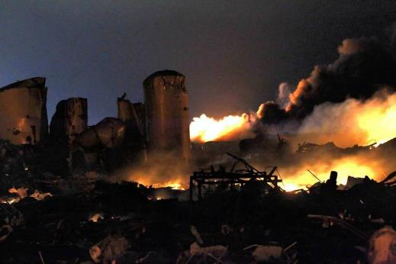
Explosive Substances
Fuel vapors
Paint/coatings
Cleaning solvents
Hydrogen sulfide
Dusts
Fertilizer

Slide 43
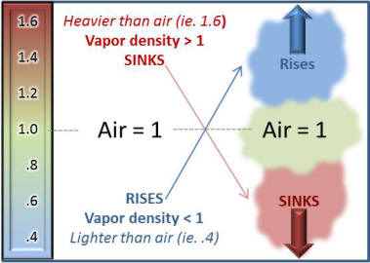
Vapor Density

Slide 44
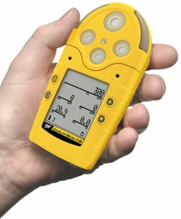
Testing and Monitoring
Ensure instruments are calibrated with calibration gas every 180 days when not in use.
Calibrate daily if the instrument is used frequently
Bump test the instrument before atmospheric testing begins

Slide 45
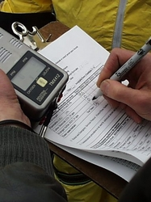
Testing and Monitoring cont.
Atmospheric testing begins by testing all the required locations.
Oxygen content of at least 19.5% but not greater than 23.5%
A combustible gas/vapor mixture 10% of the lower explosive limit.
A concentration of any hazardous chemical is less than ½ the limits listed in 29 CFR 1910.

Slide 46
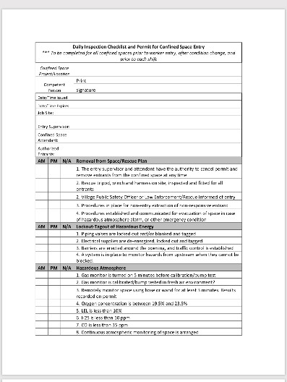
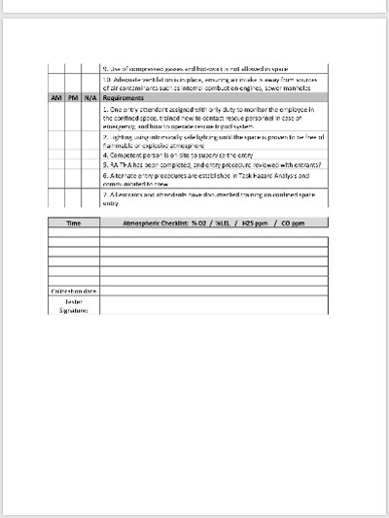
Confined Space Entry Permit

Slide 47
Classroom Activity 5
Gas Monitors

Slide 48
Non-Permit Confined Space Requirements
Permit required confined space may be reclassified as non-permit confined space if certain criteria is met. If the criteria is met, rescue teams and special PPE are not required.
Confined space must not contain a hazardous atmosphere.
All hazards can be eliminated without entry into the space, such as locking out and tagging equipment.
Forced air ventilation does not constitute elimination of hazards.
If the employer can neither declassify a permit required confined space to a non-permit confined space, or provide alternate entry procedures, all aspects of a permit confined space must be followed.

Slide 49
Permit Confined Space Requirements
Requires a written program
Implement measures to prevent unauthorized entry into the permit required confined space
Workers must be trained in CSE
Identify all the hazards prior to entry into CS
Document all the required information on the confined space permit form
Develop and implement safety procedures which includes before entry into CS
Rescue plan in place

Slide 50
Permit Confined Space Requirements Continued
Oxygen content between 19.5% and 23.5%
Explosive hazards are 10% of the lower explosive limit (LEL)
Energy isolation in place such as lock-out tag-out (LOTO)
Control or elimination of atmospheric hazards through purging, inerting, flushing or ventilating.
Protection of pedestrians from traffic hazards using barriers
Verify that conditions in the permit confined space remain at safe levels throughout entry.

Slide 51
Equipment for Permit Required Confined Space
Gas detection equipment to monitor atmosphere
Lighting to avoid struck against and slips trips and falls
Barriers to prevent unauthorized personnel out
Ladders that provide safe egress
Rescue and emergency equipment
Communication equipment between entrant and attendant

Slide 52
Confined Space
Alternate Entry Procedures
No written program required
Only hazards are atmospheric
Atmospheric hazards can be controlled through forced air ventilation
Atmosphere is tested periodically
It may be necessary to conduct a permit required confined space to test atmosphere if it cannot be tested from the outside. If it is determined that there is only an atmospheric hazard and can be controlled through force air ventilation-then alternate entry procedures can be used.

Slide 53
Duties of the Entry Supervisor
Knowledge of hazards that may be faced during entry, including information on mode, signs or symptoms, and consequences of exposure.
Verifies, by checking that appropriate entries have been made on permit, that all tests specified by permit have been conducted, and all procedures and equipment specified by permit are in place before endorsing permit and allowing entry to begin.
Terminates entry and cancels permit

Slide 54
Duties of the Entry Supervisor Continued
Verifies that rescue services are available and means for summoning are operable.
Removes unauthorized individuals who enter or attempt to enter permit space during entry operations.
Determines, whenever responsibility for permit space entry operation is transferred, and at intervals dictated by hazards and operations performed within space, that entry operations remain consistent with terms of entry permit and acceptable entry conditions are maintained.

Slide 55
Duties of the Attendants
Knowledge of hazards that may be faced during entry
Aware of possible behavioral effects of hazard exposure in authorized entrants
Continuously maintains accurate count of authorized entrants
Remains outside permit space during entry operations until relieved by another attendant

Slide 56

Duties of the Attendant Continued
Communicates with authorized entrants
Monitors activities inside & outside space
Summons rescue & other emergency services
Performs non-entry rescues as specified by employer's rescue procedure
Performs no other duties that might interfere with primary duty to monitor & protect authorized entrants (Note: AKOSH standards)

Slide 57
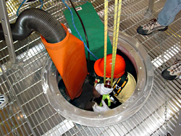
Duties of the Authorized Entrant
  Employee authorized by employer to enter permit space:
Knowledge of hazards that may be faced during entry, including information on mode, signs or symptoms, and consequences of exposure.
Properly use equipment
Communicate with attendant as necessary to enable attendant to monitor entrant status and alert entrants of need to evacuate space.

Slide 58
Duties of the Authorized Entrant Continued
Alert attendant whenever:
  Entrant recognizes any warning signs or symptoms of exposure to dangerous situation
  Entrant detects prohibited condition
  Exit from permit space as quickly as possible whenever:

Slide 59
Duties of Authorized Entrants
Know When to Exit
Order to evacuate is given by the attendant or entry supervisor
Recognizes the risks and hazard warning signs or symptoms of exposures to a dangerous situation
Detects prohibited condition
Evacuation Alarm is activated

Slide 60
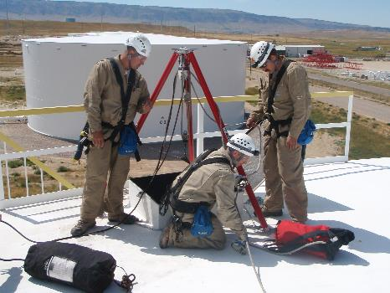
Rescue Operations
Requires sufficient number of people to effectively rescue the entrant
Only trained personnel with safety equipment
If person is unconscious in a confined space, DO NOT enter space to help without appropriate training, personal protective equipment and safety equipment.

Slide 61
Program Review
Shall be reviewed at least annually by the confined space manager
And immediately following any incident or near incident

Slide 62
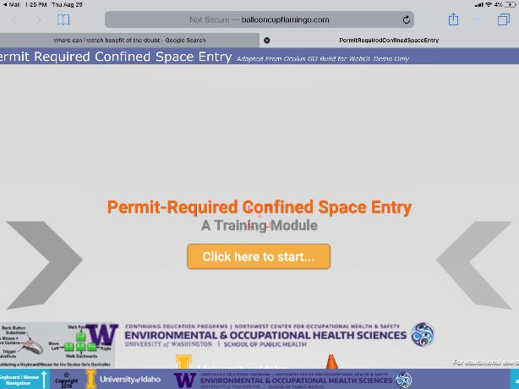
Virtual Reality Exercise
Open with Google Chrome

Slide 63
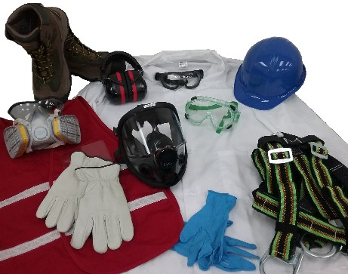
Personal Protective Equipment (PPE)
Use appropriate PPE for entry
Hard hat
Impermeable clothing
Safety toe shoes
Eye protection
Hearing protection
Hand/skin protection
Respiratory protection

Slide 64
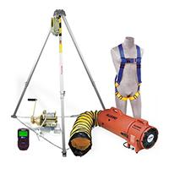
Specialized Equipment Inventory
Tripod system with fall protection/retrieval system.
Fall arrest harness
Ventilation equipment.
Multi-gas detection monitor
Barriers

Slide 65
Classroom Activity 6
Tripod, Ventilation and Fall Harness

Slide 66

This Concludes our Training

