Slide 1
BINGO!
Teaching Nail Salon Safety and ESL to First-Generation Vietnamese American Immigrants
This material was produced under grant number SH-05066-SH8 from the Occupational Safety and Health Administration, US Department of Labor. It does not necessarily reflect the views or policies of the US Department of Labor, nor does mention of trade names, commercial products, or organizations imply endorsement by the US Government.

Slide 2
Background on BPSOS-CCA
BPSOS Center for Community Advancement
  Serving community of Orange County since 2000
  Services include:
    ESL classes
    Citizenship Preparation classes
    Citizenship application filing
    Health/Social Service Navigation for Children with Developmental Disabilities
    Occupational Safety Training for Nail Salon Workers

Slide 3
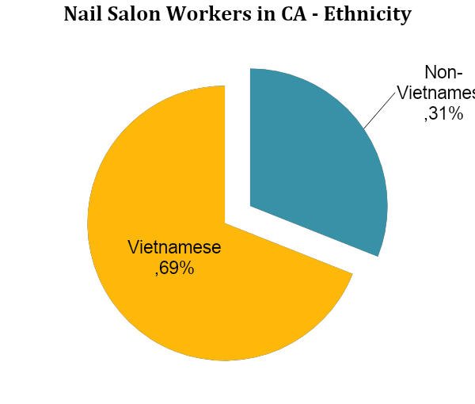
Background on Vietnamese American Nail Salon Community
In the U.S., 71,746 nail salon workers are first-generation Vietnamese American immigrants
In California, 69% of nail salon workers are Vietnamese
Need for higher standard, more consistent, and more practical training on nail salon safety practices

Slide 4
Purpose
Familiarize students with nail salon safety material in both Vietnamese and English
  To empower them with the ability to bilingually recognize and comprehend safety terminology

Slide 5
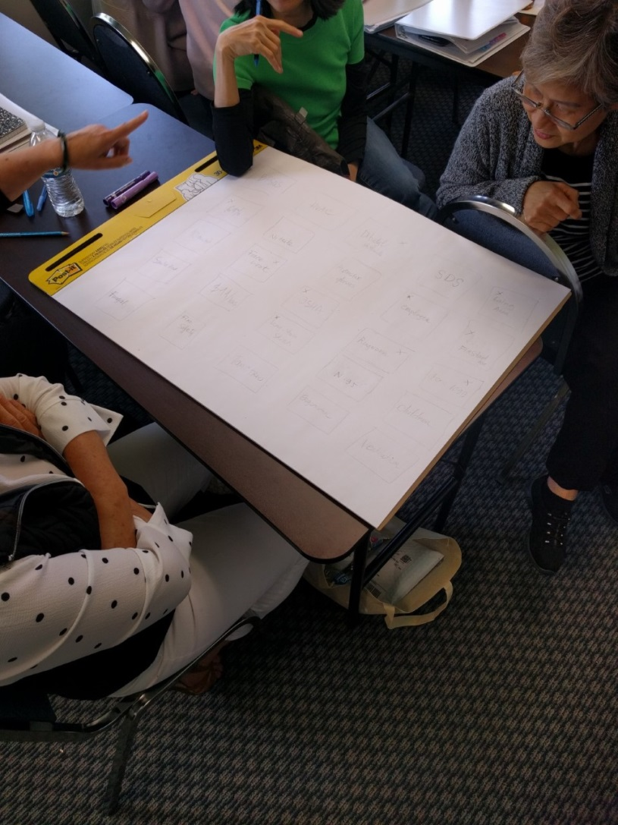
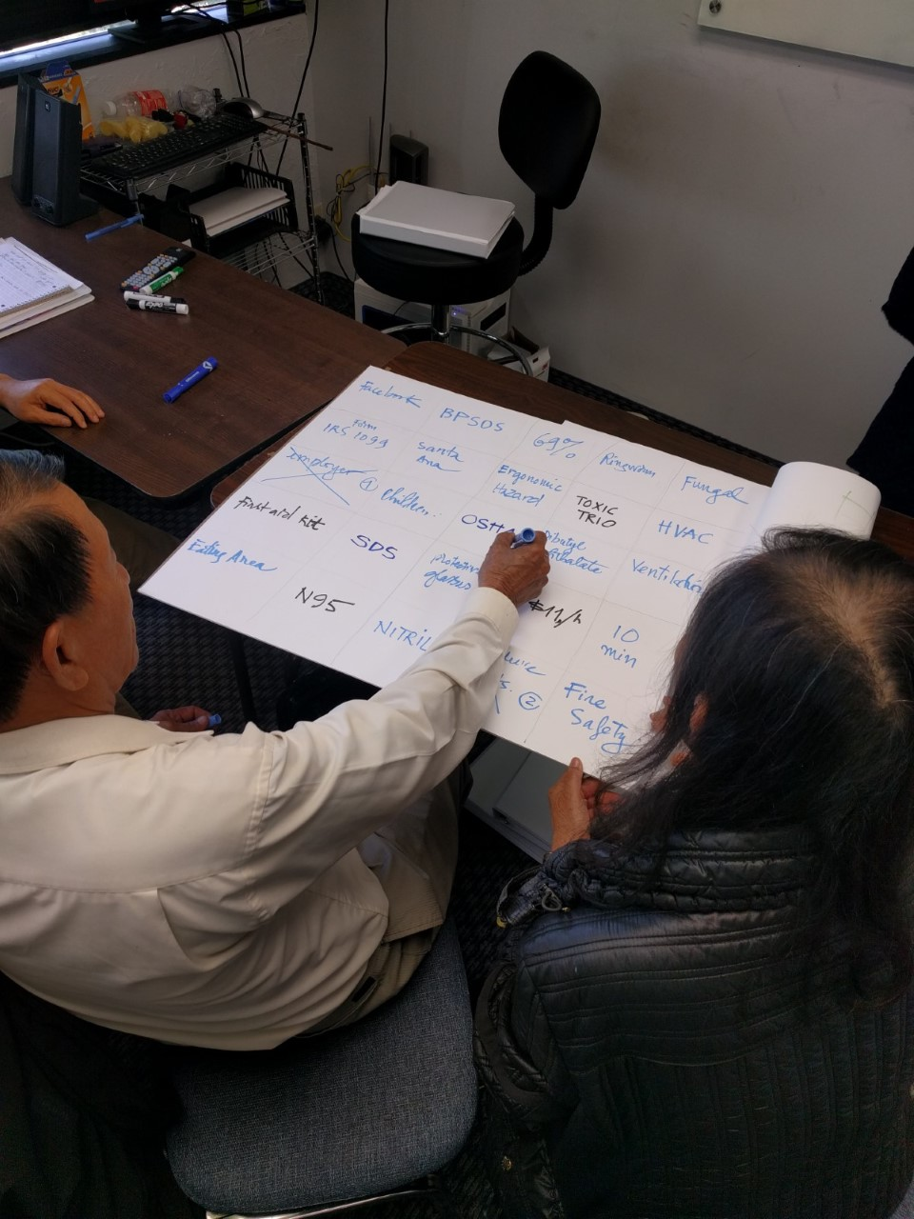
In Action!

Slide 6
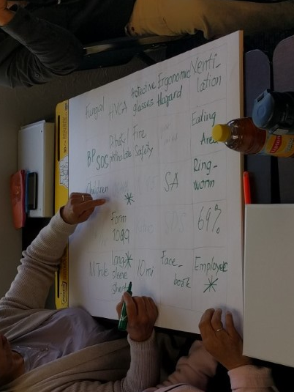
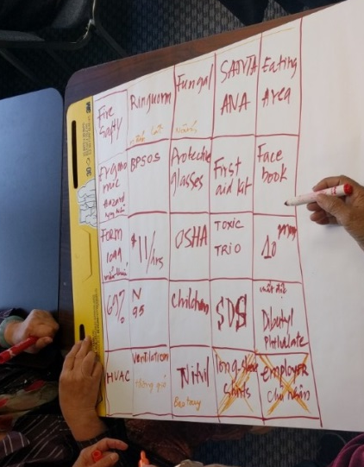
In Action! (cont.)

Slide 7
How to Play
Highlight prevalent vocabulary from the training material
  - i.e. OSHA, Chemical, Toxic Trio, SDS, Infection…
Separate trainees into groups, group size dependent on trainer’s preference
Prompt groups to each create a 5x5 bingo card
  - Materials needed: drawing pad and markers

Slide 8
How to Play (step 4)
Explain the rules to trainees:
  Fill in the blank squares with an English term learned about nail salon safety.
  The definition will be explained in Vietnamese
  After all boxes have been filled, trainees must get a bingo of 5 boxes marked vertically, horizontally, or diagonally.
    For a longer game, require them to achieve the “X” shape of 9 boxes marked.*
  First group to call “BINGO!” wins.

Slide 9
How to Play (cont.)
One term at a time, begin reading the definitions to the trainees. Do not reveal the correct answer of what term you are describing.
Make sure groups are not looking at each other’s terms.
After a group calls “BINGO!”, check their answers for correctness.
Finally review with the group all terms described, practice pronunciation (with individuals and as a group), and clarify any questions as needed.

Slide 10
Thank You!
Questions or Comments?
Hang Nguyen, Executive Director
hang.nguyen@bpsos.org
Chelsea Ho, Program Coordinator
chelsea.ho@bpsos.org

