Slide 1
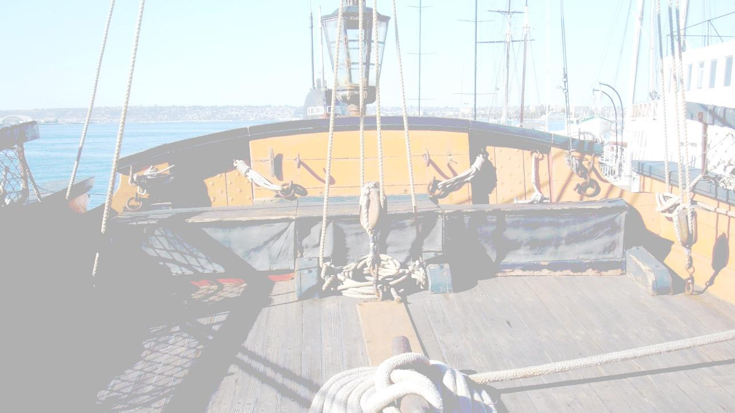
Walking Working Surfaces:
Maritime Rules
29CFR1915.71-77
29CFR1915.81

Slide 2
Disclaimer
This material was produced under grant number SH-31202-SH7 from the Occupational Safety and Health Administration, U.S. Department of Labor. It does not necessarily reflect the views or policies of the U.S. Department of Labor, nor does mention of trade names, commercial products, or organizations imply endorsement by the U.S. Government.
This presentation is intended to discuss Federal Regulations only - your individual State requirements may be more stringent as many states operate their own state OSHA and they may have adopted maritime standards that are different from information presented in this training. If you live in a state with an OSHA approved state plan, you should contact your local administrator for further information on the standards applicable in your state.

Slide 3

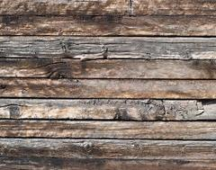
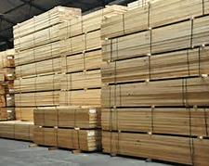
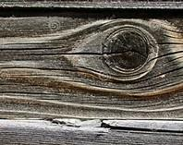
Scaffolds, ladders, and other working surfaces
29CFR1915.71(b)(4)
All lumber used in the construction of scaffolds shall be sound, straight-grained, free from cross grain, shakes and large, loose or dead knots.
It shall also be free from dry rot, large checks, worm holes or other defects which impair its strength or durability.

Slide 4
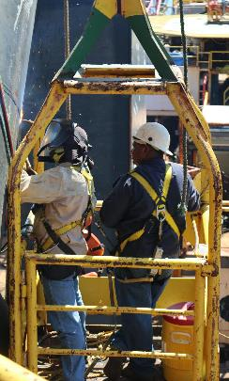
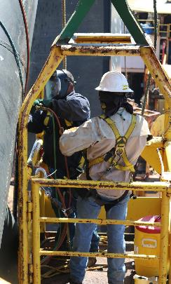
Scaffolds, ladders, and other working surfaces
29CFR1915.71(b)(8)
No welding, burning, riveting or open flame work shall be performed on any staging suspended by means of fiber rope.

Slide 5
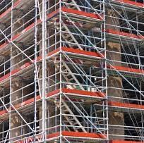
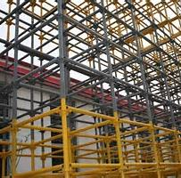
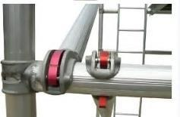
Scaffolds, ladders, and other working surfaces
29CFR1915.71(d)(1)
Metal scaffold members shall be maintained in good repair and free of corrosion.

Slide 6
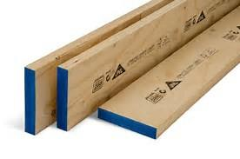
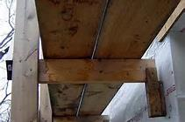
Scaffolds, ladders, and other working surfaces
29CFR1915.71(i)(1)
Platform planking shall be of not less than 2 x 10-inch lumber.
Platforms of staging shall not be less than two 10-inch planks in width except in such cases as the structure of the vessel or the width of the trestle ladders make it impossible to provide such a width.

Slide 7
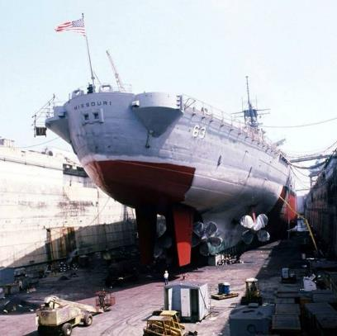
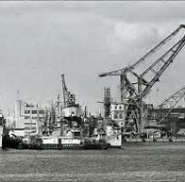
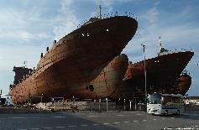
Guarding of Deck openings and edges
29CFR1915.73
Applies to ship repair and shipbuilding, does not apply to shipbreaking

Slide 8
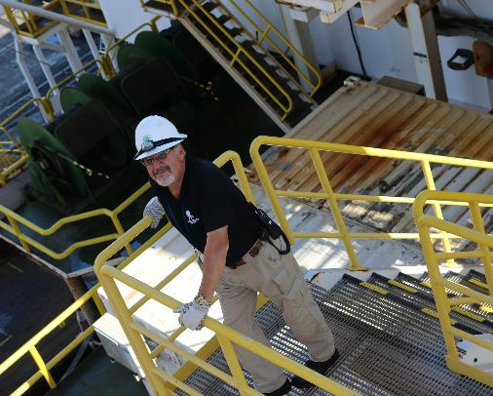
Guardrails
29CFR1915.73(d)
When employees are exposed to unguarded edges of decks, platforms, flats, and similar flat surfaces, more than 5 feet above a solid surface, the edges shall be guarded by adequate guardrails meeting the requirements of 1915.71(j)(1) and (2), unless the nature of the work in progress or the physical conditions prohibit the use or installation of such guardrails.

Slide 9
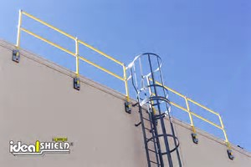
Guardrails
29CFR1915.71(j)(1)
  A top rail of 42 to 45 inches high.
  A midrail located halfway between the top rail and the platform.

Slide 10
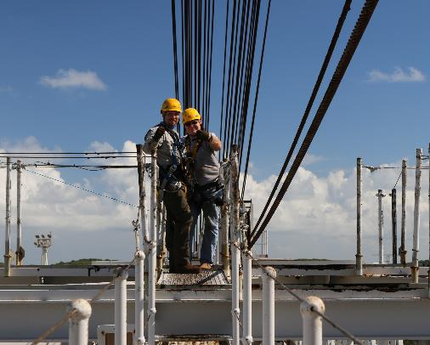
Scaffolds, ladders, and other working surfaces
When rails are omitted, employees working more than 5 feet above solid surfaces must be protected by harnesses and life lines meeting the requirements of 29 CFR 1915.159.

Slide 11
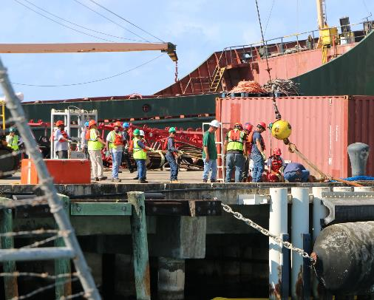
More Scaffolds, ladders, and other working surfaces
Employees working over water must be protected by buoyant work vests meeting the requirements of 29 CFR 1915.158(a).

Slide 12
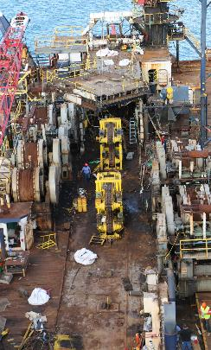
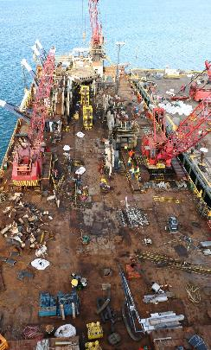
Guarding of deck openings and edges
29CFR1915.73(b)
When employees are working in the vicinity of flush manholes and other small openings of comparable size in the deck and other working surfaces, such openings shall be suitably covered or guarded to a height of not less than 30 inches, except where the use of such guards is made impracticable by the work actually in progress.

Slide 13
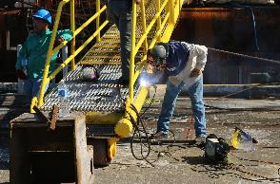
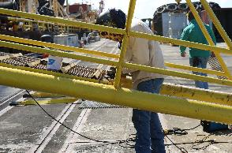
Guarding of deck openings and edges 29CFR1915.74(a)(3)
Gratings, walkways, and catwalks, from which sections or ladders have been removed, shall be barricaded with adequate guardrails.

Slide 14
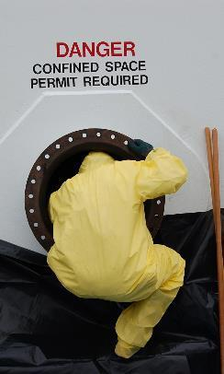
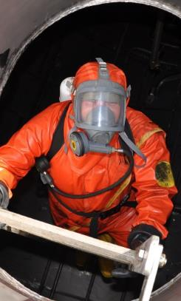
Access to cargo spaces and confined spaces
29CFR1915.76(a)(1)
There shall be at least one safe and accessible ladder in any cargo space which employees must enter.

Slide 15
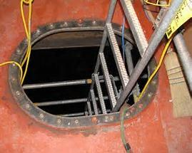
Access to cargo spaces and confined spaces
29CFR1915.76(a)(3)
Straight ladders of adequate strength and suitably secured against shifting or slipping shall be provided as necessary when fixed ladders in cargo spaces do not meet the requirements of paragraph (a)(1) of this section.

Slide 16
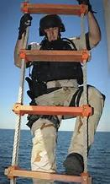
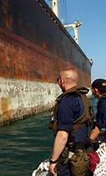
More Access to cargo spaces and confined spaces
29CFR1915.76(a)(3)
When conditions are such that a straight ladder cannot be used, a Jacob's ladder meeting the requirements of 1915.74(d) may be used.

Slide 17
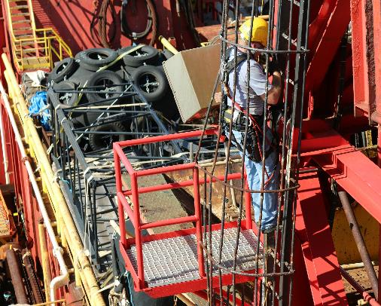
Working surfaces
1915.77(c)
Employees visually restricted by blasting hoods, welding helmets, and burning goggles shall work from scaffolds, not from ladders, except for the initial and final welding or burning operation to start or complete a job, such as the erection and dismantling of hung scaffolding, or other similar, nonrepetitive jobs of brief duration.

Slide 18
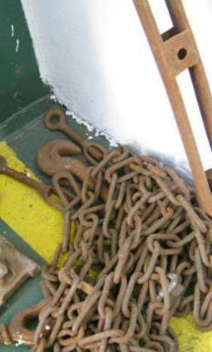
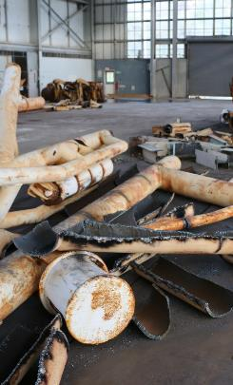
housekeeping
29CFR1915.81(a)(1) and (a)(3)
The employer shall establish and maintain good housekeeping practices to eliminate hazards to employees to the extent practicable.
The employer shall store materials in a manner that does not create a hazard for employees.

Slide 19
Time to test your knowledge of the topic

