Slide 1
Storm Damage Tree Cleanup and Chainsaw Safety
This material was produced under grant number SH-05052-SH8 from the Occupational Safety and Health Administration, U.S. Department of Labor. It does not necessarily reflect the views or policies of the U.S. Department of Labor, nor does mention of trade names, commercial products, or organizations imply endorsement by the U.S. Government.

Slide 2

Sister Margaret Ann https://youtu.be/e-ozLCZT4wg
Notes:
#2 Sister Margaret Ann Video
https://youtu.be/e-ozLCZT4wg
When disasters happen, it’s natural to want to help out. Let’s watch as Sister Margaret Ann jumps right in to help clean up after a storm.
Show the video.
We can probably agree with Sister Margaret Ann, that lending a hand is a good habit. But one of the first rules of emergency response is to make sure you don’t become another victim in need of help.
What risks do you noticed in the video? (No PPE for chainsaw user; bad positioning -cutting below knees without kneeling; clothing that can get caught in the saw; in the road with no traffic control or barriers, Poison ivy, insects, abrasions . . .) What is her plan? she appears to be making random cuts with no plan.

Slide 3
Tree Care Industry Association (statistics change, trends don’t)
Type | 2016 | 2017
Falls | 48 | 42
Struck-by | 38 | 43
Electrical Contact | 34 | 22
Total (All types) | 153 | 129
Notes:
#3 TCI Stats
The Tree Care Industry Association reported 153 Occupational Accidents in 2016 and 129 in 2017. Chainsaw cuts fall under struck-by.
The youngest victim TCIA recorded was 18, the oldest was 70. The median age of the victim (all incidents) was 39 in 2016 and 43 in 2017. This relatively high median age suggests that complacency rather than ignorance plays a significant role in these incidents.
In support of this claim:
The typical fall victim was unsecured.
The typical struck-by victim failed to clear the drop zone.
The typical electrocution victim violated MAD (Minimum Approach Distance) and made contact through a conductive tool/object.

Slide 4
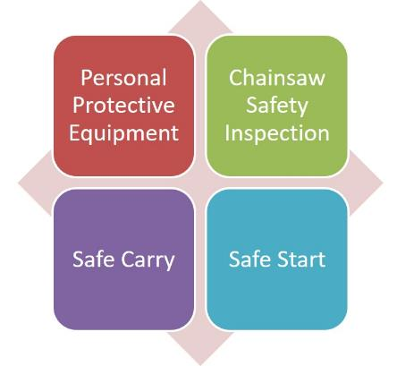
The Basics of Safety
Notes:
#3 TCI Stats
The Tree Care Industry Association reported 153 Occupational Accidents in 2016 and 129 in 2017. Chainsaw cuts fall under struck-by.
The youngest victim TCIA recorded was 18, the oldest was 70. The median age of the victim (all incidents) was 39 in 2016 and 43 in 2017. This relatively high median age suggests that complacency rather than ignorance plays a significant role in these incidents.
In support of this claim:
The typical fall victim was unsecured.
The typical struck-by victim failed to clear the drop zone.
The typical electrocution victim violated MAD (Minimum Approach Distance) and made contact through a conductive tool/object.

Slide 5
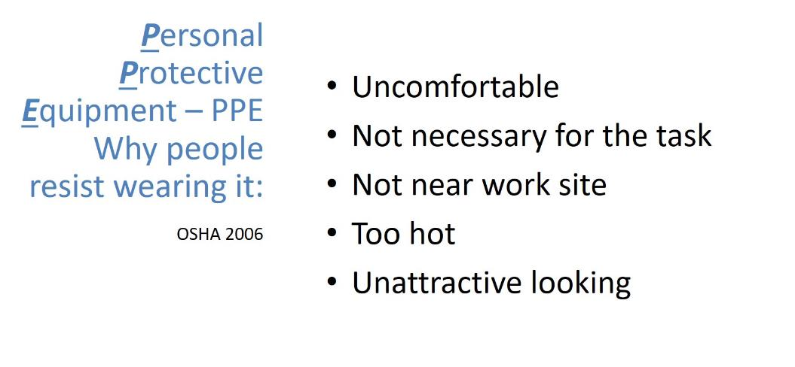
PPE
Notes:
#4 PPE Complaints
Many people don’t like PPE.
Read slide and respond to each point with these points.
If it is uncomfortable, get PPE that is comfortable. Get the appropriate size, better fit or flexibility, or a different design to work better with other PPE components.
PPE is necessary. The chain moves at 68 miles per hour or 88 feet per second. At full speed, 600 teeth pass a given point per second.
Yes, it can be hot. It is always hot in the summer, period. Stay hydrated and take cooling off breaks.
You look foolish without it. Be safe, look professional, and set a good example with it. Wear PPE.

Slide 6
OSHA Required PPE
Hard Hat (ANSI Z89.1)
Safety Glasses (ANSI Z87.1)
Ear plugs or Muffs
Chainsaw Chaps/Pants
Appropriate Foot Wear
Recommended: Glove and Chainsaw Protective Boots
Notes:
#5 Required PPE
This is the required PPE for chainsaw use. If you are an employee, your employer shall provide you with this. “Shall” is the word used in ANSI Z133. When ANSI Z133 says “shall,” it means “MUST.”

Slide 7
Hard Hat /Helmet
When should you wear it?
How do you know if it is safe?
Can I wear a cap, scarf or liner in cold weather under the helmet?
Can you put decals or spray paint the hard hat?
How long can you use a hard hat?
If a big branch falls on me, I’m going to die anyway, why bother with a hard hat?
ANSI Z89.1
Notes:
#6 Hard Hat Questions
When should a hard hat be worn? Any time there is risk for head injury. Generally speaking, any time you are near a work site.
It is safe if it says Z89.1 on it.
Manufacturers specification will say what can worn under the hat. They sometimes recommend specific liners.
Yes, decals can be use, but avoid applying paint to the hard hat. It can damage the plastic.
How long can they be used? Replace hard hats after 3-5 years, sunlight makes the plastic brittle over time. Check the harness and the squeeze the helmet to look for cracks before use.
Hand out the hard hats. Ask them to find the Z89.1 and if they would use that hard hat.

Slide 8
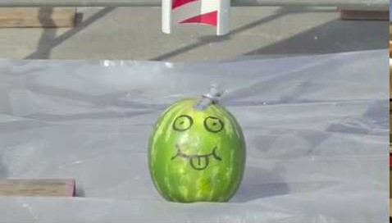
This is why you need a hard hat!
https://youtu.be/m_V8GsPdGyc
Notes:
#8 Benefits of a Hard Hat
https://youtu.be/m_V8GsPdGyc
A small object gathers great force when falling. A hard hat can make the difference between a headache and death.
This video will demonstrate.

Slide 9
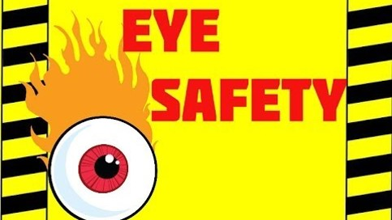
Eye Protection
https://youtu.be/pfAZwGZS-Hk
Notes:
#9 Eye Protection Video
https://youtu.be/pfAZwGZS-Hk
We are going to watch a little of this excellent video. It makes a good point about the implications of eye injuries. Stop Video around time stamp 1:05.
Some people have told me that the wood chips from a tree won’t hurt you. But the truth of the matter is that you never know what might be in the tree you’re cutting.

Slide 10
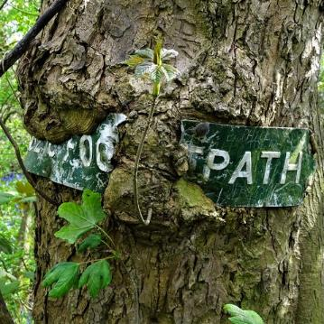
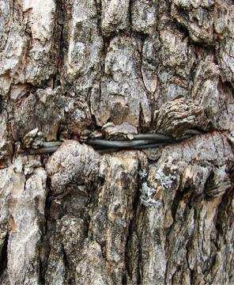
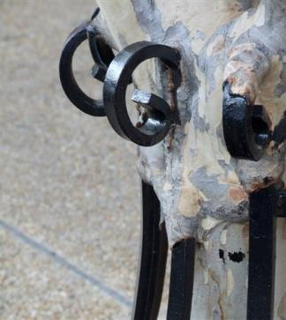
You never know what is inside a tree!
Notes:
#10 Trees Grow Around Irritations
Many strange that have been found in trees. People put wires, bullets, conduit, hook and eye latches, barbed wire, pipe flanges, tennis balls, fabric, plastic bags, concrete, and expanding foam, pipes, and rocks in them.
Trees do not expel foreign objects; they grow around them. They can grow around all sorts of irritations.
This footpath sign is about to disappear. This tree is swallowing a fence wire. This decorative fence will be inside this crepe myrtle tree in no time. People hide things in tree crotches and forget about them. Years later, a chainsaw or mill saw that finds these treasures may create flying shrapnel that can cause injury.
Photo Credits
BarkandWire by David R. Tribble
Curious Footpath sign embedded in a tree Photo © Neil Theasby (cc-by-sa/2.0)

Slide 11
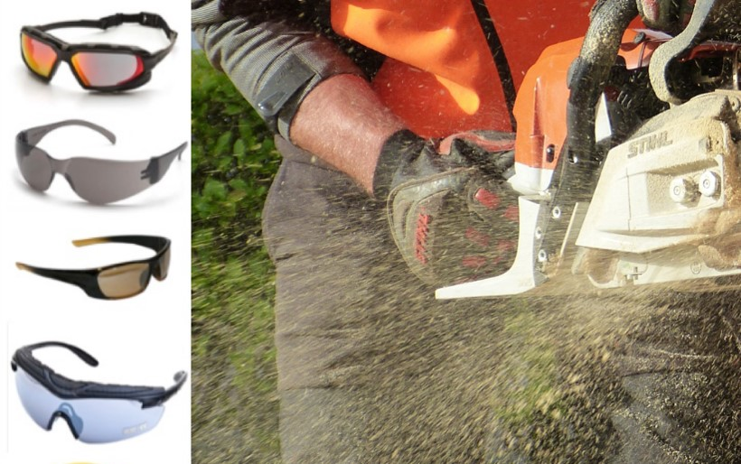
Eye Protection (ANSI Z87.1)
What happened when the tree feller didn’t wear his safety goggles?
He turned a blind eye to saw safety.
Notes:
#11 Safety Glasses
As the chainsaw blade bites into the tree, bark, wood chips, and tiny bits of the metal blade explode into the air. The face and eyes are nice, soft targets for all this flying debris. While a faceguard with a mesh screen protects the face, it isn’t enough to protect eyes from injury. Neither are eyeglasses or sunglasses. Flying objects can shatter the lenses of regular eyewear, increasing the chances of eye injury.
Safety glasses or goggles with side protection or wrap-around lenses, deflect threats that come at the eyes from both the front and the side. There are safety glasses and goggles that fit over prescription eyewear. Alternatively, safety eye wear can be made to a vision prescription, even for bifocals.
Whether prescription or off-the-shelf safety glasses are worn, select models that:
resist fogging up
resist scratches
offer UV protection to minimize eye damage from UV light, and
have an ANSI/ISEA impact rating of Z87.1.
Hand out safety glasses and ask them what the ANSI rating is. There should be at least one set of eyeglasses that is not stamped with the proper ANSI rating.

Slide 12
Lack of hearing protection leads to:
Hearing impairment with poor quality of life
Problems in speech recognition
Difficulties on the job
Notes:
#12 Hearing is Important
Hearing is very important.
Read the slide.
These problems aren’t apparent in young people in their 20s, but become apparent as they age. How many of you have experienced some hearing loss? What are the signs that hearing is damaged?
(Wait for the audience to respond. Possible answers: ringing in the ears, temporary deafness, get in the car the next day and the radio is too loud).
How loud does something need to be to cause noise induced hearing loss?

Slide 13
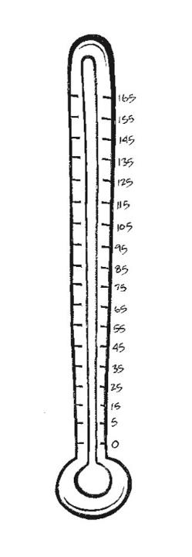
Sound Levels
Painful: 150 dB = Rock Concerts at Peak 140 dB = Firearms, Air-Raid Siren, Jet Engine 130 dB = Jackhammer 120 dB = Jet Plane Take-off, Amplified Music at 4-6 ft., Car Stereo,
Band Practice 110 dB = Machinery, Model Airplanes 100 dB = Snowmobile, Chain saw, Pneumatic Drill 90 dB = Lawnmower, Shop Tools, Truck Traffic, Subway 80 dB = Alarm Clock, Busy Street 70 dB = Vacuum Cleaner 60 dB = Conversation, Dishwasher 50 dB = Moderate Rainfall 40 dB = Quiet room 30 dB = Whisper, Quiet Library
ta
Notes:
#13. Noise Measurement
Loudness is only one factor contributing to noise induced hearing loss. Length of exposure and proximity to the noise are also factors. Sound is measured in decibels (dB). When exposed to noise at the 85dB level or above repeatedly or for long periods of time, hearing loss is likely.
How many decibels of noise does a chainsaw produce? A new saw runs at about 100 dB and old one can be louder.
ANSI Regulations are clear, “The employer shall (this means MUST) provide employees protection against the effects of noise exposure when sound levels exceed an 8-hour, time-weighted average of 85 decibels.”

Slide 14
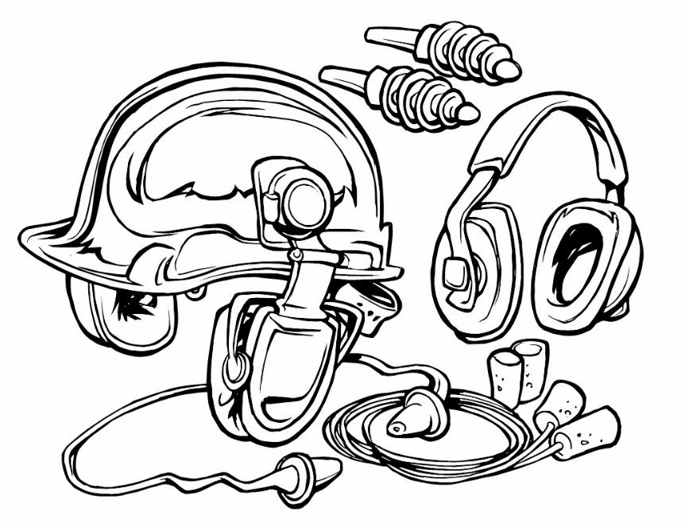
Noise Reduction Rating NRR
Notes:
#14 NRR
Look for the NRR (Noise Reduction Rating) on ear protecting equipment. The NRR is a single number rating which is required by law on the label of each hearing protector sold. It states the noise reduction the device provides.
An NRR of 25 reduces noise levels by 25 dB. An NRR of 33 reduces noise levels by 33 dB.

Slide 15


Hearing protection
Notes:
#15. Where is the NRR?
Use this slide to show them where the NRR is.
Pass out the hearing protection and ask participants to find the NRR. There should be one device that is not labeled. You should tell them not to use that one.

Slide 16

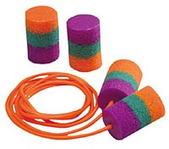
Danger!
+
=
Notes:
#16 Don’t Overprotect
It is important not to block out all the sound. There are some sounds that must be heard.
Ask the group what they need to hear? (e.g. tree cracking, co-workers, road traffic.)

Slide 17
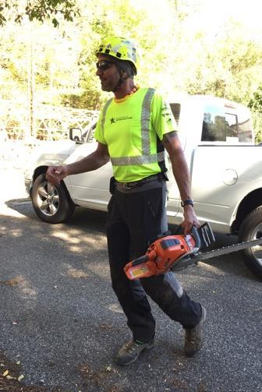
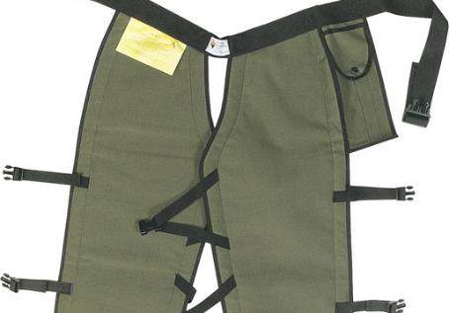
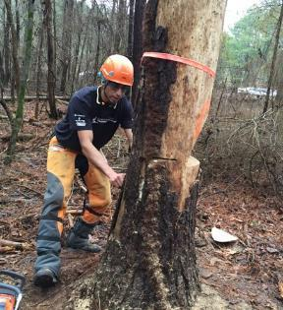
Chaps or Saw Pants
Notes:
# 17 Chaps
Moving on down, let’s look at protection for the body.
The CDC reports, “Each year, approximately 36,000 people are treated in hospital emergency departments for injuries from using chainsaws.” Saw cuts are ugly cuts. The most common place for cuts is on the left hand. Do you know why? (One handing the saw and feed brush into it with the left hand). Good technique will protect from that accident. The second most common area for a saw cut is the left leg. Why? (You get tired and the saw tends to rest there.)
There is only one article of PPE that protects from cuts. That is the chaps or chainsaw pants.
Fasten all the buckles on chaps and keep them snug. They should cover the full length of the thigh to two inches below the top of the boot.
Have someone demonstrate putting on chaps.
If a saw is used daily, it is wise to invest in safety pants. They look good, fit well, and they are always on. They cost a bit more, but the added comfort makes them worth it.
Pass around the pants.

Slide 18
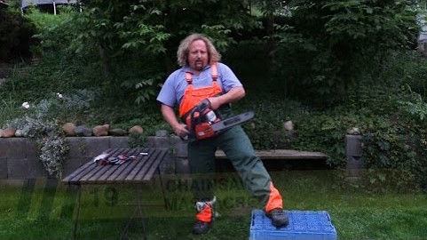
Don’t Try This At Home!
https://youtu.be/r5VSivQe760
Notes:
#18. Don’t try this at home!
Pavel is going to show us why safety chaps and pants are a good investment.
https://youtu.be/r5VSivQe760
Read and understand the manufacturer’s care and use instructions. Chaps and pants must be washed. They aren’t effective dirty. Some are machine washable in cold water, but they don’t like the dryer or chlorine bleach. Read the care guidelines and follow them.
If saw chaps/pants are cut, they must replace them. One cut, you chuck!
Pass out the cut chaps so they can see the fibers.
Always keep chaps/pants on when using a saw. They are worthless in the truck.

Slide 19

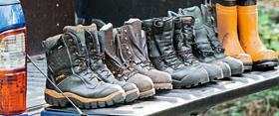
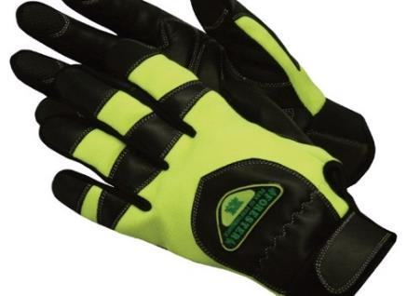
Gloves and Boots
Notes:
#19 Gloves and Boots
What are some characteristics of a good pair of gloves?
Gel padding in the palms to reduce vibration.
Lined with cut-resistant DuPont Kevlar fiber to prevent minor cuts. They should be rated at Level 3 for cut resistance. (ANSI/ISEA 105-2005 Standard).
Snug fit. Get the right size to fit your hands.
Non-slip with breathable Spandex with goatskin or other materials that provide good control for your fingers and palms. Make sure the top of the glove is well made.
Wrist closure with Velcro keeps debris out and doesn’t get caught in things like chippers, saw tips, or sticks (no cuffs).
Machine washable if possible.
What are characteristics of a good boot?
Correctly fitted to the size of your foot.
Lined with DuPont Kevlar for chain cut resistance.
High abrasion resistance.
Steel shank for support.
Moisture repellent upper.
Pillow cushion inserts.
Steel, titanium or plastic toed boots. Titanium and plastic toed boots reduce the overall weight of the boot.

Slide 20
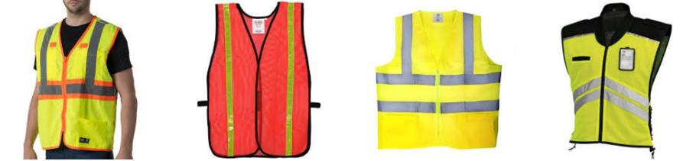
If near traffic or hunters
Notes:
#20 Vests
A high visibility safety vest is necessary near traffic and wise when out in the woods.
Show them the demonstration vests and note the pull apart vest could be good when working around chippers.

Slide 21
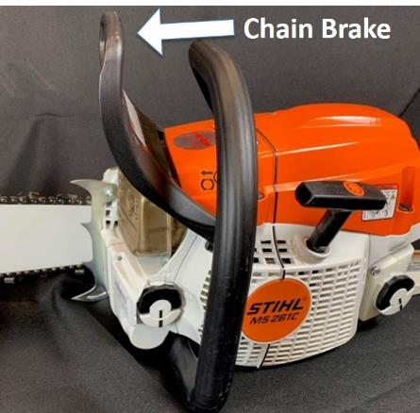
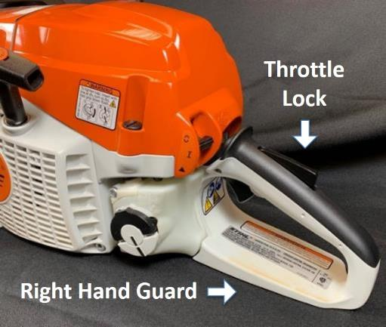
Chainsaw Safety Inspection: Five Essential Safety Features
Notes:
#28 Five Essential Safety Features
Before using a saw, look for these five essential safety features.
KICKBACK GUARD AND CHAIN BRAKE: The chain brake stops the rotation of the chain. The chain brake is designed to be activated in two ways:
If the left wrist forces the kickback guard forwards, the chain brake will activate.
Following kickback the chain brake will trigger from the inertial forces generated.
Anytime more than two steps are taken during cutting, push the chain brake forward with the back of the hand to engage the chain brake. Engage the break when the saw is set down.
Never use the right hand to engage the chain break.
THROTTLE LOCK: The throttle lock is designed to prevent accidental throttle advance. The throttle will only work if the lock is pressed in, i.e. the saw’s rear handle is held with a firm grip while accelerating.
RIGHT-HAND GUARD: The right-hand guard is designed to protect the user’s hand if the chain should break or derail.
SPARK ARRESTOR: Every chainsaw has the potential to start a wildfire. Exhaust gases from the combustion chamber of the chainsaw and hot carbon can be ejected through the exhaust port of the engine as sparks.
The muffler is where the buck stops. Chainsaw engineers have added spark arrestors to mufflers to prevent sparks from leaving the muffler. These tiny screens can get clogged up with carbon and must be cleaned occasionally.
If any of these safety features are broken, don’t use the saw. Better yet, take the blade off so that nobody else uses it and turn it in to maintenance.

Slide 22
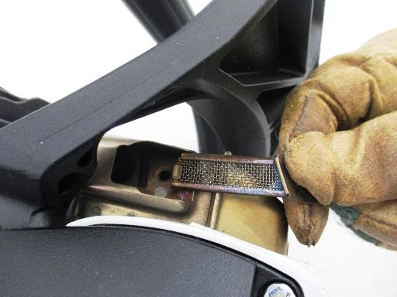
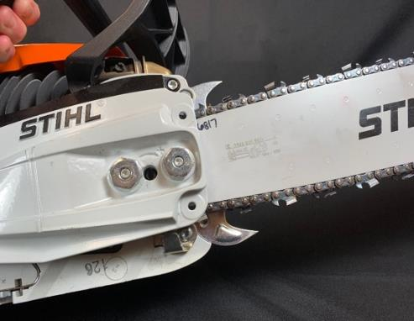
Chainsaw Safety Inspection: Five Essential Safety Features
Spark Arrestor
Chain Catcher
Notes:
#22 Saw Safety Features
CHAIN CATCHER: The chain catcher is designed to catch the chain if the chain should break or derail. It is easy to overlook because it is on the bottom of the saw. They break off but can easily be replaced at the saw shop.
SPARK ARRESTOR: Every chainsaw has the potential to start a wildfire. Exhaust gases from the combustion chamber of the chainsaw and hot carbon can be ejected through the exhaust port of the engine as sparks.
The muffler is where the buck stops. Chainsaw engineers have added spark arrestors to mufflers to prevent sparks from leaving the muffler. These tiny screens can get clogged up with carbon and must be cleaned occasionally.

Slide 23
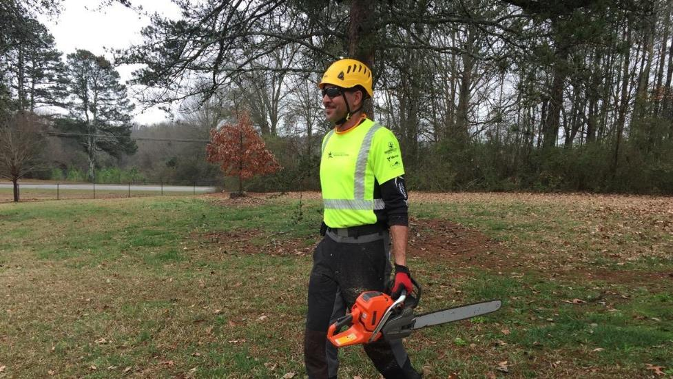
Safe Carry
Notes:
#23 Safe Carry
There are lots of ways to carry a saw, but there is only one safe way. Always carry the chainsaw with the bar pointed behind you. If the saw has been running it is important to make sure the muffler side is away from the body. Always shut the chainsaw off before transporting.
This is an example of safe carrying technique: Saw powered off, bar behind.

Slide 24
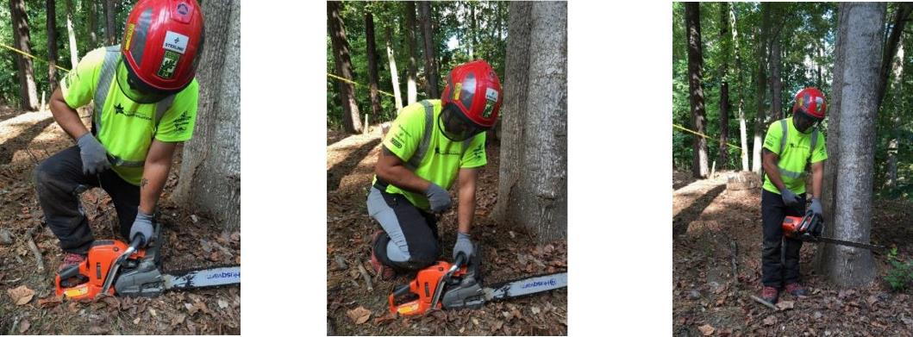
Safe Start
Notes:
#24 Safe Start
Drop-starting a chainsaw is prohibited.
Prior to starting make sure to check controls, chain tension, bolts and handles. Do not start a saw within 10’ of fuel. Engage the chain brake and place the saw on flat ground or another firm surface, place the RIGHT boot toe in the handle or knee on top to stabilize before pulling the cord. The LEFT hand should be firmly around the handle with the elbow locked. When starting on the ground make sure the bar is not in contact with the ground or any objects. If ground starting is not possible due to debris or other obstructions, then a standing or pinch start can be done. Standing on firm ground with rear handle between the legs the LEFT hand around the front handle with the elbow in a locked position.

Slide 25

Storm Damaged Tree Cleanup
Five Step Cutting Plan for Storm Damaged Trees
Hazards and Work/Drop Zones (electricity)
Lean and Load (stored energy)
Check Equipment
Cut Plan/Escape Plan (three handy cuts, shifting escape routes, and distance release)
Implementation of the plan (and then repeat the steps again)
Notes:
#25 5 Step Cutting Plan
Now that the operator had dressed for work, inspected the saw, and moved it to the storm-downed tree it is time to tackle the tree. We will present the Five Step Cutting Plan. Strict adherence to this plan will help keep you safe as you work effectively.
First hazards must be identified as well as the work and drop zones.
The second step is very important. Storms create lean and load on trees which must be identified.
The operator must check the equipment needed and assure that it is available and in working order.
The cut plan and escape plan are created based on the information assessed in the first three steps.
Finally, the cut plan is implemented, and the escape made.

Slide 26
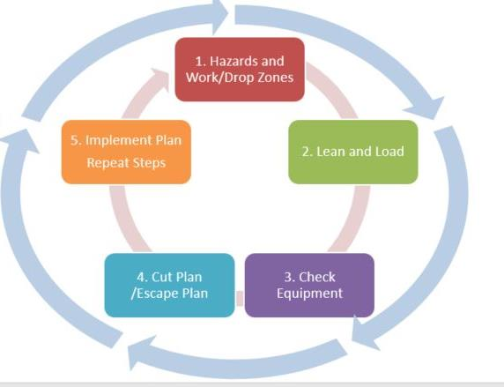
Five Step Cutting Plan for Storm Damaged Tree Cleanup
Notes:
#26. Repeat plant
This plan is similar to a standard tree felling plan with one key difference. It must be repeated with each cut. With each cut, the lean and load of the tree can shift, new hazards may become important and the drop and work zones may change. The equipment needed may change. This creates the need for a new cut plan and escape plan. With each cut, the situation changes and the plan must be reworked.

Slide 27
Step 1
Step 1. Identify:
Hazards
Work Zone
Drop Zone
Notes:
#27 First Step
The first step of the plan is to identify the hazards, the work zone and the drop zone. Take the time needed to very carefully inspect the tree and site.

Slide 28
Hazards
Tree
Widow makers, decay, leaners, wildlife
Environment
Structures, powerlines, vehicles, people, pets
Storm
Weather, hung up and tangled trees, stored energy, wood under pressure, crushed structures
Notes:
#28 Hazards
There are Hazards associated with the tree, the environment, and the storm.
Ask participants what these hazards might be. Discussion could include: leaners, snags, spring poles, hangers, widow makers, wildlife, power lines, decay, people, structures, vehicles, etc.

Slide 29
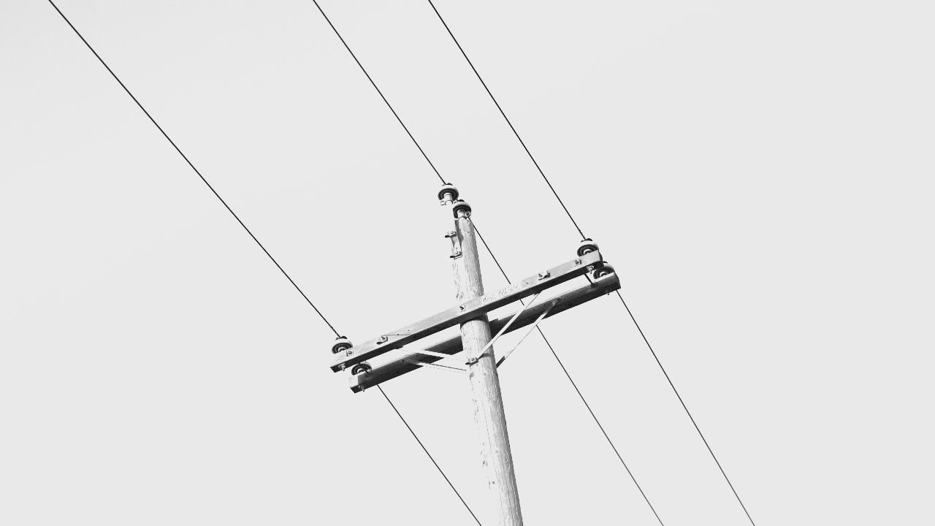
Electricity
Notes:
#29 Electricity
Any time a tree is near a wire you should be wary. There may be no indication that the tree is ”hot.”
Photo by Jeremy Perkins on Unsplash

Slide 30
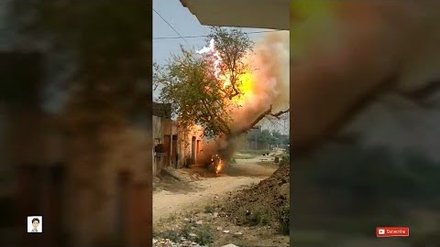
Video
https://www.youtube.com/watch?v=fxSFTAPXn9k
Notes:
#30 Electricity
Show the video.
https://www.youtube.com/watch?v=fxSFTAPXn9k

Slide 31
Electricity Before You Cut Anything!!!
Make a thorough inspection
“Line clearance shall not be performed during adverse weather conditions, such as thunderstorms, high winds, and snow and ice storm.” (ANZI Z133)
Fences, gutters, anything conductive can be ”hot”
Treat all downed lines as energized
Notes:
#31 Electricity
Tree work hazards increase significantly during or after a storm. Many of the tools that we rely on to help protect us from electrical hazards such as pole pruners, saws, and aerial lifts lose their capacity to insulate when wet. The trees we work in are also much more conductive when they are wet. Strong winds can push treetops into contact with conductors and make controlling cut limbs and tops extremely difficult even with rigging. Tree workers must exercise extreme caution and judgment in these situations and, when warranted, delay the work until the weather improves.
Make a thorough inspection before approaching the tree. Line clearance is pruning, trimming, repairing, maintaining, removing, or clearing of trees or the cutting of brush that is near (within 10 feet of) energized power lines.
Since even a streetlamp circuit or phone line can be energized with enough voltage to kill, almost all arborists in the field have at least some exposure to this hazard. In fact, workers don’t even have to touch a wire to be electrocuted – about half of all electrocution fatalities are the result of indirect contact.
Treat all downed lines as energized.
Even the ground under the feet can even conduct electricity, given the right soil conditions and voltage.

Slide 32
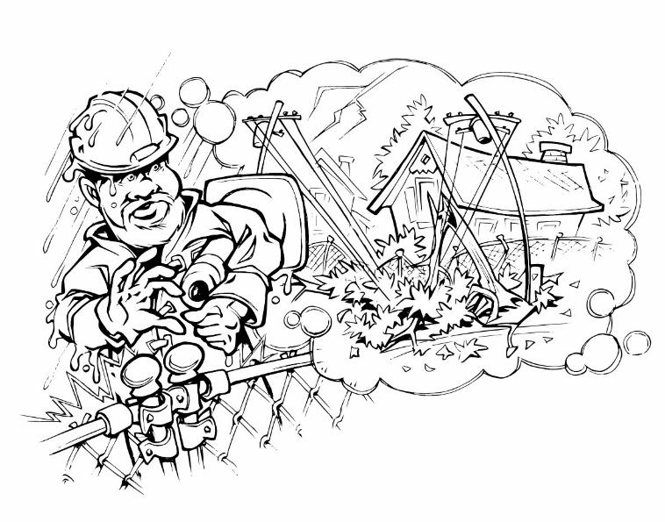
Do Not approach or touch any downed lines (power, communication, cable, or otherwise) until the utility company has cleared it as de-energized or dead.
Notes:
#32 Electricity Warning
Read the slide. Restate the slide.
Keep in mind that electricity from a downed line away from you may reach the worksite through other conductors such as chain link fences, metal curbing, or even “harmless” phone or cable lines.

Slide 33
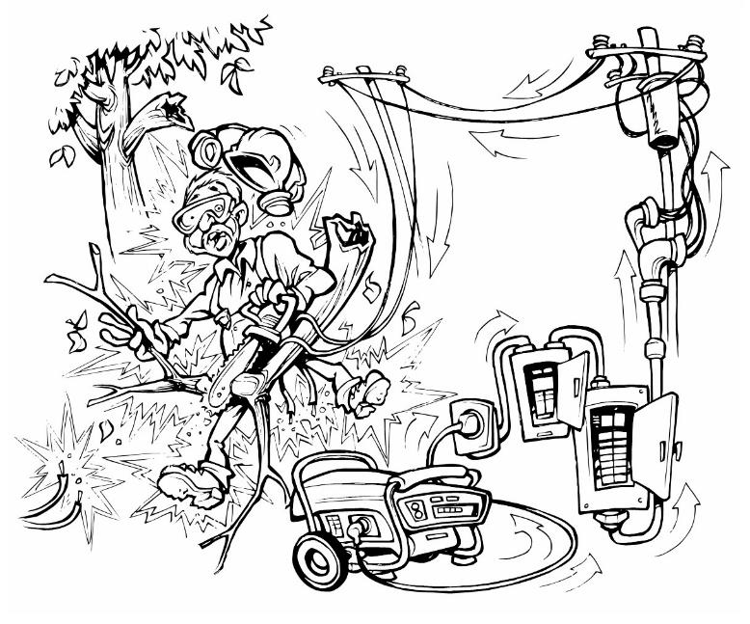
Generator Feedback
Notes:
#33 Generator Danger
In addition, homeowners using incorrectly set-up generators can cause “back feed” into their house drop, which in turn is “pumped up” in volume by transformers, reenergizing lines the tree crew may have “known” to be dead.
If a generator is operating or the lights are on at one residence in an otherwise blacked out area, consider all conductors to be energized.
Once again, do not begin working until the utility company has cleared all downed lines as dead.

Slide 34
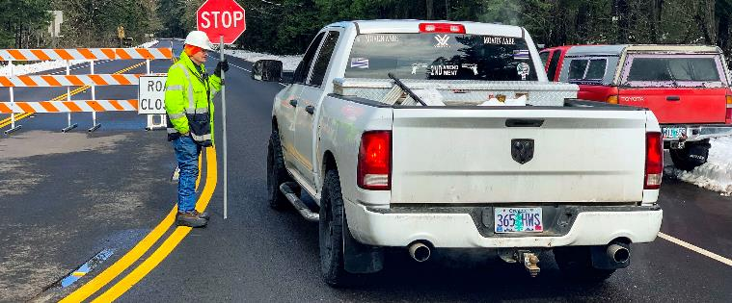
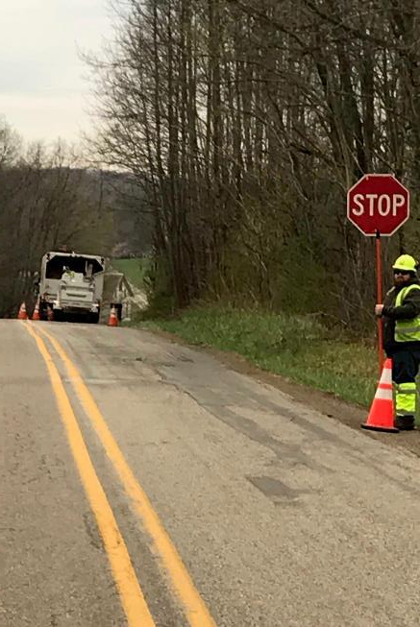
Traffic
Notes:
#34 Traffic
All workers within the right-of-way who are exposed either to traffic or to work vehicles must wear high-visibility safety apparel.
Have a plan for traffic flow and designate who is in charge of executing that plan and overseeing it. Use cones.
Pedestrians should have a path separate from vehicular traffic.
Photo credit: Oregon Department of Transportation
Phillip Kelley

Slide 35

Work/Drop Zone
Establish work zone: Two lengths of the tree or two lengths of the highest point of a downed tree
Establish drop zone: Area where anything cut from the tree will fall
Notes:
#35 Work/Drop Zone
The work zone is at least two lengths of the tree being felled. On a downed tree it is determined by the highest point of the tree.
The drop zone is the area where anything cut from the tree could fall. This includes any area with potential for struck-by injuries from fall objects.

Slide 36
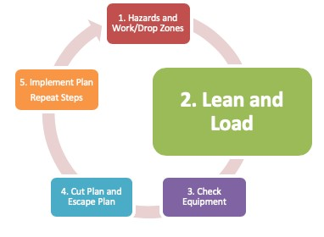
Step 2. Lean and Load
Storm damage can put limbs, branches, and trunks under great pressure
Power and communication lines
Tree trunk and root plate
Smaller branches may be pinched, creating spring poles
Potential energy may be released suddenly, explosively, and fatally!
Notes:
#36 Lean and Load
The lean and load of the tree caused by storm damage can put limbs, branches and trunks under great pressure. Trees resting on power and communication lines are under pressure and their weight stores energy in the stretched wires.
Tree trunks may be twisted and under pressure. Sometimes the tree is blown over and the root plate is ripped out of the ground. The trunk may roll and twist when freed due to pressure caused by the root plate.
The potential energy caused by lean and load may be released suddenly, explosively, and fatally if you are unaware of it.

Slide 37
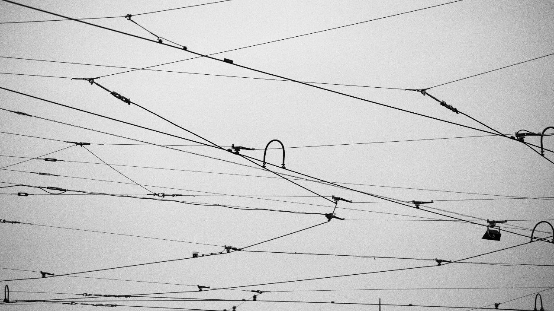
Wires
Notes:
#37 Load and Lean
When the load is released from power or communication line, the tree may be tossed into the air
Photo by Simona Sroková on Unsplash

Slide 38
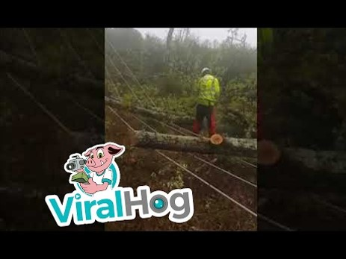
Video
https://www.youtube.com/watch?time_continue=19&v=dV86LCaVQLI
Notes:
#38
Show video:
https://www.youtube.com/watch?time_continue=19&v=dV86LCaVQLI

Slide 39
Wires
Notes:
#39
It may be difficult to predict the exact form of the energy release. This is yet another example of what stored energy can do. It is also a very good example of why one should not hang out in the drop zone.

Slide 40
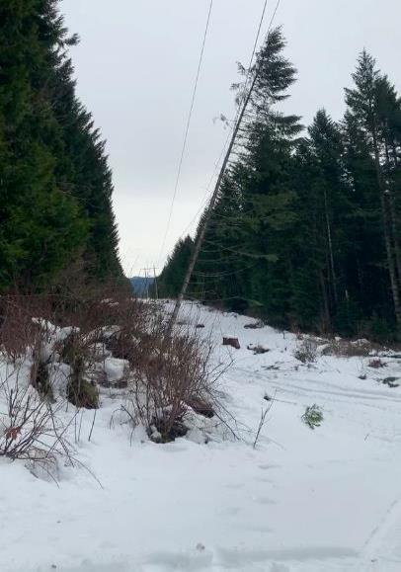
Trees against high line wires
Notes:
#40
Show Video
Video provided by Phillip Kelley

Slide 41
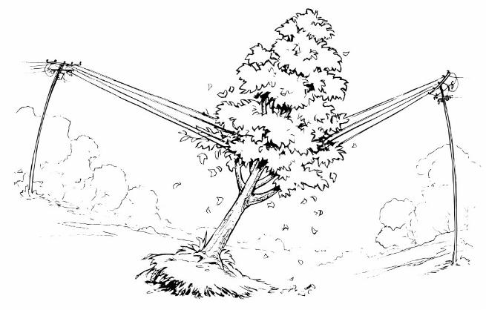
WIRES
Notes:
#41 Tie down
When a trees lean into powerlines, energy is stored in the lines that can toss the tree when it is cut free. That energy must be released slowly. Tie down the line and release it after the tree is removed.
Tie lines down in the same direction as the tree is pressing so that the energy can be released slowly after the tree is freed. Keep in mind, even a tied down line can move.

Slide 42
Compression and Tension Wood
Identification of wood under tension and compression is critical
In general - Notch in compression wood, back cut in tension wood
Notes:
# 42 Compression Tension Wood
Generally, the upper side of the tree branch is under tension and the lower side is under compression. In general one can notch in compression wood and back cut in the tension wood.
This may not be the case with storm damaged trees. It is important to study the tree carefully. Walk around the tree and take a good hard look.

Slide 43
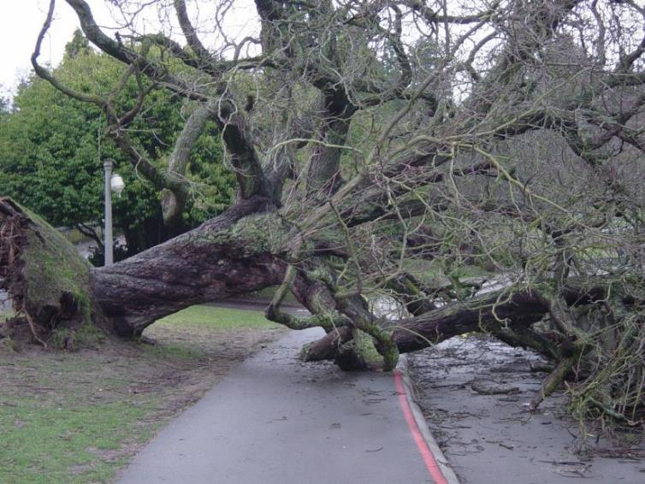
Compression and Tension Wood
Notes:
#43 Tension
Both of these points are under tension. Every cut has the potential to change the tension points as the tree moves and shifts.
Beware of pinch kick back in these situations.
The bar of the saw can be pinched. If it is pinched on the top of the saw, the operator can push back. If it is pinched on the bottom, the operator can be pulled forward.
Break the class into groups of three and hand out pictures of fallen trees. Ask them to identify wood under tension. Once they have identified it, have them report out to the class.

Slide 44
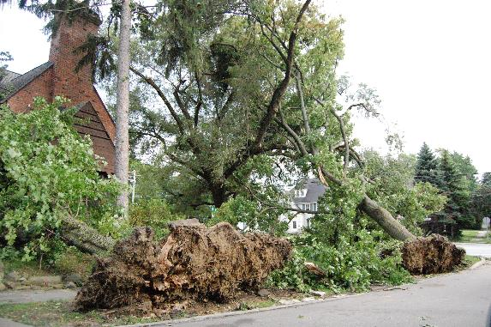
Uprooted Tree
Notes:
# 44 Uprooted Trees
There are several potentially dangerous circumstances that can occur when the trunk is cut free from the remaining root mass.
The remaining root mass could fall forward and on top of the saw operator. The other potentially dangerous result is that the root mass and remaining trunk could whip upright and back into the ground after the bucking cut is made.
Trying to determine which of these two situations is likely to occur is difficult and only becomes easier after years of experience in working on these types of trees. For this reason, never stand on or straddle the trunk of an uprooted tree while making these cuts.
Fortunately, there are safe options for dealing with this.
Stu_spivack
https://www.flickr.com/photos/hz536n/

Slide 45
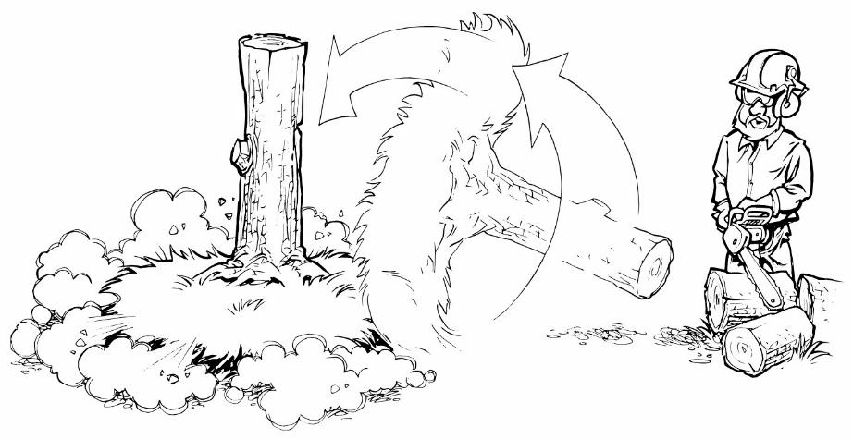
Pedestal and Root
Notes:
#45 Root mass
When it appears the root mass and rtrunk will right itself after the bucking cuts are made, start the cuts at the top of the tree, working toward the butt, cutting the trunk into short sections. This incremental removal of trunk sections allows the root mass to counterbalance the tree gradually, standing upright slowly and safely. At this point, fell the remaining upright trunk section using normal felling methods.

Slide 46
Pedestal and Root
Notes:
#46
To avoid the threat of the remaining root mass falling toward you, cut the trunk at a distance that is beyond the reach of the highest part of the root mass. Remove any branches that are in the way or that could potentially strike the operator after the tree is cut free from the stump. After being cut, the root mass will fall forward only until it is stopped by the remaining trunk section striking the ground.

Slide 47
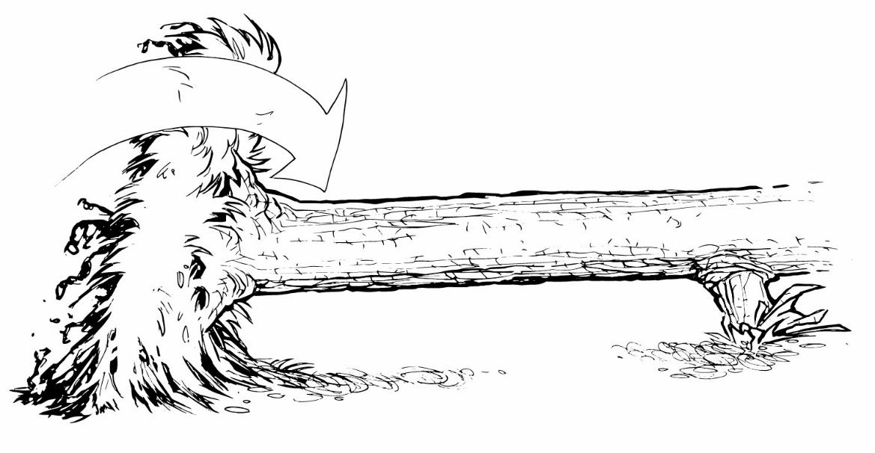
Pedestal and Root
point
Notes:
#47 Tension on bottom
If the tree appears to be under significant upward pressure from both ends, that is the trunk and root plate will likely fall forward, then make an open-face notch on the compression side of the tree followed by an undercut directly opposite the notch.

Slide 48
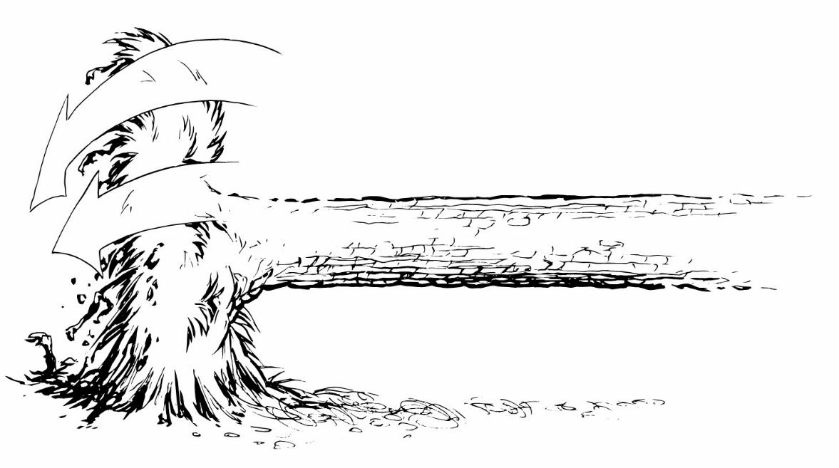
Pedestal and Root Plate
Notes:
#48 Tension on top
If it appears that the root mass will fall back in the hole, the cuts should be reversed, notch the bottom, back cut from the top.

Slide 49
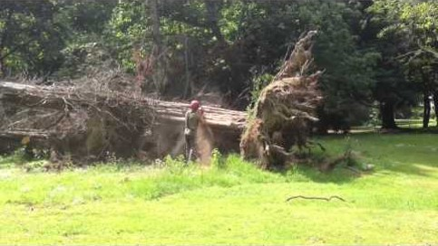
Pedestal and Root Plate
https://youtu.be/j7lduKUT0-I
Notes:
#49 Video
https://youtu.be/j7lduKUT0-I
This operator has correctly guessed which way this root plate will move.

Slide 50
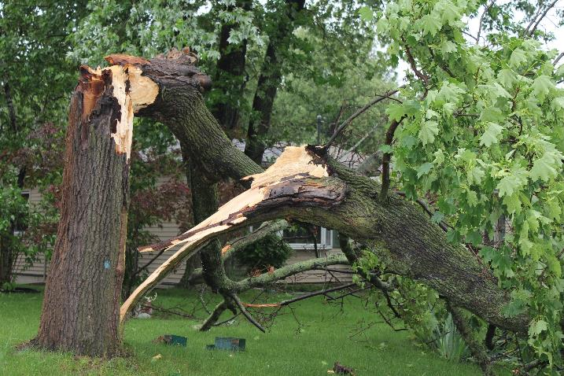
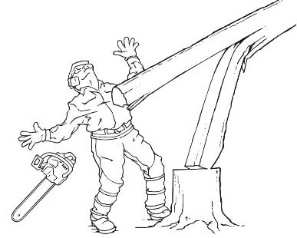
Broken and Attached
Notes:
#50 Broken and Attached
Another common type of storm damage includes trees that have broken off but still remain attached to the trunk. The upper portion may be hung up in another tree or resting on the ground. These situations are extremely hazardous as they are difficult to assess. Even when a felling plan has been carefully considered and executed it may not be possible to determine the outcome.
The greatest risk of felling these trees is if the broken portion detaches unexpectedly. Barber chair (in which the tree splits at the base, kicking backwards and falling in an uncontrolled manner) may occur. In addition, the broken portion of the tree exerts pressure against the tree trunk. This can cause the tree to fall in the wrong direction when the release cuts are made.
Assess the tree and site carefully before making any cuts. Try to visualize how the broken top will respond to the release cuts that will be made. As these cuts are made, be prepared for the broken portion to detach at any time, and be ready to retreat along the preplanned and cleared escape routes. Finally, avoid working under the hung up or hanging portion of the tree.

Slide 51
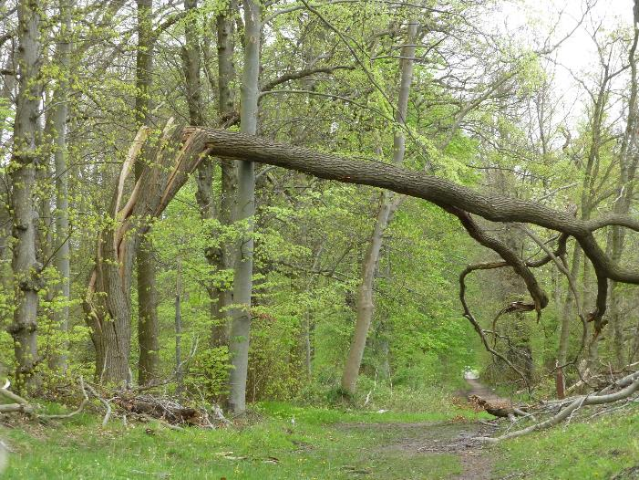
Broken and Attached
Climb?
Lift?
Cut?
Pull it down!
Notes:
#51 Broken and Attached.
This is another case of broken and attached. This is too dangerous to climb and it would be difficult to get a lift into this area. In addition, the trunk is too dangerous to cut as is. It could possibly be bound and then cut. The failure is so great, it might be relatively easy to pull it down with mechanical advantage.

Slide 52
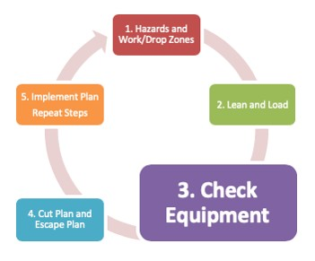
Step 3. Check Equipment
Notes:
#52 Check Equipment
And that brings us to the importance of checking the equipment. This is step three of the plan. If the equipment needed is not on sight, go get it before attempting to execute the plan.

Slide 53
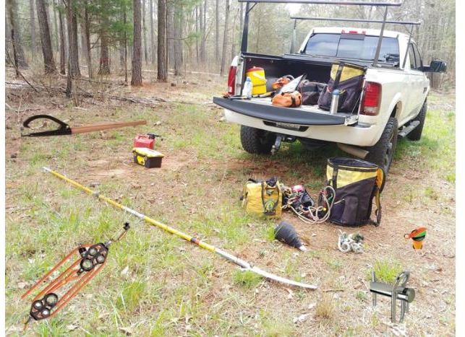
3. Check Equipment
Rope
Mechanical advantage
Cant hook
Wedges
Porta wrap
Pole saw
Throw line
Notes:
#53 Equipment
The more tools you have, the more you can do. Physical tools and mental tools. Are there any other “must-have” tools?

Slide 54
Step 4. Cut Plan and Escape Plan
Notes:
#54 Step 4 Cut Plan and Escape Plan
At this stage in the five step plan, the operator has assessed the hazards presented by the tree and work site. He or she has given full consideration to the lean and load of the tree and has the equipment and expertise needed to tackle the tree. It is time to make the cut plan and and escape plan.

Slide 55
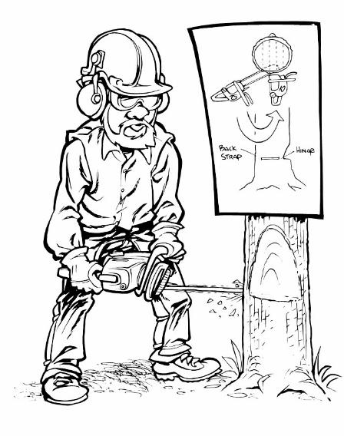
Some handy cuts:
Bore Cut
Mismatch
Knee notch
Notes:
# 55 Cuts
First we will talk about the cut plan. There are three cuts are that are relatively simple to execute and yet can handle many situations presented by storm damaged trees. These are the bore, mismatch and controlled knee cut. A well-executed bore cut will allow the operator to move away from the tree as it falls.
The mismatch and knee notch cuts can be released when the operator is at a safe distance using rope. These can be very handy when it is unclear how the tree will move or there is not safe escape route. Distance release techniques will keep the operator out of the drop zone.

Slide 56
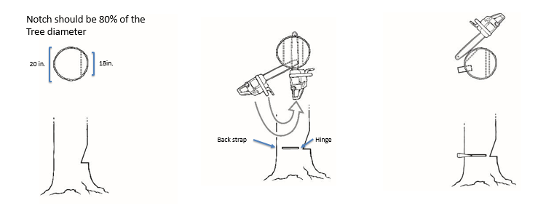
Bore cut
Notes:
#56 Why use a bore cut?
On trees with forward lean, the traditional “race to the hinge” backcut can result in an explosive “barber chair,” in which the tree splits at the base, kicking backwards and falling in an uncontrolled manner. On trees leaning backwards or in other undesirable directions, a bore cut allows you to use wedges to control the direction of its fall. This cut allows also allows the operator to work from the inside out cutting out the tension that may be in wood under pressure.
The notch should be 80% of the tree’s diameter.
If the tree is 24” in diameter or less, the hinge will be 10% of the remaining material after the notch is removed. The hinge should be the same width across the entire diameter of the tree. If the tree is more than 24” in diameter, the hinge will be 5% of the remaining material after the notch is removed.

Slide 57
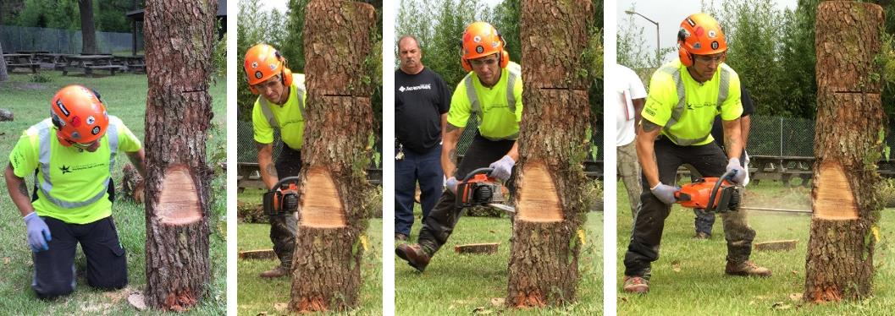
Bore Cut
Notes:
#57 Bore Cut
You can see the appropriate size of the notch cut here. As the saw operator starts the bore cut, he is using the attack portion of the bar. The attack portion is the top half of the tip of the bar. He literally steps around to use the full width of the bar. Because the saw is contained in the tree, there is no kickback.
The small backstrap holding the tree together can be cut with a pole saw at a safe distance if you suspect the tree will move or there is no safe escape route. It is important to practice this cut before using it.

Slide 58



Mismatch Cut
Notes:
#59 Mismatch Cut
The mismatch cut (or bypass cut) is similar to the technique used when snapping off wood aloft in “cut and chuck” operations, with one major exception. Operators should not attempt to snap off the hazard or danger tree by hand. Rather, use a pull rope or push stick to free the branch or trunk. This allows the operator to be well away when the release occurs. This is much safer.
Attach the pull line before cutting. The lowest cut should be made on the pull line side. It is easier to snap off the cut if it is pulled (or pushed) in the direction of the side with the lowest cut. The mismatched cuts are made from opposite sides of the tree, much like on a horizontal branch when aloft. This avoids the tension and compression fibers, (typically, but not always on the top and bottom of the tree) as much as possible. The amount of overlap or bypass, along with the distance between the cuts, will vary with diameter and wood strength. The further the cuts are apart, the more holding power.

Slide 59


Controlled Knee Cut
Notes:
#59 Controlled Knee Cut
The controlled knee cut is excellent for dealing with trees suspended on over head obstacles, whether it be wires, other trees, or houses. The notch is made and the hinge is setup with a bore cut. In a standard felling operation with an upright tree, the holding strap would be severed at level or below the hinge, but in a hazard/danger situation, this would require staying close to the tree, a location to be avoided. Instead, a mismatched back cut is made beneath the level of the hinge. Wood strength and diameter will once again affect the distance between the two cuts. In general, the further below the bore cut, the greater the amount of force that will be required to release the cut.

Slide 60

Controlled Knee Cut
Notes:
#60 More Controlled Knee
The knee cut can be used to release hung or snagged trees. It also allows for a safe distance release. This cut makes smart use of notches.
The tree must be large enough in diameter so that a bore cut can be made to create the hinge. Attach the pull line first to the tree and use any mechanical advantage needed to pull the tree. Then make an open-faced notch and set up the hinge with a bore cut. There will be a small piece of wood, called the strap, uncut at the back of the bore. Place a mismatch cut just below the bore, bypassing the two kerfs. This will hold until the pull line is loaded. The tree will fold and likely dislodge the snag. If it doesn’t dislodge the tree, move the line up and do it again. The tree will become more horizontal with each cut, walking away from the snag.

Slide 61

Escape Plan
90-5-15 Rule
Distance release – safe option
Best escape route might not be easily identified
The escape route will change
Notes:
#61 Escape Route
It is critical to get away from moving trees once they are cut. 90% of all fatalities occur within 5 ft. of the trunk within 15 seconds of tree movement.
Most of you are familiar with this figure that highlights the safest escape routes when felling a tree. Because of pressure on storm damaged trees, the best escape route might not be easily identified. It can be difficult to determine which way trees will move.
Furthermore, as the operators works the tree, the escape route will change. Everyone ALWAYS need a safe, clear escape route, regardless of the operation preformed.
The reality is that while cutting from a “distance” won’t always be possible, it is the safer option and should be considered.

Slide 62

Escape Plan
Mary Ann Hansend, VPI & State University, Bugwood.org
Notes:
#62 Remove Tripping Hazards
Clear out small debris before beginning work on a tree. This will help the operator get a better look at the tree and reduce tripping hazards. Continue removing debris throughout the operation. This is the best way to avoid tripping hazards.

Slide 63

5. Implement Plan and Repeat Steps
Load and lean change with each cut
Drop zone may shift
Different equipment may be needed
Another cut plan and escape plan needed
Notes:
#63 Implement and Repeat Steps
Every time a cut is made, the operator must run through the 5 steps of the cutting plan. It is also critical to share the plan with your team as hazards dictate.

Slide 64

Tips to Get Started
Keep your saw below your shoulders
Clear off the foliage
Remove tripping hazards
Notes:
#64 Tips to Get Started
Take all the time needed to assess the situation. Keep the saw below the shoulders. If kickback occurs above the shoulders, the saw can easily hit the head.
Clear off the foliage and remove any tripping hazards.
After the foliage has been removed, you may see hazards you had not seen before and any load and lean will become clearer.

Slide 65

Tips to Get Started
Next:
Work from the top down if possible
Take the weight off the tree
Remove non-load bearing branches
Notes:
#65 Tips to Get Started
You can kick or shake them to them to determine if the branches are bearing weight.

Slide 66
Tip to Get Started
Tip to Get Started
Systematically whittle the project down:
Tackle a pressure point
Do the easiest first
Notes:
# 66 Tips to Get Started
Implement the 5 step plan with each cut. The tree will shift and more as you proceed. You will need to reconsider the hazards, lean and load, equipment and escape plan with each cut.

Slide 67

Know Your Knots and Rope Work
Notes:
#67 Knots and Rope work.
There are many great resources for use available online that will help with these knots. Remember, the more you know, the safer you can be. You will need to be very resourceful to handle storm damaged trees safely.
Hand out rope and ask the students to tie a bowline, VT, clove hitch and cow hitch. Show them a mechanical advantage kit.

Slide 68

Why don’t you just pull it over with your vehicle or your chipper?
Notes:
#68 Use a vehicle or chipper as a base, not to pull.
It is not a good idea to pull on a rope with your vehicle or chipper. There is no way to know how much force is being used. The tree may ‘blow up.” What happens when the rope breaks? It can snap back on you, very dangerous.
This is a video of a chain breaking in deadly fashion. There is a fatality. You may want to show it.
https://www.youtube.com/watch?v=ETFFeUoq5Vw

Slide 69

How many people should be cutting?
Never more than two
The tree will shift as load and lean changes
Extra people can be spotters
The more eyes, the better
Notes:
#69 How many people should be cutting?
Never more than two people working on the tree at one time.

Slide 70
Command-and-Response Communication
“A method of verbal, audible, or visual communication shall be discussed and established during the job briefing prior to the start of removal or rigging operations.” –ANSI Z133-2017
Notes:
#70 Communication is critical.
The use of command-and-response communication to assure that important information is both sent and received. If you see something say something! Never assume everyone saw it. Assumptions can be very dangerous.

Slide 71

Multiple Hazards
Notes:
#71 This is a hot mess!
The hazards are many and there are multiple sources of lean and load.
Energized wires
Energy in wire
All over head
Traffic issues
Broken and attached
Could be root plate issues
Large work site
Ask, “Do I have the equipment and skills to handle this?”
This is not a two person job. Do you have the experience and equipment? If not, get help.

Slide 72
Do not proceed in the face of uncertainty!
Do not assume anything!
Do not rationalize away an anomaly
Do not be embarrassed to ask for help
Do not believe nothing bad can happen
Do not think the task is “simple” or “routine”
Notes:
#72 Do not proceed in the face of uncertainty.
When doubt exists, stop activity.
Place system/equipment/component and job site in a safe condition and get help.
Inform your immediate supervisor of the problem. Perform another tailgate if work conditions are different than what you thought. Speed and haste can kill you.

Slide 73
Final Comments:
Don’t cut trees or wood alone!
Look for and take advantage of training opportunities!
Notes:
#73 Final Comments
Read this slide.

Slide 74
Questions?
Notes:
#74 Any Questions?
Finally, I have an evaluation for you to fill out. Please write comments and give feedback. We will use it to improve this training.

Slide 75

Evaluation
Notes:
#75 This is a non-written evaluation.
Ask the class what they would do to remove this storm damaged tree.
Discussion points they should bring up.
First: Put on PPE
Next: Check the Saw
Identify the hazards and establish the work and drop zone.
Lean and load is tricky because we can’t see what is going on so we should take off the foliage.

Slide 76

Evaluation
Notes:
#76. Evaluation continued
Make sure they note the new hazards (mailbox and cavity)
Have a discussion on lean and load, tension and compression wood.
Develop a cut plan.

Slide 77

Evaluation 2
Notes:
#74 Evaluation Continued
Encourage conversation. These are points that could be discussed:
Work from the end toward the root mass.
Discuss escape routes
Will the tree stand up? Or the trunk fall down?
Can you save the mailbox? Do you care?
Talk about tension/compression in wood around the mail box.

Slide 78

?
Notes:
Criana https://www.flickr.com/photos/criana/42194458961/

Slide 79

tree
Notes:
Photo by Victor Zambrano on Unsplash

Slide 80

Fallen
Notes:
Photo by Karthik Chandran on Unsplash

Slide 81

scene
Notes:
Photo by Zach Reiner on Unsplash

Slide 82

hazard
Notes:
Jeremy_h
https://www.flickr.com/photos/jeremyhollis/

Slide 83

danger
Notes:
Mark
S Postcards from Beloit
https://www.flickr.com/people/oldonliner/

Slide 84

Hazard
Notes:
Mark Ahlness
https://www.flickr.com/photos/ahlness/

Slide 85



Evaluations
Notes:
Ellen Bauske

