Slide 1

Respiratory HAZARDS: Maritime Rules
29CFR1915.32
29CFR1915.154
29CFR1910.134

Slide 2
Disclaimer
This material was produced under grant number SH-31202-SH7 from the Occupational Safety and Health Administration, U.S. Department of Labor. It does not necessarily reflect the views or policies of the U.S. Department of Labor, nor does mention of trade names, commercial products, or organizations imply endorsement by the U.S. Government.
This presentation is intended to discuss Federal Regulations only - your individual State requirements may be more stringent as many states operate their own state OSHA and they may have adopted maritime standards that are different from information presented in this training. If you live in a state with an OSHA approved state plan, you should contact your local administrator for further information on the standards applicable in your state.

Slide 3
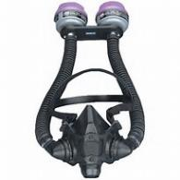
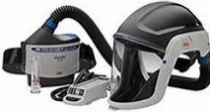
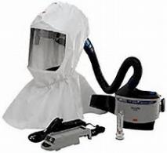
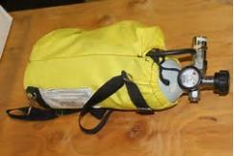
What do we expect to learn?
When Respiratory Protection is Required
Respiratory Protection Program
Worker Exposure to Shipboard Hazards
Immediately Dangerous to Life or Health (IDLH)

Slide 4
When is respiratory protection required? 29CFR1910.134(a)(1) NOTE: 29CFR1915.154 takes you to general industry
In the control of those occupational diseases caused by breathing air contaminated with harmful dusts, fogs, fumes, mists, gases, smokes, sprays, or vapors, the primary objective shall be to prevent atmospheric contamination.
This shall be accomplished as far as feasible by accepted engineering control measures (for example, enclosure or confinement of the operation, general and local ventilation, and substitution of less toxic materials).
When effective engineering controls are not feasible, or while they are being instituted, appropriate RESPIRATORS shall be used pursuant to this section.

Slide 5

Respiratory protection program 1910.134(c)(1)
In any workplace where respirators are necessary to protect the health of the employee or whenever respirators are required by the employer, the employer shall establish and implement a written respiratory protection program with worksite-specific procedures.

Slide 6
Respiratory protection program 1910.134(c)(1)(i) through 1910.134(c)(1)(viii)
Procedures for selecting respirators for use in the workplace
Medical evaluations of employees required to use respirators
Fit testing procedures for tight-fitting respirators
Procedures for proper use of respirators in routine and reasonably foreseeable emergency situations
Procedures and schedules for cleaning, disinfecting, storing, inspecting, repairing, discarding, and otherwise maintaining respirators
Procedures to ensure adequate air quality, quantity, and flow of breathing air for atmosphere-supplying respirators
Training of employees in the respiratory hazards to which they are potentially exposed during routine and emergency situations
Training of employees in the proper use of respirators, including putting on and removing them, any limitations on their use, and their maintenance

Slide 7
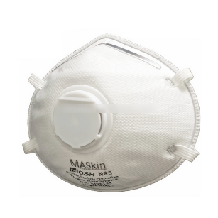
Selection of respirators 1910.134(d)(1)(i) through 1910.134(d)(1)(iii)
The employer shall select and provide an appropriate respirator based on the respiratory hazard(s) to which the worker is exposed and workplace and user factors that affect respirator performance and reliability
The employer shall select a NIOSH-certified respirator. The respirator shall be used in compliance with the conditions of its certification
The employer shall identify and evaluate the respiratory hazard(s) in the workplace:
Evaluation shall include a reasonable estimate of employee exposures to respiratory hazard(s) and an identification of the contaminant's chemical state and physical form.
Where the employer cannot identify or reasonably estimate the employee exposure, the employer shall consider the atmosphere to be *IDLH.
*IDLH – Immediately Dangerous to Life
or Health

Slide 8
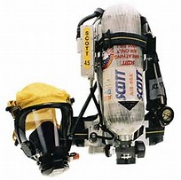
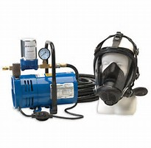
Respirators for IDLH Atmospheres 29CFR1910.134(d)(2)(i)
The employer shall provide the following respirators for employee use in IDLH atmospheres:
A full facepiece pressure demand SCBA certified by NIOSH for a minimum service life of thirty minutes, or
A combination full facepiece pressure demand supplied-air respirator (SAR) with auxiliary self-contained air supply

Slide 9
Worker exposure to shipboard hazards
Workers may be exposed to hazardous atmospheres which result in:
Being overcome by lack of oxygen.
Occupational illness due to long-term low-level exposures (for example asbestos, silica, lead).
Acute or systemic illness from exposure to solvents, paints, and cleaners.
Acute respiratory damage due to exposure to corrosives (such as acids, gases, mists).
Severe illness or even death from inhaling toxic materials (such as hydrogen sulfide, carbon monoxide).

Slide 10
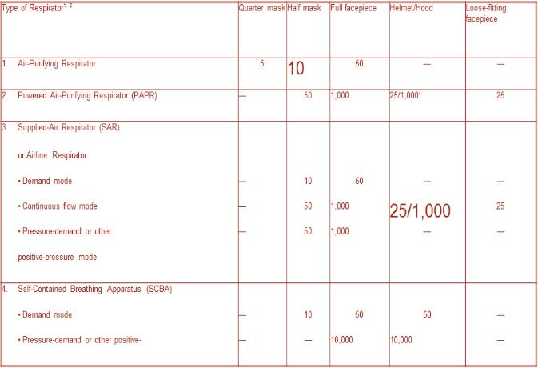
Assigned Protection factors (APF)
APF and Maximum Use Concentrations (MUC)
Employers must use the assigned protection factors listed in Table 1 to select a respirator that meets or exceeds the required level of employee protection. When using a combination respirator (e.g., airline respirators with an air-purifying filter), employers must ensure that the assigned protection factor is appropriate to the mode of operation in which the respirator is being used.

Slide 11
Maximum use concentration (MUC) 29CFR1910.134(d)(3)(i)(b)(1) through 29CFR1910.134(d)(3)(ii)
The employer must select a respirator for employee use that maintains the employee's exposure to the hazardous substance, when measured outside the respirator, at or below the MUC
Employers must not apply MUCs to conditions that are immediately dangerous to life or health (IDLH); instead, they must use respirators listed for IDLH conditions in paragraph (d)(2) of this standard
When the calculated MUC exceeds the IDLH level for a hazardous substance, or the performance limits of the cartridge or canister, then employers must set the maximum MUC at that lower limit
The respirator selected shall be appropriate for the chemical state and physical form of the contaminant

Slide 12
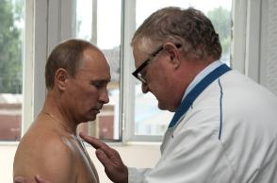

Medical Evaluation 29CFR1910.134(e)(1)
The employer shall provide a medical evaluation to determine the employee's ability to use a respirator, before the employee is fit tested or required to use the respirator in the workplace. The employer may discontinue an employee's medical evaluations when the employee is no longer required to use a respirator

Slide 13
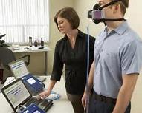
Fit testing 29CFR1910.134(f)
The employer shall ensure that employees using a tight-fitting facepiece respirator pass an appropriate qualitative fit test (QLFT) or quantitative fit test (QNFT) as stated in this paragraph

Slide 14
Qualitative fit test 29CFR1910.134(f)(8)(i)
Qualitative fit testing of respirators shall be accomplished by temporarily converting the respirator user's actual facepiece into a negative pressure respirator with appropriate filters, or by using an identical negative pressure air-purifying respirator facepiece with the same sealing surfaces as a surrogate for the atmosphere-supplying or powered air-purifying respirator facepiece

Slide 15
Quantitative fit test 29CFR1910.134(f)(8)(ii)
Quantitative fit testing of these respirators shall be accomplished by modifying the facepiece to allow sampling inside the facepiece in the breathing zone of the user, midway between the nose and mouth. This requirement shall be accomplished by installing a permanent sampling probe onto a surrogate facepiece, or by using a sampling adapter designed to temporarily provide a means of sampling air from inside the facepiec

Slide 16
Cleaning and disinfecting 29cfr1910.134(h)(1) through 29CFR1910.134(h)(1)(ii)
The employer shall provide each respirator user with a respirator that is clean, sanitary, and in good working order. The employer shall ensure that respirators are cleaned and disinfected, or procedures recommended by the respirator manufacturer, provided that such procedures are of equivalent effectiveness.
The respirators shall be cleaned and disinfected at the following intervals:
Respirators issued for the exclusive use of an employee shall be cleaned and disinfected as often as necessary to be maintained in a sanitary condition
Respirators issued to more than one employee shall be cleaned and disinfected before being worn by different individuals

Slide 17
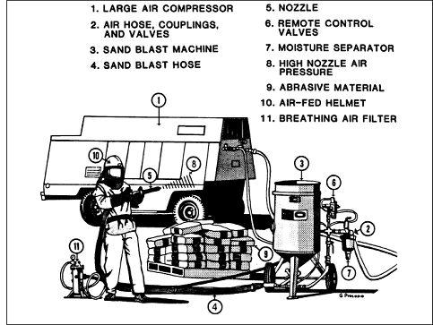
abrasive blasting
One of the most common methods of maintaining a vessel is to employ some sort of abrasive blasting or cleaning method. This activity can be defined as: the use of abrasive material surface cleaning, removal or preparation of a material.

Slide 18
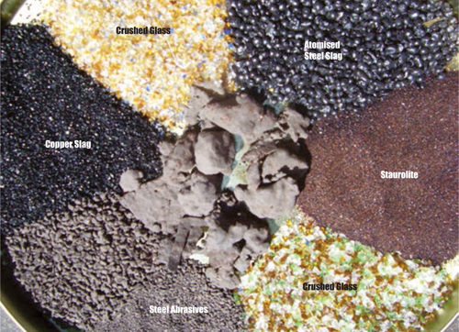
Abrasive blasting material examples

Slide 19
Sources of potential air contaminants
Base Material
Steel, aluminum, stainless steel, galvanized steel, copper-nickel and other copper alloys
Surface Coatings
Primers, anticorrosives and antifouling paints
Abrasive Blasting Materials
Coal slag, copper slag, nickel slag, glass, steel grit, garnet, silica sand

Slide 20
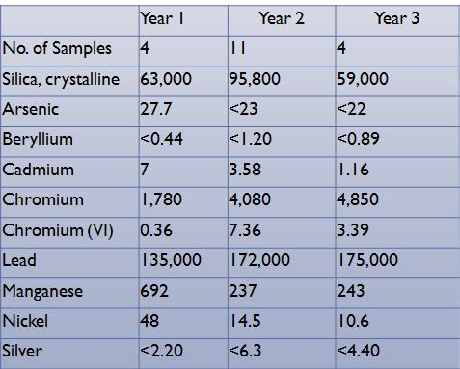
Example Surface Coating Concentrations
Other potential components of concern:
Al, Ba, Co, Cu, Fe, Mg, Mo, P, Se, Na, Te, Tl , Y, Zn, Zr
All results are in PPM

Slide 21
Abrasive blasting 29cfr1915.34(c) through 29cfr1915.34(c)(1)(iv)
Equipment. Hoses and fittings used for abrasive blasting shall meet the following requirements:
Hoses. Hose of a type to prevent shocks from static electricity shall be used
Hose couplings. Hose lengths shall be joined by metal couplings secured to the outside of the hose to avoid erosion and weakening of the couplings
Nozzles. Nozzles shall be attached to the hose by fittings that will prevent the nozzle from unintentionally becoming disengaged. Nozzle attachments shall be of metal and shall fit onto the hose externally
Dead man control. A dead man control device shall be provided at the nozzle end of the blasting hose either to provide direct cutoff or to signal the pot tender by means of a visual and audible signal to cut off the flow, in the event the blaster loses control of the hose. The pot tender shall be available at all times to respond immediately to the signal

Slide 22
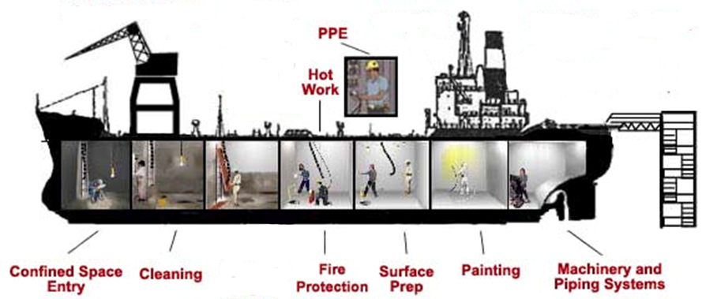
Other opportunities for exposure

Slide 23
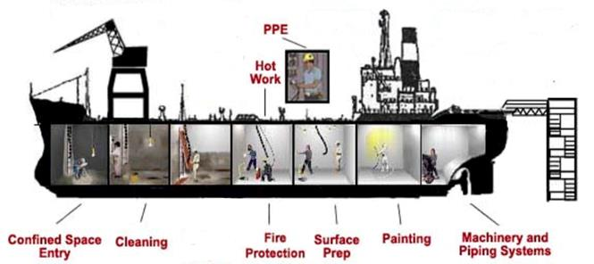
Confined space entry
Lack of O²
Other airborne hazards
Requires Self-Contained Breathing Apparatus (SCBA)
May require Emergency Breathing Apparatus (EBA)

Slide 24
Cleaning solvents
Corrosive (acids, alkalis)
Methyl Ethyl Ketone (MEK)
Trichlorethane (TCE)
May require Self-Contained Breathing Apparatus (SCBA)
May require Emergency Breathing Apparatus (EBA)

Slide 25
Toxic cleaning solvents 29CFR1915.32(a)
When toxic solvents are used, the employer shall employ one or more of the following measures to safeguard the health of employees exposed to these solvents
The cleaning operation shall be completely enclosed to prevent the escape of vapor into the working space
Either natural ventilation or mechanical exhaust ventilation shall be used to remove the vapor at the source and to dilute the concentration of vapors in the working space to a concentration which is safe for the entire work period

Slide 26
Fire Protection
May require Self-Contained Breathing Apparatus (SCBA)
May require Emergency Breathing Apparatus (EBA)

Slide 27
Surface preparation
Corrosive (acids, alkalis)
Benzol
Acetone
Amyl acetate
PPE

Slide 28
Chemical paint and preservative removers 29Cfr1915.33(a) through 29cfr1915.33(e)
Employees shall be protected against skin contact during the handling and application of chemical paint and preservative removers and shall be protected against eye injury by goggles or face shields
When using flammable paint and preservative removers, precautions shall be taken
When using chemical paint and preservative removers which contain volatile and toxic solvents, such as benzol, acetone and amyl acetate precautions shall be taken
When using paint and rust removers containing strong acids or alkalis, employees shall be protected by suitable face shields to prevent chemical burns on the face and neck
When steam guns are used, all employees working within range of the blast shall be protected by suitable face shields. Metal parts of the steam gun itself shall be insulated to protect the operator against heat burns

Slide 29
painting
Elastomeric respirator (N-95, N-99, N-100)
Depending on paint may require Self-Contained Breathing Apparatus (SCBA)
May require Emergency Breathing Apparatus (EBA)

Slide 30
Mechanical paint removers 29cfr1915.34(a) through 29CFR1915(a)(4)
Employees engaged in the removal of paints, preservatives, rusts, or other coatings by means of power tools shall be protected against eye injury by using goggles or face shields
All portable rotating tools used for the removal of paints, preservatives, rusts or other coatings shall be adequately guarded to protect both the operator and nearby workers from flying missiles
Portable electric tools shall be grounded
In a confined space, mechanical exhaust ventilation sufficient to keep the dust concentration to a minimum shall be used, or employees shall be protected by respiratory protective equipment

Slide 31
Mechanical paint removers 29cfr1915.34(b) through 29CFR1915(b)(2)
Hardened preservative coatings shall not be removed by flame in enclosed spaces unless the employees exposed to fumes are protected by air line respirators
Hardened preservative coatings shall not be removed by flame in enclosed spaces unless the employees exposed to fumes are protected by air line respirators
Flame or heat shall not be used to remove soft and greasy preservative coatings

Slide 32
Machinery and piping systems
Elastomeric respirator (N-95, N-99, N-100)
Powered Air Purifying Respirator (PAPR) if welding
Possible exposure to Asbestos if removing slag or other insulation

Slide 33
Time to test your knowledge of the topic

