Slide 1
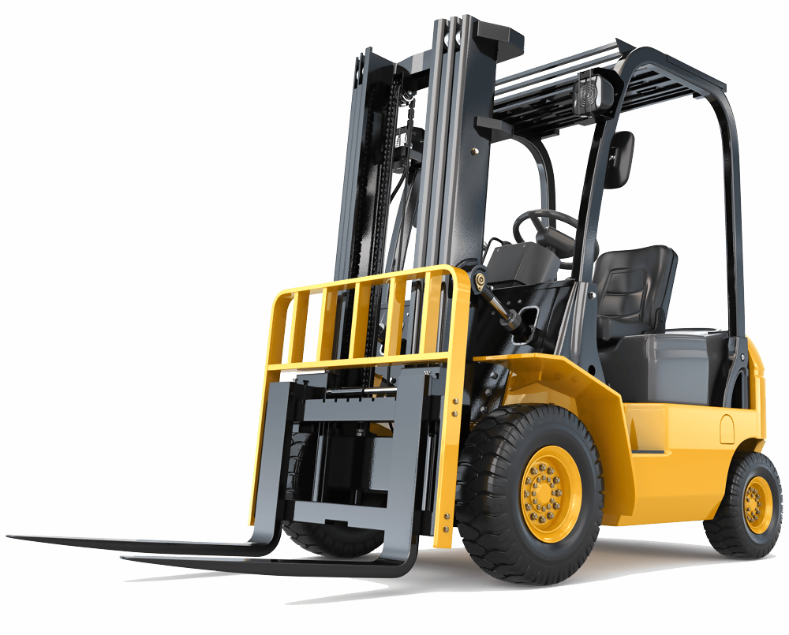
Powered Industrial Trucks

Slide 2
Disclaimer
Powered Industrial trucks
This material was produced under
grant number SH-05073-SH8 from the Occupational Safety and Health Administration, U.S. Department of Labor.
It does not necessarily reflect the views or policies of the U.S. Department of Labor, nor does mention of trade names, commercial products, or organizations imply endorsement by the U.S. Government.

Slide 3
Welcome
Powered Industrial trucks
P.I.T. Types & How they work
Pre start Inspection
Driving Safety
Maintenance

Slide 4
Module-1
Powered Industrial trucks
P.I.T. Types & How they work
Pre-Start Inspection
Driving Safety
Maintenance

Slide 5
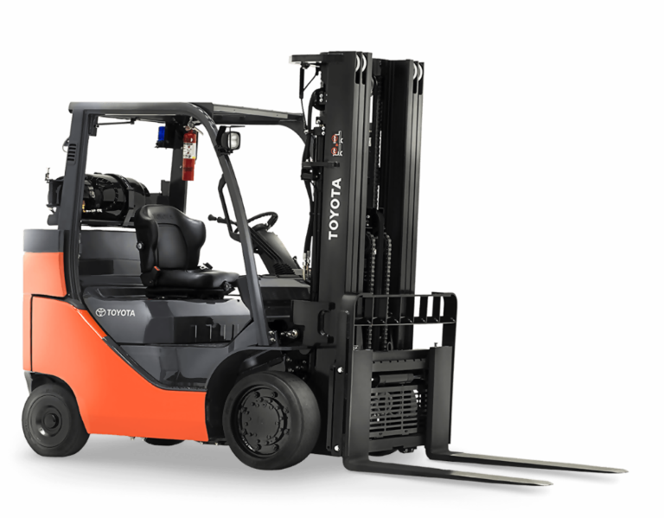
Typical Forklift
Powered Industrial trucks

Slide 6
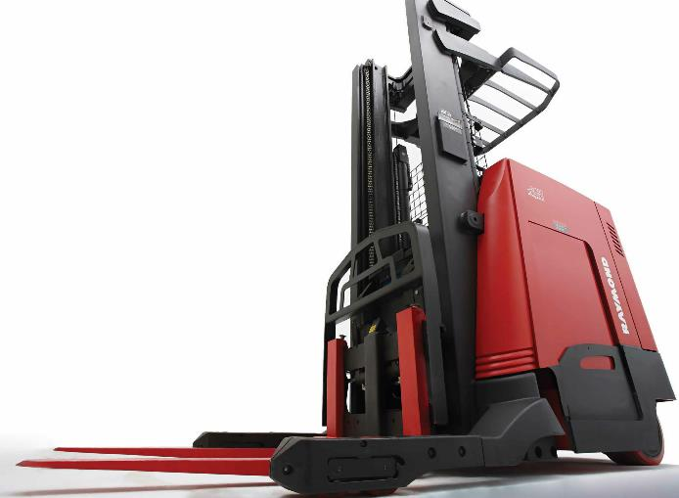
Stand-On Reach Truck
Powered Industrial trucks

Slide 7
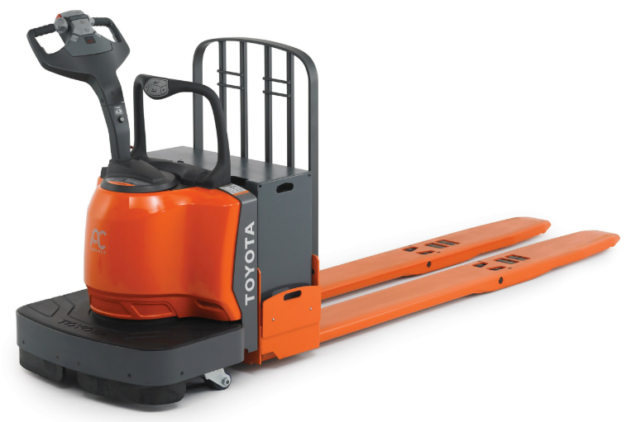
Walkie Rider
Powered Industrial trucks

Slide 8
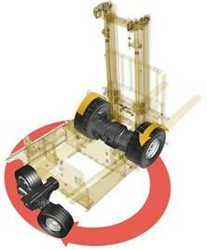
How they Work
Powered Industrial trucks
Steering Your Forklift
Isn’t as Simple as
Turning the Wheel

Slide 9
How they Work – Part 2
Powered Industrial trucks
Steering Your Forklift Isn’t as Simple as Turning the Wheel
Many accidents occur with industrial forklifts because the operators do not understand or have control of the machine’s rear end swing.
Forklift trucks steer from the rear axle and pivot on the front wheels, the rear end (counterweight) swinging wide when turning. Ensure that the rear end swings clear of materials, racks equipment and pedestrians when rounding corners or maneuvering in aisle and tight places.

Slide 10
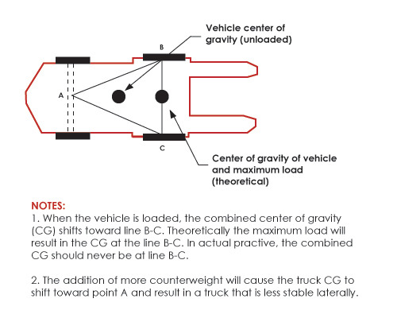
How they Work – Part 3
Powered Industrial trucks
Don’t expect a forklift to handle like a car or truck.
Because of the counterweight over its rear wheels, a forklift is much heavier than a car. As a result, it can’t stop or turn quickly.
When turning a forklift, watch behind you to make sure the rear end of the lift doesn’t run into anything – or anyone. Also keep an eye out for your forks and any load you may be carrying.
Most forklifts have a three-point suspension system. The three points are the two front wheels and the pivot point of the rear axle. Connect the three points, and you have what’s called the stability triangle.

Slide 11
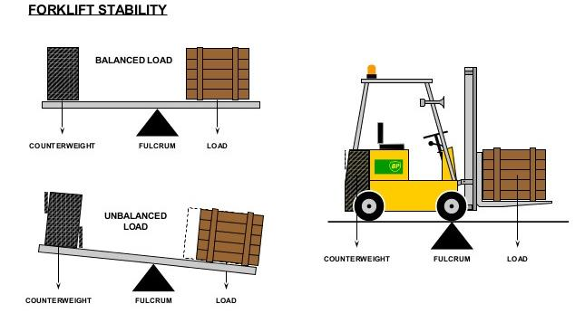
How they Work – Part 4
Powered Industrial trucks
FULCRUM
Point

Slide 12
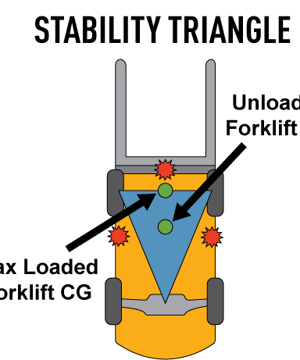
How they Work – Part 5
Powered Industrial trucks
FULCRUM
Point

Slide 13
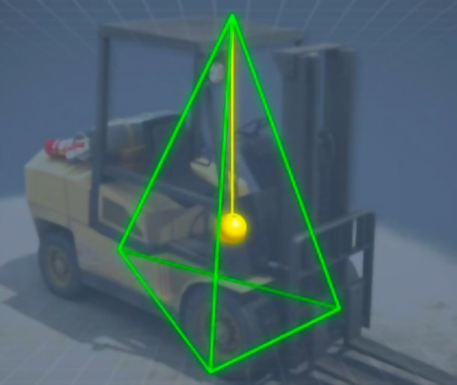
How they Work – Part 6
Powered Industrial trucks
Capacity and
Load Centers

Slide 14
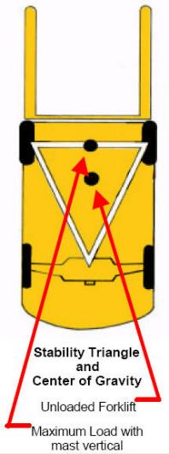
How they Work – Part 7
Powered Industrial trucks
Capacity and
Load Centers

Slide 15
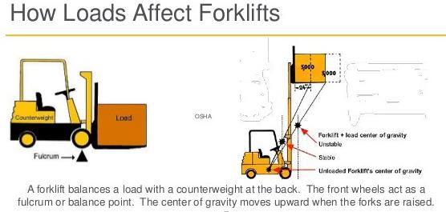
How they Work – Part 8
Powered Industrial trucks

Slide 16
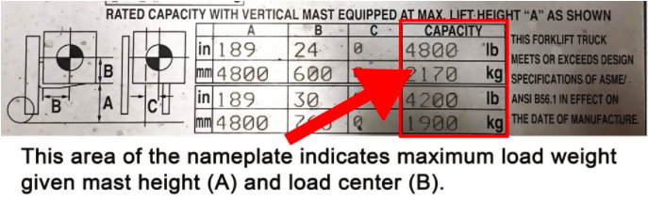
Rated Capacity
Powered Industrial trucks

Slide 17
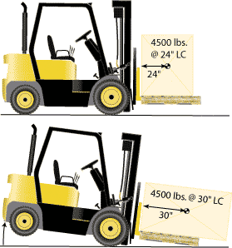
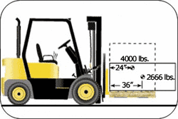
Rated Capacity – Part 2
Powered Industrial trucks

Slide 18
Module-2
Powered Industrial trucks
P.I.T. Types & How they work
Pre-Start Inspection
Driving Safety
Maintenance

Slide 19

Pre-Start Inspection
Powered Industrial trucks
It is necessary to inspect the work site also. Items to inspect include:
The surface on which the Forklift will be used,
Hazards that might create dangerous driving conditions,
Above hazards that may effect personal while the Forklift is extended,
Weather conditions

Slide 20
Pre-Start Inspection – Part 2
Powered Industrial trucks
Visual Inspection
Appearance * Tires
Forks * Overhead Guard
Hoses * Chain
Name Plate * Leaks
Battery Connector * Battery Cables

Slide 21
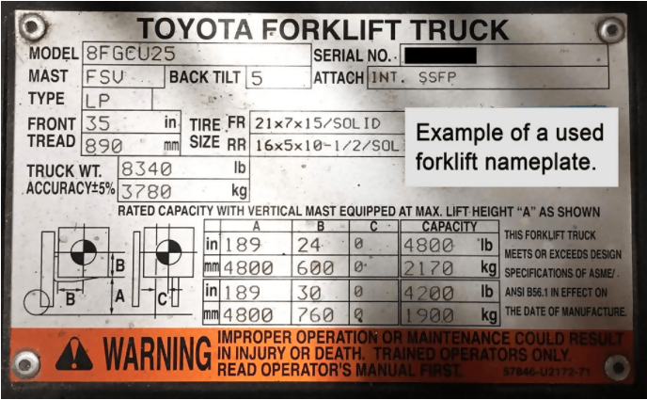
Pre-Start Inspection – Part 3
Powered Industrial trucks
Forklift Nameplate:
Basics A forklift's nameplate (also referred to
as a data plate, weight plate or load plate)
Provides integral information about the machine's capacity, fuel type, and weight.
Workers and operators can refer to the nameplate to ensure safe and efficient operation.

Slide 22
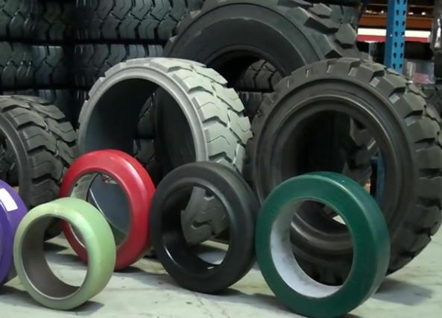
Pre-Start Inspection – Part 4
Powered Industrial trucks
Tires –
What are they generally made of?
Are they Damaged?

Slide 23
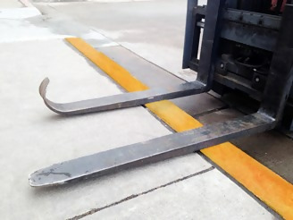
Pre-Start Inspection – Part 5
Powered Industrial trucks
Forks –
What are we looking for?
Why?

Slide 24
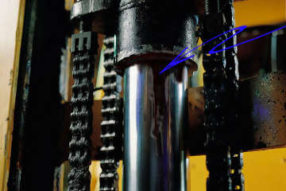
Pre-Start Inspection – Part 6
Powered Industrial trucks
Hydraulics –
Leaks?
Parking area?

Slide 25
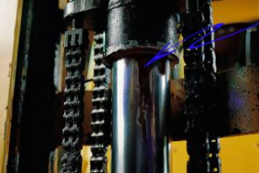
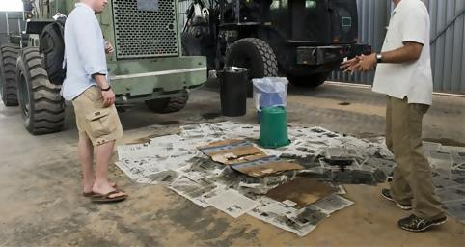
Pre-Start Inspection – Part 7
Powered Industrial trucks
Hydraulics –
Leaks?
Parking area?

Slide 26
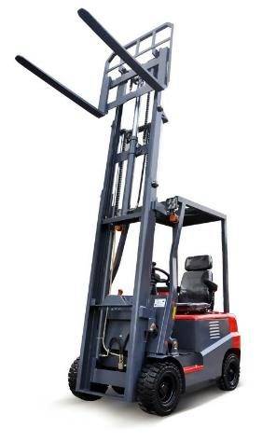
Pre-Start Inspection – Part 8
Powered Industrial trucks
Mast –
Cracks?
Broken or Elongated links?

Slide 27
Pre-Start Inspection – Part 9
Powered Industrial trucks
Operating Checks
Horn * Seat/Belt
Hour Meter * Overhead Guard
Battery Indicator * All Lights
Back-up Alarm * Mirror
Gauges

Slide 28
Module-3
Powered Industrial trucks
P.I.T. Types & How they work
Pre-Start Inspection
Driving Safety
Maintenance

Slide 29
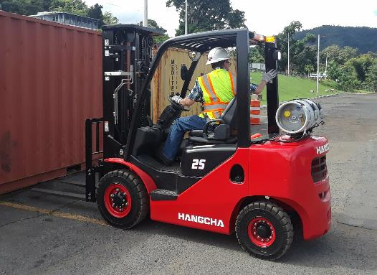
Driving Safety
Powered Industrial trucks
Authorized operators only
Quickly report accidents
Always wear seat belts
No person under the forks
Operate controls only from driver’s seat
Never block exits or emergency equipment

Slide 30
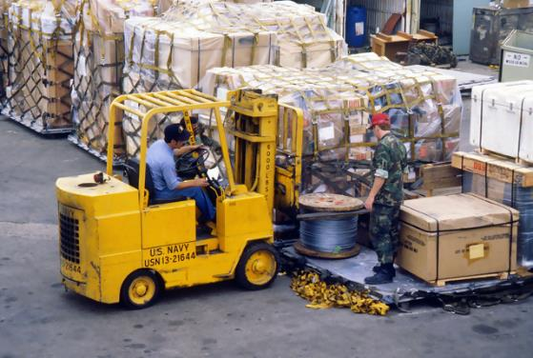
Driving Safety – Part 2
Powered Industrial trucks
Loading and Unloading
Never overload forklift
Check load weight
Locate load’s center of gravity
Inspect the load
Restack or secure unstable loads
Be sure forks are under load
Tow from rear towing pin

Slide 31
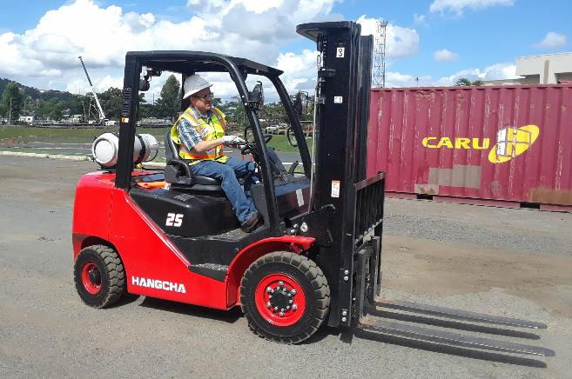
Driving Safety – Part 3
Powered Industrial trucks
Traveling
Look in the direction of travel
Keep body inside cage
Keep forks low when traveling
Sound the horn
Don’t speed
Check clearance

Slide 32
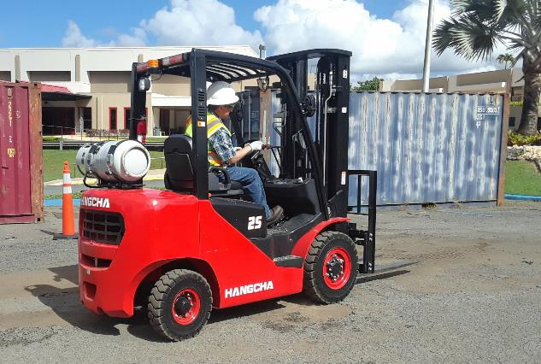
Driving Safety – Part 4
Powered Industrial trucks
Traveling
Avoid loose objects or holes
Never carry passengers
Pedestrians have the right-of-way
Keep a safe distance from the edge of ramps or docks
Never eat or drink
No horseplay

Slide 33
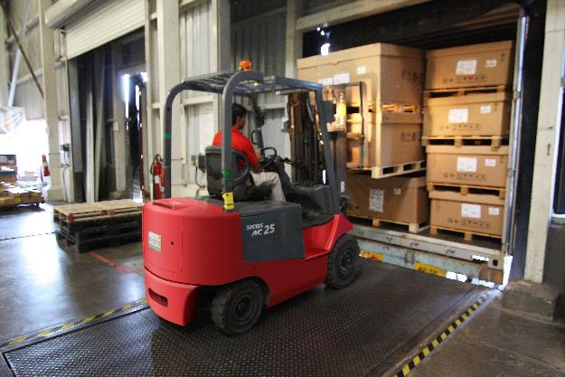
Driving Safety – Part 5
Powered Industrial trucks
Loading Docks
Inspect the dock plate
Check the trailer floor condition
Make sure trailer wheels are chocked
Ensure that the nose of the trailer is supported by the tractor or safety stabilizer.

Slide 34
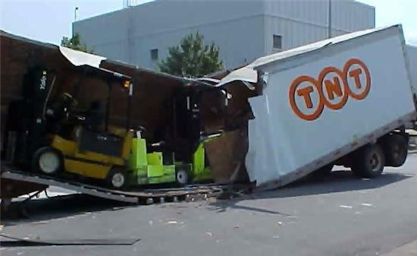
Driving Safety – Part 6
Powered Industrial trucks
Loading Docks
Inspect the dock plate
Check the trailer floor condition
Make sure trailer wheels are chocked
Ensure that the nose of the trailer is supported by the tractor or safety stabilizer.

Slide 35
Driving Safety – Part 7
Powered Industrial trucks
Parking
Don’t block exits or aisles
Lower the forks
Set gear to neutral
Set the parking brake
Turn off the ignition

Slide 36
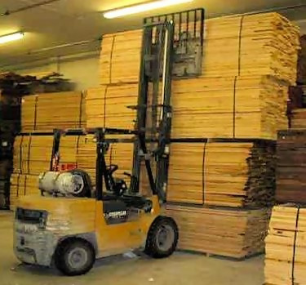
Don’t leave a forklift unattended.
Powered Industrial trucks
A forklift is considered "unattended" when the operator is 25 ft. or more away from the vehicle even if it remains in his view, or whenever the operator leaves the vehicle and it is not in his view.
When a forklift is left unattended, forks must be fully lowered, controls neutralized, power shut off, and brakes set.
Wheels must be blocked if the truck is parked on an incline.

Slide 37
Don’t leave a forklift unattended. – Part 2
Powered Industrial trucks
A forklift is considered "unattended" when the operator is 25 ft. or more away from the vehicle even if it remains in his view, or whenever the operator leaves the vehicle and it is not in his view.
When a forklift is left unattended, forks must be fully lowered, controls neutralized, power shut off, and brakes set.
Wheels must be blocked if the truck is parked on an incline.
When the operator of a forklift is within 25 ft. of the truck still in his view, the load engaging means must be fully lowered, controls neutralized, and the brakes set to prevent movement, but the power does not need to be shut off.

Slide 38
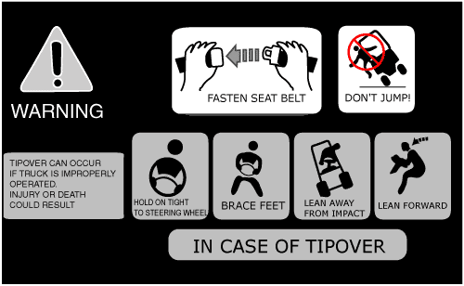
What to do in case of a tipover
Powered Industrial trucks
If the forklift tips, keep your arms and legs inside and hold on to the steering wheel.
Don’t attempt to jump out – you can’t move faster than the forklift can tip over. Most people who attempt to jump are killed by the impact of the overhead guard.

Slide 39
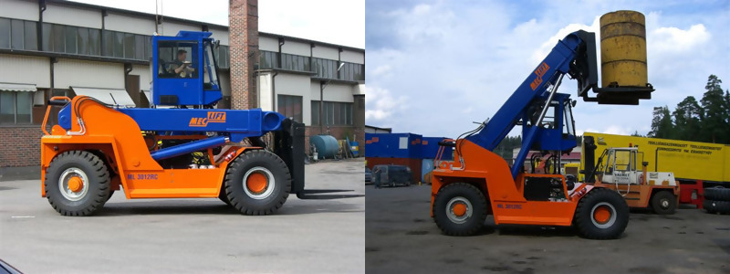
Don’t travel with a raised load
Powered Industrial trucks

Slide 40
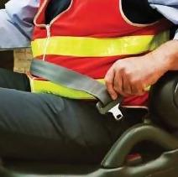
Seatbelts
Powered Industrial trucks
Seatbelts are required on all forklifts manufactured since 1992 and can be retrofitted on all older models.
You are required to uses it when it is supplied with the forklift. It will save your life.
Buckle Up - Before you drive!!

Slide 41
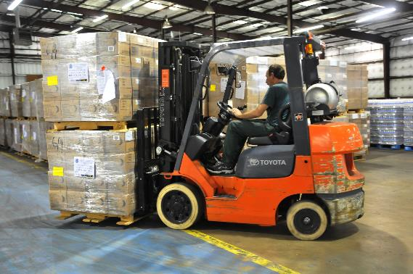
Proper loading of the fork truck:
Powered Industrial trucks
Adjust the forks to distribute the weight evenly. Note that forks are adjustable.
Tilt the mast back carefully to stabilize the load.
Do not attempt to physically move or push a fallen or misaligned load back onto the forks. ensure that the forks do not go through to the other side where pallets are closely stacked.

Slide 42
Forklift Do’s And Don'ts
Powered Industrial trucks
No one else on the forklift except the operator, unless the forklift has a seat for a rider.
Always drive with the forks lowered and lower forks to floor when parking the forklift.
No Speeding - Speed Limit not to exceed 6 MPH.
No faster than a brisk walk

Slide 43
Proper loading of the fork truck:
Powered Industrial trucks
Adjust the forks to distribute the weight evenly. Note that forks are adjustable.
Tilt the mast back carefully to stabilize the load.
Do not attempt to physically move or push a fallen or misaligned load back onto the forks. ensure that the forks do not go through to the other side where pallets are closely stacked.

Slide 44
Module-4
Powered Industrial trucks
P.I.T. Types & How they work
Pre-Start Inspection
Driving Safety
Maintenance

Slide 45
Forklift Inspection and Maintenance
Powered Industrial trucks
All forklifts be examined at least daily before being used. Forklifts used on a round-the-clock basis must be examined at the start of each shift.
Check the following:
Fluid levels -- oil, water, and hydraulic fluid.
Leaks, cracks or other visible defect in hydraulic hoses and mast chains.
Safety decals and nameplates in place and legible.
All safety devices working properly including the seat belt and backup alarm.

Slide 46
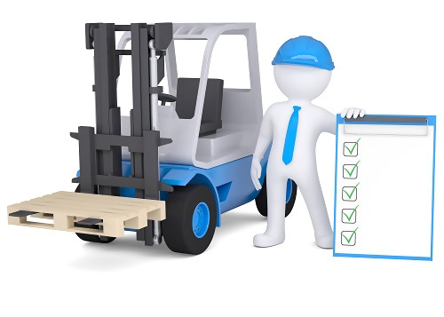
Trained and
Authorized Operators
Powered Industrial trucks
Only operate Forklifts if trained and Authorized
Understand Operating Instructions and Safety rules.
Receive Hands-on Training from a Qualified Person.
Know how to Inspect Equipment and Work Area.
Demonstrate How to Safely Operate Equipment.
Keep at Least 10 feet Away from Power Lines.
Never disable a safety or warning device.

Slide 47

Review
Powered Industrial trucks

Slide 48
Knowledge Check
What are the three basic types of Powered Industrial Trucks?

Slide 49
Knowledge Check – Part 2
What are the three basic types of Powered Industrial Trucks?
Standard Sit-down Forklift
Reach Truck
Walkie-Rider

Slide 50
Knowledge Check – Part 3
Forklifts turn on which axle?

Slide 51
Knowledge Check – Part 4
Forklifts turn on which axle?
Powered Industrial Trucks turn with their rear wheels and pivot on the front wheels, the rear end swings wide. The operator must develop the habit of allowing room for this in order to avoid hitting anything.

Slide 52
Knowledge Check – Part 5
What is the Fulcrum point?

Slide 53
Knowledge Check – Part 6
What is the Fulcrum point?

Slide 54
Knowledge Check – Part 7
4. A visual Inspection should include….?

Slide 55
Knowledge Check – Part 8
4. A visual Inspection should include….?
Visual Inspection
Appearance * Tires
Forks * Overhead Guard
Hoses * Chain
Name Plate
Battery Connector * Battery Cables
Leaks

Slide 56
Knowledge Check – Part 9
5. When is a Forklift considered . UNATTENDED?

Slide 57
Knowledge Check – Part 10
5. When is a Forklift considered . UNATTENDED?
A forklift is considered "unattended" when the operator is 25 ft. or more away from the vehicle even if it remains in his view, or
whenever the operator leaves the vehicle and it is not in his view.

Slide 58
Additional Resources
OSHA website: http://www.osha.gov and OSHA offices: Call or Write (800-321-OSHA)
Compliance Assistance Specialists in the area offices
National Institute for Occupational Safety and Health (NIOSH) – OSHA’s sister agency
OSHA Training Institute Education Centers
Standards that Apply OSHA Standards: 29 CFR 1910.67, 29 CFR 1910.269(p), 29 CFR 1926.21, 29 CFR 1926.453, 29 CFR 1926.502. American National Standards Institutes standards: ANSI/SIA A92.2-1969, ANSI/SIA A92.3, ANSI/SIA A92.5, ANSI/SIA A92.6.

