Slide 1
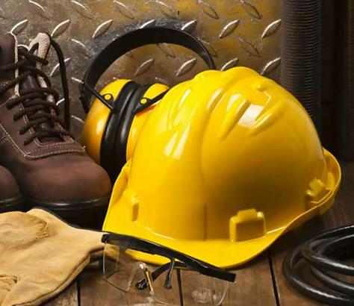
P- personal P- protective E- equipment

Slide 2
Disclaimer
Personal Protective Equipment
This material was produced under
grant number SH-05073-SH8 from the Occupational Safety and Health Administration, U.S. Department of Labor.
It does not necessarily reflect the views or policies of the U.S. Department of Labor, nor does mention of trade names, commercial products, or organizations imply endorsement by the U.S. Government.

Slide 3

PPE Training-Initial
Personal Protective Equipment (PPE) is any safety equipment workers wear to prevent injury in the workplace when engineering and administrative controls fail to eliminate the hazard.
Training is required by OSHA regulations contained in 29CFR 1910.132-140.
After going through training you will know:
When PPE is necessary
What PPE is necessary
How to properly don, doff, adjust and wear PPE
The limitations of PPE
The proper care, maintenance, useful life, and disposal of the PPE

Slide 4
What is this training based on?
Supervisors and/or safety officers from your specific work unit conducted a hazard assessment to determine any and all jobs that would require the use of PPE.
This information was then consolidated into one document Job Hazard Analysis (JHA)
PPE that shows up on the J.H.A. is required to be worn.

Slide 5
Welcome
Personal Protective Equipment
What must happen before PPE?
What is a Job Hazard Analysis?
How to wear Personal Protective Equipment, correctly.
Pictograms on labels of chemicals… WHY?
Notes:
My name is --- and I am a workplace safety expert. I am here to help you work safe and stay safe. For the next hour I will be telling you about how you can protect yourself from different types of safety hazards. You will learn how to wear equipment that will protect you from injuries and how to understand labels on chemical containers so that you handle them appropriately. What you learn today will help you protect yourself and others from accidents.
There are laws that protect you while you are at work. OSHA stands for Occupational Safety and Health Administration. OSHA is the US Government agency that gives employers rules about safe workplaces and what needs to happen to protect you from being injured or killed at work. The mission of OSHA is to save lives, prevent injuries, and protect the health of workers.
OSHA is also the agency that supports safety training to help you work safe and stay safe.

Slide 6
What happens, when we don’t use our P.P.E.

Slide 7
Module- 1
Personal Protective Equipment
What must happen before PPE?
What is a Job Hazard Analysis?
How to wear Personal Protective Equipment, correctly.
Pictograms on labels of chemicals… WHY?

Slide 8
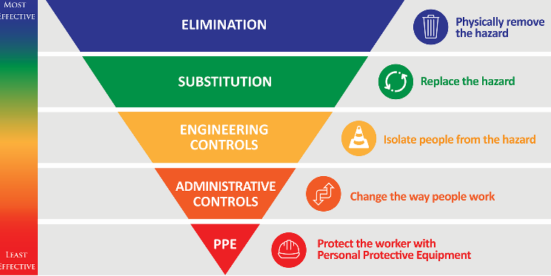
Before PPE Selection begins, one must try to ELIMINATE the danger if possible.
Personal Protective Equipment

Slide 9
Personal Protective Equipment
Employers must protect employees:
Assess the workplace
Eliminate and/or reduce the hazards found using engineering and administrative controls
If the Hazard cannot be Eliminated, then personal protective equipment, is required
Remember, Personal Protective Equipment is the last level of control.

Slide 10
Module- 2
Personal Protective Equipment
What must happen before PPE?
What is a Job Hazard Analysis?
How to wear Personal Protective Equipment, correctly.
Pictograms on labels of chemicals… WHY?

Slide 11
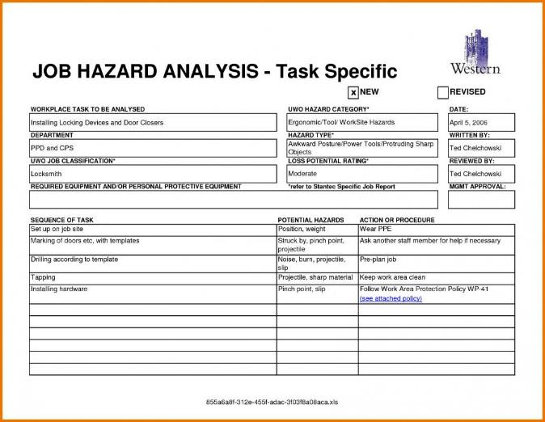
Personal Protective Equipment 2
Task
What Am I doing?
Potential Hazard
What injury can occur?
Controls to eliminate
Hazard
How Will I protect myself?

Slide 12
Personal Protective Equipment 3
Why is a JHA important?
Once you know what the hazards are, you can reduce or eliminate them before anyone gets hurt.
It will take a little time to do your JHAs, but it's time well spent.
Be sure to involve employees in the process --- they do the work and often know the best ways to work more safely.
Notes:
The JHA can also be used to investigate accidents and to train workers how to do their jobs safely.

Slide 13
Personal Protective Equipment 4
How do I do it?
1. Break the job task into steps.
Watch the worker do the job and list each step in order
Do not make it too broad or too detailed
Review the steps with the worker and other workers who do the same job to make sure you have not left anything out.

Slide 14
Personal Protective Equipment 5
How do I do it?
2. Identify the hazards of each step.
For each hazard, ask:
What can go wrong?
What are the consequences?
How could it happen?
What are other contributing factors?
How likely is it that the hazard will occur?

Slide 15
Personal Protective Equipment 6
How do I do it?
3. Establish ways to eliminate or reduce the hazards.
Safer way to do the job
Be specific - don’t use generalizations like "Be Careful“
Changes in equipment
E.g. machine guards, improved lighting, better ventilation
P.P.E.- gloves, hearing protection, hard hats, respirators.

Slide 16
Module- 3
Personal Protective Equipment
What must happen before PPE?
What is a Job Hazard Analysis?
How to wear Personal Protective Equipment, correctly.
Pictograms on labels of chemicals… WHY?

Slide 17
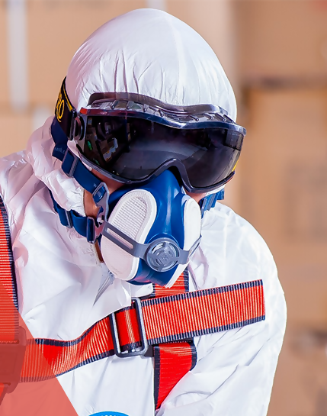
The Fundamentals of Personal Protective Equipment (PPE)

Slide 18
Eye and Face Protection
1910.133

Slide 19
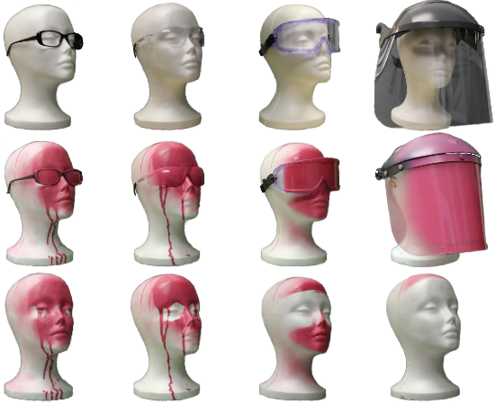
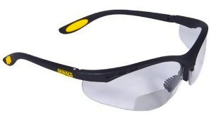
Eye and Face Protection 2
Personal Protective Equipment

Slide 20
Respiratory Protection
1910.134

Slide 21
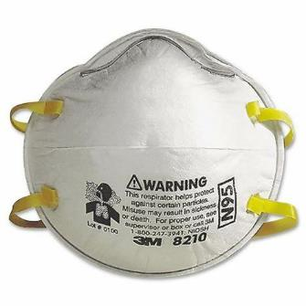
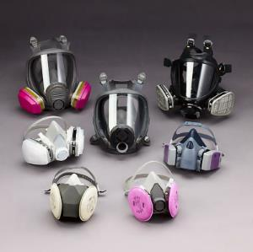
Respiratory Protection 2
Personal Protective Equipment

Slide 22
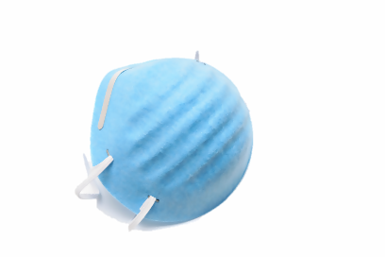
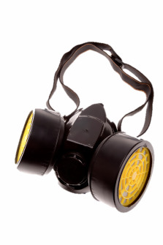
Protect Your Breathing
Employees need to be medically cleared to wear respirators before commencing use.
A physician or other licensed health care professional needs to medically evaluate employees to determine under what conditions they can safely wear respirators.
Notes:
I just described different types of eyewear that are used for specific jobs and workplaces. The same thing is true for respirators—the type of respirator you need to put on depends on what you don’t need to put in (your lungs).
There are two primary types of respirators and they are used for different purposes: an air purifying respirator and an atmosphere supplying respirator. Employees need to be medically cleared to wear respirators before commencing use. A physician or other licensed health care professional needs to medically evaluate employees to determine under what conditions they can safely wear respirators.
I will practice putting on a respirator and adjusting the fit to my face in a few minutes. I will also give you printed information from OSHA about using different types of respirators, like dust masks, half-face or full-face respirators, battery-powered fan respirators in a helmet or hood, and the type that has its own air tank.
[Show examples of different respirators and describe the type of uses for each. Demonstrate how to correctly wear, including how to perform fit checks. Also describe how to regularly inspect respirators and when to replace.]
Image source: Getty Images

Slide 23
Head Protection
1910.135

Slide 24

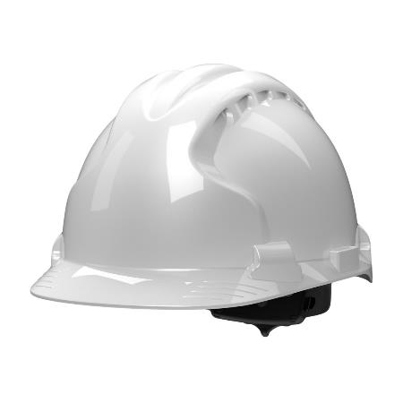
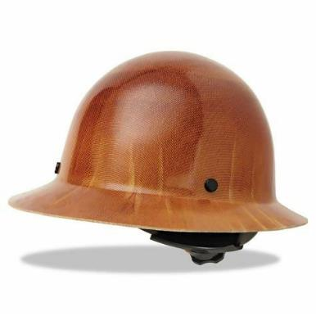
Head Protection 2
Personal Protective Equipment
Notes:
Let’s start by discussing how to protect your head. Your employer should provide you with head protection if objects could fall from above and hit you on the head; or you might bump your head on pipes or beams; or you might come into contact with electrical hazards. In these cases you will be required to wear a hard hat. Another type of protective headgear on the market is called a “bump hat," to protect you from head bumps but no other protection.
To do the job, your hard hat must fit your head size. [Demonstrate the adjustable headband and clearance between the shell and the suspension system for ventilation and distribution of an impact.] The hat should not bind, slip, fall off or irritate your skin. Your hard hat might also have slots for earmuffs, safety glasses, a face shield or a mounted light.
Remember: Inspect your hat daily for holes, cracks, tears or other damage. Let your supervisor know if you find any so that you can get it replaced.
Image source: Getty Images

Slide 25
Head PPE
Needed when employees are exposed to hazards that have potential to cause a head injury.
Examples of hazards:
Flying objects.
Falling objects or materials.
Working near exposed energized electrical equipment.
Working around or on scaffolds.
Working at construction sites.
Working around overhead tools or machinery.

Slide 26
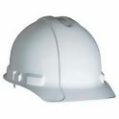
Types of Head Protection
Impact Protection
Type I – Is designed to protect only against objects falling from straight overhead, hitting the hardhat on the top.
Type II – Is designed to protect against blows on the top of the head as well as side impacts.
Electrical
Class A (old American National Standards Institute standard) or Class G (new ANSI Standard) good up to 2,200 volts.
Class B (old ANSI standard) or Class E (new ANSI Standard) good up to 20,000 volts.
Class C not rated for electrical protection.

Slide 27
Donning Head Protection
Hard hat protection is effective only if the hat is adjusted to fit properly and is worn squared and not cocked at an angle or perched on the back of the head.
Severe lacerations from relatively light blows have been incurred by workers wearing hard hats in unusual positions.
Must not be worn backwards.

Slide 28
Care and Maintenance
Check prior to each use for cracks, damaged suspension and chalky appearance (UV damage).
Be aware that stickers placed on hardhat can conceal damage. Markers will soften the plastic
Replace as necessary.
Do not store in direct sunlight.

Slide 29

Protect Your Head
Use a hard hat when:
objects might fall from above
you might bump your head, such as on pipes or beams
your head might touch electrical hazards

Slide 30
Foot Protection
1910.136

Slide 31
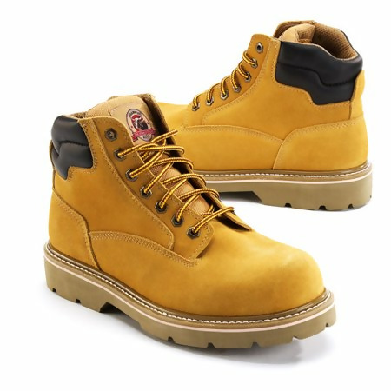
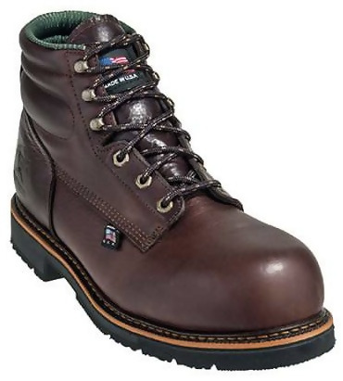
Foot Protection 2
Personal Protective Equipment

Slide 32
Foot Protection 3
Personal Protective Equipment
Use foot and leg protection when:
heavy objects might roll onto or fall on your feet
working with sharp objects that could pierce the soles or uppers of ordinary shoes
near hot metal
working on or around hot, wet or slippery surfaces
electrical hazards are present

Slide 33
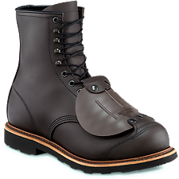
Protect Your Legs and Feet
Use foot and leg protection when:
heavy objects might roll onto or fall on your feet
working with sharp objects that could pierce the soles or uppers of ordinary shoes
working on or around hot, wet or slippery surfaces
electrical hazards are present
Notes:
Safety shoes have impact-resistant toes and heat-resistant soles that protect the feet against hot work surfaces. Electrical hazard, safety-toe shoes will prevent feet from completing an electrical circuit to the ground. Foundry shoes keep hot metal from lodging in shoe eyelets, tongues or other shoe parts. These snug-fitting leather or leather-substitute shoes have leather or rubber soles and rubber heels. Some safety shoes have metal insoles to protect the bottom of your feet against punctures wounds. Metatarsal guards protect the instep area and are strapped to the outside of shoes. [Show the workboots and metatarsal protection.] Toe guards fit over the toes of regular shoes to protect the toes from impact and compression hazards. Specialty shoes should be paid for by your employer.
Leggings may protect the lower legs and feet from heat hazards such as hot metal or welding sparks, and chemicals.
As with all protective equipment, safety leg and footwear should be inspected prior to each use. Look for cracks or holes, separation of materials, broken buckles or laces. The soles of shoes should be checked for pieces of metal or other embedded items that could present electrical or tripping hazards.
Image source: Redwing Shoes (used with permission) and Getty Images

Slide 34
Hand Protection
1910.138

Slide 35
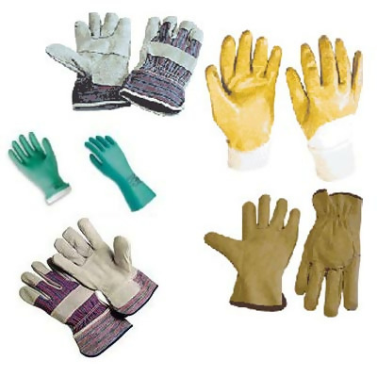
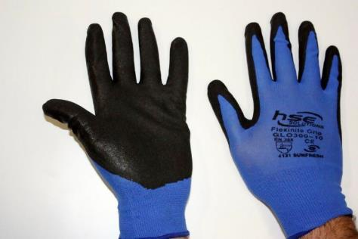
Hand Protection 2
Personal Protective Equipment

Slide 36
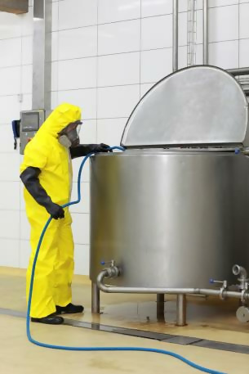
Protect Your Hands and Body
Use protective clothing when you are near:
intense heat or cold
hot metals and liquids
tools, machinery, and materials
hazardous chemicals
potentially infectious materials, like blood
radiation
Notes:
There are many different ways that you can protect your hands and body from harmful substances, burns, electrical dangers, bruises, cuts, punctures, fractures and amputations. PPE includes gloves, vests, jackets, aprons, coveralls, sleeves, and full body suits.
Many of you will wear gloves on your job. A glove designed for one function may not protect against a different function. For example, one type of glove may provide the grip you need to pick up a tool but it may not protect your arms from heat. In general, though, your gloves will be either leather, canvas or metal mesh (to protect from cuts and burns); fabric and coated fabric (to protect you from dirt, slivers, or abrasions); or rubber gloves (different types of rubber gloves protect you from various liquids and chemicals or provide insulation against electrical hazards). Inspect your gloves to make sure that they are not too worn, torn, or have any holes. If your gloves come into contact with chemicals, there may be a danger in re-using them.
If you wear other protective clothing (like jackets or coveralls), you should inspect it before each time you wear. Make sure it fits you well, too, so it won’t get caught on machinery or cause you to trip and fall.
Image source: Getty Images

Slide 37
Hearing Protection
1910.95

Slide 38
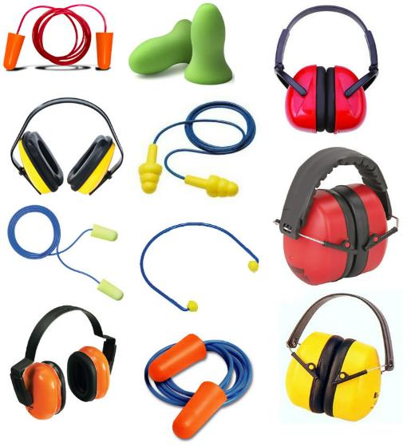
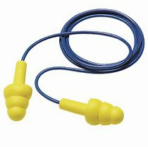
Hearing Protection 2
Personal Protective Equipment

Slide 39
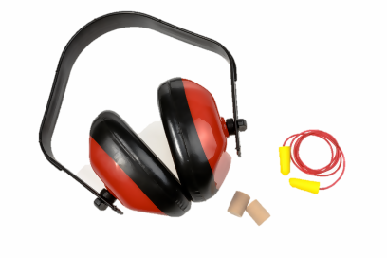
Protect Your Hearing
Use earplugs or earmuffs when:
you are exposed to loud noise from machines, tools, fans, or music systems
One sign for high noise levels is if you need to raise your voice to be heard by someone nearby (3 feet)
Notes:
“Too much” noise can cause you hearing loss. But it’s tough for you to know how much noise is “too much”. One sign for high noise levels is if you need to raise your voice to be heard by someone nearby. Your employer should measure both the level of noises and how long workers are exposed to noise to determine this.
You can protect your hearing by using earplugs or earmuffs [point to each image on the slide]. Earplugs can be either disposable or reusable. Whichever you use, getting the right fit for your ear is important. In a few minutes I will show you how to use earplugs for the best protection.
Earmuffs require that you have a perfect seal around the ear, which sometimes can be difficult if you have glasses or hair that gets in the way. Replacing your earplugs or earmuff when the fit isn’t tight is critical to protect your hearing.
[Demonstrate how to correctly insert the earplugs into the ear canal and assess correct fit for each. Show the Noise Reduction Rating on the packaging. Describe how to regularly inspect ear plugs. Repeat the demonstration with the earmuffs.]
Image source: Getty Images

Slide 40
Module- 4
Personal Protective Equipment
What must happen before PPE?
What is a Job Hazard Analysis?
How to wear Personal Protective Equipment, correctly.
Pictograms on labels of chemicals… WHY?

Slide 41
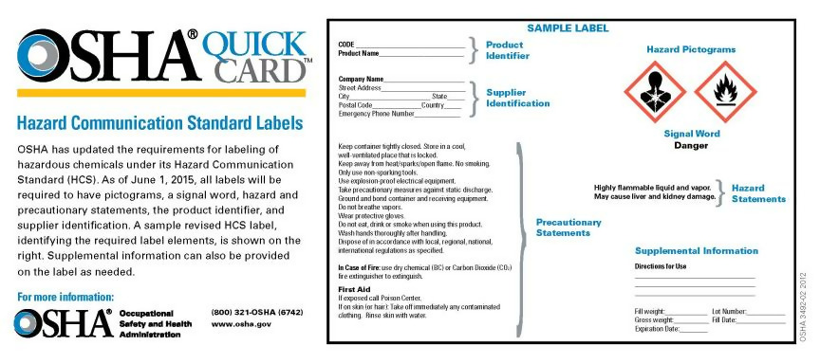
Working Around Chemicals Safely
Picture of label from Quickcard
Notes:
You have the right to know and understand the hazardous chemicals you use and how to work with them safely. Hazardous chemicals are required to have labels that help you understand the safety hazards. [Point to the label on the slide and then to different sections as you describe each. See https://www.osha.gov/Publications/HazComm_QuickCard_Labels.html and https://www.osha.gov/Publications/OSHA3636.pdf for more information. ] As of June 1, 2015, all labels will be required to have product and supplier identification, an understandable picture describing the safety hazards, a signal word that describes the extent of danger, and hazard and precautionary statements.
Image Source: OSHA

Slide 42
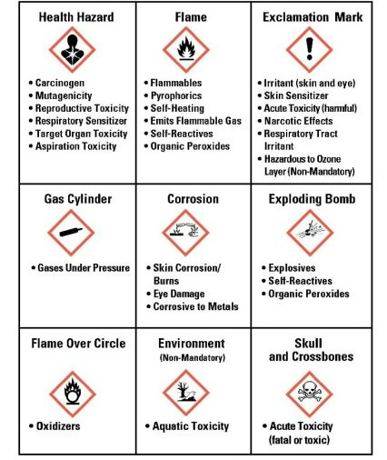
Pictograms on Labels
G.H.S.
Notes:
[Pass out the GHS wallet card to participants. Go through each of the nine pictograms in random order, having the participants put a finger on each pictogram that you describe. Explain the terms on the card using non-technical words.]
It’s not enough to know what the pictograms mean—you need to know what to do to protect yourself when you see each pictogram. The labels on chemicals provide some of this information. Your employer should also have Safety Data Sheets, a paper that gives you much more information than the label.
Image Source: OSHA

Slide 43
Safety Data Sheets
Look for Safety Data Sheets for each chemical in your work area--you should have easy access to this information.
Each Safety Data Sheet provides information that can be read quickly in an emergency, including:
first-aid instructions, symptoms, and medical care
what to do in case of fire
how to safely cleanup chemical spills or leaks
Notes:
The Safety Data Sheet gives you more information than a label can provide. For example, in an emergency the Safety Data Sheet will describe the initial care that should be given to someone who has been exposed to the chemical—based on whether fumes were inhaled, the chemical came into contact with skin or eyes, or was swallowed. The Safety Data Sheet also will describe the most important symptoms, if any of these should happen. It will also give recommendations for immediate medical care, if necessary.
Each sheet also provides recommendations for responding to fires or spills of the chemical.

Slide 44
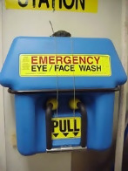
Personal Protective Measures
Personal protective equipment (PPE) can help to protect you from exposure to chemicals.
Eye, face, skin, and respiratory protection
Special PPE for chemicals includes rubber aprons or gloves
Eyewash stations
Notes:
Your employer should also have eye/face wash stations available in case of emergency.

Slide 45

Remember
You have the right and responsibility to be safe at work.
Your employer has the responsibility to provide a workplace free from safety hazards.
OSHA is the US Government agency that protects your safety rights.
Know how to contact OSHA to protect yourself and others from accidents.
Notes:
Remember:
You have the right and responsibility to be safe at work.
Your employer has the responsibility to provide a workplace free from recognized safety hazards
OSHA is the federal agency that protects your safety rights.
Know how to contact OSHA to protect yourself and others from accidents.
Image source: Getty Images

Slide 46

Review
Personal Protective Equipment

Slide 47
Knowledge Check
Before Personal Protective equipment is assigned, What Steps must be taken first?
Eliminate and/or reduce the hazards found using engineering and administrative controls
If the Hazard cannot be Eliminated then personal protective equipment, is required.
Remember, Personal Protective Equipment is the last level of control.

Slide 48
Knowledge Check 2
On a JHA… What are the 3 important steps?
Break the job task into steps.
Identify the hazards of each step.
Establish ways to eliminate or reduce the hazards.

Slide 49
Knowledge Check 3
Why is P.P.E. considered the Least Effective means to protect workers?
PPE is the least effective way to protect workers from hazards because it puts the worker in contact with the HAZARD,
If the equipment fails, workers are exposed to the hazard.

Slide 50
Knowledge Check 4
Eye Protection Must Meet What Standard?
OSHA's eye protection standard, states that OSHA will accept eye protection that can be demonstrated to be at least as effective as protective eye and face protection devices that are constructed in accordance with:
ANSI Z87.1
American National Standards Institute

Slide 51
Knowledge Check 5
Respiratory protection, meets what standard?
OSHA revised its Respiratory Protection Standard in 1998.
The new American National Standard Practices for Respiratory Protection, Z88.2-2015, was approved by ANSI on March 4, 2015,
ANSI Z88.2
American National Standards Institute

Slide 52
Knowledge Check 6
Before you can be trained and fit tested on Respiratory Protection…. What will the worker need to bring in?
A Medical Evaluation cleared by their doctor.

Slide 53
Knowledge Check 7
Before you can be trained and fit tested on Respiratory Protection…. What will the worker need to bring in?
A Medical Evaluation cleared by their doctor.
According to OSHA… How often must you be fit tested?
At least once a year, or when a DIFFERENT Respirator is going to be assigned.

Slide 54
Knowledge Check 8
What Types of Hard Hats are available?

Slide 55
Knowledge Check 9
What Types of Hard Hats are available?
Hard Hat performance is divided into three categories:
Class E, Electrical.
Class G, General.
Class C, Conductive.

Slide 56
Knowledge Check 10
What is HAZCOM?

Slide 57
Knowledge Check 11
What is HAZCOM?
Hazards Communication. Training includes
knowing how to use Safety Data sheets (SDS)

Slide 58
Knowledge Check 12
What is HAZCOM?
Hazards Communication. Training includes
knowing how to use Safety Date sheets (SDS)
What does GHS stand for?

Slide 59
Knowledge Check 13
What is HAZCOM?
Hazards Communication. Training includes
knowing how to use Safety Date sheets (SDS)
What does GHS stand for?
Globally Harmonized System of Classification and Labeling of Chemicals (GHS)

Slide 60
Additional Resources
OSHA website: http://www.osha.gov and OSHA offices: Call or Write (800-321-OSHA)
https://www.osha.gov/SLTC/personalprotectiveequipment/
National Institute for Occupational Safety and Health (NIOSH)
– OSHA’s sister agency
OSHA Training Institute Education Centers
Standards that Apply OSHA Standards: 29 CFR 1910.67, 29 CFR 1910.269(p), 29 CFR 1926.21, 29 CFR 1926.453, 29 CFR 1926.502. American National Standards Institutes standards: ANSI/SIA A92.2-1969, ANSI/SIA A92.3, ANSI/SIA A92.5, ANSI/SIA A92.6.
Notes:
OSHA website: http://www.osha.gov and OSHA offices: Call or Write (800-321-OSHA)
https://www.osha.gov/SLTC/personalprotectiveequipment/

