Slide 1

MACHINERY AND Machine guarding:
Maritime Rules

Slide 2
Disclaimer
This material was produced under grant number SH-31202-SH7 from the Occupational Safety and Health Administration, U.S. Department of Labor. It does not necessarily reflect the views or policies of the U.S. Department of Labor, nor does mention of trade names, commercial products, or organizations imply endorsement by the U.S. Government.
This presentation is intended to discuss Federal Regulations only - your individual State requirements may be more stringent as many states operate their own state OSHA and they may have adopted maritime standards that are different from information presented in this training. If you live in a state with an OSHA approved state plan, you should contact your local administrator for further information on the standards applicable in your state.

Slide 3
What do we expect to learn?
Basics of Machine Guarding
Identify Terms
Identify Common Machinery and Machines on Vessels
Hazardous Machine Actions
Methods of Safeguarding
Managing the Safeguarding Program
Notes:
Machinery and Machine Guarding is not covered in 29CFR1915 (Maritime Operations). Most of the equipment exists in the general industry and is located on the vessel.

Slide 4
Basics of machine guarding
Crushed hands and arms, severed fingers, blindness are just a few of the horrifying incidents that can occur while working on something as basic as a saw. There seem to be as many hazards created by moving machine parts as there are types of machines. Safeguards are essential for protecting workers from needless and preventable injuries.
OSHA recommends “a good rule to remember is: Any machine part, function, or process which many cause injury must be safeguarded. When the operation of a machine or accidental contact with it can injure the operator or others in the vicinity, the hazards must be either controlled or eliminated.”

Slide 5
Terms associated with machine guarding
Point of Operation – point where work is performed on the material, such as cutting, shaping, boring, or forming of stock.
Power Transmission Apparatus – components of the mechanical system which transmit energy to the part of the machine performing the work. These components include flywheels, pulleys, belts, connecting rods, coupling, cams, spindles, chains, cranks, and gears.
Other Moving Parts – parts of the machine which move while the machine is working. These can include reciprocating, rotating, and transverse moving parts, as well as feed mechanisms and auxiliary parts of the machine.

Slide 6
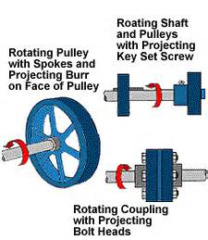
Hazardous rotating motion
A wide variety of mechanical motions and actions may present hazards to the worker. These can include the movement of rotating members, reciprocating arms, moving belts, meshing gears, cutting teeth, and any parts that impact or shear.
The basic types of hazardous mechanical motions and actions are:
Motions rotating (including in-running nip points)
Reciprocating
Transversing

Slide 7
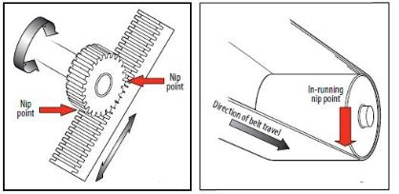
Nip points
A wide variety of mechanical motions and actions may present hazards to the worker. These can include the movement of rotating members, reciprocating arms, moving belts, meshing gears, cutting teeth, and any parts that impact or shear.
The basic types of hazardous mechanical motions and actions are:
Motions rotating (including in-running nip points)
Reciprocating
Transversing

Slide 8
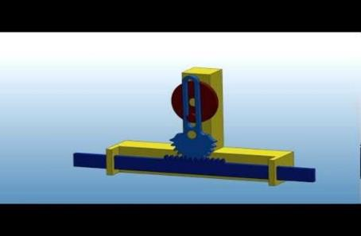
Hazardous reciprocating motion
A wide variety of mechanical motions and actions may present hazards to the worker. These can include the movement of rotating members, reciprocating arms, moving belts, meshing gears, cutting teeth, and any parts that impact or shear.
The basic types of hazardous mechanical motions and actions are:
Motions rotating (including in-running nip points)
Reciprocating
Transversing

Slide 9
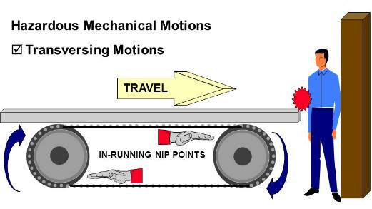
Transversing motion
A wide variety of mechanical motions and actions may present hazards to the worker. These can include the movement of rotating members, reciprocating arms, moving belts, meshing gears, cutting teeth, and any parts that impact or shear.
The basic types of hazardous mechanical motions and actions are:
Motions rotating (including in-running nip points)
Reciprocating
Transversing

Slide 10
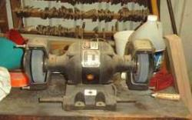
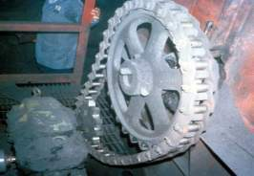
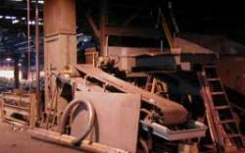
3 Types of Motion
Examples of 3 Types
of Motion
Rotating and fixed parts
Rotating and tangential
motion
Transverse motion

Slide 11
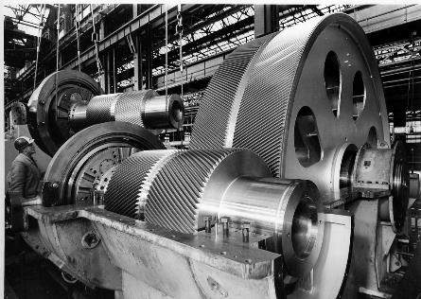
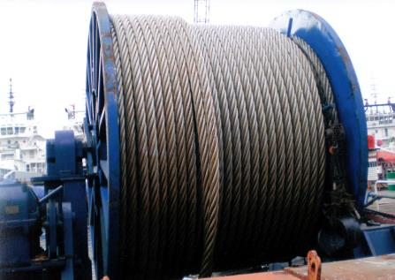
Common machinery and Machines on Vessels

Slide 12
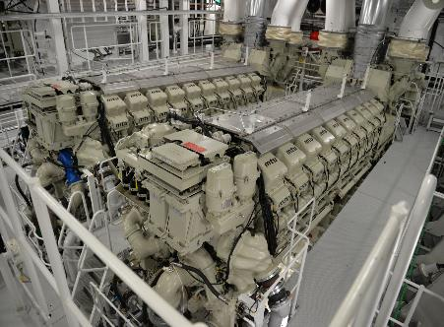
More Common machinery and Machines on Vessels

Slide 13
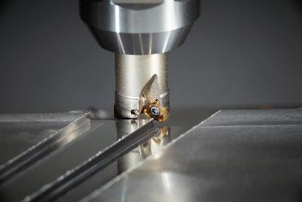
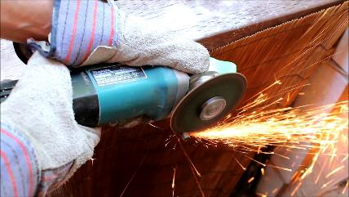
Hazardous machine actions
Cutting
Cutting action may involve rotating, reciprocating, or transverse motion. The danger of cutting action exists at the point of operation where finger, arm and body injuries can occur and where flying chips or scrap material can strike the head, particularly in the area of the eyes or face. Such hazards are present at the point of operation in cutting wood, metal, and other materials. Examples of mechanisms involving cutting hazards include bandsaws, circular saws, boring and drilling machines, turning machines (lathes), or milling machines.

Slide 14
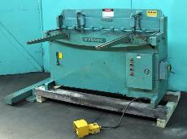
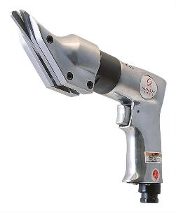
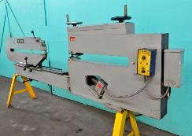
Hazardous machine actions shearing
Shearing action involves applying power to a slide or knife in order to trim or shear metal or other materials. A hazard occurs at the point of operation where stock is actually inserted, held, and withdrawn. Examples of machines used for shearing operations are mechanically, hydraulically, or pneumatically powered shears.

Slide 15
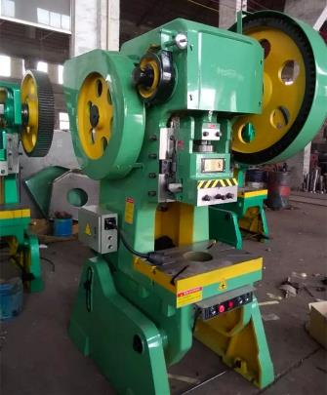
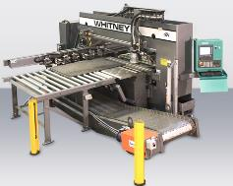
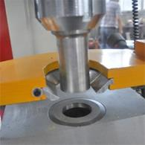
Hazardous machine actions punching
Punching action results when power is applied to a slide (ram) for the purpose of blanking, drawing, or stamping metal or other materials. The danger of this type of action occurs at the point of operation where stock is inserted, held, and withdrawn by hand. Typical machines used for punching operations are power presses.

Slide 16
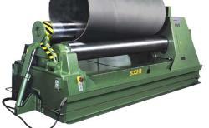
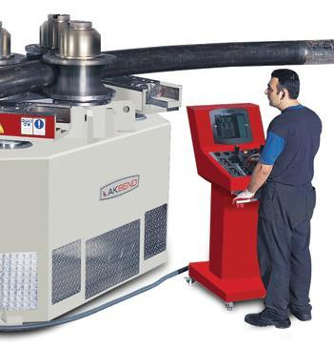
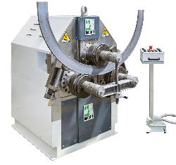
Hazardous machine actions bending
Bending action results when power is applied to a slide in order to draw or stamp metal or other materials. A hazard occurs at the point of operation where stock is inserted, held, and withdrawn. Equipment that uses bending action includes power presses, press brakes, and tubing benders.

Slide 17
Methods of safeguarding
There are many ways to safeguard machinery, and that
means any method of preventing employee contact with the
moving part.
You should first determine the machine hazards and then select a suitable guarding method based on the type of operation, the size or shape of stock, the method of handling, the physical layout of the work area, and the type of material.
Production requirements or limitations will also help determine the appropriate safeguarding method for the individual machine. The guarding system must protect the operator and other exposed workers from all machine hazards.
It is helpful to get the machine operator and machine supervisor involved in the design of the safeguarding system.

Slide 18
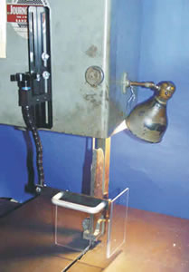
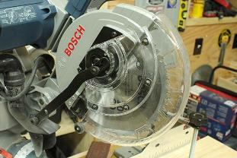
Develop & implement Program
As a general rule, power transmission apparatus is best protected by fixed guards that enclose the danger area. For hazards at the point of operation, where moving parts actually perform work on stock, several kinds of safeguarding are possible. You must always choose the most effective and practical means available.

Slide 19
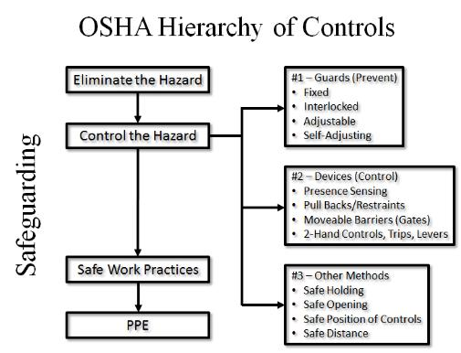
Develop & Implement Program #2
Safeguarding strategies are grouped under these
general classifications:

Slide 20
Effective guards
An effective guard must . . .
Prevent contact: The safeguard must prevent hands, arms, or any part of a worker's body or clothing from making contact with dangerous moving parts. A good safeguarding system eliminates the possibility of the operator or other workers placing any part of their bodies near hazardous moving parts.
Secured & well-constructed: Workers should not be able to easily remove or tamper with the safeguard, because a safeguard that can easily be made ineffective is no safeguard at all. They must be firmly secured to the machine. Guards should be made of durable material that will withstand the conditions of normal use. They may be constructed of sheet metal, screen, wire cloth, bars, plastic, or any other material that is substantial enough to withstand whatever impact it may receive and to endure prolonged use. P
Protect from falling objects/contain the hazard: The safeguard should ensure that no objects can fall into moving parts. A small tool which is dropped into a cycling machine could easily become a projectile that could strike and injure someone.
Continued

Slide 21
More Effective guards
Continued
An effective guard must . . .
Create no new hazards: A safeguard defeats its own purpose if it creates a hazard of its own such as a shear point, a jagged edge, or an unfinished surface which can cause a laceration or creates a pinch point between the guard and moving machine parts. The edges of guards, for instance, should be rolled or bolted in such a way that they eliminate sharp edges.
Create no interference: Any safeguard which impedes a worker from performing the job quickly and comfortably might soon be overridden or disregarded. Proper safeguarding can actually enhance efficiency since it can relieve the worker's apprehensions about injury.
Allow safe lubrication: If possible, one should be able to lubricate the machine without removing the safeguards. Locating oil reservoirs outside the guard, with a line leading to the lubrication point, will reduce the need for the operator or maintenance worker to enter the hazardous area.

Slide 22
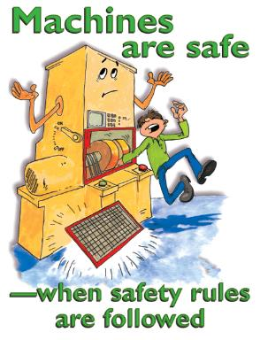
Machine Guards/Guarding
A “guard” prevents entry into the danger area.
There are four types of machine guard:
Fixed
Interlocked
Adjustable
Self-adjusting

Slide 23
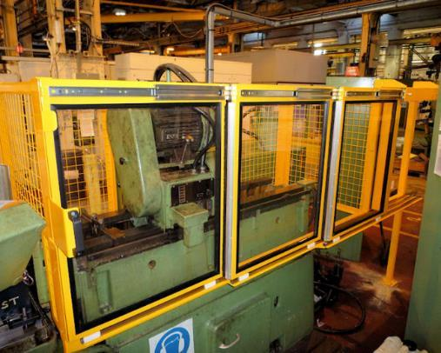
First choice – guards
(barriers that prevent access)
Fixed guards are usually a permanent part of the machine that prevent access to the danger area.
Fixed Guards
Permanent part of the machine
Not dependent upon moving parts to perform its intended function
Constructed of sheet metal, screen,
wire cloth, bars, plastic or other substantial
material.
Usually preferable to all other types because
of its relative simplicity and permanence.

Slide 24
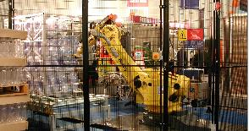
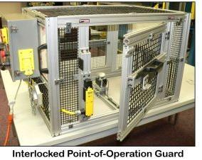
Interlocked Guards
When this type of guard is opened or removed, the tripping mechanism and/or power automatically shuts off or disengages, and the machine cannot cycle or be started until the guard is back in place.
Guards the dangerous part before the machine can be operated.
Keeps the guard closed until the dangerous part is at rest.
Prevent operation of the machine if the interlocking device fails
May use electrical, mechanical, hydraulic, or pneumatic power or any combination of these.
Should not prevent “inching” by remote control, if required.
Replacing the guard should not automatically restart the machine.
All moveable guards must be interlocked to prevent hazards.

Slide 25
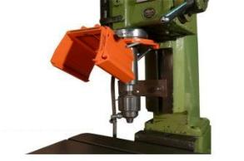
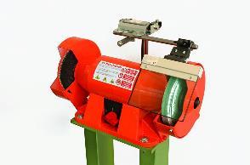
Adjustable guards
Self-Adjusting Guard: The openings of these barriers are determined by the movement of the stock. As the operator moves the stock into the danger area, the guard is pushed away, providing an opening which is only large enough to admit the stock. After the stock is removed, the guard returns to the rest position. This guard protects the operator by placing a barrier between the danger area and the operator. The guards may be constructed of plastic, metal, or other substantial material. Self-adjusting guards offer different degrees of protection. An example of this type of guard include: a radial arm saw with a self-adjusting guard. As the blade is pulled across the stock, the guard moves up, staying in contact with the stock.

Slide 26
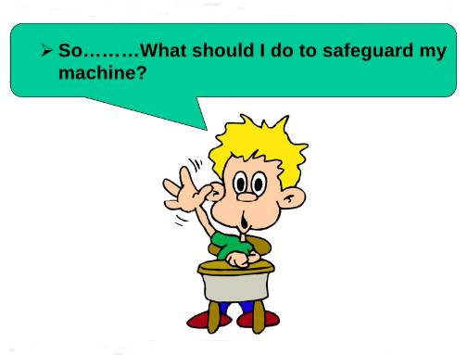
Machine guarding devices
A “device” controls entry into the danger area.
Six types of Machine Devices:
Presence sensing device
Two hand control
Pullbacks/Restraints
Moveable barriers
Safety trip controls

Slide 27
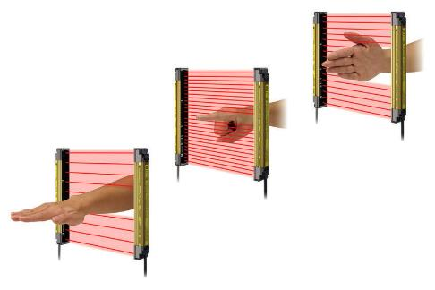
Presence sensing devices
These devices either stop the machine, or will not start the cycle, if a hand or any part of the body is inadvertently placed in the danger area. There are 4 types of presence sensing devices.
The light curtain (photoelectric-optical) presence sensing device uses a system of light sources and controls that can interrupt the machine's operating cycle. If the light field is broken, the machine stops and will not cycle. This device must be used only on machines which can be stopped before the worker can reach the danger area. The light curtain must be positioned at a minimum safe distance from the machine’s point of operation. If the light curtain is too close to the point of operation, the workers hand could reach a danger zone before the machine has time to stop.

Slide 28
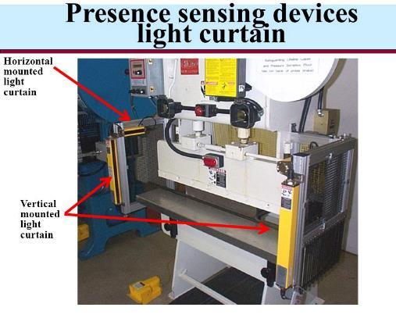
Radiofrequency presence-sensing device
Uses a radio beam that is part of the machine control circuit. When the capacitance field is broken, the machine will stop or will not activate. Like the light curtain, this device shall only be used on machines which can be stopped before the worker can reach the danger area and must be adjusted to the minimum safe distance.
This requires the machine to have a friction clutch or other reliable means for stopping. Because the radiofrequency device is very sensitive, the antenna design requires a great deal of experience and for other technical reasons it is no longer being used in the machine guarding area.

Slide 29
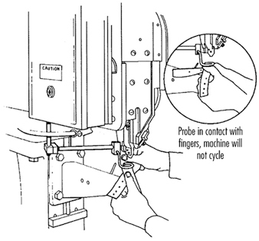
Electro-mechanical sensing device
Has a probe or contact bar which descends to a predetermined distance when the operator initiates the machine cycle. If there is an obstruction preventing it from descending its full predetermined distance, the control circuit does not actuate the machine cycle.
An electro-mechanical sensing device is shown on a riveter. The sensing probe in contact with the operator's finger is also shown. The machine will not operate until the probe comes in contact with the material. The finger prevents this by not allowing the probe to come all the way down and contact the material. The electro-mechanical sensing device is sometimes called a “Touch O-Matic”.

Slide 30
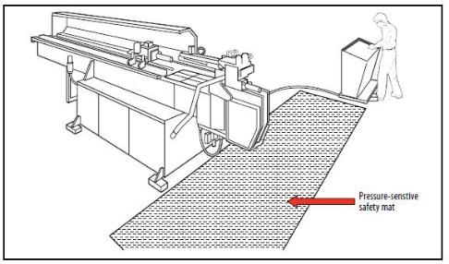
Safety mat
The safety mat is a pressure sensitive safeguarding product that is designed to detect the presence of people on its sensing surface. Picture shows guarding application using pressure sensitive floor mats. It can be used to detect the presence of someone or something within the protected area and can be used to safeguard a floor area around a machine or robot.
A matrix of interconnected mats (safety mat system) can be laid around the hazardous area and any pressure (e.g. an operator’s footstep) will cause the controller unit to send a stop signal to the machine. They can also be used as a point of entry alert method. Other safeguarding devices such as pressure sensitive safety edges and bumpers also fall into this family of devices.

Slide 31
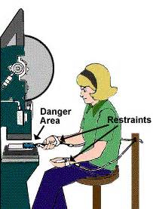
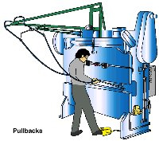
Pullback/restraints
Uses a series of cables attached to the operator’s hands, wrists, and/or arms and to a moving or fixed point.
The pullback is primarily used on machines with stroking action. When the slide/ram is up, the operator is allowed access to the point of operation. When the slide/ram begins to descend, a mechanical linkage automatically assures withdrawal of the hands from the point of operation.
The restraint (holdout) device uses cables or straps that are attached to the operator's hands and a fixed point. The cables or straps must be adjusted to let the operator's hands travel within a predetermined safe area. There is no extending or retracting action involved. Consequently, hand-feeding tools are often necessary if the operation involves placing material into the danger area.

Slide 32
Managing the Safeguarding Program
There is more to machine safeguarding than just guarding machines. The employer must:
Ensure that employees are trained to do the job,
Ensure that employees wears personal protective equipment to protect against other hazards,
Establish safe operating procedures,
Supervise to ensure compliance with company rules.

Slide 33
Managing the Safeguarding Program
Thorough operator training should involve instruction or hands-on training in the following key areas:
Parts and functions of the machine
Basic operator controls
Operator Responsibilities
Safeguarding
A description and identification of the hazards associated with particular machines
How to use the safeguards and why
How and under what circumstances safeguards can be removed, and by whom (in most cases, repairs or maintenance personnel only).
What to do (e.g., contact the supervisor) if a safeguard is damaged, missing, or unable to provide adequate protection.

Slide 34
Safeguard checklist
Do the safeguards provided meet the minimum rule requirements?
Do the safeguards prevent workers hands, arms and other body parts from making contact with dangerous moving parts?
Are the safeguards firmly secured and not easily removable?
Do the safeguards ensure that no objects will fall into the moving parts?
Do the safeguards permit safe, comfortable and relatively easy operation of the machine?
Can the machine be oiled without removing the safeguard?
Is there a system for shutting down the machinery before safeguards are removed?
Can the existing safeguards be improved?

Slide 35
Mechanical hazards
Is there a point of operation safeguard provided for the machine?
Does it keep the operator’s hands, fingers, body out of the danger area?
Is there evidence that the safeguards have been tampered with or removed?
If there is more than one operator, are separate controls provided?
Could you suggest a more practical, effective safeguard?
Could changes be made on the machine to eliminate the point of operation hazard entirely?
Are there any unguarded gears, sprockets, pulleys or flywheels on the apparatus?
Are there any exposed belts or chain drives?
Are there any exposed set screws, keyways, collars, etc.?
Are starting and stopping controls within easy reach of the operator?
Are safeguards provided for all hazardous moving parts of the machine including auxiliary parts?

Slide 36
Time to test your knowledge of the topic

