Slide 1
Improving Hazard Communications in a Rural Workforce

Slide 2
Attribution and Disclaimer
This material was produced under grant SH-05028-SH8 from the Occupational Safety and Health Administration, U.S. Department of Labor. It does not necessarily reflect the views or policies of the U.S. Department of Labor, nor does the mention of trade names, commercial products, or organizations imply endorsement by the U.S. Government.
This material provides the participant with an overview of hazard communication standards.
This presentation cannot cover all the applicable material within 2 hours and it is the participant’s responsibility to attend additional training as required.

Slide 3
OBJECTIVES
After Completing This Course You Should Be Able To:
Discuss 5 elements of OSHA’s HAZCOM Standard
Describe your rights under OSHA’s HAZCOM standard
Identify the new label symbols and explain what each means.
Describe the 4 routes of entry for chemicals and give an example of a chemical known to enter the body through each
State 3 ways to find information about chemicals found on your job site.
Use a products Safety Data Sheet(SDS), assess what the hazards are concerning a chemical

Slide 4

Why….?
Chemicals are everywhere in the environment, including workplaces. Chemicals present a wide range of health hazards (sensitization, skin irritation, mutagenicity, and carcinogenicity) and physical hazards(flammability, corrosiveness and reactivity). This presentation addresses chemicals present in the workplace under OSHA 29 CFR 1910.1200

Slide 5
Globally Harmonized System
There are over 650,000 chemical products in existence today and more are developed each year.
In 1994, OSHA developed the Hazard Communication Standard (HCS) acknowledging that workers have both a need and a right to know about the hazards and identities of the chemicals to which they are exposed when performing their tasks and duties.
The Hazard Communication Standard (HCS) is now aligned with the Globally Harmonized System of Classification and Labeling of Chemicals (GHS)

Slide 6
Hazard Communication
29CFR 1910.1200
June 1, 2015:
Chemical manufacturers, importers, distributors, and employers must use consistent information on labels and safety data sheets
Chemical manufacturers and importers must label chemicals with a signal word, pictogram, hazard statement, and precautionary statement for each hazard class and category
December 2015:
  Distributors may only ship containers meeting the new labeling requirements

Slide 7
OSHA’s Safety Standard 29 CFR 1910.1200 is sometimes called the “right to know” law.
The standard was given this nickname because the law says that employees have the “right to know” the hazards in their workplace and have the “right to know” how to protect themselves.

Slide 8

Let’s Discuss This….

Slide 9

New Standard Effective June 2016
• G Globally
• H Harmonized
• S System of Classification and Labeling of Chemicals

Slide 10
How did we get here ?
What is…the Globally Harmonized System ?
Every country had their own system of hazardous chemical classification. This caused confusion, trade barriers and hazardous incidents. A new system was needed, that would be globally. Many countries committed to the preamble to the final standard in 1983. After years of bilateral trade negotiations, an international mandate was adopted in 1992. The United States supported the process and actively participated along with multiple international organizations, resulting in the Globally Harmonized System.

Slide 11
What does the GHS Do ?
Defines physical, health and environmental hazards of chemicals and harmonizes classification criteria
Standardizes the content and format of Safety Data Sheets and Chemical Labels

Slide 12
Change under the Globally Harmonized System
This update provides:
  GHS offers better protection to workers and users and facilitates international chemical trade, by reducing barriers
  International consistency of identifying and labeling of chemicals
  Productivity improvements
  Easy to understand pictograms
  A uniform approach to the classification and hazard information

Slide 13
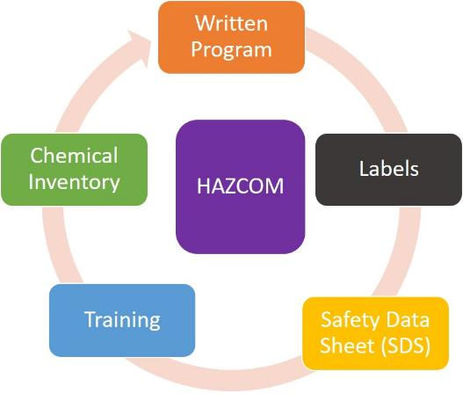
What Are The Five Key Elements In The OSHA HAZCOM Standard?
1. Employers must have a written HAZCOM Program.
2. Containers must be labeled and labels must follow a consistent format.
3. SDSs must be available for hazardous substances in the workplace.
4. Workers must be trained.
5. Employers must have an updated chemical inventory
Notes:
Written Hazard Communication Program, First major requirement of OSHA’s HAZCOM Standard, 1910.1200 (e) What is a HAZCOM Program? Employers must develop, implement, and maintain at the workplace a written, comprehensive HAZCOM program. A program is the employer’s procedure for meeting the requirements of a particular regulation, in this case, the HAZCOM regulation. Workers have the right to review the HAZCOM program on work time and to ask questions about it! A written hazard communication program ensures that all employers receive the information they need to inform and train their workers properly and to design and put in place worker protection programs. It also provides necessary hazard information to employees, so they can participate in, and support, the protective measures in place at their workplaces.

Slide 14
HAZCOM PROGRAM
The written HAZCOM program must be available at the job site and must include the following information:
• A list of the hazardous chemicals known to be present onsite.
• The methods the employer will use to inform workers about labels and SDSs
• The methods the employer will use to inform employees of the hazards of non-routine tasks
• Methods the employer will use to provide the other employers on-site access to SDSs on multi-employer sites

Slide 15

Two Significant Training Requirements
New labeling elements for chemicals
Standardized format for Safety Data Sheets (SDS)

Slide 16
How to Determine if a Chemical is “Hazardous”
Under the HCS, any chemical that is classified as a physical hazard, a health hazard, a simple asphyxiant, combustible dust, pyrophoric gas, or hazard not otherwise classified is considered a hazardous chemical.

Slide 17
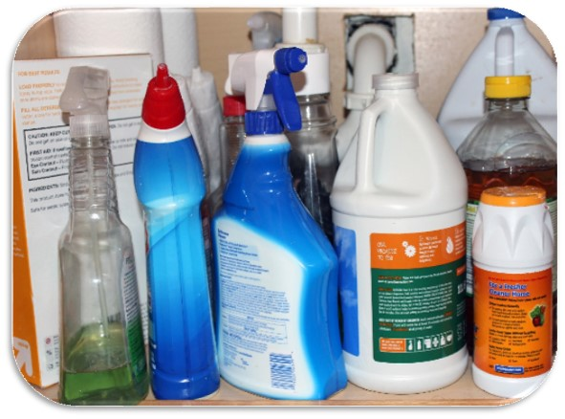
Hazardous Materials
Hazardous and toxic materials are those chemicals with the properties that can harm individuals or the environment. This can be fuels, solvents, dusts, mixtures and vapors.
A hazardous substance is any substance which can cause injury (a physical hazard) or cause an illness (a health hazard) in a person.

Slide 18
Health Hazards Can Be Either Chronic Or Acute.
Chronic health hazards create conditions or symptoms that do not go away in the body, such as cancer or mesothelioma.
Acute health hazards create conditions or symptoms that cause sudden and often intense reactions which will go away after a time, such as nausea and vomiting.

Slide 19
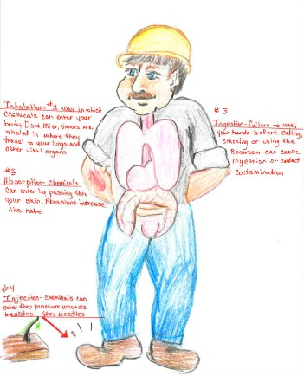
ROUTES OF ENTRY
Absorption- soaks through skin
Inhalation- you breath it; most common
Ingestion- you eat it
Injection- puncture wound
Notes:
Absorb: Spill solvents onto bare skin or open cuts; work without gloves and get chemicals on hand
Inhale: Work with dusty processes or solvents that have a high vapor pressure
Ingest: Transfer contamination from unwashed hands onto food or drink; leaving open containers of food where dust can settle
Inject: Force contamination into the skin through high pressure washing; step on contaminated nails; cut skin on protruding metal

Slide 20
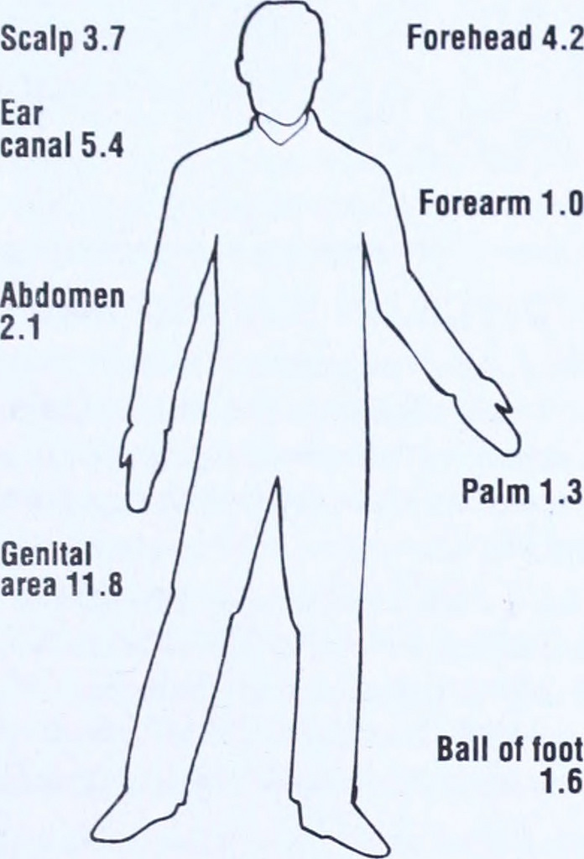
RATES OF ABSORPTION

Slide 21

What If You Have Been Exposed To A Chemical?
1. Let your supervisor and union know.
2. Find out which chemical(s) were involved.
3. Follow the first aid directions in the SDS.
4. Get medical attention as needed.
5. Call health and safety to evaluate situation and cause of exposure before returning to work

Slide 22
GHS Hazard Class, Hazard Category and Hazard Pictogram
GHS describes the nature and severity of a chemical hazard by Hazard class and Hazard category.
GHS also assigns standard pictograms representing different types of hazards.

Slide 23
Hazard Class:
The nature of a chemical hazard, i.e., flammable liquids, carcinogen.

Slide 24
Physical Hazards
Explosives
Flammable Gases
Aerosols
Oxidizing Gases
Gases Under Pressure
Flammable Liquids
Flammable Solids
Self-Reactive Substances
Pyrophoric Liquids
Pyrophoric Solids
Self-Heating Substances
Substances which, in contact with water emit flammable gases
Oxidizing Liquids
Oxidizing Solids
Organic Peroxides
Corrosive to Metals
Desensitized explosives
Notes:
GHS describes the nature and severity of a chemical hazard by hazard class and hazard category:
GHS hazard class represents the nature of a chemical hazard, i.e., flammable liquids, carcinogen.
GHS hazard category is the division of criteria within each hazard class. For example, hazard class flammable liquids can be divided into 4 categories among which flammable liquids category 1 represents the most severe hazard.
There are 29 GHS hazard classes in total in UN GHS Rev. 6. They are used to describe 3 main types of chemical hazards: physical hazards, health hazards and environmental hazards. If you wish to find hazard statements and signal word for each hazard category, please use our hazard statement and signal word finder

Slide 25
Health Hazards
Acute Toxicity (Oral/Dermal/Inhalation)
Skin Corrosion/Irritation
Serious Eye Damage/Eye Irritation
Respiratory or Skin Sensitization
Germ Cell Mutagenicity
Carcinogenicity
Reproductive Toxicology
Target Organ Systemic Toxicity - Single Exposure
Target Organ Systemic Toxicity - Repeated Exposure
Aspiration Toxicity

Slide 26
Environmental Hazards
Hazardous to Aquatic Environment (Acute/Chronic)
Hazardous to the Ozone Layer

Slide 27
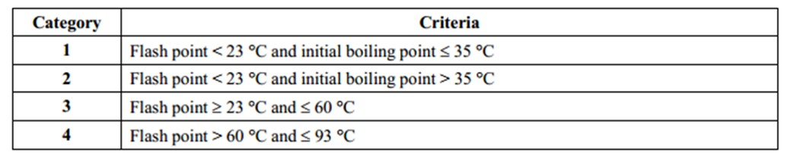
GHS Hazard Class and Hazard Category
Notes:
GHS has provided standard chemical classification criteria which are used to determine the hazard class and hazard category of a chemical. The picture below is an example of GHS classification criteria for flammable liquids. A liquid with a flash point between 23 and 60 Celsius degrees will be classified as flammable liquid category 3. A liquid with a flash point above 93 Celsius degrees does not meet GHS classification criteria and will not be regarded as a hazardous chemical

Slide 28
Hazard Category:
The division of criteria within each hazard class. For example, flammable liquids have 4 categories among which flammable liquids category 1 represents the most severe hazard.

Slide 29
Hazard Pictogram:
There are 9 pictograms conveying different types of health, physical and environmental hazards

Slide 30

Oxidizing

Slide 31

Flammable
Notes:
Flammables, Self Reactive, Pyrophoric, Self-Heating, Emits Flammable Gas, Organic Peroxides

Slide 32

Explosive
Notes:
Explosives, Self Reactive, Organic Peroxides

Slide 33

Toxic

Slide 34

Corrosive

Slide 35

Compressed Gas

Slide 36

Health Hazard
Notes:
Carcinogen
Respiratory Sensitizer
Reproductive Toxicity
Target Organ Toxicity
Mutagenicity
Aspiration Toxicity

Slide 37

Toxic To Aquatic Environment

Slide 38

Harmful Substance
Notes:
Acutely toxic(harmful)
Irritant to eyes or respiratory tract
Skin sensitizer
Hazardous to the Ozone layer
Narcotic effects

Slide 39
Labeling Hazardous Chemicals

Slide 40
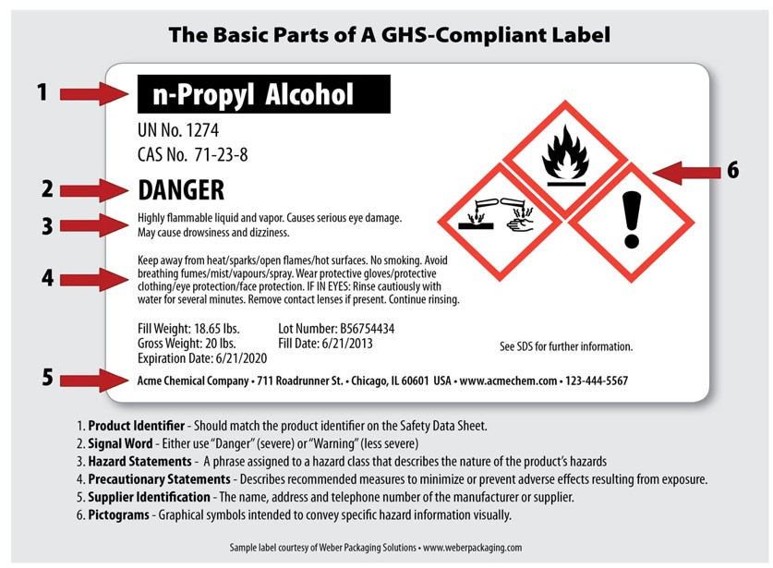
Basic parts of a GHS-compliant label

Slide 41
Label Elements
Labels will be located on chemical packaging. Labels must contain these elements:
Product Identifier
Signal Word
Pictogram
Hazard Statement
Precautionary Statements
Name, address, phone of manufacturer, distributor, importer

Slide 42
1. Product Identifier
Chemical Name
Code number or batch number
Manufacturer, importer or distributor can decide the appropriate product identifier
Product identifier must be both on the label and in Section 1 of the SDS (Identification)

Slide 43
2. Signal Word
Used to indicate the relative level of severity of hazard and alert the reader to a potential hazard on the label.
Two Words: "Danger" and "Warning."
"Danger" is used for more severe hazards.
"Warning" is used for less severe hazards.
There will only be one signal word on the label no matter how many hazards a chemical may have.
If one of the hazards warrants a "Danger" signal word and another warrants the signal word "Warning," then only "Danger" should appear on the label

Slide 44
Self-Reactive Chemicals
There Are Two (2) Broad Categories Of Self-Reactives :
  Those That Will Explode
  Those That Will Just Burn.
  If heating may cause an explosion, the signal word must be DANGER. If the signal word Is WARNING, the chemical can still catch on fire with enough heating, but will not explode.

Slide 45

3. Pictogram

Slide 46
4. Hazard Statement
Describe the nature of the hazard(s) of a chemical.
For example: "Causes damage to kidneys through prolonged or repeated exposure when absorbed through the skin."
All of the applicable hazard statements must appear on the label.
Hazard statements may be combined where appropriate to reduce redundancies and improve readability.
Hazard statements are specific to the hazard classification categories.
Chemical users should always see the same statement for the same hazards, no matter what the chemical is or who produces it.

Slide 47
5. Precautionary Statement
Phrase that describes recommended measures that should be taken to minimize or prevent adverse effects resulting from exposure to a hazardous chemical or improper storage or handling.
  EXAMPLE:
  “ Keep away from heat/sparks/open flames/hot surfaces. No Smoking. Avoid breathing fumes/mists/vapors/spray. Wear protective gloves/protective clothing/ eye protection/face protection. IF IN EYES: Rinse cautiously with water for 15 minutes. Remove contact lenses if present. Continue Rinsing .”

Slide 48
6. Name, Address, Phone Of Manufacturer, Distributor, Importer

Slide 49
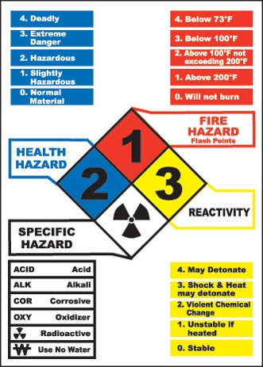
NFPA’s 704 M Diamond
(National Fire Protection Association)
Notes:
Trainer Notes:
[Ask the questions and have the students write the answers in their manual. It is fine to have them work together.]
NFPA’s 704M Diamond is widely used. For this example chemical,
What is the greatest hazard?
What is the specific hazard?
[The answers are:
Reactivity is the greatest risk with a score of 3, “Shock and heat may detonate.”
The specific hazard is that it is radioactive. This is a really hazardous chemical!]
According to the International Association of Fire Fighters (IAFF) master trainers, all “special hazard” symbols may be listed in the white diamond and it is taught in the fire and emergency services this way. NFPA committee states that only the water reactive and oxidizer should be allowed in the box. IAFF members make up the NFPA committees; mention any symbol may be seen, that covers all possibilities.

Slide 50
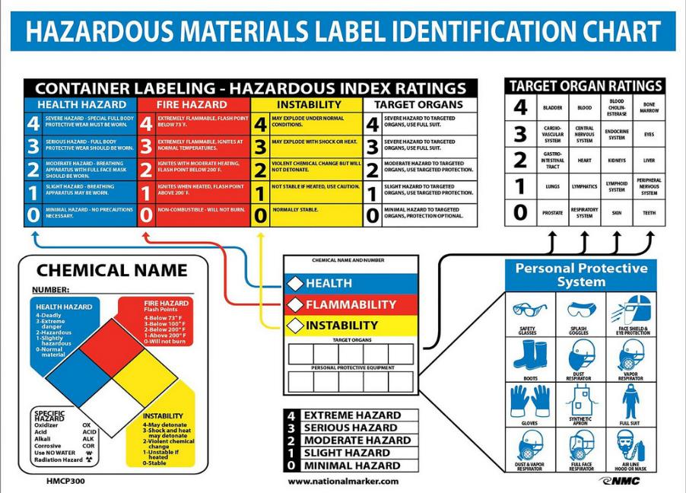
Color-coded HMIS Ranks Hazards And Recommends PPE
(Hazardous Material Identification System)
Notes:
Trainer Notes:
Color-coded HMIS ranks hazards and recommends PPE.
[Point out that this approach is commonly used on products, but it is a proprietary system. There is a good description in their student manual on page 41.]

Slide 51
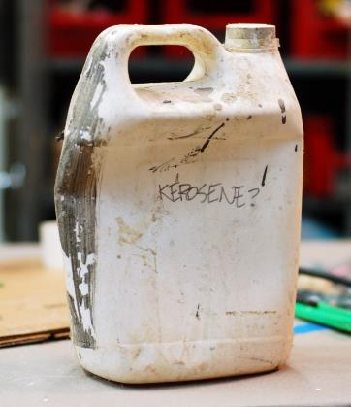
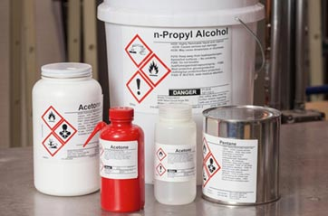
All secondary containers must be labeled.
Which of these are labeled correctly?

Slide 52
How the Elements Work Together on a Label
Where a chemical has multiple hazards, different pictograms are used to identify the various hazards.
Employees should expect to see the appropriate pictogram for the corresponding hazard class.
When there are similar precautionary statements, the one providing the most protective information will be included on the label.

Slide 53
Take Notice Of These Changes !
NFPA / HMIS
  4= Severe
  3= Serious
  2= Moderate
  1=Slight
  0= Minimal
GHS Nomenclature
  Cat 1 Severe hazard
  Cat 2 Serious hazard
  Cat 3 Moderate hazard
  Cat 4 Slight hazard
  Cat 5 Minimal hazard

Slide 54
What To Do In The Event Of Hazardous Chemical Exposure
Eyes Immediately flush at eyewash station for 15 minutes minimum
Body Immediately flush at safety shower for 15 minutes minimum and remove clothes

Slide 55
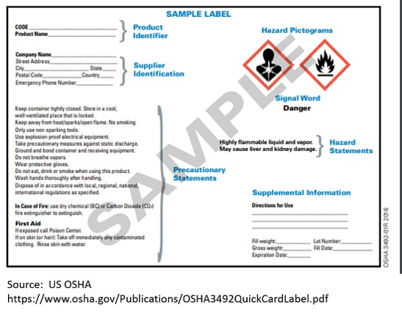
Standard GHS Label

Slide 56
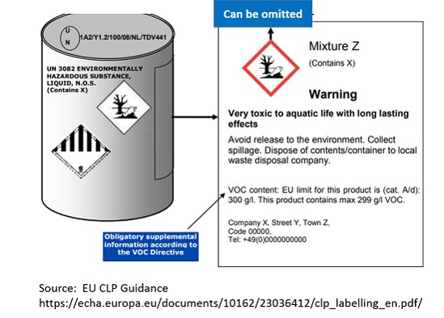
Standard GHS Label for Drum with DG Symbols

Slide 57
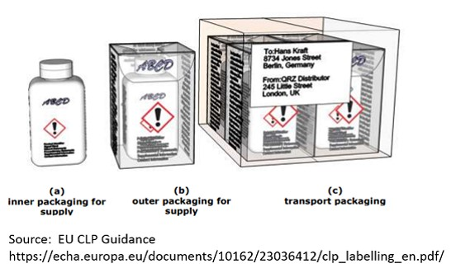
GHS Labels for Inner and Outer Packaging

Slide 58
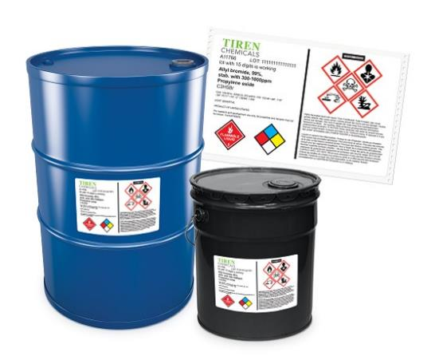
GHS Labels for Drum with NFPA Ratings (for US)

Slide 59
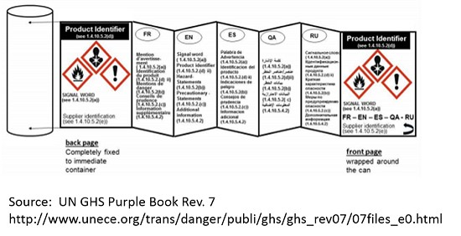
Fold-out GHS Label for Small Containers

Slide 60
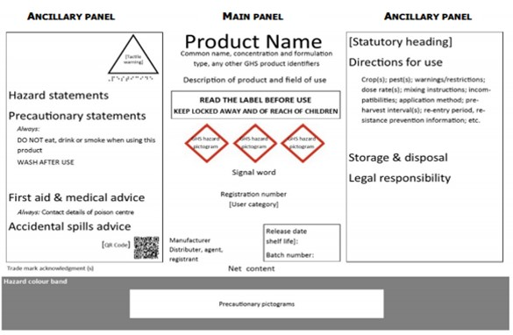
FAO Recommendations for GHS Label for End Use Pesticides

Slide 61
You Must Make A Label !
If you are pouring a chemical into a smaller container you must make a GHS Compliant label !
That Means You Must Transfer All Of The Information From The Original Container Or The SDS To The New Container Label!

Slide 62

With the implementation of the GHS standards a key term has changed from material safety data sheet to safety data sheet
Safety Data Sheet (SDS)
Notes:
Trainer Notes:
The key term has changed from material safety data sheet to safety data sheet.

Slide 63
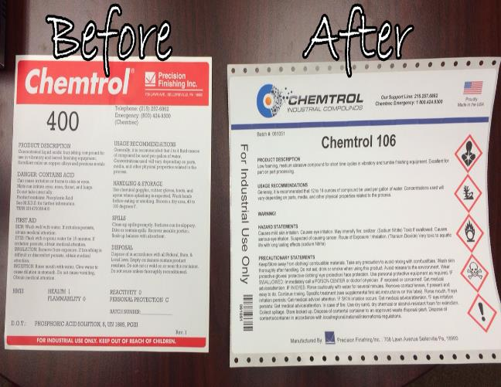
Training Requirements
Standardized 16-section format, including the type of information found in the various sections
Notes:
Example: The employee should be instructed that with the new format, Section 8 (Exposure Controls/Personal Protection) will always contain information about exposure limits, engineering controls and ways to protect yourself, including personal protective equipment.

Slide 64
Changes
In the past there were many different formats for the way you found the information that was on a “MSDS” or Material Safety .
The original MSDSs had only eight sections of information
MSDSs were basically an informal requirement that could be quite confusing to read.
MSDSs had no standardized order for finding information
At times the MSDSs did not match the label on the chemical
There was nothing to truly get your attention like a signal word or pictogram

Slide 65
Changes (cont.)
Manufacturer's name and information, hazardous ingredients, physical and chemical characteristics, fire and explosion data, reactivity data, health hazard data, precautions for safe handling, and control measures.
While this did have some very good information, it was incomplete compared to the 16 sections that are in place today

Slide 66
NEW SDS FORMAT

Slide 67
GHS FORMAT for Safety Data Sheets
Identification of the substance or mixture and of the supplier.
Hazards identification
Composition / information on ingredients
First-aid measures
Fire-fighting measures
Accidental release measures
Handling and storage
Exposure controls / personal protection
Notes:
Identification includes the product identifier, the name of the manufacturer or distributor along with the phone number and an emergency number. It also lists the recommended use of the product as well as restrictions.
Hazard(s) identification includes all the dangers about the chemical
Composition/information on ingredients lists the different chemicals in the product and any trade secret claims.
First-aid measures describe the important symptoms, immediate or delayed health effects, and required treatment.
Fire-fighting measures list the proper ways to extinguish fires, the equipment, and chemical hazards from fire.
Accidental release measures explain the emergency procedures, protective equipment and proper methods of containment and cleanup.
Handling and storage describe precautions for safe handling and storage, including other chemicals that are not compatible with the product.
Exposure controls/personal protection lists OSHA’s Permissible Exposure Limits, Threshold Limit Values along with appropriate engineering controls and personal protective equipment

Slide 68
GHS FORMAT (cont.)
Physical and chemical properties
Stability and reactivity
Toxicological information
Ecological information
Disposal considerations
Transport information
Regulatory information
Other information, including date of preparation or last revision
Notes:
9. Physical and chemical properties list the product’s characteristics such as vapor density, flash point or explosive limits.
10. Stability and reactivity refer to the chemical’s stability and the possibility of hazardous reactions.
11. Toxicological information includes the ways the chemical can enter the body the various health effects it can cause.
12. Ecological information refers to damage the chemical can cause to the environment but is not enforced by OSHA.
13. Disposal considerations cover possible dangers when disposing the chemical but is not enforced by OSHA.
14. Transport information concerns potential hazards when transporting the chemical but is not enforced by OSHA.
15. Regulatory information is not enforced by OSHA.
16. Other information includes the date the SDS was prepared or the last revision.

Slide 69
Safety Data Sheets (SDS)
As of June 1, 2015, the HCS will require new SDS to be in a uniform format, and include the section numbers, the headings, and associated information. Employers must keep copies of SDS and let employees know where these SDS will be located.

Slide 70
How the information on the label is related to the SDS
You should have a handout that says n-Propyl Alcohol & a SDS for
n-Propyl Alcohol:
Lets compare:
Now you can take the SDS and the Label and compare them and the information matches up and is the same
Notes:
Example: Explain that the precautionary statements would be the same on the label and on the SDS.
Now you can take the SDS and the Label and compare them and the information matches up and is the same
The Precautionary Statements Would Be The Same On The Label And On The SDS.
How the information on the label is related to the SDS

Slide 71
Compare SDS with Label
Does #1 match? (product name)
How about the signal word?
Hazard Statement?
Precautionary statements?
Supplier the same?
Pictograms?

Slide 72
SUMMARY
Why do we need the Globally Harmonized System of Labeling Chemicals?
What is a pictogram?
What are the points of entry for a hazard?
How many parts are there to a GHS compliant label?
Notes:
Why do we need the Globally Harmonized System of Labeling Chemicals?
Change is always good
To be fresh and innovative
To define the physical, health and environmental hazards of chemicals and harmonize the classification criteria and to standardize the content and format of Safety Data Sheets
To raise costs
What is a pictogram?
Something you post on social media
A picture symbol(icon) that conveys the hazard of a chemical
A black and white picture
A video clip
What are the points of entry for a hazard?
Absorption
Inhalation
Ingestion
Injection
All the above
How many parts are there to a GHS compliant label?
4
5
6
7

Slide 73
Summary (cont.)
How many parts are there to a GHS compliant label?
True or False: The order the information on a Safety Data Sheet doesn’t matter.
True or False: I can just write the name of a chemical on the bottle I put it in when working in a facility
True or False: I don’t have to have pictograms on a label.
True or False: I can choose any word I want for a signal word
Notes:
How many parts are there to a GHS compliant label?
4
5
6
7
It doesn’t matter what order the information on a Safety Data Sheet in in?
True
False
I can just write the name of a chemical on the bottle I put it in when working in a facility?
True
False
I don’t have to have pictograms on a label.
True
False
I can choose any word I want for a signal word
True
False

Slide 74

Questions?

Slide 75
Resources
OSHA, (2011). 29 CFR 1910.1200. Hazard Communication Standard. http://www.osha.gov/dsg/hazcom/standards.html
European Chemicals Agency, (2001). http://echa.europa.eu/
OSHA, (2008). Chemical Hazard Communication. Document 3084
DiNardi, Salvatore, Silk, Jennifer. (1997). The Occupational Environment-Its Evaluation and Control. AIHA Press; Chapter 40.
United Nations, (2003). Globally Harmonized System of Classification and Labeling of Chemicals (GHS) “The Purple Book”.

