Slide 1
Heat-Illness Prevention Plan
This material was produced under grant number SH-05032-SH8 from the Occupational Safety and Health Administration, U.S. Department of Labor. It does not necessarily reflect the views or policies of the U.S. Department of Labor, nor does mention of trade names, commercial products, or organizations imply endorsement by the U.S. Government.

Slide 2
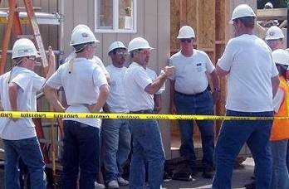
Photo Sources
Bureau of Labor Statistics (BLS)
California Occupational Safety and Health Administration (Cal OSHA)
Centers for Disease Control and Prevention (CDC)
Department of Defense (DOD)
National Institute for Occupational Safety and Health (NIOSH)
Occupational Safety and Health Administration (OSHA)
Public Health Information Library (PHIL)
Source: Cal OSHA

Slide 3
Learning Objectives
Discuss why heat-illness prevention is important
Know cause, prevention and first aid for heat illnesses
Understand the approach for heat-illness prevention
Train workers and supervisors on prevention strategies and to recognize signs and symptoms of heat-related illnesses
Monitor weather and workplace conditions
Conduct a heat hazard assessment and assess risk level
Implement appropriate prevention strategies and controls
Plan for heat-related medical emergencies
Understand how physiological monitoring can be used to help prevent heat-related illnesses
Apply these principles to conduct a heat hazard evaluation and recommend preventative controls (Class Exercises)

Slide 4
Section 1: Why is heat-illness prevention important?

Slide 5

Class Discussion: Why is heat-illness prevention important?
________________________________________________________________________________________________________________________________________________________________________________________________________________________________________________________________________________________________________

Slide 6
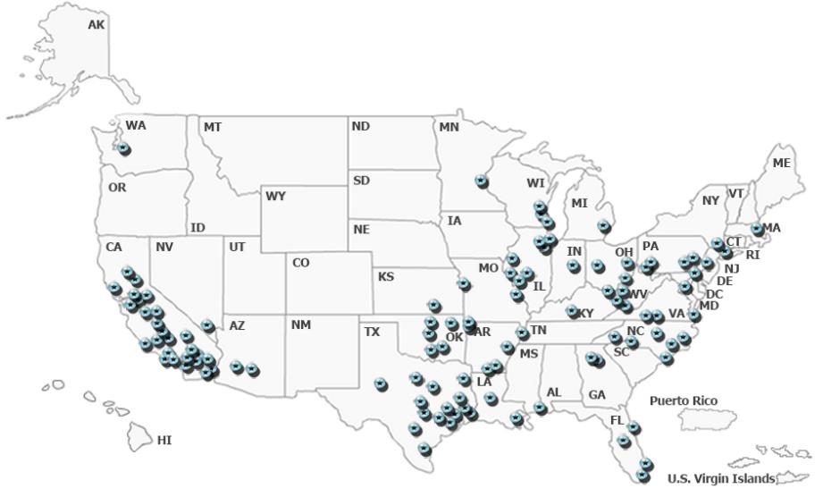
Heat-Illness Statistics
OSHA reported heat-related fatalities among outdoor workers (not all workers) 2008 to 2014
Source: OSHA

Slide 7
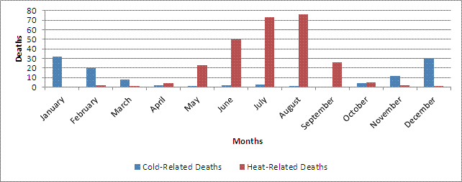
Statistics for Texas
Temperature-Related Deaths Texas, 2003-2008
Temperature-related Deaths
439 heat-related deaths reported among Texas residents
Harris County 41
Fort Bend 3
Liberty 3
Montgomery 3
Brazoria 2
Galveston 2
Source: Texas Health and Human Services (Temperature-related Deaths)

Slide 8
Houston Area Statistics
Houston Heat related data, 2013- 2016
Houston Epidemiology Report
Source: Houston Health Department

Slide 9

#1: The number one reason why we all need to look after each other on the job
We all deserve to go home safe to our family and friends

Slide 10
Section 2: Heat-Illness Prevention Plan

Slide 11
Purpose and Scope
Purpose
This heat-illness prevention plan was developed to provide supervisors and workers with the training and tools to help protect them from heat-related exposures and illnesses.
Scope
Each work site and job task can be unique and contain a number of heat stress hazards that must be addressed prior to the beginning work and during work activities. Supervisors and workers are responsible for assessing these hazards and taking necessary corrective actions to reduce heat-related illnesses.

Slide 12

Employer Responsibilities
Employer must ensure that all employees understand and adhere to the policies and procedures of the plan.
On the job, responsibility of the Safety Manager and supervisors to implement the Heat-Illness Prevention Plan.
Continual observational safety checks of work operations
Enforcement of the safety policy and procedures
Correcting any unsafe practices or conditions immediately
Safety Manager must approve any changes to the Plan.
Supervisors Source: OSHA

Slide 13
Who is responsible for implementation at your company?
Designated Safety Manager
____________________________
Supervisors
____________________________
____________________________
____________________________
____________________________
____________________________
Supervisors (continued)
____________________________
____________________________
____________________________
____________________________
____________________________
____________________________
____________________________

Slide 14
Employee Training and Responsibilities
Each employee trained on procedures and will strictly adhere to them except when doing so would expose the employee to a greater hazard
Employees are to notify their supervisor of a concern and have the concern addressed before proceeding

Slide 15
Main Elements of Heat-Illness Prevention Plan
Control | Description
1. Train supervisors and workers | Train supervisors and workers on heat-illness prevention strategies, as well as to recognize and report the signs and symptoms of heat-related illnesses.
2. Monitor weather and workplace conditions | Monitor weather workplace conditions and take preventative measures to protect workers when the temperatures exceed 70 °F (21 °C).
3. Conduct a heat hazard assessment when temperatures exceed 70 °F | Determine an effective wet-bulb globe temperature (WBGT-Effective) and use established recommended alert limits (non-acclimatized workers) and exposure limits (acclimatized workers) to determine the heat stress risk level.
4. Implement heat-illness prevention strategies | Implement appropriate heat-illness prevention strategies based on established risk levels for heat stress.
5. Plan for heat-related medical emergencies | Ensure adequate supervision, first aid and medical services are readily available in the event a worker suffers from a heat illness.

Slide 16
Section 3: Training

Slide 17

Elements Heat-Illness Prevention Plan
Training
Monitoring
Hazard Assessment
Heat-Illness Prevention Strategies
Emergency Preparedness
Plan (Clipart)

Slide 18
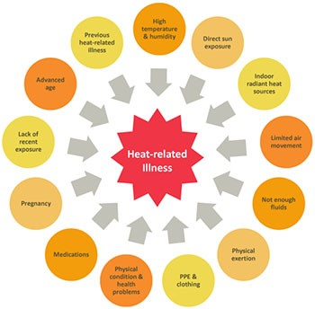
Risk Factors for Heat Stress Environmental risk factors
Temperature
Humidity
Air movement
Radiant heat (e.g., sun exposure)
Risk Factors (Source: NIOSH)

Slide 19
Risk Factors for Heat Stress Work-related risk factors
Age
Physical fitness
Acclimatization
Medical conditions
Medications
Alcohol and/or drug use
Caffeine
Risk Factors (Source: NIOSH)

Slide 20
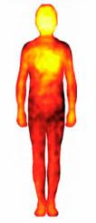
How the Body Handles Heat
Increased heart rate
Increased blood circulation to skin
Evaporative cooling from sweating
Thermogram (Stock Photo)

Slide 21
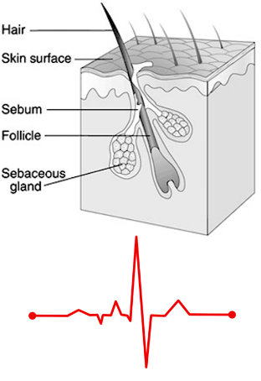
The importance of acclimatization
Reduces risks of dehydration and salt loss
Sweating and evaporative cooling becomes more efficient
Salt loss becomes more efficient (less loss)
Core body temperature maintained more efficiently
Reduces strain on heart
Blood circulation to skin becomes more efficient
Recovery heart rate improves
More efficient sweating, blood flow to skin and heart rate recovery (CDC & Stock Photo)

Slide 22
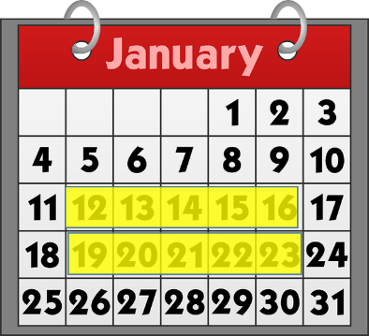
Human body needs to acclimate to hot environments, typically 10-14 days
Gradually increase exposure to hot environment over 7-14 days
Avoid prolonged exertion during hottest times of day
Schedule heavy exertion for cooler parts of day
Calendar (Clipart)

Slide 23
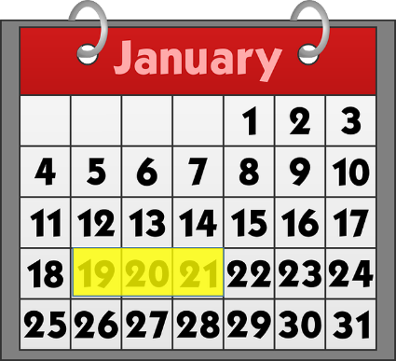
When acclimated workers take an extended break they need to re-acclimate
Acclimatized workers will need 2-3 days of re-acclimatization if they stop working under heat stress conditions more than a week
Calendar 2 to 3 days (Clipart)

Slide 24
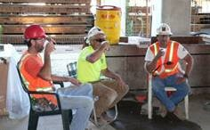
The importance of consuming water throughout the work shift
One cup (8 oz.) of cool water or an electrolyte replacement fluid every 15-20 minutes; four cups of water every hour.
Increased water intake may be needed to account for increased physical exertion and/or sweating.
Source: Cal OSHA

Slide 25
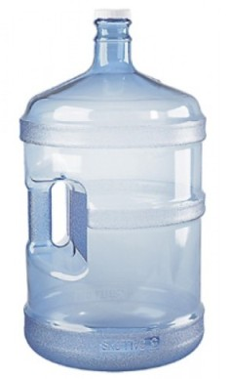
Too much water intake can be dangerous
Too much water intake can lead to headache, nausea, vomiting and/or mental confusion
Water bottle (Stock Photo)

Slide 26
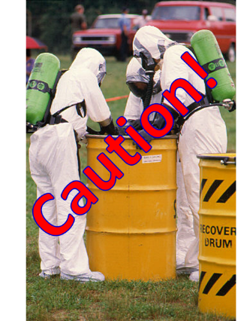
Physiological monitoring for dehydration may be necessary under extreme conditions
If sweat is not trapped within clothing, then we can monitor body weight, which should not drop below 1.5% of starting body weight.
Urine color is another indicator of potential dehydration. Normal urine should be a pale yellow.
Sweat trapped by encapsulating suit (Source: PHIL)

Slide 27
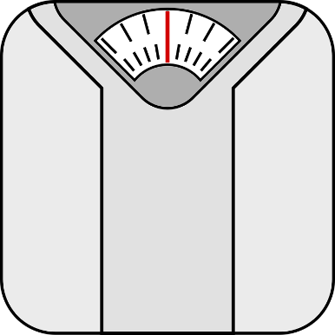
Monitoring Body Weight
Body Scale (Clipart)
Use a scale capable of accurately reading within ± 0.25 lbs.
Measure your weight at breaks, at least every hour if you are sweating a lot
Your body weight should not drop by more than 1.5%
If 150 lbs., then not more than 2 lbs.
If 200 lbs., then not more than 3 lbs.

Slide 28
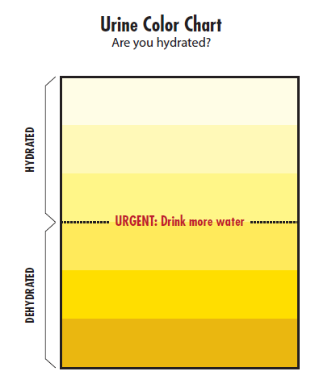
Monitoring Urine Color
Urine Color Chart
Normal urine should be pale yellow
Darker urine can indicate dehydration
Some diets, medications and illnesses may affect results
Source: NIOSH

Slide 29
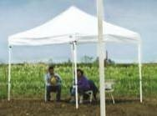
Importance of frequent rest breaks and shade
Prolonged physical exertion and muscle activity increases the body’s core temperature and reduces the body’s ability to cool itself.
Breaks allow blood to flow to the skin to be cooled.
Rest breaks slow down the buildup of heat in the body from prolonged muscle activity.
Rest breaks are important for the heart and allow your heart rate to recover from sustained heat stress and physical exertion.
Rest breaks in the shade help with cooling, especially if there is air movement with cool air.
Shade (Source Cal OSHA)

Slide 30
Heat-Related Illnesses
Major Heat-Related Illnesses
What You Need to Know
Heat Rash
Heat Cramps
Heat Syncope
Heat Exhaustion
Heat Stroke
Rhabdomyolysis
Cause
Preventative measures
Signs & symptoms
First aid treatment
When to report

Slide 31
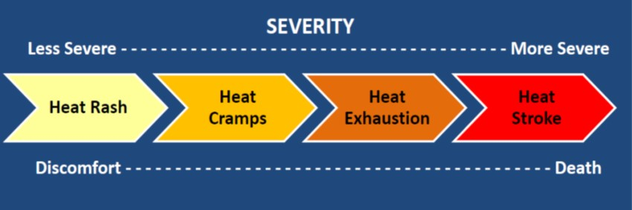
Progression of Heat-Related Illnesses (Source: NIOSH)
Less Severe More Severe
Heat Rash Heat Cramps Heat Exhaustion Heat Stroke
Heat Syncope Rhabdomyolysis

Slide 32
Heat Rash: Cause and Prevention
Cause
Preventative Measures
Irritation of skin due to excessive sweating
Wear loose fitting clothing that allows sweat to dissipate
Wear freshly laundered clothing each day
Avoid working in sweat soaked clothing for prolonged periods (e.g., change at breaks as needed)
Wash sweat-soaked areas with mild soap and water and dry thoroughly at breaks and after your shift ends

Slide 33
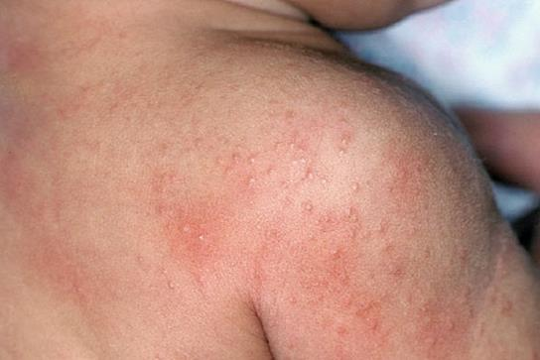
Heat Rash: Signs & Symptoms
Itchy and painful clusters of red blisters
Common to the neck, chest, groin, armpits and creases of the elbows and knees
Heat rash (Source DOD)

Slide 34
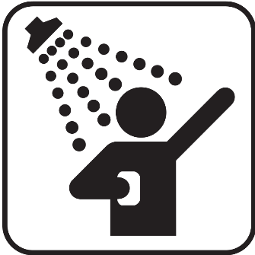
Heat Rash: First Aid Treatment
Move person to a cool location
Have person take a cool shower
Thoroughly dry the skin following shower
Continue to ensure skin is cleaned and dried frequently, especially before and after shifts
Seek medical treatment if rash persists for more than two days or if rash become infected
Shower (Clipart)

Slide 35
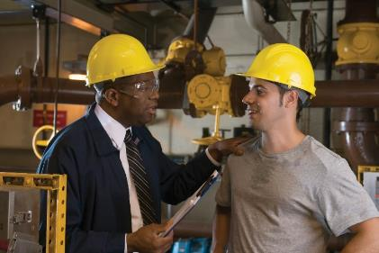
Heat Rash: Reporting
Report to supervisor or safety manager
Seek medical treatment if rash persists for more than two days or if rash becomes infected
Report to Supervisor (Stock Photo)

Slide 36
Heat Cramps: Cause and Prevention
Cause
Preventative Measures
Depletion of salt and water in body due to excessive sweating.
This is a precursor to more serious heat exhaustion and/or heat stroke.
Acclimatization to heat helps reduce salt and water loss
Drink adequate amounts of water throughout the day
Salt your foods to taste

Slide 37
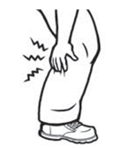
Heat Cramps: Signs & Symptoms
Muscle cramps, spasms and/or pain
Common to major muscles used for work
Arm muscles
Leg muscles
Abdominal muscles
Back muscles
Heat cramps (Source OSHA)

Slide 38
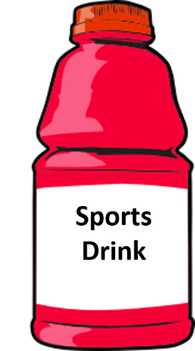
Heat Cramps: First Aid Treatment
Move person to a cool location
Provide person with an electrolyte replacement fluid to replace lost salt and water
Seek medical treatment if cramps persist or other heat-illness symptoms develop
Sports Drink (Stock Photo)

Slide 39
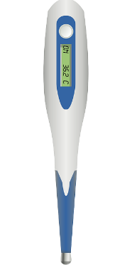
Heat Cramps: Reporting
Report to supervisor or safety manager
Seek medical treatment if cramps persist or other heat-illness symptoms develop
Elevated body temperature
Elevated heart rate
Headache
Dizziness, etc.
Check Temperature and heart rate (Stock Photo)

Slide 40
Heat Syncope: Cause and Prevention
Cause
Preventative Measures
Prolonged standing or sudden rising from a sitting or resting (supine) position
Dehydration can be a contributing factor
Acclimatization to heat helps reduce dehydration
Drink adequate amounts of water throughout the day
Break up long periods of standing with small rest breaks
Rise slowly from sitting or resting positions

Slide 41
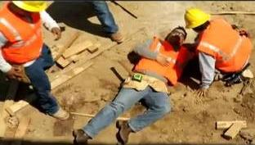
Heat Syncope: Signs & Symptoms
Light-headedness or dizziness
Fainting
Worker fainted on job (Source: Cal OSHA)

Slide 42
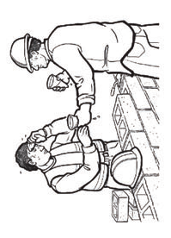
Heat Syncope: First Aid Treatment
If person fainted, then secure the area, elevate their feet above heart level and request immediate first aid and/or medical attention; do not allow them to get up quickly or walk
If person is only slightly dizzy and able to move
Have two people assist and carefully move to a cool location and have them lay down on back with feet elevated above heart level
Provide small amounts of water
If the dizziness persists, request immediate first aid and/or medical attention
Provide water and rest (Source: OSHA)

Slide 43
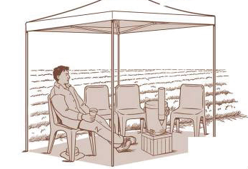
Heat Syncope: Reporting
Report to supervisor or safety manager
If they fainted or dizziness persists, request immediate first aid and/or medical attention
Provide water, rest and monitor (Source: OSHA)

Slide 44
Heat Exhaustion: Cause and Prevention
Cause
Preventative Measures
Inability of body to cool itself, often due to a combination of several factors (e.g., high temperatures, humidity, physical exertion, dehydration, clothing that blocks sweat evaporation or alcohol use).
This is a serious condition that can lead to a life-threatening heat stroke.
Acclimatization to heat helps reduce dehydration
Drink adequate amounts of water throughout the day
Take small rest breaks in shade to allow body to recover from heavy physical exertion and heat exposure
Protect skin against sunburn, which reduces body’s ability to cool itself
If possible, perform heavier physical labor towards cooler part of the day (e.g., early morning or evening)

Slide 45
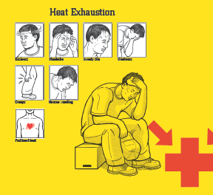
Heat Exhaustion: Signs & Symptoms
Elevated core body temperature of 100.4 to 102.2 °F; oral temperature 99.6 to 101.4 °F
Weak, but rapid pulse (elevated heart rate)
Cool, moist skin
May appear pale with clammy skin
Excessive sweating
Headache and possible irritability
Fatigue or weakness
Dizziness and/or feeling faint
Nausea and/or vomiting
Decreased urine output
Heat exhaustion (Source Cal OSHA)

Slide 46
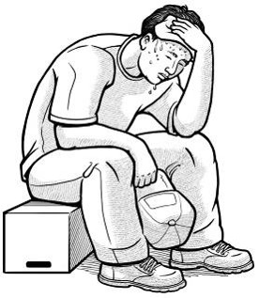
Heat Exhaustion: First Aid Treatment
Seek immediate medical care
Immediately help the person cool off & monitor them (do not let them out of sight)
Move to a cool location
Remove or loosen unnecessary clothing
Have them drink small amounts of cool water
Spray skin with cool water and fan rapidly to increase evaporation and cooling
Monitor body temperature and continue cooling efforts until body temperature returns to a normal temperature below 99 °F (37 °C).
Implement additional heat stroke treatments if body temperature does not decrease below 100 °F (37.8 °C) after 30 minutes or increases above 102 °F (38.9 °C).
Heat exhaustion (Source: OSHA)

Slide 47
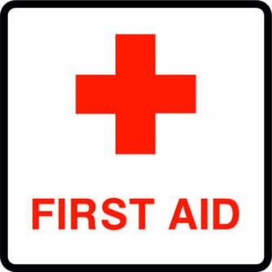
Heat Exhaustion: Reporting
Seek immediate medical care, especially if worker does not recover in first hour
Report to supervisor or safety manager
First aid (Clipart)

Slide 48
Heat Stroke: Cause and Prevention
Cause
Preventative Measures
Body is unable to cool itself and regulate core body temperature.
This is a serious and life-threatening condition that requires immediate medical attention
(call 911).
Same as for Heat Exhaustion
Acclimatization
Drink adequate amounts of water throughout the day
Take small rest breaks in shade
Protect skin against sunburn
If possible, perform heavier physical labor towards cooler part of the day

Slide 49
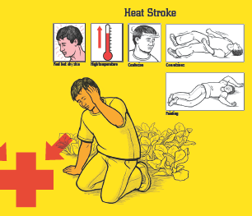
Heat Stroke: Signs & Symptoms
Elevated core body temperature above 104 °F
Oral temperature above 103.2 °F
Hot, dry skin or heavy sweating
Fainting or a loss of consciousness
Seizures or convulsions
Mental confusion, agitation
Irrational behavior
Clumsiness
Slurred speech
Heat stroke (Source Cal OSHA)

Slide 50
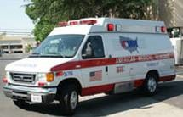
Heat Stroke: First Aid Treatment
Seek immediate medical care (call 911)
Provide immediate and aggressive cooling to their body
Elevate feet above heart level
Remove or loosen unnecessary clothing
Pack ice in groin and armpit areas
Soak skin with cool water and fan vigorously to increase cooling of skin
As an alternative, immerse them in a tub of cool water or spray body with large amounts of cool water
Do not give person fluids to drink if unconscious or vomiting
Monitor body temperature and continue cooling efforts until body temperature returns to a normal temperature below 99 °F (37 °C).
Administer CPR as needed, if blood circulation or breathing stops, until emergency medical services arrive
Call 911 (OSHA)

Slide 51
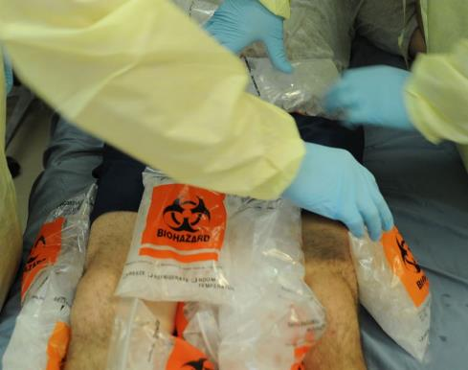
First Aid Treatment for Heat Stroke
Pack Ice along arm pit and groin areas (Source: DOD)
Remove clothing, spray skin with water and fan vigorously (Source: CDC)

Slide 52

Heat Stroke: Reporting
Seek immediate medical care (call 911)
Report to supervisor or safety manager
Hospital (Clipart)

Slide 53
Rhabdomyolysis: Cause and Prevention
Cause
Preventative Measures
Sometimes caused by a combination of heat stress and prolonged physical exertion
Muscle starts to break down and die, releasing proteins and electrolytes into the bloodstream.
This is a potentially life-threatening condition affecting the kidneys that requires immediate medical attention.
Same as for heat exhaustion and heat stroke
Avoid overexertion, such as lifting objects heavier than you can comfortably lift or straining muscles to a point where they can no longer function properly.
Those with diabetes, thyroid conditions or muscular dystrophy are at greater risk.
Those with a viral infection, such as flu, HIV or herpes, are at greater risk.
Use of alcohol & illegal drugs, such as heroin, cocaine & amphetamines can increase the risk.
Some medications, such as such as antipsychotics or statins, can increase the risk.

Slide 54
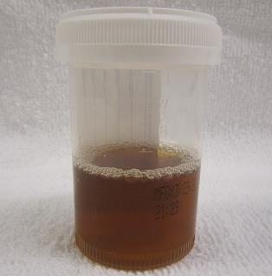
Rhabdomyolysis: Signs & Symptoms
Muscle cramps, pain and/or loss of range
Joint pain and/or stiffness
Swelling of muscles
Weakness and a decreased ability to perform physical exertion for even a small amount of time
Dark urine (similar to tea or cola in color)
If kidney damage and/or failure occurs the following life-threatening indicators may be observed:
Shortness of breath
Irregular heart beat
Swelling in the legs and feet
Seizures
Coma
Rhabdomyolysis urine (Creative Commons: James Heilman, MD)

Slide 55
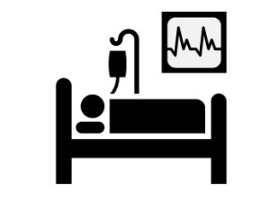
Rhabdomyolysis : First Aid Treatment
Seek immediate medical care (call 911)
IV fluids and treatments to combat toxic proteins in blood are needed to prevent kidney failure
Hospital (Clipart)

Slide 56

Rhabdomyolysis: Reporting
Seek immediate medical care (call 911)
Report to supervisor or safety manager
Hospital (Clipart)

Slide 57
Heat-illness prevention strategies
When Risk Level is High Incorporate Physiological Monitoring
Hierarchy of controls
Engineering controls
Administrative controls
Protective clothing & equipment

Slide 58
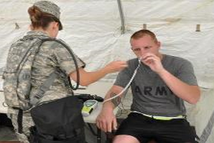
When Risk Level is High Incorporate Physiological Monitoring
Oral temperature
Heart rate recovery
Additional measures to help reduce dehydration
Body weight
Urine color
Oral temperature monitoring (US ARMY DOD)

Slide 59
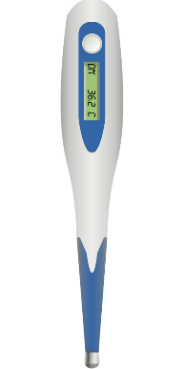
Oral temperature
It is important to make sure the thermometer is stored in a cool environment and not exposed to temperatures above 95 °F.
Readings should not be taken be taken within 15-minutes of consuming hot or cool liquids and foods or if breathing heavy (mouth breathing).
Oral temperatures should not exceed 99.5 °F.
As a precautionary measure, when the oral temperature is elevated above 99.1 °F, adjust the work-rest schedule to increase the frequency and duration of rest breaks or take other preventative measures.
Oral thermometer (Stock Photo)

Slide 60
Heart Rate Recovery
Take pulse rate readings at the beginning of a scheduled rest break.
With the worker sitting and resting, collect an initial pulse rate reading (P1) and if it is above 110 bpm, then take readings at a two-minute (P2) and four-minute (P3) interval.
If pulse rate does not drop to below 110 bpm, then this indicates heat stress conditions are above an acceptable level. The resting heart rate is too high, which indicates the work rate is too high for the individual.
With P1 above 110 bpm, if the difference between two-minute intervals is less than 10 bpm, then this also indicates heat stress conditions are above an acceptable level. The heart rate is not effectively recovering at rest, which also indicates the work rate is too high for the individual. It could also indicate dehydration.

Slide 61

Caution: Heart Rate Recovery
There can be variation among individuals and some may exhibit much lower or higher resting pulse rates. A qualified medical provider should examine individuals with pre-work pulse rates above 100 bpm when at normal rest. High resting pulse rates could be indicative of an underlying medical condition.
Medical symbol (Clipart)

Slide 62
Class Exercise #1 Body Temperature and Heart Rate Recovery
Worker #1
Worker #2
Oral temperature 98.9 °F
Heart rate
P1: 140 bpm
P2: 115 bpm
P3: 95 bpm
Oral temperature 99.4 °F
Heart rate
P1: 125 bpm
P2: 120 bpm
P3: 118 bpm

Slide 63
Class Exercise #1 What is your assessment for each worker? Can they return to normal duties?
Worker #1
Worker #2
___________________________________________________________________________________________________________________________________________________
__________________________________________________________________________________________________________________________________________________________

Slide 64
Hierarchy of Controls – a combination of several is always recommended
Engineering
Use tools & equipment to reduce physical exertion
Administrative
Acclimate workers
Training
Clothing & Equipment
Adjust clothing layers
Cooling vests and clothing
Reduce heat stress factors
Reduce WBGT
Adjust work schedule
Rest, water & shade
Light colored or reflective clothing

Slide 65
Engineering Controls
Reduce physical exertion and physical demands of work through use of powered tools and equipment, especially for tasks involving heavy lifting.
Reduce radiant heat loading from the sun or other sources of radiant heat (e.g., furnaces, combustion engines and compressors, hot surfaces, heated transfer lines, windows receiving intense sun, etc.). Place line-of-sight, reflective barriers between the heat source and workers. Insulate hot surfaces, such as furnaces.
If air temperatures are below 95 °F, then increase air speed across skin using fans or air movers, to increase evaporative cooling from skin.
If air temperatures are above 95 °F, then reduce air speed across skin, to reduce convective heat transfer from air to skin.
If humidity is below 50%, then evaporative coolers and portable fans with water mist systems can be used to effectively cool the air by about 10 to 20 °F.
Decrease humidity to below 50% to increase evaporative cooling from sweating.

Slide 66
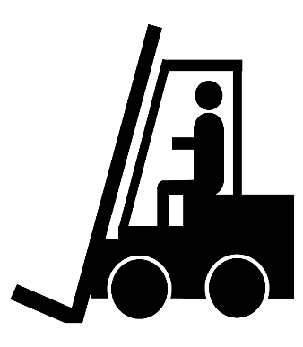
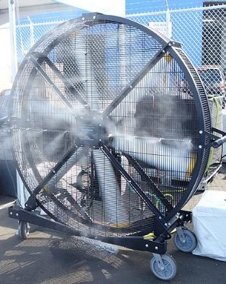
Examples of Engineering Controls
Forklift (Clipart)
Misting fan (Wikimedia Creative Commons by Tdorante10)

Slide 67
Administrative Controls 1 - 5
Adjust work schedule to acclimate workers to heat.
Schedule work or work requiring heavy physical exertion during the coolest parts of the day.
Modify the work-rest schedule to shorten heat exposure periods by including frequent rest breaks. Shorter, more frequent breaks are more effective than longer, less frequent rest breaks.
Encourage adequate water intake at frequent intervals to prevent dehydration (e.g., one 8-ounce cup of cool water or an electrolyte replacement fluid every 15-20 minutes).
Use a shaded and cool space nearby for rest and water breaks.

Slide 68
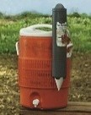
Water for Remote Job Sites
Supervisor or foreman is responsible
Ensure water containers are clean and sanitary
Ensure water containers are filled at a sanitary location
Provide sufficient disposable cups & disposal receptacle
Ensure workers do not share cups and dispose properly
Prohibit workers from opening the cooler top to fill cups and instead have workers use the provided spigot.
Provide pure and cool potable water
Do not use water from irrigation, sprinklers or fire systems
Do not use water from a garden hose (may contain contaminants and/or microbes)
Water quantities need to be sufficient and at least 1 quart per worker per hour for the entire shift
Locate water containers as close as possible
Encourage workers to frequently drink water and not wait until thirsty
Water cooler (Source: Cal OSHA)

Slide 69
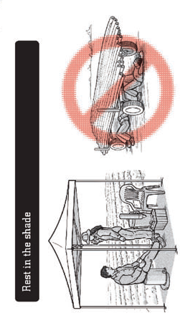

Examples of Administrative Controls
Adjust work schedule to have heavy physical exertion at cooler times of day (Clipart)
Rest in shade (OSHA)

Slide 70
Administrative Controls 6 - 11
Give training on the recognition of the signs and symptoms of heat-induced illness and on heat-illness prevention strategies.
Provide alerts for extreme heat events or heat stress conditions and review of the heat-illness prevention strategies for the day.
Work in pairs (buddy system) and monitor each other for signs and symptoms of heat stress or illness.
Avoid caffeine and alcohol before and during work in heat.
Report illnesses or medical conditions that may put you at risk of heat stress (e.g., diarrhea, fever, infection, etc.)
Get medically screened for work in hot environments.

Slide 71
Protective Clothing and Equipment Controls
Wear clothing designed to keep the body cool, such as air, cooled fluid or ice-cooled conditioned clothing.
Wear reflective clothing to reduce radiant heat loading from the sun or hot surfaces radiating heat.
If air temperatures are below 95 °F and you are protected from radiant heat, then decrease clothing coverage or layers (when feasible) to increase evaporative cooling from skin.
Caution: Do not remove clothing designed to protect you from chemical, mechanical or other hazards without a proper evaluation to address those hazards.
If air temperatures are above 95 °F, then increase clothing coverage to reduce air speed across skin, which can help reduce convective heat transfer from air to skin.

Slide 72
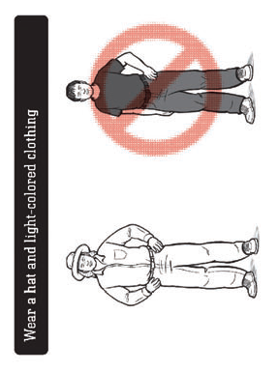
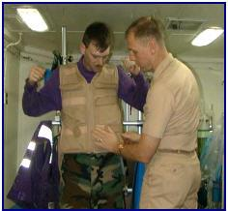
Examples of Protective Clothing Controls
Ice vest (DOD)
Light colored clothing (OSHA)

Slide 73
Section 4: Monitor weather and workplace conditions

Slide 74
Monitor weather and workplace conditions
Responsibilities
Resources
The Safety Manager and supervisors are responsible for monitoring the daily weather and workplace conditions to determine if workers will be exposed to temperatures greater than 70 °F (21 °C).
National Weather Service
www.weather.gov
Weather Underground
www.wunderground.com
Intellicast
www.intellicast.com

Slide 75
If the temperatures will exceed 70 °F for more than an hour during the work shift, then a heat hazard assessment needs to be performed.
Collect the following additional weather information for the heat hazard assessment
Air temperature (°F)
Humidity (%)
Wind speed (mph)
Barometric pressure (inches)
Longitude and latitude
Cloud cover
The Next Step
Conduct a heat hazard assessment

Slide 76
Also identify and evaluate other heat stress hazards (worksheet provided)
1. Outside work with sun exposure and temperatures above 70 °F
2. Work around hot processes and/or radiant heat sources
3. Workers will wear vapor barrier chemical protective suits
4. Work under high relative humidity conditions (e.g., greater than 50%)
5. Low wind speeds or lack of air movement
6. Manual labor and tasks requiring physical exertion
7. Workers not acclimated to work in hot environments
8. Workers wearing multiple layers of clothing
9. Other:

Slide 77
Does a Heat Hazard Evaluation Need to be Conducted?
Condition | NO | YES
Items 1, 2 or 3 were checked above. |  | ×
More than two of the above items were checked. |  | ×
There is a valid concern regarding heat stress. |  | ×
Conduct a Heat Hazard Assessment if the answer is “YES” to any of the following:

Slide 78
Heat Hazard Assessment (WBGT-Effective)
Accounts for
Environmental heat stress factors
Accounts for
Work-related heat stress factors
Temperature
Humidity
Wind speed
Solar irradiance
Metabolic work rate
Due to physical exertion
Heat generated by muscles
Clothing
Can reduce evaporative cooling

Slide 79
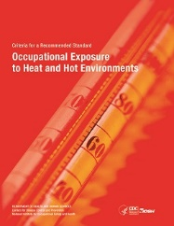
Where can I find more information on WBGT and WBGT-Effective?
OSHA Technical Manual, Section III, Chapter 4 on Heat Stress (www.osha.gov)
NIOSH Criteria for a Recommended Standard: Occupational Exposure to Heat and Hot Environments (www.cdc.gov/niosh)
NIOSH Criteria Document

Slide 80
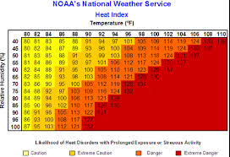
Why not just use a heat index?
Heat index only takes into account temperature and humidity
It does not take into account wind speed, radiant heat, clothing and metabolic heat from physical exertion, which are all factors that can contribute to heat stress and heat-related illnesses.
Heat Index (Source OSHA)

Slide 81
Heat Hazard Assessment in 5 Steps Worksheet provided
Step 1: Calculate WBGT Using Weather Data
Step 2. Add Clothing Adjustment Factor
Step 3. Determine the Metabolic Heat
Step 4. Determine Exposure Threshold Limit
Step 5. Determine Risk Level

Slide 82
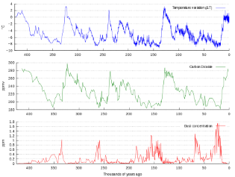
Step 1: Calculate WBGT Using Weather Data
Use Argonne National Laboratory calculator based on validated and literature-supported algorithmic equations to determine WBGT from National Weather Service data.
Available as a downloadable zip file from OSHA at:
http://www.osha.gov/dts/osta/otm/otm_iii/wbgtutil.zip
Daily Weather Data (Wikimedia CC)

Slide 83
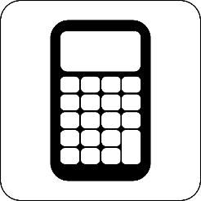
The calculator uses the following required weather and location information to determine WBGT.
Air Temperature (°F) for hottest hour of the work shift
Barometric Pressure (inches of Hg)
Relative Humidity (%) for hottest hour of the work shift
Wind Speed (mph) during hottest hour of the work shift
Date (MONTH DAY, YEAR; e.g., January 1, 2019)
Time (HH:MM AM/PM; e.g., 12:00 PM) for hottest hour of the work shift
Longitude and latitude (degrees) – input in “Options”
Solar Irradiance (W/m²) based on Table 1
Calculator (Clipart)

Slide 84
Table 1. Estimated Solar Irradiance Based on Cloud Cover
Reported Cloud Cover | Irradiance (W/m²)
Sunny | 990
Mostly Sunny, Partly Sunny/Cloudy Scattered Clouds | 980
Mostly Cloudy | 710
Cloudy | 250
Source: OSHA as adapted from A. Ben Jemaa, et al. (2013) Energy Procedia, Volume 42, Pages 406-415.

Slide 85
Step 2. Add Clothing Adjustment Factor
As recommended by OSHA, the ACGIH Clothing Adjustment Factor (CAF) can be determined from Table 2 and added to the pervious WBGT to produce an effective WBGT value, termed WBGT-Effective.
$$WBGT\text{∙}Effective=WBGT+CAF$$

Slide 86
Table 2. Clothing Adjustment Factors (CAF)
Clothing Worn | CAF (°F)
Work clothes (long sleeves and pants). Examples: Standard cotton shirt/pants. | 0
Coveralls (w/only underwear underneath). Examples: Cotton or light polyester material. | 0
Double-layer woven clothing. | 5.4
SMS (spunbond/meltblown/spunbond) Polypropylene Coveralls | 0.9
Polyolefin coveralls. Examples: Micro-porous fabric (e.g., Tyvek™). | 1.8
Limited-use vapor-barrier coveralls. Examples: Encapsulating suits, whole-body chemical protective suites, firefighter turn-out gear. | 19.8
Source: OSHA Technical Manual as adopted from ACGIH "2017 TLVs and BEIs" and converted to °F.

Slide 87
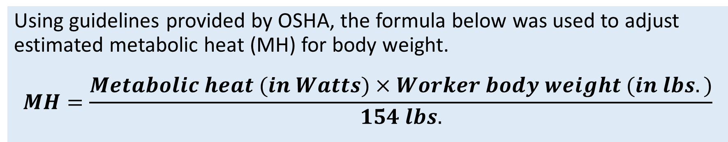
Step 3. Determine the Metabolic Heat
Select a work category in Table 3 that best represents the workload using the provided examples as a guide.
Select the heaviest workload activity to account for the highest metabolic heat, which will help ensure proper controls are in place to protect workers.
Using guidelines provided by OSHA, the formula below was used to adjust estimated metabolic heat (MH) for body weight.
$$MH=\frac{Metabolic heat (in Watts)×Worker body weight (in lbs.)}{154 lbs.}$$

Slide 88
Table 3. Work Category Based on Metabolic Work Rates Adapted from OSHA Technical Manual, NIOSH Criteria for a Recommended Standard: Occupational Exposure to Heat and Hot Environments, and ACGIH "2017 TLVs and BEIs"
Work Category | Examples | Estimated Metabolic Heat (Watts) for 154 lb. Person | Estimated Metabolic Rate (Watts) for 200 lb. Person | Estimated Metabolic Heat (Watts) for 250 lb. Person | Estimated Metabolic Heat (Watts) for 300 lb. Person
Light | Sitting, standing, light arm/hand work and occasional walking | 233 | 303 | 377 | 454
Moderate | Normal walking, moderate lifting | 349 | 454 | 565 | 681*
Heavy | Heavy material handling, walking at a fast pace | 465 | 605* | 753* | 907*
Very Heavy | Pick and shovel work | 580 | 754* | 940* | 1131*

Slide 89
Caution!
* These activities are not recommended for persons of this body weight working under heat stress conditions. Special precautionary measures must be taken to reduce physical exertion and continually monitor workers for physiological signs of heat stress (e.g., body temperature and/or heart rate).

Slide 90
Step 4. Determine Exposure Threshold Limit
Acclimated Workers
Unacclimated Workers
A NIOSH recommended exposure limit (REL) is used to establish the exposure threshold for implementation of workplace controls for heat stress in healthy workers already acclimated to work in hot environments.
The NIOSH recommended alert level (RAL) is an exposure threshold for use with unacclimatized workers.

Slide 91
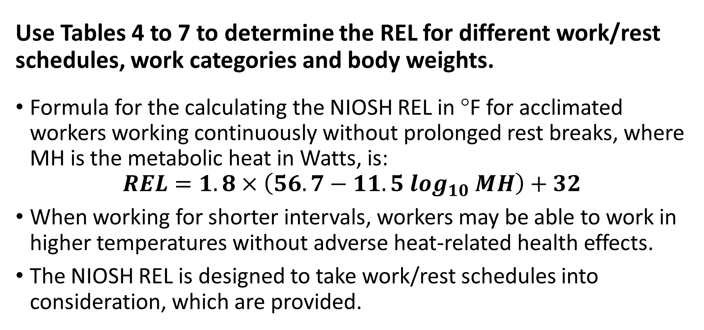
Acclimated Workers: Recommended Exposure Limit (REL)
Use Tables 4 to 7 to determine the REL for different work/rest schedules, work categories and body weights.
Formula for the calculating the NIOSH REL in °F for acclimated workers working continuously without prolonged rest breaks, where MH is the metabolic heat in Watts, is:
$$REL=1.8×\left(56.7−11.5\log_{10} MH\right)+32$$
When working for shorter intervals, workers may be able to work in higher temperatures without adverse heat-related health effects.
The NIOSH REL is designed to take work/rest schedules into consideration, which are provided.

Slide 92
Table 4. REL for Continuous Work Adapted from NIOSH Criteria for a Recommended Standard: Occupational Exposure to Heat and Hot Environments and ACGIH "2017 TLVs and BEIs"
Work Category | Example | REL for 154 lb. Person | REL for 200 lb. Person | REL for 250 lb. Person | REL for 300 lb. Person
Light | Sitting, standing, light arm/hand work and occasional walking | 85 °F | 83 °F | 81 °F | 79 °F
Moderate | Normal walking, moderate lifting | 81 °F | 79 °F | 77 °F | 75 °F *
Heavy | Heavy material handling, walking at a fast pace | 79 °F | 76 °F * | 74 °F * | 73 °F *
Very Heavy | Pick and shovel work | 77 °F | 74 °F * | 72 °F * | 71 °F *

Slide 93
Table 5. REL for 75% Work & 25% Rest Each Hour Adapted from NIOSH Criteria for a Recommended Standard: Occupational Exposure to Heat and Hot Environments and ACGIH "2017 TLVs and BEIs"
Work Category | Example | REL for 154 lb. Person | REL for 200 lb. Person | REL for 250 lb. Person | REL for 300 lb. Person
Light | Sitting, standing, light arm/hand work and occasional walking | 87 °F | 84 °F | 82 °F | 81 °F
Moderate | Normal walking, moderate lifting | 84 °F | 81 °F | 79 °F | 78 °F *
Heavy | Heavy material handling, walking at a fast pace | 82 °F | 79 °F * | 77 °F * | 76 °F *
Very Heavy | Pick and shovel work | 79 °F | 77 °F * | 75 °F * | 73 °F *

Slide 94
Table 6. 50% Work & 50% Rest Each Hour Adapted from NIOSH Criteria for a Recommended Standard: Occupational Exposure to Heat and Hot Environments and ACGIH "2017 TLVs and BEIs"
Work Category | Example | REL for 154 lb. Person | REL for 200 lb. Person | REL for 250 lb. Person | REL for 300 lb. Person
Light | Sitting, standing, light arm/hand work and occasional walking | 89 °F | 86 °F | 84 °F | 83 °F
Moderate | Normal walking, moderate lifting | 86 °F | 83 °F | 81 °F | 80 °F *
Heavy | Heavy material handling, walking at a fast pace | 84 °F | 81 °F * | 79 °F * | 78 °F *
Very Heavy | Pick and shovel work | 81 °F | 79 °F * | 77 °F * | 75 °F *

Slide 95
Table 7. REL for 25% Work & 75% Rest Each Hour Adapted from NIOSH Criteria for a Recommended Standard: Occupational Exposure to Heat and Hot Environments and ACGIH "2017 TLVs and BEIs"
Work Category | Example | REL for 154 lb. Person | REL for 200 lb. Person | REL for 250 lb. Person | REL for 300 lb. Person
Light | Sitting, standing, light arm/hand work and occasional walking | 90 °F | 88 °F | 86 °F | 84 °F
Moderate | Normal walking, moderate lifting | 88 °F | 86 °F | 84 °F | 82 °F *
Heavy | Heavy material handling, walking at a fast pace | 86 °F | 84 °F * | 82 °F * | 80 °F *
Very Heavy | Pick and shovel work | 84 °F | 82 °F * | 80 °F * | 78 °F *

Slide 96
Still Same Caution!
* These activities are not recommended for persons of this body weight working under heat stress conditions. Special precautionary measures must be taken to reduce physical exertion and continually monitor workers for physiological signs of heat stress (e.g., body temperature and/or heart rate recovery).

Slide 97
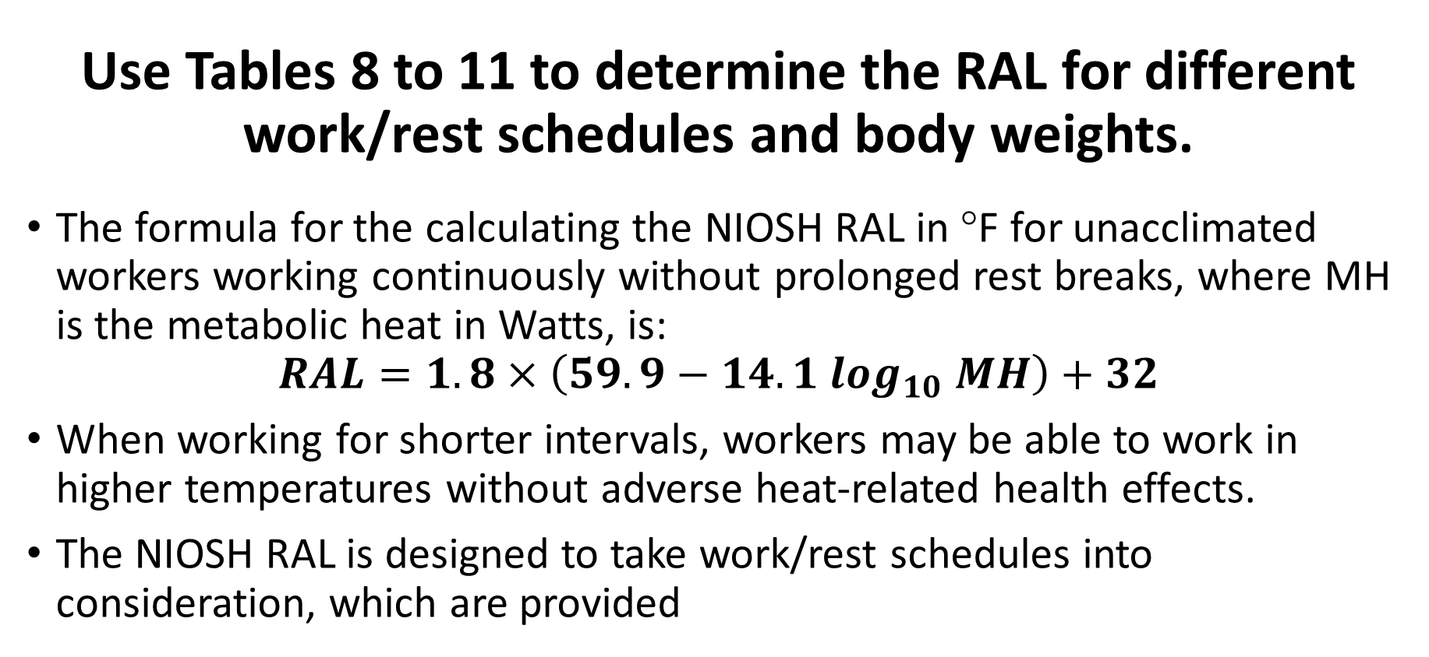
Unacclimated Workers: Recommended Alert Limit (RAL)
Use Tables 8 to 11 to determine the RAL for different work/rest schedules and body weights.
The formula for the calculating the NIOSH RAL in °F for unacclimated workers working continuously without prolonged rest breaks, where MH is the metabolic heat in Watts, is:
$$RAL=1.8×\left(59.9−14.1\log_{10} MH\right)+32$$
When working for shorter intervals, workers may be able to work in higher temperatures without adverse heat-related health effects.
The NIOSH RAL is designed to take work/rest schedules into consideration, which are provided

Slide 98
Table 8. RAL for Continuous Work Adapted from NIOSH Criteria for a Recommended Standard: Occupational Exposure to Heat and Hot Environments and ACGIH "2017 TLVs and BEIs"
Work Category | Example | REL for 154 lb. Person | REL for 200 lb. Person | REL for 250 lb. Person | REL for 300 lb. Person
Light | Sitting, standing, light arm/hand work and occasional walking | 80 °F | 77 °F | 74 °F | 72 °F
Moderate | Normal walking, moderate lifting | 75 °F | 72 °F | 70 °F | 68 °F *
Heavy | Heavy material handling, walking at a fast pace | 72 °F | 69 °F * | 67 °F * | 65 °F *
Very Heavy | Pick and shovel work | 70 °F | 67 °F * | 64 °F * | 62 °F *

Slide 99
Table 9. RAL for 75% Work & 25% Rest Each Hour Adapted from NIOSH Criteria for a Recommended Standard: Occupational Exposure to Heat and Hot Environments and ACGIH "2017 TLVs and BEIs"
Work Category | Example | REL for 154 lb. Person | REL for 200 lb. Person | REL for 250 lb. Person | REL for 300 lb. Person
Light | Sitting, standing, light arm/hand work and occasional walking | 82 °F | 79 °F | 77 °F | 75 °F
Moderate | Normal walking, moderate lifting | 78 °F | 75 °F | 73 °F | 71 °F *
Heavy | Heavy material handling, walking at a fast pace | 76 °F | 73 °F * | 70 °F * | 68 °F *
Very Heavy | Pick and shovel work | 73 °F | 70 °F * | 68 °F * | 66 °F *

Slide 100
Table 10. 50% Work & 50% Rest Each Hour Adapted from NIOSH Criteria for a Recommended Standard: Occupational Exposure to Heat and Hot Environments and ACGIH "2017 TLVs and BEIs"
Work Category | Example | REL for 154 lb. Person | REL for 200 lb. Person | REL for 250 lb. Person | REL for 300 lb. Person
Light | Sitting, standing, light arm/hand work and occasional walking | 84 °F | 81 °F | 79 °F | 77 °F
Moderate | Normal walking, moderate lifting | 81 °F | 78 °F | 76 °F | 73 °F *
Heavy | Heavy material handling, walking at a fast pace | 78 °F | 76 °F * | 73 °F * | 71 °F *
Very Heavy | Pick and shovel work | 77 °F | 74 °F * | 72 °F * | 69 °F *

Slide 101
Table 11. RAL for 25% Work & 75% Rest Each Hour Adapted from NIOSH Criteria for a Recommended Standard: Occupational Exposure to Heat and Hot Environments and ACGIH "2017 TLVs and BEIs"
Work Category | Example | REL for 154 lb. Person | REL for 200 lb. Person | REL for 250 lb. Person | REL for 300 lb. Person
Light | Sitting, standing, light arm/hand work and occasional walking | 86 °F | 83 °F | 80 °F | 78 °F
Moderate | Normal walking, moderate lifting | 83 °F | 80 °F | 78 °F | 76 °F *
Heavy | Heavy material handling, walking at a fast pace | 81 °F | 78 °F * | 76 °F * | 74 °F *
Very Heavy | Pick and shovel work | 80 °F | 77 °F * | 75 °F * | 73 °F *

Slide 102
Warning! When workers are not acclimated to work in hot environments they are at additional risk of heat stress
* These activities are not recommended for persons of this body weight working under heat stress conditions. Special precautionary measures must be taken to reduce physical exertion and continually monitor workers for physiological signs of heat stress (e.g., body temperature and/or heart rate recovery).

Slide 103
Step 5. Determine Risk Level
Risk level is assessed by comparing the WBGT-Effective to the REL (acclimated workers) or RAL (unacclimated workers).
A hazard quotient is used to compare WBGT-Effective with the respective REL or RAL
If HQ is below 1.0, then no heat stress hazard is anticipated
The greater the HQ above 1.0, the greater the heat stress hazard
Table 12. Risk Level for Acclimated and Unacclimated Workers
HQ | < 1.0 | 1.0-1.02 | 1.03-1.04 | 1.04-1.07 | > 1.07
Risk Level | Low | Moderate | High | Very High | Severe

Slide 104
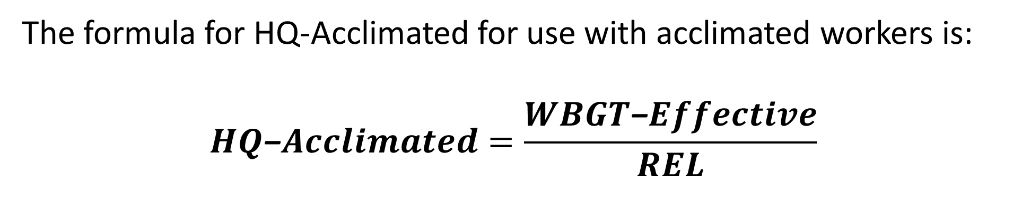
Acclimated Workers: Hazard Quotient
The formula for HQ-Acclimated for use with acclimated workers is:
$$HQ\text{−}Acclimated=\frac{WBGT\text{−}Effective}{REL}$$
Table 12. Risk Level for Acclimated and Unacclimated Workers
HQ | < 1.0 | 1.0-1.02 | 1.03-1.04 | 1.04-1.07 | > 1.07
Risk Level | Low | Moderate | High | Very High | Severe

Slide 105
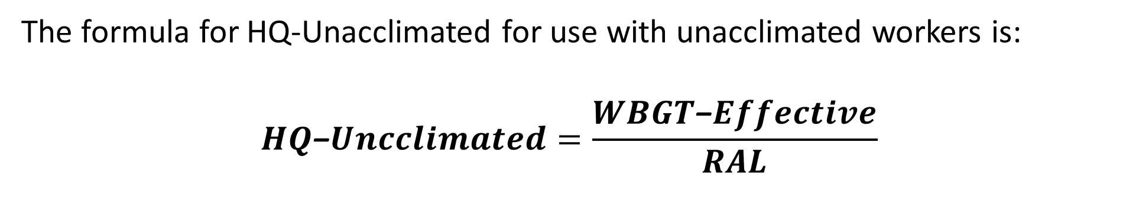
Unacclimated Workers: Hazard Quotient
The formula for HQ-Unacclimated for use with unacclimated workers is:
$$HQ\text{−}Uncclimated=\frac{WBGT\text{−}Effective}{RAL}$$
Table 12. Risk Level for Acclimated and Unacclimated Workers
HQ | < 1.0 | 1.0-1.02 | 1.03-1.04 | 1.04-1.07 | > 1.07
Risk Level | Low | Moderate | High | Very High | Severe

Slide 106
Section 5: Heat-illness prevention strategies

Slide 107
Implementing Heat-illness Prevention Strategies
When the HQ is above 1.0, heat-illness prevention controls need to be implemented to protect workers.
Heat-illness prevention strategies: 5 steps
Implement controls to reduce HQ & risk level
Implement physiological monitoring with higher risk levels
Implement engineering controls
Implement administrative controls
Implement protective clothing & equipment controls

Slide 108
Unacclimated workers
The heat-illness prevention strategies vary slightly for unacclimated workers.
If workers have not worked in a hot environment within the previous week, then those workers must be placed in an acclimatization program designed to gradually acclimate them to work in a hot environment.

Slide 109
Step 1. Implement Controls to Reduce HQ & Risk Level
Examples of highly effective controls include:
Suspend activities during the hottest part of the day and change to work schedule to cooler times of the day.
Provide shade or shelter from the sun and eliminate solar irradiance to 0 Watts/m².
When feasible, eliminate use of chemical vapor-barrier coveralls, encapsulating suits and whole-body chemical protective suits during hottest parts of day.
When feasible, eliminate double clothing layers.
When feasible, use mechanical and powered equipment to reduce worker physical exertion, especially heavy exertion. This includes the use of forklifts, hoists, earthmoving equipment (backhoes, loaders and excavators), conveyers, portable power tools (e.g., rotary auger in place of hand shoveling), etc.

Slide 110
Additional examples of effective controls to reduce risk level
When feasible, change the work-rest schedule to ensure workers receive adequate rest breaks, which will decrease accumulation of body heat. [MODERATELY TO HIGHLY EFFECTIVE]
If air temperatures are below 95 °F (skin temperature) and air velocities are less than 1-2 mph, then increasing the air velocity at workers using portable fans can be an effective control to increase cooling. Caution: If air temperatures are above 95 °F, then heat will be added to workers by convection, which puts them at risk of heat stress. [MODERATELY EFFECTIVE]
When feasible, adjust work clothing to lighter, more breathable cotton fabrics or change coveralls to a more breathable material. [SLIGHTLY EFFECTIVE]

Slide 111
Step 2. When Risk Level is High Incorporate Physiological Monitoring
When risk level is high, very high or severe, then implement physiological monitoring
Oral body temperature
Heart rate recovery
Additional Monitoring for Dehydration (See Training Section)
Body weight
Workers can monitor urine color

Slide 112
Recovery Heart Rate (Pulse Rate)
Guidelines
If the pulse rate does not drop to below 110 bpm during the test, then this indicates heat stress conditions are above an acceptable level.
The resting heart rate is too high, which indicates the work rate is too high for the individual.
With a starting pulse rate above 110 bpm, if the difference between two-minute intervals is less than 10 bpm, then this also indicates heat stress conditions are above an acceptable level.
The heart rate is not effectively recovering at rest, which also indicates the work rate is too high for the individual. It could also indicate dehydration.

Slide 113
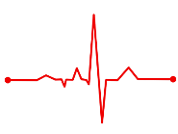
Methods for Collecting Pulse Rate
Heart rate pulse (Clipart)
The pulse rate can be collected manually
A reliable and accurate clinical pulse rate device for the finger, wrist or chest is recommended.
Use the guidelines provided by the device manufacture when collecting pulse rates.
Collect pulse rate at start of rest break
As the pulse rate will change with time, it is important to collect the pulse rate within a consistent and short interval (e.g., 5 to 10 seconds).

Slide 114

Manually Counting Pulse Rate
Count the pulses at the inner wrist just below the palm on the thumb or neck to the side of the windpipe over a 30 second timed interval (e.g., using a stopwatch).
Use the index and middle fingers to detect a pulse and do not start counting until a reliable pulse can be detected. A slight amount of pressure may be necessary.
The number of pulses is then multiplied by 2 to give the pulse rate in bpm.
Check pulse (Clipart)

Slide 115
Table 14. Collection and Interpretation of Pulse Rates
STEP | Instructions
Schedule times for collection | During the hottest times of the workday, collect pulse rates at least every hour. Under severe conditions, the cycle should be at least every 30 minutes. Collect at the start of the rest break, within the first few minutes.
Collect initial pulse rate (P1) | Have the work sit on a stool or chair and rest. Collect the initial pulse rate within a few minutes after the worker has stopped working, at the start of the rest break.
If P1 is below 110 bpm | If the pulse rate is below 110 bpm, then resume normal work activities and work-rest schedule.
If P1 is above 110 bpm | If the pulse rate is above 110 bpm, then evaluate heart rate recovery by collecting two additional pulse rate measurements at two-minute intervals.
If differences between 2-minute intervals is greater than 10 bpm and the pulse rate drops below 110 bpm | If differences between 2-minute intervals is greater than 10 bpm and the pulse rate drops below 110 bpm, then resume normal work activities and work-rest schedule.
If differences between 2-minute intervals is less than 10 bpm | If differences between 2-minute intervals is less than 10 bpm, then suspend work and physical exertion within the hot environment and take immediate actions to cool his/her body temperature (e.g., move to a cool location with air movement and provide cool fluids). Monitor pulse rate and/or body temperature and continue cooling efforts until pulse rate drops below 90 bpm or body temperature returns to normal below 99 °F. Seek medical attention if worker exhibits additional signs of heat exhaustion or pulse rate and/or temperature do not drop or continue to elevate at rest.

Slide 116
General Guidelines for Heart Rate Recovery
Within the first few minutes of rest
Your heart rate should drop to below 110 bpm
If it does not, then measure again at 2-minute intervals
Your heart rate should drop by more than 10 bpm every 2-minutes

Slide 117

Oral Body Temperature
Guidelines
Oral temperature should not exceed 99.5 °F
When the oral temperature is elevated above 99.1 °F:
Adjust the work-rest schedule to increase the frequency and duration of rest breaks or take other preventative measures
Oral thermometer (Stock Photo)

Slide 118

Oral Body Temperature Measurement
Use a reliable and accurate clinical thermometer according to the manufacturer’s instructions.
Disposable oral thermometers; readings will take longer (e.g., 3-4 min).
Digital oral thermometers can deliver an accurate reading in as little as 30 seconds.
Make sure the thermometer is stored in a cool environment below 95 °F.
Do not take readings within 15-minutes of consuming hot or cool liquids and foods or if the worker is breathing heavy by mouth.
Oral Thermometer
(Source: PHIL)

Slide 119
Table 13. Collection and Interpretation of Oral Temperatures
STEP | Instructions
Schedule times for collection | During the hottest times of the workday, collect oral temperatures at least every hour. Under severe conditions, the cycle should be at least every 30 minutes.
Collect oral temperature | If worker is not breathing heavily by mouth, then collect oral temperature at a scheduled rest breaks, before consumption of fluids. If worker is breathing heavily, then first drink fluids and collect temperature at end of rest break, 15-minutes after drinking fluids.
Reading less than 99.1 °F | If thermometer reading is less than 99.1 °F, then resume normal work activities and work-rest schedule.
Reading 99.2 to 99.5 °F | If thermometer reading is 99.2 to 99.5 °F, then take precautionary measures to reduce heat stress (e.g., adjust work-rest schedule or implement additional controls)
Reading above 99.5 °F | If thermometer reading is above 99.5 °F, then suspend work and physical exertion within the hot environment and take immediate actions to cool body temperature (e.g., relocate to a cool environment with air movement and provide cool fluids). Monitor body temperature and continue cooling efforts until body temperature returns to a normal temperature below 99 °F. Seek medical attention if worker exhibits additional signs of heat exhaustion or temperature does not drop or continues to elevate at rest.
Reading above 101.2 °F | If thermometer reading is above 101.2 °F, then seek immediate medical attention and take immediate actions to cool his/her body temperature assuming potential heat stroke conditions (e.g., relocate to a cool location with air movement, remove excess clothing, spray body with cool water and fan vigorously, and pack ice in armpits and groin area).

Slide 120

Oral Temperature Warning Levels

Slide 121
Step 3. Implement Engineering Controls
Reduce physical exertion and physical demands of work through use of powered tools and equipment, especially for tasks involving heavy lifting.
Reduce radiant heat loading from the sun or other sources of radiant heat (e.g., furnaces, combustion engines and compressors, hot surfaces, heated transfer lines, windows receiving intense sun, etc.). Place line-of-sight, reflective barriers between the heat source and workers. Insulate hot surfaces, such as furnaces.
If air temperatures are below 95 °F, then increase air speed across skin using fans or air movers, to increase evaporative cooling from skin.
If air temperatures are above 95 °F, then reduce air speed across skin, to reduce convective heat transfer from air to skin.
If humidity is below 50%, then evaporative coolers and portable fans with water mist systems can be used to effectively cool the air by about 10 to 20 °F.
Decrease humidity to below 50% to increase evaporative cooling from sweating.

Slide 122
Step 4. Implement Administrative Controls (1 – 5)
Adjust work schedule to acclimate workers to heat.
Schedule work or work requiring heavy physical exertion during the coolest parts of the day.
Modify the work-rest schedule to shorten heat exposure periods by including frequent rest breaks. Shorter, more frequent breaks are more effective than longer, less frequent rest breaks.
Encourage adequate water intake at frequent intervals to prevent dehydration (e.g., one 8-ounce cup of cool water or an electrolyte replacement fluid every 15-20 minutes).
Use a shaded and cool space nearby for rest and water breaks.

Slide 123

Review: Water for Remote Job Sites
Supervisor or foreman is responsible
Ensure water containers are clean and sanitary
Ensure water containers are filled at a sanitary location
Provide sufficient disposable cups & disposal receptacle
Ensure workers do not share cups and dispose properly
Prohibit workers from opening the cooler top to fill cups and instead have workers use the provided spigot.
Provide pure and cool potable water
Do not use water from irrigation, sprinklers or fire systems
Do not use water from a garden hose (may contain contaminants and/or microbes)
Water quantities need to be sufficient and at least 1 quart per worker per hour for the entire shift
Locate water containers as close as possible
Encourage workers to frequently drink water and not wait until thirsty
Unacceptable water (Source: Cal OSHA)

Slide 124
Step 4. Implement Administrative Controls (6 – 11)
Give training on the recognition of the signs and symptoms of heat-induced illness and on heat-illness prevention strategies.
Provide alerts for extreme heat events or heat stress conditions and review of the heat-illness prevention strategies for the day.
Work in pairs (buddy system) and monitor each other for signs and symptoms of heat stress or illness.
Avoid caffeine and alcohol before and during work in heat.
Report illnesses or medical conditions that may put you at risk of heat stress (e.g., diarrhea, fever, infection, etc.)
Get medically screened for work in hot environments.

Slide 125
Step 5. Implement Protective Clothing and Equipment Controls
Wear clothing designed to keep the body cool, such as air, cooled fluid or ice-cooled conditioned clothing.
Wear reflective clothing to reduce radiant heat loading from the sun or hot surfaces radiating heat.
If air temperatures are below 95 °F and you are protected from radiant heat, then decrease clothing coverage or layers (when feasible) to increase evaporative cooling from skin.
Caution: Do not remove clothing designed to protect you from chemical, mechanical or other hazards without a proper evaluation to address those hazards.
If air temperatures are above 95 °F, then increase clothing coverage to reduce air speed across skin, which can help reduce convective heat transfer from air to skin.

Slide 126
Class Exercise #2
Conduct an assessment using information below & Job-Specific Heat-Illness Prevention Plan (Appendix)
5 unacclimated workers digging a trench using hand shovels and wheel barrels
Outside from 8 AM to 5 PM with one hour for lunch
Continuous work with only very short breaks during work for water
Half of the workers weigh about 200 lbs.
Workers are wearing work pants, long-sleeve shirt, gloves and hard hat
National Weather Service
Air Temperature: 72 °F at 2 PM (52 °F at 7AM, 62 °F at 10 AM and 68 °F at 12 PM & 5 PM)
Barometric Pressure: 30.17 inches of Hg
Relative Humidity: 69 %
Wind Speed: 10 mph
Date: January 6, 2019
Hottest Time: 02:00 PM
29.5807° N, 95.0991° W
Partial cloud cover

Slide 127
Class Exercise #2: Plan
Corrective Actions that will be taken to Prevent Heat Stress
Step 1: Implement Controls to Reduce HQ and Reduce Risk Level
Action: __________________________________________________________
Action: __________________________________________________________
Action: __________________________________________________________
Revised Risk Level: ____________________________
Step 2: Implement Physiological Monitoring for High Risk Level
___ Oral Temperature ___ Heart Rate Recovery ____ Body Weight or ____ Urine Color
Step 3: Implement Engineering Controls
Action: __________________________________________________________
Action: __________________________________________________________
Step 4: Implement Administrative Controls
Action: __________________________________________________________
Action: __________________________________________________________
Step 4: Implement Protective Clothing or Equipment Controls
Action: __________________________________________________________
Action: __________________________________________________________

Slide 128
Section 6: Preparing for medical emergencies

Slide 129
Preparing for Medical Emergencies
When workers are exposed to heat stress conditions, it is critical to ensure adequate supervision, first aid and medical services are readily available in the event a worker suffers from a heat illness.
This includes ensuring adequate first aid supplies are available and supervisors and workers are trained on what to do if a co-worker suffers from a heat-related illness.
Preparation
Supervision
Training
First aid supplies
First aid providers
Nearby medical services

Slide 130

First Aid Supplies: Have On Hand
Reliable oral thermometer for checking body temperature.
Reliable instrument or timer for checking heart rate.
Cool water or electrolyte replacement fluids.
Cold packs or ice packs for treatment of heat stroke.
Spray bottles with water or an available water source for treating heat stroke.
First aid (Clipart)

Slide 131

First Aid Providers
Each work site should have at least one person trained to administer first aid, with two or more preferred.
The location, physical address and phone number of the nearest hospital or emergency medical services must be obtained prior to the beginning of work activities under hot conditions.
First aid (Clipart)

Slide 132

Emergency Response Information
The following emergency response information must be obtained prior to the beginning of work activities.
Names, locations and phone numbers of all first aid trained supervisors or key personnel on site.
Phone numbers for on-site or local medical emergency services.
Address, phone number and directions from site to closest emergency medical services (e.g., hospital).
Physical address and detailed directions for emergency medical services. If the site is a remote location, then check with emergency medical services to ensure they can find the location. Some providers may require GPS coordinates.
Map (Source Cal OSHA)

Slide 133

First Aid Guidelines
See Section VI Training for the general first aid guidelines for heat-related illnesses, for supervisors and workers.
It is important that all supervisors and workers know how to recognize the signs and symptoms of heat stress, when to call for emergency medical assistance and what steps they need to take to help the victim of heat stress until emergency services arrive.
First aid (Clipart)

Slide 134
Section 7: Incident Investigations

Slide 135

Incident Investigations
All incidents that result in a worker suffering from a heat-related illness, regardless of their nature, shall be investigated and reported to management.
It is an integral part of any safety program that documentation take place as soon as possible so that the cause and means of prevention can be identified to prevent a reoccurrence.
A Worksite Incident Form is provided in the Appendix.
The form is to be completed and used to initiate an incident investigation with the goal of taking corrective actions to prevent future occurrences.
Investigation (Clipart)

Slide 136

Near the end… Anything to add?
________________________________________________________________________________________________________________________________________________________________________________________________________________________________________________________________________________________________________

Slide 137
Review of Learning Objectives
Discuss why heat-illness prevention is important
Know cause, prevention and first aid for heat illnesses
Understand the approach for heat-illness prevention
Train workers and supervisors on prevention strategies and to recognize signs and symptoms of heat-related illnesses
Monitor weather and workplace conditions
Conduct a heat hazard assessment and assess risk level
Implement appropriate prevention strategies and controls
Plan for heat-related medical emergencies
Understand how physiological monitoring can be used to help prevent heat-related illnesses
Apply these principles to conduct a heat hazard evaluation and recommend preventative controls (Class Exercises)

Slide 138
Let’s look out for each other… Make sure everyone goes home safely
Questions?

