Slide 1
Hazard communication:
Including GHS
29CFR1910.1200

Slide 2
Disclaimer
This material was produced under grant number SH-31202-SH7 from the Occupational Safety and Health Administration, U.S. Department of Labor. It does not necessarily reflect the views or policies of the U.S. Department of Labor, nor does mention of trade names, commercial products, or organizations imply endorsement by the U.S. Government.
This presentation is intended to discuss Federal Regulations only - your individual State requirements may be more stringent as many states operate their own state OSHA and they may have adopted maritime standards that are different from information presented in this training. If you live in a state with an OSHA approved state plan, you should contact your local administrator for further information on the standards applicable in your state.

Slide 3
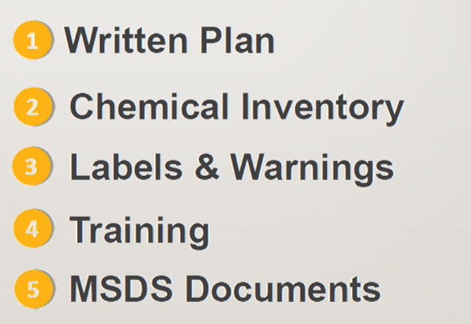
Hazard Communications / GHS
Hazard Communications / GHS
Notes:
The GHS itself is not a regulation or a standard.
The GHS is an acronym for The Globally Harmonized System of Classification and Labeling of Chemicals.
The GHS Document (referred to as “The Purple Book” which can be found at: http://www.unece.org/trans/danger/publi/ghs/ghs_rev04/04files_e.html)
establishes agreed hazard classification and communication provisions with explanatory information on how to apply the system.
The elements in the GHS supply a mechanism to meet the basic requirement of any hazard communication system, which is to decide if the chemical product produced and/or supplied is hazardous and to prepare a label and/or Safety Data Sheet as appropriate.
Regulatory authorities in countries adopting the GHS will take the agreed criteria and provisions, and implement them through their own regulatory process and procedures rather than simply incorporating the text of the GHS into their national requirements. The US will do this through OSHA’s Hazard Communication standard, 29 CFR 1910.1200.
For example, in the United States, there are an estimated 650,000 hazardous chemical products.
Adoption of requirements—Safety Data Sheets and Labels--for information to accompany the product helps address protection needs.

Slide 4
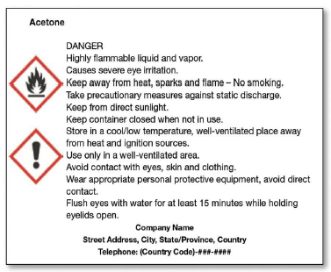
GHS Labeling Requirements
GHS Labeling Requirements
Product/Chemical Identifier
Hazard
Statement(s)
Signal Word
Precautionary
Information
Pictogram(s)
Supplier Info
Notes:
For labeling purposes the GHS system has chosen ONLY two words “Danger” and “Warning” to inform the chemical user of the severity of the hazard(s) of the chemical. The use of just two signal words has been put into place in order to simplify warnings and the labeling system.
Training NOTE: One way of getting across this information in training would be to use the scenario of driving up to a an intersection with a flashing red light. This signals to the driver that this is a dangerous intersection and that the driver is required to stop before proceeding through the intersection. If the signal word on a label is “Danger” the chemical user should understand that this is a highly hazardous chemical. If the label contains the word “Warning” this can be likened to a driver coming to an intersection with a flashing yellow light. The driver can proceed through the intersection with caution as it has the potential to be a hazardous intersection. For labels that use the signal word “Warning” the severity of hazards of the chemicals are less than those chemicals classified with the signal word “Danger.”

Slide 5
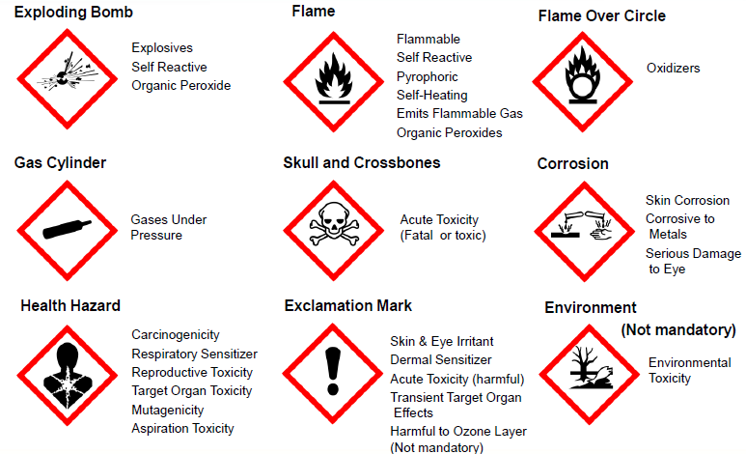
Standard GHS Pictograms
Notes:
There are nine standardized pictograms from GHS that OSHA has included in their revised Hazard Communication Standard. These pictograms are required on hazard communication labeling.
We are responsible for training our personnel on the meanings and associated hazards of the pictograms not for determining which pictogram is to be used on which chemical. The chemical manufacturer, importer or distributor is responsible for determining which pictogram applies to the chemical(s).
On the next few slides we will go over which hazards each of these pictograms identify.
Note: If anyone wants to print this slide presentation please use a color printer as the pictograms are required to have red borders. The red borders increase comprehensibility.
Note 2: Blank red diamonds are not permitted on a label.

Slide 6

Two Truths and a Lie on Secondary Containers
Chemicals kept in a secondary container may be identified using a Sharpie and duct tape.
Secondary containers must contain the name of the chemical and any warnings.
Secondary containers must contain the name of the chemical, the name and phone number of the supplier and any warnings via a pictogram.
Notes:
The key point is that secondary containers require only two things on the label: (1) name of the chemical and (2) the hazard warning.

Slide 7
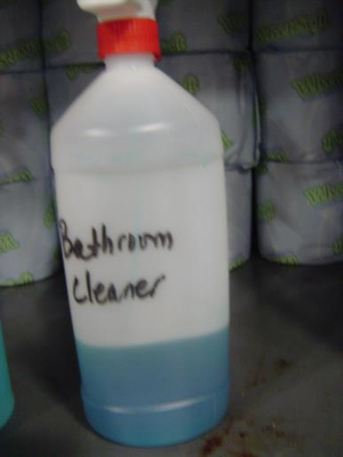
Product Name Traceable to SDS
1910.1200(f)(5) Unlabeled Containers
the employer shall ensure that each container of hazardous chemicals in the workplace is labeled, tagged or marked with the following information:
(f)(5)(i) Identity of the hazardous chemical(s) contained therein; and,
(f)(5)(ii) Appropriate hazard warnings, or alternatively, words, pictures, symbols, or combination thereof, which provide at least general information regarding the hazards of the chemicals
Notes:
The name of the product must be traceable back to the SDS. In this example, “Bathroom Cleaner” is what the product does, not what the product is (i.e. Windex)

Slide 8
Hazard Warning Example #1
Product/Chemical Identifier
Acetone
Highly Flammable
Causes severe eye irritation
general information regarding the hazards of the chemicals
Notes:
The hazard warning may be written out. For instance “highly flammable” or “causes severe eye irritation”.

Slide 9


Hazard Warning Example #2
Pictogram(s)
Product/Chemical Identifier
Acetone
Notes:
Conversely the hazard warning does not need to be written out. Instead a pictogram(s) may be used to visually convey the hazards.

Slide 10
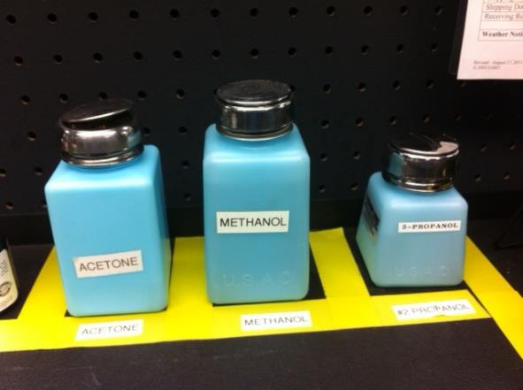
Correct or Incorrect Labeling Example
Correct or Incorrect?

Slide 11
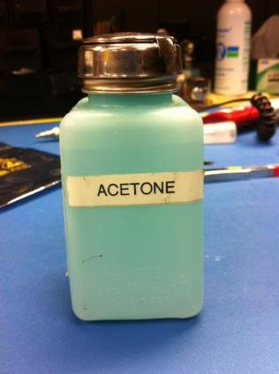


Incorrect Labeling Example
Acetone
Highly Flammable
Causes severe eye irritation
OR
Acetone
Notes:
The picture is incorrect. Simply labeling a bottle as “Acetone”, does not convey the hazards associated with that product.

Slide 12
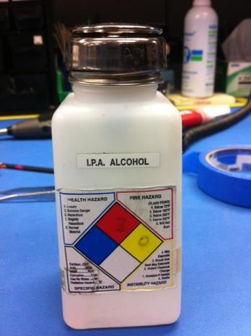
Correct or Incorrect labeling Second example
Correct or Incorrect?
Notes:
Although this container does not feature a pictogram, it does utilize another method to describe the hazards. This method is known as the NFPA 704 system.

Slide 13
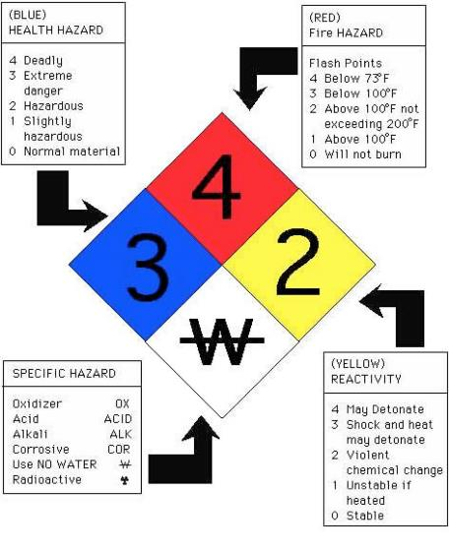
NFPA 704 Identification System
The NFPA 704 Identification System
Notes:
The NFPA 704 system uses four diamonds each with a rating from 0 (no hazard) to 4 (great hazard).
In the case of the white triangle (Specific Hazard) a legend for applicable criteria is available.

Slide 14

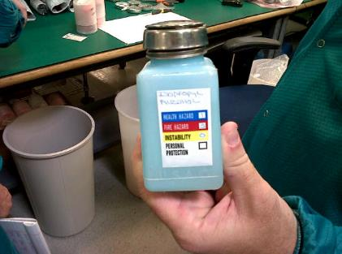
Hazardous Materials Identification System
Hazardous Materials Identification System (HMIS)
Notes:
Another labeling system is known as the “Hazardous Materials Identification System” (HMIS)
and is very similar to the NFPA 704 system.

Slide 15
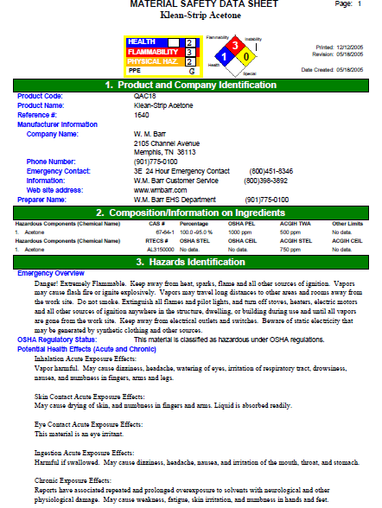
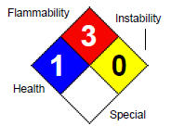
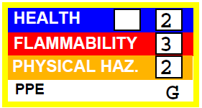
Material Safety Data Sheet Example

Slide 16
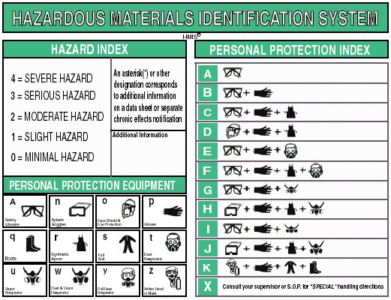
Hazardous Materials Identification System Second Examples
Notes:
The Hazardous Materials Identification System (HMIS) feature a Personal Protection Index which clarifies what PPE would be needed when using a specific product.

Slide 17
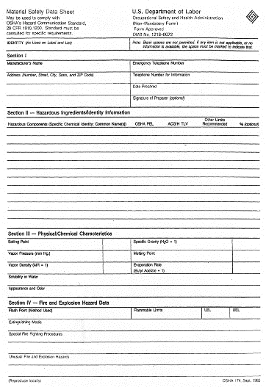
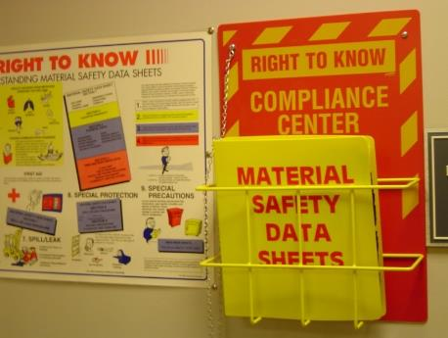
Safety Data Sheets
Safety Data Sheets
Notes:
The SDS is product related and, usually, is not able to provide information that is specific for any given workplace where the product may be used. However, the SDS information enables the employer to develop an active program of worker protection measures, including training, which is specific to the individual workplace and to consider any measures that may be necessary to protect the environment. Information in a SDS also provides a source of information for other target audiences such as those involved with the transport of dangerous goods, emergency responders, poison centers, those involved with the professional use of pesticides and consumers. The new standardized SDS format will make finding hazard and chemical information on the SDS easier for the employer and the employee.

Slide 18
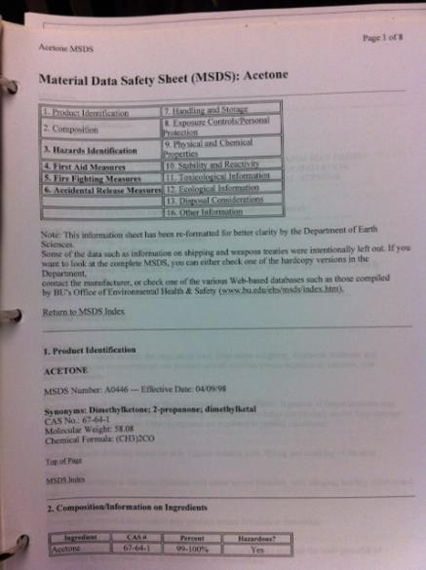
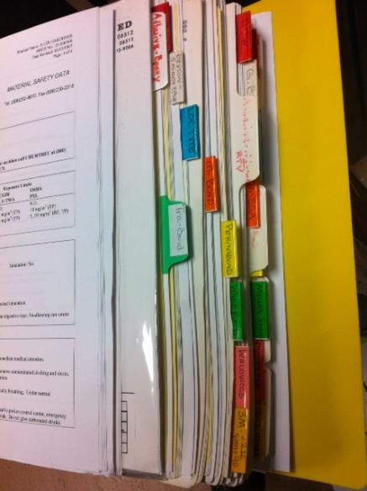
Safety Data Sheets Employer Requirements
Notes:
The employer shall maintain in the workplace copies of the required safety data sheets for each hazardous chemical, and shall ensure that they are readily accessible during each work shift to employees when they are in their work area(s). (Electronic access and other alternatives to maintaining paper copies of the safety data sheets are permitted as long as no barriers to immediate employee access in each workplace are created by such options.)
Where employees must travel between workplaces during a workshift, i.e., their work is carried out at more than one geographical location, the material safety data sheets may be kept at the primary workplace facility. In this situation, the employer shall ensure that employees can immediately obtain the required information in an emergency.

Slide 19
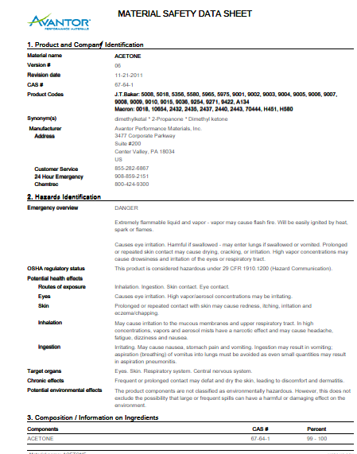
Material Safety Data Sheets Format
Section 1: Identification
Section 2: Hazard(s) Identification
Section 3: Composition / Ingredient Information
Section 4: First-aid
Section 5: Fire-fighting Measures
Section 6: Accidental Release Measures
Section 7: Handling and Storage
Section 8: Exposure Controls / Personal Protection
Section 9: Physical and Chemical Properties
Section 10: Stability and Reactivity
Section 11: Toxicological Information
Section 12: Ecological Information
Section 13: Disposal Considerations
Section 14: Transport Information
Section 15: Regulatory Information
Section 16: Other Information
Notes:
Most manufacturers put more information on the MSDS for liability issues. There is no set format to the MSDS and they can range in length from 1 page to 20 or more pages.
The SDS will contain 16 headings. All SDS will be in this standard format which will make it easier for both employers and employees to find the information that they need for their workplace. The GHS SDS headings, sequence and content are similar to the ISO, EU and ANSI MSDS/SDS requirements, except that the order of sections 2 and 3 have been reversed. The SDS should provide a clear description of the data used to identify the hazards.

Slide 20
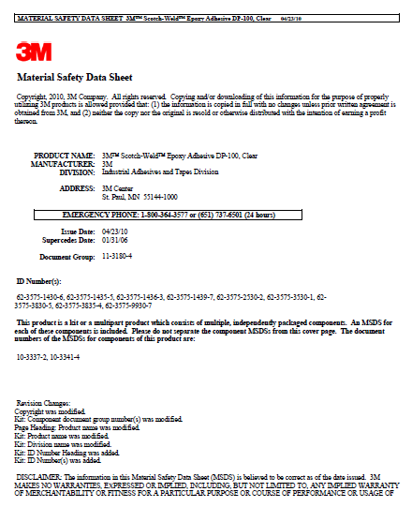
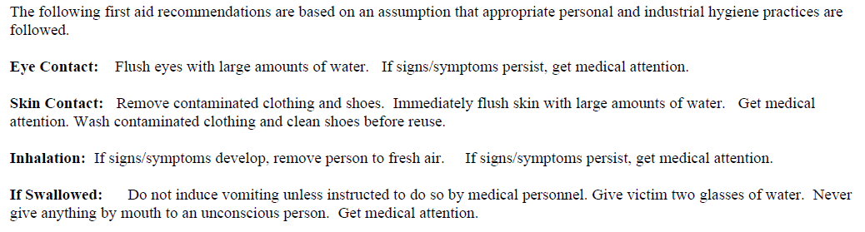
3M Epoxy Adhesive DP-100
Section 4: First Aid
Notes:
First page of a sample SDS—note the specific sections. All SDS will have the sections/headings in this order/format. This will make finding specific information easier. See appendix B-2 in the document “A Guide to The Globally Harmonized System of Classification and Labeling of Chemicals (GHS)” for full SDS example.
(http://www.osha.gov/dsg/hazcom/ghs.html)

Slide 21
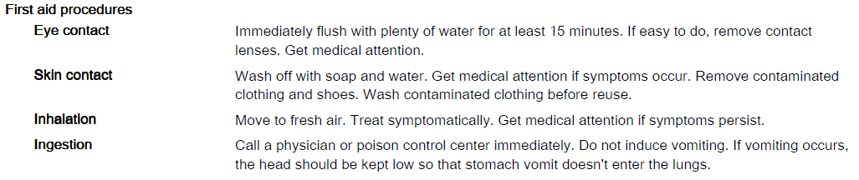
Avantor Acetone
Section 4: First Aid

Slide 22
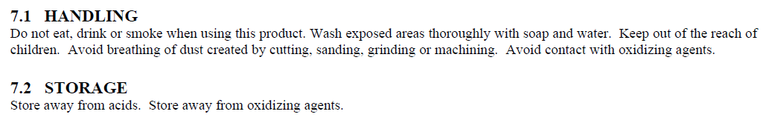
3M Epoxy Adhesive DP-100
Section 7: Handling and Storage

Slide 23
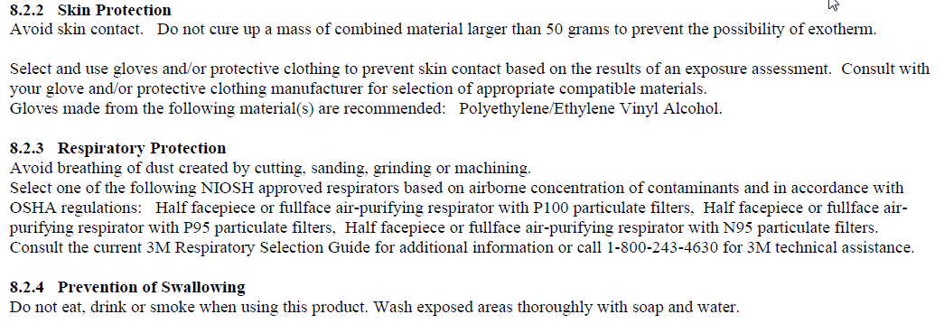
3M Epoxy Adhesive DP-100
Section 8: Personal Protective Equipment

Slide 24


Questions?
Questions?

