Slide 1

Fall Protection and Prevention
A, B, C’s to life

Slide 2
Disclaimer
Fall Protection and Prevention
This material was produced under
grant number SH-05073-SH8 from
the Occupational Safety and Health Administration, U.S. Department of Labor.
It does not necessarily reflect the views or policies of the U.S. Department of Labor, nor does mention of trade names, commercial products, or organizations imply endorsement by the U.S. Government.

Slide 3
Welcome
Fall Protection and Prevention
Seriousness of Falls
Fall Protection Planning
Components of a Fall Arrest System

Slide 4
Module-1
Fall Protection and Prevention
Seriousness of Falls
Fall Protection Planning
Components of a Fall Arrest System

Slide 5
Deaths in construction from falls
Fall Protection and Prevention
Falls —
384 out of 991 total deaths in construction in 2016
(38.7%)
SOURCE- osha.gov/oshstats/

Slide 6
Fall Protection and Prevention
According to the CDC
Trauma to the brain (TBI) was the cause of death in 41% of fall fatalities
https://www.cdc.gov/traumaticbraininjury/severe.html

Slide 7
Fall Protection and Prevention – Part 2
The median lethal distance for falls is four stories or 48 feet… according to the reference book “Trauma Anesthesia”.
This means that 50% of people who fall four stories will die. ...
It doesn't take much of a fall to cause damage. "From a height of 3 meters (roughly 10 feet) you could fracture your spine"

Slide 8
Fall Protection and Prevention – Part 3
Prevention strategies should emphasize
Education, training, creating safer environments
Prioritizing fall-related research
Establishing effective policies to reduce risk.
source- www.who.int/en/news-room/fact-sheets/detail/falls

Slide 9
Module-2
Fall Protection and Prevention
Seriousness of Falls
Fall Protection Planning
Components of a Fall Arrest System

Slide 10
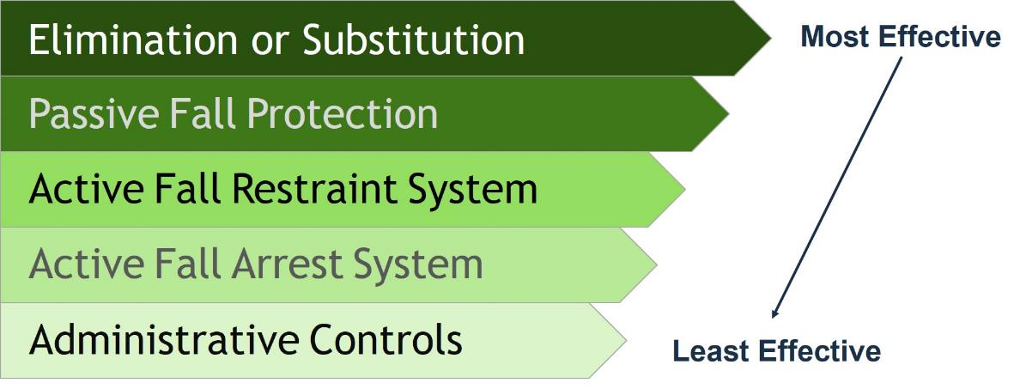
HIERARCHY OF FALL PROTECTION
Notes:
Hierarchy of Fall Protection: A series of fall protection solutions ranging from the best solution to the worst.
Eliminate the Fall Hazard (Most Effective)
Passive Fall Restraint
Active Fall Restraint
Active Fall Arrest
Administrative Controls (Least Effective)

Slide 11
FALL PROTECTION PLANNING
Elimination or Substitution
Most Effective
Passive Fall Protection
Active Fall Restraint System
Active Fall Arrest System
Administrative Controls
Least Effective
Notes:
Hierarchy of Fall Protection: A series of fall protection solutions ranging from the best solution to the worst.
Eliminate the Fall Hazard (Most Effective)
Passive Fall Restraint
Active Fall Restraint
Active Fall Arrest
Administrative Controls (Least Effective)

Slide 12
Fall Protection and Prevention – Part 4
Elimination or Substitution
The preferred solution to all fall hazards is elimination. The reason for exposure to the fall hazard is challenged and evaluated to determine if a change in the procedure, practice, location or equipment will eliminate exposure to the fall hazard. Specifying equipment be located on the ground, or in an equipment room rather than by the edge of the roof, is an example of hazard elimination.
Best Practice
The hierarchy should be applied to any hazard before buying inappropriate equipment or systems. By evaluating a fall hazard using the hierarchy, the best solution is often very evident.

Slide 13
Fall Protection Planning – PART 2
Elimination or Substitution
Most Effective
Passive Fall Protection
Active Fall Restraint System
Active Fall Arrest System
Administrative Controls
Least Effective
Notes:
Hierarchy of Fall Protection: A series of fall protection solutions ranging from the best solution to the worst.
Eliminate the Fall Hazard (Most Effective)
Passive Fall Restraint
Active Fall Restraint
Active Fall Arrest
Administrative Controls (Least Effective)

Slide 14
Fall Protection and Prevention – Part 5
Active Fall Restraint System
Physical barriers like guardrails around unprotected edges and covers over holes are examples of passive fall protection.
Passive protection is generally considered to provide a higher level of safety since the opportunity for error is less than using personal protective equipment (PPE). The initial costs of passive protection, while possibly high, are often more efficient than the long-term costs of PPE.
A thorough hazard assessment provides the information needed to make these kinds of decisions to maximize cost-effectiveness.

Slide 15
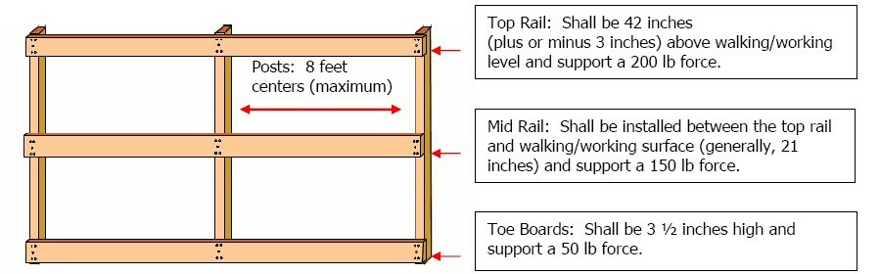
Fall Protection and Prevention – Part 6
Active Fall Restraint System- OSHA structured

Slide 16
Fall Protection Planning – PART 3
Elimination or Substitution
Most Effective
Passive Fall Protection
Active Fall Restraint System
Active Fall Arrest System
Administrative Controls
Least Effective
Notes:
Hierarchy of Fall Protection: A series of fall protection solutions ranging from the best solution to the worst.
Eliminate the Fall Hazard (Most Effective)
Passive Fall Restraint
Active Fall Restraint
Active Fall Arrest
Administrative Controls (Least Effective)

Slide 17
Fall Protection and Prevention – Part 7
Active Fall Restraint System
Fall restraint systems are set up in such a manner that a fall cannot occur. Fall restraint systems use PPE to restrict the worker’s range of movement so they cannot physically travel to the fall hazard.
Fall restraint systems are often underutilized because they are not specifically mentioned in many regulations, but they are preferred over fall arrest systems. Free fall distance is not an issue for fall restraint systems, therefore arresting forces, clearance requirements, secondary injuries, and rescue issues are virtually eliminated.
Fall restraint is always better than fall arrest. Fall restraint systems prevent most secondary injuries due to the fall and make rescue easy since the worker is still accessible.

Slide 18
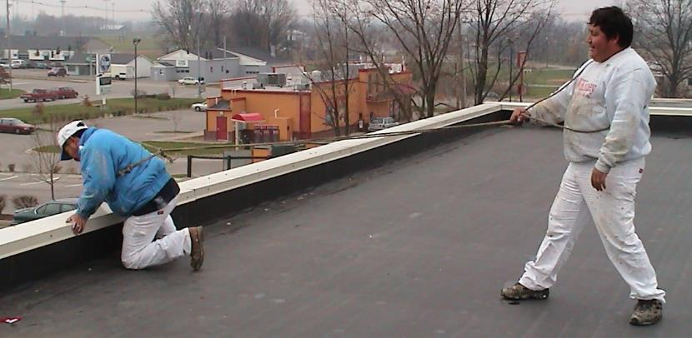
Fall Protection and Prevention – Part 8
NOT an Active Fall Restraint System

Slide 19
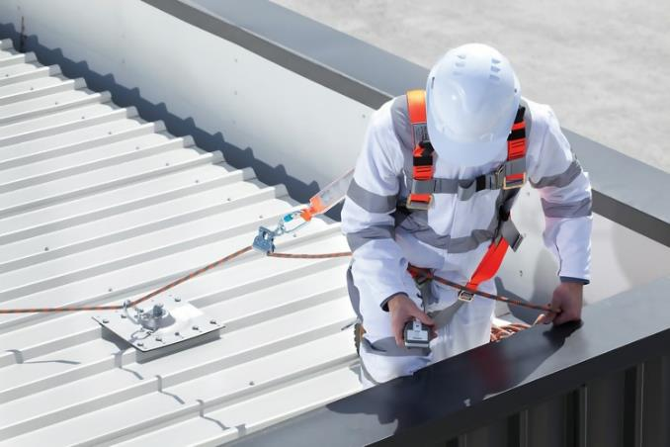
Fall Protection and Prevention – Part 9
Active Fall Restraint System- Good Example

Slide 20
Fall Protection Planning – PART 4
elimination
Elimination or Substitution
Most Effective
Passive Fall Protection
Active Fall Restraint System
Active Fall Arrest System
Administrative Controls
Least Effective
Notes:
Hierarchy of Fall Protection: A series of fall protection solutions ranging from the best solution to the worst.
Eliminate the Fall Hazard (Most Effective)
Passive Fall Restraint
Active Fall Restraint
Active Fall Arrest
Administrative Controls (Least Effective)

Slide 21
Fall Protection and Prevention – Part 10
Active Fall Arrest System
Fall arrest systems are erected in such a manner that a fall can occur, but the fall is arrested within acceptable force and clearance margins.
Fall arrest systems have a higher risk associated with them, since we must stop the falling worker within an acceptable level of force and prevent him/her from contacting the surrounding structure or the ground.
Training for both fall restraint and fall arrest systems is key.
ANSI Z359.2-2007 includes specific information about fall protection training for authorized persons, competent persons, qualified persons, rescuers and trainers.

Slide 22
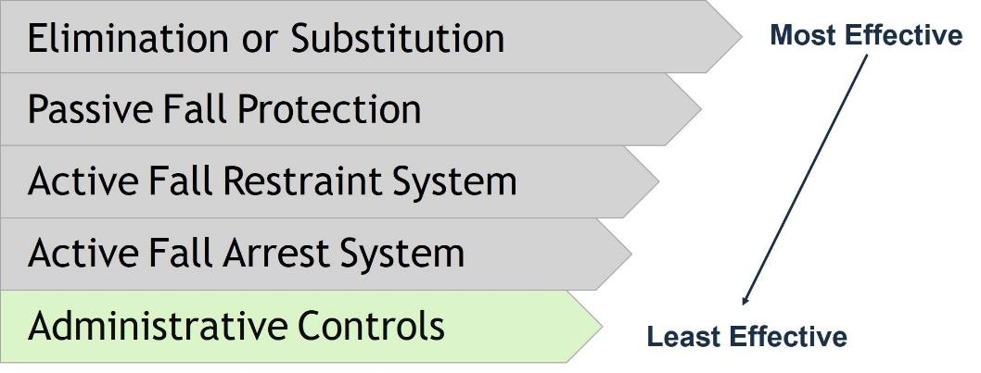
Fall Protection Planning – PART 5
Notes:
Hierarchy of Fall Protection: A series of fall protection solutions ranging from the best solution to the worst.
Eliminate the Fall Hazard (Most Effective)
Passive Fall Restraint
Active Fall Restraint
Active Fall Arrest
Administrative Controls (Least Effective)

Slide 23
Fall Protection and Prevention – Part 11
Administrative Controls
Administrative controls are work practices or procedures that increase a worker’s awareness of a fall hazard. Please note that administrative controls are the least preferred method of protection because they do not provide a physical or positive means of protection.
Administrative controls are preventive measures taken to reduce the likelihood of a fall. These methods include Training, safety monitors, warning lines, designated areas, or control lines.
OSHA regulates the use of many administrative controls
It is mandatory on the fall protection program administrator to understand the jurisdictions and regulations that apply.

Slide 24
Module-2b
Fall Protection and Prevention
Seriousness of Falls
Fall Protection Planning
MUST INLUDE RESCUE TRAINING
Components of a Fall Arrest System

Slide 25
Fall Protection and Prevention – Part 12
Employer Requirements
OSHA 1926.502 (d)(20) states that:
“The employer shall provide for prompt rescue of employees in the event of a fall or shall assure that employees are able to rescue themselves.”
Rescue
Personal Fall Arrest Systems require a rescue plan
Employer must develop and communicate the rescue plan to all involved

Slide 26
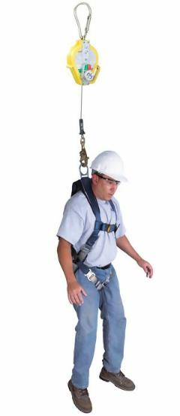
Fall Protection and Prevention – Part 13
How long is too long while suspended in a full-body harness?
A recent survey found that almost all workers would not want to be left for longer than 15 minutes.
Average times were between 17 and 28 minutes (although they ranged from 3.5 right up to 60 minutes). This tells us that tolerance varies greatly from person to person, and that negative effects from the suspension can set in quickly.
While OSHA Standards don’t specify a time rescues need to be carried out within, they have previously stated "research indicates that suspension . . .
can result in unconsciousness, followed by death, in less than 30 minutes."
Notes:
A more scientific study into the matter was performed in 1987 by Wright-Patterson Air Force Base, looking into how long a physically fit person could dangle in a fall protection harness without extreme discomfort.

Slide 27
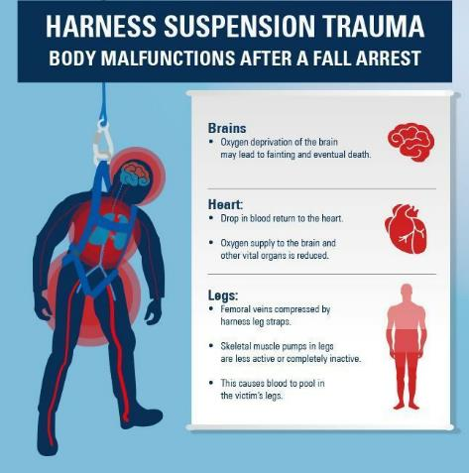
Fall Protection and Prevention – Part 14
After Rescue
After a fallen worker has been rescued, it is important to follow these steps to prevent the pooled blood from rushing back into their heart and brain all at once:
Whatever plan you have written, it is vital that the lowering system can be controlled to prevent the worker’s body from being laid flat as it reaches the ground.
Anyone released from immobile suspension should be kept in a sitting position for at least 30 minutes
Keep the harness on and do not release the leg straps
Get Medical attention IMMEDIATELY
Notes:
A more scientific study into the matter was performed in 1987 by Wright-Patterson Air Force Base, looking into how long a physically fit person could dangle in a fall protection harness without extreme discomfort.

Slide 28
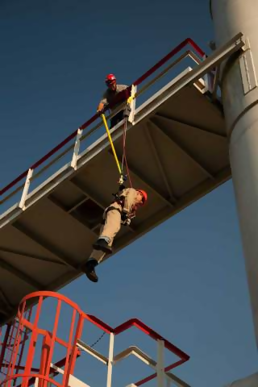
How Do You Prepare For A Fall?
Develop a Fall Rescue Plan
Locate rescue equipment
Train workers
Practice the plan
Photo: Fall Rescue

Slide 29
Module-3
Fall Protection and Prevention
Seriousness of Falls
Fall Protection Planning
Components of a Fall Arrest System

Slide 30

Fall Protection and Prevention – Part 15
Personal Fall Arrest Systems (PFAS)
A PFAS consists of the following components:
  Anchorage Point
  Body Harness
  Connector

Slide 31
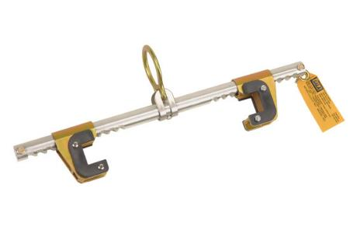
Fall Protection and Prevention – Part 16
Personal Fall Arrest Systems (PFAS)
A PFAS consists of the following components:
  Anchorage Point
  Body Harness
  Connector
1926.502(d)(15)
Anchorages used for attachment of personal fall arrest equipment shall be independent of any anchorage being used to support or suspend platforms and capable of supporting at least 5,000 pounds (22.2 kN) per employee attached.

Slide 32
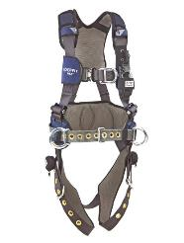
Fall Protection and Prevention – Part 17
Personal Fall Arrest Systems (PFAS)
A PFAS consists of the following components:
  Anchorage Point
  Body Harness
  Connector
OSHA defines a Body Harness as:
“… straps which may be secured about the employee in a manner that will distribute the fall arrest forces over at least the thighs, pelvis, waist, chest and shoulders with means for attaching it to other components of a personal fall arrest system”

Slide 33
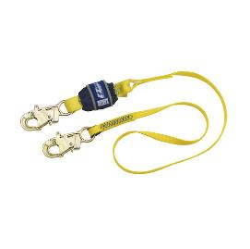
Fall Protection and Prevention – Part 18
Personal Fall Arrest Systems (PFAS)
A PFAS consists of the following components:
  Anchorage Point
  Body Harness
  Connector
Connector
The connecting subsystem is the critical link which joins the body wear to the anchorage/anchorage connector. It can be an energy-absorbing lanyard, fall limiter, self-retracting lanyard, rope grab, or retrieval system. Connecting means will vary depending on whether the worker is equipped for personal fall arrest or work positioning and travel restriction

Slide 34
Fall Protection and Prevention – Part 19
In almost every industry, there are areas where workers are subjected to fall hazards.
When selecting fall protection equipment, three components make up a complete fall protection system. These are the ABC’s of fall protection:
Anchorage... Body support… Means of Connection
Each one must be in place and properly used to provide maximum worker protection.
The connecting device is the most critical link in assembling a safe fall protection system since it bears the greatest force during a fall.
Notes:
Careful consideration must be given to the selection, materials, construction and inspection/maintenance of fall Protection equipment

Slide 35

Fall Protection and Prevention – Review

Slide 36
Knowledge Check
What is the first line of defense when it comes to falls in the workplace?
    Control the fall itself once it occurs
    Eliminate the fall hazard completely
    With the fall hazard present, prevent the fall.
    Use personal protective equipment

Slide 37
Knowledge Check – Part 2
What is the first line of defense when it comes to falls in the workplace?
    Control the fall itself once it occurs
    Eliminate the fall hazard completely
    With the fall hazard present, prevent the fall.
    Use personal protective equipment
  Answer: b. Eliminate the fall hazard completely

Slide 38
Knowledge Check – Part 3
A worker is required to remove a section of guardrail in order to receive materials from a fork truck; which of the following provides the best protections to prevent a fall?
    Avoid the edge
    Use a personal fall arrest system
    Use a fall restraint system
    Use grab handles

Slide 39
Knowledge Check – Part 4
A worker is required to remove a section of guardrail in order to receive materials from a fork truck; which of the following provides the best protections to prevent a fall?
    Avoid the edge
    Use a personal fall arrest system
    Use a fall restraint system
    Use grab handles
  Answer: c. Use a fall restraint system

Slide 40
Knowledge Check – Part 5
A personal fall arrest system (PFAS) anchorage point must be capable of handling ___ pounds.
    2,000
    3,000
    4,000
    5,000

Slide 41
Knowledge Check – Part 6
A personal fall arrest system (PFAS) anchorage point must be capable of handling ___ pounds.
    2,000
    3,000
    4,000
    5,000
  Answer: d. 5,000

Slide 42
Additional Resources
OSHA website: http://www.osha.gov and OSHA offices: Call or Write (800-321-OSHA)
Compliance Assistance Specialists in the area offices
National Institute for Occupational Safety and Health (NIOSH) – OSHA’s sister agency
OSHA Training Institute Education Centers
Public libraries

