Slide 1
Silica Hazards in Construction
Construction Safety Council
Notes:
Title slide: Silica Hazards in Construction
An unknown number of workers are exposed every year to the hazards of respirable crystalline silica. Some of these workers will develop a serious illness called Silicosis.
Working with and around silica containing materials should be taken seriously as a dangerous business. This is no place to cut corners or cheat on safety. You should pay attention and know what it takes to stay safe…
This material was produced under grant number SH-05009-SH8 from the Occupational Safety and Health Administration, U.S. Department of Labor. It does not necessarily reflect the views or policies of the U.S. Department of Labor, nor does mention of trade names, commercial products, or organizations imply endorsement by the U.S. Government.

Slide 2
OSHA Disclaimer
This material was produced under grant number SH-05009-SH8 from the Occupational Safety and Health Administration, U.S. Department of Labor. It does not necessarily reflect the views or policies of the U.S. Department of Labor, nor does mention of trade names, commercial products, or organizations imply endorsement by the U.S. Government.
Notes:
This material was produced under grant number SH-05009-SH8 from the Occupational Safety and Health Administration, U.S. Department of Labor. It does not necessarily reflect the views or policies of the U.S. Department of Labor, nor does mention of trade names, commercial products, or organizations imply endorsement by the U.S. Government.

Slide 3
Learning Objectives
The health hazards associated with exposure to respirable crystalline silica.
Specific tasks in the workplace that could result in exposure to respirable crystalline silica.
Specific measures employers can implement to protect employees from exposure to respirable crystalline silica, including engineering controls, work practices, and respirators to be used.
The contents of OSHA’s Respirable Crystalline Silica standard.
Notes:
The health hazards associated with exposure to respirable crystalline silica.
Specific tasks in the workplace that could result in exposure to respirable crystalline silica.
Specific measures employers can implement to protect employees from exposure to respirable crystalline silica, including engineering controls, work practices, and respirators to be used.
The contents of OSHA’s Respirable Crystalline Silica standard.

Slide 4
Pre-test
Notes:
Pre-test

Slide 5
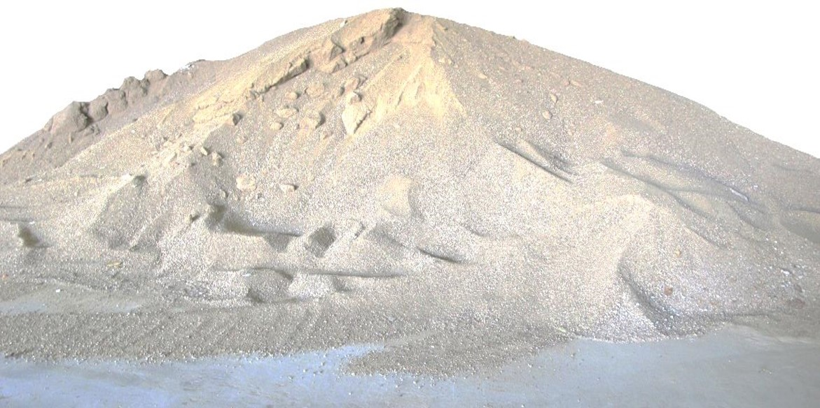
What is Silica?
Silicon Dioxide
Quartz
Soil
Sand
Concrete
Masonry
Rock
Granite
Landscaping Materials
Notes:
Crystalline silica is a common mineral found in many naturally occurring and man-made materials used at construction sites. Materials like sand, concrete, brick, block, stone and mortar contain crystalline silica.

Slide 6
What is Silicosis?
Very small (respirable) particles are inhaled.
Disabling, non-reversible and sometimes fatal lung disease
Chronic bronchitis
Kidney disease
Lung cancer
Notes:
Crystalline silica has been classified as a human lung carcinogen ¹, ², ³.
Breathing in very small ("respirable") crystalline silica particles, causes multiple diseases, including silicosis, an incurable lung disease that leads to disability and death. Respirable crystalline silica also causes lung cancer, chronic obstructive pulmonary disease (COPD), and kidney disease. Exposure to respirable crystalline silica is related to the development of autoimmune disorders and cardiovascular impairment. These occupational diseases are life-altering and debilitating disorders that affect thousands of workers annually.
¹ International Agencies for Research on Cancer (IARC). Monographs on the Evaluation of Carcinogenic Risks to Humans / Silica, Some Silicates, Coal Dust and para Aramid Fibrils (1997).
² National Toxicology Program (NTP). Report on Carcinogens, Eleventh Edition. Silica, Crystalline (Respirable Size). U.S. Department of Health and Human Services, Public Health Service, National Toxicology Program (2005).
³ The National Institute for Occupational Safety and Health (NIOSH). NIOSH Hazard Review: Health Effects of Occupational Exposure to Respirable Crystalline Silica [DHHS (NIOSH) Publication No. 2002-129] (2002).

Slide 7
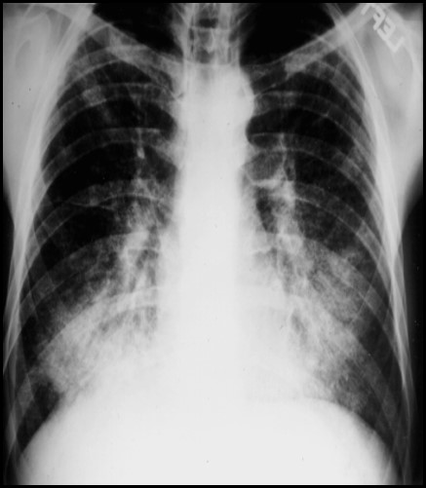
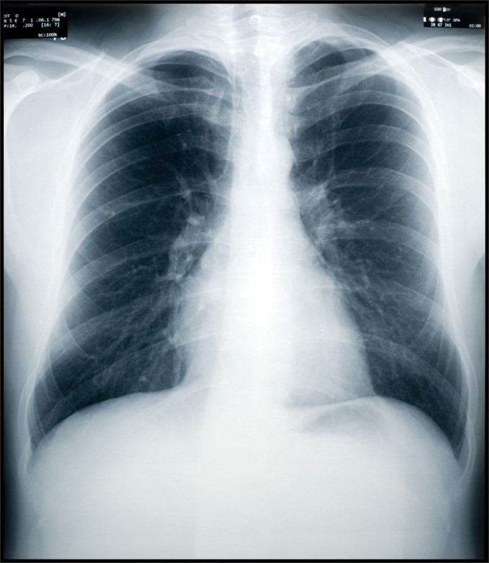
Examples of Silicotic and Healthy Lungs
Silicotic Lungs
Normal Healthy Lungs
Notes:
Silicosis is a type of fibrotic lung disease that develops when silica dust particles become trapped in the lungs and form scar tissue.
This can be seen in x-rays by the light areas on the lungs.
Special doctors referred to as “B” Readers are trained to identify diseases of the lungs caused by dust exposure.

Slide 8
Symptoms of Silicosis
Chronic/classic silicosis (15 – 20 years)
Accelerated Silicosis (5 – 10 years)
Acute Silicosis (few months – 2 years)
Notes:
Types of Silicosis:
Chronic/classic silicosis, the most common, occurs after 15–20 years of moderate to low exposures to respirable crystalline silica. Symptoms associated with chronic silicosis may or may not be obvious; therefore, workers need to have a chest x-ray to determine if there is lung damage. As the disease progresses, the worker may experience shortness of breath upon exercising and have clinical signs of poor oxygen/carbon dioxide exchange. In the later stages, the worker may experience fatigue, extreme shortness of breath, chest pain, or respiratory failure.
Accelerated silicosis can occur after 5–10 years of high exposures to respirable crystalline silica. Symptoms include severe shortness of breath, weakness, and weight loss. The onset of symptoms takes longer than in acute silicosis.
Acute silicosis occurs after a few months or as long as 2 years following exposures to extremely high concentrations of respirable crystalline silica. Symptoms of acute silicosis include severe disabling shortness of breath, weakness, and weight loss, which often leads to death.

Slide 9
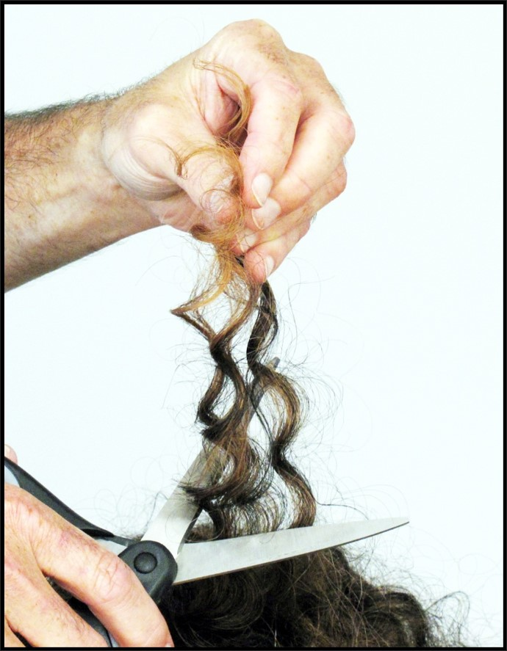
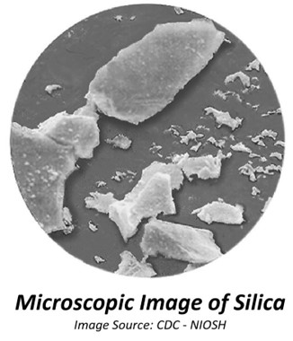
Respirable Particles
Respirable dust is less than 10 microns (µm) in diameter!
Human hair is between 80 – 120 microns (µm) in diameter.
Notes:
Dust, fibers, fumes and other particles that can go past the nose and mouth and enter deep into the respiratory system are considered to be respirable; these particles are less than 10 microns (µm) in diameter.
A micron is 1 millionth of a meter (1/96,000 of an inch).
Human hair is between 80 – 120 microns (µm) in diameter.
Some exposures in construction, such as toxic fumes, dusts and mists occur from particles that are less than 10 microns (µm) in diameter; these exposures are invisible.
Examples of respirable (invisible) fume or dust:
Silica
Lead
Asbestos
Hexavalent Chromium

Slide 10
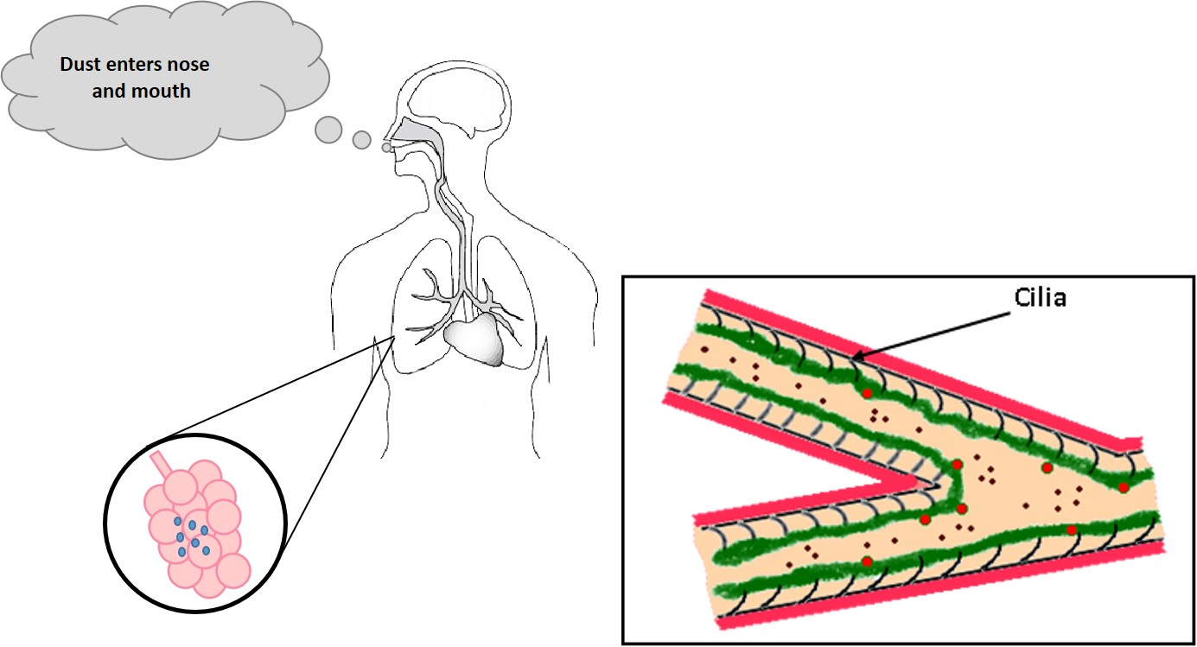
How Silicosis Develops
Notes:
As dust enters the nose and mouth, it is trapped in a mucus membrane that lines our nose and throat.
Dust particles that are large, get stuck in the mucus membrane and are removed by small hairs called cilia that pushes these dust particles up the throat and are eventually coughed up or swallowed.
Small (respirable) sized dust particles pass through the lungs and enter the alveoli. Once inside, the tissue of the lungs become inflamed and tiny fibers grow around the silica particles, called nodules. The lungs become scar; this condition is called silicosis.

Slide 11
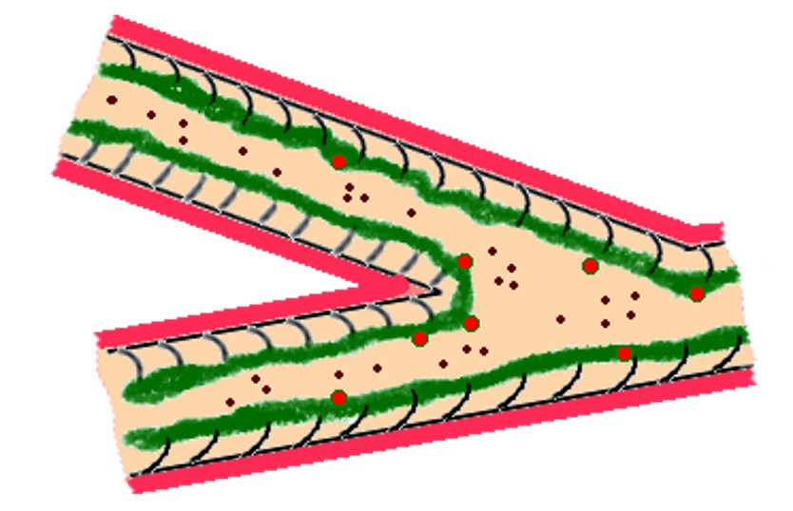

Effects of Smoking
Smoking paralyses the body’s natural defense – cilia.
Smoking adds to the damage.
Notes:
Smoking increases the chances of illness if you work around hazardous substances.
When two or more hazardous materials are present at the same time, the resulting effect can be greater than the effect anticipated based on the cumulative effect of the individual substances.
An example of synergism is the increased risk of developing lung cancer caused by exposures to both cigarette smoking and asbestos. By either smoking one pack of cigarettes per day or being heavily exposed to asbestos, you may increase your risk of lung cancer to five to ten times higher than someone who does neither. But if you smoke a pack a day and are heavily exposed to asbestos, your risk may be 50 times higher than someone who does neither.
Smoking paralyses the body’s natural defense, specifically the cilia; smoking causes the cilia to relax and not perform its function as a dust capturing mechanism. This means that more dust and/or fiber can get inhaled into the lungs where damage can occur.

Slide 12
Diagnosing & Treating Silicosis
No Cure!
Only prevention and treating symptoms
Special doctors referred to as "B" Readers are trained to identify diseases of the lungs caused by dust exposure.
Notes:
If you work or have worked in an occupation with exposure to inhaled silica and have a cough, phlegm, or breathing difficulty, you should be evaluated for silicosis.
A medical examination that includes a complete work history and a chest X-ray and lung function test is the only sure way to determine if a person has silicosis. Workers who believe they are overexposed to silica dust should visit a doctor who knows about lung diseases.
There is no cure for silicosis. Prevention is still the best way to avoid the disease. Once silicosis has developed, your doctor will assess the degree of lung damage with tests. Some people may need urgent treatment with oxygen and support for breathing. Others may need medicines to decrease sputum production, such as inhaled steroids. Some may need inhaled bronchodilators, which relax the air tubes.

Slide 13

Silica Related Complications
Lung Cancer
Chronic Obstructive Pulmonary Disease (COPD)
Kidney Disease
Notes:
Exposure to respirable crystalline silica increases the risk of developing lung cancer. Lung cancer is a disease where abnormal cells grow uncontrollably into tumors, interfering with lung function. The abnormal cancer cells can also travel ("metastasize") and cause damage to other parts of the body. Most cases are not curable.
Exposure to respirable crystalline silica increases the risk of other lung diseases, primarily COPD, which includes emphysema and chronic bronchitis. The main symptom of COPD is shortness of breath due to difficulty breathing air into the lungs. COPD is not usually reversible and may worsen over time.
Studies of workers exposed to respirable crystalline silica have found that these workers are at increased risk of developing kidney disease. For instance, kidney failure has been observed among workers with high silica exposure, such as in abrasive blasters who also were suffering from silicosis.

Slide 14
Where are Workers Exposed?
Abrasive blasting with sand to remove paint and rust from bridges, tanks, concrete structures, and other surfaces
Jack hammering
Rock/well drilling
Concrete mixing
Concrete drilling
Brick and concrete block cutting and sawing
Tuck pointing
Tunneling operations
Notes:
An estimated 2.3 million people in the U.S. are exposed to silica at work. Exposure occurs during many different construction activities, including:
Abrasive blasting with sand to remove paint and rust from bridges, tanks, concrete structures, and other surfaces
Jack hammering
Rock/well drilling
Concrete mixing
Concrete drilling
Brick and concrete block cutting and sawing
Tuck pointing
Tunneling operations

Slide 15
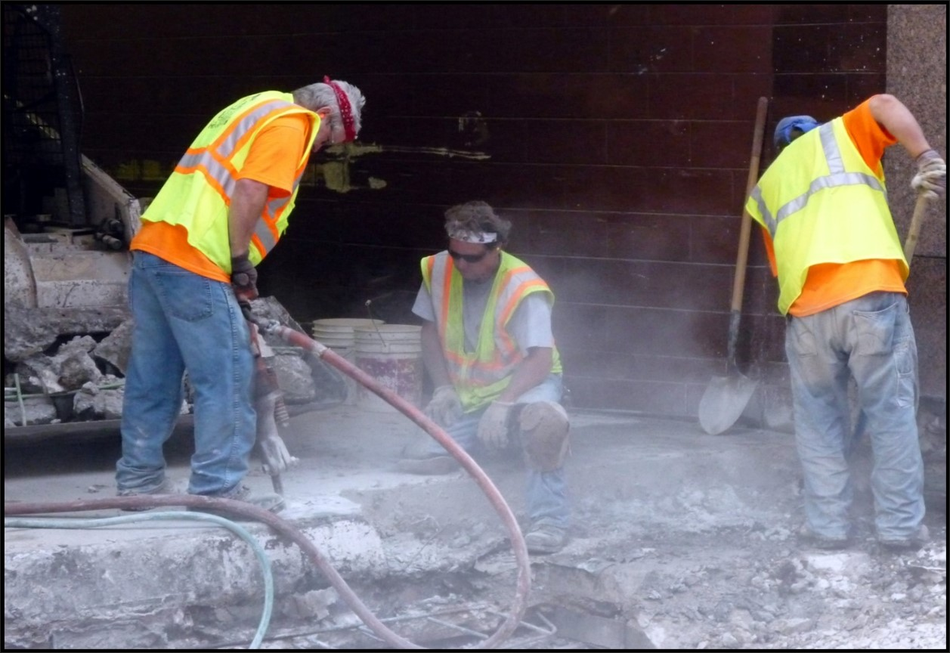
DANGER! Workers exposed to respirable crystalline silica.
Notes:
DANGER! Workers exposed to respirable crystalline silica.

Slide 16
Introduction to OSHA
OSHA’s purpose and employer duty to provide a safe place of employment
Employer/employee rights & responsibilities under the OSHAct
Refusing to work because conditions are dangerous
OSHA’s multi-employer worksite citation policy
Rights as a whistleblower
OSHA policy on providing and paying for personal protective equipment
Reporting of fatalities and catastrophes
Employee exposure and medical records
Notes:
OSHA’s purpose and employer duty to provide a safe place of employment
Employer/employee rights & responsibilities under the OSHAct
Refusing to work because conditions are dangerous
OSHA’s multi-employer worksite citation policy
Rights as a whistleblower
OSHA policy on providing and paying for personal protective equipment
Reporting of fatalities and catastrophes
Employee exposure and medical records

Slide 17
General Duty Clause
(a) Each employer
Shall furnish to each of his employees employment and a place of employment which are free from recognized hazards that are causing or are likely to cause death or serious physical harm to his employees.
Shall comply with occupational safety and health standards promulgated under this Act.
(b) Each employee shall comply with occupational safety and health standards and all rules, regulations, and orders issued pursuant to this Act which are applicable to his own actions and conduct.
Notes:
OSHA’s Purpose…
To assure safe and healthful working conditions for working men and women; by authorizing enforcement of the standards developed under the Act; by assisting and encouraging the States in their efforts to assure safe and healthful working conditions; by providing for research, information, education, and training in the field of occupational safety and health; and for other purposes.
Be it enacted by the Senate and House of Representatives of the United States of America in Congress assembled, that this Act may be cited as the “Occupational Safety and Health Act of 1970” (OSHAct).

Slide 18

OSHA Job-site Poster
Notes:
EMPLOYEES:
You have the right to notify your employer or OSHA about workplace hazards. You may ask OSHA to keep your name confidential.
You have the right to request an OSHA inspection if you believe that there are unsafe and unhealthful conditions in your workplace. You or your representative may participate in that inspection.
You can file a complaint with OSHA within 30 days of retaliation or discrimination by your employer for making safety and health complaints or for exercising your rights under the OSH Act.
You have a right to see OSHA citations issued to your employer. Your employer must post the citations at or near the place of the alleged violation.
Your employer must correct workplace hazards by the date indicated on the citation and must certify that these hazards have been reduced or eliminated.
You have the right to copies of your medical records or records of your exposure to toxic and harmful substances or conditions.
Your employer must post this notice (OSHA 3165-12-06R) in your workplace.
You must comply with all occupational safety and health standards issued under the OSH Act that apply to your own actions and conduct on the job.
EMPLOYERS:
You must furnish your employees a place of employment free from recognized hazards.
You must comply with the occupational safety and health standards issued under the OSH Act.

Slide 19
Refusing to Work because Conditions are Dangerous!
When all of these conditions are met, you take the following steps:
Ask your employer to correct the hazard;
Ask your employer for other work;
Tell your employer that you won’t perform the work unless and until the hazard is corrected; and
Remain at the worksite until ordered to leave by your employer.
Notes:
IF…
You believe working conditions are unsafe or unhealthful.
Your employer does not correct the hazard or disagrees with you about the extent of the hazard.
Your employer discriminates against you for refusing to perform the dangerous work.
THEN…
Call your employer’s attention to the problem.
File a complaint with OSHA.
Contact OSHA immediately. (800) 321-OSHA

Slide 20

OSHA’s Multi-Employer Worksite Citation Policy
The Creating Employer
The Exposing Employer
The Correcting Employer
The Controlling Employer
Notes:
When on a construction jobsite, multiple employers and employees are exposed to a variety of hazards that may or may not have been created or under the control of any one employer. In this “multi-employer” environment, more than one employer may be citable for a hazardous condition that violates an OSHA standard.
OSHA classifies employers into one or more of four categories – the creating, exposing, correcting, and controlling employers – to determine if a citation will be issued.

Slide 21
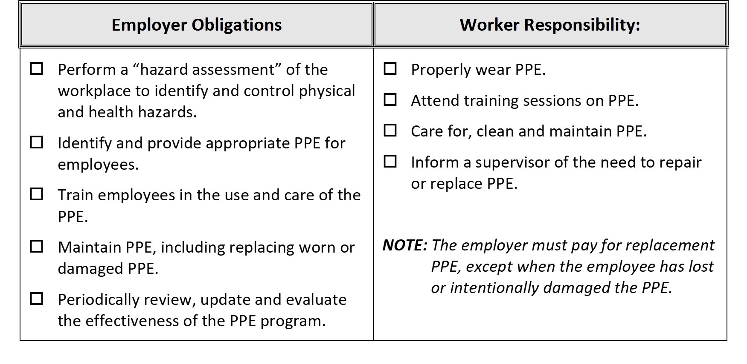
Employers must Provide and Pay for most PPE
Notes:
PPE is equipment worn to minimize exposure to a variety of hazards. Examples include items such as personal fall arrest systems, gloves, foot and eye protection, hearing protection, hard hats and respirators.

Slide 22
Reporting of Fatalities and Catastrophes
Employers must report all work related fatalities within eight (8) hours.
All work-related inpatient hospitalizations, all amputations and all losses of an eye within 24 hours.
Notes:
OSHA Standard, 29 CFR Subpart 1904.39, Reporting Fatality, Injury and Illness Information to the Government requires that employers report all work related fatalities within eight (8) hours and all work-related inpatient hospitalizations, all amputations and all losses of an eye within 24 hours. Employers must orally report the fatality/hospitalization by telephone or in-person to the OSHA Area Office or to the State Plan Office that is nearest to the site of the incident. Employers may also use the OSHA toll-free central telephone number:
1-800-321-OSHA (1-800-321-6742).

Slide 23

Employee Exposure & Medical Records
Retention of Medical Records…
Employee medical records – duration of the employee’s employment plus 30 years.
Employee exposure records for at least 30 years (personal air monitoring results).
Background data – 1 year
Notes:
Workers with possible exposure to or uses toxic substances or harmful physical agents on job-sites have rights to access exposure records. These rights and responsibilities can be found in OSHA’s standard 29 CFR 1926.33 (see 29 CFR 1910.1020 – Access to Employee Exposure and Medical Records).
Retention of Medical Records…
Employee medical records must be retained for at least the duration of the employee’s employment plus 30 years.
Employee exposure records for at least 30 years (personal air monitoring results).
Background data related to environmental, or workplace, monitoring or measuring—such as laboratory reports and worksheets—must only be retained for 1 year, so long as you preserve certain interpretive documents relevant to the interpretation of the data for 30 years.

Slide 24
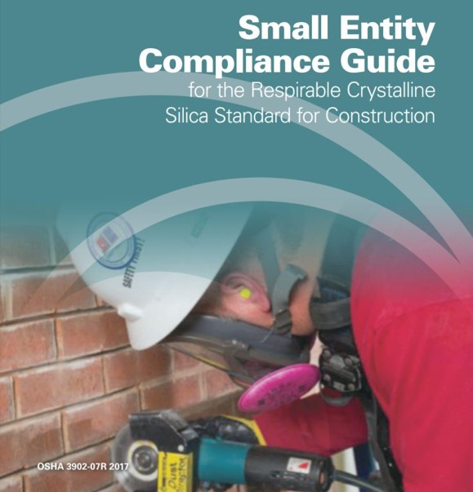
Compliance Guide for Silica
Specific exposure controls methods
Alternative exposure control methods
Permissible Exposure Limit (PEL)
Exposure Assessment
Methods of Compliance
Notes:
https://www.osha.gov/Publications/OSHA3902.pdf

Slide 25
OSHA Standards for Silica
Construction – 29 CFR 1926.1153
General Industry & Maritime – 29 CFR 1910.1053
Notes:
Go to www.osha.gov - search topic Silica, Crystalline for a complete list of OSHA standards, fact sheets, compliance guides and other tools on respirable crystalline silica.
OSHA Standards for Respirable Crystalline Silica:
Construction – 29 CFR 1926.1153
General Industry & Maritime – 29 CFR 1910.1053

Slide 26
29 CFR 1926.1153 Respirable Crystalline Silica
Scope and application. This section applies to all occupational exposures to respirable crystalline silica in construction work, except where employee exposure will remain below 25 micrograms per cubic meter of air (25 μg/m³ ) as an 8-hour time-weighted average (TWA) under any foreseeable conditions.
Notes:
OSHA standards in construction applies to all occupational exposures to respirable crystalline silica in construction work, except where employee exposure will remain below 25 micrograms per cubic meter of air (25 μg/m³) as an 8-hour time-weighted average (TWA) under any foreseeable conditions.

Slide 27
OSHA PEL for Silica
The employer shall ensure that no employee is exposed to an airborne concentration of respirable crystalline silica in excess of 50 µg/m³ , calculated as an 8-hour TWA.
Permissible Exposure Limit
50 micro grams per cubic meter of air (50 µg/m³ )
Action Level
25 micro grams per cubic meter of air (25 µg/m³ )
Notes:
The employer shall ensure that no employee is exposed to an airborne concentration of respirable crystalline silica in excess of 50 µg/m³ , calculated as an 8-hour TWA.

Slide 28
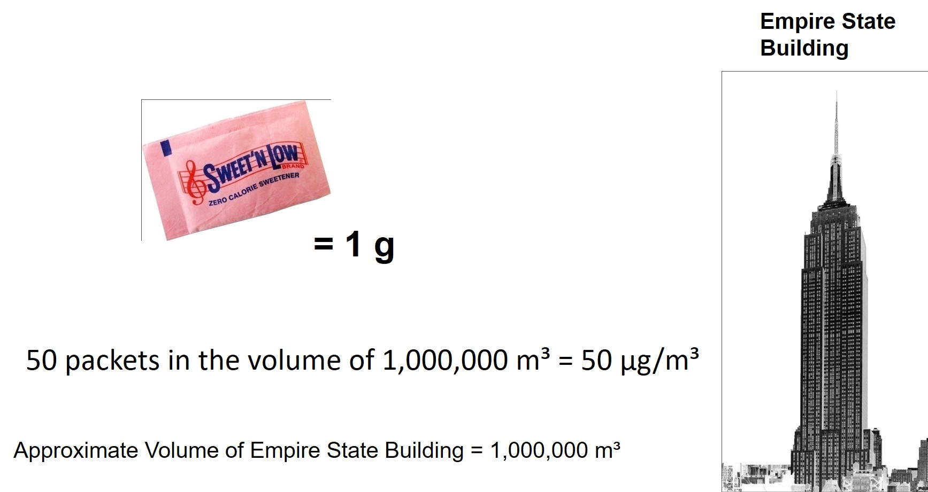
Micrograms per Cubic Meter of Air (µg/m³)
Notes:
Micrograms per Cubic Meter of Air (µg/m³)
One (1) packet of artificial sweeter in the volume of the Empire State Building is equivalent to 1 microgram per cubic meter of air (1 µg/m³).
50 artificial sweetener packets in the volume of the Empire State Building is equivalent to 50 µg/m³ (OSHA PEL for Lead).

Slide 29
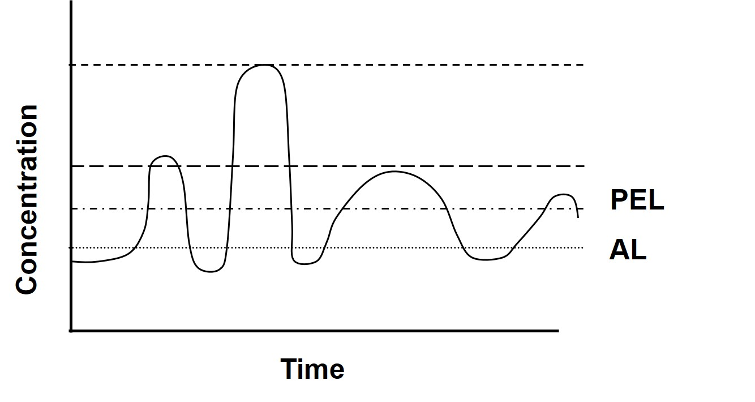
Exposure Limit Comparison Chart
Notes:
C – (Ceiling) Never to be exceeded.
PEL – Enforceable by OSHA
TLV – Not enforceable by OSHA

Slide 30
Silica Competent Person
Competent person means an individual who is capable of identifying existing and foreseeable respirable crystalline silica hazards in the workplace and who has authorization to take prompt corrective measures to eliminate or minimize them. The competent person must have the knowledge and ability necessary to fulfill the responsibilities set forth in [OSHA’s Silica Standard].
Notes:
Competent person means an individual who is capable of identifying existing and foreseeable respirable crystalline silica hazards in the workplace and who has authorization to take prompt corrective measures to eliminate or minimize them. The competent person must have the knowledge and ability necessary to fulfill the responsibilities set forth in [OSHA’s Silica Standard].

Slide 31
Compliance Options for Silica
Specified exposure control methods; or
Alternative exposure control methods.
Notes:
Option 1 – Specified Exposure Control Methods (Table 1)
Employers who choose the specified exposure controls option must fully and properly implement protections for the tasks or equipment listed in Table 1 of the silica standard (29 CFR 1926.1153).
Employers who fully and properly implement the controls in Table 1 do not have to assess employees’ silica exposure levels or keep employee exposures at or below the permissible exposure limit (PEL).
Option 2 – Alternative Exposure Control Methods (PEL)
Employers who follow alternative exposure control methods must:
Determine the levels of respirable crystalline silica that employees are exposed to;
Limit employee exposures to a PEL of 50 micrograms per cubic meter of air (50 μg/m³) as an 8-hour time-weighted average (TWA);
Use engineering and work practice controls, to the extent feasible, to limit employee exposures to the PEL, and supplement the controls with respiratory protection when necessary.
Keep records of employee exposure to respirable crystalline silica.

Slide 32
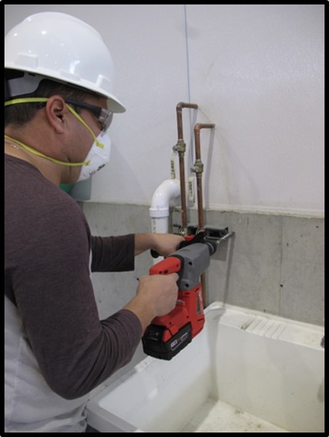
Option 1 – Specified Exposure Control Methods
Must FULLY and PROPERLY implement protection for the tasks or equipment listed in Table 1.
Do Not have to assess exposure levels.
Notes:
Fully and properly implemented means that controls are in place, are properly operated and maintained, and employees understand how to use them. OSHA requires that controls are fully and properly implemented.
Refer to equipment operators manuals for information on proper use of dust controls.

Slide 33
Option 2 – Alternative Exposure Control Methods
Determine the levels of respirable crystalline silica that employees are exposed to.
Limit employee exposures to a PEL of 50 micrograms per cubic meter of air (50 μg/m³) as an 8-hour time-weighted average (TWA).
Use engineering and work practice controls, to the extent feasible, to limit employee exposures to the PEL, and supplement the controls with respiratory protection when necessary.
Keep records of employee exposure to respirable crystalline silica.
Notes:
The performance option gives employers flexibility to determine the 8-hour TWA exposure for each employee based on any combination of air monitoring data or objective data that can accurately characterize employee exposures to respirable crystalline silica.
Air monitoring data are any results of air monitoring that the employer has done to meet the requirements of the standard.
Objective data is information that demonstrates employee exposure to respirable crystalline silica associated with a particular product or material or a specific process, task, or activity.

Slide 34
All Employers Must:
Provide respiratory protection when required;
Restrict housekeeping practices that expose employees to respirable crystalline silica where feasible alternatives are available;
Establish and implement a written exposure control plan, including designating a competent person;
Offer medical exams to employees who will be required to wear a respirator under the standard for 30 or more days a year; and
Communicate hazards, train employees and keep records of medical examinations.
Notes:
All employers covered by the standard must:
Provide respiratory protection when required;
Restrict housekeeping practices that expose employees to respirable crystalline silica where feasible alternatives are available;
Establish and implement a written exposure control plan, including designating a competent person;
Offer medical exams to employees who will be required to wear a respirator under the standard for 30 or more days a year; and
Communicate hazards, train employees and keep records of medical examinations.

Slide 35
Meeting the Requirements
Determine if the silica standard applies to your employees.
Determine what additional requirements you must meet under the standard, based on the compliance method you are following…
Notes:
No: No further action is required under the silica standard.
Yes: Choose to comply with the standard using either the:
Specified exposure control methods as stated in Table 1 of OSHA silica standard §1926.1153, or
The alternative methods of compliance.

Slide 36
Table 1: Specified Exposure Control Methods*
Notes:
List of common tasks using various types of tools or equipment found at construction sites:
Stationary masonry saws;
Handheld power saws (any blade diameter);
Handheld power saws for cutting fiber-cement board (with blade diameter of 8 inches or less)
Walk-behind saws;
Drivable saws;
Rig-mounted core saws or drills;
Handheld and stand-mounted drills (including impact and rotary hammer drills);
Dowel drilling rigs for concrete;
Vehicle-mounted drilling rigs for rock and concrete;
Jackhammers and handheld powered chipping tools;
Handheld grinders for mortar removal (i.e., tuckpointing);
Handheld grinders for uses other than mortar removal;
Walk-behind milling machines and floor grinders;
Small drivable milling machines (less than half-lane);
Large drivable milling machines (half-lane and larger);
Crushing machines;
Heavy equipment and utility vehicles when used to abrade or fracture silica-containing materials (such as hoe-ramming or rock ripping) or during demolition activities involving silica-containing materials; and
Heavy equipment and utility vehicles for tasks such as grading and excavating but not including demolishing, abrading, or fracturing silica-containing materials.

Slide 37
Employees Engaged in the Task
An employee operating a walk-behind saw and another employee helping the operator guide the saw are both engaged in the task.
An employee operating a jackhammer would be engaged in the task, but another employee directing traffic near the employee jackhammering would not be engaged in the task.
When Table 1 requires respiratory protection or additional protection, employers must provide that level of protection to all employees engaged in the task.
Notes:
When Table 1 requires respiratory protection or additional protection, employers must provide that level of protection to all employees engaged in the task. Employers must describe procedures for restricting access of employees not engaged in the task as part of its Written Exposure Control Plan.

Slide 38
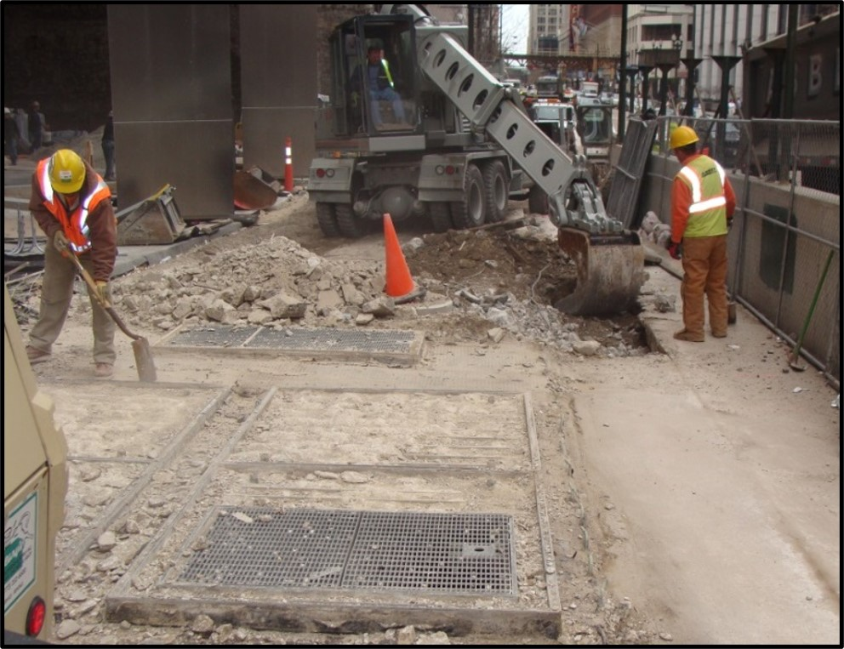
Table 1 – Entry (xvii) heavy equipment used during demolition activities.
When employees outside the cab are engaged in the task, then water must be applied to minimize dust.
Notes:
(Picture) Two workers helping with the demolition of silica-containing material.
Table 1 requires that water and/or dust suppressants be applied. If no dust suppressants are used, then the two helpers need to be evaluated for silica exposure (Alternative Method of Compliance). The operator inside an enclosed cab is protected under Table 1.

Slide 39
“Fully and Properly Implemented”
Controls are in place, are properly operated and maintained, and employees understand how to use them.
Refer to equipment operators manuals for information on proper use of dust controls.
Notes:
Fully and properly implemented means that controls are in place, are properly operated and maintained, and employees understand how to use them. OSHA requires that controls are fully and properly implemented.
Refer to equipment operators manuals for information on proper use of dust controls.

Slide 40
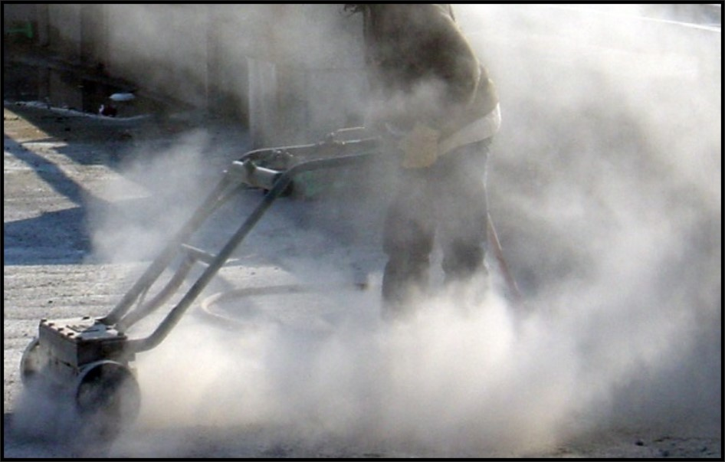
“Fully and Properly Implemented” Bad
 The presence of large amounts of visible dust generally indicates that controls are not fully and properly implemented.
Notes:
The presence of large amounts of visible dust generally indicates that controls are not fully and properly implemented. Large amounts of visible dust means controls are not fully and properly implemented.

Slide 41
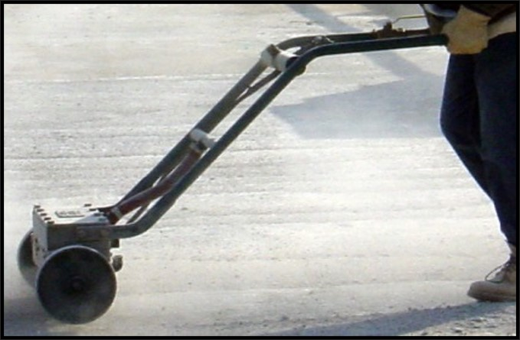
“Fully and Properly Implemented” Good
A small amount of dust can be expected from equipment that is operating as intended by the manufacturer.
A noticeable increase in dust generation during the task is a sign that the dust controls are not operating correctly.
Notes:
A small amount of dust can be expected from equipment that is operating as intended by the manufacturer; however, a noticeable increase in dust generation during the task is a sign that the dust controls are not operating correctly. The difference between the small amounts of dust generated when control measures are working properly and the large amount of dust generated during tasks when control measures are not used or not operated effectively is easily observed. When this happens, prompt corrective actions are required.

Slide 42
Manufacturer’s Instructions
Water flow rates,
Vacuum equipment air flow rate and capacity,
Rotation of the blade (speed, direction),
Maintaining and changing blades, and
Frequency for changing water.
Notes:
Integrated water systems must be developed specifically for the type of tool in use so they will apply water at the appropriate dust emission points based on tool configuration and do not interfere with other tool components or safety devices. Water systems designed for blade cooling also suppress dust and meet the requirements for Table 1.

Slide 43
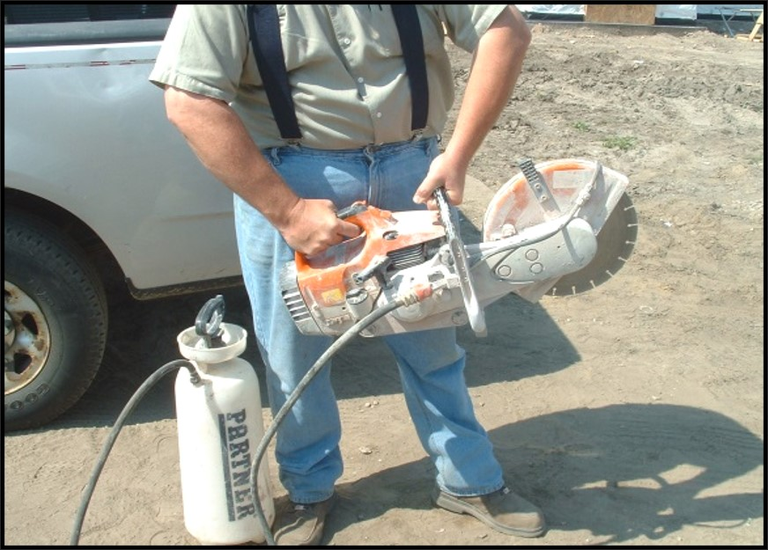
Water Delivery Systems
Integrated water systems must be developed specifically for the type of tool .
Not interfere with safety devices.
Notes:
The water must be applied at flow rates sufficient to minimize release of visible dust. Effective control of the dust depends on factors such as dust particle size, dust particle velocity, spray nozzle size and location, use of surfactants or other binders, and environmental factors (water hardness, humidity, weather, etc.), all of which must be considered when using wet methods.

Slide 44
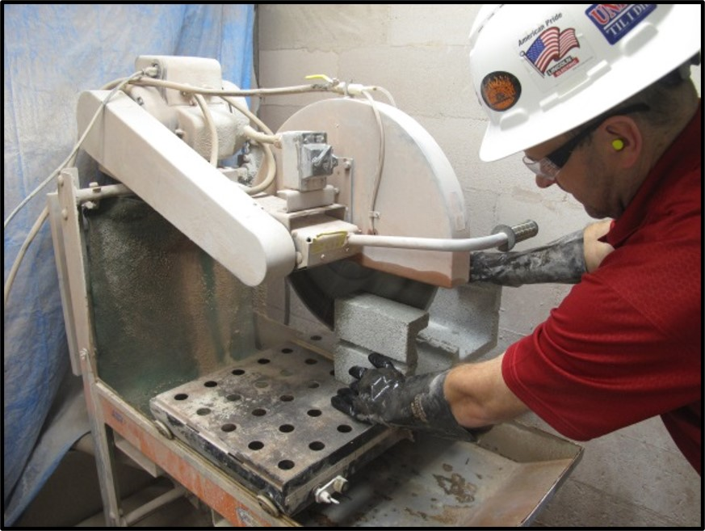
Water Delivery Systems – Stationary Masonry Saw
The water must be applied at flow rates sufficient to minimize release of visible dust.
Notes:
The water must be applied at flow rates sufficient to minimize release of visible dust. Effective control of the dust depends on factors such as dust particle size, dust particle velocity, spray nozzle size and location, use of surfactants or other binders, and environmental factors (water hardness, humidity, weather, etc.), all of which must be considered when using wet methods.

Slide 45
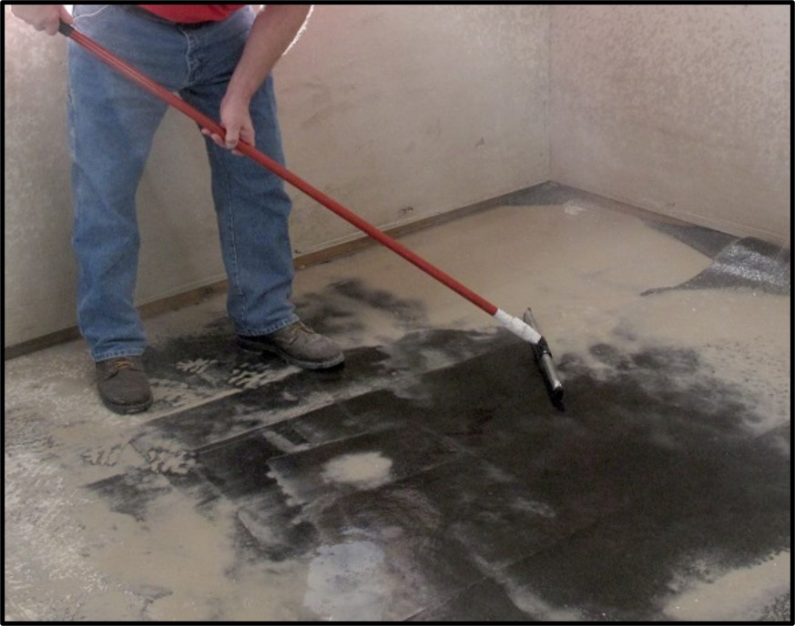
Water Delivery Systems – Good Housekeeping
Any slurry generated when using water to suppress dust should be cleaned up to limit secondary exposure to silica dust.
Notes:
Any slurry generated when using water to suppress dust should be cleaned up to limit secondary exposure to silica dust. If the slurry dries, then follow procedures described in the employer’s Written Exposure Control Plan. No dry sweeping allowed!
Clean up slurry to limit secondary exposure to silica dust

Slide 46
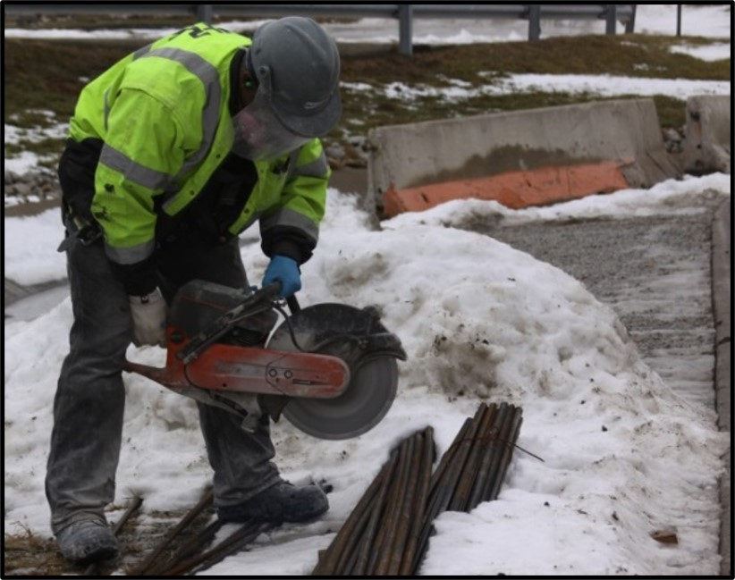
Water Delivery Systems – Integrated Water Delivery System
When working in cold temperatures, where there is a risk of water freezing, additional work practices such as insulating drums, wrapping drums with gutter heat tape or adding environmentally-friendly antifreeze additives to water may be needed.
Notes:
WorkWhen working in cold temperatures, where there is a risk of water freezing, additional work practices such as insulating drums, wrapping drums with gutter heat tape or adding environmentally-friendly antifreeze additives to water may be needed.
Water delivery systems require additional work practices in cold weather.

Slide 47
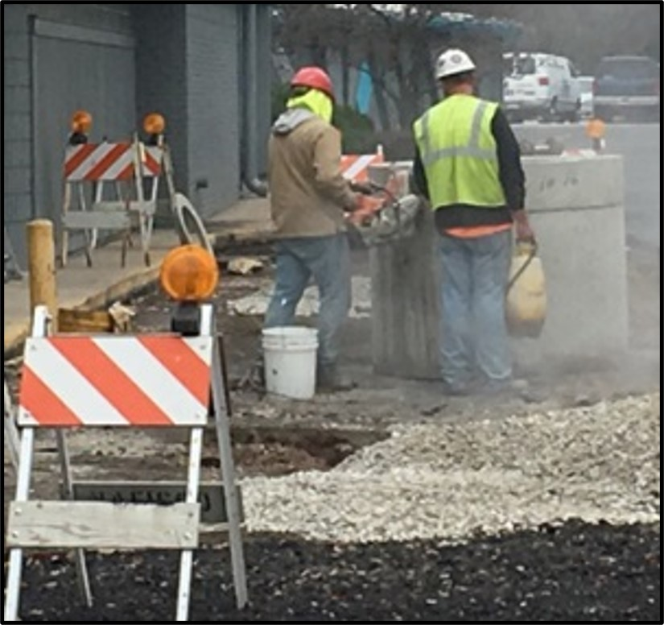
Water Delivery Systems - Bad
 Water delivery systems that are not integrated from the manufacturer are not allowed!
Notes:
Water delivery systems that are not integrated from the manufacturer are not allowed!
Water delivery systems that are not integrated from the manufacturer are not allowed!

Slide 48
Dust Collection Systems
Must be “commercially available”.
Designed to effectively capture dust generated by the tool.
Does not interfere with safety mechanisms.
Notes:
Commercially available dust collection systems are required for several types of equipment in Table 1. This requirement ensures that employers use equipment that is designed to effectively capture dust generated by the tool being used and does not introduce new hazards such as obstructing or interfering with safety mechanisms. The “commercially available” limitation is meant only to eliminate on-site improvisations of equipment by the employer.

Slide 49

Aftermarket Manufacturers
Designed to work effectively with the equipment and not introduce new hazards such as obstructing or interfering with safety mechanisms.
Notes:
Employers can use products that are made by aftermarket manufacturers (someone other than the original tool manufacturer) that are intended to fit the make and model of the tool. This includes custom-designed products made to meet the particular needs and specifications of the employer purchasing the product. These systems are designed to work effectively with the equipment and not introduce new hazards such as obstructing or interfering with safety mechanisms. DustBull Universal Dust Shroud for Cut Off Saws, by Dustless Technologies

Slide 50

Filter Cleaning Mechanism - Vacuums
Cyclonic pre-separators and filter cleaning mechanisms to prevent buildup of debris on filters that result in less dust capture.
Notes:
Some Table 1 entries for dust collection systems specify use of cyclonic pre-separators and filter cleaning mechanisms to prevent buildup of debris on filters that result in less dust capture. A cyclonic pre-separator collects large debris before the air reaches the filters. A filter cleaning mechanism prevents the need for manually cleaning filters to prevent buildup of debris (caking). Some vacuums are equipped with a gauge indicating filter pressure or an equivalent device (e.g., timer to periodically pulse the filter) to help employees in determining when it is time to run a filter cleaning cycle.
A self-cleaning system makes a “thumping” sound which is caused when a solenoid closes a butterfly valve and reverses the air flow thru the filter. This action blows the fine dust off the filter keeping it clean and then reopens the vale. DEWALT HEPA Vacuum DWV012

Slide 51
Indoors or Enclosed Areas
Areas where airborne dust can build up unless additional exhaust is used.
Provide a means of exhaust as needed to minimize the accumulation of visible airborne dust for tasks performed indoors or in enclosed areas.
Portable fans (box fans, floor fans, axial fans);
Portable ventilation systems; or
Other systems that increase air movement and assist in the removal and dispersion of airborne dust.
Notes:
Several Table 1 entries refer to tasks performed “outdoors” or “indoors or in an enclosed area.” Indoors or in an enclosed areas mean areas where airborne dust can build up unless additional exhaust is used. For example, a work area with only a roof that does not affect the dispersal of dust would not be considered enclosed; however, an open-top structure with three walls and limited air movement or a roof that does limit dispersal would be considered enclosed.

Slide 52
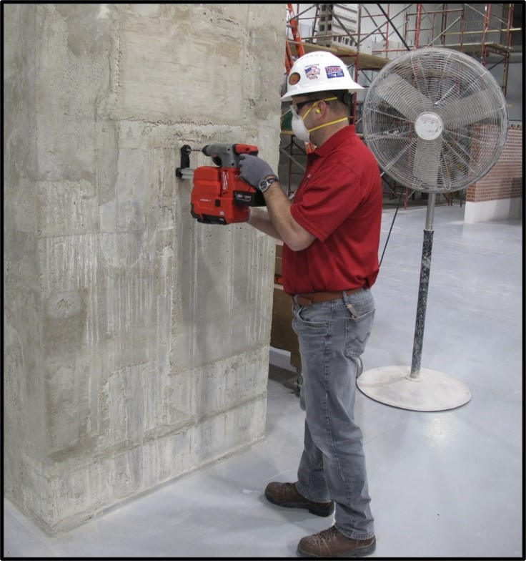
Indoors or Enclosed Areas – Means of Exhaust
Work performed indoors or in enclosed spaces requires a means of exhaust, such as a portable fan, to minimize the accumulation of visible airborne dust.
Notes:
Sufficient air circulation in enclosed or indoor environments is important to ensure the effectiveness of the control strategies and to prevent the accumulation of airborne dust. Employers following Table 1 are required to provide a means of exhaust as needed to minimize the accumulation of visible airborne dust for tasks performed indoors or in enclosed areas.
The means of exhaust necessary could include:
Portable fans (box fans, floor fans, axial fans);
Portable ventilation systems; or
Other systems that increase air movement and assist in the removal and dispersion of airborne dust.
To be effective, the ventilation must be set up so that movements of employees during work, or the opening of doors and windows will not negatively affect the airflow.

Slide 53
Enclosed Cabs
Specified for rock drilling, crushers, and heavy equipment (Table 1).
Maintained as free as practicable from settled dust;
Has door seals and closing mechanisms that work properly;
Has gaskets and seals that are in good condition and work properly;
Is under positive pressure maintained through continuous delivery of filtered air;
Has intake air that is filtered through a pre-filter that is 95% efficient in the 0.3-10.0 µm range (e.g., MERV-16 or better); and
Has heating and cooling capabilities.
Notes:
The controls for enclosed cabs lower the potential for dust to be re-suspended inside the cab or enter the enclosed cab or booth. They also ensure that the filtered air provided to the employee does not contain silica particles and that the working conditions in the cab are comfortable so that employees are less likely to open windows and be exposed. Equipment operator in enclosed cab with positive pressure.

Slide 54
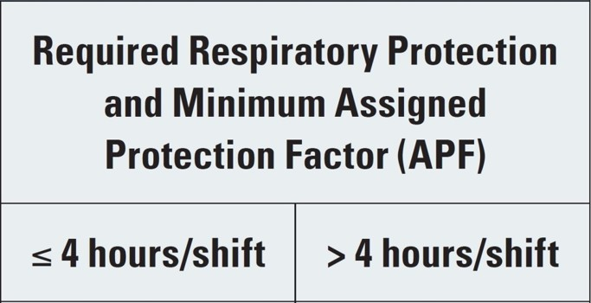
Task Duration & Respirator Use
A standard 8-hour work period;
A day with a break between work periods (e.g., four hours on, two hours off, four hours on);
Work periods longer than eight hours;
Double shifts within a single day;
A work period spanning two calendar days (e.g., 8 p.m. until 4 a.m.)
Notes:
Each of the following scenarios is considered a “shift” for purposes of determining the maximum amount of time that an employee may spend on Table 1 tasks without respiratory protection:
A standard 8-hour work period;
A day with a break between work periods (e.g., four hours on, two hours off, four hours on);
Work periods longer than eight hours;
Double shifts within a single day;
A work period spanning two calendar days (e.g., 8 p.m. until 4 a.m.).
Task duration time starts when the operator begins using the tool, and continues to be counted until he or she completes the task. This time includes intermittent breaks in tool usage and clean-up. However, tasks that are performed multiple times per day, during distinct time periods, should be counted as separate tasks, and times should be combined.
The requirement to provide respirators is based on the anticipated duration of the task. Employers must make a good-faith judgment of the task’s anticipated duration over the work shift, whether performed continuously or intermittently, based on previous experience and all other available information.

Slide 55
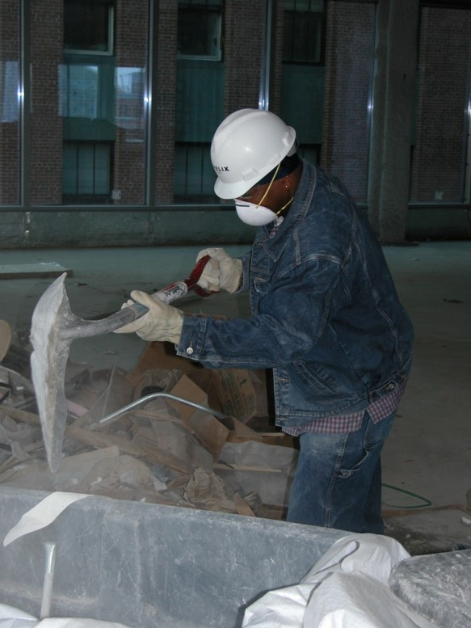
Alternative Exposure Control Methods
Tasks not covered under Table 1; or
Do not fully and properly implement the engineering controls, work practices, and respiratory protection described in Table 1.
The PEL
Exposure Assessment
Methods of Compliance
Notes:
Employers that conduct tasks not listed in Table 1 or do not fully and properly implement the engineering controls, work practices, and respiratory protection described in Table 1 of the specified exposure control methods approach must follow the alternative exposure control methods approach. The alternative exposure control methods approach involves assessing employee exposure to respirable crystalline silica, and limiting exposure to the PEL using feasible engineering and work practice control methods, and respiratory protection when necessary.

Slide 56
Exposure Assessment
Must assess the 8-hour TWA exposure for each employee who is or may reasonably be expected to be exposed to respirable crystalline silica at or above the action level of 25 µg/m³ as an 8-hour TWA.
Performance Option
Scheduled Air Monitoring
Notes:
Construction employers following alternative exposure control methods must assess the 8-hour TWA exposure for each employee who is or may reasonably be expected to be exposed to respirable crystalline silica at or above the action level of 25 µg/m³ as an 8-hour TWA.
The purposes of assessing employee exposures include:
Identifying where exposures are occurring;
Helping the employer select control methods and make sure those methods are effective;
Preventing employees from being exposed above the PEL;
Providing employees with information about their exposure levels; and
Allowing the employer to give the physician or other licensed health care professional [PLHCP] performing medical examinations information about employee exposures.

Slide 57
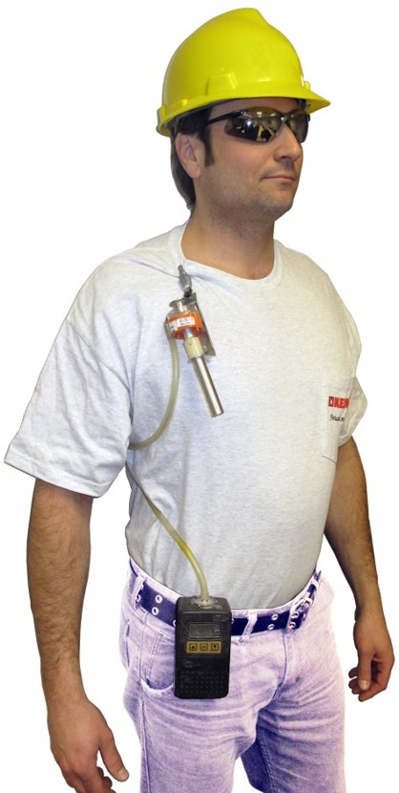
Exposure Assessment – Silica Sample Pump
Silica sampling equipment
Air pump
Hose
Cassette assembly
Near breathing zone
In hemisphere forward of the shoulders
6 to 9 inches
Notes:
Personal monitoring is done to determine individual worker exposure and area monitoring may be done to estimate possible exposure of a group of workers in a particular area. It is usually done during a specific time period, often as an 8-hour shift or 15 minute period to ensure compliance with OSHA standards.
Air monitoring may be done in a number of ways. Some toxins are measured by placing a small pump on your belt and a filter cassette or tube clipped on your collar with a flexible tube running between them. The filter or tube should be located as close as possible to your breathing zone (the air in front of your nose and mouth which you breathe).
The pump pulls air through the filter or tube, which traps the dust or toxin. After the sample has been taken, the filter or tube is sent to a laboratory. The laboratory uses scientific methods to measure the amount of contaminant on the filter or tube. It may take several days or longer before the results are ready from the laboratory.

Slide 58
Performance Option
Objective Data
Combination of air monitoring and objective data
Air monitoring data from industry-wide surveys;
Calculations based on the composition of a substance;
Area sampling results and exposure mapping profile approaches; and
Historical air monitoring data collected by the employer.
Notes:
Employers choosing the performance option must:
Conduct the exposure assessment before work begins;
Reassess exposures whenever a change in production, process, control equipment, personnel, or work practices may reasonably be expected to result in new or higher exposures at or above the action level, or when the employer has any reason to believe that new or additional exposures at or above the action level have occurred;
Make sure that the exposure assessment reflects the exposures of employees on each shift, for each job classification, in each work area (i.e., types of material, control methods, work practices, and environmental conditions).

Slide 59
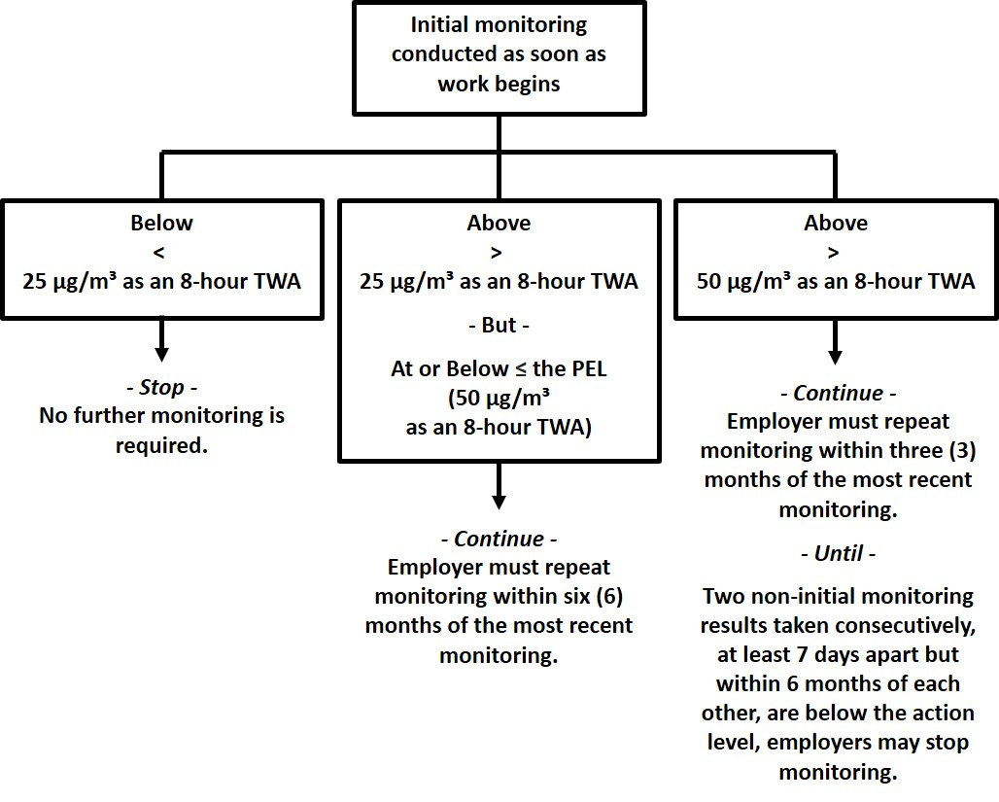
Scheduled Monitoring Option
Notes:
The employer must reassess exposures whenever a change in production, process, control equipment, personnel, or work practices may reasonably be expected to result in new or additional exposures to respirable crystalline silica at or above the action level.

Slide 60
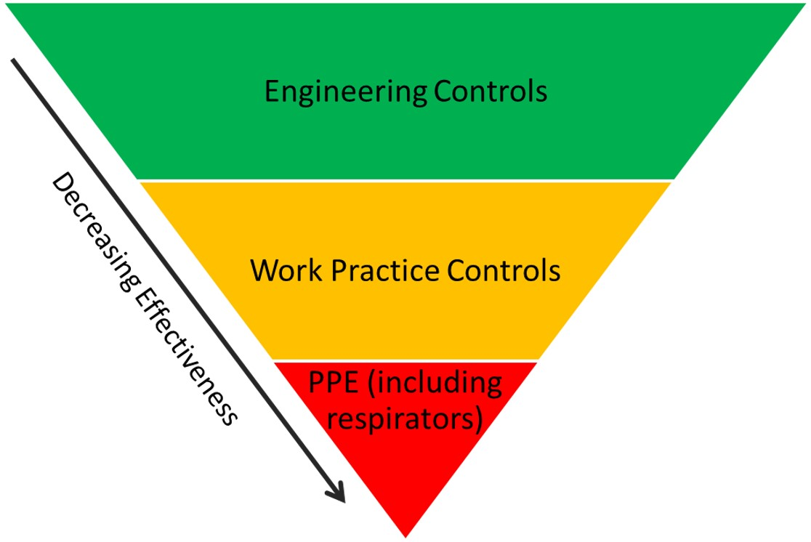
Methods of Compliance
Notes:
Employers following alternative exposure control methods must comply with the methods of compliance requirements of the standard. The methods of compliance section of the standard requires employers to protect employees following the hierarchy of controls, which relies on engineering and work practice controls for reducing exposures and allows for respirator use, in addition to those controls, only when feasible engineering controls cannot reduce exposures to acceptable levels.

Slide 61
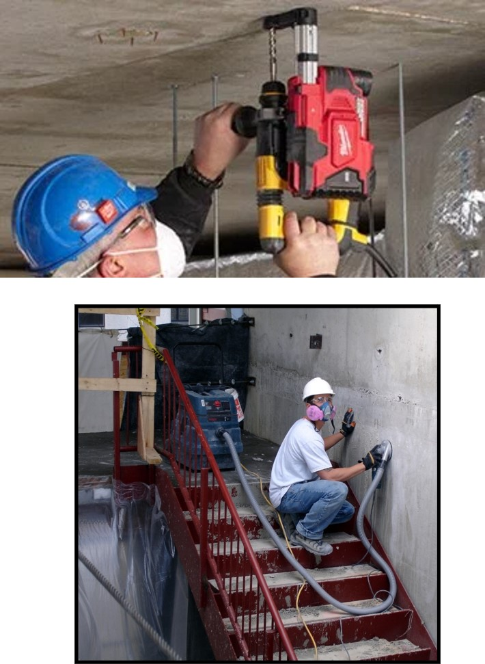
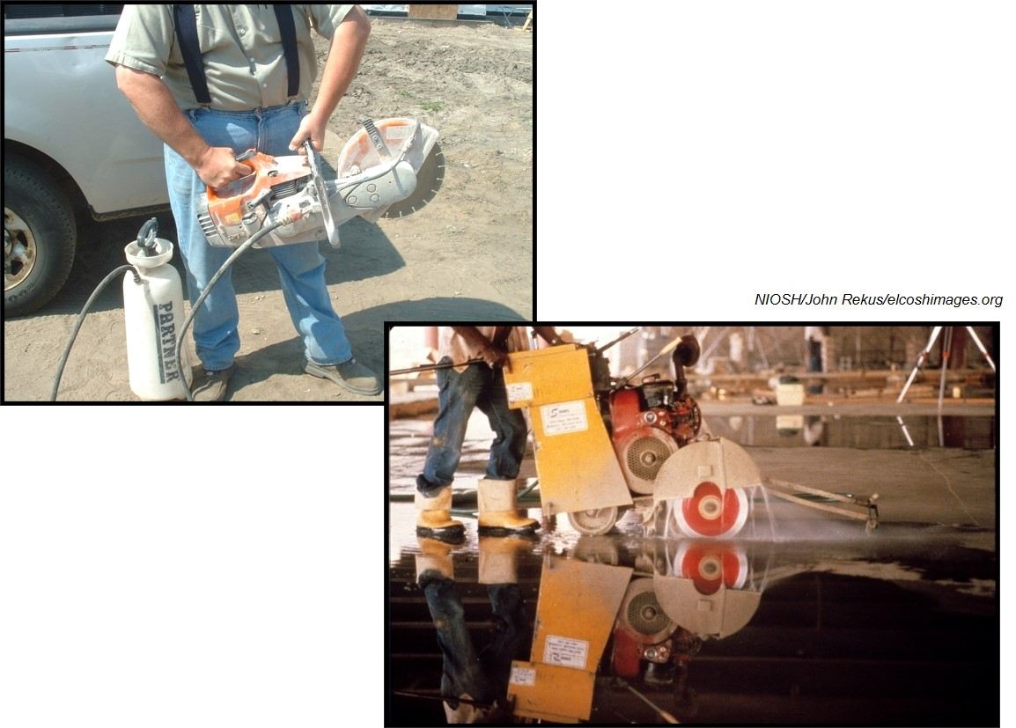
Engineering Controls
Notes:
Engineering Control Example…

Slide 62
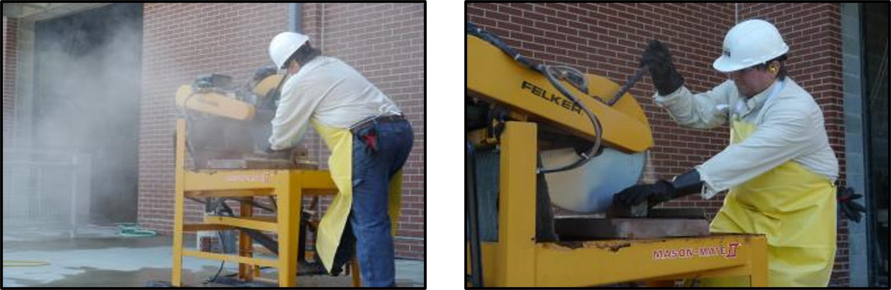
Image Source: CPWR Silica Safe
Notes:
Advantages of engineering controls are that they:
Control crystalline silica-containing dust particles at the source, thus minimizing exposures to all persons in the surrounding work area;
Are reliable, predictable, and provide consistent levels of protection to a large number of employees;
Can be monitored; and
Are less prone to human error than the use of personal protective equipment.

Slide 63
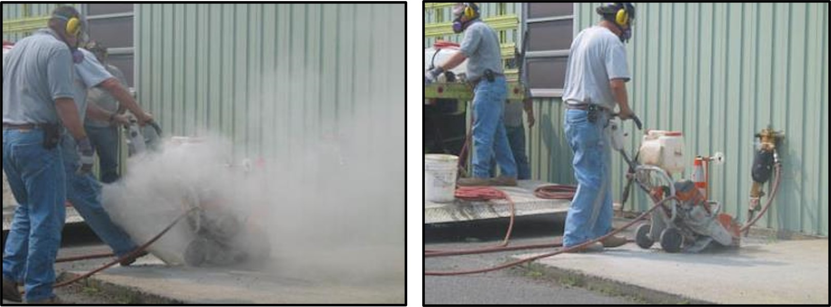
Poor vs. Good Work Practice
Notes:
Advantages of engineering controls are that they:
Control crystalline silica-containing dust particles at the source, thus minimizing exposures to all persons in the surrounding work area;
Are reliable, predictable, and provide consistent levels of protection to a large number of employees;
Can be monitored; and
Are less prone to human error than the use of personal protective equipment.

Slide 64
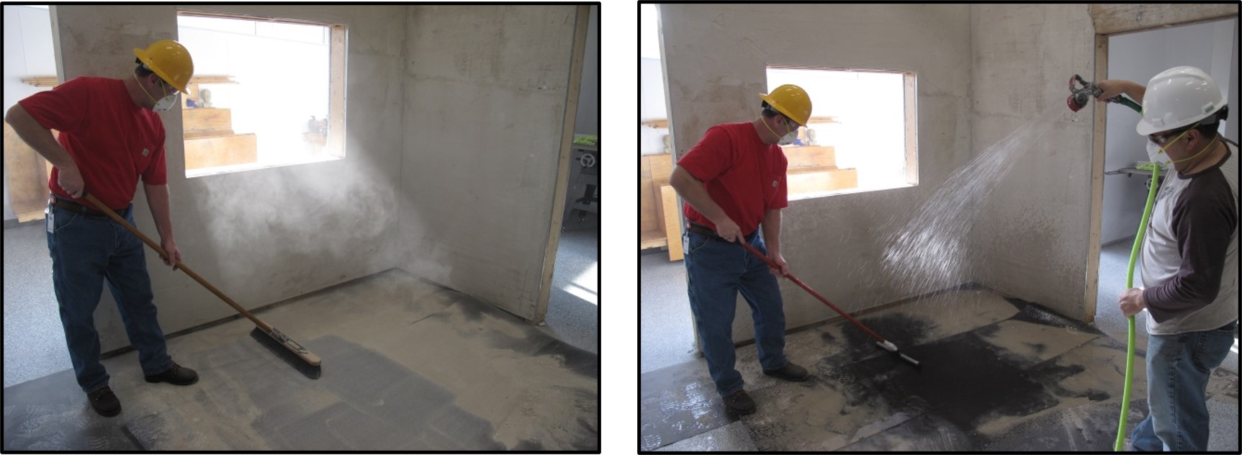
Poor Work Practice vs. Good Work Practice
Notes:
Advantages of engineering controls are that they:
Control crystalline silica-containing dust particles at the source, thus minimizing exposures to all persons in the surrounding work area;
Are reliable, predictable, and provide consistent levels of protection to a large number of employees;
Can be monitored; and
Are less prone to human error than the use of personal protective equipment.

Slide 65
Work Practice Controls
Housekeeping
No dry sweeping
No use of compressed air
Written Exposure Control Plan
Medical Surveillance
Hazard Communication & Employee Training
Recordkeeping
Notes:
Work practice controls involve performing a task in a way that reduces the likelihood or levels of exposure. Work practice controls are often used with engineering controls to protect employees. Employees must know the appropriate work practices for maximizing the effectiveness of controls and minimizing exposures.

Slide 66
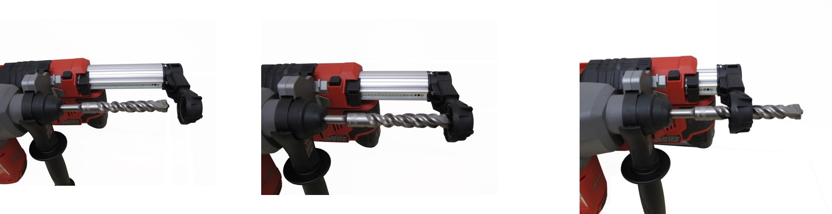
Drill Bits
Notes:
Proper Fitting of Drill Bit
To operate a handheld drill in accordance with manufacturer’s instructions and to allow proper suction, position the nozzle assembly so the bit is flush with the forward face of the nozzle.

Slide 67
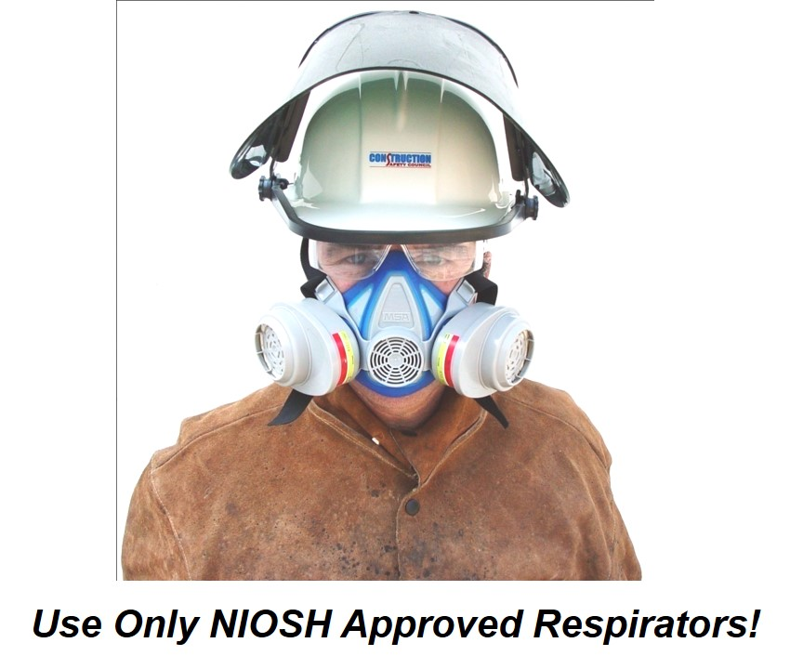
Limitations & Use of Respirators
All respirators leak!
Must be properly fitted and worn.
Respirators protect only the employees who are wearing them.
Respirators are uncomfortable to wear.
Notes:
Engineering and work practice controls are generally regarded as the most effective methods to control exposures to airborne hazardous substances. OSHA considers the use of respirators to be the least satisfactory approach to exposure control because…
All respirators leak!
Respirators provide adequate protection only if employers ensure, on a constant basis, that they are properly fitted and worn.
Respirators protect only the employees who are wearing them from a hazard, rather than reducing or eliminating the hazard from the workplace as a whole (which is what engineering and work practice controls do).
Respirators are uncomfortable to wear, cumbersome to use, and interfere with communication in the workplace, which can often be critical to maintaining safety and health.
The costs of operating a functional respiratory protection program are substantial — including regular medical examinations, fit testing, training, and the purchasing and maintenance of equipment.
Use Only NIOSH Approved Respirators!

Slide 68
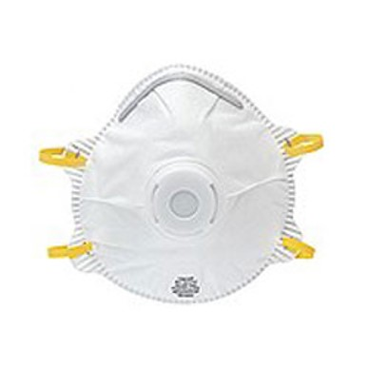
Approved Filtering Facepieces (Disposable)
Least protection (rated the same as elastomeric half-face).
Not allowed for use in atmospheres with less than 19.5% oxygen.
Should only use in voluntary situations. Must read and understand Appendix D of OSHA respiratory protection standard.
Notes:
The appropriate respirator will depend on the contaminant(s) to which you are exposed and the protection factor (PF) required. Required respirators must be NIOSH-approved and medical evaluation, fit testing and training must be provided before use.

Slide 69
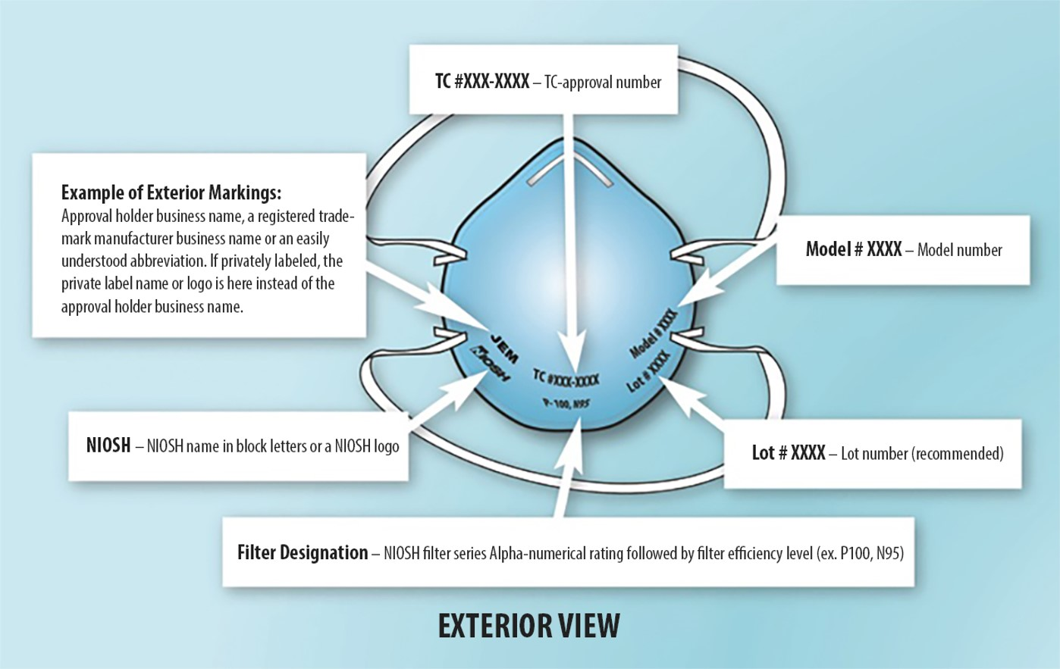
NIOSH Approved Respirator Identification
Notes:
NIOSH Filtering Facepiece Respirator (FFR) Labels
Individual filtering facepiece respirators (disposable) are required to have the following markings:
Name of approval holder (usually the manufacturer), a registered trademark, or an easily understood abbreviation of the approval holder’s business name as recognized by NIOSH. When applicable, the name of the entity to which the FFR has been private-labeled by the approval holder may replace the approval holder business name, registered trademark, or abbreviation of the approval holder business name as recognized by NIOSH.
NIOSH in block letters or the NIOSH logo.
NIOSH Testing and Certification approval number, e.g., TC-84A-XXXX.
NIOSH filter series and filter efficiency level, e.g., N95, N99, N100, R95, P95, P99, P100.
Model number or part number: The approval holder’s respirator model number or part number, represented by a series of numbers or alphanumeric markings, e.g., 8577 or 8577A.

Slide 70
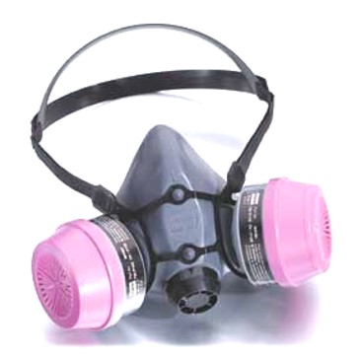
Half-Face Respirators (Elastomeric)
Can be used with a variety of cartridges/filters.
Requires regular cleaning & maintenance.
Not allowed for use in atmospheres with less than 19.5% oxygen.
Notes:
The appropriate respirator will depend on the contaminant(s) to which you are exposed and the protection factor (PF) required. Required respirators must be NIOSH-approved and medical evaluation, fit testing and training must be provided before use.

Slide 71
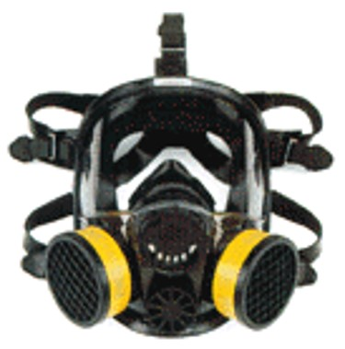
Full-Face Respirators (Elastomeric)
Can be used with a variety of cartridges/filters.
Requires regular cleaning & maintenance.
Built in safety eye protection (ANSI Z87).
Not allowed for use in atmospheres with less than 19.5% oxygen.
Notes:
The appropriate respirator will depend on the contaminant(s) to which you are exposed and the protection factor (PF) required. Required respirators must be NIOSH-approved and medical evaluation, fit testing and training must be provided before use.

Slide 72
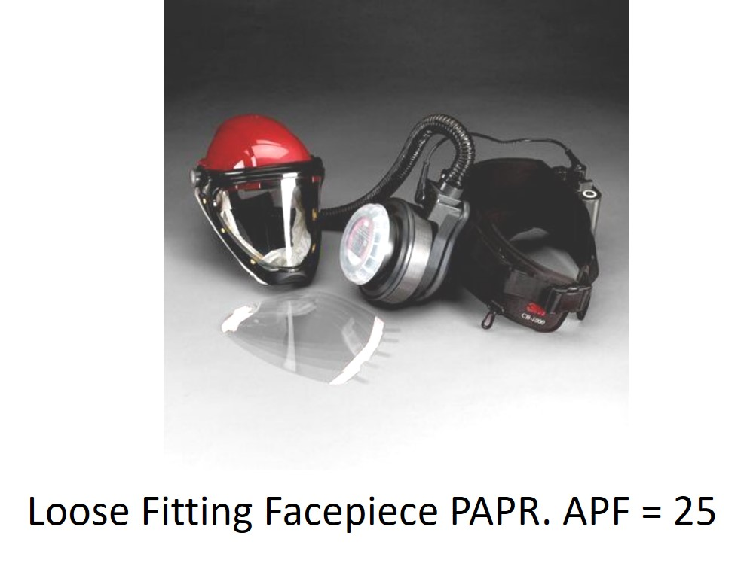
Powered-Air-Purifying Respirators (PAPR)
Battery powered fan pulls air through filters and blows air into the facepiece or hood.
Can be used with a variety of cartridges/filters.
Requires regular cleaning & maintenance.
Built in safety eye protection (ANSI Z87).
Easier to fit, easier on heart and lungs.
Not allowed for use in atmospheres with less than 19.5% oxygen.
Notes:
The appropriate respirator will depend on the contaminant(s) to which you are exposed and the protection factor (PF) required. Required respirators must be NIOSH-approved and medical evaluation, fit testing and training must be provided before use.

Slide 73
Assigned Protection Factors
Type of respirator | Quarter mask | Half mask | Full facepiece | Helmet hood | Loose Fitting facepiece
Air-Purifying Respirator | 5 | 10 | 50 | .............. | ..............
Powered Air-Purifying Respirator (PAPR) | .............. | 50 | 1,000 | 25/1,000 | 25
Supplied-Air Respirator (SAR) or Airline Respirator Demand mode Continuous flow mode Pressure-demand or other positive-pressure mode | .................. .................. .................. | 10 50 50 | 50 1,000 1,000 | .................. 25/1,000 .................. | ................. 25 .................
Self-Contained Breathing Apparatus (SCBA) Demand mode Pressure-demand or other positive-pressure mode (e.g., open/closed circuit) | .................. .................. | 10 .................. | 50 10,000 | 50 10,000 | ................. .................
Notes:
Notes:
1 Employers may select respirators assigned for use in higher workplace concentrations of a hazardous substance for use at lower concentrations of that substance, or when required respirator use is independent of concentration.
2 The assigned protection factors in Table 1 are only effective when the employer implements a continuing, effective respirator program as required by this section (29 CFR 1910.134), including training, fit testing, maintenance, and use requirements.
3 This APF category includes filtering facepieces, and half masks with elastomeric facepieces.
4 The employer must have evidence provided by the respirator manufacturer that testing of these respirators demonstrates performance at a level of protection of 1,000 or greater to receive an APF of 1,000. This level of performance can best be demonstrated by performing a WPF or SWPF study or equivalent testing. Absent such testing, all other PAPRs and SARs with helmets/hoods are to be treated as loose-fitting facepiece respirators, and receive an APF of 25.
5 These APFs do not apply to respirators used solely for escape. For escape respirators used in association with specific substances covered by 29 CFR 1910 subpart Z, employers must refer to the appropriate substance-specific standards in that subpart. Escape respirators for other IDLH atmospheres are specified by 29 CFR 1910.134 (d)(2)(ii).

Slide 74
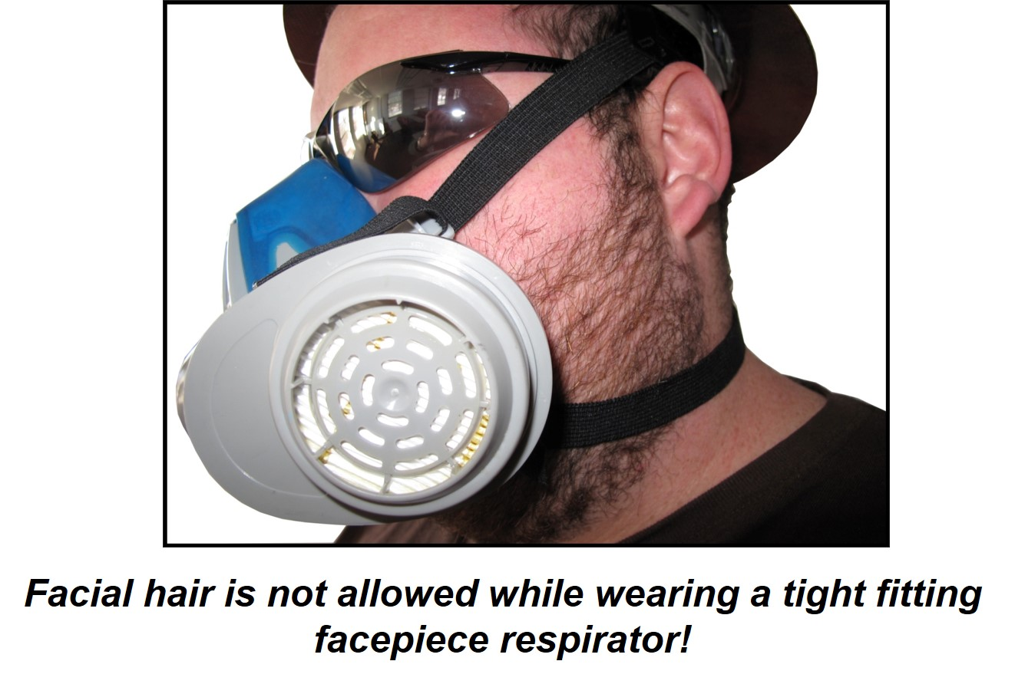
Facial Hair
Notes:
Facial hair is not allowed while wearing a tight fitting facepiece respirator; it interferes with the fit and will allow more hazardous substances to leak into the facepiece. However, some mustaches, sideburns, and small goatees that are trimmed so that no hair underlies the seal of the respirator present no hazard and may be worn – only a properly performed fit test will ensure this.

Slide 75
Medical Surveillance
The employer shall make medical surveillance available at no cost to the employee, and at a reasonable time and place, for each employee who will be required under this section to use a respirator for 30 or more days per year.
Notes:
After determining which respirator is required, the employer’s Program Administrator must ensure that employees are physically capable of wearing respirators. A medical evaluation may be performed in one of two ways. First, a confidential questionnaire (Appendix C of the Respirator Standard, 29 CFR 1910.134) may be given during work hours, or at a time and location convenient for the employee, in a language that the employee can read. OSHA provides a translated questionnaire in Spanish. The employee may provide a translator to read the questions to the employee. The employer may not provide a translator or be present during the questioning. After completing the questionnaire, the employee puts it into an envelope and seals it. The employer is required to send the sealed envelope to its designated Physician or Licensed Health Care Professional (PLHCP).
Another option for employee medical evaluation is a face-to-face interview with the PLHCP asking the same questions as those found on the questionnaire. The employer must provide a copy of its written respirator program to the PLHCP and the medical evaluation section of the Respirator Standard (29 CFR 1910.134).
After evaluating the employee, the PLHCP shall reply to the employer and state:
If the employee can wear a respirator;
Any limitations on respirator use for the employee;
The need and frequency for follow-up evaluations; and
That the PLHCP has communicated the same information to the employee.
This information comprises the Medical Record, which must be kept for the employee’s duration of employment plus thirty (30) years thereafter, but the questionnaire is not shared with the employer.

Slide 76
Initial Examination
The employer shall make available an initial (baseline) medical examination within 30 days after initial assignment, unless the employee has received a medical examination that meets the requirements of this section within the last three years.
A medical and work history, with emphasis on: past, present, and anticipated exposure to respirable crystalline silica, dust, and other agents affecting the respiratory system;
A physical examination with special emphasis on the respiratory system;
A chest X-ray interpreted by a NIOSH-certified B Reader;
A pulmonary function test (PFT);
Testing for latent tuberculosis infection; and
Any other test deemed necessary.
Notes:
Employers must make an initial or periodic medical examination available to employees who will be required by the silica standard to wear a respirator for 30 or more days during the next 365 days. If the employee is required to wear a respirator at any time during a day, then that period of time is considered one day of respirator use.

Slide 77
Periodic Examinations
The employer shall make available medical examinations at least every three years, or more frequently if recommended by the PLHCP.
Physician or other licensed health care professional [PLHCP]
Notes:
Employers must offer medical examinations:
Within 30 days of initial assignment (i.e., the date when the employee starts working in a job/ task in which he or she will be required by the silica standard to wear a respirator for 30 or more days per year), unless the employee has had an examination that meets the requirements of the silica standard within the past three years.
Every three years from the employee’s last examination that met the requirements of the silica standard, or more frequently if recommended by the PLHCP, if the employee will continue to perform tasks that require respirator use under the silica standard for 30 or more days per year.

Slide 78
Communication of respirable crystalline silica hazards to employees—(1) Hazard communication.
The employer shall include respirable crystalline silica in the program established to comply with the hazard communication standard (HCS) (29 CFR 1910.1200).
The employer shall ensure that each employee has access to labels on containers of crystalline silica and safety data sheets, and is trained in accordance with the provisions of HCS.
The employer shall ensure that at least the following hazards are addressed: Cancer, lung effects, immune system effects, and kidney effects.
Notes:
Employers must comply with the OSHA Hazard Communication Standard (HCS) (29 CFR 1910.1200). HCS requires employers to inform employees about hazardous chemicals in the workplace, such as respirable crystalline silica, through their written hazard communication programs. Written hazard communication programs must describe how requirements for container labels, safety data sheets (SDSs), and employee training will be met.
As part of its hazard communication program for respirable crystalline silica, an employer must address, at a minimum, these health hazards: cancer, lung effects, immune system effects, and kidney effects.

Slide 79
Employer Responsibilities for Silica
The employer shall establish and implement a written exposure control plan:
A description of the tasks in the workplace that involve exposure to respirable crystalline silica.
A description of the engineering controls, work practices, and respiratory protection used to limit employee exposure to respirable crystalline silica for each task.
A description of the housekeeping measures used to limit employee exposure to respirable crystalline silica.
A description of the procedures used to restrict access to work areas.
Notes:
The employer shall establish and implement a written exposure control plan:
A description of the tasks in the workplace that involve exposure to respirable crystalline silica.
A description of the engineering controls, work practices, and respiratory protection used to limit employee exposure to respirable crystalline silica for each task.
A description of the housekeeping measures used to limit employee exposure to respirable crystalline silica.
A description of the procedures used to restrict access to work areas.

Slide 80
Paragraph (g) Written exposure control plan.
A description of the tasks in the workplace that involve exposure to respirable crystalline silica.
A description of the engineering controls, work practices, and respiratory protection used to limit employee exposure to respirable crystalline silica for each task.
A description of the housekeeping measures used to limit employee exposure to respirable crystalline silica.
A description of the procedures used to restrict access to work areas.
Notes:
A description of the tasks in the workplace that involve exposure to respirable crystalline silica.
A description of the engineering controls, work practices, and respiratory protection used to limit employee exposure to respirable crystalline silica for each task.
A description of the housekeeping measures used to limit employee exposure to respirable crystalline silica.
A description of the procedures used to restrict access to work areas.

Slide 81
Written Exposure Plan…
The employer shall review and evaluate the effectiveness of the written exposure control plan at least annually and update it as necessary.
The employer shall make the written exposure control plan readily available for examination and copying, upon request, to each employee covered by this section, their designated representatives, the Assistant Secretary and the Director.
The employer shall designate a competent person to make frequent and regular inspections of job sites, materials, and equipment to implement the written exposure control plan.
Notes:
The employer shall review and evaluate the effectiveness of the written exposure control plan at least annually and update it as necessary.
The employer shall make the written exposure control plan readily available for examination and copying, upon request, to each employee covered by this section, their designated representatives, the Assistant Secretary and the Director.
The employer shall designate a competent person to make frequent and regular inspections of job sites, materials, and equipment to implement the written exposure control plan.

Slide 82
Employee Information & Training
The employer shall ensure that each employee covered by this section can demonstrate knowledge and understanding of at least the following:
The health hazards associated with exposure to respirable crystalline silica;
Specific tasks in the workplace that could result in exposure to respirable crystalline silica;
Specific measures the employer has implemented to protect employees from exposure to respirable crystalline silica, including engineering controls, work practices, and respirators to be used;
The contents of the standard;
The identity of the competent person designated by the employer;
The purpose and a description of the medical surveillance program required by this standard.
Notes:
Employers must ensure that employees trained under the silica standard demonstrate knowledge and understanding of:
Health hazards such as cancer, lung effects, immune system effects, and kidney effects.
Workplace tasks that could expose employees to respirable crystalline silica, especially those listed in Table 1.
Measures the employer has implemented to protect employees from respirable crystalline silica exposure, including engineering controls, work practices, or respirators.

Slide 83
Now you Know!
Several health hazards associated with exposure to respirable crystalline silica.
Specific tasks in the workplace that could result in exposure to respirable crystalline silica.
Specific measures employers can implement to protect employees from exposure to respirable crystalline silica, including engineering controls, work practices, and respirators to be used.
The contents of OSHA’s Respirable Crystalline Silica standard, including Table 1.
Notes:
Several health hazards associated with exposure to respirable crystalline silica.
Specific tasks in the workplace that could result in exposure to respirable crystalline silica.
Specific measures employers can implement to protect employees from exposure to respirable crystalline silica, including engineering controls, work practices, and respirators to be used.
The contents of OSHA’s Respirable Crystalline Silica standard, including Table 1.

Slide 84
Post-test
Notes:
Post-test

Slide 85
Questions?
Notes:
Thank you
Ask class for questions.

