Slide 1
Heat-Related Illnesses: Employer Responsibilities
A Risk Easy to Battle

Slide 2
OSHA
Under OSHA law:
Employers have a duty to protect workers from recognized serious hazards including heat-related illnesses.
Workers have a right to a safe workplace.
Notes:
Every year, dozens of workers die and thousands more become ill while working in extreme heat or humid conditions.
OSHA does not have a specific standard that covers working in hot environments. Nonetheless, under the OSH Act, employers have a duty to protect workers from recognized serious hazards in the workplace, including heat-related hazards.
OSH Act – Occupational Safety and Health Act of 1970

Slide 3
At-Risk Industries
Construction
Agricultural
Firefighting
Mining
Bakery, boiler room and factory workers
Any work indoors or outdoors in a hot environment
Notes:
In 2010 the largest number of workers died from heat-related illnesses in the construction industry, followed by natural resources (including agriculture) and mining. Deaths also occurred in waste management, remediation, and manufacturing workers.
Any worker working in a hot environment whether indoors or outdoors is at risk.

Slide 4
Recommendations
Determine risk to environmental heat
Develop a medical monitoring program
Develop an acclimatization plan for new and returning workers
Inform and train workers
Modify work conditions
Notes:
Acclimatization was the program element most commonly missing and most clearly associated with worker death.
Preplacement medical evaluations for those persons who are candidates for hot jobs and periodic medical evaluations for those workers who are currently working in hot jobs.

Slide 5
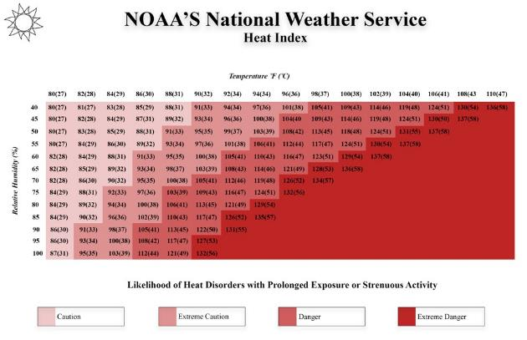
Environmental Heat Risk
Notes:
The Heat Index is a measure of how hot it really feels when relative humidity is factored in with the actual air temperature.
This chart is adapted from a NOAA chart developed in 2012.
NOAA – National Ocean and Atmospheric Administration.
This chart is provided in English and Spanish as part of the curriculum. You may hand it our to the students if desired.

Slide 6
Medical Monitoring
Recommendations for a medical monitoring program:
Work and medical history
Physical exam
Assessment: use of therapeutic drugs, over-the-counter medications, supplements, alcohol, or caffeine
Assessment: ability to wear personal protective clothing and equipment
Notes:
These are basic recommendations for a medical monitoring program. You should check with your healthcare provider.
Work and medical history to determine past work experience in hot environments and any previous heat-related illnesses.
Physical exam to determine any at-risk factors for heat-related illnesses. (Discussed later in “Recognition” section.)
Assessment of use of therapeutic drugs, over-the-counter medications, supplements, alcohol, or caffeine as some may increase the risk of heat-related illnesses and injury.
Can they wear PPE properly and in a hot environment.

Slide 7
Acclimatization Plan
Lack of acclimatization – major factor in worker heat-related illness and death
New and returning workers
Increasing worker heat tolerance over time
Workers acclimatize at different rates
Gradually increase amount of time working in heat over 7-14 days
Notes:
More details are discussed in the “Prevention” section.
An acclimatization plan increases worker heat tolerance over time.
Lack of acclimatization has been shown to be a major factor associated with worker heat-related illnesses and death.

Slide 8
Training
Train employees on recognition, prevention and treatment of heat-related illnesses
Post educational and hazard warning signs

Slide 9
Work Conditions
Engineering controls
  Reduce air temperature and humidity
  Shield heat sources
  Modify hot process
Work practices
  Limit time in heat – modify schedules
  Decrease physical requirements of tasks
  Schedule rest periods
  Provide personal protective clothing for heat
  Provide adequate amount of cool water
Notes:
Use air conditioning, fans, any ventilation to reduce air temperature.
Shield workers from hot sources, such as ovens and furnaces, when possible.
Increase the distance from workers and hot sources.
Modify the processes to reduce the amount of heat and humidity generated.
Modify schedules based on heat index.
Lower the physical requirements of the task by increasing the number of workers, mechanizing or using special tools.
Schedule rest periods in a cool or shaded location.
Provide clothing that reduces the heat load on the body or that cools the body.
Cool water is less than 15°C or 59°F.
Each specific work industry will have additional work conditions that can be modified to reduce the risk of heat-related illnesses.

Slide 10
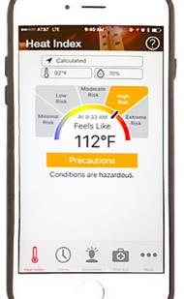
Resources
OSHA-NIOSH Heat Safety Tool App - www.cdc.gov/niosh/topics/heatstress/heatapp.html
OSHA Training Requirements and Resources - www.osha.gov/dte/library/
Center for Disease Control and Prevention - www.cdc.gov/features/prevent-heat-illness/index.html
Notes:
OSHA-NIOSH Heat Safety Tool App: A visual indicator of the current heat index and associated risk levels specific to your current geographical location; precautionary recommendations specific to heat index-associated risk levels; and signs, symptoms and treatment for heat-related illnesses.
OSHA and CDC websites are good sources of materials for training workers.

Slide 11
Heat-Related Illnesses: Recognition
A Risk Easy to Battle

Slide 12
Heat-Related Illnesses
Caused by environmental exposure to heat
Can occur indoors as well as outdoors
Heat rash
Heat syncope
Heat cramps
Heat exhaustion
Hyponatremia
Heat stroke
Notes:
Heat-related illnesses are caused by environmental exposure to heat.
Heat-related illnesses can occur indoors as well as outdoors.
Includes minor conditions such as heat cramps, heat rash and heat syncope (fainting), the serious condition of heat exhaustion, and the severe condition of heat stroke, which can be fatal.
Hyponatremia when caused by exercise, such as working outdoors, is considered a heat-related illnesses.
Heat rash – sweat produced by skin cannot evaporate – red bumps, tiny blisters, itching.
The usual progression is dehydration, heat exhaustion, heat stroke. But under extreme temperatures such as those seen in the southwest, workers can progress to heat exhaustion and heat stroke even when well hydrated. The body simply cannot cool itself.

Slide 13
Risk Factors
Workers who are not acclimatized to heat
Environmental: High temperatures, high humidity, direct sun exposure and lack of air movement
Indoor radiant heat sources
Clothing: multiple layers, dark colors, tight-fitting or restricts air movement
Not drinking enough fluids - dehydration
Notes:
Lack of acclimatization. Workers should gradually increase their heat exposure over 7-14 days.
Environment: High temperatures, high humidity. direct sun exposure, lack of air movement. High humidity inhibits the evaporation of sweat, the bodies natural cooling mechanism.
Indoor radiant heat sources such as furnaces and ovens.
Clothing: multiple layers, dark colors, tight-fitting or restricts air movement. Personal protective equipment that is air and vapor impermeable increases the risk of heat-related illnesses.
Not drinking enough fluids may lead to dehydration.

Slide 14
Risk Factors Continued
Some medications
Alcohol and caffeine
Age
Obesity and lack of physical fitness
Pregnant workers
Workers in poor health
Previous heat-related illness
Notes:
Some medications affect heat tolerance. Workers should talk with their health care provider.
Alcohol use prior to or during work in a hot environment is known to increase the risk of heat-related illnesses.
Caffeine is a mild diuretic, is a hot beverage and should not be given to workers to replace fluids from sweating.
Age - Older workers are more susceptible to heat-related illnesses.
Obesity and lack of physical fitness.
Pregnant workers – as pregnancy progresses heat tolerance is reduced.
Workers in poor health.
Previous heat-related illness.

Slide 15
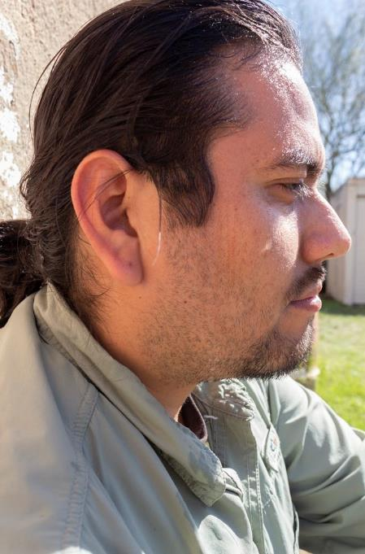
Dehydration
When you use or lose more fluid than you take in
Notes:
Your body doesn't have enough water and other fluids to carry out its normal functions.
Often caused by heavy sweating in high temperatures.
If dehydration exceeds 1.5% to 2% of body weight, then tolerance to heat stress begins to deteriorate, heart rate and body temperature increase, and work capacity decreases.

Slide 16
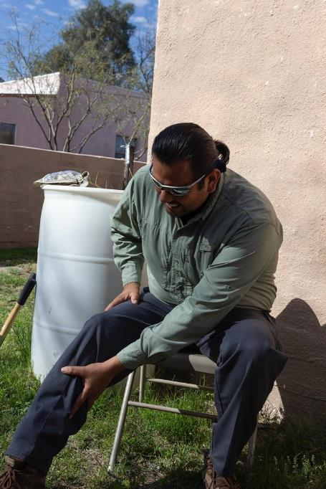
Heat Cramps
Muscle cramps or spasms caused by the loss of electrolytes from heavy sweating.
Notes:
Muscle cramps, pain or spasms that can be caused by the loss of electrolytes from heavy sweating.••
Often in the abdomen, legs or arms.
Can also be caused by drinking large quantities of water and diluting the electrolytes.
Can be a sign and symptom of heat exhaustion.

Slide 17
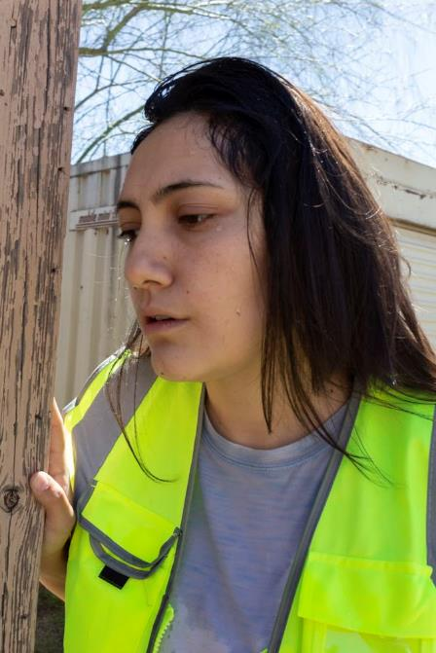
Heat Exhaustion
Your body is overheating
Pale, cool, clammy skin
Headache, nausea, dizziness
Heavy sweating
Irritability
Thirst
Elevated body temperature
Notes:
Heat exhaustion is a condition that is a result of your body overheating.
Signs and symptoms of heat exhaustion include: pale, cool, clammy skin; headache; nausea; dizziness heavy sweating; irritability; thirst; and an elevated body temperature.
Usually there is a decrease in urine output.
Heat cramps can also be a sign and symptom.
Skin is usually pale, cool and clammy.
Heat exhaustion can lead to heat stroke if not treated.

Slide 18
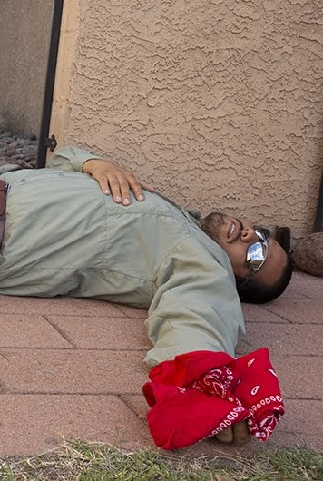
Heat Stroke
Your body can no longer regulate its core temperature
A true medical emergency.
Change in mental status
Loss of consciousness
Hot, dry, red skin
Seizures
Very high body temperature
Notes:
The most serious heat-related illnesses.
Heat stroke is a true medical emergency.
Signs and symptoms include confusion; loss of consciousness; hot, dry, and red skin; seizures and a very high body temperature.
We used to think that as long as someone was sweating they were not in heat stroke. This is wrong. Victims can be sweating.
Untreated heatstroke can quickly damage your brain, heart, kidneys and muscles.
Heat stroke can be FATAL if not quickly treated.

Slide 19
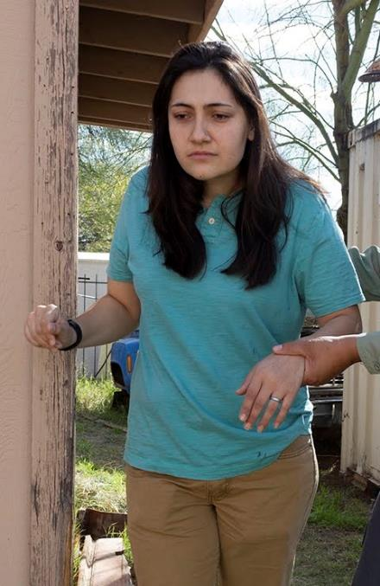
Hyponatremia
Low level of sodium in the blood
Nausea, vomiting
Headache, irritability, confusion
Loss of energy, fatigue and drowsiness
Muscle weakness or cramps
Frequent urination
Seizures, coma
Notes:
Low plasma sodium.
Can occur in people working for long periods of time in hot environments, usually great than 4 hours.
Caused by drinking large quantities of water without replacing the sodium lost from sweating.
Signs and symptoms: nausea, vomiting, headache, confusion, loss of energy, fatigue, drowsiness, irritability, muscle weakness or cramps, seizures, coma.
Can be fatal.
Frequent urination. Clear or very pale yellow urine.
Can be confused with heat exhaustion.

Slide 20
Heat-Related Illnesses: Prevention
A Risk Easy to Battle
Notes:
We’ve talked about how to recognize and treat heat-related illnesses.
Now we are going to talk about ways workers can help prevent these illness while working in hot environments.

Slide 21
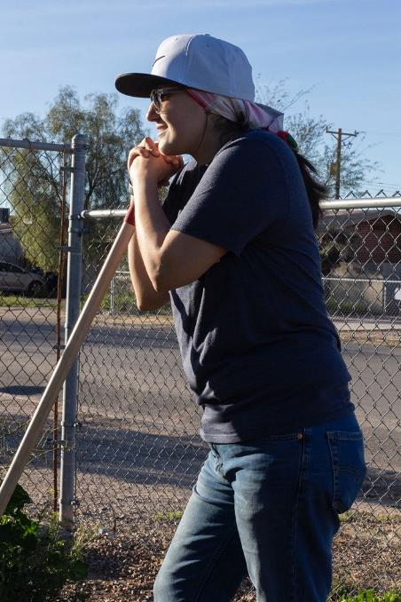
Prevention
Heat-related illnesses can be prevented
Key factors include:
  Training
  Acclimatizing
  Resting in shade
  Drinking fluids
  Monitoring
Notes:
A heat-related illness prevention program includes training, acclimatizing, resting in shade, drinking fluids and monitoring. We’ll be discussing each of these in more detail.

Slide 22
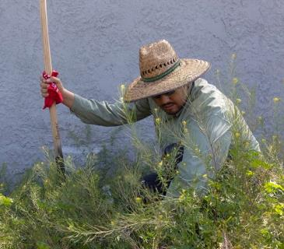
Acclimatize
Acclimatize – increasing your heat tolerance over time
Gradually increase work time in hot conditions over 10 – 14 days
After a vacation heat tolerance can be regained in 2 – 3 days.
Notes:
Heat acclimatization means becoming more heat tolerant over time.
Gradually increase the time workers work in hot conditions over a period of 7 to 14 days.
Workers can regain acclimatization after a week-long vacation in a cooler climate in 2 to 3 days upon returning to a hot job.
Heat acclimati­zation increases sweating and therefore workers will have an increased need for fluids.

Slide 23
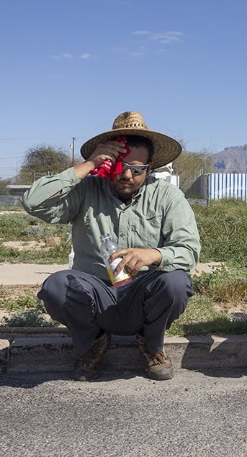
Adjust Schedule
Try to work during the cooler part of day
New workers may not be acclimatized – adjust schedule to allow time for acclimatization
Notes:
Try to work during the cooler part of the day if possible.
New workers who are not acclimatize to the heat should not work the same outdoor schedule for the first few days as acclimatized workers. Adjust their schedule until they are acclimatized.

Slide 24
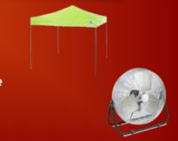
Take Frequent Breaks
Out of direct sun
Cool, shady location
Provide a shade structure if no shade available
Fan to circulate air
Notes:
Take frequent breaks.
Get out of the direct sun.
Rest in a cool location
Indoors in air conditioning
Shady location
No shade – provide a portable shade structure or industrial umbrella. These can be used while working as well to get workers out of the direct sun.
Use a fan to circulate air.

Slide 25
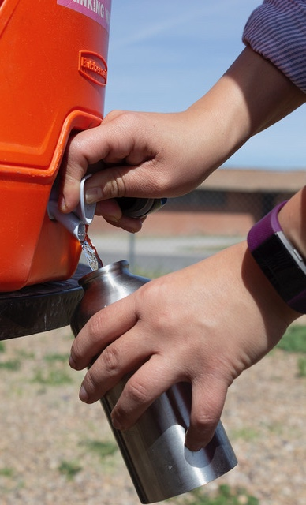
Drink Plenty of Fluids
A cup of cool water every 15 to 20 minutes
Water less than 59 °F
Individual drinking cups
During prolonged sweating - drinks such as sports drink to replace electrolytes
Notes:
Workers should drink a cup of cool water every 15 to 20 minutes when working in a hot environment.
Cool water is potable water less than 59 °F provided in individual not communal drinking cups.
During prolonged sweating lasting several hours workers should drink a drink that contains electrolytes such as a sports drink.

Slide 26
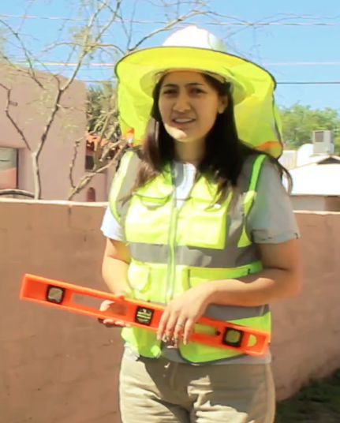
Wear Appropriate Clothing
Hat with a wide brim
Light-colored, loose-fitting clothing
Sun glasses
Sunscreen
Notes:
The clothing workers wear can help keep them cooler.
Workers should wear a hat with a wide brim. These are preferred over ball caps that only shade the face.
Light-colored, loose-fitting clothing is best.
Workers should wear sun glasses to protect their eyes.
Workers should use sunscreen to protect their skin.
Cooling garments can be worn to help keep workers cool.

Slide 27
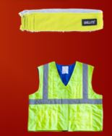
Wear Cooling Garments
Cooling bands - water evaporates and cool
Cooling shirts - wick sweat and cool
Special cooling personal protective equipment
Notes:
Cooling garments can be worn to help keep workers cool.
Cooling bands that are wetted and worn around the neck. The water evaporates and cools the worker.
Cooling shirts that wick sweat away from the skin and help with evaporation and cooling
Special cooling personal protective equipment.

Slide 28
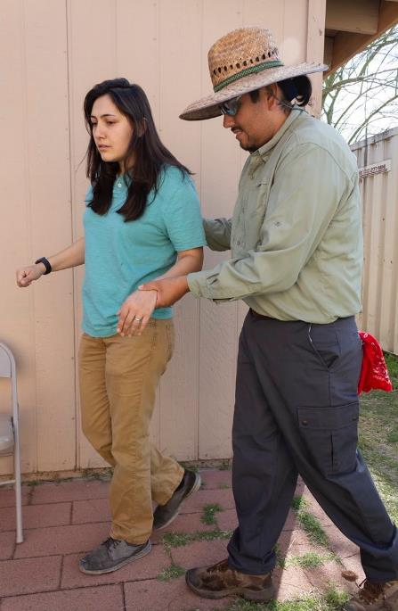
Monitor
Use a buddy system
Don’t work alone
Monitor each other for signs and symptoms of heat-related illnesses
Notes:
A buddy system can help prevent heat-related illnesses.
Workers should not working alone in hot environments.
Workers should be trained in recognizing, preventing and treating heat-related illnesses.
Workers should monitor each other for early signs and symptoms of heat-related illnesses.

Slide 29
Heat-Related Illnesses: Treatment
A Risk Easy to Battle
Notes:
Now we are going to talk about treatment for heat stroke, heat exhaustion, hyponatremia and heat cramps.

Slide 30
Review
Dehydration
Heat-Related Illnesses
Heat rash
Heat syncope
Heat cramps
Heat exhaustion
Hyponatremia
Heat stroke
Notes:
Dehydration - when you use or lose more fluid than you take in
Heat rash – sweat produced by skin cannot evaporate – red bumps, tiny blisters, itching
Heat syncope - fainting
Heat cramps - muscle cramps or spasms caused by the loss of electrolytes from heavy sweating
Heat exhaustion – your body is overheating
Heat stroke – your body can no longer regulate its core temperature
Hyponatremia – low level of sodium in the blood

Slide 31
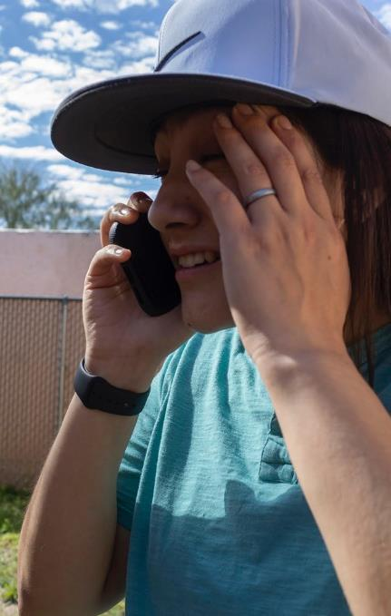
Heat Stroke: Call
CALL 911 - Heat stroke is a medical emergency
Notes:
The first step is to recognize the emergency.
Heat stroke is a medical emergency and can be fatal. CALL 911.
Someone should stay with the worker until help arrives.
While waiting for help, there are additional first aid steps that you can take.

Slide 32
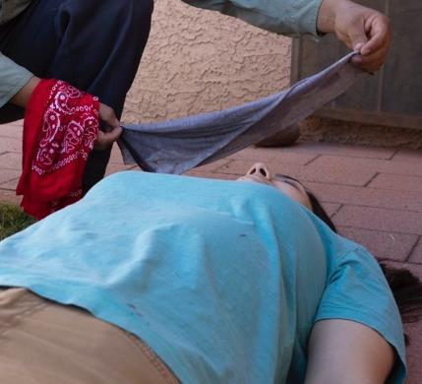
Heat Stroke: Cool
Move to shady cool area
Cool the worker any way you can
Notes:
Move the worker to a shady cool area or air conditioned building.
Remove outer clothing.
Cool the worker any way you can.
Cold compresses especially on head, neck, groin, and armpits
Cold water or ice bath
Spray with cold water
Fan the worker
Soak clothing with cold water
Sponge with cold water

Slide 33
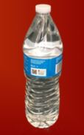
Heat Stroke: Drink
If the worker is responsive, give cool water to drink
Notes:
If the worker is responsive, give cool water to drink.
Do not give coffee, tea or other caffeinated beverages.
Do not give alcohol or sugary beverages.
Do not give very cold drinks as they may cause stomach cramps.
Be prepared to give CPR if worker stops breathing and is unresponsive.

Slide 34
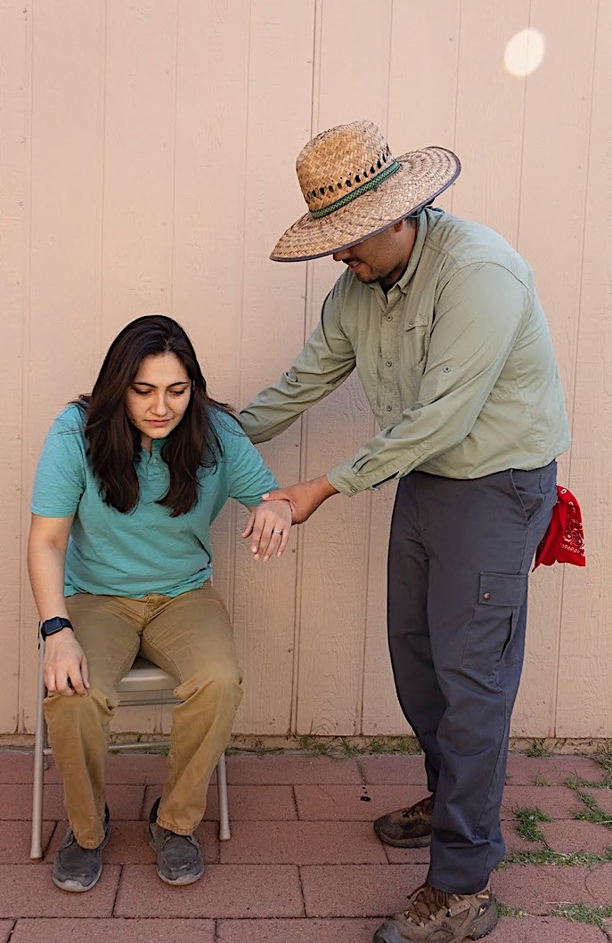
Heat Exhaustion: Call
Call 911 if no medical assistance on site
Move worker to a cool shady area
Notes:
Call 911 if medical assistance is not available on site.
Move the worker to a shady cool area or air conditioned building.
Stay with the worker until help arrives.
While waiting for help, there are additional first aid steps that you can take.

Slide 35
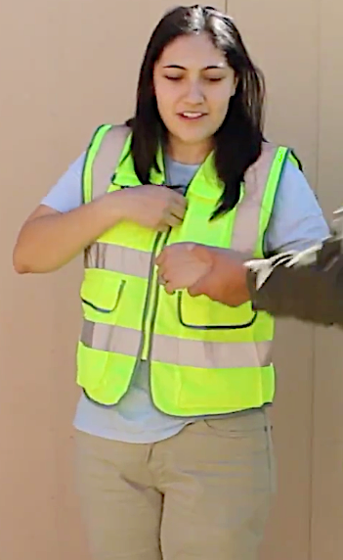
Heat Exhaustion: Cool
Loosen tight clothing and remove extra layers
Cool the worker
Notes:
Loosen tight clothing and remove unnecessary layers.
Cool the worker.
Cold compresses especially on head, neck, groin, and armpits
Spray with cold water
Fan the worker
Soak clothing with cold water
Sponge with cold water
Have them rest.

Slide 36
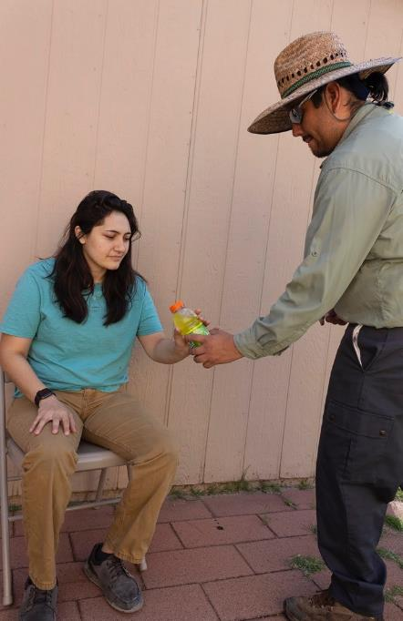
Heat Exhaustion: Drink
Give cool drinks
Water or sports drinks
No coffee or alcohol
Notes:
Give cool water or sports drinks to drink.
Encourage frequent small sips.
Do not give coffee, tea or other caffeinated beverages.
Do not give alcohol or sugary beverages.
Do not give very cold drinks as they may cause stomach cramps.
Monitor the person.

Slide 37
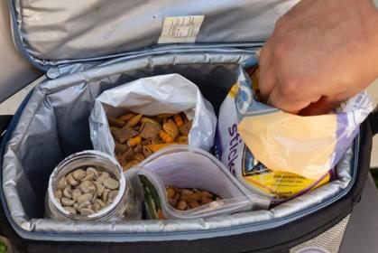
Hyponatremia: Eat
Move the worker to a cool, shady area
If the worker is responsive have them eat salty snacks
No salt tablets
Notes:
Move the worker to a cool, shady area.
Have the worker rest.
Have the worker eat salty snacks.
Avoid salt tablets.

Slide 38

Hyponatremia: Call
If the worker is
  Confused, disoriented or unresponsive,
  Has a heart condition, or
  Not improving within an hour.
Notes:
For hyponatremia, get medical help if the worker:
Has a heart condition or on a low sodium diet,
Is confused, disoriented or unresponsive, or
Is not improving within an hour.

Slide 39
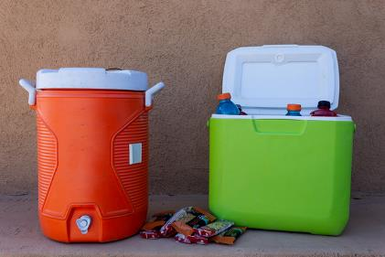
Heat Cramps: Treatment
Move the worker to a cool, shady area to rest
Have worker eat salty snacks and drink sports drinks
Call for medical assistance if not improving within an hour
Notes:
Move the worker to a cool, shady location.
Have the worker rest.
Have the worker eat salty snacks.
Have the worker drink electrolyte replacement drinks (sports drinks).
Avoid salt tablets.
Call for medical assistance if worker does not improve within an hour.

Slide 40
Case Study
You and your coworker have been working outside on a construction site for several hours. It’s one of the first really hot days of the year. You notice that your coworker is really sweating a lot and looks a little pale. When you ask him how he is feeling, he tells you that he feels a little dizzy and nauseous.
Notes:
You can find more case studies. In the Case Study Worksheet or the Case Study PowerPoint Presentation
Discussion:
Your coworker is showing signs and symptoms of heat exhaustion.
It’s the first hot day, so he may not be acclimatized to the heat yet, and you’ve been working outside for several hours.
If medical care isn’t available at your work site, call 911.
Remove your coworker from the hot area by going into the shade or indoors to a cool environment.
Remove any unnecessary clothing including shoes and socks. Place cold compresses on his head, face and neck. Have him sip cool water or a cool sports drink. Stay with him until medical care arrives.

