Slide 1
Electrical Hazards in Construction
A Language and Literacy Appropriate Safety Training
This material was produced under a grant (SH-05044-SH8) from the Occupational Safety and Health Administration, U.S. Department of Labor. It does not necessarily reflect the views or policies of the U.S. Department of Labor, nor does mention of trade names, commercial products, or organizations imply endorsement by the U.S. Government.

Slide 2
Disclaimer
No legal advice is offered or implied, and no attorney-client relationship is intended or established. If legal advice or other expert assistance is required, the services of a competent professional should be sought.
It is the responsibility of the employer and its employees to comply with all pertinent OSHA rules and regulations in the jurisdiction in which they work.
Notes:
Note for Trainer:
This page is copied from the fy10_sh-20999-10-electrical-safety PowerPoint
2

Slide 3
Objectives
Understand basic concepts of electricity
Recognize major types of electrical hazards in construction workplaces
Identify and prevent electrical accidents at construction sites
Notes:
3

Slide 4
Step-by-Step Training Agenda
Sign Up
Basic Terms
Pre-Test
Case Study
Training Modules
Electrical Hazards
Case Study
Electrical Incidents
Hazards Prevention
Post-Test
Feedback Survey
Notes:
4

Slide 5
Sign-In
It is time to fill out the sign-in sheet
Notes:
5

Slide 6
Pre-Test
Please Begin Pre-Test (15 Minutes)
Notes:
6

Slide 7
Pre-Test
Please Submit Pre-Test
Notes:
7

Slide 8
Training Modules Overview
Section I: Basic Terms and Case Study
Worker Rights under OSH Act
Electrical Hazards Statistics
Basic Terms of Electricity
A Case Study Discussion
Section II: Electrical Hazards (BESAFE)
Electrical Burn
Electrocution
Electrical Shock
Electrical Arc Flash
Electrical Fire
Electrical Explosion
Notes:
8

Slide 9
Training Modules Overview
Section III: Electrical Incidents in Construction
Contact with Power Lines
Lack of Ground-Fault Protection
Path to Ground Missing or Discontinuous
Equipment Not Used in Manner Prescribed
Improper Use of Extension or Flexible Cords
Contact with Energized Sources
Notes:
9

Slide 10
Training Modules Overview
Section IV: Electrical Hazards Prevention
Maintain Safe Distance from Overhead Power Lines
Use Ground-Fault Circuit Interrupters (GFCI)
Inspect Portable Tools and Extension Cords
Use Power Tools and Equipment as Designed
Follow Lockout/Tagout Procedures
Personal Protective Equipment
Isolate Electrical Parts
Notes:
10

Slide 11
Training Modules Overview
Section 1: Basic Terms and Case Study
Worker Rights under OSHA Act
Electrical Hazard Statistics
Basic Terms of Electricity
A Case Study Discussion
Section 2: Electrical Hazards (BESAFE)
Section 3: Electrical Incidents in Construction
Section 4: Electrical Hazards Prevention
Notes:
11

Slide 12
Worker Rights Under the OSH Act
Workers have rights to
Working condition without a risk of serious harm
Review employer’s records of work injuries and illnesses
Get a copy of their medical records
Receive information and training about hazards and prevention methods, and the OSHA standards
Notes:
https://www.osha.gov/SLTC/electrical/

Slide 13
Worker Rights Under the OSH Act
Workers have rights to
File a complaint asking OSHA to inspect workplace
OSHA will keep all identities confidential
Exercise rights under the law without retaliation
If a worker is retaliated against for using their rights, the worker must file a complaint with OSHA as soon as possible (no later than 30 days)
Notes:
https://www.osha.gov/SLTC/electrical/

Slide 14
Worker Rights Under the OSH Act
OSHA electrical safety standard for construction industry, in Title 29, Code of Federal Regulations (29 CFR 1926), mandates that “The employer shall instruct each employee in the recognition and avoidance of unsafe conditions and the regulations applicable to his work environment to control or eliminate any hazards or other exposure to illness or injury”.
Notes:
https://www.osha.gov/SLTC/electrical/construction.html

Slide 15
Electrical Hazard Statistics
According to U.S. Department of Labor, electrocution is top 3 causes of death in 2017
Falls – 381 deaths, Stuck by Object – 80 deaths
Electrocutions – 71 deaths (a death per 5 days)
Caught-in/between – 50 deaths
Workers are unaware of potential hazards
Safety training instruct workers safety knowledge
Safety knowledge reduces or eliminate risks of injury
Safety Knowledge is Life !
Notes:
Note for Trainer:
Whenever you work with power tools, electrical circuits or working around power lines, there is a risk of electrical hazards, especially electrical shock. Construction workers face an increased risk because many jobs requires using electric power tools.
Electricity has long been recognized as a serious workplace hazard, exposing employees to electric shock, electrocution, burns, fires, and explosions. In 2017, for example, 71 workers died from electrocutions at work, accounting for almost 8 percent of all on-the-job fatalities that year in construction, according to the Bureau of Labor Statistics. What makes these statistics more tragic is that most of these fatalities could have been easily avoided.
Data source: U.S. Department of Labor Statistics https://www.bls.gov/iif/oshwc/ cfoi/cftb0321.htm
Approximately 350 electrical-related fatalities occur each year. Data source: https://www.osha.gov/SLTC/etools/construction/electrical_incidents/mainpage.html

Slide 16
Basic Terms
Electron: a particle with negative charge
Current: electrons movement
(1 ampere = 6×10¹⁹ electrons moving per second)
Notes:
Note for Trainer:
Electricity is energy can be made either by man or by nature. It is like a flow of water, but must have a complete path or circuit to flow.

Slide 17

Basic Terms
Voltage: a force to push electron movement
Resistance: an obstacle to restrict electron movement
High voltage or low resistance make high current
Notes:
Note for Trainer:
Back to the water flow example, the resistance is bigger when the pipe is thinner, so the water flow is decreased.

Slide 18
Basic Terms
Conductor: little resistance to electron movement
Insulator: high resistance to electron movement
Little obstacle
Strong obstacle
Notes:
Note for Trainer:
Electricity flows through some materials better than others. Based on the capacity of allowing electivity to flow through, materials that have very little resistance to the flow of electrical current are called “conductors”. Typical conductors are metals such as copper, water, the earth, and the human body.

Slide 19


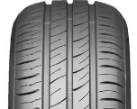



Basic Terms
Please group these materials into correct category
Metal
Conductor
dry wood
Wet wood
Rubber
Insulator
Glass
Ceramic

Slide 20
Basic Terms
Please group these materials into correct category
Metal
Wet wood
Conductor
Glass
dry wood
Insulator
Ceramic
Rubber

Slide 21
Basic Terms
Cable structures with conductors or insulators
Notes:
Note for Trainer:
This is why If you have a defective tool, frayed wire, bad outlet or other electrical hazard, you may come in contact with electrical current through copper conductor.
When you contact electrical current, the results may be deadly. You may receive an electrical shock, be burned by the electricity or by thermal contact, or be electrocuted and die.

Slide 22
Basic Terms
Electrical Circuit: a complete path of current
Open current path can stop current conduction

Slide 23
Basic Terms
Current always flows through least-resistant path
After closing the switch, all current flows through the switch due to its lower resistance
Notes:
Note for Trainer:
Explain why a metal ladder contact power lines generates high current. Use ladders made from wood or fiberglass when working near power lines
Operating an electric switch is like turning on a water faucet.
Behind the faucet (or switch) there is a source of water (or electricity) with a way to transport it, and pressure to make it flow. The faucet’s water source is a reservoir or pumping station. A pump provides enough pressure for the water to travel through the pipes. For electricity the source is the power generating station. A generator provides the pressure (voltage) for the electrical current to travel through electric conductors (wires).

Slide 24
Electrical Hazard Symbols
These symbols tell you if the situation in the picture is safe or not safe during this training.
Safe
Not safe
√
×
Notes:
Note for Trainer:
This program will help you first getting familiar with basic concepts of electricity, and then being able to recognize common electrical hazards in construction and finally learning your ways to decrease those hazards at your job site. Throughout this whole program, you will be shown some examples of safe and unsafe practice and conditions. The green “Yes” checkmark will be used to denote safe conditions, while the red “No” circle symbol is used to denote unsafe conditions.

Slide 25
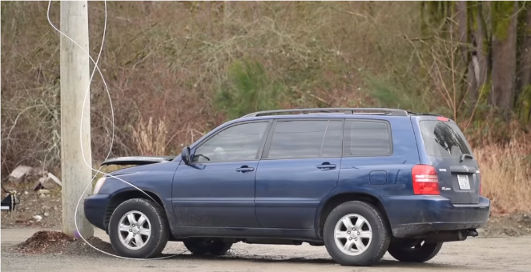
A Case Study Discussion
Fallen Power Lines
A driver inside this car
Picture Source: https://www.youtube.com/watch?time_continue=317&v=fLVzvMTgGDY
A car hits an electricity pole, so downed power lines touch the car. A driver is inside of this car.
Video -This Might Shock You: Downed Power Line

Slide 26
A Case Study Discussion 1
Q1: Can people touch down power lines by hand?
Answer: No
Always assume that down power lines are live and energized
Notes:
Note for Trainer:
Voltages of overhead lines range from 120 to 750,000 volts. The most reliable way to know the voltage is to ask the utility company that owns the powerline.
This figure is copied from OSHA website (https://www.osha.gov/SLTC/etools/electric_power/illustrated_glossary/transmission_lines.html)

Slide 27
A Case Study Discussion 2
Q2: If people touch down power lines by skin, how much current will flow through a human body?
Video - Electrical Shock
Answer: assume the power line voltage is 7Kv
Human Body | Resistance | Current (assume 7Kv)
Wet skin | 1K ohms | 7 (unit: A)
Dry skin | 100~600K ohms | 11~70 (unit: mA)
Notes:
Note for Trainer:
Reaction information is from OHSA website (https://www.osha.gov/Publications/3075.html)
Emphasize Ohm's Law by using the chart in this slide, since wet skin shows way less resistance, when the voltage is certain, the possible current flow through a human body will increase dramatically.

Slide 28
A Case Study Discussion
Consequences if current flow through human body
Current in Human Body | Reaction
5 mA | Slight shock, not painful but disturbing; average individual can let go.
6-25 mA (Women) | Painful shock, loss of muscular control
9-30 mA (men) | Body freeze
50-150 mA | Extreme pain, respiratory arrest, severe muscular contractions. Death is possible.
1-4.3 A | Heart stop, muscular contraction, nerve damage, death likely
10 A | Cardiac arrest, severe burns, death probable
Wet or Dry hand
Notes:
Reaction information is from OHSA website (https://www.osha.gov/Publications/3075.html)

Slide 29
Q3: Can people touch down power lines by a stick, pole, or broom?
A Case Study Discussion 3
Answer: No
Not safe to use traditional non-conducting materials to touch power lines.
×
Notes:
Note for Trainer:
Wood doesn't conduct electricity. This one isn't actually a myth — wood is, in fact, nonconductive. However, water does conduct electricity, and wood that is wet or damp can still pose a risk.
Summary: In construction worksites, we cannot assume a down power line is safety because it is on the ground or it is not sparking. We should also avoid touching down power lines with hands or common objects (such as boards, poles, sticks).

Slide 30
Q4: Can the car driver touch car frame or metal parts?
A Case Study Discussion 4
Answer: No
Metal frame of the car would be charged with electricity
×
Notes:
Note for Trainer:
Even though rubber is a good insulator, car tires are conductors, because there are made of multiple conductive materials. If there is no fire, the driver is not in immediate danger. The safest thing for the driver is to stay in the car.
https://www.wikihow.com/React-if-a-Power-Line-Falls-on-Your-Car
30

Slide 31
Q5: What is safe distance from fallen power lines?
A Case Study Discussion 5
Answer: At least 35 feet (for voltage up to 750Kv)
Notes:
Note for Trainer:
https://www.esfi.org/resource/downed-power-lines-261
Reference: CFR1926.1408 Table A
Safe distance means:
1. People can touch any metals
2. people can walk with a normal step size
3. People can call user mobile phones

Slide 32
A Case Study Discussion 6
Q6: If car starts fire, can the driver leaves?
Answer: Yes, but very carefully
Electricity spreads outward through the ground
Step potential creates large voltage differences to shock
Notes:
Note for Trainer:
Some sentences are copied from OSHA website (https://www.osha.gov/OshDoc/data_General_Facts/downed_electrical_wires.pdf)
The ground near this car may be energized by the down power lines.
Electricity spreads outward through the ground in a circular shape from the point of contact.

Slide 33

A Case Study Discussion
×
Step voltage could be up to 744 V, assume the potential of the point of touch is 5.7 KV
Notes:
Note for Trainer:
Refer to the calculation link: https://wiki.openelectrical.org/index.php?title=Earthing_Calculation

Slide 34
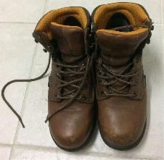


A Case Study Discussion 7
Q7: How to leave car without electrical shocks?
Answer: Small step for little step potential
√
×
√
Shuffle away
No large step
Shock resistance shoes
More Details
Put hands at your sides, jump completely.
No touch car and ground at the same time.
Put feet together, take tiny steps without lifting feet.
Notes:
Note for Trainer:
https://www.osha.gov/OshDoc/data_General_Facts/downed_electrical_wires.pdf
Summary: In construction worksites, you exit equipment because of fire or other safety reasons, try to jump completely clear, making sure that you do not touch the equipment and the ground at the same time. Land with both feet together and shuffle away in small steps to minimize the path of electric current and avoid electrical shock. Be careful to maintain your balance.

Slide 35
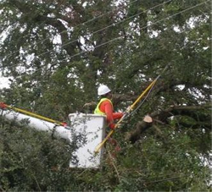
A Case Study Discussion 8
Q8: What distance is safely away from power lines?
Answer:
Depends on the power line voltage (see next slide)
10 feet rule for voltage up to 50Kv
Always use maximum possible distance to avoid accidental touch
?? feet
Notes:
Note for Trainer:
Discuss that the 10 foot minimum clearance( with voltage up to 50Kv) applies to all types of equipment and any part of the equipment.
Photo is copied from (https://www.osha.gov/SLTC/etools/electric_power/overheadlinework_lineclearance.html)

Slide 36
A Case Study Discussion
Voltage (nominal, Kv, alternating current) | Minimum clearance distance (feet)
<=50 | 10
50-200 | 15
200-350 | 20
350-500 | 25
500-750 | 35
750-1000 | 45
>1000 | Determined by utility owner/operator or a registered professional engineer
Notes:
Note for Trainer:
CFR1926.1408 Table A

Slide 37
A Case Study Discussion
Date | Place | What happen? | Injury
December 2018 | Michigan | A boom truck contacted overhead power lines | Electrocuted (died)
May 2018 | North Carolina | A boom truck contacted overhead power lines | Electric Shocked (died)

Slide 38
A Case Study Discussion
Date | Place | What happen? | Injury
July 2018 | Ohio | A crane touched a power line | Electrocuted (died)
June, 2018 | Kentucky | A dump truck struck power lines, the driver got out of the truck and was electrocuted. He tried to help the truck driver. | Electrocuted (died) Shocked
Notes:
Note for Trainer:
The last accident is quite similar to the case study that we discuss.
https://www.ishn.com/articles/109913-utility-worker-dies-after-making-contact-with-overhead-electrical-line
https://www.wdtn.com/news/local-news/construction-worker-dies-after-being-electrocuted/1298978711
https://www.e-hazard.com/blog/worker-electrocution-due-to-contact-with-high-voltage-power-lines/

Slide 39
Other Reported Accidents
Source: https://www.osha.gov/pls/imis/accidentsearch.search
Event Description
Employee touches aluminum ladder to overhead power line
Employee is electrocuted and killed after touching live power lines
Employee is found unresponsive and may have been electrocuted
Employee comes into contact with power line while trimming
Employee is shocked when comes into contact with live power lines
Employee touches live energized parts within a power generator
Notes:
https://www.osha.gov/oshstats/commonstats.html

Slide 40
Training Modules Agenda
Section 1: Basic Terms and Case Study
Section 2: Electrical Hazards (BESAFE)
Electrical Burn
Electrocution
Electrical Shock
Electrical Arc Flash
Electrical Fire
Electrical Explosion
Section 3: Electrical Incidents in Construction
Section 4: Electrical Hazards Prevention
Notes:
https://www.osha.gov/oshstats/commonstats.html

Slide 41
Warning: The pictures in next few slides deal with injuries and death related to electrical accidents and might be disturbing to some people.
Notes:
Note for Trainer:
Please remind the trainee that the injury pictures in next few slides may cause discomfort.

Slide 42
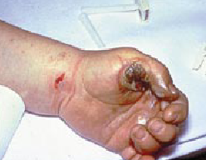
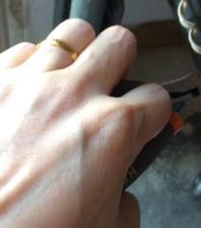
Electrical Burn
Most common shock-related injury
Electrical energy is transformed into heat
Immediate medical attention is needed
Source: OSHA’s Electrical Incidents eTool
×
Don’t wear jewelry (ring, necklace, bracelet)

Slide 43
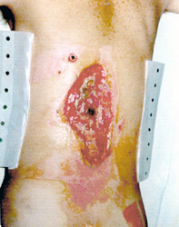

Electrical Burn
Burns around current exit point
Burns around current entrance point
Entrance Wound
Exit Wound
Source: OSHA’s Electrical Incidents eTool
An accident report
Two workers troubleshoot power outage. Worker #1 was holding a flashlight while worker #2 tested a 7,200 volt transformer. Worker #1 came close to or contacted live electrical parts, and was burned to arm, hand, and chest.
Notes:
Note for Trainer:
Entrance Wound: High resistance of skin transforms electrical energy into heat, which produces burns around the entrance point (dark spot in center of wound). This man was lucky, the current narrowly missed his spinal cord.
Exit Wound: Current flows through the body from the entrance point, until finally exiting where the body is closest to the ground. This foot suffered massive internal injuries, which weren't readily visible, and had to be amputated a few days later.
Source: OSHA’S Electrical Incidents eTool

Slide 44
Electrocution
A serious injury caused by electrical shock
71 workers died from electrocution in 2017
7.3% of total deaths in construction in 2017
Video - What Really Happens To Your Body When You're Electrocuted?
Source: OSHA’s Focus-four
Notes:
Note for Trainer:
Currents above 10 mA can paralyze or “freeze” muscles. When this “freezing” happens, a person is no longer able to release a tool, wire, or other object. In fact, the electrified object may be held even more tightly, resulting in longer exposure to the shocking current. For this reason, hand-held tools that give a shock can be very dangerous. If you can’t let go of the tool, current continues through your body for a longer time, which can lead to respiratory paralysis (the muscles that control breathing cannot move). You stop breathing for a period of time. People have stopped breathing when shocked with currents from voltages as low as 49 volts. Usually, it takes about 30 mA of current to cause respiratory paralysis.
Photo copied from (https://www.osha.gov/dte/outreach/construction/focus_four/)
Data refer to (https://www.osha.gov/oshstats/commonstats.html)

Slide 45

Electrical Shock
Low voltage does not imply low hazard
Electrical shock injury depends on
current path
current amount
body contact time
Source: OSHA’s Electrical Incidents eTool
What is the most dangerous path for electricity shock through body? Head, Heart, or feet?
Answer: Heart. A current of 50mA flowing through heart triggers cardiac arrest
Notes:
Note for Trainer:
The real danger of electric shock is not voltage, but the amount of current. As the amount of current rises so does the damage to the body.
If people touch a 5V battery using wet skin (1000 ohm), current flowing through the body is 5mA (feel painful). 50V is possible death.
For example, 1/10 of an ampere (amp) of electricity going through the body for just 2 seconds is enough to cause death.

Slide 46
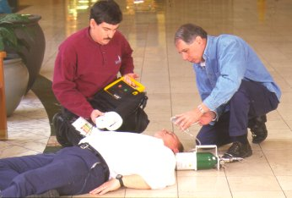
Electrocution
If current > 75mA, death occurs in few minutes if no defibrillator in use
75 mA is not much current – a small power drill uses 30 times as much current as killing current
×
Worst case: current flows through heart
Defibrillator in use
Notes:
Note for Trainer:
Currents above 10 mA can paralyze or “freeze” muscles. When this “freezing” happens, a person is no longer able to release a tool, wire, or other object. In fact, the electrified object may be held even more tightly, resulting in longer exposure to the shocking current. For this reason, hand-held tools that give a shock can be very dangerous. If you can’t let go of the tool, current continues through your body for a longer time, which can lead to respiratory paralysis (the muscles that control breathing cannot move). You stop breathing for a period of time. People have stopped breathing when shocked with currents from voltages as low as 49 volts. Usually, it takes about 30 mA of current to cause respiratory paralysis.

Slide 47
Electrical Shock
Electricity travels in closed circuits.
Shock results when the body becomes part of the electrical circuit.
×
×
×
Notes:
Note for Trainer:
Electricity travels in closed circuits, normally through a conductor. Shock results when the body becomes part of the electrical circuit; current enters the body at one point and leaves at another.
Metallic parts of electric tools and machines can become energized if there is a break in the insulation of their wiring. A low-resistance wire between the metallic case of the tool/machine and the ground - an equipment grounding conductor - provides a path for the unwanted current to pass directly to the ground. This greatly reduces the amount of current passing through the body of the person in contact with the tool or machine. Properly installed, the grounding conductor provides protection from electric shock.

Slide 48
Electrical Shock
Electric current leaves intended path and travels through ionized air to one conductor, or to ground
Could happen by carelessly touching electrical equipment or switches
×
Notes:
Note for Trainer:
The real danger of electric shock is not voltage, but the amount of current. As the amount of current rises so does the damage to the body.
If people touch a 5V battery using wet skin (1000 ohm), current flowing through the body is 5mA (feel painful). 50V is possible death.

Slide 49
Electrical Arc Flash
What causes an electrical arc flash?
Accidental contact
Equipment failure due to poor maintenance
Faulty installation
Material failure or corrosion
Release of heat, bright light, gases, vapors
Notes:
Note for Trainer:
https://www.bradyid.com/applications/arc-flash-labeling-requirements

Slide 50
Electrical Arc Flash
An accident report
Employees changed out a breaker in a 480-volt, 2000-amp, 3-phase system that was not de-energized. Employees did not wear PPE to protect from arc flash. One employee shorted out the system when his wrench, while connecting a conductor to one leg of the three phases, causing a short circuit and subsequent arc flash. The employee died.
×
Notes:
Note for Trainer:
https://www.osha.gov/pls/imis/accidentsearch.accident_detail?id=101176.015

Slide 51
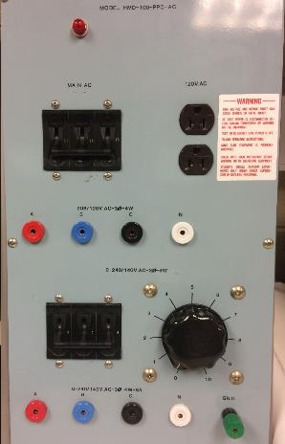
Electrical Arc Flash
OSHA requires warning labels in energized equipment
OSHA Regulation: 1926.403, 1926.416
Switchboards
Panel boards
Industry control panels
Disconnect switches
Notes:
Note for Trainer:
https://www.bradyid.com/applications/arc-flash-labeling-requirements
An arc flash is the sudden release of electrical energy through the air when a high-voltage gap exists and there is a breakdown between conductors. An arc flash gives off thermal radiation (heat) and bright, intense light that can cause burns. Temperatures have been recorded as high as 35,000 °F. High-voltage arcs can also produce considerable pressure waves by rapidly heating the air and creating a blast.
Most electrical distribution fires result from problems with "fixed wiring" such as faulty electrical outlets and old wiring. Problems with cords (such as extension and appliance cords), plugs, receptacles, and switches also cause electrical fires.
An explosion can occur when electricity ignites an explosive mixture of material in the air.

Slide 52
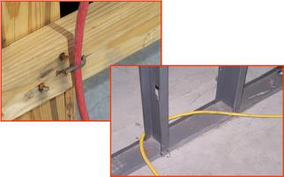
Electrical Fire
Possible reason: insulation jacket of cords is broken
×
×
Cords run through sharp objects, doors or windows
Damage insulation jacket of cords
Sparks or over-heat for fire

Slide 53
Electrical Fire
Do not put water on electrical fire
electricity spreads to workers (electrical shock)
Video - Electrical Fire
Which fire extinguishers are for electrical fire?
×
×
√
√
Notes:
Note for Trainer:
Water may enable to fire to spread by conducting electricity throughout the room and potentially igniting flammable materials.

Slide 54
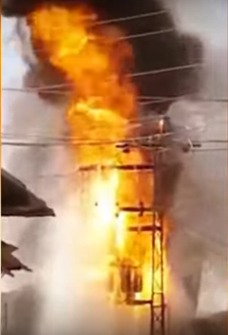
Electrical Explosion
Sudden release of energy when electricity ignites an explosive mixture of material
Heat radiation, pressure wave
Molten or fragmented metal flies in all directions
Video - Electrical Explosion
Picture Source: https://www.youtube.com/watch?v=cH9Zfq6zjgY

Slide 55
Training Modules Agenda
Section 1: Basic Terms and Case Study
Section 2: Electrical Hazards (BESAFE)
Section 3: Electrical Incidents in Construction
Contact with Power Lines
Lack of Ground-Fault Protection
Path to Ground Missing or Discontinuous
Equipment Not Used in Manner Prescribed
Improper Use of Extension or Flexible Cords
Contact with Energized Sources
Section 4: Electrical Hazards Prevention

Slide 56
Incident 1: Contact with Power Lines
Q9: What are potential electrical hazards below?
×
Answer:
Never spraying water near power lines.
A circuit may be formed and shock persons

Slide 57
Incident 1: Contact with Power Lines
Q10:What are potential electrical hazards below?
×
Answer: possible contact with power line, fall hazard
Notes:
Note for Trainer:
https://www.osha.gov/pls/imis/accidentsearch.accident_detail?id=99082.015

Slide 58
Incident 1: Contact with Power Lines
Q11: Are power lines well insulated to prevent electric shock?
×
Answer: No. Power lines are not insulated.
A bird safely stop on power lines, because it always perches on a single wire, and its two feet are at the same electrical potential so no current being formed.
Notes:
Note for Trainer:
Although overhead power lines may appear to be insulated, often these coverings are intended only to protect metal wires from weather conditions and may not protect you from electric shock.
https://www.machinedesign.com/blog/6-dangerous-myths-about-electrical-safety
Misunderstanding: all power lines appear to be well insulated.
More explanation about “How do birds sit on high-voltage power lines without getting electrocuted?”
Please refer to https://engineering.mit.edu/engage/ask-an-engineer/how-do-birds-sit-on-high-voltage-power-lines-without-getting-electrocuted/

Slide 59
Energized vs. Deenergized Work
Energized Work Methods
Insulating gloves
insulating live line tools
Live line/bare hand techniques
Insulating Protective Equipment (IPE)
Notes:
Note for Trainer:
All line work procedures emphasize preventing potentially hazardous voltage differences across a worker's body. Such prevention usually involves avoiding contact between the worker and energized parts through the use of engineering controls, administrative controls (including deenergizing), and electrical protective equipment (for example, PPE, IPE). Live Line/Bare Hand Work (LLBHW) is different—269-qualified employees [See 1910.269(x)] are in direct contact with energized conductors and must maintain minimum approach distances from the tower and all other grounded surfaces and other lines and circuits. (See 1910.269(q)(3).) This work is frequently performed from an electrically insulated aerial lift (for example, a bucket truck), which has its platform insulated from the ground or earth. (See 1910.269(q)(3)(iii).) The workers on the platform electrically bond, or connect, the platform to the power line and are literally charged to the same voltage as the line. (See 1910.269(q)(3)(vi).) This is the "bird on the wire" concept like birds landing on overhead power lines safely. In addition, PPE for LLBHW consists of conductive rather than insulating materials. Workers performing LLBHW wear conductive hooded coveralls and gloves and are bonded to the conductor. When aerial lifts are not used, workers performing LLBHW typically access the energized conductor using insulated ladders or platforms, which insulate the workers from the tower.
Reference:
https://www.osha.gov/SLTC/etools/electric_power/energized_liveline_barehand.html
https://www.osha.gov/SLTC/etools/electric_power/energized_deenergized.html

Slide 60
Energized vs. Deenergized Work
Helicopter Transfering Lineman to Wire
Notes:
Note for Trainer:
“how do helicopter lineman not get electrocuted?”
There are several methods used to protect lineman from electrically hazard:
Proper PPE
Helicopter: Neither the worker nor the helicopter is connected to the ground to prevent forming the circuit.
As the helicopter approaches the line, the lineman reaches out with a metallic wand that is conductively connected to the helicopter to equalize the potential of the helicopter to that of the line.
Reference:
https://engineering.mit.edu/engage/ask-an-engineer/how-do-birds-sit-on-high-voltage-power-lines-without-getting-electrocuted/
https://books.google.com/books?id=YtmIBwAAQBAJ&pg=PA210&lpg=PA210&dq=lineman+wand+equalize+potencial&source=bl&ots=chFPaE0mdC&sig=ACfU3U3LcC4uTWJXGrBl2D7h1LIOIm6pTA&hl=en&sa=X&ved=2ahUKEwi6o56H5YbkAhVRPn0KHcqJDSAQ6AEwCXoECAoQAQ#v=onepage&q=lineman%20wand%20equalize%20potencial&f=false P210

Slide 61
Incident 1: Contact with Power Lines
Video - Electrocution/Work Safely with Ladders Near Power Lines

Slide 62
Incident 2: Lack of Ground-Fault Protection
Current flows through an unintended path (human body) to ground
×

Slide 63
Incident 2: Lack of Ground-Fault Protection
Video - What is Ground? Earth Ground/Earthing

Slide 64
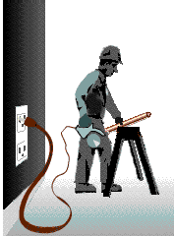
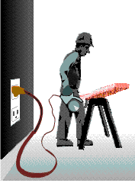
Incident 2: Lack of Ground-Fault Protection
Below show examples of good or bad grounding
Improper Grounding
Proper Grounding
Notes:
Note for Trainer:
A GFCI monitors the electrical current flow from hot to neutral and if it detects an imbalance it will trip the circuit in less than a second and cuts off the electricity.

Slide 65
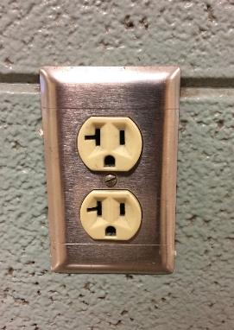
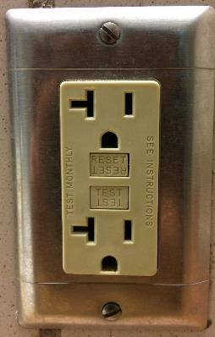
Incident 2: Lack of Ground-Fault Protection
When receptacles are not protected by GFCI
×
√

Slide 66
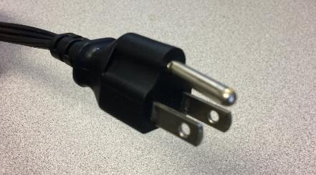
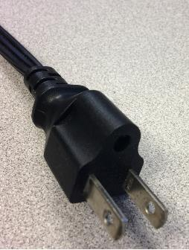
Incident 3: Path to Ground Missing or Discontinuous
Ground path is loose or broken
prong missing
×
×
prong loose
OSHA Regulation: 1926.405

Slide 67
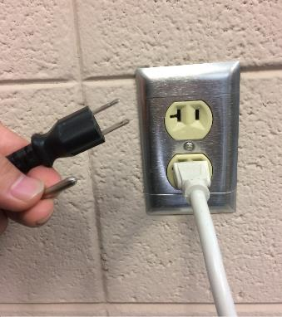
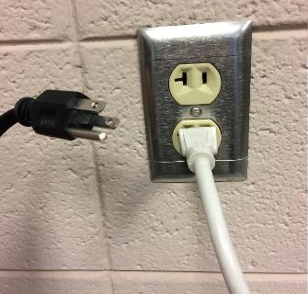
Incident 3: Path to Ground Missing or Discontinuous
Q12: If bottom 3-prong outlet is occupied, break the ground pin of plug to fit 2-prong outlet?
2-prong outlet
?
×
3-prong plug
3-prong outlet
Notes:
Tools plugged into improperly grounded circuits may become energized

Slide 68
Incident 3: Path to Ground Missing or Discontinuous
Do Not use hand-held non-double-insulated electric tools
Dangerous !
Faulty current may travel through a worker’s body
×

Slide 69
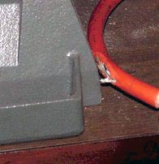
Incident 4: Equipment not Used in Manner Prescribed
No use damaged electric tools or worn cords
No use indoor only equipment outdoors
×
OSHA Regulation: 1926.405

Slide 70
Incident 4: Equipment not Used in Manner Prescribed
No use wrong-rating circuit breakers or fuses for over-current protection
I don’t know what circuit breakers to use, so just use the highest rating ones.
×

Slide 71
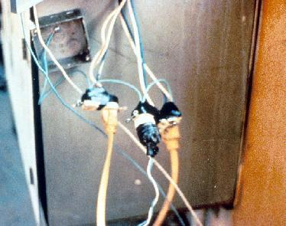
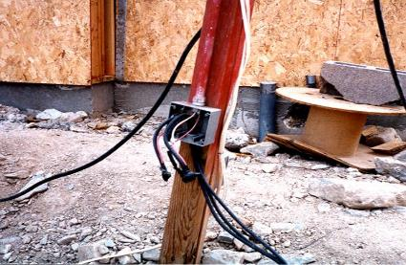
Incident 5: Improper Use of Extension or Flexible Cords
For temporary use, not for permanent wiring
Cords are improperly wired directly to circuits
GFCIs should be used for fault protection
×
×
Notes:
Note for Trainer:
It should not be coiled, bent, or twisted, far away from nails or staples.
Picture is from (https://www.osha.gov/SLTC/etools/construction/electrical_incidents/powertools.html)

Slide 72
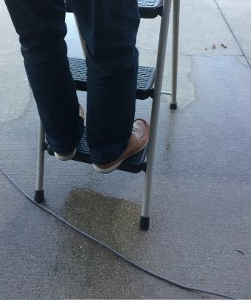
Incident 5: Improper Use of Extension or Flexible Cords
No use extension or flexible cords in moisture or wet places
Bathrooms
×
Kitchens
Basements
Laundry room

Slide 73
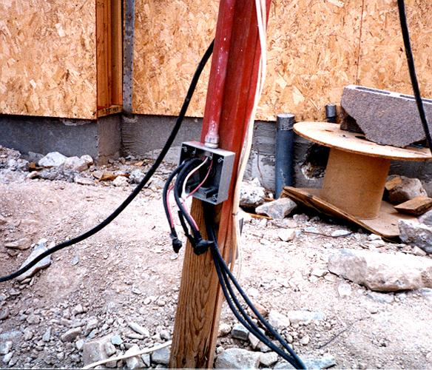
Incident 6: Contact with Energized Sources
×
Notes:
Note for Trainer:
The major hazards regarding contact with energized sources are electrical shock and burns.
If the power supply to electrical equipment is not grounded or the path has been broken, or if there are live parts or bare wires, a fault current may travel through a worker's body, causing electrical burns or death. Even when the power system is properly grounded, electrical equipment can instantly change from safe to hazardous because of extreme conditions and rough treatment.
Problem in this picture: Cover removed from wiring or breaker box

Slide 74
Training Modules Agenda
Section 1: Basic Terms and Case Study
Section 2: Electrical Hazards (BESAFE)
Section 3: Electrical Incidents in Construction
Section 4: Electrical Hazards Prevention
Maintain Safe Distance from Overhead Power Lines
Use Ground-Fault Circuit Interrupters (GFCI)
Inspect Portable Tools and Extension Cords
Use Power Tools and Equipment as Designed
Follow Lockout/Tagout Procedures
Personal Protective Equipment
Isolate Electrical Parts

Slide 75
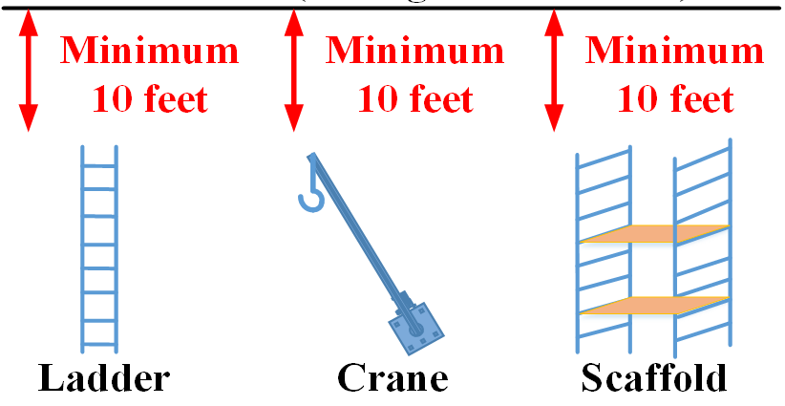
Maintain Safe Distance from Overhead Power Lines
Power Line (Assume voltage is 50Kv)
√
OSHA Regulation: 1926.600; 1926.416

Slide 76
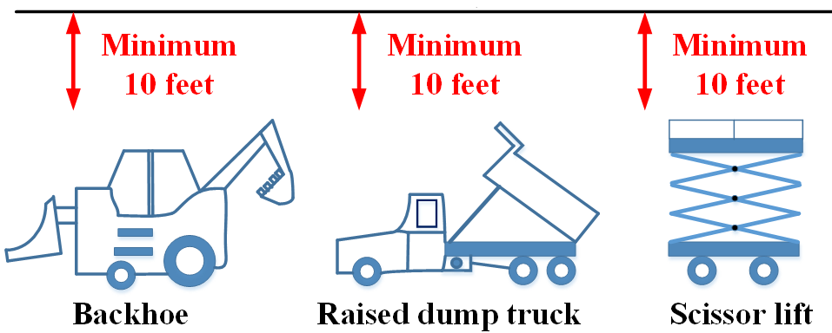
Maintain Safe Distance from Overhead Power Lines
Power Line (Assume voltage is 50Kv)
√
OSHA Regulation: 1926.600; 1926.416

Slide 77
Maintain Safe Distance from Overhead Power Lines
Contact utilities to de-energize overhead or buried power lines
Let me first call the utility company to de-energize power lines.
√
OSHA Regulation: 1926.961

Slide 78
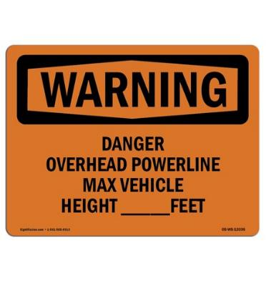
Maintain Safe Distance from Overhead Power Lines
Use non-conductive wood or fiberglass ladder
Put warning signs
OSHA Regulation: 1926.1408
OSHA Regulation: 1926.1053
√
√

Slide 79
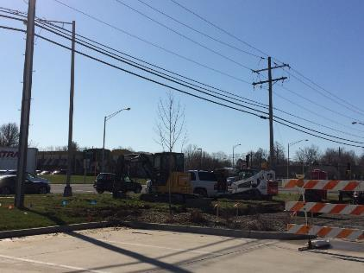
Maintain Safe Distance from Overhead Power Lines
Survey construction site
No materials/equipment placed under power lines
OSHA Regulation: 1926.850
OSHA Regulation: 1926.1408
×
Power Lines
√
Notes:
Note for Trainer:
Avoid storing materials underneath power lines

Slide 80

Use Ground-Fault Circuit Interrupters (GFCIs)
A GFCI is a circuit breaker which shuts off power when it senses ground faults
Test and reset every GFCI before you use
Reset Button
OSHA Regulation: 1926.404
Test Button
Notes:
Note for Trainer:
A GFCI monitors the electrical current flow from hot to neutral and if it detects an imbalance it will trip the circuit in less than a second and cuts off the electricity.
If the GFCI won't reset or the button doesn't pop out when you press the “test” button, there may be no power to the GFCI or you may have a bad GFCI.

Slide 81
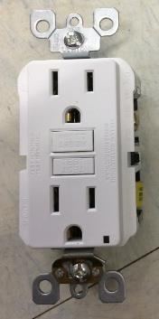

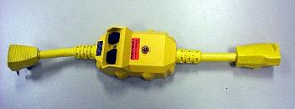
Use Ground-Fault Circuit Interrupters (GFCIs)
Types of GFCIs for construction applications
Receptacle type
Portable type
Cord-connected type
OSHA Regulation: 1926.404
Notes:
https://www.osha.gov/SLTC/etools/construction/electrical_incidents/gfci.html

Slide 82
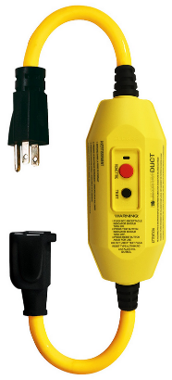
Use Ground-Fault Circuit Interrupters (GFCIs)
Use GFCIs on all 120-volt, single-phase, 15- and 20-ampere receptacles
Always use GFCIs in flexible or extension cords
OSHA Regulation: 1926.404
Notes:
Note for Trainer:
A GFCI monitors the electrical current flow from hot to neutral and if it detects an imbalance it will trip the circuit in less than a second and cuts off the electricity.

Slide 83
Use Ground-Fault Circuit Interrupters (GFCIs)
OSHA’s Regulation for Construction Industry
1926.404(b)(1)(ii) Ground-fault circuit interrupters. All 120-volt, single-phase 15- and 20-ampere receptacle outlets on construction sites, which are not a part of the permanent wiring of the building or structure and which are in use by employees, shall have approved ground-fault circuit interrupters for personnel protection.

Slide 84
Use Ground-Fault Circuit Interrupters (GFCIs)
OSHA’s Regulation for General Industry
1910.304(b)(3)(ii) Ground-fault circuit interrupters. All 125-volt, single-phase, 15-, 20-, and 30-ampere receptacle outlets that are not part of the permanent wiring of the building or structure and that are in use by personnel shall have ground-fault circuit-interrupter protection for personnel.

Slide 85
Use Ground-Fault Circuit Interrupters (GFCIs)
Circuit Breaker vs. GFCI
 | Circuit Breaker | GFCI
Operation | Automatic | Automatic
What to Protect | Electrical circuit | Human body
What hazards to Protect | Damaged caused by overload or short circuit | Current imbalance between going to and returning from electrical equipment

Slide 86
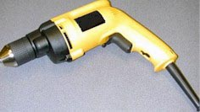
Use Ground-Fault Circuit Interrupters (GFCIs)
Use double-insulated hand-held tools
OSHA Regulation: 1926.302
Double Insulation Symbol
Non-conducting plastics
No metallic case
√
Reduce ground-fault risk and avoid electrical shocks
Notes:
Picture is from (https://www.osha.gov/SLTC/etools/construction/electrical_incidents/powertools.html)

Slide 87
Use Grounding Rod
Enable a low-resistance path to the earth
Fault current does not flow through human body
OSHA Regulation: 1926.962
√

Slide 88
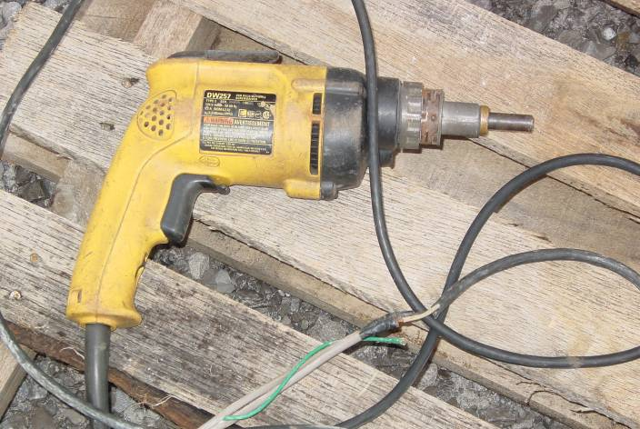
Inspect Portable Tools and Extension Cords
OSHA Regulation: 1926.1412
Visually inspect electrical equipment before use
Take any defective equipment out of service
Damaged insulation in flexible cords
×
If there any cracks or broken?
Notes:
Photos copied from Electrocution Hazard Recognition from (https://www.osha.gov/dte/outreach/construction/focus_four/)

Slide 89
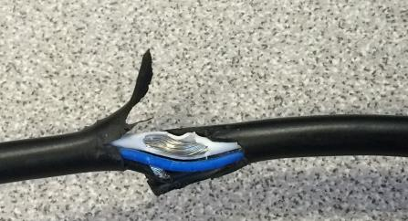
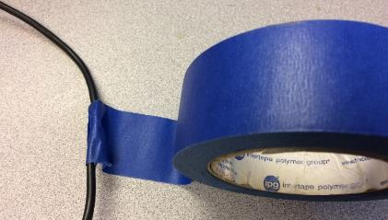
Inspect Portable Tools and Extension Cords
Inspect frayed, cut, or broken wires
Exposed metal in damaged cords is dangerous
No repair cords with tape
×
×
OSHA Regulation: 1926.1412

Slide 90

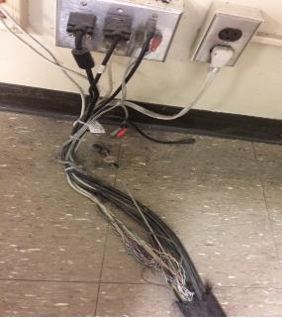
Inspect Portable Tools and Extension Cords
OSHA Regulation: 1926.416
No cords through sharp objects
Keep cords far way from nails, staples, screws
Do not run extension cords across walkways
×
×
×
Notes:
Left pictures are from SH-20-843-SH0

Slide 91
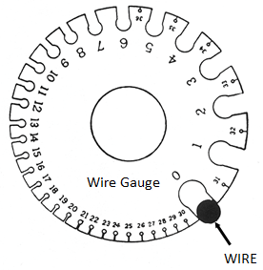
Inspect Portable Tools and Extension Cords
American wire gauge (AWG) measures wire size or diameter
AWG | Electrical Current Rating | Typical Usage
16 | 13 A | Extension cords
12 | 20 A | Small appliances
10 | 30 A | Window HVAC, clothes dryers
8 | 40 A | Central HVAC
6 | 55 A | Electric Furnace
Notes:
Note for Trainer:
A smaller gauge number indicates a larger wire. Large wires can safely transfer a higher electrical current. Likewise, longer cords aren’t able to handle as much current as a stronger cord that has the same gauge.
Extension cords have sizes from 0 to 36

Slide 92
Inspect Portable Tools and Extension Cords
Choose right wire size
Under-sized wire
Excessive power loss
Temperature heats up for fire risk
Do not overload the socket
OSHA Regulation: 1926.405

Slide 93
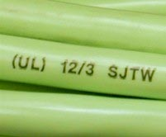
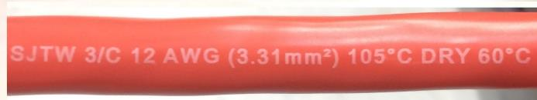
Inspect Portable Tools and Extension Cords
OSHA requires flexible cords to be rated for hard or extra-hard
√
Hard codes: S, ST, SO, STO, SJ, SJO, SJTO
OSHA Regulation: 1926.405
Notes:
https://www.osha.gov/SLTC/etools/construction/electrical_incidents/flexiblecords.html

Slide 94
Use Power Tools and Equipment as Designed
Use only equipment that is approved to meet OSHA standards
Use all equipment according to manufacturer’s instruction
Remove damaged tools from use
OSHA Regulation: 1926.1417
Notes:
https://www.bradyid.com/applications/arc-flash-labeling-requirements

Slide 95
Use Power Tools and Equipment as Designed
Q13: Should you pull the plug or the cable?
√
×
Answer: When you disconnect the power plug from the outlet, always pull the plug (not the cable).

Slide 96
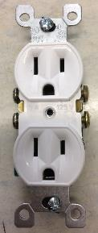
Use Power Tools and Equipment as Designed
Use correct-rating circuit breakers or fuses for over-current protection
×
15-amp receptacle
30-amp
circuit breaker
OSHA Regulation: 1926.449
No overload protection because it will not trip
Notes:
Note for Trainer:
This is a common mistake by using circuit breakers or fuses with the wrong rating for over-current protection, e.g., using a 30 amp breaker in a system with 15 or 20 amp receptacles. Protection is lost because it will not trip when the system’s load has been exceeded.
https://www.bradyid.com/applications/arc-flash-labeling-requirements

Slide 97
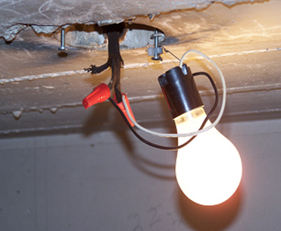
Use Power Tools and Equipment as Designed
Temporary lighting
Receptacles shall be of the grounding type.
Be equipped with heavy duty electric cords
×
OSHA Regulation: 1926.405
Notes:
https://www.osha.gov/SLTC/etools/shipyard/ship_breaking/working_conditions/illumination.html

Slide 98
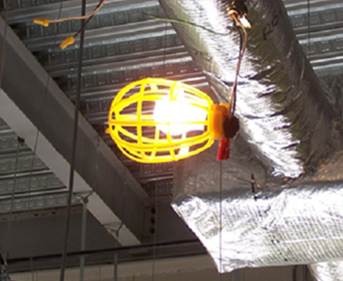
Use Power Tools and Equipment as Designed
Temporary lighting
Do not suspend by their electrical cords
Cords must be protected from damage, bulbs must be guarded
Must be equipped with overcurrent protection such as fuses or circuit breakers
√
OSHA Regulation: 1926.405
Notes:
https://www.osha.gov/SLTC/etools/shipyard/ship_breaking/working_conditions/illumination.html

Slide 99
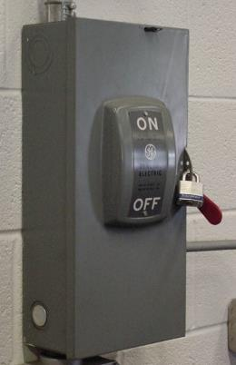
Follow Lockout/Tagout Procedures
Apply locks to power source after de-energizing
Tag deactivated controls
√
OSHA Regulation: 1926.417
Notes:
Note for Trainer:
Workers performing service or maintenance on machinery and equipment may be exposed to injuries from the unexpected energization, startup of the machinery or equipment, or release of stored energy in the equipment. The Lockout/Tagout standard requires the adoption and implementation of practices and procedures to shut down equipment, isolate it from its energy source(s), and prevent the release of potentially hazardous energy while maintenance and servicing activities are being performed. It contains minimum performance requirements, and definitive criteria for establishing an effective program for the control of hazardous energy. However, employers have the flexibility to develop lockout/tagout programs that are suitable for their respective facilities.
Reference 1926.417:
(a) Controls. Controls that are to be deactivated during the course of work on energized or de-energized equipment or circuits shall be tagged.
(b) Equipment and circuits. Equipment or circuits that are deenergized shall be rendered inoperative and shall have tags attached at all points where such equipment or circuits can be energized.
(c) Tags. Tags shall be placed to identify plainly the equipment or circuits being worked on.

Slide 100
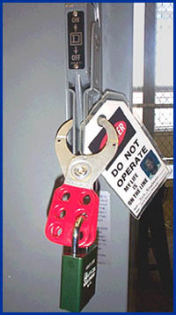
Follow Lockout/Tagout Procedures
Tag de-energized equipment and circuits at all points where they can be energized
Tags must identify equipment or circuits being worked on
√
OSHA Regulation: 1926.417
Notes:
Note for Trainer:
Reference 1926.417:
(a) Controls. Controls that are to be deactivated during the course of work on energized or de-energized equipment or circuits shall be tagged.
(b) Equipment and circuits. Equipment or circuits that are deenergized shall be rendered inoperative and shall have tags attached at all points where such equipment or circuits can be energized.
(c) Tags. Tags shall be placed to identify plainly the equipment or circuits being worked on.

Slide 101
Follow Lockout/Tagout Procedures
Video - Case Study: Overhead Crane Servicing and Maintenance
Notes:
Note for Trainer:
Interactive Case Study with four questions for students to discuss

Slide 102
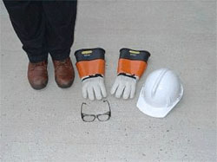
Personal Protective Equipment
Wear proper personal protective equipment (PPE)
Safety glasses
Face shields
Insulating gloves
Insulating sleeves
Safety shoes
Hard hats
Flame resistant clothing
OSHA Regulation: 1926.28
1926.100
OSHA has special PPE requirements for electrical hazards
Notes:
https://www.bradyid.com/applications/arc-flash-labeling-requirements
https://www.osha.gov/SLTC/etools/electric_power/personal_protective_equipment.html

Slide 103
Personal Protective Equipment
NFPA 70E is an standard for electrical safety
NFPA (National Fire Protection Association)
Help avoid injuries and fatalities due to electrical hazards
OSHA approaches NFPA 70E from both a standards perspective and an enforcement perspective.
Assist in complying with OSHA 1910 Subpart S and OSHA 1926 Subpart K
Notes:
Full version of NFPA-70E document is from https://www.nfpa.org/codes-and-standards/all-codes-and-standards/list-of-codes-and-standards/detail?code=70E

Slide 104
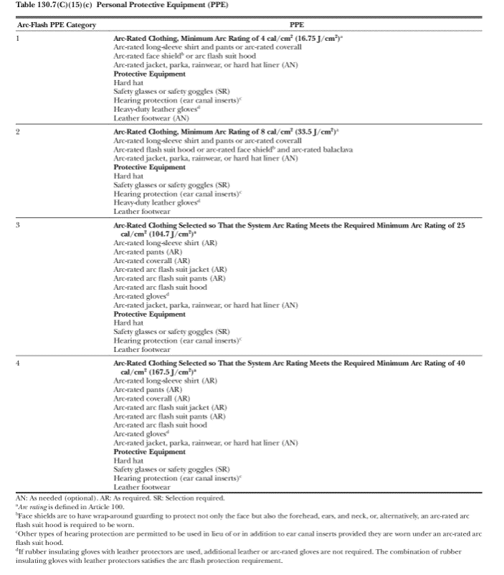
2018 edition of NFPA 70E: Table 1307.(C)(15)(c)
Notes:
Note for Trainer:
Reference:
2018 edition of NFPA 70E: Table 1307.(C)(15)(c) Personal Protective Equipment(PPE)

Slide 105
Personal Protective Equipment
Not any PPE device works for everyone
OSHA Regulation: 1926.28, 1926.100
For example, types of hard hats
Class of Hard Hat | Electrical Voltage Protection
Class G (General) | 2,200 volts
Class E (Electrical) | 20,000 volts
Class C (Conductive) | No electrical hazards protection
OSHA PPE Requirement

Slide 106
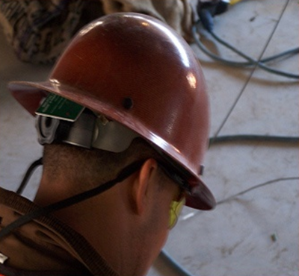
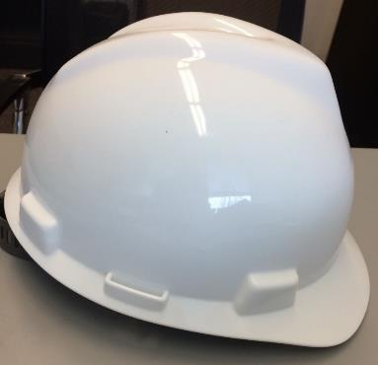
Personal Protective Equipment
Do not wear metal hard hats near electrical lines
√
×
Class C Hard Hat
Class E/G Hard Hat
OSHA Regulation for Hard Hat Usage: 1926.100
Notes:
From SH-20-843-SH0

Slide 107
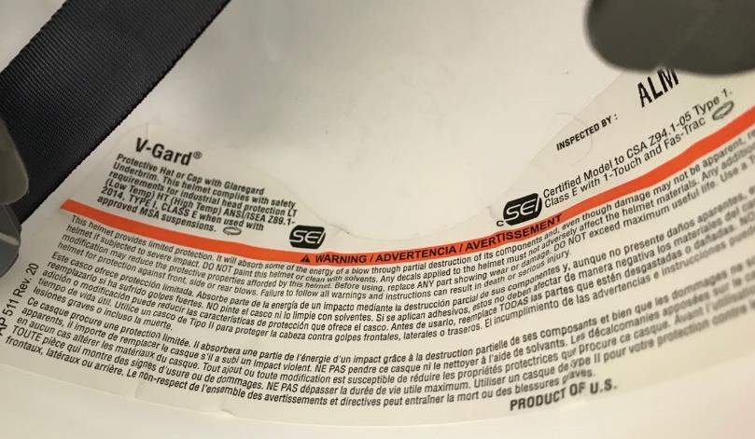
Personal Protective Equipment
A label of certification shows its class type
Class C Hard Hat
Class A/B Hard Hat
Notes:
Note for Trainer:
It is important to know that all hard hats contain a label of certification on the inside of the hard hat shell. This label identifies the type and class standards the hard hat was designed to meet.

Slide 108
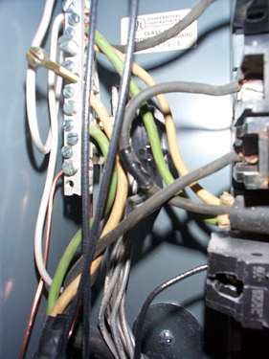
Isolate Electrical Parts
Use guards or barriers
Replace covers
Guard live parts of electric equipment operating at 50 volts or more against accidental contact
OSHA Regulation: 1926.403(i)(2)(i)
×
Class C Hard Hat
Class A/B Hard Hat
Notes:
Note for Trainer:
Reference 1926.403(i)(2)(i)
Except as required or permitted elsewhere in the subpart, live parts of electric equipment operating at 50 volts or more shall be guarded against accidental contact by cabinets or other forms of enclosures, or by any of the following means:
(A) By location in a room, vault, or similar enclosure that is accessible only to qualified persons.
(B) By partitions or screens so arranged that only qualified persons will have access to the space within reach of the live parts. Any openings in such partitions or screens shall be so sized and located that persons are not likely to come into accidental contact with the live parts or to bring conducting objects into contact with them.
(C) By location on a balcony, gallery, or platform so elevated and arranged as to exclude unqualified persons.
(D) By elevation of 8 feet or more above the floor or other working surface and so installed as to exclude unqualified persons.

Slide 109


Isolate Electrical Parts
Conductors going into them must be protected, and unused openings must be closed.
×
×
Notes:
Note for Trainer:
Reference1926.405(b)(1)
Conductors entering boxes, cabinets, or fittings. Conductors entering boxes, cabinets, or fittings shall be protected from abrasion, and openings through which conductors enter shall be effectively closed. Unused openings in cabinets, boxes, and fittings shall also be effectively closed.

Slide 110

Isolate Electrical Parts
Junction boxes, pull boxes, and fittings must have approved covers
Unused openings in boxes, cabinets, and fittings must be closed
×
OSHA Regulation: 1926.405(b)(2)
Notes:
Note for Trainer:
Reference 1926.405(b)(2)
Covers and canopies. All pull boxes, junction boxes, and fittings shall be provided with covers. If metal covers are used, they shall be grounded. In energized installations each outlet box shall have a cover, faceplate, or fixture canopy. Covers of outlet boxes having holes through which flexible cord pendants pass shall be provided with bushings designed for the purpose or shall have smooth, well-rounded surfaces on which the cords may bear.
Problem of the picture: Photo shows violations of these two requirements

Slide 111
Training Modules Summary
Hazard Recognition
Prevention Methods
Contact with power lines
Lack of ground-fault protection
Path to ground missing or discontinuous
Equipment not used in manner prescribed
Improper use of extension and flexible cords
Contact with energized sources
Effective safety training
Inspect all tools before use
No touch fallen power lines
Proper grounding
Use GFCIs with all tools
Lockout or tagout
Proper use of flexible cords
Do not use damaged tools
No work in wet conditions
Wear PPE
Isolate electrical parts
Notes:
https://www.bradyid.com/applications/arc-flash-labeling-requirements

Slide 112
Training Modules Summary
Worker to Build a Safe Working Environment
Good sense and aware of electrical hazard recognition
Don’t work alone, multiple workers together
Don’t work overtime to make your body tired
Only work on the tasks that a worker is qualified
Pre-job hazard analysis (OSHA booklet)
Notes:
http://www.elcosh.org/document/1624/894/d000543/section8.html

Slide 113

Training Modules Summary
Job hazard analysis form from OSHA booklet
Notes:
http://www.elcosh.org/document/1624/894/d000543/section8.html

Slide 114
Training Modules Summary
Worker to Build a Safe Working Environment
Lock out or tag out active circuits and equipment
Inspect and test circuits before using them
Know what to do if an electrical accident occurs
Know how to shut off to de-energize equipment
Know the location for circuit switches or breakers
Notes:
http://www.elcosh.org/document/1624/894/d000543/section8.html

Slide 115

Case Study
What electrical hazards can you find below?
×
Notes:
If you must operate equipment such as cranes near power lines, contact the utility company to de-energize and ground the lines.

Slide 116
Case Study
What electrical hazards can you find below?
×
Crane may contact overhead power lines
Traffic lights indicates that it is probably not call utility to de-energize power lines
×
Notes:
If you must operate equipment such as cranes near power lines, contact the utility company to de-energize and ground the lines.

Slide 117

Case Study
What electrical hazards can you find below?
×

Slide 118
Case Study
×
A worker could easily contact any part of an electric power circuit
Notes:
Photos copied from Electrocution Hazard Recognition from (https://www.osha.gov/dte/outreach/construction/focus_four/)

Slide 119

Case Study
What electrical hazards can you find below?
×
Notes:
Photos copied from Electrocution Hazard Recognition from (https://www.osha.gov/dte/outreach/construction/focus_four/)

Slide 120
Case Study
×
Crossing electrical line must be supported, protected or removed to safeguard workers
Notes:
Photos copied from Electrocution Hazard Recognition from (https://www.osha.gov/dte/outreach/construction/focus_four/)

Slide 121

Case Study
What electrical hazards can you find below?
×
Notes:
Photos copied from Electrocution Hazard Recognition from (https://www.osha.gov/dte/outreach/construction/focus_four/)

Slide 122
Case Study
×
Openings not closed
Panel boards have no dead front
×
×
×
×
No GFCI
Boxes not covered
System not grounded
Notes:
Photos copied from Electrocution Hazard Recognition from (https://www.osha.gov/dte/outreach/construction/focus_four/)

Slide 123

Case Study
What electrical hazards can you find below?
×
Notes:
Photos copied from Electrocution Hazard Recognition from (https://www.osha.gov/dte/outreach/construction/focus_four/)

Slide 124
Case Study
Distance between scaffold and power line less than 10 feet
×
Notes:
Photos copied from Electrocution Hazard Recognition from (https://www.osha.gov/dte/outreach/construction/focus_four/)

Slide 125

Case Study
What electrical hazards can you find below?
×
Notes:
Photos copied from Electrocution Hazard Recognition from (https://www.osha.gov/dte/outreach/construction/focus_four/)

Slide 126
Case Study
Use 3-prong plug in 2-prong outlet, no grounding
Damaged extension cord
×
×
Notes:
Photos copied from Electrocution Hazard Recognition from (https://www.osha.gov/dte/outreach/construction/focus_four/)

Slide 127

Case Study
What electrical hazards can you find below?
×
Notes:
Photos copied from Electrocution Hazard Recognition from (https://www.osha.gov/dte/outreach/construction/focus_four/)

Slide 128
Case Study
Ground pin is missing
×
Notes:
Photos copied from Electrocution Hazard Recognition from (https://www.osha.gov/dte/outreach/construction/focus_four/)

Slide 129

Case Study
What electrical hazards can you find below?
×
Notes:
Photos copied from Electrocution Hazard Recognition from (https://www.osha.gov/dte/outreach/construction/focus_four/)

Slide 130

Case Study
Flexible cords pass through doorway (a pinch point)
×
Notes:
Photos copied from Electrocution Hazard Recognition from (https://www.osha.gov/dte/outreach/construction/focus_four/)

Slide 131
Case Study
What lessons do we learn from this accident?
A construction worker is manually digging holes, and the project stops due to rain. After the rain stops, the worker returns to dig. Because the electrical wire that is connected to a pull box is not protected, the insulation layer of wire is abraded by the pull box, causing the pull box, lifting machine, wire rope, and bucket to be charged. The worker carried out construction without any inspection. When he touched the charged bucket, he was subjected to a strong electric shock and died.
Notes:
Power line into a pull box needs case protection
Protective cover is needed at the entrance of the pull box
A grounding rod is needed to protect energized pull box surface

Slide 132
Case Study
Workers spray solar panels for cleaning on wet building roof. Workers stand on a roof, they have the same elevation as power lines
×
Any potential electrical hazards?
Notes:
https://www.osha.gov/pls/imis/accidentsearch.accident_detail?id=99840.015
Spraying results in puddles on the roof and creates electrical ground

Slide 133
Any Questions?

Slide 134
Post-Test
Please Begin Post-Test (15 Minutes)
Notes:
134

Slide 135
Feedback Survey
Please fill in the feedback survey
(Hand in the training package to the trainer)
Notes:
135

Slide 136
Post-Test Solution
Interactive Post-Test Q/A Session
Notes:
136

Slide 137
The End Thank you!

