Slide 1
Hazardous Materials Safety & Security
Awareness Training
Section V
Criminal and Terrorist Events

Slide 2
Funding Acknowledgement
This material was produced under grant number SH-31200-SH7 from the Occupational Safety and Health Administration, U.S. Department of Labor. It does not necessarily reflect the views or policies of the U.S. Department of Labor, nor does mention of trade names, commercial products, or organizations imply endorsement by the U.S. Government.

Slide 3
Section V Objectives
  Identify potential locations which may be targets for criminal or terrorist activity using Hazmat as presented in this course
  Identify the actions of the Awareness level trainer responder during a Hazmat/WMD incident

Slide 4
Criminal and Terrorist Incidents
Terrorism
  the unlawful use of force against persons or property to intimidate or coerce a government, the civilian population, or any segment thereof, in furtherance of political or social objectives.

Slide 5
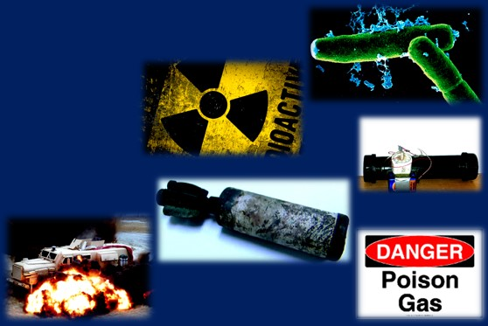
Incidents
Terrorist acts can be international or domestic groups or individuals
Potential agents used:
  Chemical
  Biological
  Radiological
  Nuclear
  Explosive

Slide 6
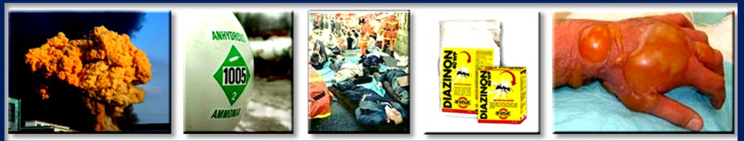
Chemical Attacks
  Produce lethal/damaging effects
  Over 100 chemical warfare agents
  Toxic industrial chemicals

Slide 7
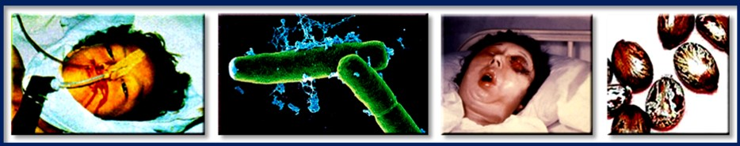
Types of Biological Agents
  Pathogens (living organisms)
  Toxins (poison from organism)
  Endogenous Biological Regulators (EBRs)

Slide 8
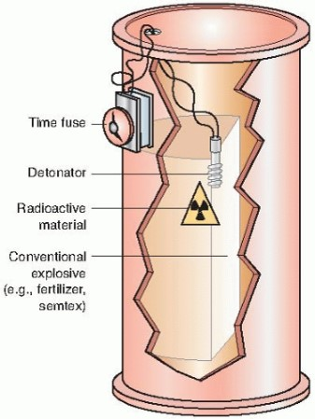
Radiation and Radiation Dispersal Device (RDD)
  Radiation is invisible energy
  Cannot be seen, felt, smelled, or tasted
  Once radiation reaches a person, that person has been exposed

Slide 9
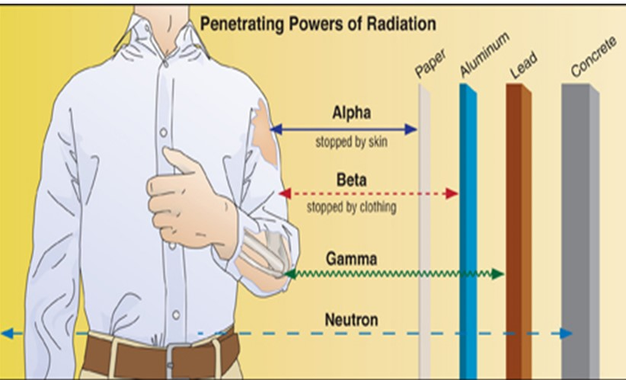
Four Types of Radiation
  Alpha
  Beta
  Gamma
  Neutron

Slide 10
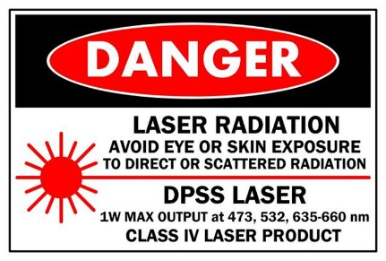
Low-Level Radiation Sources
  Smoke detectors
  Tritium gun sites
  Radiopharmaceuticals
  Lantern mantles
Refer to ERG guide 163 for radioactive materials.

Slide 11
High-Level Radiation Sources
  Hospitals
  Cancer treatment facilities
  Industrial/Construction sites
  Nuclear power plants
  In-transit
    Inside metal Type B containers (ERG guide 163)
  Nuclear powered vessels
  Cruise ships with medical facilities

Slide 12
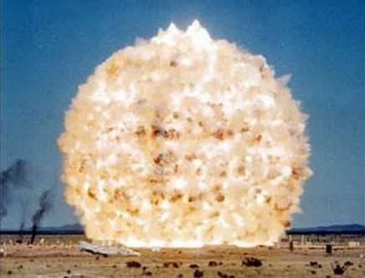
Incidents Involving Explosives
  70% of terrorist incidents involve explosives/ incendiary agents
  Basic understanding of explosives is needed for Awareness

Slide 13
Levels of Explosives
  Primary
  Extremely sensitive, requires small amounts
  Secondary
  Less sensitive, used in bulk quantities
  Tertiary
  Insensitive, require a booster from a secondary

Slide 14
Improvised Explosive Devices (IED)
  A bomb that is manufactured from commercial, military, or homemade explosives
  Three types:
    Type I - pipe bombs, backpacks
    Type II - Belts, vests shoes
    Type III – vehicle-born improvised explosive devices (VBIED)

Slide 15
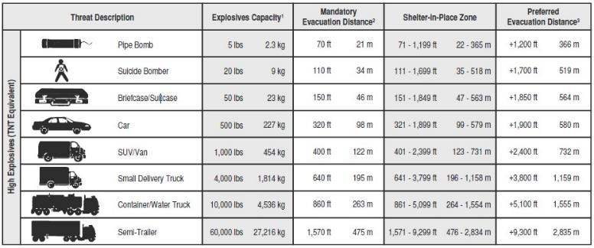
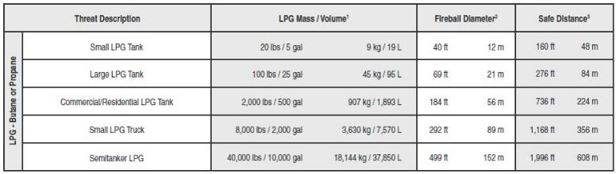
IED Safe Stand-Off Distance

Slide 16
Potential Indicators of Suicide Bombers
  Persons trying get close to large crowds
  Individual dressed more warmly than weather calls for
  Person sweating or nervously looking around
  Someone taking pictures, making notes, etc.

Slide 17
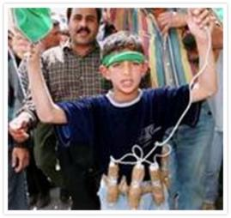
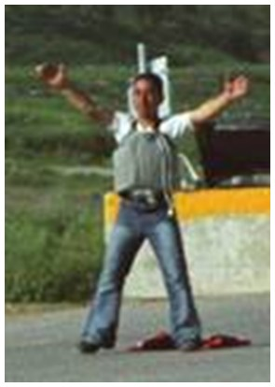
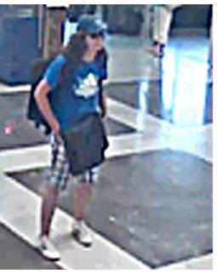
Suicide Bombers

Slide 18
Incidents Involving Illicit Laboratories
  Clandestine labs produce chemicals, and biological and explosive weapons
  First responders may not identify a terrorist lab for a clandestine lab
  Could be located in vacant structures, ships, rental properties, etc.

Slide 19
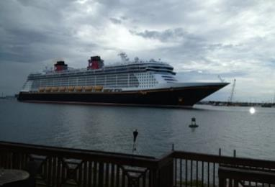
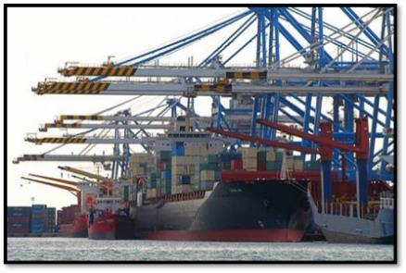
Potential Targets
  Vessels
  Ports
  Facilities
  Container yards
  Airports

Slide 20
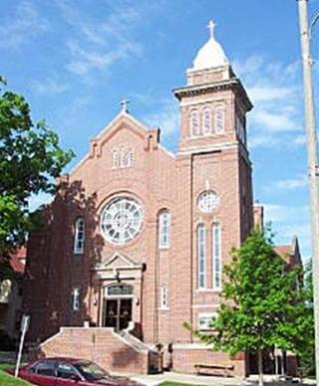
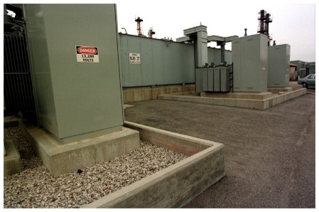
Potential Targets (Cont.)
  Church/Religious icons
  Utilities/Industrial facilities

Slide 21

Maritime Transportation Security Act
Unified Command System (UCS) Addition
  Security Officer

Slide 22
Maritime Transportation Security Act (Cont.)
  Maritime Security General – 33 CFR 101
  Area Maritime Security – 33 CFR 103
  Vessel Security Plans (VSP) – 33 CFR 104
  Facility Security Plans (FSP) – 33 CFR 105
  OCS Facility Plans (OCS) – 33 CFR 106

Slide 23
Maritime Security (MARSEC) Guidelines
Level 1 - Threat Level Exists
  Unlawful act not likely
Level 2 - Unlawful Act Is Possible
  Intelligence suggests terrorists are active in a particular area
Level 3 - Threat Probable
  Intelligence confirms terrorists are active in a particular area

Slide 24
Roles and Responsibilities
Awareness Level
  If at a crime scene, safety is priority
  Notification of security (911)
  Site preservation/evidence
  Remove victims
  Limit number of personnel on scene

Slide 25
Non-Law Enforcement Personnel
  Assist in preserving evidence
  Personnel should not move anything that is not necessary to save a life
  Establish perimeters immediately
  Pay attention to details
  Record information

Slide 26
Summary
  Potential agents used in a terrorist incidents
  Different types of terrorist incidents
  Types and sources of radiation
  Improvised Explosive Devices (IED)
  Anticipate potential targets of incidents
  Roles of the non-law enforcement responder

