Slide 1
Hazardous Materials Safety & Security
Awareness Training
Section IV
Initiating Protective Actions

Slide 2
Funding Acknowledgement
This material was produced under grant number SH-31200-SH7 from the Occupational Safety and Health Administration, U.S. Department of Labor. It does not necessarily reflect the views or policies of the U.S. Department of Labor, nor does mention of trade names, commercial products, or organizations imply endorsement by the U.S. Government.

Slide 3
Section IV Objectives
  List the four Routes of Exposure
  Identify Safety Levels of Protection
  Identify the four levels of chemical Personal Protective Equipment (PPE)
  List two lengths of time for health hazards

Slide 4
Vessel/Facility Emergency Plans
  Reference Documents
    Vessel Response Plans (VRP)
    Facility Response Plans, (FRP)
  Maintain Awareness
    Know your facility hazards
    Know your role in defensive actions
    Know security for the vessel/facility

Slide 5
Health Hazard
Immediate health hazard - acts on contact (Ex. acid burns)
Delayed health hazard - reaction may take hours, days, months, or years (Ex. certain poisons)
Chemicals may have both immediate and delayed reactions

Slide 6
Types of Exposures
Acute - one time; short duration
Sub-acute - series of acute intervals over time
Chronic - long-term; repetitive exposures
Effects of exposure depend on
  Length of exposure
  Concentration
  Route of exposure
  Characteristics of the chemical

Slide 7
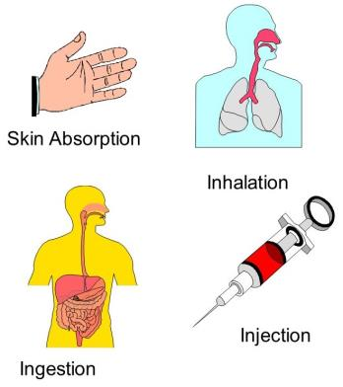
Routes of Exposure
  Inhalation - contact with respiratory tract
  Ingestion - contact with digestive tract
  Absorption - contact with skin/eyes/ears
  Injection - enters a break in the skin

Slide 8
Protection Options
  Initial Isolation/Protective Action
    First action is to isolate area
  Strategies for public protection
    Evacuation
    Shelter in Place
  Mark the Area

Slide 9
Evacuation
Physical relocation of people who are threatened by an incident
Correct action when:
  Incident will last a long time
  Severe hazard
  Population is susceptible

Slide 10
Evacuation (Cont.)
  Begins by warning people they must go
  Provide people time to get ready
  Provide people with a place to go/stay
  Takes time
  Causes confusion
  May cause ill-will

Slide 11
Shelter In Place
  Close up (button up) the structure
  Shut off equipment that can pull outside air into facility
  Remain in-place until informed that hazard has passed
  Communication

Slide 12
Reasons to Shelter in Place
  Evacuation will expose individuals to hazardous atmospheres
  Protect disabled
  Critically ill
  Critical service personnel

Slide 13
Reasons NOT to Shelter in Place
  Threat of massive fire
  Threat of explosion
  Long duration
  Large release

Slide 14
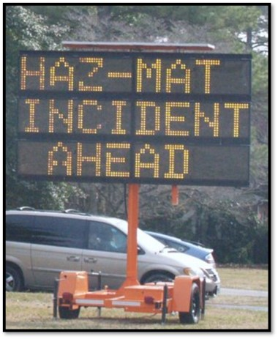
Mark the Area
Identifies that the area has been evacuated or is limited access
  Barrier tape
  Cones
  Security personnel

Slide 15
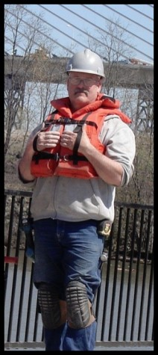
Daily Personal Protective Equipment (PPE)
  Used for daily work duties
  Provides little or no chemical protection for the wearer from vapor, splash, or dust
  No respiratory protection

Slide 16
Respiratory Protection Requirements
  Initial training in use, care, and handling
  Fit testing/certification required
  Protection can vary from dust mask up to SCBA and SAR
  Awareness level personnel are non-intervention and may not require PPE

Slide 17
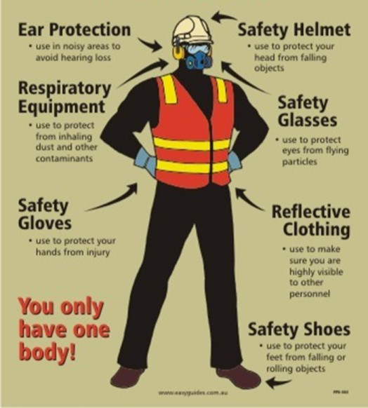
Chemical Protection

Slide 18
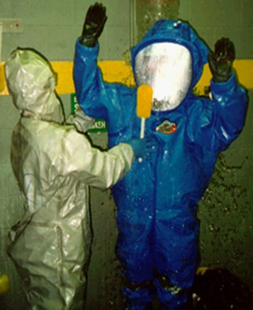
Chemical Protective Equipment
4 levels of protection (EPA)
  Level A
  Level B
  Level C
  Level D
    Awareness Level

Slide 19
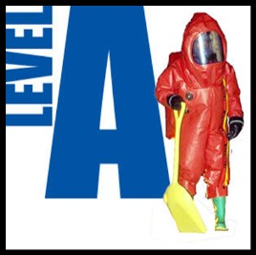
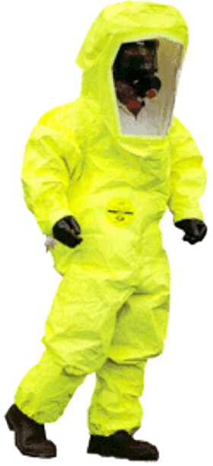
Level A
  Highest protection
  Chemical splash
  Chemical vapor
  Fully encapsulates wearer in air tight seal

Slide 20
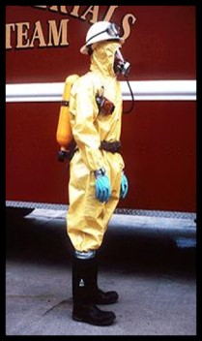
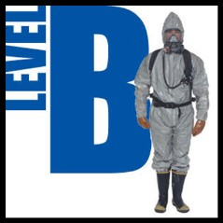
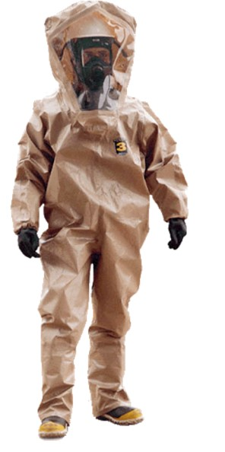
Level B
  Chemical splash protection
  No vapor protection
  Respiratory protection with SCBA or SAR

Slide 21
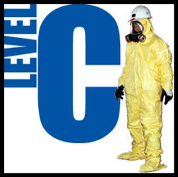
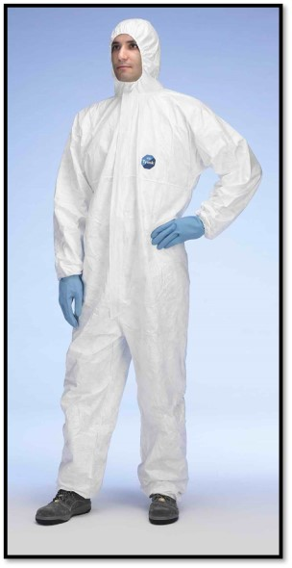
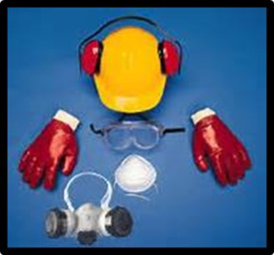
Level C
  Limited chemical protection
  Limited respiratory protection with use of APR, SCBA, or SAR

Slide 22

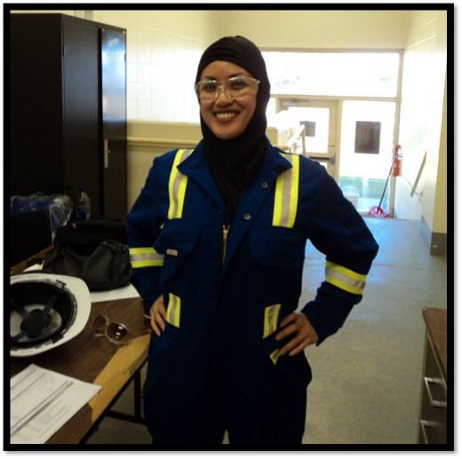
Level D
  Lowest level PPE
  Awareness level

Slide 23
Summary
  Health Hazards
  Routes of Exposure
  Safety Levels of Protection
  Four levels of chemical PPE
    Level A
    Level B
    Level C
    Level D

